Slide 1
Instructions for use
This resource is not a teaching and learning program. It should be used in conjunction with the program and teacher resource Intelligent systems– Enterprise Computing 11–12.
Classroom teachers are encouraged to add and adapt slides as required to meet the needs of their students.
Save a copy of the file to make changes to the slide deck. Go to File > Download a Copy (this downloads a copy to the computer to edit in the PowerPoint app).
To convert the PowerPoint to Google Slides:
  Upload the file into Google Drive and open it.
  Go to File > Save as Google Slides.
  (Note – conversion may cause formatting changes in the slides.)

Slide 2

Learning intentions and success criteria
Intelligent systems
Enterprise Computing 11-12

Slide 3
Learning intentions and success criteria
Week 1
We are learning to
understand intelligent systems and decision support systems and their applications.
We can
define and describe a system and explain how intelligent systems differ from traditional systems.
explain and justify the use of decision support systems for a range of enterprise scenarios and case studies.
Notes:
Notes for teachers:
Learning intentions and success criteria are best co-constructed with students. Adapt the learning intention as required and add matching success criteria.
For more information See ⁠AITSL or the NSW Department of Education explicit teaching strategies, ⁠Sharing learning intentions and ⁠Sharing success criteria
LISC is not necessarily presented at the beginning of the lesson. Teacher needs to consider most effectual time to introduce
LISC should be revisited during the lesson to support students' evaluation of their learning

Slide 4
Learning intentions and success criteria
Week 2
We are learning to
describe categories of decision-making within decision support systems including unstructured, semi-structured and structured.
We can
identify and describe categories of decision-making and apply these to an enterprise startup scenario and for my enterprise project.
replicate the steps in an IF Function in Excel
replicate the steps in a VLOOKUP tutorial and apply this understanding to a digital examination practice question.
Notes:
Notes for teachers:
Learning intentions and success criteria are best co-constructed with students. Adapt the learning intention as required and add matching success criteria.
For more information See ⁠AITSL or the NSW Department of Education explicit teaching strategies, ⁠Sharing learning intentions and ⁠Sharing success criteria
LISC is not necessarily presented at the beginning of the lesson. Teacher needs to consider most effectual time to introduce
LISC should be revisited during the lesson to support students' evaluation of their learning

Slide 5
Learning intentions and success criteria
Week 3
We are learning to
understand the evolution and applications of expert systems, including their key features and the influence of human needs on their development.
We can
explain common applications of expert systems
describe the advancements of expert systems from rule-based systems to those that integrate probability
discuss how human needs have influenced the design and functionality of expert systems.
Notes:
Notes for teachers:
Learning intentions and success criteria are best co-constructed with students. Adapt the learning intention as required and add matching success criteria.
For more information See ⁠AITSL or the NSW Department of Education explicit teaching strategies, ⁠Sharing learning intentions and ⁠Sharing success criteria
LISC is not necessarily presented at the beginning of the lesson. Teacher needs to consider most effectual time to introduce
LISC should be revisited during the lesson to support students' evaluation of their learning

Slide 6
Learning intentions and success criteria
Week 4
We are learning to
explore the operation of intelligent agents, the techniques of inference engines, the hardware involved in intelligent systems, and the application of computational thinking.
We can
Describe the operation of both simplistic and complex intelligent agents, including predictive search strings and voice assistants
Define and provide use cases for techniques such as truth maintenance, hypothetical reasoning, heuristic knowledge, fuzzy logic, and ontology classification
Explain the general workings of hardware used in intelligent systems.
Demonstrate the application of computational thinking concepts like decomposition, pattern recognition, abstraction, and algorithms in designing intelligent systems.
Notes:
Notes for teachers:
Learning intentions and success criteria are best co-constructed with students. Adapt the learning intention as required and add matching success criteria.
For more information See ⁠AITSL or the NSW Department of Education explicit teaching strategies, ⁠Sharing learning intentions and ⁠Sharing success criteria
LISC is not necessarily presented at the beginning of the lesson. Teacher needs to consider most effectual time to introduce
LISC should be revisited during the lesson to support students' evaluation of their learning

Slide 7
Learning intentions and success criteria
Week 4
We are learning to
explore the operation of intelligent agents, the techniques of inference engines, the hardware involved in intelligent systems, and the application of computational thinking.
We can
demonstrate the application of computational thinking concepts like decomposition, pattern recognition, abstraction, and algorithms in designing intelligent systems.
Notes:
Notes for teachers:
Learning intentions and success criteria are best co-constructed with students. Adapt the learning intention as required and add matching success criteria.
For more information See ⁠AITSL or the NSW Department of Education explicit teaching strategies, ⁠Sharing learning intentions and ⁠Sharing success criteria
LISC is not necessarily presented at the beginning of the lesson. Teacher needs to consider most effectual time to introduce
LISC should be revisited during the lesson to support students' evaluation of their learning

Slide 8
Learning intentions and success criteria
Week 5
We are learning to
communicate the logical processes by using flowcharts, data flow diagrams and infographics and understand the disruptive effects of intelligent systems.
We can
recognise and apply the flowcharts, data flow diagrams and infographics from the
Enterprise Computing HSC Course Specifications (PDF 2.3 MB) in Intelligent systems
identify and mitigate against the disruptive effects of intelligent systems.
Notes:
Notes for teachers:
Learning intentions and success criteria are best co-constructed with students. Adapt the learning intention as required and add matching success criteria.
For more information See ⁠AITSL or the NSW Department of Education explicit teaching strategies, ⁠Sharing learning intentions and ⁠Sharing success criteria
LISC is not necessarily presented at the beginning of the lesson. Teacher needs to consider most effectual time to introduce
LISC should be revisited during the lesson to support students' evaluation of their learning

Slide 9
Learning intentions and success criteria
Week 6
We are learning to
communicate the logical processes by using flowcharts, data flow diagrams and infographics and understand the disruptive effects of intelligent systems.
We can
explain the social and ethical issues related to the development and use of intelligent systems
discuss current and emerging technologies associated with intelligent systems, including AI
propose combinations of innovative techniques and technologies that can effectively meet the needs of enterprises.
Notes:
Notes for teachers:
Learning intentions and success criteria are best co-constructed with students. Adapt the learning intention as required and add matching success criteria.
For more information See ⁠AITSL or the NSW Department of Education explicit teaching strategies, ⁠Sharing learning intentions and ⁠Sharing success criteria
LISC is not necessarily presented at the beginning of the lesson. Teacher needs to consider most effectual time to introduce
LISC should be revisited during the lesson to support students' evaluation of their learning

Slide 10
Learning intentions and success criteria
Week 7
We are learning to
understand the key components and functionalities of intelligent networks, particularly in the context of IoT, and how these systems are applied in various enterprises, including their role in surveillance.
We can
list and describe the necessary infrastructure components for establishing an intelligent network
in an enterprise.
explain how data is collected, stored, processed, and transmitted in IoT networks.
identify and provide examples of how simulation, data modelling, and automation are utilised across different enterprises.
articulate the functions and benefits of intelligent systems in enhancing surveillance operations.
Notes:
Notes for teachers:
Learning intentions and success criteria are best co-constructed with students. Adapt the learning intention as required and add matching success criteria.
For more information See ⁠AITSL or the NSW Department of Education explicit teaching strategies, ⁠Sharing learning intentions and ⁠Sharing success criteria
LISC is not necessarily presented at the beginning of the lesson. Teacher needs to consider most effectual time to introduce
LISC should be revisited during the lesson to support students' evaluation of their learning

Slide 11
Learning intentions and success criteria
Week 8
We are learning to
explore the role of artificial intelligence in enhancing efficiency within IoT networks, and will develop skills in creating expert systems and decision-making tools.
We can
explain the ways in which AI contributes to improved efficiency in IoT networks
create a comprehensive set of rules and facts for an expert system and describe its functionality
construct a decision tree that incorporates certainty factors to aid in decision-making processes
apply a checklist to evaluate and verify the reliability of data sources used in a decision support system for my enterprise project.
Notes:
Notes for teachers:
Learning intentions and success criteria are best co-constructed with students. Adapt the learning intention as required and add matching success criteria.
For more information See ⁠AITSL or the NSW Department of Education explicit teaching strategies, ⁠Sharing learning intentions and ⁠Sharing success criteria
LISC is not necessarily presented at the beginning of the lesson. Teacher needs to consider most effectual time to introduce
LISC should be revisited during the lesson to support students' evaluation of their learning

Slide 12
Learning intentions and success criteria
Weeks 9 & 10
We are learning to
develop a knowledge base for expert systems, represent that knowledge visually, and understand the functionality of automated smart systems in various applications.
We can
design and describe the workflow of an automated smart system using IF-THEN rules
create a flowchart that effectively represents a knowledge base for an expert system
explain how automated smart systems operate and identify the software used to automate these processes
assess and compare the outputs of a decision support system (DSS) with the actual outputs of a system, and create a simple macro to demonstrate automated processes.
Notes:
Notes for teachers:
Learning intentions and success criteria are best co-constructed with students. Adapt the learning intention as required and add matching success criteria.
For more information See ⁠AITSL or the NSW Department of Education explicit teaching strategies, ⁠Sharing learning intentions and ⁠Sharing success criteria
LISC is not necessarily presented at the beginning of the lesson. Teacher needs to consider most effectual time to introduce
LISC should be revisited during the lesson to support students' evaluation of their learning

Slide 13
Key features of an expert system
Intelligent systems
Enterprise Computing 11-12

Slide 14
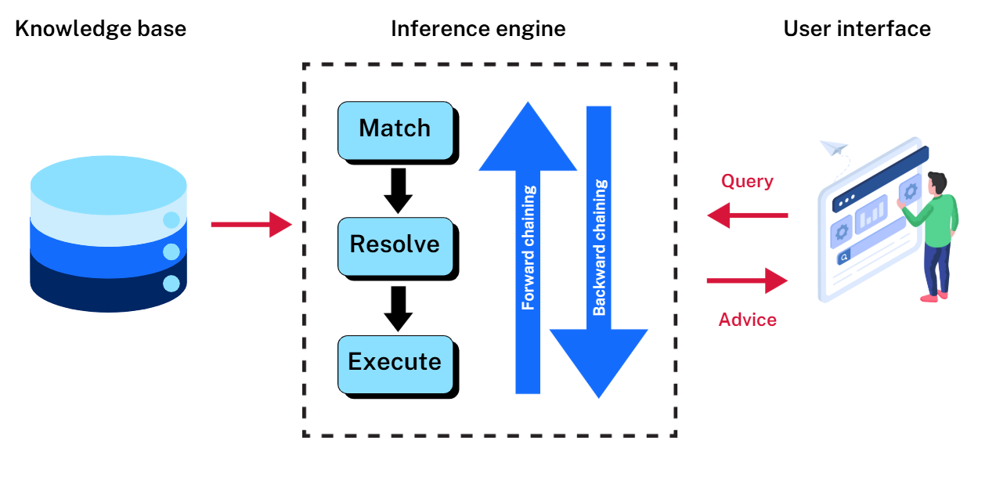
Describe key features of an expert system
Expert system diagram
Knowledge base
Inference engine
User interface
Query
Advice

Slide 15
Expert systems
What are they and what are some examples?
Expert systems are computer systems designed to emulate the decision-making abilities of human experts, solving specific problems in a particular domain using a knowledge base and inference engine.
Examples of expert systems include weather apps, medical diagnostic tools and recommendation systems (like Netflix or Spotify).

Slide 16
Expert systems
What components do they have?
Expert systems typically consist of three main components:
Knowledge base – provides the necessary information
Inference engine, including forward chaining and backward chaining – processes that information
User interface (UI) – ensures that users can interact with the system efficiently

Slide 17
Knowledge base
What is a knowledge base?
The knowledge base is a collection of facts, rules and data that the expert system uses to make decisions. It contains all the information needed to solve specific problems within a particular domain, such as medical conditions, legal regulations or technical troubleshooting.
Example – In a medical expert system, the knowledge base would include information on symptoms, diseases, treatments and diagnostic protocols.
Role in the expert system – The knowledge base is the foundation of the expert system. The quality and accuracy of the knowledge base determine how well the system can replicate expert-level decision-making. It is continually updated to reflect new information and changes in the field.

Slide 18
Inference engine, including forward chaining and backward chaining
The inference engine is the reasoning component of the expert system. It processes the information in the knowledge base to draw conclusions or make decisions. The inference engine uses logical rules to apply the knowledge base to specific problems.
Forward chaining – The system begins with known facts and applies rules to derive new conclusions.
This is useful for diagnostic problems where you start with symptoms and work toward a diagnosis.
Backward chaining – The system starts with a goal or hypothesis and works backward to determine what conditions must be met to achieve that goal. This is often used in problem-solving scenarios.

Slide 19
Inference engine, including forward chaining and backward chaining
Example – In a troubleshooting system for machinery, the inference engine might use forward chaining to identify the possible cause of a malfunction, or backward chaining to figure out what maintenance steps are needed to prevent future issues.
Role in the expert system – The inference engine acts as the decision-making brain of the expert system. It processes inputs and determines the best course of action or conclusion based on the knowledge base.

Slide 20
User interface (UI)
What is UI?
The user interface (UI) is the part of the expert system that allows users to interact with the system. It is designed to be user-friendly, enabling users to input data, ask questions and receive recommendations or solutions from the system.
Example – In a legal expert system, the UI might allow a lawyer to input details about a case and receive advice or legal precedents in an easy-to-understand format.
Role in the expert system – The UI is critical for making the expert system accessible to users who may not be experts themselves. A well-designed UI ensures that users can effectively interact with the system, understand its recommendations and apply them to real-world situations.

Slide 21
References
This presentation contains NSW Curriculum and syllabus content. The NSW Curriculum is developed by the NSW Education Standards Authority. This content is prepared by NESA for and on behalf of the Crown in the right of the State of New South Wales. The material is protected by Crown copyright.
Please refer to the NESA Copyright Disclaimer for more information https://educationstandards.nsw.edu.au/wps/portal/nesa/mini-footer/copyright.
NESA holds the only official and up-to-date versions of the NSW Curriculum and syllabus documents. Please visit the NSW Education Standards Authority (NESA) website https://educationstandards.nsw.edu.au/wps/portal/nesa/home and the NSW Curriculum website https://curriculum.nsw.edu.au.
Enterprise Computing 11–12 Syllabus © NSW Education Standards Authority (NESA) for and on behalf of the Crown in right of the State of New South Wales, 2022.
Enterprise Computing 11–12 Course Specifications © NSW Education Standards Authority (NESA) for and on behalf of the Crown in right of the State of New South Wales, 2022.

Slide 22
Copyright
© State of New South Wales (Department of Education), 2025
The copyright material published in this resource is subject to the Copyright Act 1968 (Cth) and is owned by the NSW Department of Education or, where indicated, by a party other than the NSW Department of Education (third-party material).
Copyright material available in this resource and owned by the NSW Department of Education is licensed under a Creative Commons Attribution 4.0 International (CC BY 4.0) license.
This license allows you to share and adapt the material for any purpose, even commercially.
Attribution should be given to © State of New South Wales (Department of Education), 2025.
Material in this resource not available under a Creative Commons license:
the NSW Department of Education logo, other logos and trademark-protected material
Material owned by a third party that has been reproduced with permission. You will need to obtain permission from the third party to reuse its material.
Links to third-party material and websites
Please note that the provided (reading/viewing material/list/links/texts) are a suggestion only and implies no endorsement, by the New South Wales Department of Education, of any author, publisher, or book title. School principals and teachers are best placed to assess the suitability of resources that would complement the curriculum and reflect the needs and interests of their students.
If you use the links provided in this document to access a third-party’s website, you acknowledge that the terms of use, including licence terms set out on the third-party’s website apply to the use which may be made of the materials on that third-party website or where permitted by the Copyright Act 1968 (Cth). The department accepts no responsibility for content on third-party websites.

