Slide 1
Instructions for use
This resource is not a teaching and learning program. It should be used in conjunction with Aquatic Technology 7–10 – Beneath the surface: safety secrets– sample program of learning
Classroom teachers are encouraged to add and adapt slides as required to meet the needs of their students
Save a copy of the file to make changes to the slide deck – go to File > Download a Copy (this downloads a copy to the computer to edit in the PowerPoint app).
To convert the PowerPoint to Google Slides:
  Upload the file into Google Drive and open it.
  Go to File > Save as Google Slides.

Slide 2
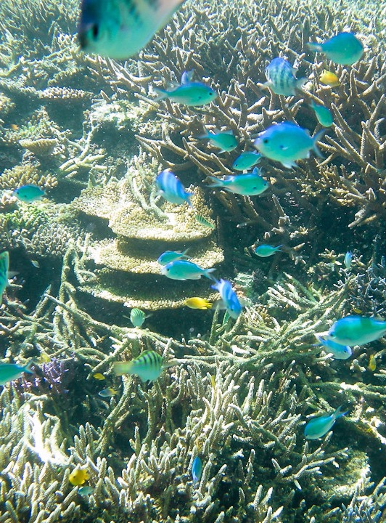
Beneath the surface: safety secrets
Stage 5
Aquatic Technology 7–10 (2024)
Aquatic activities focus area
"Snorkeling with colourful fish of tropical Japan" by Ippei & Janine Naoi is licensed under CC BY-SA 2.0.

Slide 3
Weeks 1–2

Slide 4
Learning intention and success criteria (1)
We are learning to
analyse drowning statistics so we can explain, trends, patterns and risk factors in different learning environments.
We can
interpret data to describe where and when drowning risks are most common.
compare statistics to the local region.
Notes:
Notes for teachers:
Learning intentions and success are best co-constructed with students. Adapt the learning intention as required and add co-constructed success criteria.

Slide 5
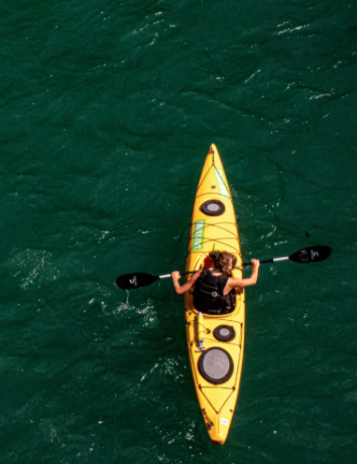
Introduction to Aquatic activities
This unit will equip students with knowledge and understanding of water safety first aid and relevant regulations through practical and theoretical learning experiences.
Water safety
First aid and sun safety
Water activities
Regulations

Slide 6
Water safety (1)
Understanding the evidence
Access Royal Life Saving’s National summer drowning toll
Use the information to complete the questions in your student workbook.

Slide 7
Water safety (2)
Improving safety in and around water
You will become an expert on an allocated water setting.
Using the Royal Life Saving website to research and respond to the questions in your workbook.
Develop a one pager to present to your peers.

Slide 8
Water safety (3)
Technologies and water safety
KWLH Chart
What do you know about drones, smart drumlines, shark smart app or smart remote area rescue tubes?
What I know | What I want to know | What I learned | How I learn more
In this column write what you already know about the topic. | In this column write what you want to know about the topic. | In this column write down what you already have learned about the topic. | In this column write about how you will learn more about the topic.

Slide 9


Knowledge check (1)
End of section student skills formative assessment checklist
Students can | Checkbox
interpret data to describe where and when drowning risks are most common. compare statistics to the local region.

Slide 10
Weeks 3–4

Slide 11
Learning intention and success criteria (2)
We are learning to
identify hazards in and around aquatic environments.
demonstrate water skills that meet safety criteria.
We can
identify a variety of hazards in different settings
meet identified safety criteria to help maintain safety in the water.
Notes:
Notes for teachers:
Learning intentions and success are best co-constructed with students. Adapt the learning intention as required and add co-constructed success criteria.

Slide 12
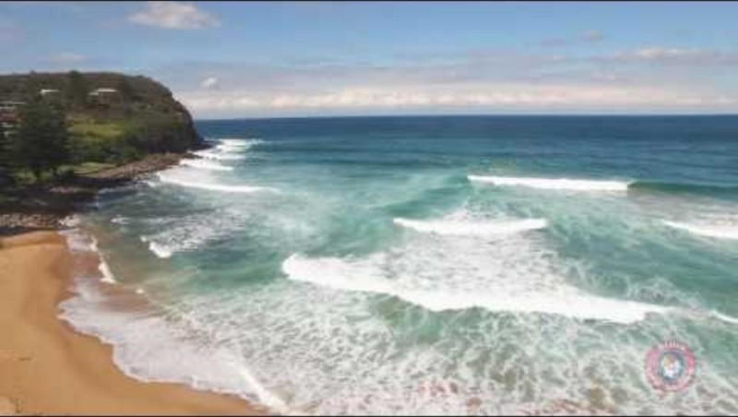
Water safety (4)
Survival Swimming and water skills
Watch How to spot a rip current (2:31)
How many people know how to spot a rip?
What is a rip and how do they form?
What type of rips can be found?
Describe what to look for when identifying a rip?
Do rips show these signs all the time?

Slide 13
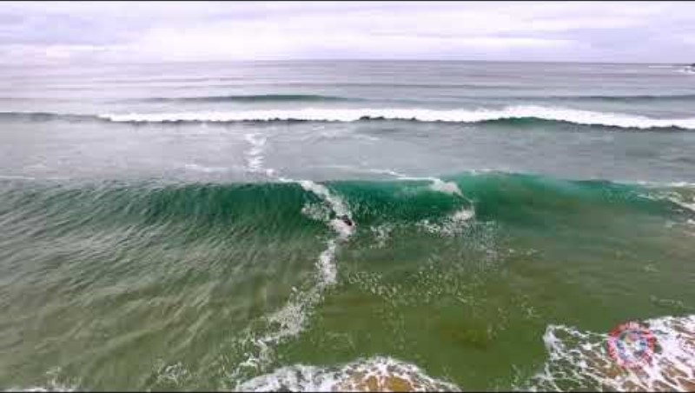
Water safety (5)
Survival Swimming and water skills
Watch how to survive a rip (1:38)
Will a rip pull you under water?
What are the main causes of drowning in a rip?
What are your options if you are caught in a rip

Slide 14
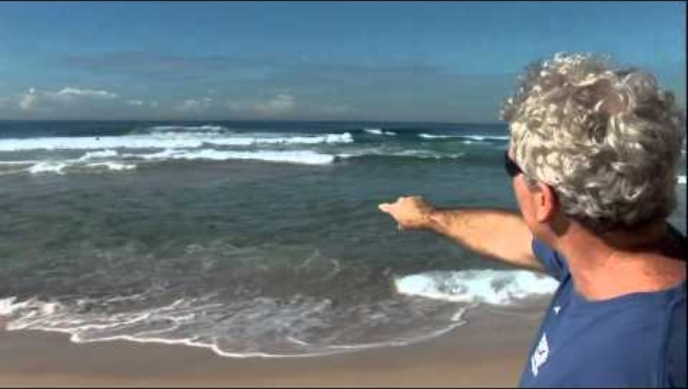
Water safety (6)
Survival Swimming and water skills
Watch the Beach survival Guide (5:51)
Define a plunging wave and a surging wave.
Define the term rip.
What should you do with your arms when body surfing?
What is the best way to spot a rip?
List 2 Do’s and 2 Don’ts about getting stuck in a rip.

Slide 15
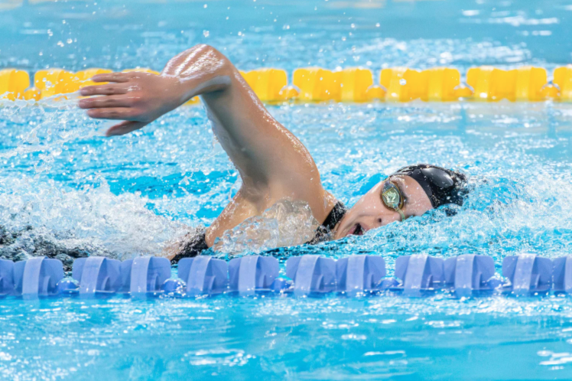
Water safety (7)
Survival Swimming and water skills
Demonstrate water skills
200m in still water,
swim 25 metres fully clothed,
swim 10 metres underwater and
tread water for 3 minutes.

Slide 16

Knowledge check (2)
End of section student skills formative assessment checklist
Students can: | Checkbox
identify a variety of hazards in different settings meet identified safety criteria to help maintain safety in the water.

Slide 17
Weeks 5–6

Slide 18
Learning intention and success criteria (3)
We are learning to
outline a range of first aid treatments used during aquatic activities.
identify water safety strategies.
understand the risks of sun exposure.
We can
accurately demonstrate a range of first aid treatments in a variety of scenarios.
create an infographic to mitigate the risks of sun exposure.
Notes:
Notes for teachers:
Learning intentions and success are best co-constructed with students. Adapt the learning intention as required and add co-constructed success criteria.

Slide 19
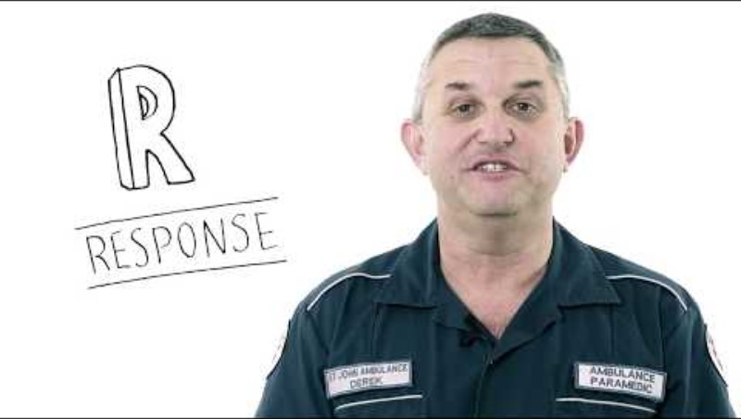
Water safety (8)
First aid including CPR
Watch DRSABCD action plan explained (2:47)
Describe each step of the DRSABCD action plan.

Slide 20
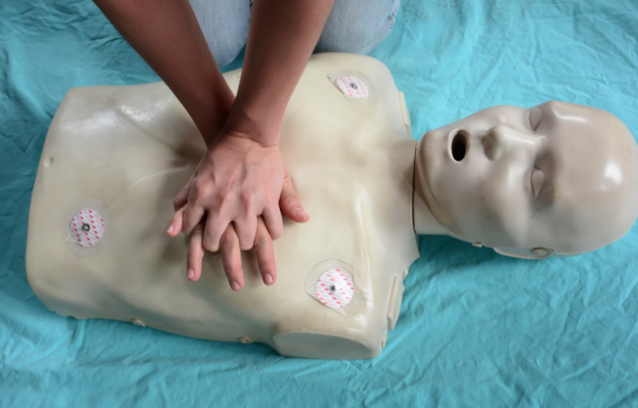
Water safety (9)
First aid including CPR
CPR practical activity
Students to practice and demonstrate correct CPR procedure on mannequins/Little Anne’s (single person and partner)

Slide 21
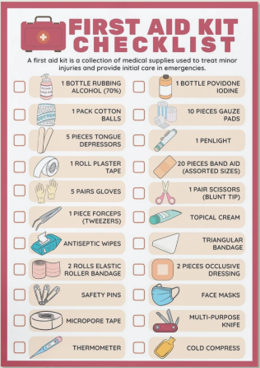
Water safety (10)
First aid including CPR
Create a flashcard for one the following injuries encountered in aquatic environments:
Bleeding – from cuts, bites and abrasions
Soft tissue injuries – sprains and strains
Foreign bodies/puncture wounds
Stings – compare treatments for different jellyfish
Envenomation – stonefish, blue-ringed octopus and cone snail
Breathing difficulties e.g. asthma
Shock
Hypothermia
Hyperthermia and heatstroke

Slide 22

Water safety (11)
First aid including CPR
First aid practical role play
Use the flashcards created to correctly treat a range of scenarios

Slide 23
Water safety (12)
Sun safety
For each case study, respond to the questions in your student workbook
Case study 1
Jackson loves to skate, spending all his spare time at the local skate park. He leaves early in the morning and comes home only at dinner time. In summer he wears a cap under his helmet. He doesn’t think he can get sunburnt when he is skating as that only happens to people at the beach!
Case study 2
Sarah wears a hat all the time when she plays soccer. As the match starts early in the morning, she doesn’t think it is necessary to put sunscreen on her face, arms or legs.
Case study 3
Oscar never feels better than when he is outside. He loves to surf, ride his mountain bike and play tennis. In summer he spends many hours outside. He often gets a light tan and thinks that his ‘natural colour’ shows that he is fit and healthy.

Slide 24
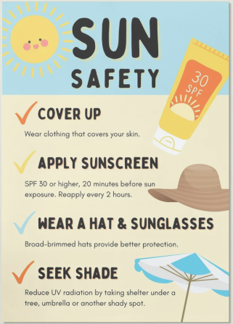
Water safety (13)
Sun safety
Infographic development
Create an infographic on Canva that could be used on social media to inform their peers about effective sun protection and increase their understanding of the risk associated with sun exposure and UV (ultraviolet) radiation. Include reference to any technologies, materials, clothing, wearable accessories or behaviours that minimise exposure to the sun.

Slide 25
Knowledge check (3)
End of section student skills formative assessment checklist
Students can: | Checkbox
accurately demonstrate a range of first aid treatments in a variety of scenarios. create an infographic to mitigate the risks of sun exposure.

Slide 26
Weeks 7–8

Slide 27
Learning intention and success criteria (4)
We are learning to
assess the impact of aquatic activities on the environment.
understand a range of aquatic activities, safety and their equipment.
demonstrate the use of terms relating to aquatic activities, and types of communication used on and around water.
We can
understand human impacts on aquatic environments.
maintain a range of aquatic equipment.
carry out and understand a variety of communication and safety strategies used in and around water.
Notes:
Notes for teachers:
Learning intentions and success are best co-constructed with students. Adapt the learning intention as required and add co-constructed success criteria.

Slide 28

Water activities (1)
Impact of aquatic activities on the environment – debate
You will be planning for and participating in a debate:
Is taking a coral souvenir really that detrimental to the marine environment?
Step 1) Become informed
Step 2) Plan
Step 3) Debate
"Snorkeling with colourful fish of tropical Japan" by Ippei & Janine Naoi is licensed under CC BY-SA 2.0.

Slide 29
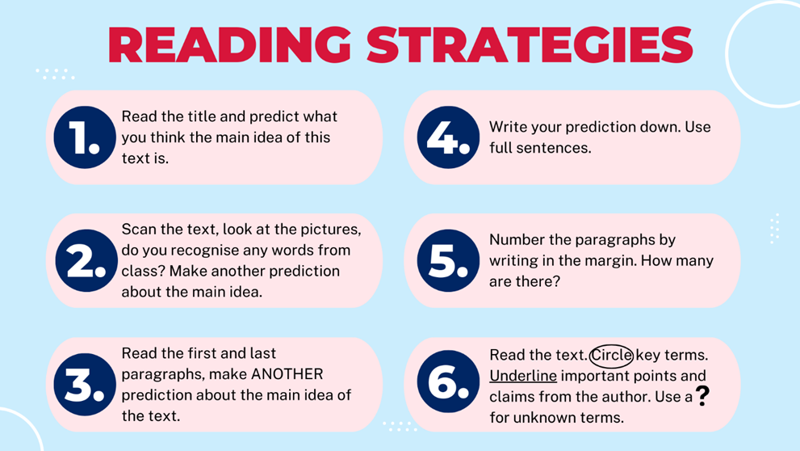
Water activities (2)
Impact of aquatic activities on the environment – debate
Is taking a coral souvenir really that detrimental to the marine environment?
Step 1) Become informed
Visit one of the following websites to build your understanding
The Problem with Marine Souvenirs
How Australian Coral Became Big Business
Divers fined $12k for taking protected coral near Tannum

Slide 30
Water activities (3)
Debate planner
Topic | Is taking a coral souvenir really that detrimental to the marine environment?
Side | For or against
Argument 1 | Explain your reasoning with supporting facts
Argument 2
Closing statements
Impact of water activities on the environment – debate
Is taking a coral souvenir really that detrimental to the marine environment?
Step 2) Plan
Using the debate planner in your workbook apply the knowledge learned from your reading to prepare for the debate.

Slide 31
Water activities (4)
Impact of water activities on the environment – debate
Is taking a coral souvenir really that detrimental to the marine environment?
DEBATE

Slide 32
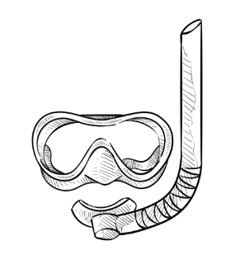
Aquatic activities (5)
Snorkelling – equipment
How do you clean, maintain and store your equipment?
Describe how to clean a snorkel
Describe how to clean a face mask
Describe how to clean your fins
Outline how to store your equipment
Outline how to clean your wetsuit

Slide 33
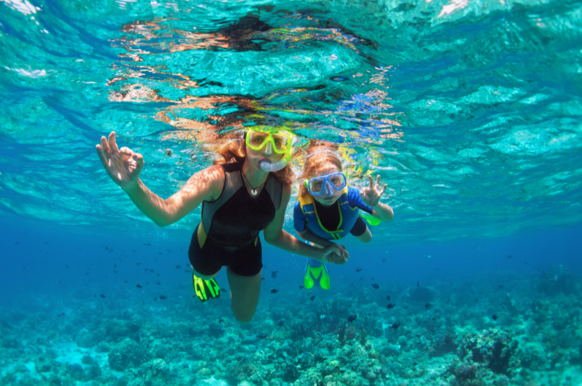
Aquatic activities (6)
Communication and safety – Buddy system
Think pair share:
What are the benefits of having a buddy system?
What makes a good buddy?

Slide 34
Aquatic activities (7)
Communication and safety – Diver below flags
Describe the need for dive flags
Draw and colour the alpha flag and diver-down flag
Dive flag rules

Slide 35
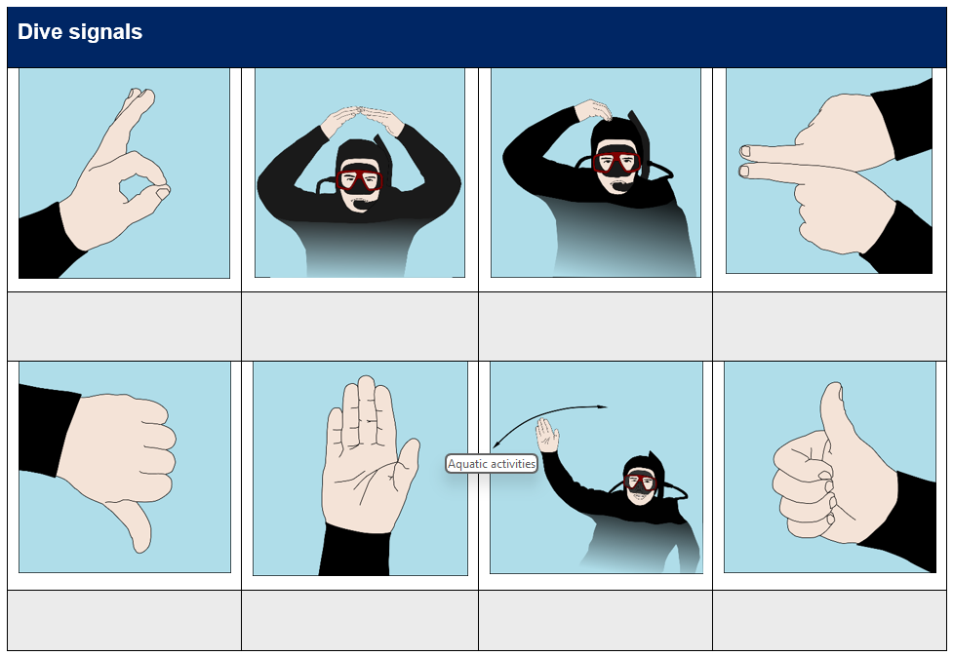
Aquatic activities (8)
Communication and safety – Dive signals

Slide 36
Aquatic activities (9)
Communication and safety – Risk assessment
RISK | LIKELIHOOD/ PROBABILTY? (1: not likely–5 extremely likely) | PRECAUTION/PREVENTION
Poor weather and sea conditions
Snorkelling experience of participants
Boat traffic
Water temperature (cold exposure)
Dangerous marine animals e.g. jellyfish, sharks
Entanglement e.g. fishing line

Slide 37
Aquatic activities (10)
Snorkeling skills
Demonstrate skills allocated by your teacher in a pool setting before progressing to enclosed/open water settings.

Slide 38
Knowledge check (4)
End of section student skills formative assessment checklist
Students can: | Checkbox
understand human impacts on aquatic environments. maintain a range of aquatic equipment. carry out and understand a variety of communication and safety strategies used in and around water.

Slide 39
Weeks 9–10

Slide 40
Learning intention and success criteria (5)
We are learning to
assess the impact technologies have on aquatic activities.
know and understand boating rules in NSW.
investigate regulation and the bodies that support their application in aquatic environments.
We can
communicate the impact emerging technology has had on aquatic activities.
successfully complete a practice test for a NSW boating license.
explain the role of different regulatory bodies and the role education and technology has in regulating aquatic activities.
Notes:
Notes for teachers:
Learning intentions and success are best co-constructed with students. Adapt the learning intention as required and add co-constructed success criteria.

Slide 41
Aquatic activities (11)
Emerging technologies – Jigsaw
Technology | Description | Impact on snorkelling
GoPro Video: How to Capture Underwater Dive + Snorkel Shots With Your GoPro (2:57)
Full face snorkel Video: How it works – full face snorkel (0:48)
Wetsuit technologies Video: Shark stop wetsuits (0:37)
Diver propulsion vehicles Video: Introducing LEFEET P1: the most versatile underwater scooter (2:11)
Reef safe sunscreens

Slide 42
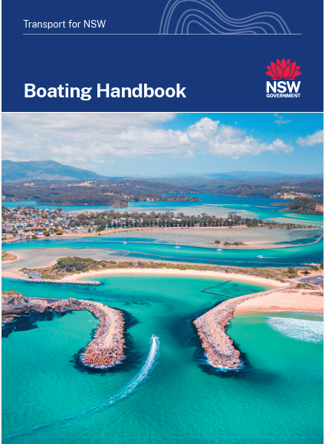
Aquatic activities (12)
Licensing
Refer to NSW Boating Handbook.
Describe regulations specific to boaters/PWC users in relation to snorkelling e.g. minimum distances, dive flags.
Describe the requirements for obtaining an NSW boat licence.
Complete the online practice quiz
©Transport for New South Wales(2023)

Slide 43
Aquatic activities (13)
Regulation
Body | Role description
NSW Police Force
Fisheries (Department of Primary Industries)

Slide 44
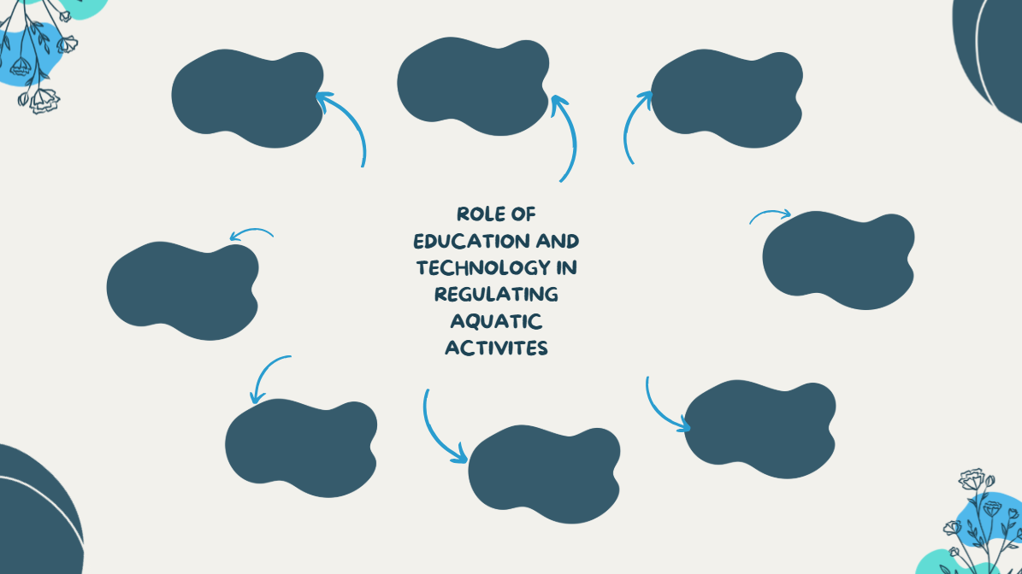
Aquatic activities (14)
Regulation brainstorm

Slide 45
Knowledge check (5)
End of section student skills formative assessment checklist
Students can | Checkbox
communicate the impact emerging technology has had on aquatic activities. successfully complete a practice test for a NSW boating license. explain the role of different regulatory bodies and the role education and technology has in regulating aquatic activities.

Slide 46
References (1)
This presentation contains NSW Curriculum and syllabus content. The NSW Curriculum is developed by the NSW Education Standards Authority. This content is prepared by NESA for and on behalf of the Crown in the right of the State of New South Wales. The material is protected by Crown copyright.
Please refer to the NESA Copyright Disclaimer for more information https://educationstandards.nsw.edu.au/wps/portal/nesa/mini-footer/copyright.
NESA holds the only official and up-to-date versions of the NSW Curriculum and syllabus documents. Please visit the NSW Education Standards Authority (NESA) website https://educationstandards.nsw.edu.au/wps/portal/nesa/home and the NSW Curriculum website https://curriculum.nsw.edu.au.
Aquatic technology 7-10 Syllabus © NSW Education Standards Authority (NESA) for and on behalf of the Crown in right of the State of New South Wales, 2024.
ABC news, How Australian Coral Became Big Business, accessed 24 September 2025
Canva, Creating a one-pager:How-tos, templates, and tips, accessed 24 September 2025
The Courier Mail, Divers fined $12k for taking protected coral near Tannum, accessed 24 September 2025
NSW Department of Education (n.d.) ‘Think Pair Share’, Digital Learning Selector, accessed 24 April 2025.
NSW Department of Education (n.d.) Digital learning selector: Jigsaw, accessed 24 September 2025.
NSW Department of Education (n.d.) Digital Learning Selector: KLWH, accessed 24 April 2025.

Slide 47
References (2)
NSW Department of Education (n.d.) Digital learning selector, Peer discussion and conferencing, accessed 24 September 2025.
NSW Department of Education (n.d.) Explicit teaching: Activating prior knowledge, accessed 24 September 2025.
NSW Department of Education (n.d.) Explicit Teaching: Checking for understanding, accessed 24 September 2025.
NSW Department of Education (n.d.) Explicit teaching: Chunking and sequencing learning, accessed 24 September 2025.
NSW Department of Education (n.d.) Explicit teaching: Connecting learning, accessed 24 September 2025
NSW Department of Education (n.d.) Explicit teaching: Modelling technique guide, accessed 24 April 2025.
NSW Department of Education (n.d.) Explicit teaching, Using effective questioning, accessed 24 September 2025.
NSW Department of Education (n.d.) Teacher Standards and Accreditation: Strategies for differentiation, accessed 24 September 2025.
NSW Department of Education (n.d.) School sport unit, Swimming and water safety, accessed 24 September 2025.
NSW Department of Education (n.d.) Universal Resource Hub Data 1 - resource package, accessed 24 September 2025.
NSW Department of Education (n.d.) Digital learning selector: Brainstorming, accessed 24 September 2025.
Transport for NSW (n.d) Boating Handbook, accessed 12 March 2026

Slide 48
References (3)
Royal Life Saving Australia, National summer drowning toll, accessed 24 September 2025
Shark Smart, drones, accessed 24 September 2025
Shark Smart, smart drumlines, accessed 24 September 2025
Shark Smart, shark smart app, accessed 24 September 2025
Video resources:
60 minutes, Shallow water blackout - the devastating cause of drowning in swimmers: 60 Minutes Australia (12:55), YouTube, accessed 24 September 2025
ABC Dive, 20 August 2023, Duckdive – advanced snorkelling – PADI open water diver course demo (1:18), YouTube, accessed 24 September 2025
Channel 10, Bondi Rescue season 6 episode 4, YouTube, accessed 24 September 2025
Global Triathlon Network, 12 December 2023, How to scull; this skill will change the way you swim! (3:09 – 5:04), YouTube, accessed 24 September 2025
Daniel Mann, 3 August, 2023, How to stop your dive mask fogging forever (2:07), YouTube, accessed 24 September 2025
The reef-world foundation, The Problem with Marine Souvenirs, accessed 24 September 2025

Slide 49
References (4)
Dive SSI, 1 March 2022, Tired diver tow (side tow) (0:35), YouTube, accessed 24 September 2025
Dive SSI, 26 February 2022, Unconscious diver on the surface (0:58), YouTube, accessed 24 September 2025
PADI, 14 August 2019, Hot to equalize (0:30), YouTube, accessed 24 September 2025
PADI, How to mask clear (0:50), accessed 24 September 2025
Personal Swimming, 19 December 2018, Back Scull - Improve your swimming with Personal Swimming (0:46), YouTube, accessed 24 September 2025
Scuba Diving International, 23 July 2023, How to relieve cramps while scuba diving - SDI open water skills (1:06), YouTube, accessed 24 September 2025
Scuba Diver Magazine, 30 July 2023, How to properly check your dive mask fits (11:52), YouTube, accessed 24 September 2025
St John WA, 4 May 2018, DRSABCD action plan explained (2:47), YouTube, accessed 24 September 2025
Surf Life Saving Australia, 5 October 2016, How to spot a rip current (2:31), YouTube, accessed 24 September 2025
Surf Life Saving Australia, 19 December 2018, How to survive a rip (1:38), YouTube, accessed 24 September 2025
UNSW, 17 December 2010, Beach survival Guide (5:51), YouTube, accessed 24 September 2025

Slide 50
Copyright
© State of New South Wales (Department of Education), 2026
The copyright material published in this resource is subject to the Copyright Act 1968 (Cth) and is owned by the NSW Department of Education or, where indicated, by a party other than the NSW Department of Education (third-party material).
Copyright material available in this resource and owned by the NSW Department of Education is licensed under a Creative Commons Attribution 4.0 International (CC BY 4.0) licence.
This licence allows you to share and adapt the material for any purpose, even commercially.
Attribution should be given to © State of New South Wales (Department of Education), 2026.
Material in this resource not available under a Creative Commons licence:
the NSW Department of Education logo, other logos and trademark-protected material
Material owned by a third party that has been reproduced with permission. You will need to obtain permission from the third party to reuse its material.
Links to third-party material and websites
Please note that the provided (reading/viewing material/list/links/texts) are a suggestion only and implies no endorsement, by the New South Wales Department of Education, of any author, publisher, or book title. School principals and teachers are best placed to assess the suitability of resources that would complement the curriculum and reflect the needs and interests of their students.
If you use the links provided in this document to access a third party’s website, you acknowledge that the terms of use, including licence terms set out on the third-party’s website apply to the use which may be made of the materials on that third-party website or where permitted by the Copyright Act 1968 (Cth). The department accepts no responsibility for content on third-party websites.

