Slide 1
Instructions for use
This resource is not a teaching and learning program. It should be used in conjunction with Agriculture Technology 7–10 – From fleece to feast.
Classroom teachers are encouraged to add and adapt slides as required to meet the needs of their students.
Save a copy of the file to make changes to the slide deck. Go to File > Download a Copy (this downloads a copy to the computer to edit in the PowerPoint app).
To convert the PowerPoint to Google Slides:
  Upload the file into Google Drive and open it.
  Go to File > Save as Google Slides.
  (Note – conversion may cause formatting changes in the slides.)

Slide 2
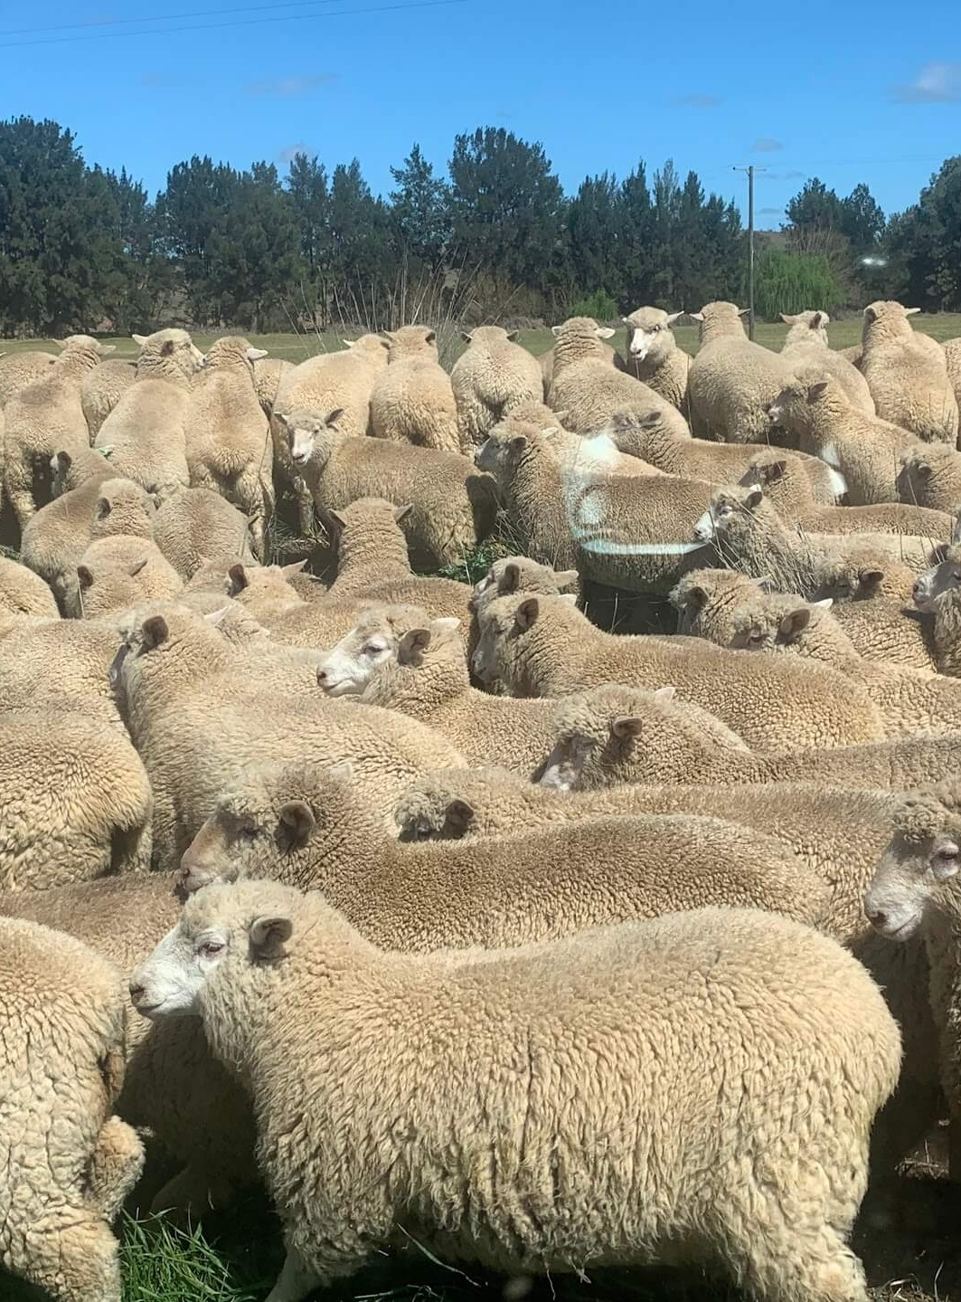
Sheep production
Agriculture Technology – Stage 5
From fleece to feast
Term X

Slide 3
Lessons
1
Sheep production in Australia
2
About the animal
3
Working on a sheep farm
4
Wool enterprises
5
Sheep meat enterprises
Notes:
Teacher notes:
Click lesson numbers to go to specific lessons
Interactive features can be viewed in slide show
Notes for vendors [to be removed after slide deck creation]:
Create hyperlinks to dividers that match lesson numbers by
Right click on the number>edit link>select slide in deck to connect to

Slide 4
Sheep production in Australia

Slide 5
1. Sheep production in Australia
Learning intentions and success criteria
We are activating prior knowledge and making connections between sheep production and agricultural systems in Australia.
We can
recall and share what we already know about sheep and farming in Australia
recognise that sheep production is a significant part of Australian agriculture
Notes:
Notes for teachers:
Learning intentions and success criteria are best co-constructed with students. Adapt the learning intention as required and add matching success criteria.
For more information See ⁠AITSL or the NSW Department of Education explicit teaching strategies, ⁠Sharing learning intentions and ⁠Sharing success criteria
LISC is not necessarily presented at the beginning of the lesson. Teacher needs to consider most effectual time to introduce
LISC should be revisited during the lesson to support students' evaluation of their learning

Slide 6
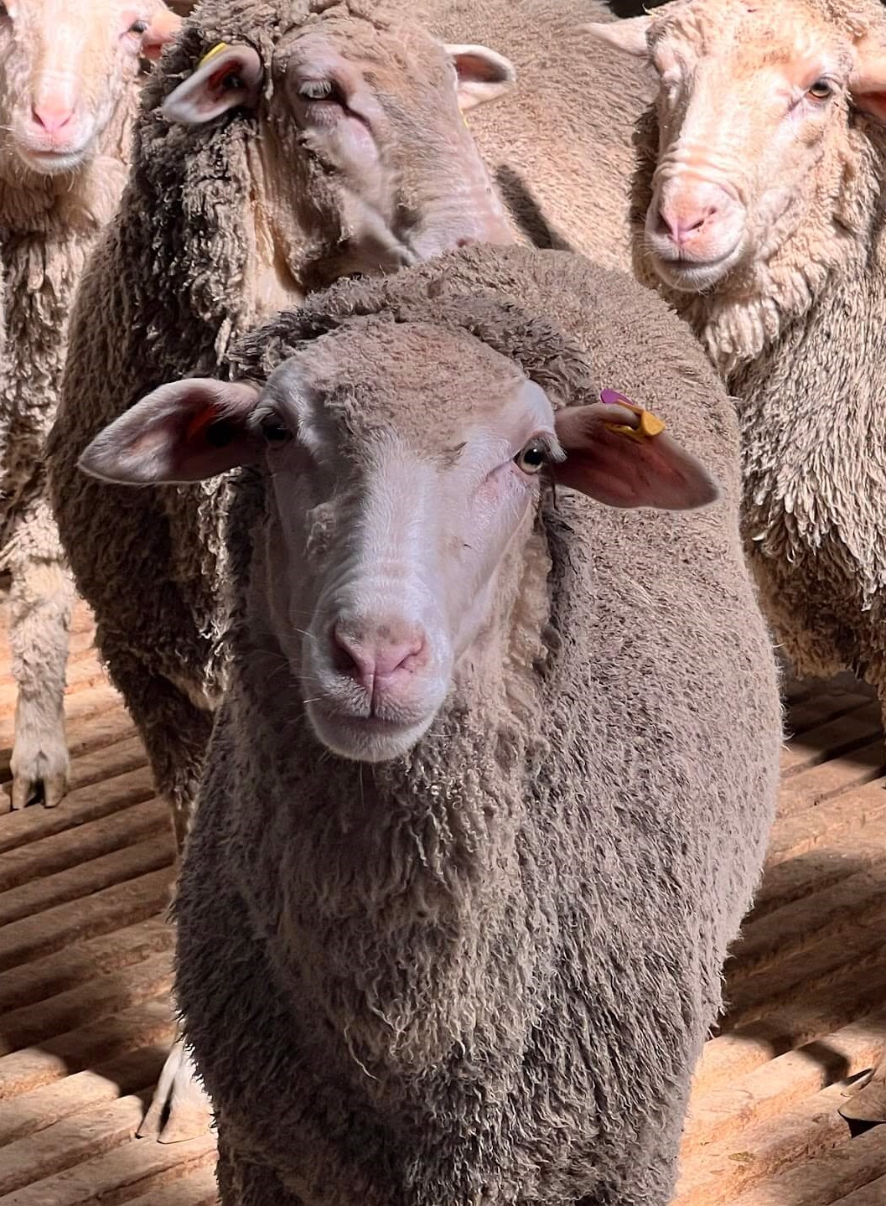
Key terms (1)
Livestock – farm animals raised to produce food, fibre or work, like sheep, cattle and goats.
Export – sending Australian farm products, like wool and meat, to other countries for sale.
Agricultural enterprise – a farm or business that produces food or fibre as its main activity.
Notes:
Teaching notes:
Introduce key terms before starting each section. They support student understanding by linking core agricultural vocabulary to the lesson content. Encourage students to look out for how these terms are used in the activities that follow.

Slide 7
Think Pair Share
My thoughts
My partner’s thoughts
What we will share
List 3 products that come from sheep
Where in Australia do you think most sheep are raised?
What do you think affects how many sheep farmers keep from year to year?
Notes:
Teaching notes:
What do students already know about sheep production in Australia? Use a think-pair-share technique to activate prior knowledge on the topic. This classic template can be used to support the activity and share the class responses at the end.

Slide 8
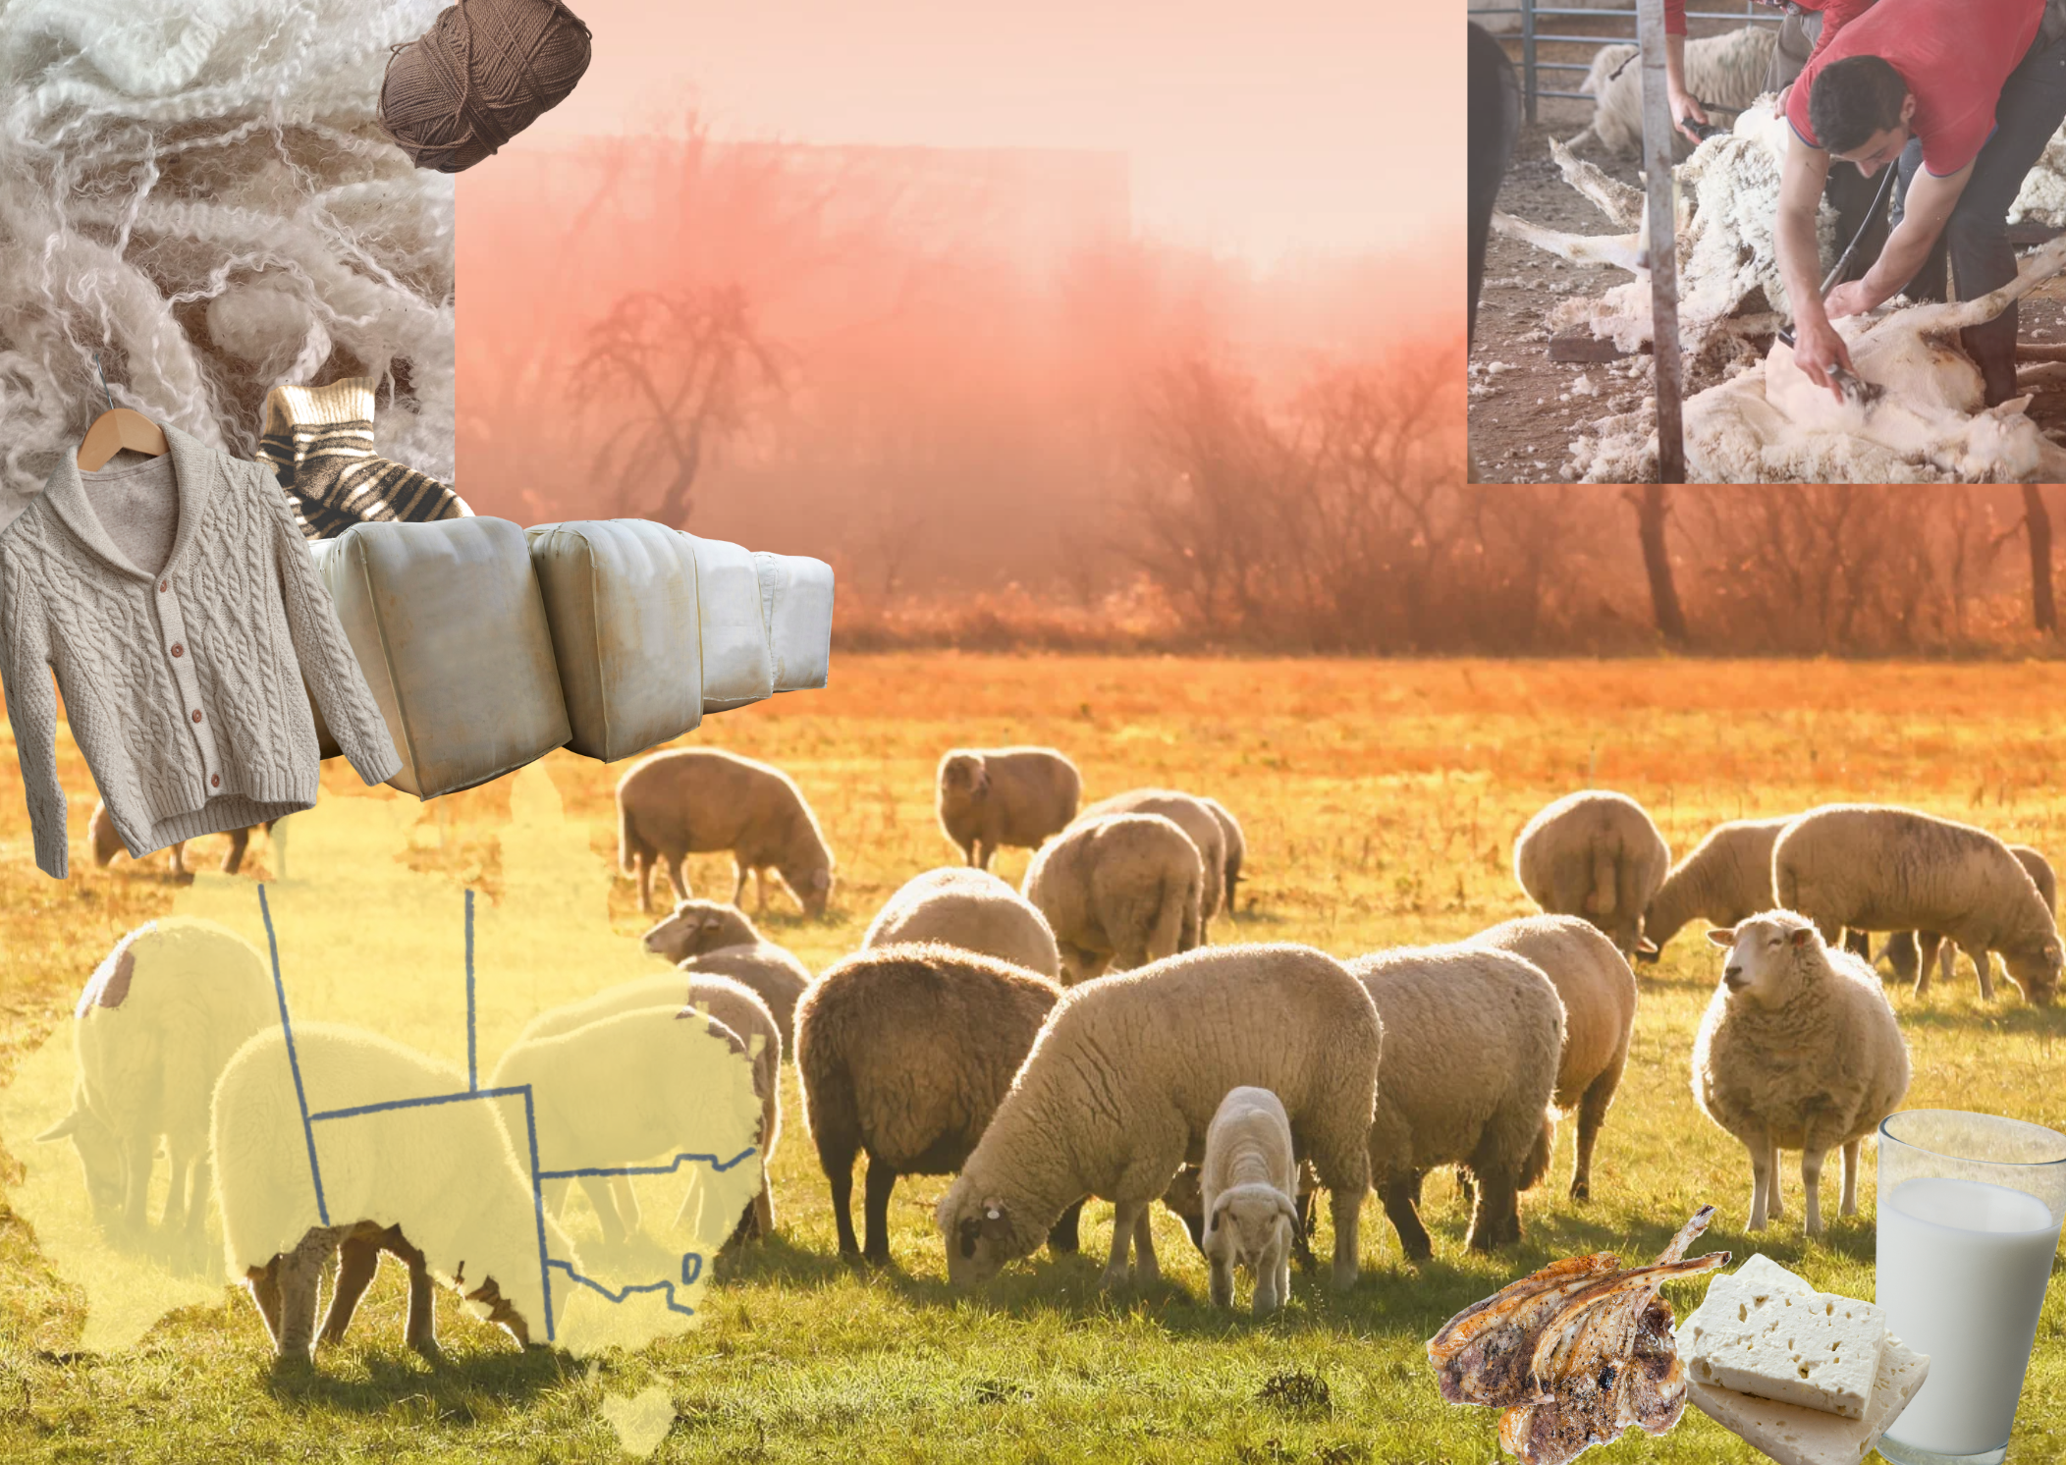
Sheep in Australia poster
Image created using Canva
Notes:
Teaching notes:
For classes who need some inspiration for the think-pair-share activity, use this visual support aid.

Slide 9
2. Sheep population in Australia
Learning intentions and success criteria
We are creating representations of historical data to identify and analyse trends.
We can:
construct accurate graphs
identify and explain possible causes for patterns and trends in changing sheep populations.
Notes:
Notes for teachers:
Learning intentions and success criteria are best co-constructed with students. Adapt the learning intention as required and add matching success criteria.
For more information See ⁠AITSL or the NSW Department of Education explicit teaching strategies, ⁠Sharing learning intentions and ⁠Sharing success criteria
LISC is not necessarily presented at the beginning of the lesson. Teacher needs to consider most effectual time to introduce
LISC should be revisited during the lesson to support students' evaluation of their learning

Slide 10

Key terms (2) 2
Trend – a general pattern or direction something is moving in over time, such as rising or falling sheep numbers.
Drought – a long period without enough rainfall, which can reduce feed and sheep numbers.
Commodity – a raw agricultural product like wool or sheep meat that is bought and sold.
Notes:
Teaching notes:
Introduce key terms before starting each section. They support student understanding by linking core agricultural vocabulary to the lesson content. Encourage students to look out for how these terms are used in the activities that follow.

Slide 11
Numbers of sheep in Australia from 2016 to 2022
What type of graph?
Line or column?
Year | Sheep numbers (millions)
2016–17 | 72,125
2017–18 | 70,607
2018–19 | 65,755
2019–20 | 63,529
2020–21 | 68,047
2021–22 | 70,235
Statistics from Agricultural commodities, Australia, Australian Bureau of Statistics.
Notes:
Teaching notes:
Table direct from workbook to display on board during discussion.

Slide 12
Sample answer
Notes:
Teaching notes:
Use this sample answer as a guide to demonstrate the important features of a graph and also discuss the trends for the data analysis section of the workbook.

Slide 13
Interpretation of data
What years showed the highest and lowest sheep numbers? How did you know this?
Using what you know about major events in Australia over the past decade, what factors could explain the drop between 2018–19 and 2019–20?
Would the sheep numbers in Australia over the past year be higher or lower than the 2021–22 period? Justify your prediction.
Notes:
This is an opportunity to use questioning to build complexity in interpreting the graph. Starting with an opportunity to deepen thinking where students read the graph and explain to you how they got their answer. Question 2 is about making connections from the data to their everyday lives and the opportunity to discuss with their class partner for further information and ideas. The final question is a prediction that requires a justification.

Slide 14
3. Sheep production zones in Australia
Learning intentions and success criteria
We are learning to identify and explain the factors that influence agricultural production in different regions
We can:
locate suitable sheep production areas on a map of Australia
explain how environmental factors affect sheep farming.
Notes:
Notes for teachers:
Learning intentions and success criteria are best co-constructed with students. Adapt the learning intention as required and add matching success criteria.
For more information See ⁠AITSL or the NSW Department of Education explicit teaching strategies, ⁠Sharing learning intentions and ⁠Sharing success criteria
LISC is not necessarily presented at the beginning of the lesson. Teacher needs to consider most effectual time to introduce
LISC should be revisited during the lesson to support students' evaluation of their learning

Slide 15
Key terms (3) 3
Stocking density – how many animals are kept on a set area of land, like sheep per hectare.
Pasture – grass or plants grown to feed grazing animals like sheep.
Rainfall zone – areas grouped by how much rain they get each year, which affects farming decisions.
Notes:
Teaching notes:
Introduce key terms before starting each section. They support student understanding by linking core agricultural vocabulary to the lesson content. Encourage students to look out for how these terms are used in the activities that follow.

Slide 16
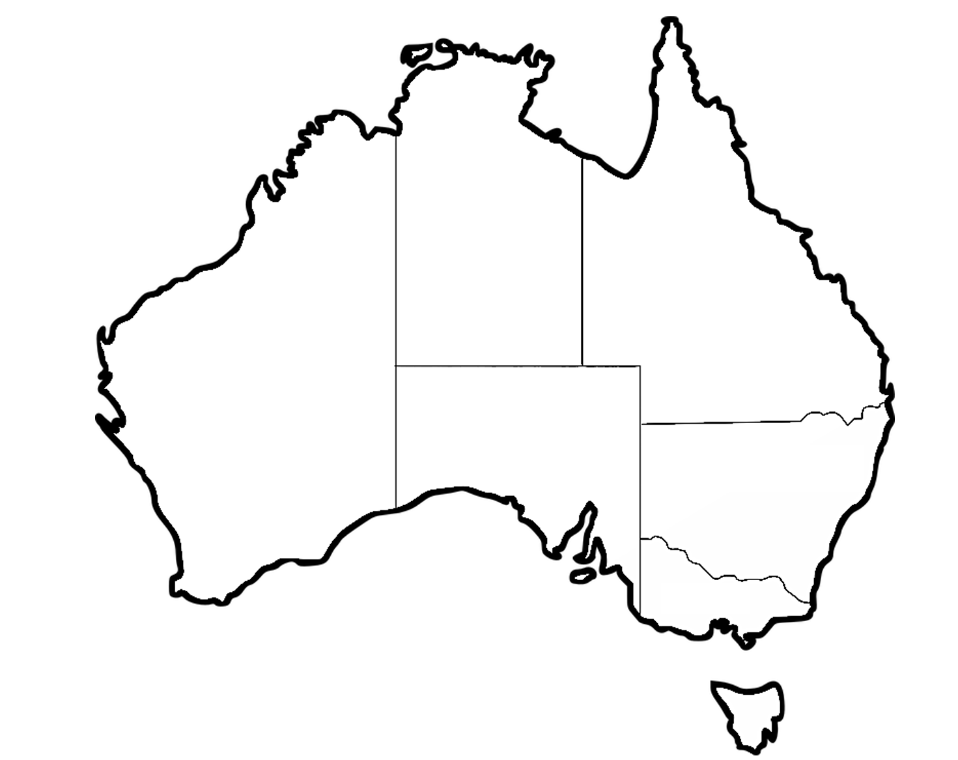
Agricultural zones in Australia
Blank map of Australia
Notes:
Teaching notes:
Use the following sites for further support with mapping sheep populations, pasture production zones and rainfall averages:
Wool production in Australia – Learn about wool
Average annual, seasonal and monthly rainfall maps – Australian Bureau of Meteorology
Snapshot of Australian agriculture 2025 – Department of Agriculture, Fisheries and Forestry ABARES

Slide 17
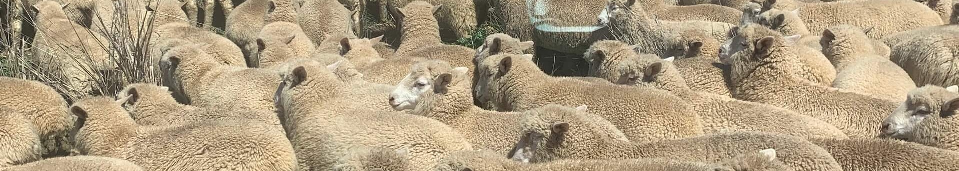
Challenge question (1)
If rainfall decreased in a wool-producing region, how might that affect enterprise choices?
Notes:
Teaching notes:
Challenge questions can be used for students who understand the content learnt and are ready to apply it to a real-world scenario. Use these for individual students requiring extension of the work, homework for individuals or the class, or as a whole class discussion prompt.

Slide 18
4. What do we get from sheep?
Learning intentions and success criteria
We are learning to recognise different products that come from livestock and how they are processed and used.
We can:
list raw and processed products from sheep
categorise sheep products by type and use.
Notes:
Notes for teachers:
Learning intentions and success criteria are best co-constructed with students. Adapt the learning intention as required and add matching success criteria.
For more information See ⁠AITSL or the NSW Department of Education explicit teaching strategies, ⁠Sharing learning intentions and ⁠Sharing success criteria
LISC is not necessarily presented at the beginning of the lesson. Teacher needs to consider most effectual time to introduce
LISC should be revisited during the lesson to support students' evaluation of their learning

Slide 19
Key terms (4) 4
Raw product – an unprocessed item straight from the animal, like wool or meat.
By-product – a secondary product made during the processing of sheep, like lanolin or hides.
Value-added product – something made by changing a raw material to increase its use or value, like wool fabric.
Notes:
Teaching notes:
Introduce key terms before starting each section. They support student understanding by linking core agricultural vocabulary to the lesson content. Encourage students to look out for how these terms are used in the activities that follow.

Slide 20
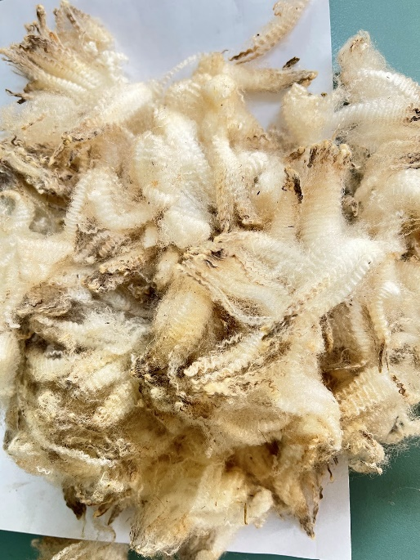
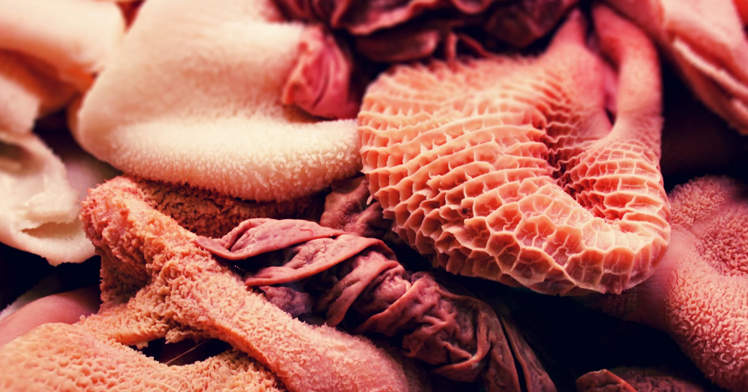
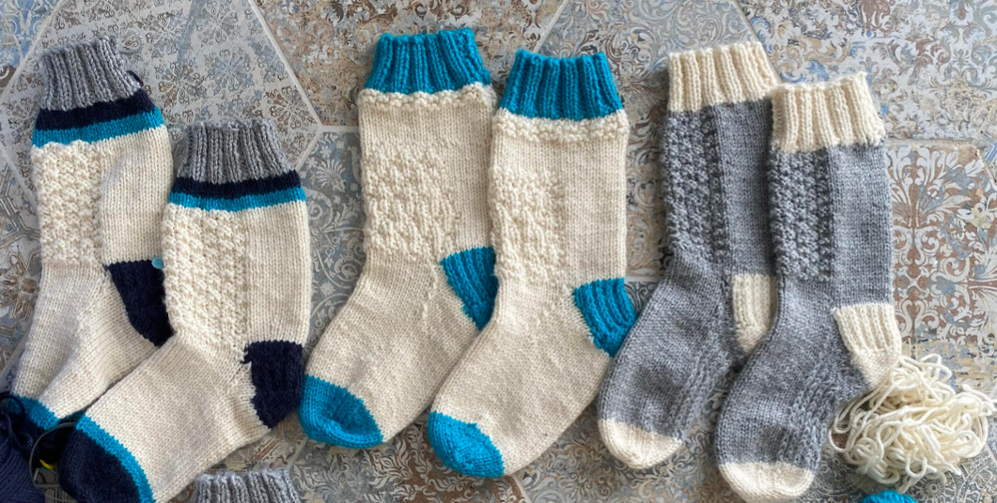
Key term – suggested activity sample
Raw product
How does the term relate to the image?
By – product
How does the term relate to the image?
Offal
Value added product
How does the term relate to the image?
Notes:
Key terms are included for each lesson to support student understanding of subject-specific language and to encourage consistent use of accurate terminology. Teachers are encouraged to introduce these terms at the beginning of each lesson as part of an explicit vocabulary focus.
This suggested activity is:
displaying the key terms alongside relevant images and prompting students to describe how each term may relate to the image.
Use this slide as a template to add any of the key terms throughout the unit of work.

Slide 21
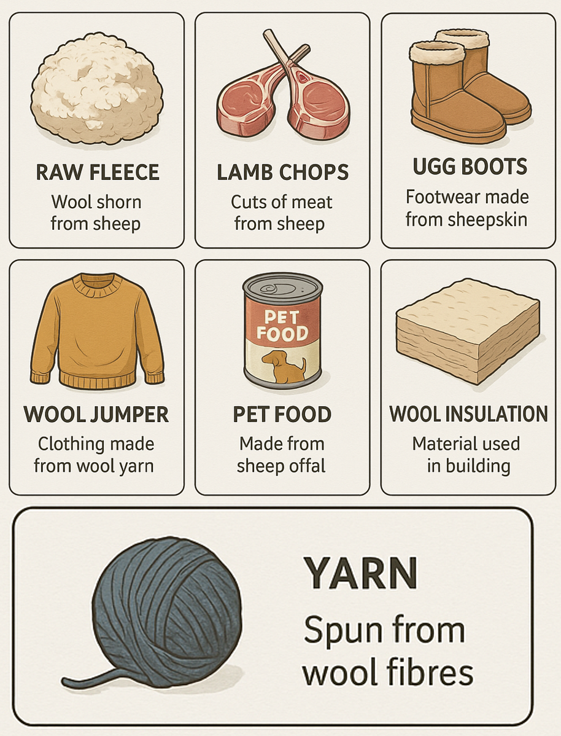
Products from sheep production
Notes:
Teaching notes:
This poster supports visual understanding of some of the products obtained from sheep farming. Use this to talk through the products listed in the workbook, what they are where they are used in everyday life. Please note, offal is missing from the poster.

Slide 22
Raw versus value-added activity
Fleece
Raw
Value-added
Meat
Pet food
Hides
Clothing
Offal
Insulation
Notes:
Teaching notes:
Alternative matching activity in digital form to support the workbook activity. This can be copied to your students Learning management system for individual exercise, or completed on the main screen as a whole class activity.

Slide 23
Describe paragraph
Write a short paragraph describing how sheep contribute to everyday products in Australian households.
Introduce the topic
What does or did it look like?
What does or did it do?
Conclude with a summarising sentences (for example, why is it important?)
Notes:
Writing paragraphs, Australian Education Research Organisation for student scaffold (https://www.edresearch.edu.au/guides-resources/practice-guides/writing-paragraphs)
This is the generic scaffold for writing a describe paragraph with students, see the following slides to break this down into a specific writing task, modelled alongside you as the teacher.

Slide 24
Describe paragraph – topic specific
Write a short paragraph describing how sheep contribute to everyday products in Australian households.
How are sheep linked to things we use at home?
Describe the materials sheep provide us.
Say how we use these materials in our homes.
Summarise why sheep are important in our daily life (optional).
Notes:
Writing paragraphs, Australian Education Research Organisation for student scaffold (https://www.edresearch.edu.au/guides-resources/practice-guides/writing-paragraphs)
This is the continued or more heavily scaffolded writing example to support teaching writing in lessons. This takes the generic prompts from the previous slide and contextualises them into targeted questions for this activity.
See the next slide for sample sentence starters to build this paragraph from and followed by a worked example for teachers to use as a model.

Slide 25
Describe paragraph – sentence starters
Write a short paragraph describing how sheep contribute to everyday products in Australian households.
1. Sheep are linked to things we use at home because…
2. Sheep give us materials like…
3. Wool from sheep is used for…..
4. Sheep are important in our daily life because……
Notes:
Writing paragraphs, Australian Education Research Organisation for student scaffold (https://www.edresearch.edu.au/guides-resources/practice-guides/writing-paragraphs)
This is the continued or more heavily scaffolded writing example to support teaching writing in lessons. Use this slide for sample sentence starters to build this paragraph from. This can be useful for differentiation of materials for student who require the further support. Download this slide directly into your LMS for individual student support.
The following slide is a worked example for teachers to use as a model.

Slide 26
Describe paragraph – worked example
Write a short paragraph describing how sheep contribute to everyday products in Australian households.
Sheep are linked to things we use at home because they provide materials that we use every day. Sheep give us wool, meat, and leather. Wool is used to make warm blankets, jumpers, and carpets. Meat from sheep, such as lamb and mutton, is cooked and eaten as part of meals. Leather from sheep can be used for making shoes, bags, and furniture coverings. Sheep are important in our daily life because they provide products that keep us warm, give us food, and make our homes comfortable.
Notes:
Writing paragraphs, Australian Education Research Organisation for student scaffold (https://www.edresearch.edu.au/guides-resources/practice-guides/writing-paragraphs)
This slide is a worked example using the sentence starters from the previous slide. This can be used as a modelled activity for teachers or create a simple cloze activity for further differentiation.

Slide 27
5. Sheep breeds
Learning intentions and success criteria
We are learning to understand how breed characteristics relate to production goals and environmental conditions.
We can:
describe features of different sheep breeds
explain why certain breeds are suited to specific climates or markets.
Notes:
Notes for teachers:
Learning intentions and success criteria are best co-constructed with students. Adapt the learning intention as required and add matching success criteria.
For more information See ⁠AITSL or the NSW Department of Education explicit teaching strategies, ⁠Sharing learning intentions and ⁠Sharing success criteria
LISC is not necessarily presented at the beginning of the lesson. Teacher needs to consider most effectual time to introduce
LISC should be revisited during the lesson to support students' evaluation of their learning

Slide 28
Key terms (5) 5
Breed – a group of animals with similar traits, such as Merino or Dorper sheep.
Dual-purpose breed – a type of sheep that is used for both meat and wool.
Adaptation – features or traits that help an animal survive in a specific environment or climate.
Notes:
Teaching notes:
Introduce key terms before starting each section. They support student understanding by linking core agricultural vocabulary to the lesson content. Encourage students to look out for how these terms are used in the activities that follow.

Slide 29
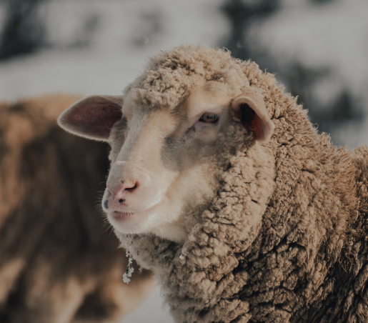
Breed comparison matrix
Breed name | Main product | Preferred climate | Key physical features | Fibre diameter (if applicable) | Picture
Example: Merino | Wool | Temperate, arid inland | Wrinkled skin, large fleece | 18–24 microns
Notes:
Teaching notes:
Table direct from workbook, including the sample answer to use as a model in class.

Slide 30
Sheep breeds spotlight – sample answer Dohne
Profile | Information
Sheep breed | Dohne
Origin | Dohne was developed in South Africa with an initial one-off cross between the Peppin Merino and the German Mutton Merino.
Main product | Wool and meat – dual purpose
Physical features | White fleece, plain bodied, open face, bare breech, lean and high yielding carcasses with even fat distribution.
Typical weight (adult) | Large framed sheep, adult ewes weighing between 50–75kg.
Horn status (horned/polled) | Polled
Preferred environment | Adapted to varied climates including harsh conditions.
Disease resistance or known issues | Plain body and open face reduces many potential health risks. Known for its natural resistance to internal and external parasites.
Why are they suitable in your local area | Can withstand harsh conditions with low protein pastures.
Notes:
Teaching notes:
This is a sample answer for use as a model during lessons.

Slide 31
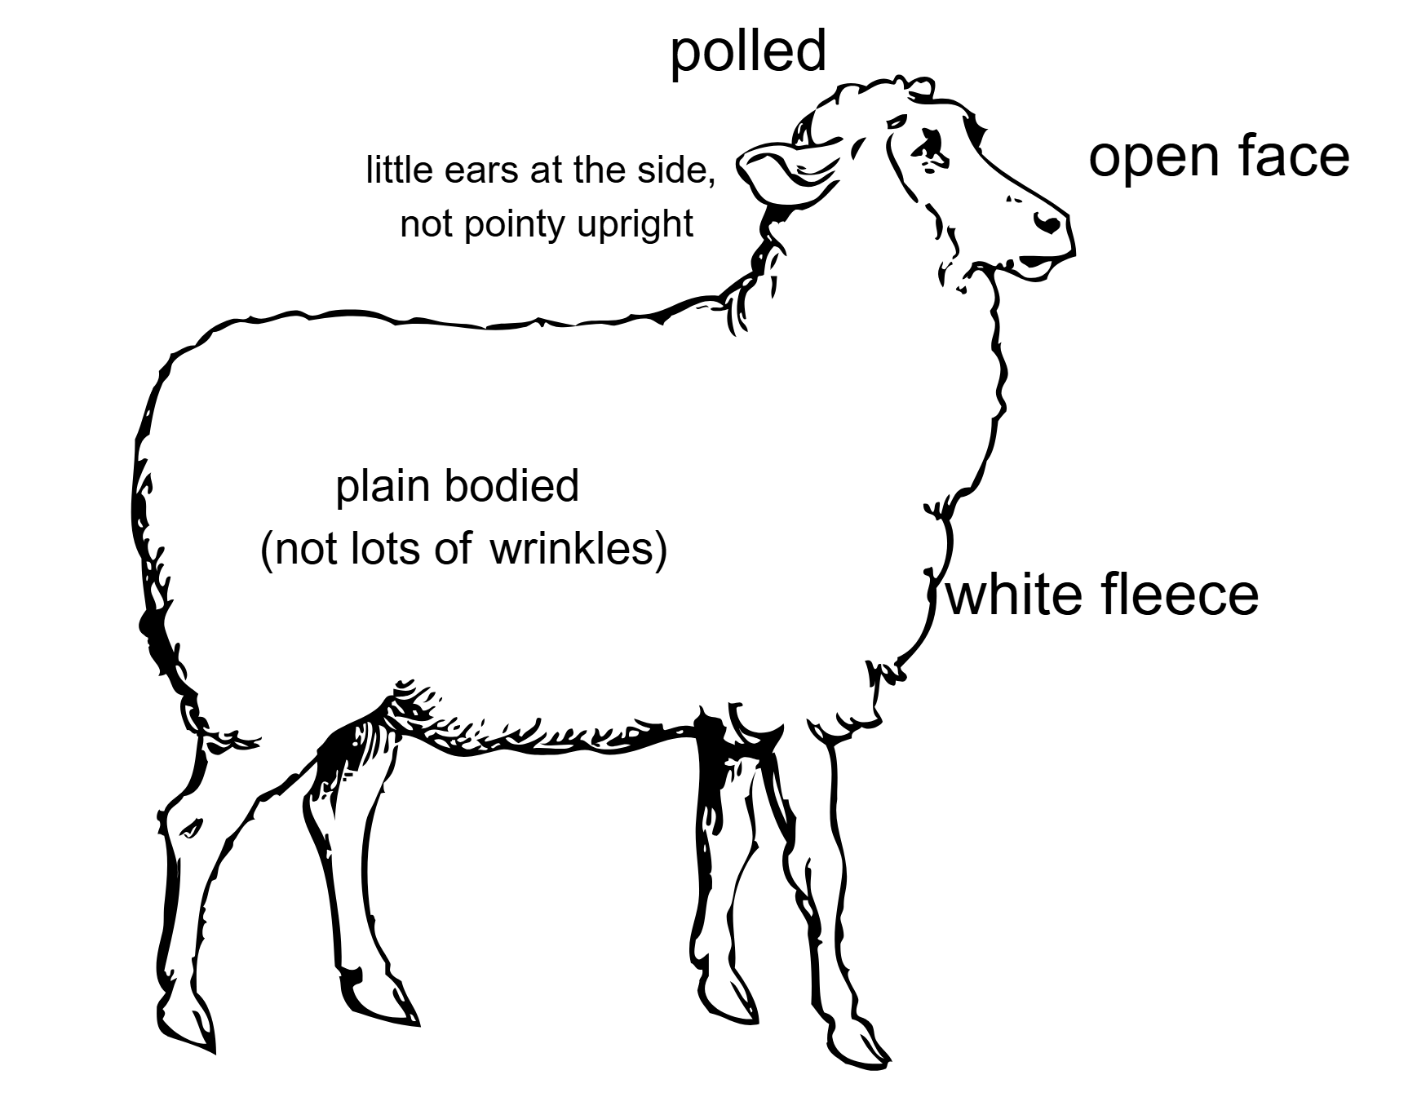
Modelled example – Dohne (1)
Image created using Canva
Notes:
Teaching notes:
This is a simple example of the sheep spotlight image completed and and annotated. It can be used as a modelled example for students completing the activity. See next slide for the same image, not annotated for alternative to this activity.

Slide 32
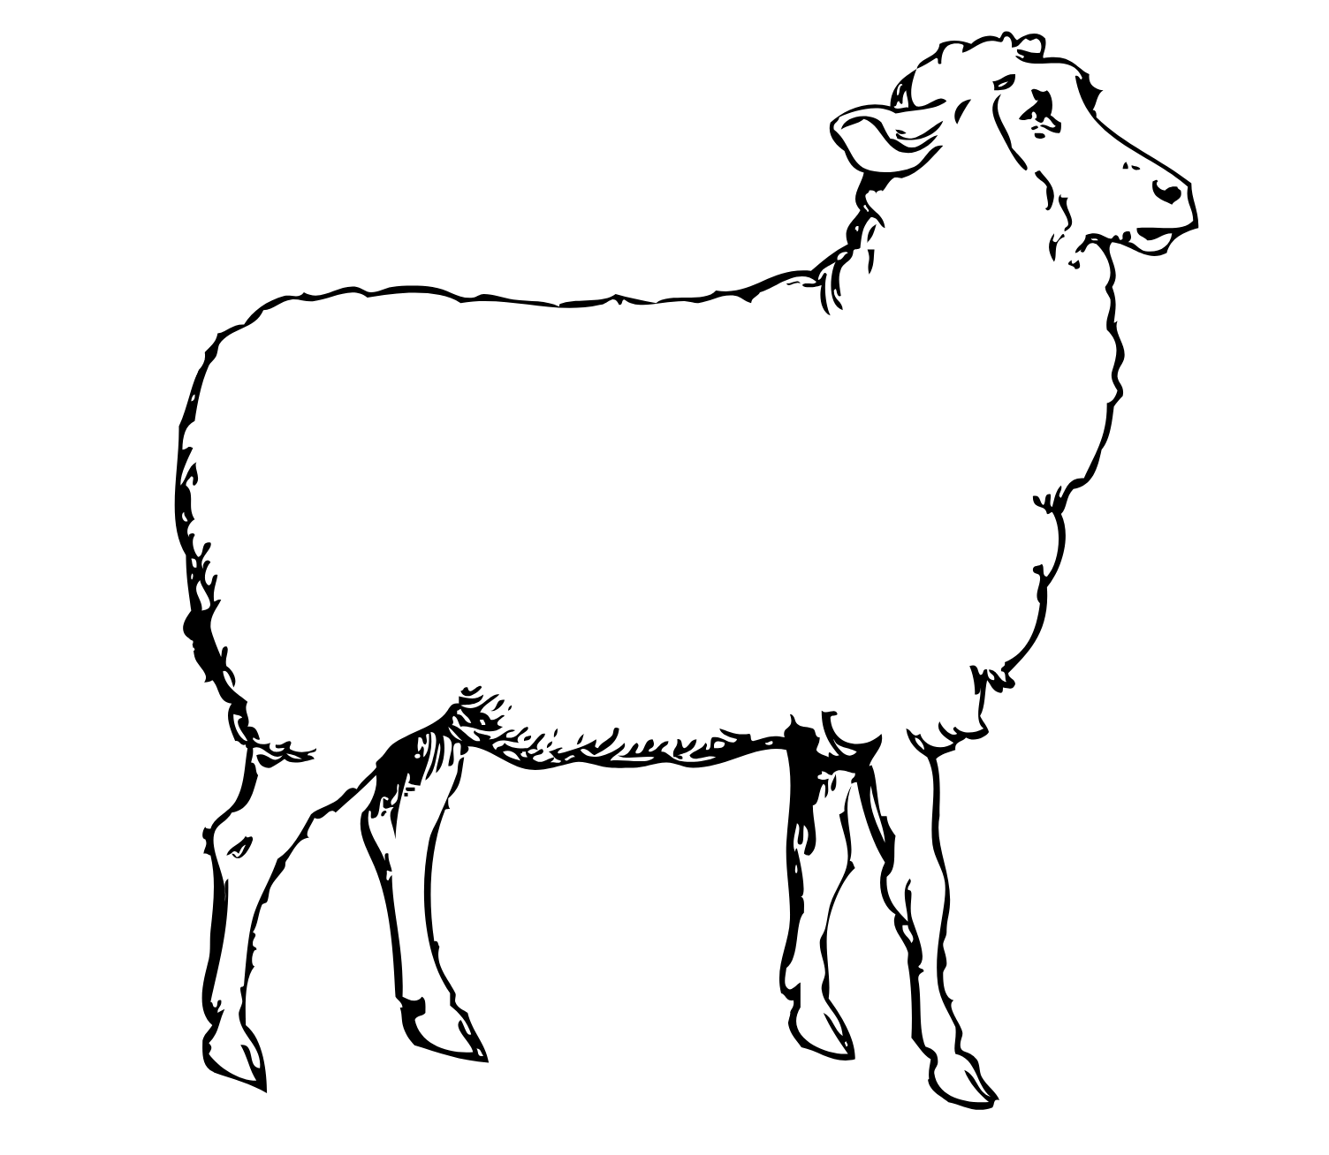
Modelled example – Dohne (2) without annotations
Image created using Canva
Notes:
Teaching notes:
This is a simple example of the sheep spotlight image completed but not annotated. Use this for an alternative to the activity, annotate the features of this sheep diagram according to the profile information. See previous slide for completed example.

Slide 33
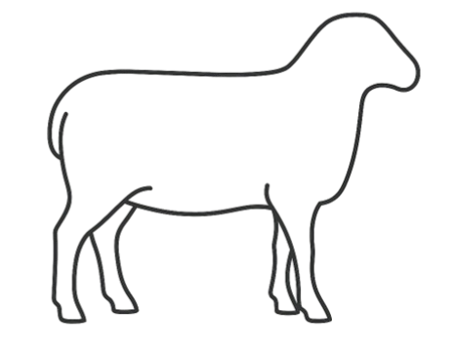
Sketching your spotlight breed
Notes:
Teaching notes:
This is the activity direct from the workbook that students will complete. Use this for in class teacher demonstration or to add directly to your student Learning management system to draw digitally over the outline.

Slide 34
6. Safety first in the sheep yards
Learning intentions and success criteria
We are learning to identify workplace hazards and apply safe animal handling practices.
We can:
recognise risks in sheep yards
suggest ways to reduce harm to people and animals.
Notes:
Notes for teachers:
Learning intentions and success criteria are best co-constructed with students. Adapt the learning intention as required and add matching success criteria.
For more information See ⁠AITSL or the NSW Department of Education explicit teaching strategies, ⁠Sharing learning intentions and ⁠Sharing success criteria
LISC is not necessarily presented at the beginning of the lesson. Teacher needs to consider most effectual time to introduce
LISC should be revisited during the lesson to support students' evaluation of their learning

Slide 35
Key terms (6) 6
Work Health and Safety (WHS) – rules and practices to keep people safe while working with animals and equipment.
Hazard – something that could cause harm or make a situation unsafe.
Risk – the chance that something could go wrong and cause harm.
Notes:
Teaching notes:
Introduce key terms before starting each section. They support student understanding by linking core agricultural vocabulary to the lesson content. Encourage students to look out for how these terms are used in the activities that follow.

Slide 36
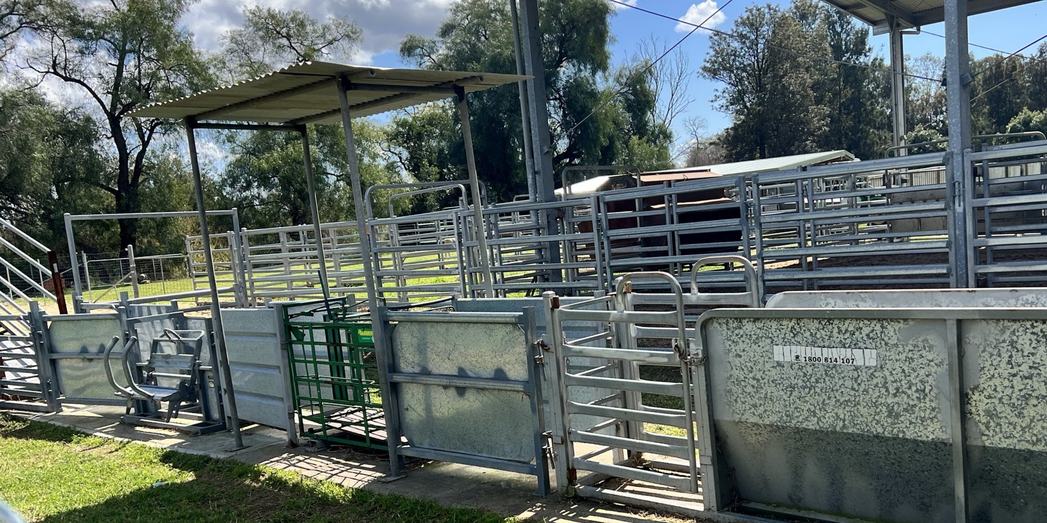
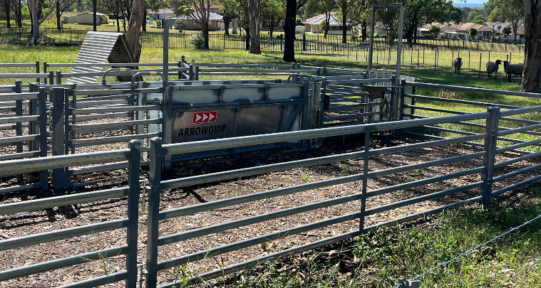
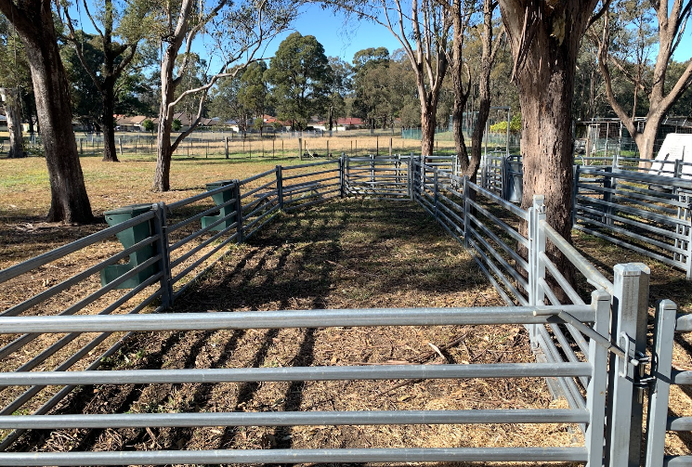
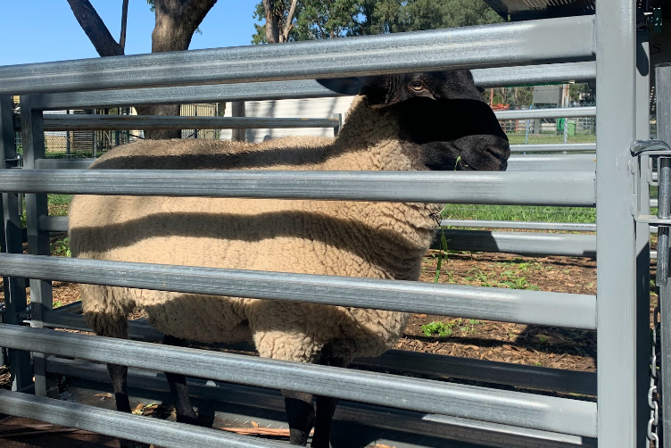
Example sheep yards
Notes:
Teaching notes:
For schools without sheep yards or classes needing an alternative activity for this section, these are samples of different sheep yards in schools to use for whole class discussion about potential hazards. Expand these images as required to see details close up during discussions.

Slide 37
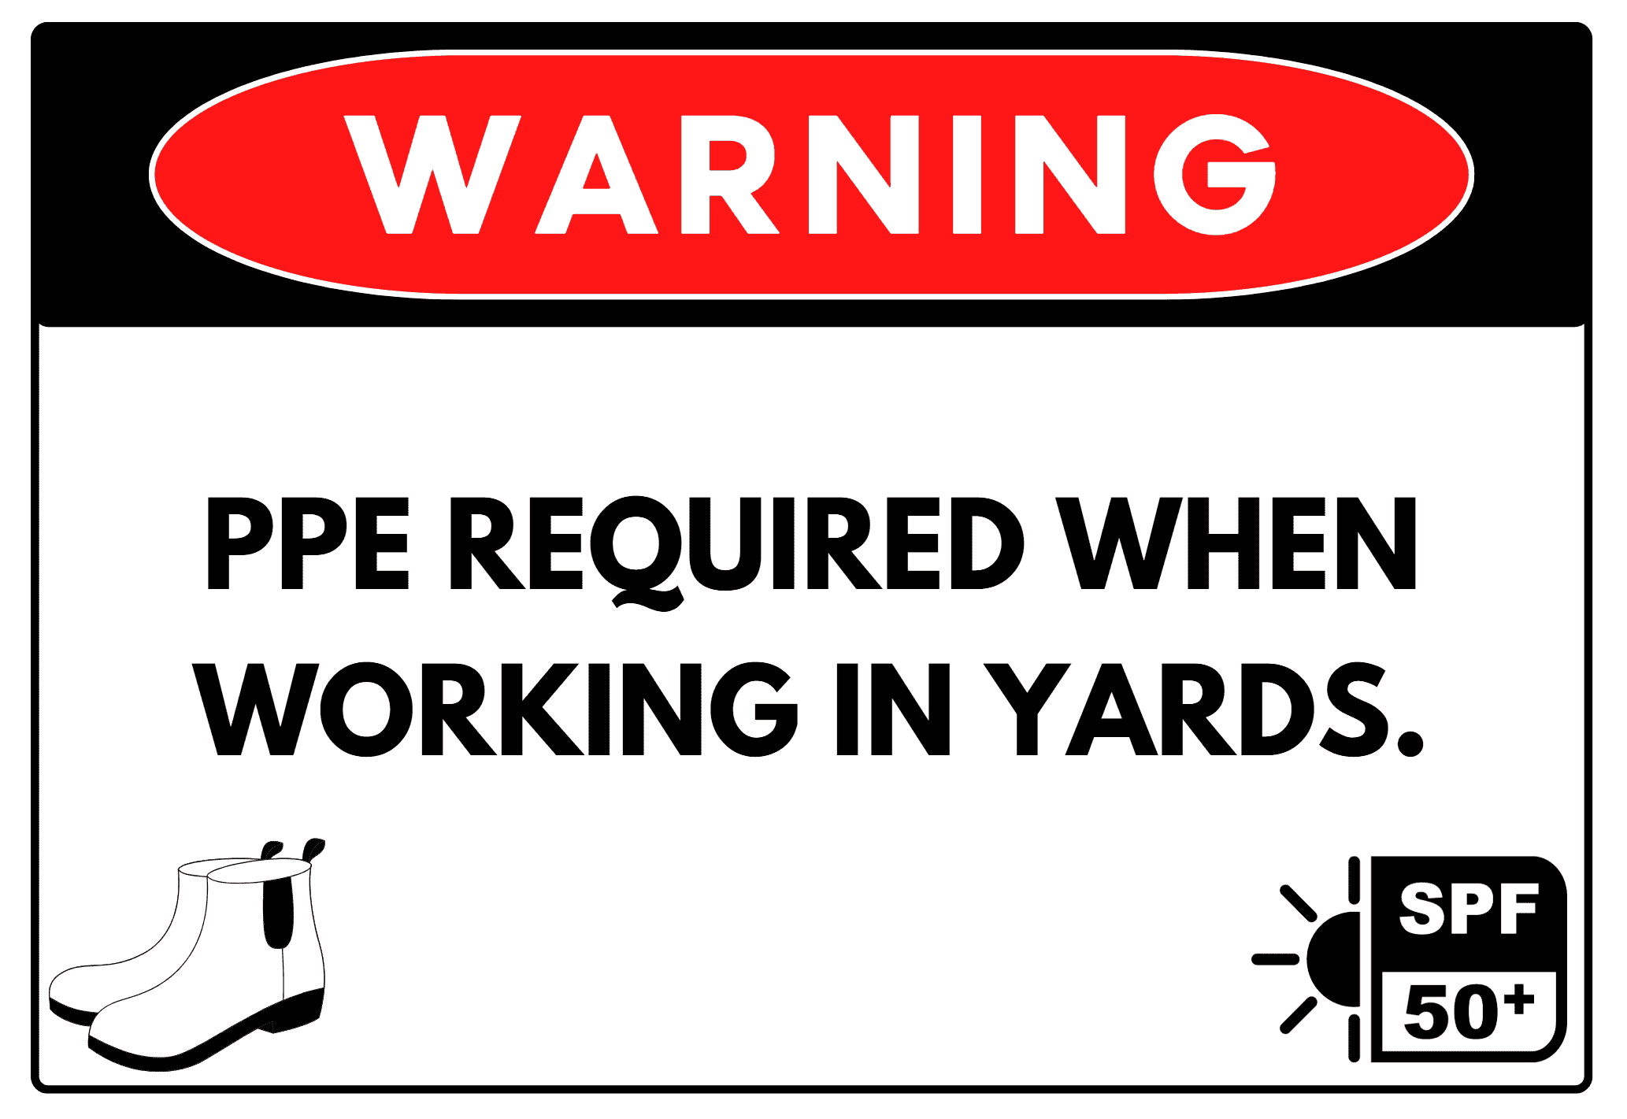
Safety poster for sheep yards
Image created using Canva
Notes:
Teaching notes:
Modelled example of a safety poster included in the workbook. Use as an example or model for students working on this activity. Alternatively, students can annotate this image to highlight the features and explain why it is or is not effective for the intended use.

Slide 38
About the animal

Slide 39
7. Ruminant digestive systems
Learning intentions and success criteria
We are learning to describe the parts and functions of a digestive system.
We can:
label the digestive organs of ruminant animals
describe the role each part plays in digestion.
Notes:
Notes for teachers:
Learning intentions and success criteria are best co-constructed with students. Adapt the learning intention as required and add matching success criteria.
For more information See ⁠AITSL or the NSW Department of Education explicit teaching strategies, ⁠Sharing learning intentions and ⁠Sharing success criteria
LISC is not necessarily presented at the beginning of the lesson. Teacher needs to consider most effectual time to introduce
LISC should be revisited during the lesson to support students' evaluation of their learning

Slide 40
Key terms (7) 7
Ruminant – an animal with a stomach that has four compartments, like sheep and cattle.
Digestion – the process of breaking down food so the body can absorb nutrients.
Microorganisms – tiny living things, like bacteria, that help sheep break down tough plant material in their stomachs.
Notes:
Teaching notes:
Introduce key terms before starting each section. They support student understanding by linking core agricultural vocabulary to the lesson content. Encourage students to look out for how these terms are used in the activities that follow.

Slide 41
Ruminant digestion (1)
Organ | Function
Mouth and oesophagus | The mouth is used to chew food and produce saliva. The oesophagus transports food down into the rumen and back up from the rumen.
Rumen | First compartment of the main stomach, contains microorganisms that break down the plant material and digest the food.
Reticulum | Second compartment of the main stomach. It works with the rumen and has bacteria and fungi to produce enzymes that help digest fibrous (tough) plant parts.
Notes:
Teaching notes:
See Meat and Livestock Australia Ruminant digestion poster, Good Meat, for a well labelled poster to support this information and the student workbook.

Slide 42
Ruminant digestion (2) 2
Organ | Function
Omasum | Third compartment of the main stomach that absorbs a lot of the water out of the food mixture before it moves on.
Abomasum | Fourth compartment and referred to as the ‘true stomach’. It works like our stomach, using acid and juices to digest food and kill microbes from the first two compartments.
Small intestine | This is where most digestion happens. Nutrients from the food are absorbed into the blood here through the villi.
Large intestine | Some further breakdown may occur here. Takes in any extra water and gets the leftover waste ready to be pushed through to the rectum and out the anus as faeces.
Notes:
Teaching notes:
See Meat and Livestock Australia Ruminant digestion poster, Good Meat, for a well labelled poster to support this information and the student workbook.

Slide 43
8. Dietary requirements of sheep
Learning intentions and success criteria
We are investigating how nutrition affects sheep at different stages of production and how to plan appropriate feeding.
We can:
explain why dietary needs change during the production cycle
create a simple feed plan for a specific stage.
Notes:
Notes for teachers:
Learning intentions and success criteria are best co-constructed with students. Adapt the learning intention as required and add matching success criteria.
For more information See ⁠AITSL or the NSW Department of Education explicit teaching strategies, ⁠Sharing learning intentions and ⁠Sharing success criteria
LISC is not necessarily presented at the beginning of the lesson. Teacher needs to consider most effectual time to introduce
LISC should be revisited during the lesson to support students' evaluation of their learning

Slide 44
Key terms (8) 8
Nutrient – a substance in food that animals need to grow, stay healthy and produce products.
Supplementary feeding – giving extra food like hay or grain when pasture isn't enough.
Feed ration – the amount and type of food given to animals each day.
Notes:
Teaching notes:
Introduce key terms before starting each section. They support student understanding by linking core agricultural vocabulary to the lesson content. Encourage students to look out for how these terms are used in the activities that follow.

Slide 45
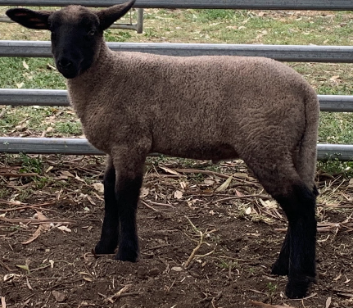
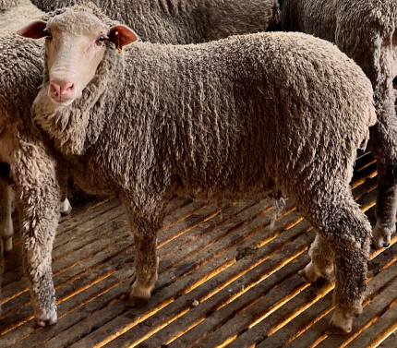
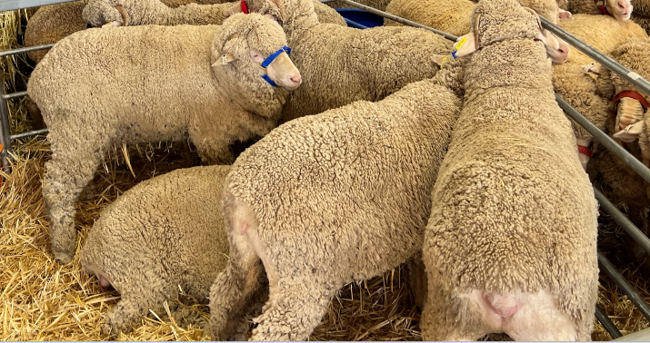
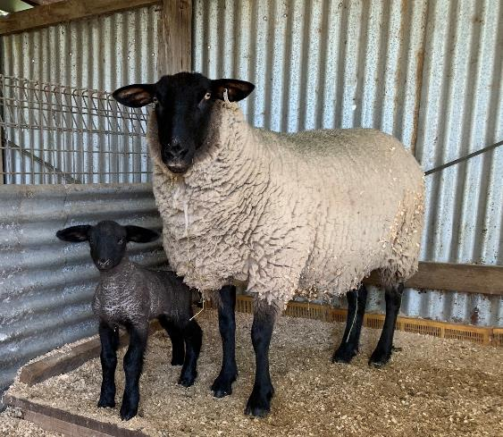
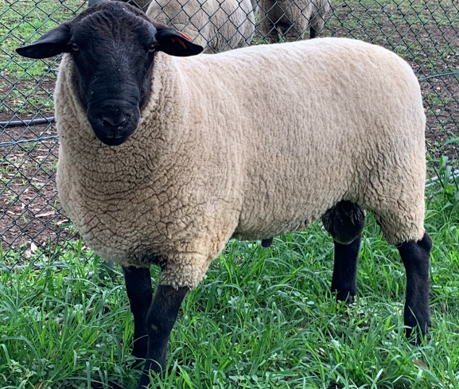
Stages of sheep
Left to right; top to bottom:
Lamb, dry ewe, wethers, lactating ewe with lamb, ram.
Notes:
Teaching notes:
For visual understanding of different life stages to support classroom discussion for this activity.

Slide 46

Mini feed plan
Lactating ewe
What does this sheep need more of right now? Energy, protein, calcium
What feed types are available? Lucerne hay, pellets and pasture
How will I feed it safely? Pasture will be available ad-lib, pellets will be supplemented in small amounts
What are the risks if feeding goes wrong? Too many pellets can cause bloating
How do weather and pasture conditions change your plans?
If it is too dry and pasture grows slower, I will need to increase the lucerne hay and pellets
Notes:
Teaching notes:
Sample answer for a specific life stage and mini feed plan to use as a class scaffold or modelling.

Slide 47
Challenge question (2)
Why do pregnant ewes need more energy and calcium?
What could happen if lambs are underfed post-weaning?
Notes:
Teaching notes:
Challenge questions can be used for students who understand the content learnt and are ready to apply it to a real-world scenario. Use these for individual students requiring extension of the work, homework for individuals or the class, or as a whole class discussion prompt.

Slide 48
Feed plan – worked example
Feed calculation
A group of 10 ewes needs to be fed for 10 days.
Each ewe eats 2 kg/day of mixed ration (50% hay at $300/tonne, 50% pellets at $200/tonne).
Step 1: Calculate total feed required.
Step 2: Break it into hay and pellet quantities.
Step 3: Work out the total cost of the feeding program.
Step 1: 10 ewes X 2 kg/day = 20kg/day
20 kg/day X 10 days = 200 kg
Step 2: 200 ÷ 100 X 50 = 100 kg is 50% hay
200 ÷ 100 X 50 = 100 kg are pellets
Step 3: 1000 kg = 1 tonne
0.1t hay X $300 = $30
0.1t pellets X $200 = $20
30 + 20 = $50 total
Notes:
Teaching notes:
Sample answers to support teacher modelling
Students may need support in calculating a percentage of an amount. There are multiple ways for this to be done.

Slide 49
9. Sheep reproductive systems
Learning intentions and success criteria
We are identifying the parts and functions of the reproductive systems in sheep.
We can:
label key reproductive organs
describe what each part does.
Notes:
Notes for teachers:
Learning intentions and success criteria are best co-constructed with students. Adapt the learning intention as required and add matching success criteria.
For more information See ⁠AITSL or the NSW Department of Education explicit teaching strategies, ⁠Sharing learning intentions and ⁠Sharing success criteria
LISC is not necessarily presented at the beginning of the lesson. Teacher needs to consider most effectual time to introduce
LISC should be revisited during the lesson to support students' evaluation of their learning

Slide 50
Key terms (9) 9
Reproduction – the process of animals making offspring (babies).
Fertilisation – when a sperm cell from the ram joins with an egg cell from the ewe to start a pregnancy.
Gestation – the length of time a ewe is pregnant, around 5 months for sheep.
Notes:
Teaching notes:
Introduce key terms before starting each section. They support student understanding by linking core agricultural vocabulary to the lesson content. Encourage students to look out for how these terms are used in the activities that follow.

Slide 51
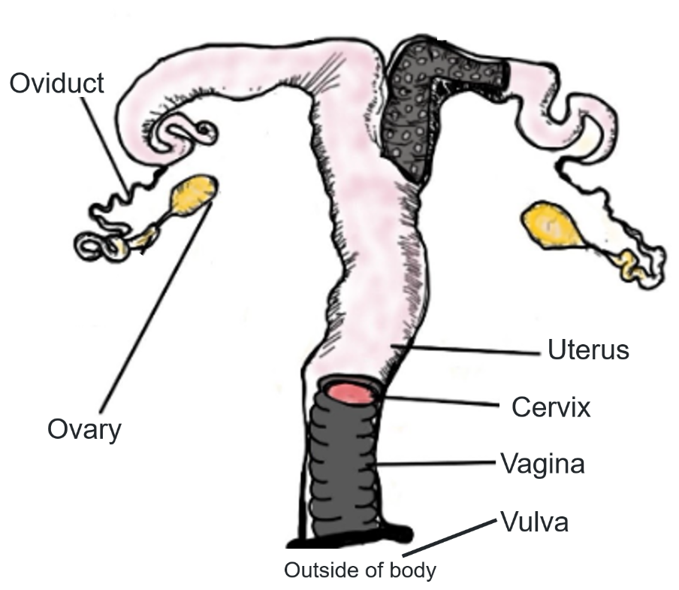
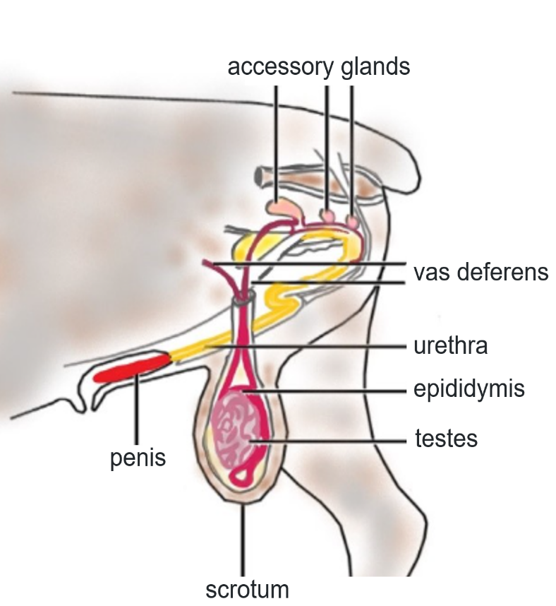
Reproductive systems of sheep
Female
Male
51
Notes:
Teaching notes:
Completed and labelled diagrams of the female and male reproductive system of sheep.

Slide 52
Ewe’s reproductive organs
Ovary
Organ | Function
 | Contain the ova (eggs) and releases one each cycle. Also makes the hormones that control reproduction.
 | Catches the egg after it’s released. This is where fertilisation happens if sperm is present. Then it carries the fertilised egg to the uterus.
 | Where the lamb grows during pregnancy. It feeds the lamb, keeps it safe, and helps push it out during birth.
 | A strong, tight muscle between the uterus and vagina. It keeps out germs during pregnancy and helps guide sperm through during mating.
 | The birth canal and where the ram’s semen goes during mating.
 | The outside part of the reproductive system. It protects the opening from dirt and germs.
Cervix
Uterus
Vulva
Oviduct
Vagina
Notes:
Teaching notes:
Rearrange the organs to match the correct function, this is a drag and drop activity opportunity.
In correct order from top to bottom: Ovary, Oviduct/fallopian tubes, Uterus, Cervix, Vagina, Vulva

Slide 53
Rams' reproductive system
Penis
Organ | Function
 | Make the sperm (male sex cells) and the male hormone testosterone.
 | A skin-covered sac that holds the testes outside the body to keep them cool, which helps sperm grow properly.
 | A long-coiled tube attached to each testicle. It stores sperm, helps them mature, and gets them ready for use.
 | A tube that carries the sperm from the epididymis to the urethra when the ram ejaculates.
 | These glands add liquid to the sperm to make semen. This liquid helps sperm move and stay alive.
 | The final tube the sperm travels through inside the penis. It also carries urine, but never at the same time as semen.
 | The organ used to deliver semen into the ewe during mating. It becomes firm when filled with blood during arousal.
Urethra
Epididymis
Vas deferens
Scrotum
Accessory glands
Testes
Notes:
Teaching notes:
Rearrange the organs to match the correct function, this is a drag and drop activity opportunity.
In correct order from top to bottom: Testes, Scrotum, Epididymis, Vas deferens, Accessory glands, Urethra, Penis

Slide 54
10. Breeding choices in sheep production
Learning intentions and success criteria
We are comparing different breeding systems and how they affect production outcomes.
We can:
describe common sheep breeding systems
explain how each system affects enterprise goals.
Notes:
Notes for teachers:
Learning intentions and success criteria are best co-constructed with students. Adapt the learning intention as required and add matching success criteria.
For more information See ⁠AITSL or the NSW Department of Education explicit teaching strategies, ⁠Sharing learning intentions and ⁠Sharing success criteria
LISC is not necessarily presented at the beginning of the lesson. Teacher needs to consider most effectual time to introduce
LISC should be revisited during the lesson to support students' evaluation of their learning

Slide 55
Key terms (10) 10
Crossbreeding – mating two different breeds to combine their best traits.
Genetic traits – qualities passed from parents to offspring, like wool type or growth rate.
Selective breeding – choosing animals with desirable traits to be parents of the next generation.
Notes:
Teaching notes:
Introduce key terms before starting each section. They support student understanding by linking core agricultural vocabulary to the lesson content. Encourage students to look out for how these terms are used in the activities that follow.

Slide 56
Key terms – suggested activity sample
Match the term to its definition
Genetic traits
  Mating two different breeds to combine their best traits.
Selective breeding
  Qualities passed from parents to offspring, like wool type or growth rate.
Crossbreeding
Choosing animals with desirable traits to be parents of the next generation.
Notes:
Key terms are included for each lesson to support student understanding of subject-specific language and to encourage consistent use of accurate terminology. Teachers are encouraged to introduce these terms at the beginning of each lesson as part of an explicit vocabulary focus.
This suggested activity is:
- matching terms to mixed-up definitions prior to commencing the lesson
Use this slide as a template to add any of the key terms throughout the unit of work.

Slide 57
Case study analysis
Which breeding system you would choose and why?
"You’re running a sheep meat enterprise. You want lambs that grow quickly and reach market weight fast. You also want to avoid long-term health issues in your flock."
Notes:
Teaching notes:
This is direct from the workbook. Use this prompt as an alternative to completing this task individually by students and instead, use it for whole class discussion.

Slide 58
Explain paragraph
"You’re running a sheep meat enterprise. You want lambs that grow quickly and reach market weight fast. You also want to avoid long-term health issues in your flock."
Write a short paragraph explaining which breeding system you would choose and why, based on what you’ve learned.
Introduce the topic
How did or does it happen?
Why did or does it happen?
Conclude with a summarising sentences (for example, what is the relationship between these 2 things?)
Notes:
Writing paragraphs, Australian Education Research Organisation for student scaffold (https://www.edresearch.edu.au/guides-resources/practice-guides/writing-paragraphs)
This is the generic scaffold for writing a explain paragraph with students, see the following slides to break this down into a specific writing task, modelled alongside you as the teacher.

Slide 59
Explain paragraph – topic specific
"You’re running a sheep meat enterprise. You want lambs that grow quickly and reach market weight fast. You also want to avoid long-term health issues in your flock."
Write a short paragraph explaining which breeding system you would choose and why, based on what you’ve learned.
State which breeding system you would use.
Explain how this breeding system works.
Explain why this system is the best choice for your breeding goals.
Summarise how this choice helps produce lambs for market and keep the flock healthy (optional).
Notes:
Writing paragraphs, Australian Education Research Organisation for student scaffold (https://www.edresearch.edu.au/guides-resources/practice-guides/writing-paragraphs)
This is the continued or more heavily scaffolded writing example to support teaching writing in lessons. This takes the generic prompts from the previous slide and contextualises them into targeted questions for this activity.
See the next slide for sample sentence starters to build this paragraph from and followed by a worked example for teachers to use as a model.

Slide 60
Explain paragraph – sentence starters
1. The breeding system I would choose is……
2. This system works by…….
3. This is the best choice because………
It would help my flock by…….
4. Choosing this system means………
Notes:
Writing paragraphs, Australian Education Research Organisation for student scaffold (https://www.edresearch.edu.au/guides-resources/practice-guides/writing-paragraphs)
This is the continued or more heavily scaffolded writing example to support teaching writing in lessons. Use this slide for sample sentence starters to build this paragraph from. This can be useful for differentiation of materials for student who require the further support. Download this slide directly into your LMS for individual student support.
The following slide is a worked example for teachers to use as a model.

Slide 61
Explain paragraph – worked example
The breeding system I would choose is crossbreeding. This system works by mating animals from different breeds within the same species. Crossbreeding is the best choice because it creates hybrid vigour, which means the lambs grow quickly and have improved meat traits. It would help my flock reach market weight faster and produce high-quality meat for sale. Choosing crossbreeding also lowers the risk of long-term health problems compared to inbreeding, which helps keep the flock strong and healthy.
Notes:
Writing paragraphs, Australian Education Research Organisation for student scaffold (https://www.edresearch.edu.au/guides-resources/practice-guides/writing-paragraphs)
This slide is a worked example using the sentence starters from the previous slide. This can be used as a modelled activity for teachers or create a simple cloze activity for further differentiation.

Slide 62
11. Australian Sheep Breeding Values (ASBVs)
Learning intentions and success criteria
We are learning to interpret breeding values and use them to make informed decisions.
We can:
explain what ASBVs are and how they are used
justify breeding decisions using trait data.
Notes:
Notes for teachers:
Learning intentions and success criteria are best co-constructed with students. Adapt the learning intention as required and add matching success criteria.
For more information See ⁠AITSL or the NSW Department of Education explicit teaching strategies, ⁠Sharing learning intentions and ⁠Sharing success criteria
LISC is not necessarily presented at the beginning of the lesson. Teacher needs to consider most effectual time to introduce
LISC should be revisited during the lesson to support students' evaluation of their learning

Slide 63
Key terms (11)
ASBV (Australian Sheep Breeding Value) – a number that predicts how likely an animal is to pass on good traits.
Worm resistance – a genetic trait where sheep are less affected by internal parasites.
Performance data – information about how an animal grows or produces that is used to guide breeding.
Notes:
Teaching notes:
Introduce key terms before starting each section. They support student understanding by linking core agricultural vocabulary to the lesson content. Encourage students to look out for how these terms are used in the activities that follow.

Slide 64
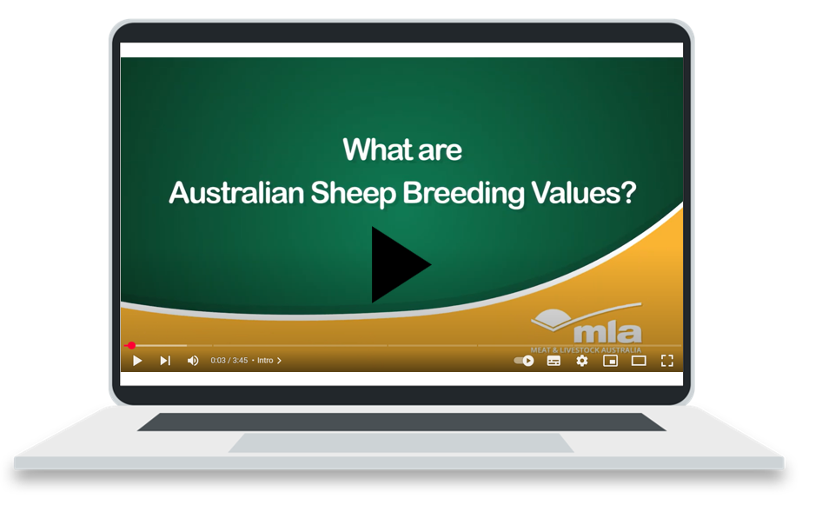
What are Australian sheep breeding values?
Notes:
Teaching notes:
Click the image to access the video What are Australian Sheep Breeding Values? (duration 3.45).

Slide 65
Meet BrightWool 221 – A ram for wool production
BrightWool 221(purpose) – To breed maiden ewes for fine wool production.
Trait code | Trait name | Value | What it means
BWT | Birth Weight | 0.2 | Slightly higher than average – suitable for maiden ewes
WWT | Weaning Weight | 4.0 | Good early growth for lambs
PWT | Post-Weaning Weight | 6.5 | Continues growing well after weaning
CFW | Clean Fleece Weight | +12% | Produces 12% more clean wool
FD | Fibre Diameter | -1.8 | Finer wool, more valuable
FAT | Fat Depth | 0.0 | Balanced fat cover
EMD | Eye Muscle Depth | 1.2 | Slightly better muscle for meat value
WEC | Worm Egg Count | -50% | Very good parasite resistance
NLW | Number of Lambs Weaned | +10% | More lambs successfully raised
Notes:
Teaching notes:
This is a fictional rams ASBV table (simplified). It has been selected as a good candidate for purchase for a farmer who is looking to produce quality fine wool, but also use this ram for their maiden ewes (first year of breeding). Use this table to introduce some of the common acronyms used in ASBV table, such as BWT and the use of both positive and negative values.
Glossary
ASBV: Genetic score for traits
Micron: Measures wool thickness
Worm Egg Count (WEC): Lower = better parasite resistance
Clean Fleece Weight (CFW): How much clean wool after washing

Slide 66
Why choose BrightWool 221?
BrightWool 221(purpose) – To breed maiden ewes for fine wool production.
Produces high-quality wool with fine fibre
Lambs grow well but stay small enough for first-time mums
Naturally more resistant to worms
Helps build a productive, low-maintenance flock
Notes:
Teaching notes:
Revisit the fictional purpose the farmer looking at this ram wanted, to breed for quality and fine wool, but also use the ram for their maiden ewes. The four points listed here are reason why this ram might be a good selection for this farmer.
Discussion: what factors cannot be determined by the ASBV table that might be important to the farmer when selecting their ram? Consider the rams overall health, it is free from disease, does it have a limp or poor back legs which could cause mating issues for the ewes, what is its age?

Slide 67
12. Sheep pests and diseases
Learning intentions and success criteria
We are learning to recognise the impact of parasites and disease and identify how to manage them in sheep.
We can:
describe symptoms of common parasites and diseases
recommend control and prevention strategies.
Notes:
Notes for teachers:
Learning intentions and success criteria are best co-constructed with students. Adapt the learning intention as required and add matching success criteria.
For more information See ⁠AITSL or the NSW Department of Education explicit teaching strategies, ⁠Sharing learning intentions and ⁠Sharing success criteria
LISC is not necessarily presented at the beginning of the lesson. Teacher needs to consider most effectual time to introduce
LISC should be revisited during the lesson to support students' evaluation of their learning

Slide 68
Key terms (12)
Parasite – a living organism that lives on or in an animal and causes harm, like worms or lice.
Infection – when harmful germs enter the body and cause illness.
Prevention – actions taken to stop a disease or problem before it happens.
Notes:
Teaching notes:
Introduce key terms before starting each section. They support student understanding by linking core agricultural vocabulary to the lesson content. Encourage students to look out for how these terms are used in the activities that follow.

Slide 69
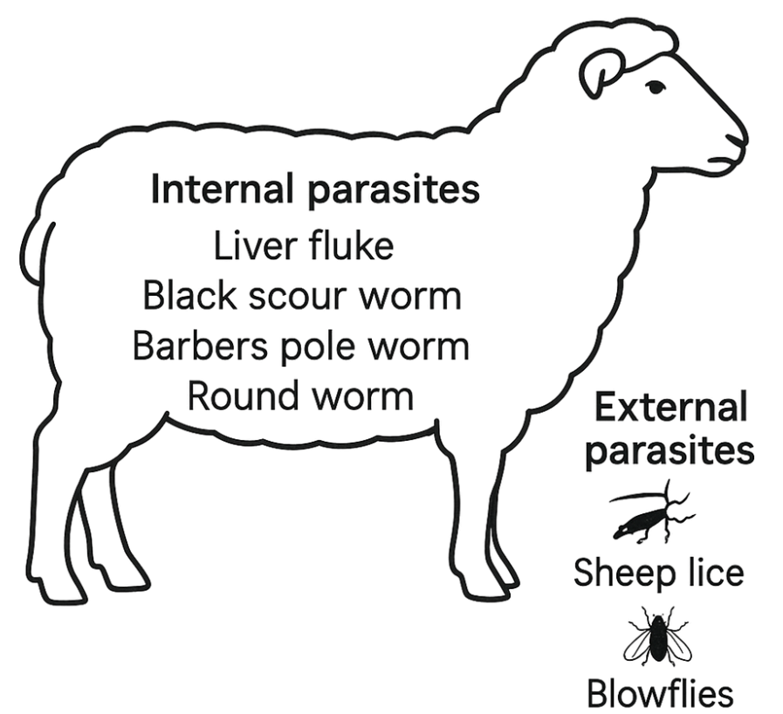
Internal and external
Notes:
Teaching notes:
The terms internal and external parasites are introduced in the initial text for this lesson. Use this slide as a discussion starter to ensure all students understand the difference between the two, and are introduced to some examples of both.

Slide 70
Agricultural show flyer – peer review
Use the following criteria to review your peer's informative flyer
Criteria | Feedback
Clarity and purpose The information is clear and easy to understand.
Content accuracy The symptoms and management strategies are accurate and well explained. Correct terminology has been used throughout.
Visual presentation Images or diagrams help explain the topic clearly.
Impact and relevance It includes advice that could help prevent economic loss on farms.
Suggestions for improvement One thing that could be added or improved is: One thing I really liked was:
Notes:
Teaching notes:
This peer review table can be used by students to provide feedback for another student in their class on the flyer produced in the activity from the workbook. This can be added to your classes LMS, or printed for students if preferred. It is an introductory step into providing effective feedback to peers.

Slide 71
Zoonotic diseases
When animal illness affects humans
Zoonotic diseases are diseases that can be passed from animals to humans. They may be caused by bacteria, viruses, fungi or parasites. Farmers, vets and people who work closely with animals are more likely to come into contact with zoonotic diseases, but some can spread more widely through food, water, or the environment.
Examples of zoonotic diseases in sheep include:
Q fever – caused by bacteria, can spread to humans through dust contaminated with sheep birth fluids or faeces.
Scabby mouth – a viral disease that can be transferred through skin contact with infected sheep.
Leptospirosis – a bacterial infection found in urine that can affect both animals and humans.
Ringworm – a fungal skin disease that can easily spread between humans and animals.
Notes:
Teaching notes:
This information is an option for students to collect information about zoonotic disease in livestock, alternatively, students can research the information required for the workbook questions or use prior knowledge and whole class discussion.

Slide 72
Preventing zoonotic disease on farms
There are simple, effective ways to reduce the risk of zoonotic disease:
Wash hands thoroughly after handling animals.
Wear protective clothing like gloves, overalls and masks when assisting with lambing or handling sick animals.
Vaccinate livestock and humans where appropriate
Quarantine new or sick animals.
Keep animal areas clean and limit exposure to manure and contaminated dust.
Notes:
Teaching notes:
Continuation from the previous slide.

Slide 73
13. Sheep handling – estimating age
Learning intentions and success criteria
We are developing practical skills to estimate an animal’s age using visible characteristics.
We can:
describe how sheep teeth change over time
use mouthing to estimate age.
Notes:
Notes for teachers:
Learning intentions and success criteria are best co-constructed with students. Adapt the learning intention as required and add matching success criteria.
For more information See ⁠AITSL or the NSW Department of Education explicit teaching strategies, ⁠Sharing learning intentions and ⁠Sharing success criteria
LISC is not necessarily presented at the beginning of the lesson. Teacher needs to consider most effectual time to introduce
LISC should be revisited during the lesson to support students' evaluation of their learning

Slide 74
Key terms (13) 14
Mouthing – checking a sheep’s teeth to estimate its age.
Incisors – the front teeth used to tell how old a sheep is.
Cull – to remove an animal from the flock, often due to age or poor health.
Notes:
Teaching notes:
Introduce key terms before starting each section. They support student understanding by linking core agricultural vocabulary to the lesson content. Encourage students to look out for how these terms are used in the activities that follow.

Slide 75
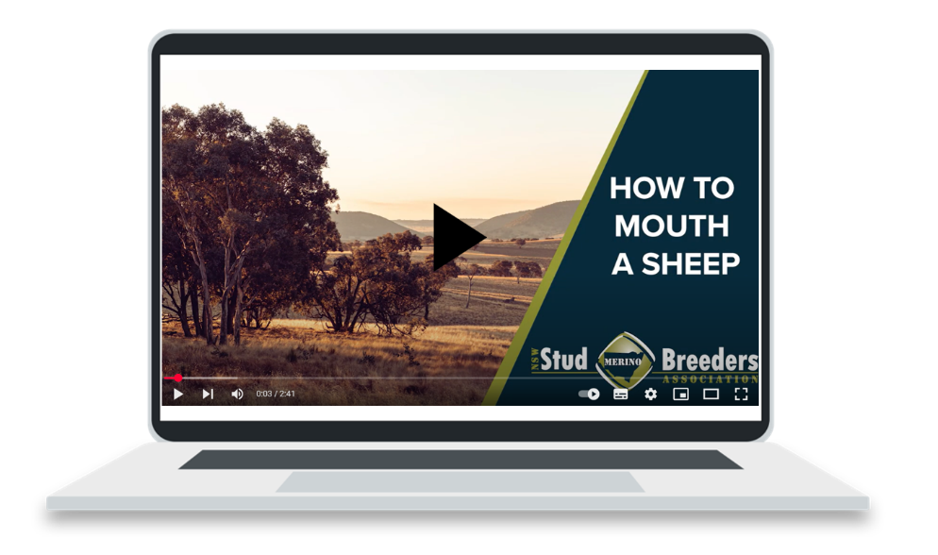
Mouthing a sheep
Notes:
Teaching notes:
Click the image to watch: ‘How to mouth a Merino sheep’ (duration 2.42)

Slide 76
Challenge question (3)
Why is age estimation important when deciding whether to keep a sheep for breeding or send it to market?
Notes:
Teaching notes:
Challenge questions can be used for students who understand the content learnt and are ready to apply it to a real-world scenario. Use these for individual students requiring extension of the work, homework for individuals or the class, or as a whole class discussion prompt.

Slide 77
14. Sheep handling – fat and condition scoring
Learning intentions and success criteria
We are developing practical skills to assess the physical condition of livestock to evaluate health and productivity.
We can:
identify condition scores and what they show about animal health.
Notes:
Notes for teachers:
Learning intentions and success criteria are best co-constructed with students. Adapt the learning intention as required and add matching success criteria.
For more information See ⁠AITSL or the NSW Department of Education explicit teaching strategies, ⁠Sharing learning intentions and ⁠Sharing success criteria
LISC is not necessarily presented at the beginning of the lesson. Teacher needs to consider most effectual time to introduce
LISC should be revisited during the lesson to support students' evaluation of their learning

Slide 78
Key terms (14) 15
Condition score – a rating of a sheep’s body fat and muscle, used to check health.
Fat cover – the layer of fat over a sheep’s ribs and spine that shows how well it’s been fed.
Backbone – A key area felt during condition scoring to assess body condition.
Notes:
Teaching notes:
Introduce key terms before starting each section. They support student understanding by linking core agricultural vocabulary to the lesson content. Encourage students to look out for how these terms are used in the activities that follow.

Slide 79
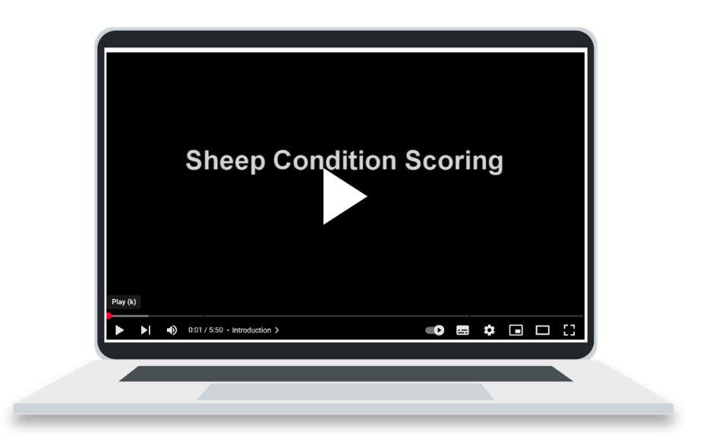
Condition scoring a sheep
Notes:
Teaching notes:
Click the image to watch: How to condition score sheep (duration 5.50)

Slide 80
Challenge question (4)
Why is a condition score of 3 often considered ideal for production animals?
Notes:
Teaching notes:
Challenge questions can be used for students who understand the content learnt and are ready to apply it to a real-world scenario. Use these for individual students requiring extension of the work, homework for individuals or the class, or as a whole class discussion prompt.

Slide 81
Working on a sheep farm

Slide 82
15. Husbandry practices
Learning intentions and success criteria
We are investigating and describing husbandry tasks and when they are carried out during the production year.
We can:
describe common husbandry practices and the tools used
explain the timing of key tasks and their purpose.
Notes:
Notes for teachers:
Learning intentions and success criteria are best co-constructed with students. Adapt the learning intention as required and add matching success criteria.
For more information See ⁠AITSL or the NSW Department of Education explicit teaching strategies, ⁠Sharing learning intentions and ⁠Sharing success criteria
LISC is not necessarily presented at the beginning of the lesson. Teacher needs to consider most effectual time to introduce
LISC should be revisited during the lesson to support students' evaluation of their learning

Slide 83
Key terms (15) 16
Husbandry – the regular care and management of animals to keep them healthy and productive.
Marking – a group of tasks done to lambs, like tagging, vaccinating and castrating.
Joining – the process of putting rams with ewes for breeding.
Notes:
Teaching notes:
Introduce key terms before starting each section. They support student understanding by linking core agricultural vocabulary to the lesson content. Encourage students to look out for how these terms are used in the activities that follow.

Slide 84
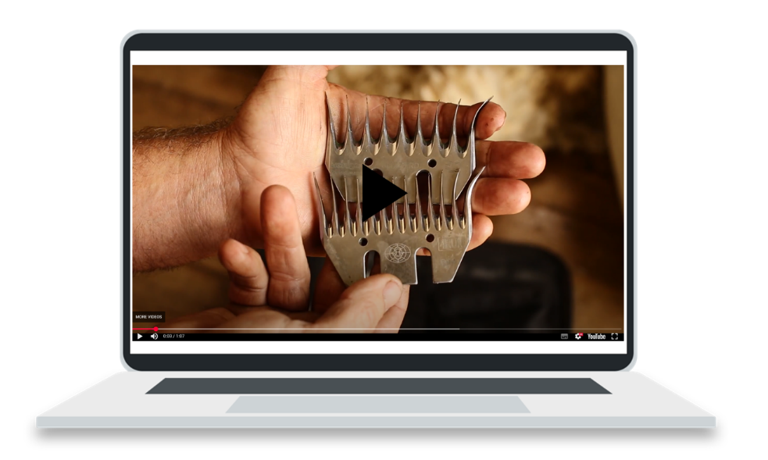
Shearing
Notes:
Teaching notes:
Click the image to watch: Shearing (duration 1.07) This video resource will support teachers in introducing shearing as a husbandry activity for classes or students who have not seen the activity before. Other husbandry activities can also be shown with video resources, or during a visit to a local sheep farm.

Slide 85
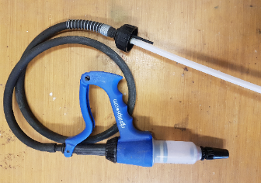
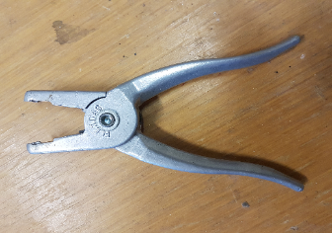
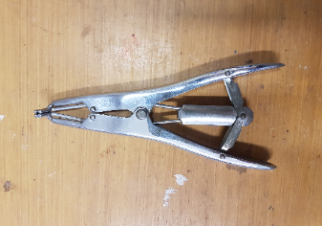
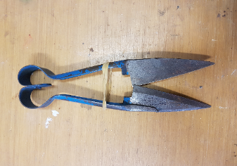
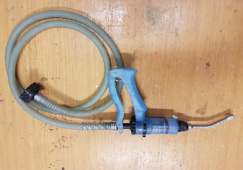
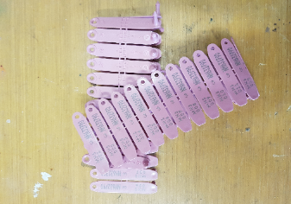
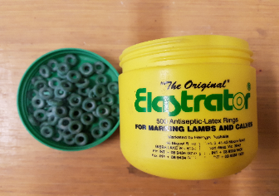
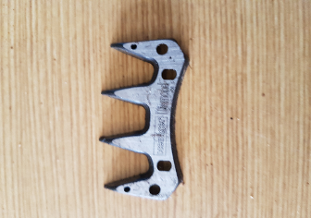
Husbandry tools
Ear tag applicator
Ear tags
Vaccination gun
Hand shears
Elastrator ring applicator
Electric clipper
Elastrator rings
Drench gun
Notes:
Teaching notes:
Larger, colour version photos of the sheep husbandry tools for classes and students who may require larger images, or if workbooks are printed in black and white.
Drag and drop the names of the husbandry tools to the correct picture.

Slide 86
Calendar of operations
Operations to include:
Month | Operation/s
January
February
March
April
May
June
July
August
September
October
November
December
Drenching
Ear tagging
Marking
Crutching
Culling
Weaning
Joining
Shearing
Selling
Vaccinating
Notes:
Teaching notes:
Drag and drop the operations onto the correct months of the year to build a simple calendar of operations.
This activity can cut downloaded and saved into your preferred LMS for individual hands-on learning for students.

Slide 87
16. How livestock are bought and sold
Learning intentions and success criteria
We are learning to understand how livestock marketing systems operate and how market decisions are made.
We can:
describe key features of livestock auctions and marketing platforms
compare option and decide which method suits different situations.
Notes:
Notes for teachers:
Learning intentions and success criteria are best co-constructed with students. Adapt the learning intention as required and add matching success criteria.
For more information See ⁠AITSL or the NSW Department of Education explicit teaching strategies, ⁠Sharing learning intentions and ⁠Sharing success criteria
LISC is not necessarily presented at the beginning of the lesson. Teacher needs to consider most effectual time to introduce
LISC should be revisited during the lesson to support students' evaluation of their learning

Slide 88
Key terms (16) 17
Auction – a public sale where buyers bid to buy animals.
Saleyard – a place where live animals are sold in person.
Lot – a group of animals sold together with the same sale ID.
Notes:
Teaching notes:
Introduce key terms before starting each section. They support student understanding by linking core agricultural vocabulary to the lesson content. Encourage students to look out for how these terms are used in the activities that follow.

Slide 89
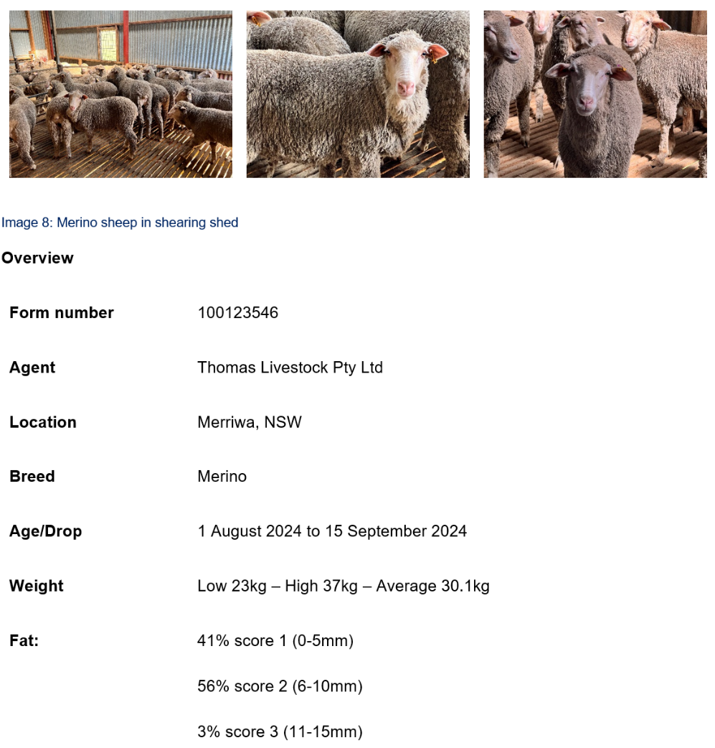
Mock auction example
Merriwa Central School Flock sale
Notes:
Teaching notes:
This is a completed example for use as a model in lessons.

Slide 90
How do farmers sell their sheep?
Online livestock auctions | Forward contracts | Local saleyard auctions
💡 Online bidding | 💡 Pre-agreed price | 💡 Physical public sale
✅ Convenience, wide reach | ✅ Risk reduction | ✅ Competitive pricing
⚠️ Requires good photos | ⚠️ May miss top prices | ⚠️ Transport stress
Notes:
Teaching notes:
This is a completed sample answer for class use during discussions or as a self marking activity.

Slide 91
17. Traditional and contemporary agricultural practices
Learning intentions and success criteria
We are learning how traditional land management knowledge influences sustainable farming today.
We can:
describe Aboriginal land management practices
explain how these practices support sustainable sheep production.
Notes:
Notes for teachers:
Learning intentions and success criteria are best co-constructed with students. Adapt the learning intention as required and add matching success criteria.
For more information See ⁠AITSL or the NSW Department of Education explicit teaching strategies, ⁠Sharing learning intentions and ⁠Sharing success criteria
LISC is not necessarily presented at the beginning of the lesson. Teacher needs to consider most effectual time to introduce
LISC should be revisited during the lesson to support students' evaluation of their learning

Slide 92
Key terms (17) 18
Sustainability – farming in a way that looks after animals, land, and resources for the future.
Regenerative agriculture – modern farming practice that improves soil, plants and biodiversity over time.
Integrated Pest Management (IPM) – a mix of natural and chemical methods to control pests with less harm.
Notes:
Teaching notes:
Introduce key terms before starting each section. They support student understanding by linking core agricultural vocabulary to the lesson content. Encourage students to look out for how these terms are used in the activities that follow.

Slide 93
Challenge question (5) 4
“Aboriginal land management practice is based on a system of understanding the interactions between the soil, living things, climate, and spiritual and social connections…”
Explain how this system can benefit sheep production today — for example, by improving pasture condition, reducing parasites, or supporting animal welfare.
Notes:
Teaching notes:
Challenge questions can be used for students who understand the content learnt and are ready to apply it to a real-world scenario. Use these for individual students requiring extension of the work, homework for individuals or the class, or as a whole class discussion prompt.

Slide 94
Sustainable choices
Match the farming practice to sustainable or unsustainable classification
Sustainable
Unsustainable
Rotational grazing
Clearing trees
IPM
Firestick farming
Use of chemicals for parasites
Continuous cropping
Replanting native shelterbelts
Overstocking during drought
Leaving chemicals uncollected
Unrestricted livestock access to creeks
Notes:
Teaching notes:
This activity matches the workbook table, drag and drop the farming practices into the correct category, sustainable or unsustainable and discuss as a whole class, or in small groups as to why each practice fits where you have placed it.

Slide 95
18. Biosecurity
Learning intentions and success criteria
We are learning to understand how biosecurity protects farms from pests and diseases.
We can:
define biosecurity and explain its importance
describe how threats to biosecurity are managed on farms.
Notes:
Notes for teachers:
Learning intentions and success criteria are best co-constructed with students. Adapt the learning intention as required and add matching success criteria.
For more information See ⁠AITSL or the NSW Department of Education explicit teaching strategies, ⁠Sharing learning intentions and ⁠Sharing success criteria
LISC is not necessarily presented at the beginning of the lesson. Teacher needs to consider most effectual time to introduce
LISC should be revisited during the lesson to support students' evaluation of their learning

Slide 96
Key terms (18) 19
Biosecurity – the steps taken to stop diseases, pests or weeds from entering or spreading on a farm.
Invasive species – animals or plants that don’t belong and can harm farms or the environment.
Quarantine – isolating new or sick animals to stop disease spreading.
Notes:
Teaching notes:
Introduce key terms before starting each section. They support student understanding by linking core agricultural vocabulary to the lesson content. Encourage students to look out for how these terms are used in the activities that follow.

Slide 97
Biosecurity
What if …biosecurity failed?
Imagine this:
You’re managing a 300-head sheep enterprise in regional NSW. It’s mid-spring, and lambs are nearly ready for market. A neighbouring property brings in new sheep from interstate.
Two weeks later, sheep on your farm begin showing signs of illness — loss of appetite, fever, and lameness. Tests confirm an outbreak of foot-and-mouth disease (FMD), a highly contagious virus.
Your property is placed in lockdown. All movement stops. Sales are cancelled. Inspectors are called in. You must report every recent visitor, delivery, and animal movement.
You later learn that no biosecurity checks were made when the neighbour’s sheep arrived.
Notes:
Teaching notes:
This is not included in the workbook, it is a good introduction activity to discuss a scenario as a whole class. This activity can help teachers formatively assess student understanding about biosecurity in Australia. Discussion prompts are on the next slide for this activity.

Slide 98
Discussion
What went wrong in this scenario?
What biosecurity steps could have prevented this?
How would this impact:
        the sheep?
        the farmer’s income?
        the wider livestock industry?
Notes:
Teaching notes:
Leading questions for discussion of the previous scenario.

Slide 99
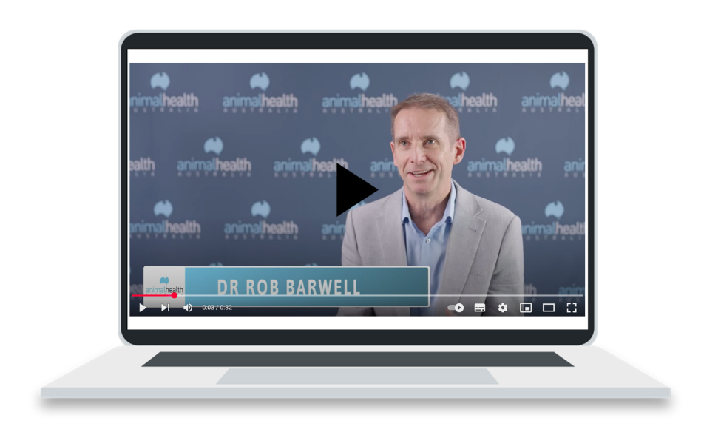
What is biosecurity?
Notes:
Teaching notes:
Click the image to watch the video resource What is biosecurity? Animal Health Australia (duration 0.33)

Slide 100
What is biosecurity? 2
Biosecurity refers to the systems and behaviours that prevent the introduction and spread of pests and disease. Good biosecurity protects animal health and the entire industry.
Risk identification table
Biosecurity risk | How it enters the farm | Control measure
New stock | From market or other farms | Quarantine on arrival
People | Clothing, vehicles | Provide clean boots, footbath
Feed | Contaminated hay or grain | Check source, store securely
Wildlife | Contact with flock | Maintain fencing, reduce attractants
Notes:
Teaching notes:
Direct from the workbook to display on the larger screen and facilitate discussion.

Slide 101
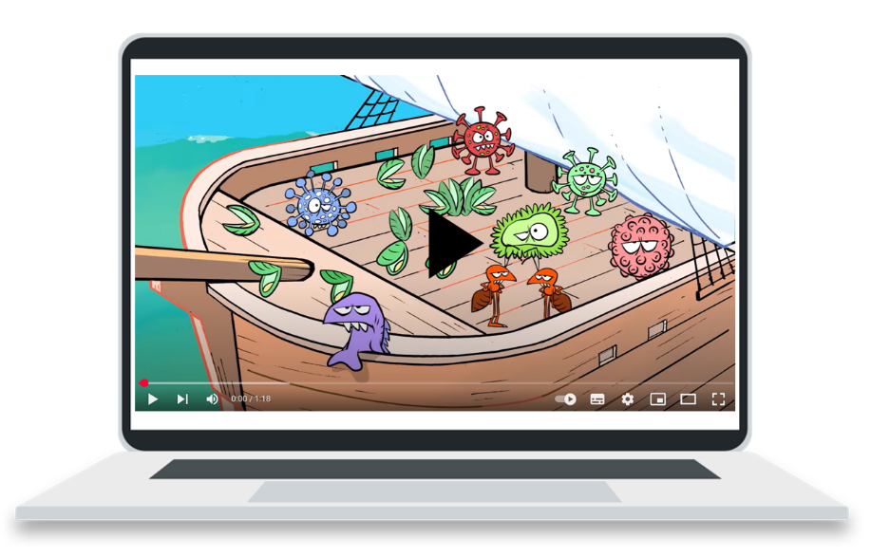
Biosecurity basics
Notes:
Teaching notes:
Click the image to watch the video resource Biosecurity basics – overview (duration 1.18)

Slide 102
Challenge question (6) 5
What could happen to the Australian sheep industry if a major disease like FMD (foot-and-mouth disease) entered the country?
Notes:
Teaching notes:
Challenge questions can be used for students who understand the content learnt and are ready to apply it to a real-world scenario. Use these for individual students requiring extension of the work, homework for individuals or the class, or as a whole class discussion prompt.

Slide 103
19. Sheep identification and traceability
Learning intentions and success criteria
We are exploring how identification systems support animal welfare and livestock traceability.
We can:
explain the purpose of ear tags and the NLIS
describe how identification and welfare practices work together.
Notes:
Notes for teachers:
Learning intentions and success criteria are best co-constructed with students. Adapt the learning intention as required and add matching success criteria.
For more information See ⁠AITSL or the NSW Department of Education explicit teaching strategies, ⁠Sharing learning intentions and ⁠Sharing success criteria
LISC is not necessarily presented at the beginning of the lesson. Teacher needs to consider most effectual time to introduce
LISC should be revisited during the lesson to support students' evaluation of their learning

Slide 104
Key terms (19) 20
Traceability – the ability to follow an animal’s movements through the supply chain.
Property Identification Code (PIC) – a unique code used to track where animals come from.
Electronic Identification (eID) – a tag with a chip that stores and shares animal information.
Notes:
Teaching notes:
Introduce key terms before starting each section. They support student understanding by linking core agricultural vocabulary to the lesson content. Encourage students to look out for how these terms are used in the activities that follow.

Slide 105

Property Identification Code (PIC)
Notes:
Teaching notes:
The following 3 video resources will help students understand the link between the PIC, NLIS website and eID tags on stock. It can help to draw a diagram showing how each aspect works together to support traceability of livestock and link back to biosecurity.
Click the image to watch the video resource What are Property Identification Codes (PICs)? (duration 4.00)

Slide 106
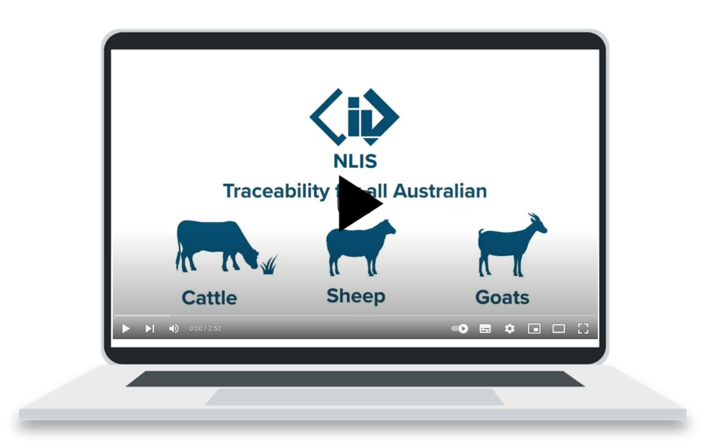
How NLIS works
Notes:
Teaching notes:
Click the image to watch the video resource How the National Livestock Identification System (NLIS) works (duration 2.52)

Slide 107
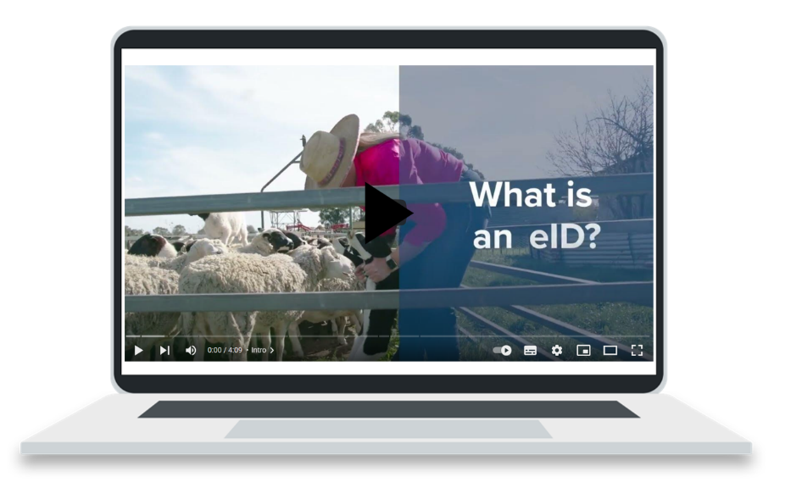
What is an eID?
Notes:
Teaching notes:
Click the image to watch the video resource Sheep and Goat eID’s Explained (duration 4.09)

Slide 108
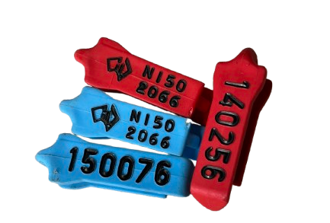
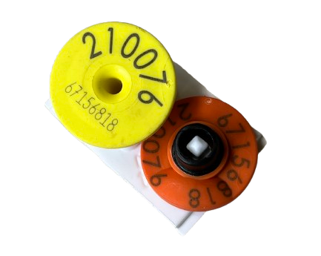
Sheep identification and traceability
Notes:
Teaching notes:
Images of different eID tags. Use real life examples if you have them available.

Slide 109
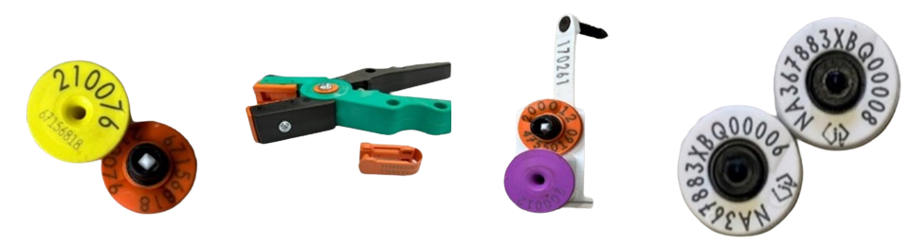
Compare and discuss
Compare eID and RFID devices and their use with other devices that require visual or manual record keeping applications.
Why might a farm manager would want to use the eID and RFID devices instead of visual tags.
Notes:
Teaching notes:
Class discussion prompt to compare the differences and/or similarities between devices and manual recording systems.

Slide 110
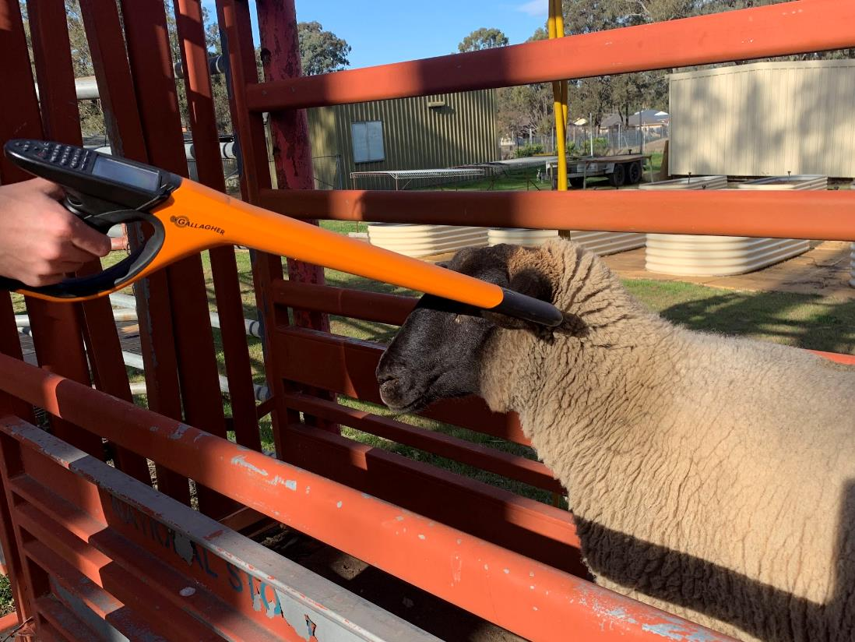
Discuss
Why is traceability critical in a disease outbreak?
Notes:
Teaching notes:
Discussion prompt to link this section of learning to the previous one about biosecurity.

Slide 111
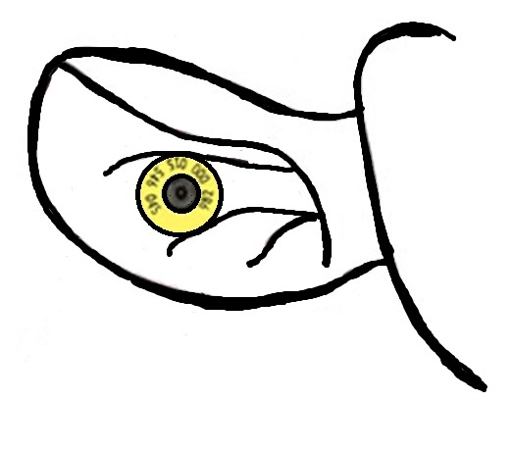
Ear tag placement
Notes:
Teaching notes:
Model of correct tag placement in the ear for round tags. This image is also in the appendix of the workbook for easy printing and further activities.

Slide 112
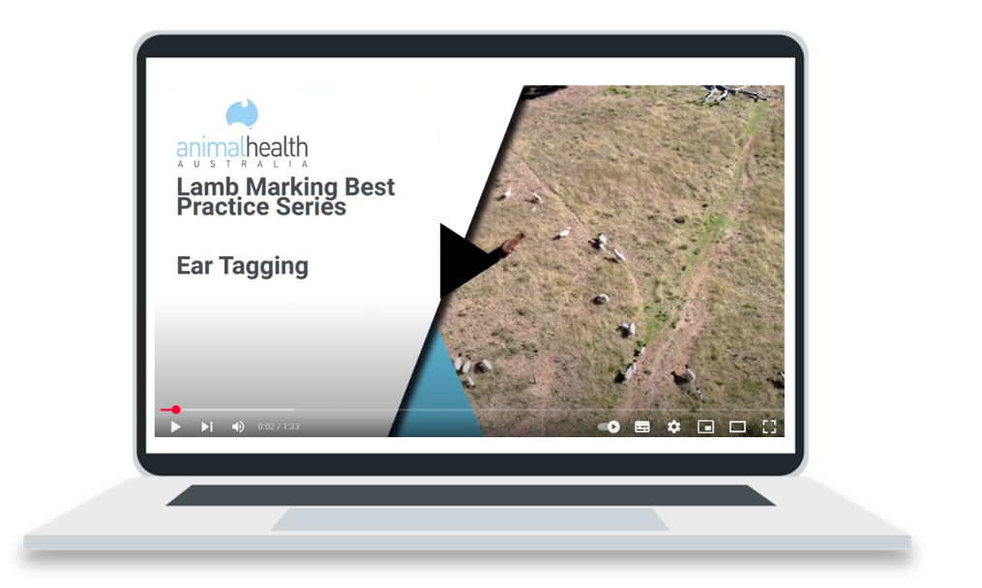
Ear tagging best practice
Notes:
Teaching notes:
For use with classes and teachers who have not had experience in tagging livestock, or do not have livestock available for tagging.
Click the image to watch the video resource Lamb marking best practice series: ear tagging (duration 1.33)

Slide 113
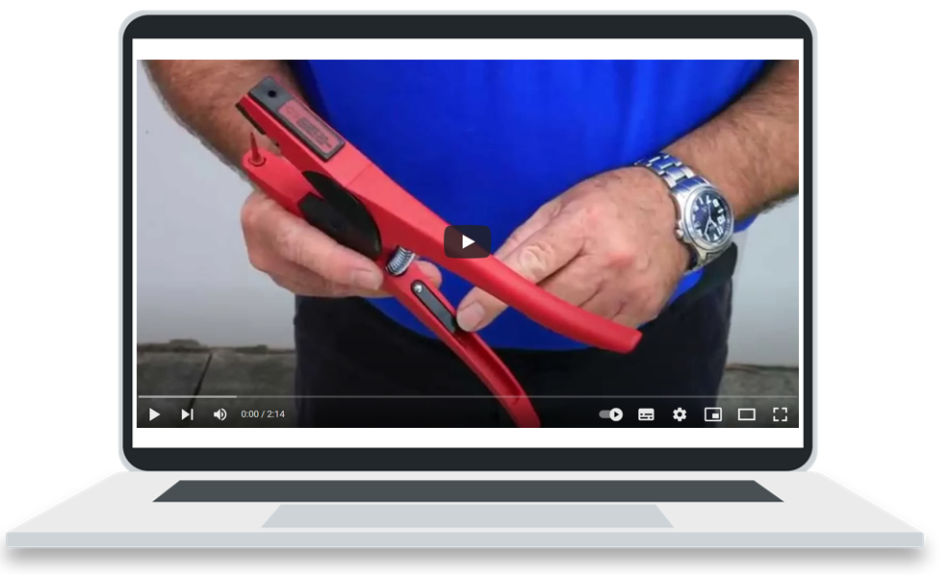
Applying visual tags
Notes:
Teaching notes:
For use with classes and teachers who have not had experience in tagging livestock, or do not have livestock available for tagging.
Click the image to watch the video resource Universal applying visual tags (duration 2.14)

Slide 114

Best practice applicator use
Notes:
Teaching notes:
For use with classes and teachers who have not had experience in tagging livestock, or do not have livestock available for tagging.
Click the image to watch the video resource Allflex UTT3S Applicator (duration 2.59)

Slide 115

Sheep tagging and eID
Notes:
Teaching notes:
Click the image to watch the video resource Shearwell data – sheep tagging and electronic ID introduction (duration 5.01)

Slide 116

Exit ticket (1)
What could go wrong if an ear tag is incorrectly placed, and how can this be avoided?
Notes:
Teaching notes:
Formative assessment opportunity for teachers and students to ensure students understand the content taught during this lesson sequence. Can be completed on paper for submission at end of lesson, made into a digital form or verbally discussed in groups or as a class.

Slide 117
20. Record keeping
Learning intentions and success criteria
We are exploring how digital tools support farm record-keeping and decision-making.
We can:
identify types of farm records
explain how RFID and digital tools improve efficiency.
Notes:
Notes for teachers:
Learning intentions and success criteria are best co-constructed with students. Adapt the learning intention as required and add matching success criteria.
For more information See ⁠AITSL or the NSW Department of Education explicit teaching strategies, ⁠Sharing learning intentions and ⁠Sharing success criteria
LISC is not necessarily presented at the beginning of the lesson. Teacher needs to consider most effectual time to introduce
LISC should be revisited during the lesson to support students' evaluation of their learning

Slide 118
Key terms (20) 21
Health records – notes about treatments like vaccinations or drenching.
Production records – data like fleece weight or lamb growth used to make farm decisions.
Financial records – information about farm income and costs that helps manage the business.
Notes:
Teaching notes:
Introduce key terms before starting each section. They support student understanding by linking core agricultural vocabulary to the lesson content. Encourage students to look out for how these terms are used in the activities that follow.

Slide 119
Why good data matters
Types of data
Record type | What it includes | Why it’s important
Health | Drenching, vaccinations, treatments | Monitors welfare and prevents overuse
Reproduction | Joining, lambing, scanning | Tracks fertility and lambing success
Production | Weights, fleece test results | Supports selection and marketing
Identification | EID tags, ear marks | Animal tracking and traceability
Financial | Feed costs, sales, vet bills | Manages enterprise viability
Notes:
Teaching notes:
Modelled answer for the workbook activity.

Slide 120

Using RFID tags
Individual ID codes or numbers stored on integration circuits (IC) attached to antenna within the ear tags.
Scanning equipment such as RFID hand-held wands scan the tag using radio waves, accessing the unique number/code. Information can be stored by the reader under that number or sent to another storage device such as a computer via Bluetooth or connecting cable. Information can be accessed later and compared or updated as further data on this animal is collected.
Notes:
Teaching notes:
Larger image in colour for students and classes who need to visual content.

Slide 121

How to use the RFID scanner (1)
Demonstrate how to safely and correctly use the RFID scanner to scan one of the eID or RFID tags.
If using a HR5 Gallagher hand eID tag reader:
Power the device on.
Start a new session using the sessions icon and press ok (a session must exist before the reader will scan any tags).
Select ‘yes’ in the data fields section to record notes against eID tags. Next.
Use the arrow keys to select the required data field and press the select key. A good option to begin with is adding condition, or weight for an individual. Next.
Example screen for HR5 handheld reader, no field notes selected.
Notes:
Teaching notes:
Practical activity support for teachers leading the activity. This slide and the following only relate to the Gallagher HR5 scanner, see your user manual for other models and brands.

Slide 122
How to use the RFID scanner (2)
Return to the main menu and click the ‘read tags’ icon.
Press ok to start reading tags.
Squeeze the trigger on your reader and pass the antenna near the tag. A beep will sound to indicate success, and the screen will show information.
Data fields will show if they were selected, use the arrow keys to move to the required field and input data, such as weight of animal.
Click ok and move on to the next scan.
For more detailed instructions and diagrams, read your device manual.
Example screen for HR5 handheld reader, no field notes selected.
Notes:
Teaching notes:
Practical activity support for teachers leading the activity. This slide and the following only relate to the Gallagher HR5 scanner, see your user manual for other models and brands.

Slide 123
Sample data for RFID data collection scenarios
Tip
The data tables below have sample information that can be used in the 5 scenarios. Replace the VID (visual identification number) with the eID numbers of the school tags. A different scenario can be completed each week for the fake flock to continue practicing the skills as a class.
Notes:
Teaching notes:

Slide 124
Sample data for 20 sheep – sheep 1–10
VID | Sex | Age | Weight (kg) | Pregnancy status | Health inspection | Sire ID | Previous lambing
001 | F | 2 | 45.2 | N | Good | 04200 | Maiden
002 | F | 5 | 41.8 | N | Good | 03952 | Twin
003 | F | 5 | 50.5 | Y | Lame, front right hoof | 03952 | Twin
004 | F | 3 | 48.9 | Y | Good | 04283 | Single
005 | F | 5 | 46.3 | Y | Good | 04200 | Twin
006 | F | 3 | 42.7 | Y | Good | 03952 | Twin
007 | F | 2 | 47.1 | Y | Good | 04200 | Twin
008 | F | 3 | 44.6 | N | Pinkeye | 04283 | Single
009 | F | 3 | 49.8 | N | Good | 04277 | Single
010 | F | 2 | 43.5 | Y | Flystrike, breech | 03952 | Single
Notes:
Teaching notes:

Slide 125
Sample data for 20 sheep – sheep 11–20
VID | Sex | Age | Weight (kg) | Pregnancy status | Health inspection | Sire ID | Previous lambing
011 | F | 3 | 48.0 | N | Good | 03952 | Empty
012 | F | 4 | 46.9 | Y | Good | 04200 | Twin
013 | F | 2 | 51.2 | N | Good | 04200 | Maiden
014 | F | 2 | 48.8 | N | Pinkeye | 04200 | Single
015 | F | 4 | 44.3 | N | Good | 04277 | Single
016 | F | 4 | 50.0 | Y | Foot abscess | 04277 | Single
017 | F | 2 | 45.7 | Y | Open wound on back right leg | 04277 | Maiden
018 | F | 5 | 48.5 | Y | Good | 04200 | Empty
019 | F | 4 | 46.6 | N | Good | 04200 | Single
020 | F | 5 | 42.1 | Y | Lame, back left hoof | 03952 | Twin
Notes:
Teaching notes:

Slide 126
21. Technology in Australia’s sheep industry
Learning intentions and success criteria
We are investigating how agricultural technologies have developed over time and how they improve production.
We can:
describe key agricultural innovations past and present
explain how technology improves welfare, sustainability, and productivity.
Notes:
Notes for teachers:
Learning intentions and success criteria are best co-constructed with students. Adapt the learning intention as required and add matching success criteria.
For more information See ⁠AITSL or the NSW Department of Education explicit teaching strategies, ⁠Sharing learning intentions and ⁠Sharing success criteria
LISC is not necessarily presented at the beginning of the lesson. Teacher needs to consider most effectual time to introduce
LISC should be revisited during the lesson to support students' evaluation of their learning

Slide 127
Key terms (21) 22
Innovation – a new tool or idea that improves how farming is done.
Efficiency – doing a task with less time, effort or waste.
Walk-over weigher – a device that automatically weighs sheep as they walk over it.
Notes:
Teaching notes:
Introduce key terms before starting each section. They support student understanding by linking core agricultural vocabulary to the lesson content. Encourage students to look out for how these terms are used in the activities that follow.

Slide 128

Technology in Australia’s sheep industry
Case study David Unaipon
Invention: Straight line motion shearing machine
Year: 1909
David Unaipon (1872–1967) was a remarkable Aboriginal inventor and writer from Raukkan, South Australia. He was a proud Ngarrindjeri man and made important contributions to science, literature and agriculture.
In the early 1900s, wool was a major industry in Australia, and shearing sheep was physically demanding and labour-intensive. Inspired by this, Unaipon created a special shearing handpiece. Unlike the traditional machines that used a rotary motion, his design used a straight-line motion for the blades. This change made shearing easier and more efficient while reducing strain on the workers.
Notes:
Teaching notes:
This is further information to the story included in the workbook. It can help answer the questions that are included, or alternatively, watch the video resource included on slide 119.

Slide 129
Straight line motion shearing machine
Unaipon's innovative design, patented in 1909, allowed the shearing blades to move smoothly and precisely. This not only made the job safer for the shearers but also helped protect the sheep from injury. His ideas were so advanced that they are still relevant in modern engineering today.
Although his shearing machine wasn’t widely used during his lifetime, it paved the way for future developments in sheep-shearing technology. Many of today's shearing machines include features inspired by Unaipon's work, highlighting his lasting impact on the wool industry.
David Unaipon's journey was not easy. As an Aboriginal man in a time of discrimination, he faced many challenges. However, his determination and creativity led to significant advancements in agriculture. His invention is a powerful example of how one person's innovative ideas can transform an entire industry.
Notes:
Teaching notes:

Slide 130

Australia’s Da Vinci
Notes:
Teaching notes:
Click the image to watch the resource David Unaipon – Australia's First Inventor (duration 9.07)

Slide 131





Technology in Australia’s sheep industry 2
Drones
Electric shears
Electronic dosing drench gun
Wool press
Walk over weighers
Notes:
Teaching notes:
Full colour, large images of the technologies included in the workbook to help students picture the technologies they are learning about.

Slide 132
22. Careers
Learning intentions and success criteria
We are exploring career opportunities in agriculture and the training required for different roles.
We can:
describe a range of sheep industry careers
outline the role at least three of these careers have in the sheep industry.
Notes:
Notes for teachers:
Learning intentions and success criteria are best co-constructed with students. Adapt the learning intention as required and add matching success criteria.
For more information See ⁠AITSL or the NSW Department of Education explicit teaching strategies, ⁠Sharing learning intentions and ⁠Sharing success criteria
LISC is not necessarily presented at the beginning of the lesson. Teacher needs to consider most effectual time to introduce
LISC should be revisited during the lesson to support students' evaluation of their learning

Slide 133
Careers brainstorm
On-farm
Marketing
Careers in the sheep industry
Research
Processing
Notes:
Teaching notes:
This is an example of a brainstorm model that can be used as a whole class discussion about what careers are available in the sheep industry. Four main categories are given as a prompt to help students think past the farm gate and include careers further along the supply chain if possible.

Slide 134
Careers in the sheep industry: scenarios 1 – 2
Scenario 1: Disease outbreak on a sheep farm
A sheep farmer in central NSW notices that several lambs are weak, not feeding, and some have died overnight. The farmer suspects a disease outbreak and needs urgent support to save the rest of the flock.
Scenario 2: Launching a new wool product
An Australian wool company wants to launch a new eco-friendly fashion line using fine merino wool. They aim to market it to a global audience and need to ensure the quality, sustainability, and brand message are on point.
Notes:
Teaching notes:
These are the careers scenarios for the career cards activities linked in the appendix of the teaching resource workbook.
Careers involved:
Scenario 1:
Livestock Veterinarian
Animal Nutritionist
Extension Officer
Scenario 2:
Wool Classer
Wool Textile Designer
Marketing Manager (Wool/Meat)

Slide 135
Careers in the sheep industry: scenarios 3 – 4
Scenario 3: Drought management planning
A farm in western Victoria is experiencing ongoing drought. The farm owners want to plan for more sustainable water use and reduce environmental damage to the land while keeping the sheep
healthy and productive.
Scenario 4: Building a farm-to-plate business
A young farming couple wants to sell their lamb meat directly to local customers through a branded online shop. They need help figuring out the logistics, legal requirements, and marketing
strategy.
Notes:
Careers involved:
Scenario 3:
Environmental Advisor
Animal Nutritionist
Agricultural Engineer
Scenario 4:
Supply Chain Manager
Stock and Station Agent
Marketing Manager (Wool/Meat)

Slide 136
Careers in the sheep industry: scenarios 5 – 6
Scenario 5: Wool auction goes wrong
During a major wool auction in Melbourne, a shipment is rejected because the wool wasn’t classed properly, and contamination was found in several bales. The broker must investigate what went wrong and stop it from happening again.
Scenario 6: Introducing robotics to shearing
A start-up company wants to design a new robotic shearing machine to reduce injury to both sheep
and shearers. They need input from experts on wool, engineering, and farm use to make it
practical and effective.
Notes:
Careers involved:
Scenario 5:
Wool Classer
Quality Assurance Officer
Wool Handler
Scenario 6:
Agricultural Engineer
Shearer
Geneticist (Livestock)

Slide 137
Wool enterprises

Slide 138
Key terms (22) 23
Wool clip – the total amount of wool collected from a group of sheep in one shearing.
Infrastructure – the buildings and systems needed for farming, like shearing sheds or roads.
Investment – putting money into improvements that help the farm grow or produce more.
Biodegradable – able to break down naturally in the environment.
Consumer choice – the decisions people make when buying, using or reusing products.
Notes:
Teaching notes:
Introduce key terms before starting each section. They support student understanding by linking core agricultural vocabulary to the lesson content. Encourage students to look out for how these terms are used in the activities that follow.

Slide 139
23. Wool production in Australia
Learning intentions and success criteria
We are interpreting data and justifying infrastructure investment using evidence.
We can:
identify trends in wool production across states
justify investment priorities with relevant data.
Notes:
Notes for teachers:
Learning intentions and success criteria are best co-constructed with students. Adapt the learning intention as required and add matching success criteria.
For more information See ⁠AITSL or the NSW Department of Education explicit teaching strategies, ⁠Sharing learning intentions and ⁠Sharing success criteria
LISC is not necessarily presented at the beginning of the lesson. Teacher needs to consider most effectual time to introduce
LISC should be revisited during the lesson to support students' evaluation of their learning

Slide 140

Number of sheep shorn in each state (million)
Image created using Canva
Notes:
Teaching notes:
Visual representation of the table of data as a further support for the activity.

Slide 141
Climate and breeds fact sheet for each state (1)
State | Typical climate zones | Dominant sheep breeds | Impact on wool production
New South Wales | Temperate, tablelands, slopes; moderate to high rainfall in south-east | Merino (fine wool), crossbreds | Reliable rainfall supports high wool yields; tablelands ideal for fine wool Merino.
Victoria | Temperate, cooler in highlands, consistent rainfall in south | Merino, Border Leicester x Merino | High-quality fine and medium wool; proximity to ports and processors.
Western Australia | Mediterranean in south-west; dry inland | Merino (medium wool) | Large properties and efficient systems, but drought affects consistency.
Notes:
Teaching notes:
Further information on each state as an alternative to students researching during the lesson. Display this information or share with students who need differentiation within the lesson.

Slide 142
Climate and breeds fact sheet for each state (2) continued
State | Typical climate zones | Dominant sheep breeds | Impact on wool production
South Australia | Semi-arid to arid inland, temperate in south-east | Merino, Poll Merino | Adapted to dry conditions, focus on resilience; moderate wool yields.
Queensland | Tropical north, arid west, subtropical south-east | Merino (broad wool), some Dohne Merino | Hot and dry conditions reduce wool quality and quantity; sheep in southern QLD mostly.
Tasmania | Cool temperate, high rainfall | Saxon Merino (ultra-fine wool) | Premium-quality wool; small scale but very high value fleece due to fineness.
Notes:
Teaching notes:
Further information on each state as an alternative to students researching during the lesson. Display this information or share with students who need differentiation within the lesson.

Slide 143
Suggested upgrades (to inspire students’ planning)
Irrigation systems or drought-resistant pasture upgrades (QLD, SA, WA)
Wool processing infrastructure or port access improvements (TAS, WA)
Research funding into breed development (NSW, QLD)
Transport or shearing team access for remote properties (SA, WA)
Training centres or education hubs for wool handlers and classers (VIC, NSW)
Notes:
Teaching notes:
Further support for differentiation if required, or alternative delivery of the activity.

Slide 144
24. Characteristics of wool
Learning intentions and success criteria
Topic: Feeling for fineness – assessing wool in the shed
We are developing practical skills in assessing wool quality using observable traits.
We can:
describe features that affect fleece value
assess wool quality against market needs.
Notes:
Notes for teachers:
Learning intentions and success criteria are best co-constructed with students. Adapt the learning intention as required and add matching success criteria.
For more information See ⁠AITSL or the NSW Department of Education explicit teaching strategies, ⁠Sharing learning intentions and ⁠Sharing success criteria
LISC is not necessarily presented at the beginning of the lesson. Teacher needs to consider most effectual time to introduce
LISC should be revisited during the lesson to support students' evaluation of their learning

Slide 145



Characteristics of wool
Crimp
Colour
Dust penetration
Micron
Notes:
Teaching notes:
Visuals of different characteristics of wool to support students with understanding traits. Use real wool samples as well where possible.

Slide 146
Wool characteristics practical activity
Wool colour – Is it white and bright, or yellowed/stained?
Crimp / Character – Is the crimp regular and even? Fine and tight?
Dust / VM – Are there burrs, seeds, dirt? Clean wool scores better.
Staple length – Use a ruler to measure. Longer, even locks are better.
Total score – Add up the scores from the first four columns (1–5 scale per trait).
Rating – Based on total:
  4–7 = Premium
  8–11 = Average
  12+ = Poor
Suggested Market – Choose one: fine garments, insulation, carpet wool
Notes:
Teaching notes:
Further directions to support the practical activity. Use these questions to support students in scoring their wool samples.

Slide 147
Example of completed table
Fleece ID | Wool colour | Crimp / Character | Dust / VM | Staple length (cm) | Total score | Rating (poor / average / premium) | Suggested market
A | 3 | 3 | 2 | 3 (4cm) | 11/20 | average | Bedding
B | 4 (very yellow) | 3 | 4 (burrs and seeds present) | 3 (4cm) | 14/20 | Poor | Carpets and upholstery
C | 2 (mostly white) | 1 (tight crimp) | 1 (no VM) | 2 (6cm) | 6/20 | Premium | Clothing
Notes:
Teaching notes:
Modelled example of a completed table for the practical activity.

Slide 148
25. Wool processing
Learning intentions and success criteria
We are describing how wool is processed and evaluating its sustainability.
We can:
sequence the steps in wool processing
evaluate how wool products contribute to sustainability and the circular economy.
Notes:
Notes for teachers:
Learning intentions and success criteria are best co-constructed with students. Adapt the learning intention as required and add matching success criteria.
For more information See ⁠AITSL or the NSW Department of Education explicit teaching strategies, ⁠Sharing learning intentions and ⁠Sharing success criteria
LISC is not necessarily presented at the beginning of the lesson. Teacher needs to consider most effectual time to introduce
LISC should be revisited during the lesson to support students' evaluation of their learning

Slide 149

Wool production and processing
Notes:
Teaching notes:
Each step in the processing of wool is included in this video resource. Work as a class to provide a simple description of each step.
Click the image to watch the video resource Wool production and processing (duration 3.09)

Slide 150
26. Agricultural issues – shearer shortage
Learning intentions and success criteria
We are investigating workforce challenges in agriculture and their impact.
We can:
explain the causes and consequences of shearer shortages
suggest realistic strategies to address them.
Notes:
Notes for teachers:
Learning intentions and success criteria are best co-constructed with students. Adapt the learning intention as required and add matching success criteria.
For more information See ⁠AITSL or the NSW Department of Education explicit teaching strategies, ⁠Sharing learning intentions and ⁠Sharing success criteria
LISC is not necessarily presented at the beginning of the lesson. Teacher needs to consider most effectual time to introduce
LISC should be revisited during the lesson to support students' evaluation of their learning

Slide 151
Attracting more shearers
From overseas
From school
Attracting shearers
From Australia
In general
Notes:
Teaching notes:
This is an example of a brainstorm model that can be used as a whole class discussion about what how we can attract more people into a career of shearing. Four main categories are given as a prompt to help students think about different groups of people and one for in general, something that may appeal to everyone, for example, more pay or better conditions.

Slide 152
Sheep meat enterprises

Slide 153
Key terms (23) 24
Processor – a company that turns live sheep into meat for sale.
Market specification – the preferred size, weight, and quality of animals for a buyer.
Conformation – the shape and muscle build of an animal’s body.
Animal welfare – making sure animals are treated kindly and kept healthy.
Stakeholder – a person or group with an interest in a farming issue, like farmers or animal rights groups.
Notes:
Teaching notes:
Introduce key terms before starting each section. They support student understanding by linking core agricultural vocabulary to the lesson content. Encourage students to look out for how these terms are used in the activities that follow.

Slide 154
27. Australia’s sheep meat industry
Learning intentions and success criteria
We are learning to analyse trends in sheep meat production and trade.
We can:
interpret production and export data
explain what makes Australian sheep meat competitive globally.
Notes:
Notes for teachers:
Learning intentions and success criteria are best co-constructed with students. Adapt the learning intention as required and add matching success criteria.
For more information See ⁠AITSL or the NSW Department of Education explicit teaching strategies, ⁠Sharing learning intentions and ⁠Sharing success criteria
LISC is not necessarily presented at the beginning of the lesson. Teacher needs to consider most effectual time to introduce
LISC should be revisited during the lesson to support students' evaluation of their learning

Slide 155

Top export destinations
Blank world map
Notes:
Teaching notes:
Blank world map to support modelling in this activity.

Slide 156
28. Sheep meat market specifications
Learning intentions and success criteria
We are matching animals to market specifications using carcase data.
We can:
use weight and fat score to identify the most suitable market for each animal.
Notes:
Notes for teachers:
Learning intentions and success criteria are best co-constructed with students. Adapt the learning intention as required and add matching success criteria.
For more information See ⁠AITSL or the NSW Department of Education explicit teaching strategies, ⁠Sharing learning intentions and ⁠Sharing success criteria
LISC is not necessarily presented at the beginning of the lesson. Teacher needs to consider most effectual time to introduce
LISC should be revisited during the lesson to support students' evaluation of their learning

Slide 157

Sheep meat market specifications
Notes:
Teaching notes:
Click the image to view the resource: Meat Standards Australia (MSA) for sheep meat (duration 8.50)

Slide 158
Exit ticket (2) 2
How could a producer use this feedback to change their feeding program or market timing?

Slide 159
29. What makes quality lamb?
Learning intentions and success criteria
We are learning how meat quality is assessed and how it relates to on-farm decisions.
We can
define key meat quality traits
explain how farming practices help meet market specifications.
Notes:
Notes for teachers:
Learning intentions and success criteria are best co-constructed with students. Adapt the learning intention as required and add matching success criteria.
For more information See ⁠AITSL or the NSW Department of Education explicit teaching strategies, ⁠Sharing learning intentions and ⁠Sharing success criteria
LISC is not necessarily presented at the beginning of the lesson. Teacher needs to consider most effectual time to introduce
LISC should be revisited during the lesson to support students' evaluation of their learning

Slide 160
Exit ticket (3)
Why do markets have specific quality requirements for lamb, and how do these impact the way sheep are raised?

Slide 161
30. Understanding sheep carcase cuts
Learning intentions and success criteria
We are identifying lamb carcase cuts and linking them to cooking methods and value.
We can:
label major lamb cuts
describe how value and cooking method relate to each cut.
Notes:
Notes for teachers:
Learning intentions and success criteria are best co-constructed with students. Adapt the learning intention as required and add matching success criteria.
For more information See ⁠AITSL or the NSW Department of Education explicit teaching strategies, ⁠Sharing learning intentions and ⁠Sharing success criteria
LISC is not necessarily presented at the beginning of the lesson. Teacher needs to consider most effectual time to introduce
LISC should be revisited during the lesson to support students' evaluation of their learning

Slide 162

Carcase cuts
Neck
Shoulder
Loin
Rack
Leg
Shank
Flank
Blank sheep outline
Notes:
Teaching notes:
Blank sheep for modelling this activity in class.

Slide 163
Cut comparisons
Cut | Cooking method | Description | Value tier
Loin | Grilling, frying | Very tender, boneless | High
Shoulder | Roasting, stewing | Flavourful, more connective tissue | Medium
Shank | Braising, slow cook | Tough, needs time | Low
Rack | Roasting | Premium, tender, fancy cut | High
Leg | Roasting, grilling | Versatile, lean, large cut | Medium
Neck | Stewing | Cheap, flavourful | Low
Flank | Grilling, stir-fry | Thin cut, low fat | Low
Notes:
Teaching notes:
Sample answer provided for student self marking or class discussion.

Slide 164
31. Agricultural issues – live exports
Learning intentions and success criteria
We are exploring the live export trade and considering different perspectives on the issue.
We can:
describe how live export operates
explain the economic, ethical and social arguments for and against the trade.
Notes:
Notes for teachers:
Learning intentions and success criteria are best co-constructed with students. Adapt the learning intention as required and add matching success criteria.
For more information See ⁠AITSL or the NSW Department of Education explicit teaching strategies, ⁠Sharing learning intentions and ⁠Sharing success criteria
LISC is not necessarily presented at the beginning of the lesson. Teacher needs to consider most effectual time to introduce
LISC should be revisited during the lesson to support students' evaluation of their learning

Slide 165
Challenge question (7) 6
Should Australia ban live sheep exports?
Notes:
Teaching notes:
Challenge questions can be used for students who understand the content learnt and are ready to apply it to a real-world scenario. Use these for individual students requiring extension of the work, homework for individuals or the class, or as a whole class discussion prompt.

Slide 166
References
This presentation contains NSW Curriculum and syllabus content. The NSW Curriculum is developed by the NSW Education Standards Authority. This content is prepared by NESA for and on behalf of the Crown in the right of the State of New South Wales. The material is protected by Crown copyright.
Please refer to the NESA Copyright Disclaimer for more information https://educationstandards.nsw.edu.au/wps/portal/nesa/mini-footer/copyright.
NESA holds the only official and up-to-date versions of the NSW Curriculum and syllabus documents. Please visit the NSW Education Standards Authority (NESA) website https://educationstandards.nsw.edu.au/wps/portal/nesa/home and the NSW Curriculum website https://curriculum.nsw.edu.au.
Agriculture technology 7-10 Syllabus © NSW Education Standards Authority (NESA) for and on behalf of the Crown in right of the State of New South Wales, 2024.

Slide 167
Copyright
© State of New South Wales (Department of Education), 2025
The copyright material published in this resource is subject to the Copyright Act 1968 (Cth) and is owned by the NSW Department of Education or, where indicated, by a party other than the NSW Department of Education (third-party material).
Copyright material available in this resource and owned by the NSW Department of Education is licensed under a Creative Commons Attribution 4.0 International (CC BY 4.0) license.
This license allows you to share and adapt the material for any purpose, even commercially.
Attribution should be given to © State of New South Wales (Department of Education), 2025.
Material in this resource not available under a Creative Commons license:
the NSW Department of Education logo, other logos and trademark-protected material
Material owned by a third party that has been reproduced with permission. You will need to obtain permission from the third party to reuse its material.
Links to third-party material and websites
Please note that the provided (reading/viewing material/list/links/texts) are a suggestion only and implies no endorsement, by the New South Wales Department of Education, of any author, publisher, or book title. School principals and teachers are best placed to assess the suitability of resources that would complement the curriculum and reflect the needs and interests of their students.
If you use the links provided in this document to access a third-party’s website, you acknowledge that the terms of use, including licence terms set out on the third-party’s website apply to the use which may be made of the materials on that third-party website or where permitted by the Copyright Act 1968 (Cth). The department accepts no responsibility for content on third-party websites.

