Slide 1
Instructions for use
This resource is not a teaching and learning program. It should be used in conjunction with Technology 7–8 – Textile materials and production processes – Sew sustainable, sew awesome!
Classroom teachers are encouraged to add and adapt slides as required to meet the needs of their students
Save a copy of the file to make changes to the slide deck – go to File > Download a Copy (this downloads a copy to the computer to edit in the PowerPoint app).
To convert the PowerPoint to Google Slides:
  Upload the file into Google Drive and open it.
  Go to File > Save as Google Slides.

Slide 2
Sew sustainable, sew awesome!
Technology 7–8
Materials and production processes – Textiles

Slide 3
Learning intention and success criteria (1)
We are learning to:
identify what textiles are so that we can see how they differ and what they are used for.
We can:
identify what textiles items are.
explain how textiles are used differently.
Notes:
Notes for teachers:
Learning intentions and success are best co-constructed with students. Adapt the learning intention as required and add co-constructed success criteria.

Slide 4
Classroom expectations
Notes:
This slide has been left blank for you to complete with your class as per teaching and learning program.

Slide 5
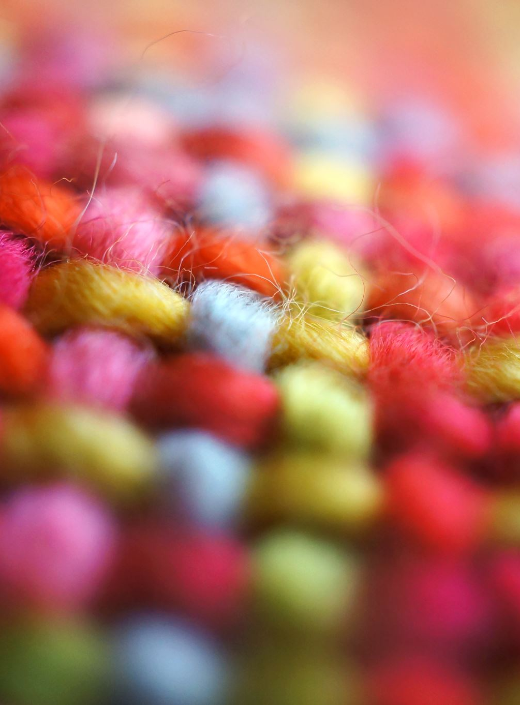
Part 1
Textile tales – a beginner’s journey

Slide 6
Where are textiles found?
Textiles in 24 hours

Slide 7





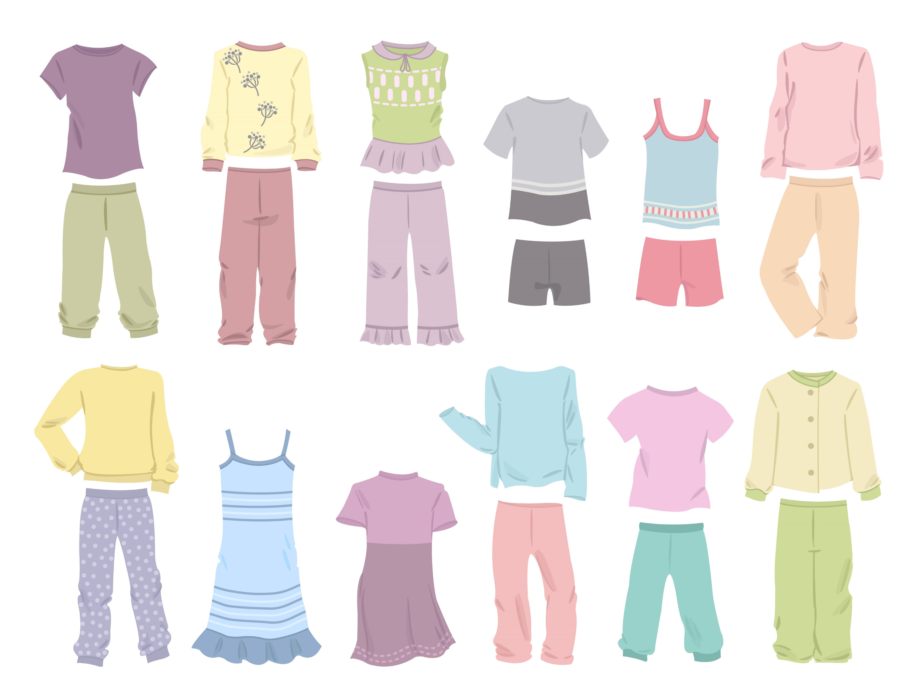
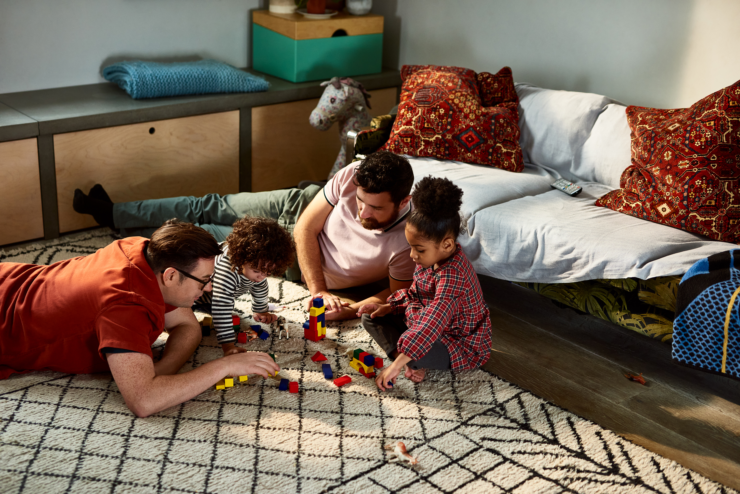
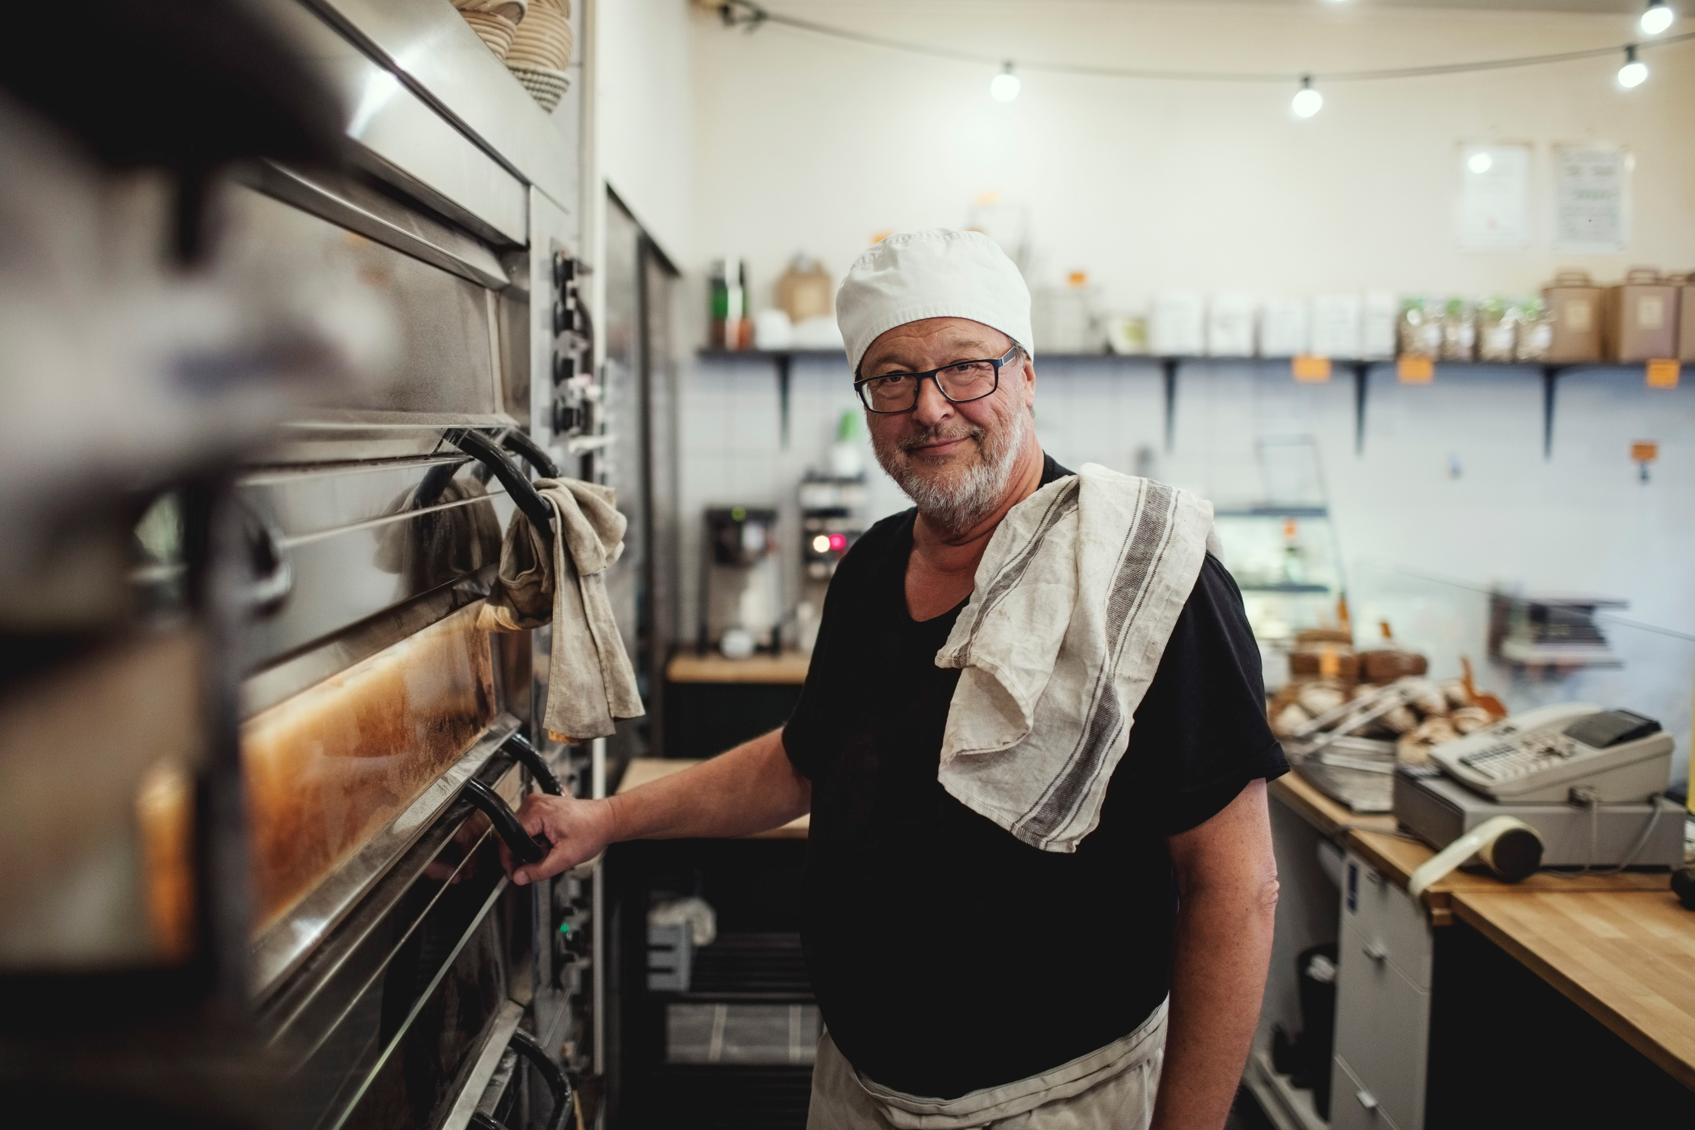
Where are textiles found – answers
pillows
sheets and bedding
bags
and shoes
towels
clothing
Textiles in 24 hours
in cars
in kitchen, tea towels
flooring
Notes:
Discuss characteristics of each of these items

Slide 8
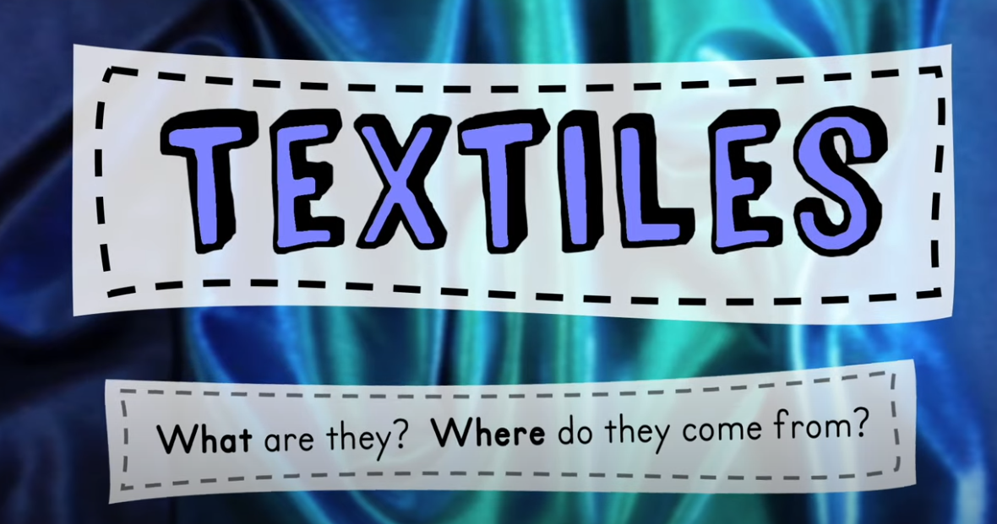
Textiles: What are they? Where do they come from?
Watch Textiles: what are they? Where did they come from? (8:50)
Notes:
Watch Textiles: what are they? Where did they come from?

Slide 9
Learning intention and success criteria (2)
We are learning to:
investigate how textiles differ in their look and feel so that we can understand how this might contribute to their uses.
We can:
identify how textile fabrics are different.
explain why there are different types of fabrics.
Notes:
Notes for teachers:
Learning intentions and success are best co-constructed with students. Adapt the learning intention as required and add co-constructed success criteria.

Slide 10
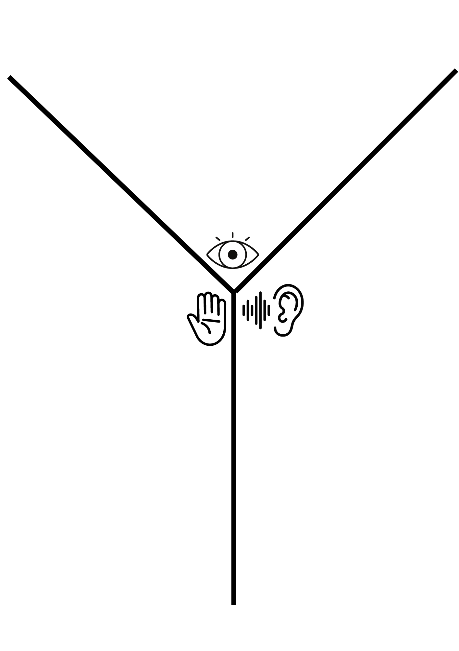
Looks like, feels like, sounds like
After looking closely at each fabric sample complete this chart to describe them.

Slide 11
Looks like, feels like, sounds like – answers
After looking closely at each fabric sample, complete this chart to describe them.
Shiny, fluffy, matt, furry
Smooth, rough, cold, warm, crisp, firm, stretchy, itchy, fluffy
Silent, crunchy, squeaking, rustling, swooshing, crumpling, swishing

Slide 12
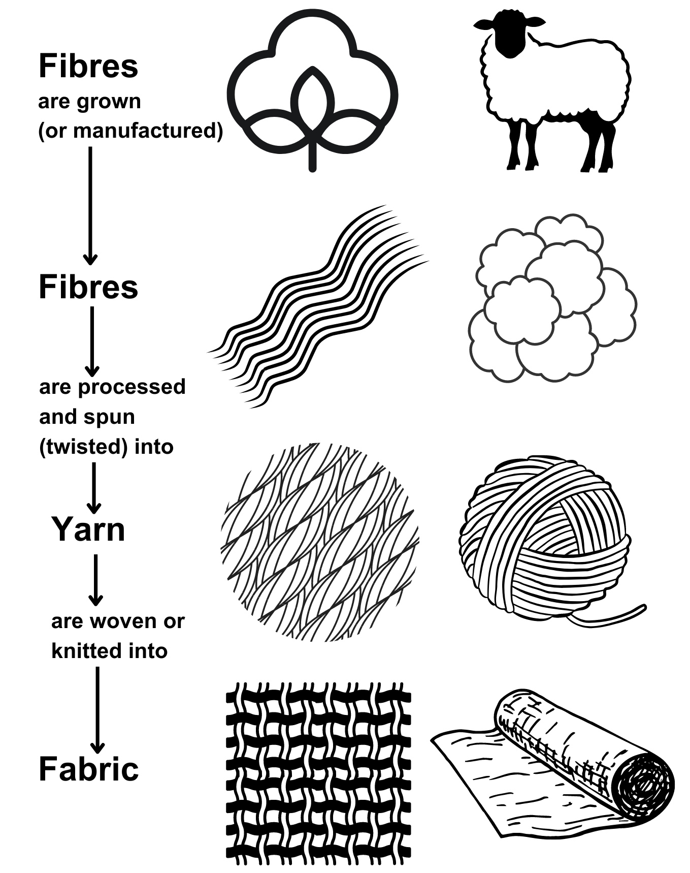
Fibres, yarns and fabrics

Slide 13
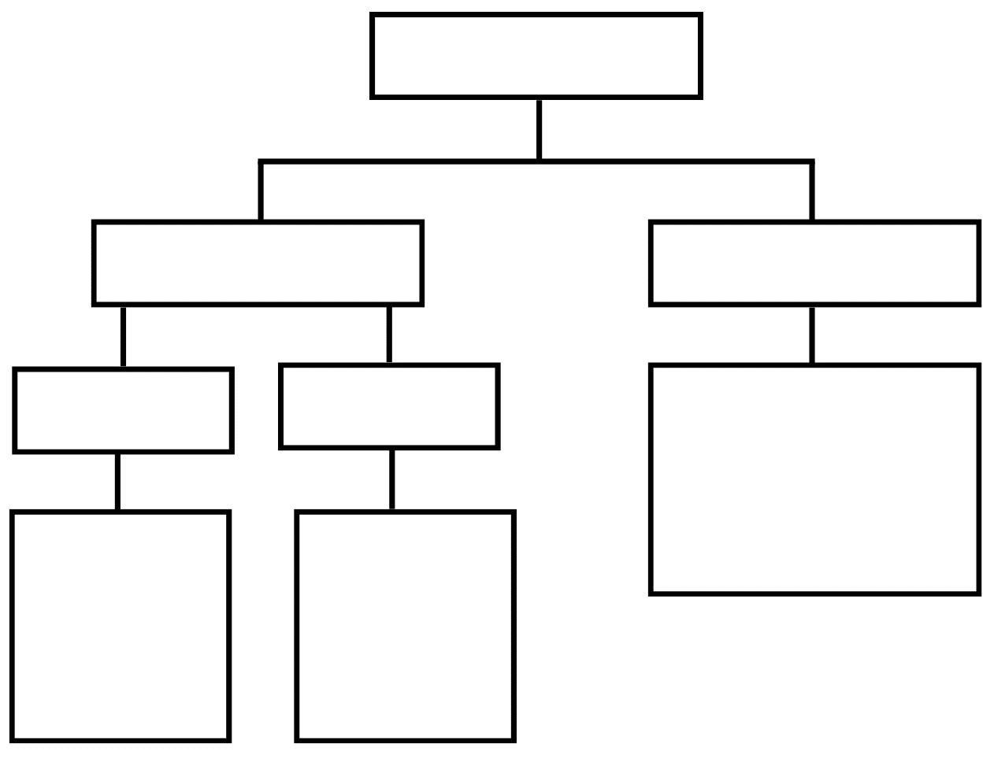
Classification of fibres

Slide 14
Classification of fibres – activity
Drag and drop the labels to classify the types of fibres
Natural
Man-made
Plant
Animal
silk
nylon
hemp
wool
flax
polyester
bamboo
cotton
Types of fibres

Slide 15
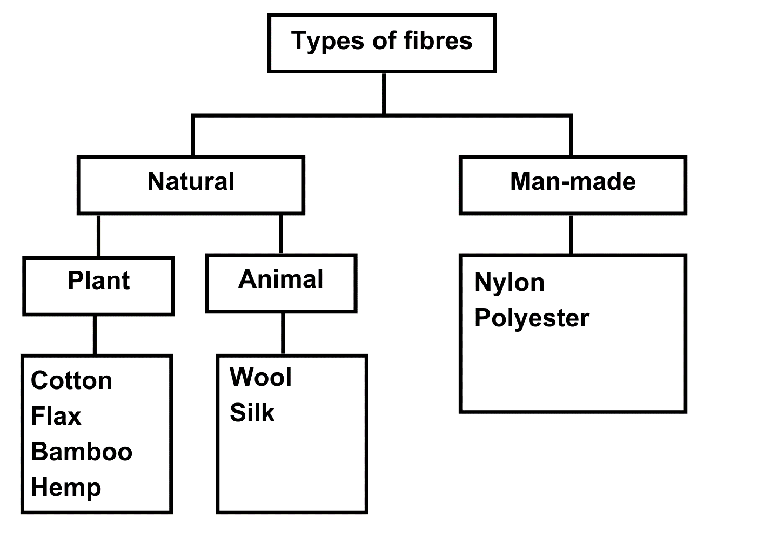
Classification of fibres – answers
Answers

Slide 16
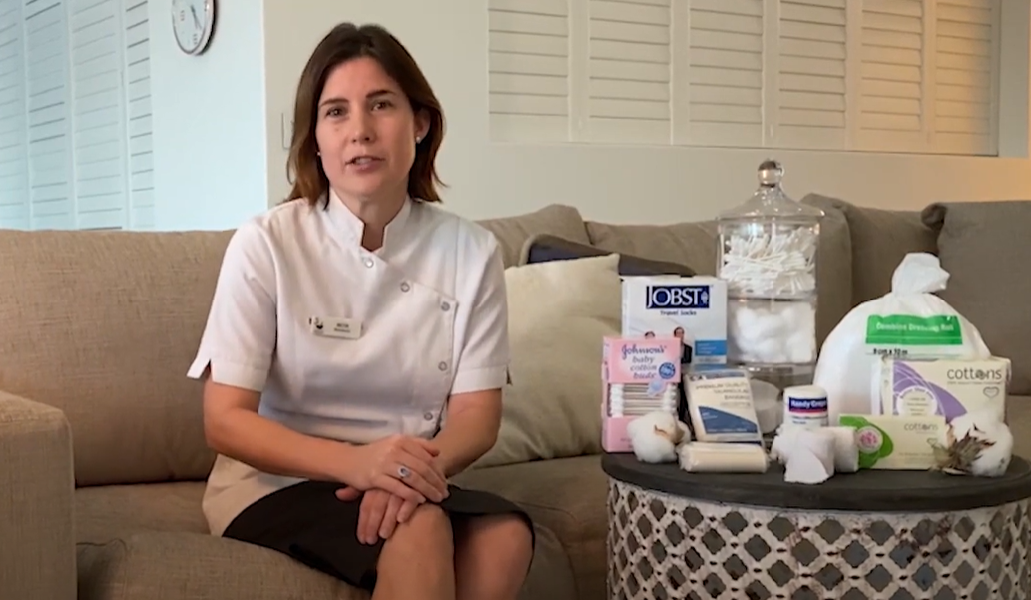
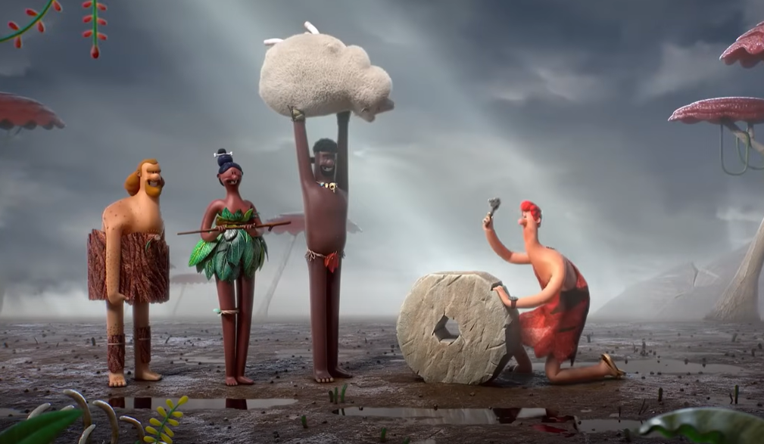
Cotton and wool
Watch Cotton Products and Uses (3:07)
Watch The innovator (1:47)

Slide 17
Do now
Cotton and wool
In your workbook sketch one textile item you would make from cotton and one textile item you would make from wool.
Underneath each sketch explain why you made that choice.

Slide 18
Learning intention and success criteria (3)
We are learning to:
identify safety issues in a textile room so that we can complete practical work safely.
We can:
identify what safety issues are in a textile room
explain how to use textile items and equipment safely.
Notes:
Notes for teachers:
Learning intentions and success are best co-constructed with students. Adapt the learning intention as required and add co-constructed success criteria.

Slide 19
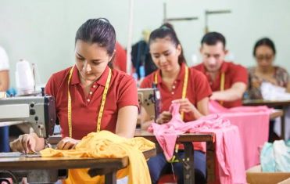
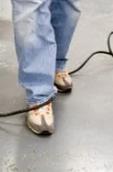


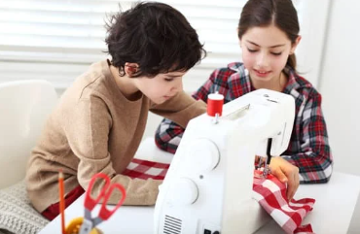
Safety in the textiles room – revision
Do now – What is unsafe about each image?

Slide 20
Learning intention and success criteria (4)
We are learning to:
recognise the uses of a range of textile related items and equipment so that we can make correct choices for practical work.
We can:
identify and name a range of textile equipment
explain what each piece of equipment is used for.
Notes:
Notes for teachers:
Learning intentions and success are best co-constructed with students. Adapt the learning intention as required and add co-constructed success criteria.

Slide 21
Textile equipment revision
Do now
Match each piece of textile equipment with the correct description in your workbook.

Slide 22
Learning intention and success criteria (5)
We are learning to:
identify the different parts of the sewing machine, their uses, and how to thread the sewing machine so that we can use them independently.
We can:
identify the different parts of a sewing machine
explain what each part of the sewing machine is used for
thread a sewing machine ready for use.
Notes:
Notes for teachers:
Learning intentions and success are best co-constructed with students. Adapt the learning intention as required and add co-constructed success criteria.

Slide 23
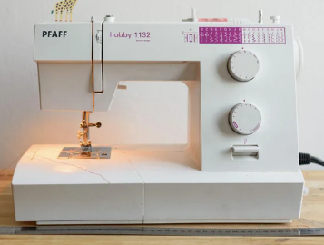
Sewing machine
Note: replace this image with an image from a machine in your room

Slide 24
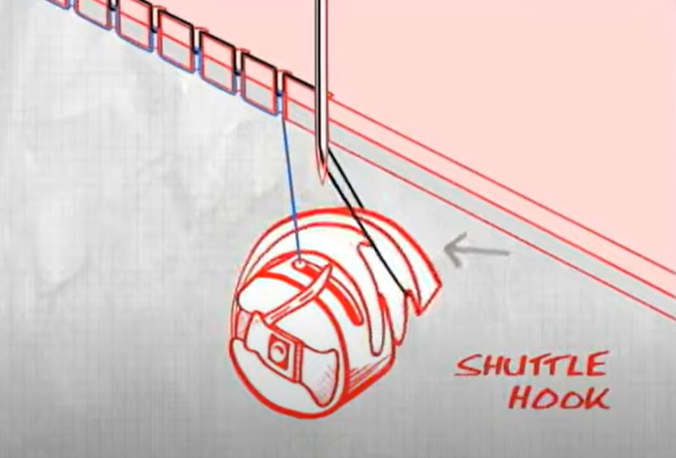
What does the bobbin do?
Watch How a sewing machine works via animation (0:26)

Slide 25
Learning intention and success criteria (6)
We are learning to:
control the sewing machine and complete simple sewing processes safely and successfully so that we have the skills needed for our project.
We can:
control the speed and direction of the sewing machine safely
set up the machine and sew a seam
change the settings on a sewing machine to sew a variety of stitch types.
Notes:
Notes for teachers:
Learning intentions and success are best co-constructed with students. Adapt the learning intention as required and add co-constructed success criteria.

Slide 26
Tips for success
Do now
What are 3 simple tips to remember when threading a sewing machine?

Slide 27



Seam sample evaluation
PMI – seam sample
PLUS Identify the most positive aspects of your sample. | MINUS Identify something that might need improvement next time. | INTERESTING What were you surprised about when completing this sample?

Slide 28
Evaluate skills learnt so far
Do now
In your workbook complete these statements.
So far, the skills I have enjoyed the most, and achieved at the best are …
The skill that I have found the most challenging is …

Slide 29
Learning intention and success criteria (7)
We are learning to:
decorate fabric with a variety of techniques that could be used to decorate fabric in a project so that we can trial them for our projects.
We can:
use technology to assist with creating templates to decorate fabric
design a template to create appliqué
use appliqué to decorate fabric.
Notes:
Notes for teachers:
Learning intentions and success are best co-constructed with students. Adapt the learning intention as required and add co-constructed success criteria.

Slide 30
Fabric decoration
Fabric decoration techniques

Slide 31
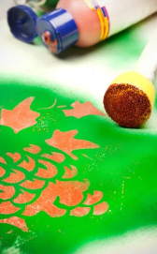
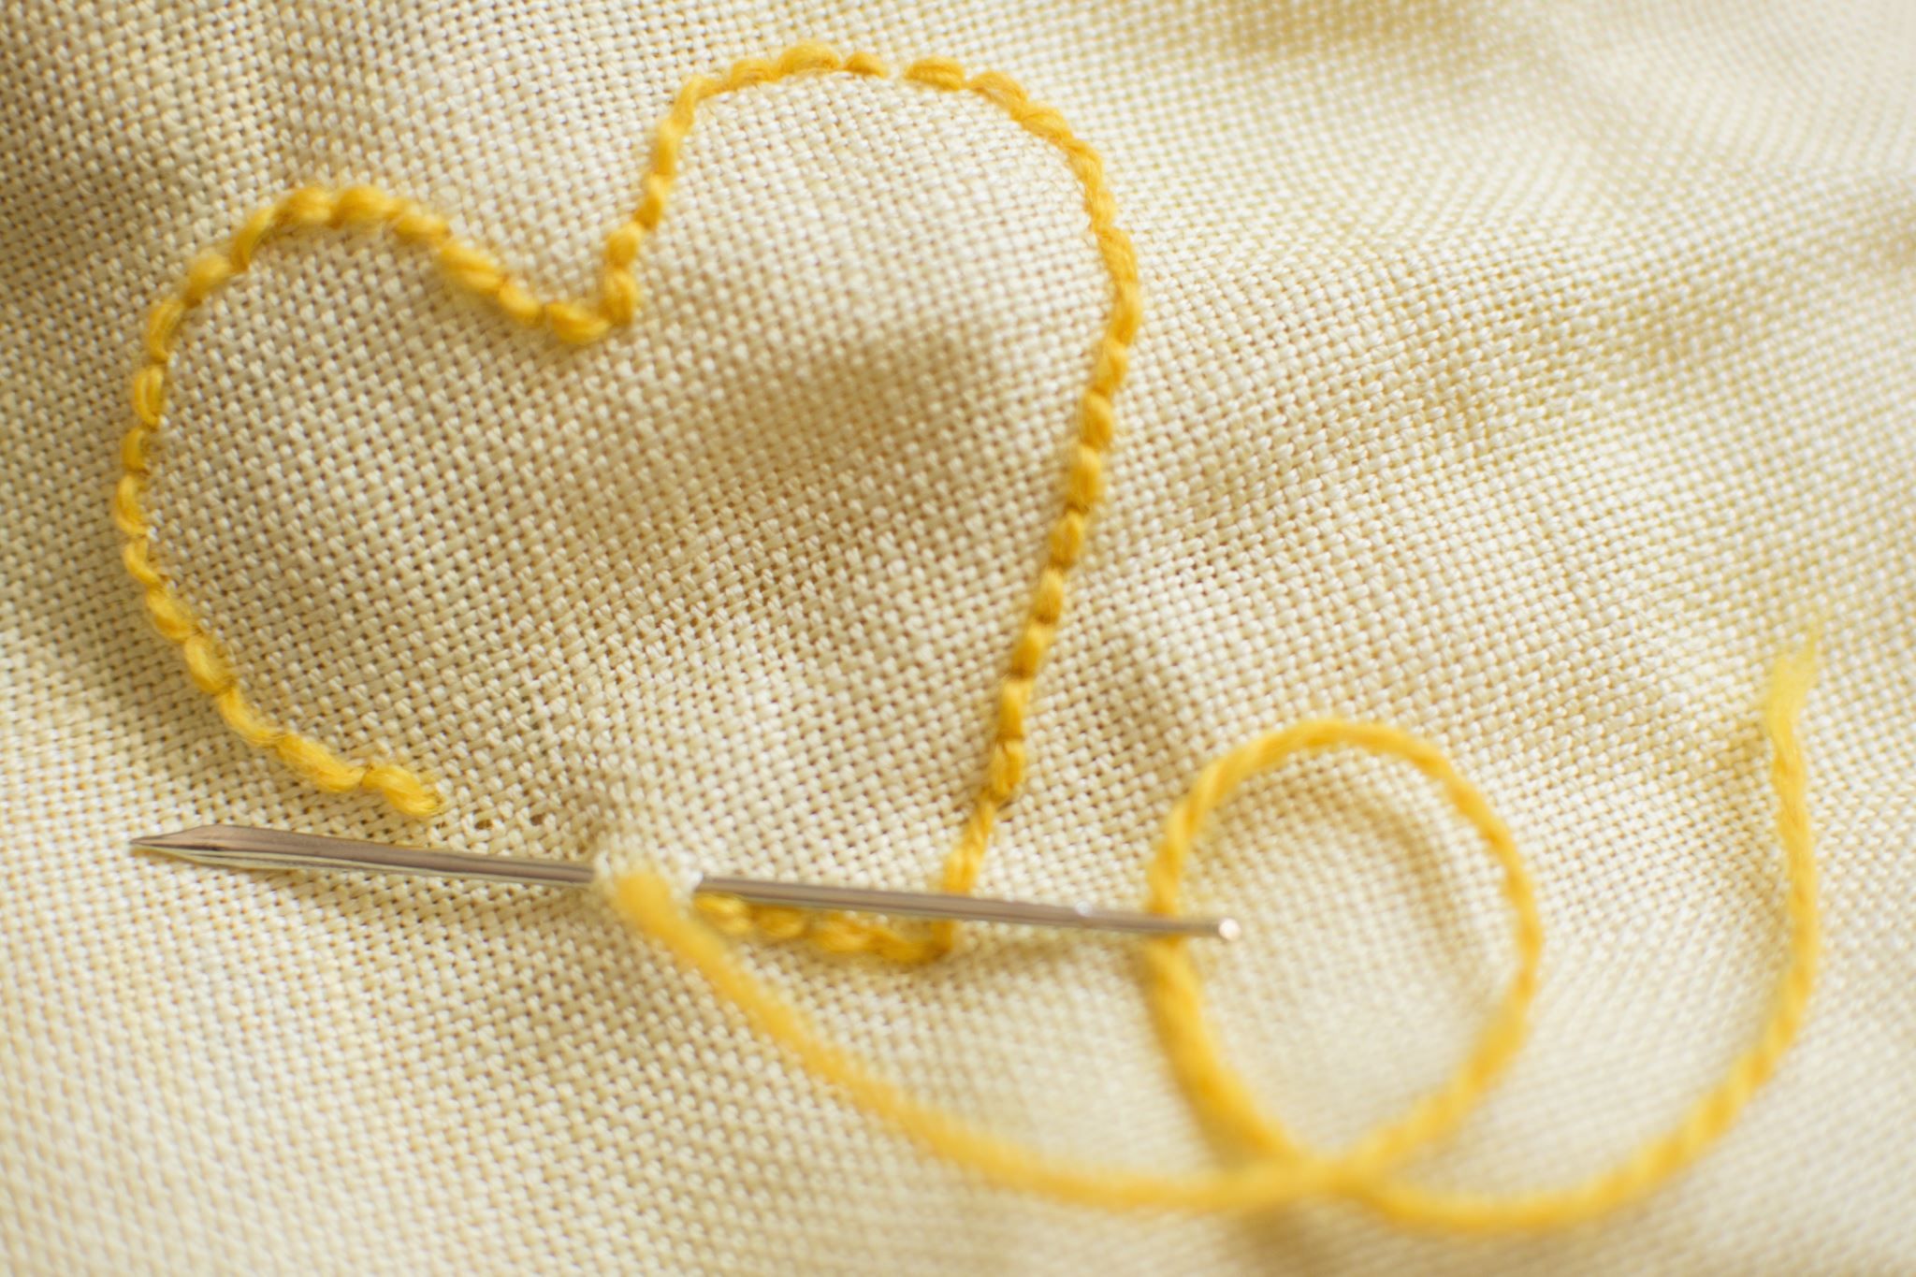
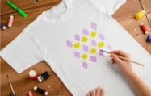

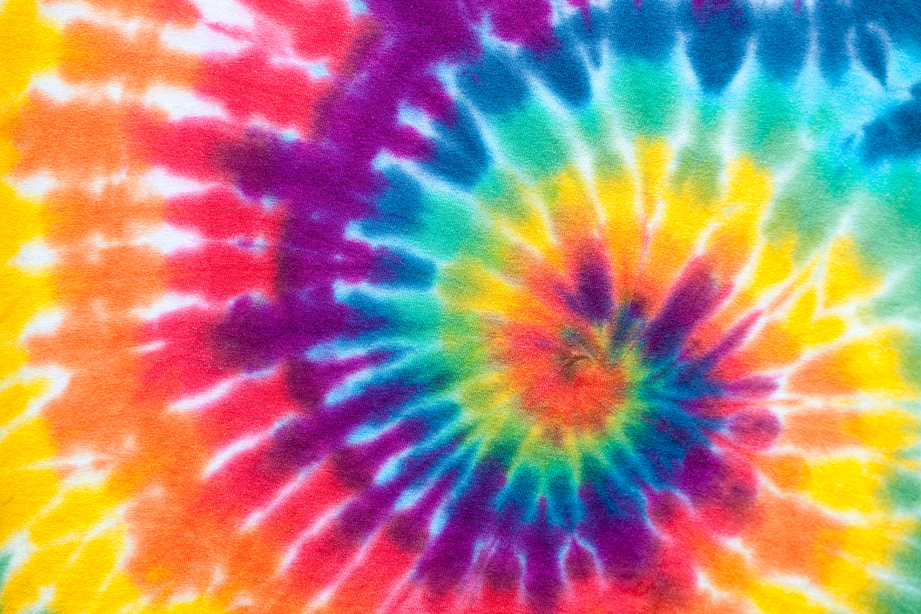
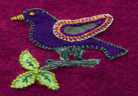
Fabric decoration – answers
Match the image with the technique
paint
Iron on
transfer
dye
Fabric decoration techniques
embroidery
stencil
appliqué

Slide 32
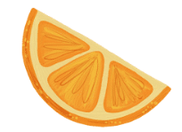




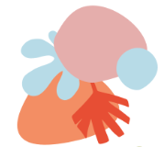
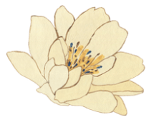

Which of these designs are suitable for appliqué – top or bottom?
or
or
or
or

Slide 33
Appliqué process
Fill in the blanks
Create a ________ for the shape you will use as your appliqué shape (this can be done on the computer or by hand on paper).
Choose your base fabric (what you will stick your appliqué shape to) and your ________ material (this can be a fabric, fabric scraps or fused plastic).
________ the paper-backed ________ heat bonding web onto the ________ of your appliqué material
You can now carefully ________ the paper backing.
Place the appliqué shape onto your ________ and ________ with heat from the iron.
base fabric | fusible | template | appliqué
iron | remove | secure | back

Slide 34
Appliqué process – answers
Fill in the blanks
Create a template for the shape you will use as your appliqué shape (this can be done on the computer or by hand on paper).
Choose your base fabric (what you will stick your appliqué shape to) and your appliqué material (this can be a fabric, fabric scraps or fused plastic).
Iron the paper-backed fusible heat bonding web onto the back of your appliqué material You can now carefully remove the paper backing.
Place the appliqué shape onto your base fabric and secure with heat from the iron.

Slide 35
PMI – appliqué sample
Seam sample evaluation
PLUS Identify the most positive aspects of your sample | MINUS Identify something that might need improvement next time | INTERESTING What were you surprised about when completing this sample?

Slide 36
Learning intention and success criteria (8)
We are learning to:
decorate fabric and experiment with a variety of techniques that could be used to decorate fabric in a project so that we can trial them for our project.
We can:
decorate fabric using a range of techniques in a safe manner
use stencilling and sun printing to decorate fabric.
Notes:
Notes for teachers:
Learning intentions and success are best co-constructed with students. Adapt the learning intention as required and add co-constructed success criteria.

Slide 37
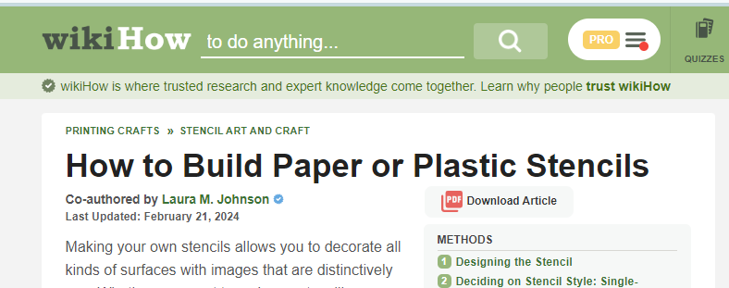
Stencilling
4 ways to build stencils

Slide 38
PMI – stencilling
Seam sample evaluation
PLUS Identify the most positive aspects of your sample | MINUS Identify something that might need improvement next time | INTERESTING What were you surprised about when completing this sample?

Slide 39

Never Have I Ever
Do now
Now that you have completed a term learning how to use the sewing machine and decorate fabric, complete the ‘Never Have I Ever’ activity in your workbook to highlight 3 areas that you have improved on most throughout the term and will need to remember in the future. Place a tick in the correct box.

Slide 40
Learning intention and success criteria (9)
We are learning to:
experiment with construction techniques to create samples that can be used to make class bunting and/or a pencil case.
We can:
sew samples into a bunting and a pencil case.
Notes:
Notes for teachers:
Learning intentions and success are best co-constructed with students. Adapt the learning intention as required and add co-constructed success criteria.

Slide 41

Bunting
Instructions
Fold your sample fabric in half with the design side facing inward.
Sew the top open triangles (15 cm wide x 20 cm long) along the length of the fabric.
Cut out your bunting pieces, trimming away any excess fabric at the pointed ends before turning them inside out and pressing them flat.
Fold in and press the top 2 cm of the open end to create a neat edge.
Sew your triangle onto the length of ribbon to form a class bunting.

Slide 42

Pencil case
Instructions
Prepare the edges – fold each long edge of the fabric down 1 cm and iron them with a hot iron.
Attach the hook and loop strips – place one-half of the hook and loop strip on each folded end, 1.5 cm from each side of the fabric. Pin the hook and loop strips in place, ensuring you are looking at the wrong side of the fabric.
Sew the hook and loop strips – sew along the top and bottom edges of both hook and loop strips.
Fold the fabric in half with the right sides touching and the hook and loop strips back-to-back, then iron.
Sew the seams – turn the fabric inside out and sew the side seams in a straight line using a straight stitch.
Secure the edges – use a zig-zag stitch to sew along the edges for added durability.
Finish – turn the pencil case right-side out. Your pencil case is now complete and ready to use!

Slide 43
Learning intention and success criteria (10)
We are learning to:
understand the impact the textile industry has on our environment so that we can make better decisions through our design.
We can:
identify some of the issues that our planet is facing because of the textile industry
communicate solutions to the environmental problems faced by the textile industry.
Notes:
Notes for teachers:
Learning intentions and success are best co-constructed with students. Adapt the learning intention as required and add co-constructed success criteria.

Slide 44
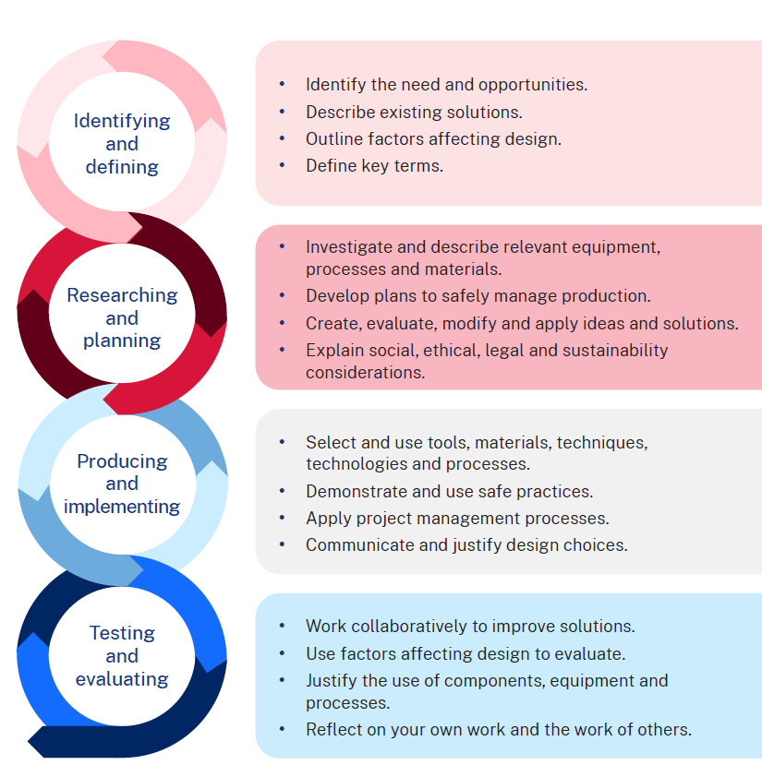
Design and production process

Slide 45

Environmental issues
Brainstorm

Slide 46
Environmental issues – suggested answers
Brainstorm
Climate change, pollution of land, water pollution, land pollution, soil degradation

Slide 47

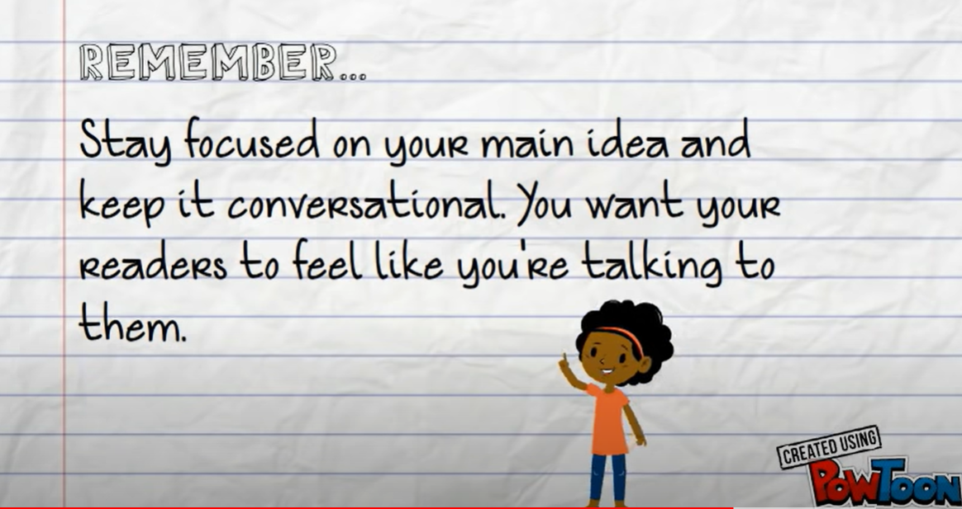
Blogging
Watch What is Blogging? for Elementary Students (1:23)
Watch 5 simple steps to write a blog (2:27)

Slide 48
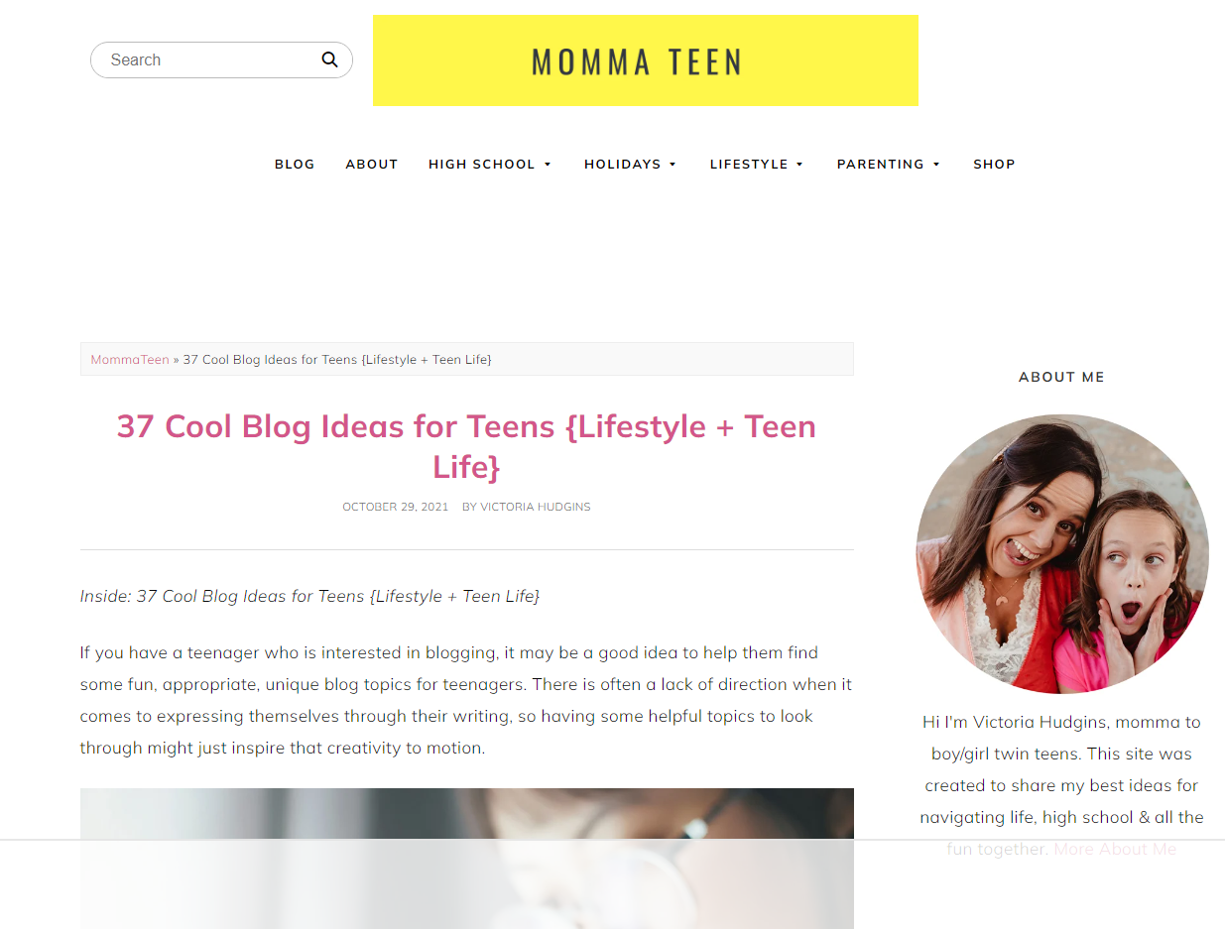

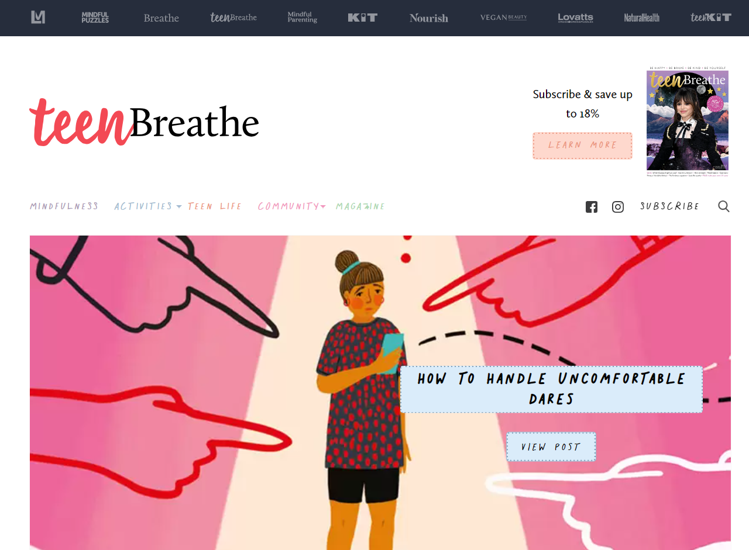

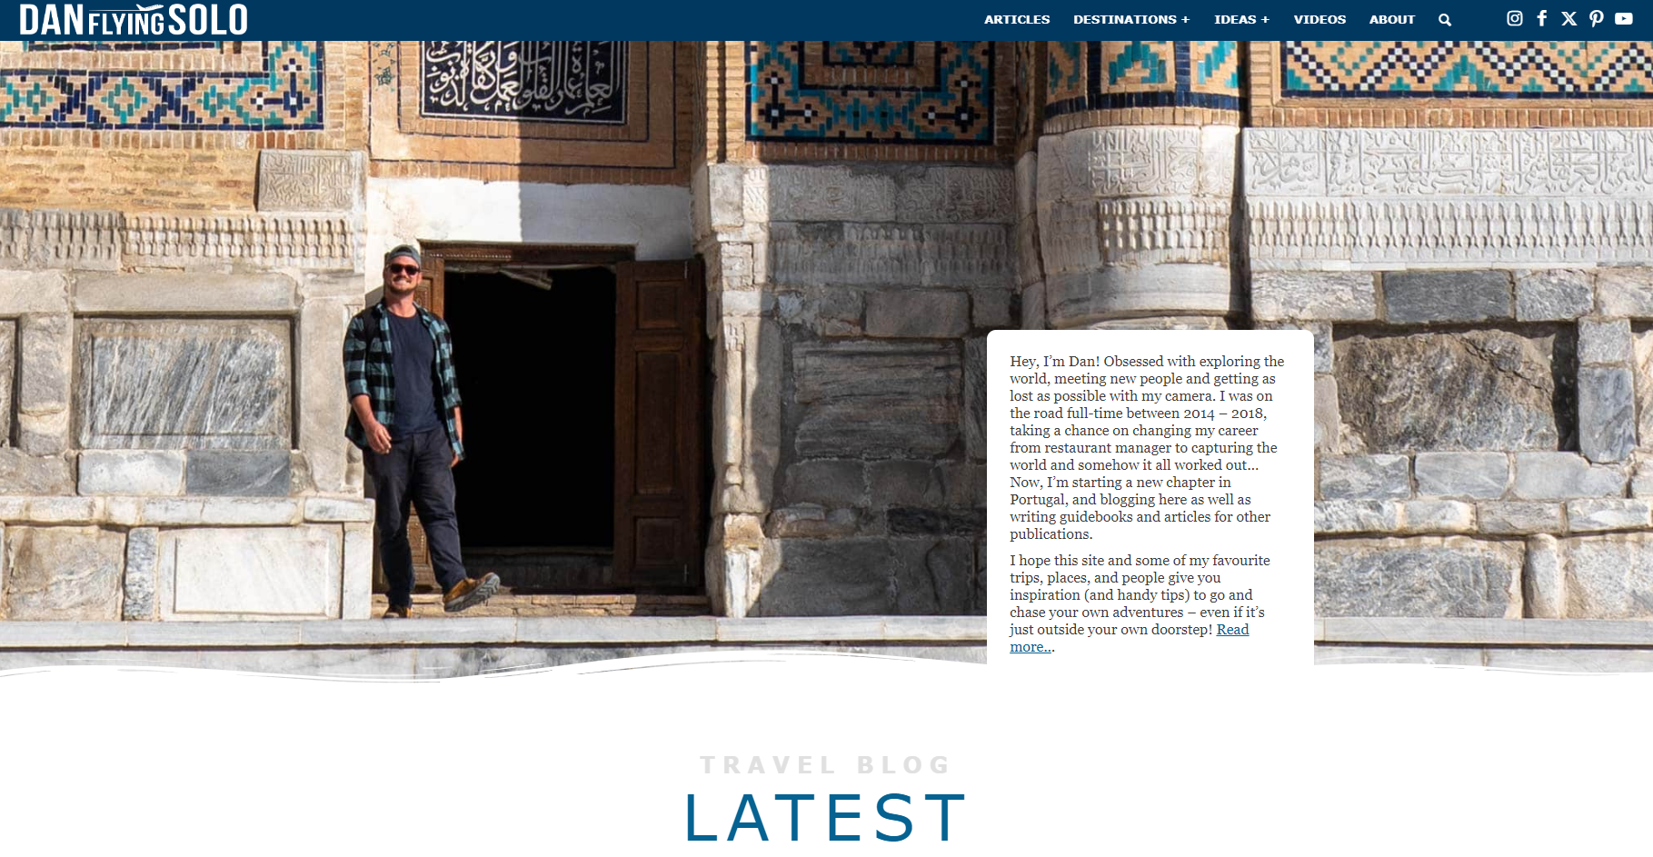
Blog examples
Teen Breathe Australia | A teen's guide to happy & authentic living
37 Cool Blog Ideas for Teens {Lifestyle + Teen Life} - momma teen
Dan Flying Solo | Travel Blog & Travel Photographer
This Teenage Life
Home - SchoolHabits

Slide 49
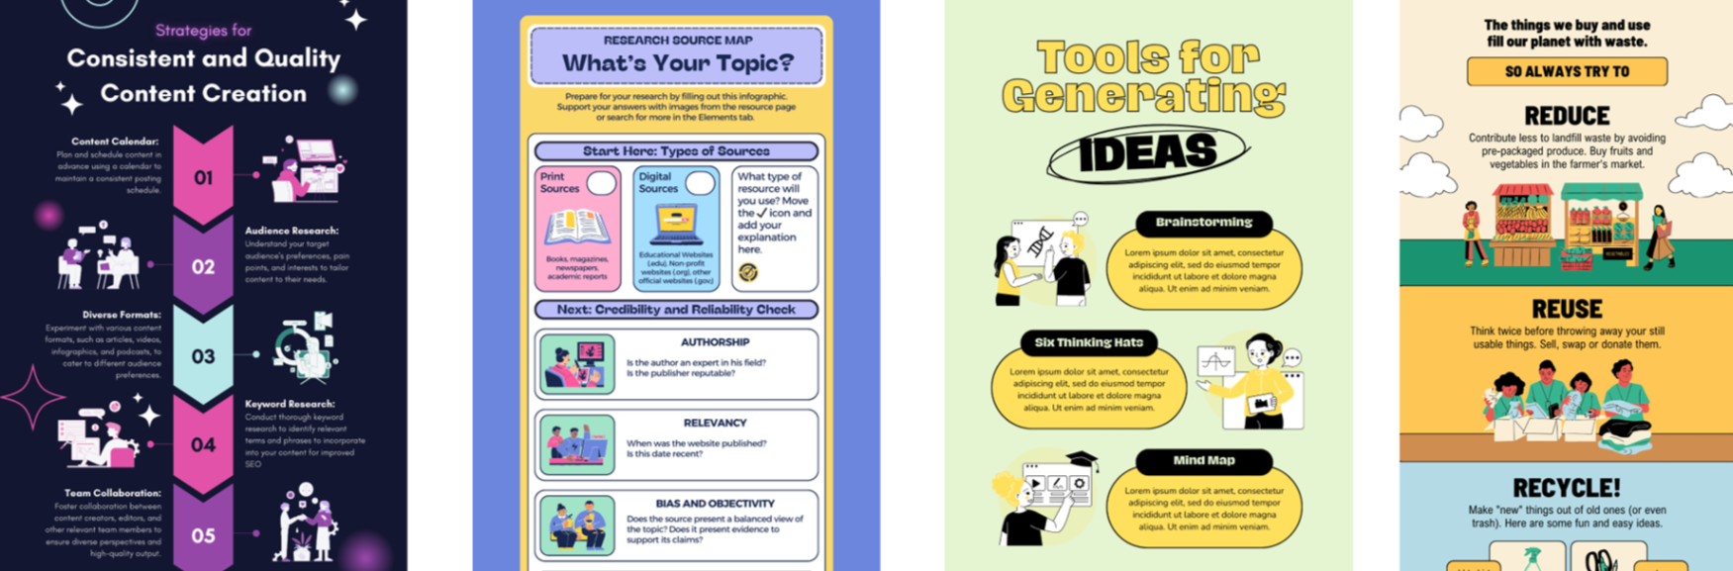
Infographics
Identify the design features from the infographics that help us to understand their messaging.

Slide 50
Part 2
Sew sustainable, sew awesome!

Slide 51
Learning intention and success criteria (11)
We are learning to:
understand the impact of single use plastics and understand the impact that my design will have on our natural surroundings so that we can reduce our impact.
We can:
explain the impact that our project design will have on the environment.
Notes:
Notes for teachers:
Learning intentions and success are best co-constructed with students. Adapt the learning intention as required and add co-constructed success criteria.

Slide 52
Identifying and defining – design situation (1)
Sew sustainable, sew awesome!
Design situation
Indigenous communities have long relied on local materials to create tools for carrying goods. But now, with our resources dwindling and the need for carrying still vital, we face a challenge. We must design carry items that not only serve practical needs but also help tackle environmental problems, like cutting down on single-use plastics and protecting our land. By taking on this challenge, we can protect our environment for the future while honouring Indigenous traditions of resourcefulness and caring for country.

Slide 53
Identifying and defining – design brief (1)
Sew sustainable, sew awesome!
Design brief
Your task is to create a carry item for yourself that addresses an environmental problem, for example, reducing single-use plastics. This item should also spread awareness to others about the issue.
Your challenge is to design a carry item for your own personal use that helps stop single-use plastics being used, or another environmental issue of your choosing, from going into our landfill and ruining our environment.

Slide 54
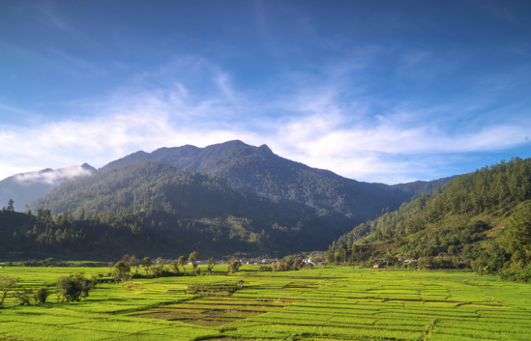
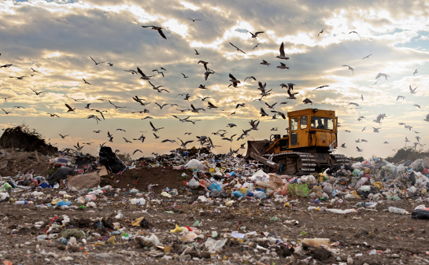
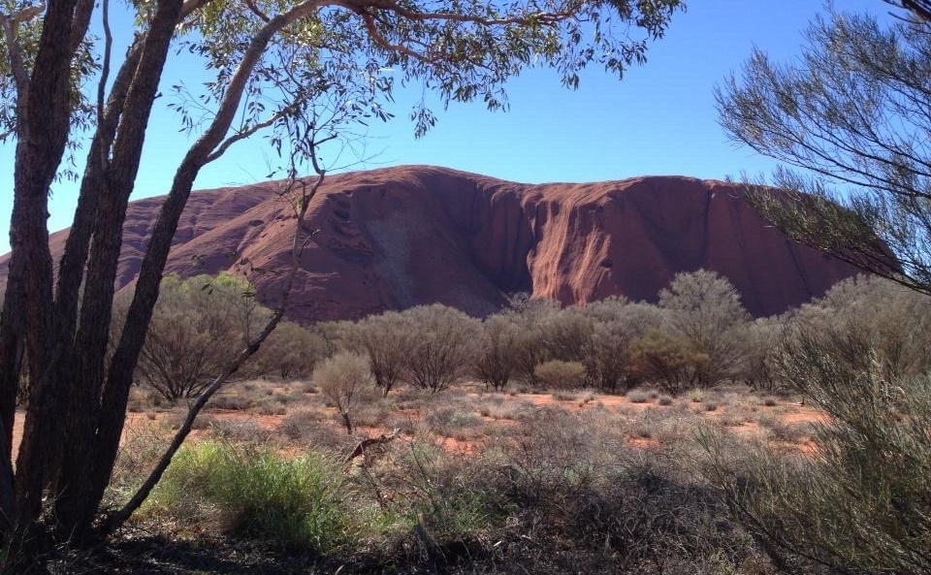
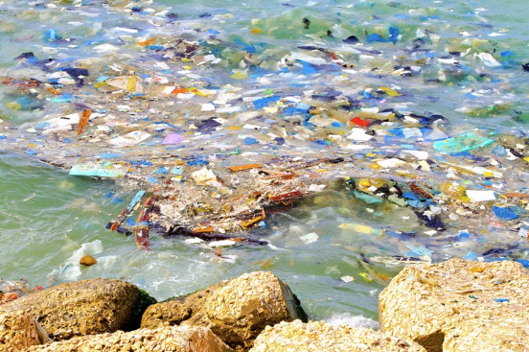
Landscapes
What do you think of when you hear the word landscape?

Slide 55

Landscape collage
Sample

Slide 56
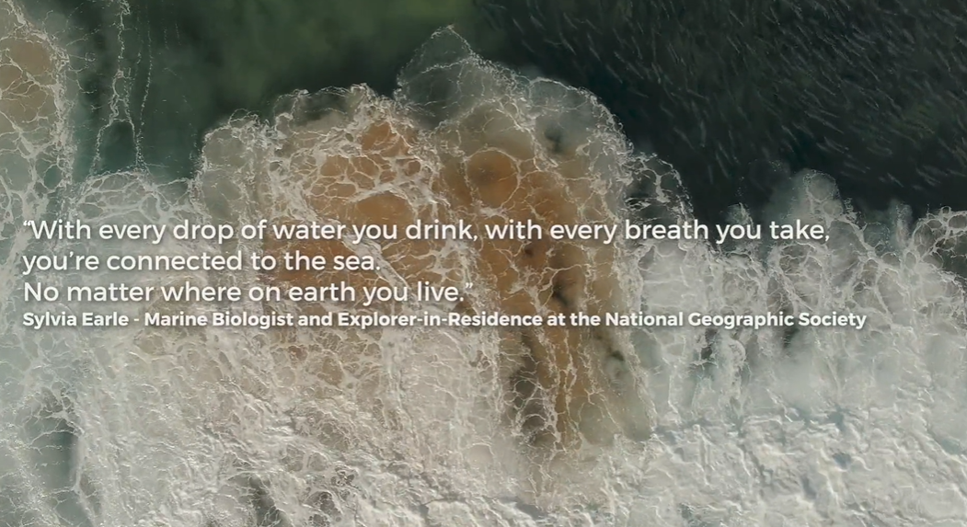
Connection
Complete Think, Pair, Share activity in workbook
Watch Take 3 - Connection (6:04)

Slide 57
Think, Pair, Share
How we use land and water
How we impact land and water
Ways Aboriginal and Torres Strait Islander People use and connect to land and water
How we can care for our land and water

Slide 58
Think, Pair, Share – sample answers
How we use land and water
swimming, horse riding, kayaking, fishing, camping, hiking
How we impact land and water
plastic waste, pollution, land degradation, climate change
Ways Aboriginal and Torres Strait Islander People use and connect to land and water
spiritual and cultural practices, sustainable land management, ceremonies, storytelling, community wellbeing and environmental stewardship.
How we can care for our land and water
make better consumer choices for example not buy produce in plastic containers

Slide 59
Think, Pair, Share – suggested answers
Sample answers
Ways we use our land and water | Ways we impact our land and water | Ways we can care for our land and water
swimming horse riding kayaking fishing camping hiking | plastic waste pollution land degradation climate change | make better consumer choices for example don’t buy produce in plastic containers

Slide 60
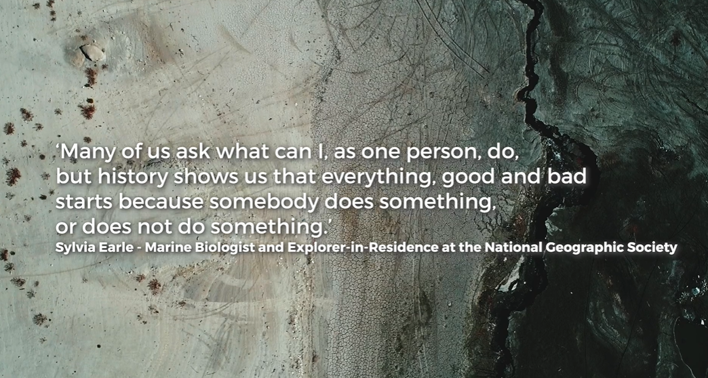
Personal action
Complete the ‘Sphere of influence’ activity
Watch Take 3 – Personal Action (6:40)

Slide 61
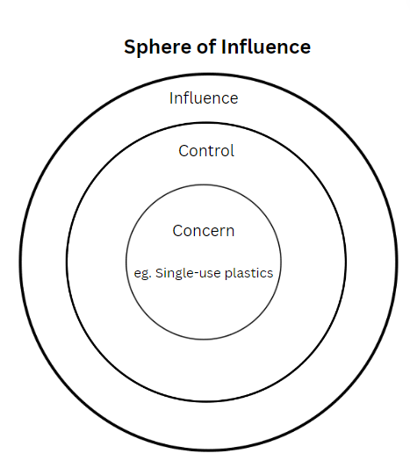
Sphere of influence

Slide 62
How many bags and plastics?
Class results
Type of bags and plastics | Mon | Tues | Wed | Thurs | Fri | Sat | Sun
Plastic shopping bag
Plastic fruit and vegetable bag
Paper bags
Reusable bag or box
Biodegradable carry bag
Single use plastic food packaging
Weekly total

Slide 63
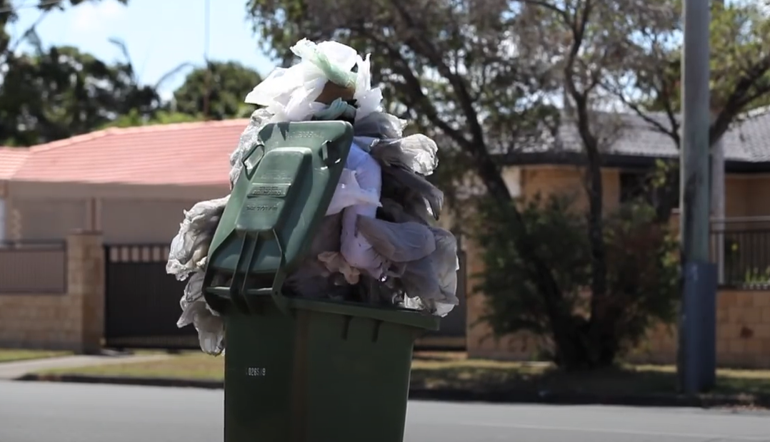
The life of a plastic bag
Watch The Life of a Plastic Bag (2:33)

Slide 64

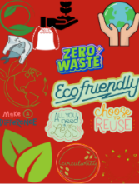
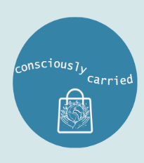

Logo design
Sample logos
Discuss what message each logo idea is sharing and how.
Logo examples designed using Canva

Slide 65
Logo design (statements)
Do now
Underneath your logo design in your workbook there is a space to answer these statements.
My logo design will spread this message to the public …
This is why it will be successful in spreading this message …

Slide 66
Learning intention and success criteria (12)
We are learning to:
understand how Aboriginal communities historically carried items around using textile methods and materials found nearby so that we can learn from their success.
We can:
give an example of an Aboriginal textile item, and the success criteria that helped them to carry items.
Notes:
Notes for teachers:
Learning intentions and success are best co-constructed with students. Adapt the learning intention as required and add co-constructed success criteria.

Slide 67
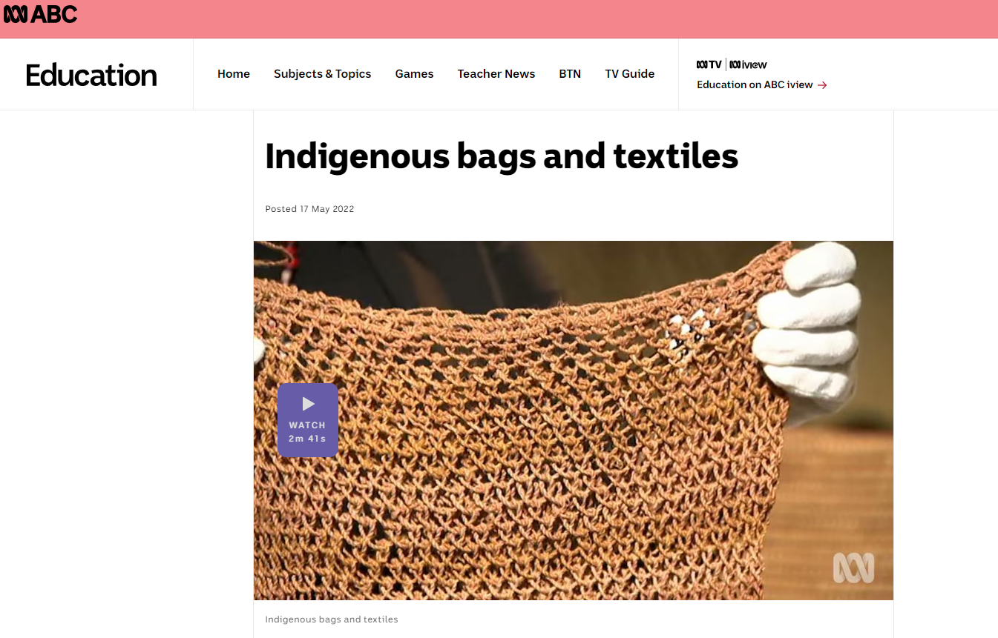
Indigenous bags and textiles
Watch Indigenous bags and textiles (2:41)

Slide 68
Aboriginal weaving overview
Note: review the following videos and watch the most suitable for your context. Utilise the content in the PowerPoint for students to complete the questions below. Sample answers have been provided.
Weaving Workshop (19:12) – extended overview of Aboriginal weaving
Waking up Indigenous weaving practices | Art Works (4:43)
We Can, We Do: Aunty Connie Hart breaks all the rules to keep tradition alive (3:26)
The learning on the following slides has been sourced from public-facing materials available online.

Slide 69
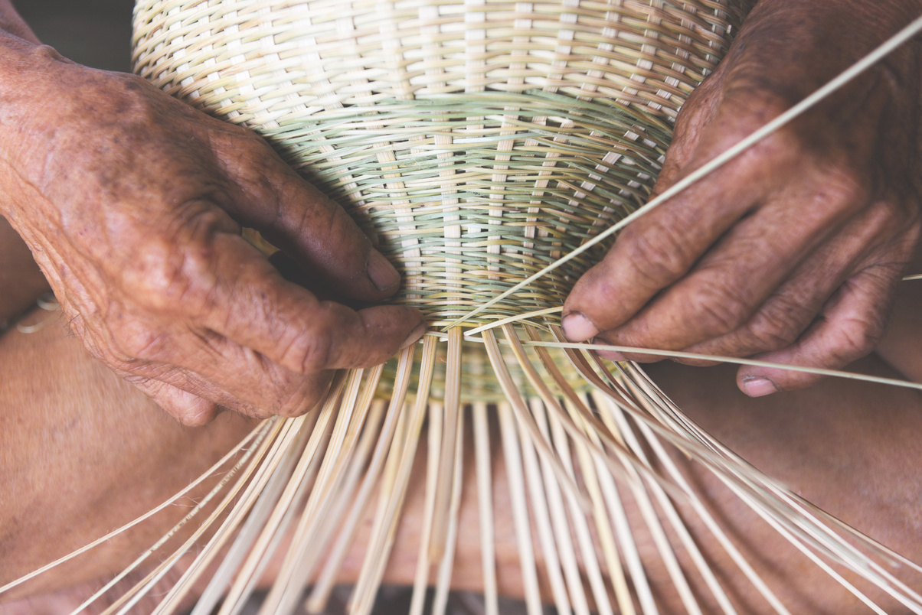
Aboriginal weaving
Aboriginal weaving is a rich and diverse tradition that has been practiced for thousands of years by Indigenous communities across Australia. This art form not only showcases the technical skills of Aboriginal weavers but also embodies cultural, spiritual, and practical significance.

Slide 70
Materials and techniques
Traditional materials: Aboriginal weavers use natural materials found in their environment. These include grasses, reeds, bark fibres, and other plant materials. The selection of materials is often specific to the region and the availability of resources.
Techniques: various weaving techniques are used, including twining, coiling, and plaiting. These techniques are passed down through generations and are integral to creating functional and decorative items.

Slide 71
Cultural significance and design and patterns
Cultural significance: weaving is deeply embedded in Aboriginal culture. The practice is often linked to the land, with materials collected during specific seasons. Weaving items such as baskets, mats, and fish traps are not only functional but also carry cultural stories and are used in ceremonies.
Design and patterns: the designs and patterns in Aboriginal weaving can be highly symbolic, often representing elements of the natural world, ancestral beings, and cultural stories. The patterns can vary significantly between different Aboriginal groups.

Slide 72
Types of woven items
Baskets and bags: these are among the most common items, used for carrying food, tools, and other essentials. Different styles and shapes reflect the diverse uses and regional variations.
Mats and rugs: often used for sitting, sleeping, or as decorative items, these woven pieces can be quite intricate and large.
Fish traps and nets: functional items used in traditional fishing practices. These items are designed to effectively capture fish and other aquatic animals.
Ornamental items: weaving is also used to create decorative items, including jewellery, headbands, and ceremonial objects.

Slide 73
Modern adaptations and revivals
Contemporary art: Aboriginal artists continue to innovate within the tradition of weaving, creating contemporary art pieces that are displayed in galleries and exhibitions worldwide. These modern works often blend traditional techniques with new materials and forms.
Community projects: many Aboriginal communities engage in weaving projects to preserve and revitalize traditional practices. These projects often involve intergenerational teaching and community collaboration.
Economic opportunities: weaving provides economic opportunities for Aboriginal artists through the sale of handmade items. This supports the sustainability of traditional practices and provides income for communities.

Slide 74
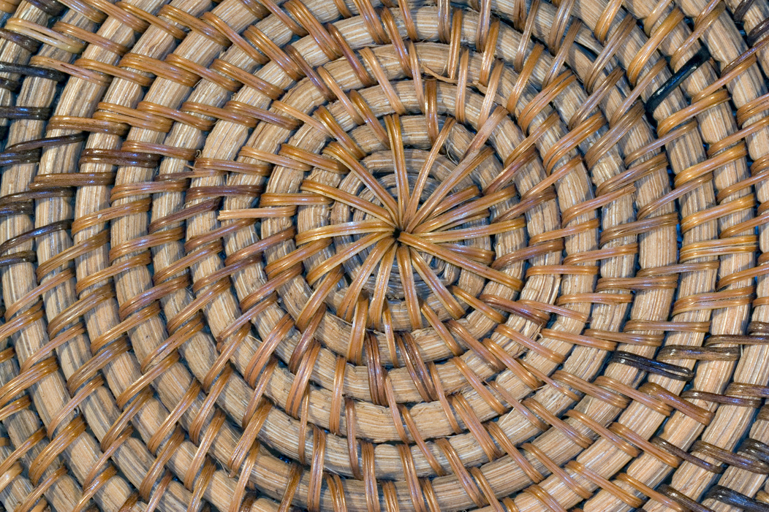
Indigenous Cultural Intellectual Property (ICIP)
It is essential to respect ICIP rights, ensuring that traditional knowledge and cultural expressions are protected and that Aboriginal communities maintain control over their cultural heritage.

Slide 75
Recall fibre to yarn to fabric process
What is the different between woven and knitted fabrics?
Notes:
Discuss the difference between woven and knitted fabrics:
They are produced differently
They have different properties
They are used for different purposes.

Slide 76
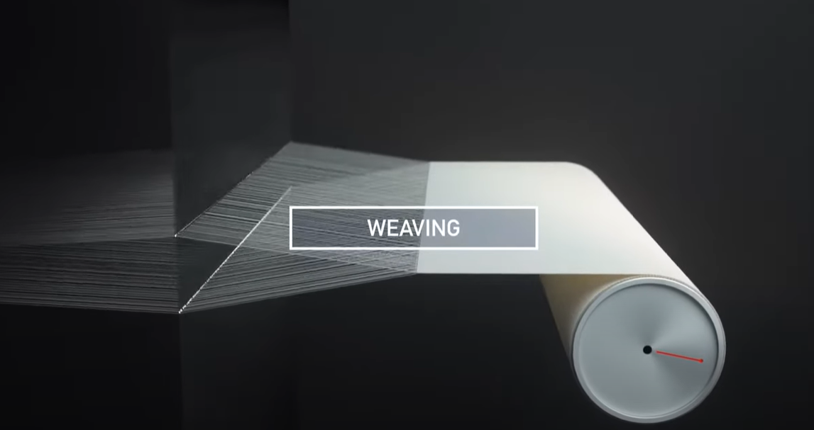
Weaving process
Watch Weaving Machine Animation and Basic Principle of Weaving (0:10)

Slide 77
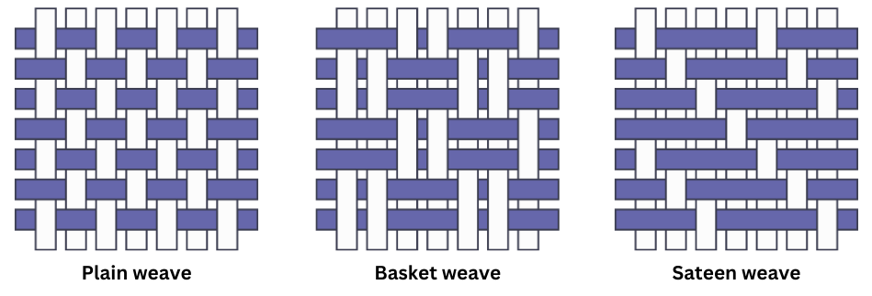
Types of weaves (1)
Plain, basket, sateen

Slide 78
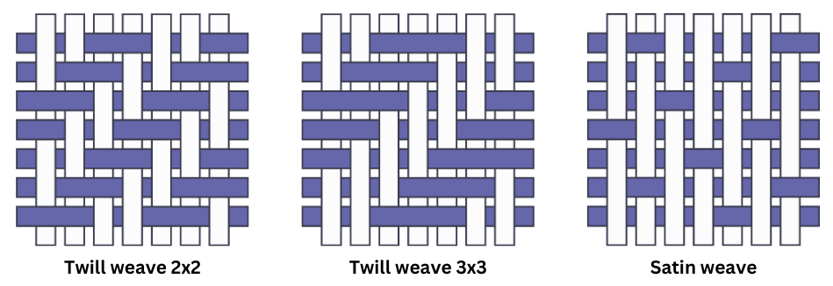
Types of weaves (2)
Twill, satin

Slide 79
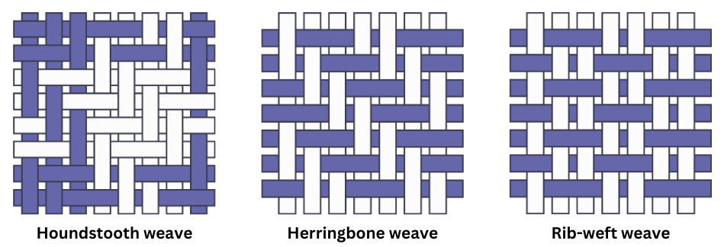
Types of weaves (3)
Houndstooth, herringbone, rib

Slide 80
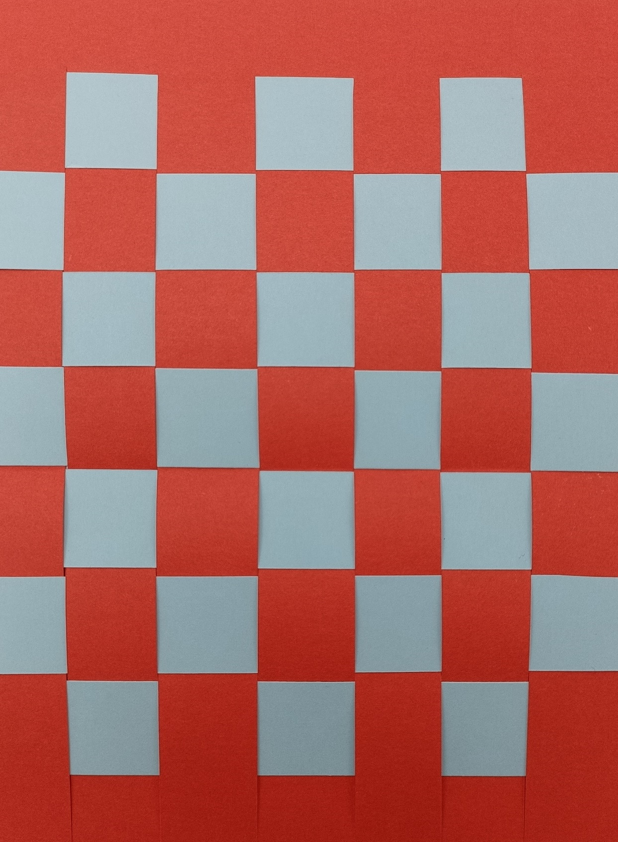
Paper weaving
Resources needed:
2 A5 sized pieces of paper
Scissors
Ruler

Slide 81
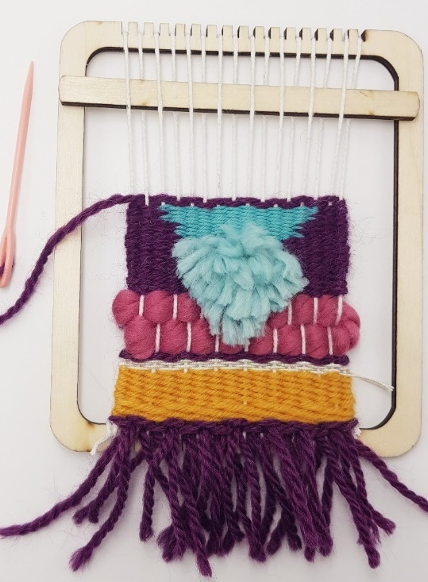
Loom weaving activity
Students create a mini-wall hanging by weaving yarn on a basic loom. Students examine different fabric or material structures through using different weaving techniques.

Slide 82
Complete this statement in your workbook
Do now
Even with primitive technology and limited access to resources, Aboriginal communities were successful survivors because …
82

Slide 83
Learning intention and success criteria (13)
We are learning to:
experiment with modern uses of materials in innovative textile items and identifying their properties to help make decisions about my project.
We can:
identify innovative uses for modern materials in textile projects
safely and successfully complete an experiment of plastic fusion.
Notes:
Notes for teachers:
Learning intentions and success are best co-constructed with students. Adapt the learning intention as required and add co-constructed success criteria.

Slide 84


Materials and solutions
Innovative uses for plastics
Watch Is this a better use for plastic bags? (13:38)
Watch Can Your Chip Bags Save Lives? (16:35)

Slide 85

See-Think-Wonder
85

Slide 86

Safety
Plastic fusion

Slide 87
Safety – suggested answers
Plastic fusion
Correct iron temperature, turn off after use
Well ventilated
Don’t touch hot melted plastic
Don’t let the iron touch the plastics
Teacher supervision

Slide 88
PMI – plastic fusion
PLUS Identify the most positive aspects of your sample | MINUS Identify something that might need improvement next time | INTERESTING What were you surprised about when completing this sample?

Slide 89
Part 3
Achieving vision – project development

Slide 90
Learning intention and success criteria (14)
We are learning to:
explore factors that affect design and the criteria for success so that we can design a suitable carry item and meet the design brief.
We can:
describe the aesthetics and functionality of our design
list criteria for the success of our design.
Notes:
Notes for teachers:
Learning intentions and success are best co-constructed with students. Adapt the learning intention as required and add co-constructed success criteria.

Slide 91
Project development
Design and production process diagram

Slide 92
Identifying and defining – design situation (2)
Sew sustainable, sew awesome!
Design situation
Indigenous communities have long relied on local materials to create tools for carrying goods. But now, with our resources dwindling and the need for carrying still vital, we face a challenge. We must design carry items that not only serve practical needs but also help tackle environmental problems, like cutting down on single-use plastics and protecting our land. By taking on this challenge, we can protect our environment for the future while honouring Indigenous traditions of resourcefulness and caring for country.

Slide 93
Identifying and defining – design brief (2)
Sew sustainable, sew awesome!
Design brief
Your task is to create a carry item for yourself that addresses an environmental problem, for example, reducing single-use plastics. This item should also spread awareness to others about the issue.
Your challenge is to design a carry item for your own personal use that helps stop single-use plastics being used, or another environmental issue of your choosing, from going into our landfill and ruining our environment.

Slide 94
Factors affecting design
Factor affecting design | Description of how my design could address the factor
Aesthetics (how it looks)
Durability (how strong it is)
Ergonomics (how comfortable is it to use)
Ethics
Safety

Slide 95
Criteria for success
List a minimum of 3 criteria for which you will evaluate if your design is successful in meeting the design brief.

Slide 96
Criteria for success – sample
Sample answer
Environmental impact – the item reduces single-use plastics and/or uses recycled fabric. The item is reusable
Functionality – the item is strong, easy to use, comfortable, and fits my items.
Aesthetics – the design looks good.
Cultural and ethical considerations – the design respects Aboriginal and/or Torres Strait Islander peoples traditions and is made using ethical practices.

Slide 97
Learning intention and success criteria (15)
We are learning to:
document the research and planning phase of our project so that we can develop a range of suitable ideas for a finished project.
We can:
brainstorm design ideas
sketch design ideas
evaluate design ideas.
Notes:
Notes for teachers:
Learning intentions and success are best co-constructed with students. Adapt the learning intention as required and add co-constructed success criteria.

Slide 98

Research and planning
Idea development

Slide 99




Research and planning – example
Idea development

Slide 100
Idea development
Design idea 1 | Design idea 2 | Design idea 3

Slide 101

Peer feedback on final design
What was done well: ‘I like the way … ’
What can be improved: ‘The criteria you have missed … ’
Next steps for improvement: ‘Would you consider …. ’

Slide 102
PMI – evaluation of design ideas
PLUS Identify the most positive aspects of your designs | MINUS Identify something that might need improvement next time | INTERESTING What is something interesting and unique about your designs?

Slide 103
Final design
Explanation of design choice
I have chosen to make design number _ because …
It meets the design brief by …
The design is suitable because it meets the factors affecting design by …
The design meets the criteria for success by …

Slide 104

Final design – image
Sample annotated

Slide 105
Learning intention and success criteria (16)
We are learning to:
develop an action plan so that we can manage our time and resources to successfully complete our project on time.
We can:
develop a project goal and list of tasks
set deadlines and create a timeline
list resources needed to complete our design project.
Notes:
Notes for teachers:
Learning intentions and success are best co-constructed with students. Adapt the learning intention as required and add co-constructed success criteria.

Slide 106
Creating an action plan
An action plan is a detailed guide that outlines the steps a designer needs to take to complete a project.
It includes specific tasks, deadlines, and resources needed.
An action plan breaks down the project into smaller, manageable tasks to ensure the project is completed on time.

Slide 107






Steps to create an action plan
Define the goal – What is the final product you want to create? What specific features or design elements will it have (for example, fused plastics, stencilling, sun printing, embroidery)?
List the tasks – break down the project into smaller tasks.
Estimate the time for each task – think about how long each task will take. Be realistic and consider any other commitments you have (school, extracurricular activities and so on).
Set deadlines – assign a deadline for each task. Make sure the deadlines are spread out and achievable. Work backwards from the final due date to ensure you have enough time for everything.
Create a timeline – use a calendar or planner to map out your tasks and deadlines. This can be a simple list with dates or a more detailed timeline with specific days and times.
Gather resources – make a list of all the materials and resources you will need.
Notes:
This slide could be printed and displayed around the room as visual prompt for students.

Slide 108
Action plan – timeframe
Steps | Time plan

Slide 109
Learning intention and success criteria (17)
We are learning to:
evaluate our project so that we can ensure we have met the design brief.
We can:
evaluate our projects against the success criteria
explain how our completed carry item meets the design brief and criteria for success.
Notes:
Notes for teachers:
Learning intentions and success are best co-constructed with students. Adapt the learning intention as required and add co-constructed success criteria.

Slide 110



Testing and evaluating
Evaluate your final product in terms of your success criteria
In your workbook choose which icon best reflects how your design meets each success criteria.
It meets this criteria very well.
It meets most of this criteria.
It does not meet this criteria.

Slide 111
References (1)
This presentation contains NSW Curriculum and syllabus content. The NSW Curriculum is developed by the NSW Education Standards Authority. This content is prepared by NESA for and on behalf of the Crown in the right of the State of New South Wales. The material is protected by Crown copyright.
Please refer to the NESA Copyright Disclaimer for more information https://educationstandards.nsw.edu.au/wps/portal/nesa/mini-footer/copyright.
NESA holds the only official and up-to-date versions of the NSW Curriculum and syllabus documents. Please visit the NSW Education Standards Authority (NESA) website https://educationstandards.nsw.edu.au/wps/portal/nesa/home and the NSW Curriculum website https://curriculum.nsw.edu.au.
Technology 7–8 Syllabus © Syllabus NSW Education Standards Authority (NESA) for and on behalf of the Crown in right of the State of New South Wales, 2024.
ABC (Australian Broadcasting Corporation) (17 May 2022) 'Indigenous bags and textiles' [video], ABC Education, ABC website accessed 17 June 2024.
ABC iview (12 September 2021) 'Waking up Indigenous weaving practices | Art Works' [video], ABC iview, YouTube, accessed 12 June 2024.
ABC News (Australia) (9 July 2018) 'We Can, We Do: Aunty Connie Hart breaks all the rules to keep tradition alive' [video], ABC News (Australia), YouTube, accessed 12 June 2024.

Slide 112
References (2)
This presentation contains NSW Curriculum and syllabus content. The NSW Curriculum is developed by the NSW Education Standards Authority. This content is prepared by NESA for and on behalf of the Crown in the right of the State of New South Wales. The material is protected by Crown copyright.
Please refer to the NESA Copyright Disclaimer for more information https://educationstandards.nsw.edu.au/wps/portal/nesa/mini-footer/copyright.
NESA holds the only official and up-to-date versions of the NSW Curriculum and syllabus documents. Please visit the NSW Education Standards Authority (NESA) website https://educationstandards.nsw.edu.au/wps/portal/nesa/home and the NSW Curriculum website https://curriculum.nsw.edu.au.
Boomerang Bags (7 March 2014) 'The Life of a Plastic Bag' [video], Boomerang Bags, YouTube, accessed 17 June 2024.
Boomerang Bags (2022) Boomerang Bags [website], accessed 17 June 2024.
Brothers Make ( 2 March 2024) 'Can Your Chip Bags Save Lives?' [video], Brothers Make, YouTube, accessed 17 June 2024.
Brothers Make (24 September 2022) 'Beginners' Guide to Plastic Bag Recycling - How to Make a Wallet´ [video], Brothers Make, YouTube, accessed 17 June 2024.
Brothers Make (27 May 2023) 'Is this a better use for plastic bags?' [video], Brothers Make, YouTube, accessed 14 June 2024.
Cool.org (25 August 2020) ‘Take 3 – Connection' [video], Cool.org, Vimeo, accessed 17 June 2024.

Slide 113
References (3)
This presentation contains NSW Curriculum and syllabus content. The NSW Curriculum is developed by the NSW Education Standards Authority. This content is prepared by NESA for and on behalf of the Crown in the right of the State of New South Wales. The material is protected by Crown copyright.
Please refer to the NESA Copyright Disclaimer for more information https://educationstandards.nsw.edu.au/wps/portal/nesa/mini-footer/copyright.
NESA holds the only official and up-to-date versions of the NSW Curriculum and syllabus documents. Please visit the NSW Education Standards Authority (NESA) website https://educationstandards.nsw.edu.au/wps/portal/nesa/home and the NSW Curriculum website https://curriculum.nsw.edu.au.
CottonAustralia (18 August 2020) 'Cotton Products and Uses´[video], CottonAustralia, YouTube, accessed 14 June 2024.
DiPietro B (21 May 2023) ‘Magical Summer SunPrinting on Fabric’, MadeByBarb Tutorials, accessed 17 June 2024.
Jenn’s Creativity Corner (29 April 2017) 'How to Fuse Plastic Bags -- Recycling Craft!' [video], Jenn’s Creativity Corner, YouTube, accessed 17 June 2024.
Mrs Deeming Tech (17 May 2020) 'Textiles: What are they? where do they come from?' [video], Mrs Deeming Tech, YouTube, accessed 17 June 2024.
Sewers Delight (25 November 2026) 'How a Sewing Machine Works via animation' [video], Sewers Delight, YouTube, accessed 9 June 2024.

Slide 114
References (4)
This presentation contains NSW Curriculum and syllabus content. The NSW Curriculum is developed by the NSW Education Standards Authority. This content is prepared by NESA for and on behalf of the Crown in the right of the State of New South Wales. The material is protected by Crown copyright.
Please refer to the NESA Copyright Disclaimer for more information https://educationstandards.nsw.edu.au/wps/portal/nesa/mini-footer/copyright.
NESA holds the only official and up-to-date versions of the NSW Curriculum and syllabus documents. Please visit the NSW Education Standards Authority (NESA) website https://educationstandards.nsw.edu.au/wps/portal/nesa/home and the NSW Curriculum website https://curriculum.nsw.edu.au.
Take 3 for the Sea (29 June 2023) '4:6 EP4 PERSONAL ACTION' [video], Take 3 for the Sea, YouTube, accessed 17 June 2024.
The Rocks (9 November 2020) 'Weaving Workshop' [video], The Rocks, YouTube, accessed 17 June 2024.
The Woolmark Company (3 June 2016) 'The Innovator' [video], The Woolmark Company, YouTube, accessed 24 July 2024.
Upcycle DesignLab (12 March 2022) 'How to make FABRIC from PLASTIC grocery bags – Upcycling Plastic' [video], Upcycle DesignLab, YouTube, accessed 17 June 2024

Slide 115
Copyright
© State of New South Wales (Department of Education), 2024
The copyright material published in this resource is subject to the Copyright Act 1968 (Cth) and is owned by the NSW Department of Education or, where indicated, by a party other than the NSW Department of Education (third-party material).
Copyright material available in this resource and owned by the NSW Department of Education is licensed under a Creative Commons Attribution 4.0 International (CC BY 4.0) license.
This license allows you to share and adapt the material for any purpose, even commercially.
Attribution should be given to © State of New South Wales (Department of Education), 2024.
Material in this resource not available under a Creative Commons license:
the NSW Department of Education logo, other logos and trademark-protected material
Material owned by a third-party that has been reproduced with permission. You will need to obtain permission from the third-party to reuse its material.
Links to third-party material and websites
Please note that the provided (reading/viewing material/list/links/texts) are a suggestion only and implies no endorsement, by the New South Wales Department of Education, of any author, publisher, or book title. School principals and teachers are best placed to assess the suitability of resources that would complement the curriculum and reflect the needs and interests of their students.
If you use the links provided in this document to access a third-party’s website, you acknowledge that the terms of use, including licence terms set out on the third-party’s website apply to the use which may be made of the materials on that third-party website or where permitted by the Copyright Act 1968 (Cth). The department accepts no responsibility for content on third-party websites.

