Slide 1
Instructions for use
This resource is not a teaching and learning program. It should be used in conjunction with the program tas-s4-mixed material-10-week-program DOCX 488KB and teacher resource tas-s4-mixed material-10-week-teacher resource DOCX 12.7MB.
There is a sample assessment task tas-s4-mixed material-10-week-assessment DOCX 559KB and scaffolded portfolio for use in Google Sites Portfolio Sample Technology 7-8 or MS Word tas-s4-mixed materials-portfolio DOCX 1.16MB.
Classroom teachers are encouraged to add and adapt slides as required to meet the needs of their students.
Save a copy of the file to make changes to the slide deck – go to File > Download a Copy (this downloads a copy to the computer to edit in the PowerPoint app).
To convert the PowerPoint to Google Slides:
  Upload the file into Google Drive and open it.
  Go to File > Save as Google Slides.

Slide 2
Bling it on
Mixed materials-jewellery
Stage 4
Technology 7-8
Materials and production processes focus area

Slide 3
Weekly topics
Materials, tools, technology, production, process and practice of designers, design considerations
Jewellery practical
1
6
Aboriginal and Torres Strait Islander jewellery, cultural jewellery, sustainability, glossary
Jewellery practical
2
7
Safety tests and demonstrations, workshop induction, production processes, idea generation, design considerations
Jewellery practical
8
3
Jewellery practical and portfolio
Jewellery basic skills practical
9
4
Design development, planning and management, final design and prototyping
Quality control, trouble shooting and evaluation
5
10
Notes:
Teacher notes:
Click lesson numbers to go to specific lessons
Interactive features can be viewed in slide show
Notes for vendors [to be removed after slide deck creation]:
Create hyperlinks to dividers that match lesson numbers by
Right click on the number>edit link>select slide in deck to connect to

Slide 4
Weeks 1-2

Slide 5
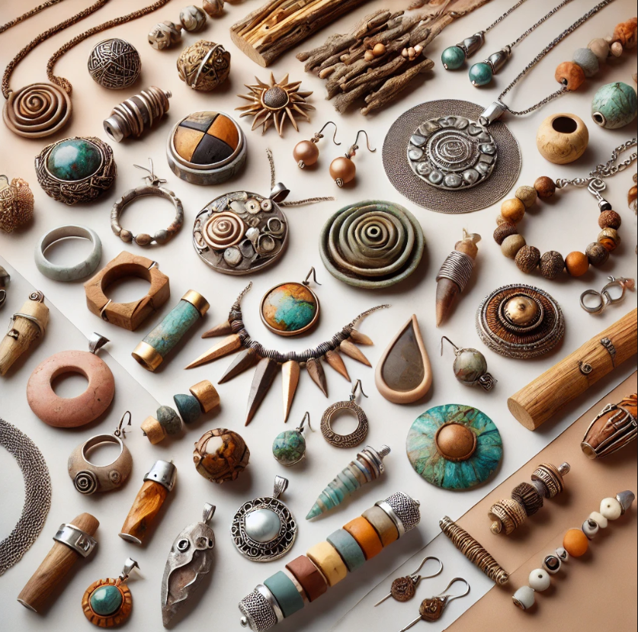
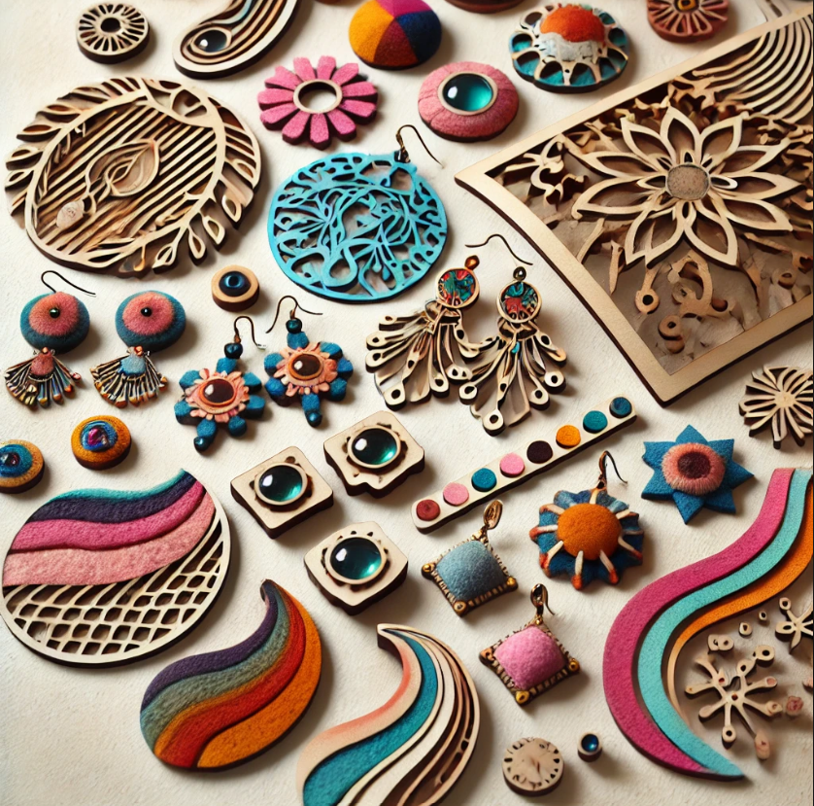
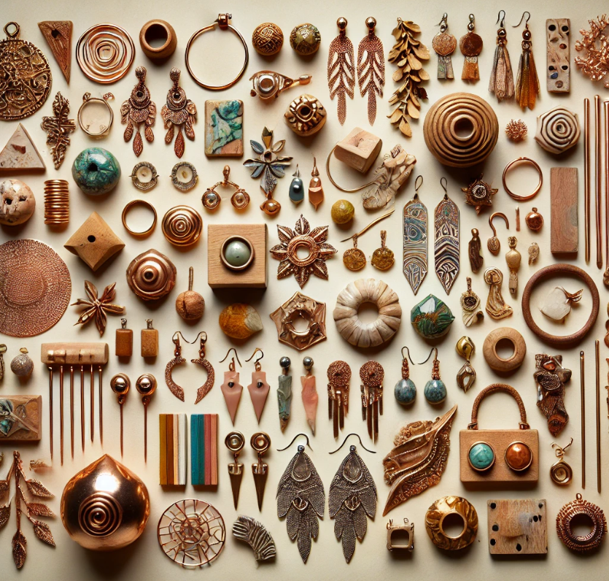
Do now
Examine the PowerPoint collage and identify the names of the materials that you can see the jewellery is made from.
Figures 1, 2, 3: Images generated using Chat GPT (free) from the prompt collage of mixed material jewellery items.

Slide 6
Learning intentions (1)
Success criteria
We are:
Investigating why jewellery is worn and the different types of materials that jewellery items can be made from.
I can:
identify what the functions of jewellery are
explain how materials are used differently to create jewellery
identify the characteristics and properties of different materials.

Slide 7
KWLH
Use the KWHL table at the beginning of the unit to document what you already know about jewellery pieces, materials used and processes for making it. What else do you want to know? At the end of the learning sequence, complete the last two columns too reflect on your learning.
K
What do I know?
W
What do I want to know?
L
What have I learned?
H
How can I learn more?

Slide 8
Exit ticket – sticky note
At the end of the lesson, complete the questions to reflect on your learning and hand in to the teacher.
What can jewellery be made of?
What are some types of jewellery?
What are some reasons for wearing jewellery?

Slide 9
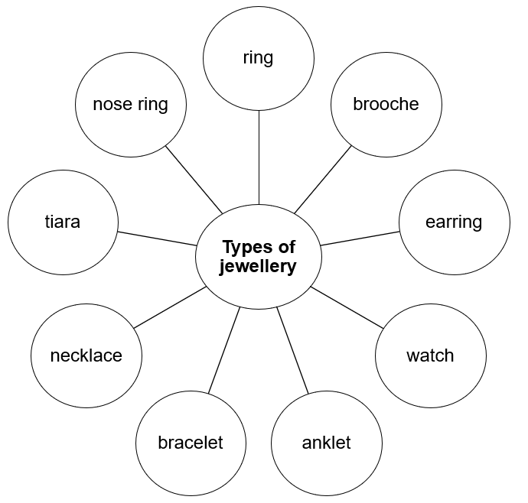
Types of jewellery

Slide 10
Week 1 lesson 2 – Do now
Think about the distinguishing characteristics of features of one of the materials you examined in the previous lesson.
Material | Characteristics | Features
Brass
Copper
Silver
Polymer clay
Timber
Acrylic
Other

Slide 11
Learning intentions (2)
Success criteria
We are:
Exploring and documenting the design and production processes used to create sustainable and functional products.
I can:
document the design and production processes in my portfolio
Identify a design problem and write a design brief
recognise and describe how jewellery designers apply design and production processes.

Slide 12
Assessment task
You are a designer tasked with creating a unique piece of jewellery that reflects sustainability, cultural significance, or inspiration from nature (biomimicry).
Your design must combine at least two different materials for example, metals, polymers, wood to showcase how contrasting materials can work together to create an aesthetically pleasing and functional jewellery piece.
In addition, your jewellery design should:
Consider sustainability by minimising waste, using recyclable materials, or incorporating materials with a lower environmental impact.
Draw inspiration from either:
Nature- by applying principles of biomimicry (e.g., patterns, structures, or functions found in plants or animals).
  Culture- by reflecting the traditions, symbols, or artistic styles of a specific cultural group.

Slide 13
Sample portfolio templates
Your final product will demonstrate your skills in designing and producing a quality product while reflecting your ability to innovate and consider the impact of your design choices on the environment and society.
You will submit one piece of jewellery with a completed portfolio documenting your design and production processes.
We can use any of the portfolio scaffold below – make a COPY and name the file with your full name and class. tas-s4-mixed material-10-week-assessment DOCX 559KB
tas-s4-mixed materials-portfolio DOCX 1.16MB MS Word Sample Portfolio
Portfolio Sample Technology 7-8 Google Sites Sample Portfolio

Slide 14

Design and production process
Identify the need and opportunities.
Describe existing solutions.
Outline factors affecting design.
Define key terms.
Identifying
and
defining
Investigate and describe relevant equipment, processes and materials.
Develop plans to safely manage production.
Create, evaluate, modify and apply ideas and solutions.
Explain social, ethical, legal and sustainability considerations.
Researching
and
planning
Select and use tools, materials, techniques, technologies and processes.
Demonstrate and use safe practices.
Apply project management processes.
Communicate and justify design choices.
Producing
and
implementing
Work collaboratively to improve solutions.
Use factors affecting design to evaluate.
Justify the use of components, equipment and processes.
Reflect on your own work and the work of others.
Testing
and
evaluating

Slide 15
Week 1 lesson 3 – Do now
Brainstorm: What are some characteristics of well-made jewellery? (e.g., function, aesthetic appeal, durability, sustainability).
What are characteristics of well-made jewellery?
Function | 1 | Easy to put on and take off
 | 2 | No sharp edges that will cut skin or clothes when being worn
 | 3
Aesthetics | 1 | Finish attracts the eyes. May be bright and shiny or colourful
 | 2
 | 3
Durability | 1
 | 2
Sustainability | 1
 | 2

Slide 16
Learning intentions (3)
Success criteria
We will:
Explore the factors influencing the design of products and solutions and the production techniques and materials used by designers, producers, and manufacturers.
I can:
identify and describe characteristics of well-made jewellery
research and analyse existing jewellery designs, materials, and techniques for inspiration
use creative thinking techniques to refine and develop innovative design ideas.

Slide 17
Brainstorm – How would a jewellery designer follow a design and production process?
Identify Materials – Research metals, sustainability options.
Study Existing Jewellery – Explore traditional and modern techniques.
Outline Design Factors – Consider trends, budget, ethics, and sustainability.
Develop Initial Ideas – Create sketches, mood boards, and CAD designs.
Plan Production – Choose tools, materials, and manufacturing techniques.
Create Prototype – Use 3D printing, wax models, or sample materials.
Refine & Improve – Test and modify designs based on feedback.
Identifying
and
defining
Researching
and
planning
Producing
and
implementing
Testing
and
evaluating

Slide 18
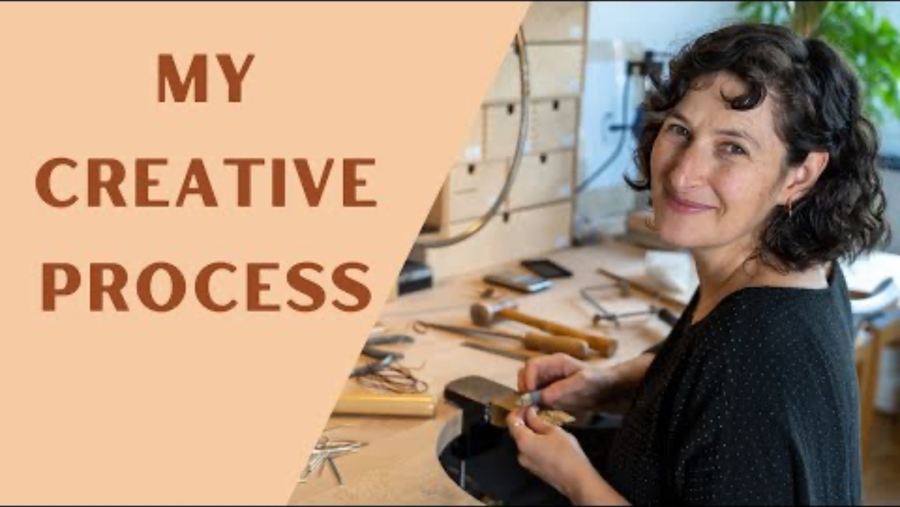
Jewellery Creative Design Process
Watch video
Notes:
Watch "Jewellery Creative Design Process" video (10:09) https://youtu.be/Z7gNm_20VT8

Slide 19
Week 2 lesson 4 – Do now
As you enter, look at the images of Aboriginal and Torres Strait Islander jewellery on the board. On a sticky note, write down one observation or question you have about the jewellery. Stick your note on the 'Wonder Wall'.

Slide 20
Learning intentions (4)
Success criteria
We are:
Investigating jewellery made by Aboriginal and Torres Strait Islander Peoples and other cultures to understand how material properties and production techniques contribute to the quality and purpose of jewellery.
I can:
identify examples of Aboriginal and Torres Strait Islander jewellery and describe the materials and techniques used
compare jewellery from different cultures based on materials, purpose, and production methods
explain how material properties influence the design and function of jewellery.

Slide 21
Exit ticket (1)
What is one material you researched today, and how does it contribute to the quality or purpose of the jewellery?

Slide 22
Week 2 lesson 5 – Do now
What does the term ‘sustainability’ mean to you?
Write your response in your notebook or on a sticky note and share them with a partner.

Slide 23
Learning intentions (5)
Success criteria
We are:
Learning to understand how sustainability, ethical practices, and legal considerations impact the design, production, and innovation of products and solutions.
I can:
explain how sustainable practices influence product design and production
compare sustainable sourcing practices between different materials and processes
identify ethical and legal considerations in the design and production process.

Slide 24
Exit ticket (2)
What is one sustainable practice you learned about today, and how does it impact product design?

Slide 25
Weeks 3-4

Slide 26
Week 3 lesson 1 – Do now
Think-Pair-Share
Individually brainstorm as many Work Health and Safety (WH&S) considerations as you can for:
Competent working habits.
Safe use of hand tools.
Machine safety.
After brainstorming, students pair up to discuss their ideas briefly.

Slide 27
Learning intentions (6)
Success criteria
We are:
Learning to identify safety issues in a workshop so that we can complete practical work safely.
I can:
identify what safety issues are in a workshop
explain how to use materials and equipment safely.

Slide 28
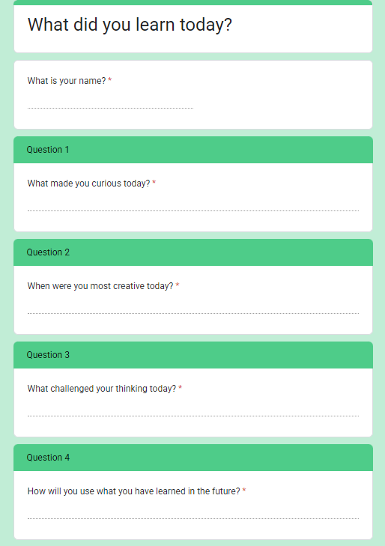
Exit ticket (3)
Complete and submit the Google Forms exit ticket for the lesson today.

Slide 29
Week 3 lesson 2 – Do now
Match the correct piece of equipment with its definition.
Identify one key safety rule for using each tool/material.

Slide 30
Learning intentions (7)
Success criteria
We will:
Learn about key production processes and safe practices for designing and creating a product using [chosen material: metal, polymer, acrylic/timber, ABS/PLA].
I can:
identify and explain tools and techniques for [material].
follow safety rules when working with tools, materials, and processes.
demonstrate basic production techniques to create a simple component or product.

Slide 31
Exit ticket (4)
What is one new skill you learned today?
What is one safety consideration you must remember when using [metal/polymer/timber/acrylic/PLA/ABS]?

Slide 32
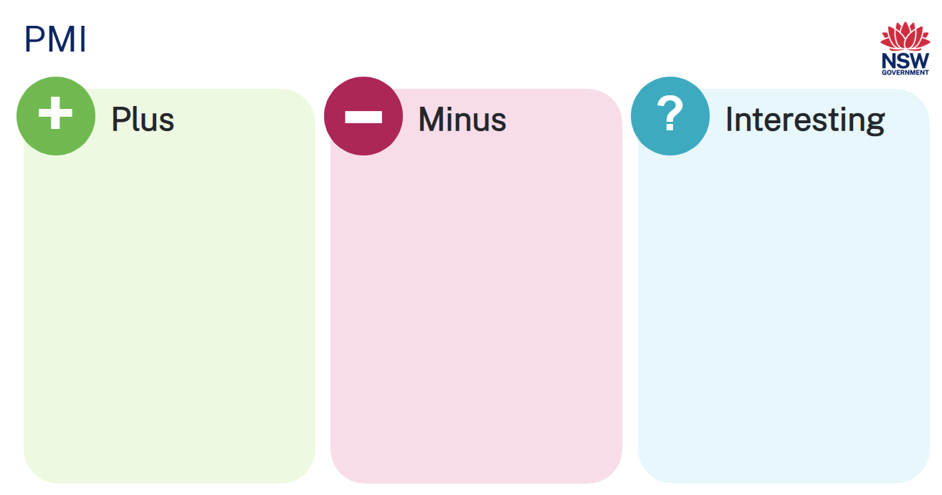
Week 3 lesson 3 – Do now
Reflect on the jewellery item you started designing.
What worked well (Plus)?
What challenges did you face (Minus)?
What interesting aspects or improvements could you incorporate?

Slide 33
Learning intentions (8)
Success criteria
We will:
Understand how designers evaluate success using criteria, by exploring the factors affecting design and applying them to our design brief.
I can:
define and apply factors affecting design to our project.
develop and justify criteria for evaluating our designs.
create annotated sketches showing functional and aesthetic features of our jewellery design.
reflect on and improve our design ideas through PMI analysis and peer feedback.

Slide 34
Week 4 lesson 4 – Do now
What goal do I want to achieve in the workshop today?
(consider your jewellery design, WHS, materials and equipment needed, basic skills and production plan).
Use a quick write technique for 3 minutes of silent writing.

Slide 35
Learning intentions (9)
Success criteria
We will:
Understand and safely apply the practical steps involved for metalworking, polymer clay, or acrylic to create simple jewellery components.
I can:
Identify and explain the tools, materials, and processes required for the project.
Describe and apply safe practices for handling materials and tools.
Demonstrate fabrication techniques for the chosen material:
Metalworking: Cutting, filing, annealing, forming (twisting), soldering, and polishing.
Polymer Clay: Conditioning, shaping, curing, and finishing.
Acrylic/Timber: CAD, Cutting, shaping, bending, and laser cutting.
ABS/PLA: CAD, 3D printing

Slide 36
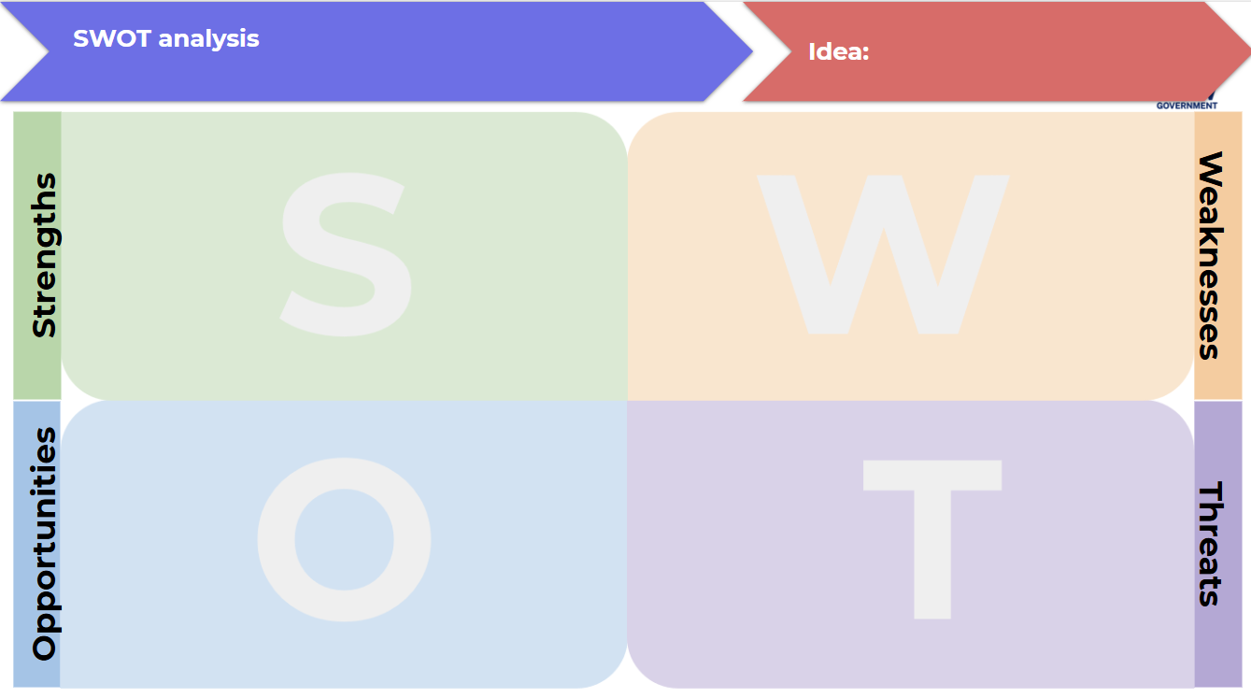
Week 4 lesson 5 – Do now
Complete an evaluation of your practical work/skills/experiences from last lesson using the SWOT analysis chart in your workbook.
Record the strengths, weaknesses, opportunities and threats analysis from your previous practical lesson.

Slide 37
Learning intentions (10)
Success criteria
We will:
Safely use tools, materials and processes in the workshop to transform a design into a finished product using a specific material (metal, polymer clay, or acrylic).
I can:
Identify and explain the tools, materials, and production methods needed for the project.
Demonstrate safe and accurate use of equipment and materials.
Apply fabrication techniques to produce a component or product, such as:
Metalworking: Cutting, filing, annealing, forming (twisting), soldering, and polishing.
Polymer Clay: Conditioning, shaping, curing, and finishing.
Acrylic: Cutting, shaping, bending, and laser cutting.

Slide 38
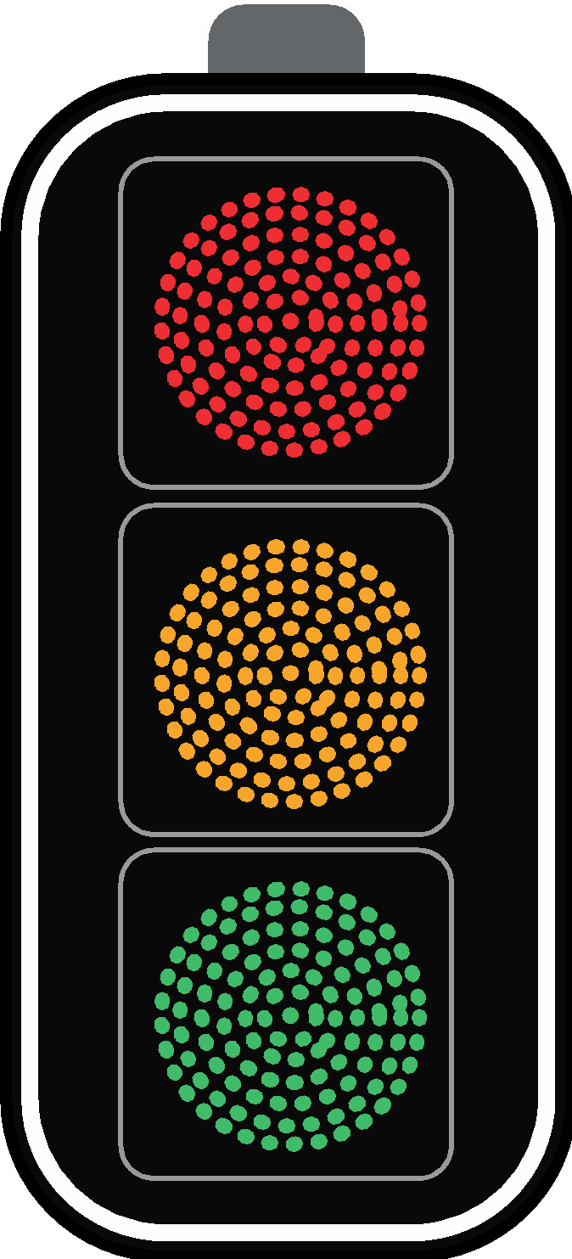
Exit ticket – Traffic light reflection
I need to improve on...
I need some help!
I am still working on...
I’m getting there!
I am most proud of...
I get it!

Slide 39
Weeks 5-6

Slide 40
Week 5 lesson 1 – Do now
Review the design brief and reflect on your practical experimentation from previous lessons.
What techniques have you mastered that could be used in your design?
What challenges from your practical work might influence your design decisions?

Slide 41
Learning intentions (11)
Success criteria
We will:
Develop and refine design concepts for a jewellery piece and evaluate our design ideas using structured feedback and self-assessment techniques.
I can:
Create three detailed, labelled sketches that clearly communicate my design ideas.
Identify and describe how my designs demonstrate practical techniques and address factors affecting design.
Provide and receive constructive feedback to refine my design concepts.

Slide 42
PMI of design ideas
+
?
Plus
Minus
Interesting

Slide 43

Peer-assessment teaching techniques
TAG scaffold
T
Tell them something they did well
A
Ask them what was difficult
G
Give a suggestion for improvement
Notes:
Purpose: To highlight practical techniques for peer assessment.
Facilitator notes:
One effective peer-assessment strategy is the TAG scaffold as observed in practice in the video. To use the TAG scaffold students could work in pairs.
Firstly, students would review their peer’s work and tell their peer something they did well based on the success criteria.
Students would then ask their peer what they found difficult about the work to identify areas for improvement.
Lastly, students would assess their peer’s work and give a positive suggestion to identify and successfully action next steps to demonstrate improvement.
We could use the TAG peer-assessment strategy at multiple points during the lesson for ongoing assessment. Students use the success criteria to assess work against, helping peers understand their strengths and identify areas for improvement.
[NEXT SLIDE]

Slide 44
Week 5 lesson 2 – Do now
On a post it note write a quick response of a time you had to plan something that you have actioned.

Slide 45
Learning intentions (12)
Success criteria
We are:
Developing an action plan so that we can manage our time and resources to successfully complete our project on time.
I can:
develop a project goal and list of tasks
set deadlines and create a timeline
list resources needed to complete my design project.

Slide 46
3-2-1 things I learned today
List 3 things you learned today:
3
1.
2.
3.
List 2 questions you have about these things:
2
1.
2.
Give 1 reason why it’s important to learn about these things:
1
1.

Slide 47
Week 5 lesson 3 – Do now
Review your annotated sketches and peer feedback from the previous lesson.
Based on feedback, what adjustments do you plan to make to your design?
How can you represent your design idea as a working prototype?

Slide 48
Learning intentions (13)
Success criteria
We are:
Constructing a 1:1 scale prototype to test our design's form and functionality.
I can:
Create a scale prototype using cardboard or paper.
Test and evaluate the prototype for accuracy and functionality.
Communicate the purpose and features of my design through annotations and feedback.

Slide 49
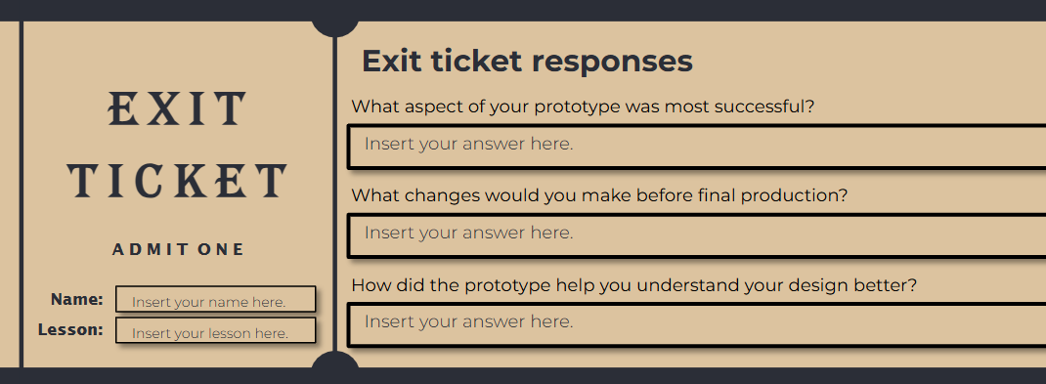
Exit ticket (5)

Slide 50
Week 6 lesson 4 – Do now
Review the final prototype or annotated sketches completed in the previous lesson.
What key dimensions and features need to be included in your technical drawings?

Slide 51
Learning intentions (14)
Success criteria
We will:
Use technical drawing techniques to represent design ideas accurately (by hand or using CAD software).
I can:
Create orthogonal drawings of my final design that are to scale (AS1100) and dimensioned.
Produce an accurate isometric drawing of my design.
Render my isometric drawing with appropriate colour and shading for presentation.

Slide 52
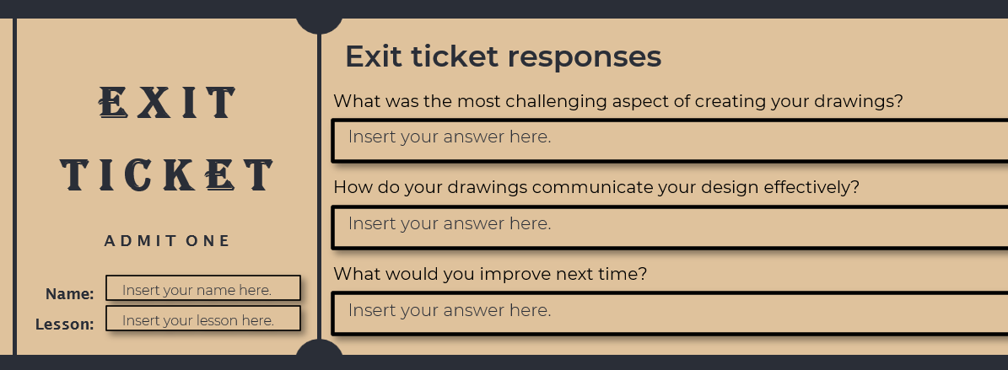
Exit ticket (6)

Slide 53
Week 6 lesson 5 – Do now
You will be using the next 7 lessons to produce your final jewellery practical.
Put your PPE on and quietly stand behind your workstation.
THINK about what materials and tools will you need to start your project today?

Slide 54
Learning intentions (15)
Success criteria
We will:
Use workshop tools and materials to begin producing our jewellery item safely and effectively.
I can:
Select and prepare the appropriate tools, materials, and processes for my project.
Use tools and materials safely and correctly to produce my jewellery item.
Follow my production plan to complete the initial stages of my project.

Slide 55
Reflection (1)
What went well during today’s production?
What challenges did you face, and how did you overcome them?
Share one success and one challenge from the lesson during the reflection session.

Slide 56
Weeks 7-8

Slide 57
Weeks 7-8 (5 lessons practical) – Do now
Put your PPE on and quietly stand behind your workstation.
What is your key focus for this session?
What tools or equipment will you need to prepare?

Slide 58
Learning intentions (16)
Success criteria
We will:
Safely operate tools and apply advanced techniques to produce and enhance the jewellery piece.
I can:
Use advanced techniques and tools effectively and safely to create components of my project.
Follow my production plan and adjust it as needed to achieve a high-quality outcome.
Work efficiently, maintaining a clean and safe workspace.

Slide 59
Reflection (2)
What went well during today’s production?
What challenges did you face, and how did you overcome them?
Share one success and one challenge from the lesson during the reflection session.

Slide 60
Weeks 9-10

Slide 61
Week 9 lesson 1 – Do now
Review your current project and reflect on the production process.
What is the most significant challenge you faced during production?
How did your final product meet the success criteria?
Have you considered the sustainability aspects of your design and production choices?

Slide 62
Learning intentions (17)
Success criteria
We will:
Evaluate the success of our jewellery pieces using a set of criteria.
Reflect on the sustainability and efficiency of our design and production process.
Document and analyse each step of the production process for future reference.
I can:
Use a set of criteria to evaluate the quality and success of my jewellery piece.
Reflect on the design and production process, identifying areas for improvement.
Justify my tool, material, and process choices with consideration of sustainability and efficiency.
Document each step of my process in detail in my portfolio.

Slide 63
Reflection (3)
Based on your evaluation today, what are the next steps you need to take to finalise your project?
What did you learn about the sustainability and efficiency of your process?

Slide 64
Week 9 lesson 2 – Do now
Review your jewellery project and reflect on the work done so far.
What step do you think will be the most challenging during the final assembly and finishing of your piece?
Are there any areas of the design or production process where you need to adjust your approach?

Slide 65
Learning intentions (18)
Success criteria
We will:
Complete the final assembly and apply finishing touches to our jewellery projects, ensuring they meet design specifications and quality standards.
I can:
Safely use tools, materials, and processes during the final assembly and finishing stages of my project.
Ensure my jewellery piece meets the design specifications and quality standards.
Apply finishing techniques such as polishing, soldering, and securing components.
Maintain a safe working environment while completing the final touches.

Slide 66



Exit ticket
A positive success or highlight
What steps will you take in future projects to ensure a smoother final assembly process?
What part of the final assembly and finishing process did you find most challenging, and how did you overcome it?

Slide 67
Week 9 lesson 3 – Do now
Review your portfolio progress so far.
What component of your portfolio still needs the most attention?
Write your response on a post it note and stick on your laptop.

Slide 68
Learning intentions (19)
Success criteria
We will:
Finalise our digital portfolios, ensuring all required elements are completed and well-organised with effective communication techniques.
We can:
Use Google Sites or the MS Word template to complete a well-organised and visually engaging portfolio.
Ensure all classwork, design documentation, and feedback are included.
Evaluate and refine our portfolios based on peer and self-assessment.

Slide 69


Two stars and a wish
Task:
Presenter:
Feedback given by:
Notes:
https://docs.google.com/presentation/d/1D8EvY1V2HeuWg3-dK2raranN_mskczfb5qXB1dnp7cY/edit?usp=sharing

Slide 70
Reflection (4)
What is one specific improvement you made to your portfolio today, and why?

Slide 71
Week 10 lesson 4 – Do now
Reflect on your jewellery project.
What part of your design might need adjustments or final modifications?
What quality standards will you check during this session?

Slide 72
Learning intentions (20)
Success criteria
We will:
Work to identify and resolve issues in the final stages of our jewellery project.
Ensure our project meets quality standards by conducting troubleshooting and quality control.
I can:
Test and modify my project as needed.
Safely use tools and techniques to troubleshoot and make adjustments.
Ensure the final product meets the design specifications and quality standards.
Demonstrate safe practices throughout the troubleshooting process.

Slide 73
Reflection (5)
What was the most significant challenge you encountered during the troubleshooting process, and how did you resolve it?
What changes would you make to your approach in future projects?

Slide 74
Week 10 lesson 5 – Do now
What was the most challenging part of creating your jewellery piece?
What are you most proud of in your final product?

Slide 75
Learning intentions (21)
Success criteria
We are:
Evaluating the success of our final jewellery design and our production processes against the initial design brief and criteria for success
Identifying strengths, weaknesses and areas for improvement
I can:
critically evaluate my jewellery product by comparing it to the design brief and criteria to evaluate success
identify specific evidence to justify my evaluation of function, aesthetics, sustainability, and other aspects
write a well-structured self-evaluation (300 words)

Slide 76
Self-evaluation
Students complete their 300-word self-evaluation, focusing on:
The design problem and their solution.
How well their final product met the criteria for success (for example, function, aesthetics, quality, sustainability).
Improvements for the future (for example, material selection, production process, time management).

Slide 77
References
This presentation contains NSW Curriculum and syllabus content. The NSW Curriculum is developed by the NSW Education Standards Authority. This content is prepared by NESA for and on behalf of the Crown in the right of the State of New South Wales. The material is protected by Crown copyright.
Please refer to the NESA Copyright Disclaimer for more information https://educationstandards.nsw.edu.au/wps/portal/nesa/mini-footer/copyright.
NESA holds the only official and up-to-date versions of the NSW Curriculum and syllabus documents. Please visit the NSW Education Standards Authority (NESA) website https://educationstandards.nsw.edu.au/wps/portal/nesa/home and the NSW Curriculum website https://curriculum.nsw.edu.au.
Technology 7-8 © Syllabus NSW Education Standards Authority (NESA) for and on behalf of the Crown in right of the State of New South Wales, 2023.

Slide 78
Copyright
© State of New South Wales (Department of Education), 2025
The copyright material published in this resource is subject to the Copyright Act 1968 (Cth) and is owned by the NSW Department of Education or, where indicated, by a party other than the NSW Department of Education (third-party material).
Copyright material available in this resource and owned by the NSW Department of Education is licensed under a Creative Commons Attribution 4.0 International (CC BY 4.0) licence.
This licence allows you to share and adapt the material for any purpose, even commercially.
Attribution should be given to © State of New South Wales (Department of Education), 2025.
Material in this resource not available under a Creative Commons licence:
the NSW Department of Education logo, other logos and trademark-protected material
Material owned by a third party that has been reproduced with permission. You will need to obtain permission from the third party to reuse its material.
Links to third-party material and websites
Please note that the provided (reading/viewing material/list/links/texts) are a suggestion only and implies no endorsement, by the New South Wales Department of Education, of any author, publisher, or book title. School principals and teachers are best placed to assess the suitability of resources that would complement the curriculum and reflect the needs and interests of their students.
If you use the links provided in this document to access a third party’s website, you acknowledge that the terms of use, including licence terms set out on the third-party’s website apply to the use which may be made of the materials on that third-party website or where permitted by the Copyright Act 1968 (Cth). The department accepts no responsibility for content on third-party websites.

