Slide 1
Instructions for use
This resource is not a teaching and learning program. It should be used in conjunction with Technology 7-8 – Metal - morphosis – sample program of learning
Classroom teachers are encouraged to add and adapt slides as required to meet the needs of their students
Save a copy of the file to make changes to the slide deck – go to File > Download a Copy (this downloads a copy to the computer to edit in the PowerPoint app).
To convert the PowerPoint to Google Slides:
  Upload the file into Google Drive and open it.
  Go to File > Save as Google Slides.

Slide 2

Metal-morphosis
Stage 4
Technology 7-8
Materials and production processes focus area

Slide 3
Learning intention and success criteria
We are learning to:
understand the properties and everyday applications of metal
apply safe production techniques for materials and production processes.
We can:
explain where metals come from and how they are processed
identify key tools and equipment used in metalwork
understand and apply safety procedures in the metal workshop
safely and accurately use metalworking processes to produce components and solutions
test, collaboratively evaluate and apply rectification measures.
Notes:
Notes for teachers:
Learning intentions and success are best co-constructed with students. Adapt the learning intention as required and add co-constructed success criteria.

Slide 4
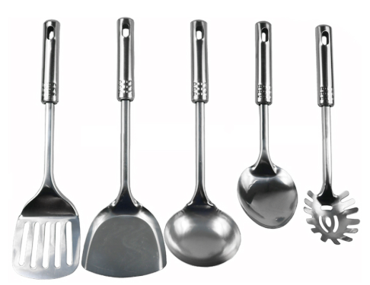
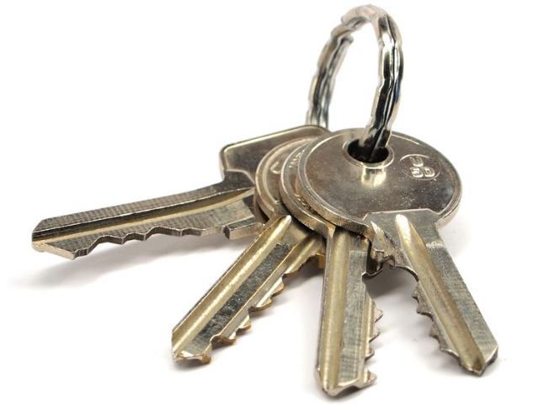
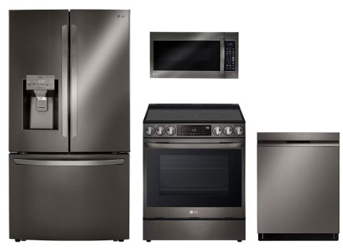
What ‘metal’ you know?
Materials and production processes
Think of 10 things you used in the past 24 hours that were made from metal. They could be small to very large items. ?
What I have used that is made from metal …

Slide 5
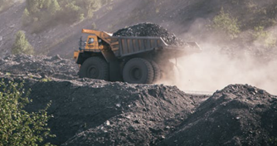
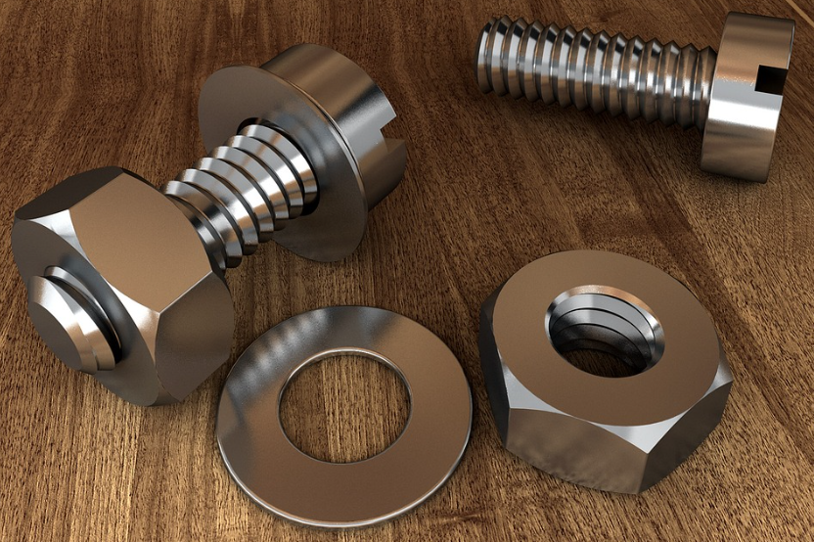
Where in the earth do metals come from?
Describe the difference between raw metal and finished metal

Slide 6
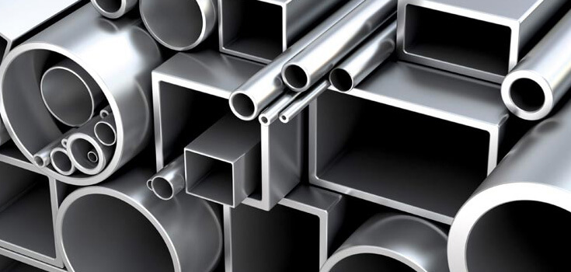
Where in the earth do metals come from?
Metals are strong, solid materials that are all around us - in buildings, tools, cars, electronics and more. But metals don’t start out as shiny sheets or bolts. Most metals come from rocks called ores that are mined from the Earth.
These ores are crushed, melted and purified to remove other materials. This process creates pure metal or metal alloys, which are then shaped into useful forms like rods, sheets, or bars. These can be cut, drilled, bent or joined to create everyday products.
Describe the difference between raw metal ore and finished metal.
Raw metal ore is rock taken from the Earth that contains metal mixed with other materials. Finished metal has been melted, cleaned, and shaped so it can be used to make tools, parts or products.

Slide 7
Types of metals
Metal | Physical properties | Common uses
Mild Steel
Stainless steel
Aluminium
Metals are usually solid materials that are used in everyday products because of their strength, durability and ability to be shaped. Some metals occur in pure form, while others are alloys - made by combining two or more metals to improve their properties.
In this activity, you’ll explore a variety of common metals and alloys, compare their features, and understand where and why they are used in the real world.
Bonus Question: Name a metal that exists as a liquid at room temperature

Slide 8
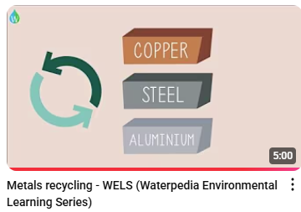
Metal Sustainability
Watch Metals Recycling
Outline the steps involved in the recycling steel or aluminium
1
2
4
3

Slide 9
Sheet metal
Let's explore the properties, types, finishes and uses of sheet metal, and understand how it can be protected against corrosion
Sheet Metal Type | Description
1. Aluminium | a. Strong, rust-resistant steel coated in zinc
2. Galvanised Steel | b. Soft, lightweight metal often used in roofing and signs
3. Stainless Steel | c. Contains chromium, resistant to rust and has a shiny finish
4. Copper | d. Reddish-brown metal, good conductor, often used in wiring
Match the sheet metal type with its correct description
1. Aluminium _______
2. Galvanised Steel _______
3. Stainless Steel _______
4. Copper _______

Slide 10
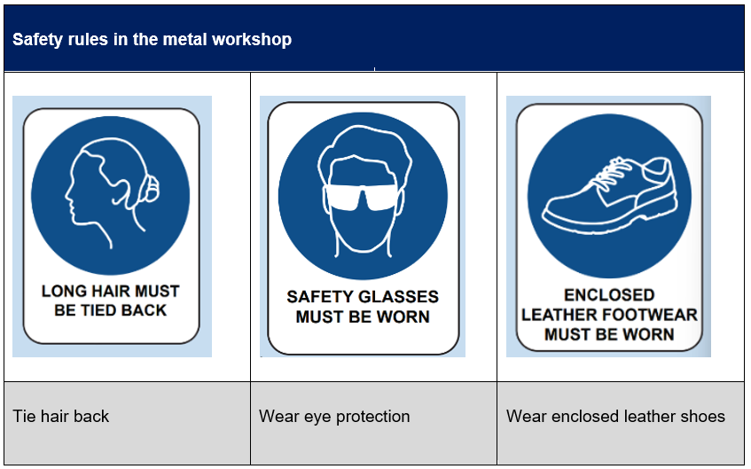

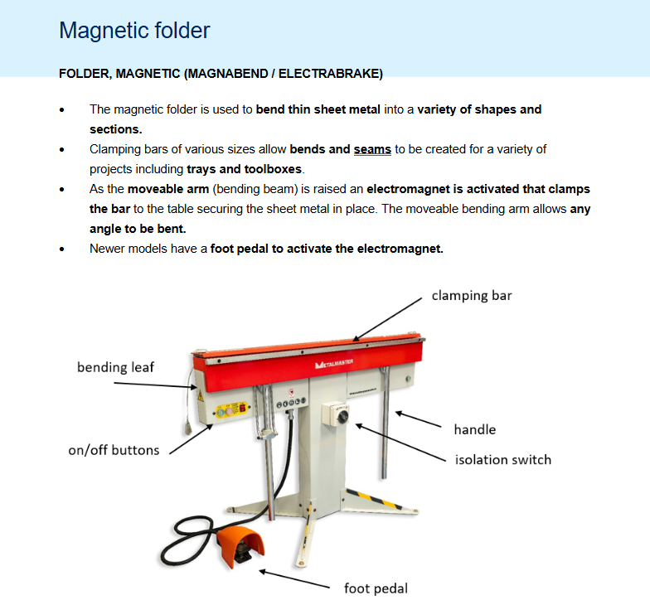
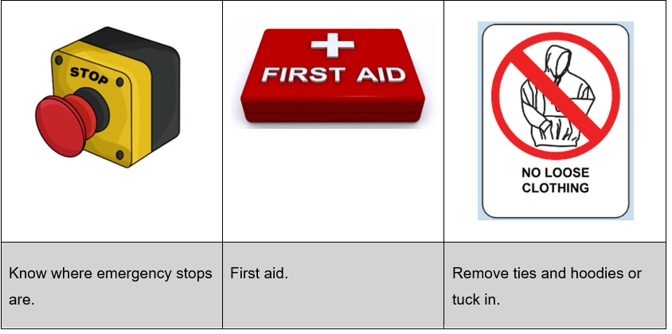
Safety
Safety rules and hazards in the metal workshop
Complete safety tests as directed.

Slide 11
Safety
Safety rules in the metal workshop
List 5 safety rules that are to be followed in the Metal workshop
____________________________________
____________________________________
____________________________________
____________________________________
____________________________________

Slide 12
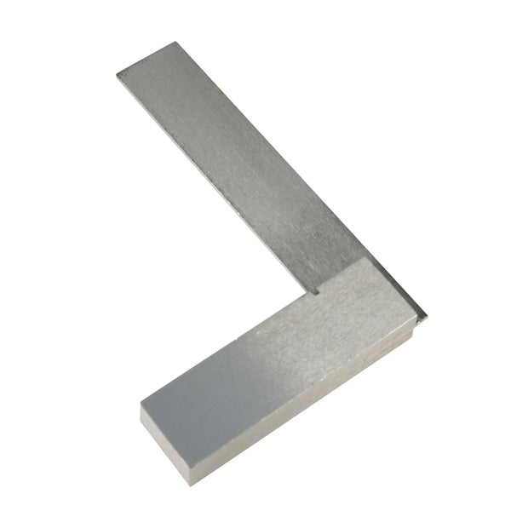
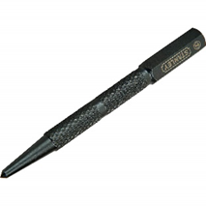
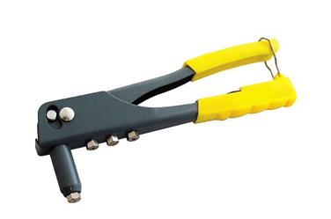
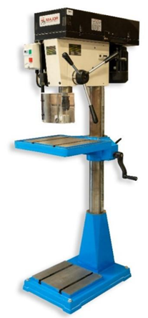
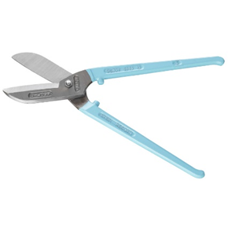
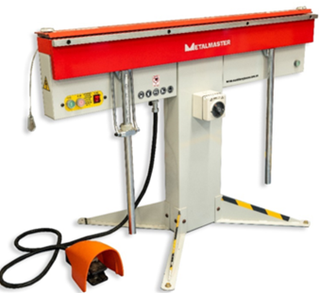
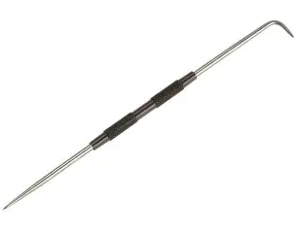
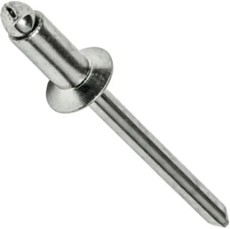
Materials, tools and techniques
Tools and machine identification

Slide 13
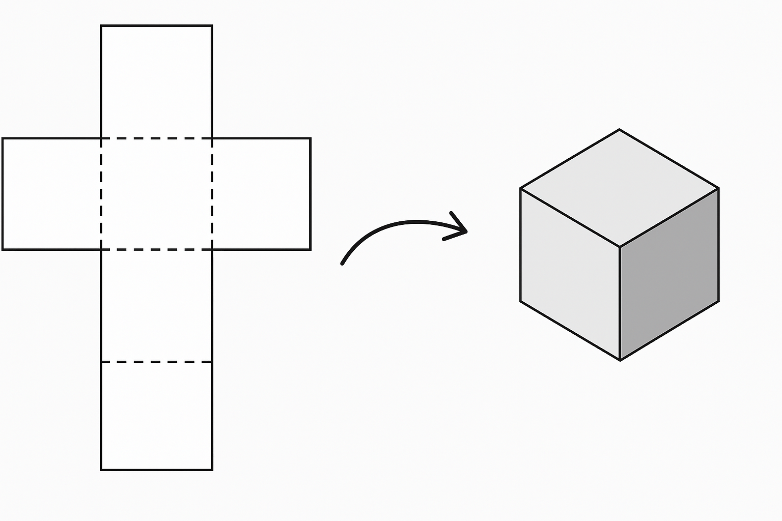
Folding sheet metal into a 3D object
Creating a cube
To Consider
The dashed lines represent _____?
What happens if a square is missing?
Why do we need flaps (tabs)?
Where might this apply in real-world manufacturing?

Slide 14
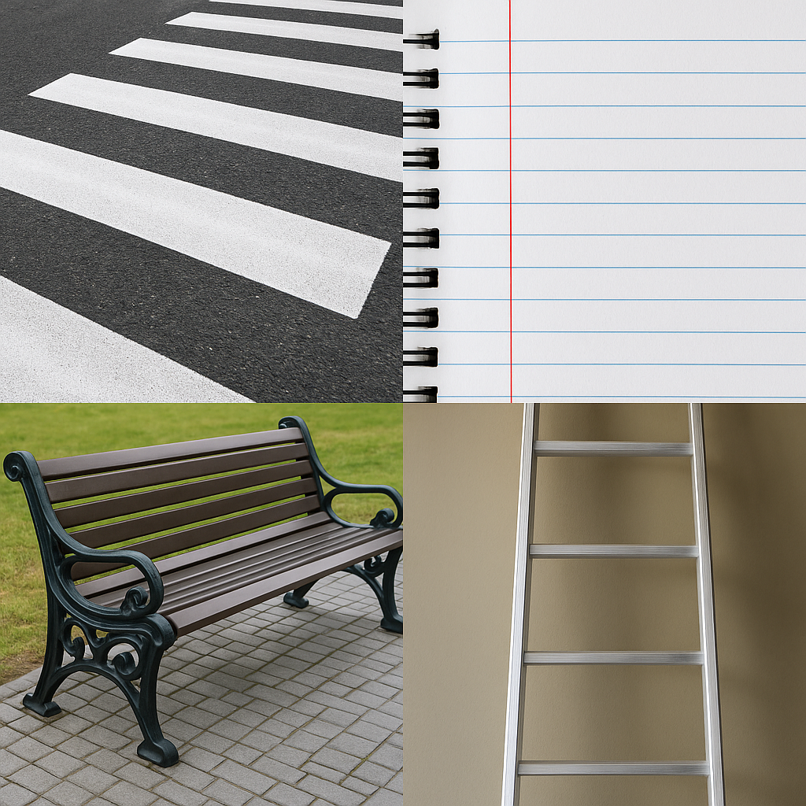
Parallel
Examples of parallel
Train tracks | the two rails stay the same distance apart all the way.
Rungs on a ladder | each rung is parallel to the others.
what does it mean?
Think pair share
In pairs students consider how to explain the concept of parallel lines to the class group.

Slide 15
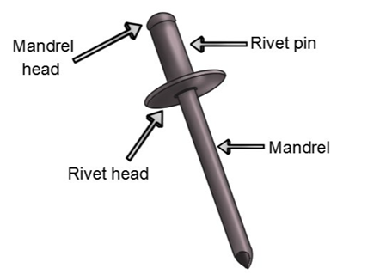
Joining metal
The pop rivet
Metal parts need strong, secure joining methods to stay connected and handle pressure or movement. In metalwork, we use fasteners and joining techniques to make sure metal parts stay fixed and perform their function safely.
Used to permanently join sheet metal. Inserted into a drilled hole and fastened with a rivet gun.
Mechanical fasteners | Fusion joining processes

Slide 16

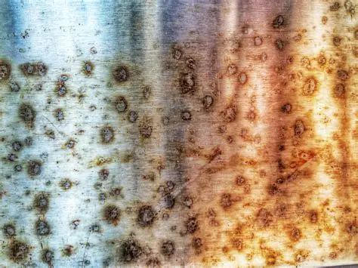
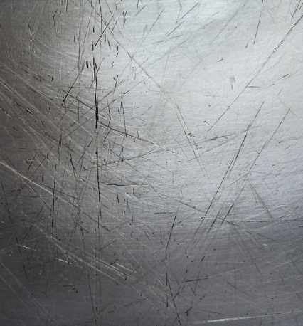
Surface finishes
Finishing metal is important to protect it from rust, wear and damage. A good finish also makes the metal look more appealing and improves its durability, especially if the item will be handled often or used outdoors
Finishes can protect metal from
Corrosion (like rusting)
Scratches and wear
Heat or moisture damage
Discolouration and dullness

Slide 17
Types of Metal Finishes
Type of finish | Description | Common Uses
Paint | A liquid colour finish applied to clean metal; helps protect against rust. | School projects, machinery, furniture
Powder Coating | Dry powder sprayed and baked onto the metal, forming a hard, protective layer. | Outdoor furniture, bike frames, appliances
Polishing | Smoothing the metal with abrasives until it reflects light; no coating added. | Decorative items, trophies, display pieces
Galvanising | Coating steel with a layer of zinc to prevent rusting. | Gutters, poles, fences
Bluing | A controlled rust process that gives steel a dark blue/black finish. | Tools, firearm parts, steel artwork
Clear Coat (Lacquer) | A transparent protective layer to enhance shine and resist oxidation. | Aluminium signs, jewellery, artistic pieces

Slide 18

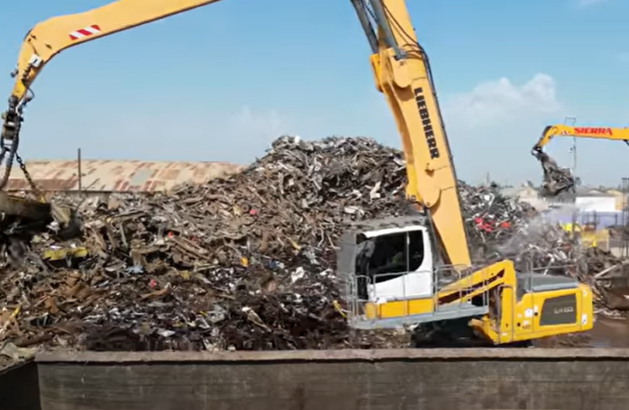
Ethical use of metal
Repurposed – Season 1 (Ep 1): "It Takes Grit"

Slide 19
Renewable and non-renewable resources
Write a description of what is meant by the following terms
Term | Description
Resource
Natural resource
Renewable natural resource
Non-renewable resource
Resource management
Mining
Recycling

Slide 20
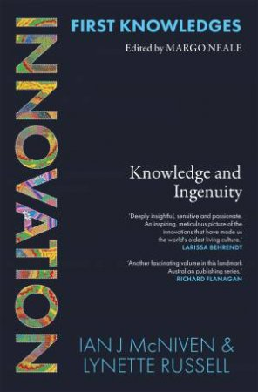
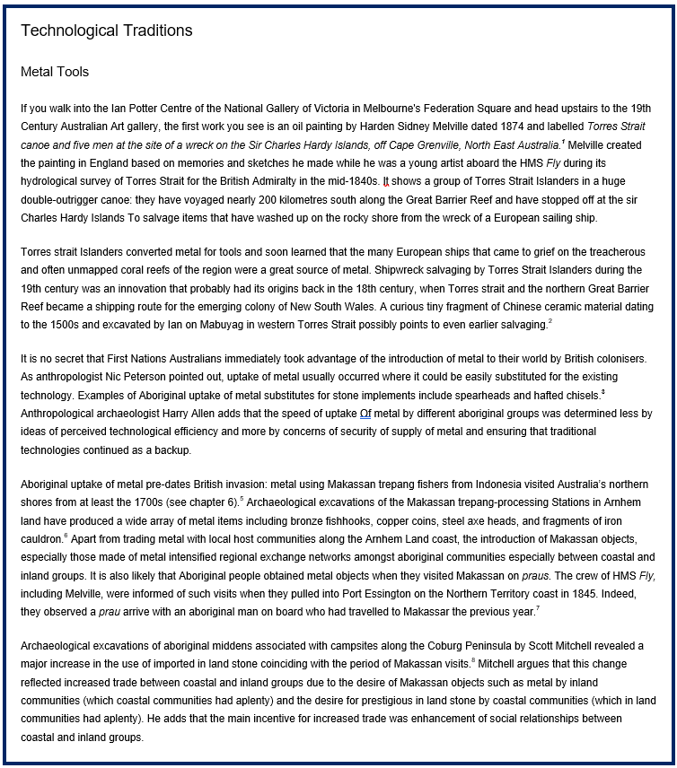
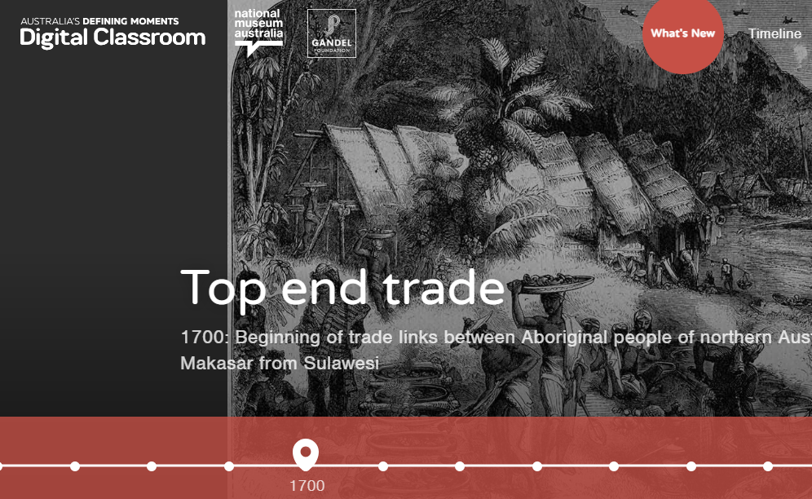
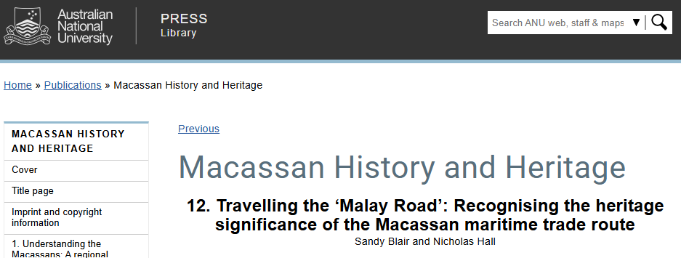
Metal Meets Innovation:
Indigenous Trade Before European Contact
Aboriginal and Torres Strait Islander Peoples were trading and using metal tools with visitors from Indonesia long before Europeans arrived — today we’ll explore how they used these tools, how they spread through trade, and whether they brought more benefits or challenges.

Slide 21
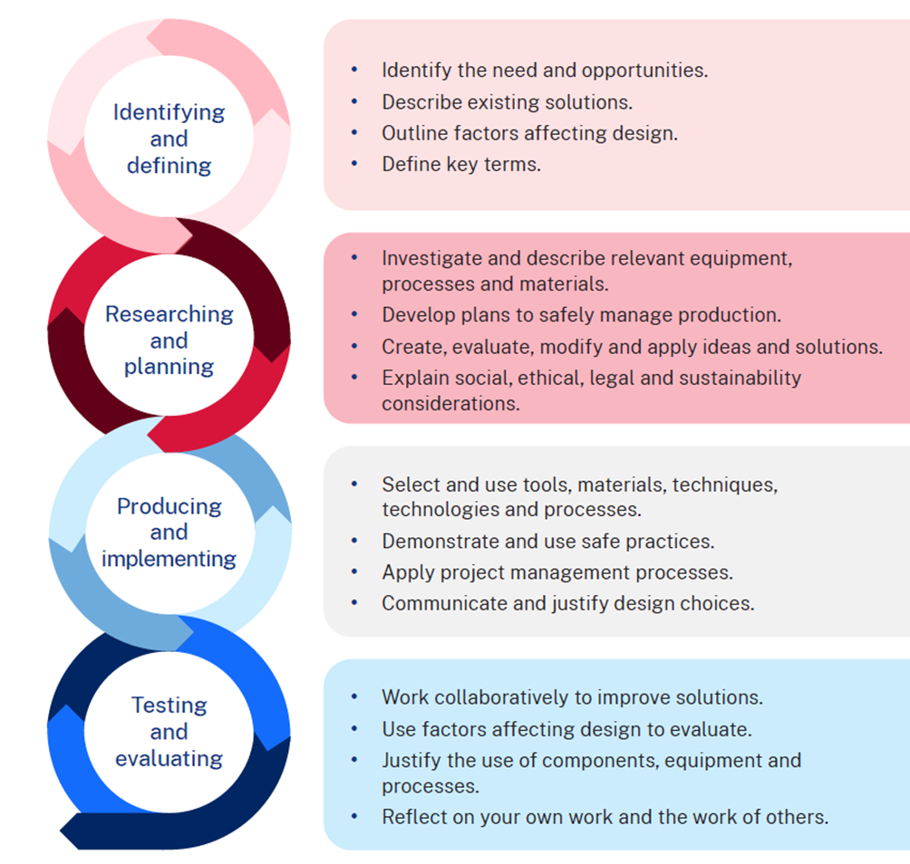
The design and production process
There are 4 main steps in the process that help to create a quality solution to design challenges or problems. Evaluation happens at each step and is constant throughout the process.

Slide 22
Factors affecting design
Safety
Durability
Ethics
When designing and making a small multifunctional metal tray, a variety of factors influence the overall success of the final product. These considerations help ensure that the tray is practical, safe, and appealing for its intended use
Design
Ergonomics
Aesthetics
Accessibility

Slide 23
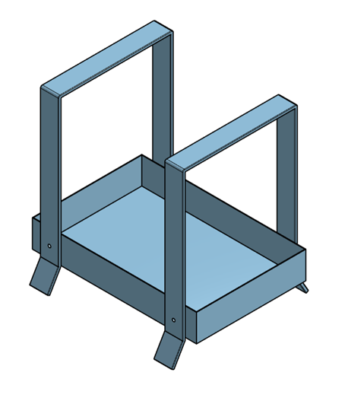
Alternative designs
What is the intended Purpose
Your challenge is to take the base metal tray project and imagine three different, practical purposes it could be adapted for. Each purpose should involve the addition of at least one unique feature that transforms the tray to suit that purpose.
Base project design

Slide 24

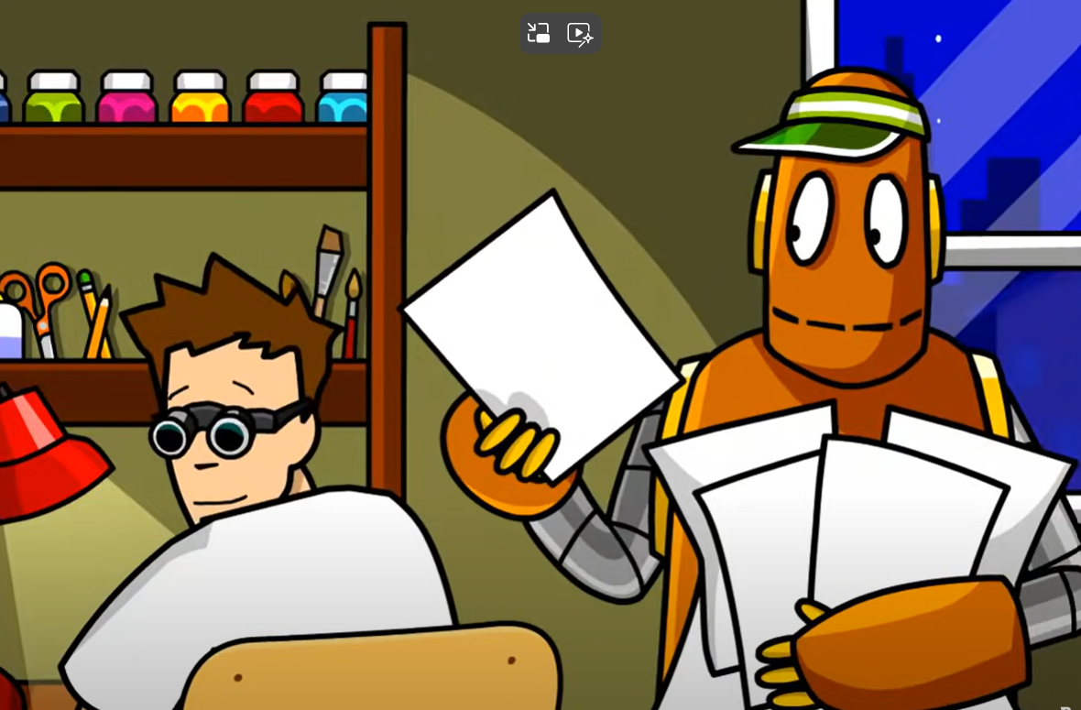
Ethical & Legal Considerations in design and production
Introduction to ethics and legal considerations
Watch the following video: ETHICS
“What is the difference between ethical and legal?”

Slide 25

How could ethics and legal considerations apply to my project?
One ethical consideration in my project:
One legal consideration in my project:

Slide 26

Understanding Intellectual Property (IP)
What is Intellectual Property?
IP Type | What it protects | Example
Copyright | Artistic works, drawings, written material, software | A jewellery maker’s original design sketches
Design Rights | The visual appearance of a product (shape, pattern, configuration) | The unique shape of a Coca-Cola bottle
Patents | How an invention works (new products, processes, methods) | Dyson’s cyclone vacuum technology
Trademarks | Words, symbols, logos that identify a brand | Nike “Swoosh” logo
Example answer:
Intellectual Property (IP) refers to creations of the mind — such as inventions, designs, artistic works, symbols, names, and images — that are protected by law.

Slide 27

How can I protect my ideas/ work?
Automatic Protection – Some IP rights (like copyright in Australia) are automatic as soon as the work is created and recorded.
Registration – Other IP rights (like patents, design registration, trademarks) require you to apply and be granted protection by IP Australia or another official body.
Duration – Different types of IP last for different time periods (e.g., copyright usually lasts for the life of the creator plus 70 years in Australia).
Enforcement – IP owners can take legal action if someone uses their protected work without permission.

Slide 28
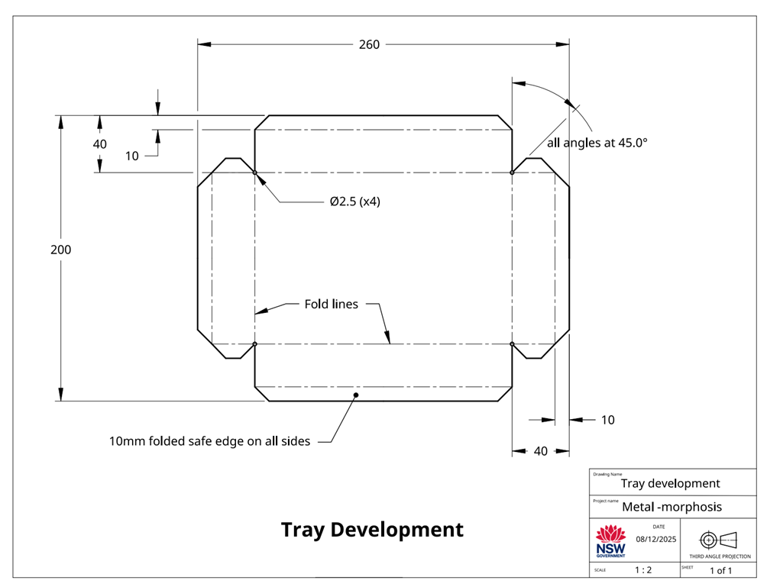
Project management – Base project
Tray development
What information is presented in this working drawing?

Slide 29
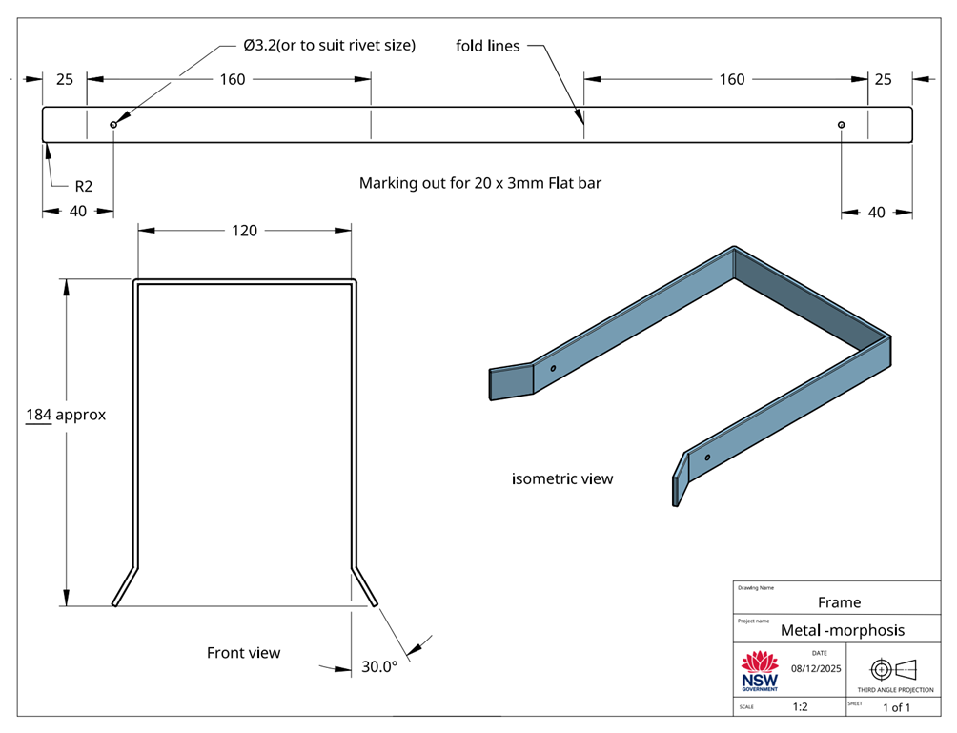
Project management – Base project
Metal frame

Slide 30

Project management – Base project
Assembled base project
Your challenge is to take the base project and imagine three different, practical purposes it could be adapted for.
Each purpose should involve the addition of at least one unique feature that transforms the tray to suit that purpose.

Slide 31
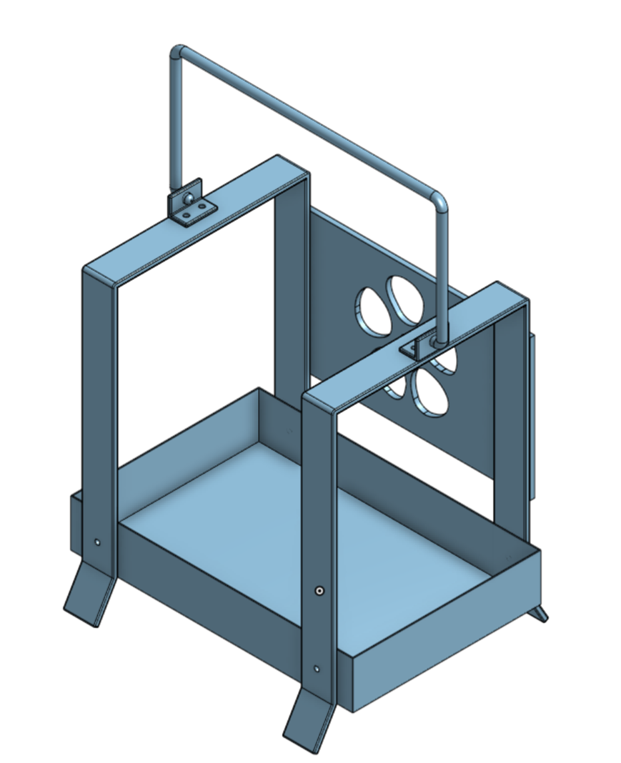
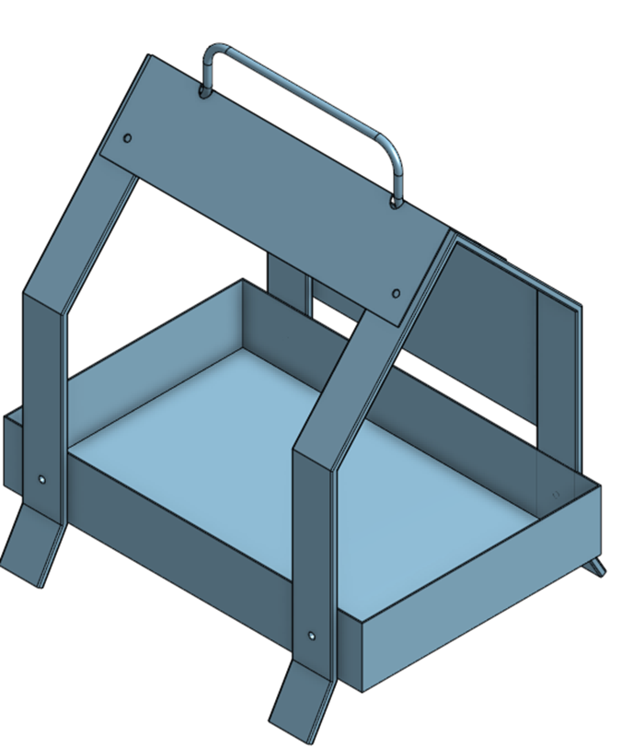
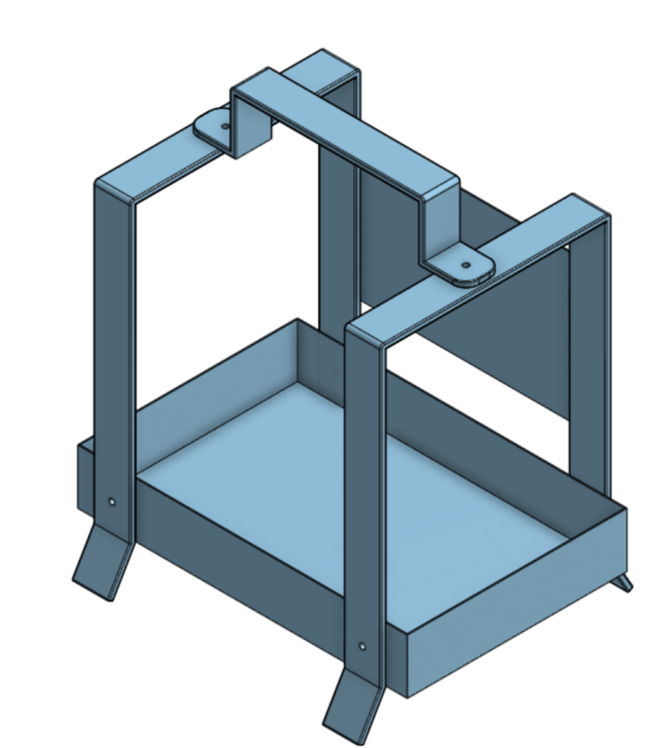
Potential Designs

Slide 32
Parts list
The parts list is presented as a table and describes the:
type of material to be used
dimensions of the material
number of parts
name of each part
other information relevant to the manufacture of the project.
Complete the table for your project adding the additional parts of your design.
No. | Description | Qty | L mm | W mm | T mm | Material
1 | Tray | 1 | 260 | 200 | 0.55 | 0.55mm gal sheet
2 | Frame | 2 | 590 | 20 | 3 | Mild steel flat bar
3
4
5
6

Slide 33
Time management
Time available
Time management is the planning we do to make sure our project is completed in the time we have available. When we are planning the time management for this project, we need to look at the time we have available and the tasks we need to do to complete the project.
Question | Answer
How many weeks do we have available to make the multi-functional tray?
How many practical lessons do we have in a week?
How many practical lessons do we have to complete the project?

Slide 34
Time management
Step | Task | Estimated time (in lessons)
1 | Mark out and cut base tray
2 | Deburr and file all cut edges
3 | Bend tray base and sides into shape
4 | Mark out and drill holes for rivets
5 | Pop rivet or sport weld tray sides to base
6 | Mark out and cut frame brackets or supports
7 | Bend both frames
8 | Rivet and attach frame brackets to tray
Construction steps – Base project
In the table provided, sort the following construction steps into the correct order then estimate how much time should be allocated to each task.

Slide 35
Time management
Step | Task | Estimated time (in lessons)
1 | Mark out and cut base tray
2 | Deburr and file all cut edges
3 | Bend tray base and sides into shape
4 | Mark out and drill holes for rivets
5 | Pop rivet or sport weld tray sides to base
6 | Mark out and cut frame brackets or supports
7 | Bend both frames
8 | Rivet and attach frame brackets to tray
Construction steps – Base project
In the table provided, sort the following construction steps into the correct order then estimate how much time should be allocated to each task.
Completed version

Slide 36
Time management
Construction steps – Design additions
Step | Task | Estimated time (in lessons)
8 | Mark out and cut handle to length
9 | Bend handle to shape
10 | Attach handle to frame pieces
11 | Mark out and cut sheet metal back panel. Clean and prepare all surfaces for finishing
12 | Mark out and drill holes in back panel to suit
13 | Fasten back panel to frame using pop rivets
14 | Clean and prepare all surfaces for finishing (filing and sanding)
15 | Apply protective finish
We need to consider the proposed design’s additional features.
Note: example provided for reference only

Slide 37

Evaluation
Think like a designer:
Step back and ask yourself:
Does my project meet its purpose?
Also consider:
How could it be improved?
What did you enjoy?
What skills did you develop?

Slide 38
References
This presentation contains NSW Curriculum and syllabus content. The NSW Curriculum is developed by the NSW Education Standards Authority. This content is prepared by NESA for and on behalf of the Crown in the right of the State of New South Wales. The material is protected by Crown copyright.
Please refer to the NESA Copyright Disclaimer for more information https://educationstandards.nsw.edu.au/wps/portal/nesa/mini-footer/copyright.
NESA holds the only official and up-to-date versions of the NSW Curriculum and syllabus documents. Please visit the NSW Education Standards Authority (NESA) website https://educationstandards.nsw.edu.au/wps/portal/nesa/home and the NSW Curriculum website https://curriculum.nsw.edu.au.
Technology 7-8 syllabus © NSW Education Standards Authority (NESA) for and on behalf of the Crown in right of the State of New South Wales, 2023.

Slide 39
References
This presentation contains NSW Curriculum and syllabus content. The NSW Curriculum is developed by the NSW Education Standards Authority. This content is prepared by NESA for and on behalf of the Crown in the right of the State of New South Wales. The material is protected by Crown copyright.
Please refer to the NESA Copyright Disclaimer for more information https://educationstandards.nsw.edu.au/wps/portal/nesa/mini-footer/copyright.
NESA holds the only official and up-to-date versions of the NSW Curriculum and syllabus documents. Please visit the NSW Education Standards Authority (NESA) website https://educationstandards.nsw.edu.au/wps/portal/nesa/home and the NSW Curriculum website https://curriculum.nsw.edu.au.

Slide 40
Copyright
© State of New South Wales (Department of Education), 2025
The copyright material published in this resource is subject to the Copyright Act 1968 (Cth) and is owned by the NSW Department of Education or, where indicated, by a party other than the NSW Department of Education (third-party material).
Copyright material available in this resource and owned by the NSW Department of Education is licensed under a Creative Commons Attribution 4.0 International (CC BY 4.0) licence.
This licence allows you to share and adapt the material for any purpose, even commercially.
Attribution should be given to © State of New South Wales (Department of Education), 2024.
Material in this resource not available under a Creative Commons licence:
the NSW Department of Education logo, other logos and trademark-protected material
Material owned by a third party that has been reproduced with permission. You will need to obtain permission from the third party to reuse its material.
Links to third-party material and websites
Please note that the provided (reading/viewing material/list/links/texts) are a suggestion only and implies no endorsement, by the New South Wales Department of Education, of any author, publisher, or book title. School principals and teachers are best placed to assess the suitability of resources that would complement the curriculum and reflect the needs and interests of their students.
If you use the links provided in this document to access a third party’s website, you acknowledge that the terms of use, including licence terms set out on the third-party’s website apply to the use which may be made of the materials on that third-party website or where permitted by the Copyright Act 1968 (Cth). The department accepts no responsibility for content on third-party websites.

