Slide 1
Instructions for use
This resource is not a teaching and learning program. It should be used in conjunction with Technology7-8-materials-timber-10-weeks-program.docx
Classroom teachers are encouraged to add and adapt slides as required to meet the needs of their students.
Save a copy of the file to make changes to the slide deck. Go to File > Download a Copy (this downloads a copy to the computer to edit in the PowerPoint app).
To convert the PowerPoint to Google Slides:
  Upload the file into Google Drive and open it.
  Go to File > Save as Google Slides.
  (Note – conversion may cause formatting changes in the slides.)

Slide 2
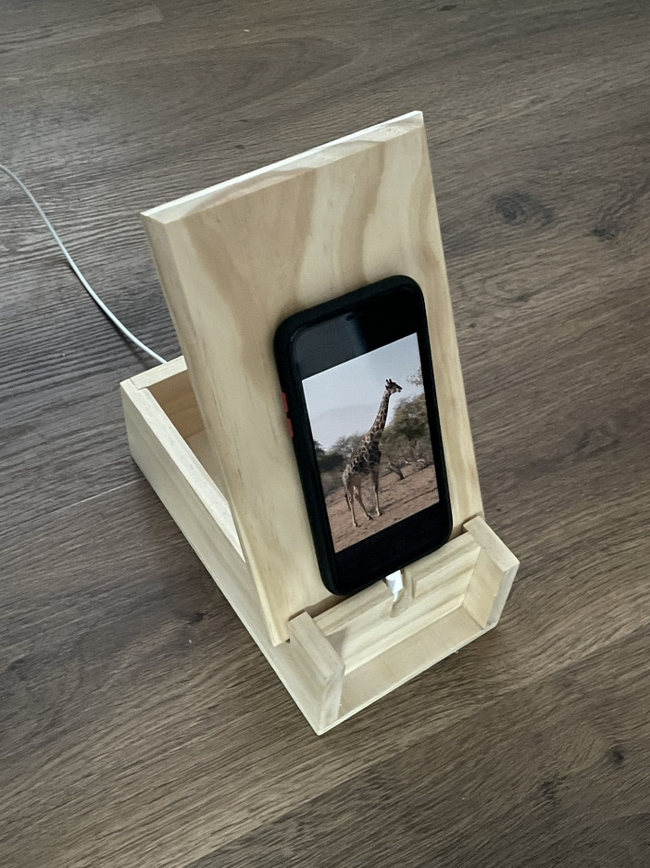
Boxing Clever
Technology – Stage 4/Years 7–8
Materials and production processes – timber

Slide 3
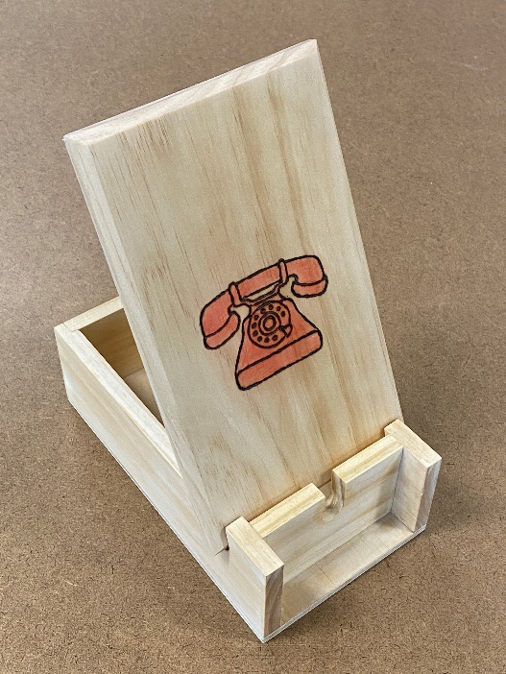
Phone stand project
Design brief
The mobile phone has become an essential in our lives to communicate, research, entertain and record and share our lives. You will:
design a phone stand to sit on a desk or table, so that your mobile phone can be easily viewed while it is being charged.
have an opportunity to personalise your project with graphics to reflect your abilities and interests.

Slide 4
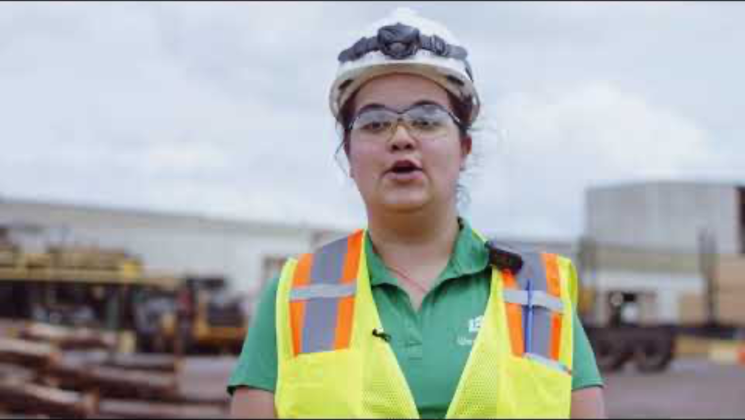
Difference between wood and timber
Wood is still in the form of a tree or branches and logs. It becomes timber after it has been converted to useable lengths and shapes, and after it has been seasoned. Seasoning is the process of removing much of the moisture from timber.
Watch From Trees to Lumber: Watch how boards are made from pine trees (8:12)

Slide 5
Learning intentions and success criteria one
We are:
learning to understand and apply safe processes and practices in the workshop.
We can:
follow safe processes and practices when learning in the workshop
identify PPE required to use workshop equipment.
Notes:
Notes for teachers:
Learning intentions and success criteria are best co-constructed with students. Adapt the learning intention as required and add matching success criteria.
For more information See ⁠AITSL or the NSW Department of Education explicit teaching strategies, ⁠Sharing learning intentions and ⁠Sharing success criteria
LISC is not necessarily presented at the beginning of the lesson. Teacher needs to consider most effectual time to introduce
LISC should be revisited during the lesson to support students' evaluation of their learning

Slide 6
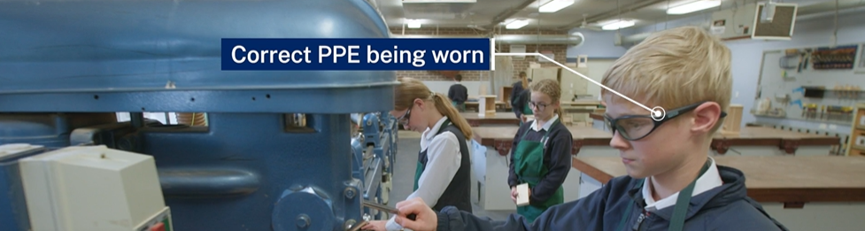

Workshop safety
Timber Technology - Workshop Walkthrough.mp4
Notes:
Watch workshop walk through.
Teacher note: the TAS Safety resources (sharepoint.com) are created for Department of Education schools, using relevant information from Equipment safety in schools (ESIS). These resources have been developed specifically for the equipment and machinery that has been approved for use in department schools.
Safety tests are mandated by ESIS for selected equipment and machinery.
The tests may be attempted in electronic or other formats with the result recorded and retained as per the Department's records management policy.
Students must provide the correct answer (with or without support) to each question on the safety test as evidence that they knew correct procedures at that point in time for the tool, equipment or machine. Students may attempt each test multiple times to achieve correct answers.

Slide 7
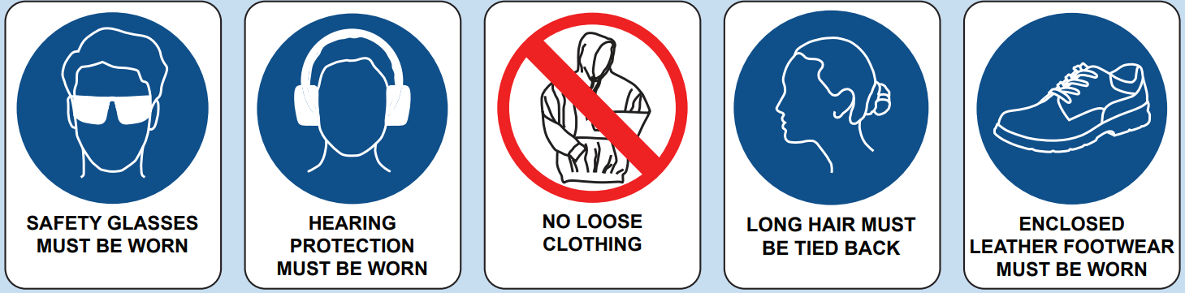
Safety signage

Slide 8
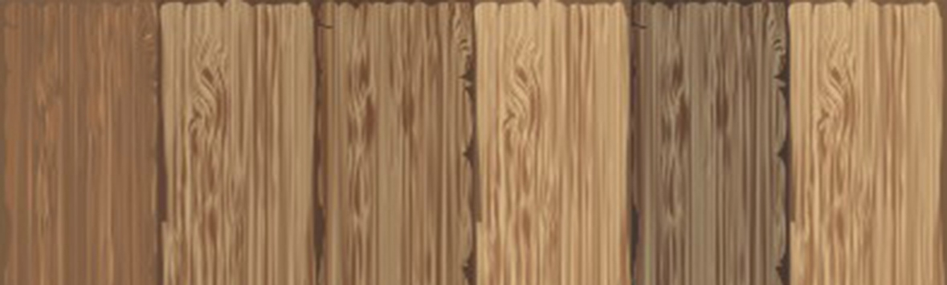
Class expectations
Co-construct class expectations for safe lessons in technology 7-8 – timber

Slide 9
Class procedures
Co-construct procedures for safe lessons in technology 7-8 – timber

Slide 10
Learning intentions and success criteria 2
We are:
developing an understanding of why everyday objects are made the way they are
We can:
identify the steps in the design and production process
identify design features that contribute to a successful product.
Notes:
Notes for teachers:
Learning intentions and success criteria are best co-constructed with students. Adapt the learning intention as required and add matching success criteria.
For more information See ⁠AITSL or the NSW Department of Education explicit teaching strategies, ⁠Sharing learning intentions and ⁠Sharing success criteria
LISC is not necessarily presented at the beginning of the lesson. Teacher needs to consider most effectual time to introduce
LISC should be revisited during the lesson to support students' evaluation of their learning

Slide 11
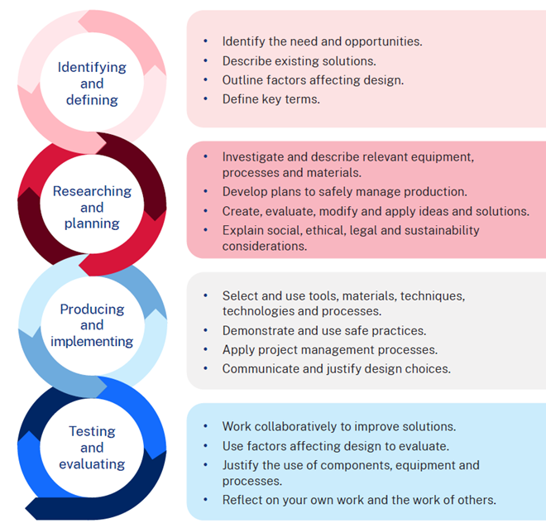
The design and production process
There are four main steps in the process that help to create a quality solution to design challenges or problems.
Evaluation happens at each step and is constant throughout the process.

Slide 12

Factors affecting design
There are many factors that affect design. These must be considered when creating a product, system, or solution to ensure the success of a project. By carefully considering these factors during the design process, designers, producers and manufacturers can create more effective and efficient solutions. Factors affecting the success and quality of designs include:
accessibility,
aesthetics,
durability,
ergonomics,
ethics,
functionality,
safety.
Briefly describe each factor affecting design.

Slide 13
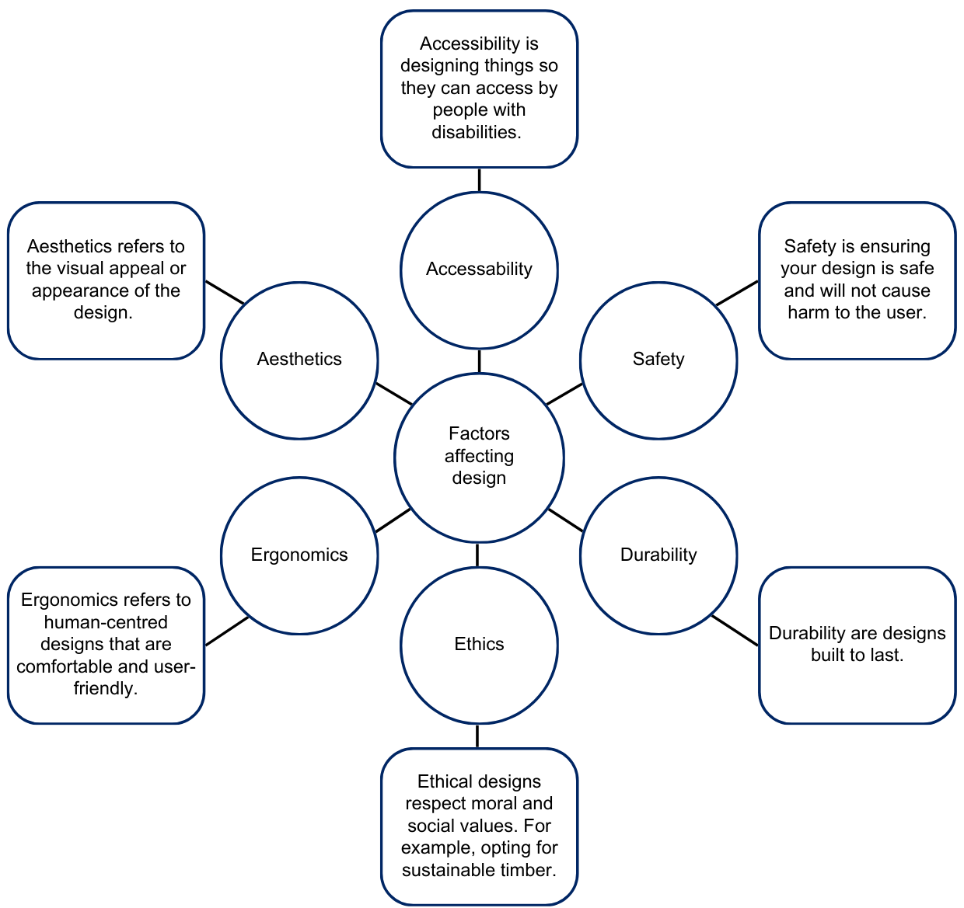
Sample answers - Factors affecting design
13

Slide 14
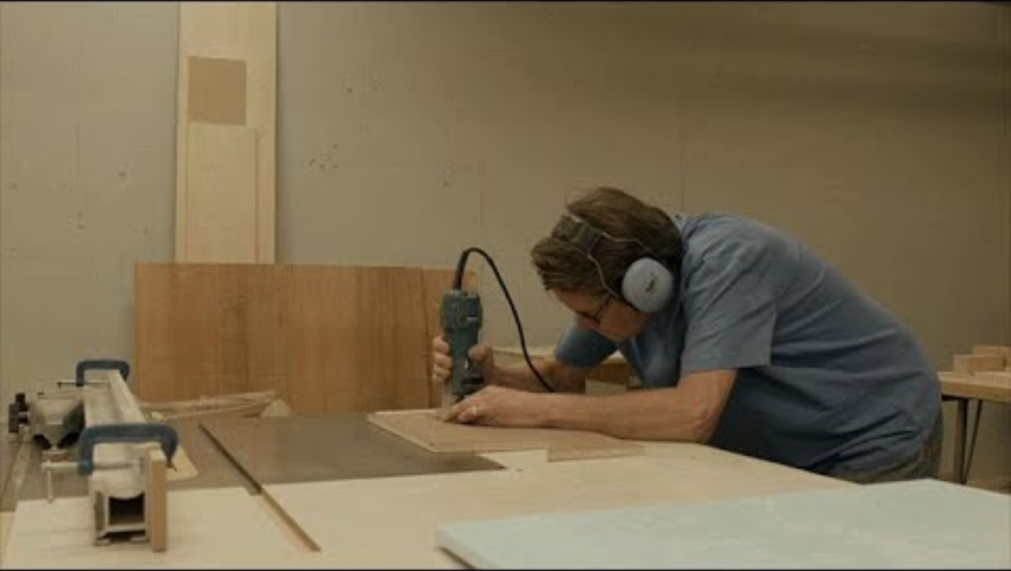
Design spotlight
Watch: Designer, Furniture Maker (Episode 87) (4:47).
Notes:
Video URL: https://youtu.be/9mm9PWMEbmM?si=Hz2zdmP2j2ssqm6h

Slide 15
Designer, Furniture maker – questions
How does Judson start his day?
Judson says “A career in woodworking can take you in all different directions” – list 3 directions it can take you.
True or False – Judson creates cheap, fast-fashion timber pieces designed to last a season and be replaced. Explain your response.
How does Judson describe the pieces he creates for his clients?
Woodworking is a career with a lot of opportunities for growth. List some possible careers Judson mentioned.
What is Judson’s adrenaline rush?

Slide 16
Learning intentions and success criteria 3
We are:
learning to understand and apply safe processes and practices in the workshop.
We can:
follow safe processes and practices when learning in the workshop
identify key features of timber
apply a sequence of steps when marking out and cutting.
Notes:
Notes for teachers:
Learning intentions and success criteria are best co-constructed with students. Adapt the learning intention as required and add matching success criteria.
For more information See ⁠AITSL or the NSW Department of Education explicit teaching strategies, ⁠Sharing learning intentions and ⁠Sharing success criteria
LISC is not necessarily presented at the beginning of the lesson. Teacher needs to consider most effectual time to introduce
LISC should be revisited during the lesson to support students' evaluation of their learning

Slide 17
Measurement – FEWTEL
The acronym FEWTEL helps you remember the correct order for processing wood into a finished, usable product. By following this sequence, you handle the wood more efficiently, save time, and reduce the risk of accidents.
Acronym | Description | Process
F | Face side | Select and mark the face side
E | Face edge | select and mark the face edge
W | Width | Check and cut timber to width
T | Thickness | Check and plane timber to desired thickness
E | Square end | Square one end
L | Length | Measure and mark length

Slide 18
Marking out and cutting
Apply a sequence of steps when marking out and cutting
using a try square
marking out
supporting timber
sawing timber

Slide 19
Learning intentions and success criteria 4
We are:
learning to understand how drawings contribute to the success of a project.
We can:
understand the purpose of workshop drawings in various industries
read a drawing to understand the features and where they are located on the parts
create a cutting list that includes all materials required for the project.
Notes:
Notes for teachers:
Learning intentions and success criteria are best co-constructed with students. Adapt the learning intention as required and add matching success criteria.
For more information See ⁠AITSL or the NSW Department of Education explicit teaching strategies, ⁠Sharing learning intentions and ⁠Sharing success criteria
LISC is not necessarily presented at the beginning of the lesson. Teacher needs to consider most effectual time to introduce
LISC should be revisited during the lesson to support students' evaluation of their learning

Slide 20
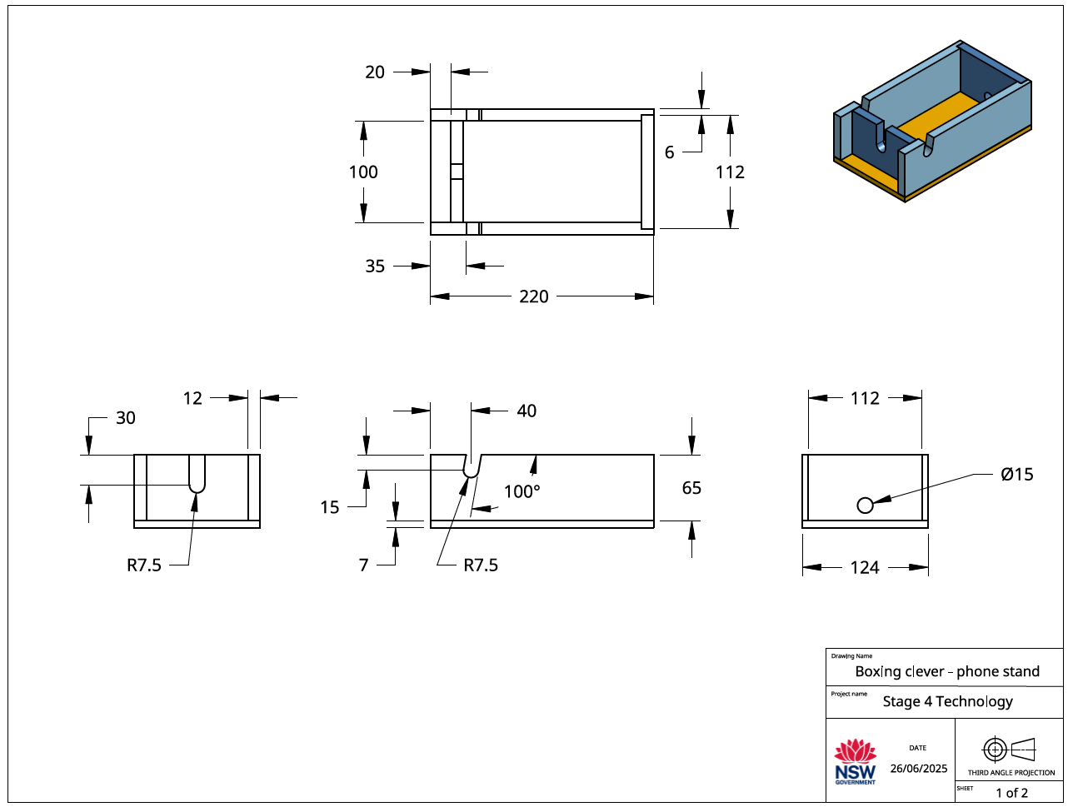
Workshop drawings
Workshop drawings are detailed and precise drawings used in the construction and manufacturing of a product or structure.
They provide essential information that guides builders, engineers, and manufacturers in creating the design as intended.

Slide 21
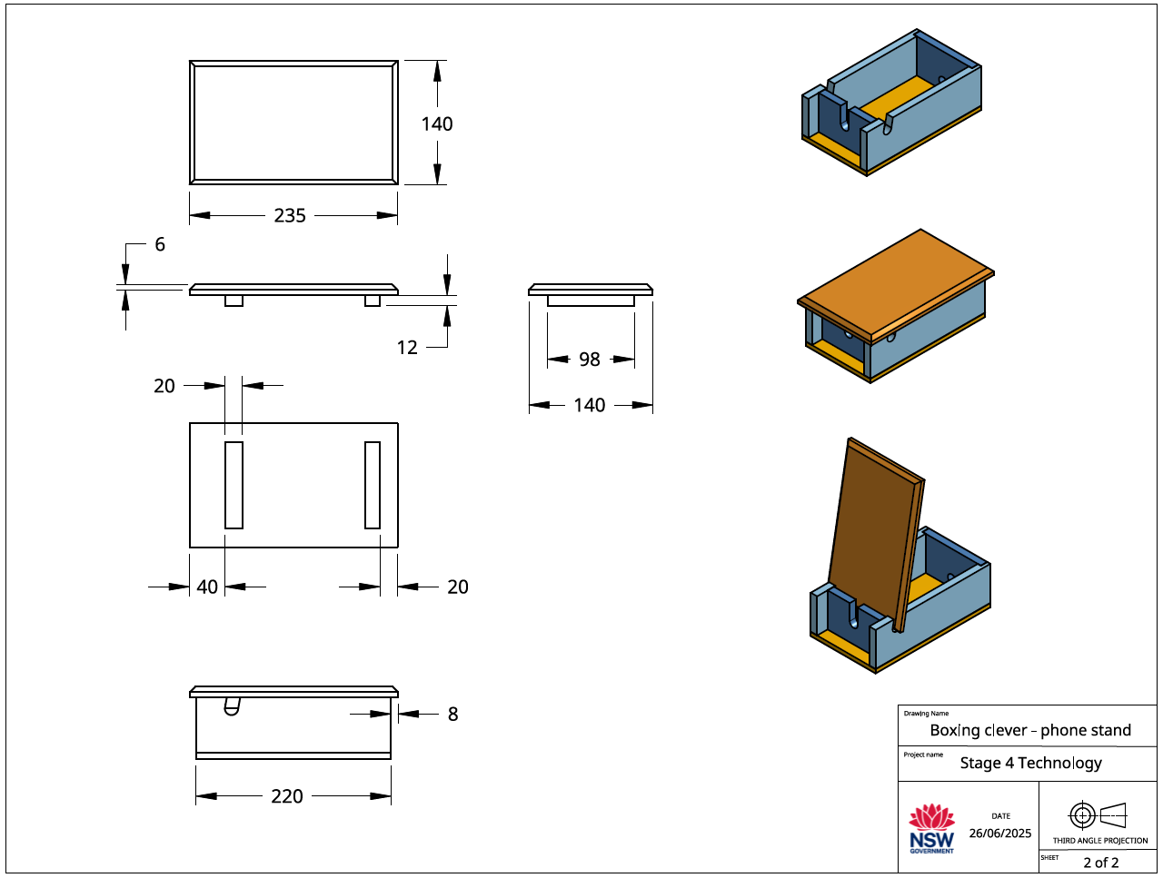
Phone stand workshop drawing - lid
21

Slide 22
Production planning – cutting list
The cutting list:
describes the type of material to be used
the dimensions (sizes) of the material
the number of parts
the name of each part
other information relevant to the manufacture of the project
is presented as a table.
No. | Description | Qty | L mm | W mm | T mm | Material
1 | Sides | 2 | 220 | 65 | 12 | Radiata Pine
2 | Back | 1 | 112 | 65 | 12 | Radiata Pine
3 | Front | 1 | 100 | 65 | 12 | Radiata Pine
4 | Base | 1 | 220 | 124 | 7 | Plywood
5 | Lid | 1 | 220 | 140 | 12 | Radiata Pine
6 | Strips | 2 | 98 | 20 | 12 | Radiata Pine

Slide 23
Learning intentions and success criteria 5
We are:
investigating where wood comes from
Investigating products that are made from timber.
We can:
identify where wood is commonly found in the built environment
describe where timber is sourced from
Identify a range of products made from timber.
Notes:
Notes for teachers:
Learning intentions and success criteria are best co-constructed with students. Adapt the learning intention as required and add matching success criteria.
For more information See ⁠AITSL or the NSW Department of Education explicit teaching strategies, ⁠Sharing learning intentions and ⁠Sharing success criteria
LISC is not necessarily presented at the beginning of the lesson. Teacher needs to consider most effectual time to introduce
LISC should be revisited during the lesson to support students' evaluation of their learning

Slide 24

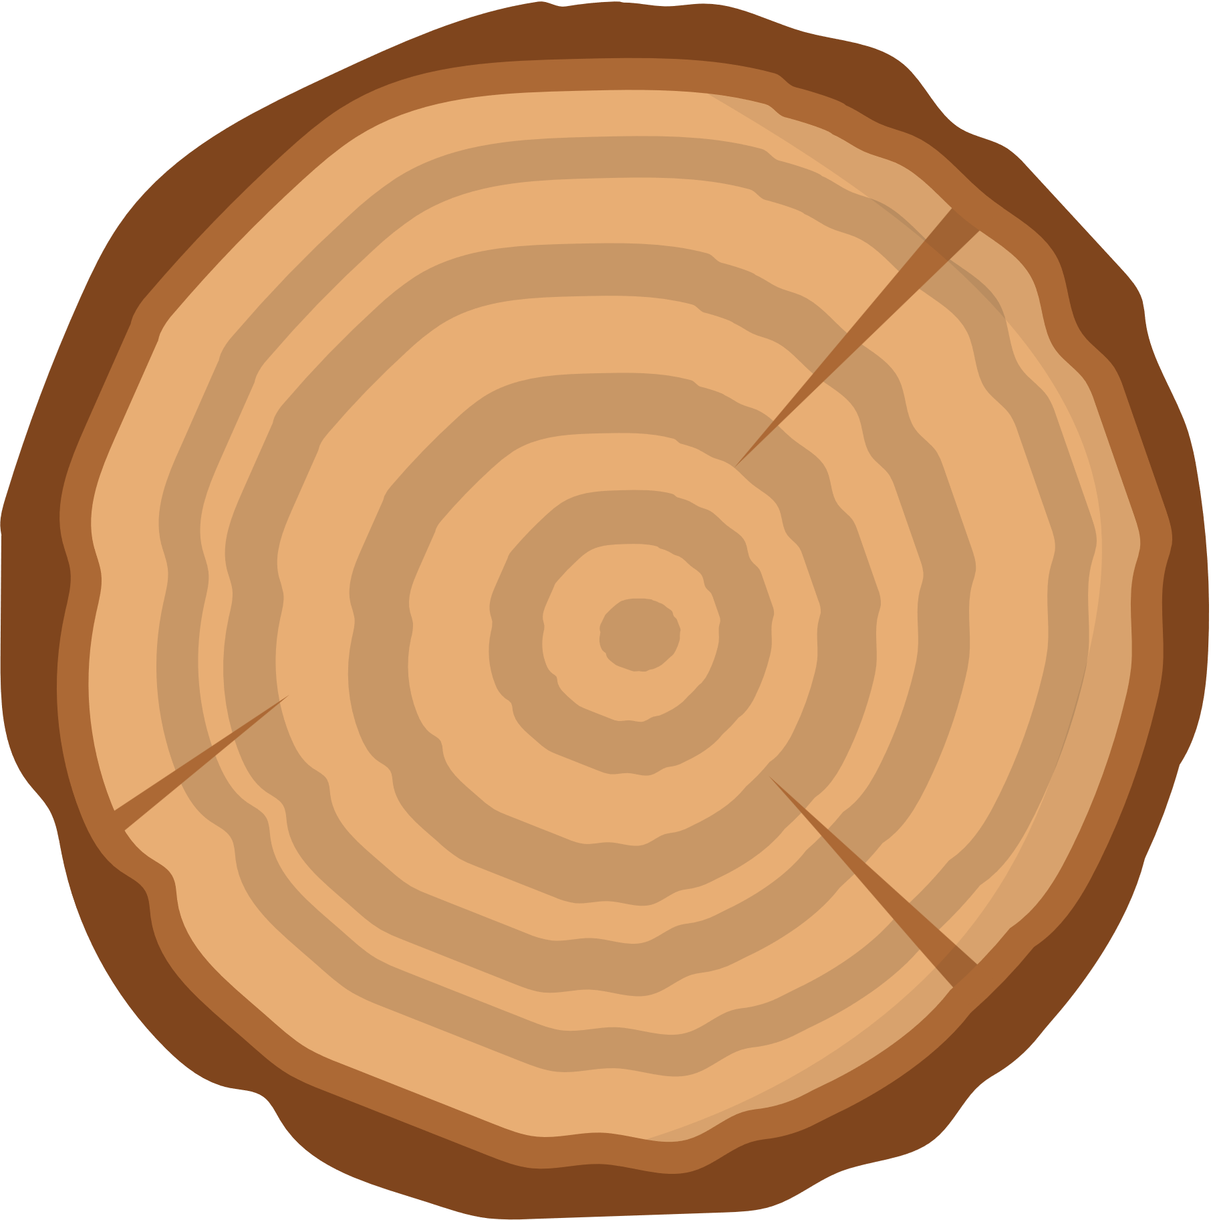
Made from timber
Brainstorm 10 things you have used in the last 24 hours made from timber
Made
from
timber

Slide 25
What are the properties of timber?
List the properties of timber

Slide 26
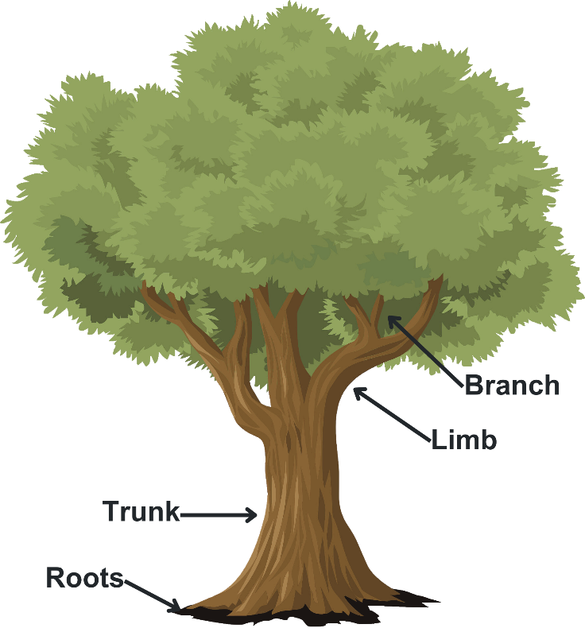
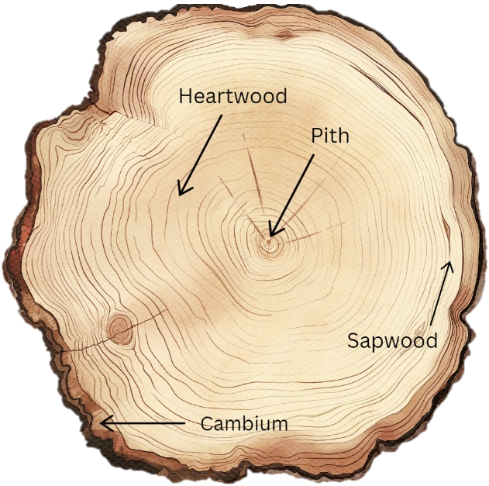
Parts of a tree

Slide 27
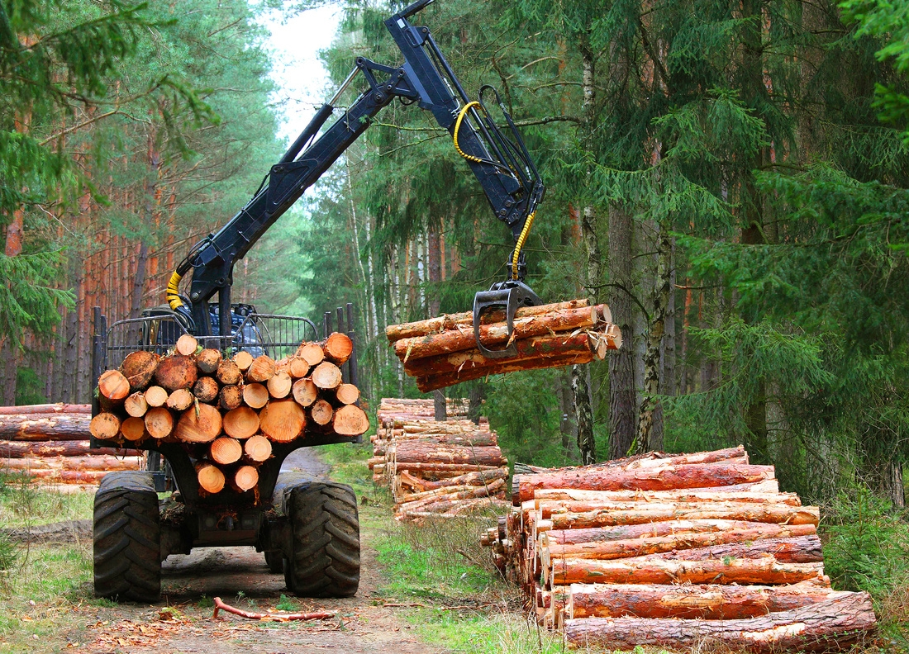
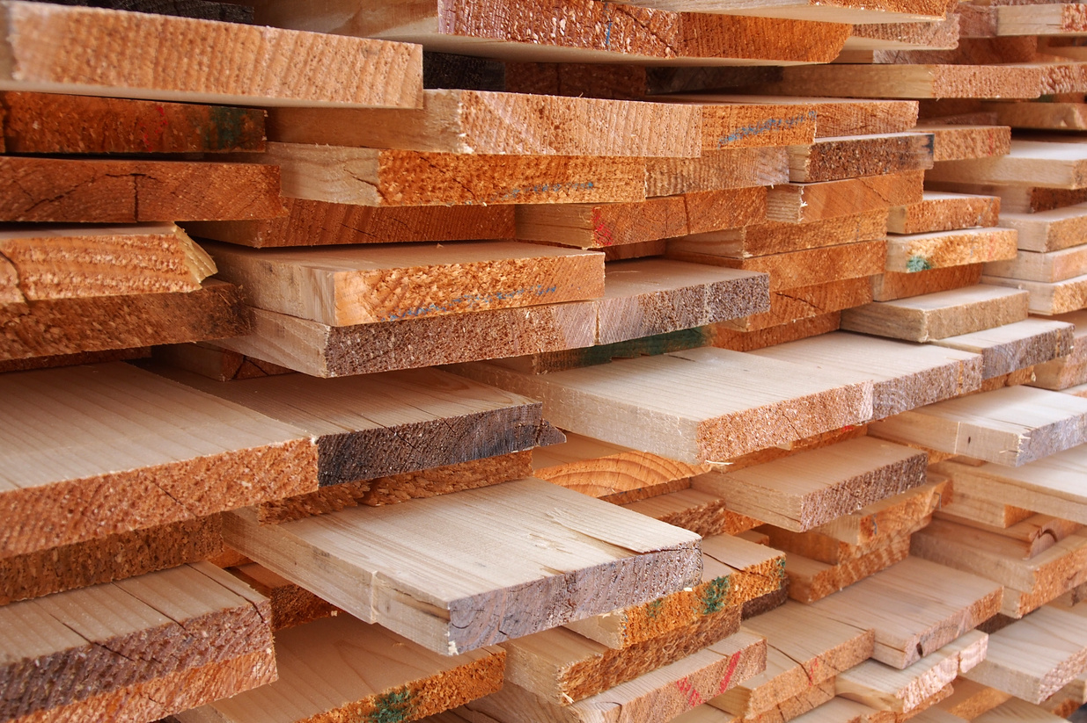
Trees to timber
1
  tree felled
  cut to lengths required by the mills
2
  lengths debarked
3
  cut round logs into square
  cut into dimensional (sized) timber
4
  seasoned in a kiln
  planed to finished dimensions

Slide 28
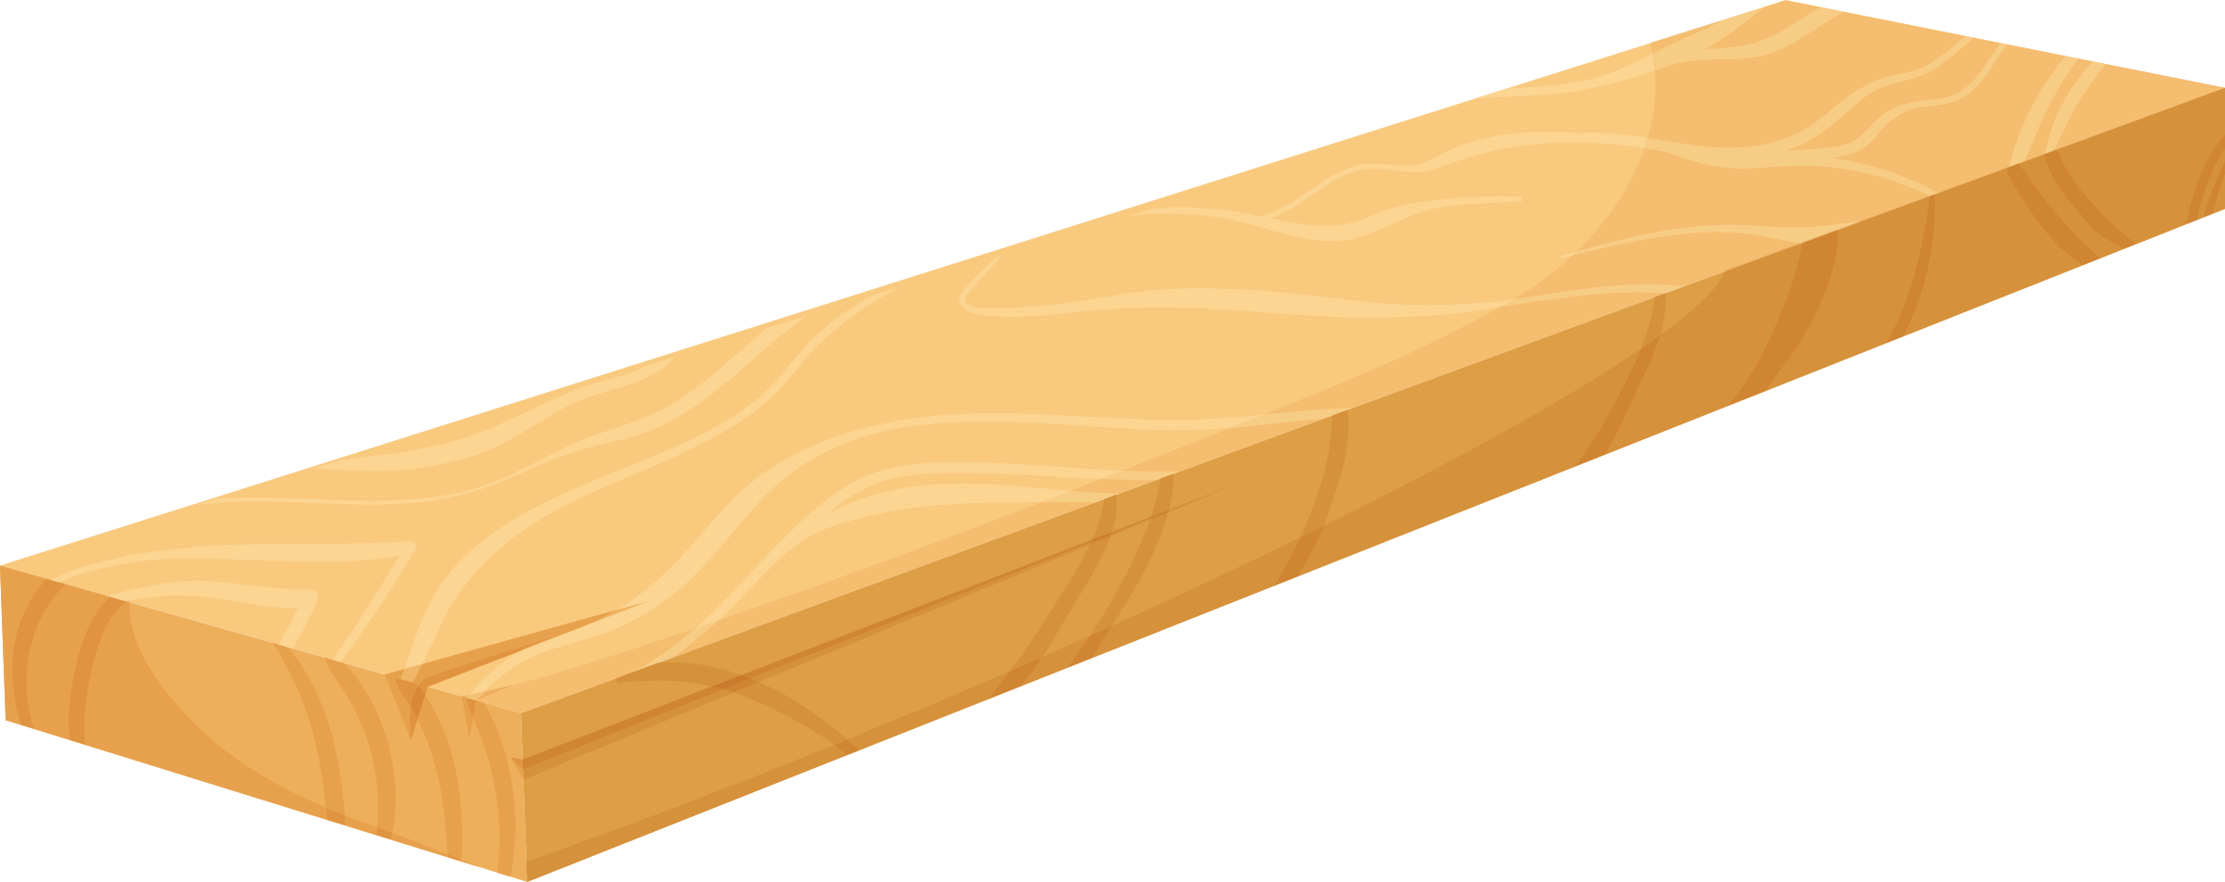
Timber terminology
Label the piece of timber
Face | Across the grain | With the grain | End
Thickness | Width | Length

Slide 29
Timber terminology
End
Label the piece of timber - answers
With the grain
Face
Across the grain
Length
Thickness
Width
Face | Across the grain | With the grain | End
Thickness | Width | Length

Slide 30
Learning intentions and success criteria 6
We are:
understanding the different types of timber (hardwood, softwood and engineered).
learning about the properties, characteristics and uses of each timber type.
We can:
identify and describe the different types of timber and their significance in woodworking and construction.
present key characteristics and uses of a specific type of timber to our peers effectively.
Notes:
Notes for teachers:
Learning intentions and success criteria are best co-constructed with students. Adapt the learning intention as required and add matching success criteria.
For more information See ⁠AITSL or the NSW Department of Education explicit teaching strategies, ⁠Sharing learning intentions and ⁠Sharing success criteria
LISC is not necessarily presented at the beginning of the lesson. Teacher needs to consider most effectual time to introduce
LISC should be revisited during the lesson to support students' evaluation of their learning

Slide 31
Types of timbers
Hardwood and softwood
Softwoods and hardwoods are used by designers, producers and manufacturers for specific purposes.
Feature | Hardwoods | Softwoods
Physical Properties | Denser, stronger, more durable | Less dense, better workability
Fibre Structure | Higher density of longer, thicker-walled fibres | Fewer, shorter, less dense fibres
Growth Rings | More irregular and varied in size | More uniform and distinct
Types

Slide 32
Properties of Radiata Pine
Botanical Name | Pinus radiata
Other Common Names | Monterey Pine, Insignis Pine
Tree Description | Evergreen tree, 30-50 meters tall, straight trunk, conical crown, rough dark grey to brown bark.
Timber Colour | Pale yellow to light brown heartwood; lighter sapwood.
Grain and Texture | Straight and even grain, medium to coarse texture; easy to work with.
Density | Ranges from 500 to 600 kg/m³, depending on moisture content and growth conditions.
Durability | Moderately durable; natural resistance to decay and insects but best treated for outdoor use.
Sustainability | Grown in plantations; sustainable choice with responsible forestry practices.
Uses | Construction (framing, beams, flooring), furniture, plywood, fencing, decking, packaging.

Slide 33
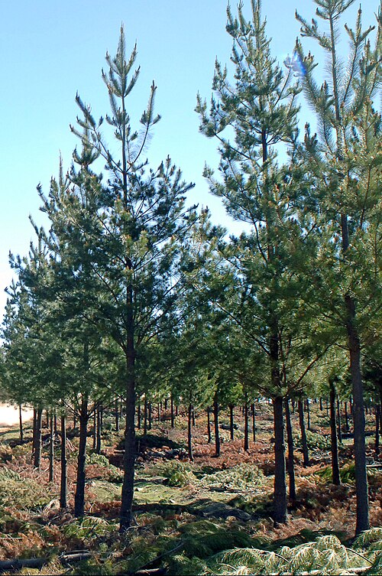
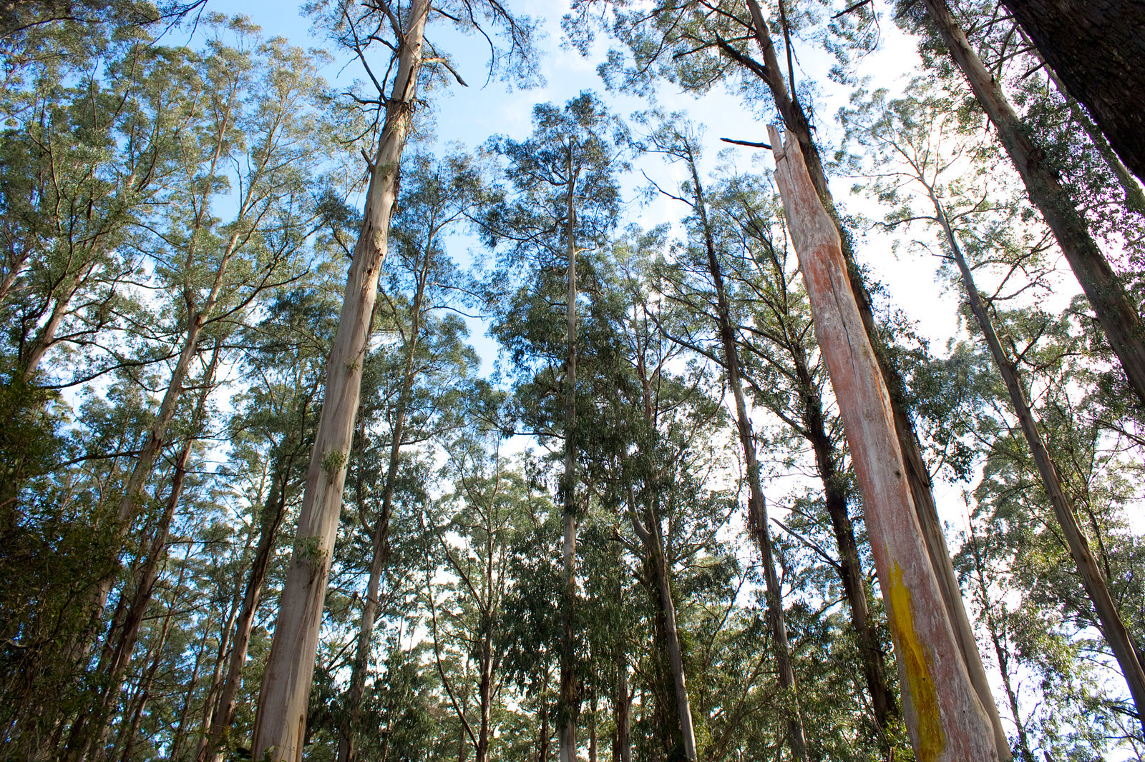
Radiata Pine and Tasmanian Oak
Tasmanian Oak Forest
https://www.flickr.com/photos/rexness/4782570338
Radiata Pine Plantation
File:CSIRO ScienceImage 10752 Radiata pine trees focus of the Juvenile Wood Initiative.jpg

Slide 34
Properties of Tasmanian Oak
Botanical Name | Eucalyptus delegatensis
Other Common Names | Tasmanian Ash, Victorian Ash, Mountain Ash
Tree Description | Tall evergreen tree, can grow up to 60 meters; straight trunk with a smooth, greyish bark.
Timber Colour | Light to medium brown with pinkish or yellow hues; colour may darken with age.
Grain and Texture | Fine to medium grain with a straight texture; generally has a smooth finish.
Density | Density ranges from 600 to 800 kg/m³, depending on the specific species and moisture content.
Durability | Moderately durable; has good resistance to wear but can be susceptible to insect attack.
Sustainability | Often sourced from sustainably managed forests in Tasmania and Victoria; considered eco-friendly.
Uses | Furniture, flooring, cabinetry, joinery, and decorative items; widely used in construction.

Slide 35
Learning intentions and success criteria 7
We are:
applying safe processes and practices to create timber joints.
We can:
follow safe processes and practices when learning in the workshop
use tools and processes to create timber joints.
Notes:
Notes for teachers:
Learning intentions and success criteria are best co-constructed with students. Adapt the learning intention as required and add matching success criteria.
For more information See ⁠AITSL or the NSW Department of Education explicit teaching strategies, ⁠Sharing learning intentions and ⁠Sharing success criteria
LISC is not necessarily presented at the beginning of the lesson. Teacher needs to consider most effectual time to introduce
LISC should be revisited during the lesson to support students' evaluation of their learning

Slide 36
Cutting rebate joints
Apply a sequence of steps when marking out and cutting rebate joints
mark out width of rebate on the end
mark the depth of the rebate
guide block clamped to timber

Slide 37
Cutting rebate joints
Apply a sequence of steps when cutting rebate joints
saw the side of the rebate
saw down to the marking gauge line
remove waste by chiselling vertically
pare the timber flat and smooth
position timber horizontally in vice

Slide 38
Making holes and slots
Apply a sequence of steps to holes and create square angled slots
clamping safely when drilling holes
drilling holes
cutting slots
sanding slots
finished slots

Slide 39
Learning intentions and success criteria 8
We are:
learning about the importance of production planning.
We can:
develop a correct sequence of production steps.
Notes:
Notes for teachers:
Learning intentions and success criteria are best co-constructed with students. Adapt the learning intention as required and add matching success criteria.
For more information See ⁠AITSL or the NSW Department of Education explicit teaching strategies, ⁠Sharing learning intentions and ⁠Sharing success criteria
LISC is not necessarily presented at the beginning of the lesson. Teacher needs to consider most effectual time to introduce
LISC should be revisited during the lesson to support students' evaluation of their learning

Slide 40

Production planning – BBQ caddy key phases
What tasks do we need to do and how long will they take?
Mark out and cut sides and ends
Sand sides and ends to length
Mark out and cut rebate joints
Mark out, drill holes and cut slots for lid
Glue and nail sides and ends
Sand box edges flush
Glue and nail base to box
Plane and sand base flush with box
Mark out, cut and sand parts for lid
Glue and nail lid together
Sand all parts ready for finishing
Apply a suitable finish

Slide 41
Phone Stand key phases time estimates
Step | Estimated Time (in lessons)
Mark out and cut sides and ends
Sand sides and ends to length
Mark out and cut rebate joints
Mark out, drill holes and cut slots for lid
Glue and nail sides and ends
Sand box edges flush
Glue and nail base to box
Plane and sand base flush with box
Mark out, cut and sand parts for lid
Glue and nail lid together
Sand all parts ready for finishing
Apply a suitable finish

Slide 42
Learning intentions and success criteria 9
We are:
learning about differences between sustainable and traditional timber sourcing practices and their environmental impact.
exploring how sustainable design can benefit both the user and the environment.
We can:
explain ethical and legal responsibilities involved in sourcing timber and other materials.
compare sustainable sourcing practices and resource management practices.
minimise waste during design and production.
Notes:
Notes for teachers:
Learning intentions and success criteria are best co-constructed with students. Adapt the learning intention as required and add matching success criteria.
For more information See ⁠AITSL or the NSW Department of Education explicit teaching strategies, ⁠Sharing learning intentions and ⁠Sharing success criteria
LISC is not necessarily presented at the beginning of the lesson. Teacher needs to consider most effectual time to introduce
LISC should be revisited during the lesson to support students' evaluation of their learning

Slide 43
Sustainability
What is it?
Sustainability is the practice of meeting present needs while ensuring that future generations can also meet theirs. It is a way of using resources that meets our needs today without harming the ability of future generations to meet their own needs. It’s about balancing how we use resources like timber, water, and energy, so that they will still be available for people in the future.

Slide 44
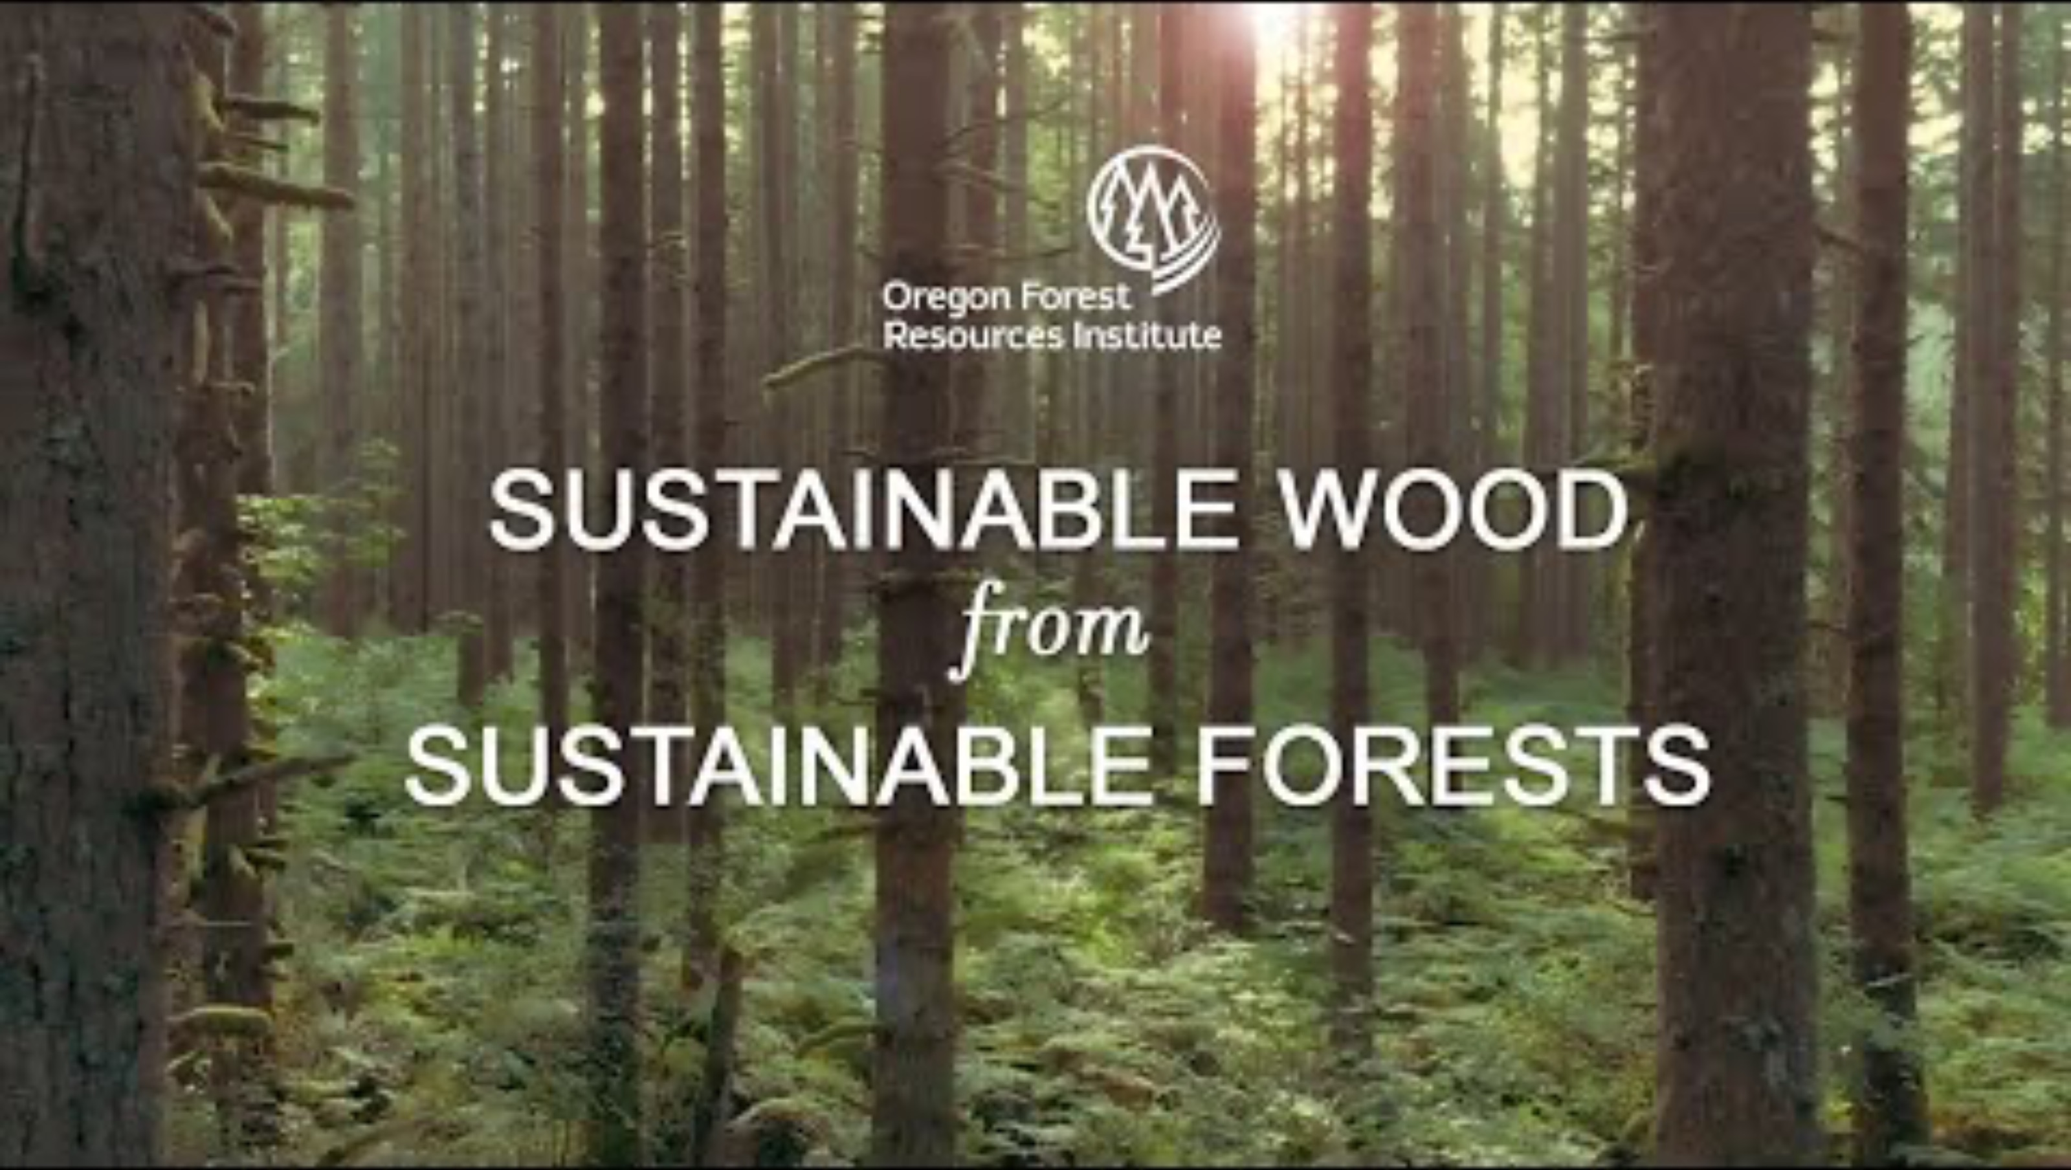
Sustainable wood from sustainable forests
Watch Sustainable Wood from Sustainable Forests (15:35).

Slide 45
Sustainable terms
Term | Description
Resource | A resource is any material, substance, or asset that can be used to produce goods and services, fulfil needs, or provide benefits. Resources can be natural or human-made.
Natural Resource | A natural resource is a material or substance that occurs in nature and can be used for economic gain. This includes resources like water, minerals, forests, and fossil fuels.
Renewable Natural Resource | A renewable natural resource is a resource that can be replenished naturally over time. Examples include sunlight, wind, water, and forests, which can regenerate through natural processes.
Non-renewable Resource | A non-renewable resource is a resource that exists in finite amounts and cannot be replaced once it is depleted. Examples include fossil fuels (coal, oil, natural gas) and certain minerals.
Resource Management | Resource management refers to the planning, monitoring, and control of natural resources to ensure their sustainable use and conservation. This includes practices aimed at balancing ecological health and human needs.
Harvesting | Harvesting is the process of collecting or gathering resources, particularly renewable resources like timber, crops, or fish. It involves the methods and practices used to obtain these resources responsibly.

Slide 46
Learning intentions and success criteria 10
We are:
applying techniques to successfully complete and assemble multiple parts of a project.
We can:
mark out, cut and drill to add features to the project
follow a set procedure to assemble a quality project
use fasteners to aid the assembly process.
Notes:
Notes for teachers:
Learning intentions and success criteria are best co-constructed with students. Adapt the learning intention as required and add matching success criteria.
For more information See ⁠AITSL or the NSW Department of Education explicit teaching strategies, ⁠Sharing learning intentions and ⁠Sharing success criteria
LISC is not necessarily presented at the beginning of the lesson. Teacher needs to consider most effectual time to introduce
LISC should be revisited during the lesson to support students' evaluation of their learning

Slide 47

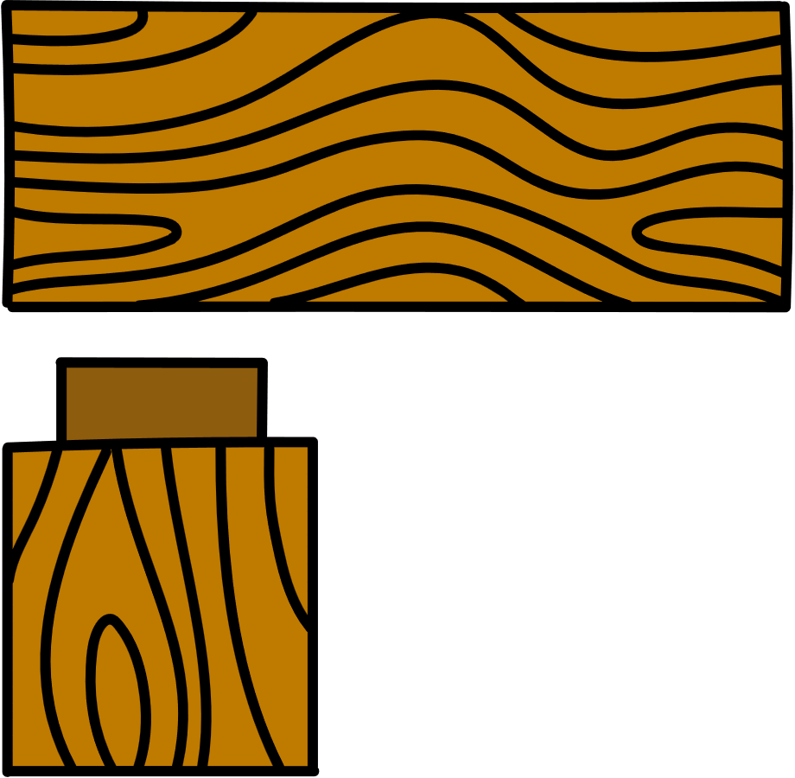

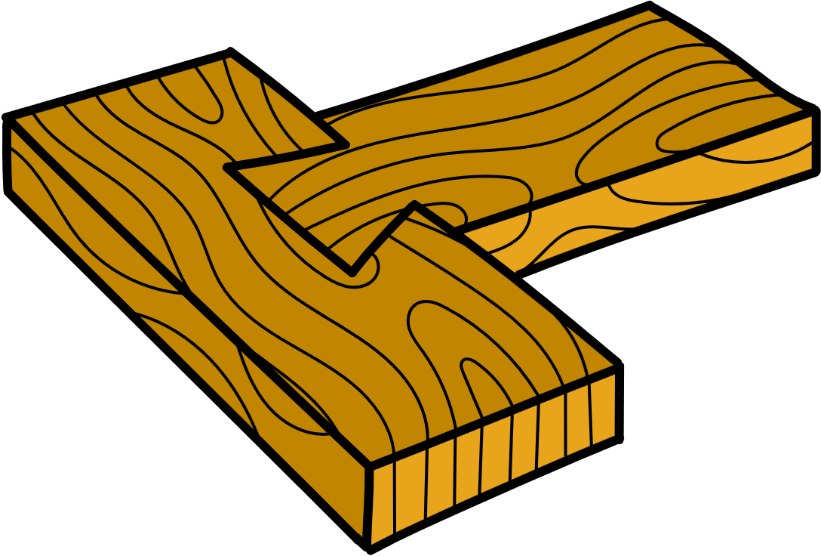

Joining timber
When we make projects, some joining methods alone won’t hold materials together securely. If we join two pieces without extra support, they could easily fall apart. To fix this, we use fasteners to keep them attached. Fasteners can be mechanical, like nails or screws, or chemical, like glue.

Slide 48
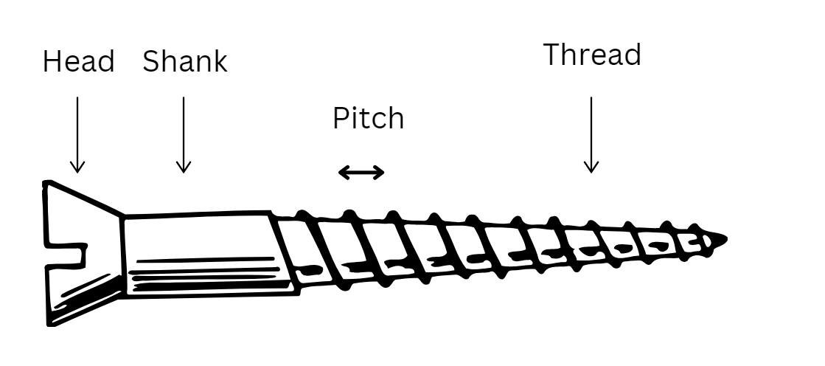
Types of screws
Wood screw – usually has coarse threads to provide a very strong grip in the timber. A pilot hole is necessary, often used on door hinges.
Particleboard screw – usually has coarse threads and a pointed tip so it can be driven into the timber without a pilot hole, often used to assemble kitchen cabinets.

Slide 49







Screw head shapes
Screw head types
Flat head
Round head
Pan head
Phillips head
Square head
Allen head
Slotted/Flat head

Slide 50
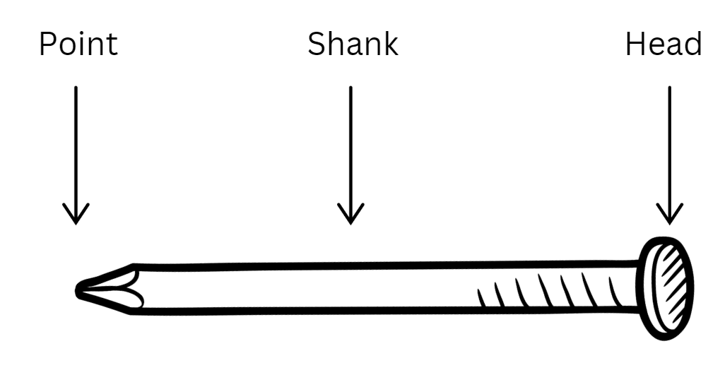
Types of nails
Panel pin – a smaller, light duty nail used for cabinetwork where the head can be punched below the surface and concealed with putty.
Bullet head – general purpose construction nail, smaller head allows it to be punched below the surface.
Flat head – has a large, flat head to resist being pulled through the timber.

Slide 51
Assembling the box
Apply a sequence of steps to assemble the box component
apply glue to both sides of joint
nail timber joint
punch nail heads
glue and clamp front

Slide 52
Sanding the box
Apply a sequence of steps to sand edges and joints flush
sand top and bottom edges
orbital sand rebates on end
assembled box

Slide 53
Learning intentions and success criteria 11
We are:
completing the box component by attaching the base and making a lid.
We can:
shape and attach the plywood base
make a lid to fit onto the top of the box.
Notes:
Notes for teachers:
Learning intentions and success criteria are best co-constructed with students. Adapt the learning intention as required and add matching success criteria.
For more information See ⁠AITSL or the NSW Department of Education explicit teaching strategies, ⁠Sharing learning intentions and ⁠Sharing success criteria
LISC is not necessarily presented at the beginning of the lesson. Teacher needs to consider most effectual time to introduce
LISC should be revisited during the lesson to support students' evaluation of their learning

Slide 54
Attaching the base and making a lid
Apply a sequence of steps to attach the base and make a lid
mark out and
pre-nail
punch nail heads
plane base flush with sides

Slide 55
Learning intentions and success criteria 12
We are:
learning about the history and culture of products and systems developed by Aboriginal and Torres Strait Islander Peoples
developing an awareness of the ethical and legal considerations in design and production.
We can:
describe the historical engineering and function of timber products and design by Aboriginal and Torres Strait Islander Peoples
appreciate Aboriginal and Torres Strait Islander Peoples art and identify the difference between inspiration and copyright (ICIP).
Notes:
Notes for teachers:
Learning intentions and success criteria are best co-constructed with students. Adapt the learning intention as required and add matching success criteria.
For more information See ⁠AITSL or the NSW Department of Education explicit teaching strategies, ⁠Sharing learning intentions and ⁠Sharing success criteria
LISC is not necessarily presented at the beginning of the lesson. Teacher needs to consider most effectual time to introduce
LISC should be revisited during the lesson to support students' evaluation of their learning

Slide 56
Aboriginal and Torres Strait Islander Peoples materials, products and systems
Aboriginal people used a variety of tools, utensils and weapons as they hunted, fished and gathered foods. Some technology was simple with the item being made and used for its purpose. Others needed more complex methods of making them like heat and pressure to set sap and fibres to determine the shape, flexibility and durability of the item.
Australia contains many different climates and environments. The general pattern of Aboriginal life was similar, small groups moved with the seasons over their territory. The tools, utensils and weapons made by Aboriginal people were adapted to the environment in which they were used. They were developed over many generations and made from readily available materials.

Slide 57
Aboriginal and Torres Strait Islander – tools and equipment
Aboriginal and Torres Strait Islander people invented many tools, pieces of equipment and technology to use in everyday life. This technology was made using natural resources in highly creative ways.
Aboriginal Plant use and Technology
Tools & Technology – Deadly Story
Yandi (coolamon) fact sheet (PDF)
13 Indigenous innovations that are truly amazing

Slide 58
Aboriginal and Torres Strait Islander – art and symbols
Aboriginal art is vibrant, diverse, and carries important cultural meaning. Throughout time, it has been used as a mode through which knowledge and stories are passed down through the generations. When you look at Aboriginal art, you will see that symbols are often used, and their meanings and ways of depicting them vary greatly across nations. Examples of symbols engraved or painted on rock art sites show a record of use of these marks for tens of thousands of years.
Read: Understanding symbols in Aboriginal art – Red Kangaroo
Research: Where is local place of yarning for Aboriginal people in your local area?

Slide 59

Protecting Indigenous Cultural Intellectual Property
watch Protecting Indigenous Cultural and Intellectual Property rights (ICIP) (2:02)

Slide 60
Indigenous Cultural Intellectual Property (ICIP)
It is essential to respect ICIP rights, ensuring that traditional knowledge and cultural expressions are protected and that Aboriginal communities maintain control over their cultural heritage.
Read First Nations artists and souvenir sellers back crackdown on fake Indigenous art and identify important issues and actions raised in the article.
What are the issues with non-Aboriginal people selling Aboriginal Art?
Are there laws protecting ICIP?
Would it be appropriate for you to decorate your bedroom sign with Aboriginal symbols? Why/Why not?

Slide 61
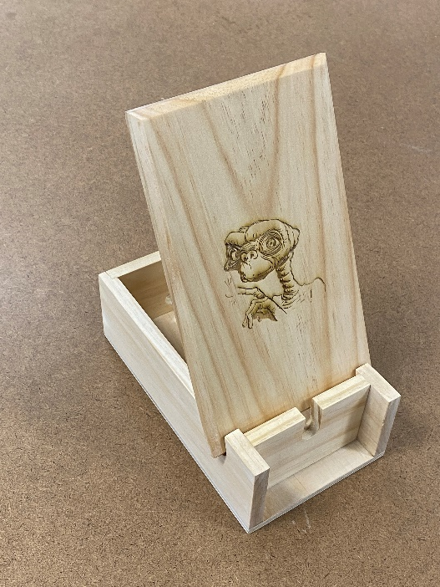
Learning intentions and success criteria 13
We are:
learning surface decoration skills and techniques appropriate to the resources of the school.
We can:
apply functional and aesthetic requirements to my project
apply techniques to enhance the appearance of the project.
Notes:
Notes for teachers:
Learning intentions and success criteria are best co-constructed with students. Adapt the learning intention as required and add matching success criteria.
For more information See ⁠AITSL or the NSW Department of Education explicit teaching strategies, ⁠Sharing learning intentions and ⁠Sharing success criteria
LISC is not necessarily presented at the beginning of the lesson. Teacher needs to consider most effectual time to introduce
LISC should be revisited during the lesson to support students' evaluation of their learning

Slide 62
Surface decoration
Using a pokerwork tool to decorate parts of your phone stand
tracing your design onto timber
burn over the lines
colour the image

Slide 63
Surface decoration
Using a laser cutter to decorate parts of your phone stand
image in drawing program
laser engraved image

Slide 64
Learning intentions and success criteria 14
We are:
learning about types of finishes and how they are applied to timber.
We can:
identify and select appropriate finishing techniques for my project.
Notes:
Notes for teachers:
Learning intentions and success criteria are best co-constructed with students. Adapt the learning intention as required and add matching success criteria.
For more information See ⁠AITSL or the NSW Department of Education explicit teaching strategies, ⁠Sharing learning intentions and ⁠Sharing success criteria
LISC is not necessarily presented at the beginning of the lesson. Teacher needs to consider most effectual time to introduce
LISC should be revisited during the lesson to support students' evaluation of their learning

Slide 65
Surface finishes
Finishing timber is essential for enhancing its durability, protecting it from environmental factors, improving its aesthetic appeal, and ensuring ease of maintenance. These benefits contribute to the longevity and performance of timber products in various applications.

Slide 66
Types of finishes
There are a range of finishes that can be applied to timber, including:
Oil
Wax
Varnish
Lacquer
Stain
Paint
water-based finish.
Each has its own practical use and application method.
Consider how and where your Phone Stand will be used. What finishes would be suitable for your project? Give a brief explanation for your choice.

Slide 67
Preparing for surface finishing
The quality of finish on wood depends a lot on how smooth and clean the wood surface is before you apply it. Clear finishes, like varnish or lacquer, can make any scratches or marks on the wood more noticeable. This is why it’s important to prepare the wood surface properly before putting on the finish. Taking the time to make the surface nice and smooth will help ensure that the final look is great.
The following procedure should be used.
Cleaning up
Removal of dents
Initial use of abrasive paper
Final use of abrasive paper
Application of finish

Slide 68
Preparation for finishing
Applying a finish to protect your phone stand
remove pencil marks with eraser
stopping nail holes with putty
sand with the grain

Slide 69
Applying the finish
Applying a finish to protect your phone stand
apply the wax finish
completed project

Slide 70
Learning intentions and success criteria 15
We are:
investigating evaluation to self-assess our work and our peers.
learning to use the criteria for success to gauge the success of our project.
We can:
evaluate the success of our project and my peers against the criteria for success.
select and apply appropriate finishing techniques to my project.
Notes:
Notes for teachers:
Learning intentions and success criteria are best co-constructed with students. Adapt the learning intention as required and add matching success criteria.
For more information See ⁠AITSL or the NSW Department of Education explicit teaching strategies, ⁠Sharing learning intentions and ⁠Sharing success criteria
LISC is not necessarily presented at the beginning of the lesson. Teacher needs to consider most effectual time to introduce
LISC should be revisited during the lesson to support students' evaluation of their learning

Slide 71
References
This presentation contains NSW Curriculum and syllabus content. The NSW Curriculum is developed by the NSW Education Standards Authority. This content is prepared by NESA for and on behalf of the Crown in the right of the State of New South Wales. The material is protected by Crown copyright.
Please refer to the NESA Copyright Disclaimer for more information https://educationstandards.nsw.edu.au/wps/portal/nesa/mini-footer/copyright.
NESA holds the only official and up-to-date versions of the NSW Curriculum and syllabus documents. Please visit the NSW Education Standards Authority (NESA) website https://educationstandards.nsw.edu.au/wps/portal/nesa/home and the NSW Curriculum website https://curriculum.nsw.edu.au.
Technology 7–8 © Syllabus NSW Education Standards Authority (NESA) for and on behalf of the Crown in right of the State of New South Wales, [Year of publication].
Archae-aus, 2024, Yandi (coolamon) fact sheet (PDF), Archae-aus, accessed 19 November 2024.
Australian National Botanic Gardens, 2020, Aboriginal Plant use and Technology (PDF), Australian National Botanic Gardens, accessed 19 November 2024.
Deadly Story, 2023, Tools & Technology, Deadly Story, accessed 19 November 2024.
Dion Devow, D, 2017, 13 Indigenous innovations that are truly amazing, Téa&Belle Collective, accessed 19 November 2024.
NSW Department of Education, 2024, understand local community protocols and engage with the community respectfully and authentically, Getting to know local Aboriginal and/or Torres Strait Islander Histories and Cultures, accessed 19 November 2024.
Rayonier Inc. (1 October 2021) From Trees to Lumber: Watch how boards are made from pine trees (8:12) Rayonier Inc., YouTube, accessed 19 November 2024.
Red Kangaroo, 2024, Understanding symbols in Aboriginal art, Red Kangaroo, accessed 19 November 2024.

Slide 72
References 2
Responsible Wood, 2023, responsiblewood.org.au, Responsible Wood, accessed 19 November 2024.
Responsible Wood, 2023, Value Of Australian Sustainable Timber, Responsible Wood, accessed 19 November 2024.
Richardson H, Testa C, Lee J, 2023, First Nations artists and souvenir sellers back crackdown on fake Indigenous art, ABC News, accessed 19 November 2024.
WorkBC's Career Trek (11 June 2020) Designer, Furniture Maker (Episode 87) (4:47) WorkBC's Career Trek, YouTube, accessed 19 November 2024.

Slide 73
Copyright
© State of New South Wales (Department of Education), 2025
The copyright material published in this resource is subject to the Copyright Act 1968 (Cth) and is owned by the NSW Department of Education or, where indicated, by a party other than the NSW Department of Education (third-party material).
Copyright material available in this resource and owned by the NSW Department of Education is licensed under a Creative Commons Attribution 4.0 International (CC BY 4.0) license.
This license allows you to share and adapt the material for any purpose, even commercially.
Attribution should be given to © State of New South Wales (Department of Education), 2025.
Material in this resource not available under a Creative Commons license:
the NSW Department of Education logo, other logos and trademark-protected material
Material owned by a third party that has been reproduced with permission. You will need to obtain permission from the third party to reuse its material.
Links to third-party material and websites
Please note that the provided (reading/viewing material/list/links/texts) are a suggestion only and implies no endorsement, by the New South Wales Department of Education, of any author, publisher, or book title. School principals and teachers are best placed to assess the suitability of resources that would complement the curriculum and reflect the needs and interests of their students.
If you use the links provided in this document to access a third-party’s website, you acknowledge that the terms of use, including licence terms set out on the third-party’s website apply to the use which may be made of the materials on that third-party website or where permitted by the Copyright Act 1968 (Cth). The department accepts no responsibility for content on third-party websites.

