Slide 1
Instructions for use
This resource is not a teaching and learning program. It should be used in conjunction with Technology 7–8 Year 7 – Food and agricultural practices – Scrambled
Classroom teachers are encouraged to add and adapt slides as required to meet the needs of their students.
Save a copy of the file to make changes to the slide deck. Go to File > Download a Copy (this downloads a copy to the computer to edit in the PowerPoint app).
To convert the PowerPoint to Google Slides:
  Upload the file into Google Drive and open it.
  Go to File > Save as Google Slides.
  (Note – conversion may cause formatting changes in the slides.)

Slide 2
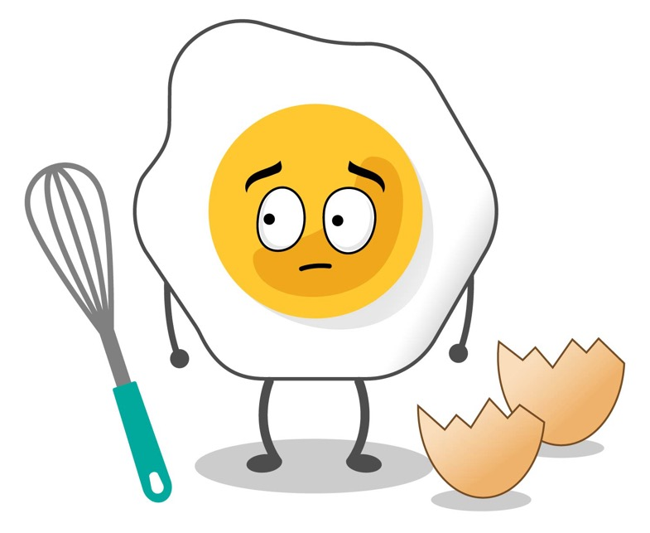
Scrambled
Stage 4
Technology 7–8
Food and Agricultural practices focus area

Slide 3
Weeks 1–2

Slide 4
Learning intentions and success criteria (1)
We are learning to:
Identify the variety of ways we can use and eat eggs in cooking.
We can:
Recall how eggs are used.
Provide examples of recipes that include eggs.
Identify the different methods of cooking with eggs in recipes.
Notes:
Notes for teachers:
Learning intentions and success criteria are best co-constructed with students. Adapt the learning intention as required and add matching success criteria.
For more information See ⁠AITSL or the NSW Department of Education explicit teaching strategies, ⁠Sharing learning intentions and ⁠Sharing success criteria
LISC is not necessarily presented at the beginning of the lesson. Teacher needs to consider most effectual time to introduce
LISC should be revisited during the lesson to support students' evaluation of their learning

Slide 5
Classroom expectations

Slide 6
How do you have your eggs? (1)
https://www.freewordcloudgenerator.com/

Slide 7


How do you have your eggs? (2)
Watch video – Get cracking Australia! Families

Slide 8
Methods of cooking eggs (1)
Drag and drop to match the word with the definition
Boiling
Eggs are beaten together and then cooked gently in a pan, usually with butter or oil. The mixture is stirred to create soft, fluffy pieces. | A liquid, usually water, is heated to its boiling point (100 degrees Celsius), causing bubbles to form and rise to the surface. Food is submerged into the bubbling liquid to cook.
Egg yolks can be used in custards and sauces like hollandaise to thicken and enrich. | Food is cooked using dry heat, typically in an oven. Heat surrounds the food, cooking it evenly from all sides.
Food is cooked in hot oil or fat. | Food is gently cooked in simmering liquid (usually water, sometimes with vinegar) just below the boiling point. The food is submerged in the liquid and cooked without reaching boiling point.
Frying
Scrambled
Poaching
Baking
Thickening

Slide 9
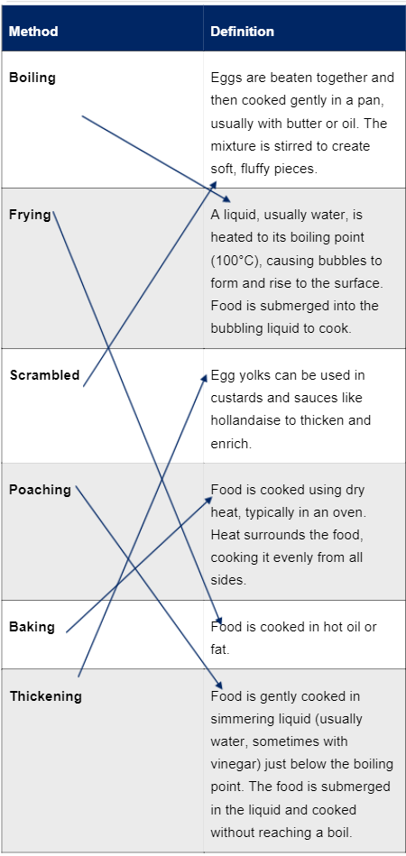
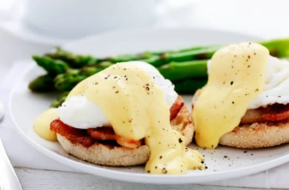
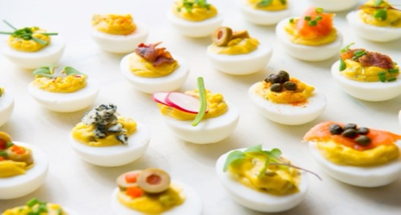
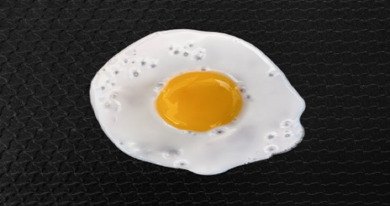



Methods of cooking eggs (2)
Answers

Slide 10
Learning intentions and success criteria (2)
We are learning about:
How to handle eggs safely and hygienically.
We can:
Understand the importance of handling eggs correctly.
Follow hygienic steps when handling eggs.
Store eggs correctly.
Notes:
Notes for teachers:
Learning intentions and success criteria are best co-constructed with students. Adapt the learning intention as required and add matching success criteria.
For more information See ⁠AITSL or the NSW Department of Education explicit teaching strategies, ⁠Sharing learning intentions and ⁠Sharing success criteria
LISC is not necessarily presented at the beginning of the lesson. Teacher needs to consider most effectual time to introduce
LISC should be revisited during the lesson to support students' evaluation of their learning

Slide 11

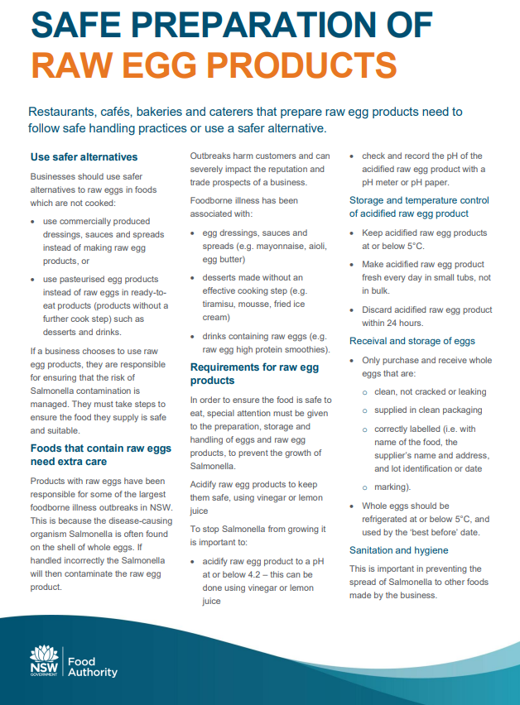
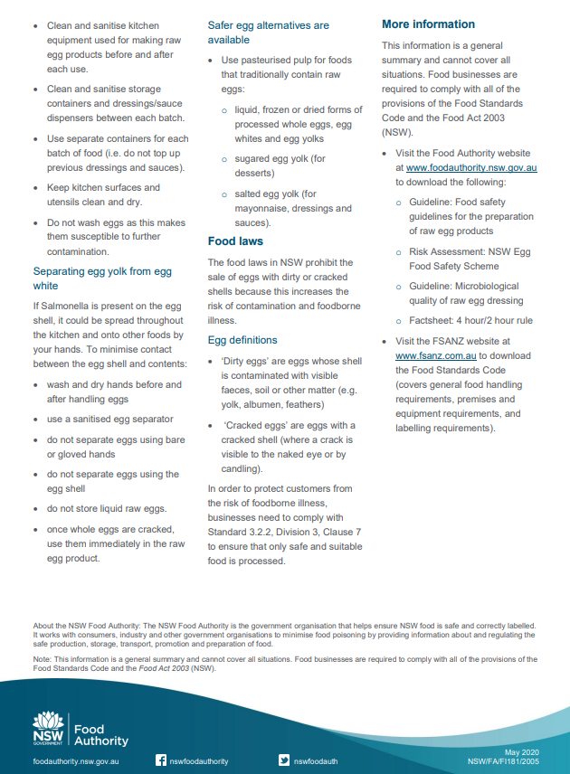
NSW Food Authority raw egg guidelines (1)
Safe preparation of raw egg products

Slide 12

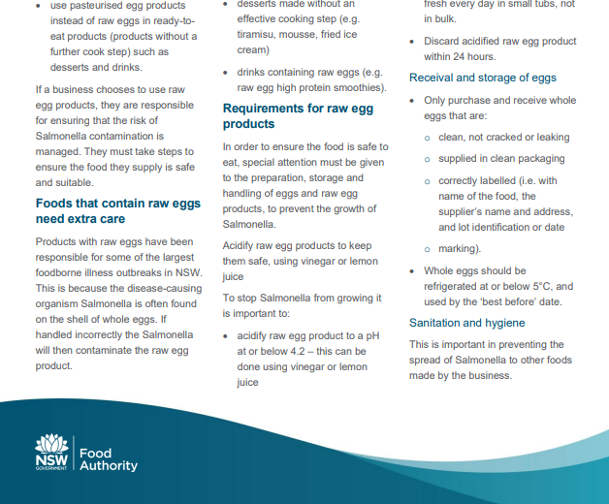
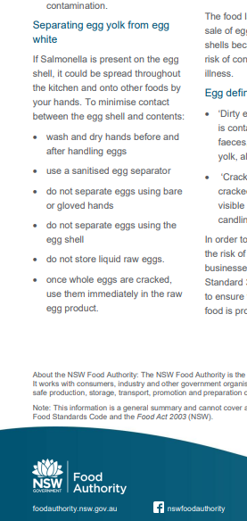
NSW Food Authority raw egg guidelines (2)
Safe preparation of raw egg products

Slide 13
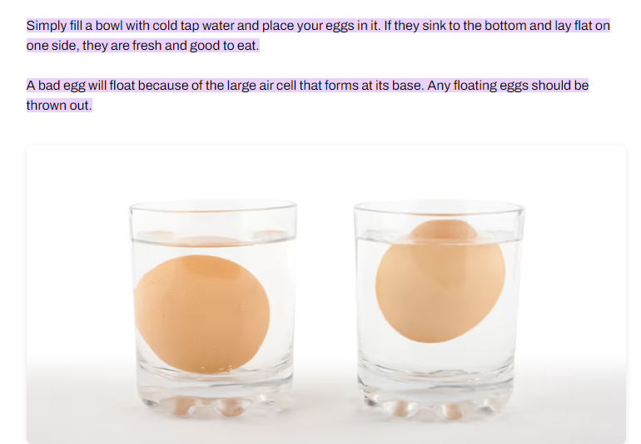
How to tell if eggs are off
How to tell if your eggs are off

Slide 14
Learning intentions and success criteria (3)
We are learning to:
Use our senses to describe foods.
We can:
Identify how our senses experience foods.
Describe foods using sensory words.
Notes:
Notes for teachers:
Learning intentions and success criteria are best co-constructed with students. Adapt the learning intention as required and add matching success criteria.
For more information See ⁠AITSL or the NSW Department of Education explicit teaching strategies, ⁠Sharing learning intentions and ⁠Sharing success criteria
LISC is not necessarily presented at the beginning of the lesson. Teacher needs to consider most effectual time to introduce
LISC should be revisited during the lesson to support students' evaluation of their learning

Slide 15
Food memories
Descriptive sensory words for foods
Smell | Look | Taste | Texture

Slide 16
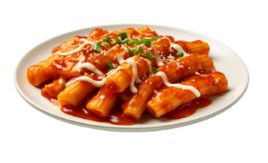
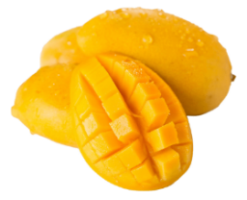

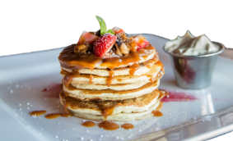

Title 1

Slide 17
Learning intentions and success criteria (4)
We are learning to:
Apply safe processes and practices in the kitchen.
We can:
Identify PPE required to prepare food items.
Use personal hygiene practices.
Recall key safe processes and practices to follow when preparing food items in the kitchen.
Notes:
Notes for teachers:
Learning intentions and success criteria are best co-constructed with students. Adapt the learning intention as required and add matching success criteria.
For more information See ⁠AITSL or the NSW Department of Education explicit teaching strategies, ⁠Sharing learning intentions and ⁠Sharing success criteria
LISC is not necessarily presented at the beginning of the lesson. Teacher needs to consider most effectual time to introduce
LISC should be revisited during the lesson to support students' evaluation of their learning

Slide 18
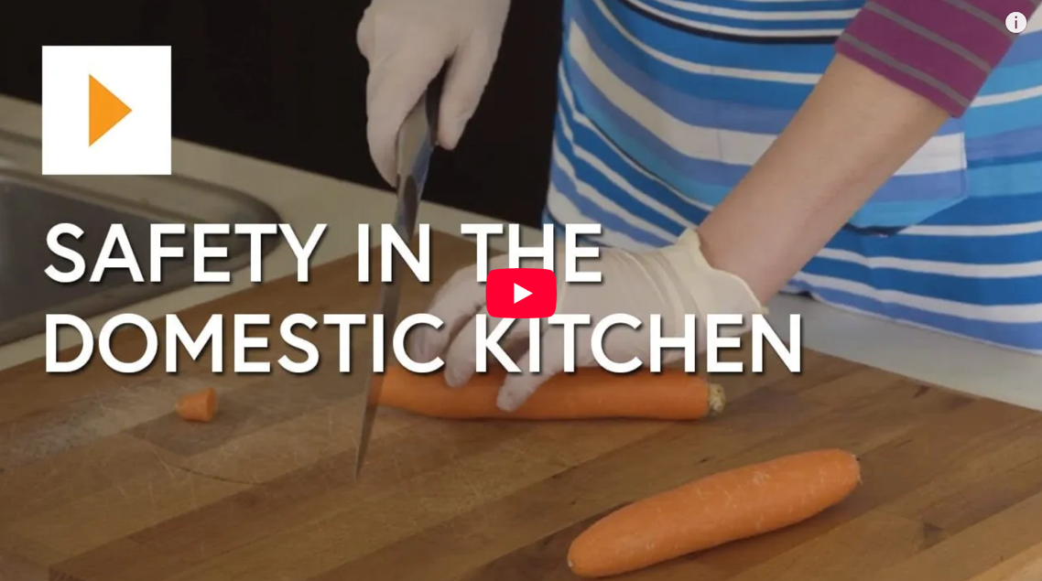

Watch Video (1)
Safety in the Domestic Kitchen – Food Technology

Slide 19
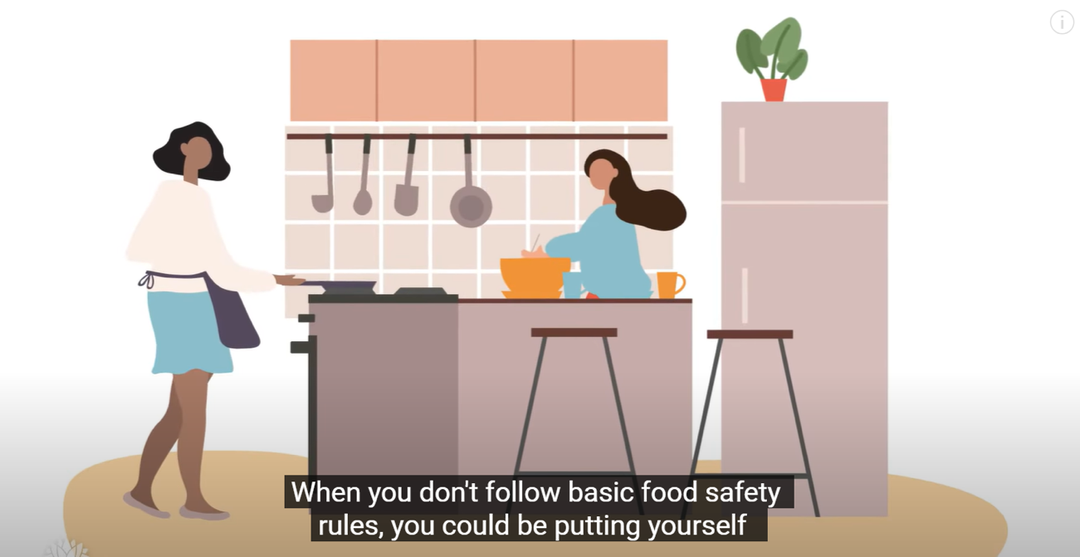
Watch Video (2)
Four Golden Rules of food safety – NSW Food Authority

Slide 20
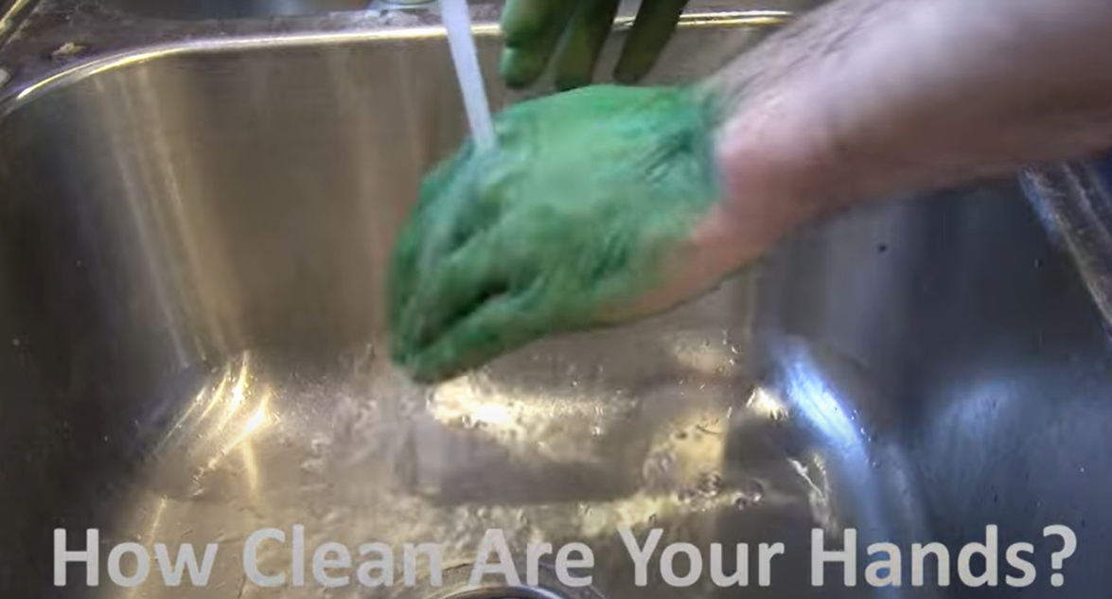
Watch Video (3)
See Germs! Hand Washing Science Experiment

Slide 21
Weeks 3–4

Slide 22
Learning intentions and success criteria (5)
We are learning about:
The nutritional needs of individuals and groups.
We can:
Identify reasons for eating food.
Identify nutrients found in food and describe their function.
Suggest food sources containing specific nutrients.
Provide suitable food examples for an adolescent.
Notes:
Notes for teachers:
Learning intentions and success criteria are best co-constructed with students. Adapt the learning intention as required and add matching success criteria.
For more information See ⁠AITSL or the NSW Department of Education explicit teaching strategies, ⁠Sharing learning intentions and ⁠Sharing success criteria
LISC is not necessarily presented at the beginning of the lesson. Teacher needs to consider most effectual time to introduce
LISC should be revisited during the lesson to support students' evaluation of their learning

Slide 23

Do now scrambled activity
In the time set write down as many safety and hygiene words that relate to a kitchen.

Slide 24
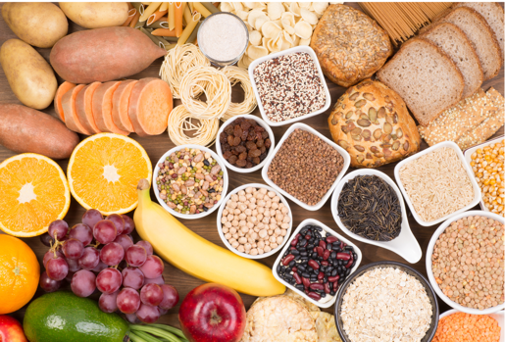
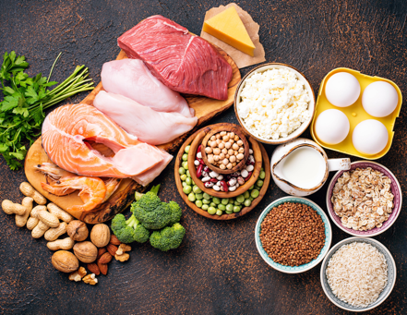
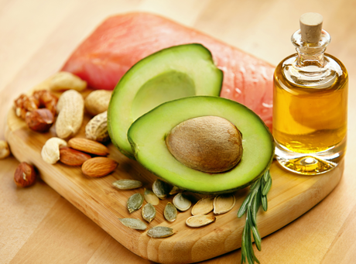
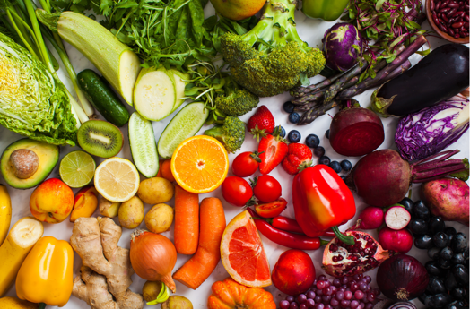

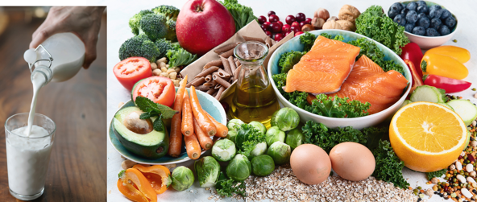
Nutrients and where to find them
Carbohydrates | Proteins | Fats
Vitamins | Minerals | Water

Slide 25

Watch Video (4)
Food Groups And Nutrition (5:06)

Slide 26
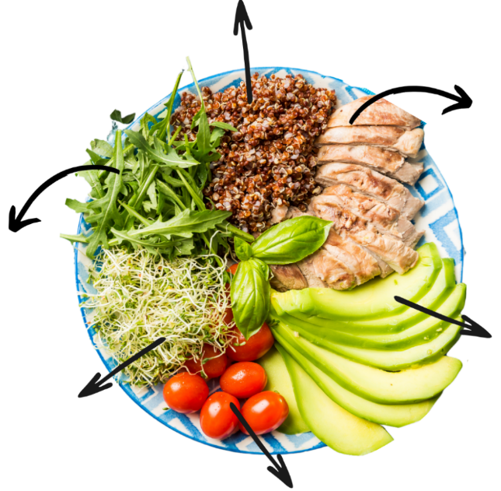
Nutrient sources
Drag and drop the ingredients, nutrients and functions below to correctly identify the components of the meal.
Support body function and the immune system
Provide energy
Promote growth and repair of muscles
and cells in the body
Maintain nerve and muscle function
Protects internal organs, move some
vitamins around the body and helps to
regulate body heat
Supports healthy cell growth and function
Rocket leaves
Chicken breast
Fats
Vitamin C
Alfalfa sprouts
Quinoa
Protein
Minerals – folate
Avocado
Cherry tomatoes
Carbohydrates
Minerals – magnesium

Slide 27
Learning intentions and success criteria (6)
We are learning about:
The nutritional benefits of eggs.
We can:
Identify the nutrients present in eggs.
Describe how eggs can be incorporated into every day eating habits.
Notes:
Notes for teachers:
Learning intentions and success criteria are best co-constructed with students. Adapt the learning intention as required and add matching success criteria.
For more information See ⁠AITSL or the NSW Department of Education explicit teaching strategies, ⁠Sharing learning intentions and ⁠Sharing success criteria
LISC is not necessarily presented at the beginning of the lesson. Teacher needs to consider most effectual time to introduce
LISC should be revisited during the lesson to support students' evaluation of their learning

Slide 28
Do now scrambled activity (1)
Using the quick write technique, use your knowledge of eggs as good nutrition and give ideas of how the ‘Scrambled’ icon could be used on a daily basis. It likes to be busy so the more ideas the better to fill their day.

Slide 29
Do now scrambled activity (2)
Match the food sources with the nutrient and the function
Support body function and the immune
system
Provide energy
Promote growth and repair of muscles
and cells in the body
What meal could be created using the food source below?
Maintain nerve and muscle function
Protects internal organs, move some
vitamins around the body and helps to
regulate body heat
Supports healthy cell growth and function
Spinach
Beef mince
Fats
Vitamin C
Carrots
Spaghetti
Protein
Minerals – iron
Olive oil
Carbohydrates

Slide 30
Learning intentions and success criteria (7)
We are learning about:
The nutritional needs of groups.
We can:
Identify groups and the nutritional considerations of each.
Investigate reasons for the nutritional considerations of groups.
Notes:
Notes for teachers:
Learning intentions and success criteria are best co-constructed with students. Adapt the learning intention as required and add matching success criteria.
For more information See ⁠AITSL or the NSW Department of Education explicit teaching strategies, ⁠Sharing learning intentions and ⁠Sharing success criteria
LISC is not necessarily presented at the beginning of the lesson. Teacher needs to consider most effectual time to introduce
LISC should be revisited during the lesson to support students' evaluation of their learning

Slide 31
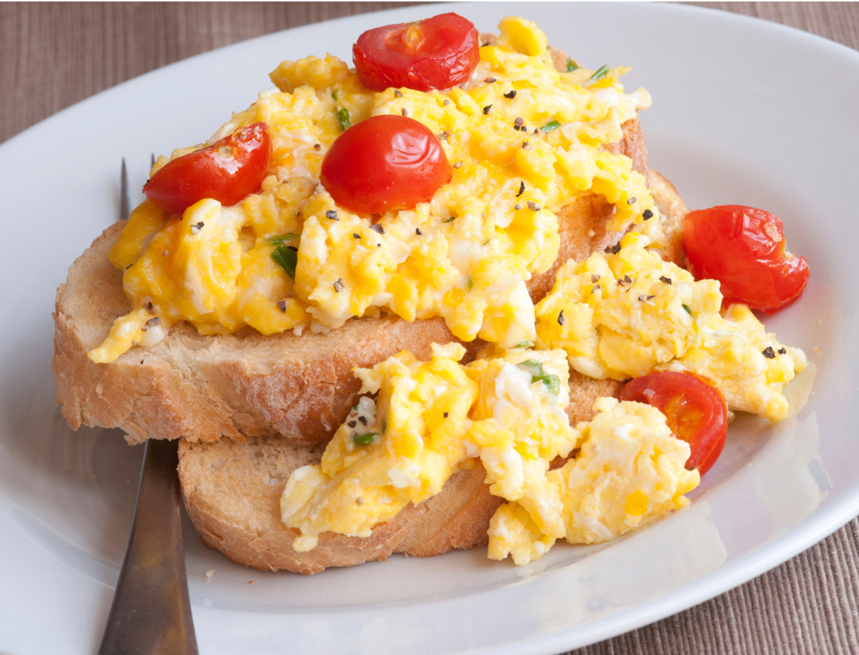
Cheesy eggs on toast (1)
Eggs for breakfast lunch and dinner.

Slide 32
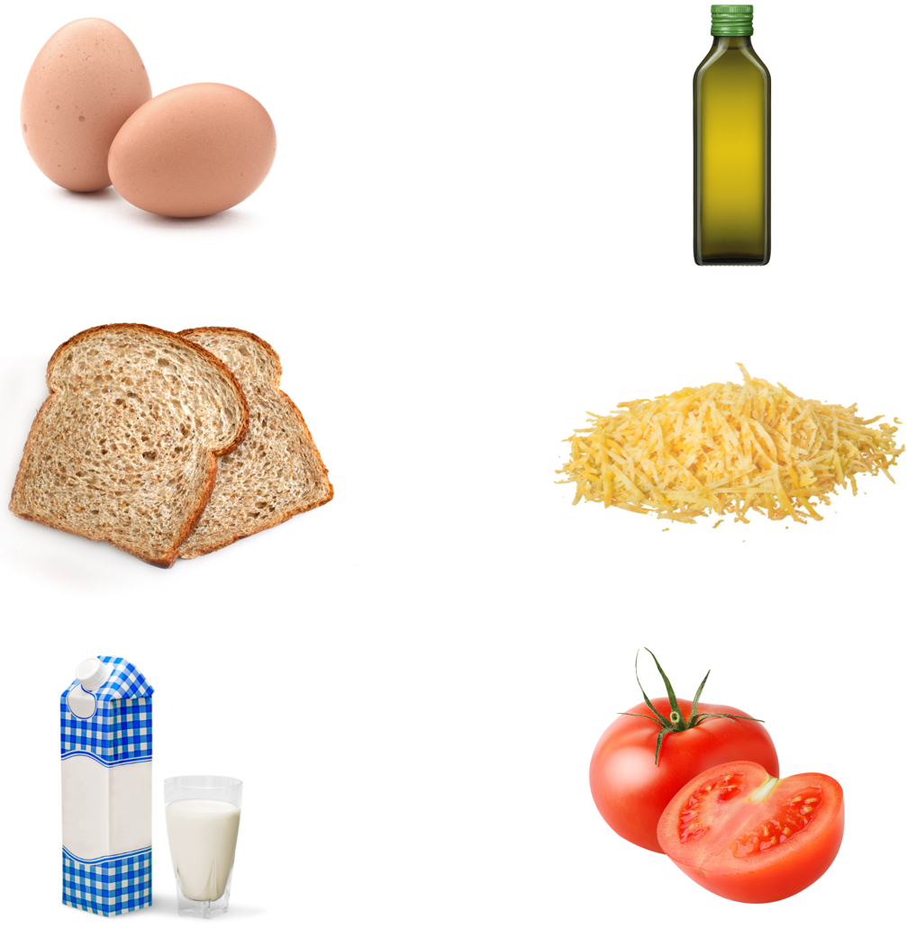
Cheesy eggs on toast (2)
Eggs for breakfast lunch and dinner

Slide 33
Do now scrambled activity (3)
Quick write
Using your knowledge of eggs as part of good nutrition ,use the Quick write technique to give ‘Scrambled’ ideas of how they could be used for good nutrition on a daily basis.

Slide 34
Learning intentions and success criteria (8)
We are learning about:
Egg substitutes.
We can:
Discuss the reasons for egg substitutes including allergies and intolerances.
Suggest substitutes for eggs that can be incorporated into everyday eating habits.
Investigate current products that are available as a substitute to eggs.
Notes:
Notes for teachers:
Learning intentions and success criteria are best co-constructed with students. Adapt the learning intention as required and add matching success criteria.
For more information See ⁠AITSL or the NSW Department of Education explicit teaching strategies, ⁠Sharing learning intentions and ⁠Sharing success criteria
LISC is not necessarily presented at the beginning of the lesson. Teacher needs to consider most effectual time to introduce
LISC should be revisited during the lesson to support students' evaluation of their learning

Slide 35
What if I can’t eat eggs?
Groups who can’t eat eggs
Some cultures
Lifestyle choices e.g. vegans
Medical reasons
Religious reasons e.g. Hinduism
Different lifecycle stages

Slide 36
Recipe using egg alternative
16 household substitutes for eggs to get you through the shortage SBS Food
Chocolate chip ingredients with eggs | Chocolate chip ingredients without eggs
150 g butter ½ C brown sugar ½ C caster sugar 1 egg 1 tsp vanilla extract 1 3/4C plain flour ½ C milk chocolate chip bits ½ C dark chocolate chip bits 1 tbsp extra milk chocolate chips 1 tbsp extra dark chocolate chips | 150 g butter ½ C brown sugar ½ C caster sugar ½ C mashed banana 1 tsp vanilla extract 1 3/4C plain flour ½ C milk chocolate chip bits ½ C dark chocolate chip bits 1 tbsp extra milk chocolate chips 1 tbsp extra dark chocolate chips

Slide 37
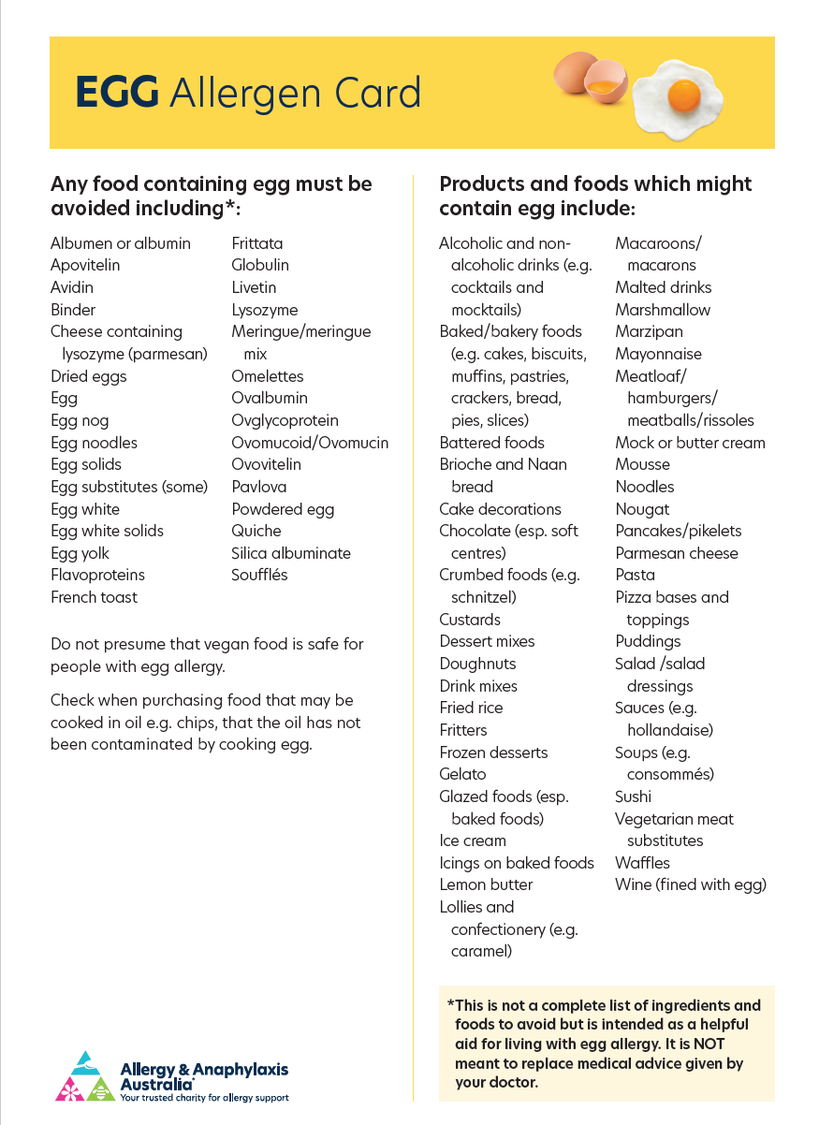
Egg Food Allergens
https://allergyfacts.org.au/allergy/egg/

Slide 38
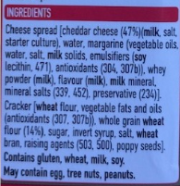
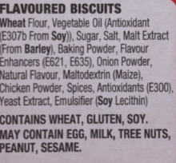
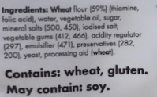
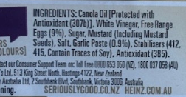
Do now scrambled activity (4)
Looking at the ingredients list identify which ingredients would contain egg product by highlighting or placing a circle around it. Choose one of these and write another substitute for it.

Slide 39
Learning intentions and success criteria (9)
We are learning about:
The sustainable and nutritional use of emu eggs.
We can:
Discuss the nutritional value of emu eggs.
Discuss the traditional process of obtaining emu eggs.
Provide examples of sustainable farming/harvesting of emu eggs and the reasons for such practices.
Notes:
Notes for teachers:
Learning intentions and success criteria are best co-constructed with students. Adapt the learning intention as required and add matching success criteria.
For more information See ⁠AITSL or the NSW Department of Education explicit teaching strategies, ⁠Sharing learning intentions and ⁠Sharing success criteria
LISC is not necessarily presented at the beginning of the lesson. Teacher needs to consider most effectual time to introduce
LISC should be revisited during the lesson to support students' evaluation of their learning

Slide 40
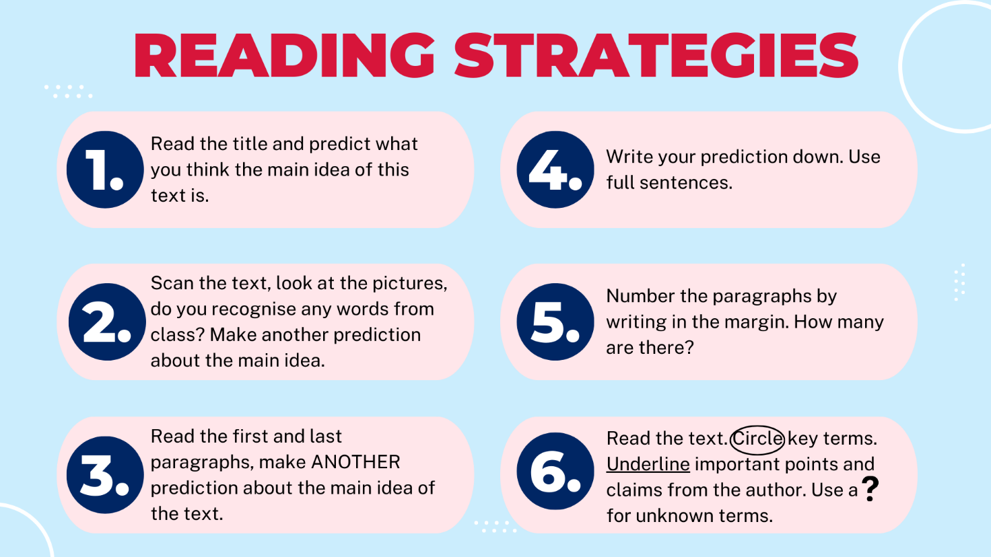
Reading strategies
Use the reading strategies below.

Slide 41

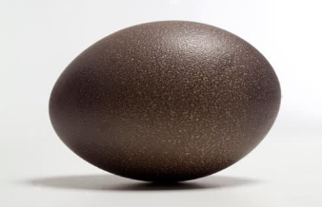
Emu egg
Did you know emu eggs are a nutritious, chef-approved ingredient with a deep Indigenous connection?

Slide 42

Watch Video (11)
In the footsteps of his great-grandmother, Jareece searches for emu eggs and his mob carve their history (2:30)

Slide 43
Learning intentions and success criteria (10)
We are learning to:
Use tools and equipment in the kitchen.
We can:
Identify and select tools and equipment required for food preparation.
Safely use tools and equipment for food preparation.
Use correct washing up procedures for equipment.
Notes:
Notes for teachers:
Learning intentions and success criteria are best co-constructed with students. Adapt the learning intention as required and add matching success criteria.
For more information See ⁠AITSL or the NSW Department of Education explicit teaching strategies, ⁠Sharing learning intentions and ⁠Sharing success criteria
LISC is not necessarily presented at the beginning of the lesson. Teacher needs to consider most effectual time to introduce
LISC should be revisited during the lesson to support students' evaluation of their learning

Slide 44
Do now scrambled activity (5)
Complete equipment find a word in the recipe book. Choose five pieces of equipment and write what they could be used for.

Slide 45
Learning intentions and success criteria (11)
We are learning to:
Use correct techniques and practices to produce food products.
We can:
Document additional techniques to create food items.
Follow a recipe and use preparation techniques and equipment to produce food items.
Describe and implement the safe practices to follow when using knives.
Notes:
Notes for teachers:
Learning intentions and success criteria are best co-constructed with students. Adapt the learning intention as required and add matching success criteria.
For more information See ⁠AITSL or the NSW Department of Education explicit teaching strategies, ⁠Sharing learning intentions and ⁠Sharing success criteria
LISC is not necessarily presented at the beginning of the lesson. Teacher needs to consider most effectual time to introduce
LISC should be revisited during the lesson to support students' evaluation of their learning

Slide 46

Watch Video (5)
Jamie Oliver on knife skills – 30-minute meals

Slide 47
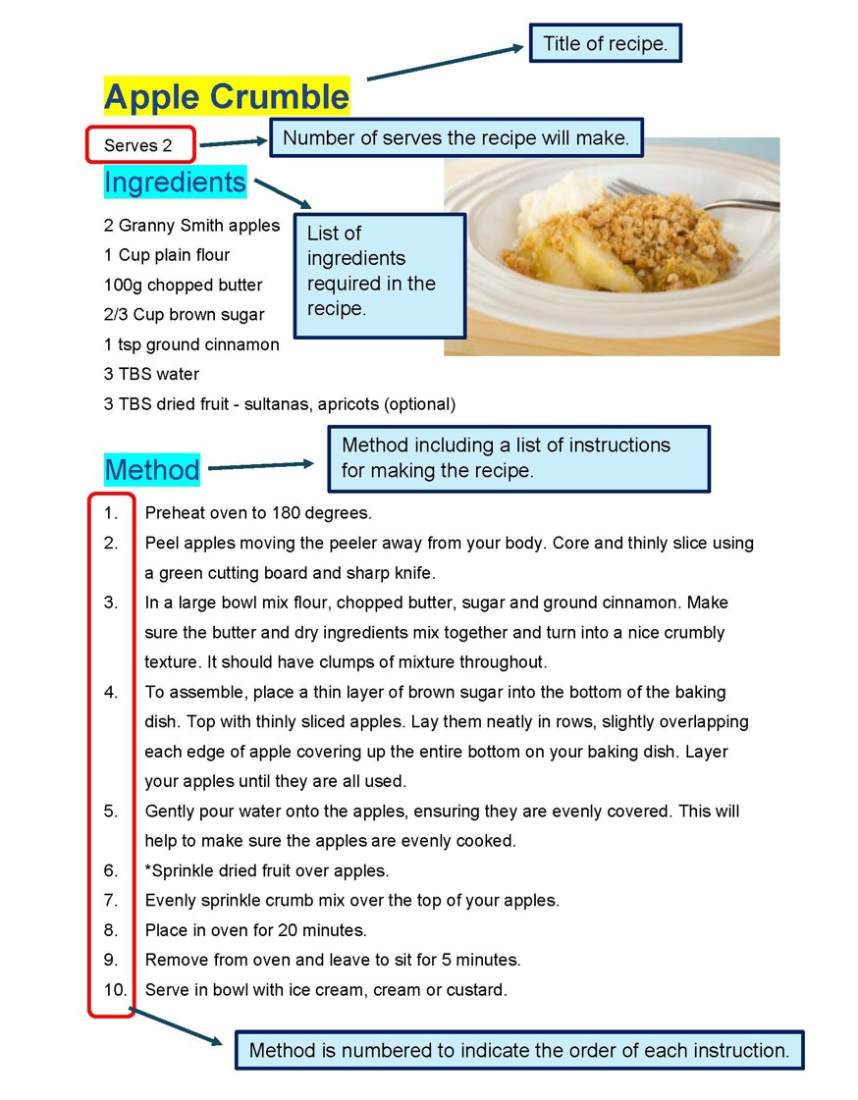
Structure of a recipe

Slide 48
Weeks 5–6

Slide 49
Do now scrambled activity (6)
Sketch a design on the emu egg template in your workbook that could be carved into an emu egg. What story are you leaving behind for future generations?

Slide 50
Learning intentions and success criteria (12)
We are learning to:
Identify the parts of an egg and their functions.
We can:
Identify the parts of an egg.
Describe the function of each part of an egg.
Notes:
Notes for teachers:
Learning intentions and success criteria are best co-constructed with students. Adapt the learning intention as required and add matching success criteria.
For more information See ⁠AITSL or the NSW Department of Education explicit teaching strategies, ⁠Sharing learning intentions and ⁠Sharing success criteria
LISC is not necessarily presented at the beginning of the lesson. Teacher needs to consider most effectual time to introduce
LISC should be revisited during the lesson to support students' evaluation of their learning

Slide 51

Watch Video (6)
How an egg forms

Slide 52
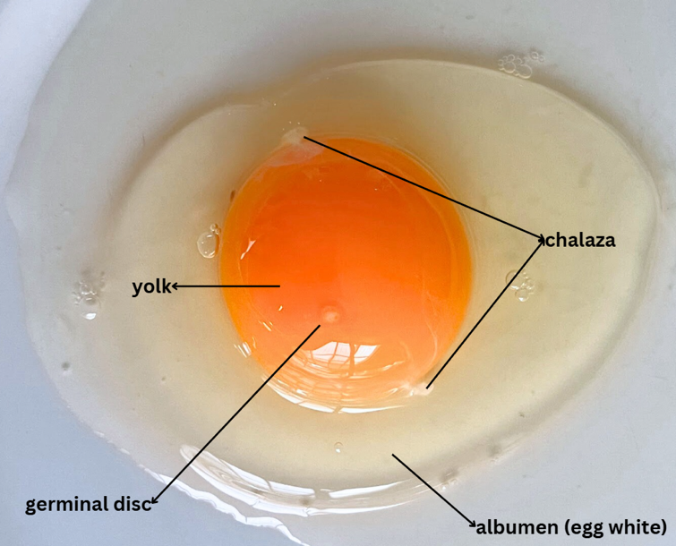

Parts of an egg

Slide 53
Parts of an egg labelled
Answer
Germinal disk
Egg yolk
Shell
Air cell
Albumen
Chalaza

Slide 54
Do now scrambled activity (7)
Choose one part of the egg structure, for example the air cell, and write a short story pretending to be its character. It is titled ‘Who am I?’.
The story must contain at least three important facts. In the story you could outline why you are there, what you do, how you change and how you work.
You may choose to draw your character as part of your story.

Slide 55
Learning intentions and success criteria (13)
We are learning to:
Understand the different functions of eggs in cooking.
We can:
Recall the functions of eggs in cooking.
Identify recipes where eggs are used for these functions.
Notes:
Notes for teachers:
Learning intentions and success criteria are best co-constructed with students. Adapt the learning intention as required and add matching success criteria.
For more information See ⁠AITSL or the NSW Department of Education explicit teaching strategies, ⁠Sharing learning intentions and ⁠Sharing success criteria
LISC is not necessarily presented at the beginning of the lesson. Teacher needs to consider most effectual time to introduce
LISC should be revisited during the lesson to support students' evaluation of their learning

Slide 56
Recipes that have eggs in them
Egg Recipes
Egg Recipes

Slide 57


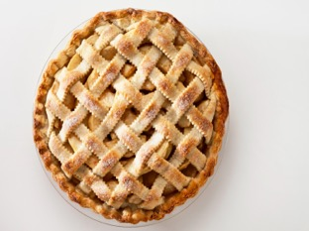
Functions of eggs
Some new words
Coagulation
Binding
Aeration
Egg wash
Emulsifier

Slide 58

Watch Video (7)
Let’s egg-splore

Slide 59
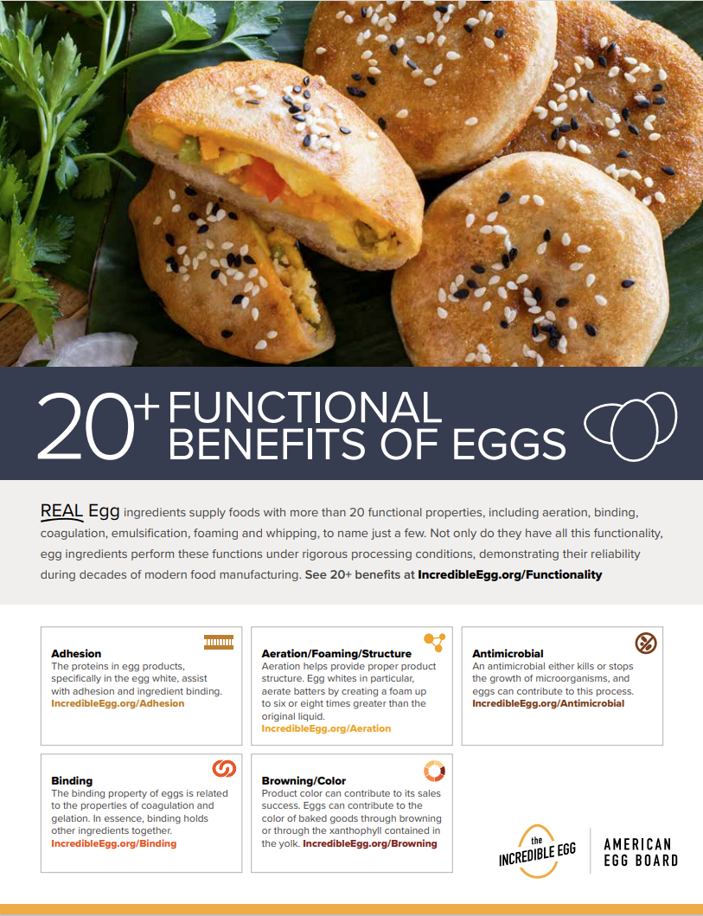
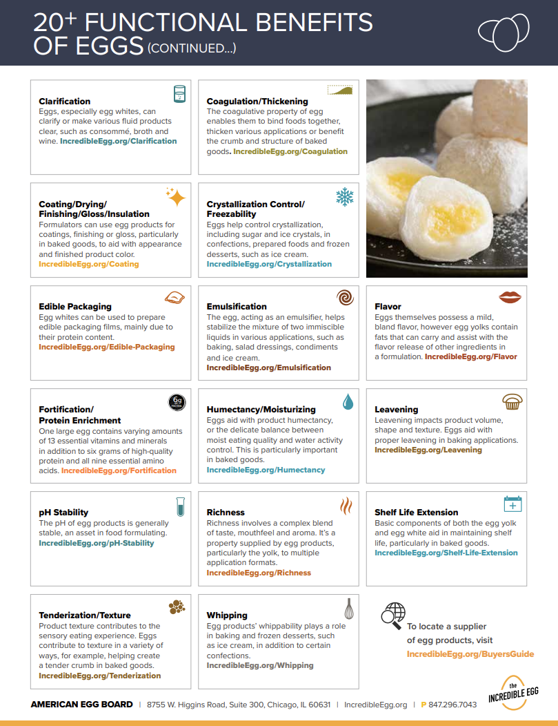
Functional Benefits of Eggs
AEB_20plus_FunctionalitySheet_2023.pdf

Slide 60
Functions of eggs (1)
Answers
Function | Definitions
Coagulation | Blending of two ingredients that do not normally combine, for example oil and water. Helps to join these ingredients in recipes such as cakes and mayonnaise.
Aeration and leavening | The coagulation of the egg proteins works like glue in joining ingredients together.
Emulsification | The process by which air is incorporated into food products to increase volume.
Binding | A mixture of beaten eggs and a liquid that is brushed onto baked goods such as pies, before baking to give them a shiny, golden-brown finish.
Egg wash | Changing from a liquid to a solid. When heated or cooled the proteins in eggs coagulate.

Slide 61
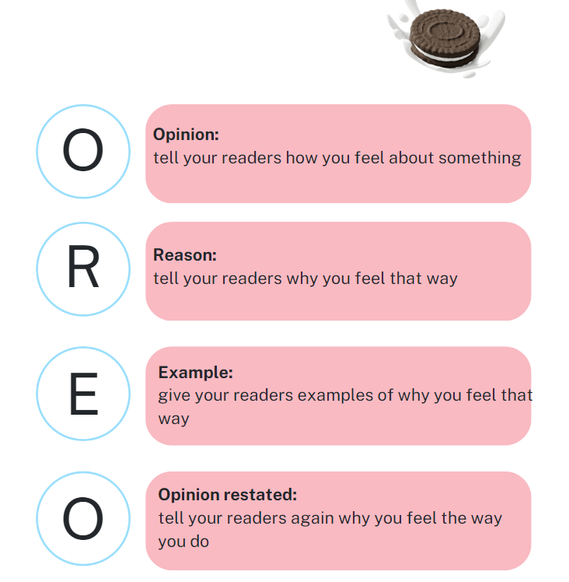
Persuasive writers remember their OREO’s
OREA opinion – an opinion is a belief, judgement or way of thinking about something
61

Slide 62
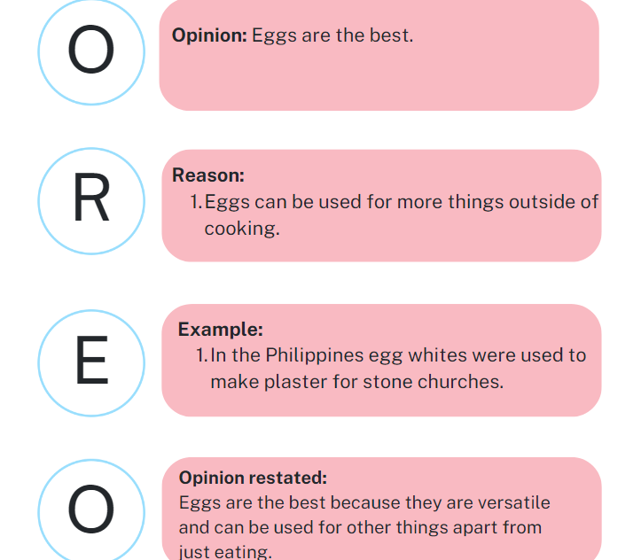
SBS Food
Separation of church and eggs: The surprising history of yolks and whites in the Philippines | SBS Food
What are some facts from this article that we could add to our persuasive argument?

Slide 63
Do now scrambled activity (8)
Complete the true/false activity in your workbook.

Slide 64
Learning intentions and success criteria (14)
We are learning about:
The different types of eggs available.
We can:
Identify the differences in eggs.
Explain how different eggs will impact on cooking.
Notes:
Notes for teachers:
Learning intentions and success criteria are best co-constructed with students. Adapt the learning intention as required and add matching success criteria.
For more information See ⁠AITSL or the NSW Department of Education explicit teaching strategies, ⁠Sharing learning intentions and ⁠Sharing success criteria
LISC is not necessarily presented at the beginning of the lesson. Teacher needs to consider most effectual time to introduce
LISC should be revisited during the lesson to support students' evaluation of their learning

Slide 65
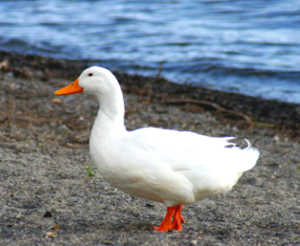
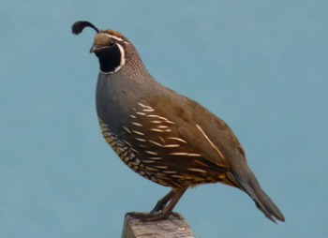
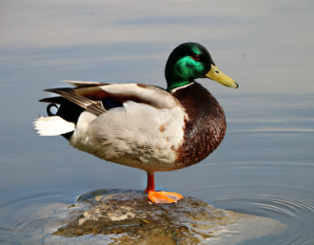
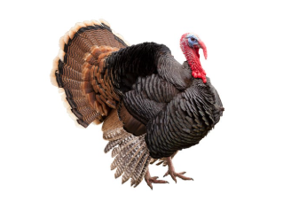
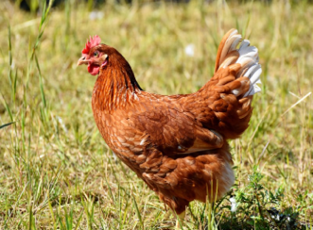
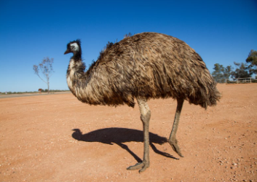
Meet the birds
goose
duck
chicken
quail
turkey
emu

Slide 66
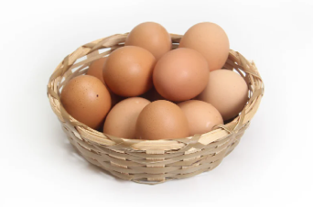
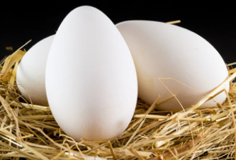
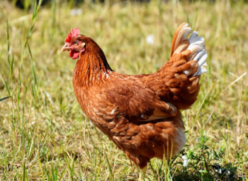

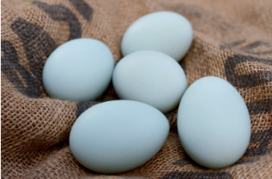
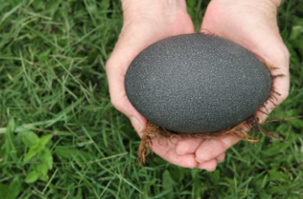


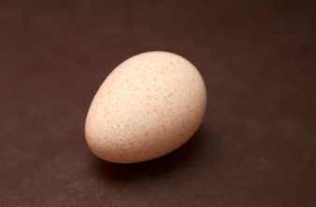



Which egg comes from which bird?
Drag and drop

Slide 67
Jigsaw activity
Topic – Bird/animal – Chicken
Response – Record key information/answers
Other important information/questions –

Slide 68








Egg cartons (1)
Spot the difference

Slide 69






Egg cartons (2)
Spot the difference

Slide 70
Learning intentions and success criteria (15)
We are learning to:
Identify initial ideas and opportunities for the assessment task.
We can:
Identify how an existing solution meets the assessment task.
Create initial ideas and questions to the brief.
Provide and receive feedback from peers.
Notes:
Notes for teachers:
Learning intentions and success criteria are best co-constructed with students. Adapt the learning intention as required and add matching success criteria.
For more information See ⁠AITSL or the NSW Department of Education explicit teaching strategies, ⁠Sharing learning intentions and ⁠Sharing success criteria
LISC is not necessarily presented at the beginning of the lesson. Teacher needs to consider most effectual time to introduce
LISC should be revisited during the lesson to support students' evaluation of their learning

Slide 71

Project development
Design and production process diagram

Slide 72
Help – We’re in a scramble!
Identifying and defining
Design situation
Help – we’re in a scramble!
Did you know, during 2022–2023 eggs made our country $1 194 700 000 (that means $1194 7 million dollars). Eggs are an important part of our country’s economy.
Design Brief
You are required to design and produced a product to encourage the purchase and continued use of our eggs in Australia.
You are required to design and produce your idea for an audience of your choosing. For example, the local community, school peers, teachers, parents, chicken etc.

Slide 73

Initial ideas
Brainstorm

Slide 74
Learning intentions and success criteria (16)
We are learning to:
Use correct techniques and practices to produce food products.
We can:
Follow a recipe and use preparation techniques and equipment to produce food items.
Identify and select tools and equipment required for food preparation.
Identify methods of cooking and function of eggs.
Notes:
Notes for teachers:
Learning intentions and success criteria are best co-constructed with students. Adapt the learning intention as required and add matching success criteria.
For more information See ⁠AITSL or the NSW Department of Education explicit teaching strategies, ⁠Sharing learning intentions and ⁠Sharing success criteria
LISC is not necessarily presented at the beginning of the lesson. Teacher needs to consider most effectual time to introduce
LISC should be revisited during the lesson to support students' evaluation of their learning

Slide 75
Weeks 7–8

Slide 76
Do now scrambled activity (9)
Complete the five-finger fact worksheet to recall five facts that you now know about eggs.

Slide 77
Learning intentions and success criteria (17)
We are learning about:
Australia's egg industry.
We can:
Recall the key features of Australia’s egg industry.
Identify the changes and trends in Australia’s egg industry.
Notes:
Notes for teachers:
Learning intentions and success criteria are best co-constructed with students. Adapt the learning intention as required and add matching success criteria.
For more information See ⁠AITSL or the NSW Department of Education explicit teaching strategies, ⁠Sharing learning intentions and ⁠Sharing success criteria
LISC is not necessarily presented at the beginning of the lesson. Teacher needs to consider most effectual time to introduce
LISC should be revisited during the lesson to support students' evaluation of their learning

Slide 78
‘Egg-sploration’ time (1)
Australian Egg Industry Overview
Fact 1. How many eggs are consumed each year in Australia?
Per capita, egg consumption grew to 263 eggs on 2022–2023, from 262 eggs in 2021–2022. With an average egg weighing 58 grams, this equals 15 kilograms of egg per person, per year.
What else weighs 15 kilograms?

Slide 79
‘Egg-sploration’ time (2)
Australian Egg Industry Overview
Fact 2. Where are eggs produced in Australia and who are our top egg-producing states?
In the 202–23 financial year. New South Wales produced 34.20 % of Australia's eggs with Queensland (31.25%) and Victoria (19.47%) not far behind.

Slide 80



‘Egg-sploration’ time (3)
Australian Egg Industry Overview
Fact 3.There are three main egg farming systems in Australia:
Free range, cage and barn-laid. Free range egg production has grown significantly over the last 15 years and now makes up to 56/5% of all grocery retails sales. There remains strong demand for cage and barn-laid eggs as an affordable source of high-quality protein.

Slide 81



Egg farming systems
PMI
Plus Identify the most positive aspects of each farming system | Minus Identify something that might be a negative of each farming system | Interesting What were you surprised about each farming system?

Slide 82

‘Egg-sploration’ time
Australian Egg Industry Overview
Fact 4. Egg production from 2016–2023

Slide 83
What’s trending?
Watch Future Farmers – Farming eggs in Australia

Slide 84

Do now scrambled activity (11)
In your workbook complete the sentence starter – “Technology has helped the egg industry by…’

Slide 85
Learning intentions and success criteria (18)
We are learning about:
The importance of caring for our laying hens.
We can:
Identify requirements of a chicken coop.
Explain what animal welfare issues are.
Assess a chicken coop according to animal welfare requirements.
Notes:
Notes for teachers:
Learning intentions and success criteria are best co-constructed with students. Adapt the learning intention as required and add matching success criteria.
For more information See ⁠AITSL or the NSW Department of Education explicit teaching strategies, ⁠Sharing learning intentions and ⁠Sharing success criteria
LISC is not necessarily presented at the beginning of the lesson. Teacher needs to consider most effectual time to introduce
LISC should be revisited during the lesson to support students' evaluation of their learning

Slide 86

Animal welfare
Complete pre-quiz Animal welfare what is it all about

Slide 87







Chicken coop
Nesting box
Perching space
Feeding station
Drinking station

Slide 88
Learning intentions and success criteria (19)
We are learning to:
Identify existing solutions for the assessment task.
We can:
Identify and evaluate existing solutions available.
Develop criteria for success for assessment task.
Notes:
Notes for teachers:
Learning intentions and success criteria are best co-constructed with students. Adapt the learning intention as required and add matching success criteria.
For more information See ⁠AITSL or the NSW Department of Education explicit teaching strategies, ⁠Sharing learning intentions and ⁠Sharing success criteria
LISC is not necessarily presented at the beginning of the lesson. Teacher needs to consider most effectual time to introduce
LISC should be revisited during the lesson to support students' evaluation of their learning

Slide 89

Watch Video – Pre-existing solutions
Googy Eggs Song

Slide 90
Learning intentions and success criteria (20)
We are learning to:
Use correct techniques and practices to produce food products.
We can:
Document additional techniques to create food items.
Follow a recipe and use preparation techniques and equipment to produce food items.
Use safe practices to avoid cross contamination of raw and cooked foods.
Identify methods of cooking and function of eggs.
Notes:
Notes for teachers:
Learning intentions and success criteria are best co-constructed with students. Adapt the learning intention as required and add matching success criteria.
For more information See ⁠AITSL or the NSW Department of Education explicit teaching strategies, ⁠Sharing learning intentions and ⁠Sharing success criteria
LISC is not necessarily presented at the beginning of the lesson. Teacher needs to consider most effectual time to introduce
LISC should be revisited during the lesson to support students' evaluation of their learning

Slide 91
Weeks 9–10

Slide 92
Do now scrambled activity (12)
Create an animal welfare slogan or design an idea for a sign to educate others on the importance of caring for laying hens and promoting their well-being.

Slide 93
Learning intentions and success criteria (21)
We are learning about:
How eggs are packaged and distributed.
We can:
Recall the process of how eggs are distributed.
Identify the legal requirements for egg packaging, labelling and distribution.
Notes:
Notes for teachers:
Learning intentions and success criteria are best co-constructed with students. Adapt the learning intention as required and add matching success criteria.
For more information See ⁠AITSL or the NSW Department of Education explicit teaching strategies, ⁠Sharing learning intentions and ⁠Sharing success criteria
LISC is not necessarily presented at the beginning of the lesson. Teacher needs to consider most effectual time to introduce
LISC should be revisited during the lesson to support students' evaluation of their learning

Slide 94


How do they get to me?
How are eggs packaged and distributed?
The journey of an egg
Future Farmers – Australian Agriculture – ABC Education (4:14 – 5:37)

Slide 95
Food labels
Food labels
Nutrition information panel
Shows average amount of energy, protein, fat, saturated fat, carbohydrate, sugars and sodium in 100g
FSANZ Food labels what do they mean?

Slide 96

Watch Video (9)
Egg-splore technology

Slide 97
Do now scrambled activity (13)
Choose one of the ‘You Can’t Say That’ activity cards and describe the supply chain stage in your workbook. Remember, you can’t use the words listed in the sheet.

Slide 98
Learning intentions and success criteria (22)
We are learning about:
How we keep our eggs safe for human consumption.
We can:
Recall how to manage biosecurity risks.
Notes:
Notes for teachers:
Learning intentions and success criteria are best co-constructed with students. Adapt the learning intention as required and add matching success criteria.
For more information See ⁠AITSL or the NSW Department of Education explicit teaching strategies, ⁠Sharing learning intentions and ⁠Sharing success criteria
LISC is not necessarily presented at the beginning of the lesson. Teacher needs to consider most effectual time to introduce
LISC should be revisited during the lesson to support students' evaluation of their learning

Slide 99
Learning intentions and success criteria (23)
We are learning to:
Develop a final concept for the assessment task.
We can:
Complete research to help us inform about the importance of eggs.
Brainstorm and evaluate development ideas.
Complete peer evaluation about our ideas.
Sketch our final idea for our assessment task.
Notes:
Notes for teachers:
Learning intentions and success criteria are best co-constructed with students. Adapt the learning intention as required and add matching success criteria.
For more information See ⁠AITSL or the NSW Department of Education explicit teaching strategies, ⁠Sharing learning intentions and ⁠Sharing success criteria
LISC is not necessarily presented at the beginning of the lesson. Teacher needs to consider most effectual time to introduce
LISC should be revisited during the lesson to support students' evaluation of their learning

Slide 100
Learning intentions and success criteria (24)
We are learning to:
Use correct techniques and practices to produce food products.
We can:
Document additional techniques to create food items.
Follow a recipe and use preparation techniques and equipment to produce food items.
Use safe practices to avoid cross contamination of raw and cooked foods.
Identify methods of cooking and function of eggs.
Notes:
Notes for teachers:
Learning intentions and success criteria are best co-constructed with students. Adapt the learning intention as required and add matching success criteria.
For more information See ⁠AITSL or the NSW Department of Education explicit teaching strategies, ⁠Sharing learning intentions and ⁠Sharing success criteria
LISC is not necessarily presented at the beginning of the lesson. Teacher needs to consider most effectual time to introduce
LISC should be revisited during the lesson to support students' evaluation of their learning

Slide 101
Weeks 11–12

Slide 102
Do now scrambled activity (14)
Complete the Egg Word Search and choose three words to define.

Slide 103
Learning intentions and success criteria (25)
We are learning about:
The impact that Australia’s food industry has on sustainability.
We can:
Recall what sustainability is.
Describe the impact the food industry has on sustainability.
Identify ways we can improve sustainability.
Notes:
Notes for teachers:
Learning intentions and success criteria are best co-constructed with students. Adapt the learning intention as required and add matching success criteria.
For more information See ⁠AITSL or the NSW Department of Education explicit teaching strategies, ⁠Sharing learning intentions and ⁠Sharing success criteria
LISC is not necessarily presented at the beginning of the lesson. Teacher needs to consider most effectual time to introduce
LISC should be revisited during the lesson to support students' evaluation of their learning

Slide 104

What is your environmental footprint?
Click on https://www.footprintcalculator.org/home/en

Slide 105

Home food audit
Watch Life of A Strawberry

Slide 106

Australian Seasonal Fruit Chart
https://www.coles.com.au/content/dam/coles/about-coles/supporting-aussie-producers/farm-to-store/fruit-and-veg/pdfs/Australian%20Seasonal%20Fruit%20Chart.pdf

Slide 107

What is being done – Nationally (1)
National Food Waste Strategy – Halving Australia's Food Waste by 2030

Slide 108

What is being done – Nationally (2)
A Roadmap for reducing Australia's food waste by half by 2030

Slide 109



What is being done – NSW
Love Food Hate Waste

Slide 110

What is being done – Locally
Inner West expanding food recycling to schools and childcare centres

Slide 111

Draft letter
Writing scaffolds

Slide 112
Learning intentions and success criteria (26)
We are learning to:
Plan and test our final product design.
We can:
Identify the equipment and materials for our product design.
Write a procedural text for how we will complete our product design.
Text our product design and identify any changes needed.
Notes:
Notes for teachers:
Learning intentions and success criteria are best co-constructed with students. Adapt the learning intention as required and add matching success criteria.
For more information See ⁠AITSL or the NSW Department of Education explicit teaching strategies, ⁠Sharing learning intentions and ⁠Sharing success criteria
LISC is not necessarily presented at the beginning of the lesson. Teacher needs to consider most effectual time to introduce
LISC should be revisited during the lesson to support students' evaluation of their learning

Slide 113
Learning intentions and success criteria (27)
We are learning to:
Use correct techniques and practices to produce food products.
We can:
Follow a recipe and use preparation techniques and equipment to produce food items.
Use safe practices to avoid cross contamination of raw and cooked foods.
Identify methods of cooking and function of eggs.
Notes:
Notes for teachers:
Learning intentions and success criteria are best co-constructed with students. Adapt the learning intention as required and add matching success criteria.
For more information See ⁠AITSL or the NSW Department of Education explicit teaching strategies, ⁠Sharing learning intentions and ⁠Sharing success criteria
LISC is not necessarily presented at the beginning of the lesson. Teacher needs to consider most effectual time to introduce
LISC should be revisited during the lesson to support students' evaluation of their learning

Slide 114
Weeks 13–14

Slide 115
Do now scrambled activity (16)
https://whiteboard.microsoft.com
Revise the various ways that National, State and local governments are attempting to reduce food waste and the impact that his has on our environment.

Slide 116
Learning intentions and success criteria (28)
We are learning about:
How our egg industry can help build a sustainable future.
We can:
Recall what the egg industry is doing to be sustainable.
Identify ways we can use household waste and food scraps to keep our chickens healthy.
Design sustainable food packaging.
Notes:
Notes for teachers:
Learning intentions and success criteria are best co-constructed with students. Adapt the learning intention as required and add matching success criteria.
For more information See ⁠AITSL or the NSW Department of Education explicit teaching strategies, ⁠Sharing learning intentions and ⁠Sharing success criteria
LISC is not necessarily presented at the beginning of the lesson. Teacher needs to consider most effectual time to introduce
LISC should be revisited during the lesson to support students' evaluation of their learning

Slide 117

Watch Video (10)
Australian egg industry sustainability

Slide 118




Feed lab cards (1)
Corn Nutritional Content: Carbohydrates: High Protein: Low (7%) Calcium: None Description – Corn is a great source of energy for hens. It’s a high-carbohydrate ingredient but lacks protein and calcium, so it needs to be balanced with other nutrient-rich ingredients. | Soybean meal Nutritional Content: Protein: High (44%) Fats: Low Calcium: None Description – Soybean Meal is an excellent source of protein, essential for egg production and muscle health. It should be used in combination with carbohydrate sources like corn. | Limestone Nutritional Content: Calcium: Very high (36%) Protein: None Carbohydrates: None Description – Limestone is crucial for strong eggshells, providing high levels of calcium. It’s essential to include this for egg-laying hens, but it should be balanced with protein and energy sources. | Sunflower seeds Nutritional Content: Fats: High (45%) Protein: Moderate (15%) Calcium: None Description – Sunflower seeds provide healthy fats and a moderate amount of protein, making them great for energy and maintaining the hens’ metabolism. However, they lack calcium. | Fish Meal Nutritional Content: Protein: Very high (65%) Vitamins: High (A,D) Calcium: Moderate Description – Fish meal is a high-protein ingredient that also provides vitamins A and D, helping to support overall health and egg production. It can be expensive, so use it sparingly in your mix.

Slide 119





Feed lab cards (2)
Alfalfa Nutritional Content: Fibre: High Vitamins: High (A,E,K) Protein: Moderate (17%) Description – Alfalfa is rich in fibre and vitamins, supporting digestion and general health. It also contains moderate protein, which is helpful for hens during egg production. | Molasses Nutritional Content: Carbohydrates: Very high (sugars) Protein: None Calcium: None Description – Molasses adds sweetness and energy to the feed, making it more palatable. However, it lacks protein and calcium, so it should be used in small amounts. | Bone Meal Nutritional Content: Calcium: Very high (32%) Phosphorus: High Protein: None Description – Bone meal is a great source of calcium and phosphorus, which are essential for eggshell strength. However, it needs to be balanced with protein and energy-rich ingredients. | Wheat Nutritional Content: Carbohydrates: High Protein: Moderate (12%) Calcium: Low Description – Wheat provides a good balance of energy and protein for hens, but it lacks calcium. It works well when combined with calcium-rich and high-protein ingredients. | Oats Nutritional Content: Carbohydrates: High Proteins: Moderate (13%) Calcium: Low Description – Oats are a good source of energy and provide some protein. They help with digestion but need to be combined with higher calcium and protein sources for laying hens.

Slide 120
Learning intentions and success criteria (29)
We are learning to:
Produce a product to encourage the purchase and continued use of eggs in Australia.
We can:
Follow a procedural text to complete an egg product.
Apply project management processes to complete the product design.
Notes:
Notes for teachers:
Learning intentions and success criteria are best co-constructed with students. Adapt the learning intention as required and add matching success criteria.
For more information See ⁠AITSL or the NSW Department of Education explicit teaching strategies, ⁠Sharing learning intentions and ⁠Sharing success criteria
LISC is not necessarily presented at the beginning of the lesson. Teacher needs to consider most effectual time to introduce
LISC should be revisited during the lesson to support students' evaluation of their learning

Slide 121
Learning intentions and success criteria (30)
We are learning to:
Use correct techniques and practices to produce food products.
We can:
Follow a recipe and use preparation techniques and equipment to produce food items.
Use safe practices to avoid cross contamination of raw and cooked foods.
Identify methods of cooking and function of eggs.
Notes:
Notes for teachers:
Learning intentions and success criteria are best co-constructed with students. Adapt the learning intention as required and add matching success criteria.
For more information See ⁠AITSL or the NSW Department of Education explicit teaching strategies, ⁠Sharing learning intentions and ⁠Sharing success criteria
LISC is not necessarily presented at the beginning of the lesson. Teacher needs to consider most effectual time to introduce
LISC should be revisited during the lesson to support students' evaluation of their learning

Slide 122
Weeks 15–16

Slide 123
Do now scrambled activity (17)
Brainstorm
Complete a brainstorm of other ways eggs might be able to be used outside of cooking.

Slide 124
Learning intentions and success criteria (31)
We are learning about:
Alternate uses for eggs outside of cooking.
We can:
Recall different uses of eggs.
Demonstrate how eggs can be used other than cooking.
Write a creative piece about eggs.
Notes:
Notes for teachers:
Learning intentions and success criteria are best co-constructed with students. Adapt the learning intention as required and add matching success criteria.
For more information See ⁠AITSL or the NSW Department of Education explicit teaching strategies, ⁠Sharing learning intentions and ⁠Sharing success criteria
LISC is not necessarily presented at the beginning of the lesson. Teacher needs to consider most effectual time to introduce
LISC should be revisited during the lesson to support students' evaluation of their learning

Slide 125
Learning intentions and success criteria (32)
We are learning to:
Evaluate our peer’s egg product design.
We can:
Complete a gallery walk to observe the different egg product designs.
Provide feedback to peers about their egg product design.
Notes:
Notes for teachers:
Learning intentions and success criteria are best co-constructed with students. Adapt the learning intention as required and add matching success criteria.
For more information See ⁠AITSL or the NSW Department of Education explicit teaching strategies, ⁠Sharing learning intentions and ⁠Sharing success criteria
LISC is not necessarily presented at the beginning of the lesson. Teacher needs to consider most effectual time to introduce
LISC should be revisited during the lesson to support students' evaluation of their learning

Slide 126
Peer evaluation gallery walks
Gallery walks
TAG feedback

Slide 127
Weeks 17–18

Slide 128
Learning intentions and success criteria (33)
We are learning to:
Use and celebrate eggs in a full menu design.
We can:
Identify suitable eggs recipes for several meal types throughout the day.
Complete a food order for the egg cafe.
Notes:
Notes for teachers:
Learning intentions and success criteria are best co-constructed with students. Adapt the learning intention as required and add matching success criteria.
For more information See ⁠AITSL or the NSW Department of Education explicit teaching strategies, ⁠Sharing learning intentions and ⁠Sharing success criteria
LISC is not necessarily presented at the beginning of the lesson. Teacher needs to consider most effectual time to introduce
LISC should be revisited during the lesson to support students' evaluation of their learning

Slide 129
Learning intentions and success criteria (34)
We are learning to:
Use correct techniques and practices to produce food products.
We can:
Follow a recipe and use preparation techniques and equipment to produce food items.
Use safe practices to avoid cross contamination of raw and cooked foods.
Identify methods of cooking and function of eggs.
Notes:
Notes for teachers:
Learning intentions and success criteria are best co-constructed with students. Adapt the learning intention as required and add matching success criteria.
For more information See ⁠AITSL or the NSW Department of Education explicit teaching strategies, ⁠Sharing learning intentions and ⁠Sharing success criteria
LISC is not necessarily presented at the beginning of the lesson. Teacher needs to consider most effectual time to introduce
LISC should be revisited during the lesson to support students' evaluation of their learning

Slide 130
Weeks 19–20

Slide 131
Do now scrambled activity (18)
Egg café PMI
Plus Identify the most positive aspects | Minus Identify something that might be a negative | Interesting What is interesting about the egg café design?

Slide 132
Learning intentions and success criteria (35)
We are learning to:
Showcase eggs.
We can:
Complete a recipe that uses eggs.
Use our egg product design to showcase eggs to others.
Notes:
Notes for teachers:
Learning intentions and success criteria are best co-constructed with students. Adapt the learning intention as required and add matching success criteria.
For more information See ⁠AITSL or the NSW Department of Education explicit teaching strategies, ⁠Sharing learning intentions and ⁠Sharing success criteria
LISC is not necessarily presented at the beginning of the lesson. Teacher needs to consider most effectual time to introduce
LISC should be revisited during the lesson to support students' evaluation of their learning

Slide 133
References (1)
This presentation contains NSW Curriculum and syllabus content. The NSW Curriculum is developed by the NSW Education Standards Authority. This content is prepared by NESA for and on behalf of the Crown in the right of the State of New South Wales. The material is protected by Crown copyright.
Please refer to the NESA Copyright Disclaimer for more information https://educationstandards.nsw.edu.au/wps/portal/nesa/mini-footer/copyright.
NESA holds the only official and up-to-date versions of the NSW Curriculum and syllabus documents. Please visit the NSW Education Standards Authority (NESA) website https://educationstandards.nsw.edu.au/wps/portal/nesa/home and the NSW Curriculum website https://curriculum.nsw.edu.au.
Technology 7–8 © Syllabus NSW Education Standards Authority (NESA) for and on behalf of the Crown in right of the State of New South Wales, 2023.
FreeWordCloudGenerator free word cloud generator, ©2025 FreeWordCloudGenerator, accessed 21 January 2025.
NSW Food Authority (May 2020) Safe preparation of raw egg products [website].NSW Food Authority accessed 28 January 2025.
Australian Eggs (2024) How to tell if eggs are bad, Australian Eggs, accessed 8 April 2025.
Australian Eggs Limited (31 January 2014) How an egg forms [video], Australian Eggs, YouTube, accessed 21 January 2025.
American Egg Board (2023) AEB_20plus_FunctionalitySheet_2023.pdf, © 2023 American Egg Board, accessed 21 January 2025.

Slide 134
References (2)
Nikki Alfonso-Gregorio (23 February 2022) Separation of church and eggs: The surprising history of yolks and whites in the Philippines | SBS Food, SBS Food, accessed 21 January 2025.
NSW Department of Education. (n.d.). jigsaw [website]. NSW Department of Education, accessed 28 January 2025.
Incredible Egg (22 July 2020) Wednesday Is Officially Weggsday! [video], Incredible Eggs, YouTube, accessed 21 January 2025.
Australian Eggs (2024) Animal Welfare – What it is all about? (Interactive) - Australian Eggs., accessed 8 April 2025
NSW DPI Schools Program (3 June 2019) Numeralla free-range egg farm at TOCAL [video], NSW DPI Schools Program, YouTube, accessed 21 January 2025.
George the Farmer (10 August 2022) Googy Eggs Song from 'Farm Hits for Kids' album by George the Farmer[video], George the Farmer, YouTube, accessed 21 January 2025.
Australian Eggs Limited (2024) PIEFA Food and Fibre Card Game – Australian Eggs Supply Chain,, accessed 10 April 2025
2002 - 2025 Australian Eggs Limited (2002–2025 ) Egg Types & Labels: A Guide For Choosing The Right Eggs, accessed 10 April 2025.
Australian Eggs Limited (2024) You Can't Say That, accessed 10 April 2025

Slide 135
References (3)
Project Zero, Harvard Graduate School of Education (n.d.) Thinking routine - What Makes You Say That, ©2011 President and Fellows of Harvard College, accessed 21 January 2025.
Australian Eggs Limited (2024) Student-Worksheet-7-8-Lesson-5.pdf, accessed 10 April 2025.
Wikipedia (5 December 2024) Wikipedia, accessed 21 January 2025.
Coles (May 2019) Australian Seasonal Fruit Chart.pdf, Coles, accessed 21 January 2025.
Inner West Council (9 December 2024) Inner West expanding food recycling to schools and childcare centres – Inner West Council, Inner West Council ,accessed 21 January 2025.
NSW Department of Education. (n.d.). Writing scaffolds [website]. NSW Department of Education, accessed 28 January 2025.
Muru Mittigar Limited (2025) Discovering the Marvels of the Australian Paper Bark Tree, Muru Mittigar Limited – © 2023, accessed 21 January 2025.
Stephen Dowling (21 March 2013) The egg box that updates a humble yet classic design (bbc.com), BBC, accessed 21 January 2025.
Brand and Packaging (1 April 2015) 20+ Egg Packaging Designs - Design & Paper, Design and Paper, accessed 21 January 2025.

Slide 136
References (4)
The Official Stellenbosch Academy Blog (July 14 2013) Eva Valicsek – Egg Packaging Redesign | The Official Stellenbosch Academy Blog (wordpress.com), The Official Stellenbosch Academy Blog, accessed 21 January 2025.
ABC Lifestyle (12 December 2024) The best way to store eggs and how to know if they've gone bad (msn.com) accessed 21 January 2025.
Youbeauty (11 June 2015) 11 Ways to Use Eggs as a Beauty Product | YouBeauty , accessed 21 January 2025.
Twin Science (27 July 2021) How to make glue with egg white? [video], Twin Science, YouTube, accessed 21 January 2025
NSW Department of Education. (n.d.). Gallery walks [website]. NSW Department of Education, accessed 28 January 2025.
Bianca Soldani (16 June 2016) 16 household substitutes for eggs to get you through the shortage | SBS Food, SBS Food, accessed 10 April 2025.
Allergy and Anaphylaxis Australia (2025), Egg – Allergy & Anaphylaxis Australia, accessed 10 April 2025.

Slide 137
Copyright
© State of New South Wales (Department of Education), 2025
The copyright material published in this resource is subject to the Copyright Act 1968 (Cth) and is owned by the NSW Department of Education or, where indicated, by a party other than the NSW Department of Education (third-party material).
Copyright material available in this resource and owned by the NSW Department of Education is licensed under a Creative Commons Attribution 4.0 International (CC BY 4.0) license.
This license allows you to share and adapt the material for any purpose, even commercially.
Attribution should be given to © State of New South Wales (Department of Education), 2025.
Material in this resource not available under a Creative Commons license:
the NSW Department of Education logo, other logos and trademark-protected material
Material owned by a third party that has been reproduced with permission. You will need to obtain permission from the third party to reuse its material.
Links to third-party material and websites
Please note that the provided (reading/viewing material/list/links/texts) are a suggestion only and implies no endorsement, by the New South Wales Department of Education, of any author, publisher, or book title. School principals and teachers are best placed to assess the suitability of resources that would complement the curriculum and reflect the needs and interests of their students.
If you use the links provided in this document to access a third-party’s website, you acknowledge that the terms of use, including licence terms set out on the third-party’s website apply to the use which may be made of the materials on that third-party website or where permitted by the Copyright Act 1968 (Cth). The department accepts no responsibility for content on third-party websites.

