Slide 1
Instructions for use
This resource is not a teaching and learning program. It should be used in conjunction with Technology 7–8 – Heli Launcher – sample program of learning
Classroom teachers are encouraged to add and adapt slides as required to meet the needs of their students
Save a copy of the file to make changes to the slide deck – go to File > Download a Copy (this downloads a copy to the computer to edit in the PowerPoint app).
To convert the PowerPoint to Google Slides:
  Upload the file into Google Drive and open it.
  Go to File > Save as Google Slides.

Slide 2
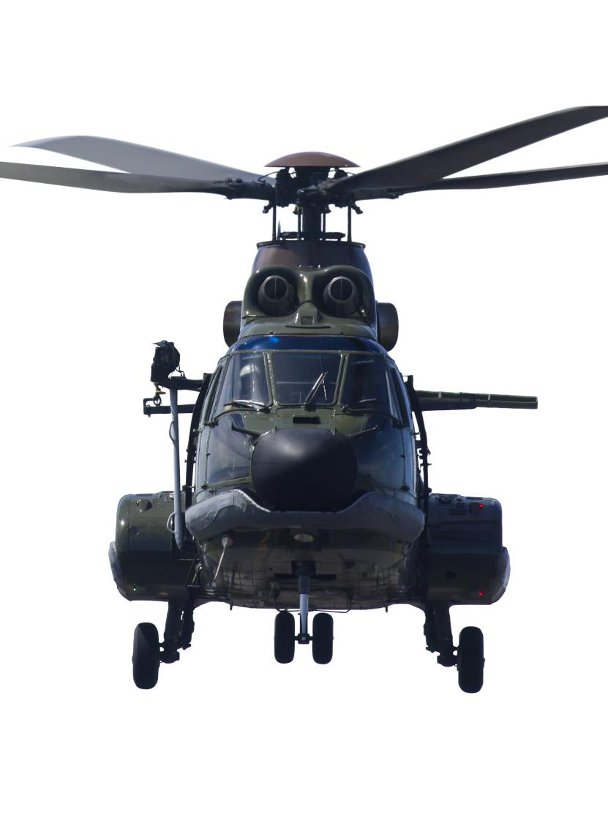
Heli Launcher
Stage 4
Engineering technologies and systems focus area
Technology 7–8

Slide 3
Weeks 1–2

Slide 4
Learning intention and success criteria (1)
We are learning to
understand how objects achieve lift to glide or fly.
We can
explain how helicopters fly
understand how to safely use workshop tools, machines and equipment.
Notes:
Notes for teachers:
Learning intentions and success are best co-constructed with students. Adapt the learning intention as required and add co-constructed success criteria.

Slide 5

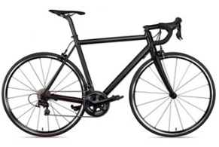
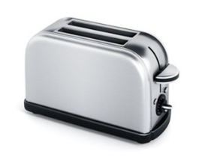
Introduction to engineering systems
Engineered products
Think, pair, share – what engineering systems have you used today?
Engineered product | How it might work | Materials used
Toaster | The toaster has an element on either side of the bread to toast it. As it heats up the bread cooks. | Steel for the body of the toaster, copper for the wiring to the power point, plastic.

Slide 6
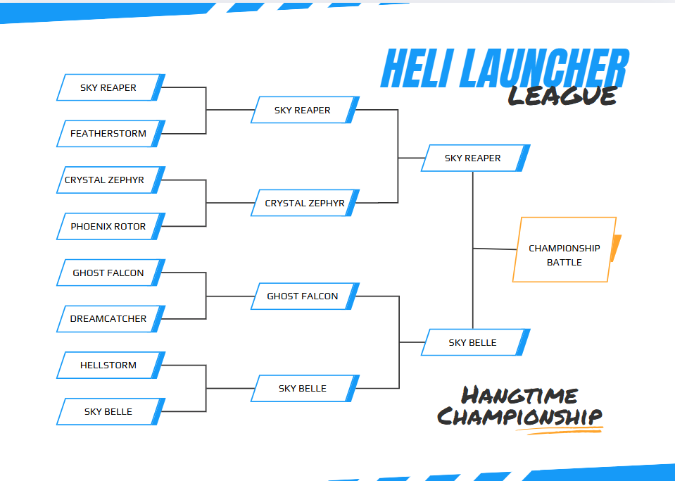
Heli Launcher League (1)

Slide 7
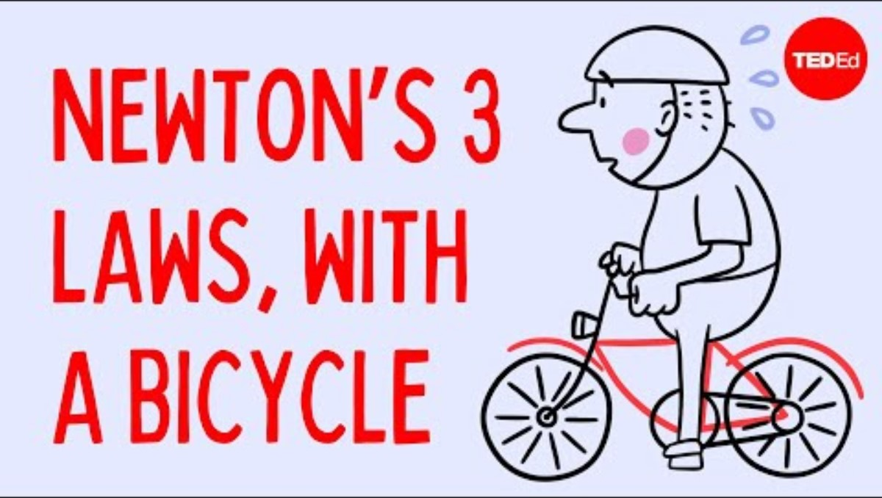
Force, motion and energy
Newton’s 3 laws, with a bicycle
Watch Newton’s 3 Laws, with a bicycle (3:32)
What is Newton's First Law of Motion, and how does it relate to the concept of inertia? Provide an example from everyday life.
According to Newton's Second Law, what is the relationship between force, mass, and acceleration?
Have you ever experienced the effects of inertia when riding a bicycle? Explain a situation where you noticed it.
Why is it harder to start pedalling a bicycle compared to maintaining its speed once it's moving?

Slide 8
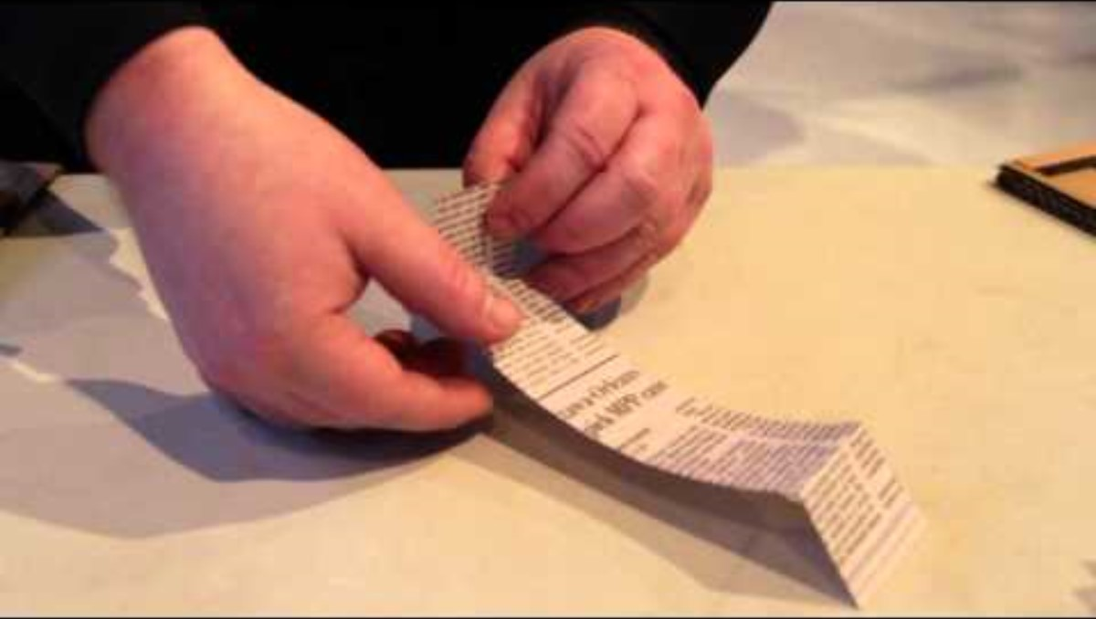
Flight (1)
Tumblewing flyer relay
Watch How to make a tumblewing walkalong flyer (2:27)
Practical activity
Make a tumblewing flyer, practice flying it and then have a relay race.
Brainstorm answers to the questions below.
Reflection questions
How does the tumblewing fly?
How does the cardboard help the tumblewing stay in the air?

Slide 9
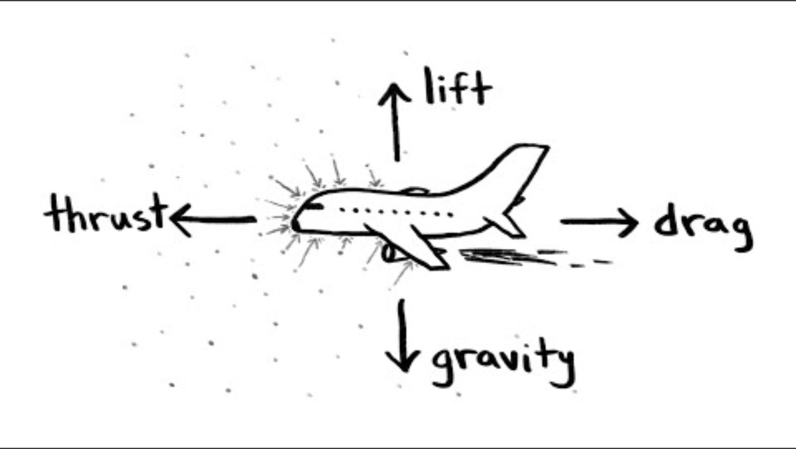
Flight (2)
Generating lift
Watch How do airplanes fly? (3:10)
Change the shape of the aerofoil below to create more lift. Annotate your sketch to explain why your shape generates lift.

Slide 10

Flight (3)
Identify flight characteristics applied to helicopters
Watch How does a helicopter work: Everything you need to know about helicopters (7:58)
Label the diagram of the helicopter to define lift, weight, thrust and drag.
Explain how each force effects flight.

Slide 11
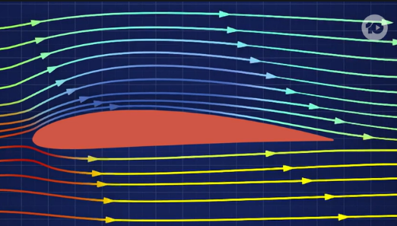

Flight (4)
Boomerang flight
Watch The First Inventors season 1, episode 4 (0:00 – 12:34, 26:20 – 31:30)
Complete the questions in your workbook as you watch the UNSW students develop a drone using Boomerangs.
Notes:
Teacher note: You will need to be logged into 10play to view to video.
How to Create a 10play Account
Go to the 10play website: Visit www.10play.com.au on your web browser.
Click on 'Sign In': Look for the 'Sign In' button, located at the top right corner of the homepage. Select ‘Sign up’ button at the top of the pop up.
Enter your details: Provide your email address, create a password, and enter any other required information.
Verify your email: Check your email inbox for a verification message from 10play and click the verification link to activate your account.
Log in: Return to the 10play website and click 'Log In.' Enter your email and password to access the video content.
Access the video: Use the provided link to the video. You will need to be logged in to watch it.

Slide 12
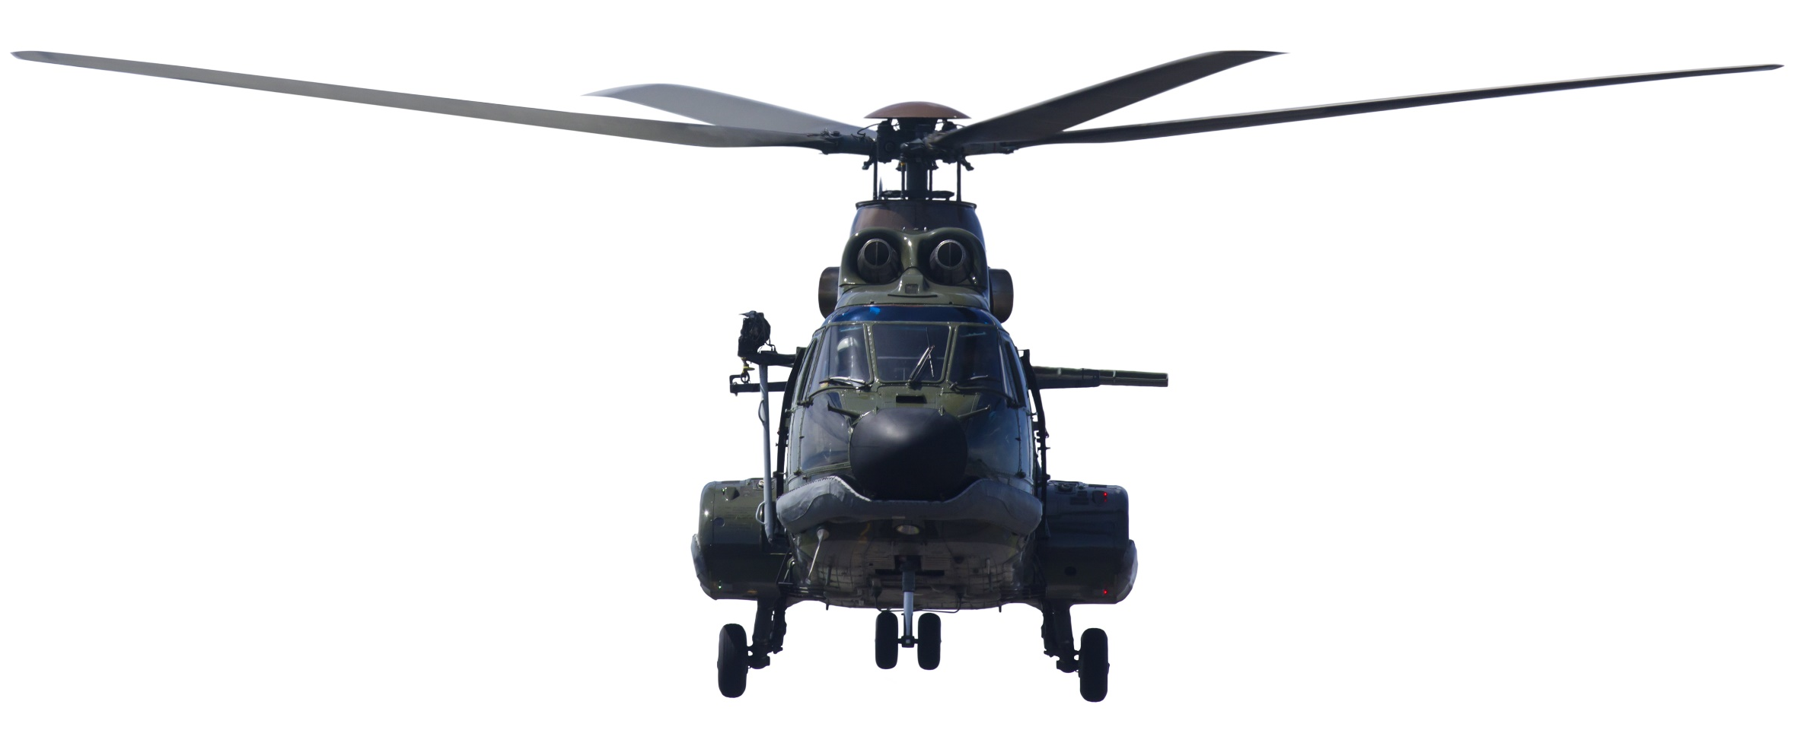
Rotor design (1)
Rotor blade materials
Brainstorm the types of materials that could be used for real helicopter blades and toy helicopter blades.
Real helicopter blades | Prototype toy helicopter blades

Slide 13
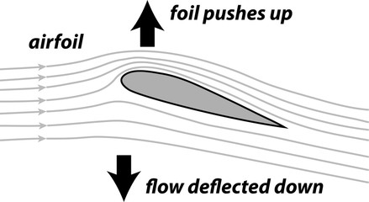
Rotor design (2)
Ideas Development
Think Pair Share – Form into groups of 3–5, each student completes an annotated sketch of an aerofoil idea. Within your groups, share your understanding of how your idea will work.

Slide 14

Rotor design (3)
Ideas sketches
Individually, produce 4 annotated sketches for aerofoil ideas.
Sketch
Annotation
This rotor blade is like a plane wing. The shape and angle of the aerofoil causes air travels faster over the wing resulting in higher air pressure under the wing. This can cause lift.

Slide 15

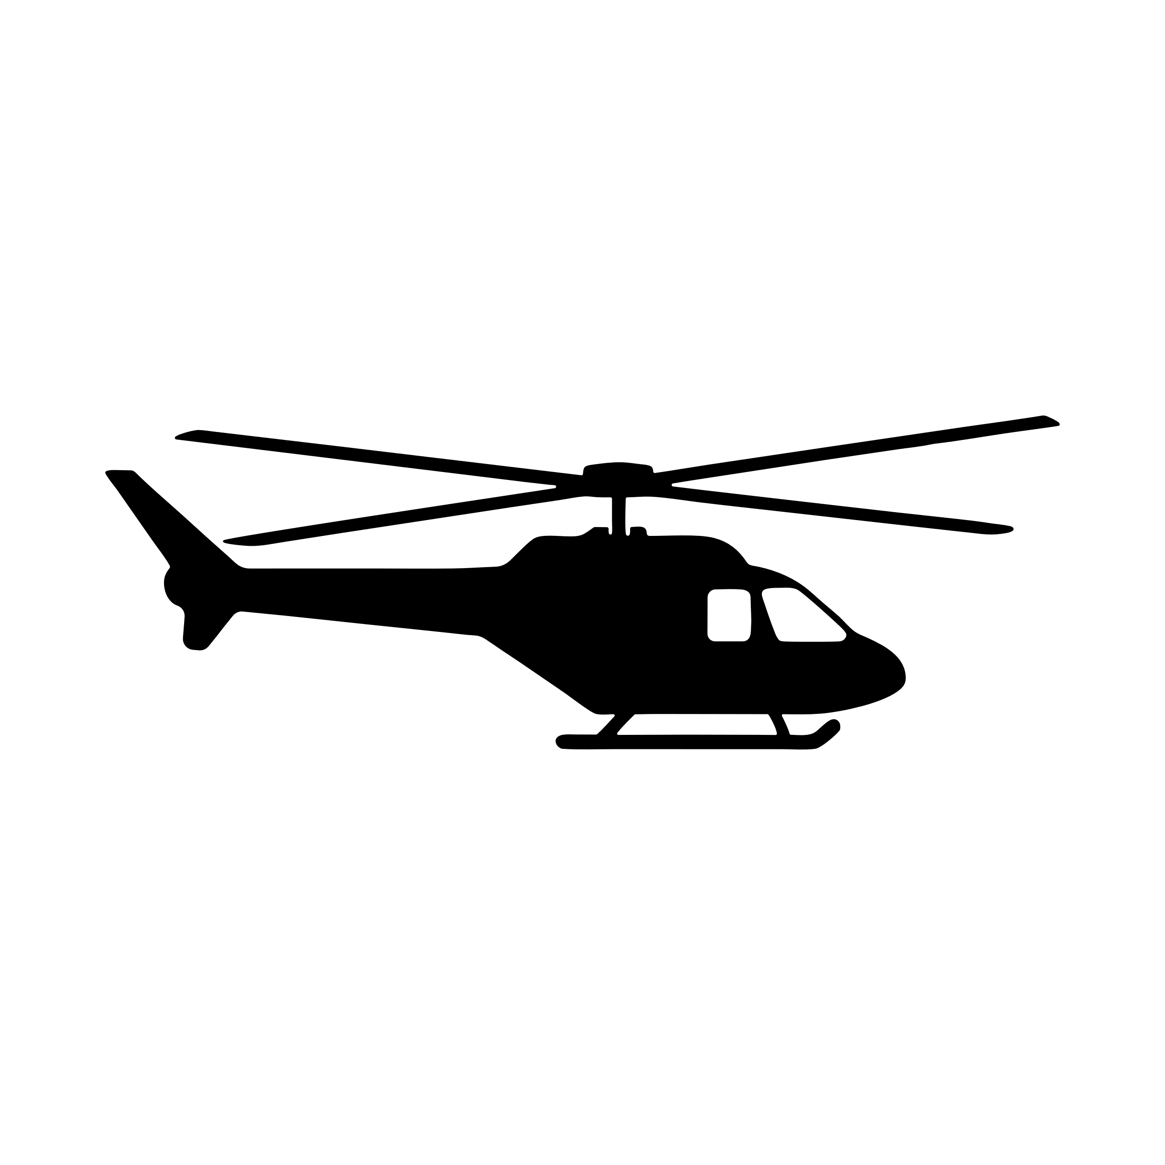
End of section student skills formative assessment checklist (1)
Students can | Checkbox
explain how planes and helicopters fly.

Slide 16
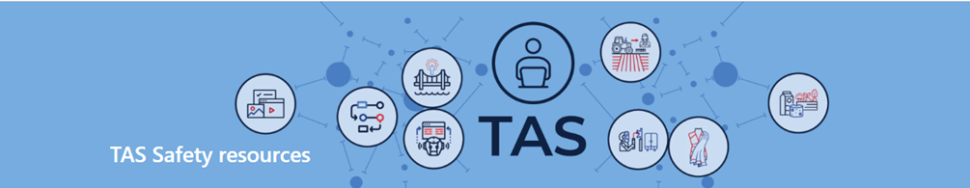
Safety
Safety rules and hazards in the timber workshop
Watch timber technology workshop walkthrough (5:37) (DoE staff only) and discuss as a class.
Complete safety tests as directed.

Slide 17
End of section student skills formative assessment checklist (2)
Students can | Checkbox
Know the safety requirements for the workshop, tools, equipment and machines.

Slide 18
Weeks 3–4

Slide 19
Learning intention and success criteria (2)
We are learning to
apply safe production techniques to make components of engineered systems.
We can
safely and accurately produce components for an engineered solution
test, collaboratively evaluate and apply rectification measures.
Notes:
Notes for teachers:
Learning intentions and success are best co-constructed with students. Adapt the learning intention as required and add co-constructed success criteria.

Slide 20
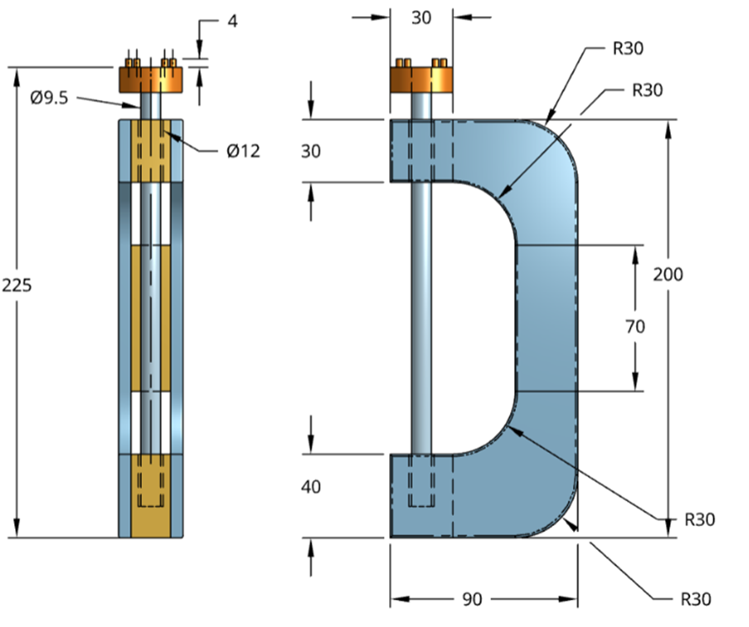
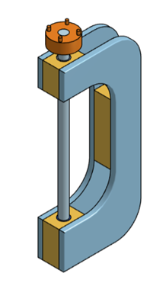
Launcher (1)
Manufacture

Slide 21
Launcher (2)
Peer and self-evaluation
Quality control record
Production step | Describe what have you done well | Describe what could be improved

Slide 22
End of section student skills formative assessment checklist (3)
Students can | Checkbox
Accurately and safely produce components for an engineered solution
Evaluate and apply rectification measures.

Slide 23
Weeks 5–6

Slide 24
Learning intention and success criteria (3)
We are learning to
develop and communicate engineering ideas.
We can
produce a drawing to aid with the production of an engineered solution.
Notes:
Notes for teachers:
Learning intentions and success are best co-constructed with students. Adapt the learning intention as required and add co-constructed success criteria.

Slide 25
Communicating engineering ideas
CAD

Slide 26
End of section student skills formative assessment checklist (4)
Students can | Checkbox
Produce a drawing to aid with the production of an engineered solution.

Slide 27
Learning intention and success criteria (4)
We are learning to
understand how materials’ properties impact their suitability.
We can
identify suitable materials to use in each component and explain why.
Notes:
Notes for teachers:
Learning intentions and success are best co-constructed with students. Adapt the learning intention as required and add co-constructed success criteria.

Slide 28
Materials (1)
Material properties applied to engineering projects
Jigsaw – form into groups of 3–5 students, each group researches and describes the properties of one material.
Share your understanding of the material with the other students in your group.
The group selects and justifies the most appropriate materials.
Potential materials to consider:
Timber – for example, radiata pine or balsa
Metal – for example, aluminium or mild steel
Composite – for example, plywood or cardboard
Polymer – for example, acrylic or PVC.

Slide 29
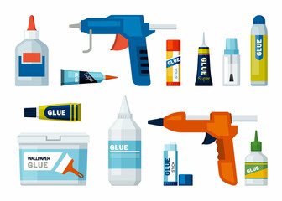
Materials (2)
Adhesives
Use the information in your workbook, to rank the adhesives from most to least suitable for your launcher.
Adhesive | Rank
Contact adhesive
Epoxy
PVA (polyvinyl acetate)
Hot glue
Gorilla glue

Slide 30
End of section student skills formative assessment checklist (5)
Students can | Checkbox
Identify materials to use in each component and explain why.

Slide 31
Weeks 7–8

Slide 32
Learning intention and success criteria (5)
We are learning to
to use materials, components, processes and technologies to make engineering projects.
We can
safely and accurately produce components for an engineered solution
test, collaboratively evaluate and apply rectification measures.
Notes:
Notes for teachers:
Learning intentions and success are best co-constructed with students. Adapt the learning intention as required and add co-constructed success criteria.

Slide 33
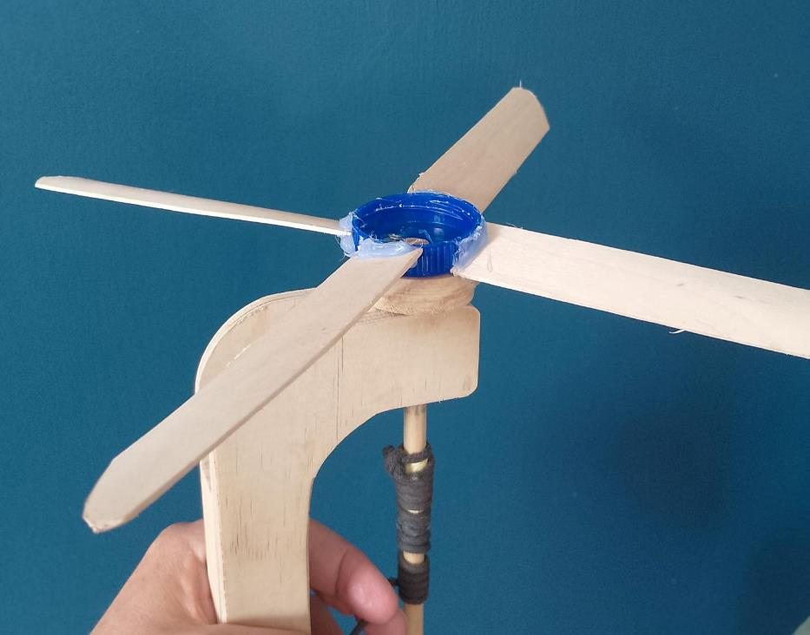
Rotor (1)
Practical activity
After listening to teacher instruction, use the resources provided to produce a prototype rotor.
Manufacture
Resources required are:
sketches of blade design,
milk bottle lid,
large paddle pop sticks or balsa,
300mm x 9mm dowel,
tub of water,
masking tape and
hot glue.

Slide 34
Rotor (2)
Peer and self evaluation
Quality control record
Production step | Describe what have you done well | Describe what could be improved

Slide 35
End of section student skills formative assessment checklist (6)
Students can | Checkbox
Accurately and safely produce components for an engineered solution
Test, collaboratively evaluate and apply rectification measures.

Slide 36
Weeks 9–10

Slide 37
Learning intention and success criteria (6)
We are learning to
apply engineering processes to create and collaboratively evaluate engineered solutions.
We can
safely and accurately produce components for engineered solutions
test, collaboratively evaluate and apply rectification measures.
Notes:
Notes for teachers:
Learning intentions and success are best co-constructed with students. Adapt the learning intention as required and add co-constructed success criteria.

Slide 38
Flight evaluation (1)
How does rotor design impact lift?
Brainstorm how rotor design impacts lift.
When brainstorming:
think back to the boomerang, aeroplane and helicopter
conceptualise any changes to shapes, angles and dimensions that may need to carry out as you test, evaluate and rectify your copter.

Slide 39
Flight evaluation (2)
Criteria for success
Engineers test and evaluate engineered products to ensure that they are safe, fit for purpose and meet quality control measure. The table provides a criteria to aid with evaluating your prototypes.
Specification | High | Medium | Low
Height | Rotor reaches a height of 5 meters or more. | Rotor reaches a height between 3 and 5 meters. | Rotor reaches a height of less than 3 meters.
Airtime | Rotor stays airborne for 5 seconds or more. | Rotor stays airborne for 3–5 seconds. | Rotor stays airborne for less than 3 seconds.
Trajectory | Rotor follows a straight, stable path with minimal deviation. | Rotor follows a somewhat stable path with moderate deviation. | Rotor has an erratic trajectory with significant deviation.
Durability | Rotor shows no signs of damage after 10 flights. | Rotor shows minor wear and tear but functions after 10 flights. | Rotor is damaged or non-functional after 10 flights.
Repeatability | Rotor performs consistently (same height and airtime) across 5 consecutive flights. | Rotor shows some variation in performance across 5 flights. | Rotor performance varies widely across 5 flights, with inconsistent results.

Slide 40
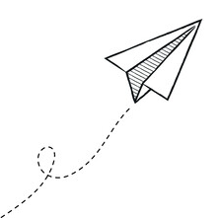
Flight evaluation (3)
Flight Tests
Observe and record each other’s flights.
Document each test assessing the criteria for success.
Compare designs and flight to help make suggestions for improvements.
Specification | Flights notes
Height
Airtime
Trajectory
Durability
Repeatability

Slide 41
Flight evaluation (4)
Ongoing evaluation
Does your helicopter fly to a satisfactory height?
Was it stable in flight?
How long did it stay in the air?
Is the launcher efficient to operate?
Remember, always:
think about the causes and effects
consider how to improve the design and why the change might work.

Slide 42

Flight evaluation (5)
Specification | High | Medium | Low
Height | Rotor reaches a height of 5 meters or more. | Rotor reaches a height between 3 and 5 meters. | Rotor reaches a height of less than 3 meters.
Airtime | Rotor stays airborne for 5 seconds or more. | Rotor stays airborne for 3–5 seconds. | Rotor stays airborne for less than 3 seconds.
Trajectory | Rotor follows a straight, stable path with minimal deviation. | Rotor follows a somewhat stable path with moderate deviation. | Rotor has an erratic trajectory with significant deviation.
Durability | Rotor shows no signs of damage after 10 flights. | Rotor shows minor wear and tear but functions after 10 flights. | Rotor is damaged or non-functional after 10 flights.
Repeatability | Rotor performs consistently (same height and airtime) across 5 consecutive flights. | Rotor shows some variation in performance across 5 flights. | Rotor performance varies widely across 5 flights, with inconsistent results.
Final evaluation
Using the criteria for success:
assess how your project achieves for each specification,
explain the reasons for your selections.

Slide 43
Heli hang time competition
Rotor vs rotor knock out.
This is the ultimate test of flight and durability.
In each match the rotor with the longest airtime is victorious.
In battle after battle, whose rotor will be triumphant?
Eyes to the skies. Let’s take flight.

Slide 44
Heli Launcher League (2)

Slide 45
References
This presentation contains NSW Curriculum and syllabus content. The NSW Curriculum is developed by the NSW Education Standards Authority. This content is prepared by NESA for and on behalf of the Crown in the right of the State of New South Wales. The material is protected by Crown copyright.
Please refer to the NESA Copyright Disclaimer for more information https://educationstandards.nsw.edu.au/wps/portal/nesa/mini-footer/copyright.
NESA holds the only official and up-to-date versions of the NSW Curriculum and syllabus documents. Please visit the NSW Education Standards Authority (NESA) website https://educationstandards.nsw.edu.au/wps/portal/nesa/home and the NSW Curriculum website https://curriculum.nsw.edu.au.
Technology 7-8 syllabus © NSW Education Standards Authority (NESA) for and on behalf of the Crown in right of the State of New South Wales, 2023.
Channel 10 (6 July, 2023) The First Inventors season 1, episode 4, TenPlay, accessed 9 July 2025.
Joshua Manley (20 September, 2012) ‘Newton's 3 Laws, with a bicycle’, TED-Ed, YouTube, accessed 15 July 2025
Henry Reich (9 April, 2015) 'How do airplanes fly?', minutephysics, YouTube, Accessed 1July 2025.
Science ABC (26 December 2019) 'How does a helicopter work: Everything you need to know about helicopters', Science ABC, YouTube, accessed 8 July 2025.
Darcy Whyte (8 January, 2014) ‘How to make a tumblewing walkalong flyer’, Ottawa Citizen, YouTube, Accessed 8 July 2025.

Slide 46
Copyright
© State of New South Wales (Department of Education), 2024
The copyright material published in this resource is subject to the Copyright Act 1968 (Cth) and is owned by the NSW Department of Education or, where indicated, by a party other than the NSW Department of Education (third-party material).
Copyright material available in this resource and owned by the NSW Department of Education is licensed under a Creative Commons Attribution 4.0 International (CC BY 4.0) licence.
This licence allows you to share and adapt the material for any purpose, even commercially.
Attribution should be given to © State of New South Wales (Department of Education), 2024.
Material in this resource not available under a Creative Commons licence:
the NSW Department of Education logo, other logos and trademark-protected material
Material owned by a third party that has been reproduced with permission. You will need to obtain permission from the third party to reuse its material.
Links to third-party material and websites
Please note that the provided (reading/viewing material/list/links/texts) are a suggestion only and implies no endorsement, by the New South Wales Department of Education, of any author, publisher, or book title. School principals and teachers are best placed to assess the suitability of resources that would complement the curriculum and reflect the needs and interests of their students.
If you use the links provided in this document to access a third party’s website, you acknowledge that the terms of use, including licence terms set out on the third-party’s website apply to the use which may be made of the materials on that third-party website or where permitted by the Copyright Act 1968 (Cth). The department accepts no responsibility for content on third-party websites.

