Slide 1
Instructions for use
This resource is not a teaching and learning program. It should be used in conjunction with the program and teacher resource Grow up! – vertical garden adventure.
Classroom teachers are encouraged to add and adapt slides as required to meet the needs of their students.
Save a copy of the file to make changes to the slide deck. Go to File > Download a Copy (this downloads a copy to the computer to edit in the PowerPoint app).
To convert the PowerPoint to Google Slides:
  Upload the file into Google Drive and open it.
  Go to File > Save as Google Slides.
  (Note: conversion may cause formatting changes in the slides.)

Slide 2
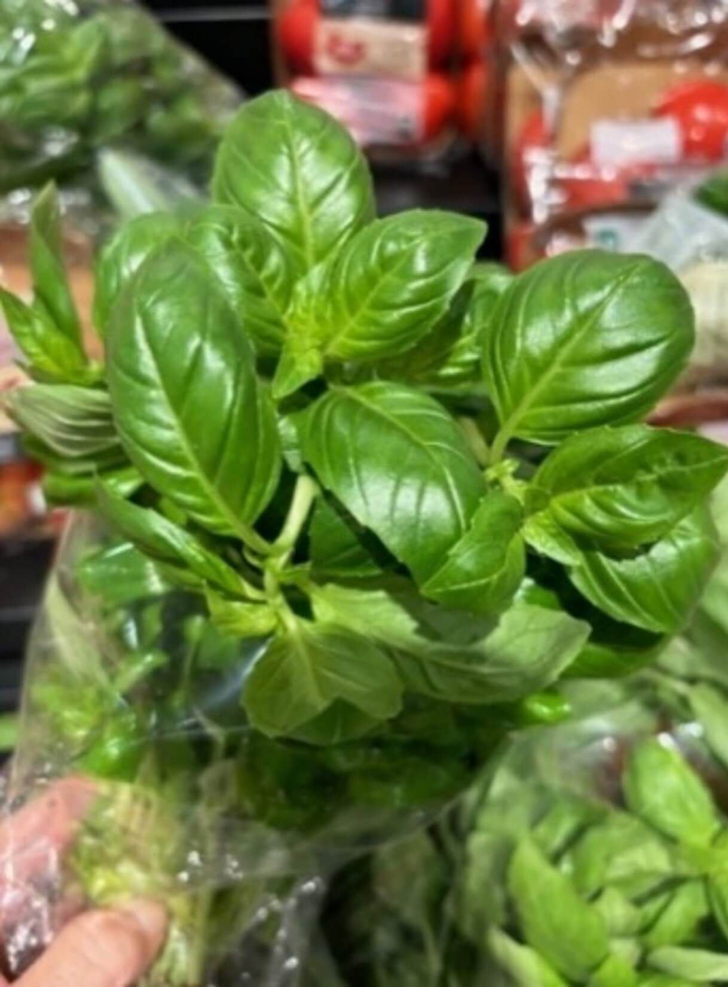
Technology 7–8
Food and agricultural practices
Stage 4
Grow up! Vertical garden adventure

Slide 3
Lessons
1
6
Introduction to agricultural production
Looking at the markets
2
7
Horticulture – fresh herbs
Emerging technologies in horticulture
3
8
Grow up! Designing a vertical garden
Record keeping
4
9
Practical skills safety
Comparing management practices
5
10
Building a working model
Evaluation and feedback
Notes:
Teacher notes:
Click lesson numbers to go to specific lessons
Interactive features can be viewed in slide show

Slide 4
Introduction to agricultural production

Slide 5
Learning intention and success criteria 1
We are learning to:
understand what agriculture is and why it is important to provide items such as food and clothing, so that we can see how it affects our daily lives.
We can:
clearly define agriculture and identify 3 ways it connects to my daily life.
Notes:
Notes for teachers:
Learning intentions and success are best co-constructed with students. Adapt the learning intention as required and add matching success criteria.
For more information See ⁠AITSL or the NSW Department of Education explicit teaching strategies, ⁠Sharing learning intentions and ⁠Sharing success criteria
LISC is not necessarily presented at the beginning of the lesson. Teacher needs to consider most effectual time to introduce
LISC should be revisited during the lesson to support students' evaluation of their learning

Slide 6
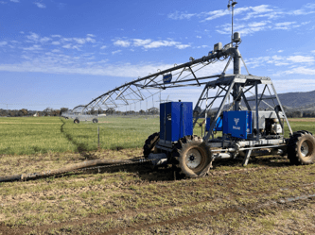
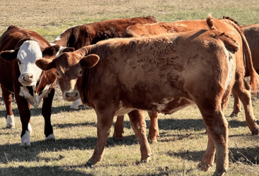
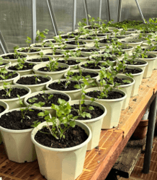
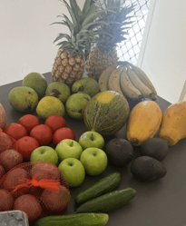
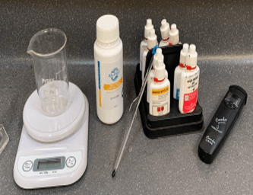
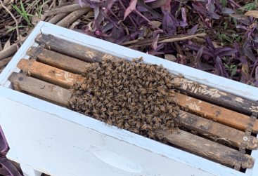
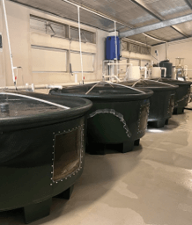
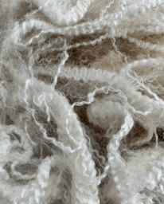
What is agriculture?
What words do you think about when you hear or see the word ‘agriculture’?

Slide 7
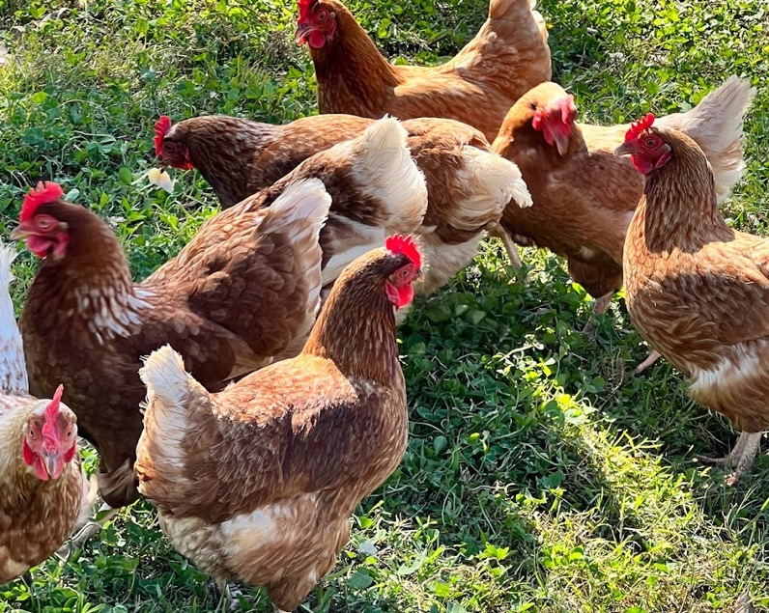
What is agriculture and why is it important?
Think, Pair, Share
What do I think?
What does my partner think?
What will we share?

Slide 8
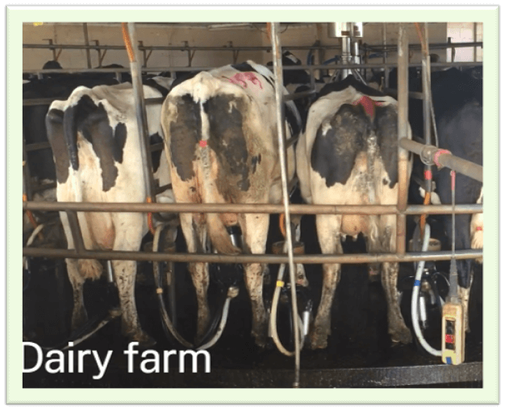
Products from farms
Brainstorm different types of agriculture in Australia and include a short list of products obtained from each.
Milk
Butter
Ice-cream

Slide 9
Learning intention and success criteria 2
We are learning to:
explore different types of farming in Australia and its effect on NSW so that we can understand the importance of local farms and what they produce.
We can:
identify the top 5 primary industries in my local area
list the top-producing regions in NSW and key agricultural products grown.
Notes:
Notes for teachers:
Learning intentions and success are best co-constructed with students. Adapt the learning intention as required and add matching success criteria.
For more information See ⁠AITSL or the NSW Department of Education explicit teaching strategies, ⁠Sharing learning intentions and ⁠Sharing success criteria
LISC is not necessarily presented at the beginning of the lesson. Teacher needs to consider most effectual time to introduce
LISC should be revisited during the lesson to support students' evaluation of their learning

Slide 10
Recap opportunity
?
What have we already learnt?
3
Outline 3 ways agriculture or agricultural products impact your life.
1.
2.
3.
1
Name a local shop and one product it sells that comes from a farm. What type of farm does it come from?
1.

Slide 11
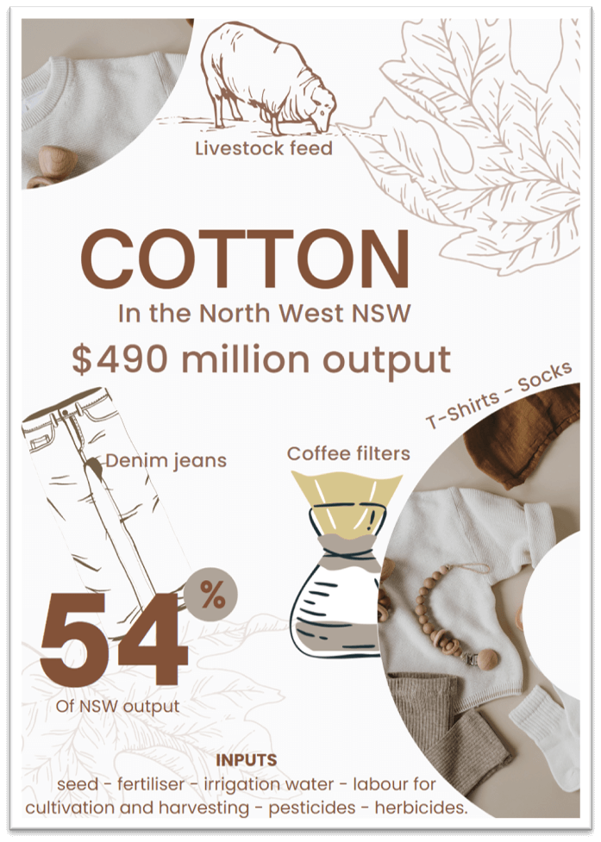
Product postcard
Example postcard to display at the Sydney Royal Easter Show, teaching people about Cotton production in Northwest NSW.
Information from NSW Department of Primary Industries, Regional Output.

Slide 12
Horticulture – fresh herbs

Slide 13
Learning intention and success criteria 3
We are learning to:
understand the basics of growing plants, especially herbs, and how we use them so that we can use this knowledge in cooking and horticulture.
We can:
identify and list various types of herbs commonly grown in horticulture
describe the properties of different herb samples and explain their uses in food preparation
create a scale sketch of a plant, labelling its main structures and identify the parts of the plant that are consumed.
Notes:
Notes for teachers:
Learning intentions and success are best co-constructed with students. Adapt the learning intention as required and add matching success criteria.
For more information See ⁠AITSL or the NSW Department of Education explicit teaching strategies, ⁠Sharing learning intentions and ⁠Sharing success criteria
LISC is not necessarily presented at the beginning of the lesson. Teacher needs to consider most effectual time to introduce
LISC should be revisited during the lesson to support students' evaluation of their learning

Slide 14
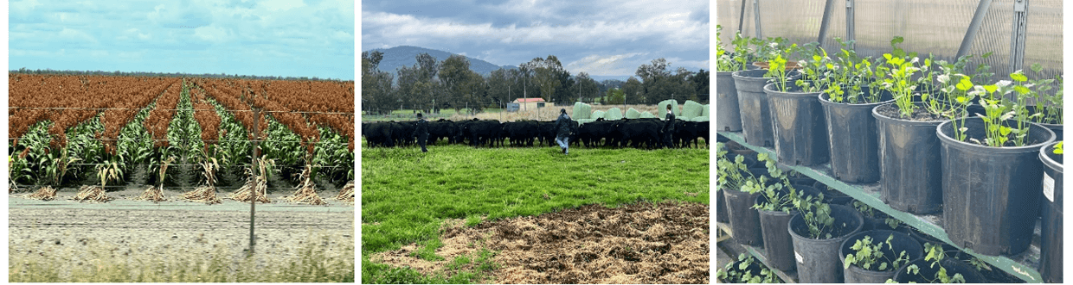
What do you already know?
Circle the picture that best represents the agricultural industry ‘horticulture’.

Slide 15
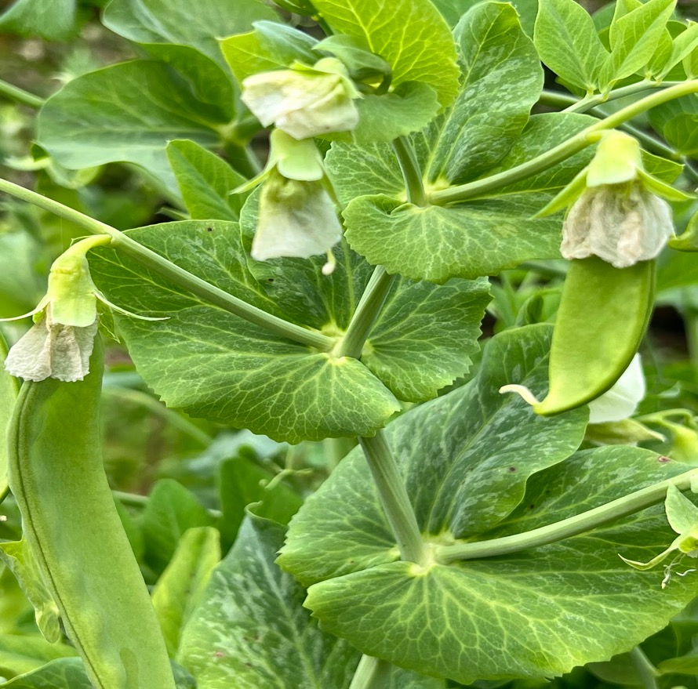
What do you already know? Part 2
What is horticulture?
What types of produce are grown on horticulture farms?

Slide 16
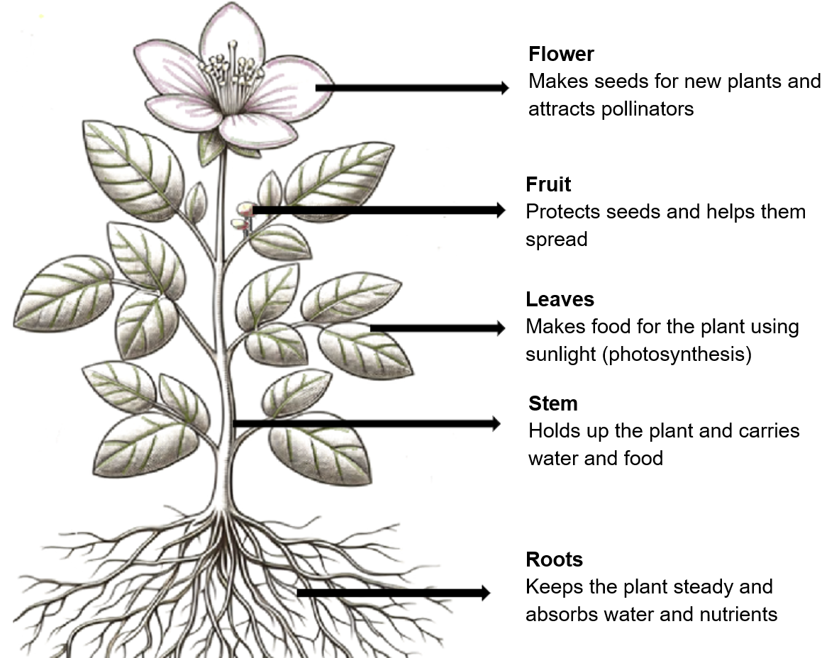
Parts and functions of a typical flowering plant
Sample answer with annotations
Image partially generated using Copilot and used in accordance with Copilot copyright commitment.

Slide 17
Recap opportunity 2
?
Checking for understanding – end of lesson
Work with a partner to brainstorm a range of common plants grown in horticulture.
!
For each of the plants listed above, identify the parts of the plant that are eaten.

Slide 18
Grow up!
Designing a vertical garden

Slide 19
Learning intention and success criteria 4
We are learning to:
understand the design requirements and constraints for creating a simple vertical garden system for urban food production.
We can:
clearly articulate 3 criteria for success that demonstrates how I know if my design meets the brief.
Notes:
Notes for teachers:
Learning intentions and success are best co-constructed with students. Adapt the learning intention as required and add matching success criteria.
For more information See ⁠AITSL or the NSW Department of Education explicit teaching strategies, ⁠Sharing learning intentions and ⁠Sharing success criteria
LISC is not necessarily presented at the beginning of the lesson. Teacher needs to consider most effectual time to introduce
LISC should be revisited during the lesson to support students' evaluation of their learning

Slide 20
Recap opportunity 3
?
Fast 5 – What did we learn last lesson?
5
For each of the following plants, name one part that is commonly eaten:
1. Zucchini
2. Spinach
3. Celery
4. Peas
5. Potatoes

Slide 21
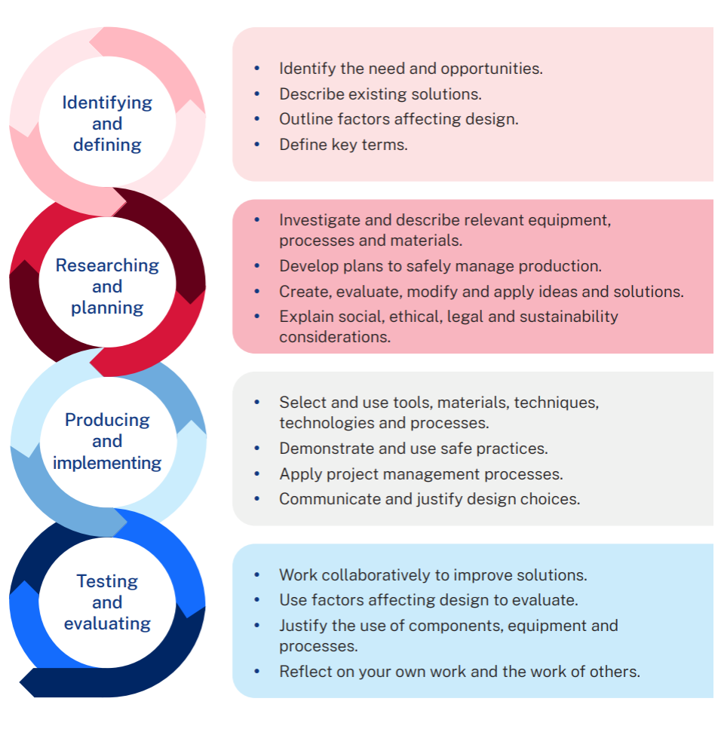
Design and production process

Slide 22

How do I know if I understand the brief?
What will a successful project design look like when it is complete?
Make a list of 3 things that can be measured or observed at the end that indicate success.
These are your criteria for success.

Slide 23
Learning intention and success criteria 5
We are learning to:
explore how crops are grown in Australia and the steps involved – from planting to the product reaching consumers, so that we can understand how our food gets from the farm to our table.
We can:
identify the sequence of activities on a field-grown lettuce farm
create a flow chart that maps the supply chain for lettuce.
Notes:
Notes for teachers:
Learning intentions and success are best co-constructed with students. Adapt the learning intention as required and add matching success criteria.
For more information See ⁠AITSL or the NSW Department of Education explicit teaching strategies, ⁠Sharing learning intentions and ⁠Sharing success criteria
LISC is not necessarily presented at the beginning of the lesson. Teacher needs to consider most effectual time to introduce
LISC should be revisited during the lesson to support students' evaluation of their learning

Slide 24
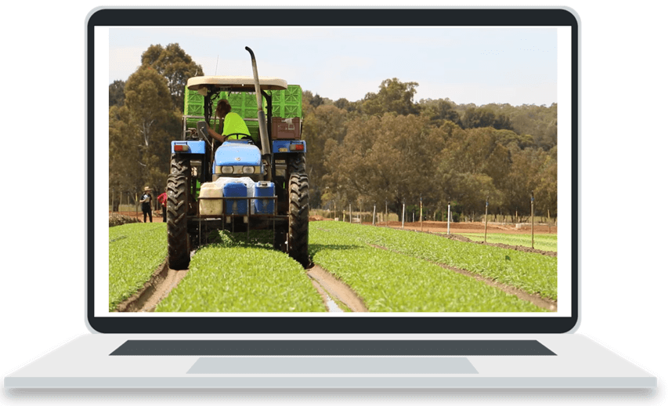

A day on a lettuce farm in Western Australia
Click on the image – (duration 3:33)

Slide 25
Flow charts
Draw a flow chart showing the steps in the supply chain, from planting on the farm through to your plate at home.
Shows the steps of a process from beginning to end
using process boxes
and flow lines or arrows to show the order of operation.

Slide 26
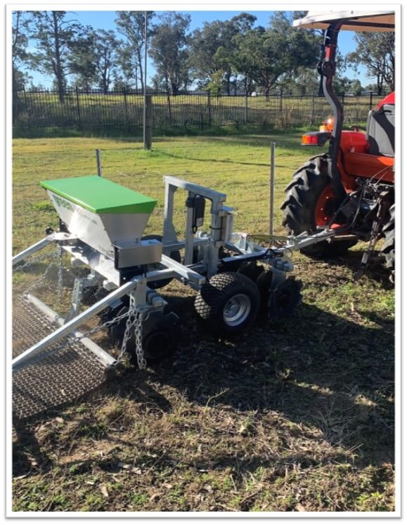
Discussion
Which steps do you think could be automated in the future?
How do you imagine this would look?

Slide 27
Practical skills safety

Slide 28
Learning intention and success criteria 6
We are learning to:
understand the requirements for growing basil and the best practices for successful cultivation and harvest so that we can grow healthy basil plants.
We can:
collate information about optimal conditions for growing basil using secondary sources.
Notes:
Notes for teachers:
Learning intentions and success are best co-constructed with students. Adapt the learning intention as required and add matching success criteria.
For more information See ⁠AITSL or the NSW Department of Education explicit teaching strategies, ⁠Sharing learning intentions and ⁠Sharing success criteria
LISC is not necessarily presented at the beginning of the lesson. Teacher needs to consider most effectual time to introduce
LISC should be revisited during the lesson to support students' evaluation of their learning

Slide 29
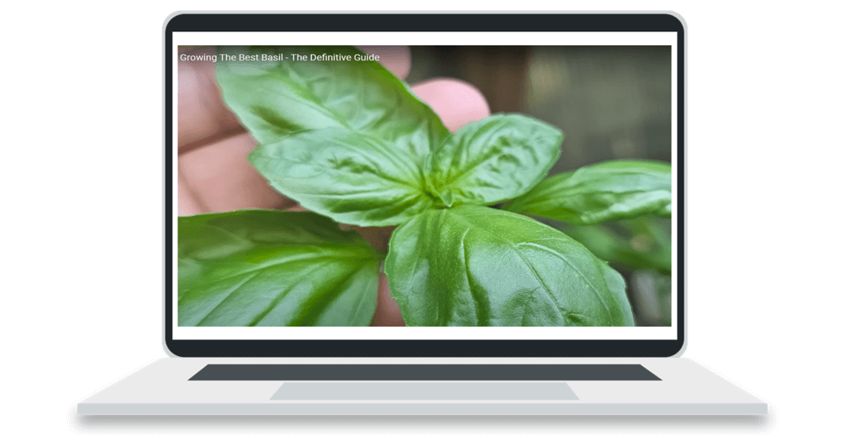
Growing The Best Basil – The Definitive Guide
Click on the image – (duration 15:28)

Slide 30
Converting Fahrenheit into Celsius
Use a simple formula to convert the temperatures into Celsius with students.
Step 1: Subtract 32 from the temperature given in Fahrenheit.
Step 2: Multiply the difference value by 5.
Step 3: Divide the product by 9.
Worked example
Fahrenheit temperature 212°F
Step 1: 212 - 32 = 180
Step 2: 180 × 5 = 900
Step 3: 900 ÷ 9 = 100
Answer: 212°F = 100°C

Slide 31
Learning intention and success criteria 7
We are learning to:
understand safety protocols and the proper use of personal protective equipment (PPE) when handling potting mix and horticultural tools so that we can stay safe while performing practical activities.
We can:
identify potential hazards associated with potting mix and list appropriate safety measures
demonstrate the correct use of various types of PPE
follow teacher instructions to safely sow seeds for germination.
Notes:
Notes for teachers:
Learning intentions and success are best co-constructed with students. Adapt the learning intention as required and add matching success criteria.
For more information See ⁠AITSL or the NSW Department of Education explicit teaching strategies, ⁠Sharing learning intentions and ⁠Sharing success criteria
LISC is not necessarily presented at the beginning of the lesson. Teacher needs to consider most effectual time to introduce
LISC should be revisited during the lesson to support students' evaluation of their learning

Slide 32
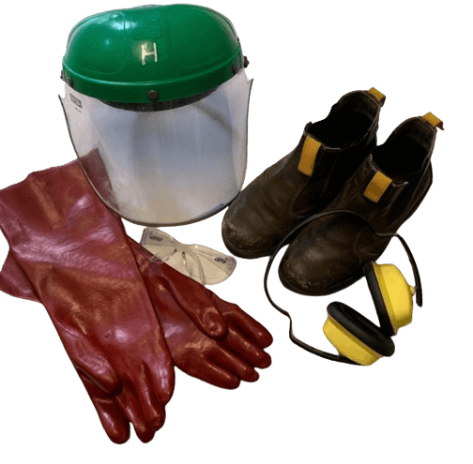






Examples of Personal Protective Equipment (PPE)

Slide 33
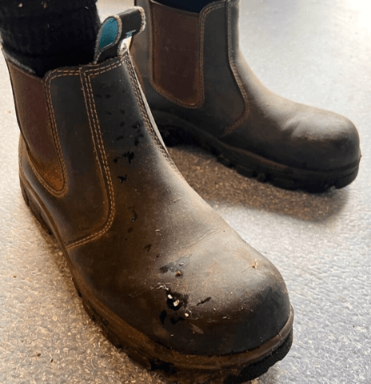
Recap opportunity 4
?
Hinge question – Describe a simple scenario in agriculture where PPE might be required and why?

Slide 34
Building a working model

Slide 35
Learning intention and success criteria 8
We are learning to:
design a working model of a vertical garden, considering structure, planters and adjustable mechanisms so that we can create innovative gardening solutions in limited spaces.
We can:
create a sketch of a vertical garden structure, showing the materials used with consideration to stability, safety and space
identify various mechanisms for raising and lowering the vertical garden and asses their advantages and disadvantages
work collaboratively to build a working model of the design sketched for a vertical garden.
Notes:
Notes for teachers:
Learning intentions and success are best co-constructed with students. Adapt the learning intention as required and add matching success criteria.
For more information See ⁠AITSL or the NSW Department of Education explicit teaching strategies, ⁠Sharing learning intentions and ⁠Sharing success criteria
LISC is not necessarily presented at the beginning of the lesson. Teacher needs to consider most effectual time to introduce
LISC should be revisited during the lesson to support students' evaluation of their learning

Slide 36
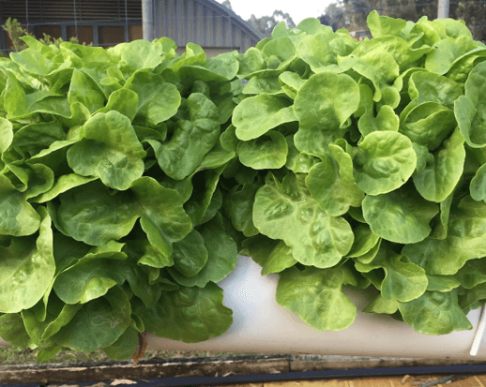
Recap opportunity 5
?
Entry ticket
Check for understanding
Describe the design brief for the project you are completing.
What is the end product?
How will you determine your project is successful?

Slide 37
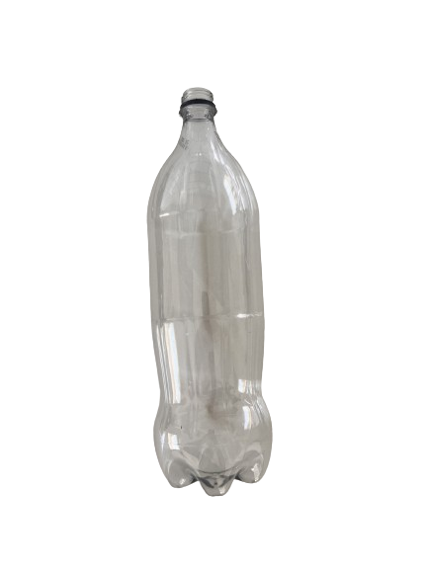
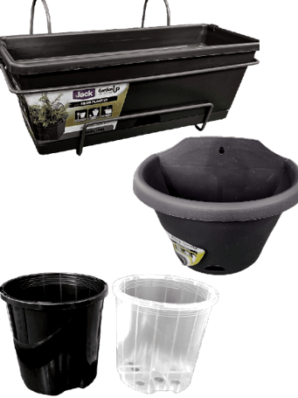
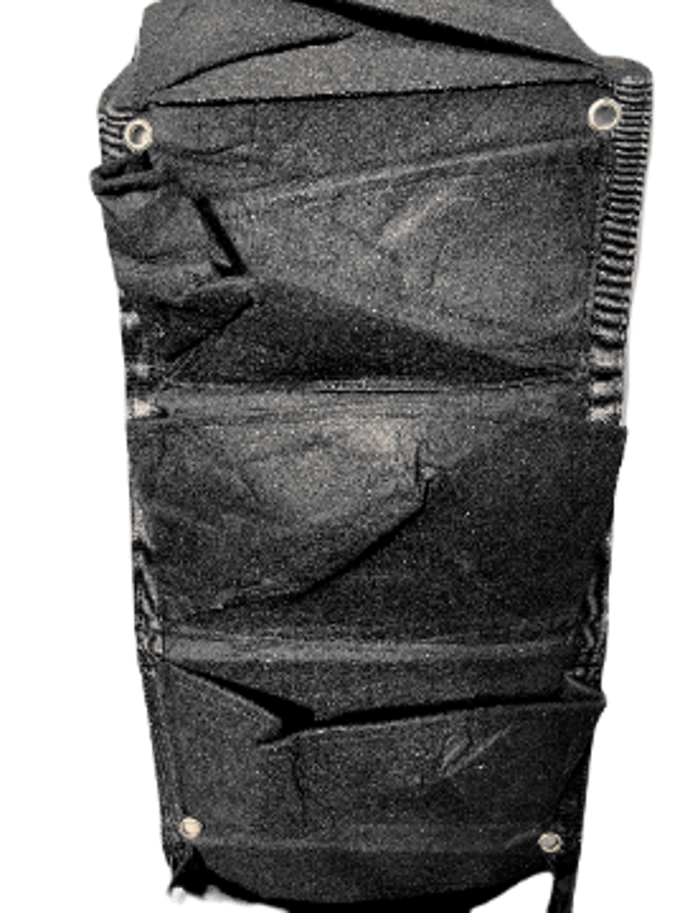
Research and planning
Planter types

Slide 38
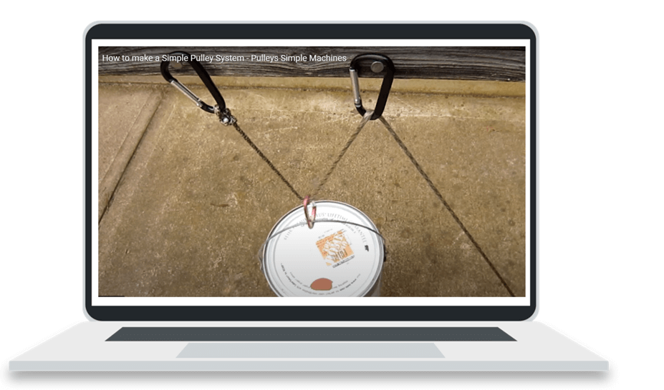
Raising and lowering mechanisms – pulley
Click on the image – (duration 2:10)

Slide 39
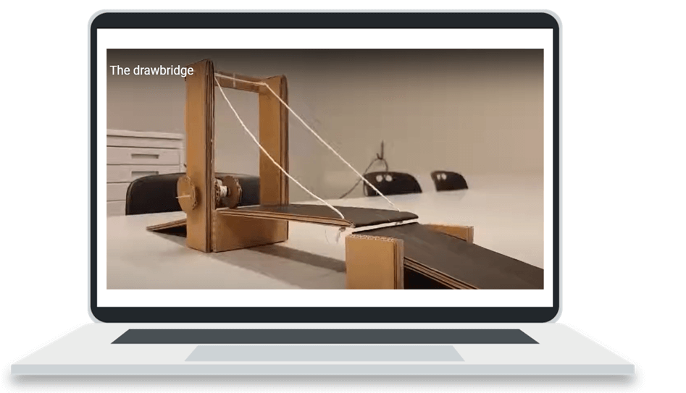
Raising and lowering mechanisms – drawbridge
Click on the image – (duration 0:25)

Slide 40
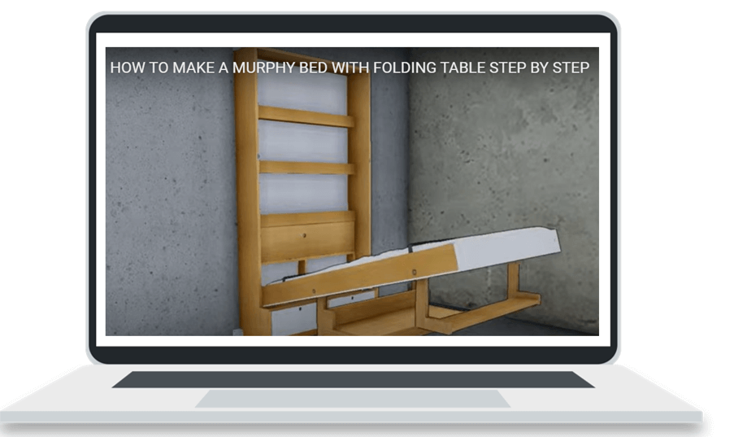
Raising and lowering mechanisms – murphy bed
Click on the image – (duration 18:50)

Slide 41
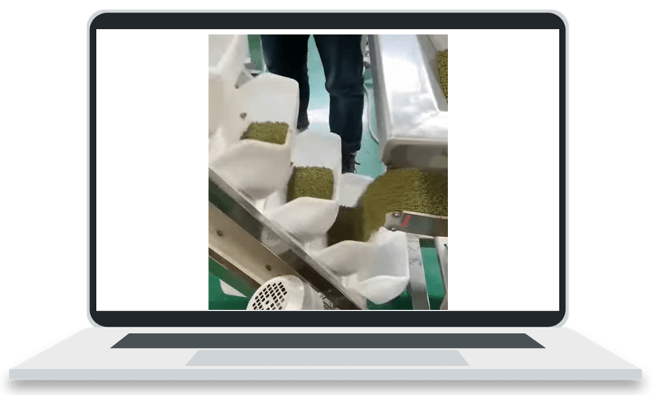
Raising and lowering mechanisms – inclined bucket
Click on the image – (duration 0:07)

Slide 42

Raising and lowering mechanisms – Ferris wheel
Click on the image – (duration 3:24)

Slide 43
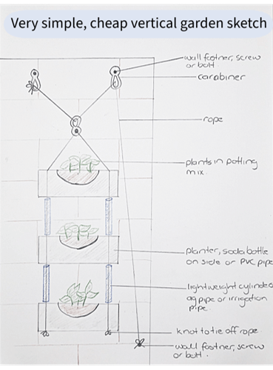
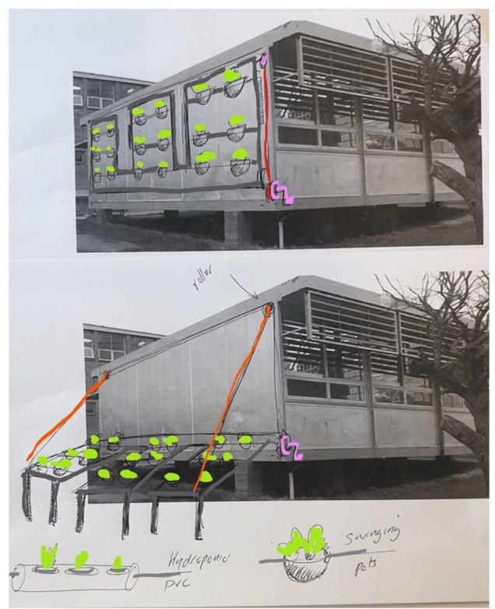
Sample sketches

Slide 44
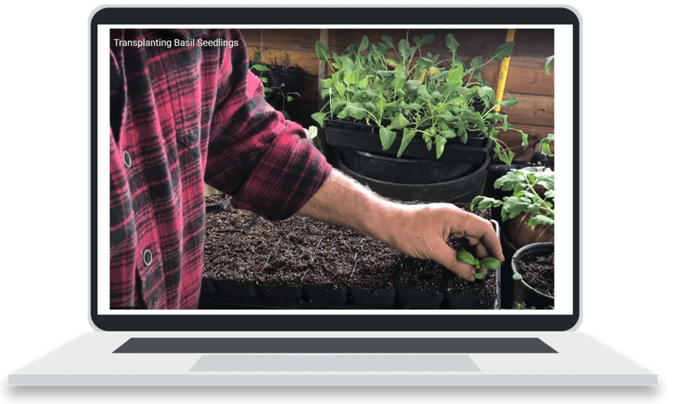
Transplanting Basil Seedlings
Click on the image – (duration 8:03)

Slide 45
Looking at the markets

Slide 46
Learning intention and success criteria 9
We are learning to:
understand the role of wholesale markets in the distribution of fresh produce and explore the issues related to transporting food so that we can appreciate the journey our food takes to reach us.
We can:
calculate the distances between farms, wholesale markets and supermarkets
discuss issues related to food mileage.
Notes:
Notes for teachers:
Learning intentions and success are best co-constructed with students. Adapt the learning intention as required and add matching success criteria.
For more information See ⁠AITSL or the NSW Department of Education explicit teaching strategies, ⁠Sharing learning intentions and ⁠Sharing success criteria
LISC is not necessarily presented at the beginning of the lesson. Teacher needs to consider most effectual time to introduce
LISC should be revisited during the lesson to support students' evaluation of their learning

Slide 47
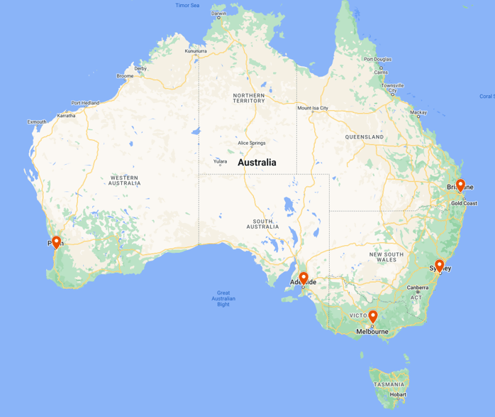
Main wholesale market locations in Australia

Slide 48
Class discussion
What could be the consequences of increased food mileage on the environment?
What concerns might your local community have with access to food?

Slide 49
Emerging technologies in horticulture

Slide 50
Learning intention and success criteria 10
We are learning to:
explore new and emerging technologies in agriculture and how they address sustainability and food production in urban areas so that we can understand modern farming challenges and solutions.
We can:
identify and describe different technologies used in agriculture that address sustainability and food production challenges
compare urban and rural farming methods.
Notes:
Notes for teachers:
Learning intentions and success are best co-constructed with students. Adapt the learning intention as required and add matching success criteria.
For more information See ⁠AITSL or the NSW Department of Education explicit teaching strategies, ⁠Sharing learning intentions and ⁠Sharing success criteria
LISC is not necessarily presented at the beginning of the lesson. Teacher needs to consider most effectual time to introduce
LISC should be revisited during the lesson to support students' evaluation of their learning

Slide 51
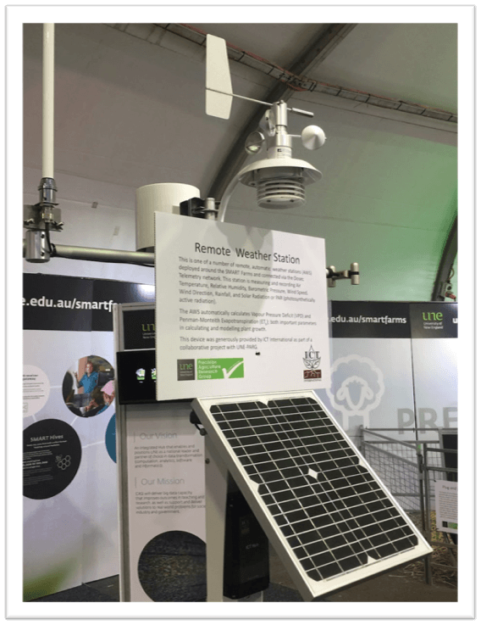
Brainstorm
What technologies can be found on a horticulture farm?
What are some benefits to using technology in agriculture?

Slide 52
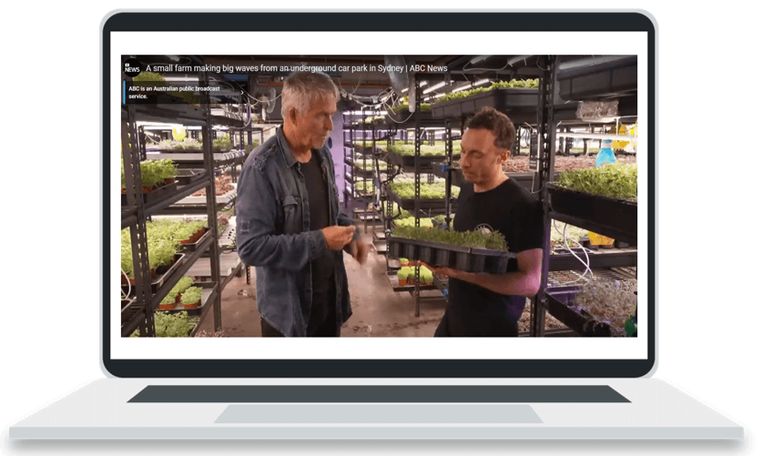
A small farm making big waves from an underground car park in Sydney
Click on the image – (duration 8:06)

Slide 53
Comparing horticulture production methods
Urban Green
Field grown
Features similar to both objects
Features of object 1
Features of object 2

Slide 54
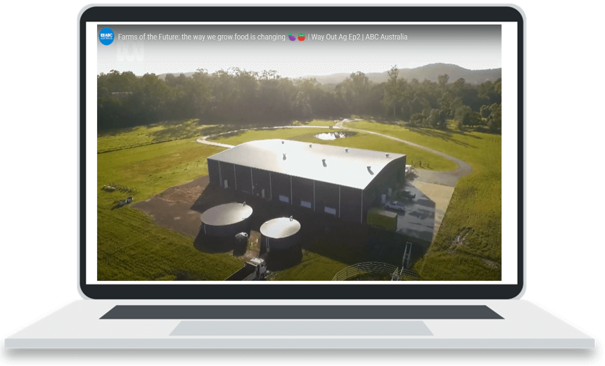
Farms of the Future: the way we grow food is changing
Click on the image – (duration 15:01)

Slide 55
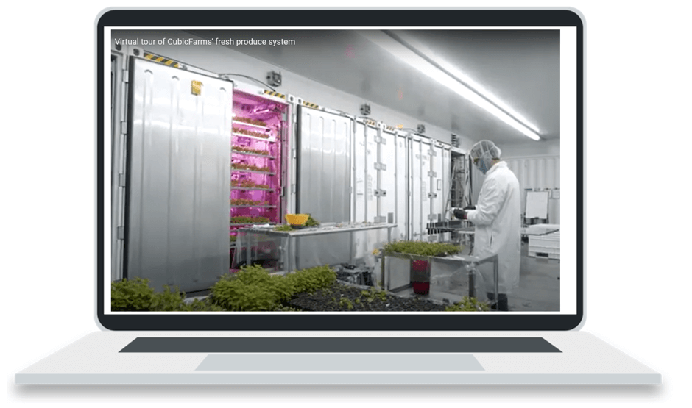
Virtual tour of CubicFarms’ fresh produce system
Click on the image – (duration 8:50)

Slide 56
Record keeping

Slide 57
Learning intention and success criteria 11
We are learning about:
the importance of record keeping and the types of data that can be collected during the lifecycle of a horticultural project so that we can effectively track and analyse our gardening projects.
We can:
design a suitable table or other representation method to collate first-hand data collected.
Notes:
Notes for teachers:
Learning intentions and success are best co-constructed with students. Adapt the learning intention as required and add matching success criteria.
For more information See ⁠AITSL or the NSW Department of Education explicit teaching strategies, ⁠Sharing learning intentions and ⁠Sharing success criteria
LISC is not necessarily presented at the beginning of the lesson. Teacher needs to consider most effectual time to introduce
LISC should be revisited during the lesson to support students' evaluation of their learning

Slide 58
Parts of a table
Recall the key parts of a table used for data collection.
Commodity description | Gross value ($)
Broadacre crops | 3,072,484
Hay | 12,242,123
Nurseries, cut flowers or cultivated turf | 24,558,571
Fruit and nuts (excluding grapes) | 1,705,189
Fruit and nuts – grapes | 5,050,679
Vegetables for human consumption | 6,791,434
Livestock Products – wool | 4,666,488
Livestock – sheep and lambs | 4,067,323
Livestock products – milk | 128,104,089
Livestock – cattle and calves | 214,324,161
Livestock – poultry | 93,239,975
Livestock products – eggs | 72,156,452
Livestock – pigs | 43,158
Total agriculture | 570,317,890

Slide 59
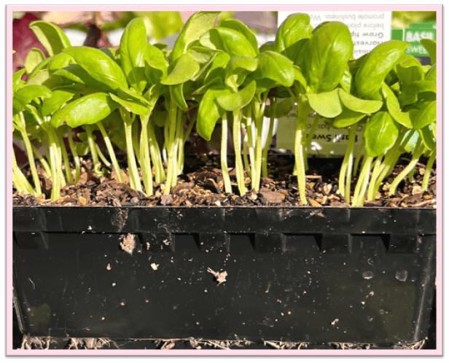
Data collection
What types of data can be collected during the project?
What measurements would be taken?

Slide 60
Comparing management practices

Slide 61
Learning intention and success criteria 12
We are learning to:
compare traditional Aboriginal and Torres Strait Islander land management practices with emerging agricultural techniques so that we can appreciate the value of different farming methods.
We can:
identify and describe at least 2 traditional land management practices used by Aboriginal and Torres Strait Islander Peoples
compare traditional and contemporary or emerging agricultural techniques, highlighting similarities and differences with reference to sustainability and the local environment.
Notes:
Notes for teachers:
Learning intentions and success are best co-constructed with students. Adapt the learning intention as required and add matching success criteria.
For more information See ⁠AITSL or the NSW Department of Education explicit teaching strategies, ⁠Sharing learning intentions and ⁠Sharing success criteria
LISC is not necessarily presented at the beginning of the lesson. Teacher needs to consider most effectual time to introduce
LISC should be revisited during the lesson to support students' evaluation of their learning

Slide 62
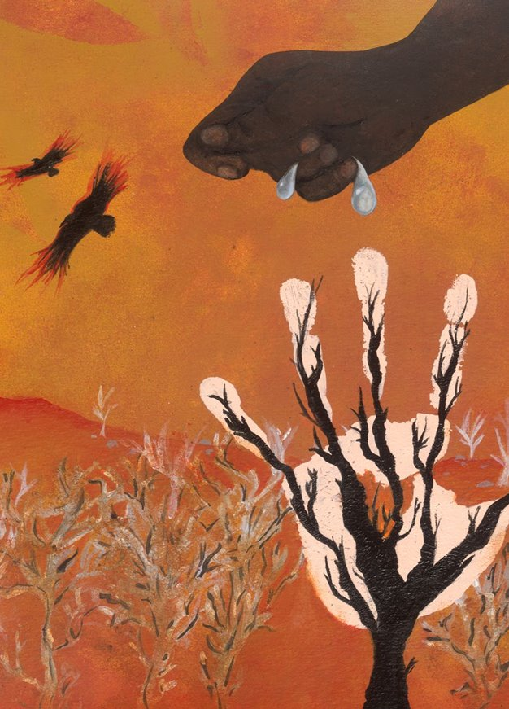
Recap opportunity 6
?
Entry ticket
Check for understanding
Recall land management practices used by Aboriginal and Torres Strait Islander peoples you may have learnt about in other classes or at home.
Recall new and emerging technologies learnt about in previous lessons.
‘The Land Heals Us’ created by Sarah Whitfield from Winmalee High School as part of the 2016 Schools Reconciliation Challenge.

Slide 63
Evaluation and feedback

Slide 64
Learning intention and success criteria 13
We are learning to:
evaluate the quality of harvested crops using market specifications and reflect on the criteria for success of our design project so that we can improve our gardening skills and project outcomes.
We can:
assess plant products using given market specifications
evaluate the success of a design project by comparing the final design with predefined criteria for success, identifying areas for improvement
link the design project skills learnt with real-world applications.
Notes:
Notes for teachers:
Learning intentions and success are best co-constructed with students. Adapt the learning intention as required and add matching success criteria.
For more information See ⁠AITSL or the NSW Department of Education explicit teaching strategies, ⁠Sharing learning intentions and ⁠Sharing success criteria
LISC is not necessarily presented at the beginning of the lesson. Teacher needs to consider most effectual time to introduce
LISC should be revisited during the lesson to support students' evaluation of their learning

Slide 65
Recap opportunity 7
?
Entry ticket
Check for understanding
In your project groups, create a simple flow chart to demonstrate how to harvest your basil.
Shows the steps of a process from beginning to end
using process boxes
and flow lines or arrows to show the order of operation.

Slide 66
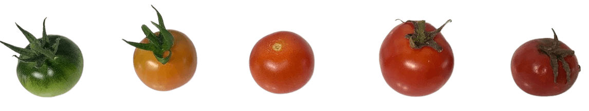
Market specifications
Practical activity – tomatoes

Slide 67
Market specifications for basil
Criteria type | Specification for basil
Colour | Bright green leaves and stems.
Visual appearance | Finely ridged, square stems covered with fine hairs, smooth, glossy leaves with distinct veins, no foreign matter.
Sensory | Crisp, juicy stems, firm leaves, strong sweet but spicy flavour. Free from forging odours or tastes.
Size | Bunch length 200 – 300 mm, bunch weight > 70 g.
Maturity | Young, tender stems and leaves, flower buds may be present but not fully open.

Slide 68
Real-world application
This design project was about building a vertical garden working model for growing basil from planting to harvest. Where would you see the skills you’ve learnt during this project used in the real-world?

Slide 69
References
This presentation contains NSW Curriculum and syllabus content. The NSW Curriculum is developed by the NSW Education Standards Authority. This content is prepared by NESA for and on behalf of the Crown in the right of the State of New South Wales. The material is protected by Crown copyright.
Please refer to the NESA Copyright Disclaimer for more information https://educationstandards.nsw.edu.au/wps/portal/nesa/mini-footer/copyright.
NESA holds the only official and up-to-date versions of the NSW Curriculum and syllabus documents. Please visit the NSW Education Standards Authority (NESA) website https://educationstandards.nsw.edu.au/wps/portal/nesa/home and the NSW Curriculum website https://curriculum.nsw.edu.au.
Technology 7–8 Syllabus © NSW Education Standards Authority (NESA) for and on behalf of the Crown in right of the State of New South Wales, 2023.
ABC Australia (4 March 2022) 'Farms of the Future: the way we grow food is changing 🍆🍅 | Way Out Ag Ep2 | ABC Australia' [video], ABC Australia, YouTube, accessed 9 April 2024.
ABC News (Australia) (7 July 2022) 'A small farm making big waves from an underground car park in Sydney | ABC News' [video], ABC News (Australia), YouTube, accessed 9 April 2024.
CubicFarm Systems (26 June 2020) ‘Virtual tour of CubicFarms’ fresh produce system’ [video], CubicFarm Systems, YouTube, accessed 9 April 2024.
Department of Primary Industries & Regional Development (29 October 2020) 'A Day on a Lettuce Farm in Western Australia' [video], Department of Primary Industries & Regional Development, YouTube, accessed 26 March 2024.
Engineering8 (13 October 2017) '10 Tallest Ferris Wheels in the World' [video], Engineering8, YouTube, accessed 2 May 2024.

Slide 70
References continued
This presentation contains NSW Curriculum and syllabus content. The NSW Curriculum is developed by the NSW Education Standards Authority. This content is prepared by NESA for and on behalf of the Crown in the right of the State of New South Wales. The material is protected by Crown copyright.
Please refer to the NESA Copyright Disclaimer for more information https://educationstandards.nsw.edu.au/wps/portal/nesa/mini-footer/copyright.
NESA holds the only official and up-to-date versions of the NSW Curriculum and syllabus documents. Please visit the NSW Education Standards Authority (NESA) website https://educationstandards.nsw.edu.au/wps/portal/nesa/home and the NSW Curriculum website https://curriculum.nsw.edu.au.
INVENTORINDO FURNITURE (29 April 2023) 'HOW TO MAKE A MURPHY BED WITH FOLDING TABLE STEP BY STEP' [video], INVENTIRINDO FURNITURE, YouTube, accessed 2 May 2024.
Specific Love Creations (27 March 2015) 'How to make a Simple Pulley System - Pulleys Simple Machines' [video], Specific Love Creations, YouTube, accessed 2 May 2024.
Star Mountain, Inc. (7 March 2019) 'Transplanting Basil Seedlings' [video], Star Mountain, Inc., YouTube, accessed 20 February 2024.
The Ripe Tomato Farms (21 August 2023) 'Growing The Best Basil - The Definitive Guide' [video], The Ripe Tomato Farms, YouTube, accessed 12 March 2024.
Thiel O (29 January 2019) 'The drawbridge' [video], Oliver Thiel, YouTube, accessed 2 May 2024.

Slide 71
Copyright
© State of New South Wales (Department of Education), 2024
The copyright material published in this resource is subject to the Copyright Act 1968 (Cth) and is owned by the NSW Department of Education or, where indicated, by a party other than the NSW Department of Education (third-party material).
Copyright material available in this resource and owned by the NSW Department of Education is licensed under a Creative Commons Attribution 4.0 International (CC BY 4.0) license.
This license allows you to share and adapt the material for any purpose, even commercially.
Attribution should be given to © State of New South Wales (Department of Education), 2024.
Material in this resource not available under a Creative Commons license:
the NSW Department of Education logo, other logos and trademark-protected material
Material owned by a third party that has been reproduced with permission. You will need to obtain permission from the third party to reuse its material.
Links to third-party material and websites
Please note that the provided (reading/viewing material/list/links/texts) are a suggestion only and implies no endorsement, by the New South Wales Department of Education, of any author, publisher, or book title. School principals and teachers are best placed to assess the suitability of resources that would complement the curriculum and reflect the needs and interests of their students.
If you use the links provided in this document to access a third-party’s website, you acknowledge that the terms of use, including licence terms set out on the third-party’s website apply to the use which may be made of the materials on that third-party website or where permitted by the Copyright Act 1968 (Cth). The department accepts no responsibility for content on third-party websites.

