Slide 1
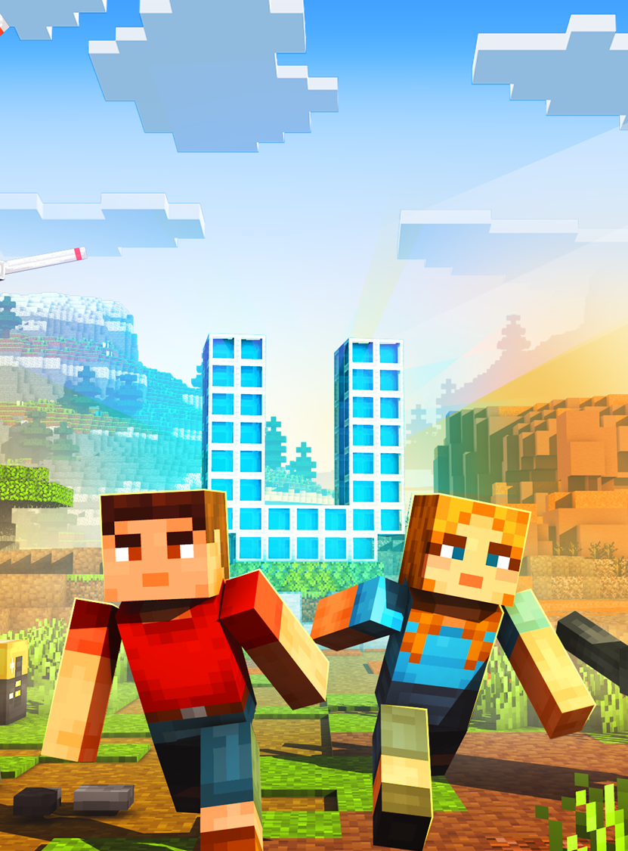


Race to zero!
NSW Department of Education
Eco Detectives Unite
Teacher introduction
Proudly supported by

Slide 2
Instructions for use
Minecraft Education – Eco Detectives Unite – Race to zero!
  This resource is not a teaching and learning program. It should be used in conjunction with Minecraft Education game Eco Detectives Unite – Race to zero!
  Classroom teachers are encouraged to add and adapt slides as required to meet the needs of their students.
  Save a copy of the file to make changes to the slide deck.
    Go to File > Download a Copy (this downloads a copy to the computer to edit in the PowerPoint app).
  To convert the PowerPoint to Google Slides:
    Upload the file into Google Drive and open it.
    Go to File > Save as Google Slides.
(Note – conversion may cause formatting changes in the slides.)
2
Notes:
Remove this slide before using with a class.
Installing Minecraft Education onto student devices:
Minecraft Education is available to all NSW DoE users and is a packaged application available for installation for all schools.
Many schools have moved to Intone/CDM, which means the main user of a device can install this application themselves through the company portal, such as teachers.
Students in most cases will not be known as a ‘main user’ as they may have shared devices.
For students, may need Minecraft Education pushed out to the appropriate student devices by the school Technical Support Officer (TSO) or Computer Coordinator (CC).
If your school does not have a TSO or CC, you can log an EdConnect ticket to have a local field services representative upload Minecraft Education to student devices.

Slide 3

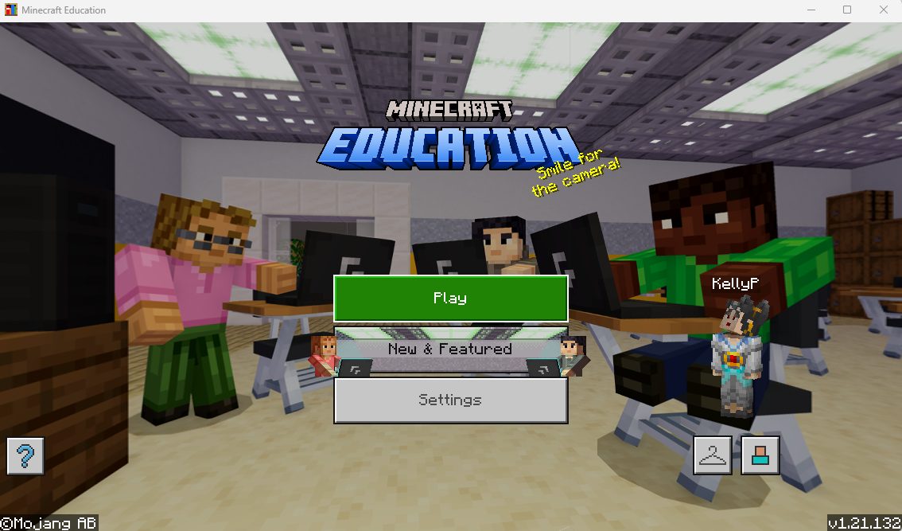

Teacher Preparation – device set up
Minecraft Education – Eco Detectives Unite – race to zero!
This is what the Minecraft Education app looks like.
Version Number located here.
Ensure all students have the most recent version of Minecraft downloaded on their device.
Students will need this installed on their devices.
FREE for all NSW DoE students and teachers.
Notes:
Teacher Preparation:
To guide students effectively, it is highly recommended that you explore the Minecraft Education Eco Detectives Unite – Race to zero!, before the lesson.
Playing the beginning of the game will help to understand the mission sequence, anticipate student questions, and identify key learning points related to Net Zero and Children’s Rights.
Students will play the game in groups of 3–6, with one student in each group assigned as the HOST of the world (details provided in later slides).
Here is the link to the game and downloadable resources on the Minecraft Education platform: https://education.minecraft.net/en-us/lessons/eco-detectives-unite-race-to-zero
You can also search for the game in the "Library" section of the Minecraft Education app.
Prerequisites before starting:
Confirm all students have Minecraft Education installed (or updated to the most recent version) on their devices such as, an iPad, Tablet or Laptop (use an external mouse to play; track pads are not effective for playing Minecraft Education).
Ensure students have an active Minecraft Education account. NSW Department of Education teachers and students are to use their school email account and password to access Minecraft Education.
Make sure all devices have internet access.

Slide 4
Classroom presentation
NSW Department of Education
Eco Detectives Unite
Race to zero!
Proudly supported by
Notes:
Purpose of this slide deck:
This is designed to introduce students to key concepts in the game before they play Eco Detectives Unite – Race to Zero! Our goal is to spark curiosity and build foundational knowledge to support student success as they play.
Key learning focus:
The concepts covered here align with the main themes students will encounter in the game, providing important context and preparing them for the in-game tasks.
Video resources:
The slide deck includes brief Behind the News (BtN) video clip links (located in the notes section) that assist to explain major game concepts. Please review these videos in advance to choose those best suited to your students.
Maximising learning outcomes:
You can download and adapt the slide deck based on the needs of your class.
After students engage with the slide deck and play the game the first time, further learning can be supported through the following resources;
EZEC networks: https://education.nsw.gov.au/teaching-and-learning/unique-settings/environmental-zoo-centres
Science and Technology K-6 Curriculum Resources: https://education.nsw.gov.au/teaching-and-learning/curriculum/science/science-curriculum-resources-k-12/science-and-technology-k-6-curriculum-resources
STEM Curriculum Resources: https://education.nsw.gov.au/teaching-and-learning/curriculum/stem/stem-curriculum-resources
Encourage students to play the game a second time or third time to reinforce and build on their understanding of key concepts — Students will become more confident problem solvers and builders by completing repeated playthroughs.

Slide 5
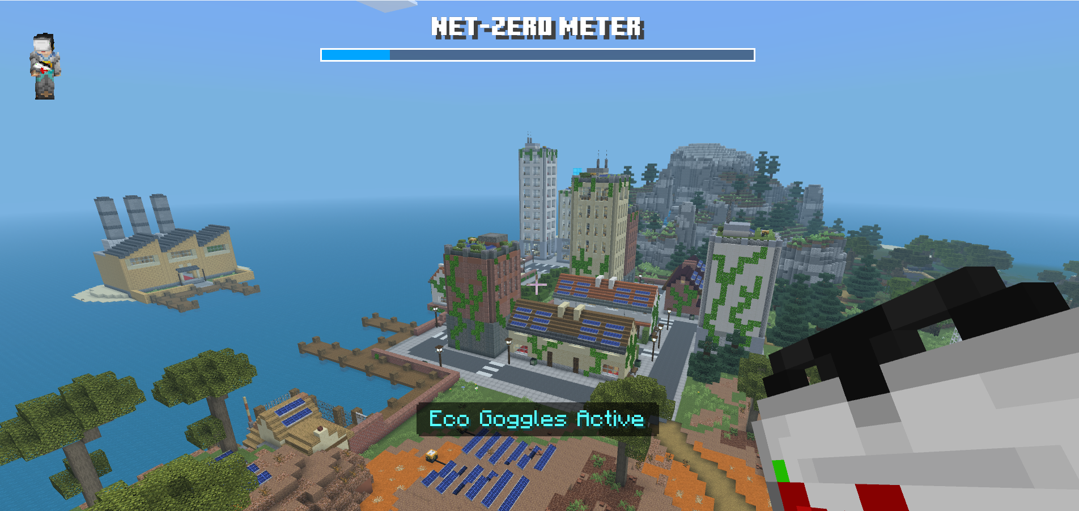
Learning intentions and success criteria
We are learning to:
  understand the concept of Net Zero
  identify different types of renewable energy sources
  recognise the importance of children’s rights
  collaborate in a multiplayer game.
We can:
  explain what net zero means and give examples
  match renewable energies to suitable biomes
  describe at least one children’s right
  work together in our group to build and problem solve in the game.
5
Notes:
Notes for teachers:
Learning intentions and success criteria are best co-constructed with students. Adapt the learning intention as required and add matching success criteria.
For more information See ⁠AITSL or the NSW Department of Education explicit teaching strategies, ⁠Sharing learning intentions and ⁠Sharing success criteria
LISC is not necessarily presented at the beginning of the lesson. Teacher needs to consider most effectual time to introduce
LISC should be revisited during the lesson to support students' evaluation of their learning

Slide 6
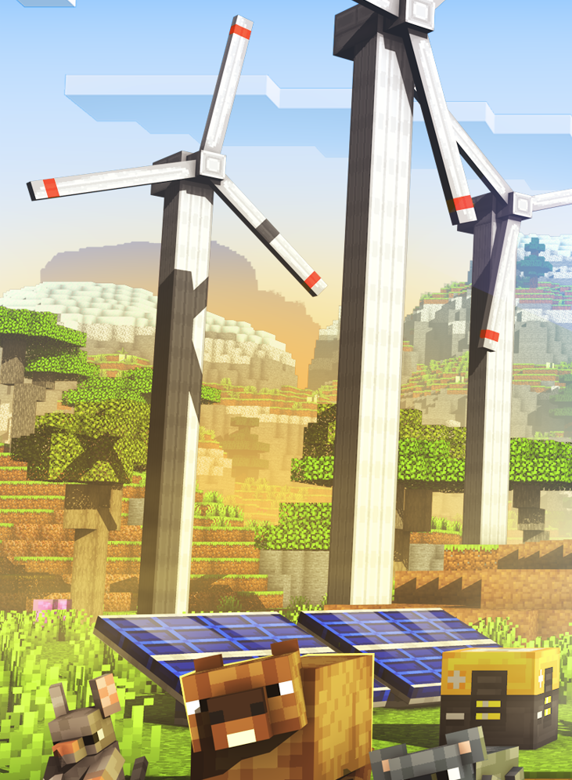
Net Zero and renewable energy sources
Explained
Net Zero means balancing the amount of greenhouse gas emissions we produce, such as carbon dioxide, with the amount we remove from the atmosphere.
Renewable energies are types of energy that come from sources that do not run out and can be used repeatedly, like sunlight (solar), wind, and water (hydro). We use renewable energy sources to make electricity without creating pollution or harming the environment.
Notes:
Notes for teachers:
Encourage students to read the slide content aloud to engage with key concepts.
Use the BtN videos to complement learning and reinforce understanding. Review BtN videos beforehand and select the most appropriate clips for your students’ needs and context.
For Zero Emissions (BtN, 3:23 mins), full video suitable for student viewing.
Link: https://www.abc.net.au/btn/classroom/zero-emissions/13533742 (Date: 14 Sep 2021)
For Net Zero (BtN, 3:45 mins), recommended to watch up to 2:29 mins to avoid political content; teacher discretion advised.
Link: https://www.abc.net.au/btn/classroom/net-zero/105993938 (Date: 11 Nov 2025)

Slide 7

Mix and Match
Draw lines to connect related concepts
1. Emissions
a) A gas in the air. It’s produced when we breathe out, and by cars and factories. Too much of it can make the Earth warmer.
2. Carbon dioxide
b) Energy sources like coal, oil, and natural gas. Burning them produces electricity or powers cars but also creates pollution.
3. Fossil fuels
c) Are actions that can help to reduce or remove our carbon emissions from the air.
4. Carbon Offsets
d) Gases, like carbon dioxide, released into the air from sources such as factories, cars, or power stations.
Notes:
Notes for teachers:
To assess comprehension, use these formative activities by matching definitions, or drawing lines to connect related concepts.
Definition/s:
Emissions are gases, particles, or other substances that are released into the air or surroundings. For example, when we burn fossil fuels like coal, oil, or gas, we create emissions—most importantly, carbon dioxide (CO₂). Emissions can also be other things, such as sound, light, or radio waves, that are sent out from a source. We often use the word 'emissions' to talk about pollution from cars, factories, and other activities that send gases into the atmosphere.
Carbon dioxide is a gas in the air. We make it when we breathe out, burn things like petrol, coal, and wood, or when factories and cars run. Plants use carbon dioxide to help them grow, and too much of it in the air can make the Earth warmer.
Fossil fuels are energy sources like coal, oil, and natural gas that come from the remains of plants and animals that lived a long time ago. We burn them to make electricity, run cars, and heat homes, but this creates pollution and adds greenhouse gases to the atmosphere.
Carbon offsets an action that can help to reduce or remove our carbon emissions from the air.

Slide 8
Knowledge check – Net Zero
Definition
Facts/characteristics
Net Zero
Examples
Non-examples
Notes:
Notes for teachers:
Frayer Model activity: this is a graphic organiser that helps students understand key vocabulary or concepts. Students fill in each section for the target word or concept, e.g. Net Zero. This activity encourages deeper understanding and promotes discussion. Teachers can use it individually, in pairs or as a class for new topics or vocabulary.
Net Zero
Definition:
Net Zero refers to a plan or goal to reduce the amount of greenhouse gases released into the atmosphere as much as possible, and to balance any remaining emissions by absorbing an equal amount (for example, through planting trees or using technology), so that the total net amount of emissions is zero.
Facts/Characteristics:
Net Zero is about balancing emissions produced and emissions removed from the atmosphere.
Carbon dioxide (CO₂) is the main greenhouse gas considered in Net Zero plans.
Achieving Net Zero helps slow down the impact of climate change.
Methods to absorb emissions include reforestation and carbon capture technologies.
All sectors—energy, transport, agriculture—may need to change their practices to reach Net Zero.
Examples:
A country reduces its emissions and plants enough trees to absorb what remains, reaching Net Zero.
A factory uses renewable energy and offsets remaining emissions by supporting carbon capture projects.
A city encourages public transport and renewable energy, while investing in local tree planting.
Non-examples:
Continually burning fossil fuels without reducing or offsetting emissions.
Ignoring the amount of greenhouse gases released into the atmosphere.
Making no effort to absorb or balance emissions.

Slide 9
Knowledge check – renewable energy sources
Definition
Facts/characteristics
Renewable Energy Sources
Examples
Non-examples
Notes:
Notes for teachers:
Frayer Model activity: this is a graphic organiser that helps students understand key vocabulary or concepts. Students fill in each section for the target word or concept, e.g. Renewable Energy Sources. This activity encourages deeper understanding and promotes discussion. Teachers can use it individually, in pairs or as a class for new topics or vocabulary.
Renewable Energy Sources
Definition:
Are forms of energy that are generated from natural processes that are continuously replenished. These include sunlight (solar), wind, water (hydropower), geothermal heat, and biomass. Unlike fossil fuels, renewable energy sources do not deplete over time and generally produce less pollution, making them a sustainable option for powering homes, businesses, and industries.
Facts/Characteristics:
Renewable energies are naturally replenished.
They don’t create as much pollution as fossil fuels.
They help reduce greenhouse gas emissions.
Common types include solar, wind, hydro (water), and geothermal (heat from the earth).
Using renewable energies helps fight climate change.
Examples:
Solar panels making electricity from sunlight.
Wind turbines producing energy from wind.
Hydroelectric dams using flowing water.
Geothermal plants using heat from underground.
Non-examples:
Burning coal to make electricity.
Using petrol or oil for cars.
Gas-powered power stations.
Any energy source that will eventually run out and pollutes the environment.

Slide 10



Quick check
Which biome is best?
 | Protect drylands soil health, build a solar farm to generate clean energy. | Restore the rainforest and protect powerful carbon-storing trees. | Harness wind and waterpower, let’s reforest mountain (alpine) slopes.
 | Save woodland biodiversity with tree troughs, wildlife pods and replant native trees. | Super charge the wetlands, build boardwalks and plant carbon capturing mangroves. | Design a green city with solar power, rooftop gardens, and recycling stations.
Wind turbines
Solar panels
Recycling station
Water (hydro) turbines
Notes:
Notes for teachers:
Students will explore 6 different biomes in the Eco Detectives Unite- Race to zero! Minecraft Education world.
Activity: Match the items in the blue column to the most suitable biome. Discuss as a class why the item fits best with that biome. See suggested responses below.
Wind turbines = Mountains (alpine)
Reasoning: Mountainous areas have strong and consistent winds ideal for wind energy.
Solar panels = Drylands
Reasoning: Drylands receive abundant sunlight, making them suitable for solar energy.
Water (hydro) turbines = Mountains
Reasoning: Mountains provide the gravity and falling water needed for hydroelectric power.
Recycling station = City (urban)
Reasoning: Urban areas produce more waste, so recycling stations are commonly located in cities.
To learn more about the importance of using recycling stations, watch the video resource: “Food Waste Explained: Why wasting food is wasting everything” (OzHarvest, 2m 12s)
https://www.youtube.com/watch?v=wgLuXvtaLyQ

Slide 11
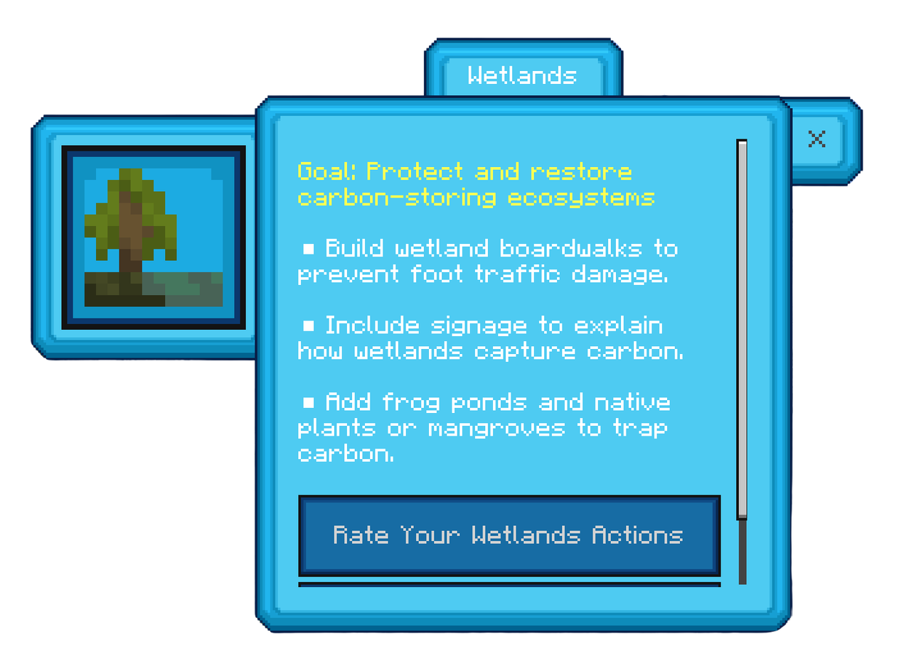
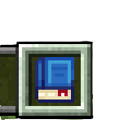
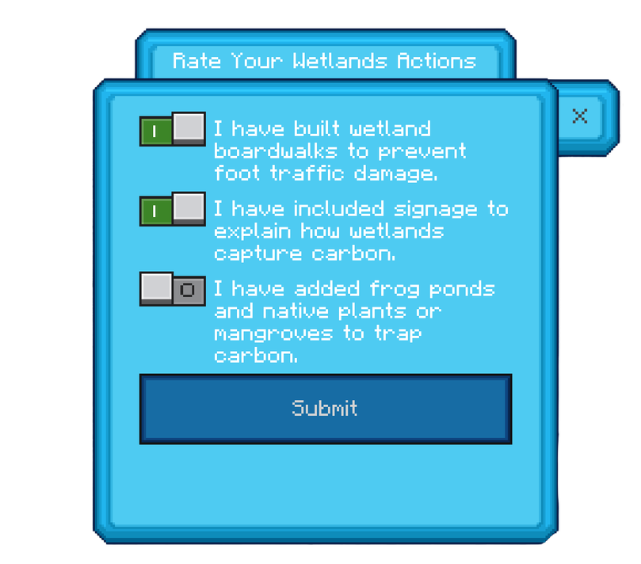
Handbook – actions
Keep track of the tasks you need to complete by using the Handbook.
When your teammates all agree that a task is completed, rate your actions by selecting the checkbox next to the task to turn it green, then click submit.
12
Notes:
Notes for teachers:
In the game each biome has 3 tasks for the group to complete, 3 tasks x 6 biomes = 18 tasks.
Students will receive a "Handbook" in the inventory bar when they reach Eco Island. The inventory bar is located at the bottom of the game screen.
Players can see what task/s need to be completed in each biome by accessing (clicking) the "Handbook" (see blue book on slide).
Once the task has been completed students open the "Handbook" select a biome e.g. Wetlands and click the checkbox to turn it green.
Students should check with their teammates before marking a task as completed, to make sure everyone agrees the task is done.

Slide 12

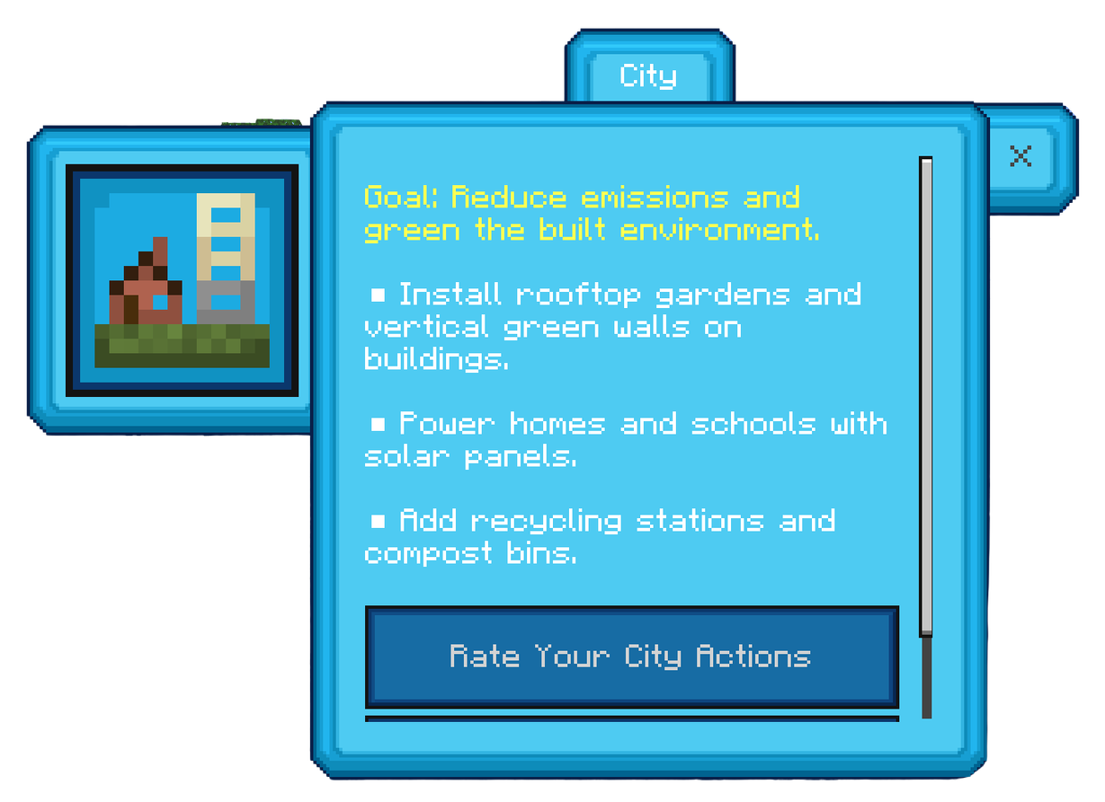
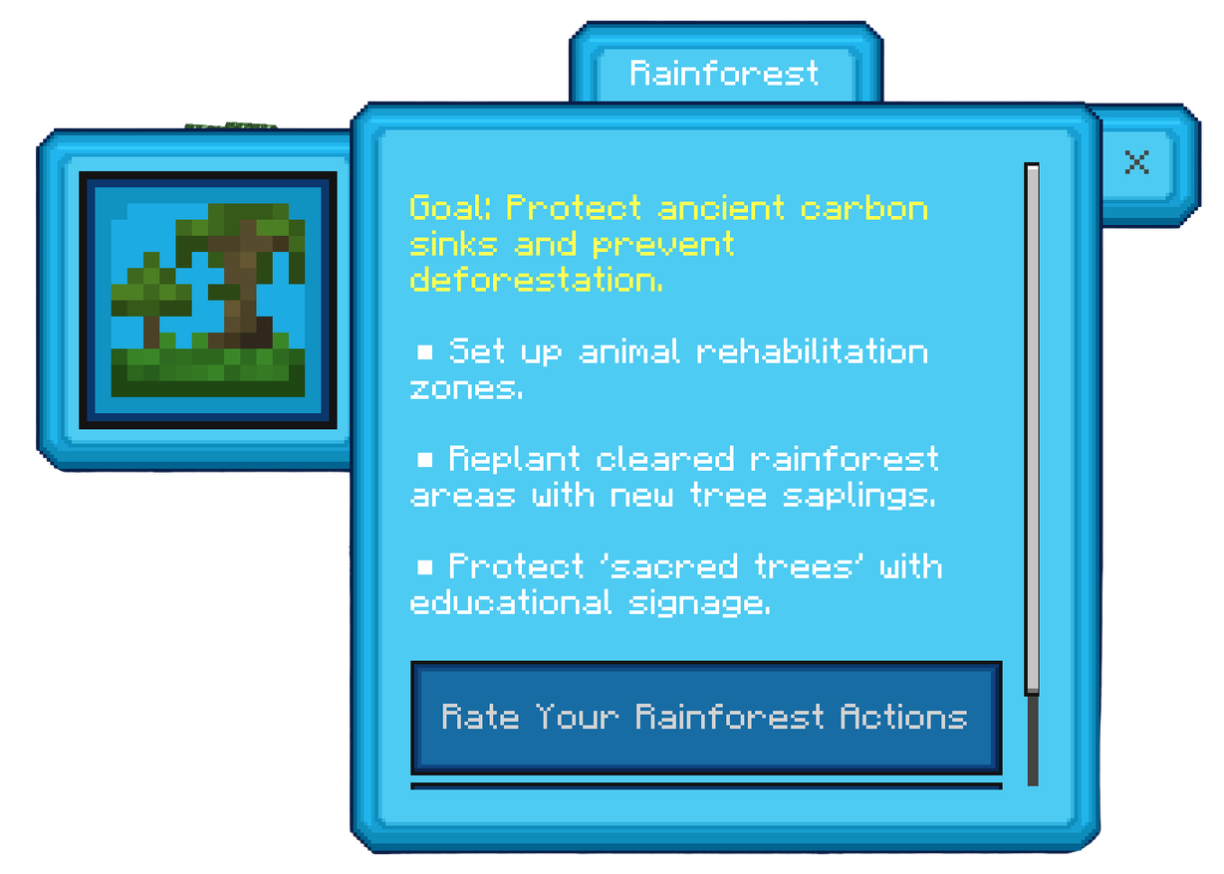
Main mission – City and Rainforest
Complete 3 activities in each biome
11
Notes:
Notes for teachers:
This is what students will see in the game when they open the "Handbook" and select a biome.
The overarching goal of each biome is listed at the top of the blue biome card in yellow. The 3 tasks to be complete in the biome are listed below in white font.
Students read the 3 missions for each biome aloud as a class.
There are 6 biomes; each has different tasks. Here are the tasks for the City and Rainforest

Slide 13
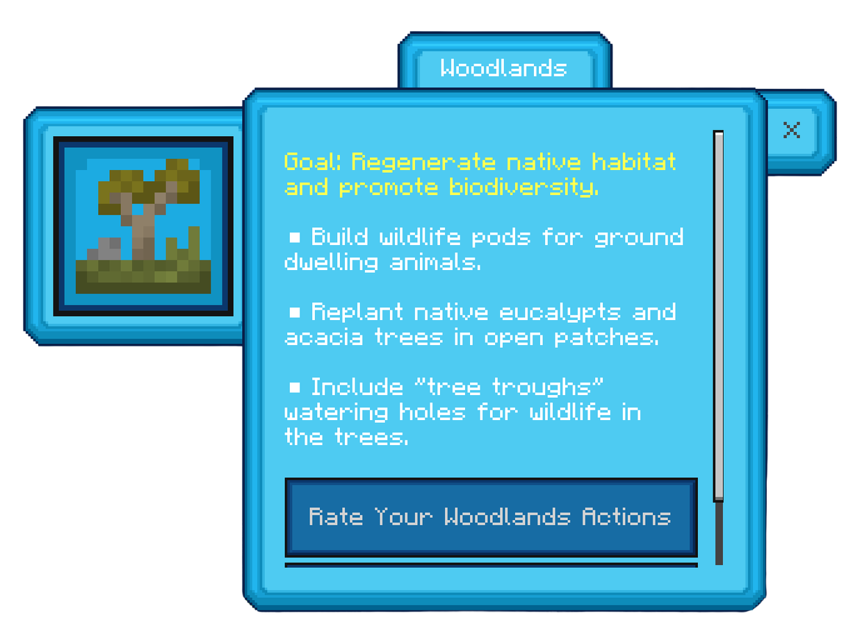
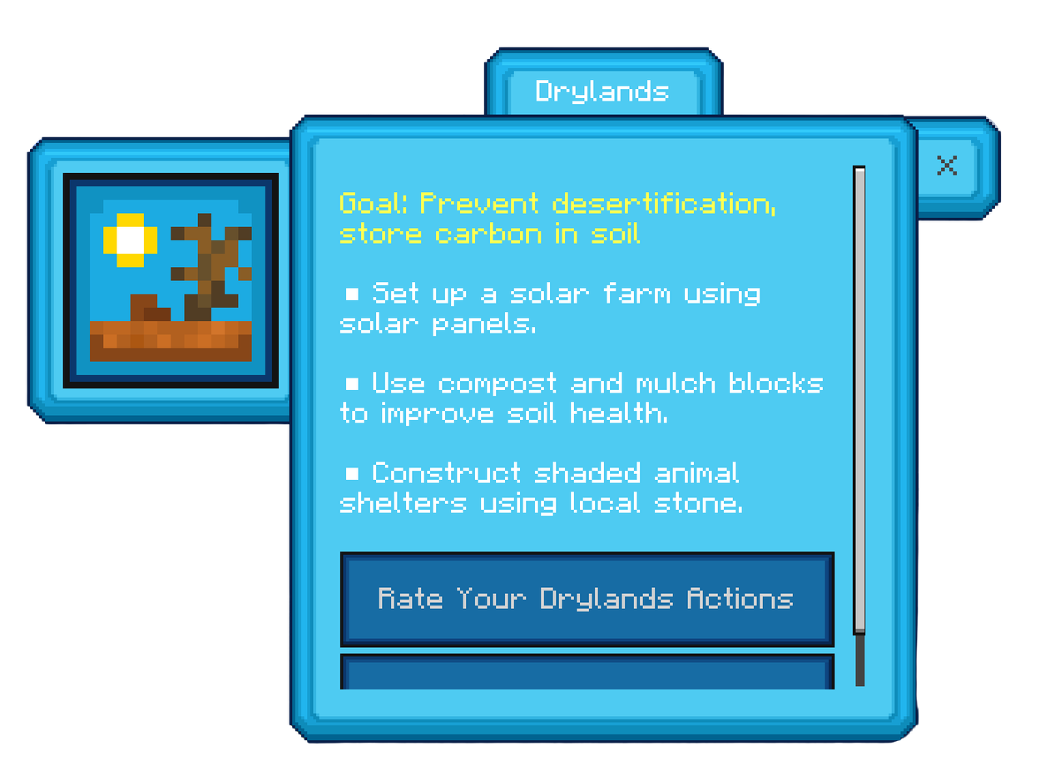
Main mission – Woodlands and Drylands
Complete 3 activities in each biome
11
Notes:
Notes for teachers:
Let students read the 3 missions for each biome aloud. Here are the tasks for the Woodlands and Drylands.
In game tip, when connecting renewable energy sources to the battery blocks.
Battery Blocks in the game don't have an actual gameplay use and are purely to show logics behind energy storage. Meaning that gaining energy from the sun is 1 but storing it on a location is 2.
The battery block can be used to demonstrate part 2.
Wires can be used to connect individual power sources, such as solar cells, wind turbine and hydro turbines to those batteries. Every bar on the battery is 1 power source. You can connect 4 power sources to one battery block to fill it up.

Slide 14
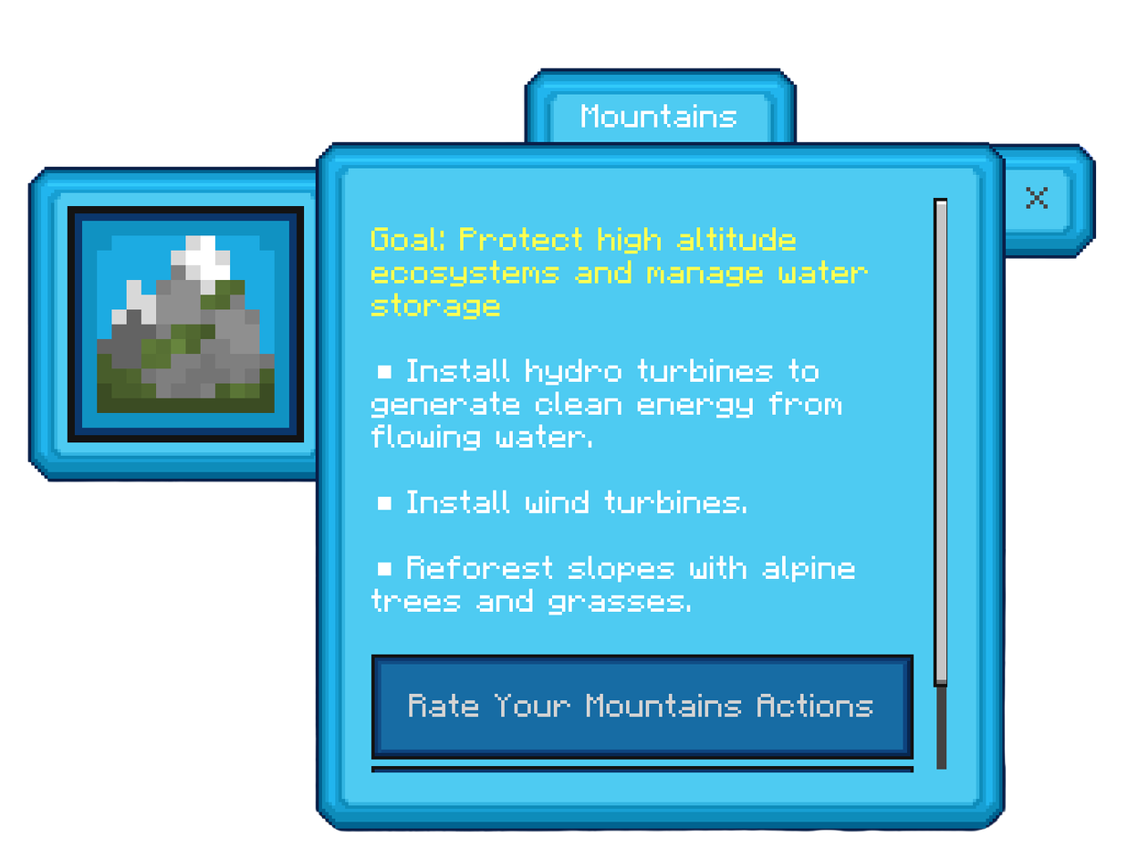
Main mission – Mountains and Wetlands
Complete 3 activities in each biome
11
Notes:
Notes for teachers:
Let students read the 3 missions for each biome aloud. Here are the tasks for the Mountains and Wetlands.
Ask students, “What do you need to remember when rating each biome task?”
Suggested responses:
Students should check with their teammates before marking a task as completed, to make sure everyone agrees the task is done.
Once the task has been completed students open the "Handbook" select a biome and click the checkbox to turn it green.

Slide 15
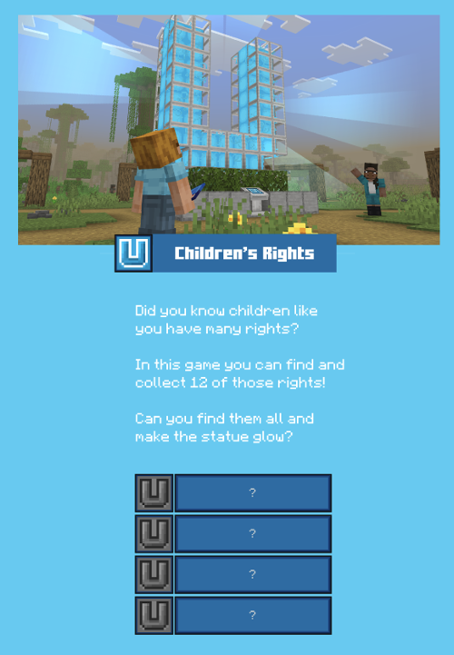
Children’s rights
Collect them all
The United Nations Convention on the Rights of the Child was introduced in 1989.
Watch the BTN video to learn what children’s rights are and how people worldwide work to protect them.
In Eco Detectives Unite – race to zero, collect all the U’s to discover more about your rights!
Notes:
Notes for teachers:
Read the slide as a class, then view the BtN World Children's Day video.The BtN video is 4 minutes 9 seconds long.
Focus on the first 2 minutes 30 seconds, which clearly explains children’s rights. The rest of the video covers World Children’s Day (20th November) and is optional to view.
Video link World Children’s Day:
https://www.youtube.com/watch?v=ODwdACpU2rg (Published 19 Nov 2024)
After watching the video, ask students to turn to a partner and name one right that children have, as explained in the video.
Invite some students to share their answers with the class.
For further exploration of children's rights, refer to the 5 x PDHPE syllabus aligned lessons available on the Minecraft Education platform Eco Detectives Unite - Race to zero! under the SUPPORTING FILES section located at this location: https://education.minecraft.net/en-us/lessons/eco-detectives-unite-race-to-zero

Slide 16
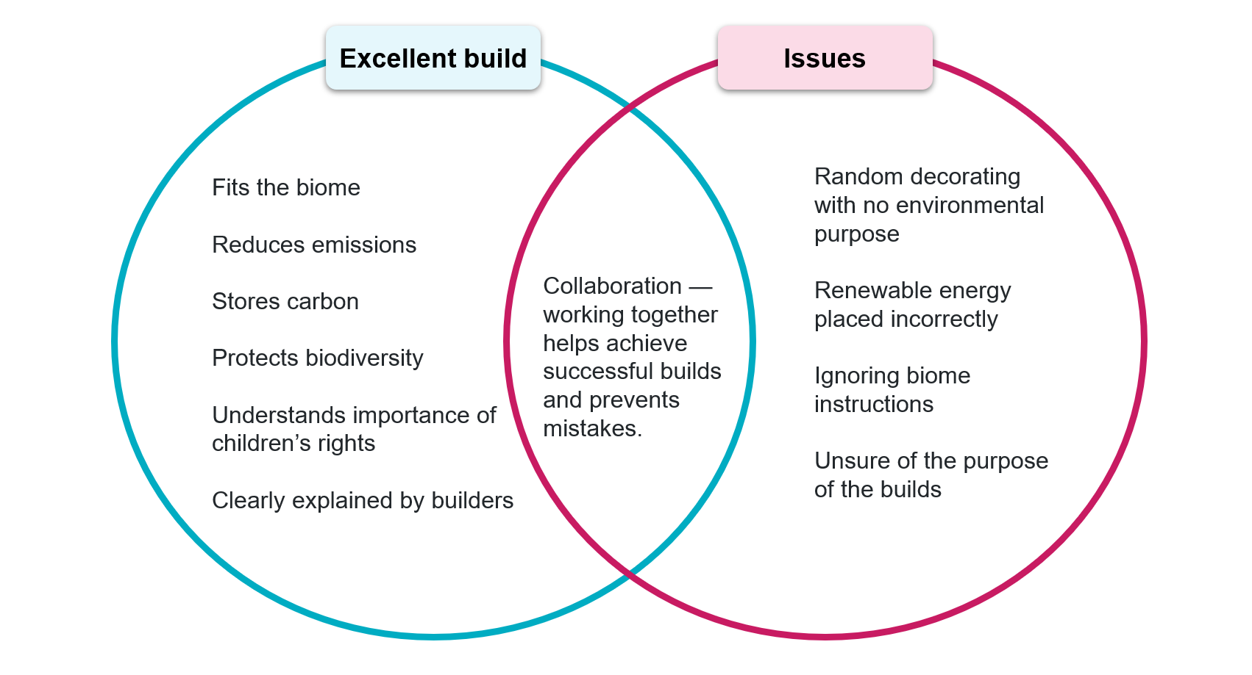
In the game think about...
What makes an excellent build?
14
Notes:
Notes for teachers:
Explain to students before they play Eco Detectives Unite-Race to zero! that they will compare what makes an excellent build in a Minecraft Education game with common issues to avoid by discussing the double Venn diagram above.
Discuss each section briefly with the class, use the following prompts to lead a focused discussion that connects the diagram to students’ gameplay and teamwork experiences.
Let’s look at the two circles: What are some key features of an excellent build?
What are some common issues or mistakes we need to avoid?
Why do you think collaboration is placed in the overlap?
How does working together help both create better builds and avoid problems?
How does understanding the biome help us make better choices in our builds?
Can you think of examples from the game where teamwork helped improve your build or avoid a mistake?
How can planning and collaborating with others make your build more successful overall?
Emphasize that the overlapping section represents something important to both sides—in this case, collaboration.
Highlight that working together in the multiplayer game helps create better builds and prevents common mistakes.
Use this activity to reinforce the importance of planning, understanding biomes, and teamwork in the game.
Encourage students to think about how collaboration affects their choices and outcomes.

Slide 17
Knowledge check
K
What do I know?
W
What do I want to know?
Notes:
Notes for teachers:
KWLH table activity
This activity helps students organise their learning about a topic. Students fill in the chart as they learn – first what they know, then what they want to find out, what they have learned and how they will research or investigate concepts further. It helps students think about their learning process and keeps track of progress.
As a class complete the K (What I Know) and W (What I Want to Know) columns. Discuss some of the responses as a class.
Once K and W columns are completed pause the KWLH activity; students will complete the L and H columns after gameplay.
K – What do we already KNOW?
Teacher prompts:
“What do you already know about Net Zero or reducing carbon emissions?”
“Where do we see pollution or waste in everyday life?”
“What do factories need in order to run?”
“What do you think might happen if factories don’t manage their waste or energy well?”
“What actions do communities take to protect the environment?”
“What clues might an eco detective look for when investigating environmental problems?”
“What rights do you think all children have?”
“Who do you think protects children’s rights?”
“How should children be treated?”
“Is there a special day for children’s rights? What do you know about it?”
Follow-up prompts:
“What makes you think that?”
“Where did you learn that?”
“Does anyone have a different idea?”
W – What do we WANT to know?
Teacher prompts:
“What questions do you have about how factories can reach Net Zero?”
“What do you want to discover while exploring the world?”
“What environmental problems do you think you might need to solve?”
“How might technology help reduce pollution?”
“What clues do you think the game will give you?”
“What are some other rights children have?”
“How are children’s rights protected in Australia?”
“What happens if a child’s rights are ignored?”
“Who helps defend children’s rights around the world?”
“How can I help support children’s rights?”
Extension prompts:
“What would you ask a real environmental scientist?”
“What are you curious about in this world?”

Slide 18

Let’s play – HOST (1)
Step 1: Open the game
Open the Minecraft Education app
Step 2: Sign in
Use your school email and password to log in, ensure you are using your school account.
    ____________@education.nsw.gov.au
    Password: _________________
16
Notes:
Notes for teachers:
Divide students into teams of 3-6 people per team. Handout devices, select a student to be the HOST of the world is for each team. One student per team will host the game so other student can join the same world. E.g. 4 teams of 3 students = 4 hosts.
Student Management:
To maintain focus and minimise distractions, have only the host students keep their devices out as they prepare the Minecraft Education world and follow the instructions on the next 4 slides (18-21).
All other students should keep their devices closed or turned over until the hosts are ready. Once the hosts signal, they are set up, the rest of the class can open their devices and log in. This ensures everyone stays on task and helps the session run smoothly.
⚠️ Troubleshooting Tips
Restart the app if the world doesn’t appear.
Check Wi-Fi / network connection
Make sure everyone is using the same version of Minecraft Education.
Ask your teacher or IT assistant if multiplayer is blocked on your network.

Slide 19
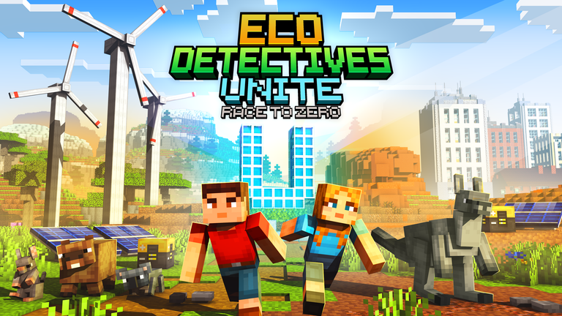
Let’s play – HOST (2)
Step 3: Access the world
  Click on PLAY
  Click on LIBRARY
  In the top right hand corner of your screen click into the Search Library...
  Type in Eco Detectives Unite: Race to Zero
    Click on the game
  Click on CREATE WORLD
    It will take a moment to load...
16
Notes:
Notes for teachers:
Host students are to follow the steps on the screen.

Slide 20
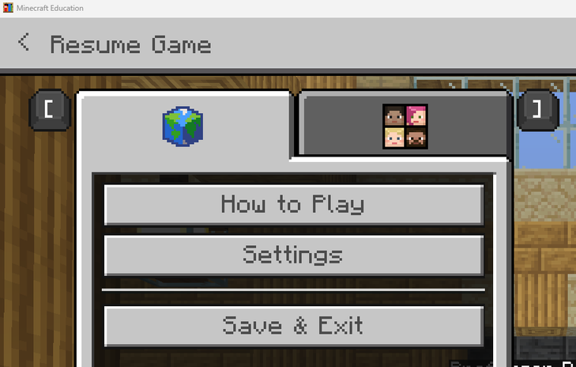
Let’s play – HOST (3)
Step 4: Host the world
Laptop players
  press the Esc button on your keyboard.
  Click on the host button
with the faces.
  Tablet/iPad users
    Touch the middle hamburger button at the top of the screen in the middle.
16
Notes:
Notes for teachers:
Host students can follow the steps on the screen. Note on the above slide the difference if using a laptop versus a tablet device.

Slide 21
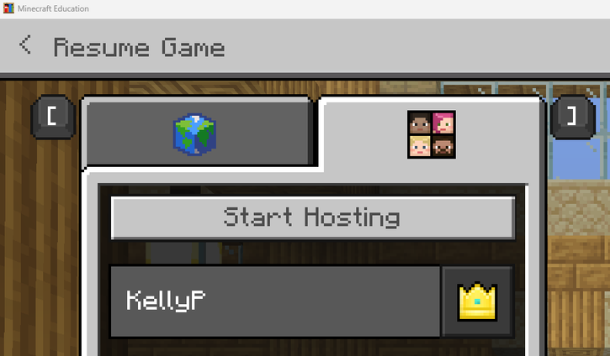
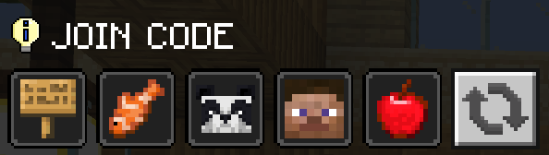
Let’s play – HOST (4)
Step 4: Host the world continued...
Click on Start Hosting
  Click on the “Confirm” box.
Share the JOIN CODE with the members of your group.
When everyone has joined the world, the Host can select
< Resume Game
16
Notes:
Notes for teachers:
Host students can follow the steps on the screen.

Slide 22
Let’s play – Team Member – Join world (1)
Step 1: Open the game
Open the Minecraft Education app
Step 2: Sign in
Use your school email and password to log in, ensure you are using your school account.
    ____________@education.nsw.gov.au
    Password: _________________
17
Notes:
Notes for teachers:
Student team member instructions: students access their devices and follow the steps on the next 2 slide (22-23) to JOIN WORLD with the Host team member.
⚠️ Quick Tips
Make sure you’re on the same school network
If it doesn’t work, restart Minecraft Education

Slide 23
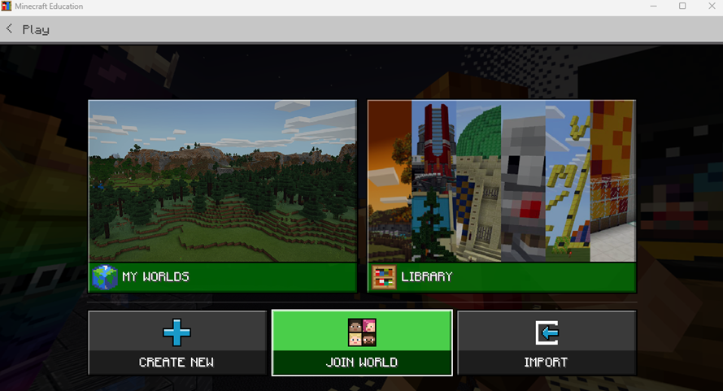
Let’s play - Team Member - Join world (2)
Step 3: Join the world
Click on PLAY
Click on JOIN WORLD
  Enter the JOIN CODE your host will share with you.
Step 4: Enter the game
Wait for the world to load
  You will spawn into your team’s world.
17
Notes:
Notes for teachers:
Once students have signed in to Minecraft Education app, students select PLAY.
Next step is to select JOIN WORLD.
The Host will share the JOIN CODE with their group. The JOIN CODE is made up of various images, such as fish, apple, panda, Steve, Alex.
Check the Join Code carefully (case-sensitive icons)

Slide 24
Evaluation
What do I know? | What do I want to know? | What have I learned? | How can I learn more?
Net Zero means not adding more greenhouse gases to the atmosphere than we take away. Children have the right to be protected, educated, and have their opinions heard. Renewable energy comes from sources like the sun, wind and water. Renewable energies can help reduce pollution and climate change. Minecraft is a game where you can build things and explore worlds. | How people and businesses actually achieve net zero? What happens if we don't reach Net Zero? What happens if a child's rights are ignored or broken? How are children's rights enforced in different countries? How do solar panels and wind turbines actually make electricity? How can Minecraft be used for learning in school?
K
What do I know?
W
What do I want to know?
L
What have I learned?
H
How can I learn more?
Notes:
Instructions for L and H Sections of the KWLH Table (after gameplay):
After students finish playing the Minecraft game, ask them to complete the L (What I Learned) section—write down new information or insights gained from the activity.
Then, have students fill in the H (How I Can Find Out More) column—list ways or sources (e.g., books, websites, asking adults) to keep learning about concepts in the game.
Discuss some responses as a class to consolidate learning and encourage curiosity.
L – What have we LEARNED?
(During pauses in gameplay or after playing)
Teacher prompts:
“What problem did you solve in the game today?”
“What actions helped reduce environmental impact?”
“What surprised you?”
“What did the factory need to change to become more sustainable?”
“What clues helped you figure out the solution?”
“Which solution worked best and why?”
What new things did you learn about children’s rights?
How did the game help you understand children’s rights better?
Reflection prompts:
“How did working as a team help?”
“What would happen in the real world if we didn’t make these changes?”
H – HOW can we learn more?
(After gameplay reflection)
Teacher prompts:
“Where could we find more information about these solutions in real life?”
“What experts could help us understand these problems?”
“How could we test one of these ideas in our school?”
“What experiment or investigation could we design?”
“How could our community move closer to Net Zero?”
Where could you look to learn more about children’s rights?
Who could you ask if you wanted to know more about children’s rights?
Action prompts:
“What is one small action we could take this week?”
“How could we share what we learned with others?”
Maximising Learning Outcomes:
Feel free to adapt and run through the slides based on your class's needs. After students engage with the slide deck and play the game, further learning can be supported through relevant syllabus links (see Notes section on Slide 9).
Encourage students to play the game a second time to reinforce and build on their understanding — they will become more confident problem solvers and builders on repeat playthroughs.

Slide 25
Second lesson – play through
NSW Department of Education
Eco Detectives Unite
Race to zero!
Proudly supported by
Notes:
Notes for teachers:
Start of second lesson, using Eco Detectives Unite - Race to zero! Minecraft Education game.

Slide 26
Second lesson play through refresher
What do I know? | What do I want to know? | What have I learned? | How can I learn more?
Net Zero means not adding more greenhouse gases to the atmosphere than we take away. Children have the right to be protected, educated, and have their opinions heard. Renewable energy comes from sources like the sun, wind and water. Renewable energies can help reduce pollution and climate change. Minecraft is a game where you can build things and explore worlds. | How people and businesses actually achieve net zero? What happens if we don't reach Net Zero? What happens if a child's rights are ignored or broken? How are children's rights enforced in different countries? How do solar panels and wind turbines actually make electricity? How can Minecraft be used for learning in school? | I learned that net zero means reducing emissions by changing the way we use energy, like switching to renewables or planting trees. I learned that children's rights are protected by laws and organisations, and that everyone has the right to go to school and feel safe. I learned renewable energy is important because it doesn't pollute. Minecraft can teach teamwork, problem-solving. | We discussed our builds as a class and watched a video about real-life net-zero projects. In Minecraft, I saw that when we look after the environment, we protect every kid's right to a safe and healthy life. I learned by building renewable energy systems in Minecraft, then comparing them to real ones using videos and websites. I learned through playing Minecraft with my classmates, solving building challenges, and talking about our strategies afterwards.
K
What do I know?
W
What do I want to know?
L
What have I learned?
H
How can I learn more?
Notes:
Notes for teachers:
Preparation:
Before the second lesson play session, have the previous completed KWLH chart from the first gameplay lesson ready to display.
Purpose:
The goal is to refresh students’ memories of what they learned and discussed during the first lesson and to clearly set the purpose and focus for this follow-up lesson.
Instructions:
Display the completed KWLH chart prominently where all students can see it.
Briefly review each section: What students Knew, Wanted to know, what they Learned, and How they found further information.
Highlight key points, insights, or any questions that were particularly interesting or important.
Emphasize how this session will build on that prior learning, setting clear learning intentions or goals for the day.
Strategies:
Engage students by asking a few quick questions based on the chart to activate prior knowledge.
Use this review to address any misconceptions or clarify important concepts before diving back into the game.
Clearly articulate how today’s gameplay and activities connect to the chart and overall learning objectives.
Benefits:
Reinforces continuity between sessions, helping students see their progress.
Helps maintain focus and motivation by explicitly connecting past learning to new tasks.
Provides an opportunity for students to reflect on their learning process.

Slide 27
Knowledge check – vocabulary
Non-Player Character (NPC)
NPC – Professor Deanna:
“Our goal is to help the factory reach _____ _________ operations - that means making as little _______
as possible and using __________ practices.
Your mission on Eco Island - create ___________ offsets and build habitat-positive spaces.
A carbon _______ is an action that can help to ________or remove our carbon ________.”
NPC – Ruzika:
“When we ________ the planet, we protect every child’s __________”
Word Bank
Net Zero, pollution, sustainable, carbon, offset, reduce, emissions, protect, future.
21
Notes:
Notes for teachers:
Word bank activity to be completed BEOFRE the second playthrough of Eco Detectives Unite - Race to Zero! Minecraft Education game.
Purpose:
This activity is designed to consolidate student understanding of the main concepts in the game. Students will be provided with sentences containing blank spaces, where key words have been omitted.
Instructions:
The sentences are adapted from language used by NPCs (Non-Player Characters) within the Eco Detectives Unite-Race to zero! game. Students must select the correct words from the provided Word Bank to fill in the empty sentence spaces.
How it works:
Display the sentences and Word Bank on the slide.
Students individually or in pairs read each sentence and use clues from context and prior learning to identify which word correctly completes each statement.
The focus is on vocabulary and comprehension relating to the two main concepts explored in the game.
Expected outcomes:
Students demonstrate recall and understanding of key terms and ideas.
Students connect in-game content to broader lesson objectives.
This activity acts as a formative assessment, helping to gauge student understanding of the concepts before moving forward.
Teacher tips:
Encourage students to discuss their choices and reasoning, fostering a deeper understanding.
If students struggle, prompt them to revisit relevant sections in the game or lesson.
Use student responses to identify any areas where further teaching may be required.
Play the game:
Ask students to play the game a second time, encouraging each group to select a different host.
Direct students to use slides 18 - 23 to assist with the hosting and sign-in process.

Slide 28
3-2-1 things I learned today
List 3 things you learned today:
3
1.
2.
3.
List 2 questions you have about these things:
2
1.
2.
Give 1 reason why it’s important to learn about these things:
1
1.
Notes:
Notes for teachers:
Using a 3-2-1 Exit Ticket once the gameplay session has finished.
Purpose:
The 3-2-1 Exit Ticket is a quick, reflective strategy that helps consolidate student learning, encourages metacognition, and provides you with immediate feedback on student understanding after the session.
Instructions:
At the end of the second lesson, ask students to complete the 3-2-1 exit ticket individually.
This consists of:
3 things they learned during the session
2 questions they still have or things they found confusing
1 way they applied or can apply what they learned
Implementation:
Distribute paper exit tickets or digital forms, or have students write responses in their exercise books.
Give students 5–10 minutes to complete the activity, working quietly and thoughtfully.
Collect the exit tickets before they leave or have students submit their digital responses.
Benefits:
Encourages students to reflect deeply on their learning and consolidate key ideas.
Helps identify areas of misunderstanding or curiosity that can guide future lessons.
Provides insight into how students are connecting game content to real-world applications or concepts.
Supports differentiation by identifying students who may need additional support or opportunities for extension.
Teacher Tips:
Review responses to adjust pacing or revisit challenging concepts in the next lesson.
Use interesting student questions to spark discussion or further exploration.
Praise students for thoughtful reflection to build a positive learning culture.

Slide 29
Third lesson – play through
NSW Department of Education
Eco Detectives Unite
Race to zero!
Proudly supported by
Notes:
Notes for teachers:
Start of third lesson.

Slide 30
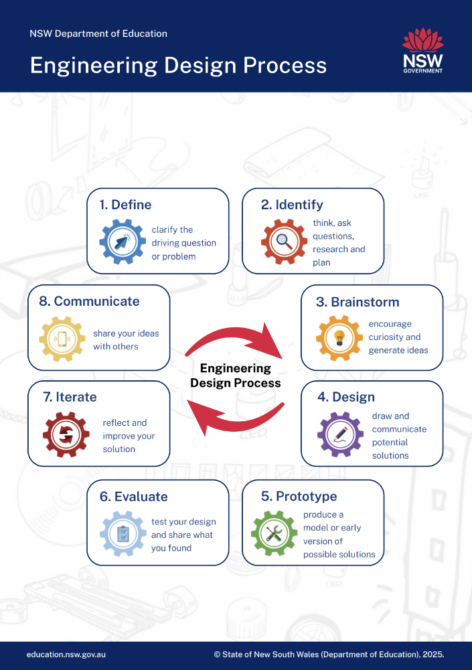
Level Up: Design your own Net Zero world!
Use the Engineer Design Process (EDP)
Use the EDP steps in the picture to plan and build your own Net Zero world in Minecraft Education.
Think about ways to save energy and make your world sustainable.
Use the Table Top cards to help organise your ideas and guide your design.
Be creative and show how your world can help the environment.
Notes:
Notes for teachers:
OPTIONAL ACTIVITY: Levelling up student learning (after second playthrough)
After the students have completed the second playthrough/lesson of the Eco Detectives Unite-Race to zero! game, it is time to deepen their engagement and critical thinking.
Introduce the next challenge: designing their own Net Zero world within Minecraft Education.
Explain the Task:
Students will apply the Engineer Design Process (EDP) steps highlighted in the image above to create a sustainable, Net Zero world.
Emphasize creativity, problem-solving, and real-world application of sustainability concepts.
Use Tabletop Cards:
Print and distribute the EDP Tabletop card resources. These cards provide prompts, constraints, and considerations that will guide students through each stage of the EDP.
Encourage students to refer to these cards to organise their ideas and plan their designs systematically.
To access the Tabletop cards and instructions on how to use them, cut and paste the link below into a web browser.
https://education.nsw.gov.au/content/dam/main-education/documents/teaching-and-learning/curriculum/stem/stem-k-10-engineering-design-process-poster-tabletop-and-lanyard-cards.pdf
Teacher Support:
For deeper understanding and scaffolding strategies, refer to the comprehensive EDP guide link below. This guide offers detailed explanations of each step, examples, and tips for supporting diverse learners.
Encourage students to document their design process and reflect on how their Net Zero world addresses energy use, resource management, and sustainability goals. This activity not only reinforces the concepts explored during gameplay but also cultivates design thinking and environmental awareness.
Engineering Design Process – comprehensive guide (PDF770KB) cut and paste the link below into a web browser.
https://education.nsw.gov.au/content/dam/main-education/documents/teaching-and-learning/curriculum/stem/stem-k-10-comprehensive-teacher-guide-engineering-design-process.pdf

Slide 31





NSW Department of Education
Eco Detectives: Unite – The race to zero is an initiative of the NSW Department of Education and has been proudly supported by UNICEF Australia, Taronga Conservation Society Australia, ACHPER NSW, Auckland Zoo, Perth Zoo, and Zoos South Australia.
<insert quote>
MAJOR PARTNER
LEAD PARTNER
PROFESSIONAL LEARNING PARTNER
SUPPORTER
SUPPORTER
SUPPORTER

Slide 32
References
This presentation contains NSW Curriculum and syllabus content. The NSW Curriculum is developed by the NSW Education Standards Authority. This content is prepared by NESA for and on behalf of the Crown in the right of the State of New South Wales. The material is protected by Crown copyright.
Please refer to the NESA Copyright Disclaimer for more information https://educationstandards.nsw.edu.au/wps/portal/nesa/mini-footer/copyright.
NESA holds the only official and up-to-date versions of the NSW Curriculum and syllabus documents. Please visit the NSW Education Standards Authority (NESA) website https://educationstandards.nsw.edu.au/wps/portal/nesa/home and the NSW Curriculum website https://curriculum.nsw.edu.au.
ABC News. (2021, September 14). Zero Emissions. Behind the News. Retrieved March 19, 2026, from https://www.abc.net.au/btn/classroom/zero-emissions/13533742
ABC News. (2024, November 23). World Children’s Day. Behind the News. Retrieved March 19, 2026, from https://www.youtube.com/watch?v=ODwdACpU2rg
ABC News. (2025, November 11). Net Zero. Behind the News. Retrieved March 19, 2026, from https://www.abc.net.au/btn/classroom/net-zero/105993938
NSW Department of Education. (n.d.). Environmental zoo centres. Retrieved March 19, 2026, from https://education.nsw.gov.au/teaching-and-learning/unique-settings/environmental-zoo-centres
NSW Department of Education. (n.d.). Science and technology: Stage 1 units. Retrieved March 19, 2026, from https://education.nsw.gov.au/teaching-and-learning/curriculum/science/science-curriculum-resources-k-12/science-and-technology-k-6-curriculum-resources/science-and-technology-s1-units
NSW Department of Education. (n.d.). STEM curriculum resources. Retrieved March 19, 2026, from https://education.nsw.gov.au/teaching-and-learning/curriculum/stem/stem-curriculum-resources
NSW Department of Education. (n.d.). STEM K–10 comprehensive teacher guide: Engineering design process [PDF]. Retrieved March 19, 2026, from https://education.nsw.gov.au/content/dam/main-education/documents/teaching-and-learning/curriculum/stem/stem-k-10-comprehensive-teacher-guide-engineering-design-process.pdf
NSW Department of Education. (n.d.). STEM K–10 engineering design process [PDF]. Retrieved March 19, 2026, from https://education.nsw.gov.au/content/dam/main-education/documents/teaching-and-learning/curriculum/stem/stem-k-10-engineering-design-process-poster-tabletop-and-lanyard-cards.pdf
OzHarvest. (n.d.). Food waste explained: Why wasting food is wasting everything [Video]. YouTube. Retrieved March 19, 2026, from
https://www.youtube.com/watch?v=wgLuXvtaLyQ
11

Slide 33
Copyright
© State of New South Wales (Department of Education), 2026
The copyright material published in this resource is subject to the Copyright Act 1968 (Cth) and is owned by the NSW Department of Education or, where indicated, by a party other than the NSW Department of Education (third-party material).
Copyright material available in this resource and owned by the NSW Department of Education is licensed under a Creative Commons Attribution 4.0 International (CC BY 4.0) license.
This license allows you to share and adapt the material for any purpose, even commercially.
Attribution should be given to © State of New South Wales (Department of Education), 2025.
Material in this resource not available under a Creative Commons license:
the NSW Department of Education logo, other logos and trademark-protected material
Material owned by a third party that has been reproduced with permission. You will need to obtain permission from the third party to reuse its material.
Links to third-party material and websites
Please note that the provided (reading/viewing material/list/links/texts) are a suggestion only and implies no endorsement, by the New South Wales Department of Education, of any author, publisher, or book title. School principals and teachers are best placed to assess the suitability of resources that would complement the curriculum and reflect the needs and interests of their students.
If you use the links provided in this document to access a third-party’s website, you acknowledge that the terms of use, including licence terms set out on the third-party’s website apply to the use which may be made of the materials on that third-party website or where permitted by the Copyright Act 1968 (Cth). The department accepts no responsibility for content on third-party websites.

