Slide 1
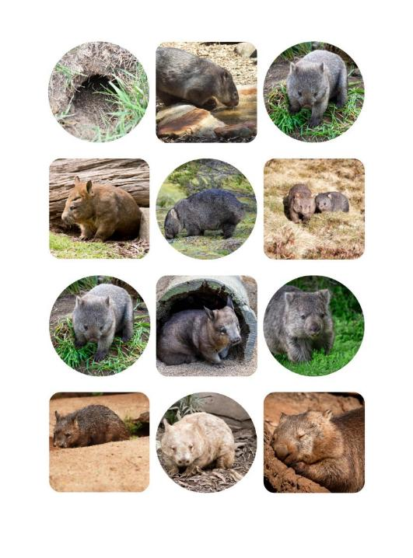
Designing a
Wombat Environment
Integrated STEM Resource
Engineering Design Process
Early Stage 1 and Stage 1
2026
Notes:
Images: Sourced from Pixabay and Canva; edited using Canva.

Slide 2
Instructions for use
This resource has been developed to support teachers in planning and delivering engaging integrated STEM learning experiences using the Engineering Design Process (EDP).
Lessons connect with relevant outcomes from the K–6 Science and Technology, Mathematics and English syllabuses.
Teachers are encouraged to adapt activities, pacing and supports to suit their class context, students' needs and school priorities.
Additional notes, guidance and suggestions are included in the notes section of this PowerPoint.
Notes:
Teacher note:
This slide provides guidance for the teacher and is not intended for direct student display.
Save a copy of the file to make changes to the slide deck
Go to file > Download a copy (this downloads a copy to the computer to edit in the PowerPoint app.)
To convert the PowerPoint to Google Slides:
Upload the file into Google Drive and open it.
Go to File > Save as Google Slides (Note: Conversion may cause formatting changes to the slides.)

Slide 3
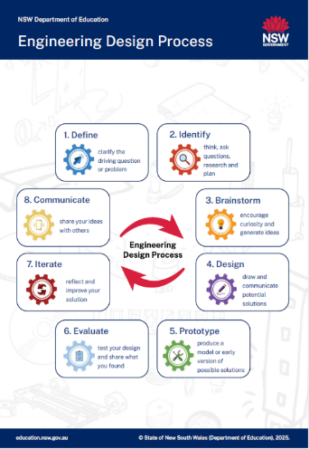
Instructions for use - EDP
Using the Engineering Design Process (EDP)
The Engineering Design Process (EDP) provides consistent language and structure for students as they solve problems and create solutions.
Colour-coded cog icons are used throughout this resource to help students recognise each phase and support understanding and recall.
Important to Note:
The process is flexible and does not always happen in a straight line.
Students may move between phases depending on the task or problem.
The phases support creativity, critical thinking, collaboration, communication, and problem-solving.
3
Notes:
Teacher note:
This slide supports teacher understanding of the Engineering Design Process (EDP).
For student-facing content, access the EDP materials here:
https://education.nsw.gov.au/teaching-and-learning/curriculum/stem/stem-curriculum-resources/engineering-design-jiggler-challenge
Available resources include:
EDP Comprehensive Teacher Guide
EDP Design Folio (K-10)
EDP Posters
EDP Tabletop and lanyard cards

Slide 4
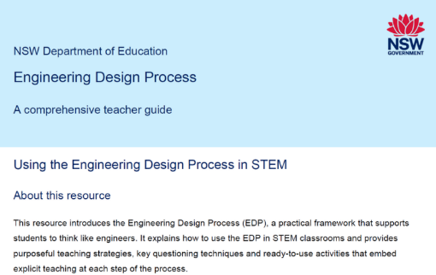
Instructions for use - guide
Using the EDP Comprehensive Teacher Guide
The EDP Comprehensive Teacher Guide provides additional support for teachers using the Engineering Design Process in the classroom.
It includes:
practical teaching strategies
questioning prompts
examples of each EDP phase
classroom implementation ideas
ways to embed explicit teaching in STEM learning
This 'Designing a Wombat Environment' resource can be used alongside the guide to support planning and delivery.
Notes:
Teacher note:
This slide introduces the EDP Comprehensive Teacher Guide to support planning and classroom implementation.
Access the guide using the link provided.
Engineering Process Resources: Link
EDP Comprehensive Teacher Guide

Slide 5

Instructions for use - folio
Using the Design Folio
The design folio supports students to record:
ideas and drawings
measurements
reflections
Improvements.
Teachers may adapt, simplify or expand folio pages to suit student needs, class context and lesson focus.
The folio may be used whole-class, in groups, or individually.
It can also provide useful evidence of student thinking and progress over time.
Notes:
Teacher note:
This slide introduces the design folio as a flexible tool to support student thinking, reflection and assessment. Access the design folio using the link provided.
Engineering Process Resource: Link
EDP Design Folio (K-10)

Slide 6

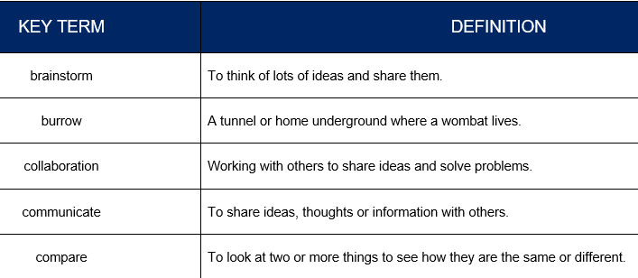
Instructions for use - terms
Glossary of Key Terms
A glossary is included at the end of the unit as a teacher reference to support consistent vocabulary across the unit.
Teachers may use selected terms for:
anchor charts and word walls
discussion prompts
vocabulary and writing support
A student-friendly printable version is included in this PowerPoint.
Consistent vocabulary supports reading, speaking, writing and explaining ideas.
Teachers may adapt terms to suit class context and student needs.
Notes:
Teacher note:
The glossary supports explicit teaching of key vocabulary throughout the unit.
Teachers are encouraged to introduce, model, and revisit these terms to support student understanding and consistent use of language.
A digital version of the unit and supporting resources are available on the department website LINK HERE.*******

Slide 7
Unit Overview: Lesson Sequence

Slide 8
Unit Overview: Lessons
1
5
9
Exploring wombat needs and
behaviours
Define – The visiting wombat
problem
Prototype – Produce a model
2
6
10
Exploring wombat habitats and
environments
Identify – What does a wombat
need?
Evaluate – Test and share
designs
3
7
11
Investigating wombat facts –
measuring the length of a wombat
Brainstorm – Generating ideas
for a wombat habitat
Iterate – reflect and improve designs
4
8
12
Investigating wombat facts –
measuring the mass of a wombat
Design – Draw and
communicate potential solutions
Communicate – Share ideas
with others
8
Notes:
Teacher notes:
This slide provides an overview of the lesson sequence and includes links to navigate directly to each lesson.

Slide 9
Lesson 1: Exploring wombat needs and behaviours
Key Words:
living
non-living
wombat
needs
features
environment
Notes:
Key vocabulary is used throughout the unit. Refer to the glossary as needed.

Slide 10
Lesson 1 – learning intentions and success criteria
Early Stage 1
We are learning to
describe the characteristics and behaviours of a wombat
recognise the basic needs of living things.
We can
join a class discussion by describing what a wombat looks like and what it does
share simple examples of what living things need to stay alive
explain how living things are different from non-living things.
Stage 1
We are learning to
describe what animals look like and what they do
group living things and explain how they are the same or different
use diagrams or models to show how animals grow.
We can
name and describe animals in our school or local environment
group animals and explain why they belong together
show how animals grow and change using drawings, labels or models.
Notes:
Notes for teachers:
Learning intentions and success criteria are best co-constructed with students. Adapt the learning intention as required and add matching success criteria.
For more information See ⁠AITSL or the NSW Department of Education explicit teaching strategies, ⁠Sharing learning intentions and ⁠Sharing success criteria
LISC is not necessarily presented at the beginning of the lesson. Teacher needs to consider most effectual time to introduce
LISC should be revisited during the lesson to support students' evaluation of their learning

Slide 11
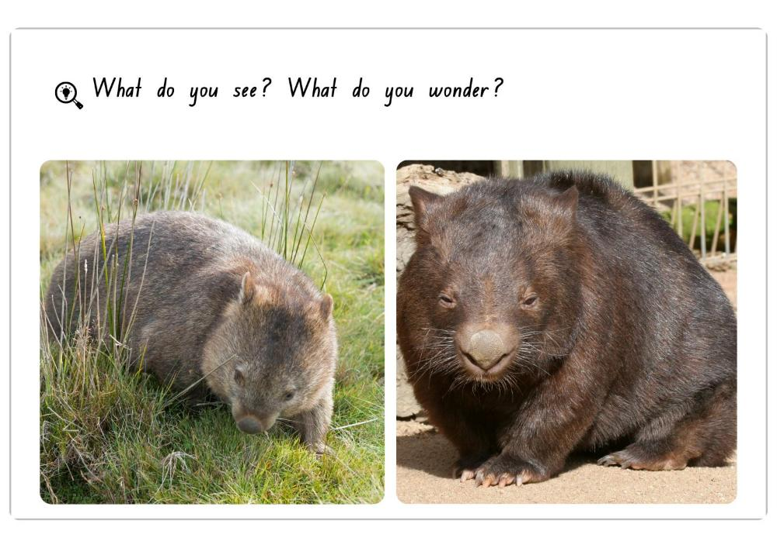
What do you see? What do you wonder?
11
Notes:
Teacher prompts / discussion cues
Observe
What do you notice first?
What colours, shapes or body parts can you see?
What body parts does a wombat have like other animals?
What animal does the wombat remind you of? Why?
Infer / Predict
Where might this wombat live?
What do you think it eats?
How might it stay safe?
Do you think it is awake in the day or night? Why?
Wonder
What are you curious about?
What do you still want to know?
Checking for understanding
Do wombats live in the wild?
Are zoos where wombats normally live, or are zoos special places where people look after them?
Students look closely at images and discuss:
Prompts:
Does this wombat have small eyes?
Why do you think wombat’s have small eyes?
Does this wombat have a large body?
Does this wombat have a pointy nose?
Do both wombats look exactly the same?
Why do you think wombats have sharp claws?
Follow-up prompt: How do you know? / What can you see?
Images: Sourced from Canva; edited using Canva.

Slide 12
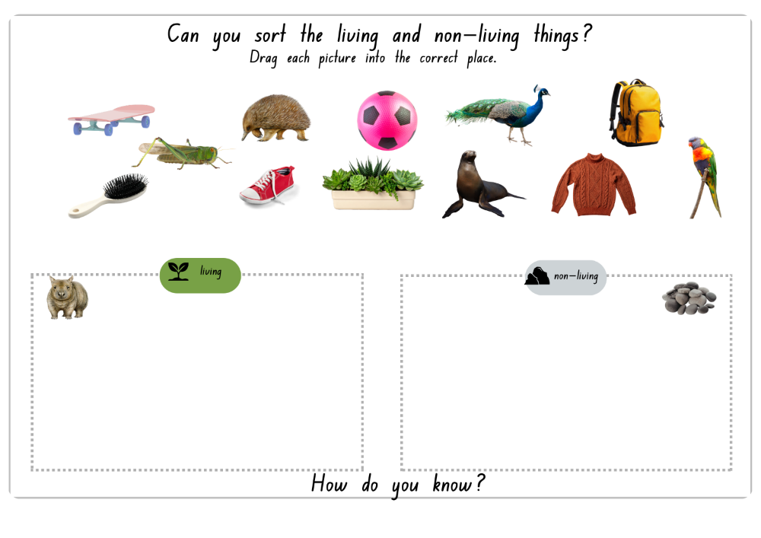
Sorting living and non-living things
12
Notes:
Teacher prompts / discussion cues
What do you notice about these pictures?
Which items are living? How do you know?
Which items are non-living? How do you know?
Reasoning prompts:
Does it grow and change?
Does it need food or water?
Can it move by itself?
Was it once living? (wood, clothing material)
Challenge thinking and misconception prompts:
Is a toy wombat living? Why not?
Can something move but still be non-living? (bike, ball)
What do all living things have in common?
Emphasise: Living things grow, need specific resources, and change over time. Clarify: not everything that moves is living. Plants are living things even though they do not walk.
Images: Sourced from Canva; edited using Canva.

Slide 13
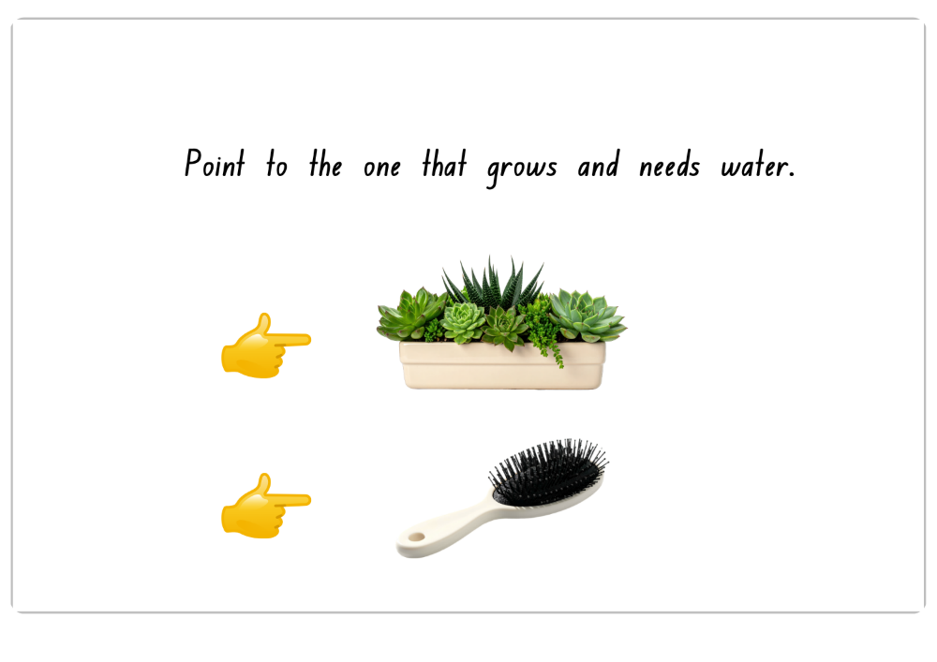
Checking for understanding – point to the one that grows and needs water.
13
Notes:
Teacher note:
Pause after asking the question before students point.

Slide 14
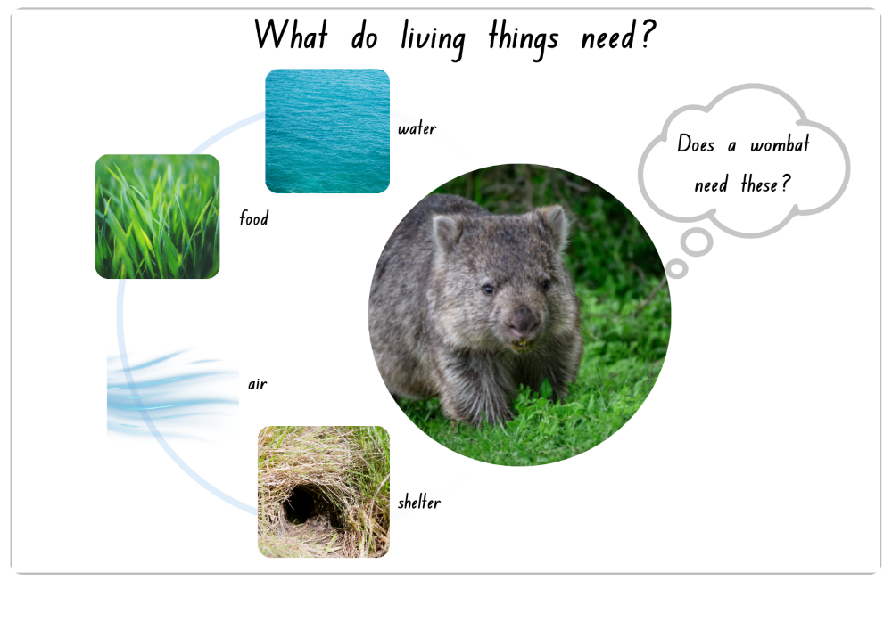
What do living things need?
14
Notes:
Teacher prompts / discussion cues
What things can you see on the slide?
Which of these are needs of living things?
What does each picture represent?
Checking for understanding – use yes and no cards
Does a wombat need water?
Does a wombat eat grass?
Is a burrow a suitable shelter for a wombat?
Do all living things need water?
Reasoning
What might happen if a wombat had no water?
What if it had no shelter?
Which need do you think is most important? Why?
Ensure students understand that all living things, including wombats, need food, water, air and shelter to survive. Prompt students to explain why each need is important and how it supports the wombat (e.g. shelter keeps it safe, food gives it energy).
Watch for students thinking animals only need food and water. Reinforce that air and shelter are also essential for survival.
Images: Sourced from Canva; edited using Canva.

Slide 15
Lesson 2: Exploring wombat habitats and environments
Key Words:
habitat
environment
burrow
shelter
safe
Notes:
Key vocabulary is used throughout the unit. Refer to the glossary as needed.

Slide 16
Lesson 2 – learning intentions and success criteria
Early Stage 1
We are learning to
identify features of a wombat's habitat
describe what a wombat needs in its habitat to live safely and comfortably.
We can
name things found in a wombat habitat
share how the habitat helps a wombat survive
create a drawing or model of a suitable wombat habitat.
Stage 1
We are learning to
describe features of a wombat habitat and environment
explain how habitat features help a wombat survive
represent a suitable habitat using drawings, labels or models.
We can
identify natural features found in a wombat habitat
explain why these features are important
represent and label a habitat that meets a wombat's needs.
Notes:
Notes for teachers:
Learning intentions and success criteria are best co-constructed with students. Adapt the learning intention as required and add matching success criteria.
For more information See ⁠AITSL or the NSW Department of Education explicit teaching strategies, ⁠Sharing learning intentions and ⁠Sharing success criteria
LISC is not necessarily presented at the beginning of the lesson. Teacher needs to consider most effectual time to introduce
LISC should be revisited during the lesson to support students' evaluation of their learning

Slide 17
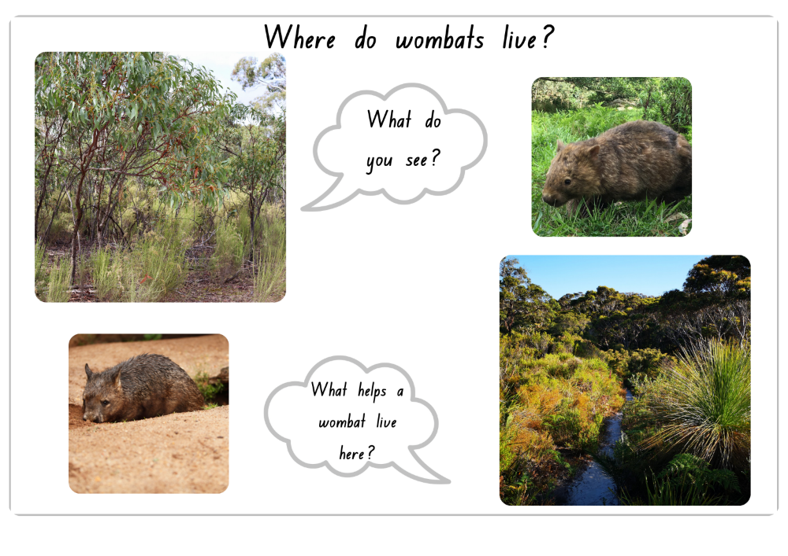
Where do wombats live?
17
Notes:
Teacher note
To support understanding and address misconceptions, ensure students understand that wombats may be seen in zoos where people care for them, but they do not usually live there. Wombats live in the wild, in natural habitats where they find their own food, water and shelter and dig burrows.
Teacher prompts / discussion cues
Why might a wombat live here?
What helps keep it safe?
What does it need in this place?
Is it grassy or dry?
Is there shelter?
Is there water nearby?
Is it quiet?
Where could a burrow be?
Where could it hide?
Images: Sourced from Canva; edited using Canva.

Slide 18
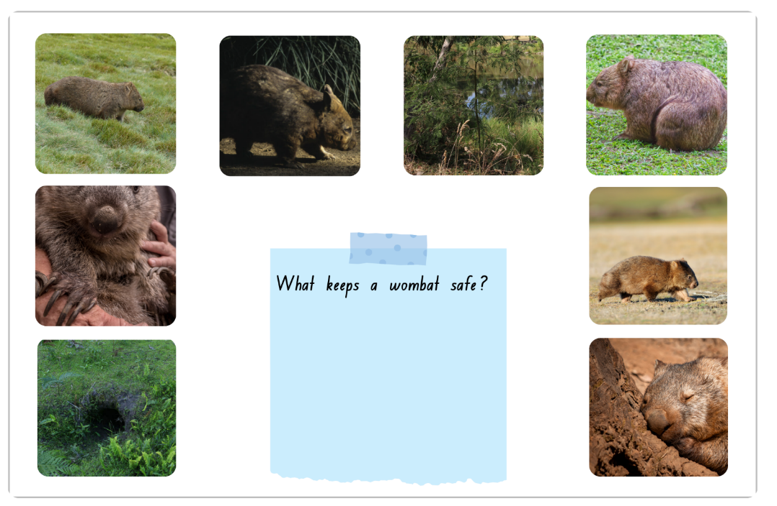
What keeps a wombat safe?
18
Notes:
Teacher prompts / discussion cues
How could this body shape help?
Why might a wombat run fast?
How could a burrow protect it?
Why come out at night?
How do claws help?
Check-in (True/False cards)
A wombat stays safe by living in a burrow or shelter.
Emphasise: A habitat must meet needs: shelter, food, water, safety.
Watch for: Students may choose 'pretty' habitats rather than suitable ones.
Images: Sourced from Canva; edited using Canva.

Slide 19
Lesson 3: Investigating wombat facts - measuring the length of a wombat
Key Words:
measure
length
estimate
compare
longer
shorter
Notes:
Key vocabulary is used throughout the unit. Refer to the glossary as needed.

Slide 20
Lesson 3 – learning intentions and success criteria
Early Stage 1
We are learning to
describe and compare length using words such as longer and shorter
recognise that length is how long something is from end to end.
We can
use words such as longer and shorter when comparing a wombat and its burrow model
show that length is how long something is from end to end.
Stage 1
We are learning to
measure and compare length using uniform informal units placed end to end.
We can
use uniform informal units placed end to end without gaps or overlaps to measure the length of a wombat and its burrow
record how many units and what kind were used.
Notes:
Notes for teachers:
Learning intentions and success criteria are best co-constructed with students. Adapt the learning intention as required and add matching success criteria.
For more information See ⁠AITSL or the NSW Department of Education explicit teaching strategies, ⁠Sharing learning intentions and ⁠Sharing success criteria
LISC is not necessarily presented at the beginning of the lesson. Teacher needs to consider most effectual time to introduce
LISC should be revisited during the lesson to support students' evaluation of their learning

Slide 21
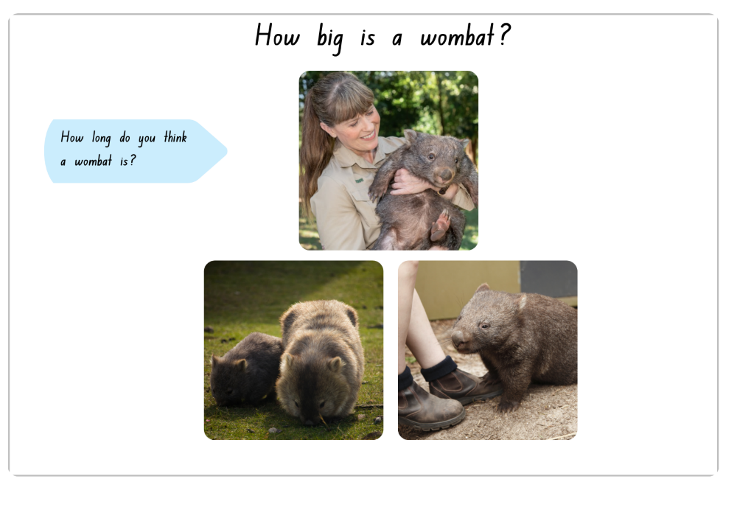
How big is a wombat?
21
Notes:
Teacher prompts / discussion cues
What do you notice about the wombat’s size?
Does it look bigger or smaller than you expected?
What clues help you decide?
Compare
Is the wombat bigger or smaller than the person’s arms?
How does the wombat compare to the boots?
How is the adult wombat different from the baby wombat?
Estimate
How long do you think a wombat might be?
Would it be shorter or longer than your desk?
Would it be longer than your arm span?
Check-in (True/False cards)
An adult wombat is as small as a mouse.
An adult wombat can be as long as your school desk
Ensure students understand that adult wombats can grow to about 1 – 1.3 metre in length, using familiar classroom comparisons such as a table or desk. Support students to use comparison language such as about the same as, longer than and shorter than.
Images: Top image sourced from Australia Zoo website: https://australiazoo.com.au/support-wildlife/adopt-an-animal/common-wombat-elle/Canva; edited using Canva. Other images from Canva; edited using Canva.

Slide 22
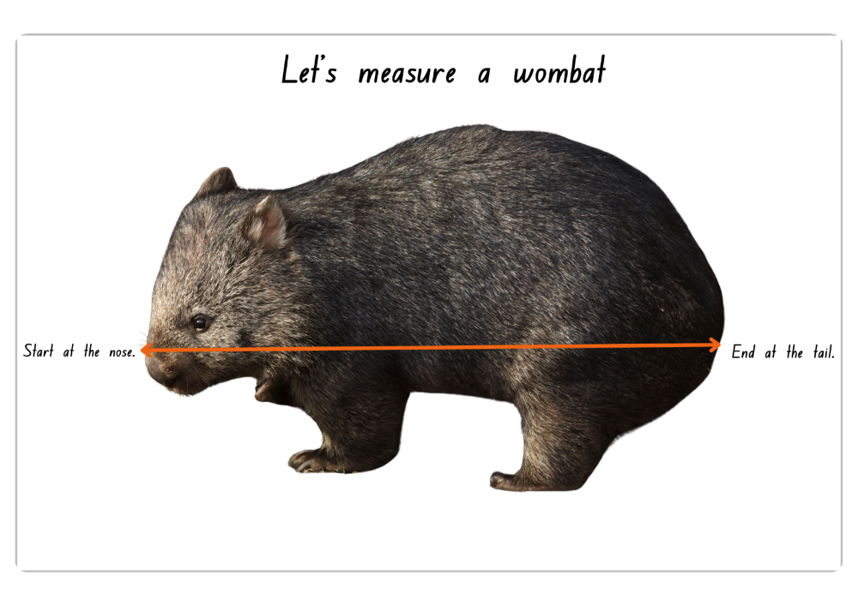
Let’s measure a wombat
22
Notes:
Teacher note:
Guide students to place measuring materials end to end with no gaps or overlaps when measuring the model wombat. Encourage students to start at one end, align each unit carefully, and count each unit once.
Teacher prompts / discussion cues
Where should we start measuring?
Where should we stop?
Why do we measure from end to end?
What materials could we use?
What did you learn about measuring length?
Why is using the same start point important?
Which material was easiest to use?
Why did groups get different results?
What happens if there are gaps?
What happens if units overlap?
Which material gives a fairer measurement?
Ensure: Students measure from one end to the other using a straight row of equal units. Units are placed end to end, no overlaps and counted once.
Watch for: Gaps, overlaps, or units not aligned in a straight line.
Images: Sourced from Canva; edited using Canva.

Slide 23
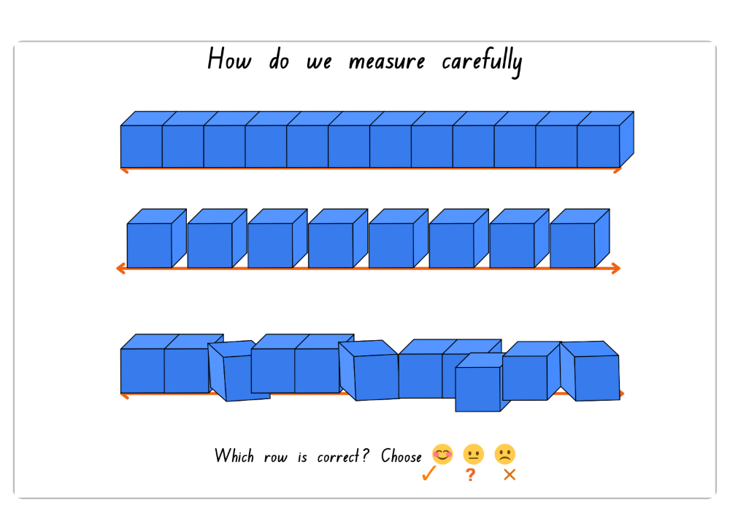
How do we measure carefully
23
Notes:
Teacher prompts / discussion cues
What is different about the cubes in each row?
Which row measures most carefully? Why?
Which row has gaps? overlaps?
Which row has no spaces between the cubes?
Which row is lined up neatly?
Why must cubes touch end to end?
Which row gives the fairest result?
Which face did you choose and why?
What is wrong with the second row?
What is wrong with the third row?
Why is the first row correct?
What should we remember when measuring the wombat?
Images: Sourced from Canva; edited using Canva.

Slide 24
Lesson 4: Investigating wombat facts - measuring the mass of a wombat
Key Words:
mass
measure
heavy
light
estimate
Notes:
Key vocabulary is used throughout the unit. Refer to the glossary as needed.

Slide 25
Lesson 4 – learning intentions and success criteria
Early Stage 1
We are learning to
compare the mass of objects by holding (hefting) them
use the words ‘heavier than’, ‘lighter than’, and ‘about the same’ when comparing objects learning.
We can
hold two objects and say which one feels heavier or lighter
explain why we think an object is heavier or lighter.
Stage 1
We are learning to
compare and order the mass of objects using hefting and an equal-arm balance
explain what they noticed using every day and mathematical language.
We can
compare and order the masses of objects by holding (hefting) them
use an equal-arm balance to check if two objects have the same mass
explain what we noticed using everyday words such as heavier, lighter and equal.
Notes:
Notes for teachers:
Learning intentions and success criteria are best co-constructed with students. Adapt the learning intention as required and add matching success criteria.
For more information See ⁠AITSL or the NSW Department of Education explicit teaching strategies, ⁠Sharing learning intentions and ⁠Sharing success criteria
LISC is not necessarily presented at the beginning of the lesson. Teacher needs to consider most effectual time to introduce
LISC should be revisited during the lesson to support students' evaluation of their learning

Slide 26
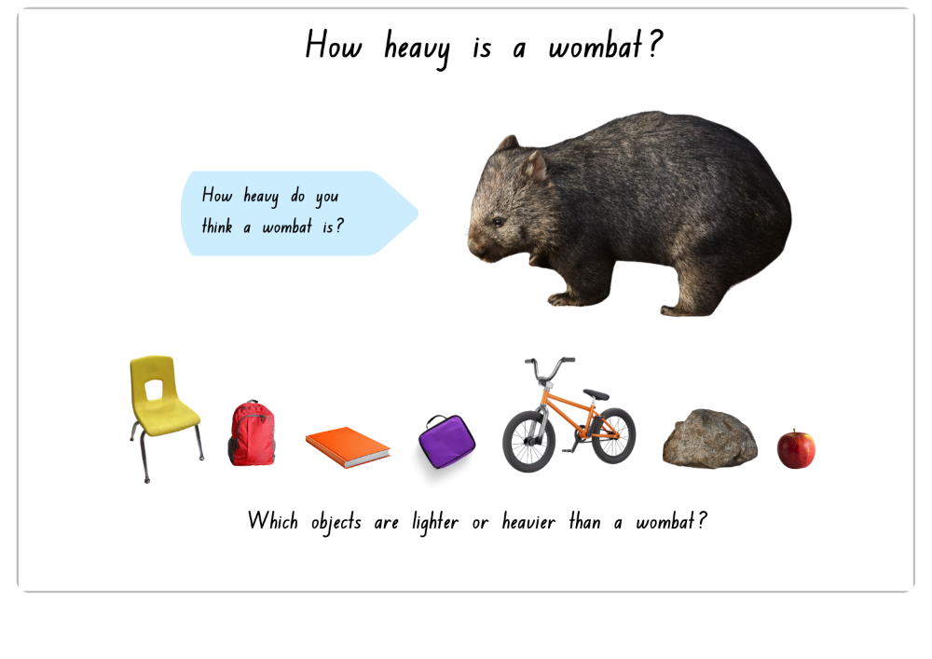
How heavy is a wombat?
26
Notes:
Teacher prompts / discussion cues
Which objects are lighter than a wombat?
Which objects might be heavier?
Reasoning
How do you know?
Does bigger always mean heavier?
Could a small rock be heavy?
Discussion
Which object was hardest to decide? Why?
Watch for: Students assuming bigger means heavier.
Emphasise: Size, shape and mass are not always related. Large objects are not always heavier, and small objects are not always lighter.
Images: Sourced from Canva; edited using Canva.

Slide 27
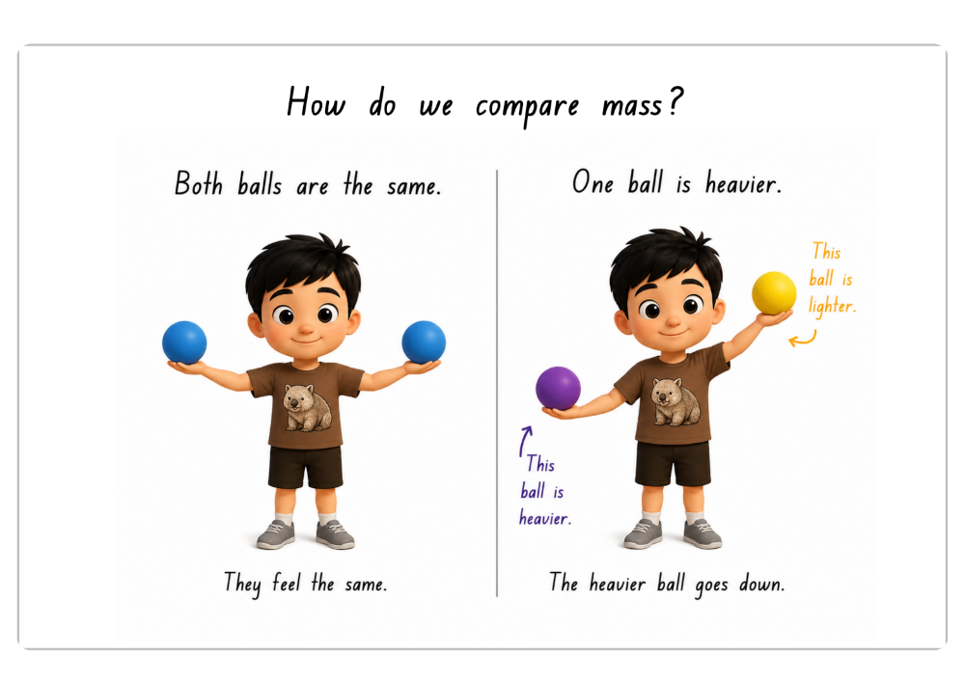
How do we compare mass? (1)
27
Notes:
Teach note
Conduct a think–pair–share activity where students look closely at the images, identify whether the balls are the same or if one is heavier, and explain how they know.
Teacher prompts / discussion cues
What do you notice about the boy’s arms in the first picture?
What do you notice in the second picture?
Are both arms at the same height or different heights?
Why does the heavier side go down?
Why is the lighter ball higher?
Can two balls look different but still have the same mass?
Connect to student action
Can you use your arms to compare two classroom objects by hefting?
What might you compare first?
How will you know if they feel the same?
Ensure students are using vocabulary: heavier, lighter and same mass.
Image generated using ChatGPT (OpenAI) and edited using Canva.

Slide 28
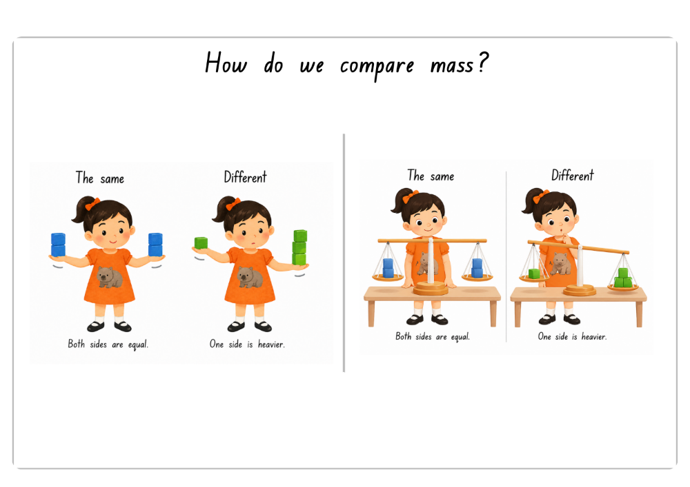
How do we compare mass? (2)
28
Notes:
Teach note
Ensure students understand that ES1 compares mass by hefting (holding objects in their hands), while Stage 1 compares mass using hefting and an equal arm balance.
Conduct a think–pair–share activity where students look closely at the images, identify whether the balls are the same or if one is heavier, and explain how they know.
Consolidation
What do you notice about the pictures on the left?
What do you notice about the pictures on the right?
How are these pictures the same?
How are they different?
Teacher prompts / discussion cues
How are the girl’s arms like the balance scale?
What happens when both sides are equal?
What happens when one side is heavier?
How can we tell when two objects have the same mass?
Compare prompts
Which picture shows equal mass?
Which picture shows one side heavier?
How do you know?
Image generated using ChatGPT (OpenAI) and edited using Canva.

Slide 29
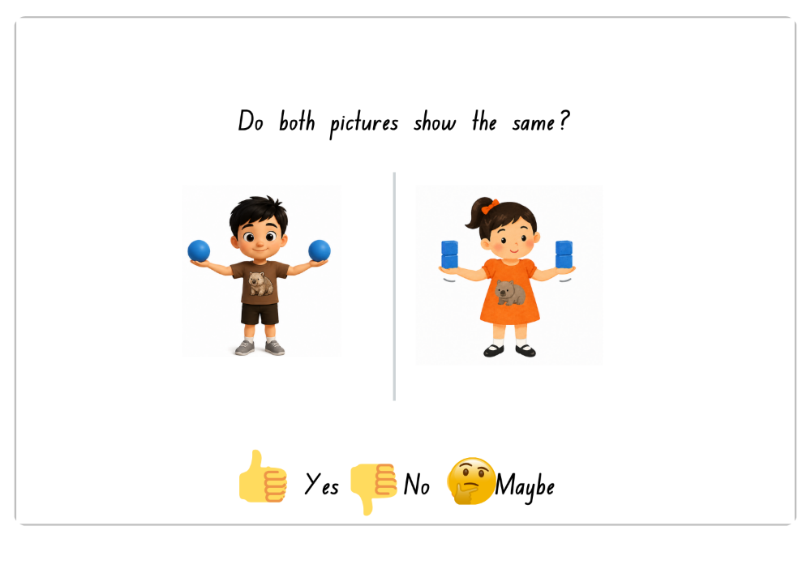
Do both pictures show the same?
29
Notes:
Teacher note
Guide students to focus on how the hands are level, showing the mass is the same.

Slide 30
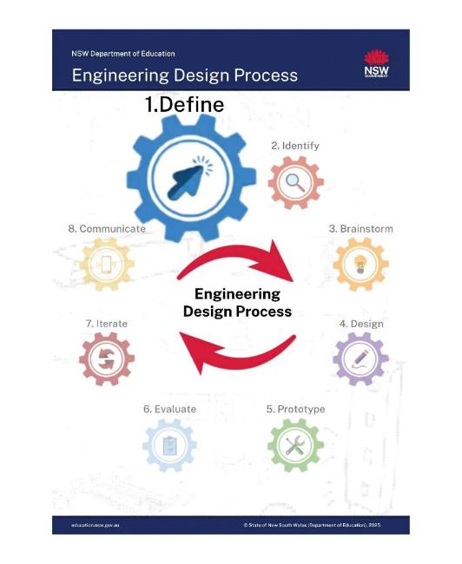
Lesson 5: Define – The visiting wombat problem
Key Words:
define
problem statement
user
needs
Engineer
30
Notes:
Key vocabulary is used throughout the unit. Refer to the glossary as needed.
Teacher note:
The Engineering Design Process (EDP) provides a consistent approach and shared language across these lessons (Lessons 5–12).
Coloured cog icons are used throughout to indicate each phase of the process and support student understanding and recall.
The process is flexible and may not always be followed in a strict order. Students may return to the iterate phase at different points to improve their design.
Student note:
You will see coloured cogs on these slides. They show which part of the design process you are working in.

Slide 31
Lesson 5 – learning intentions and success criteria
Early Stage 1
We are learning to
understand the problem of creating a suitable environment for a wombat
talk about what a wombat needs to be safe and comfortable
share and draw ideas.
We can
say what the problem is
name at least one thing a wombat needs
draw an idea for a wombat home and talk about it.
Stage 1
We are learning to
describe the design problem and the needs of a wombat
ask questions to help understand what is needed for the design
use simple design steps to begin planning a solution.
We can
explain what the design problem is
describe the needs of a wombat
use steps (for example, think, plan, draw) to plan a design.
Notes:
Notes for teachers:
Learning intentions and success criteria are best co-constructed with students. Adapt the learning intention as required and add matching success criteria.
For more information See ⁠AITSL or the NSW Department of Education explicit teaching strategies, ⁠Sharing learning intentions and ⁠Sharing success criteria
LISC is not necessarily presented at the beginning of the lesson. Teacher needs to consider most effectual time to introduce
LISC should be revisited during the lesson to support students' evaluation of their learning

Slide 32

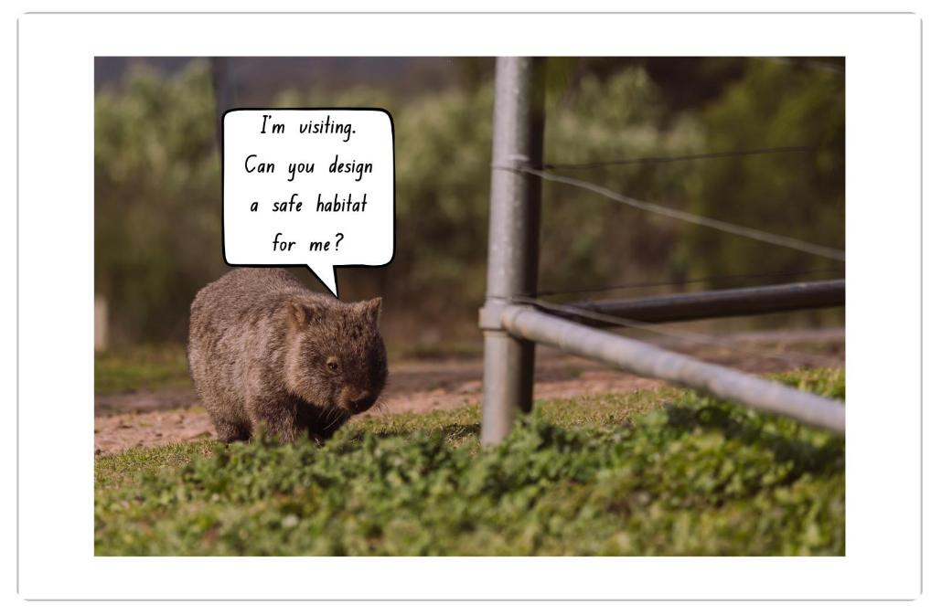
The arrival of a visiting wombat
32
Notes:
Teacher notes:
Conduct a think–pair–share activity where students imagine a wombat is visiting their school. Encourage students to make connections to prior learning about wombats and what they need to survive (e.g. shelter, food, water, space, safety).
Discussion cues:
What do you notice about the wombat?
Why might it need our help?
How can you use what you know about wombats to help it?
What would a safe habitat include?
What dangers might be in this environment?
Images: Sourced from Canva; edited using Canva.

Slide 33
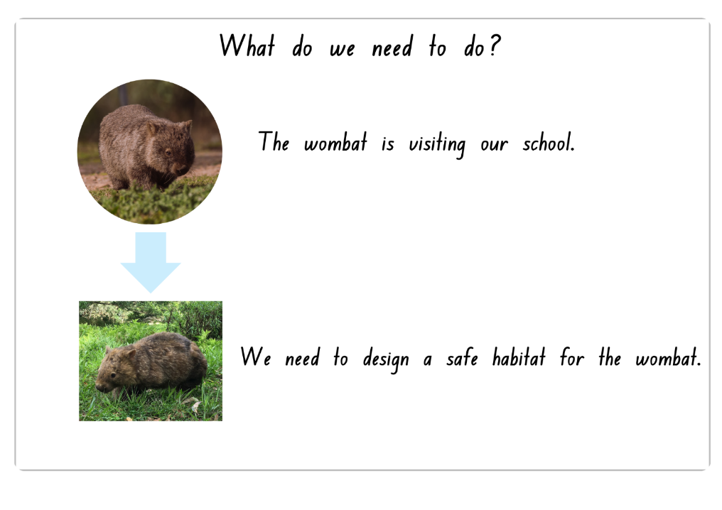
What do we need to do?
33
Notes:
Teacher notes
Explicitly revisit the problem statement and support students to identify the problem, the task and the user. Ask:
What is the problem?
Who is the user?
What do we need to design?
Refer to co-constructed class charts and briefly review the wombat’s identified needs (for example, shelter, food, water, protection, quiet and space). Reinforce that before designing, students need to clearly understand the problem and the needs of the wombat.

Slide 34
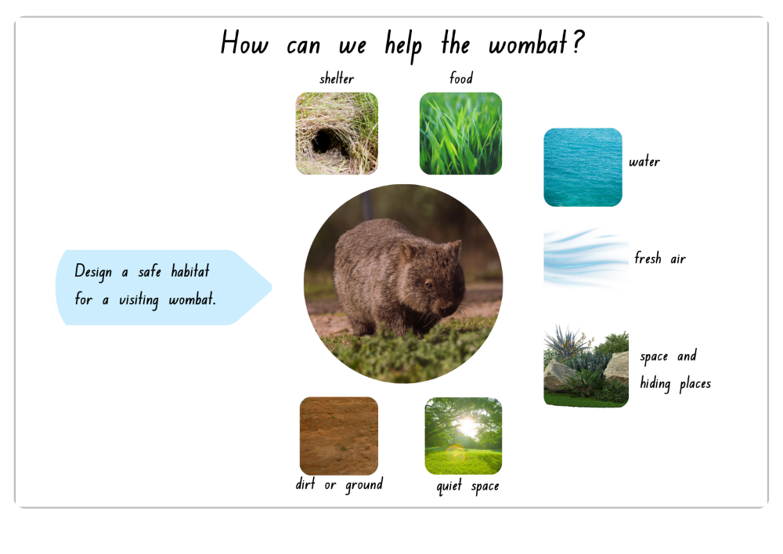
How can we help the wombat?
34
Notes:
Checking for understanding – Yes/No questions
Does a wombat need food?
Is it important to have water for the wombat?
Does a wombat need a place to hide?
Does a wombat need fresh air?
Would a quiet place to rest help the wombat?
Teacher prompts / discussion cues
What must every habitat include?
Which needs help the wombat stay alive?
Which needs help the wombat stay safe?
Which needs help the wombat feel comfortable?
If we could only include three things first, what should they be? Why?
Which need is most important in hot weather?
Which need is most important at night?
Why would a wombat need places to hide?
Partner Prompt: think- pair- share
Which need would you add first? Why?
Tell your partner one feature your habitat must have.
Ensure: Students identify the user, the problem and key needs before designing. Clarify vocabulary and link to prior learning.
Watch for: Confusion about who the user is, vague problem descriptions, or wants instead of needs.
Images: Sourced from Canva; edited using Canva.

Slide 35
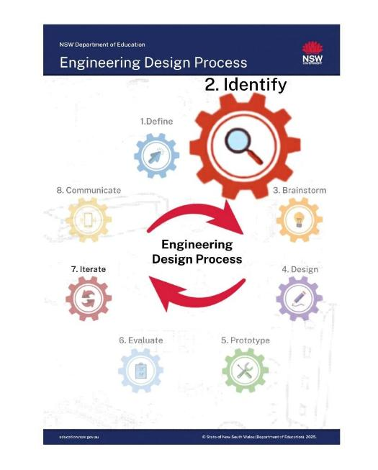
Lesson 6: Identify – What does a wombat need?
Key Words:
identify
features
materials
needs
solution
35
Notes:
Key vocabulary is used throughout the unit. Refer to the glossary as needed.

Slide 36
Lesson 6 – learning intentions and success criteria
Early Stage 1
We are learning to
identify what a wombat needs to feel safe and comfortable
plan a simple design for an environment that meets the wombat’s needs.
We can
say what the wombat needs and why
draw and talk about a planned design for a wombat environment.
Stage 1
We are learning to
identify a wombat’s needs to help plan a design solution
ask questions, gather ideas and plan what the design needs.
We can
explain what a wombat needs and why it is important
share ideas about what should be included in the design
make a simple plan based on those needs.
Notes:
Notes for teachers:
Learning intentions and success criteria are best co-constructed with students. Adapt the learning intention as required and add matching success criteria.
For more information See ⁠AITSL or the NSW Department of Education explicit teaching strategies, ⁠Sharing learning intentions and ⁠Sharing success criteria
LISC is not necessarily presented at the beginning of the lesson. Teacher needs to consider most effectual time to introduce
LISC should be revisited during the lesson to support students' evaluation of their learning

Slide 37

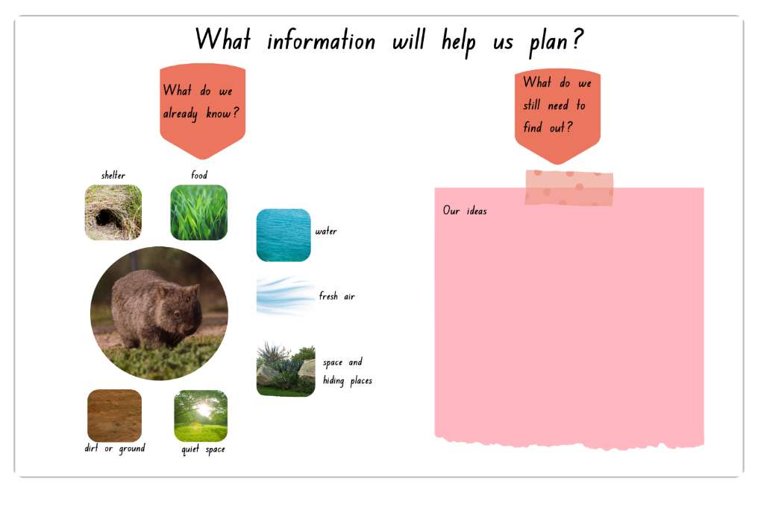
What information will help us plan?
37
Notes:
Teacher notes
Support students to identify what they already know about wombat needs and habitats, and what information may still help them plan a safe environment. Encourage students to refer to previous learning, class charts, the book Diary of a Wombat and videos viewed during earlier lessons.
Teacher prompts / discussion cues
Which needs do we already understand well?
What do we still need to learn before planning?
Which information is most important first?
What questions should we investigate?
What features must the habitat have?
What materials might help later?
What might be tricky at school?
Ensure: Students understand this phase is about gathering and organising information, not designing yet.
Watch for: Students repeating facts without deciding how the information helps planning.
Images: Sourced from Canva; edited using Canva.

Slide 38
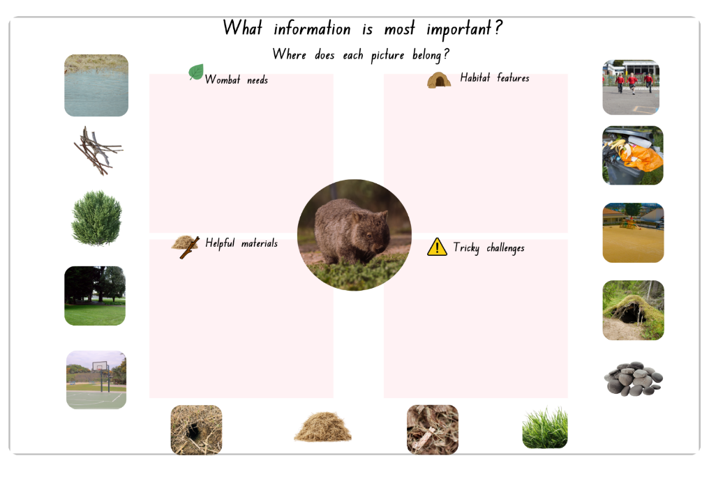
What information is most important?
38
Notes:
Teacher notes
Guide students to sort and discuss which information is most important for designing a wombat habitat. Encourage students to explain their thinking and identify needs, helpful materials, habitat features and possible challenges.
Review the concepts of needs, environment and habitat.
Remind students that a habitat provides what living things need to survive.
Consolidation
Which box should this picture go in? Why?
Is it a need, a feature, a material, or a challenge?
Could an item fit in more than one box?
Teacher prompts / discussion cues
Which category should we think about first?
Why is that important?
How could noise affect a wombat?
Why might rubbish be unsafe?
Would this place feel calm or stressful?
Could this item help in one way but cause a problem in another?
How is a school different from a natural habitat?
Ensure: Students justify sorting decisions using wombat needs. Students make connections between school features and how they may help or hinder the wombat’s safety, comfort and wellbeing.
Watch for: Students placing items randomly or by colour/position instead of reasoning. Students making choices based on personal preference rather than the wombat’s needs.
Emphasise: Some items may be helpful in some ways and unhelpful in others. Encourage reasoning.
Images: Sourced from Canva; edited using Canva.

Slide 39
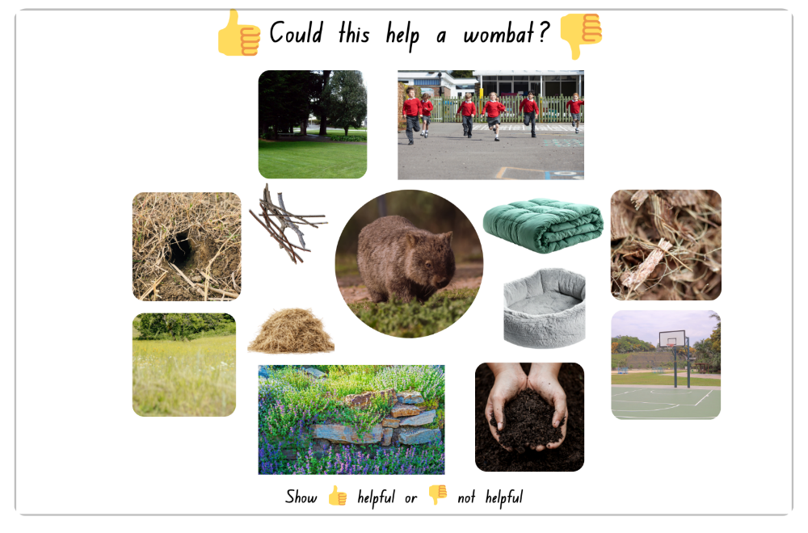
Could this help a wombat?
39
Notes:
Teacher notes
Support students to identify which features, materials and environments may help a wombat in the wild. Reinforce that students should think about natural wombat habitats rather than human wants or household items.
For each image or item, ask students to indicate using a thumbs up for ‘Yes, it is helpful for a wombat’ or a thumbs down for ‘No, it is not helpful for a wombat’.
Prompt brief justification using sentence stems such as: ‘This would help because…’ or ‘This would not help because…’
Prompt students to explain connections to safety, shelter, space and comfort.
Discussion cues
Which ideas belong together?
Which needs are most important first?
What could be tricky?
What materials might help?
Images: Sourced from Canva; edited using Canva.

Slide 40
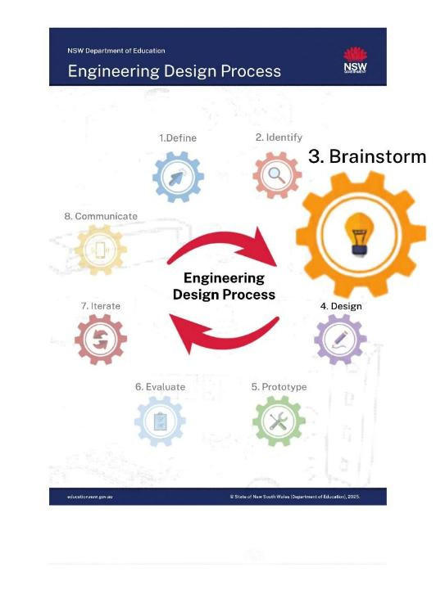
Lesson 7: Brainstorm –Generate ideas for a wombat habitat
Key Words:
brainstorm
design
solution
collaboration
40
Notes:
Key vocabulary is used throughout the unit. Refer to the glossary as needed.

Slide 41
Lesson 7 – learning intentions and success criteria
Early Stage 1
We are learning to
generate ideas to help solve a design problem
suggest things that could help meet a wombat’s needs
share ideas using drawings, words and talk.
We can
suggest one or more ideas for a wombat habitat
explain how an idea could help a wombat
share ideas with a partner or group using drawings or talk.
Stage 1
We are learning to
generate multiple design ideas to solve a design problem
connect design ideas to the needs of a wombat
build on and discuss ideas with others.
We can
share more than one idea for a wombat habitat
explain how ideas meet the wombat’s needs
share, compare and build on ideas with others.
Notes:
Notes for teachers:
Learning intentions and success criteria are best co-constructed with students. Adapt the learning intention as required and add matching success criteria.
For more information See ⁠AITSL or the NSW Department of Education explicit teaching strategies, ⁠Sharing learning intentions and ⁠Sharing success criteria
LISC is not necessarily presented at the beginning of the lesson. Teacher needs to consider most effectual time to introduce
LISC should be revisited during the lesson to support students' evaluation of their learning

Slide 42

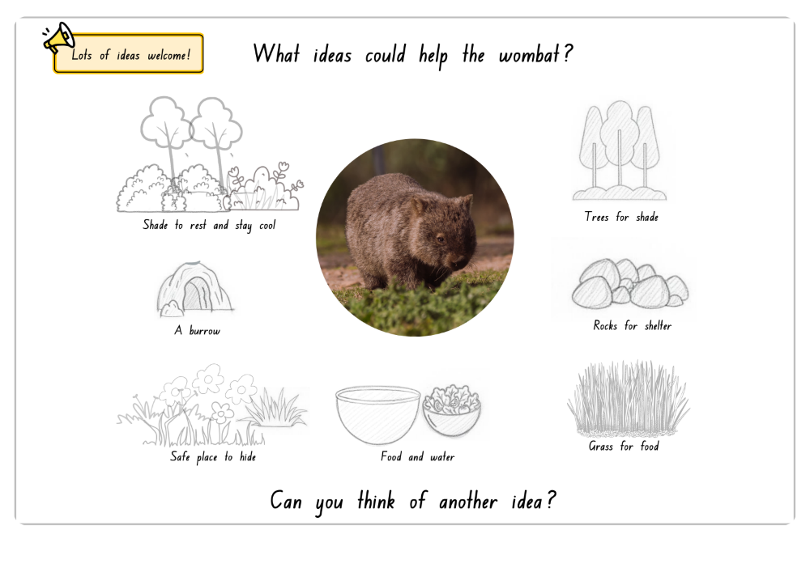
What ideas could help the wombat?
42
Notes:
Teacher notes
Revisit prior learning by reviewing the concepts of needs, environment and habitat.
Prompt students to recall what living things need to survive (food, water, shelter, space and safety) and discuss how an environment provides these needs.
Encourage students to generate many possible ideas that could help meet the wombat’s needs. Reinforce that brainstorming is about sharing lots of ideas before deciding which ideas may work best.
Teacher prompts / discussion cues
What else could help the wombat?
Can you think of an idea not on the slide?
Which ideas help with shelter?
Which ideas help with comfort?
Which ideas use natural materials?
Ensure: Students know these are examples only and they should generate their own additional ideas.
Watch for:
students selecting ideas because they “look nice”
copying another design without explaining thinking
decorative additions that do not support wombat needs
students becoming fixated on one idea too early
Images: Sourced from Canva; edited using Canva.

Slide 43

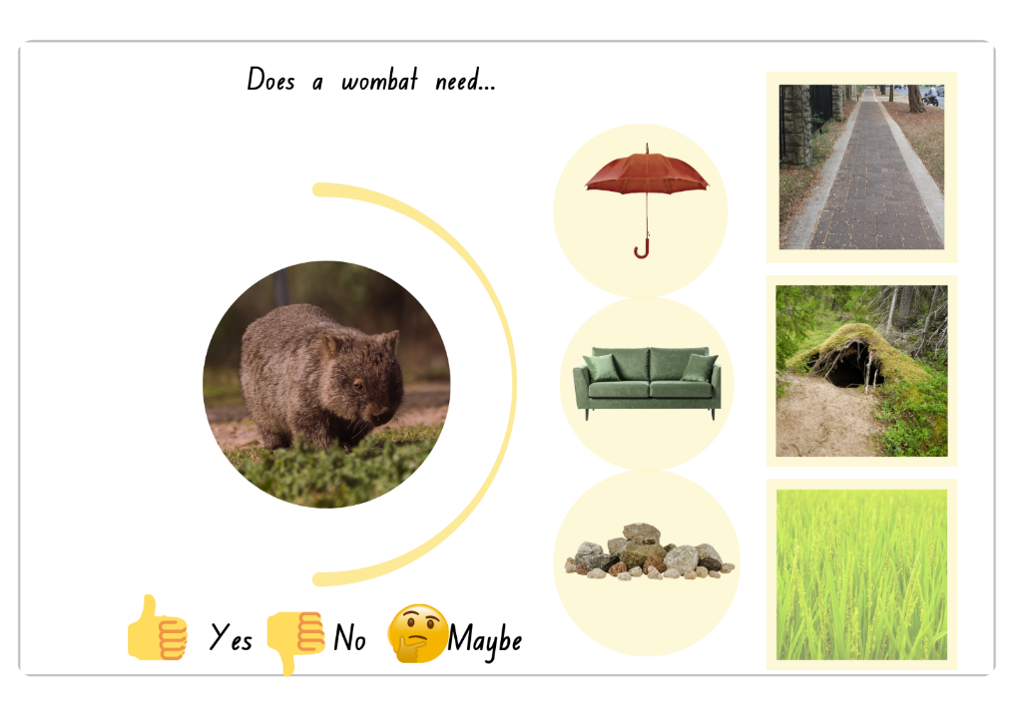
Does a wombat need…(1)
43
Notes:
Teacher note
Ensure students are thinking about wombats in the wild (natural habitat) when responding.
Clarify that Diary of a Wombat and videos may show wombats in home or zoo environments, but for this task students should consider what a wombat needs to survive in the wild.
Support students to discuss whether each feature or material may help a wombat in the wild. Encourage students to explain their thinking using prior learning about wombat needs, habitats and safety.
Teacher prompts / discussion cues
Why did you choose maybe?
Could this help in one way but not another?
Is this better for humans or wombats?
Would this keep the wombat safe and comfortable?
Which item helps most in hot weather?
Ensure: Students explain decisions using wombat needs (shelter, comfort, safety, food).
Watch for: Students choosing based on what they personally like rather than what helps a wombat.
Emphasise: Some ideas may help in one way but not in another.
Images: Sourced from Canva; edited using Canva.

Slide 44
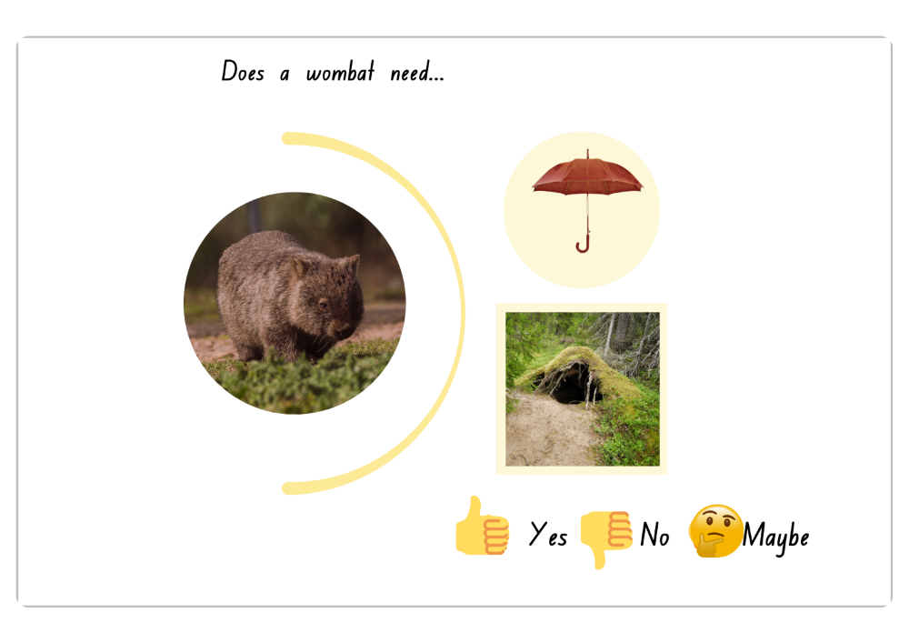
Does a wombat need…(2)
44
Notes:
Teacher note
Use this slide as a quick check for understanding. Encourage students to justify whether an item may or may not help a wombat and explain their reasoning using vocabulary such as shelter, safety, habitat and needs.
Ensure students do not develop misconceptions by assuming that items humans use (e.g. an umbrella) are also needed by wombats.
Reinforce that wombats in the wild rely on natural features such as burrows for shelter and protection.
Check for understanding
A wombat needs a burrow to stay safe.
A wombat needs an umbrella to stay dry.

Slide 45
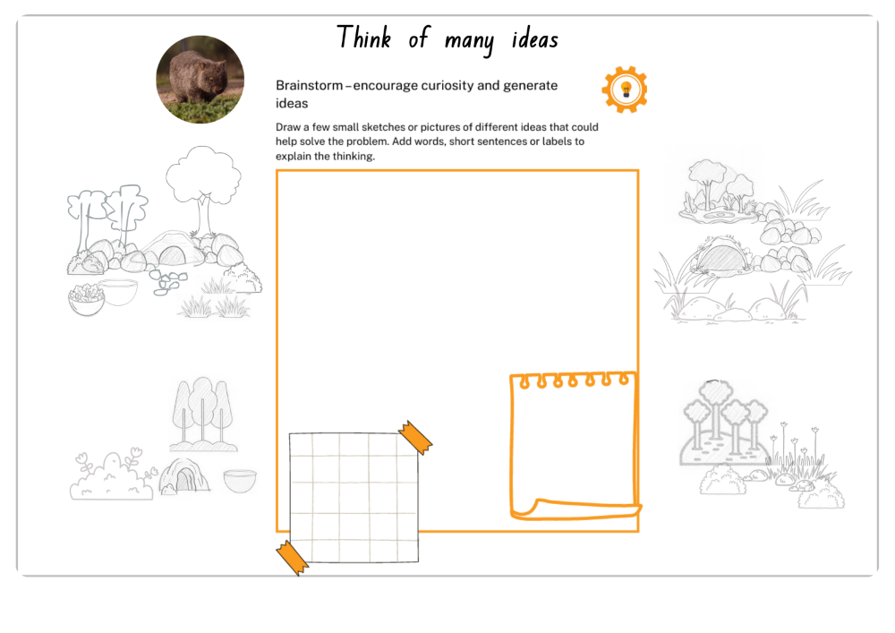
Think of many ideas
45
Notes:
Teacher note
Reinforce that brainstorming is about generating many ideas rather than creating one perfect solution straight away. Encourage students to sketch, label and explain ideas that may help meet the wombat’s needs. Accept a range of ideas and support students to explain how features may help the wombat stay safe, sheltered and comfortable.
Teacher prompts / discussion cues
What ideas could help the wombat stay safe?
What could help it feel comfortable?
What else could we add?
Can you think of another idea?
Screenshot of folio template sourced from [insert link].
Images: Sourced from Canva; edited using Canva.
Image: Screenshot of folio template sourced from Engineering Design Process – design folio K-10 (Engineering design process – Jiggler challenge) for educational use.

Slide 46
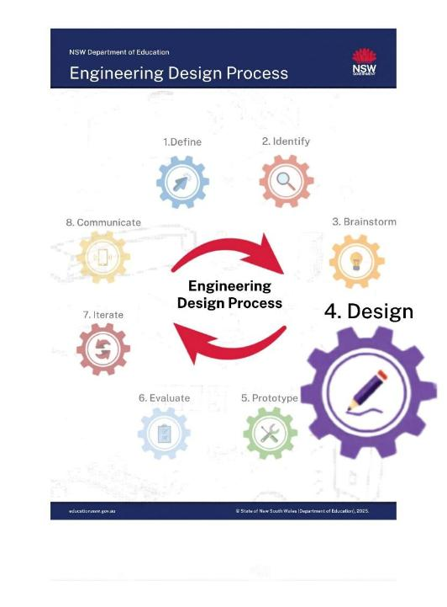
Lesson 8: Design –
Draw and communicate potential solutions
Key Words:
design
communicate
features
materials
solution
46
Notes:
Key vocabulary is used throughout the unit. Refer to the glossary as needed.

Slide 47
Lesson 8 – learning intentions and success criteria
Early Stage 1
We are learning to
draw and share a design for a place where a wombat can live safely.
We can
draw a place for a wombat
include something a wombat needs (e.g. shelter, food, space)
talk about our ideas.
Stage 1
We are learning to
draw, label and explain a design solution that meets the needs of a wombat.
We can
draw and label our design
include features that help a wombat survive
explain how our design solves the problem.
Notes:
Notes for teachers:
Learning intentions and success criteria are best co-constructed with students. Adapt the learning intention as required and add matching success criteria.
For more information See ⁠AITSL or the NSW Department of Education explicit teaching strategies, ⁠Sharing learning intentions and ⁠Sharing success criteria
LISC is not necessarily presented at the beginning of the lesson. Teacher needs to consider most effectual time to introduce
LISC should be revisited during the lesson to support students' evaluation of their learning

Slide 48

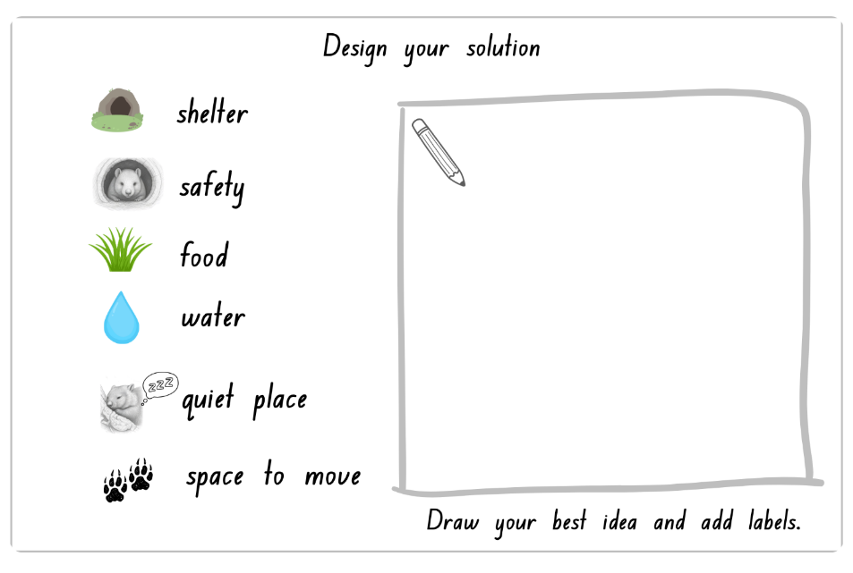
Design your solution
48
Notes:
Teacher notes
Support students to create a design plan that clearly shows how the habitat may help meet the wombat’s needs. Encourage students to draw, label and explain important features such as shelter, food, water, safety and space to move.
Encourage students to explain how their design features may help meet the wombat’s needs. Reinforce that good designs are purposeful and support safety, shelter, food, water and movement.
Teacher prompts / discussion cues
Which needs will your design meet?
What will you include first?
What still needs to be added?
What labels can you add?
Consolidation
How will the wombat stay safe?
Where will it rest quietly?
How can it move around?
Where at school would this habitat go?
Would that place be quiet enough?
Checking for understanding
A wombat needs shade to stay cool?
A wombat needs space to move around safely?
Plants near a burrow can help a wombat stay safe.
Ensure: Students make connections with the problem statement, include features linked to wombat needs and previous discussions about habitats and safety.
Make connections with the school environment by discussing where the habitat could be safely placed within the school grounds.
Watch for:
designs focused mainly on decoration
labels that do not explain purpose
students copying ideas without explaining thinking
features included without connection to wombat needs
Images: Sourced from Canva; edited using Canva.

Slide 49

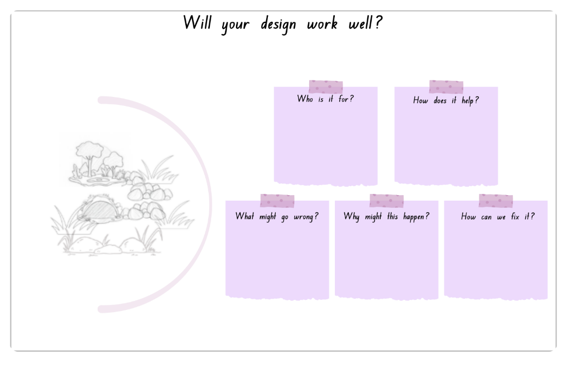
Will your design work well?
Notes:
Teacher notes
Guide students to think carefully about whether their design may work well for the wombat. Encourage students to discuss possible challenges, explain why problems may occur and suggest simple improvements before building.
Teacher prompts / discussion cues
Who is using this design?
Which part helps the wombat most?
What might fall over or break?
What if it gets wet?
What if it is too noisy?
How could we make it better?
Make connections with previous learning by asking students to justify how their design meets shelter, safety, food, water and quiet space needs.
Ensure: Students explain how their design meets the wombat’s needs (for example shelter, safety, food, water, quiet space and room to move) and identify realistic ways it could be improved before building.
Watch for: Students focusing only on how the design looks, saying “nothing could go wrong,” or suggesting fixes that do not connect to the wombat’s needs or the school environment.
Images: Sourced from Canva; edited using Canva.

Slide 50
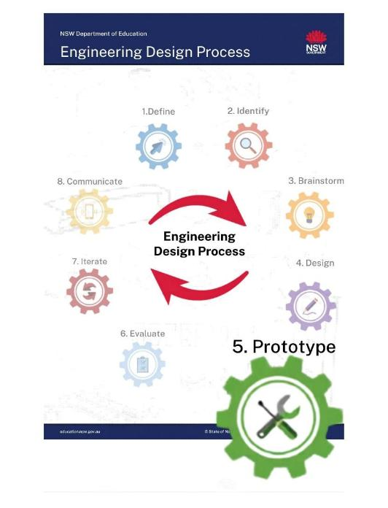
Lesson 9: Prototype – Produce a model
Key Words:
prototype
materials
build
features
test
50
Notes:
Key vocabulary is used throughout the unit. Refer to the glossary as needed.

Slide 51
Lesson 9 – learning intentions and success criteria
Early Stage 1
We are learning to
build and explain a model habitat that meets a wombat's needs.
We can
build a prototype of a wombat habitat
choose materials for different parts of the habitat
explain why we chose certain materials.
Stage 1
We are learning to
build and explain a prototype solution that meets a wombat's needs.
We can
build a prototype using selected materials
include features that help keep a wombat safe and meet its needs
explain why we chose certain materials.
Notes:
Notes for teachers:
Learning intentions and success criteria are best co-constructed with students. Adapt the learning intention as required and add matching success criteria.
For more information See ⁠AITSL or the NSW Department of Education explicit teaching strategies, ⁠Sharing learning intentions and ⁠Sharing success criteria
LISC is not necessarily presented at the beginning of the lesson. Teacher needs to consider most effectual time to introduce
LISC should be revisited during the lesson to support students' evaluation of their learning

Slide 52

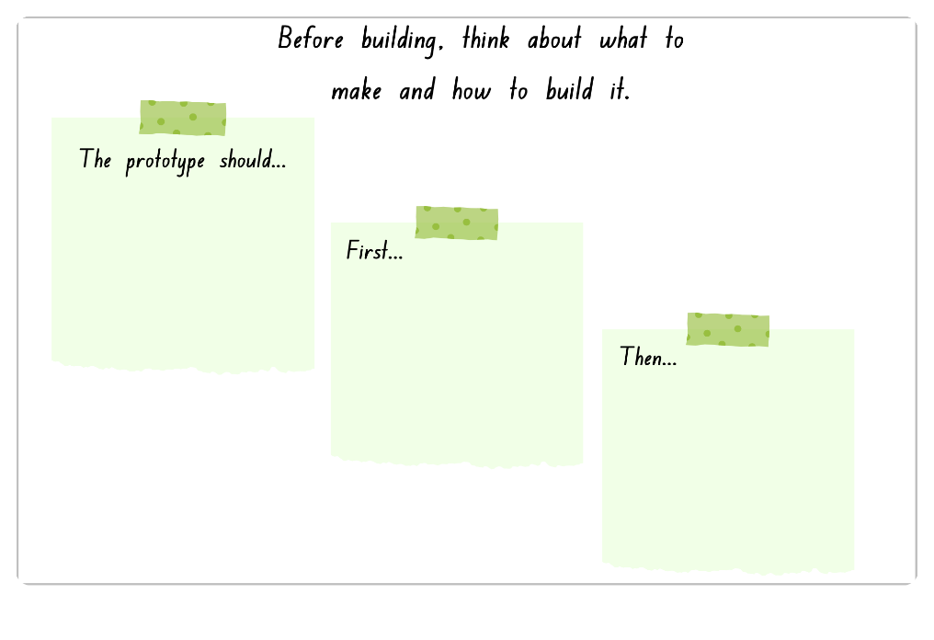
Before building, think about what to make and how to build it.
Notes:
Teacher note
Support students to plan their prototype before building. Encourage students to explain what they will make first, which materials may help and how features will support the wombat’s needs.
Teacher prompts / discussion cues
What does your prototype need to do for the wombat?
What will you build first? Why?
How will your steps help you build carefully and safely?
Check-in (True/False cards)
We should start building straight away without planning first.
When making a prototype, we should follow steps in order (first, then…).
Make connections to times when planning helped you do something successfully.
Images: Sourced from Canva; edited using Canva.

Slide 53
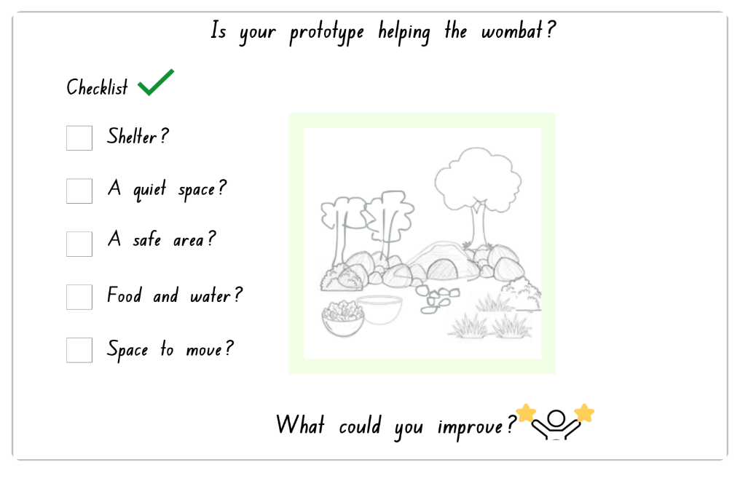
Is your prototype helping the wombat?
Notes:
Teacher notes
Guide students to check whether their prototype includes important habitat features such as shelter, safety, food, water and space to move. Encourage students to explain how each feature may help the wombat.
Teacher prompts / discussion cues
Which part of your prototype helps the wombat the most? Why?
What is missing from your design?
How could you improve one part to better help the wombat?
Does your design meet all the checklist items? Show me.
Watch for that students refer to the checklist when explaining their design.
Images: Sourced from Canva; edited using Canva.

Slide 54
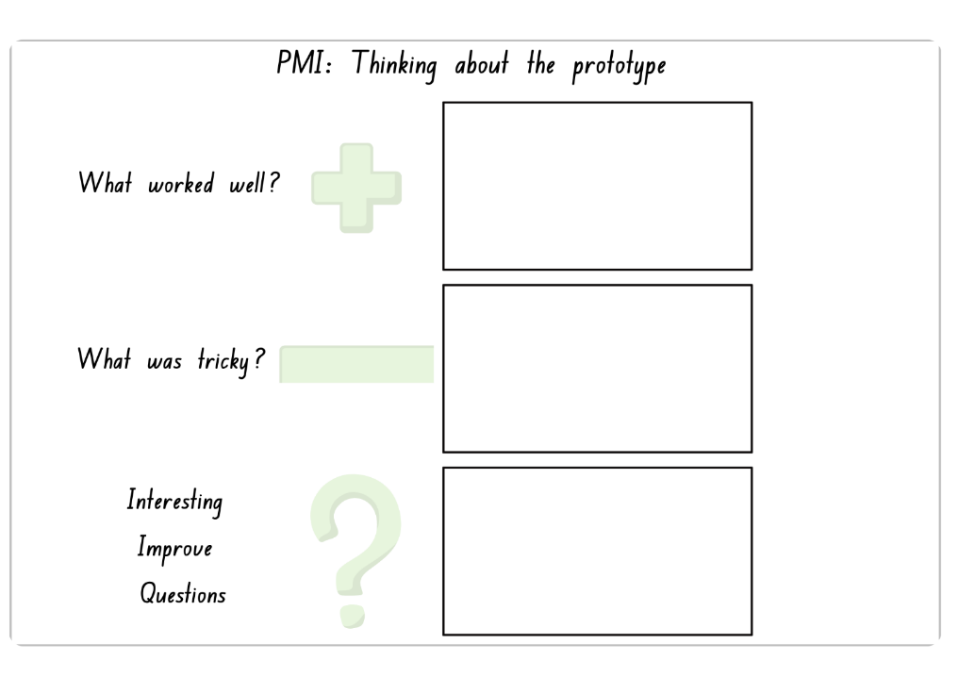
PMI: Thinking about the prototype
Notes:
Teacher note
Explicitly explain and model:
PMI = Plus, Minus, Interesting
Plus (+) → what worked well
Minus (–) → what didn’t work or needs fixing
Interesting (?) → something to think about, test or improve
For ES1/Stage 1:
Worked well
Needs fixing
Needs thinking / testing
PLUS (+)
What worked well in your habitat?
Which part helps the wombat most?
Why is this a good idea?
MINUS (–)
What didn’t work as planned?
Which part needs fixing?
What was tricky?
INTERESTING (?)
What could you test again?
What are you still thinking about?
What could you improve next?
Is there something missing for the wombat?
Ensure students understand each section and contribute at least one idea for each part of the PMI.
Watch for students placing all ideas in the ‘plus’ section, misunderstanding 'interesting' or giving responses that are not connected to the wombat’s needs.
Images: Sourced from Canva; edited using Canva.

Slide 55
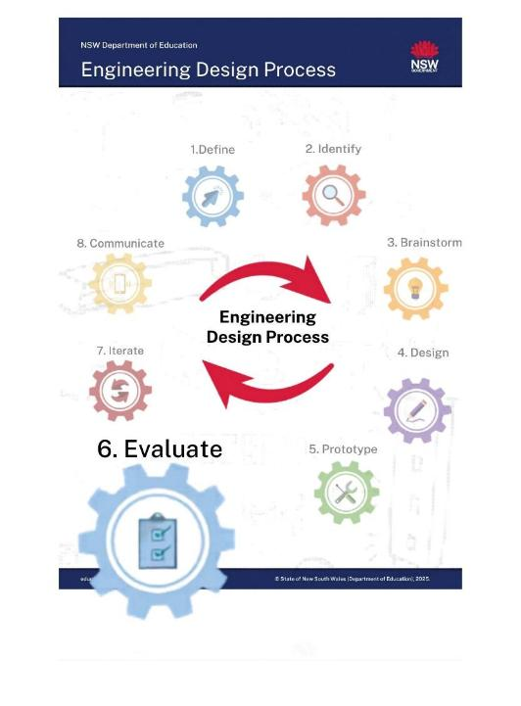
Lesson 10: Evaluate – Test and share designs
Key Words:
evaluate
feedback
communicate
improve
reflect
55
Notes:
Key vocabulary is used throughout the unit. Refer to the glossary as needed.

Slide 56
Lesson 10 – learning intentions and success criteria
Early Stage 1
We are learning to
test and share our habitat design to see how it helps a wombat.
We can
look at our habitat and talk about what works well
show features that help the wombat
share our prototype with others
say one thing we could change or add.
Stage 1
We are learning to
test, evaluate and explain how a habitat design meets the needs of a wombat.
We can
test parts of our prototype to see if they work
explain how our design helps the wombat
describe strengths of our prototype
suggest a change to improve our design.
Notes:
Notes for teachers:
Learning intentions and success criteria are best co-constructed with students. Adapt the learning intention as required and add matching success criteria.
For more information See ⁠AITSL or the NSW Department of Education explicit teaching strategies, ⁠Sharing learning intentions and ⁠Sharing success criteria
LISC is not necessarily presented at the beginning of the lesson. Teacher needs to consider most effectual time to introduce
LISC should be revisited during the lesson to support students' evaluation of their learning

Slide 57

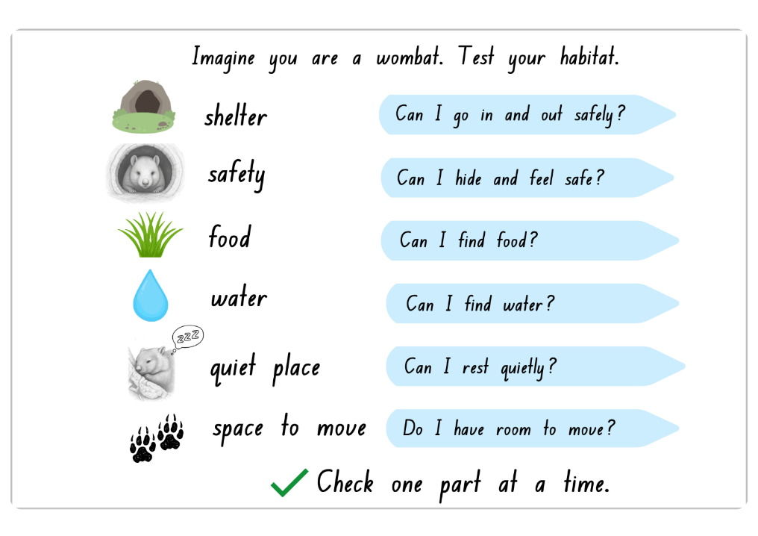
Imagine you are a wombat. Test your habitat.
57
Notes:
Teacher notes
Support students to imagine they are the wombat and test one feature of the habitat at a time. Encourage students to check whether the habitat provides shelter, safety, food, water, space to move and a quiet place to rest.
Teacher prompts / discussion cues
Which part will you test first?
What works well?
What needs changing?
Which need is missing?
How could you improve one part?
Reinforce that evaluation means checking how well a design works and identifying what may need improvement.
Make connections with the wombat’s needs by encouraging students to explain why each feature works or does not work.
Watch for students answering yes/no without checking the actual model or giving a reason.
Images: Sourced from Canva; edited using Canva.

Slide 58
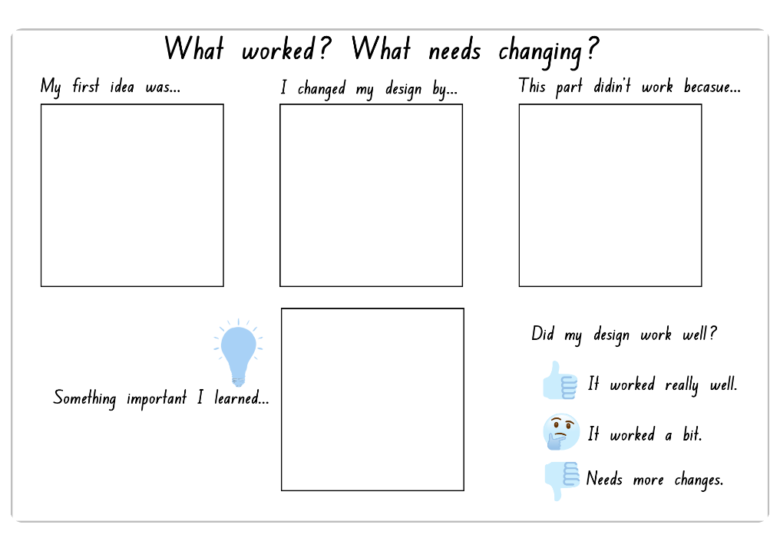
What worked? What needs changing?
58
Notes:
Teacher note
Guide students to reflect on what worked well in their design, what needed changing and what they learned during testing. Encourage students to explain how changes helped improve the habitat for the wombat.
Support students to understand that designs can always be improved and that mistakes or challenges are part of the design process.
Teacher prompts / discussion cues
What worked well in your habitat?
What needed changing?
What surprised you?
What would you improve next?
Describe your first design.
What did you want it to do?
What did you add?
What did you move?
What did you remove?
Why did you make that change?
What was tricky?
Ensure students understand that mistakes, setbacks and changes are a normal part of designing, testing and improving.
Watch for:
students focusing only on appearance rather than function
students saying everything “worked well”
frustration when designs need improvement
students forgetting to connect reflections to wombat needs
Make connections with:
design plans and prototype testing
identified wombat needs
feedback from peers and teachers
previous discussions about safety, shelter and habitat features
Images: Sourced from Canva; edited using Canva.

Slide 59
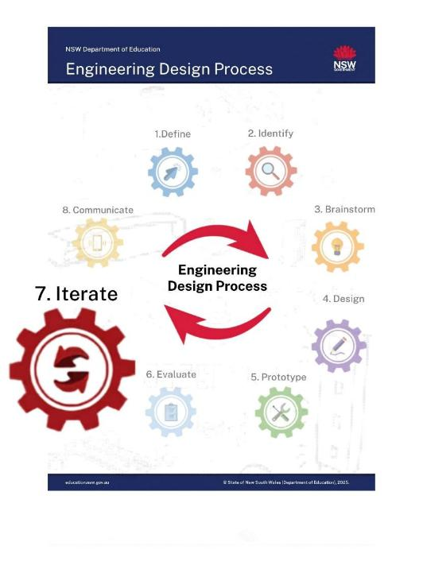
Lesson 11: Iterate – Reflect and improve solution
Key Words:
iterate
test
improve
feedback
prototype
solution
59
Notes:
Key vocabulary is used throughout the unit. Refer to the glossary as needed.

Slide 60
Lesson 11 – learning intentions and success criteria
Early Stage 1
We are learning to
improve our habitat design and talk about changes we made.
We can
make a change to our prototype
explain what we changed
tell how it helps the wombat
share something we learned.
Stage 1
We are learning to
refine our habitat design using feedback and reflection.
We can
improve our prototype based on feedback
explain changes we made and why
describe how our prototype better meets the wombat’s needs
reflect on what we learned as a designer.
Notes:
Notes for teachers:
Learning intentions and success criteria are best co-constructed with students. Adapt the learning intention as required and add matching success criteria.
For more information See ⁠AITSL or the NSW Department of Education explicit teaching strategies, ⁠Sharing learning intentions and ⁠Sharing success criteria
LISC is not necessarily presented at the beginning of the lesson. Teacher needs to consider most effectual time to introduce
LISC should be revisited during the lesson to support students' evaluation of their learning

Slide 61

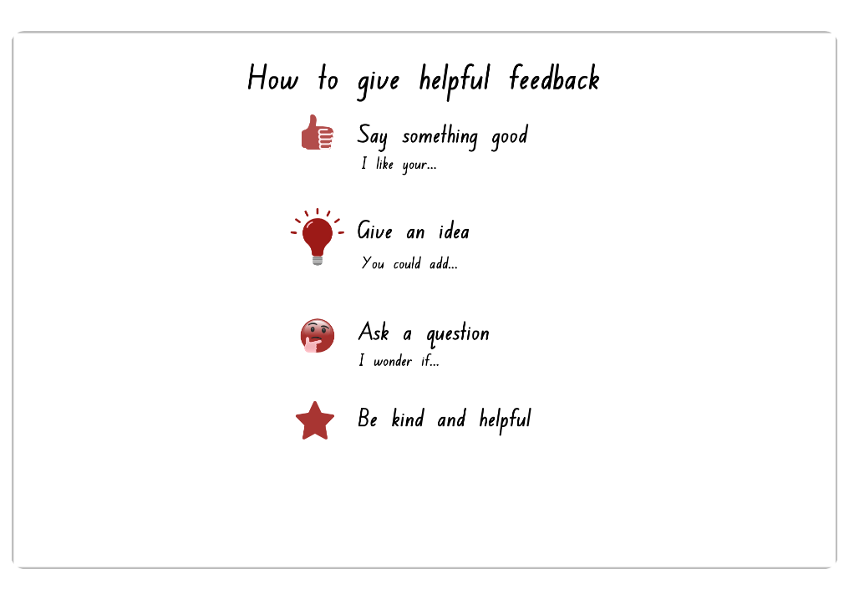
How to give helpful feedback
61
Notes:
Teacher note
Model and reinforce how to give helpful, kind and specific feedback. Encourage students to explain what they like about a design, suggest an idea for improvement and ask respectful questions connected to the wombat’s needs.
Support students to focus feedback on how well the habitat helps the wombat rather than appearance only.
Teacher prompts / discussion cues
For peer feedback:
What do you like about this design?
How does this help the wombat?
Can you give one helpful idea?
What could they add or change?
Can you ask a kind question?
What does the wombat still need?
Ensure students link feedback to wombat needs
Watch for students saying ‘I like it’ with no explanation, feedback about appearance only and same feedback repeated with no deeper thinking.
Make connections to the EDP or wombat or particular phases of the EDP (such as Evaluate : how did you check what was working?)
Images: Sourced from Canva; edited using Canva.

Slide 62
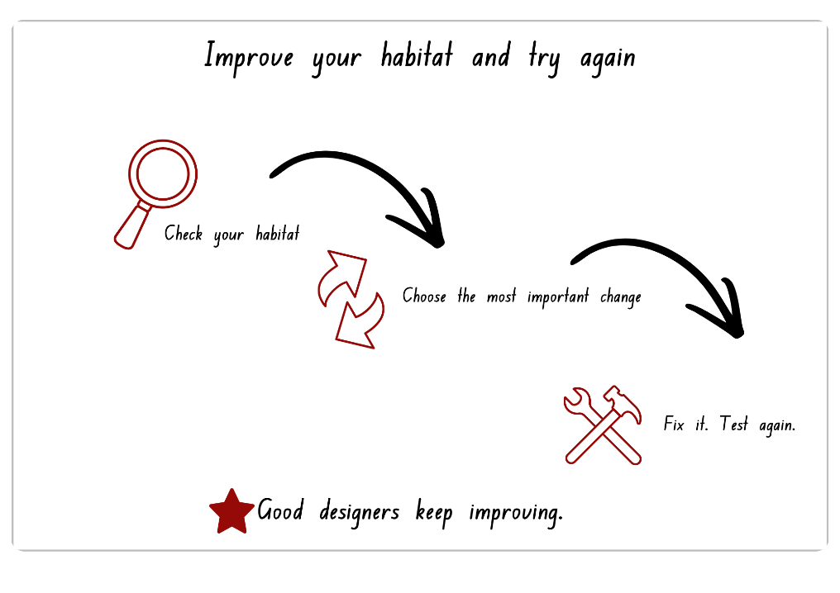
Improve your habitat and try again
62
Notes:
Teacher note
Guide students to review feedback, choose one important improvement and test their design again. Reinforce that iteration means making changes to improve a solution over time.
Encourage students to explain how their changes may better support the wombat’s safety, shelter, comfort or movement.
Teacher prompts / discussion cues
What worked well already?
What needs improving first?
Which change will help the wombat most?
How will you know it improved?
What happened after you tested again?
Ensure students prioritise one meaningful improvement linked to the wombat’s needs before making changes.
Watch for students
changing many parts at once without retesting to see what improved
wanting to rebuild everything
changes made without purpose
students viewing changes as “failure” rather than improvement
Ask students to point:
What are you checking?
What will you change?
What will you test again?
Images: Sourced from Canva; edited using Canva.

Slide 63
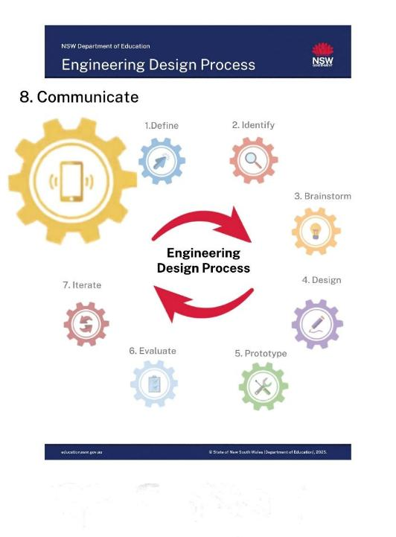
Lesson 12: Communicate –
Share ideas with others
Key Words:
communicate
design
explain
reflect
solution
prototype
63
Notes:
Key vocabulary is used throughout the unit. Refer to the glossary as needed.

Slide 64
Lesson 12 – learning intentions and success criteria
Early Stage 1
We are learning to
share our habitat design ideas with others and explain how the habitat helps a wombat.
We can
show our habitat to others and talk about one part that helps the wombat
use words, drawings or labels to share our ideas and explanations
listen to others and give one kind comment.
Stage 1
We are learning to
communicate our habitat design ideas
explain how the design meets the needs of a wombat
reflect on our learning.
We can
explain how our habitat helps the wombat
describe features and improvements in our design
listen to others and give helpful feedback
reflect on what was easy, challenging or what we would change next time.
64
Notes:
Notes for teachers:
Learning intentions and success criteria are best co-constructed with students. Adapt the learning intention as required and add matching success criteria.
For more information See ⁠AITSL or the NSW Department of Education explicit teaching strategies, ⁠Sharing learning intentions and ⁠Sharing success criteria
LISC is not necessarily presented at the beginning of the lesson. Teacher needs to consider most effectual time to introduce
LISC should be revisited during the lesson to support students' evaluation of their learning

Slide 65

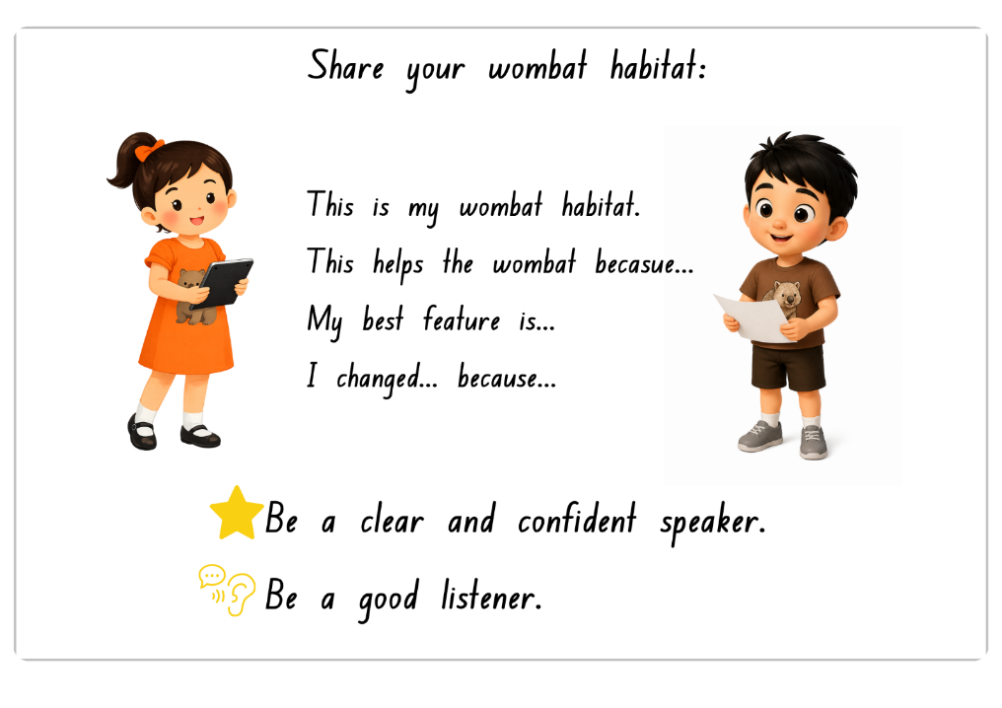
Share your wombat habitat:
Notes:
Teacher notes
Support students to communicate their habitat design clearly and confidently. Encourage students to explain how their design helps meet the wombat’s needs and describe any important changes or improvements they made during the design process.
Provide opportunities for students to practise speaking, listening and responding respectfully to others.
Teacher prompts / discussion cues
Use during rehearsals and presentations
Can you tell us about your habitat?
How does your design help the wombat?
Which feature are you most proud of?
Why did you include that?
What did you change and why?
How does this help the wombat stay safe or comfortable?
Can you point to the part you are talking about?
Ensure students use the provided sentence stems on the slide and have rehearsed before sharing.
Watch for students listing features within explaining, talking about themselves instead of the wombat, very quiet or rushed speaking, not listening to others and repeating same ideas.
Make connections to the problem statement, the wombat (user) and previous learning and experiences.
Image generated using ChatGPT (OpenAI) and edited using Canva.

Slide 66
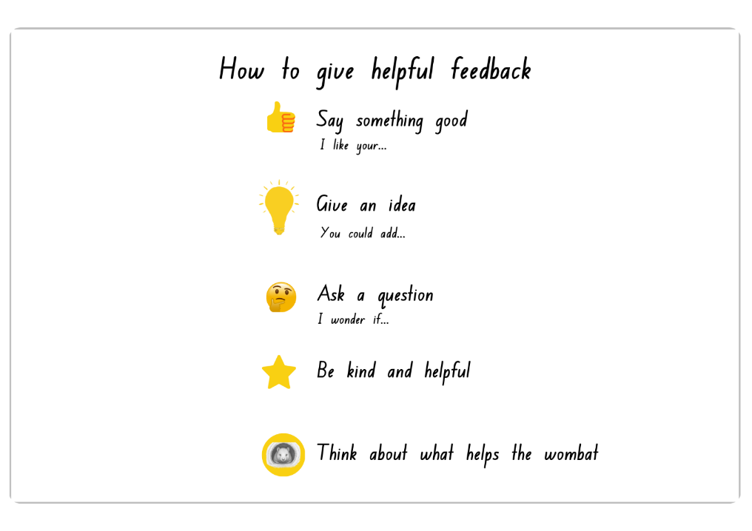
How to give helpful feedback (1)
Notes:
Teacher note
Model and reinforce how to give helpful, respectful and purposeful feedback. Encourage students to focus feedback on how well the habitat supports the wombat’s needs rather than appearance only.
Use prompts such as:
I like…
You could add…
I wonder if…
Support students to listen carefully and respond kindly to others’ ideas.
Teacher prompts / discussion cues
For peer feedback:
What do you like about this design?
How does this help the wombat?
Can you give one helpful idea?
What could they add or change?
Can you ask a kind question?
What does the wombat still need?
Ensure students link feedback to wombat needs
Watch for students
saying ‘I like it’ with no explanation
feedback about appearance only
same feedback repeated with no deeper thinking
feedback unrelated to wombat needs
students interrupting or speaking over others
students feeling nervous about presenting
.
Make connections to the EDP or wombat or particular phases of the EDP (such as Evaluate : how did you check what was working?)
Images: Sourced from Canva; edited using Canva.

Slide 67
References
Images have been edited using Canva: Visual design platform website http://www.canva.com and includes image content on slide 27, 28, 29 and 65 from ChatGPT (OpenAI) .
Introduction slide 1, includes images sourced from Pixabay and Canva; edited using Canva.
English K-10 Syllabus © NSW Education Standards Authority (NESA) for and on behalf of the Crown in right of the State of New South Wales, 2024
Mathematics K-10 Syllabus © NSW Education Standards Authority (NESA) for and on behalf of the Crown in right of the State of New South Wales, 2022
Science and Technology K-6 Syllabus © NSW Education Standards Authority (NESA) for and on behalf of the Crown in right of the State of New South Wales, 2024
67

Slide 68
Copyright
© State of New South Wales (Department of Education), 2026
The copyright material published in this resource is subject to the Copyright Act 1968 (Cth) and is owned by the NSW Department of Education or, where indicated, by a party other than the NSW Department of Education (third-party material).
Copyright material available in this resource and owned by the NSW Department of Education is licensed under a Creative Commons Attribution 4.0 International (CC BY 4.0) license.
This license allows you to share and adapt the material for any purpose, even commercially.
Attribution should be given to © State of New South Wales (Department of Education), 2026.
Material in this resource not available under a Creative Commons license:
the NSW Department of Education logo, other logos and trademark-protected material
Material owned by a third party that has been reproduced with permission. You will need to obtain permission from the third party to reuse its material.
Links to third-party material and websites
Please note that the provided (reading/viewing material/list/links/texts) are a suggestion only and implies no endorsement, by the New South Wales Department of Education, of any author, publisher, or book title. School principals and teachers are best placed to assess the suitability of resources that would complement the curriculum and reflect the needs and interests of their students.
If you use the links provided in this document to access a third-party’s website, you acknowledge that the terms of use, including licence terms set out on the third-party’s website apply to the use which may be made of the materials on that third-party website or where permitted by the Copyright Act 1968 (Cth). The department accepts no responsibility for content on third-party websites.

