Slide 1
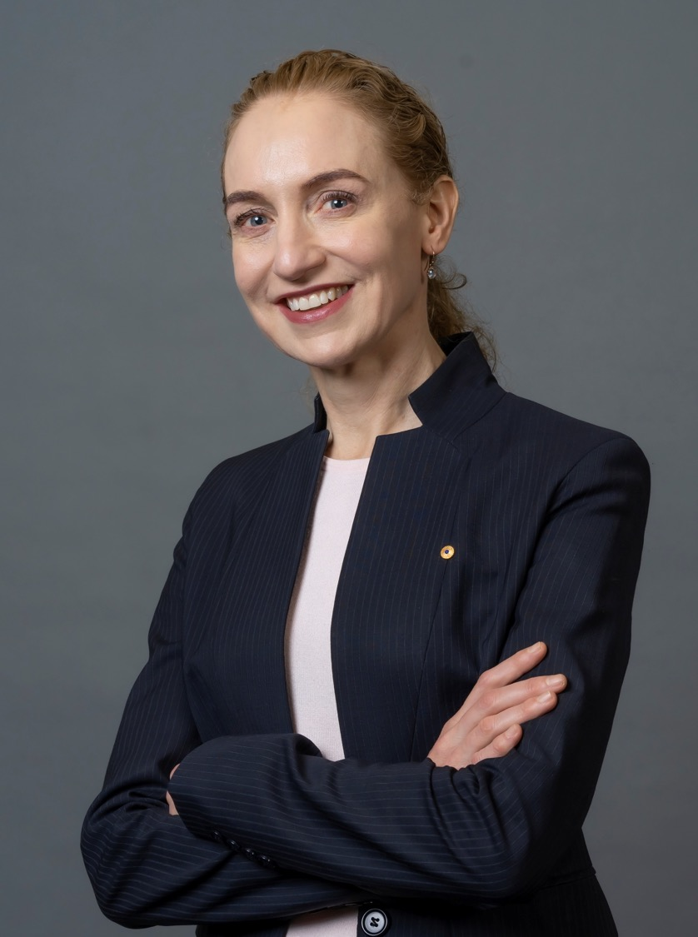
T cells, Immunotherapy and CAR-T therapy
Medical Science with Professor Georgina Long AO
STEM Enrichment

Slide 2
Instructions for use
The video series and companion student and teacher resources highlight the application of critical skills in scientific inquiry, technological understanding, and mathematical analysis, as outlined in the NSW Mathematics and Science syllabuses including:
Mathematics Standard 11–12 Syllabus (2024)
Mathematics Extension 1 11–12 (2024)
Biology 11–12 (2025)
Science Extension Stage 6 (2017), and
Investigating Science Stage 6 (2017).
Assess this support material within the context of your school and class and adjust where appropriate.
Notes:
This resource is designed to support learning in a variety of STEM subjects to be used with the Medical Research with Professor Georgina Long video suite.
By showcasing authentic clinical research, the series highlights the connection between syllabus outcomes and practical application, inspiring and equipping students with skills and knowledge to become scientific, mathematical and technological researchers.
With curriculum adjustments the resource could
To convert the PowerPoint into Google Slides:
Upload the file into Google Drive and open it.
Go to File > Save as Google Slides.

Slide 3
Instructions for use – Medical Research with Professor Georgina Long AO
Students are introduced to the nature and practice of STEM through the work of Professor Georgina Long AO, Australian medical oncologist, clinical trialist and translational researcher who leads an extensive clinical trials team and laboratory at the Melanoma Institute of Australia with a focus on targeted therapies and immuno-oncology in melanoma.
By showcasing authentic clinical research, the video series and companion resources highlights the connection between syllabus outcomes and practical application, inspiring and equipping the next generation of scientific, mathematical and technological researchers.
This resource is provided to support programmed unit of learning rather than a standalone lesson.
Notes:
Teacher notes:
To delete
Develop the learning intentions as required according to course and student requirements and add matching success criteria.
This resource is intended to build on prior knowledge.
For more information see ⁠NSW Department of Education explicit teaching strategies https://education.nsw.gov.au/teaching-and-learning/curriculum/explicit-teaching.

Slide 4
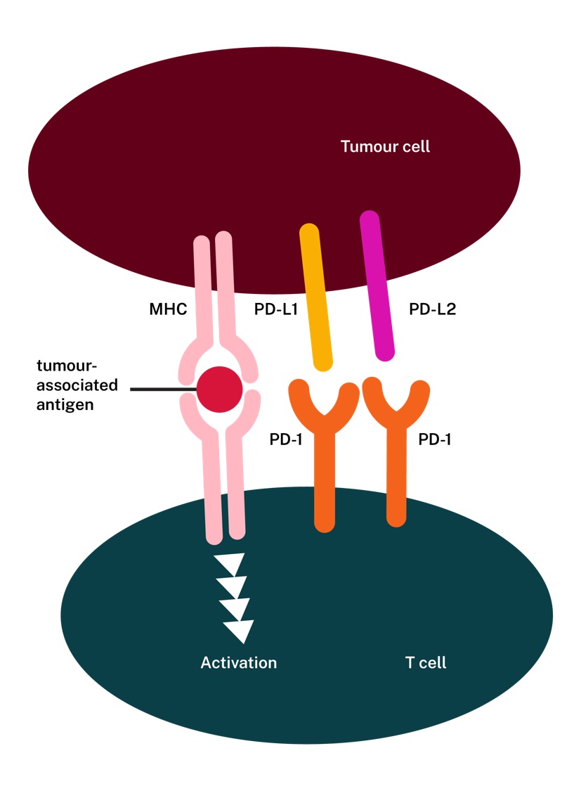
T cells and tumours
This tumour cell has the MHC1 protein on its surface, which binds to a tumour-associated antigen.
When this binding occurs, it activates the T cell, leading to the destruction of the tumour cell.
4

Slide 5
Suppression of anti-tumour activity
This tumour cell has PD-L1 and PD-L2 proteins on its surface. When these proteins bind to PD-1 receptors on T cells, the T cells die.
This suppresses the immune response against the tumour.
5
Notes:
Teacher notes:
In this scenario, the tumour cell suppresses the T cell response against it. Even though the MHC1-tumour-associated antigen complex activates the T cell, the PD-L1 and PD-L2 proteins on the tumour cell bind to the PD-1 proteins on the T cell, triggering its death.

Slide 6
Programmed T cell death
PD-1 receptors are located on T cells. When ligands bind to these receptors, they trigger a process that leads to T cells undergoing a form of cell death called apoptosis, or programmed cell death.
This helps to reduce immune responses, especially in cases of immunological tolerance.
6
Notes:
Teacher notes:
In this scenario, the tumour cell suppresses the T cell response against it. Even though the MHC1-tumour-associated antigen complex activates the T cell, the PD-L1 and PD-L2 proteins on the tumour cell bind to the PD-1 proteins on the T cell, triggering its death.

Slide 7
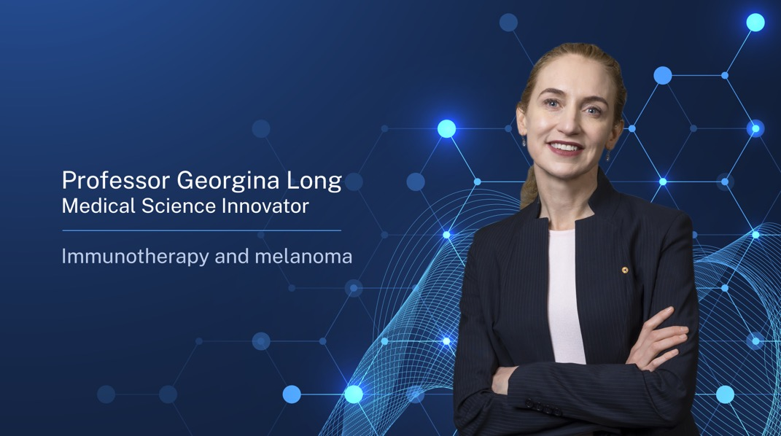

Immunotherapy: treatment for melanoma
What is the relationship between cancer and the immune system?
What is the role of checkpoints and T cells?
Immunotherapy and Melanoma
7

Slide 8
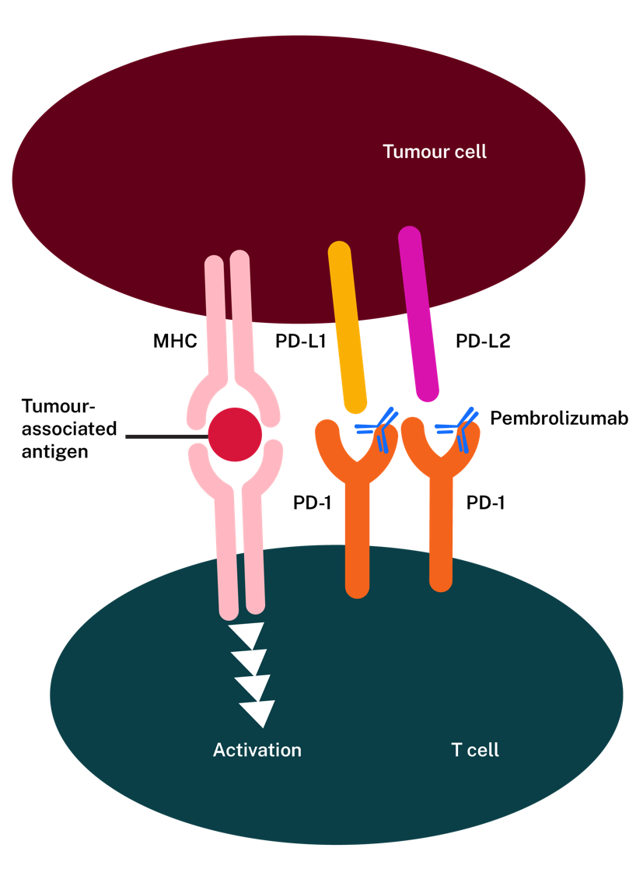
Immunotherapy: tumour destruction
Pembrolizumab is a small antibody that attaches to the PD-1 protein. This attachment does not lead to T cell death because it doesn't trigger the pathways that cause it.
Instead, pembrolizumab prevents PD-L1 and PD-L2 from binding to PD-1.
8
Notes:
Teacher notes:
In this scenario, the MHC1-tumour-associated antigen complex activates the T cell. Since apoptosis of the T cell is not triggered, the activated T cell will destroy the tumour cell.

Slide 9
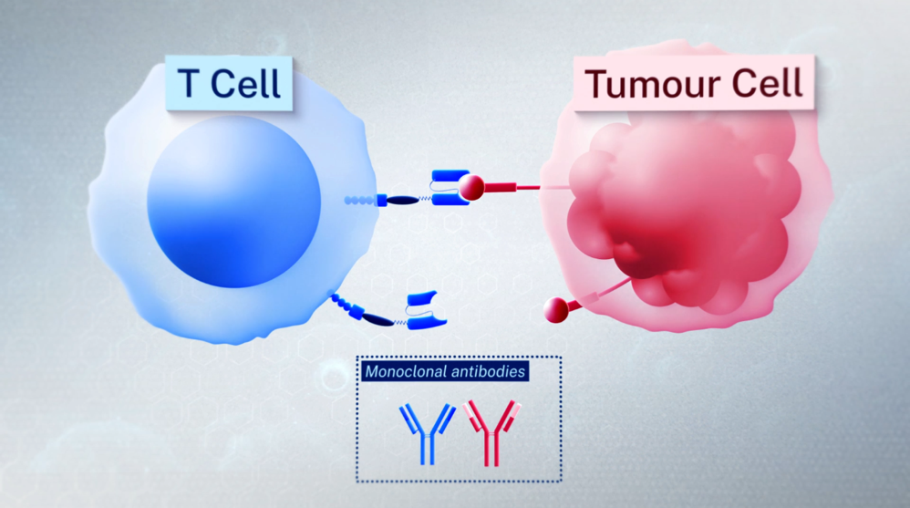
Immunotherapy: tumour destruction process
The tumour protein involved in the initial recognition is a tumour antigen presented on an MHC protein.
Antibodies bind to the T cell protein (PD-1).
The chemicals released by the T cells to destroy the tumour cell are perforins.
Immunotherapy T cell tumour destruction
9
Notes:
Animation showing:
1. The tumour protein involved in the initial recognition is a tumour antigen presented on an MHC protein.
2. The antibodies bind to the T cell protein (PD-1).
3. The chemicals released by the T cells to destroy the tumour cell are perforins.

Slide 10
Immune evasion
In conventional T cell responses, the T cell receptors (TCR) on T cells bind to tumour antigens that are bound to MHC1 proteins. Often, tumour cells downregulate MHC1 expression, thereby preventing the immune system from recognising and responding to them.
This is known as immune evasion.
10

Slide 11
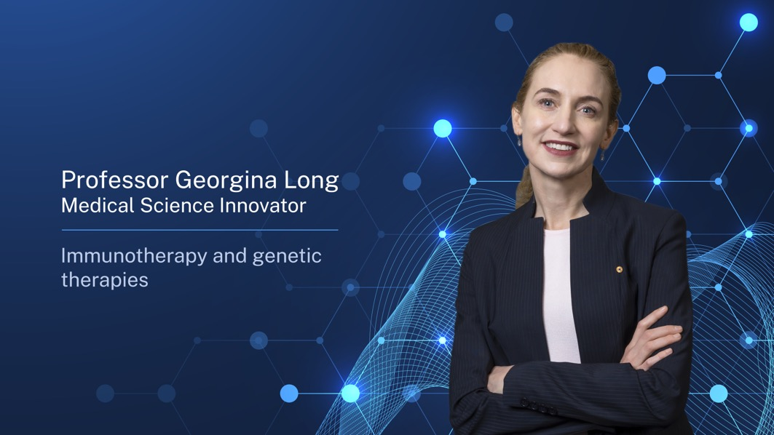
Immunotherapy and CAR-T cells
Treatment for melanoma
What are CAR-T cells and how are they modified to treat cancers such as melanoma?
Immunotherapy and genetic therapies
11

Slide 12
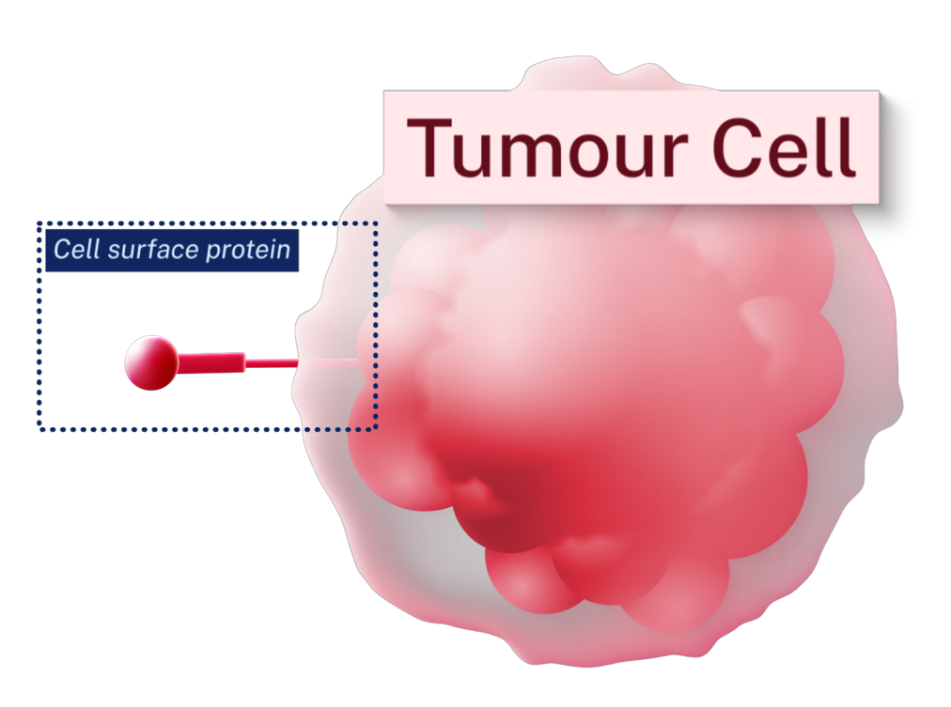
CAR-T therapy (1 of 3)
Cell collection and genetic engineering
The process of CAR-T cell therapy begins with cell collection, during which T cells, a type of immune cell, are extracted from the patient's blood.
12
Notes:
Teacher note:
Test for understanding: Students could list the process of CAR-T therapy as steps:
T cells are collected from the patient’s blood
T cells are genetically modified in a lab
Modified cells grow and multiply
CAR-T cells are returned to the patient

Slide 13
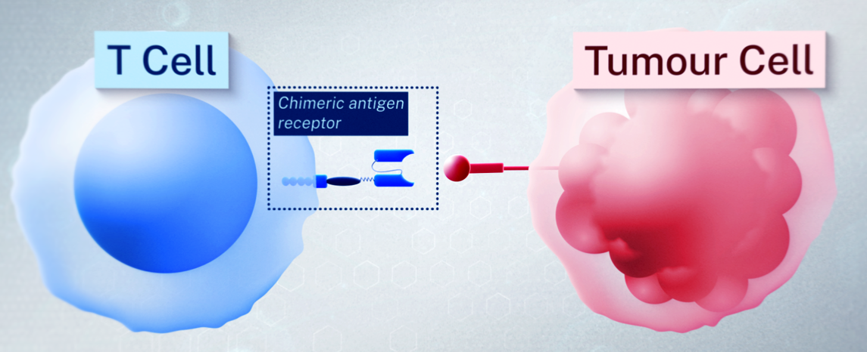
CAR-T therapy (2 of 3)
Cell growth and infusion
These T cells are then genetically engineered in a laboratory to produce special receptors known as Chimeric Antigen Receptors (CARs) on their surface. After modification, the CAR-T cells are grown and multiplied until their numbers reach the millions. Once sufficient quantities are available, the CAR-T cells are infused back into the patient’s bloodstream.
13

Slide 14
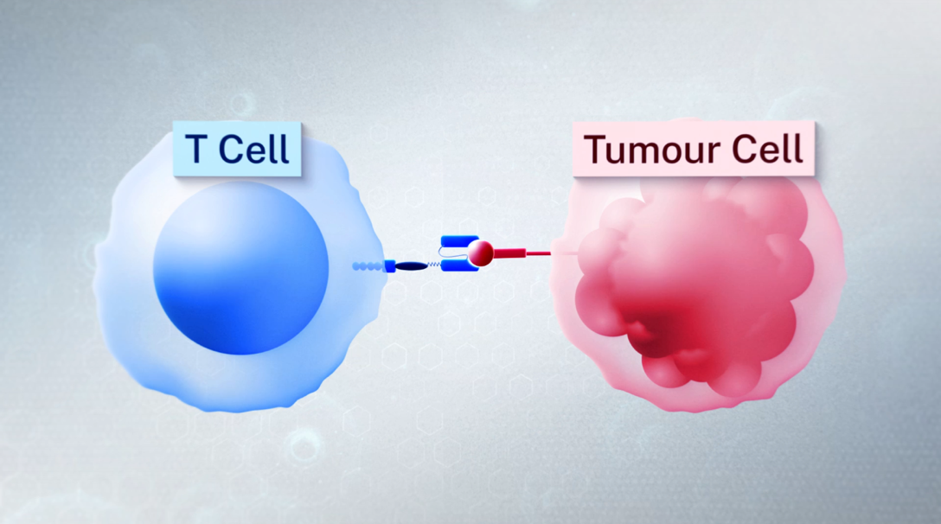
CAR-T therapy (3 of 3)
T cell activation
The infused CARs enable T cells to recognise and bind to specific antigens on cancer cells, thereby activating them to destroy the cancer. The recognition of tumour antigen by CARs is not dependent on MHC1-restricted antigen presentation.
CAR-T cell therapy
14

Slide 15
References
This presentation contains NSW Curriculum and syllabus content. The NSW Curriculum is developed by the NSW Education Standards Authority. This content is prepared by NESA for and on behalf of the Crown in the right of the State of New South Wales. The material is protected by Crown copyright.
Please refer to the NESA Copyright Disclaimer for more information https://www.nsw.gov.au/education-and-training/nesa/copyright.
NESA holds the only official and up-to-date versions of the NSW Curriculum and syllabus documents. Please visit NESA https://www.nsw.gov.au/education-and-training/nesa and NSW Curriculum https://curriculum.nsw.edu.au.
Commonwealth of Australia (2023), What is a clinical trial? Australian Clinical Trials website, accessed 29 January 2026.
Long, Georgina & Garnett-Benson, Charlie & Dolfi, Sonia & Ascierto, Paolo & Guo, Jun & Tarhini, Ahmad & Chandra, Sunandana & Muñoz-Couselo, Eva & Vecchio, Michele & Melo, Andreia & Callahan, Margaret & Gogas, Helen & Dummer, Reinhard & Schadendorf, Dirk & Koelblinger, Peter & Quereux, Gaelle & Thomas, Ioannis & Yu, Jia Xin - Annie & Fisher, Andrew & Hassan, Abdul. (2025). Adjuvant nivolumab and relatlimab in stage III/IV melanoma: the randomized phase 3 RELATIVITY-098 trial. Nature Medicine. 31. 4301-4309. 10.1038/s41591-025-04032-8.
Long, Georgina & Nair, Nitya & Marbach, Daniel & Scolyer, Richard & Wilson, Sabine & Cotting, Denise & Staedler, Nicolas & Amaria, Rodabe & Ascierto, Paolo & Tarhini, Ahmad & Robert, Caroline & Hamid, Omid & Gaudy-Marqueste, Caroline & Lebbé, Celeste & Muñoz-Couselo, Eva & Menzies, Alexander & Pagès, Clàudia & Curigliano, Giuseppe & Mandala, Mario & Blank, CU. (2025). Neoadjuvant PD-1 and LAG-3-targeting bispecific antibody and other immune checkpoint inhibitor combinations in resectable melanoma: the randomized phase 1b/2 Morpheus-Melanoma trial. Nature Medicine. 31. 3700-3712. 10.1038/s41591-025-03967-2.
Peters, Solange & Kerr, Keith & Stahel, Rolf. (2017). PD-1 blockade in advanced NSCLC: A focus on pembrolizumab. Cancer Treatment Reviews. 62. 10.1016/j.ctrv.2017.10.002.

Slide 16
Copyright
© State of New South Wales (Department of Education), 2026
The copyright material published in this resource is subject to the Copyright Act 1968 (Cth) and is owned by the NSW Department of Education or, where indicated, by a party other than the NSW Department of Education (third-party material).
Copyright material available in this resource and owned by the NSW Department of Education is licensed under a Creative Commons Attribution 4.0 International (CC BY 4.0) license.
This license allows you to share and adapt the material for any purpose, even commercially.
Attribution should be given to © State of New South Wales (Department of Education), 2026.
Material in this resource not available under a Creative Commons license:
the NSW Department of Education logo, other logos and trademark-protected material
Material owned by a third party that has been reproduced with permission. You will need to obtain permission from the third party to reuse its material.
Links to third-party material and websites
Please note that the provided (reading/viewing material/list/links/texts) are a suggestion only and implies no endorsement, by the New South Wales Department of Education, of any author, publisher, or book title. School principals and teachers are best placed to assess the suitability of resources that would complement the curriculum and reflect the needs and interests of their students.
If you use the links provided in this document to access a third-party’s website, you acknowledge that the terms of use, including licence terms set out on the third-party’s website apply to the use which may be made of the materials on that third-party website or where permitted by the Copyright Act 1968 (Cth). The department accepts no responsibility for content on third-party websites.

