Slide 1
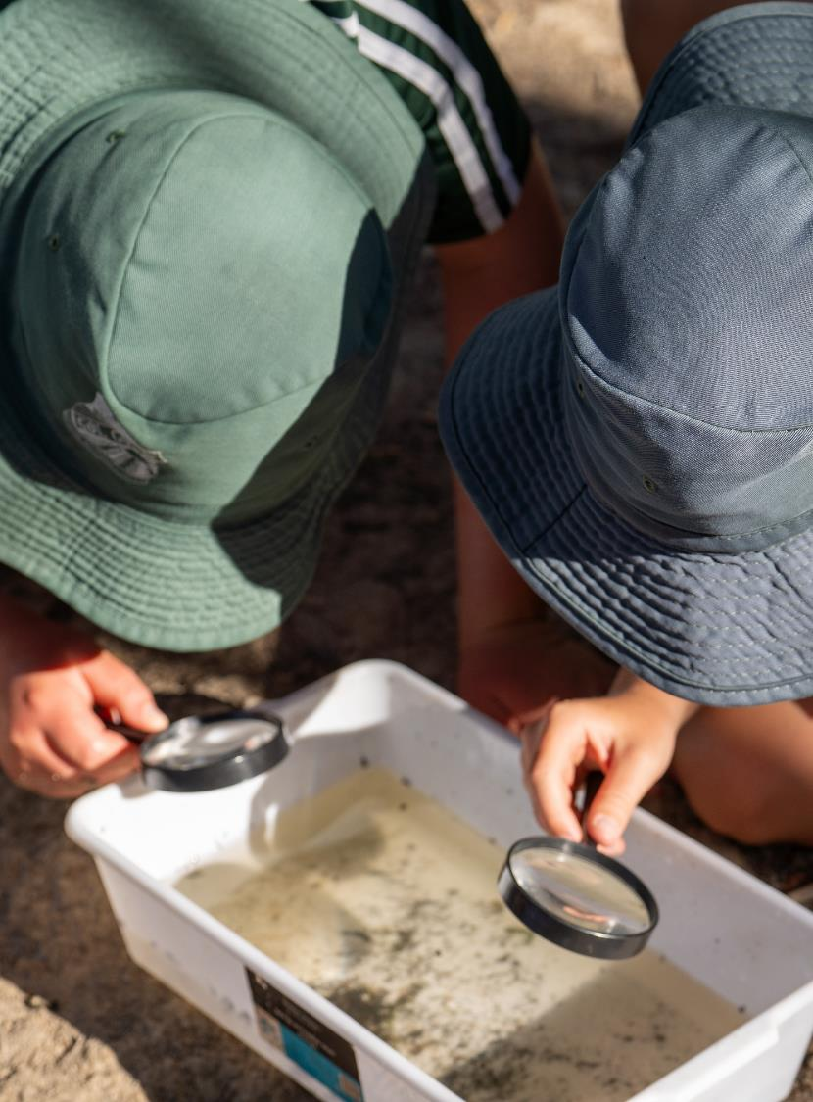
Science and technology
May 2025
Notes:
1. Purpose: Science and technology title slide
Time: 15 sec
Presenter Notes:
Good morning everyone and welcome to our Term 2 Professional Learning Workshop. We are looking forward to working with you today to build knowledge and understanding of the NSW Science and Technology K-6 (2024) syllabus.
[NEXT SLIDE]

Slide 2
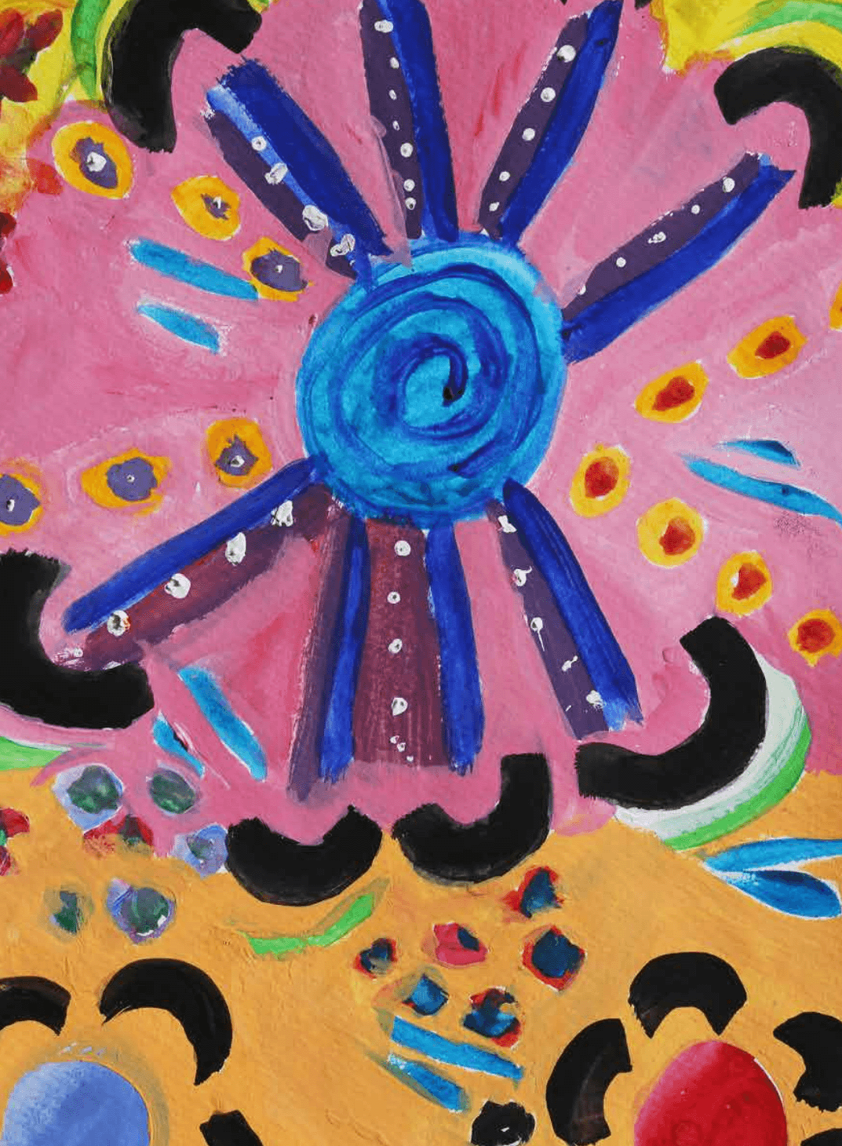
Acknowledgement of Country
We recognise the Ongoing Custodians of the lands and waterways where we work and live. We pay respect to Elders past and present as ongoing teachers of knowledge, songlines and stories. We strive to ensure every Aboriginal and Torres Strait Islander learner in NSW achieves their potential through education.
‘Kariong – Our meeting place’ created by Stella Haynes from Cammeray Public School on Eora Country as part of the 2022 Calendar for cultural diversity.
Notes:
2. Purpose: Acknowledgement of Country
Time: 30 sec
Presenter notes:
I would like to pay my respect and acknowledge the Ongoing Custodians of the lands on which we meet. I pay respect to Elders past and present and extend that respect to other Aboriginal and Torres Strait people with us here today.

Slide 3
Australian Professional Standards for Teachers
Standard descriptors
6.2 – Engage in professional learning and improve practice
6.2.2 – Participate in learning to update knowledge and practice, targeted to professional needs and school and/or system priorities.
6.3 – Engage with colleagues and improve practice
6.3.2 – Contribute to collegial discussions and apply constructive feedback from colleagues to improve professional knowledge and practice
Notes:
3. Purpose: To outline the teaching standards addressed in this professional learning.
Time: 15 sec
Presenter notes:
Here are the Australian Professional Standards for Teachers that today’s presentation will address. Please take a moment to read through them.
Pause 10 seconds
[NEXT SLIDE]

Slide 4


Learning intentions and success criteria
Learning intention
Success criteria
I will be successful if I can
We are learning to deepen our understanding of Science and technology K–6 syllabus content.
understand the role of research in connecting content in the Science and technology K–6 Syllabus
Notes:
4. Purpose: To outline the learning intention and success criteria for the workshop
Time: 30 sec
Presenter notes:
We are learning to deepen our understanding of Science and technology K-6 syllabus content.
By the end of this workshop, we will be successful if we can:
engage with research supporting the Science and technology K-6 Syllabus and understand its role in connecting content
[NEXT SLIDE]

Slide 5

Let's get loud
Notes:
5. Purpose: To lead into the first participant activity
Time: 10 sec
Presenter notes:
In today’s session, we’re going to start by engaging with a hands-on task that will not only spark your curiosity but also deepen your understanding of science and design content in Stage 1.
[NEXT SLIDE]
Image Credit: Canva Education. 2025. Images via Canva. https://www.canva.com/ accessed 14 May 2025.

Slide 6

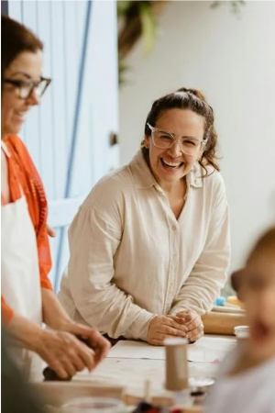
Participant activity
Stage 1 – Light and sound interact with materials in different ways
Task – In small groups, make a musical instrument
Criteria
The instrument must produce 3 distinct pitches.
It must be capable of producing 2 different volumes.
You must use at least 2 different materials.
Notes:
6. Purpose: To introduce the participant activity.
Time: 7 mins 30 sec
Presenter notes:
In small groups, you will work together to design and construct an instrument that meets specific criteria.
Read criteria on slide and instruct participants that they have 5 minutes to complete the task, they can use any materials on the table/in the room.
[CLICK] Start timer
After 5 minutes: Thanks everyone.
2 minutes: We will now share 2-3 instruments. (Try to select different approaches to the task)
Presenter may ask following questions as instruments are shared:
Did you meet all 3 criteria?
What was challenging?
What background knowledge would be needed for students to complete this task?
[NEXT SLIDE]
NOTE: Presenters may provide some materials such as: rubber bands, cups, pens, pencils etc. Participants may have brought with them other materials that could be used e.g. drink bottles, notebooks etc.
Examples of instruments -
Tap water bottle with pencil, level of water can change pitch, how hard you tap can change volume.
Use a pen to flick ruler on the edge of a table, pitch changes depending on how much of the ruler is sitting on the table, the force applied can change the volume.
Image Credit: Canva Education. 2025. Images via Canva. https://www.canva.com/ accessed 14 May 2025.

Slide 7


Participant activity
Stage 1 – Light and sound interact with materials in different ways
Review the Stage 1 Syllabus Information – Identify content related to the activity.
2. Discussion Points
  Science Content – What scientific principles or topics are covered?
  Design Content – How does this activity incorporate design elements?
  Digital Content – Explore the potential integration of digital tools or resources.
  Additional Connections – Consider other relevant connections. E.g. data, Creating written texts, other KLAs etc.
  Surprises: Has anything surprised you?
3. Annotation – Reflect on each content area and annotate your thoughts and insights.
Notes:
7. Purpose: To identify connections within the science and technology syllabus and beyond.
Time: 12 mins
Presenter notes:
Now we are going to explore the connections between science, design and potential digital content that relate to the musical instrument activity. This will help us identify key concepts and deepen our understanding of the syllabus.
Extracts from the syllabus are provided in your participant workbook.
After identifying relevant content, add any other connections you notice, for example with creating written texts or even with other KLAs. Annotate your workbooks with your thoughts.
You have 8 minutes for this task.
[CLICK] start timer
After 8 minutes, facilitate whole group discussion using the prompts on the slide. (3 minutes)
Thank you everyone for your contributions.
[NEXT SLIDE]
NOTE: content is in the participant workbook, participants may like to look at the online Science and Technology syllabus or the syllabus for other KLAs to explore additional connections.
Additional notes for presenters only:
Presenter Hints: The content points below relate to the activity. We've called out the main ones and it is important to explain to teachers that some content points will lead into the activity and some content points will naturally flow from it. In the design content points, when students are “applying one or more steps of the design process” teachers may use this opportunity to focus on developing manual skills, manipulating materials and learning how to build prototypes (practical skills). Equally, in “applying one or more steps of the design process”, teachers may focus the learning on generating ideas as a skill.
Science content:
Light and sound interact with materials in different ways
Recognise that light and sound can travel through air, water and some solids and are affected by those materials
Recognise that sound is created and carried by vibrations
Test how different materials and actions affect the volume and pitch of sound – this is the central content point addressed in this activity
Design technologies content:
A design process is used to define user needs and create solutions:
Recognise that a design process breaks large projects into manageable, logical steps
Pose questions and test how materials with different properties contribute to the effectiveness of a product
Apply one or more steps of a design process to make a product - this is the central content point addressed in this activity
Digital technologies potential:
Because in this session we are focusing on mainly one content point, there could be limited digital connections – although there may be connections within a broader unit.
Describe how digital systems are used in everyday life and for learning
Use the basic features of common digital tools to capture, save and retrieve data to communicate and collaborate following agenda rules.
e.g. take a video or record instrument on an iPad
Additional connections:
Creative arts: music - Performing: Music is performed to communicate musical ideas through sound content points: Explore changes in pitch and pitch patterns, indicating changes with gestures; Use sound sources to experiment with dynamic effects, including gradual or sudden changes in volume
Surprises:
Example responses:
The number of content points that are covered from one activity

Slide 8
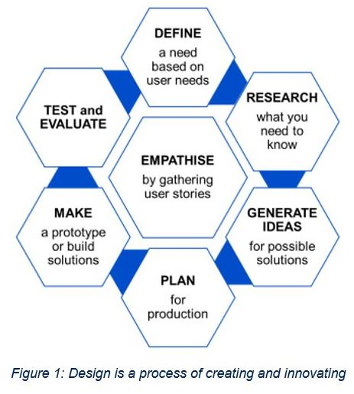
Discussion summary
Science – 'Test how different materials and actions affect the volume and pitch of sound'
Design – 'Apply one or more steps of a design process to make a product'
Potential integration of digital content and data – For example, students take a photograph or video and annotate the image with descriptions.
Posing questions – Questioning is the starting point for all scientific investigations.
image: © NSW Education Standards Authority (NESA)
Notes:
8. Purpose: To sum up the identified connected content from the previous activity.
Time: 2 mins
Presenter notes:
This design process graphic is introduced in the Stage 1 Teaching advice under the Design and digital technologies outcome. The Teaching advice states that there are many design processes, but they are all similar and they are all iterative. The design process may begin and end at different steps, and each step does not have to be followed every time.
As discussed, the musical instrument activity highlights key syllabus connections: the science content point of testing how different materials and actions affect the volume and pitch of sound, and the design content point of applying steps in a design process to create a product. In Stage 1, it is not necessary to cover all elements of the design process; this activity primarily focuses on the 'make' step. However, you can adapt it to include more components, such as generate ideas, plan and test and evaluate. Focusing on one or a few steps allows students to effectively develop their design skills. We will look at the design process in more detail in a little while.
Although there is no digital or data component in the activity as it stands, there are opportunities to integrate this content. For example, students could collect and record data by taking a photograph or video and annotating the image with descriptions. This also incorporates the use of digital technologies.
Each stage has an outcome dedicated to posing questions. In Stage 1, students pose questions based on observations and information to investigate cause and effect. For this activity, students may have made an instrument using their drink bottle and may question how the level of water could impact the pitch of the sounds made. This could also be another opportunity to collect data.
[NEXT SLIDE]
Additional notes for presenters only:
If participants bring up the Posing questions outcome and why it is standalone -
Questioning is the starting point for all scientific investigations—it sparks curiosity and inquiry. Studies (e.g. Chin & Osborne, 2008) show that students who generate meaningful questions are more likely to develop deeper conceptual understanding. Similarly, Cellitti and Wright (2019) highlight that encouraging student-generated questions increases curiosity and engagement — especially in younger learners

Slide 9

Connecting scientific, design, and digital content
Notes:
9. Purpose: Explore the research
Time: 10 sec
Presenter notes:
Now let's explore some of the research that underpins the Science and technology K-6 Syllabus.
[NEXT SLIDE]

Slide 10
Key research findings
Ofsted (2021) states that science should be curriculum-led and structured to show how disciplinary knowledge is embedded within substantive content, allowing students to engage with science meaningfully rather than treating skills as stand alone.
Lewis (2005) explicitly explores how problem-solving, and design thinking are strengthened when disciplinary knowledge (like science content) is used within the design process.
Notes:
10. Purpose: Highlight the interconnectedness of science, design, and digital technologies.
Time: 2 mins
Presenter notes:
The syllabus highlights how science, design, and digital technologies are related to each other. This is based on educational research that supports learning across different key learning areas and shows how these connections are relevant in everyday life.
Please take a moment to read these key research findings.
[Pause for 20 seconds]
Substantive content refers to the core content—the facts, concepts, and information students need to know. For example, understanding energy transfer in science.
Disciplinary knowledge refers to how that content is developed and used in practice—it’s the methods, thinking, and inquiry of the discipline. For example, designing an experiment or evaluating a prototype.
Willingham's cognitive science research shows that skills and knowledge are tightly linked and cannot be taught separately.
This is especially powerful when we look at design and technology. Lewis shows that creativity and innovation in design are strongest when students draw on disciplinary knowledge within the design process. So, for example, designing a sustainable home is much more meaningful when students apply their understanding of energy efficiency and material properties.
[NEXT SLIDE]
Additional notes for presenters only:
Lewis T (2005) 'Creativity—a framework for the design/problem solving discourse in technology education', Journal of Technology Education, 17(1):35–52.
Ofsted (Office for Standards in Education, Children's Services and Skills) (2021) Research review series: science, Ofsted, accessed 8 May 2025.
Willingham D (2019) How to teach critical thinking [PDF 373KB], NSW Department of Education, accessed 8 May 2025.

Slide 11

Connections between content
Provide authentic contexts for applying scientific and technological skills
Provide opportunities to apply scientific knowledge to a designed product or process by:
  collecting and interpreting data to define user needs​
  testing and selecting new materials and processes​
  scientifically evaluating prototypes and products​
Can content groups be taught without connections to other parts of the syllabus?
Notes:
11. Purpose: Explain the value of making connections between syllabus content.
Time: 2 mins
Presenter notes:
So, what does it look like in practice?
As we program, we will find logical and clear connections where the technologies and science support each other. Of course, it's not the case that we must make connections in every single content group.
[CLICK]
An important factor throughout this syllabus is the relevance to authentic and real-life contexts.
[CLICK]
Applying scientific skills within a design process can give students the opportunity to apply science knowledge and practice skills in an authentic way.
This might look like students conducting fair tests to understand more about the materials they might use in a design, or collecting objective information as they seek to understand the user needs that underpins a design.
As these scientific processes help students to identify new knowledge, that knowledge can be applied through the design process and lead to a more effective product. When students come to evaluate their prototypes they can again conduct scientific and objective testing to determine if the design meets the criteria.
[CLICK]
Question? Can some content groups be taught without connections to other parts of the syllabus?
[PAUSE]
Yes, some content groups could be taught without any connections to other parts of the syllabus or any other key learning area.
However, one should consider the missed opportunities by not making those connections. Most content has natural connections and contexts. For example, saving and retrieving files could be applied to many of the other content groups especially as students are observing scientific investigations, collecting and interpreting data.
[NEXT SLIDE]

Slide 12
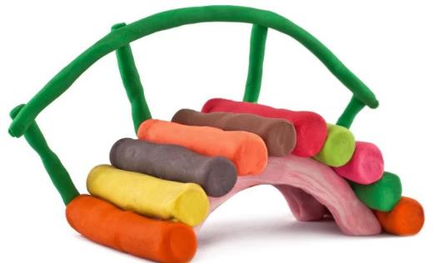
Connecting science and technology content (1)
Early Stage 1 – Objects are made of materials that have observable properties​
Example – Early Stage 1 students learn about the properties of materials and build a product based on those properties, for example building a bridge to carry a toy.
Design
Science
Opportunities for students to:
identify user needs
design and build a simple product.
Opportunities for students to:
pose questions about materials
observe and manipulate materials to describe their properties.
Notes:
12. Purpose: To provide an Early Stage 1 example of connecting content.
Time: 1 min
Presenter notes:
In Early Stage 1 we need to be mindful that students are beginning to pose questions about what they observe, and they are at a very early stage of designing products. They are becoming aware that products can be designed based on the properties of materials.​
​
In the case of designing a bridge to carry a toy, we would guide students to ask questions about the materials they've chosen. Did I choose the material that was strong enough for a bridge? Are there different ways to use that material that might make the bridge stronger? ​
​
Early Stage 1 is not introduced to the whole design process but are introduced to ‘products that meet a user's need’, and the properties of materials are considered when making products.
Let’s look at a Stage 2 example.
[NEXT SLIDE]
Image credit: Canva Education. 2025. Images via Canva. https://www.canva.com/ accessed 15 May 2025.

Slide 13
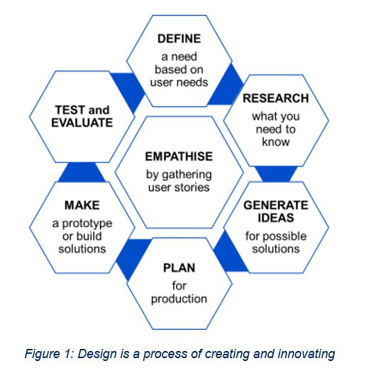
Connecting science and technology content (2)
Stage 2 – Heat energy can be transferred
Example – Year 4 students learning about heat energy. The science is presented through the context of designing a product that provides insulation, for example food packaging, clothing, buildings, etc.
Opportunities for students to:
use sensors/thermometers to collect data
Opportunities for students to:
collecting data to understand user story and needs
pose questions about different types of materials
conduct fair tests to compare how different materials absorb or reflect heat energy
describe the properties of materials
Centre image: © NSW Education Standards Authority (NESA)
Notes:
13. Purpose: To provide a Stage 2 example of connecting content.
Time: 1 min 30 sec
Presenter notes:
In this Stage 2 example, students explore heat transfer—specifically how materials absorb or reflect heat energy.
While students should ideally identify the problem and solution, for today's exercise, we have used the syllabus examples of designing food packaging, clothing, or a building.
Let's unpack how science knowledge and skills can enhance the design of a product.
The design process on the slide, shows the empathise phase at the centre—this is highlighting a strong focus on user needs. Around the design cycle, there are clear points where science skills connect:
In the research phase, students investigate conduction and insulation, developing fair tests and scientific vocabulary.
During prototyping, they apply fair tests to materials, to understand if the materials are suitable for the design.
At the evaluate stage, fair testing is used again to assess if the final product works as intended.
This approach supports deep learning—students use scientific knowledge and skills to inform design thinking.
[NEXT SLIDE]
Additional notes for presenters only:
– image is taken from Stage 1 Teaching advice.

Slide 14

Connections in practice
In practice, connections:
identify opportunities to incorporate science, design and digital technologies in units
frame tasks around real-world problems to build engagement
encourage students to apply scientific concepts through problem identification, designing, building, and testing.
Notes:
14. Purpose: To provide examples of connections.
Time: 2 mins 30 sec
Presenter notes:
As we think about practical next steps, here are some key takeaways for the classroom.
First, look for natural opportunities to connect science, design, and digital technologies. These connections do not always exist, don’t force them. Some content in science and technology is best taught in isolation.
Second, try to frame tasks around real-world problems. This not only boosts engagement but also helps students see the relevance of what they’re learning.
For example, in Stage 3 students will learn that 'a fixed amount of useable matter makes up all the material on earth'. They could apply this knowledge and possibly identify a problem of waste in their school. They might design an educational campaign to raise awareness of sustainability and can evaluate the effectiveness of their campaign through peer feedback and data collection.
Finally, we need to encourage students to apply scientific knowledge actively—not just in theory, but, by identifying problems, designing solutions, building prototypes, and testing them. This gives them a chance to think and work like scientists, designers, and engineers.
I’d like you to take 60 seconds to quietly reflect on how you connect science, design, and/or digital technologies in your teaching? What works well? What is challenging?
[NEXT SLIDE]

Slide 15

Bringing it together
Notes:
15. Purpose: To allow participants time to explore connections in a stage of their choice.
Time: 10 sec
Presenter notes:
We are now going to give you time to explore the connections in a stage relevant to you.
[NEXT SLIDE]

Slide 16
Sample connections
Stage 1
Science content
Light and sound interact with materials in different ways:
Recognise that light and sound can travel through air, water and some solids and are affected by those materials
Recognise that sound is created and carried by vibrations
Test how different materials and actions affect the volume and pitch of sound
Design content
A design process is used to define user needs and create solutions:
Recognise that a design process breaks large projects into manageable, logical steps
Pose questions and test how materials with different properties contribute to the effectiveness of a product
Apply one or more steps of a design process to make a product
Digital content
Digital systems use inputs and algorithms to produce an output:
Use the basic features of common digital tools to capture, save and retrieve data to communicate and collaborate following agreed rules
Posing questions
poses questions based on observations and information to investigate cause and effect
Data
collects, represents and uses data to identify patterns and relationships
Classroom activities
Make a musical instrument
Test how differently the same sound travels through air, water and solids
Use a digital pitch detector to explore changes in pitch
Notes:
16. Purpose: To revisit connections in content from the first activity.
Time: 1 min
Presenter notes:
Revisiting the Stage 1 content covered in the ‘Making a musical instrument’ activity, we have drawn out the connections between
[CLICK] science
[CLICK] design and digital
[CLICK] data and posing questions
[CLICK] we used a simple practical activity to show how these aspects of the syllabus connect.
We have only included three examples of practical activities here:
You could make an instrument, test how the same sound travels through different materials or use a digital pitch detector to explore the pitch of different materials. However, there are many other learning activities you could use to link related content. Connections to Creating Written Texts (CWT) and other KLAs such as creative arts are also possible.
[NEXT SLIDE]

Slide 17

Participant activity – making connections
Use the participant workbook
Choose a stage of learning other than Stage 1
Highlight opportunities for connections to enhance learning
Consider classroom activities
Be prepared to share your findings
17
Notes:
17. Purpose: To explain the participant activity.
Time: 13 mins - 1 min introduction; 12-min activity
Presenter notes:
The participant workbook has selected content from other stages.
Choose a stage of learning relevant to you, other than Stage 1.
Select a stage and work with a partner.
Together, highlight natural connections between the content. Remember, you are not trying to force incompatible syllabus elements together.
Also highlight clear connections with posing questions and data.
Think about practical classroom activities that bring your chosen content to life, and for you to share your findings with the whole group at the end of the activity.
[Use your phone to time]
Additional notes for presenters only:
For the Stage 2 content group 'Energy is required to change the properties of matter' participants may not find an immediate connection between Science and design. When schools are planning, please encourage them to not force the connection, suggest that they find connections with other digital content, posing questions, data, creating written texts and other KLAs.
[NEXT SLIDE]

Slide 18

Participant sharing
What connections did you find?
Did you think of any classroom activities that support the connections?
What are you still wondering about making meaningful connections?
Notes:
18. Purpose: Share participant findings.
Time: 5 mins
Presenter notes:
Select a pair from each stage (ES1, S2, S3) to share their findings with the group:
What connections did you find?
Did you think of any classroom activities that support the connections?
What are you still wondering about making meaningful connections?
Additional information (for facilitator only, do not read aloud to participants):
If participants do not find an immediate connection between the Stage 2 Science content group, and design, please encourage them to not force the connection. Suggest that they find connections with other digital content, posing questions, data, creating written texts and other KLAs.
[NEXT SLIDE]
Image Credit: Canva Education. 2025. Images via Canva. https://www.canva.com/ accessed 14 May 2025.

Slide 19
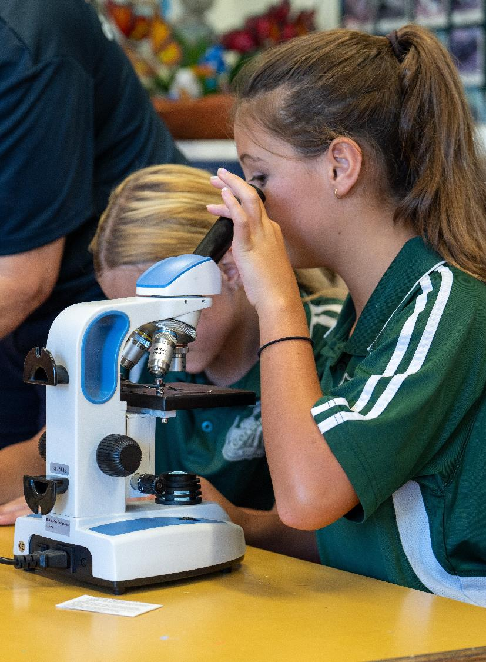
Key takeaways (1)
Consider how you can:
provide opportunities for content to be connected in a meaningful way in your classroom/school?
use your knowledge about the way content is connected to enhance student understanding and inform whole school planning?
Notes:
19. Purpose: To reflect on the key takeaways of the Science and technology presentation.
Time: 1 min
Presenter notes:
We ask you now to think about what the implementation of the K-6 Science and technology syllabus will look like in your context.
How can you provide opportunities for content to be connected in a meaningful way in your classroom or school?
How can you use your knowledge about the way content is connected to enhance student understanding to inform whole school planning?
Please record your thoughts in the workbook provided.
[NEXT SLIDE]

Slide 20
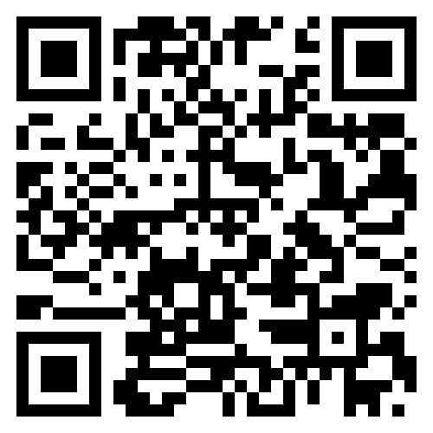
Contact us
Primary Curriculum Statewide Staffroom
primarycurriculum@det.nsw.edu.au
Notes:
20. Purpose: Contact details for the Primary Curriculum team
Time: 30 sec
Presenter notes:
If you have any questions or would like to reach out to the Primary Curriculum team, please contact us via this email address, or through the Statewide Staffroom.
This QR code takes you to the enrolment page to join the statewide staffroom.
[NEXT SLIDE]

Slide 21
Copyright
© State of New South Wales (Department of Education), 2025
The copyright material published in this resource is subject to the Copyright Act 1968 (Cth) and is owned by the NSW Department of Education or, where indicated, by a party other than the NSW Department of Education (third-party material).
Copyright material available in this resource and owned by the NSW Department of Education is licensed under a Creative Commons Attribution 4.0 International (CC BY 4.0) license.
This licence allows you to share and adapt the material for any purpose, even commercially.
Attribution should be given to © State of New South Wales (Department of Education), 2025.
Material in this resource not available under a Creative Commons licence:
the NSW Department of Education logo, other logos and trademark-protected material
Material owned by a third party that has been reproduced with permission. You will need to obtain permission from the third party to reuse its material.
Links to third-party material and websites
Please note that the provided (reading/viewing material/list/links/texts) are a suggestion only and implies no endorsement, by the New South Wales Department of Education, of any author, publisher, or book title. School principals and teachers are best placed to assess the suitability of resources that would complement the curriculum and reflect the needs and interests of their students.
If you use the links provided in this document to access a third party’s website, you acknowledge that the terms of use, including licence terms set out on the third-party’s website apply to the use which may be made of the materials on that third-party website or where permitted by the Copyright Act 1968 (Cth). The department accepts no responsibility for content on third-party websites.

