Slide 1
Instructions for use
This resource is not a teaching and learning program. It should be used in conjunction with the Reactions program of learning and teacher resource books.
Classroom teachers are encouraged to add and adapt slides as required to meet the needs of their students.
Save a copy of the file to make changes to the slide deck. Go to File > Download a Copy (this downloads a copy to the computer to edit in the PowerPoint app).
To convert the PowerPoint to Google Slides:
  Upload the file into Google Drive and open it.
  Go to File > Save as Google Slides.
  (Note – conversion may cause formatting changes in the slides.)

Slide 2

Reactions
Stage 5
Supporting PowerPoint

Slide 3
Contents1
TRB 1
1.1
1.6
Law of conservation of mass
The pH scale
1.2
1.7
Naming compounds
pH changes in neutralisation
1.3
Writing chemical formula
1.4
Balancing equations
1.5
Chemical reactions
Notes:
Teacher notes:
Click lesson numbers to go to specific lessons
Interactive features can be viewed in slide show
Notes for vendors [to be removed after slide deck creation]:
Create hyperlinks to dividers that match lesson numbers by
Right click on the number>edit link>select slide in deck to connect to

Slide 4
Contents 2
TRB 2
2.1
TRB 3
3.1
Rate of reaction
Nuclear decay reactions
2.2
3.2
Investigating the rate of reaction
Half life
2.3
Investigating factors affecting the rate of reaction
3.3
Use of radioisotopes
2.4
Reaction rate: temperature and concentration
3.4
Fission in context
3.5
The first elements
Notes:
Teacher notes:
Click lesson numbers to go to specific lessons
Interactive features can be viewed in slide show

Slide 5
Essential question 1
Content in this section aligns with essential question ‘How do substances combine to make new substances?’ in the program of learning and Teacher resource book 1

Slide 6
1.1 Law of conservation of mass
Learning intentions and success criteria
We are learning: | I can:
to describe the law of conservation of mass in chemical reactions. | define the law of conservation of mass account for mass changes in chemical reactions distinguish between open and closed systems.
to make accurate observations and measurements. | use an electronic balance to accurately measure mass calculate mass changes that occur in a chemical reaction.
to predict the outcome of a scientific investigation | predict mass changes in open and closed systems based on knowledge and observations.
Notes:
Teacher notes:
Display this slide at the beginning of the learning activity. Revisit the slide where appropriate during lesson activities and encourage students to reflect on their progress.

Slide 7
1.1 Checkpoint
Classify the following processes as a chemical or physical change
Process | Chemical/Physical
Water evaporating | Physical
Burning wood | Chemical
Rusting | Chemical
Salt dissolving in water | Physical
Notes:
Teacher notes:
This slide contains animations to bring up the correct answers
Use this slide to check students understanding of physical and chemical change. Students covered this in the Change focus area in Stage 4.

Slide 8
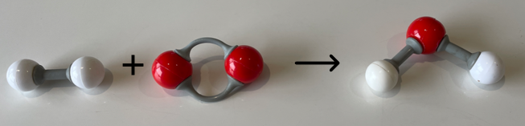
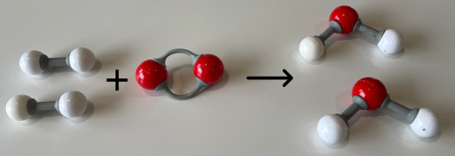
1.1 Law of conservation of mass (1 of 3)
Matter cannot be created or destroyed
H₂ + O₂ → H₂O
2H₂ + O₂ → 2H₂O
Notes:
Teacher notes
This slide has animations
As students to consider what the term ‘conserve’ means.
Tell students that the Law of conservation of mass means that in chemical reactions:
atoms are rearranged but cannot be created or destroyed
all atoms present in the reactants of a chemical reaction will also be found in its products.
Ask students to consider the reaction where the red balls represent oxygen atoms and the white hydrogen atoms.
Ask students what the problem is here. Students should recognise that the hydrogen atoms are conserved but the oxygen atoms are not.
Tell students that a chemical reaction can rearrange atoms but it cannot create or destroy them.
CLICK to bring up the correct representation
Tell students that this chemical equation and representation with the molecular models is the correct representation of this reaction. Demonstrate by counting the number of hydrogens and oxygens on both sides of the equation.

Slide 9
1.1 Law of conservation of mass (2 of 3)
Mass cannot be created or destroyed
mass of reactants = mass of products
magnesium + oxygen → magnesium oxide
3 g + 2 g → 5 g
Notes:
Teacher notes
Define the law of conservation of mass stating that ‘mass can not be created or destroyed’. Explain that this means that in chemical reactions:
the mass of the reactants must equal the mass of the products.
For example, Magnesium burns in oxygen to produce magnesium oxide.
If 3 g of magnesium reacts with 2 g of oxygen it will produce 5 g of magnesium oxide.
The mass of the reactants equals the mass of the products.

Slide 10
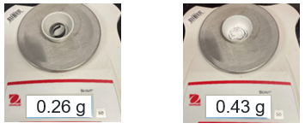
1.1 Law of conservation of mass (3 of 3)
Mass cannot be created or destroyed
mass of reactants = mass of products
magnesium + oxygen → magnesium oxide
Mass of magnesium before burning Mass of magnesium oxide after burning
What mass of oxygen reacted with the magnesium?
Notes:
Teacher notes
The image on the left shows the mass of unburnt magnesium.
The image on the RHS shows the magnesium after it has reacted with oxygen to form magnesium oxide.
Explain to students what is shown in each image. Considering the previous, mass of reactants equals mass of products, ask students to determine what mass of oxygen must have reacted with the magnesium.
To do this students will take the final mass and subtract the initial mass to find that it has reacted with 0.23 g of oxygen.

Slide 11
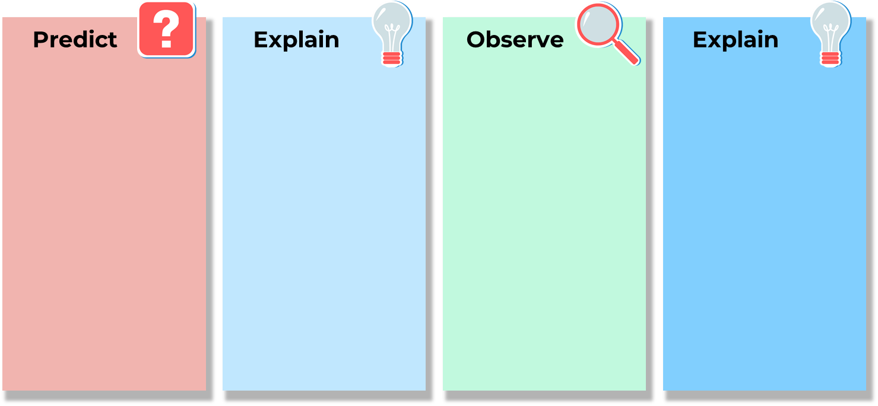
1.1 Predict–Explain–Observe–Explain
As the steel wool burns, what will happen to the mass?
Notes:
Teacher notes:
Ask students predict what will happen to the mass of steel wool when it burns.
Then ask them to explain their prediction.
After the demonstration, discuss the observations and compare them to the prediction.
Ensure that all students generate a correct explanation, which is modelled on the next slide

Slide 12
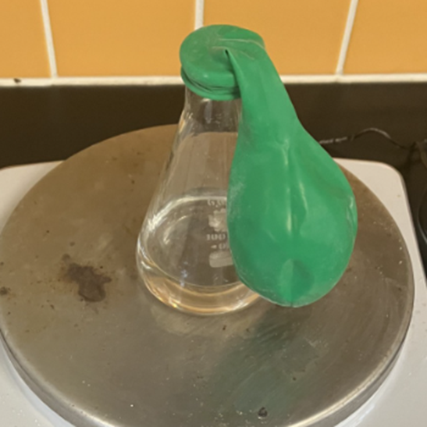
1.1 Vinegar and sodium hydrogen carbonate set-up
sodium bicarbonate powder in balloon
vinegar
Notes:
Teacher notes:
Show students this setup.
Place the sodium bicarbonate in the balloon and place it over the flask with vinegar to weigh the entire setup.
Then tip the contents of the balloon into the vinegar and observe.

Slide 13
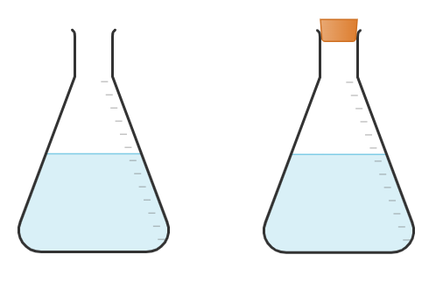
1.1 Open and closed systems
In an open system, both matter and energy can move into and out of the system.
In a closed system, only energy can move into and out of the system.
Matter
Energy
Energy
Open
Closed
This work has been generated using Chemix.
Notes:
Teacher notes:
Use students' observations from the investigations 1, 2 and 3 to consider which investigations gave expected results considering the conservation of mass.
Students should consider why the conservation of mass was not followed in all investigations.
Introduce students to concepts of open and closed systems.
In an open system, both matter and energy can move into and out of the system.
In a closed system, only energy can move into and out of the system.
Discuss with students the 3 investigations and consider which of the investigations had an opened system and which was closed? How do we know this? How did this impact the results observed?
Students should note that investigation 3 was closed and none of the gaseous reactants or products were lost. As a result, the law of conservation of mass was observed. In investigation 1 and 2, mass was lost as matter could move out of the open system.

Slide 14
1.2 Nomenclature
Learning intentions and success criteria
We are learning: | I can:
describe a range of chemical compounds | distinguish between ionic and covalent compounds name simple ionic compounds using IUPAC naming conventions name ionic compounds containing polyatomic ions using IUPAC naming conventions name simple covalent compounds consisting of 2 elements using IUPAC naming conventions.
Notes:
Teacher notes:
Display this slide at the beginning of the learning activity. Revisit the slide where appropriate during lesson activities and encourage students to reflect on their progress.

Slide 15
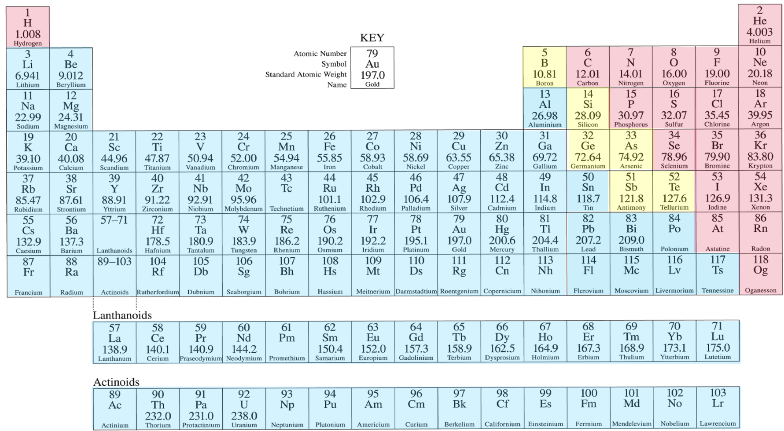

1.2 Checkpoint 1 (1 of 3)
Classify the following as metals or non-metals
Element | metal/non-metal
Na | metal
Li | metal
O | non-metal
Os | metal
Br | non-metal
Periodic table of the elements adapted from the Science 7-10 Data book..
Notes:
Teacher notes:
This slide has animations
Support students in recalling information from the Stage 4 Periodic Table focus area and the atomic structures of metal and non-metal elements.
Use the periodic table to determine if the following elements are metals or non-metals.
Click through to animate answers
Sample responses:
Metals: N, Li, Os
Non metals: O and Br

Slide 16
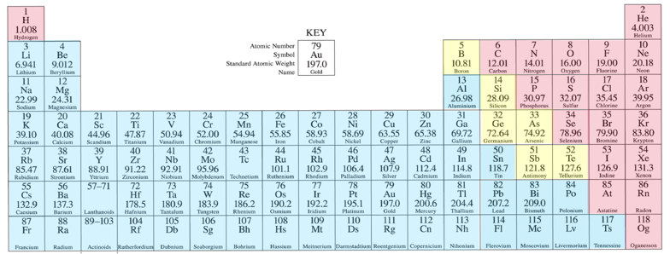
1.2 Checkpoint 1 (2 of 3)
How many electrons in a neutral sodium atom?
How many electrons in a sodium ion?
Periodic table of the elements adapted from the Science 7-10 Data book..
Notes:
Teacher notes:
Support students in recalling information from Stage 5: Materials on cations and anions.
Ask students the following questions:
1. How many electrons are in a neutral sodium atom?
2. How many electrons are in a sodium ion?
Sample responses:
1. Na atom has 11
2. Na ion has 10. This is because sodium’s 11th electron sits on the outer shell. It is easier for sodium to lose 1 electron to become a stable ion than to gain 7 electrons to fill the outer shell.

Slide 17
1.2 Checkpoint 1 (3 of 3)
Classify the following as ionic or covalent compounds
NaCl | ionic
H₂O | covalent
CO₂ | covalent
BaO | ionic
Notes:
Teacher notes:
This slide contains animations to bring up the correct answers
Support students to recall information from Stage 5, Materials on ionic compounds and covalent molecules.
Ask students to classify each as an ionic or a covalent compound.
Sample responses:
NaCl and BaO are ionic
H₂O and CO₂ are covalent
If students seem unfamiliar with this content, ask them what types of elements the 2 ionic species are composed of (metal and non-metal) then compare this to the covalent species (2 non-metals)
Remind students that typically ionic compounds contain metals and non-metals while covalent compounds typically contain only non-metals.

Slide 18
1.2 Types of compounds
Types of compounds matching activity
Covalent compounds
Ionic compounds
A substance formed when two or more non-metal atoms bond together by sharing electrons.
A compound consisting of positively charged metal ions and negatively charged non-metal ions that are connected by ionic bonds.
Notes:
Teacher notes:
This slide contains animations
As the teacher reads out each definition, students should try to match the correct definition to the type of compound.
*CLICK* A substance formed when two or more non-metal atoms bond together by sharing electrons.
*CLICK* A compound formed from two or more different elements, typically consisting of positively charged metal ions (cations) and negatively charged non-metal anions held together by an ionic bond. *CLICK* (Ionic compounds)
*CLICK to align covalent compound with its definition*
*CLICK to align ionic compound with its definition*

Slide 19
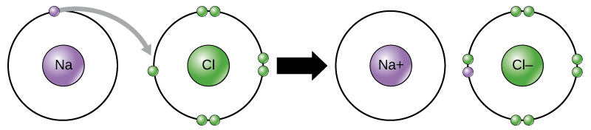
1.2 Ionic compounds
Monatomic and polyatomic ions
Ionic compounds are formed when positively charged ions (cations) and negatively charged ions (anions) bond through electrostatic attraction.
Ionic compounds can be made of monatomic or polyatomic ions.
Monatomic ions are charged particles consisting of single atoms that have gained or lost electrons
Polyatomic ions are charged particles consisting of two or more atoms covalently bonded together as a single unit.
Only valence electrons are represented here
CNX OpenStax, CC BY 4.0 <https://creativecommons.org/licenses/by/4.0>, via Wikimedia Commons
Notes:
Teacher notes:
When metals and nonmetals react, they form ionic compounds by forming ions.
The atom of the metal loses electrons and becomes a positively charged, a cation.
The non-metal gains the lost electrons and becomes a negative ion, an anion.
These charged atoms are attracted to each other by electrostatic forces, known as ionic bonding. Forming an ionic compound.
Sodium chloride contains two monatomic ions Na⁺ and Cl⁻. Sodium (Na) is a metal with 1 valence electron. This electron is lost and Na becomes overall positively charged. Chlorine gains this electron and becomes negatively charged.
Polyatomic compounds are unpacked in more detail in a future lesson.

Slide 20
1.2 Naming ionic compounds
Rule: Name the metal first and modify the name of the non-metal to end in –ide.
Example: MgCl₂ magnesium chloride
NaF
Al₂O₃
CuS
sodium fluoride
aluminium oxide
copper sulfide
Notes:
Teacher notes:
This slide has animations
Recall that ionic compounds consist of metal and nonmetal elements. When naming ionic compounds, the metal is always named first. The non-metal element is modified to include –ide.
For example, magnesium chloride (MgCl₂) is an ionic compound. Magnesium is a metal and chlorine is a non-metal. Resulting in the naming of the ionic compound “magnesium chlor-ide”.
CLICK Ask students to name the next 3 ionic compounds
CLICK for answers
Note: Many students will incorrectly name CuS copper sulfate because of their familiarity with it. This is a good opportunity to reinforce the nomenclature rule

Slide 21
1.2 Checkpoint 2
Name the ionic compounds
Na₂O sodium oxide
2. AlCl₃ aluminium chloride
Notes:
Teacher notes:
This slide has animations
Check students understanding of naming simple ionic compounds before moving on. If students grasp the concept move onto the next part of the lesson. If they have not grasped the concept, re-teach it and provide additional practice.
CLICK to reveal the ionic compounds

Slide 22
1.2 Polyatomic ions
Mg + H₂SO₄ MgSO₄ + H₂
Polyatomic ions are a charged group of atoms that tend to behave as a single entity.
Rule: When the ion consists of a non-metal (other than hydrogen) combined with oxygen, the name of the non-metal is modified to end in –ate or –ite.
Examples of polyatomic ions
Name | Formula
sulfate | SO₄²⁻
carbonate | CO₃²⁻
nitrate | NO₃⁻
hydroxide | OH⁻
Notes:
Teacher notes:
This slide contains animations.
Introduce and unpack the term polyatomic ion: A polyatomic ion is a charged particle made of two or more atoms that are chemically bonded together and act as a single unit in reactions.
During chemical reactions they stay grouped together.
CLICK to bring up an example equation
For example, a sulfate ion SO₄²⁻ has a 2- charge. In sulfuric acid (H₂SO₄), the sulfate group is part of the compound with hydrogen. During the reaction, the sulfate group remains intact and is transferred to magnesium to form magnesium sulfate. We can see this highlighted in red in the chemical equation.
Click to bring up the rule
Unpack the rule, when the ion consists of a non-metal combined with oxygen (other than hydrogen), the name of the non-metal is modified to end in –ate or –ite.
CLICK to bring up examples of common polyatomic ions
The hydroxide ion does not follow the ate rule but is included here because it is one of the most commonly encountered ions.
Note:
When introducing the naming of and writing formulas of compounds containing polyatomic ions, it is preferable to restrict the examples to the more common examples

Slide 23
1.2 Naming compounds with polyatomic ions.
In most cases, the compound will consist of a metal combined with a polyatomic ion.
Example: CaCO₃
Rule: Name the metal first, Ca (calcium), followed by the name of the polyatomic ion, CO₃²⁻ (carbonate).
CaCO₃ calcium carbonate
Activity – name the following compounds:
NaNO₃ Mg(OH)₂
sodium nitrate magnesium hydroxide
Notes:
Teacher notes:
This slide has animations
Use this slide to illustrate the naming conventions for compounds containing polyatomic ions.
In most cases, the positive ion is a metal.
If you choose to introduce the ions on slide ‘1.2 More polyatomic ions’, it include the ammonium ion which is a positive ion that does not contain a metal.
Answers: CLICK sodium nitrate and magnesium hydroxide
Highlight to students that although magnesium hydroxide has 2 hydroxide there is no prefix required

Slide 24
1.2 More polyatomic ions
Name | Formula
phosphate | PO₄³⁻
hydrogen carbonate | HCO₃⁻
ethanoate | CH₃COO⁻
ammonium | NH₄⁺
CH₃COONa sodium ethanoate
NH₄Cl ammonium chloride
Notes:
Teacher notes:
This slide contains animations
Here are some more examples that will be important in Stage 6.
Some things to note include that polyatomic ions can contain more than 2 elements.
The ethanoate and ammonium ions are very important in stage 6 and illustrate the differences among polyatomic ions. CLICK
Despite being a negative ion, the ethanoate ion is often written first in the formula but named last.
Ammonium is a positive ion and behaves a bit like a metal ion, so it is named and written first

Slide 25
1.2 Checkpoint 3
Naming compounds with polyatomic ions
Ca(NO₃)₂ calcium nitrate
Mg(OH)₂ magnesium hydroxide
Notes:
Teacher notes:
This slide has animations.
CLICK for answers

Slide 26
1.2 Naming covalent compounds (1 of 2)
The charge of the ions in ionic compounds means that they can only combine in one possible ratio.
Rule: Non-metals in covalent compounds can combine in a variety of ratios, therefore prefixes such as mono, di, tri etc are used to denote the number of each atom in the compound.
Example: nitrogen and oxygen can combine in the following ratios:
NO nitrogen monoxide
NO₂ nitrogen dioxide
N₂O dinitrogen monoxide
N₂O₄ dinitrogen tetroxide
Note: mono is not used for the first element
Notes:
Teacher notes:
The charges of ions in ionic compounds mean they can only combine in one possible ratio.
Non-metals in covalent compounds can combine in a variety of ratios; prefixes such as mono, di, tri, etc. must be used to provide an unambiguous name.
For example, nitrogen and oxygen can combine in the following ratios
If we called them all nitrogen oxide, we would get in trouble
N2O is a happy gas, whereas NO2 is poisonous and will irritate the respiratory system, so it is important to distinguish between them

Slide 27
1.2 Naming covalent compounds (2 of 2)
Rules:
Mono is not used on the first element.
CO₂ is carbon dioxide, not monocarbon dioxide
The O is omitted from mono when it precedes oxygen
CO is carbon monoxide, not carbon monooxide
Prefix | Number of atoms
mono | 1
di | 2
tri | 3
tetra | 4
pent | 5
Notes:
Teacher notes:
Use this slide to ensure students are aware of what prefixes to use as well as illustrate some of the conventions that are used when naming covalent compounds.

Slide 28
1.2 Checkpoint 4
Identify the type of compound and then name the compound
Compound formula | Type of compound | IUPAC name
KCl | Ionic | potassium chloride
Ca(NO₃)₂ | Ionic | calcium nitrate
N₂O | Covalent | dinitrogen monoxide
Na₂O | Ionic | sodium oxide
PCl₃ | Covalent | phosphorous trichloride
MgI₂ | Ionic | magnesium iodide
Ba(OH)₂ | Ionic | barium hydroxide
Notes:
Teacher notes:
This slide contains animations to bring up the correct answers one by one.
These examples are a mix of covalent and ionic compounds so students will first have to determine what type of compound it is. Students may need to be reminded that covalent compounds contain two or more non-metals, whereas an ionic compound contains a metal ion and a non-metal ion.
Students then determine the compound name for each.

Slide 29
1.3 Writing chemical formulas
Learning intentions and success criteria
We are learning: | I can:
to describe chemical compounds | distinguish between ionic and molecular formulas construct the formula for named covalent compounds using IUPAC conventions construct the formula for ionic compounds using IUPAC conventions construct the formula and name compounds containing elements with variable valency, such as lead, copper and iron using IUPAC conventions.
to process information and data. | determine valency from the periodic table to construct a chemical formula.
Notes:
Teacher notes:
Display this slide at the beginning of the learning activity. Revisit the slide where appropriate during lesson activities and encourage students to reflect on their progress.

Slide 30
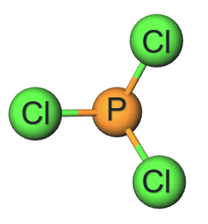
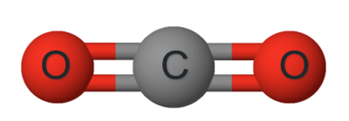
1.3 Molecular formula
A molecule is a group of two or more atoms that are chemically bonded together and act as a single particle.
A molecular formula tells you how many atoms of each element are in that molecule.
Carbon dioxide CO₂
Each molecule consists of 1 carbon and 2 oxygen atoms.
Phosphorous trichloride PCl₃
Each molecule consists of 1 phosphorous and 3 chlorine atoms.
Images created using Molview
Notes:
Teacher notes:
A molecule is a group of two or more atoms that are chemically bonded together and act as a single particle. A molecular formula tells you how many atoms of each element are in that molecule.
Covalent molecules are named with the least electronegative atom first.
To write the formula, simply write down the symbol of each element in the same order as the name and add a subscript number to reflect the number of each type of atom.
Note: 1 is not represented in formulas.

Slide 31
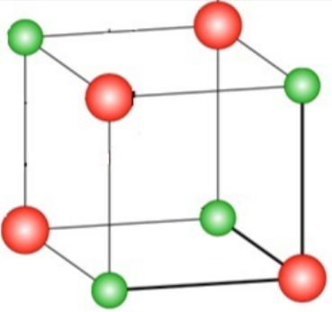
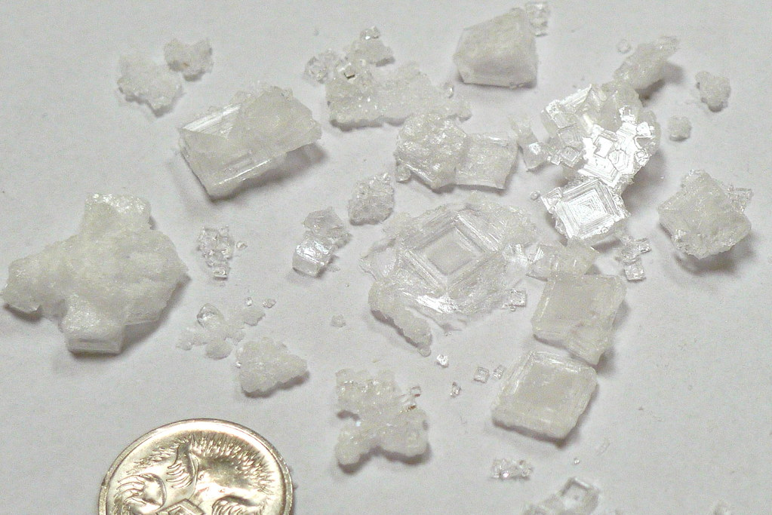
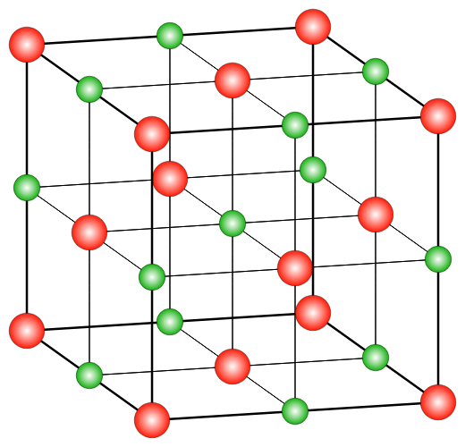
1.3 Ionic formula
NaCl
"Ionlattice-fcc" by Prolineserver is licensed under CC BY-SA 3.0.
"Salt crystals we made" by Richard Jones is licensed under CC BY 2.0.
Notes:
Teacher notes:
This slide contains animations
Salt crystals come in all sizes
The number of ions in each crystal can vary enormously but the ratio is always the same.
Ionic compounds typically exist as crystalline lattice structures.
Click to bring up a lattice structure
A lattice is a regular, repeating three-dimensional arrangement of particles.
In ionic substances, this lattice is made up of alternating positive and negative ions held together by strong forces (electrostatic attractions) between oppositely charged ions.
Click to bring up larger lattice.
The lattice extends in all directions, forming a continuous structure rather than individual units or molecules. Each ion is surrounded by several oppositely charged ions, which maximises attractive forces and contributes to the stability of the solid.
As ionic lattice is a continuous, repeating structure, it does not contain individual, independent particles like molecules. Therefore, the chemical formula of an ionic compound does not represent a single particle; instead, it shows the simplest whole-number ratio of ions that is repeated throughout the three-dimensional lattice.
Click to circle one sodium and one chlorine ion
In sodium chloride the ratio of sodium ions to chloride ions is always 1:1 therefore the formula is NaCl

Slide 32
1.3 Checkpoint 1
Write the formula for these covalent compounds
Nitrogen dioxide NO₂
Phosphorous trichloride PCl₃
Notes:
Teacher notes:
This slide has animations
Ask students to write the formula for each
CLICK for answers

Slide 33

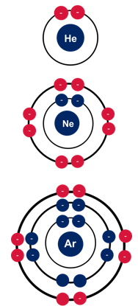
1.3 Noble gases
Noble gas electron configuration
Electron configuration
Most neutral atoms are unstable and cannot exist on their own.
The only atoms capable of existing on their own are the noble (inert) gases.
They have a stable electron configuration.
2
2, 8
2, 8, 8
Notes:
Teacher notes:
This content should be a review of what was covered in Stage–5 Materials focus area

Slide 34
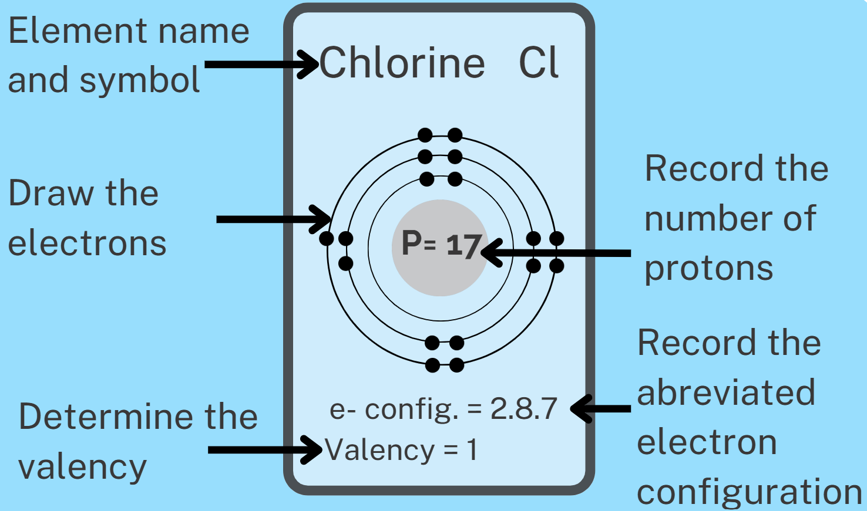
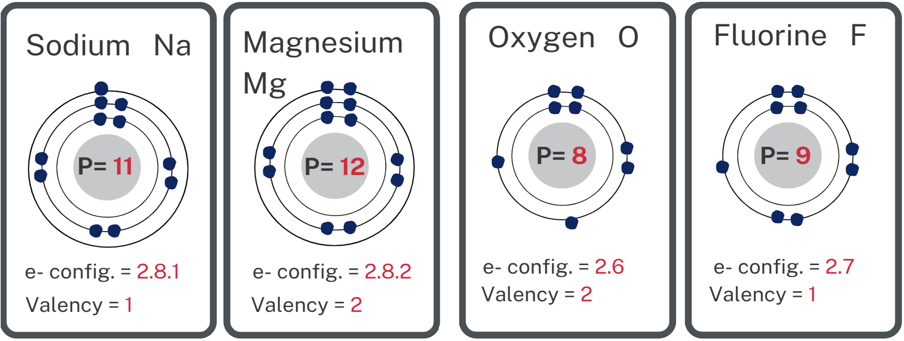
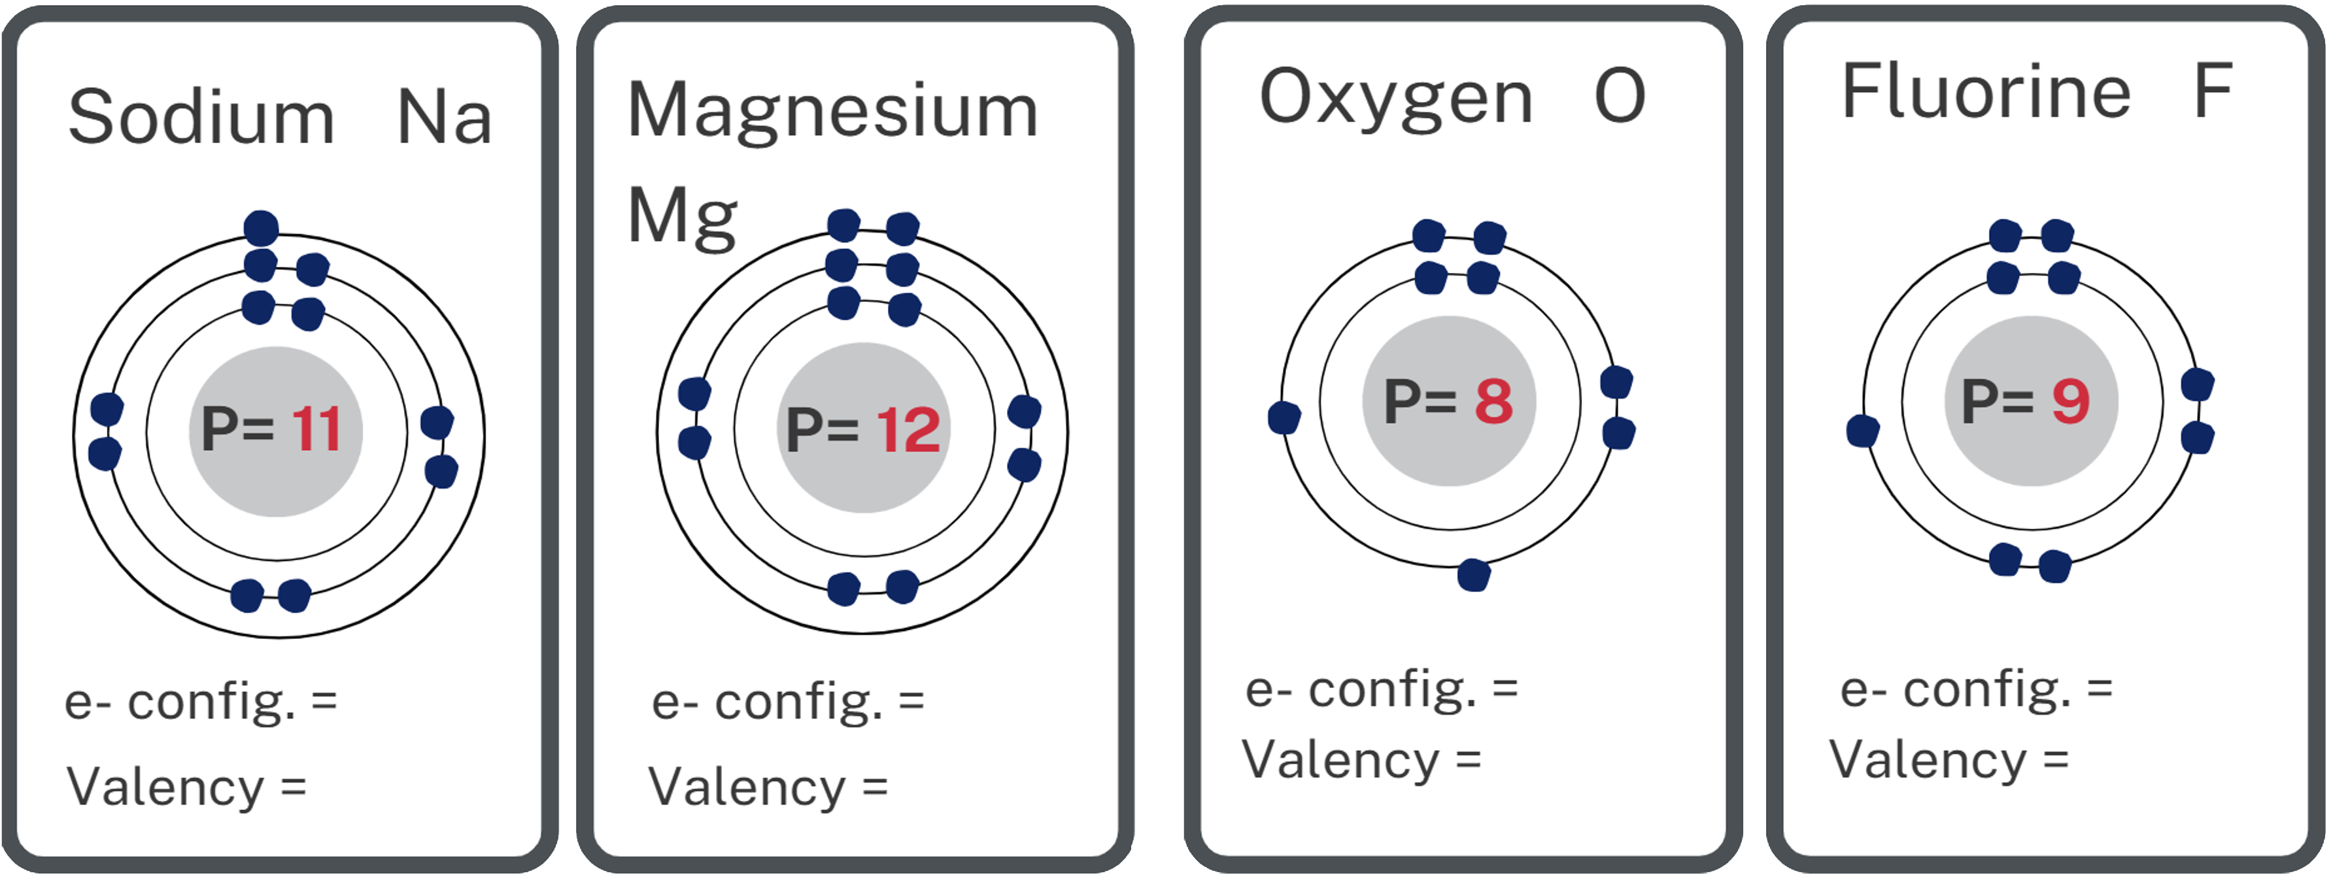
1.3 Valency
The number of chemical bonds an atom can make with a univalent atom such as hydrogen
Notes:
Teacher notes:
This slide contains animations.
Review that valency is defined as ‘the number of chemical bonds an atom can make with a univalent atom such as hydrogen’ (NESA 2025, Glossary).
Discuss the information presented about chlorine.
The number of protons = 17. This defines what element it is and does not change during chemical reactions.
Point out that the first 2 shells are full with 2 and 8 electrons respectively.
Identify how many electrons in the outer shell.
Tell students that during the formation of ionic compounds valency equates to the number of electrons an atom needs to gain or lose to achieve the noble gas electron configuration.
Chlorine needs to gain 1 electron to be like argon and has a valency of 1.
CLICK to bring up a blank template.
Ask students to complete question 1 in student resource - ionic compounds. Where they complete the tiles for Na, Mg, O and F.
CLICK to display answers

Slide 35
1.3 Why atoms bond
-
-
-
-
-
-
-
-
-
-
-
-
-
-
-
-
-
-
-
Na
Na+
Ne
-
-
-
-
-
-
-
-
-
-
-
-
11 protons, 11 electrons
Electron configuration 2,8,1
11 protons, 10 electrons
Electron configuration 2,8
10 protons, 10 electrons
Electron configuration 2,8
Notes:
Teacher notes:
Ask students what do they think is more stable, a neutral sodium atom or a positively charged sodium ion. If unsure
Click to reveal the electron configurations If still unsure click to reveal the Neon atom (a Noble gas) and its electron configuration.
Restate that Noble gases are INERT because they have a stable electron configuration.
Highlight that the sodium ion has the same configuration as neon and is therefore more stable than the sodium atom.

Slide 36
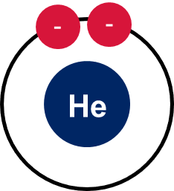
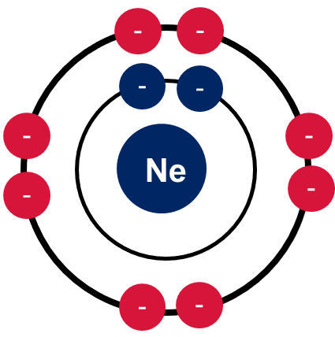
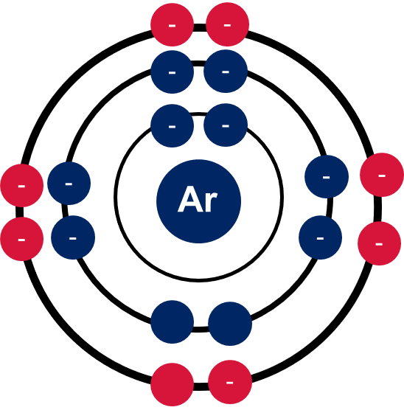
1.3 How atoms bond
Atoms bond to achieve a noble gas electron configuration which is more stable. They can achieve this by gaining or losing valence electrons.
-
-
-
-
-
-
-
-
-
-
+
-
Na
-
F
-
-
-
-
-
-
-
-
-
11 protons
11 electrons
11 protons
10 electrons
9 protons
9 electrons
9 protons
10 electrons
Notes:
Teacher notes:
This slide has animations.
Atoms bond to achieve a noble gas electron configuration which is more stable. They can achieve this by gaining or losing valence electrons. Metals typically lose and nonmetals typically gain.
Sodium has 11 protons and 11 electrons making it neutral. It has 1 electron it its outer (valence shell). It could gain 7 to be like argon but that is too difficult. Instead, it can lose 1 electron to be like neon
Fluorine has 9 protons and 9 electrons making it neutral. It has 7 electrons in its outer (valence) shell. It could lose 7 to be like helium but this is too difficult Instead it can gain 1 electron to be like neon.
If sodium donates its valence electron to fluorine CLICK they now both a stable electron configuration, the same as neon.
Now sodium still has 11 protons (protons remain intact during chemical reactions) but only 10 electrons leaving it positively charged.
Fluorine still has its 9 protons but now has 10 electrons leaving it negatively charged.
The electrostatic attraction that now exists between these 2 oppositely charged ions is what contributes to the ionic bond.

Slide 37
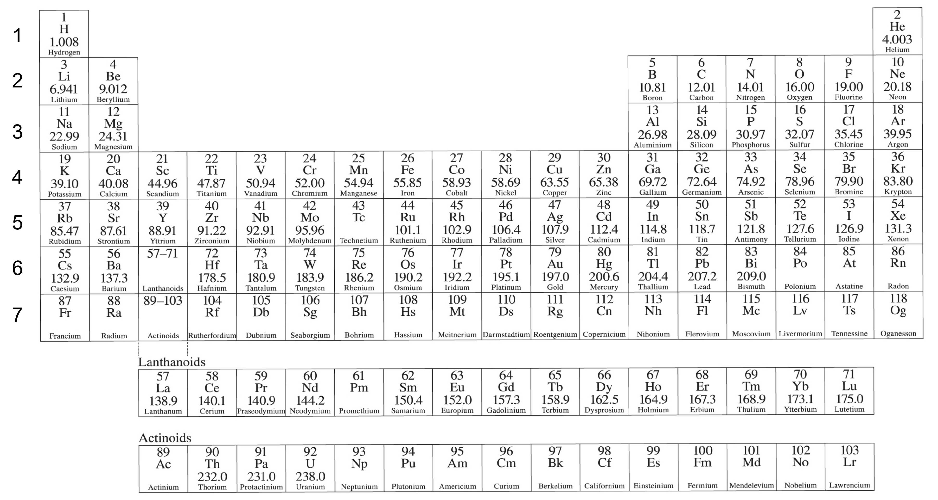
1.3 The periodic table
1
18
2
13
14
15
16
17
Group | Gain or lose
1 | Lose 1
2 | Lose 2
15 | Gain 3
16 | Gain 2
17 | Gain 1
18 | Stable
3
4
5
6
7
8
9
10
11
12
Periodic table of the elements adapted from the Science 7-10 Data book..
Notes:
Teacher notes:
This slide contains animations.
The periodic table makes it easy for us to determine how many electrons each atom needs to gain or lose.
All atoms in the same group have the same number of electrons in the outer shell and therefore need to lose or gain the same number of electrons. They have the same valency.
Click to place a border around group 1 elements.
For example, elements in group 1 have 1 electron in their outer (valence) shell so they need to lose 1 electron to get a stable noble gas configuration..
Click to place a border around group 2 elements.
Group 2 elements have 2 electrons in their outer (valence) shell so need to lose 2 electrons to get a stable noble gas configuration..
Click to place a border around group 17 elements.
Similarly, Group 17 elements have 7 electrons in their outer (valence) shell, so need to gain 1 electron to get a stable noble gas configuration..
Click to place a border around the transition metals.
Point out that groups 3 to 12 are transition metals that can have varying valencies
Click to bring up a summary table.
In the periodic table, the group number indicates the number of valence (outer shell) electrons, which helps predict valency.
So, the group number helps you work out how many electrons an atom will lose, gain, or share when forming bonds.

Slide 38
1.3 Checkpoint 2
Use your periodic table to determine how many electrons each of the following atoms need to gain or lose to achieve a stable electron configuration.
Element | Gain | Lose
Na |  | 1
Cl | 1
O | 2
Mg |  | 2
N | 3
Element | Gain | Lose
Na
Cl
O
Mg
N
Notes:
Teacher notes:
This slide has animations
Direct students to use their Periodic table to determine how many electrons the following atoms need to gain or lose based on which group they are in.
CLICK to bring up the answers

Slide 39
1.3 Determining the ionic formula (1 of 5)
The right ratio
–
–
Sodium needs to lose 1 electron.
Chlorine needs to gain 1 electron.
So, one chlorine can accommodate one sodium atom therefore they combine in a 1:1 ratio, therefore the formula is NaCl.
Once they have exchanged electrons the sodium becomes positively charged and the chlorine negatively charged.
The electrostatic attraction between these 2 oppositely charged ions is the ionic bond.
Na
Cl
–
–
–
–
–
–
–
–
Na
Cl
+
–
-
–
–
–
–
–
Notes:
Teacher notes:
This slide contains animations.
Sodium needs to lose 1 electron to achieve a noble gas configuration, but this can only be achieved by donating it to another atom.
Chlorine needs to gain 1 electron, so they can combine in a 1:1 ratio
Recall that the formula for ionic compounds represent the simplest ratio that the atoms can combine in.
CLICK through to show the transfer of the electron and the resulting oppositely charged ions
The electrostatic attraction between these oppositely charged ions creates the double bond.

Slide 40
1.3 Determining the ionic formula (2 of 5)
–
–
–
–
–
–
–
–
–
–
–
Mg
–
O
–
–
–
–
–
–
–
–
Magnesium 2+
Oxygen 2-
Notes:
Teacher notes:
This slide contains animations.
Mg is in group 2 and has 2 electrons in its outer shell, so it needs to donate 2 electrons
Oxygen is in group 16 and has 6 electrons in its outer shell, so it needs to gain 2 electrons
Therefore 1 oxygen atom can accommodate 1 magnesium atom
So they combine in a 1:1 ratio, and the formula is MgO
CLICK to show arrows which show the movement of two valence electrons from Magnesium to Oxygen.
CLICK to go to the next slide to see the ionic compound.

Slide 41
1.3 Determining the ionic formula (3 of 5)
Chemical formula = MgO
–
–
–
–
–
–
–
–
–
Mg
–
–
O
–
2+
2-
–
–
–
–
–
–
–
–
Notes:
Teacher notes:
Toggle between this slide and the previous to show how the magnesium oxide is formed.

Slide 42
1.3 Determining the ionic formula (4 of 5)
–
–
–
–
–
–
–
–
Cl
–
–
–
–
–
–
–
–
–
–
–
–
–
–
–
–
Mg
–
–
–
–
–
–
–
–
–
–
–
Cl
–
–
–
–
–
–
–
–
–
–
–
Magnesium 2+
Chlorine 1-
Notes:
Teacher notes:
This slide contains animations.
Mg is in group 2 and has 2 electrons in its outer shell, so it needs to donate 2 electrons
Chlorine is in group 17 and has 7 electrons in its outer shell, so it needs to gain 1 electron
So we need 2 chlorine atoms to accept an electron each from magnesium.
CLICK to bring up arrows to show the movement of the electrons.
CLICK to the next slide to show the formation of magnesium chloride.

Slide 43
1.3 Determining the ionic formula (5 of 5)
–
–
–
–
–
–
–
–
Cl
1-
–
–
–
–
–
–
–
–
–
–
–
–
–
–
–
–
–
Mg
–
–
–
2+
–
–
–
–
–
–
Cl
1-
–
–
–
–
–
–
–
–
–
–
Chemical formula = MgCl₂
–
–
Notes:
Teacher notes:
Toggle between this slide and the last to show the formation of magnesium chloride.
So magnesium and chlorine combine in a 1:2 ratio
1 Mg and 2 Cl
So the formula is MgCl₂ (magnesium chloride).

Slide 44
1.3 Checkpoint 3
Write the formula for these ionic compounds
magnesium fluoride MgF₂
potassium oxide K₂O
Notes:
Teacher notes:
This slide contains an animation to reveal the answers
Check that students are able to construct the chemical formula for these ionic compounds.
Click for each answer

Slide 45
1.3 Strategies for writing ionic formula (1 of 3)
Balancing charges
Determine the charge of ion that each atom forms then determine what combination of charges adds to zero.
Magnesium chloride
Determine the charge of each ion Mg²⁺ + Cl⁻
Add the charges to see if they equal zero 2 + (-1) = +1 X
Adjust number of ions to reach zero Mg²⁺ + Cl⁻ + Cl⁻
Check to see if the charges equal zero 2 + (-1) + (-1) = 0
1 x Mg and 2 x Cl therefore formula is MgCl₂
Notes:
Teacher notes:
This slide has animations
One strategy is to treat it like a mathematical equation and balance the charges
Firstly CLICK determine the charge on each ion the
CLICK Add the charges to see if they add to zero. In this case they add to plus 1 therefore we need to add -1
CLICK so add another Cl
CLICK check they add to zero
CLICK therefore we have 1 Mg and 2 Cl therefore they must combine in a 1:2 and the formula is MgCl2

Slide 46
1.3 Strategies for writing ionic formula (2 of 3)
Down and across method
Write down the symbols of each atom
Use the periodic table to determine the valency of each and write above the symbol.
Bring the valencies down and across.
Reduce to the simplest ratio and omit ones.
Magnesium chloride
Mg Cl
2 1
Mg Cl
2 1
Mg Cl Mg₁Cl₂
MgCl₂
Notes:
Teacher notes:
Write down the symbols of each atom
Use the periodic table to determine the valency of each and write above the symbol.
Bring the valencies down and across.
Reduce to simplest ratio and omit ones.

Slide 47
1.3 Strategies for writing ionic formula (3 of 3)
Down and across method
Write down the symbols of each atom
Use the periodic table to determine the valency of each and write above the symbol.
Bring the valencies down and across.
Reduce to the simplest ratio and omit ones.
Magnesium oxide
Mg O
2 2
Mg O
2 2
Mg O Mg₂O₂
MgO
Notes:
Teacher notes:
Same again with MgO, but when the valencies are brought down and across, they are 2:2, which can be simplified to 1:1

Slide 48
1.3 Writing formula with polyatomic ions (1 of 3)
Name | Formula | Valency
sulfate | SO₄²⁻ | 2
carbonate | CO₃²⁻ | 2
nitrate | NO₃⁻ | 1
hydroxide | OH⁻ | 1
Notes:
Teacher notes:
Polyatomic ions can be treated just like any other atom with a similar valency.
They combine with oppositely charged ions in a ratio that produces a neutral compound

Slide 49
1.3 Writing formula with polyatomic ions (2 of 3)
magnesium hydroxide
magnesium sulfate
Mg²⁺ + OH⁻
Mg²⁺ + SO₄²⁻
2 + (-1) = 1
2 + (-2) = 0
Mg²⁺ + OH⁻ + OH⁻
MgSO₄
2 + (-1) + (-1) = 0
Mg(OH)₂
Notes:
Teacher notes:
This slide has animations
When writing a formula for compounds with polyatomic ions, it is often easier to look at what combination of charges adds to give zero.
CLICK
Consider magnesium sulphate
CLICK
Mg forms 2+ ions (from periodic table) and sulfate has a charge of 2- (from table on previous slide)
CLICK
2 + (-2) = 0 CLICK
So they combine in a 1:1 ratio, and the formula is MgSO4
Consider magnesium hydroxide
CLICK
Mg forms 2+ ions (from periodic table), and hydroxide has a charge of -1 (from table on previous slide)
CLICK
2 + (-1) = 1 CLICK Not zero, so we need to adjust. Need to add another (-1) Click
So they combine in a 1:2 ratio, and the formula is Mg(OH)2

Slide 50
1.3 Writing formula with polyatomic ions (3 of 3)
Mg(OH)₂
MgOH₂
1 x Mg
2 x O
2 x H
1 x Mg
1 x O
2 x H
Notes:
Teacher notes:
When doubling (or tripling) the number of the polyatomic ion brackets must be used

Slide 51
1.3 Writing formula with polyatomic ions (alternate)
Down and across method
Write down the symbols of each ion (brackets around polyatomic ion)
Write the valency (or magnitude of charge) above the symbol
Bring the valencies down and across.
Reduce to simplest ratio and omit ones. Remove brackets if only 1 polyatomic ion.
Magnesium hydroxide
Mg (OH)
2 1
Mg (OH)
2 1
Mg (OH) Mg₁(OH)₂
Mg(OH)₂
Notes:
Teacher notes:
Another strategies is to treat the polyatomic ion as a single entity and use the down and across method

Slide 52
1.3 Checkpoint 4
Write the formula for these compounds
1 calcium chloride CaCl₂
2. magnesium nitrate Mg(NO₃)₂
3. carbon disulfide CS₂
4. potassium hydroxide KOH
5. sulfur dioxide SO₂
6. aluminium oxide Al₂O₃
sodium nitride Na₃N
barium chloride BaCl₂
Notes:
Teacher notes:
This slide has animations.
These examples are a mix of covalent and ionic compounds
CLICK for answers

Slide 53
1.4 Balancing equations
Learning intentions and success criteria
We are learning: | I can:
to describe a range of chemical reactions | identify the number of atoms of elements in the reactants and products recognise when to use a coefficient or subscript in a chemical equation balance chemical equations given the reactants and products
to process data and information | use molecular model kits to represent simple chemical reactions.
Notes:
Teacher notes:
Display this slide at the beginning of the learning activity. Revisit the slide where appropriate during lesson activities and encourage students to reflect on their progress.

Slide 54
1.4 Checkpoint 1 (1 of 4)
Chemical formula
Chemical formula
How many of each type of atom are in Mg(OH)₂
Mg = 1
H = 2
O = 2
Notes:
Teacher notes:
This slide has animations
Ask students How many of each type of atom are in Mg(OH)2
CLICK for answer

Slide 55
1.4 Checkpoint 1 (2 of 4)
Chemical formula
What if we add the coefficient 2 out the front
2Mg(OH)₂
Mg = 2
H = 4
O = 4
Notes:
Teacher notes:
This slide has animations
What about now when we add the coefficient 2
CLICK for answer

Slide 56
1.4 Checkpoint 1 (3 of 4)
Chemical formula
How many of each type of atom are in
Al₂(SO₄)₃
Al = 2
S = 3
O = 2
Notes:
Teacher notes:
This slide has animations
Ask students How many of each type of atom are in Al2(SO4)3
CLICK for answer

Slide 57
1.4 Checkpoint 1 (4 of 4)
Chemical formula
How many now
2Al₂(SO₄)₃
Al = 4
S = 6
O = 24
Notes:
Teacher notes:
This slide has animations
What about now when we add the coefficient 2
CLICK for answer

Slide 58
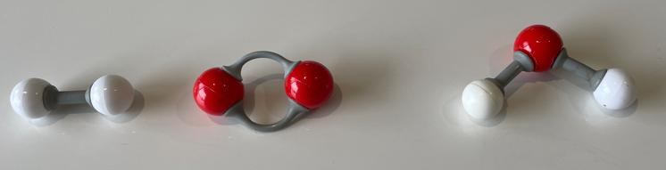
1.4 The need to balance (1 of 4)
Key
Oxygen atom
Hydrogen atom
H₂ + O₂ → H₂0
2 x H 2 x O ≠ 2 x H 1 x O
What happened to the oxygen atom?
Notes:
Teacher notes:
The law of conservation of matter states that matter cannot be created or destroyed in a chemical reaction.
Consider the reaction between hydrogen and oxygen to produce water.
On the left, we have a molecule of hydrogen gas that contains 2 atoms of hydrogen and a molecule of oxygen gas with 2 atoms of oxygen, but on the RHS, we have a water molecule with 2 H atoms and only one oxygen atom.
This does not align with the law of conservation of matter
An oxygen atom can’t just disappear, so we need to adjust the equation.

Slide 59
1.4 The need to balance (2 of 4)
Key
Oxygen atom
Hydrogen atom
H₂ + O₂ → H₂O
₂
Notes:
Teacher notes:
This slide has animations
It is tempting to do add a subscript to the oxygen atom to balance the number of oxygen atoms CLICK
But now we have changed water to hydrogen peroxide which is a different molecular compound.
Never add subscripts to balance the chemical equation.
CLICK
You can only balance an equation by adding coefficients in front of a chemical formula, because this multiplies the entire formula (all atoms in that substance) without changing what the substance is.

Slide 60
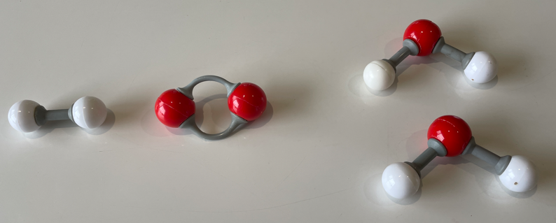
1.4 The need to balance (3 of 4)
Key
Oxygen atom
Hydrogen atom
H₂ + O₂ → 2H₂O
2 x H 2 x O ≠ 4 x H 2 x O
Notes:
Teacher notes:
So let’s add another water molecule to account for that oxygen atom.
Ok, now we have 2 oxygen atoms on both sides, but we have 2 extra hydrogen atoms on the right hand side.

Slide 61
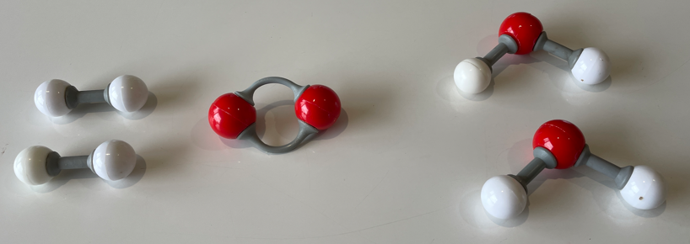
1.4 The need to balance (4 of 4)
Key
Oxygen atom
Hydrogen atom
2H₂ + O₂ → 2H₂0
4 x H 2 x O = 4 x H 2 x O
Notes:
Teacher notes:
To balance this, add another hydrogen molecule to the left-hand side
Quick check to see that everything balances.
LHS has 4 hydrogen atoms and 2 oxygen atoms, and the RHS has 4 hydrogen atoms and 2 oxygen atoms.
The chemical equation is now balanced!

Slide 62
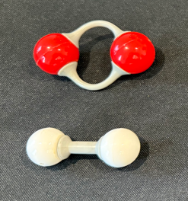
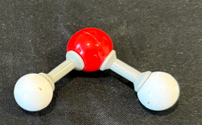

1.4 Molecular model activity (1 of 8)
Synthesis of water unbalanced
Key
Oxygen atom
Hydrogen atom
$$O_{2}+ H_{2 }→ H_{2}O$$
Notes:
Teacher notes:
This series of slides are to help support the students and provide the answers for the Molecular modelling activity.
This slide shows the unbalanced for synthesis of water

Slide 63
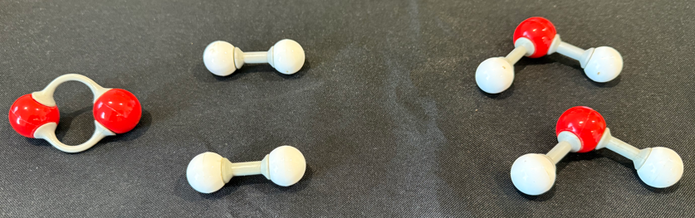


1.4 Molecular model activity (2 of 8)
Synthesis of water balanced
Key
Oxygen atom
Hydrogen atom
$$O_{2}+ {2H}_{2 }→ {2H}_{2}O$$
Notes:
Teacher notes:
This slide shows the balanced synthesis of water

Slide 64

1.4 Molecular model activity (3 of 8)
Decomposition of water unbalanced
Key
Oxygen atom
Hydrogen atom
$H_{2}O→ H_{2 }+ O_{2}$
Notes:
Teacher notes:
Unbalanced for decomposition of water

Slide 65
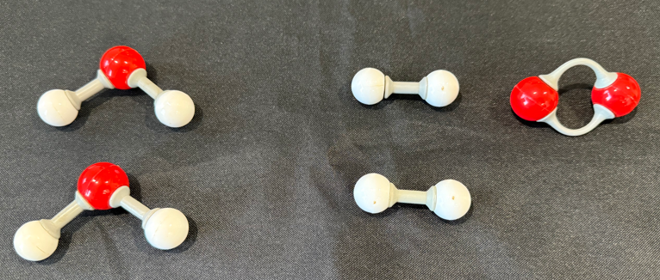

1.4 Molecular model activity (4 of 8)
Decomposition of water balanced
Key
Oxygen atom
Hydrogen atom
${2H}_{2}O→ {2H}_{2 }+ O_{2}$
Notes:
Teacher notes:
Balanced for decomposition of water
Remind students that:
1. The number of atoms in the reactant molecules equals the number of atoms in the product molecules.
2. The mass of the reactant molecules equals the mass of the product molecules (get students to weigh the molymod models

Slide 66
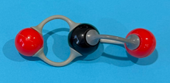
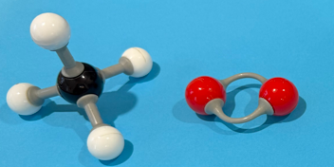
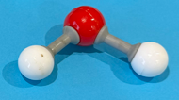

1.4 Molecular model activity (5 of 8)
Combustion of methane unbalanced
Key
Oxygen atom
Hydrogen atom
Carbon atom
${CH}_{4}+ O_{2}→ {CO}_{2 }+ H_{2}O$
Notes:
Teacher notes:
Unbalanced for combustion of methane

Slide 67
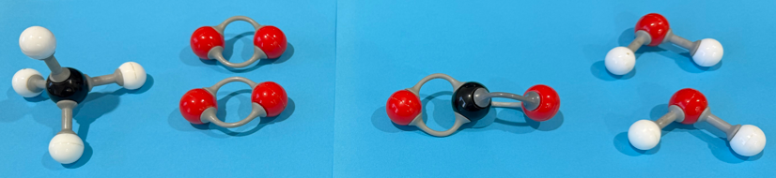

1.4 Molecular model activity (6 of 8)
Combustion of methane balanced
Key
Oxygen atom
Hydrogen atom
Carbon atom
${CH}_{4}+ {2O}^{2}→ {CO}_{2 }+ {2H}_{2}O$
Notes:
Teacher notes:
Balanced for combustion of methane
Remind students that:
1. The number of atoms in the reactant molecules equals the number of atoms in the product molecules.
2. The mass of the reactant molecules equals the mass of the product molecules (get students to weigh the molymod models

Slide 68
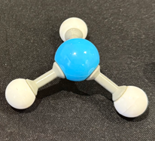
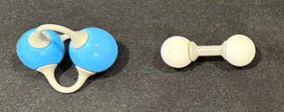

1.4 Molecular model activity (7 of 8)
Synthesis of ammonia unbalanced
Key
Nitrogen atom
Hydrogen atom
$$N_{3}+ H_{2}→ {NH}_{3}$$
Notes:
Teacher notes:
Unbalanced for synthesis of ammonia

Slide 69
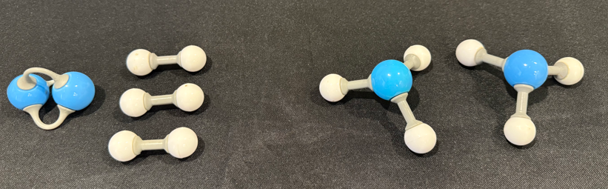

1.4 Molecular model activity (8 of 8)
Synthesis of ammonia balanced
Key
Nitrogen atom
Hydrogen atom
$$N_{2}+ {3H}_{2}→ {2NH}_{3}$$
Notes:
Teacher notes:
Balanced for synthesis of ammonia

Slide 70
1.4 Checkpoint 2
Decomposition of water – balance the equation
H₂O → O₂ + H₂
2H₂O → O₂ + 2H₂
Notes:
Teacher notes:
This slide has animations
Water can decompose into oxygen and hydrogen.
See if you can balance this equation
CLICK to reveal the answer

Slide 71
1.4 Balancing equations (1 of 7)
CaCO₃ → CaO + CO₂
calcium carbonate → calcium oxide + carbon dioxide
Ca = 1
C = 1
O = 3
Ca = 1
C = 1
O = 3
Notes:
Teacher notes:
This slide has animations
Count the number of each atom on either side of the equation.
Is it balanced?
CLICK
CLICK
yes

Slide 72
1.4 Balancing equations (2 of 7)
Al₂(CO₃)₃ → Al₂O₃ + CO₂
calcium carbonate → calcium oxide + carbon dioxide
Al = 2
C = 3
O = 9
Al = 2
C = 1
O = 5
Notes:
Teacher notes:
This slide has animations
Let’s look at one that is a bit trickier
Count up the number of each atom on either side
CLICK to bring up the reactants
CLICK to bring up the products
What can we do?
If we try to start balancing the Oxygen it becomes very difficult because it is in all species.
Start by balancing the Carbon.
If an element occurs in multiple species on either side of the equation, leave it till last.

Slide 73
1.4 Balancing equations (3 of 7)
Al₂(CO₃)₃ → Al₂O₃ + 3CO₂
calcium carbonate → calcium oxide + carbon dioxide
Al = 2
C = 3
O = 9
Al = 2
C = 3
O = 9
Notes:
Teacher notes:
This slide has animations
We need 2 more carbon, so let’s multiply the carbon dioxide by 3.
Now my aluminium and carbons are balanced, what about the oxygen?
How many O’s on RHS now? 9

Slide 74
1.4 Balancing equations (4 of 7)
1. Balance elements other than hydrogen and oxygen first.
2. Then balance hydrogen
3. Then balance oxygen last.
Notes:
Teacher notes:
To support students with balancing complex chemical equations, here is a handy tip.
Balance other elements (like carbon, metals or other elements) first, then hydrogen (H), and finally oxygen (O).
By leaving them until the end, you will often find that balancing the other, more complex molecules makes the H and O balance themselves.

Slide 75
1.4 Balancing equations (5 of 7)
H₂SO₄ + NaOH → Na₂SO₄ + H₂O
sulfuric acid + sodium hydroxide → sodium sulfate + water
Na = 1
S = 1
H = 3
O = 5
Na = 2
S = 1
H = 2
O = 5
Notes:
Teacher notes:
This slide has animations
Let’s look at the reaction between sulfuric acid and sodium hydroxide.
CLICK to bring up the count for the reactants
CLICK to bring up the count for the products
What do you suggest?
We need one more sodium, so let’s start there and double the number of NaOH.

Slide 76
1.4 Balancing equations (6 of 7)
H₂SO₄ + 2NaOH → Na₂SO₄ + H₂O
sulfuric acid + sodium hydroxide → sodium sulfate + water
Na = 2
S = 1
H = 4
O = 6
Na = 2
S = 1
H = 2
O = 5
Notes:
Teacher notes:
This slide has animations
CLICK to bring up the new values for reactants
CLICK to bring up the new values for the products
Now what do we do ?
Lets multiply our water by 2

Slide 77
1.4 Balancing equations (7 of 7)
H₂SO₄ + 2NaOH → Na₂SO₄ + 2H₂O
sulfuric acid + sodium hydroxide → sodium sulfate + water
Na = 2
S = 1
H = 4
O = 6
Na = 2
S = 1
H = 4
O = 6
Notes:
Teacher notes:
This slide has animations
Now, how does it look?
CLICK to bring up the new values for reactants
CLICK to bring up the new values for the products
Reinforce the importance of leaving H then O until last

Slide 78
1.4 Checkpoint 3
Balancing the following equation
HCl + Mg(OH)₂ → MgCl₂ + H₂O
hydrochloric acid + magnesium hydroxide → magnesium chloride + water
2HCl + Mg(OH)₂ → MgCl₂ + 2H₂O
Notes:
Teacher notes
This slide has animations
Check if students can balance this equation
CLICK for answer

Slide 79
1.5 Chemical reactions
Learning intentions and success criteria
We are learning: | I can:
to describe a range of chemical reactions | distinguish between synthesis, decomposition, displacement reactions write balanced equations including states for synthesis and decomposition reactions when given the reactants and products predict the products of and write word and balanced equations for displacement reactions.
to follow a planned procedure to undertake a safe investigation. | assemble and use identified equipment to conduct an investigation use appropriate personal protective equipment identify the steps to minimise or eliminate the risks.
Notes:
Teacher notes:
Display this slide at the beginning of the learning activity. Revisit the slide where appropriate during lesson activities and encourage students to reflect on their progress.

Slide 80
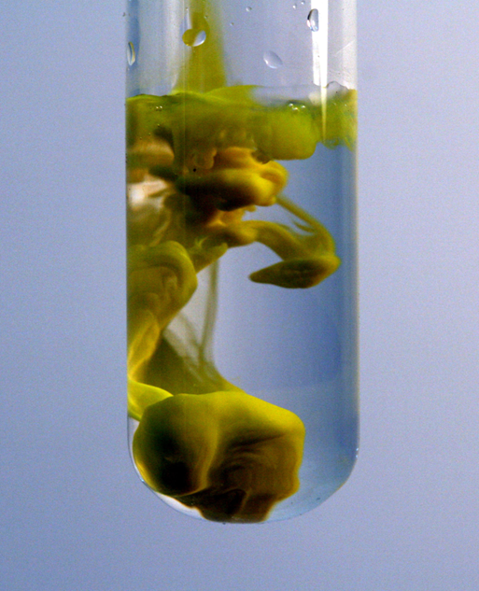
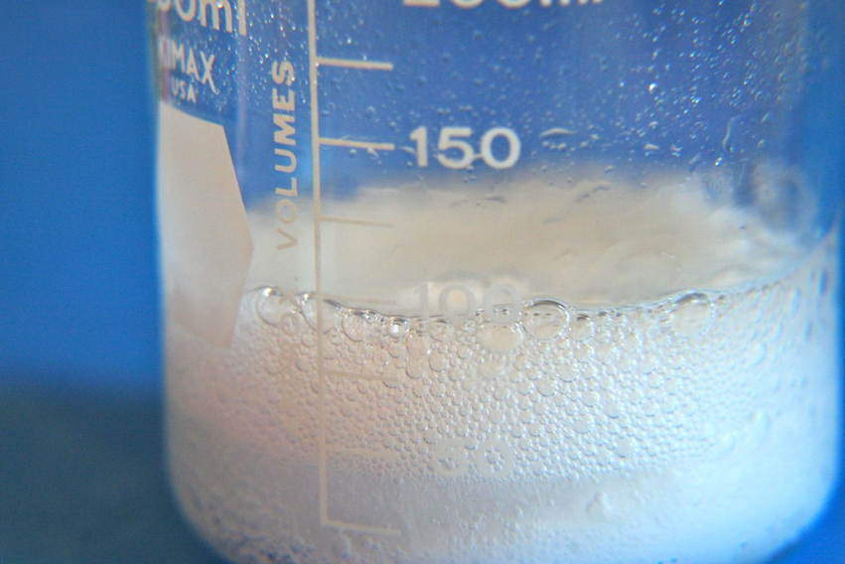
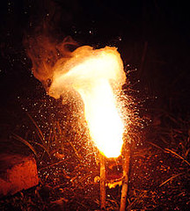
1.5 Checkpoint 1
Identify 2 indicators of a chemical reaction
Colour change
Bubbles of gas
Temperature change
"File:Lead (II) iodide precipitating out of solution.JPG" by PRHaney is licensed under CC BY-SA 3.0.
"Chemical Reaction" by katerha is licensed under CC BY 2.0.
"exothermic reaction" by Mr. Schwalen is licensed under CC BY-SA 2.0.
Notes:
Teacher notes:
This slide has animations
Ask students to identify 2 indicators of a chemical change
Click to bring up possible answers.

Slide 81
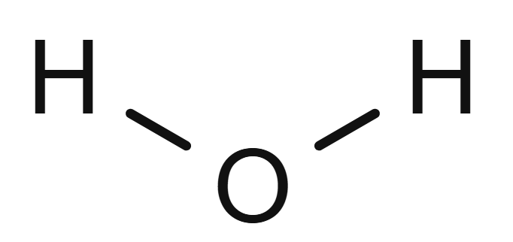
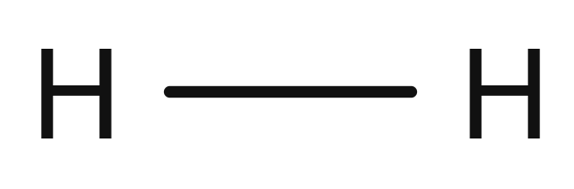




1.5 Synthesis of water
Notes:
Teacher notes:
If we remember back to the reaction between hydrogen and oxygen to form water.
Bonds were broken, atoms were rearranged, and new bonds were formed.
You broke 2 x H-H bonds and 1 x O=O bond, rearranged the atoms and formed 4 x H-O bonds to create 2 molecules of water

Slide 82
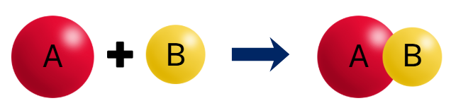
1.5 Synthesis reactions (1 of 2)
A reaction in which a more complex compound is produced from simpler substances.
Notes:
Teacher notes:
Define a synthesis reaction as one in which a more complex compound is produced from simpler substances.
Also referred to as a combination reaction

Slide 83
1.5 Synthesis reactions (2 of 2)
A reaction in which a more complex compound is produced from simpler substances 2H₂ + O₂ → 2H₂O
Hydrogen and oxygen combined to form a more complex compound, water.
Other examples include:
metal reacting with oxygen to form metal oxides 4Fe + 3O₂ → 2Fe₂O₃
oxygen reacting with non-metal elements N₂ + 2O₂ → 2NO₂ C + O₂ → CO₂
and photosynthesis 6CO₂ + 6H₂O → C₆H₁₂O₆ + 6O₂
Notes:
Teacher notes:
In the synthesis of water. The elements hydrogen and oxygen (simpler substances) combine to form water, which is a more complex substance.
Other examples of synthesis reactions include
CLICK
metal reacting with oxygen to form metal oxides 4Fe + 3O₂ → 2Fe₂O₃
CLICK
oxygen reacting with non-metal elements N₂ + 2O₂ → 2NO₂ C + O₂ → CO₂
CLICK
and photosynthesis 6CO₂ + 6H₂O → C₆H₁₂O₆ + 6O₂

Slide 84
1.5 States
Solid (s) Liquid (l) Gas (g) Aqueous (aq)
2Mg + O₂ → 2MgO
Substance | State at 25ºC | Symbol
Mg | solid | (s)
O₂ | gas | (g)
MgO | solid | (s)
Substance | State at 25ºC | Symbol
Mg
O₂
MgO
2Mg(s) + O₂(g) → 2MgO(s)
Notes:
Teacher notes:
This slide contains animations to reveal answers
Whether an element or compound is a solid, liquid, gas or in solution can significantly impact the way it behaves; therefore, it is important to denote what state they are in equations using the following symbols ‘s’ for a solid, ‘l’ for a liquid, ‘g’ for a gas and ‘aq’ for an aqueous solution. An aqueous solutions occurs when a substance is dissolved in water.
Ask students to identify the states of each component of the combustion of magnesium reaction.
CLICK to bring up the answers.
Mg solid, oxygen gas and MgO solid
Ask them to add the symbols to write a complete balanced equation for the reaction with states.
CLICK to reveal the balanced equation

Slide 85
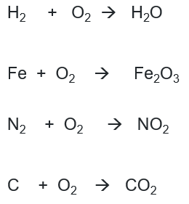
1.5 Balancing synthesis equations with states (1 of 2)
Substance | State at 25ºC
H₂ | g
O₂ | g
H₂0 | l
Fe | s
Fe₂O₃ | s
N₂ | g
NO₂ | g
C | s
CO₂ | g
Notes:
Teacher notes:
Discuss with the class that substances will have a particular state at a given temperature. The substances listed on the slide are either solid, liquid or a gas at 25 °C.
CLICK
Then ask students to balance these equations using the appropriate states from the student resource.
Answers are on the next slide

Slide 86
1.5 Balancing synthesis equations with states (2 of 2)
Substance | State at 25ºC
H₂ | g
O₂ | g
H₂0 | l
Fe | s
Fe₂O₃ | s
N₂ | g
NO₂ | g
C | s
CO₂ | g
2H₂(g) + O₂(g) → 2H₂O(l)
4Fe(s) + 3O₂(g) → 2Fe₂O₃(s)
N₂(g) + 2O₂(g) → 2NO₂(g)
C(s) + O₂(g) → CO₂(g)
Notes:
Teacher notes:
This slide contains the correct balanced equations with states.

Slide 87
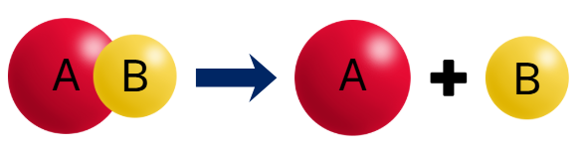
1.5 Decomposition reactions (1 of 2)
A chemical reaction in which a complex reactant (that consists of multiple components or molecules) breaks down into 2 or more simpler products.
Notes:
Teacher notes:
A chemical reaction in which a complex reactant (that consists of multiple components or molecules) breaks down into 2 or more simpler products.

Slide 88
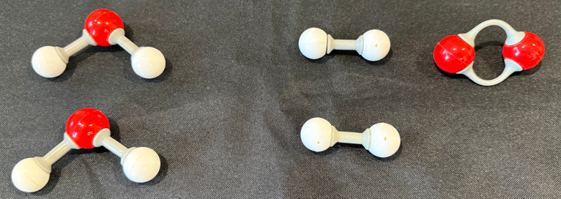
1.5 Decomposition of reactions (2 of 2)
Notes:
Teacher notes:
With the input of electrical energy, water can be decomposed into its constituent elements, hydrogen and oxygen.

Slide 89
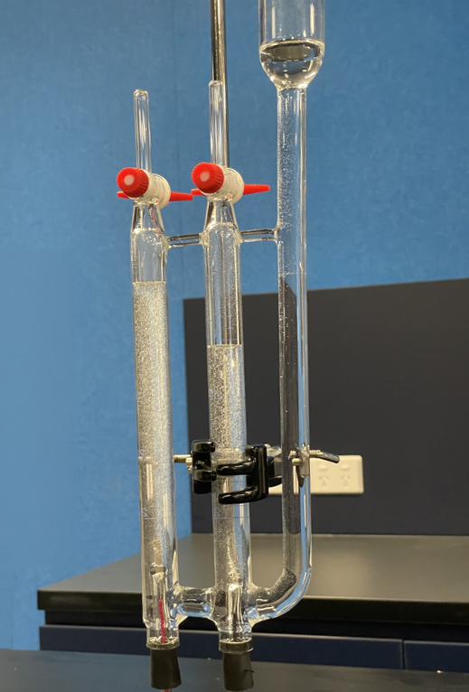
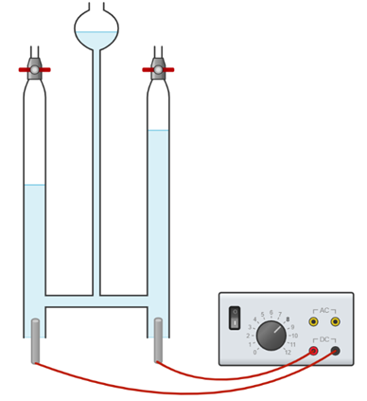
1.5 Decomposition of water
Acidified water
Hydrogen
Oxygen
Oxygen gas
Hydrogen gas
2H₂O(l) → 2H₂(g) + O₂(g)
+ -
electrodes
Notes:
Teacher notes:
This slide contains animations
This is an image of a Hoffman voltammeter.
It contains acidified (for conductivity) water and is connected to a DC power supply.
Electrical energy is being used to decompose the water into hydrogen and oxygen. As the gas forms it displaces the water from the columns, the amount of space above the water in each column represents the amount of gas being formed.
Ask students to suggest which gas is which and explain why. If needed, direct them to the coefficients in the equation
CLICK to reveal which gas is which

Slide 90
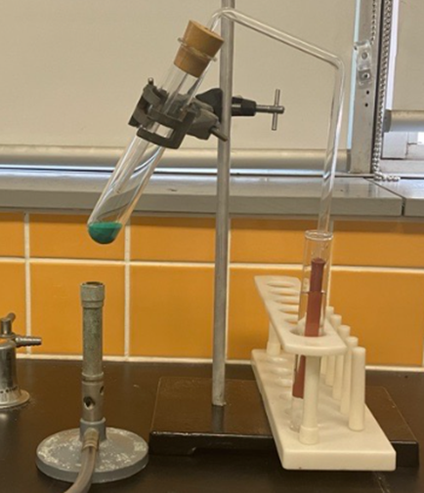
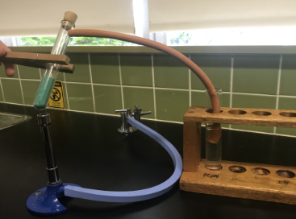
1.5 Decomposition of copper carbonate
Equipment setup – configuration 1
Equipment setup – configuration 2
Notes:
Teacher notes:
Select the appropriate image for the equipment you have available to demonstrate the setup for the decomposition of copper carbonate.
Take the opportunity to emphasise the need to separate the apparatus from the lime water by removing the tube or stopper (depending on the setup) before removing the heat

Slide 91
1.5 Energy and decomposition reactions
water 2H₂O(l) → 2H₂(g) + O₂(g)
hydrogen peroxide 2H₂O₂(l) → 2H₂O(l) + O₂(g)
sodium carbonate Na₂CO₃(s) → Na₂O(s) + CO₂(g)
calcium carbonate CaCO₃(s) → CaO(s) + CO₂(g)
silver chloride 2AgCl(s) → 2Ag(s) + Cl₂(g)
Electrical
Spontaneous but slow room temp
Heat
Heat
light
Notes:
Teacher notes:
This slide has animations
All theses reactions are decomposition reactions
Tell students that energy input is required for decomposition reactions. This energy input could be in any form such as heat energy, light energy or electrical energy. Energy is used in breaking the bonds in the reactants.
CLICK to show answers
Discuss that although hydrogen peroxide decomposes spontaneously at room temperature, it does involve a small amount of heat energy.
You may like to demonstrate the decomposition of AgCl. This is similar to the reaction that was used to expose old photographic film.
Before digital cameras, KODAK was one of the largest consumers of silver.

Slide 92
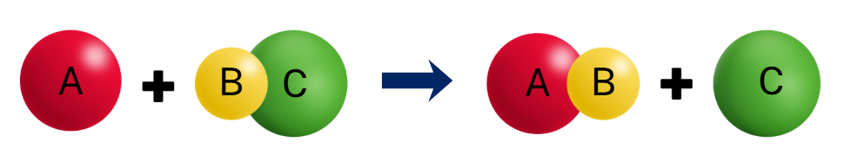
1.5 Displacement reactions
A chemical reaction in which one atom (or group of atoms) is replaced by another atom (or group of atoms) in a compound.
Notes:
Teacher notes:
A displacement reaction is a chemical reaction in which one atom (or group of atoms) is replaced by another atom (or group of atoms) in a compound.

Slide 93



1.5 Metal displacement
A more active metal will displace a less active metal from solution
Zinc is more reactive than copper, it displaces copper from copper sulfate (compound) solution.
Copper ions in the copper sulfate solution gain electrons from zinc, and are converted into neutral copper atoms, forming a brown solid on the surface.
After losing their valence electrons to copper, neutral zinc atoms become zinc ions, which dissolve in solution.
zinc(s) + copper sulfate(aq) → copper(s) + zinc sulfate(aq)
Zn(s) + CuSO₄(aq) → Cu(s) + ZnSO₄(aq)
Notes:
Teacher notes:
A more reactive metal will displace a less active metal from a solution.
Zinc is more reactive than copper, so when a solid piece of zinc is placed in a copper sulfate solution, the zinc displaces the copper ions from the solution.
Click
Copper ions in the copper sulfate solution gain electrons and are converted into neutral copper atoms, forming a brown solid on the surface.
Click
Point out to the Zinc strip in the
Neutral zinc atoms lose electrons and are converted into zinc ions, which dissolve into the solution.
Click
The word equation for this reaction is zinc(s) + copper sulfate(aq) → copper(s) + zinc sulfate(aq)
Click
The balanced chemical equation for this reaction is Zn(s) + CuSO₄(aq) → Cu(s) + ZnSO₄(aq)

Slide 94
1.5 Checkpoint 2
Metal displacement
Write the word equation to represent what happens when
steel wool (iron) displaces copper from a solution of copper (II) sulfate.
Iron(s) + copper (II) sulfate(aq) → copper(s) + iron (II) sulfate(aq)
Notes:
Teacher notes:
This slide has animations
Write the word equation for the reaction steel wool (iron) displaces copper from a solution of copper (II) sulfate
CLICK answer
At a minimum students should come up with iron + copper sulfate → iron sulfate + water.

Slide 95
1.5 Activity series of metals
Potassium
Sodium
Calcium
Magnesium
Aluminium
Zinc
Iron
Lead
Copper
Fe(s) + CuSO₄(aq) → FeSO₄(aq) + Cu(s)
iron(s) + copper(II) sulfate(aq) → iron (II) sulfate(aq) + copper(s)
Most reactive
Zn(s) + CuSO₄ → ZnSO₄(aq) + Cu(s)
zinc(s) + copper(II) sulfate(aq) → copper(s) + zinc(II) sulfate(aq)
copper(s) + iron(II) sulfate(aq) (NO REACTION)
Least reactive
Notes:
Teacher notes:
This slide contains animations to reveal answers
In our demonstration, we placed iron (Fe) in a solution of copper sulfate.
What is an activity series?
The activity series of metals ranks metals from most reactive to least reactive, based on how readily they lose their valence electrons in chemical reactions.
Metals higher up this series react readily with substances such as water, oxygen, and acids, while metals at the bottom are more stable and less likely to react.
The activity series helps us predict the products of chemical reactions, particularly displacement reactions, in which a more reactive metal can displace a less reactive metal from its compound.
As you have seen in the demonstration that when a piece of iron is placed in copper sulfate solution, brown precipitates of copper start appearing.
Why does iron displace copper ?
Iron displaces (pushes out) copper from its compound (copper sulfate solution) because it is more reactive than copper. This means it has higher tendency to lose electrons and covert to Fe2+ ion, which has stable noble gas configuration. Therefore, solid iron ionises to form iron ions which move into solution, while the displaced copper ions form solid copper which is deposited on the steel wool
What do you think will happen when zinc is placed in a solution of copper sulfate?
CLICK
zinc(s) + copper(II) sulfate(aq) → copper(s) + zinc(II) sulfate (aq) WHY? (Zinc is more reactive than copper)
Zinc will displace copper from its solution because Zinc is more reactive than copper.
What about if copper is added to iron sulfate?
CLICK: no reaction becauseaccording to the metal activity series, copper is less reactive than iron (copper is below iron).
To sum it up- The activity series is a list in which the metals are ranked form most reactive to least reactive, with the most reactive metals at the top and less reactive metals at the bottom.
It also helps explain real-world applications such as rusting and corrosion prevention, and why some metals like sodium calcium, magnesium, aluminium require more energy to extract from their ores as compared to the less reactive metals like copper or gold

Slide 96
1.5 Checkpoint 3
Activity series of metals
Select which of the following combinations would produce a reaction and complete the word equation.
magnesium(s) + sodium nitrate(aq) →
calcium(s) + magnesium nitrate(aq) →
Potassium
Sodium
Calcium
Magnesium
Aluminium
Zinc
Iron
Lead
Copper
Most reactive
calcium nitrate(aq) + magnesium(s)
Least reactive
Notes:
Teacher notes:
This slide has animations
Sodium is more reactive than magnesium; therefore will not be displaced.
Calcium is more reactive than magnesium, so the following reaction will occur:
calcium(s) + magnesium nitrate(aq) → calcium nitrate(aq) + magnesium(s)

Slide 97




1.5 Acid metal reactions
acid + metal → salt + hydrogen
A salt is an ionic compound that consist of cations and anions held together by an ionic bond. In these reactions they consist of the metal (magnesium) and the negative ion from the acid (chlorine)
hydrochloric acid + magnesium → magnesium chloride + hydrogen
2HCl(aq) + Mg(s) → MgCl₂(aq) + H₂(g)
Notes:
Teacher notes:
Acid - metal reactions are also called single displacement reactions.
In these reactions a metal atom replaces the hydrogen in the acid solution to produce hydrogen gas.
Click
The general equation for the reaction is acid + metal → salt + hydrogen gas
Click
A salt is an ionic compound that consist of cations and anions held together by an ionic bond.
Using this general equation, you can predict the products of the reaction
Click
For example, if hydrochloric acid reacts with magnesium metal,
Click
Magnesium displaces hydrogen from acid to produce salt (magnesium chloride) and hydrogen gas.
A salt is made up of:
a cation (positive ion), which comes from the metal
an anion (negative ion), which comes from the acid
The balanced chemical equation for this reaction is
Click
2HCl(aq) + Mg(s) → MgCl₂(aq) + H₂(g)

Slide 98
1.5 Common acids and the salts they produce
Acid name | Formula | Salt
hydrochloric | HCl | metal chloride
nitric | HNO₃ | metal nitrate
sulfuric | H₂SO₄ | metal sulfate
In a salt, the positive ion (cation) comes from the metal, and the negative ion (anion) from the acid.
hydrochloric acid + calcium → calcium chloride + hydrogen
nitric acid + calcium → calcium nitrate + hydrogen
sulfuric acid + calcium → calcium sulfate + hydrogen
sulfuric acid + sodium → sodium sulfate + hydrogen
Notes:
Teacher notes:
This slide has animations
This table shows the types of salts produced by the common acids we will be focusing on. Key: Red=metal, Blue=Salt, Green=hydrogen gas
Regardless of the acid used, hydrogen gas is always produced when a metal reacts with an acid. However, the salt formed will vary depending on the specific metal and acid involved.
In a salt, the positive ion (cation) comes from the metal, and the negative ion (anion) from the acid.
CLICK
hydrochloric acid + calcium → calcium chloride + hydrogen
The metal is calcium and the acid anion is chloride-salt is calcium chloride
CLICK
nitric acid + calcium→ calcium nitrate + hydrogen
CLICK
sulfuric acid + calcium → calcium sulfate + hydrogen
Click
sulfuric acid + sodium → sodium sulfate + hydrogen

Slide 99
1.5 Writing the balanced equation
Write the balanced equation for the reaction between hydrochloric acid and magnesium
Recall the general equation:
acid + metal → salt + hydrogen
2. Determine the salt produce by recalling the salts from table 1.
metal chloride
hydrochloric acid + magnesium → magnesium chloride + hydrogen
3. Write the word equation:
4. Work out the formula of each species
hydrochloric acid HCl (recall from Table 1)
magnesium Mg (symbol from periodic table)
magnesium chloride MgCl₂ (use valencies from periodic table or table xx for polyatomic ions)
hydrogen H₂ (remember it is diatomic)
5. Write down the symbols then balance 2HCl(aq) + Mg(s) → MgCl₂(aq) + H₂(g)
Notes:
Teacher notes:
This slide has animations to step students through the process and reveal answers as you go
When students are asked to produce a balanced equation from the names of the reactants, it can be quite overwhelming, so it is important to break it down step by step. The slide also shows where students need to access information from to address each component. When working through the slide, make sure students have access to a periodic table and the table mentioned in the notes.

Slide 100
1.6 The pH scale
Learning intentions and success criteria
We are learning: | I can:
to describe a range of chemical reactions | define acidic and basic substances define the pH scale classify common substances as acidic or basic based on their pH
to follow a planned procedure to undertake a safe investigation. | identify hazards, determine potential risks and relevant control measures follow steps in the procedure to systematically record pH and colour change data for a range of chemical substances.
Notes:
Teacher notes:
Display this slide at the beginning of the learning activity. Revisit the slide where appropriate during lesson activities and encourage students to reflect on their progress.

Slide 101



1.6 Acidity and basicity
An acid is a substance that produces hydrogen ions in aqueous solutions. For example, hydrochloric acid, which produces hydrogen ions in aqueous solutions.
A base is a substance that produces hydroxide ions in aqueous solutions.
OH⁻
Na⁺
NaOH
An aqueous solution means a solution in which water is the solvent.
NaOH
OH⁻
Na⁺
Notes:
Teacher notes:
This slide includes animations
Click. An acid is a substance that produces hydrogen ions in aqueous solutions.
Point out that the acids are covalent molecular substances, but they produce hydrogen ions in aqueous solutions, as illustrated by the model of HCl.
Click. A base is a substance that produces hydroxide ions in aqueous solutions
Highlight how bases are different, as illustrated by the NaOH lattice, which dissociates into the constituent ions- Na⁺ and OH⁻. Unlike acids that only produce ions when dissolved in water, most bases consist of ions even in the solid form, but the ions dissociate and are free to move around when dissolved in water (aqueous solution)
Recap what is meant by an aqueous solution
Click
Emphasise that the definitions of acids and bases — acids releasing hydrogen ions (H⁺) and bases releasing hydroxide ions (OH⁻) — are only valid when the substances are dissolved in water.

Slide 102

1.6 What is pH?
pH is a logarithmic scale used in science to show how many hydrogen ions are in a solution.
$pH$ = $−log10$($H^{+}$)
It shows the quantitative measure of acidity or basicity of aqueous or other liquid solutions.
The pH scale goes from 0 to 14
Notes:
Teacher notes:
pH is a logarithmic scale used in science to show how many hydrogen ions are in a solution.
$pH$ = $−log10$($H^{+}$)
It is a negative log of the hydrogen ion concentration
Note: this equation is beyond the scope of Stage 5.
It shows the quantitative measure (numerical value) of acidity or basicity of aqueous or other liquid solutions.
The pH scale goes from 0 to 14

Slide 103

1.6 Logarithmic scale versus a linear scale
pH cannot be measured on a linear scale, as it is not effective over more than one or two orders of magnitude.
A logarithmic scale converts these very large or very small numbers into a more manageable range.
Notes:
Teacher notes:
This slide includes animations
Why do we need to use a logarithmic scale instead of a linear scale?
Note: It is essential to explain the reasoning for using a logarithmic scale for recording pH as compared to a linear scale. This diagram can assist with demonstrating how a numerical data set with a large range can be effectively displayed using a logarithmic scale.
Click
Point to the linear scale- this scale is a linear scale, and it is going up by 1. For example, the gap between 10 and 100 includes the numbers 11-99,(numbers that are between these 2 numbers)
Point to the log scale- this scale is going up tenfold, for example, 10, 100, then 1000 and so on.
Click
Let us consider the linear scale: the fractions between 0 and 1 could be really small, such as 0.1 or 0.001, and so on.
Click
It is difficult to represent that on a linear scale,
Click
But the same fractions can be easily represented on a logarithmic scale.
Thus, in summary:
pH cannot be measured on a linear scale, as it is not effective over more than one or two orders of magnitude.
A logarithmic scale converts these very large or very small numbers into a more manageable range.
Click
pH cannot be measured on a linear scale as it will not be effective for more than one or two orders of magnitude.
A logarithmic scale converts these very large or very small numbers into a more manageable range.
The same data that is manageable on a logarithmic scale will be either clustered or spread out if represented on a linear scale.
Tell students how the data between 0 and 1 on a linear scale (in a black circle) is spread out on a logarithmic scale as shown with coloured lines.
If the concentration of hydrogen ions changes by a factor of 10 , such as from 10 to 100, the pH scale only changes by 1, that means from pH of 1 to pH of 2, so a large data range can fit on a logarithmic scale.

Slide 104

1.6 pH scale
A pH of 7 means the solution is neutral, like water
A pH less than 7 means the solution is acidic (like lemon juice).
A pH greater than 7 means the solution is basic or alkaline (like soap or baking soda)
The lower the pH, the more acidic it is; the higher the pH, the more basic it is.
Notes:
Teacher notes:
This slide includes animations
Tell students that the pH scale ranges from 1 to 14.
Click
A pH of 7 means the solution is neutral, like pure water
A pH less than 7 means the solution is acidic (like lemon juice).
A pH greater than 7 means the solution is basic or alkaline (like soap or baking soda)
The colours shown on the scale correspond to the universal indicator in different solutions.
For example, if a solution has a pH of 1, it will be red, which shows it is very acidic. As the pH increases, the solution becomes less acidic. The colour of the Universal indicator changes from red to orange.
The green colour of Universal indicator shows that the solution is neutral, such as pure water.
In basic solutions, the colour of the Universal indicator changes from light purple (slightly basic) to dark purple and then blue, which indicates the solution is highly basic
To extend students, you can relate the pH to the concentration of hydrogen ions

Slide 105


1.6 How can we measure pH?
pH meter provides a precise numerical reading of how acidic or basic a solution is.
Universal indicator changes colour depending on the pH, which can be compared to a colour chart. It provides an estimated pH.
Acidic
Neutral
Basic
"Science daily #11: Thing I'm in charge for." by Sergei Golyshev (AFK during workdays) is licensed under CC BY-SA 2.0.
Notes:
Teacher notes:
This slide includes animations
Click. There are various methods to measure pH, such as a digital pH meter, which provides readings to at least 2 decimal places. As seen in the picture, the reading for the solution is 5.87. It is suitable for applications where small differences matter. To get accurate readings (that is, readings close to the actual value), it must be calibrated before use.
Click. On the other hand, a universal indicator gives a colour range based on the approximate pH. It is easy to use but less precise because two solutions with slightly different pH might appear the same colour. For example, pH 6.8 and 7.2 might appear the same colour (green) on the Universal Indicator card.

Slide 106


1.6 pH simulation (1 of 4)
1. Click on pH scale. This will open the PhET simulation.
2.Click on ‘Macro’
Simulation by PhET Interactive Simulations, University of Colorado Boulder, licensed under CC-BY-4.0
Notes:
Teacher notes:
This slide includes animations
Click
Click on the pH scale. This will open the PhET simulation.
Click
Click on the yellow-highlighted box labelled Macro

Slide 107

1.6 pH simulation (2 of 4)
3. Click on the drop-down box to display the test items.
Simulation by PhET Interactive Simulations, University of Colorado Boulder, licensed under CC-BY-4.0
Notes:
Teacher notes:
This slide includes animations
Click
Click on the drop-down box to display the test items.
Click
Show students how expanding the drop-down box shows all the substances in the list

Slide 108

1.6 pH simulation (3 of 4)
4. Immerse pH probe in each substance and record the pH.
pH probe
Simulation by PhET Interactive Simulations, University of Colorado Boulder, licensed under CC-BY-4.0
Notes:
Teacher notes:
This slide includes animations
Click
Show students how dragging the pH probe and immersing it in each substance displays the pH of that substance

Slide 109

1.6 pH simulation (4 of 4)
5. Classify the substance as acidic basic or neutral based on the pH.
pH probe
Simulation by PhET Interactive Simulations, University of Colorado Boulder, licensed under CC-BY-4.0
Notes:
Teacher notes:
This slide includes animations
Go through this step with students
Click
Classify the substance as acidic, basic or neutral based on the pH.
Click
Explain that a substance with pH=7, like water, is neutral. To extend students further, you may delve into the conceptual underpinnings, such as “because the concentrations of hydrogen ions and hydroxide ions are equal in water”.
Reiterate that if a substance has A pH less than 7 means the solution is acidic, whereas a pH greater than 7 means the solution is basic or alkaline.
Point to the pH scale and explain
The colour intensity on the pH scale in this simulation is analogous to the extent of a substance’s acidity or basicity. For example,
If the substance is neutral, the pH lies in the middle, and the colour is white
If the substance is acidic, the pH will lie between 0 and 7. The extent of acidity is shown by the red colour intensity on the pH scale in this simulation. For example, if the pH is close to 7, say between 5 and 6, the colour is light red, the substance is mildly acidic,
Click
whereas, if it is closer to 0, say between 1 and 2, the colour is dark red, then it is very acidic.
Click
whereas, if it is closer to 14, say between 12 and 13, the colour is dark blue, then it is very basic.

Slide 110
1.6 Checkpoint
The pH scale
Refer to the pH values given in the table below and choose the correct option.
Vinegar is more acidic than lemon juice because its higher pH means a more acidic solution
Baking soda is slightly acidic because its pH is higher than that of water
Lemon juice is similar to vinegar in acidity, as their pH values are not significantly different
Baking soda is slightly basic because its pH is higher than that of water
Substance | pH
Pure water | 7.0
Vinegar | 3.0
Baking soda | 9.0
Lemon juice | 2.0
Oven cleaner | 12.0
Notes:
Teacher notes:
Display the question and the stimulus. Students can answer the question on a mini whiteboard or in their books.
A Incorrect. Vinegar has a higher pH (3) than lemon juice (2), which means it is less acidic
B Incorrect. Baking soda is basic, not acidic, because its pH value is higher than that of pure water
C Incorrect. Lemon juice is more acidic than vinegar because the pH scale is a logarithmic scale, which means that although the pH of lemon juice differs by one, the concentration of hydrogen ions is 10 times higher in lemon juice than in vinegar.
D Correct. Baking soda is slightly basic because its pH is higher (9) than water’s (7), but it is not very high, such as 13 or 14.

Slide 111
1.7 pH changes in a neutralisation reaction (1 of 2)
Learning intentions and success criteria
We are learning: | I can:
to describe a range of chemical reactions | define neutralisation reactions predict the products of a neutralisation reaction describe the changes in pH in neutralisation reactions
to use the right tools to make accurate observations and measurements | use digital tools to measure the pH of different chemical substances compare how precise the digital and visual methods are in measuring pH
Notes:
Teacher notes:
Display this slide at the beginning of the learning activity. Revisit the slide where appropriate during lesson activities and encourage students to reflect on their progress.

Slide 112
1.7 pH changes in a neutralisation reaction (2 of 2)
Learning intentions and success criteria
We are learning: | I can:
to follow a planned procedure to undertake a valid investigation. | use a pH meter to accurately and correctly record pH data use universal indicator to estimate the pH of a given solution identify errors in the investigation procedure and use of tools such as a pH meter that can impact the results.
Notes:
Teacher notes:
Display this slide at the beginning of the learning activity. Revisit the slide where appropriate during lesson activities and encourage students to reflect on their progress.

Slide 113

1.7 Neutralisation reactions (1 of 2)
A neutralisation reaction is a type of chemical reaction in which an acid reacts with a base to produce a salt and water.
For example, an acid, such as hydrochloric acid, reacts with a base, such as sodium hydroxide, to produce a salt (ionic compound) and water.
General equation: acid + base → salt + water
OH⁻
H₂O
Hydrogen ions from an acid combine with hydroxide ions from a base to form water.
Notes:
Teacher notes:
This slide includes animations
A neutralisation reaction is a type of chemical reaction in which an acid reacts with a base to produce a salt and water.
Click. Explain the general equation that acid and a base react to produce salt and water.
Click. Highlight that regardless of the acid or base, neutralisation reaction involves the reaction between the hydrogen ions of the acid and hydroxide ions of the base to form water.

Slide 114
1.7 Neutralisation reactions 2 of 2
Predicting products
A salt is an ionic compound that consist of cations and anions held together by an ionic bond.
To predict the salt formed in a neutralisation reaction:
Identify the anion in the acid to predict the anion in the salt.
Acid | cation | Anion
hydrochloric acid | hydrogen (H⁺) | chloride (Cl⁻)
sulfuric acid | hydrogen (H⁺) | sulfate (SO₄²⁻)
nitric acid | hydrogen (H⁺) | nitrate (NO₃⁻)
The name of the salt is
formed by:
metal cation +
anion from the acid
Identify the cation in the base to predict the cation in the salt.
Base | cation | Anion
sodium hydroxide | sodium (Na⁺) | hydroxide (OH⁻)
potassium hydroxide | Potassium (K⁺) | hydroxide (OH⁻)
Salt formed by the reaction of hydrochloric acid and sodium hydroxide is sodium chloride
Notes:
Teacher notes:
Tell students that salt is an ionic compound that consists of cations and anions held together by an ionic bond.
Click
Identify the anion in the acid to predict the anion in the salt.
Click
Every acid has hydrogen ion as the cation (refer to the definition of an acid)
Identify the anion in the acid
Click
For example: hydrochloric acid has chloride as the anion, sulfuric acid has sulfate anion, and nitric acid has nitrate anion.
Click
Identify the cation in the base to predict the anion in the salt.
Click
Identify the cation (metal ion) in the base
Click(for example: sodium hydroxide → sodium, calcium hydroxide → calcium, potassium hydroxide → potassium).
Click
Combine the cation from the base with the anion from the acid to name the salt.
Example: hydrochloric acid + sodium hydroxide → sodium chloride.
Check that your salt name follows the pattern:
metal + ion from the acid

Slide 115
1.7 Checkpoint
Predicting products
Acid | Base | Salt | Chemical formula of the salt
hydrochloric acid | sodium hydroxide
sulfuric acid | sodium hydroxide
nitric acid | potassium hydroxide
hydrochloric acid | calcium hydroxide
Notes:
Teacher notes:
Display this slide and ask students:
to predict the salt formed for each set of acid and base
and write the chemical formula of the predicted salt.

Slide 116
1.7 Checkpoint – sample answer
Predicting products
Acid | Base | Salt | Chemical formula of the salt
hydrochloric acid | sodium hydroxide | sodium chloride | NaCl
sulfuric acid | sodium hydroxide | sodium sulfate | Na₂SO₄
nitric acid | potassium hydroxide | potassium nitrate | KNO₃
hydrochloric acid | calcium hydroxide | calcium chloride | CaCl₂
Notes:
Teacher notes:
Neutralisation reactions – sample answer
1.
Look at the name of the acid - hydrochloric acid
Look at the name of the base - sodium hydroxide
Identify the metal ion or positive ion in the base – sodium
Identify the anion (negative ion in the acid) - chloride
Combine the metal ion from the base with the negative ion (anion) from the acid to name the salt.- sodium chloride
2.
Look at the name of the acid - sulfuric acid
Look at the name of the base - sodium hydroxide
Identify the metal ion or positive ion in the base – sodium
Identify the anion (negative ion in the acid) – sulfate
Combine the metal ion from the base with the negative ion (anion) from the acid to name the salt.- sodium sulfate
3.
Look at the name of the acid- nitric acid
Look at the name of the base - potassium hydroxide
Identify the metal ion or positive ion in the base – potassium
Identify the anion (negative ion in the acid) - nitrate
Combine the metal ion from the base with the negative ion (anion) from the acid to name the salt.- potassium nitrate
4.
Look at the name of the acid- hydrochloric acid
Look at the name of the base - calcium hydroxide
Identify the metal ion or positive ion in the base – calcium
Identify the anion (negative ion in the acid) - chloride
Combine the metal ion from the base with the negative ion (anion) from the acid to name the salt.- calcium chloride

Slide 117


1.7 Neutralisation reaction examples (1 of 2)
Everyday applications
Some soils are naturally acidic, which can prevent plants from absorbing essential nutrients. Adding lime (calcium carbonate) or other bases to acidic soil neutralises the acidity, creating better conditions for crop growth.
Indigestion or heartburn, caused by excess stomach acid (hydrochloric acid), is treated with antacids, which are mild bases such as magnesium hydroxide or calcium carbonate, to neutralise the acid.
‘’Alka-Seltzer dissolving progression 3 - sinking 2.png” by Mysterymanblue under the Creative Commons Attribution 4.0 International license.
“Testing_soil_pH.jpg”.by CSIRO under Creative Commons Attribution 3.0 Unported license.
Notes:
Teacher notes:
This slide includes animations
Everyday applications
Click. Indigestion or heartburn, caused by excess stomach acid (hydrochloric acid), is treated with antacids, which are mild bases such as magnesium hydroxide or calcium carbonate, to neutralise the acid.
Click. Some soils are naturally acidic, which can prevent plants from absorbing essential nutrients. Adding lime (calcium carbonate) or other bases to acidic soil neutralises the acidity, creating better conditions for crop growth.

Slide 118


1.7 Neutralisation reaction examples (2 of 2)
Everyday applications
Acidic or basic waste produced by industries must be neutralised before being released into the environment to prevent damage to ecosystems.
Toothpaste is slightly basic and helps neutralise acids in the mouth produced by bacteria, preventing tooth decay.
Water testing contaminated water from lake.jpg by Environment Protection Authority Victoria under the Creative Commons Attribution 4.0 International license.
“Toothbrush, Toothpaste, Dental Care” by Steve Buissinne, South Africa under the Creative Commons CC0 1.0 Universal Public Domain Dedication.
Notes:
Teacher notes:
Click
Acidic or basic waste produced by industries must be neutralised before being released into the environment to prevent damage to ecosystems.
Click
Toothpaste is slightly basic and helps neutralise acids in the mouth produced by bacteria, preventing tooth decay.

Slide 119

1.7 Equipment set up for a neutralisation reaction
Equipment set up
This work has been generated using Chemix.
Notes:
Teacher notes:
This slide shows the equipment set up for the investigation.
The picture shows a pH of 1.00 for a 0.1 M HCl solution, which is the theoretical value. If the HCl solution is not freshly prepared, the pH reading may differ slightly because the acid solution consists of hydrogen chloride gas dissolved in water, and the gas can escape, thus diluting the solution. There may be other factors, such as evaporation, which may change the pH.
It is essential to calibrate the pH meter beforehand to eliminate errors in the pH readings.

Slide 120
Essential question 2
Content in this section aligns with essential question ‘How can you manipulate the rate of reaction?’ in the program of learning and Teacher resource book 2

Slide 121
2.1 Rate of reaction
Learning intentions and success criteria
We are learning: | I can:
to describe the factors that affect the rate of chemical reactions. | define the rate of reaction identify the factors that affect the rate of reaction describe how each factor affects the rate of a reaction define collision theory use collision theory to explain how each factor affects the rate of a reaction.
Notes:
Teacher notes:
Display this slide at the beginning of the learning activity. Revisit the slide where appropriate during lesson activities and encourage students to reflect on their progress.

Slide 122
2.1 Checkpoint 1
Check for prior learning
Which statement best describes what happens during a chemical reaction at the particle level?
New atoms are created to form products, but the total number of atoms remains the same.
Atoms in the reactants are rearranged to form products, but the total number of atoms remains the same.
Some atoms in the reactant are destroyed, and some new atoms are created to form products, but the total mass remains the same.

Slide 123

2.1 Introduction to rate of reaction
Real world example
Dough rises because of a chemical reaction which produces carbon dioxide gas.
The reaction happens faster when the dough is warm – causing it to rise quicker.
Notes:
Teacher notes:
Bread dough rises because of a chemical reaction carried out by yeast. The yeast breaks down sugars in the dough. This produces carbon dioxide gas and ethanol. The carbon dioxide gas gets trapped in the dough, forming bubbles and the dough expands or rises over time.
The rate of reaction is how fast the carbon dioxide is produced. You may have noticed if you have made your own bread or pizza dough that it can take longer for the dough to rise if it is too cold. This is why we try and sit it in a warm place to speed up the rate of chemical reaction.

Slide 124
2.1 Frayer diagram – rate of reaction
Definition
Rate of reaction refers to the speed at which a reaction proceeds. It is a measure of the change in the quantity of reactants or products over time.
Facts/Characteristics
Different reactions occur at different speeds.
Factors, such as temperature, concentration, surface area and catalyst can affect the rate of reaction.
Rate of reaction
Qualitative description
Fast reaction – reactants are used up or products are formed in a short period of time, such as explosions or fireworks.
Slow reaction – reactants are used up or products are formed in a long period of time, such as the rusting of iron.
Quantitative description
Average rate method – how long it takes for a reaction to go to completion or for a specific amount of product to be formed.
Continuous-rate method – amount of product formed at regular intervals, for example, amount of gas produced every 10 seconds.
Notes:
Teacher notes:
This slide includes animations
Click
Definition: It refers to the speed at which a reaction proceeds (takes place). That means how fast the reactants are used up or products are formed. It is a measure of the change in the quantity of reactants or products over time. You can measure the rate of reaction by monitoring the change in the concentration of reactants or products over time.
Click
Facts/Characteristics
Different reactions occur at different speeds. That means some reactions are slow (it takes a long time for the formation of product/s – may be several hours), and some reactions are fast (may take only a few minutes or seconds)
Factors such as temperature, concentration, surface area, and catalyst can affect the rate of reaction. That means we can manipulate the rate of reaction by altering factors such as temperature (heating or cooling the reaction mixture instead of conducting the reaction at room temperature) and concentration (increasing or decreasing the concentration of reactants).
Click
Qualitative description
We can use qualitative observations to describe reaction rate such as fast and slow
Click
Quantitatve description
We can collect quantitative data on the amount of product formed at completion, or over a particular timeframe (interval) to determine reaction rate.

Slide 125
2.1 Johnstone’s triangle
Macroscopic
(what we see)
Symbolic
(representations)
Sub microscopic
(what we cannot see)
Notes:
Teacher notes:
Explain to students that the chemical reactions can be represented at 3 levels:
Macroscopic (what we see during experiments): observations that we make, such as a change in colour, formation of bubbles, fizzing, change in temperature.
Sub-microscopic (what we cannot see): we try to understand what is happening at the particle level by using models, such as pictures or 2D models, and 3D models, such as ball-and-stick models.
Symbolic (representations): such as graphs to show trends and patterns, chemical equations.
Understanding chemical reactions requires knowing what happens at the particle level.
We will be referring to ‘what is happening at the particle level’ throughout this section.

Slide 126

2.1 Collision theory and reactions video
Collision Theory & Reactions Part 1 (2:28)
Notes:
Teacher notes:
Closed captions and transcript are available for this video.
This video outlines the features of collision theory using models for atoms/molecules
Watch the video Collision theory part 1.

Slide 127
2.1 Collision theory (1 of 3)
Chemical reactions
In a chemical reaction, reactant particles collide with one another.
For particles to react and form a product, they must collide with enough kinetic energy (KE).
Particles with insufficient energy do not form a product.
Notes:
Teacher notes:
This slide contains animations.
Explain to students what happens at the particle level in a chemical reaction.
Click
The collision theory states that for a chemical reaction to occur, the reactant particles must collide.
In a chemical reaction, reactant particles collide with one another.
Click
For particles to react and form a product, they must collide with enough kinetic energy (KE)
Click
Particles with insufficient energy do not form a product

Slide 128




2.1 Collision theory (2 of 3)
Successful collisions
Reactants
Product
hydrogen gas
iodine
hydrogen iodide
Bonds break in the reactant molecules
Atoms rearrange and form new bonds to make product molecules
The collision is successful
Reactant particles collide with sufficient KE
Notes:
Teacher notes:
Explain to students what happens at the particle level in a chemical reaction.
Step 1 shows that reactant particles (hydrogen gas molecules and iodine molecules) are moving randomly.
Step 2 highlights that only collisions with sufficient energy
are effective.
Bonds break in the reactant molecules
Atoms rearrange and form new bonds to make product molecules
The collision is successful
Step 3 shows that new bonds form and products are created. Not all collisions result in a reaction — only successful, high-energy collisions do.
When reactant particles collide with sufficient kinetic energy, the collision is successful resulting in the formation of a product.

Slide 129

2.1 Collision theory (3 of 3)
Unsuccessful collisions
Reactants
Products are not formed
hydrogen gas
iodine
Bonds do not break in the reactant molecules
The reactant particles move away from each other after colliding
The collision is unsuccessful
Reactant particles do not collide with sufficient KE
Notes:
Teacher notes:
Explain to students what happens at the particle level in a chemical reaction.
Step 1 shows that reactant particles (hydrogen gas molecules and iodine molecules) are moving randomly.
Step 2 models a collision without sufficient energy
As a result,
Bonds do not break in the reactant molecules
The reactant particles move away from each other after colliding
The collision is unsuccessful
Step 3
No new substance is formed (products)

Slide 130
2.1 Collision theory and rate of reaction
The rate of a chemical reaction is a measure of how fast a reaction proceeds. The greater the number of successful collisions per unit of time, the faster the rate of reaction
Energy is needed to break the chemical bonds in the reactants.
The minimum amount of energy required for particles to react is called activation energy. For example, striking a match provides the required activation energy to light the match (a chemical reaction).
Notes:
Teacher notes:
The rate of reaction is linked to the collisions between particles. More successful collisions mean a higher reaction rate, and vice versa.
Energy is required to break the bonds in reactants. If there is not enough energy to break the bonds, the number of successful collisions per unit time (frequency) will be low, resulting in a low reaction rate.
The activation energy is the minimum amount of energy required for particles to react.
If particles do not have sufficient energy (energy is lower than the activation energy), the reaction does not take place
This energy varies for different types of chemical substances. Some reactions have very low activation energy, whereas some have quite high activation energy. This could be in different forms as well. For example, striking a match provides the required activation energy to light it.

Slide 131
2.1 Collision theory – extension (1 of 3)
Chemical reactions
In a chemical reaction, reactant particles collide with one another.
For particles to react and form a product, they must collide with:
  enough kinetic energy (KE)
  correct orientation
Particles with insufficient energy and incorrect orientation do not form a product.
Notes:
Teacher notes:
The collision theory – extension slides include orientation of the collision. If you choose to go to this depth with students they may be unhidden and delivered to the class.
Explain to students what happens at the particle level in a chemical reaction.
The collision theory states that for a chemical reaction to occur, the reactant particles must collide.
In a chemical reaction, reactant particles collide with one another.
For particles to react and form a product, they must collide with enough kinetic energy (KE) and the correct orientation. That means when reactant particles collide with sufficient kinetic energy and correct orientation, it results in a successful collision, resulting in the formation of a product
Particles with insufficient energy do not form a product. That means that if the reactant particles do not have enough energy or do not collide with the correct orientation, the collision is unsuccessful and the reactant particles do not form a product.

Slide 132

2.1 Collision theory – extension (2 of 3)
Successful collisions
Reactants
Product
hydrogen gas
iodine
hydrogen iodide
AND
Bonds break in the reactant molecules
Atoms rearrange and form new bonds to make product molecules
The collision is successful
Reactant particles collide with sufficient KE
Reactant particles collide with correct orientation
Notes:
Teacher notes:
The collision theory – extension slides include orientation of the collision. If you choose to go to this depth with students they may be unhidden and delivered to the class.
Explain to students what happens at the particle level in a chemical reaction.
Step 1 shows that the reactant particles are hydrogen gas molecules and iodine molecules. These particles move randomly and collide with other reactant particles
Step 2 highlights that only collisions with sufficient energy and
are effective.
Bonds break in the reactant molecules
Atoms rearrange and form new bonds to make product molecules
The collision is successful
Step 3 shows that new bonds form and products are created. Not all collisions result in a reaction — only successful, high-energy collisions where reactant particles have the correct orientation do.
When reactant particles collide with sufficient kinetic energy and correct orientation, the collision is successful, resulting in the formation of a product.

Slide 133

2.1 Collision theory – extension (3 of 3)
Unsuccessful collisions
Reactants
Products are not formed
hydrogen gas
iodine
Bonds do not break in the reactant molecules
The reactant particles move away from each other after colliding
The collision is unsuccessful
AND/OR
Reactant particles do not collide with sufficient KE
Reactant particles do not collide with correct orientation
Notes:
Teacher notes:
The collision theory – extension slides include orientation of the collision. If you choose to go to this depth with students they may be unhidden and delivered to the class.
Explain to students what happens at the particle level in a chemical reaction.
Step 1 shows that reactant particles (hydrogen gas molecules and iodine molecules)
Step 2 models a collision without sufficient energy or incorrect orientation
As a result,
Bonds do not break in the reactant molecules
The reactant particles move away from each other after colliding
The collision is unsuccessful
Step 3
No new substance is formed (products)

Slide 134

2.1 Factors that affect the rate of reaction video
Factors that affect Rate of Reaction (3:06)
Notes:
Teacher notes:
Closed captions and a transcript are available for this video.
This video outlines the factors affecting the rates of reactions using models for atoms/molecules
Watch the video Collision theory part 1 (00:03:06).
Skip the part of the video on inhibitors (00:02:12 to 00:02:40) as this is beyond the scope of the Stage 5 syllabus.

Slide 135



2.1 Factors affecting the rate of reaction (1 of 5)
Temperature
Concentration
Surface area
Catalyst
Notes:
Teacher notes:
Use this slide to unpack the factors which affect reaction rate.
Identify the four factors affecting the rate of reaction:
Temperature – an increase in temperature increases the rate of reaction
Concentration – an increase in concentration increases the rate of reaction.
Surface area – an increase in surface are increases the rate of reaction. In the image the single cube on the left has less surface area than the 4 small cubes.
Catalyst – A catalyst is a substance that speeds up a chemical reaction without being consumed or permanently changed in the process.

Slide 136


2.1 Factors affecting the rate of reaction (2 of 5)
Temperature
Low temperature
High temperature
At low temperatures, the reaction rate is slow because
particles have low kinetic energy,
fewer successful collisions
At higher temperatures, the reaction rate is higher because
particles have more kinetic energy,
more successful collisions
Notes:
Teacher notes:
Let’s look at left hand side, which shows particles with low kinetic energy. These particles move slowly, so collisions occur less frequently and with less energy, resulting in fewer successful collisions. This results in a slower reaction rate.
The right-hand side shows what happens as the temperature increases. This means particles gain kinetic energy, and they move faster. Although collisions will occur more frequently, they also occur with higher average energy, so a larger proportion are successful.

Slide 137


2.1 Factors affecting the rate of reaction (3 of 5)
Concentration
Low concentration
High concentration
The rate of reaction is low when the concentration of reactant/s is low because
fewer particles
less frequent collisions
fewer chances of successful collisions to form product/s.
The rate of reaction increases with increased concentration of reactant/s because
more particles involved
more frequent collisions
higher chances of successful collisions to form product/s.
Notes:
Teacher notes:
Let’s look at left hand side, which models a low concentration of reactant particles. As there are fewer particles in the same volume, collisions occur less frequently. With fewer collisions, fewer successful collisions overcome the activation energy, resulting in a slower reaction rate.
Now look at the right-hand side, which shows a high concentration of particles. As there are more particles in the same volume, collisions occur more frequently. This increases the number of collisions with enough energy to overcome the activation energy, leading to more successful collisions per second and therefore a faster rate of reaction.”

Slide 138


2.1 Factors affecting the rate of reaction (4 of 5)
Surface area
Low surface area
High Surface area
The rate of reaction is low when the surface area is low, such as lumps of reactants, because:
fewer particles involved
less frequent collisions
fewer chances of successful collisions to form product/s.
The rate of reaction increases with increased surface area of solid reactants, such as powdered because
more particles involved
more frequent collisions
higher chances of successful collisions to form product/s.
Notes:
Teacher notes:
Let’s look at left hand side, which shows a solid reactant with low surface area. Only the particles on the surface are available to collide with other reactant particles, so there are fewer collision sites. This results in fewer effective collisions and a slower rate of reaction.
Now let’s look at the right-hand side, which shows a solid reactant with high surface area (smaller pieces or powder). Explain that breaking the solid into smaller pieces increases the exposed surface area, creating more collision sites. This allows more frequent collisions, more particles to overcome the activation energy, and therefore a faster reaction rate.
To understand this, you can show a lump of Play-Doh and then cut it into smaller pieces to show how smaller pieces have more surface area for interaction as compared to a bigger lump.

Slide 139

2.1 Factors affecting the rate of reaction (5 of 5)
Catalyst
Catalysed reaction
A catalyst speeds up the reaction by lowering the activation energy, so a greater fraction of reactant particles can form products.
A catalyst
is not consumed in the reaction
appears unchanged
Enzymes are biological catalysts that catalyse many reactions in the body.
Notes:
Teacher notes:
A catalyst speeds up the reaction by lowering the activation energy, so a greater fraction of reactant particles can form products. It is not consumed in the reaction or appears unchanged.
Enzymes are biological catalysts that catalyse many reactions in the body. For example, enzymes in the stomach help the process of digestion.
A catalyst will not form more product if the amount of reactants is kept the same, but the product will be formed in lesser time.

Slide 140
2.1 Factors affecting the rate of reaction (sample answer)
Factor | Impact on the rate of reaction | Describe what is happening at the particle level
Temperature | The rate of reaction increases when temperature is high and slows when temperature is lower. | At higher temperatures, particles have more kinetic energy, so they move faster and collide more often.
Concentration | A higher concentration of reactant(s) increases the rate of reaction. | A higher reactant concentration results in more particles per unit volume, increasing the frequency of collisions and, in turn, the number of successful collisions per second.
Surface area | The higher the surface area of a reactant exposed then the greater the rate of reaction. | A larger exposed surface allows more reactant particles to collide with the solid's surface, increasing the frequency of successful collisions.
Catalyst | A catalyst speeds up the reaction by lowering the activation energy, so a greater fraction of reactant particles can form products. | More collisions succeed without increasing temperature or concentration when a catalyst is present.
Notes:
Teacher notes:
Go through each factor step by step and support students in refining their summary of each factor.

Slide 141
2.1 Checkpoint 2
Rate of reaction
Which of the following explanations about reaction rates is correct?
Adding a catalyst provides more energy to the reactant particles, making them move faster.
Increasing the concentration means more reactant particles, leading to more energetic collisions.
Increasing the temperature makes particles move faster and collide with more energy, increasing the number of successful collisions.
Using smaller pieces of solid reactants decreases the surface area, allowing particles to collide more easily.

Slide 142
2.2 Investigating the rate of reaction (1 of 2)
Learning intentions and success criteria
We are learning: | I can:
to explain the factors that affect the rate of chemical reactions. | identify ways to calculate the rate of reaction qualitatively and quantitatively describe the rate of reaction.
plan a valid and reliable investigation | identify the types of data that can be collected to measure the products of a chemical reaction identify features in a method that help to ensure the collected data is reliable identify risks that need to be controlled in an investigation identify ways to modify an investigation to improve the reliability or validity
Notes:
Teacher notes:
Display this slide at the beginning of the learning activity. Revisit the slide where appropriate during lesson activities and encourage students to reflect on their progress.

Slide 143
2.2 Investigating the rate of reaction (2 of 2)
Learning intentions and success criteria
We are learning: | I can:
to follow a planned procedure to conduct a safe and valid investigation. | assemble and manipulate equipment to conduct the experiment follow a procedure to conduct an experiment implement safe work practices to manage risks
to process and represent data. | tabulate collected data graph experiment data using an appropriate graph
to analyse data from investigations to identify trends and draw conclusions. | assess the validity of an investigation assess the reliability of an investigation describe the rate of reaction from the graphed data determine the rate of reaction from the graphed data.
Notes:
Teacher notes:
Display this slide at the beginning of the learning activity. Revisit the slide where appropriate during lesson activities and encourage students to reflect on their progress.

Slide 144
2.2 Investigating the rate of reaction
Qualitative and quantitative observations
Reaction between acid and metal, such as magnesium and hydrochloric acid produces hydrogen gas.
magnesium + hydrochloric acid → hydrogen gas + magnesium chloride solution
Qualitative observations
What will you see when magnesium reacts with hydrochloric acid?
bubbles due to hydrogen gas
magnesium ribbon decreases in size
magnesium ribbon disappears (completely reacted)
Quantitative observations
What can you measure to determine the rate of reaction?
change in mass of magnesium ribbon
volume of gas produced every 10 seconds till it becomes constant
total volume of gas produced when magnesium has completely reacted ( disappears)
time taken for magnesium to react completely
Notes:
Teacher notes:
This slide includes animations.
Tell students that when we do an investigation into reaction rate we need to collect data that can represent the reaction rate.
Ask students to recall the reaction between a metal and an acid that they covered in earlier lessons.
Ask them to give an example of this type of reaction and to identify the products.
A reaction between an acid and a metal, such as magnesium and hydrochloric acid, produces hydrogen gas.
What will we see when magnesium reacts with hydrochloric acid?
Click to bring up qualitative observations
bubbles due to hydrogen gas.
The magnesium ribbon decreases in size.
Magnesium ribbon disappears (completely reacted). Emphasise that it may appear that it is dissolving in the acid, but it is reacting with the acid, which is a chemical reaction, whereas dissolving is a physical change. That means you cannot recover magnesium by simply heating up the solutions, as it has converted into a compound- magnesium chloride.
Click to bring up Quantitative observations
What can you measure to determine the rate of reaction?
The change in mass of the magnesium ribbon. Tell students that it is not a practical option.
volume of gas produced every 10 seconds till it becomes constant. Possible option.
The total volume of gas produced when magnesium has completely reacted. Possible option.
time taken for magnesium to react completely. Possible option.
Relate the observations that can be made, to how we can then calculate the reaction rate.

Slide 145




2.2 Determining the rate of reaction (1 of 3)
Mean rate method
Mean rate of reaction method
$$rate of reaction \text{=} \frac{∆ in amount of reactant or product}{∆time}$$
Example 1: In a reaction between magnesium and hydrochloric acid 48 mL of gas is produced in 17 seconds. What is the mean rate of reaction at completion?
Example 2: In the same investigation, at 10 seconds, 42 mL of gas was produced. Calculate the rate of reaction between 10 seconds and 17 seconds.
$$rate of reaction \text{=} \frac{(48−0)}{(17−0)}$$
$$rate of reaction \text{=} \frac{(48−42)}{(17−10)}$$
$$rate of reaction \text{=}\text{ 2.82 }\text{mL}\text{/}\text{s}$$
$$rate of reaction \text{=}\text{ 0.85 }\text{mL}\text{/}\text{s}$$
Notes:
Teacher notes
This slide includes animations.
When we can measure the change in amount of reactants or products we can calculate the mean rate of reaction.
The mean rate of reaction is calculated by finding the change in amount of a reactant or a product and dividing it by the change in time.
CLICK to bring up a worked example calculating the mean reaction rate from start to completion of reaction .
In this example we are calculating the mean rate of reaction over the
CLICK to bring up a worked example for calculating the mean reaction rate over a particular time interval in a reaction.

Slide 146



2.2 Determining the rate of reaction (2 of 3)
Instantaneous rate method
Amount of product
Instantaneous rate is the rate of reaction at a specific point in time.
The curve shows how the total amount of product changes over time.
The tangent is a straight line that just touches the curve at one point.
The slope (gradient) of the tangent represents the rate of reaction at that specific time.
tangent at t₁
$∆$(product)
$∆$(time)
t₁
Time
$$instantaneous rate of reaction reaction \text{=} \frac{∆ reactant or product}{∆time}$$
Notes:
Teacher notes
When we have data about the amount of reactant or product plotted over time on a graph we can calculate the rate of reaction at a specific instant of time. As we can see on the graph the amount of product produced over time slowed down towards the completion of the reaction. The mean rate of reaction does not tell us the rate of reaction at t1… but we can calculate it using a tangent.
A tangent is a straight line that just touches the curve of the graph at one point. We can calculate the gradient of this line using ∆reactant or product / ∆time (∆ is the symbol delta and means ‘change in’).

Slide 147



2.2 Determining the rate of reaction (3 of 3)
Relative rate of reaction
Relative rate of reaction can be used when we cannot measure the change in amount of a reactant or product (such as the volume of gas produced in a reaction).
Relative rate of reaction can be used when:
time taken to reach a set endpoint is measured
the amount of product formed or reactant consumed is consistent
$$relati\text{ve} \text{rate} \text{of} \text{reaction} α \frac{1}{time}$$
*$α$stands for ‘is proportional to’
Sodium thiosulfate reacts with hydrochloric acid to form sulfur, which makes the mixture cloudy. You time how long it takes until you cannot see a black cross under the flask. At 20 °C it took 45 seconds and at
40 °C it took 21 seconds. Calculate the relative rate of reaction for each trial.
$relati\text{ve} \text{rate} \text{of} \text{reaction} \text{at}\text{ 20 }°C α \frac{1}{45}$ = 0.02 s⁻¹
$relati\text{ve} \text{rate} \text{of} \text{reaction} \text{at}\text{ 40 }°C α \frac{1}{21}$ = 0.05 s⁻¹
Notes:
Teacher notes
This slide includes animations.
The rate of a chemical reaction is usually calculated as the amount of reactants consumed per unit time, or the amount of product formed per unit time. If the amounts of reactants consumed or products formed cannot be easily measured, the reciprocal of the time taken for the reaction to complete ($\frac{1}{time}$) can be used to determine reaction rates.
The key principle behind using the relative rate of reaction is that, at the measured time, a consistent amount of product has been formed, or a consistent amount of reactant has been used up.
In a reaction between sodium thiosulfate and hydrochloric acid a transparent solution (like the one on the right) will turn opaque (like the image on the left)once a certain amount of product is formed. The sulfur produced in the reaction forms a cloudy yellow white precipitate and provides a way we can measure the reaction rate. To do this we would need to measure the time from the start of the reaction until the X disappears indicating a specific amount of the sulfur product has been formed. We can then use the equation 1/time to calculate the relative rate of reaction.
CLICK to bring up a scenario and demonstrate how relative rate of reaction can be calculated.

Slide 148
2.2 Risk assessment
Hazard | Risk | Controls/precautions
Equipment, chemicals | What harm they may cause? | How can you minimise the risk?
Notes:
Teacher notes:
Recall the meanings of
Hazard: means a situation or thing that has the potential to harm a person. Such as equipment or chemicals
Risk is the possibility that harm (death, injury or illness) might occur when exposed to a hazard.
Controls/precautions are an action to eliminate health and safety risk so far as is reasonably practicable, and if that is not possible, minimising the risks so far as is reasonably practicable.
Discuss the hazards, the associated risks and the relevant control measures

Slide 149





2.2 Chemical safety
Information for Magnesium
Information for hydrochloric acid
Hazard pictogram
Hazard pictogram
Hazard statement
Hazard statement
Precautionary statement
Precautionary statement
Notes:
Teacher notes:
This slide includes animations.
You will see information about the chemicals – hydrochloric acid and magnesium that you will be using in this experiment.
This information is obtained from the safety data sheet, which has important safety information about the hazardous chemicals. Each chemical has a separate SDS that includes the relevant safety information that is used to develop the risk assessment.
Let’s look at the safety information on Magnesium
This is the hazard pictogram, which communicates the visual warning for the chemicals.
What do you notice about the symbol? Response – flame symbol with a red border
Based on the picture, what could be the dangers associated with the use of this? Response- it’s flammable, which means it can easily catch fire.
What precautions will you take to handle this chemical safely? Response- keep it away from flames.
This is the hazard statement, which describes the specific danger associated with a chemical. Unlike pictograms (which are visual warnings), hazard statements are short written descriptions that explain the exact risk.
What does this hazard statement tell you could happen? Response- It can catch fire, it also causes eye irritation
This is the precautionary statement, which is a short instruction that tells you what you must do to stay safe when using a chemical.
What are these precaution statements telling you to do?
Response
Keep away from heat, water/moisture.
Avoid contact with skin and eyes.
Wear protective gear such as safety glasses.
Click to brin up the information for hydrochloric acid
This is the hazard pictogram, which communicates the visual warning for the chemicals.
What do you notice about the symbol? Response – Two test tubes are pouring liquid on a bench and onto a hand. It has a red border
Based on the picture, what could be the dangers associated with the use of this chemical? Response- The liquid is shown burning a solid surface and a hand.
What precautions will you take to handle this chemical safely? Response- keep it away from flames.
This is the hazard statement, which describes the specific danger associated with a chemical. Unlike pictograms (which are visual warnings), hazard statements are short written descriptions that explain the exact risk.
What does this hazard statement tell you could happen? Response- It can catch fire, and it also causes eye irritation
This is the precautionary statement, which is a short instruction that tells you what you must do to stay safe when using a chemical.
What are these precaution statements telling you to do?
Response
Keep away from heat, water/moisture.
Avoid contact with skin and eyes.
Wear protective gear such as safety glasses.

Slide 150

2.2 How to develop a risk assessment?
Equipment
Consider the equipment and materials that you will use in the investigation
Identify the potential hazards
Outline the risks related to those hazards
Outline the precautions/control measures
Notes:
Teacher notes:
Give students a moment to look at the equipment on the screen.
Consider the equipment that you will use in the investigation, such as glass equipment like test tubes, measuring cylinders
Identify the potential hazards- What could cause harm – for example, glass equipment can break, water spillage, trip hazards such as bags on the floor.
Outline the risks related to those hazards- such as glass equipment that can break, resulting in cuts from broken glass, falls due to water spillage and trip hazards such as bags and furniture.
Outline the precautions/control measures: use standard handling procedures. Sweep up broken glass with a dustpan and a broom; do not use fingers to clean it up. Clean water spillage appropriately ( either using a paper towel or a mop. Keep the lab bench clear of bags and furniture

Slide 151
2.2 Sample risk assessment
Hazard | Risk | Controls/precautions
Magnesium ribbon (flammable solid) | Sharp edges may cause cuts. Damage to retina due to bright light when burnt. Burns. | Handle carefully Keep away from heat, hot surfaces, sparks,
Hydrochloric acid (corrosive) | Splashing chemicals in eyes or on skin will cause irritation | Wear safety glasses throughout the experiment. Wear enclosed leather footwear. Wash splashes off the skin immediately with cool water.
Broken glassware | Cuts from chipped glassware | Inspect and discard broken glassware. Sweep up broken glass with a dustpan and a brush; do not use fingers to clean it up.
Water spills, chairs | Slips, trips and falls. | Spills are to be cleaned immediately. No running in the lab.
Notes:
Teacher notes:
Recall the meanings of
hazard: a situation or thing that has the potential to harm a person.
Risk is the possibility that harm (death, injury or illness) might occur when exposed to a hazard.
Controls/precautions means taking action to eliminate health and safety risks so far as is reasonably practicable, and if that is not possible, minimising the risks so far as is reasonably practicable.
Discuss the hazards, the associated risks and the relevant control measures
Explain the meaning of Hazard pictograms
The flame symbol means the hazardous substance is flammable (that means it can easily catch fire), self-heating, and emits flammable gas
The corrosion symbol means the hazardous substance can cause eye damage, skin corrosion /burns, and it is corrosive to metals.

Slide 152

2.2 Equipment set-up
Note: Remove any air bubbles to avoid errors in the measurement of gas volume
Image created using Chemix
Notes:
Teacher notes:
Display this slide for students when setting up the equipment for collecting gas by displacement method

Slide 153



2.2 Practical tips for setting up the equipment
Ensure the test tube is tightly sealed with a stopper
Bubbles of gas
Secure the measuring cylinder using a retort stand and clamp
Ensure the graduated scale is visible and easy to read
Secure the mouth of the measuring cylinder using plasticine to avoid any leakage
Notes:
Teacher notes:
Practical tips for setting up the equipment
Secure the measuring cylinder using a retort stand and clamp; otherwise, it will be difficult to keep it stable in one place.
Secure the mouth of the measuring cylinder with blue tac or plasticine to prevent gas leakage; this will affect the collected data (random error).
Ensure the graduated scale is visible and easy to read. Check this before you start the timer.
As soon as you drop the piece of magnesium into the acid, you will see bubbles of gas rise into the measuring cylinder and displace water. If this is not observed, there may be a leak either at the mouth of the measuring cylinder where the rubber tubing is inserted or from a loose test tube stopper.

Slide 154

2.2 Equipment set-up – integrated instruction
  1. Fill a trough with water.
  2. Invert a water filled measuring cylinder in the trough and clamp it.
  3. Fill a test tube with 10mL HCl and insert the rubber tubing under water.
  4. Add a 3cm piece of magnesium ribbon to the test tube, stopper and start the timer.
  Repeat steps 2–4 three times.
  T1, T2 and T3 refer to the trial numbers.
T1 T2 T3
□ □ □
T1 T2 T3
□ □ □
4
2
T1 T2 T3
□ □ □
3
1
Image created using Chemix
Notes:
Integrated instruction:
Integrated instructions reduce extraneous load on learners, increasing the capacity of their working memory to think about what they are doing and why.
Copy the picture of this slide and include it in the student resource to support EAL/D students

Slide 155

2.2 Measuring the gas volume
Keep the inverted measuring cylinder steady in the water trough.
When the gas starts collecting, bring your eyes level with the water surface in the measuring cylinder to avoid parallax error.
Read the scale at the bottom of the water meniscus (the curved surface).
That number on the scale is the volume of gas collected, because it equals the volume of water displaced.
Notes:
Teacher notes:
Let’s look at the steps for measuring the gas volume.
Keep the inverted measuring cylinder steady in the water trough.
When the gas starts collecting, bring your eyes level with the water surface in the measuring cylinder to avoid parallax error.
Read the scale at the bottom of the water meniscus (the curved surface).
That number on the scale is the volume of gas collected, because it equals the volume of water displaced.

Slide 156

2.2 Checkpoint
Measuring the gas volume
Read the scale showing the water level in each measuring cylinder to determine the volume of gas collected.
A = ______mL
B = ______mL
C = ______mL
D = ______mL
A
B
C
D

Slide 157
2.2 Checkpoint sample answer
Measuring the gas volume
Read the scale showing the water level in each measuring cylinder to determine the volume of gas collected.
A = 60 mL
B = 45 mL
C = 66 mL
D = 31 mL
A
B
C
D

Slide 158
2.2 Results table
The table is numbered for easy reference.
The label is positioned above the table.
A descriptive title.
The table is enclosed and has ruled sides.
A column spanner to group the trials. It contains the heading and, where applicable, the units for the dependent variable.
Table# : Title
Independent variable (units) | Dependent variable (units)
 | Trial 1 | Trial 2 | Trial 3 | Mean
Column heading for independent variable, including units where required
The first column contains the independent variable.
Only the data is recorded in the cells. Units should only be written in column headings.
Notes:
Teacher notes:
CLICK
This is a sample of what the table might look like for an investigation on metal and acid. This is one of the investigations in the ‘Reactions’ resource package.
You may use this slide to consolidate or further student understanding of the required components of a quality table.
This slide is animated to allow the teacher to unpack each component.
This slide shows only a section of the table, but the actual table will have more rows to record data for up to 120 seconds.
CLICK through the animations

Slide 159
2.2 Results table model
The table is numbered for easy reference.
The label is positioned above the table.
A descriptive title.
The table is enclosed and has ruled sides.
A column spanner to group the trials. It contains the heading and units where applicable for the dependent variable.
Table 1 - volume of gas collected over time for the reaction between Mg and HCl
Time (seconds) | Volume of hydrogen gas produced (mL)
 | Trial 1 | Trial 2 | Trial 3 | Mean
0
20
40
60
80
Column heading for independent variable, including units where required
The first column contains the independent variable.
Only the data is recorded in the cells. Units should only be written in column headings.
Notes:
Teacher notes:
CLICK
This is a sample of what the table might look like for an investigation on metal and acid. This is one of the investigations in the ‘Reactions’ resource package.
You may use this slide to consolidate or further student understanding of the required components of a quality table.
This slide is animated to allow the teacher to unpack each component.
This slide only shows a section of the table, but the actual table will have more rows to allow for recording data up to 120 seconds
CLICK through the animations

Slide 160

2.2 Graph scaffold (1 of 3)
title
dependent variable (unit)
______________
________________________
independent variable (unit)
Notes:
Teacher notes:
This is graph scaffold 1 of 3 levels of scaffolding for constructing a line graph.
This is the least scaffolded grid paper.
If students in your class require a scaffold, select the most appropriate scaffold that supports their learning needs.
There is no requirement to use all scaffolds.

Slide 161
2.2 Graph scaffold (2 of 3)
Volume of hydrogen produced over time
volume of hydrogen gas (ml)
__________________
_____________________
time (seconds)
Notes:
Teacher notes:
This is graph scaffold 1 of 3 levels of scaffolding for constructing a line graph.
This is the more scaffolded than the previous one.
If students in your class require a scaffold, select the most appropriate scaffold that supports their learning needs.
There is no requirement to use all scaffolds.

Slide 162

2.2 Graph scaffold (3 of 3)
Volume of hydrogen produced over time
volume of hydrogen gas (mL)
__________
0 20 40 60 80 100 120
______________________________ time(seconds)
Notes:
Teacher notes:
This is graph scaffold 1 of 3 levels of scaffolding for constructing a line graph.
This is the most scaffolded grid paper.
If students in your class require a scaffold, select the most appropriate scaffold that supports their learning needs. There is no requirement to use all scaffolds.

Slide 163
2.2 Quality criteria for a graph
An appropriate graph is selected for the type of data collected
A title that reflects the independent and dependent variables
The title is written above the graph
The x-axis is labelled with the independent variable, including units (where appropriate)
The y-axis is labelled with the dependent variable, including units (where appropriate)
An appropriate scale for both axes (the graph takes up most of the grid paper)
Mean data from the table is accurately plotted
Includes the source of data written under the graph
Drawn with a pencil and ruler (when hand-drawn)
Notes:
Teacher notes:
This is essentially a self-assessment tool for students to use when plotting their graphs
It can either be projected on the board for students to see or printed out.
The quality criteria can also be used as a peer feedback tool for students.

Slide 164
2.2 Validity checklist
Rate of reaction
Were all factors (such as temperature, acid concentration, amount of acid and magnesium) the same for all trials?
Did you measure the length of the magnesium ribbon accurately?
Was the equipment set up to collect gas?
Was the apparatus checked for leaks and air bubbles before starting?
Were the time intervals consistent for recording gas volume?
Was the gas volume measured accurately, using appropriate equipment?
Were there any unusual results (outliers)?
Any suggestions for improving the method?
Notes:
Teacher notes:
This is essentially a self-assessment tool for students to use when assessing the validity of their investigation
It can either be projected on the board for students to see or printed out.
The quality criteria can also be used as a peer feedback tool for students

Slide 165
2.2 Reliability checklist
Was the experiment repeated under the same conditions?
Were the results consistent across the repeated trials (small range or standard deviation)?
Were your results within the same range as the rest of the class?
Notes:
Teacher notes:
This is essentially a self-assessment tool for students to use when assessing the reliability of their investigation
It can either be projected on the board for students to see or printed out.
The quality criteria can also be used as a peer feedback tool for students

Slide 166
2.2 CER Scaffold
Claim – state an answer to the question/prompt.
Is the investigation valid?
Is the investigation reliable?
Evidence – provide information, such as facts and stimulus data from the experiment, that supports the claim.
Reasoning – explain how the evidence supports the claim.
Helpful hints – use keywords and ideas from the question as you write your claim.
Sentence starters
The data shows …
One piece of evidence is …
Sentence starters
The evidence supports the claim because …
Based on this evidence, it can be concluded that …
Notes:
Teacher notes:
Claim-evidence-reasoning is a powerful scaffold for constructing scientific explanations and argumentation.
A claim is an answer to the question/prompt. The questions are: Is the investigation valid? Is the investigation reliable?
Evidence – provide information such as facts, stimulus data from an experiment or a reliable resource that supports the claim. Refer back to the validity checklist and see what evidence you have to support your claim- valid/invalid.
Reasoning – explain/links how the evidence supports the claim. Use reasoning such as: "The experiment is valid because….“
https://app.education.nsw.gov.au/digital-learning-selector/LearningActivity/Card/664?clearCache=856048f9-2f25-4953-ca1b-b27b8097a901

Slide 167

2.2 Analysing graph – qualitative analysis
At the beginning the curve is steeper showing a larger volume of gas produced in lesser time, indicating a higher rate of reaction
Over time, the curve becomes less steep, showing the rate of reaction has dropped.
Towards the end, in the last 20 seconds the curve plateaus, indicating the reaction has stopped.
Notes:
Speaker notes:
Qualitative analysis:
The slope is steeper at the beginning (0-40 seconds), indicating a higher rate.
As the reactants are used up, the slope becomes less steep (40-80 seconds), indicating that the rate of reaction slows.
Towards the last 40 seconds (80-120), the graph plateaus as magnesium is used up and the volume of hydrogen gas becomes constant.

Slide 168


2.2 Analysing graph – quantitative analysis (1 of 2)
Mean rate of reaction for complete reaction
Total volume of gas produced = 50 mL
Time for the reaction= 110 seconds
$Mean rate of reaction$=$\frac{volume of gas produced}{time in seconds}$
= $\frac{50}{110}$ = 0.45 mL/second
Notes:
Teacher notes:
CLICK to show the amount of gas produced at the completion of the reaction
We can see on the graph that 50 mL of hydrogen gas was produced in the reaction.
CLICK to show when the reactions completed.
The reaction was completed at 110 seconds. We can see this because the line is completely flat and no more hydrogen is being produced.
CLICK to bring up the equation for calculating the mean rate of reaction
CLICK to bring up the calculations.
Students can then apply this method to their own graph of data to calculate the mean reaction rate.

Slide 169

2.2 Analysing graph – quantitative analysis (2 of 2)
Mean rate of reaction at different intervals of time
Find T₁ and T₂ on the graph
Find V₁ and V₂ on the graph
Mean rate of reaction = $\frac{T2 −T1}{V2 −V1}$-
For 20–40 seconds
mean rate of reaction = $\frac{28−14}{40 − 20}$ = 0.7 mL/second
For 60–80 seconds
mean rate of reaction = $\frac{46 − 38}{80 − 60}$
= 0.4 mL/second
Notes:
Teacher notes:
This slide contains animations
We can use the slope of the graph to calculate the mean rate of reaction at different intervals. For example, we can calculate the rate of reaction between 20 seconds and 40 seconds.
CLICK to show how to find 20 seconds and 40 seconds on the graph
To find the volume of gas that was produced at 20 and 40 seconds we read the Y axis.
CLICK to show how to find volume of gas at 20 and 40 seconds.
Now we can put this information into the equation to calculate the mean reaction rate over the 20-40 second interval.
Click to bring up the equation
Click to bring up the worked calculations for 20-40 second time interval.
CLICK to bring up the worked calculations for the 60-80 second time interval.
Reiterate how the qualitative observations of the slope of the graph are supported by the quantitative data collected in these calculations. The earlier time interval shows a greater rate of reaction to the later interval.

Slide 170


2.2 Analysing graph – instantaneous rate of reaction
Extension activity
Rate of reaction at 40 seconds
$$instantaneous rate of reaction \text{= }\frac{∆ reactant or product}{∆time}$$
= $\frac{41−17}{60−20}$
= $\frac{24}{40}$
=0.6 mL/second
41mL
(41-17) mL
17 mL
(60-20)s
Notes:
Teacher notes:
Quantitative analysis:
Skip this slide unless you choose to provide an extension of the learning to calculate the instantaneous rate of reaction using a tangent.
The instantaneous rate of reaction is the rate at a specific moment in time during a reaction. Unlike average rate (which looks at a time interval), instantaneous rate tells us how fast the reaction is going at one exact point on the graph.
Choose the time on the curve where you want to know the rate (for example, at 40 seconds).
CLICK to bring up a line at 40 seconds
This point represents the state of the reaction at that moment.
CLICK to draw a tangent to determine the rate of reaction at 40 seconds.
Draw a straight line that just touches the curve at that point. The tangent should follow the direction of the curve at that point. It must not cut through the curve – it only touches it at one point. This line shows the rate of change at that instant.
CLICK to bring up the equation
CLICK to bring up dotted lines to highlight clear points on the tangent
Pick two points far apart on the tangent line (not just near the touching point).This improves accuracy when calculating the gradient.
CLICK to bring up the worked example
Students can now have a go at calculating the instantaneous speed using their own data.

Slide 171
2.3 Reaction rare: surface area and catalysts (1 of 2)
Learning intentions and success criteria
We are learning: | I can:
to explain the factors that affect the rate of chemical reactions | explain how the surface area of reactants affects the rate of reaction explain how the presence of a catalyst affects the rate of reaction
to use scientific tools for accurate observations | use equipment correctly make precise observations
plan a valid and reliable investigation | identify the purpose of an investigation identify the independent, dependent and controlled variables used in an investigation
Notes:
Teacher notes:
Display this slide at the beginning of the learning activity. Revisit the slide where appropriate during lesson activities and encourage students to reflect on their progress.

Slide 172
2.3 Reaction rare: surface area and catalysts (2 of 2)
Learning intentions and success criteria
We are learning: | I can:
follows a planned procedure to undertake a valid and reliable investigation | assemble equipment to conduct an investigation collect and record precise measurements
use data to draw conclusions in a scientific investigation | describe relationships between variables and draw conclusions.
Notes:
Teacher notes:
Display this slide at the beginning of the learning activity. Revisit the slide where appropriate during lesson activities and encourage students to reflect on their progress.

Slide 173

2.3 The effect of surface area on the rate of reaction
Investigating the rate of reaction between hydrochloric acid and calcium carbonate (pellets and powder)
3. Weigh 1 g of calcium carbonate pellets, add to the conical flask, stopper and start the timer
1. Clamp the gas syringe and connect it to the delivery tube inserted in a stopper
2. Measure 20 mL of hydrochloric acid and add to the conical flask
Image created using Chemix
Notes:
Teacher notes:
Integrated instruction
Integrated instructions reduce extraneous load on learners, increasing the capacity of their working memory to think about what they are doing and why.
Copy the picture of this slide and include it in the student resource to support EAL/D students

Slide 174
2.3 Johnstone’s triangle – surface area (1 of 3)
The factors affecting the rate of reaction – surface area
Macroscopic
(what we see)
Fizzing (gas bubbles in both cases, calcium carbonate pellets and powder)
Powdered calcium carbonate produces more gas than pellets
The plunger in the gas syringe moves further with powdered calcium carbonate than with pellets
The effect of surface area on the rate of reaction
Notes:
Teacher notes:
Recall that chemical reactions are represented at 3 levels:
Refer to the observations made between the reaction of calcium carbonate pellets and powdered calcium carbonate with hydrochloric acid.
Macroscopic (what we see during experiments): observations
Fizzing (gas bubbles in both cases, calcium carbonate pellets and powder
Powdered calcium carbonate produces more fizzing than pellets
The plunger in the gas syringe moves further with powdered calcium carbonate than with pellets

Slide 175
2.3 Johnstone’s triangle – surface area (2 of 3)
The factors affecting the rate of reaction – surface area
Sub microscopic
(what we cannot see)
What is happening at the particle level?
The pellets have a smaller surface area, so there are fewer exposed particles for collisions with other reactant/s
The powdered calcium carbonate has a higher surface area, so there are more exposed particles resulting in a higher frequency of successful collisions
The effect of surface area on the rate of reaction
Notes:
Teacher notes:
Explain to students that although they cannot see what is happening at the particle level, they can link their observations to the rate of reaction by applying the concept of collision theory.
Sub microscopic (what we cannot see):
The pellets have a smaller surface area, so less frequent collisions
The powdered calcium carbonate has a higher surface area, so a higher frequency of successful collisions

Slide 176

2.3 Johnstone’s triangle – surface area (3 of 3)
The factors affecting the rate of reaction – surface area
Symbolic
Word equation
calcium carbonate + hydrochloric acid→ calcium chloride + carbon dioxide + water
Balanced chemical equation
$$CaCO3\left(s\right)+2HCl\left(aq\right)→ CaCl2\left(aq\right)+CO2\left(g\right)+H2O(l)$$
The effect of surface area on the rate of reaction
Notes:
Teacher notes:
Symbolic (representations): such as graphs to show trends and patterns, chemical equations, etc.
The chemical reaction can also be represented by a balanced chemical equation, and the comparison of the mean gas volumes produced for different particle sizes of calcium carbonate shows differences in reaction rates.

Slide 177


2.3 The effect of a catalyst on rate of reaction
Procedure
Investigating the rate of decomposition of hydrogen peroxide with and without a catalyst
Decomposition of hydrogen peroxide without a catalyst
Decomposition of hydrogen peroxide with a catalyst (catalase from yeast)
Image created using Chemix
Notes:
Teacher notes:
Integrated instruction
Integrated instructions reduce extraneous load on learners, increasing the capacity of their working memory to think about what they are doing and why. Use this slide to support students in understanding the procedure.

Slide 178
2.3 Johnstone’s triangle – catalyst (1 of 3)
The factors affecting the rate of reaction – catalyst
Macroscopic
(what we see)
No observable change in the measuring cylinder without the catalyst
Gas production was observed, and the foam rose up in the measuring cylinder with the catalyst
The effect of catalyst on the rate of reaction
Notes:
Teacher notes:
Recall that chemical reactions are represented at 3 levels:
Macroscopic (what we see during experiments): observations.
Refer to the observations to infer the difference in the rate of decomposition of hydrogen peroxide.
No observable change in the measuring cylinder without yeast
Fizzing was observed, and the foam rose up in the measuring cylinder with the yeast

Slide 179
2.3 Johnstone’s triangle – catalyst (2 of 3)
The factors affecting the rate of reaction – catalyst
Sub microscopic
(what we cannot see)
What is happening at the particle level?
The enzyme peroxidase in yeast speeds up the reaction by lowering the activation energy, so a greater fraction of reactant particles (hydrogen peroxide) can form products (oxygen and water) at room temperature.
The effect of catalyst on the rate of reaction
Notes:
Teacher notes:
Sub-microscopic (what we cannot see): we try to understand what is happening at the particle level by using models, such as pictures or 2D models, and 3D models, such as ball-and-stick models.
Tell students that although they cannot see what is happening at the particle level, they can relate their observations to the rate of reaction by applying collision theory.
A catalyst speeds up the reaction by lowering the activation energy, so a greater fraction of reactant particles can form products at room temperature.
Yeast is a catalyst in this reaction.

Slide 180

2.3 Johnstone’s triangle – catalyst (3 of 3)
The factors affecting the rate of reaction – catalyst
Symbolic
Word equation: hydrogen peroxide → water + oxygen
Balanced chemical equation
$$2H2O2\left(l\right)→ O2\left(g\right)+2H2O(l)$$
The effect of catalyst on the rate of reaction
Conclusion
Compare the changes happening in the two measuring cylinders
No reaction in the measuring cylinder without yeast but fizzing lasts for a few seconds that indicate the decomposition of hydrogen peroxide
Notes:
Teacher notes:
Symbolic (representations): such as graphs to show trends and patterns, chemical equations, etc.
Tell students that the chemical reaction can also be represented by a balanced chemical equation and the comparison between the changes happening in the two measuring cylinders.
Remind students that a complete scientific explanation should include all three levels of Johnstone’s triangle: what we see (macroscopic), what happens at the particle level, and how we represent it using symbols or equations.

Slide 181
2.4 Reaction rate: temperature and concentration (1 of 2)
Learning intentions and success criteria
We are learning: | I can:
to explain the factors that affect the rate of a chemical reaction. | describe the effect of temperature on the rate of reaction describe the effect of concentration on the rate of reaction
to develop hypotheses based on observations and scientific knowledge | develop a measurable hypothesis.
to design a valid scientific investigation. | identify the purpose of an investigation identify the variables in the investigation explain how the investigation method is valid.
Notes:
Teacher notes:
Display this slide at the beginning of the learning activity. Revisit the slide where appropriate during lesson activities and encourage students to reflect on their progress.

Slide 182
2.4 Reaction rate: temperature and concentration (2 of 2)
Learning intentions and success criteria
We are learning: | I can:
to follow a planned procedure. | undertake a safe, valid and reliable investigation Accurately collect data and record it in a table.
to process and represent data. | plot experimental data on an appropriate graph plot multiple sets of data on the same graph.
to analyse data from investigations to identify trends, patterns and relationships, and draw conclusions. | analyse data from investigations to identify trends analyse data from investigations to identify relationships between variables and draw conclusions. assess the validity and reliability of the collected data.
Notes:
Teacher notes:
Display this slide at the beginning of the learning activity. Revisit the slide where appropriate during lesson activities and encourage students to reflect on their progress.

Slide 183
2.4 Frayer diagram – hypothesis
Facts/Characteristics
It links the independent and dependent variables and includes a predicted outcome based on scientific reasoning
It can be proved or disproved.
It is written as ‘if’ (independent variable, ‘then’ (effect on the dependent variable), because (scientific reasoning/ explanation) statement.
Definition
A testable statement or prediction that explains the expected outcome of an investigation based on research, observations or prior knowledge.
.
Hypothesis
Example
If an effervescent tablet is crushed, it dissolves faster because more surface area is exposed for collisions with water molecules.
Non-example
The temperature changes the rate of reaction
Notes:
Teacher notes:
Go through each section of the Frayer diagram to define and outline a scientific question
Definition: unpack the definition; A testable statement or prediction that explains the expected outcome of an investigation based on research or prior knowledge. Emphasis that prior knowledge is required to predict the outcome
Main features of the hypothesis:
It links the independent and dependent variables and includes a predicted outcome based on scientific reasoning
It can be proved or disproved.
It is written as ‘if’ (independent variable, ‘then’ (effect on the dependent variable), ‘because’ (scientific reasoning/ explanation) statement.
Example
If an effervescent tablet is crushed, it dissolves faster because more surface area is exposed for collisions with water molecules.

Slide 184
2.4 Developing hypothesis
A testable statement or prediction that explains the expected outcome of an investigation based on research, observations or prior knowledge.
It links independent and dependent variable and includes a predicted outcome based on scientific reasoning.
It can be supported or refuted with evidence.
independent variable
Hypothesis: If an effervescent vitamin C tablet is crushed before being placed in water, then it will dissolve faster than a whole tablet, because more surface area is exposed for collisions with water molecules.
dependent variable
scientific reasoning
Notes:
Teacher notes:
Unpacking the term hypothesis
Click
Tell students that a hypothesis is a prediction based on prior knowledge or research. They can test that prediction by designing an investigation
Identify the independent variable (what you change), dependent variable (what you measure). The hypothesis statement must link the predicted outcome to the independent variable.
The hypothesis may or may not be proved, meaning it may or may not be supported; the results could either agree with it or contradict it.
Click
Let’s look at this example - If an effervescent vitamin C tablet is crushed before being placed in water, then it will dissolve and fizz faster than a whole tablet, because more surface area is exposed for collisions with water molecules. In this example, notice how the hypothesis is structured: it makes a clear prediction about what will happen when we crush the vitamin C tablet versus leaving it whole.
Click
The independent variable is whether the tablet is crushed or whole; the dependent variable is the time it takes to dissolve and fizz. The predicted outcome is that the crushed tablet will dissolve and fizz faster.
Click
The reasoning is included: crushing the tablet increases its surface area, allowing more collisions with water molecules and speeding up the reaction.
This makes the hypothesis testable—an experiment can be conducted to gather evidence that either supports or refutes the prediction.
The statement includes ‘if’, ‘then’, and ‘because’.
‘If’ and ‘then’ link the independent and dependent variable ( meaning if you change the independent variable, how will it affect the prediction of the dependent variable). ‘Because ‘ links the scientific reasoning for the predicted outcome.

Slide 185
2.4 Checkpoint
Students are investigating how the presence of a catalyst affects the rate of decomposition of hydrogen peroxide. Which of the following is correct hypothesis statement? Provide a reason for your choice?
Reason the hypothesis is suitable or unsuitable
It does not include the scientific reasoning.
It is testable; links the independent (catalyst) and dependent variable (rate of reaction). It includes the expected outcome (the rate of reaction will increase) and provides the scientific reasoning.
It does not specify how the addition of a catalyst affects the rate of reaction (increase or decrease), and the scientific reasoning is unclear.
# | Hypothesis statement | Reason the hypothesis is suitable or unsuitable
1 | If a catalyst is added to hydrogen peroxide, then the rate of reaction will increase.
2 | If a catalyst is added to hydrogen peroxide, then the rate of reaction will increase because the catalyst lowers the activation energy required for the reaction to occur.
3 | If a catalyst is added to hydrogen peroxide, then it will affect the rate because the catalyst changes the activation energy for the reaction to occur.
Notes:
Teacher notes:
This slide contains animations to bring up the answers.
Give students a moment to read the statements in the table. Ask students to identify the hypothesis statement from the list that best describes the hypothesis and providing reasons for their choice.

Slide 186
Essential question 3
Content in this section aligns with essential question ‘How do nuclear reactions affect our lives and the world around us?’ in the program of learning and Teacher resource book 3

Slide 187
3.1 Nuclear decay reactions
Learning intentions and success criteria
We are learning: | I can:
to describe nuclear reactions. | identify the condition that produce alpha and beta decay write equations to represent alpha and beta decay reactions predict the products of alpha and beta decay
Notes:
Teacher notes:
Display this slide at the beginning of the learning activity. Revisit the slide where appropriate during lesson activities and encourage students to reflect on their progress.

Slide 188


3.1 Atomic structure
Mass number
Atomic number
"Carbon atom (Bohr model)" by SrKellyOP is marked with CC0 1.0.
Notes:
Teacher notes:
The atomic number is the same as the number of protons. The number of protons defines what the element is, for example, carbon always has 6 protons. In a neutral atom the number of electrons will be the same as the number of protons.
The mass number is the sum of protons and neutrons. If we count the number of protons (grey circles with a + symbol) and the neutrons (white circles) we get a mass number of 12 for this carbon atom.
How many protons and neutrons are in C-12? (6p and 6n.)
We can also determine the number of neutrons in an atom when given the mass number and atomic number by subtracting the atomic number (same as the number of protos), from the mass number.

Slide 189
3.1 Checkpoint
How many protons, neutrons and electrons are in a neutral atom of sodium – 23 ?
Mass number
23
Na
11
Atomic number
Protons =11
Neutrons =12
Electrons =11
Notes:
Teacher notes:
This slide has an animation to reveal the answers
How many protons, neutrons and electrons are there in a neutral atom of sodium -23
CLICK to reveal the answer.

Slide 190

3.1 Isotopes
Isotopes are variants of a chemical element that have the same number of protons but different numbers of neutrons in their nuclei. Carbon 12 and carbon -14 are isotopes of carbon.
Mass number
Atomic number
Radioisotopes are unstable isotopes that undergo spontaneous decay.
Carbon-12 is a stable isotope, while carbon-14 is unstable and undergoes spontaneous beta decay; it is classified as a radioisotope.
"Carbon atom (Bohr model)" by SrKellyOP is marked with CC0 1.0.
Notes:
Teacher notes:
Isotopes are variants of a chemical element that have the same number of protons but different numbers of neutrons in their nuclei.
They are the same element, have the same number of protons but have different numbers of neutrons.
For example, Carbon-12 and Carbon -14 are isotopes.
They have the same the same number of protons but different number of neutrons.
C-12 has 6 neutrons
C-14 has 8 neutrons
C-14 has a higher mass, as a result of the additional neutrons.
Isotopes can become unstable due to these additional neutrons.
Radioisotopes are unstable isotopes. An isotope becomes unstable when the nucleus of the atom contains an unstable (imbalanced) combination of neutrons and protons. This upsets the forces holding its nucleus together and the atom decays.
As a result, an unstable radioisotope will breakdown and emit particles or energy to become more stable. This is known as spontaneous decay.
Carbon-14 is unstable and undergoes spontaneous beta decay and is classified as a radioisotope.

Slide 191


3.1 Atomic mass
Mass number
Cl
35
17
Atomic number
Atomic mass
"Carbon atom (Bohr model)" by SrKellyOP is marked with CC0 1.0.
Notes:
Teacher notes:
The atomic mass for many elements on the periodic table is not a whole number.
This is because it is the average mass of the atoms in a naturally occurring sample.
The atomic mass for carbon is 12.01, so clearly it is mostly C-12.
The atomic mass for chlorine is 35.45, as naturally occurring chlorine sample contains 75.8 % Cl-35 and 24.2 % Cl-37.

Slide 192

3.1 Introducing stable and unstable nuclei
Radioactive decay
Stable and Unstable Nuclei | Radioactivity | Physics (4:53)
Notes:
Teacher notes:
Play this video to introduce students to radioactive decay. Students should copy the summary table at the end of the video.

Slide 193
3.1 Types of radioactive decay
Summary of the types of radioactive decay
Type of decay | Mass number after decay | Atomic number after decay (# of protons) | Emitted particle | Comments
Alpha (α) | The mass number reduces by 4 | The atomic number reduces by 2 | Alpha particle | An alpha particle is made of 2 neutrons and 2 protons. Since the atomic number changes, a new element will be formed
Beta minus (β-) | No change to the mass number | The atomic number increases by 1 | Beta particle (an electron) | A neutron changes into a proton and loses an electron. Since the atomic number changes, a new element will be formed
Beta plus (β+) | No change to the mass number | The atomic number decreases by 1 | Positron | A proton changes into a neutron and loses a positron. Since the atomic number changes, a new element will be formed.
Notes:
Teacher note:
This slide summarises the information in the previous video to support students understanding of the different types of decay. Note that Beta+ decay is not covered in detail in this unit of work. When beta decay is mentioned throughout the unit it is referring to Beta minus decay.
Students should copy this information into their notes for later reference.

Slide 194

3.1 Unstable nuclei (1 of 2)
N
Number of neutrons
Number of protons
Notes:
Teacher notes:
Explain the nuclides graph to students:
The nuclides graph shows the number of neutrons (N) on the Y axis, and the number protons (Z) on the x axis.
Each small square represents a different isotope
The black line (line of black squares) show where the neutrons = protons (1:1 ratio)
The black isotopes are considered to be stable and the rest are unstable.
Provide additional information about the isotopes:
The stable light isotopes have p:n ratios closest to 1:1, but as the isotopes become more massive, the stable ratio approaches a neutron:proton ratio of 1.5:1
The blue isotopes have a relatively high neutron:proton ratio and undergo beta decay.
The yellow isotopes undergo alpha decay. Note that they are more massive isotopes.
Note that anything above 82 protons (Pb) is unstable.
The orange isotopes undergo positron decay. A positron is the antiparticle of an electron.
Tell students the focus of the learning for this unit will be on alpha and beta decay.

Slide 195

3.1 Unstable nuclei (2 of 2)
If the neutron-to-proton ratio is too high. This leads to beta decay. For example, Carbon-14.
If the mass of the nucleus is too great. This leads to alpha decay. For example, Uranium-238.
All elements with an atomic number greater than 82 are unstable
"Table of nuclides (mul)" by Table of nuclides fr.svg: Napy1kenobi derivative work: Sjlegg (talk) is licensed under CC BY-SA 3.0.
Notes:
Teacher notes:
As the elements get larger, the ratio of neutrons to protons increases toward 1.5:1 , thus for every 1 proton there is 1.5 neutrons.
If the neutron-to-proton ratio is too high. The nucleus is neutron-rich and unstable. This leads to beta minus decay (shown on the graph in blue). For example, Carbon-14. Beta decay of Carbon-14 involves a neutron transforming into a proton, leading to the atomic number increasing by 1 and becoming Nitrogen-14.
In very heavy elements the nucleus becomes too large and therefore becomes unstable. This leads to alpha decay (shown in yellow on the graph). For example, Uranium-238 emits an alpha particle (2 protons and 2 neutrons), to become Thorium-234.
All elements with an atomic number greater than 82 are unstable (radioactive).

Slide 196




3.1 Positron decay and PET scans
${}_{9}^{18}{F →}$ ${}_{8}^{18}O$ + ${}_{+1}^{0}e$
"pet-scan-2008-06-04" by diongillard is licensed under CC BY 2.0.
"Electron-positron-annihilation-simple" by MikeRun is licensed under CC BY-SA 4.0.
"NMCSD Nuclear Medicine Department Conducts PET Scan" by NavyMedicine is marked with Public Domain Mark 1.0.
Notes:
Teacher Notes
Some radioisotopes are deficient in neutrons and undergo positron decay. A positron is the antiparticle of an electron.
For example, F-19 is stable, but F-18 is not and emits a positron to become more stable.
When matter and antimatter meet, they annihilate one another, and their mass gets converted to energy in the form of gamma radiation. This is shown in the first image where the e- and e+ are colliding and releasing gamma radiation.
Positron decay is used in PET scans (Positron Emission Tomography). PET scans are used to identify where cancer has spread in the body and can help determine how active or aggressive the cancer is.
The patient is injected with an radioactive tracer (an isotope) that undergoes positron decay. Usually Flourine-18, which is attached to a glucose molecule.
The tracer is readily taken up by cells that are using a lot of energy (high metabolic activity) such as cancer cells.
When the positron is emitted, it quickly encounters an electron, and they annihilate one another, emitting gamma rays in opposite directions. The gamma rays are detected by the PET scanner and is able to map where the tracer has accumulated in the body.
The PET scan on the slide shows where the tracer has accumulated in the body (see the dark areas).

Slide 197


3.1 Beta decay (1 of 2)
To reduce the neutron:proton ratio, a neutron is converted into a proton with the emission of an electron (a beta particle)
$${}_{0}^{1}n → {}_{1}^{1}p+{}_{−1}^{0}e$$
${}_{6}^{12}{C }$has 6 neutrons and 6 protons and is stable
${}_{6}^{14}{C }$has 8 neutrons and 6 protons and is unstable
$${}_{6}^{14}C → {}_{7}^{14}N+{}_{−1}^{0}e$$
Notes:
Teacher notes:
This slide contains animations
Beta decay occurs when the neutron:proton ratio is too high.
To reduce the neutron:proton ratio, a neutron is converted into a proton with the emission of an electron (a beta particle)
The atomic number increases by 1 because a proton is formed
The mass number stays the same.
CLICK to bring up the carbon isotope examples
Compare the relative stability of the isotopes to their neutron:proton ratio:
C-12 has 6 neutrons and 6 protons and is stable.
C-14 has 8 neutrons and 6 protons and is unstable.
Click to bring up the Carbon-14 equation
As the carbon atom has gained a proton, the atomic number is now 7. The element with the atomic number 7 is Nitrogen.
Carbon has undergone beta decay and become Nitrogen-14 with the release of an electron. Becoming a stable isotope.
The mass number remains 14 as there are now 7 neutrons and 7 protons.

Slide 198



3.1 Beta decay (2 of 2)
Predicting the product
Question: Write the equation showing C-14 undergoing beta decay.
Write down the symbol for C-14 on the left-hand side of the equation, then write the symbol for a beta particle on the right-hand side.
${}_{6}^{14}{C →}$ + ${}_{−1}^{0}e$
2. Balance the mass number and atomic numbers on each side of the arrow.
${}_{6}^{14}{C →}$ ${}_{7}^{14}{}$ + ${}_{−1}^{0}e$
3. Use the periodic table to identify which element has an atomic number of 7, then complete the equation.
${}_{6}^{14}{C →}$ ${}_{7}^{14}N$ + ${}_{−1}^{0}e$
Notes:
Teacher notes:
To write the equation for beta decay:
1. Write down the symbol of the radioisotope (C-14 ) on the left hand side of the equation, then write the symbol for a beta particle on the right hand side.
2. Balance the mass number and atomic numbers on each side of the arrow.
3. Use the periodic table to identify which element has an atomic number of 7, then complete the equation.

Slide 199

3.1 Alpha decay
An alpha particle is a helium nucleus ${}_{2}^{4}{He}$
Radioisotopes of heavy elements often emit alpha particles to reduce their mass. Generally, these are elements with atomic numbers greater than Bi (Z = 83). Common alpha particle emitters include Ra (Z = 88), Ac (Z = 89), Th (Z = 90), and U (Z = 92).
For example, U-238 undergoes alpha decay
${}_{92}^{238}{U →}$ ${}_{90}^{234}{Th+ {}_{2}^{4}{He}}$
Notes:
Teacher notes:
Alpha decay is a type of radioactive decay where an unstable nucleus emits an alpha particle.
An alpha particle is a helium nucleus (contains 2 protons and 2 neutrons).
Radioisotopes of heavy elements often emit alpha particles to reduce their mass. Generally, these are elements with atomic numbers greater than Bi (Z = 83). Common alpha particle emitters include Ra (Z = 88), Ac (Z = 89), Th (Z = 90), and U (Z = 92).
For example, U-238 undergoes alpha decay to become Th-234 and releases an alpha particle (a helium nucleus).

Slide 200



3.1 Alpha decay
Predicting the product
Question: Write the equation showing U-238 undergoing alpha decay.
Write down the symbol for U-238 on the left-hand side of the equation, then write the symbol for an alpha particle on the right-hand side.
${}_{92}^{238}{U →}$ + ${}_{2}^{4}{He}$
2. Balance the mass number and atomic numbers on each side of the arrow.
${}_{92}^{238}{U →}$ ${}_{90}^{234}{}$ + ${}_{2}^{4}{He}$
3. Use the periodic table to identify which element has an atomic number of 90, then complete the equation.
${}_{92}^{238}{U →}$ ${}_{90}^{234}{Th}$ + ${}_{2}^{4}{He}$
Notes:
Teacher notes:
To write the equation and predict the products of alpha decay:
Write down the symbol of the radioisotope (U-238) on the LHS of the equation, then write the symbol for an alpha particle on the RHS
CLICK
2. Balance the mass number and atomic numbers on each side of the arrow.
CLICK
3. Use the periodic table to identify which element has an atomic number of 90, then complete the equation.
CLICK

Slide 201











3.1 Decay series (1 of 3)
${}_{92}^{238}{U →}$ ${}_{90}^{234}{Th+ {}_{2}^{4}{He}}$
${}_{90}^{234}{Th →}$ ${}_{91}^{234}{Pa+ {}_{−1}^{0}e}$
${}_{91}^{234}{Pa →}$ ${}_{92}^{234}{U+ {}_{−1}^{0}e}$
α
β
${}_{92}^{234}{U →}$ ${}_{90}^{230}{Th+ {}_{2}^{4}{He}}$
${}_{90}^{230}{Th →}$ ${}_{88}^{226}{Ra+ {}_{2}^{4}{He}}$
${}_{88}^{226}{Ra →}$ ${}_{86}^{222}{Rn+ {}_{2}^{4}{He}}$
${}_{86}^{222}{Rn →}$ ${}_{84}^{218}{Po+ {}_{2}^{4}{He}}$
${}_{84}^{218}{Po →}$ ${}_{82}^{214}{Pb+ {}_{2}^{4}{He}}$
${}_{82}^{214}{Pb →}$ ${}_{83}^{214}{Bi+ {}_{−1}^{0}e}$
${}_{83}^{214}{Bi →}$ ${}_{84}^{214}{Po+ {}_{−1}^{0}e}$
"Series Uranium-radium" by Zátonyi Sándor, (ifj.) Fizped is licensed under CC BY 4.0.
Notes:
Teacher notes:
This slide contains animations to unpack the decay series graph
Typically, the products of radioactive decay are themselves unstable. An unstable isotope will continue to decay until it becomes stable.
Here is the decay series for U-238, showing the sequence of decay reactions leading to the stable isotope lead-206.
CLICK to highlight alpha decay of U-238 and the equation
As you can see, U-238 undergoes alpha decay to produce Th-234, but Th-234 is also unstable.
CLICK to highlight beta decay of Th-234 and the equation
And undergoes beta decay to produce Pa -234.
CLICK 7 times to highlight the decay reactions until you reach Bi-214
Highlight to students that there are 2 decay mechanisms for Bi-214. It can undergo either alpha or beta decay but it primarily undergoes beta decay
CLICK to highlight this reaction.
This is a good source for potential differentiation questions, for example
What type of decay does Ra-226 undergo? Answer: Alpha decay to form Rn-222.

Slide 202




3.1 Decay series (2 of 3)
${}_{84}^{214}{Po →}$ ${}_{}^{210}{Pb+ {}_{}^{}{} }$
1
2
$${}_{82}^{210}{Pb →} {}_{}^{}{} +{}_{−1}^{0}e$$
$${}_{}^{}{}→{}_{}^{}{}+ {}_{}^{}{}$$
3
4
3
1
4
$${}_{}^{}{}→ {}_{82}^{206}{Pb+ {}_{}^{}{} }$$
2
"Series Uranium-radium" by Zátonyi Sándor, (ifj.) Fizped is licensed under CC BY 4.0.
Notes:
Teacher notes:
Now starting from Po-214 ask students to complete the next 4 reactions to complete the series. Demonstrate how to identify Po on the right axis and follow it along until you reach 214 on the X axis.
Click to bring up the decay equation for Po-214
Follow the graph to show that P-214 undergoes alpha decay to form Pb-210.
Ask students to identify the atomic number for Pb-210 by interpreting the left hand Y axis.
Students should recall that a helium nucleus is a product of alpha decay and write it into the equation.
CLICK 3 times to highlight the reactions until the completion of the decay series.
Students should complete he missing part of the equations.

Slide 203




3.1 Decay series (3 of 3)
1
${}_{84}^{214}{Po →}$ ${}_{82}^{210}{Pb+{}_{2}^{4}{He}}$
2
$${}_{82}^{210}{Pb →}{}_{83}^{210}{Bi }+{}_{−1}^{0}e$$
3
$${}_{83}^{210}{Bi →}{}_{84}^{210}{Po }+{}_{−1}^{0}e$$
4
3
1
$${}_{84}^{210}{Po }→ {}_{82}^{206}{Pb+{}_{2}^{4}{He}}$$
2
4
"Series Uranium-radium" by Zátonyi Sándor, (ifj.) Fizped is licensed under CC BY 4.0.
Notes:
Teacher notes:
CLICK 4 times to highlight correct decay equations.

Slide 204
3.2 Half life
Learning intentions and success criteria
We are learning: | I can:
to describe nuclear reactions | define the half-life of radioisotopes interpret half-life decay curves Model radioactive decay of an isotope
to follow a procedure to undertake an investigation | systematically collect data using the half-life model
to process data and information | represent half-life data in a graph extract information from nuclear decay curves to determine half-lives and quantities of an isotope remaining at specified times.
Notes:
Teacher notes:
Display this slide at the beginning of the learning activity. Revisit the slide where appropriate during lesson activities and encourage students to reflect on their progress.

Slide 205


3.2 Analysing half life data
Half life is the time taken for half of the atoms in a radioactive sample to undergo radioactive decay
"Radioactive decay of Carbon-14" by Kurt Rosenkrantz is licensed under CC BY-SA 3.0.
Notes:
Teacher notes:
This slide contains animations
Define half life as the time taken for half of the atoms in a radioactive sample to undergo radioactive decay.
Use the graphs to explain this concept to students:
The graph on the left shows that after 1 half-life, 50% of the atoms have decayed. Thus, every time a half-life passes, only half of the remaining radioactive atoms are left.
To interpret a half-life graph:
Start by locating the starting point, this is where the substance is at 100%. For example, 100 grams (or 100 atoms)
Locate on the graph the point where half of the starting amount of substance is remaining. This would be where 50% of the substance is remaining.
For example, if you started with 100 grams of substance, this would be 50 grams of the substance remaining.
Match the 50% point on the y-axis with the corresponding time on the x-axis. This is the half life.
This can be checked by finding the next half-life. For example, when there would be 25% of the substance remaining.
Now, determine the half-life of C-14
Pause and allow students to apply the learning. Point to where 50% would be and match to the corresponding x-axis.
Click to show the half life of C-14
From the graph, it is approximately 5700 years.
Now predict how long it would take for 80% of the atoms to decay.
Pause and allow students to apply the learning.
Some students may require a hint, for example, this means there is 20% remaining.
Click to bring up the annotation to interpolate the answer.
Approximately 13000 years.

Slide 206
3.3 Use of radioisotopes (1 of 2)
Learning intentions and success criteria
We are learning: | I can:
to describe nuclear reactions | describe applications of radioisotopes in medicine, industry and environmental monitoring describe the properties of alpha, beta and gamma radiation and relate these to their uses evaluate the use of radioisotopes on society.
Notes:
Teacher notes:
Display this slide at the beginning of the learning activity. Revisit the slide where appropriate during lesson activities and encourage students to reflect on their progress.

Slide 207
3.3 Use of radioisotopes (2 of 2)
Learning intentions and success criteria
We are learning: | I can:
to conduct a reliable secondary source investigation | identify inconsistencies in articles on the same content conduct research to clarify information acknowledges sources of secondary information.
Notes:
Teacher notes:
Display this slide at the beginning of the learning activity. Revisit the slide where appropriate during lesson activities and encourage students to reflect on their progress.

Slide 208

3.3 Properties of radiation (1 of 2)
paper aluminium lead
"Penetrating power of different types of radiation - alpha, beta, gamma and neutrons" by Juhele is marked with CC0 1.0.
Notes:
Teacher notes:
The choice of radioisotopes for use in medicine or industry depends on the type of radiation they emit and their half-lives.
Summary of types of radiation:
Alpha particle
Charge +2
Large mass
Very low penetration ability, can be stopped by paper and skin.
Beta particle
Charge -1
Low mass
Medium penetration ability, can be stopped by aluminium sheet
Gamma ray
No charge (0)
No mass
High penetration ability, stopped by thick lead and concrete
In the diagram, the 3 types of radiation are shown; alpha, beta and gamma. It can be seen that gamma radiation is the most penetrating.
This is because it is massless and chargeless.
An alpha particle is the most massive and has the biggest charge (+2), it will interact more with the matter it is passing through.

Slide 209

3.3 Properties of radiation (2 of 2)
Type | Nature | Notation | Charge (relative) | Penetrating power | Ionising potential
Alpha (α) | Helium nucleus | $${}_{2}^{4}He$$ | +2 | lowest | highest
Beta (β) | electron | $${}_{0}^{−1}e$$ | -1 | intermediate | intermediate
Gamma(ɣ) | EM radiation | ɣ | 0 | highest | lowest
Notes:
Teacher notes:
This is a summary of the properties of 3 types of radiation.
In addition to the previously mentioned properties, ionising potential is a measure of how easily the radiation can ionise atoms – that is how easily it can remove electrons off atoms to form ions.
When radiation passes through matter, it can collide with atoms
If the radiation has enough energy, it removes electrons, turning neutral atoms into charged ions
The more frequently this happens, the higher the ionising potential.
Alpha is the most ionising because it has the greatest charge and is most likely to remove an electron from another atom.
Gamma is most penetrating because it is massless and chargeless. This also makes it less ionising.

Slide 210


3.3 Uses of radioisotopes (1 of 4)
Diagnostic medicine
Iodine-123 used for imaging the thyroid
Technetium-99m used for a bone scan
Pheochromocytoma Scan by Drahreg01 is licensed under CC BY-SA 3.0.
99mTc-HMDP bone scintigraphy 01 by Kazunari Mado, Yukimoto Ishii, Takero Mazaki, Masaya Ushio, Hideki Masuda and Tadatoshi Takayama is licensed under CC BY-SA 2.0.
Notes:
Teacher notes:
Radioisotopes are widely used for diagnostic imaging, including Xrays, MRI and CT scans.
Iodine-123 is a useful radioisotope that emits gamma radiation which can be detected by gamma cameras. Iodine naturally collects in the thyroid gland, so it provides targeted and detailed scans. On the left, you can see where the thyroid has taken up the iodine-123. Iodine-123 is less ionising (causes less cells damage) but is highly penetrating.
On the right, you can see where Tc-99m has been used in a bone scan.
1A is before chemotherapy. The dark spots on the ribs highlight metastases on the ribs.
1B is after chemotherapy showing the reduced dark spots.
Technetium is the most widely used radioisotope in medicine because it is a pure gamma emitter with a half-life of six hours.
Discuss with students why Tc-99m is beneficial for medical imaging:
- Gamma can penetrate the body, so it can be imaged.
- It does not release beta or alpha radiation, which are more ionising and potentially more damaging.
- A half-life of 6 hours means that a small dose will release sufficient radiation for the scan and decay quickly.

Slide 211


3.3 Uses of radioisotopes (2 of 4)
Therapeutic medicine
External beam radiation therapy, where radiation from isotopes like Cobalt-60 are directed at cancer cells to destroy them.
Prone, waiting for the mask to set by agent_mikejohnson is licensed under CC BY 2.0.
Radiation therapy for cancer by Jakembradford is licensed under CC BY-SA 4.0.
Notes:
Teacher notes:
Therapeutic medicine involves using treatments to manage, cure, or reduce the effects of diseases and medical conditions.
Radiotherapy is used to destroy cancer cells by targeting them with radiation. External beam radiotherapy directs a beam of radiation at the targeted area.
Brachytherapy is a type of cancer treatment that involves administering a radioisotope (usually a gamma or beta emitter) to the target area. For example, Iodine-131 is used to treat thyroid cancer. It is taken orally and absorbed by the thyroid, where it decays to produce beta radiation that destroys cancerous cells.

Slide 212

3.3 Uses of radioisotopes (3 of 4)
Industry
Industrial radiography uses radiation to look inside materials, helping find problems and making sure products and structures are safe and high-quality.
Industrial RT Digital Radiography by BaronNDT is licensed under CC BY NC 4.0
Notes:
Teacher notes:
Industrial radiography is a technique used to inspect and test materials or structures using radiation. Industrial radiography uses radiation to look inside materials, helping find problems and making sure products and structures are safe and high-quality. It works in a very similar way to diagnostic imaging; the radioisotope emits gamma rays that pass through industrial machinery. It helps find hidden flaws or defects inside objects without destroying or damaging the equipment. Useful for:
checking welds in pipelines and metal structures
inspecting metal parts for cracks or flaws
ensuring quality of products such as aircrafts, machinery and construction materials
In this image, radiation passes through the pipe and is detected by the plate on the side. This produces an image of the internal structures and is used to detect faults or assess the structures within the pipe.

Slide 213

3.3 Uses of radioisotopes (4 of 4)
Environmental monitoring
Radioactive tracers such as tritium are used to trace groundwater movement and track pollution.
Smoke detectors use the ionising radiation that results from the alpha decay of americium- 241.
Smoke detector by Tumi-1983 is licensed under CC BY-SA 3.0.
Notes:
Teacher notes:
Just like medical radioisotopes can trace blood flow, radioactive tracers can be used track pollution and groundwater movement.
Tritium is a radioactive isotope of hydrogen that is often used to study water movement and track groundwater. Tritium behaves like regular water but can be detected thanks to its radioactivity and scientist can follow its path through the environment or detect its accumulation to indicate a leak or pollution problem.
Americium-241 is the most common radioisotope used in smoke detectors to monitor your home environment for smoke. It works as americium-241 emits alpha particles inside the detector and allows a small electrical current to flow. When smoke enters the detector, it disrupts the ionised air and reduced the current. This drop in current triggers the alarm.

Slide 214

3.3 Radioisotopes in industry (1 of 2)
Isotope: Iridium-192
Use: Industrial radiography to inspect welds, castings, and metal parts in construction, manufacturing, and pipeline industries.
Decay reaction: ${}_{77}^{192}{Ir →}$ ${}_{78}^{192}{Th}$ + ${}_{−1}^{0}e$ + γ
Why is this type of radiation useful for this application?
The gamma radiation can penetrate metal parts and expose photographic film to produce an image which shows were damage or leaks may be.
Notes:
Teacher notes:
Use this slide as a worked example for the research activity in TRB3.3 Radioisotopes in industry and environmental monitoring.

Slide 215
3.3 Radioisotopes in industry (2 of 2)
Half-life: 74 days.
Why is this half-life useful for this application?
The half life is short enough to release enough radiation for the testing, but not too short that it needs to be constantly replaced.
Benefit to society: Iridium-192 can detect defects in equipment such as plane engines or critical infrastructure, improving safety.
Non-destructive testing with Ir-192 allows for cost-effective maintenance of equipment, pipelines and much more.
Source: National Institutes of Health (2021) Radioactive Sources and Alternative Technologies in Industrial Applications, https://www.ncbi.nlm.nih.gov/books/NBK573879/, accessed 12 December 25.
Notes:
Teacher notes:
Example continued

Slide 216
3.4 Fission in context
Learning intentions and success criteria
We are learning: | I can:
To describe nuclear reactions | define fission write equations to represent fission reactions distinguish between controlled and uncontrolled fission reactions identify energy as an important product of nuclear reactions explain how fission reactions are used to generate electricity compare coal power electricity generation to nuclear power electricity generation. Outline the impact of the use of uranium for fuel generation on the environment during mining, enrichment, reactor operation and waste production.
Notes:
Teacher notes:
Display this slide at the beginning of the learning activity. Revisit the slide where appropriate during lesson activities and encourage students to reflect on their progress.

Slide 217


3.4 Checkpoint
Write the equation for U-235 undergoing alpha decay
Notes:
Teacher notes:
To reactivate prior knowledge of atomic notation, firstly ask students to write the atomic notation for U-235.
CLICK for the answer.
Then, students are to write the equation for the alpha decay.
CLICK for the answer
This is a spontaneous reaction.
The half life of U-235 is about 700 million years

Slide 218


3.4 Nuclear fission
U-235
"Nuclear fission reaction" by MikeRun is licensed under CC BY-SA 4.0.
Notes:
Teacher notes:
This slid contains animations.
When U-235 is bombarded with a neutron, it undergoes a fission reaction. Here, U-235 absorbs a neutron to form U-236, which then almost instantly splits into Ba-144 and Kr-89, releasing 3 more neutrons. This fission reaction also releases a large amount of energy in the form of heat and radiation.
Fission is a non-spontaneous process (does not occur on its own).
Ask students to write complete the partial equation summarising the nuclear fission on U-235.
CLICK to reveal the complete equation.

Slide 219





3.4 Balancing fission reactions
$${}_{0}^{1}n+ {}_{92}^{235}U → {}_{}^{}{}+{}_{56}^{144}{Ba}+3{}_{0}^{1}n$$
$${}_{36}^{89}{Kr}$$
$${}_{0}^{1}{n+ {}_{92}^{235}{U → {}_{38}^{90}{Sr+ {}_{}^{}{}}}}+3{}_{0}^{1}n$$
$${}_{0}^{1}{n+ {}_{94}^{239}{Pu → {}_{39}^{96}{Y+ {}_{55}^{140}{Cs+ {}_{}^{}{} }}}}$$
$${}_{54}^{143}{Xe}$$
4${}_{0}^{1}n$
Notes:
Teacher notes:
This slide contains animation to reveal the answers.
In the first equation on the LHS, the mass numbers add up to 236, and the atomic numbers add up to 92.
They need to be balanced on each side
On the RHS, the mass numbers only add to 147, so add mass number 89
On the RHS, the atomic numbers only add up to 56 (and the need to add up to 92 like the LHS), so add 36
Now look at the periodic table to see what element has an atomic number of 36. It is Kr.
CLICK to reveal the answer to the first equation.
Click to reveal the next 2 examples and either allow students to attempt themselves or work through together to fill in the missing products.
The missing products in the next 2 are Xe-143 and 4 neutrons respectively.
CLICK to bring up the answers.
Students are not expected to predict the products of fission reactions.
As you can see U-235 can have different fission products.

Slide 220
3.4 E = mc²
$${}_{0}^{1}{n+ {}_{92}^{235}{U → {}_{36}^{89}{Kr+ {}_{56}^{144}{Ba + 3 {}_{0}^{1}n}}}}$$
Mass of reactants > mass of products
This mass (m) is converted to energy (E) according to the equation E = mc²
Where c (the speed of light) = 3 x 10⁸ ms⁻¹
Notes:
Teacher notes:
Fission reactions are used to produce energy in nuclear reactors.
The energy comes from mass.
If we consider the fission reaction above, the mass of reactants is less than the mass of the products. This mass is converted into energy according to Einstein's equation E=mc².

Slide 221
3.4 E = mc² calculation
1.675 x 10⁻²⁷ kg + 3.903 x 10⁻²⁵ kg 1.476 x 10⁻²⁵ kg + 2.389 x 10⁻²⁵ kg + 3 (1.675 x 10⁻²⁷) kg
3.920 x10⁻²⁵ kg 3.915 x 10⁻²⁵ kg
0.005 x 10⁻²⁵ kg is lost
This difference in mass is converted to energy
E = mc²
= 0.005 x 10⁻²⁵ x (3x10⁸)² = 4.5 x ⁻¹¹ J
Notes:
Teacher notes:
Fission reactions are used to produce energy in nuclear reactors. The nuclear equation represents the fission of U-235 nuclei when it is bombarded with fast moving neutrons. Unlike chemical reactions, mass is not conserved in nuclear reactions which will be shown on this slide.
CLICK to outline the reactants in blue and the products in red.
Where does this energy come from?
The energy comes from the difference in the mass of reactants and products – parent and daughter nuclei
CLICK: The collective mass of a U-235 atom and a neutron = 3.920x10⁻²⁵ kg
CLICK: The mass of daughter nuclei-Kr 89 and Ba-144 and the mass of 3 neutrons = 3.915 x 10⁻²⁵ kg
CLICK to reveal the mass of products and reactants.
The mass of the products (daughter nuclei) is less than the mass of the reactants(parent nuclei).
CLICK
This difference in mass is converted into 4.5 x ⁻¹¹ J of energy according to the equation, E =mc²
That does not seem like much energy, but it is just one Uranium nuclei. If the fuel is sufficiently concentrated, it can trigger a chain reaction.
NOTE: The numbers in these calculations have been rounded to simplify the process and make it easier for students to follow. The actual value is for the energy released works out to be less than this.

Slide 222









3.4 Chain reaction
U-235
"Nuclear fission reaction" by MikeRun is licensed under CC BY-SA 4.0.
Notes:
Teacher notes:
The 3 neutrons that are released from the fission of U-235 can, in turn, cause the fission of 3 U atoms, releasing 9 neutrons and so on.
This is an uncontrolled chain reaction, and the rate increases exponentially.
In controlled reactions in nuclear reactors, control rods absorb excess neutrons to control the rate while allowing the reaction to continue.

Slide 223

3.4 Simulating fission reactions (1 of 6 )
Nuclear fission by pHet interactive simulations is licensed under CC BY-NC 4.0
Notes:
Teacher notes:
These slides are intended to guide students through the simulation if they encounter difficulties. The instructions are outlined in the student resource.
Start by clicking on the chain reaction tab, then fire a neutron at the U-235 nucleus

Slide 224

3.4 Simulating fission reactions (2 of 6)
Nuclear fission by pHet interactive simulations is licensed under CC BY-NC 4.0
Notes:
Teacher notes:
Use the controls to replace the U-235 with the U-238,
Do this by sliding the U-235 slider to the left so it reads 0, then move it to the right until it reads 1.
Fire the neutron and describe what happens

Slide 225

3.4 Simulating fission reactions (3 of 6)
Nuclear fission by pHet interactive simulations is licensed under CC BY-NC 4.0
Notes:
Teacher notes:
Repeat but adjust settings to have15 U-235 and fire
Repeat 3 times

Slide 226

3.4 Simulating fission reactions (4 of 6)
Nuclear fission by pHet interactive simulations is licensed under CC BY-NC 4.0
Notes:
Teacher notes:
Repeat but adjust settings to have 100 U-235 and fire
Repeat 3 times

Slide 227

3.4 Simulating fission reactions (5 of 6)
Nuclear fission by pHet interactive simulations is licensed under CC BY-NC 4.0
Notes:
Teacher notes:
Repeat but adjust settings to have15 U-235 and fire
Repeat 3 times

Slide 228

3.4 Simulating fission reactions (6 of 6)
Nuclear fission by pHet interactive simulations is licensed under CC BY-NC 4.0
Notes:
Teacher notes:
Repeat but adjust settings to have15 U-235 and fire
Repeat 3 times

Slide 229

3.4 Electricity production
"Steam Power Generation 01" by Σ64 is licensed under CC BY 4.0.
Notes:
Teacher notes:
Apart from solar, all electricity is generated by spinning something (a turbine).
It could be a fast-flowing river, a spinning paddle wheel, or even a windmill.
Most of our generators use pressurised steam produced from burning coal to spin the turbine.
The only difference between our coal-fired generators and nuclear power plants is the source of heat.
In the coal fired generators the source of heat is coal and in nuclear power plants it is a controlled nuclear (fission) reaction.

Slide 230

3.4 Coal powered generator video
Using Coal to Generate Electricity (0:41)
Notes:
Teacher notes:
Show this video to demonstrate how electricity is produced from a coal powered generator. Play the first 25 seconds of the video.

Slide 231

3.4 Nuclear reactor
"Magnox reactor schematic" by drawn by Emoscopes and converted to SVG by User:Sakurambo is licensed under CC BY 2.5.
Notes:
Teacher notes:
Here is a schematic of a nuclear power plant.
Instead of burning coal, heat is produced by the fission of U-235.
The control rods consist of enriched uranium. Normal uranium contains less than 1% U-235. For sustainable fission, it must be enriched to around 5%.
The control rods are there to control the rate of reaction by absorbing excess neutrons, ensuring that the chain reaction doesn’t get out of control.
If we extended this diagram further to the right, it would have the same components as a coal powered generator

Slide 232

3.4 Nuclear energy video
What is Nuclear Energy? (1:57)
Notes:
Teacher notes:
Show this video to illustrate how electricity is produced form nuclear energy. Tell students that Australia does not have any nuclear powerplants. Other countries do use nuclear power plants for energy production.

Slide 233

3.4 Nuclear fuel cycle video
The nuclear fuel cycle (3:00)
Notes:
Teacher notes:
Show this video to illustrate the processes involved in producing electricity from nuclear energy to provide a context for the discussion about the environmental impacts of nuclear reactions.

Slide 234

3.4 Environmental impacts of nuclear reactions (1 of 5)
Mining
Environmental disruption due to land clearing and excavation.
Habitat destruction and biodiversity loss.
Generation of radioactive dust and radon gas.
Contamination of soil and water from mining tailings
"Ranger Uranium Mine 01" by [https://www.flickr.com/people/24134779@N00 Alberto Otero Garc�a] from Barcelona, Spain is licensed under CC BY 2.0.
Notes:
Teacher notes:
This is the Ranger Uranium mine in the Northern Territory. The mine is surrounded by, but separate from, the World Heritage listed Kakadu National Park. It is also close by to Magela Creek and East Alligator River.
The Ranger uranium mine was an open cut mine and produced uranium oxide (U3O8) via leach extraction in 1981. Mining at Ranger ceases in 2012 and ore was processed until 2021. The site is currently being rehabilitated.
Mines always have some impacts on the environment. These are some of the impacts of uranium mining:
Disruption to land clearing and excavation
Habitat destruction and biodiversity loss
Generation of radioactive dust and radon gas
Contamination of soil and water from mining tailings.
Tailings are the waste product left over after processing the uranium ore

Slide 235

3.4 Environmental impacts of nuclear reactions (2 of 5)
Enrichment
Chemical processing uses hazardous substances such as hydrofluoric acid and uranium hexafluoride that can pollute air and water if not managed properly.
Energy-intensive processes contribute to greenhouse gas emissions.
HEUraniumC.jpg by United States Department of Energy is public domain
Notes:
Teacher notes:
Uranium largely consists of two isotopes, U-235 and U238, naturally occurring.
In nuclear reactions, the production of energy from fission is from the splitting of U-235.
Uranium must be enriched to sustain fission reactions in a nuclear reactor.
Enrichment means that the proportion of uranium-235 is increased in the source to allow for a chain reaction to occur.
The U-238 isotope does not contribute directly to the fission process.
This process is quite energy-intensive and can be a source of greenhouse gases and hazardous chemicals.

Slide 236

3.4 Environmental impacts of nuclear reactions (3 of 5)
Reactor operation
The fission reactions that drive nuclear power plants do not produce carbon dioxide, making them cleaner to operate than coal or gas plants.
Small routine releases of radioactive gases and heated cooling water can affect local ecosystems, though usually within safety limits.
Heated water discharged back into rivers or oceans can cause thermal pollution, impacting fish and aquatic life.
""Salem and Hope Creek Nuclear Reactors" by peretzp is licensed under CC BY-SA 2.0..
Notes:
Teacher notes:
Once the fuel has been produced, the fission reactions that drive the generator do not produce carbon dioxide ( a greenhouse gas), but hot water can be discharged back into waterways, which can have a significant impact on aquatic life.

Slide 237

3.4 Environmental impacts of nuclear reactions (4 of 5)
Accidents
Although rare, accidents like Chernobyl (1986) and Fukushima (2011) released large amounts of radioactive material into the environment.
Impacts include long-term soil and water contamination, exclusion zones where people cannot live, and damage to ecosystems
"IAEA 02790015 (5613115146)" by IAEA Imagebank is licensed under CC BY-SA 2.0.
Notes:
Teacher notes:
The consequences of a nuclear accident are devastating but fortunately rare. The image here is of the Chernoblyl reactor after it exploded in 1986 releasing vast amounts of radioactive material into the atmosphere rendering the surrounding area uninhabitable.

Slide 238

3.4 Environmental impacts of nuclear reactions (5 of 5)
Waste
Spent nuclear fuel is highly radioactive. The fission products include isotopes such as cesium-137, which has a half-life of 30 years
Risk of radioactive contamination of land and groundwater if waste is not properly contained
Transportation risks when moving waste to disposal or storage facilities.
"Nuclear waste container 2010 nevada" by Bill Ebbesen is licensed under CC BY 3.0.
Notes:
Teacher notes:
The products of the fission reactions in reactors are themselves radioactive and can remain hazardous for 100s of years.
Storage of nuclear waste is important to avoid any chance of radiation exposure or pollution. The waste is disposed of depending on the type of waste. It may be stored below ground at different depths in waste containers or in specifically designed storage which may include cooling and additional shielding and isolation.

Slide 239
3.5 The first elements
Learning intentions and success criteria
We are learning: | I can:
to describe nuclear reaction | compare nuclear fission and nuclear fusion using a Venn diagram outline the role of nuclear fusion in the formation of the first element.
Notes:
Teacher notes:
Display this slide at the beginning of the learning activity. Revisit the slide where appropriate during lesson activities and encourage students to reflect on their progress.

Slide 240

3.5 The Big Bang
The Big Bang theory explained
The Big Bang Theory Explained (2:57)
Notes:
Teacher notes:
Ask students and get students to consider and share what they know about the beginning of the universe.
How did the stars form? Where did all the matter in the universe come from?
Introduce students to the theory of the Big Bang as the accepted scientific explanation for the origins of the universe.
In summary, around 13.7 billion years ago, everything in the universe was a condensed, small singularity (a point of dense heat) – smaller than a grain of sand. Suddenly, an expansion began and the universe expanded outwards faster than the speed of light.
Formation of order began to form, including formation of particles and the building blocks of all matter as the universe continued to expand and become less dense and cool. The Big Bang Theory is the best model currently used by astronomers to explain the creation of matter, space and time.
Watch the video on the slide.

Slide 241

3.5 Nuclear fusion
A process in which 2 or more atomic nuclei combine to form a single, heavier nucleus, releasing a large amount of energy in the process
"File:Proton-proton reaction chain.svg" by Doctor C is licensed under CC BY-SA 4.0.
Notes:
Teacher notes:
Nuclear fusion is a process smaller nuclei combine to form a single heavier one. This releases a large amount of energy by converting mass into energy (E=mc²). During the formation of the Universe, following the Big Bang, the temperature began to cool, and elements began to form as protons and neutrons fused to form heavier nuclei. This diagram shows 2 protons (hydrogen-1 nuclei) fusing to form deuterium (hydrogen-2).
Fusion is the process that powers the sun and stars as hydrogen atoms fuse together to form helium. Elements continue to form through fusion in successive stages (hydrogen to helium, carbon, oxygen…) Elements up to iron are made through nuclear fusion in stars.

Slide 242
3.5 Comparing fission and fusion (1 of 2)
Fission
Fusion
Distinct features of fission
Features similar to both processes
Distinct features of fusion
Notes:
Teacher notes:
Tell students that a Venn diagram is a good way to compare.
The similar features are placed in the middle section where the circles overlap, and the distinct features are placed in the outer sections of the circles.
Ask students to compare fission and fusion by completing the Venn diagram in the student resource.
After students have had the opportunity to attempt the question, discuss their responses and show the next slide, which has a sample response.

Slide 243
3.5 Comparing fission and fusion (2 of 2)
Fission
Fusion
Two small nuclei combine to form one larger nuclei
Its use is still experimental.
Occurs in stars
One massive nuclei splits into two smaller nuclei
Occurs in nuclear reactors and
accelerators
releases energy
not spontaneous
nuclear reactions
Notes:
Teacher notes:
Sample response when comparing fission and fusion.

Slide 244





3.5 The origin of the first elements
10 ⁻⁶ s (microsecond)
A few microseconds
10s to 20 mins
380000 years
Big Bang
Fundamental particles
Neutrons and protons
First nuclei
First atoms
Notes:
Teacher notes:
Recall the Big Bang theory as the accepted explanation of the formation of the universe.
According to the theory of the Big Bang, the universe began as a concentrated point of energy called a singularity.
After the Big Bang, this energy rapidly expanded outwards. As the space expanded, it cooled, and energy was converted to matter according to E = mc², forming the fundamental particles such a quarks (fundamental subatomic particle) and electrons.
Quarks then combine to form protons and neutrons.
Protons and neutrons then fused into small nuclei, hydrogen and helium (some lithium).
Eventually things cooled enough for the positively charged nuclei to capture the negative electrons to form the first atoms.

Slide 245

3.5 Formation of helium
"File:Proton-proton reaction chain.svg" by Doctor C is licensed under CC BY-SA 4.0.
Notes:
Teacher notes:
This reaction sequence shows how helium is formed from the fusion of lighter nuclei, similar to the fusion reactions that occur in the sun. The diagram shows the process to form Helium. Use the diagram to follow the process of fusion highlighting where nuclei are colliding and energy is being released.
The key steps:
Two protons collide to form deuterium (one proton and one neutron)
The deuterium nuclei fused with another proton to form helium-3
Two helium-3 nuclei collide and fuse, resulting in a stable helium-4 and the release of two protons (which continue to the fusion process)

Slide 246
References (1)
This presentation contains NSW Curriculum and syllabus content. The NSW Curriculum is developed by the NSW Education Standards Authority. This content is prepared by NESA for and on behalf of the Crown in the right of the State of New South Wales. The material is protected by Crown copyright.
Please refer to the NESA Copyright Disclaimer for more information https://educationstandards.nsw.edu.au/wps/portal/nesa/mini-footer/copyright.
NESA holds the only official and up-to-date versions of the NSW Curriculum and syllabus documents. Please visit the NSW Education Standards Authority (NESA) website https://educationstandards.nsw.edu.au/wps/portal/nesa/home and the NSW Curriculum website https://curriculum.nsw.edu.au.
Science 7–10 (2023) © Syllabus NSW Education Standards Authority (NESA) for and on behalf of the Crown in right of the State of New South Wales, 2023.
AITSL (Australian Institute for Teaching and School Leadership Limited) (n.d.) Learning intentions and success criteria [PDF 251 KB], AITSL, accessed 31 July 2024.
FuseSchool - Global Education (31 May 2013) ‘Collision Theory & Reactions Part 1’ [video], FuseSchool - Global Education, YouTube, accessed October 2025.
FuseSchool - Global Education (08 Nov 2018) ‘Stable and Unstable Nuclei | Radioactivity | Physics | FuseSchool [video], FuseSchool - Global Education, YouTube, accessed 07 April 2026.
IAEAvideo (2017) Nuclear fuel cycle [video], IAEAvideo, YouTube, accessed 11 December 2025.
MooMooMath and Science (12 November 2021) ‘Factors that affect Rate of Reaction’ [video], MooMooMath and Science, YouTube, accessed October 2025.
NOVA (n.d) The Elements: Forged in Stars [video], PBS Learning Media – NOVA collection, accessed 1 April 2026.

Slide 247
References (2)
This presentation contains NSW Curriculum and syllabus content. The NSW Curriculum is developed by the NSW Education Standards Authority. This content is prepared by NESA for and on behalf of the Crown in the right of the State of New South Wales. The material is protected by Crown copyright.
Please refer to the NESA Copyright Disclaimer for more information https://educationstandards.nsw.edu.au/wps/portal/nesa/mini-footer/copyright.
NESA holds the only official and up-to-date versions of the NSW Curriculum and syllabus documents. Please visit the NSW Education Standards Authority (NESA) website https://educationstandards.nsw.edu.au/wps/portal/nesa/home and the NSW Curriculum website https://curriculum.nsw.edu.au.
PhET Interactive Simulations (n.d.). Nuclear fission, University of Colorado website, accessed September 2025.
U.S. Department of Energy (2024), What is Nuclear Energy? [video], U.S. Department of Energy, YouTube, accessed 11 December 2025.
SaskPower (2014), Using Coal to Generate Electricity [video], SaskPower, YouTube, accessed 11 December 2025.

Slide 248
Copyright
© State of New South Wales (Department of Education), 2026
The copyright material published in this resource is subject to the Copyright Act 1968 (Cth) and is owned by the NSW Department of Education or, where indicated, by a party other than the NSW Department of Education (third-party material).
Copyright material available in this resource and owned by the NSW Department of Education is licensed under a Creative Commons Attribution 4.0 International (CC BY 4.0) license.
This license allows you to share and adapt the material for any purpose, even commercially.
Attribution should be given to © State of New South Wales (Department of Education), 2026.
Material in this resource not available under a Creative Commons license:
the NSW Department of Education logo, other logos and trademark-protected material
Material owned by a third party that has been reproduced with permission. You will need to obtain permission from the third party to reuse its material.
Links to third-party material and websites
Please note that the provided (reading/viewing material/list/links/texts) are a suggestion only and implies no endorsement, by the New South Wales Department of Education, of any author, publisher, or book title. School principals and teachers are best placed to assess the suitability of resources that would complement the curriculum and reflect the needs and interests of their students.
If you use the links provided in this document to access a third-party’s website, you acknowledge that the terms of use, including licence terms set out on the third-party’s website apply to the use which may be made of the materials on that third-party website or where permitted by the Copyright Act 1968 (Cth). The department accepts no responsibility for content on third-party websites.

