Slide 1
Instructions for use
This resource is not a teaching and learning program. It should be used in conjunction with the Materials resource package.
Classroom teachers are encouraged to add and adapt slides as required to meet the needs of their students.
Save a copy of the file to make changes to the slide deck. Go to File > Download a Copy (this downloads a copy to the computer to edit in the PowerPoint app).
To convert the PowerPoint to Google Slides
  Upload the file into Google Drive and open it.
  Go to File > Save as Google Slides.
  (Note – conversion may cause formatting changes in the slides.)
Notes:
Teacher notes:
This resource is not a teaching and learning program. It should be used in conjunction with the Materials resource package.
Classroom teachers are encouraged to add and adapt slides as required to meet the needs of their students.
Save a copy of the file to make changes to the slide deck. Go to File > Download a Copy (this downloads a copy to the computer to edit in the PowerPoint app).
To convert the PowerPoint to Google Slides:
Upload the file into Google Drive and open it.
Go to File > Save as Google Slides.

Slide 2

Materials
Stage 5
MAT PowerPoint

Slide 3
Contents (1 of 2)
TRB 2
2.1
Valency – use it, lose it or share it
TRB 1
1.1
Resources around us
2.2
From elements to compounds – the noble gas connection
1.2
Exploring Australia’s resources
2.3
Ionic bonding
1.3
Exploring products from Australian minerals and resources
2.4
Covalent bonding
1.4
Aboriginal and Torres Strait Islander Peoples use of minerals and resources
2.5
Metallic bonding
1.5
Evaluate the environmental impact of extracting and using a resource
2.6
Bonds and beyond – exploring the chemical properties of bonds
Notes:
Teacher notes:
Click lesson numbers to go to specific lessons
Interactive features can be viewed in slide show

Slide 4
Contents (2 of 2)
TRB 3
3.1
Is it organic or inorganic?
3.7
Properties of polymers
3.2
Hydrocarbons are everywhere
3.8
So many polymers
3.3
Give them a name
3.9
Is it biodegradable?
3.4
All things combustion (practical investigation)
3.10
Microplastics
3.5
How have we used hydrocarbons?
3.11
Sustainable alternatives
3.6
Polymer raw ingredients
T
Resource templates
Notes:
Teacher notes:
Click lesson numbers to go to specific lessons
Interactive features can be viewed in slide show

Slide 5
Essential question 1
Will today’s landfill become tomorrow’s mines?
Notes:
Teacher notes:
The slides aligned with essential question 1 start with the number 1. The Slide numbers align with the activities lesson chunks identified in the program and teacher resource books (TRB).

Slide 6
1.1 Resources around us
Learning intentions and success criteria
We are learning | I can
about finite and renewable resources. | identify examples of finite and renewable resources
Notes:
Teacher notes:
For more information See ⁠AITSL or the NSW Department of Education explicit teaching strategies, ⁠Sharing learning intentions and ⁠Sharing success criteria​
LISC is not necessarily presented at the beginning of the lesson. Teacher needs to consider most effectual time to introduce ​
LISC should be revisited during the lesson to support students' evaluation of their learning.

Slide 7
1.1 Lotus diagram – blank
 | Resources
Notes:
Teacher notes:
You may use slides 14-19 to support students in using a lotus diagram. Alternatively, slide 20 contains an animation of slides 14-19.
Use this table to support students in using a lotus diagram.
A lotus diagram can be used for organising thoughts and ideas visually.
The Lotus Diagram consists of a central box and surrounding boxes.
In the centre, we place our main idea or topic—in this case, 'Resources.'
Around the central box, we have eight surrounding boxes that represent different aspects or categories related to our main idea.
Categories that relate to the central theme can be added to the surrounding coloured boxes. For example, natural resources. (progress to the next slide)

Slide 8
1.1 Lotus diagram (1 of 5)
Natural resources
 | Resources
Notes:
Teacher notes:
We can add more categories to the coloured boxes surrounding resources. For example, renewable resources, human resources, capital resources, social resources, finite resources. (Add these to the slide or progress to the next slide)
These categories will guide our thinking and help us explore the topic in depth. (Progress to the next slide)

Slide 9
1.1 Lotus diagram (2 of 5)
Natural resources | Renewable resources | Human resources
 | Resources
Capital resources | Social resources | Finite resources
Notes:
Teacher notes:
These categories will guide our thinking and help us explore the topic in depth.
Now, copy the text from the central light blue box into the corresponding light blue box. (Progress to the next slide)

Slide 10
1.1 Lotus diagram (3 of 5)
 | Natural resources
Natural resources | Renewable resources | Human resources
 | Resources
Capital resources | Social resources | Finite resources
Notes:
Teacher notes:
We can now surround natural resources with examples.
Instruct students to fill the boxes around Natural resources with examples such as water, air, timber, wind, minerals, sunlight, soil, minerals and petroleum or progress to the next slide.

Slide 11
1.1 Lotus diagram (4 of 5)
water | air | timber
wind | Natural resources | minerals
sunlight | soil | petroleum
Natural resources | Renewable resources | Human resources
 | Resources
Capital resources | Social resources | Finite resources
Notes:
Teacher notes:
We now have a set of information and examples of natural resources.
We can now do this for the remaining categories.
Copy each category into the corresponding-coloured box. (Add these to the slide or progress to the next slide)

Slide 12
1.1 Lotus diagram (5 of 5)
water | air | timber
wind | Natural resources | minerals
sunlight | soil | petroleum
 | Renewable resources
 | Human resources
Natural resources | Renewable resources | Human resources
 | Resources
Capital resources | Social resources | Finite resources
 | Capital resources
 | Social resources
 | Finite resources
Notes:
Teacher notes:
Add examples of each of the remaining categories. Do this as a class or progress to the next slide.

Slide 13
1.1 Lotus diagram – complete
water | air | timber
wind | Natural resources | minerals
sunlight | soil | petroleum
geothermal energy | solar energy | Oxygen
air | Renewable resources | biomass
wool | bamboo | agricultural crops
employees | managers | skills
creativity | Human resources | knowledge
problem-solving skills | technical skills | volunteers
Natural resources | Renewable resources | Human resources
 | Resources
Capital resources | Social resources | Finite resources
robots | money | technology
Factories | Capital resources | machinery
Computers | Infrastructure | vehicles
networks | relationships | schools
community centres | Social resources | Not-for-profit
museums | public spaces | religious
natural gas | coal | uranium
rare earth elements | Finite resources | helium
phosphate | oil shale | bauxite
Notes:
Teacher notes:
This is an example of a complete lotus diagram. The orange and yellow sections can also be completed if other resources categories are brought up in discussions.

Slide 14
1.1 Defining key terms
Term | Definition
Finite resources | Finite resources, also known as non-renewable resources, are natural resources that exist in limited quantities and cannot be replenished or regenerated at the same rate as they are consumed. Once these resources are used up, they cannot be replaced within a human timescale. Examples include fossil fuels such as coal, oil, and natural gas, and minerals like gold, iron, and copper.
Renewable resources | Renewable resources are natural resources that can be replenished or regenerated naturally over time and are available in an unlimited supply. These resources can be used repeatedly because they are naturally restored at a rate equal to or faster than the rate at which they are consumed.
Notes:
Teacher notes:
Unpack the definitions for finite resources and renewable resources for students using the terms on the slide.

Slide 15
1.1 Agree to disagree
How much do you agree/disagree with the statement below?
Resources are finite.
I use finite resources every day.
Australia has unlimited resources.
We must be careful with our use of renewable resources.
Australia is rich in natural resources, and we will never run out.
Renewable resources are just as limited as non-renewable resources.
We should prioritise using renewable resources over non-renewable ones.
Technological advancements can solve the problem of resource scarcity.
The environmental impact of resource extraction is more important than the economic benefits.
Notes:
Teacher notes:
This slide has animations. Additional teaching advice is provided in TRB1 1.1 Agree to disagree.
Place a sign with ‘Agree’ at one end of the room and a sign with ‘Disagree’ at the other end of the room.
Ask the students to create a human continuum by positioning themselves along the line as each statement comes up on the screen.

Slide 16
1.2 Exploring Australia’s resources
Learning intentions and success criteria
We are learning | I can
to assess the use of Australia’s finite resources | identify the finite resources extracted in Australia locate where these resources are found within Australia understand that Australia’s resources are limited and have a lifetime.
To assess the authority of texts | identify indicators that show authority in a text. make a judgement on the authority of a text
Notes:
Teacher notes:
For more information See ⁠AITSL or the NSW Department of Education explicit teaching strategies, ⁠Sharing learning intentions and ⁠Sharing success criteria​
LISC is not necessarily presented at the beginning of the lesson. Teacher needs to consider most effectual time to introduce ​
LISC should be revisited during the lesson to support students' evaluation of their learning.

Slide 17
1.2 Can you trust that information?
‘What will we eat as the oil runs out?’
Tweet by Richard Heinberg
‘Predictions vary and largely depend on consumption rates, but experts estimate that it will be between 90 and 120 years before we run out of natural gas.’
A Lorenz
‘Oil will end by 2052’
G Kuo
Notes:
Teacher notes:
Detailed information for facilitating this activity is in TRB1 Can you trust that information?
Discuss one or more emotive quotes, such as the ones displayed here, that are frequently shared in the media and on social platforms. Are they accurate? Introduce the need for us, as responsible citizens and scientists, to critically assess the authority and accuracy of our sources of information before making a judgement.

Slide 18
1.2 Checkpoint 1
Which of the following factors is most important when assessing the authority of a text in science?
A) The popularity of the author on social media platforms
B) The use of up-to-date and credible scientific sources
C) The length of the text and the complexity of the vocabulary used
D) The inclusion of personal anecdotes and opinions of the author
Notes:
Teacher notes:
This slide contains an animation to bring up the correct answer.
A Incorrect
The author's popularity on social media platforms does not indicate expertise or credibility in the scientific field.
B Correct
Using reliable scientific sources is essential for establishing the authority of a text in science. It ensures that the information provided is accurate, trustworthy, and based on empirical evidence.
C Incorrect
The text's length and vocabulary complexity do not inherently determine the authority of a text in science. Clear and concise communication of scientific concepts is more important.
D Incorrect
While personal anecdotes and opinions of the author can add perspective, they should not be the primary basis for assessing the authority of a scientific text. Scientific texts should rely on empirical data and research findings.

Slide 19
1.2 Checkpoint 2
Which of the following statements best describes the impact of using finite resources?
A) Finite resources will eventually run out if we continue to use them at the current rate.
B) Finite resources can be replenished naturally if given enough time.
C) As long as we recycle, using finite resources will not have any significant impact.
D) New technologies will allow us to create more finite resources in the future.
Notes:
Teacher notes:
This slide contains an animation to bring up the correct answer.
The correct answer is A
A correct
This statement accurately reflects the nature of finite resources, available in limited quantities and cannot be replenished on a human timescale. Continued usage at the current rate will eventually lead to their depletion, making it crucial to manage and conserve them.
B incorrect
This option reflects a common misconception. Finite resources, such as fossil fuels and certain minerals, do not replenish naturally within a time frame useful to human society. Unlike renewable resources, once finite resources are depleted, they are essentially gone for good.
C incorrect
While recycling can help reduce the consumption of finite resources and minimise waste, it does not eliminate the impact of their use. Some finite resources are difficult or impossible to recycle efficiently, as the recycling itself still requires energy and other resources.
D incorrect
This option assumes that technological advances can create new finite resources, which is not possible. While technology can help us find alternatives or use existing resources more efficiently, it cannot create new finite resources from scratch. The belief that technology alone can solve the problem of finite resource depletion is a misconception.

Slide 20
1.2 Resource reserves
Terminology
Reserve Life – how long the currently verified and probable reserves will last at the current production rate. It considers only the verified and probable ore reserves, which are the economically viable portions of a mineral deposit.
Resource Life 1 – how long the measured and indicated mineral resources would last if they were all mined. It includes measured and indicated mineral resources, which are the parts of the mineral resource that have a higher level of geological confidence but are not necessarily economically viable at present.
Resource Life 2 – How long all mineral categories could last, including inferred resources.. Inferred resources have the lowest level of geological confidence and economic feasibility.
Notes:
Teacher notes:
Navigate to the webpage Australia's Estimated Ore Reserves. Explain the difference between Reserve Life, Resource Life 1, and Resource Life 2.
Reserve life in simple terms is the amount of ore that has been measured divided by the amount that is extracted each year. This allows us to predict the reserve life, if the production stays at the same level.
Resource life 1, includes the measured and the indicated mineral resources. Indicated means we have good geological information based on sampling, drilling or testing that the mineral exists in a location, but it has not yet been proven to be economically mineable. Extra studies would be required to ensure it is profitable to extract the mineral.
Resource life 2, includes all the categories (reserve life, resource life 1 and resource life 2). It includes inferred resources which means that geologists think that the mineral exists in particular locations, but this has not necessarily been confirmed with extensive testing. More studies would be required to determine if these locations are economically viable.
Note: this data assumes that production rates remain the same, deposits rated as economic / not maintain this status, and depleted resources are not replaced. Annual production varies dependent upon economic viability. For example, when the cost of gold decreases, some mines may decrease production.

Slide 21
1.2 Mineral reserves of iron ore
Notes:
Teacher notes:
What do you notice now? There are numbers on the vertical axis ranging from 0 – 80, and they represent time in years.
What does this graph tell you?
The reserve life of iron ore is 12 years, so if we keep using it at our current rate, we will only have enough iron ore to last for 12 more years.
Resource life 1 tells us that iron ore could last for 30 years if we improve our mining techniques and are able to mine the probable reserves.
Resource life 2 is even more optimistic, suggesting that iron ore could last for 75 years with improved technology and conservation efforts.
This could lead to a discussion on recycling and the developing technologies of recovering metals from discarded items – is landfill going to be tomorrow’s mine?

Slide 22
1.2 Mineral reserves of iron ore and antimony
Notes:
Teacher Notes:
This visualisation will highlight variations in resource life between iron ore and antimony. Some discussion points include:
Antimony has a very short reserve life of just 8 years, indicating that we might run out of it quite soon if we do not change our usage or find new sources.
The resource life 1 estimate gives us a bit more time, extending to 17 years. However, even the most optimistic resource life 2 only lasts 20 years.
This indicates that antimony is in very short supply, and we need to concentrate on enhancing our mining methods and recycling technologies. Otherwise, we may soon need to consider alternatives to antimony.

Slide 23
1.3 Exploring products from Australian minerals and resources
Learning intentions and success criteria
We are learning | I can
to assess the use of Australia’s finite resources | identify a copper ore outline how copper is extracted from an ore identify possible environmental concerns related to the extraction of metal from an ore identify a range of products that are made from Australian resources discuss why yield in an important measure in mining
to design a safe and ethical investigation | conduct a risk assessment put procedures in place to reduce the risks in an investigation identify ethical concerns in an investigation
Notes:
Teacher notes:
For more information See ⁠AITSL or the NSW Department of Education explicit teaching strategies, ⁠Sharing learning intentions and ⁠Sharing success criteria​
LISC is not necessarily presented at the beginning of the lesson. Teacher needs to consider most effectual time to introduce ​
LISC should be revisited during the lesson to support students' evaluation of their learning.

Slide 24
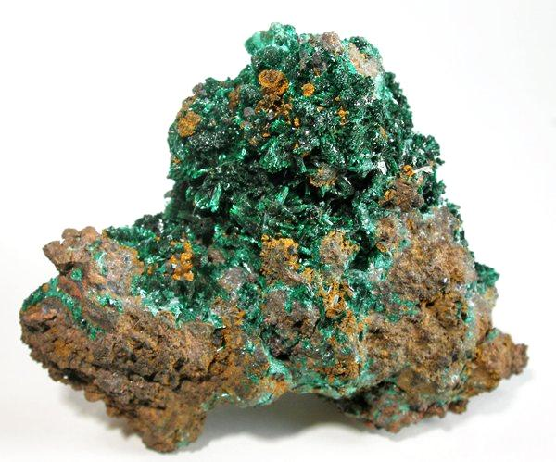
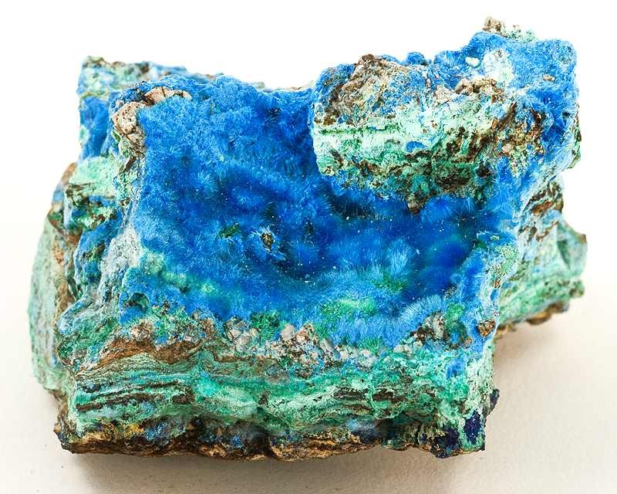
1.3 Copper ores
Malachite
Cyanotrichite-Malachite
Malachite-Copper by Lavinsky R (before Mar 2010) is licensed under CC-BY-SA-3.0
Cyanotrichite, Malachite by Lavinsky R (before Mar 2010) is licensed under CC-BY-SA-3.0
Notes:
Teacher notes:
Malachite is an ore containing copper(II) carbonate. It is commonly mined to extract copper.
Cyanotrichite is an ore containing copper(II) sulfate. Copper is not readily extracted from copper(II) sulfate.

Slide 25
1.4 Aboriginal and Torres Strait Islander Peoples use of minerals and resources
Learning intentions and success criteria
We are learning | I can
to explain the use of Australia’s resources | identify 2 ways that Aboriginal and Torres Strait Islander Peoples used minerals and resources explain how Aboriginal and Torres Strait Islander Peoples used mineral resources explain how Aboriginal and Torres Strait Islander Peoples used other resources
to communicate scientific information | use scientific language and terminology accurately to communicate a message concisely communicate information from the secondary source investigation.
Notes:
Teacher notes:
For more information See ⁠AITSL or the NSW Department of Education explicit teaching strategies, ⁠Sharing learning intentions and ⁠Sharing success criteria​
LISC is not necessarily presented at the beginning of the lesson. Teacher needs to consider most effectual time to introduce ​
LISC should be revisited during the lesson to support students' evaluation of their learning.

Slide 26
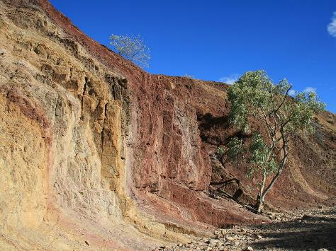

Ochre
Open the website Australian Aboriginal Ochre Painting.
AboriginalOchrePitCentralAustralia by Toby Hudson is licensed under CC BY-SA 3.0
3. How did the trade of ochre contribute to the cultural practices and communication of Australian Indigenous peoples, and why was it so valuable?
What is ochre?
What is ochre used for?
Notes:
Teacher notes:
Note that the use of ochre may serve a dual purpose: they can have both ceremonial significance and resource value, and therefore should be treated with sensitivity.
Sample responses:
1. Ochre is a natural pigment and mineral in the soil.
2. Aboriginal people use ochre for various purposes, including body painting, rock painting, and painting artefacts. They were used to depict dreamtime stories and maps. Ochre was also used as a trade resource as it had great value.
3. The trade of ochre was essential for Australian Indigenous peoples because it was a key material for cultural expression, particularly in storytelling and ceremonial practices. Ochre, a natural pigment, was used in body painting, rock art, and artefacts to depict Dreamtime stories, maps, and important spiritual symbols. Some regions did not have much ochre, so it was traded over long distances between different tribal groups, making it highly valuable, much like the silk trade in Asia.
This trade allowed communities without access to ochre to still participate in visual storytelling and ceremonies, such as initiation or rain-related dances. Ochre's ease of use compared to carving rock made it the preferred medium for art, which allowed Indigenous people to more easily communicate stories, warnings, and important information about hunting or water sources. Though it provided a limited palette of only a few colours, this scarcity taught people to use the options thoughtfully and creatively.

Slide 27
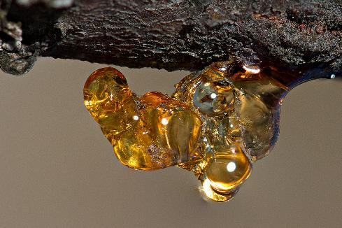
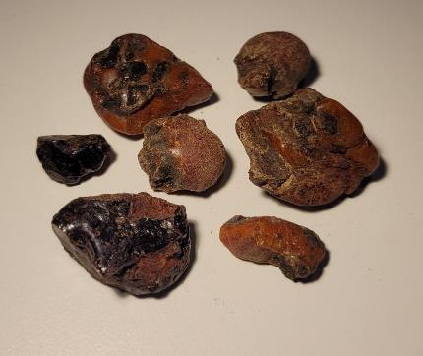
Resin
Watch the video Use for resin and sap (1:23).
Golden Wattle resin by Patrick_K59
|licensed CC BY 2.0
Where does resin come from?
What was resin used for?
What characteristics make resin useful?
Notes:
Teacher notes:
Note that the use of resin may serve a dual purpose: they can have both ceremonial significance and resource value, and therefore should be treated with sensitivity.
Sample response:
Resin comes from plants
Resin was used as a glue to make tools such as axes, and woomeras, and it was also used as a waterproofing agent on other tools.
Resin, when heated, becomes sticky and pliable making it easier to spread. As it cools it hardens which allows it to fix things in place. Its ability to resist water allows it to be used to waterproof tools which would protect them from water damage.

Slide 28
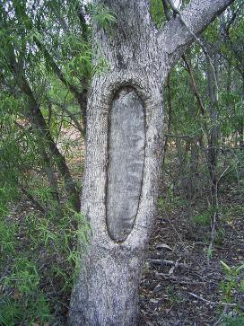
Scar trees
Open the website – Aboriginal scarred trees.
Scar tree by Garyvines is licensed
under CC BY-SA 3.0
What are scar trees and
how are they created?
What products were produced from the tree bark?
3. Why are scarred trees significant in understanding Aboriginal culture and
history?
Notes:
Teacher notes:
Note that the use of scar trees may serve a dual purpose: they can have both ceremonial significance and resource value, and therefore should be treated with sensitivity.
Sample responses:
Scarred trees are trees whose bark is removed by Aboriginal people for various purposes, such as making canoes, containers, and shelters. Removing bark exposes the sapwood, creating a scar on the trunk or branch of the tree. Aboriginal people used stone or steel axes to cut an outline of the desired shape, then lever off the bark.
Aboriginal people used the bark of trees to make canoes, containers (coolamon) and shields
Scarred trees are significant because they provide valuable insights into the everyday lives and practices of Aboriginal people. They reveal how Aboriginal people utilised natural resources for practical purposes, such as making tools and shelters. Since wood often rots away, scarred trees are some of the few remaining physical evidence of Aboriginal wood usage. Additionally, they serve as archaeological markers that help researchers locate other historical sites.

Slide 29
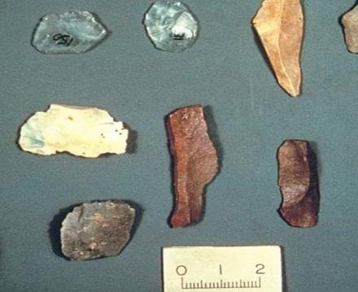
Stone
Open the website Fact sheet: Aboriginal flaked stone tools.
A group of flaked stone tools by State Government
of Victoria licensed CC BY 4.0
Considering the various uses of flaked stone tools, how might the characteristics of these tools provide insight into the daily lives and activities of Aboriginal people in different environments?
List the key
characteristics of flaked
stone tools.
How were flaked stone tools created?
What were flaked stone tools used for?
Notes:
Teacher notes:
Note that the use of stone may serve a dual purpose: they can have both ceremonial significance and resource value, and therefore should be treated with sensitivity.
Section 3
Sample responses:
1.
Flaked stone tools typically have sharp edges.
They are made from stone types that are rich in silica, such as quartzite, chert, flint, silcrete, and quartz.
Flaked stone tools are usually less than 50 mm long.
2. Flaked stone tools were created by striking a piece of stone called a core with a hammerstone, which is often a pebble. This process chips off sharp fragments known as flakes. The best materials for making these tools are stones rich in silica because they are hard and brittle.
3. Flake stone tools were used for a large range of purposes including:
a knife to butcher animals for food
to make hunting weapons such as spear heads
to carve and shape wood and bone
to scrape animal skins so that the skin could be used for clothing, containers and other items
4. The characteristics of flaked stone tools can reveal a lot about the daily lives of Aboriginal people. For example, the sharpness of the flakes indicates that they were used for various tasks such as hunting and butchering game, as well as preparing animal skins. The presence of specific tool shapes, like points or scrapers, suggests these tools were designed for particular purposes, reflecting the needs of the environment they lived in. Additionally, the fact that some tools were made from stones not found locally shows that Aboriginal people likely engaged in trade or travelled long distances to obtain the best materials for tool-making.

Slide 30
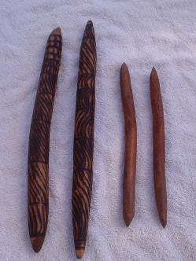
Acacia
Open the website Traditional uses of Australian acacias.
Clapsticks by Andrewa is licensed
under CC BY-SA 3.0
Identify 3 traditional uses
of acacia wood.
How did Aboriginal Australians utilise the bark| of acacia trees?
3. Select 1 of the uses and describe the characteristics that made acacia wood suitable for its purpose.
Notes:
Teacher notes:
Note that the use of wood may serve a dual purpose: they can have both ceremonial significance and resource value, and therefore should be treated with sensitivity.
Sample response:
Students may list 3 uses from:
Aboriginal people used Acacia for:
making tools and weapons. For example, they crafted digging sticks, spear shafts, clubs, and boomerangs.
musical instruments such as clap sticks.
to make strings which could be woven into items.
2. Aboriginal Australians utilised the bark of acacia trees by:
stripping it to create long strips that could be used as bandages to secure dressings on wounds or to make ropes and string for tying items together
making head decorations and sandals from inner bark
Peeling the stringy bark off Silver Witchetty into long, tough ribbons, which were softened in water and the allowed to dry in place to act as a splint for fractures
3. One use of Acacia wood bark was to make string. Some species of acacia were commonly used because their bark could be peeled into long, tough fibres. The strength and flexibility of the ribbons would allow them to be twisted to form strong string which could be used for a range of purposes.

Slide 31
1.4 Resource showcase
Your task is to create a post that highlights the significance and uses of a material
Select a material to research.
Gather information about its use and an
interesting fact.
Create a social media post.
An effective post is catchy and informative.
Character limit – 300
Video/audio limit – 30 seconds
Notes:
Teacher notes:
Note: The character limit for X includes punctuation and spaces.
Students may be given the opportunity to create a post in text, video or audio format.
Sample response:
Did you know? Aboriginal and Torres Strait Islander Peoples used flint to create sharp tools and spearheads, essential for hunting and survival. These tools were so finely crafted that they could even be used to carve intricate designs into wood and stone! (256 characters)

Slide 32
1.5 Evaluate the environmental impact of extracting and using a resource
Learning intentions and success criteria
We are learning | I can
to assess the use of Australia’s finite resources | describe 3 ways that extracting and using a resource can impact the environment
to evaluate proposed solutions to a problem | develop a set of evaluation criteria evaluate the impact of extracting a resource on the environment
to communicate scientific arguments | recognise that there are different types of scientific reports use a formal tone and correct scientific language in a report structure a report logically
Notes:
Teacher notes:
For more information See ⁠AITSL or the NSW Department of Education explicit teaching strategies, ⁠Sharing learning intentions and ⁠Sharing success criteria​
LISC is not necessarily presented at the beginning of the lesson. Teacher needs to consider most effectual time to introduce ​
LISC should be revisited during the lesson to support students' evaluation of their learning.

Slide 33
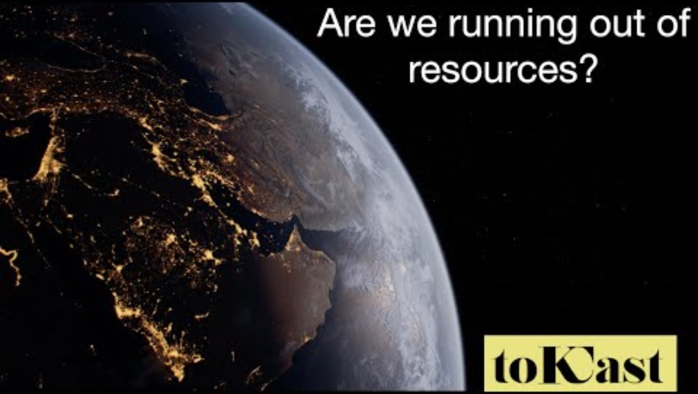
1.5 Evaluating environmental impacts
Notes:
Teacher notes:
Introduce the activity by watching a video such as Are we running out of resources? (17:25). Focus on the first 2 minutes and 30 seconds, highlighting the environmental impact of mining.

Slide 34
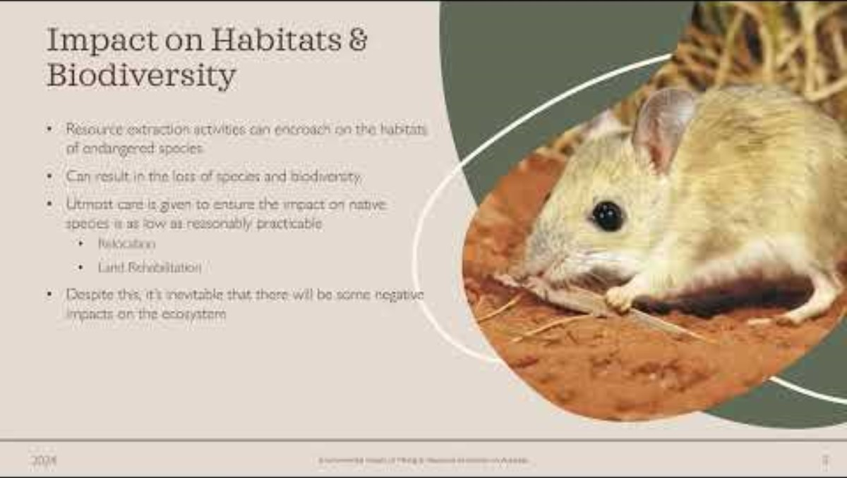
1.5 Environmental impact of mining and resource extraction in Australia
Notes:
Teacher notes:
Play this video to provide a context for students when developing their evaluation criteria.

Slide 35
1.5 Evaluation criteria
Factor | Low impact description | Moderate impact description | High impact description | Classification | Priority
 |  |  |  | Choose an item. | Choose an item.
 |  |  |  | Choose an item. | Choose an item.
 |  |  |  | Choose an item. | Choose an item.
 |  |  |  | Choose an item. | Choose an item.
Notes:
Teacher notes:
This table may be used to co-create evaluation criteria.

Slide 36
Essential question 2
Why do atoms bond?
Notes:
Teacher notes:
The content in this section of the Materials PowerPoint aligns with Essential question 2 in the program of learning and Materials teacher resource book 2.

Slide 37
2.1 Valency – use it, lose it or share it
Learning intentions and success criteria
We are learning | I can
to describe the chemical properties of materials | draw the electron configuration of the first 18 elements identify the number of electrons an atom needs to gain, lose or share to achieve a stable electron configuration define valency
Notes:
Teacher notes:
For more information See ⁠AITSL or the NSW Department of Education explicit teaching strategies, ⁠Sharing learning intentions and ⁠Sharing success criteria​
LISC is not necessarily presented at the beginning of the lesson. Teacher needs to consider most effectual time to introduce ​
LISC should be revisited during the lesson to support students' evaluation of their learning.

Slide 38
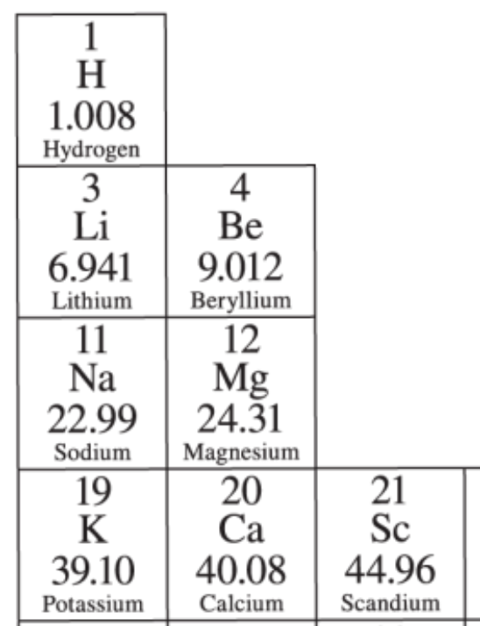
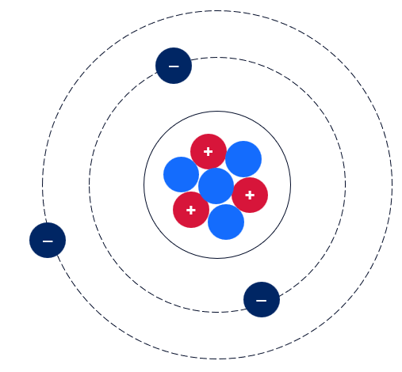
2.1 Model of an atom
Notes:
Teacher notes:
This slide contains animations.
This is a simple model of a lithium atom.
A lithium atom has 3 protons (red) and 4 neutrons (light blue) in the nucleus and 3 electrons (dark blue) in 2 shells surrounding the nucleus. There are 2 electrons in the first shell and 1 in the outer shell.
Electrons are negatively charged, protons are positively charged and the neutrons are neutral. Each lithium atom has 3 positive charges in the nucleus and 3 negative charges in the electron shells surrounding the nucleus. Therefore, the net charge on the lithium atom is zero. The lithium atom is electrically neutral.

Slide 39
2.1 Electron configuration
The first shell can hold a maximum of 2 electrons.
The second shell can hold a maximum of 8 electrons before filling the next shell.
For the first 20 elements, the third shell can hold 8 electrons before filling the next shell (from Potassium onwards it gets tricky).
–
–
–
–
–
–
–
–
–
–
–
–
–
–
–
–
Drawing the electron configuration as shown here (paired electrons) helps us count the electrons easily
–
–
Notes:
Teacher notes:
This slide contains animations.
Use this slide to demonstrate to students how to draw the electrons on the Student resource –electron configuration and valency. The element shown on this slide is argon. Tell students that argon has 18 electrons.
Point out to students that:
Electron shells are represented as concentric circles from the nucleus.
The electron shells are numbered, with the shell closest to the nucleus numbered 1, and so on.
Electrons are filled from shell #1 first. This shell can accommodate a maximum of 2 electrons. For atoms with more than 2 electrons, electron filling continues in the next shell (#2). Shell 2 can accommodate a maximum of 8 electrons.
Note: Investing time in having students draw the electron configuration in the format outlined will make it easier for students to understand bonding. This method prepares them to construct more complex bonding arrangements and create electron dot diagrams in Stage 6 Chemistry.

Slide 40
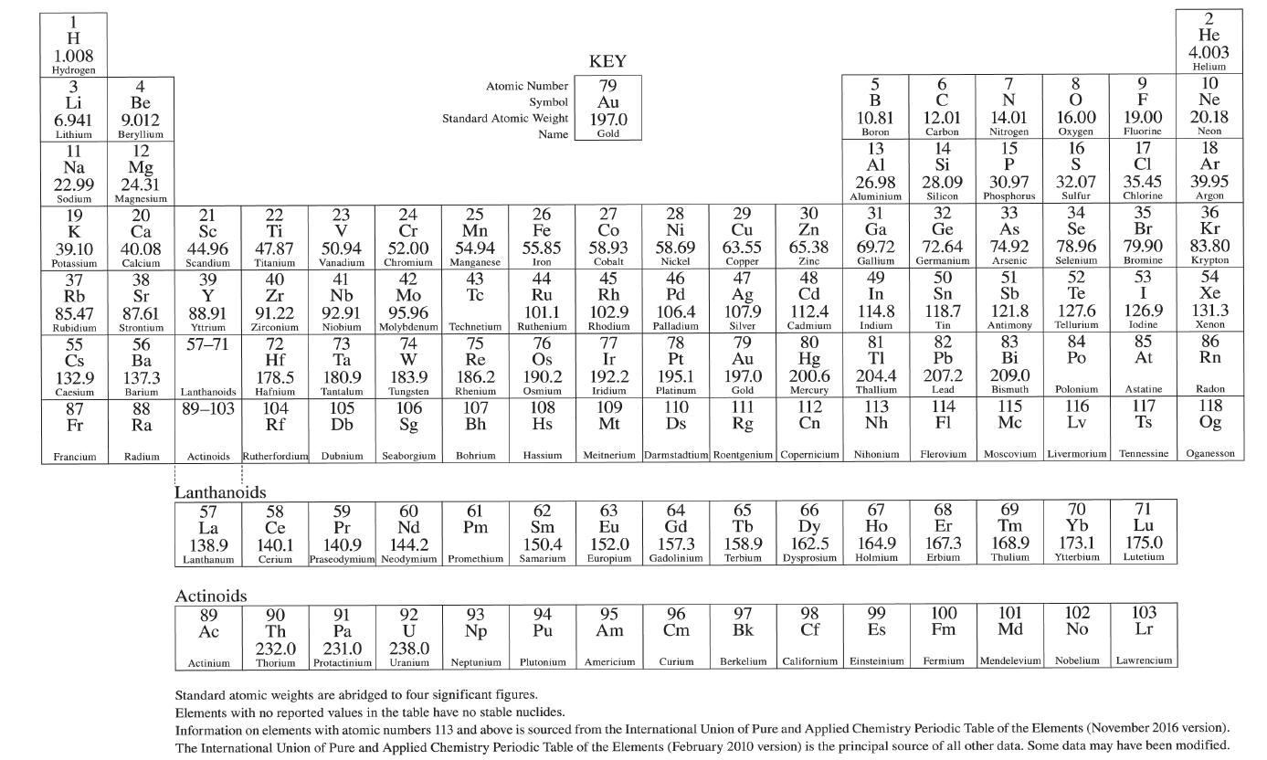
2.1 The periodic table
1
Group
18
Period
1
2
13
14
15
16
17
2
3
3
4
5
6
7
8
9
10
11
12
4
5
6
7
Elements in group 1 have 1 valence electron.
These elements have a valency of 1
Elements in group 2 have 2 valence electrons
These elements have a valency of 2
Elements in group 13 have 3 valence electrons.
These elements have a valency of 3
Elements in group 14 have 4 valence electrons.
These elements have a valency of 4
Elements in group 15 have 5 valence electrons.
These elements have a valency of 3
Elements in group 16 have 6 valence electrons.
These elements have a valency of 2
Elements in group 17 have 7 valence electrons.
These elements have a valency of 1
Elements in group 18 have a full outer shell. Helium has 2 valence electrons, and the rest have 8 valence electrons.
Elements in this group have a valency of 0
Notes:
Teacher notes:
This slide has animations.
The first animation will label the periods.
The 2nd animation labels the groups.
The remaining animations highlight a group and outline the number of valence electrons and the valency of the elements in the group.

Slide 41
2.1 Checkpoint
Which of the following statements correctly describes the electron configuration of magnesium?
A) Magnesium has 2 electrons in the first shell, and 2 electrons in the second shell.
B) Magnesium has 8 electrons in the first shell, 8 electrons in the second shell, and 2 electrons in the third shell.
C) Magnesium has 2 electrons in the first shell, 8 electrons in the second shell, and 2 electrons in the third shell.
D) Magnesium has 2 electrons in the first shell, 8 electrons in the second shell, and no electrons in the third shell.
Notes:
Teacher notes:
This slide contains animations to bring up the correct response.
The correct response is C
A incorrect
This option is incorrect because magnesium only has 2 shells of electrons. It is in period 3, so there should be 3 shells of electrons. Students have not understood the connection between the period number and the number of shells.
B incorrect
This option is incorrect because the first shell of electrons can only ever hold 2 electrons. Students have not understood the number of electrons each shell can hold.
C correct
Magnesium is in period 3 and has 3 shells of electrons. The first holds 2 electrons, the second has 8, and the third has 2 electrons.
D
incorrect
This option is incorrect because students have missed the last shell of electrons.

Slide 42
2.2 From elements to compounds – the noble gas connection
Learning intentions and success criteria
We are learning | I can
to describe the chemical properties of materials. | describe noble gas configuration describe the purpose of a chemical bond explain the link between noble gas configuration and chemical bonding identify and name the 3 types of bonds – ionic, covalent and metallic
Notes:
Teacher notes:
For more information, see ⁠AITSL or the NSW Department of Education’s explicit teaching strategies, ⁠Sharing learning intentions and ⁠Sharing success criteria​
LISC is not necessarily presented at the beginning of the lesson. Teachers should consider the most effective time to introduce ​
LISC should be revisited during the lesson to support students' evaluation of their learning.

Slide 43
2.2 Checkpoint 1
Draw the electron configuration of aluminium (atomic number 13) and identify its valency
–
–
–
–
–
–
–
–
–
–
–
OR
Valency = 3
–
Al
–
–
Al
–
–
–
–
–
–
–
–
–
–
–
–
Notes:
Teacher notes:
This slide contains animations to bring up a sample answer.
Students use mini whiteboards to draw the electron configuration of aluminium and identify its valency. This is prior learning from the previous lesson. The slide is animated to bring up the sample answer.
Aluminium is in period 3, so it has 3 electron shells. There are 2 electrons in the first shell. There are 8 electrons in the second shell, and it is in group 13, so there are 3 electrons in the outer shell.
Note: Students do not need to draw the negative symbol in their diagrams. They may draw the electrons spread out in their shells or paired as shown on the right. Pairing them like on the right makes it easier to count the electrons and see how many spaces are “unfilled”.

Slide 44
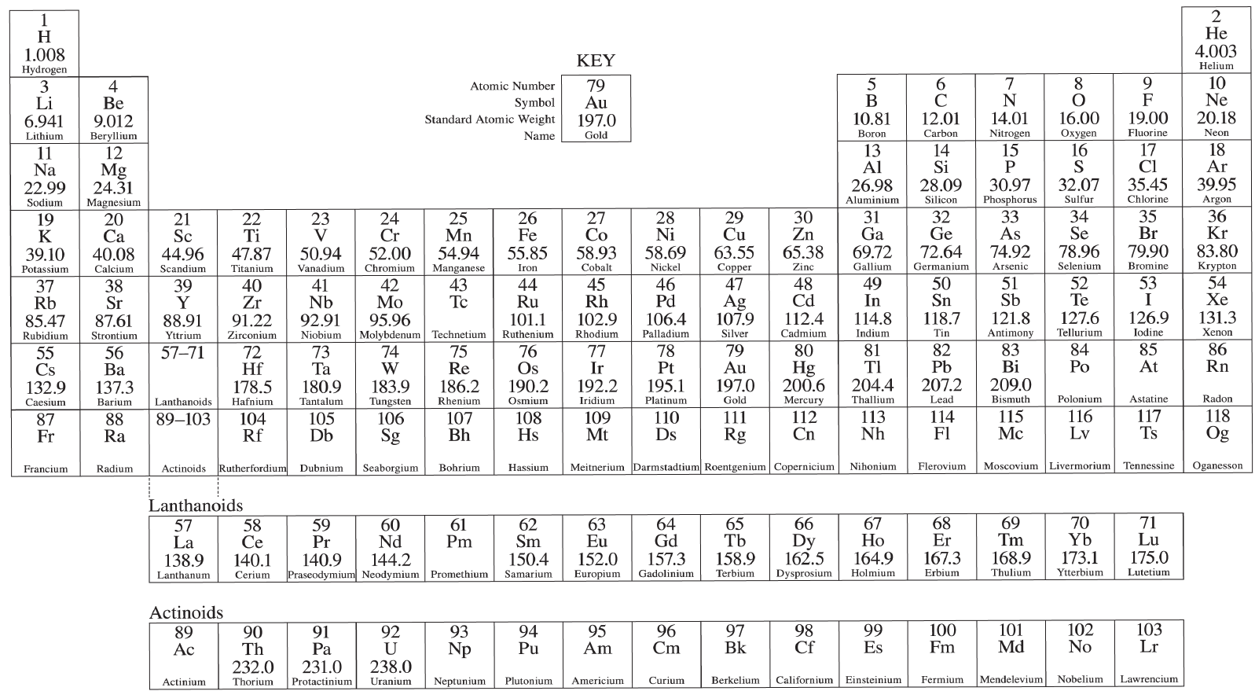
2.2 Noble gases (1 of 2)
Why are noble gases so special?
Image credit – NESA Science 7–10 Data Book
Notes:
Teacher notes:
The noble gases belong to group 18. They are a special group – they are very stable and do not react with other elements. This is because they have a full set of electrons in their outer shell.

Slide 45
2.2 Noble gases (2 of 2)
How do other elements strive to achieve their stability?
Image credit – NESA Science 7–10 Data Book
Notes:
Teacher notes:
The other elements are not stable like the noble gases because they do not have a full outer shell.
How do other elements gain their stability?
The octet rule states that atoms tend to form compounds in ways that give them eight valence electrons and thus the electron configuration of a noble gas. An exception to an octet of electrons is helium, which only has two valence electrons.

Slide 46

2.2 Noble gas configuration
-
-
-
-
-
-
-
-
-
-
-
-
-
-
-
-
Ar
-
-
He
Ne
-
-
-
-
-
-
-
-
-
Helium has 2 electrons in its outer shell
Neon has 8 electrons in its outer shell
Argon has 8 electrons in its outer shell
What do you notice about the number of electrons in the outer shell of each noble gas?
Noble gases have a complete outer shell. This is known as noble gas configuration.
They are stable because the outermost shell of electrons is completely filled. It will not tend to lose or gain electrons.
Notes:
Teacher notes:
This slide contains animations.
Click through the slide, examining the electron configuration of helium, neon and argon.
CLICK
Give the students time to record and share what they notice about the number of electrons in the outer shell of each noble gas.
CLICK
Explain that the noble gases have full outer shells of electrons. They do not need to gain or lose electrons. In most cases, this means that they have 8 electrons in the outer shell. The exception is helium which only has two, which is shown on the slide.

Slide 47
2.2 The octet rule
The octet rule states that atoms tend to gain, lose, or share electrons to achieve a full outer shell of electrons. This is what makes them stable like noble gases.
-
-
-
-
-
-
-
-
-
-
-
Na
F
-
-
-
-
-
-
-
Sodium and fluorine now both have a stable noble gas configuration. This is how they form chemical bonds and become stable.
Sodium gives fluorine 1 electron, which gives both a complete outer shell (like the noble gases).
Sodium has only 1 electron in its outer shell. It needs to lose one electron or gain 7 (but that is too much effort).
Fluorine has only 7 electrons in its outer shell. It is hard for it to lose all 7 electrons, but it can gain 1 electron to gain a full outer shell.
Notes:
Teacher notes:
This slide has animations.
Explain the octet rule to students – The octet rule states that atoms tend to gain, lose, or share electrons to achieve a full outer shell of electrons. This is what makes them stable like noble gases.
CLICK to bring up the sodium annotation
Look at the sodium atom on the screen and tell the students that it needs to lose an electron to have a full outer shell. It is easier for it to drop back to the next electron shell, rather than try and gain 7 electrons.
CLICK to bring up the fluorine atom
Look at the fluorine and outline that it needs to gain 1 electron to have a full outer shell.
CLICK to bring up the animation to sodium losing one electron to the fluorine
Sodium and fluorine now both have a stable noble gas configuration. This is how they form chemical bonds and become stable.
Sodium has given fluorine one electron, so that they both have full outer shells.

Slide 48
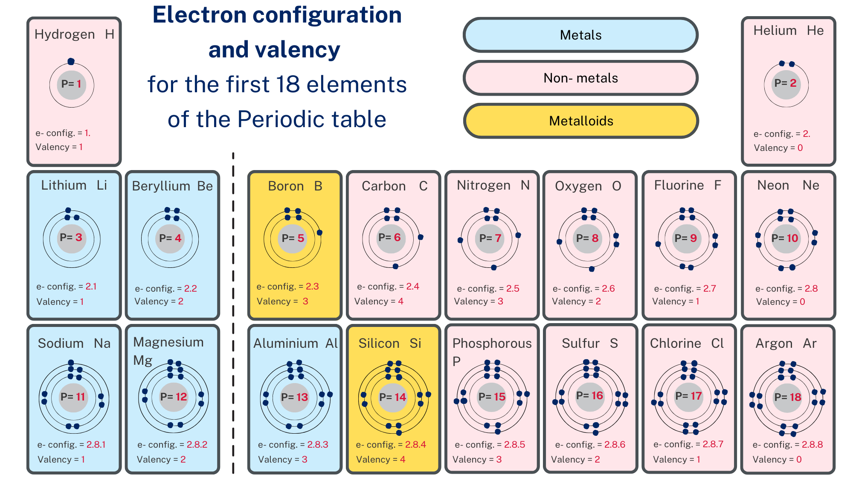









2.2 The octet rule and the period table
Notes:
Teacher notes:
This slide has animations.
This image is the student resource from lesson 2.1 (TRB2) with additional information about the elements added. It highlights which elements are metals, non-metals and metalloids.
Tell the students that metals tend to lose electrons to achieve the noble gas configuration (the drop back to the lower electron shell). Demonstrate this on the board with sodium to show how it will have the electron configuration of neon when it loses its valence electron. The sodium ion will now have a positive charge because it has 11 protons, but only 10 electrons.
Tell the students that non-metals tend to gain electrons to achieve the noble gas configuration. Demonstrate this on the board with chlorine to show how it resembles argon’s noble gas configuration when it gains an electron. The chloride ion has a negative charge because it has one more electron than protons.
CLICK to bring the entire periodic table up
The colours highlight the metals in blue, the metalloids in yellow and the non-metals in red. Point out some metals that students may have learnt about in Part 1 of the program (resources) such as Iron, copper, nickel, and gold.

Slide 49

2.2 Achieving noble gas configuration (1 of 3)
Losing or gaining electrons
–
–
Na
Cl
Metal atoms tend to donate electrons to fill their outer shell
Non-metal atoms tend to receive electrons to fill their outer shell
A very strong ionic bond is formed by the transfer of 1 or more electrons from 1 metal atom to a non-metal atom
The ions are held together by electrostatic attraction (between the positive and negative charges).
–
–
–
–
–
–
Na⁺
–
–
Cl⁻
–
–
–
–
–
–
Checkpoint – Which of these compounds is formed by ionic bonds when electrons are lost or gained?
NACI
H₂O
CO₂
MgO
MgCl₂
CH₄
Notes:
Teacher notes:
This slide contains animations.
Read through the key information on ionic bonds.
Tell students that we are only concerned with valence electrons when discussing bonding. Therefore, the sodium and chlorine drawn on the slide only show the valence electrons. Sodium has 1 valence electron, and chlorine has 7.
CLICK to show the electron move from sodium to chlorine to create sodium and chlorine ions.
When the sodium atom donates its electron (from the third and outer shell) to chlorine, its outer shell becomes the second shell, and it now has 8 electrons in its outer shell. Chlorine gains an electron, and as shown on the slide, it now has 8 electrons in its outer shell.
CLICK to bring up a check for understanding.
Students use the information on the slide and their understanding of which elements are metals and non-metals to determine if the atoms in each compound allow it to form an ionic bond.

Slide 50
2.2 Achieving noble gas configuration (2 of 3)
–
–
O
Sharing electrons
H
–
–
–
Sharing allows each of the atoms to achieve a full outer shell (noble gas configuration).
A chemical bond formed by the sharing of electrons is called a covalent bond.
Covalent bonds form between non-metal atoms.
–
–
–
–
O
H
–
–
–
–
–
–
H
Checkpoint – Which of these compounds is formed by covalent bond when electrons are shared? (Hint – covalent bonds occur between ?)
MgCl₂
CH₄
NACI
H₂O
CO₂
MgO
Notes:
Teacher notes
This slide has animations.
Ask students how many valence electrons hydrogen and oxygen have. They should respond with 1 and 6, respectively.
CLICK to bring up the valence electron diagrams for Hydrogen and oxygen.
Ask students:
How many electrons does hydrogen need to get a full shell of electrons? Answer: 1
How many electrons does oxygen need to get a full shell of electrons? Answer: 2
How many hydrogen atoms are required to share an electron with an oxygen atom so that all atoms have full valence shells? Answer 2
CLICK to bring up the water molecule showing 2 hydrogens sharing their electron with an oxygen.
Count the electrons for each hydrogen (there are 2), and for the oxygen (there are 8). All of the atoms have a full outer shell.

Slide 51
2.2 Achieving noble gas configuration (3 of 3)
+
A metal ion
Delocalised electrons
-
A delocalised valence electron
Metal atoms can lose their valence electrons to a ‘sea of electrons’; this is referred to as delocalised electrons – they can move freely.
The free-moving electrons allow metal to conduct electricity and heat.
The type of chemical bond formed between positively charged metal ions and the delocalised electrons surrounding them is metallic bonding.
-
-
+
+
+
+
-
-
-
-
+
+
-
+
-
+
-
-
-
+
+
+
+
-
-
-
+
+
+
-
+
Checkpoint Which of these atoms can form metallic bonds?
Na
Si
N
Ne
CI
Li
Fe
Cu
Notes:
Teacher notes:
This slide has animations.
Ask students to recall some metals from the periodic table. They may come up with metals such as sodium, magnesium, copper, iron, aluminium and so on.
Tell the students that the type of bond that forms between metal ions is called a metallic bond.
Click to bring up the diagram of metallic bonding
Click to bring up the checkpoint question.
Click to bring up the answers.

Slide 52
2.2 Checkpoint 2
Click on the terms to match them
Covalent bonding
Match the information with the
type of bond that it relates to
Metallic bonding
Ionic bonding
A very strong chemical bond formed by the transfer of 1 or more electrons from 1 atom to another atom.
The ions are held together by electrostatic attraction (positive and negative charges).
Typically occurs between a metal and a non-metal.
A chemical bond formed by the sharing of electrons between 2 atoms.
Covalent bonds form between non-metal atoms.
Sharing allows each atom to achieve a full outer shell (noble gas configuration).
A type of chemical bond formed between positively charged metal ions and the delocalised electrons surrounding them.
The free-moving electrons allow metal to conduct electricity and heat.
Notes:
Teacher notes:
This slide contains animations.
Check students’ understanding using this animated slide.
CLICK on the terms to align them with the related information.

Slide 53
2.3 Ionic bonding
Learning intentions and success criteria
We are learning | I can
to describe the chemical properties of materials | describe ionic bonding identify examples of ionic compounds state which types of elements ionic bonds can form between demonstrate how atoms transfer electrons to achieve stable electron configuration describe what happens to electrons when an ionic bond is formed.
Notes:
Teacher notes:
For more information, see ⁠AITSL or the NSW Department of Education’s explicit teaching strategies, ⁠Sharing learning intentions and ⁠Sharing success criteria​
LISC should be revisited during the lesson to support students' evaluation of their learning.

Slide 54
2.3 Checkpoint
Answer true or false for the below information
An ionic bond is a very strong chemical bond formed by the transfer of electrons from 1 atom to another
True
The ions are held together by electrostatic attraction (positive and negative charges)
True
Ionic bonds typically occur between non-metals
False – they occur between a metal and a non-metal
Sodium chloride (NaCl) and water (H2O) are both examples of ionic compounds.
False – Water is a covalent compound
Notes:
Teacher notes:
This slide contains animations.
Check students understanding of ionic bonds using this animated slide.
CLICK to bring up the answers one by one.

Slide 55
2.3 Magnesium + oxygen
Move the electrons in the outer shells of magnesium and oxygen so that they both have noble gas configuration
Chemical formula = MgO
–
–
–
–
–
–
–
–
–
–
–
Mg
–
O
–
2+
2-
–
–
–
–
–
–
–
Magnesium 2+
Oxygen 2-
Notes:
Teacher notes:
This slide contains animations.
Guide the students as they:
1. Identify the type of bonding (there is a metal and a non-metal, so it is ionic bonding)
2. Identify how many electrons are in the outer shell of magnesium. (2)
3. Identify whether magnesium needs to gain or lose those electrons to gain a full outer shell (lose 2 electrons)
CLICK to move two electrons from magnesium to oxygen
1. Identify how many electrons are in the outer shell of oxygen. (6)
2. Identify whether it needs to gain or lose electrons to gain a full outer shell. How many electrons will it need to gain or lose? (gain 2 electrons)
3. Draw the new atoms with full outer shells. (by moving the 2 red electrons from magnesium to the outer shell of oxygen)
CLICK to bring up the chemical formula
Tell students that because only one magnesium ion and one oxygen ion are needed to get a neutral overall charge, the chemical formula for Magnesium oxide is MgO.

Slide 56
2.3 Magnesium + chlorine
–
–
–
–
Move the electrons in the outer shells of magnesium and oxygen so that they both have noble gas configuration
–
–
–
–
Cl
1-
–
–
–
–
–
–
–
–
–
–
–
–
–
–
–
–
Mg
–
–
–
–
–
–
–
2+
–
–
–
–
Cl
1-
–
–
–
–
–
–
–
Chemical formula = MgCl₂
–
–
–
–
Magnesium 2+
Chlorine 1-
Notes:
Teacher notes:
This slide contains animations.
Guide the students as they:
Identify the type of bonding (there is a metal and a non-metal, so it is ionic bonding)
Identify how many electrons are in the outer shell of magnesium. (2)
Identify whether magnesium needs to gain or lose those electrons to gain a full outer shell (lose 2 electrons)
CLICK to move two electrons from magnesium to oxygen
Identify how many electrons are in the outer shell of chlorine. (7)
Identify whether it needs to gain or lose electrons to gain a full outer shell. how many electrons will it need to gain or lose? (gain 1 electron)
Draw the new atoms with full outer shells. (by moving the 1 red electrons from magnesium to the outer shell of each chlorine)
CLICK to bring up the chemical formula
Tell students that because we need two chlorine ions for each magnesium ion, the chemical formula is MgCl₂

Slide 57
2.3 Ionic compounds
Use the word bank to complete the sentences
Word bank –
anion
lose
gain
cation
electrostatic
Ions form when electrons are either gained or lost. Metals _________ electrons and become positive ions or _____________. Non-metals _____________ electrons and become negative ions or _____________. The oppositely charged ions are held together by a strong ______________ attraction, creating an ionic compound.
Notes:
Teacher notes:
Use this slide to form the definition for ionic compound.
Answer:
Ions form when electrons are either gained or lost. Metals lose electrons and become positive ions or cations. Non-metals gain electrons and become negative ions or anions. The oppositely charged ions are held together by a strong electrostatic attraction, creating an ionic compound.

Slide 58
2.3 Ionic compounds and chemical formula
Copy the ions and drag them into the red box to construct an ionic compound
Sodium Na⁺
Lithium Li⁺
Chloride Cl⁻
Magnesium
Fluoride F⁻
Mg²⁺
Oxide
Calcium
O²⁻
Ca²⁺
Name of compound – [insert name of compound]
Chemical formula – [insert the chemical formula]
Notes:
Teacher notes:
This slide is intended to be used by students. It should be copied into a separate presentation and assigned to each student
The students then construct 10 different ionic compounds using the cations and anions provided. Student will use copy and paste to copy the ions and arrange them in the red box to build an ionic compound that has a neutral charge.
Students then write the name of the compound and determine its chemical formula be counting the number of each ion required to make a neutral compound.
Sample answers are provided in TRB2 2.3 Forming ionic compounds.

Slide 59
2.4 Covalent bonding
Learning intentions and success criteria
We are learning | I can
to describe the chemical properties of materials | describe covalent bonding identify examples of covalent compounds construct models of covalent compounds define diatomic molecule list examples of diatomic molecules construct chemical formulas of ionic compounds.
Notes:
Teacher notes:
For more information See ⁠AITSL or the NSW Department of Education explicit teaching strategies, ⁠Sharing learning intentions and ⁠Sharing success criteria​
LISC should be revisited during the lesson to support students' evaluation of their learning.

Slide 60


2.4 Checkpoint
Which of the following compounds contains covalent bonds? Select all that apply
(there may be more than 1 correct answer)
–
–
Sodium chloride (NaCl)
H
O
–
–
–
–
–
Cl
Cl
–
–
–
–
–
–
–
–
–
–
–
H
–
–
–
Magnesium oxide (MgO)
Copper metal
Methane (CH₄)
Notes:
Teacher notes:
This slide contains animations.
Students identify all examples of covalent compounds by identifying which compounds contain only non-metal atoms.
The covalent compounds are A, B and F.
C and D are ionic compounds that contain a metal and a non-metal.
E is a pure metal, so it is neither an ionic nor a covalent compound.

Slide 61
2.5 Metallic bonding
Learning intentions and success criteria
We are learning | I can
to describe the chemical and physical properties of materials | describe metallic bonding identify examples of metallic bonding identify properties of metallic bonding that make metals suitable for certain uses
Notes:
Teacher notes:
For more information See ⁠AITSL or the NSW Department of Education explicit teaching strategies, ⁠Sharing learning intentions and ⁠Sharing success criteria​
LISC should be revisited during the lesson to support students' evaluation of their learning.

Slide 62
2.5 Checkpoint
Select the correct response
An ion is:
a neutral atom with no charge
an atom or molecule with a positive or negative charge
a type of molecule made of 2 or more atoms
an atom with a complete outer shell
Notes:
Teacher notes:
This slide contains animations.
Check students’ understanding of the term ion at the beginning of this lesson.
CLICK to reveal the correct answer
A is incorrect because a neutral atom has an equal number of protons (positively charged) and electrons (negatively charged), which means it has no overall charge. This is not an ion because ions are defined as atoms or molecules with an overall positive or negative charge due to the loss or gain of electrons.
B is correct
C is incorrect because an ion can be a single atom, like Na⁺ or Cl⁻, or a group of atoms (polyatomic), such as a sulfate ion (SO₄²⁻).
D is incorrect because this response describes a stable atom, often referred to as having a noble gas configuration, but does not necessarily mean the atom is an ion. Some ions achieve stability through a full outer shell, but not all ions have a complete outer shell, and not all atoms with complete outer shells are ions.

Slide 63
2.6 Bonds and beyond – exploring the properties of bonds
Learning intentions and success criteria
We are learning | I can
to explain the use of materials based on their physical and chemical properties | make observations about the physical and chemical properties of ionic, covalent and metallic substances compare the physical and chemical properties of ionic, covalent, and metallic substances explain how the physical and chemical properties of each substance influence its practical use in everyday life
to design a safe investigation | explain why we are doing this investigation conduct a risk assessment select an appropriate method to test a property
Notes:
Teacher notes:
For more information See ⁠AITSL or the NSW Department of Education explicit teaching strategies, ⁠Sharing learning intentions and ⁠Sharing success criteria​
LISC is not necessarily presented at the beginning of the lesson. Teacher needs to consider most effectual time to introduce ​
LISC should be revisited during the lesson to support students' evaluation of their learning.

Slide 64
2.6 Checkpoint
What is the difference between an investigation aim and purpose?
The aim is a broad statement about the investigation, while the purpose is a specific question to be answered.
The purpose explains why the investigation is being conducted, while the aim describes what the investigation intends to achieve.
The aim is the hypothesis being tested in the investigation, and the purpose is the conclusion drawn from the results.
The purpose and aim are the same thing; both refer to the outcome of the investigation.
Notes:
Teacher notes
This slide contains animations to bring up the correct answer.
The correct response is B
A incorrect
This option reverses the definitions. The aim is actually a specific statement about what the investigation seeks to achieve, whereas the purpose is the broader context or reason for conducting the investigation.
B correct
This option accurately captures the difference. The purpose provides the overarching reason for the study, while the aim focuses on a specific goal or question. It helps clarify for students that these terms are not interchangeable.
C incorrect
This option confuses the aim with the hypothesis, which is a testable prediction, and the purpose with the conclusion. The aim is not the hypothesis; rather, it is what the investigation seeks to achieve. The purpose does not equate to the conclusion but outlines the context for the research.
D incorrect
This option suggests that purpose and aim are interchangeable, which is a common misconception. While both are related to the investigation, they serve different roles: the purpose provides context, and the aim specifies what will be measured or assessed.

Slide 65
2.6 Bonds and beyond – exploring the properties of different types of bonds
Property | Ionic | Covalent | Metallic
Appearance – lustre | Dull | Dull | Shiny
Malleable | No | No | Yes
Conductivity as a solid | No | No | Yes
Conductivity in a solution | Yes | No | No
Soluble in water | Yes | Sometimes | No
Melting point | High | Low | High
Reactive with acid | No | No | Yes
Notes:
Teacher notes:
This slide may be used to discuss the chemical and physical properties of ionic, covalent and metallic bonds.

Slide 66
Essential question 3
What makes hydrocarbons so useful and potentially so harmful?
Notes:
Teacher notes:
The content in this section aligns with Essential question 3 in the Material program of learning. Additional lesson instruction will be found in Materials TRB3.

Slide 67
3.1 Is it organic or inorganic?
Learning intentions and success criteria
We are learning to | I can
describe the chemical properties of materials and their uses | recognise a C–H bond identify why a compound is inorganic or organic based on its bonding provide examples of inorganic and organic compounds and their uses
Notes:
Teacher notes:
For more information See ⁠AITSL or the NSW Department of Education explicit teaching strategies, ⁠Sharing learning intentions and ⁠Sharing success criteria​
LISC is not necessarily presented at the beginning of the lesson. Teacher needs to consider most effectual time to introduce ​
LISC should be revisited during the lesson to support students' evaluation of their learning.

Slide 68
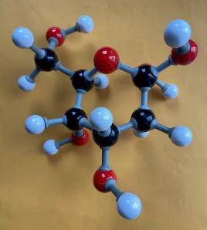
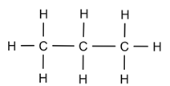
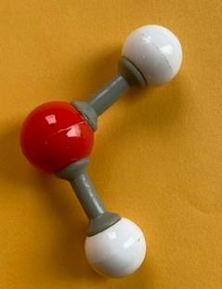
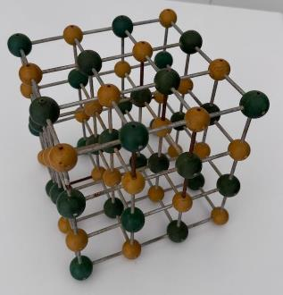
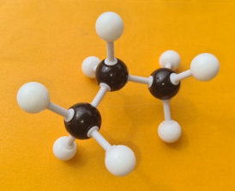
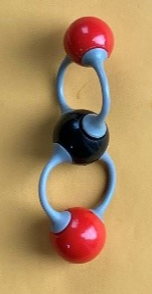
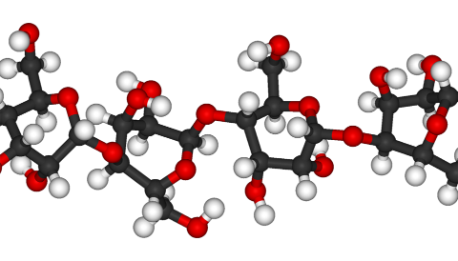
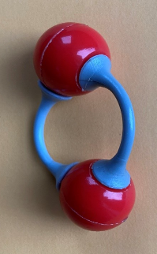
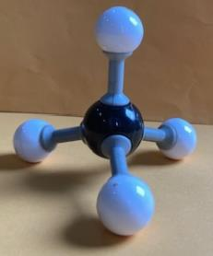
3.1 Comparing organic and inorganic molecules
What are the similarities and differences between organic and inorganic substances?
Organic
Inorganic
Propane (C₃H₈)
Water (H₂O)
Sodium chloride (salt) (NaCl)
Glucose (C₆H₁₂O₆)
Cellulose (wood) (C₆H₁₀O₅)_{n}
Carbon dioxide (CO₂)
Oxygen (O₂)
Methane (CH₄)
Cellulose is in public domain
Notes:
Teacher notes:
Draw students' attention to each of the substances represented by molecular models on the slide. Remind students that the black atoms represent carbons, the red atoms represent oxygen, and the white atoms represent hydrogens. Sodium and chlorine are represented in yellow and green using a different type of model.
All organic substances contain C–H bonds.
Most organic molecules come from living things at some point.
Glucose is produced during photosynthesis in plants and is used in respiration.
Methane and propane are both hydrocarbons, which are also considered fossil fuels.
Cellulose is a type of carbohydrate found in the cell walls of woody plants.
Some organic molecules can be synthesised in a science laboratory, for example, polymers that make plastics.
None of the inorganic molecules has a C–H bond.
Even though carbon dioxide and oxygen are used or produced by living things in respiration and photosynthesis, they do not have a C–H bond, so they are not considered organic.

Slide 69
3.2 Hydrocarbons are everywhere
Learning intentions and success criteria
We are learning to | I can
explain the use of materials based on their physical properties | define fractional distillation describe how hydrocarbons are separated from crude oil explain how hydrocarbons are separated to form useful products
use cause and effect relationship to make predictions | predict where fractions will be removed during fractional distillation based on boiling point
Notes:
Teacher notes:
For more information See ⁠AITSL or the NSW Department of Education explicit teaching strategies, ⁠Sharing learning intentions and ⁠Sharing success criteria​
LISC is not necessarily presented at the beginning of the lesson. Teacher needs to consider most effectual time to introduce ​
LISC should be revisited during the lesson to support students' evaluation of their learning.

Slide 70
3.2 Frayer diagram – crude oil
Definition
Facts/Characteristics
Crude oil
Examples (of what crude oil is used for)
Non-example
Notes:
Teacher notes:
This template can be provided to students to complete a Frayer diagram on crude oil. Teachers can co-construct each component, or students could use research to collect information to complete the components. A sample response is provided on the next slide.

Slide 71
3.2 Frayer diagram – crude oil (sample response)
Definition
Oil, as it is found naturally in underground reservoirs,
is a raw natural resource made from hydrocarbons
that formed over millions of years from the remains
of animals and plants.
Facts/Characteristics
Extracted by drilling into the Earth’s crust
It is a mixture of hydrocarbons.
It is a finite resource
Crude oil
Examples (of what crude oil is used for)
Fuel production – Used to make petrol, diesel, jet fuel, and kerosene.
Plastics – A key raw material for
manufacturing various plastics.
Other products – Used in producing lubricants, asphalt, and synthetic rubber.
Non-example
Refined fuels – Petrol, diesel, and kerosene are products derived from crude oil, but they are not
crude oil themselves.
Plant oils such as olive oil and canola oil
Notes:
Teacher notes:
Completed Frayer diagram for crude oil.

Slide 72
3.2 Frayer diagram – mixture
Definition
Facts/Characteristics
Mixture
Examples
Non-example
Notes:
Teacher notes:
This template can be provided to students to complete a Frayer diagram on crude oil. Teachers can co-construct each component, or students could use research to collect information to complete the components. A sample response is provided on the next slide.

Slide 73
3.2 Frayer diagram – Mixture (sample response)
Definition
A combination of 2 or more substances where these substances do not undergo a chemical reaction to bond together, and each part in the mixture retains its own properties.
Facts/Characteristics
Can be separated into individual components
Components retain their properties
Can be homogenous (evenly mixed) or heterogenous
Mixture
Examples
Salt water
Air
Soil
Crude oil
Metal alloy
Non-example
Distilled water
Carbon dioxide gas
Copper metal
Notes:
Teacher notes:
Completed Frayer diagram for Mixture.

Slide 74
3.2 Frayer diagram – hydrocarbon
Definition
Facts/Characteristics
Hydrocarbon
Examples
Non-example
Notes:
Teacher notes:
This template can be provided to students to complete a Frayer diagram on crude oil. Teachers can co-construct each component, or students could use research to collect information to complete the components. A sample response is provided on the next slide.

Slide 75
3.2 Frayer diagram – hydrocarbon (sample response)
Definition
A group of compounds containing only hydrogen and carbon.
Facts/Characteristics
Found in fossil fuels
Release energy when they undergo combustion
Can be solids, liquids or gases at room temp
Hydrocarbon
Examples
Methane (CH₄)
Propane (C₃H₄)
Octane (C₈H₁₈)
Non-example
Any compound that contains an element other than just hydrogen and carbon for example, Water (H₂O), ethanol (C₂H₅OH) and glucose (C₆H₁₂O₆).
Notes:
Teacher notes:
Completed Frayer diagram for hydrocarbon

Slide 76
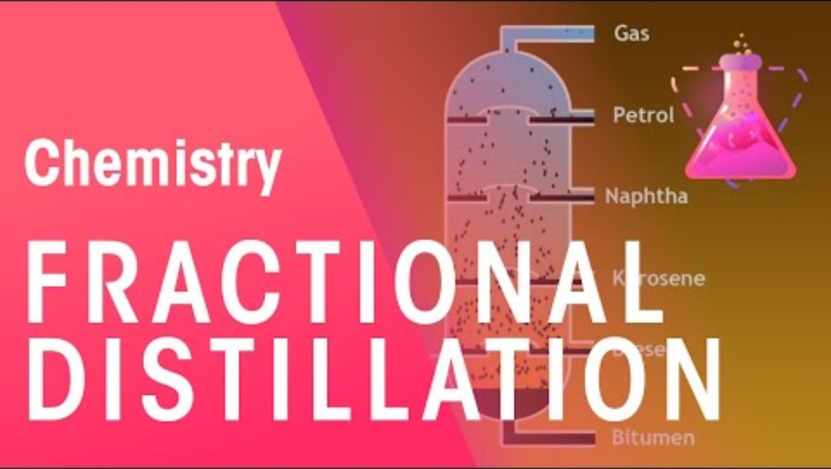
3.2 Fractional distillation
Fractional distillation (4:05)
Notes:
Teacher notes:
Click on the play button to open the Fractional distillation (4:05) YouTube video. Students complete questions while they watch the video. Those questions can be found in TRB3 3.2 Hydrocarbons are everywhere.

Slide 77
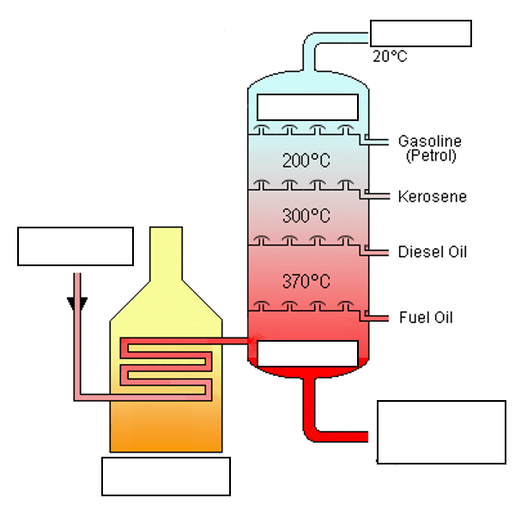
3.2 Fractional distillation diagram
Add these labels to the diagram:
Crude oil
400 ºC
Liquid petroleum gas (LPG)
Furnace
Very long hydrocarbons (lubricating oil, paraffin wax, asphalt)
150 ºC
Image credit: Crude oil distillation via Wikimedia Commons is used under the CC BY-SA 3.0 licence.
Notes:
Teacher notes:
Students label the diagram and discuss reasons for placement.

Slide 78
3.3 Give them a name
Learning intentions and success criteria
We are learning | I can
to describe the similarities and differences between materials based on their chemical properties | build molecular models of the first 8 alkanes identify the functional group of an organic compound identify and name the first 8 alkanes draw the structure of the first 8 alkanes name some simple alkenes, alkynes, alcohols and carboxylic acids
Notes:
Teacher notes:
For more information See ⁠AITSL or the NSW Department of Education explicit teaching strategies, ⁠Sharing learning intentions and ⁠Sharing success criteria​
LISC is not necessarily presented at the beginning of the lesson. Teacher needs to consider most effectual time to introduce ​
LISC should be revisited during the lesson to support students' evaluation of their learning.

Slide 79
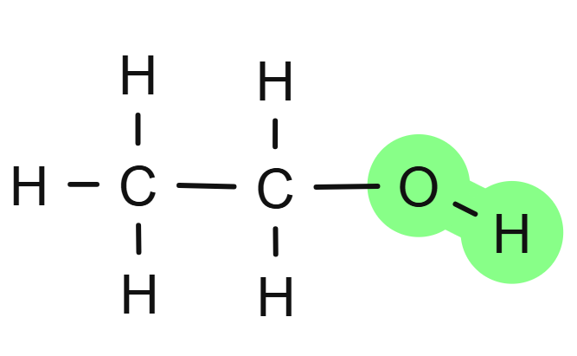
3.3 The role of IUPAC
International Union of Pure and Applied Chemistry
IUPAC is responsible for establishing clear and consistent naming systems
(also known as nomenclature) and terminology. It has a system for naming chemical compounds that provides a standard language for scientists worldwide.
Notes:
Teacher note:
Use this slide to describe the role of IUPAC and unpack the naming of organic compounds.

Slide 80
3.3 Naming organic compounds (1 of 2)
The IUPAC name of an organic compound consists of 2 main parts
Prefix – is the first part of the name of an organic compound, it refers to the number of carbon atoms are in the longest continuous carbon chain.
Suffix – is the second part of the name of an organic compound shows the type of bond between the carbon atoms or the functional group.
A functional group is a specific group of atoms or bonds within a molecule that is responsible for the characteristic chemical reactions of that compound.
Notes:
Teacher note:
Use this slide to describe the role of IUPAC and unpack the naming of organic compounds.
The compound on this slide has the –OH group highlighted to draw attention to the fact that this is an example of a functional group. This is a hydroxyl group, which would mean the suffix would ‘anol’, making this compound methanol a type of alcohol.

Slide 81
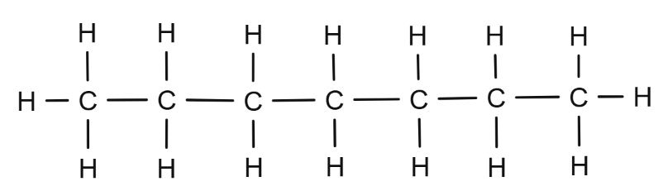
3.3 Naming organic compounds (2 of 2)
A worked example
Rules for naming organic compounds
1. Count the number of carbon atoms in the longest continuous chain. Use this number to determine the prefix.
2. Identify the functional group to determine the suffix.
3. Write the prefix followed by the suffix to name the organic compound
1
2
3
4
5
6
7
Prefix for 7 carbons = ?
Suffix for carbon chain with single bonds
= ?
Name of compound = ?
Prefix for 7 carbons = hept-
Suffix for carbon chain with single bonds
= -ane
Name of compound = heptane
Notes:
Teacher notes:
This slide contains animations to unpack how to name an organic compound.
Step 1: Count the number of carbons (click to bring up the numbers on each carbon). Ask students to look at Table 1 in the student resource and tell you what the prefix for 7 carbons is. Students should answer ‘Hept-’
Step 2: Identify the functional group. The functional groups are outlined in Table 2 of the student resource. This example is an alkane because there are only single bonds between the carbons.
Step 3: Join the prefix and suffix to write the name of the alkane.

Slide 82
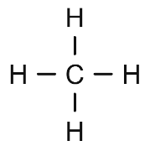
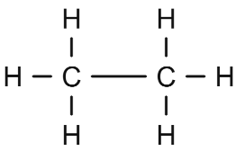
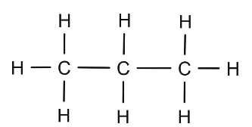
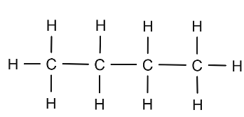
3.3 Naming organic compounds – alkanes (1 of 2)
IUPAC Name
Number of carbon atoms/functional group
Structure
Methane
1
Ethane
2
Propane
3
Butane
4
Notes:
Teacher notes:
This slide contains animations to bring up the sample answers for the IUPAC name and structure of simple alkanes. This is in problem set 1 in the Student resource – naming organic compounds found in TRB3.

Slide 83
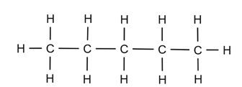
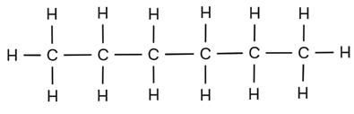
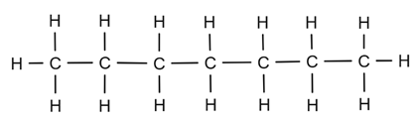
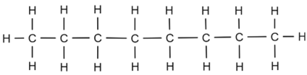
3.3 Naming organic compounds – alkanes (2 of 2)
IUPAC Name
Number of carbon atoms/functional group
Structure
Pentane
5
Hexane
6
Heptane
7
Octane
8
Notes:
Teacher notes:
This slide contains animations to bring up the sample answers for the IUPAC name and structure of simple alkanes.

Slide 84
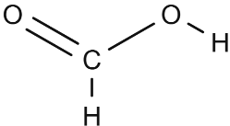
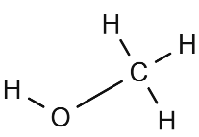
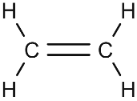
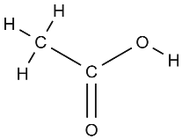
3.3 Naming organic compounds – problem set 2 (1 of 2)
Structure
Prefix (# of carbon atoms
Suffix (functional group
IUPAC Name
-anoic acid
(carboxylic acid)
meth-
(1)
methanoic acid
-anol
(alcohol)
meth-
(1)
methanol
-ene
(alkene)
eth-
(2)
ethene
-anoic acid
(carboxylic acid)
eth-
(2)
ethanoic acid
Notes:
Teacher notes:
This slide contains animations to bring up the sample answers.
This is problem set 2 from Student resource – naming organic compounds in TRB3.

Slide 85
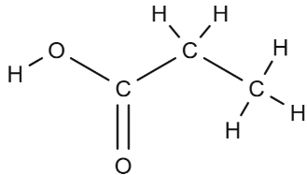
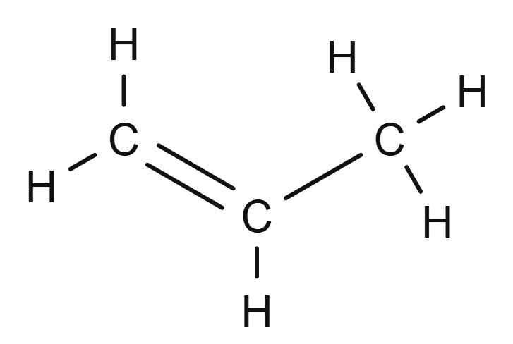
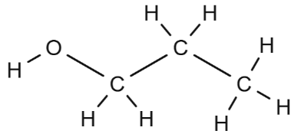
3.3 Naming organic compounds – problem set 2 (2 of 2)
Structure
Prefix (# of carbon atoms
Suffix (functional group
IUPAC Name
-anoic acid
(carboxylic acid)
Prop-
(3)
Propanoic acid
-ene
(alkene)
Prop-
(3)
Propene
-anol
(alcohol)
Prop-
(3)
Propanol
Notes:
Teacher notes:
This slide contains animations to bring up the sample answers.
This is problem set 2 from Student resource – naming organic compounds in TRB3.

Slide 86
3.4 All things combustion (practical investigation) (1 of 2)
Learning intentions and success criteria
We are learning | I can
to explain the use of materials based on their chemical properties. | define complete and incomplete combustion give an example of complete and incomplete combustion identify the products of complete and incomplete combustion compare the products of complete and incomplete combustion compare the energy released by complete and incomplete combustion.
See next slide for the other LISC
Notes:
Teacher notes:
For more information See ⁠AITSL or the NSW Department of Education explicit teaching strategies, ⁠Sharing learning intentions and ⁠Sharing success criteria​
LISC is not necessarily presented at the beginning of the lesson. Teacher needs to consider most effectual time to introduce ​
LISC should be revisited during the lesson to support students' evaluation of their learning.

Slide 87
3.4 All things combustion (practical investigation) (2 of 2)
Learning intentions and success criteria
We are learning | I can
to design a safe and valid investigation | identify the data that need to be collected in an investigation identify and mitigate risks in an investigation design a valid and safe investigation
to use cause and effect relationships to make predictions. | identify simple relationships make logical predictions based on cause-and-effect relationships provide reasoning for my predictions.
Notes:
Teacher notes:
For more information See ⁠AITSL or the NSW Department of Education explicit teaching strategies, ⁠Sharing learning intentions and ⁠Sharing success criteria​
LISC is not necessarily presented at the beginning of the lesson. Teacher needs to consider most effectual time to introduce ​
LISC should be revisited during the lesson to support students' evaluation of their learning.

Slide 88
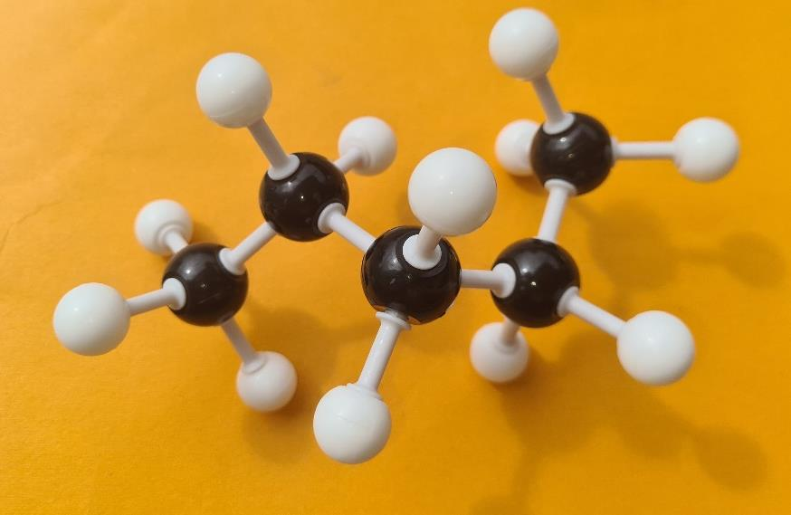
3.4 Checkpoint
Identify the common alkane in the image
Notes:
Teacher notes:
Ask the students to identify the molecule in the image.
Answer: pentane

Slide 89
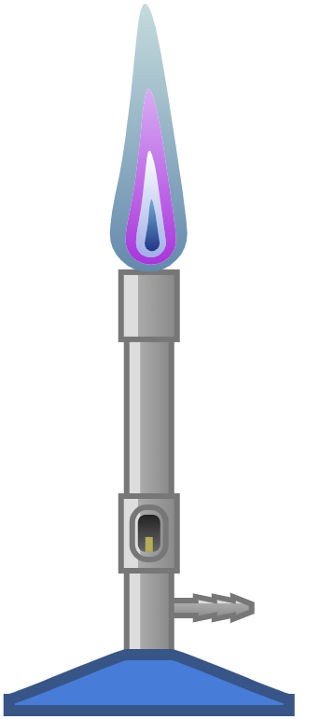
3.4 Complete combustion – sample response
Definition
Complete combustion of a hydrocarbon occurs when the hydrocarbon reacts with an excess of oxygen, ensuring that all the hydrocarbon is fully oxidised.
Products
Carbon dioxide and water.
Properties
Burns with clear flame
Low pollutants
Blue flame
High energy output
Examples
Burning natural gas in a stove
Burning propane (LPG) in a BBQ
Combustion of fuel in a car.
This work has been generated using Chemix.
Notes:
Teacher notes:
This slide contains a sample response for the worksheet. It may be used to support students as they complete their worksheet.

Slide 90
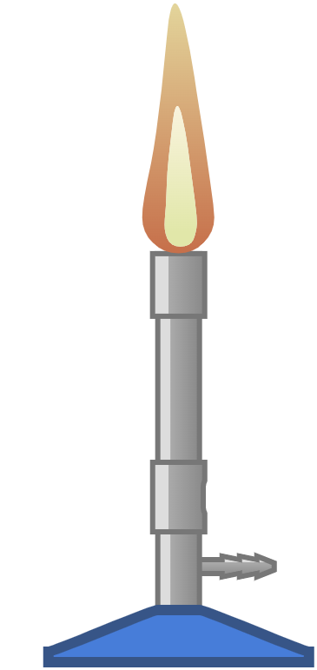
3.4 Incomplete combustion – sample response
Definition
Incomplete combustion of a hydrocarbon occurs when the hydrocarbon reacts with a limited supply of oxygen, the hydrocarbon is not fully oxidised.
Products
Carbon monoxide, carbon and water
Properties
Burns with dirty flame (coats objects with soot)
High pollutants (CO and soot)
Yellow/orange flame
Lower energy output
Examples
Burning wood in a fireplace
Car exhaust emissions
Bunsen burner with the holes on the collar closed
This work has been generated using Chemix.
Notes:
Teacher notes:
This slide contains a sample response for the worksheet. It may be used to support students as they complete their worksheet.

Slide 91
3.4 Checkpoint 1
What is a key characteristic of complete combustion?
It produces soot and carbon monoxide.
It occurs in the presence of a limited supply of oxygen.
It produces carbon dioxide and water as the main products.
It has a yellow flame.
Notes:
Teacher notes:
This slide is animated to highlight the correct answer.
Correct Answer: C) It produces carbon dioxide and water as the main products.
A incorrect
This response describes a characteristic of incomplete combustion, not complete combustion. Incomplete combustion occurs when there is not enough oxygen, leading to the production of soot and carbon monoxide.
B Incorrect
This statement is incorrect for complete combustion. Complete combustion requires an adequate supply of oxygen to fully oxidise the fuel. A limited supply of oxygen results in incomplete combustion.
C correct
D incorrect
A yellow flame is typically associated with incomplete combustion, indicating inefficient burning and the presence of soot. Complete combustion is indicated by a blue flame, which shows a clean burn with sufficient oxygen available.

Slide 92



3.4 Predict-Observe-Explain (POE)
Topic – complete and incomplete combustion
Concept – flame efficiency
Predict
[insert prediction/s and reasoning]
Observe
[insert prediction/s and reasoning]
Explain
[insert prediction/s and reasoning]
Notes:
Teacher notes:
P-O-Es are most commonly used when conducting investigations or experiments. They can also be used for predicting the opening scenes of a play or the sequel of a novel, or designing and building new inventions.
Use this template to record responses in the editable text boxes.
Predict (Before an experiment or investigation): What do you think will happen? Why do you think that will happen?
Observe (During) What actually happened? Was it different from your prediction?
Explain (After): Why did that happen? Discuss responses.

Slide 93
3.4 Calculation of energy transferred to the water
The energy transferred to the water as thermal energy, Ethermal can be calculated by the formula:
Ethermal = mass of water (m) × 4.18 (c) × change in temperature (∆T), where:
m is the mass of water (g)
c = 4.18 JK-1g-1 is the specific heat capacity of water (the energy required to raise the temperature of 1 gram of water by 1 degree Celsius)
∆T is the change in temperature of the water (°C).
For example, if the mass of water is 100 g, the change in temperature of water is 5 °C (temperature increases from 20 °C to 25 °C), when heated for 6 minutes, then energy transferred to the water, Ethermal is 2090 J.
E_{thermal} = m × 4.18 × ∆T
E_{thermal} = (100) (4.18) (5)
E_{thermal} = 2090.0 J
Notes:
Teacher notes:
This slide contains animations.
Use this slide to explain how to calculate the thermal energy produced during the combustion of methane. Demonstrate the calculations step by step. Students will then use the calculate to calculate the thermal energy transferred to water by both complete and incomplete combustion of methane gas.

Slide 94
3.4 Checkpoint 2
Exit ticket
A car engine burns petrol (a hydrocarbon) to release energy, which is used to move the car. An air filter cleans the air that goes to the motor. To burn properly, the engine requires a sufficient supply of oxygen, which is obtained from the air. An air filter helps clean the air before it enters the engine.
What would happen if the air filter became dirty or clogged?
What type of combustion is likely to occur?
Will more or less energy be released? Explain why
Notes:
Teacher notes:
Use this exit ticket after completing the practical investigation comparing complete and incomplete combustion.
Sample answers:
Not enough oxygen will be able to get to the engine, where combustion takes place.
Incomplete combustion
Less energy. The car will be less fuel-efficient because incomplete combustion does not fully burn the fuel. Instead of the petrol being burnt to produce carbon dioxide and water, it will produce carbon monoxide, carbon and water.

Slide 95
3.5 How have we used hydrocarbons?
Learning intentions and success criteria
We are learning | I can
to explain the use of materials based on their chemical properties. | outline a past use of hydrocarbons outline a current use of hydrocarbons describe how the use of hydrocarbons has changed recognise that the environmental impacts of the use have changed the use of a hydrocarbon compound.
Notes:
Teacher notes:
For more information See ⁠AITSL or the NSW Department of Education explicit teaching strategies, ⁠Sharing learning intentions and ⁠Sharing success criteria​
LISC is not necessarily presented at the beginning of the lesson. Teacher needs to consider most effectual time to introduce ​
LISC should be revisited during the lesson to support students' evaluation of their learning.

Slide 96

3.5 Using hydrocarbons
Slide 1
the name of the hydrocarbon
the formula for the hydrocarbon
an image of the structure of the hydrocarbon
an image of the hydrocarbon
Task
Research the current and historical
use of your allocated hydrocarbon.
Create a summary of your findings in 2 slides for the shared slide deck.
Slide 2
an explanation of how the hydrocarbon has been
used in the past
an explanation of how the hydrocarbon is used now
the environmental impacts of its use
relevant images
Notes:
Teacher notes:
This slide show students what they need to do in their hydrocarbon presentation. See TRB 3 for more information.

Slide 97
3.5 Checkpoint – How have we used hydrocarbons?
Match the materials with their uses.
Note – this question has a mixture of hydrocarbon fractions and pure hydrocarbon compounds.
Word bank
Oil
Kerosene
Butane
Octane
Ethene
It is used as a fuel in modern high-performance vehicles.
It has been used as a source of heat and light since the mid-19th Century.
It has been used as a lubricant and fuel since ancient times.
It is used to help ripen bananas and other fruit.
It is used as a fuel for lighters and stoves.
Notes:
Teacher notes:
This slide includes animations.
Click on the tiles under the Word bank (in any order) to match it to its meaning.

Slide 98



3.5 Think-Pair-Share
How has our use of hydrocarbons changed over time?
Think
Individual thinking time
Pair
Share your thoughts with a partner
Share
Share with a larger group or class
Notes:
Teacher notes:
Think-Pair-Share involves students thinking independently about a prompt or problem, pairing up with a classmate to discuss their ideas, and then sharing their combined knowledge with the class. It:
allows educators to change a traditional whole-class discussion into a more manageable and inclusive activity where all students are given an opportunity to respond
promotes the development of students' speaking, listening and social skills

Slide 99
3.5 How has our use of hydrocarbons changed over time?
Hydrocarbon
Properties
Modern uses
Environmental impact
Historical uses
Notes:
Teacher notes:
This slide can be printed as a graphic organiser to support students organise their thoughts.

Slide 100
3.6 Polymer raw ingredients
Learning intentions and success criteria
We are learning | I can
to identify the use of polymers based on their physical and chemical properties. | define polymer and monomer identify the different types of raw materials used for making polymers Classify polymers as synthetic polymers or biopolymers based on the source of the raw material
Notes:
Teacher notes:
For more information See ⁠AITSL or the NSW Department of Education explicit teaching strategies, ⁠Sharing learning intentions and ⁠Sharing success criteria​
LISC is not necessarily presented at the beginning of the lesson. Teacher needs to consider most effectual time to introduce ​
LISC should be revisited during the lesson to support students' evaluation of their learning.

Slide 101
3.6 Checkpoint 1
Polymer raw ingredients – prior knowledge
Which of the following substances is classified as an organic compound?
Carbon Dioxide (CO₂)
Ethane (C2H6)
Sodium Chloride (NaCl)
Water (H2O)
Why is the substance you chose classified as an organic compound?
It contains carbon.
It is naturally occurring.
It is a compound made by living organisms.
It contains carbon covalently bonded to hydrogen atoms.
Notes:
Teacher notes:
This slide is animated.
Students complete the questions on mini whiteboards. Provide feedback and refer to the answer for explanation.
This slide is animated.
The diagnostic question is two-tiered to assess students’ prior understanding of concepts covered in the previous content groups, specifically the polymers content group.
Answer
B. Methane (CH₄). Although both carbon dioxide and ethane contain carbon, carbon dioxide is an inorganic compound as it does not have carbon-carbon or carbon-hydrogen bonds.
D. It contains carbon covalently bonded to hydrogen atoms.

Slide 102
3.6 Checkpoint 2
Polymer raw ingredients – prior knowledge
Which of the following is a hydrocarbon?
        Ammonia (NH₃)
        Ethanol (C₂H₅OH)
        Glucose (C₆H₁₂O₆)
        Propane (C₃H₈)
Why is the substance you selected in Question 3 classified as a hydrocarbon?
        It is used as fuel.
        It is a component of fossil fuels.
        It contains only carbon and hydrogen atoms.
        It has more hydrogen atoms than carbon atoms.
Notes:
Teacher notes:
This slide is animated.
Students complete the questions on mini whiteboards. Provide feedback and refer to the answer for explanation.
This slide includes animation.
The diagnostic question is two-tiered to assess students’ prior understanding of concepts covered in the previous content groups, specifically the polymers content group.
Answer
D. Propane (C₃H₈). Although ethanol, glucose and propane are organic compounds but only propane is a hydrocarbon
C. It contains only carbon and hydrogen atoms.

Slide 103

3.6 Polymers
Polymers are large molecules made up of smaller repeating units called monomers. The word polymer comes from the Greek word 'poly’, meaning ‘many’ and the Greek ‘meros’, meaning 'part or portion’.
Polymers can be made synthetically, but some also occur naturally.
Examples – polyethylene (plastic bags), PVC pipes, starch, cellulose, Polyester (PET), rubber
Analogy for a polymer, with each link representing a monomer
Notes:
Teacher notes:
Define polymers using the information on the slide.
Create a chain of paper clips to illustrate the polymer analogy to students.
A paper clip represents a monomer, a small molecule that can join with others. Link several paperclips together to represent the polymerisation process, where many monomers chemically bond to form a polymer chain. The long chain of connected paperclips illustrates how polymers are composed of repeating units.

Slide 104
3.6 Polymers versus plastics
Plastics are subsets of polymers
Plastics are a group of materials, either synthetic or naturally occurring, that may be shaped when soft and then hardened to retain the given shape.
All plastics are polymers, but not all polymers are plastics.
For example, large molecules like DNA, wool, proteins, and natural rubber are all polymers, but they are not plastics.
Plastics
Polymers
Notes:
Teacher notes:
This slide includes animation.
Explain that the term ‘plastics’ is commonly used but they are subsets of polymers

Slide 105
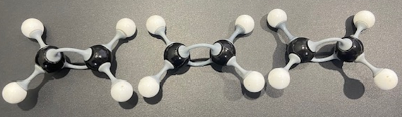
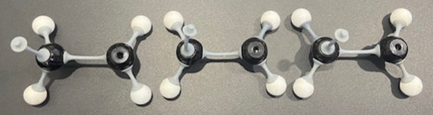
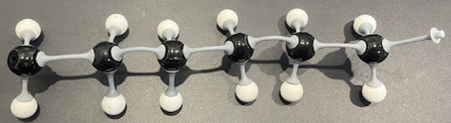
3.6 Structure of polymers
Constructing ball and stick structures of polymers
Construct 3 ball and stick models of ethene, each with 2 carbon atoms (black balls) bonded to each other with a double bond (grey sticks) and 2 hydrogen atoms (white balls) bonded to each carbon with a single bond.
Open the carbon-carbon double bond in each ethene molecule.
Connect the 3 ethene molecules with the open covalent bond (grey stick) to form a chain.
You have made polyethylene!
Notes:
Teacher notes:
This slide includes animation.
Students use Molecular model kits to make models of polyethylene consisting of 3, 4 or 5 monomers.
Extension
Ask students to make straight chain Linear) and branched Polymers and ask them to predict their density ( based on their structure.
Prompt:
linear chains, tightly packed, high density-HDPE
Branched chains-loosely packed, low density- LDPE

Slide 106
3.6 Frayer diagram – polymers (1 of 2)
Definition
Facts/Characteristics
Polymers
Examples
Non-example
Notes:
Teacher notes:
Provide a brief overview of polymers as below:
Polymers are integral to modern life and are found in a wide range of everyday materials.
Plastics are perhaps the most common example, used in packaging, construction, and electronics due to their lightweight, durable, and cost-effective nature.
Synthetic fibres, such as polyester and nylon, are essential in clothing, ropes, and industrial fabrics, offering strength and resistance to wear.
Frayer diagrams are graphic organisers that help students develop or deepen awareness of unfamiliar concepts through defining the term and identifying examples and non-examples. They:​
support educators with introducing new words or concepts in the classroom​
activate students' prior knowledge of a topic and clarify potential misconceptions​
model what deep understanding of a term entails.​

Slide 107
3.6 Frayer diagram – polymers (2 of 2)
Word bank
synthetic
large
small
polymer
monomers
natural
glucose
bonded
nylon
water
polyethene
bonded
starch
carbon dioxide
polymerisation
Definition
_______are _____ molecules made up of _______repeating structural units called_______, which are _______together through a process called_________.
Facts/Characteristics
Made of repeating monomer units.
Can be _______(man-made) or ______.
Polymers
Examples
Non-example
_______
cellulose
_______
PVC
_______
_________
sodium chloride
PVC
_________
methane
_________
Notes:
Teacher notes:
Word bank
Synthetic, large, small, polymers, monomers, natural, glucose, bonded, nylon, water, polyethene, bonded, starch, carbon dioxide, polymerisation
Elaboration on examples
Starch and cellulose are natural polymers consisting of glucose monomer units. Starch is present in many food items, such as rice and potatoes, while cellulose is a key component of plant cell walls.
Polyethene, PVC and nylon are synthetic (man-made) polymers. Polyethene is made up of ethene monomer units.
Elaboration on non-examples
Sodium chloride is an ionic compound
Water and carbon dioxide are inorganic compounds
Methane and glucose are organic compounds, but they are not polymers. They are small molecules, whereas a polymer is a large molecule consisting of thousands of smaller units(molecules) bonded together through covalent bonds.

Slide 108
3.6 Frayer diagram – polymers (sample)
Definition
Polymers are large molecules made up of repeating structural units called monomers, which are bonded together.
Facts/Characteristics
Made of repeating monomer units.
Can be synthetic (man-made) or natural.
Polymers
Examples
Starch
Cellulose
Polyethene
PVC
Nylon
Non-example
Sodium chloride
Water
Carbon dioxide
Methane
Glucose
Notes:
Teacher notes:
Elaboration on examples
Starch and cellulose are natural polymers consisting of glucose monomer units. Starch is present in many food items, such as rice and potatoes, and cellulose is a key component of plant cell walls.
Polyethene, PVC and nylon are synthetic (man-made) polymers. Polyethene is made up of ethene monomer units.
Elaboration on non-examples
Sodium chloride is an ionic compound
Water and carbon dioxide are inorganic compounds
Methane and glucose are organic compounds, but they are not polymers. They are small molecules, whereas a polymer is a large molecule consisting of thousands of smaller units(molecules) bonded together through covalent bonds.

Slide 109
3.6 Raw materials for polymers
Crude oil
Monomers like ethene (C₂H₄) and propene (C₃H₆), which are key building blocks for many polymers, are extracted from fossil fuels such (crude oil) through a series of industrial processes.
Fractional Distillation of Crude Oil
Crude oil is heated in a fractionating column. The hydrocarbons are separated into different fractions based on their boiling points.
Cracking
It breaks down large hydrocarbon molecules into smaller ones like ethene and propene. Then the mixture of smaller hydrocarbons is cooled and passed through a distillation unit to separate individual compounds.
Biomass (living things, mainly plants)
Starch
Extracted from crops like rice, corn and potatoes. Starch is processed into a polymers by plasticising it with water, glycerine, or other additives.
Cellulose
Extracted from the cell walls of plants like cotton, wood, and hemp. Cellulose is chemically modified to create plastics, that are biodegradable.
Sugars
Extracted form sugarcane, sugar beet, or corn syrup. Sugars are fermented by microorganisms to produce monomers like lactic acid, which can then be polymerised into polymers.
Notes:
Teacher notes:
This slide includes animations.
Explain to students about the two main sources of raw materials for polymers – Crude oil and biomass.
Crude oil- emphasise that the main raw materials for the most commonly used polymers are ethene and propene. Recall the processes for obtaining these raw materials from crude oil (fractional distillation and cracking).
Biomass raw materials include starch, cellulose, sugars and other raw materials. These raw materials are considered renewable. Some polymers from biomass sources are biodegradable.

Slide 110
3.6 Comparison of raw materials
Advantages and disadvantages of crude oil and plant based raw materials for polymers
 | Crude oil | Starch (PLA)
Advantages | Widely available and cost-effective. Produces durable polymers suitable for a wide range of applications. | Renewable and sustainable resource. Produces biodegradable plastics that break down easily in the soil, reducing long-term pollution.
Disadvantages | Non-renewable resource; finite supply. Significant environmental pollution during extraction and processing (greenhouse gas emissions). Resulting polymers ( such as polyethylene, polypropylene) are non-biodegradable, causing long-term plastic waste. | Requires large amounts of agricultural land, which may compete with food production. Resulting polymers are less durable and may not be suitable for all applications.
Notes:
Teacher notes:
Use this slide to outline the advantages and disadvantages of using crude oil and plant based raw materials in the production of materials.

Slide 111
3.7 Properties of polymers
Learning intentions and success criteria
We are learning | I can
to describe the use of polymers based on their physical and chemical properties | identify the properties of different types of polymers describe the properties of the different types of polymers link the properties of the polymer to its uses.
to design a safe and valid investigation | describe the purpose of the investigation conduct a risk assessment to manage safety outline suitable tests to test the properties of polymers assess the type data that needs to be collected
to solve problems | select suitable strategies to test properties identify suitable polymers for particular uses use evaluation criteria, to assess which properties make a polymer suitable for a particular use.
Notes:
Teacher notes:
For more information See ⁠AITSL or the NSW Department of Education explicit teaching strategies, ⁠Sharing learning intentions and ⁠Sharing success criteria​
LISC is not necessarily presented at the beginning of the lesson. Teacher needs to consider most effectual time to introduce ​
LISC should be revisited during the lesson to support students' evaluation of their learning.

Slide 112
3.7 Prior knowledge checkpoint
Properties of polymers
Which of the following statements about polymers is FALSE?
All polymers are synthetic substances created through human-made processes.
Polymers can be found in both natural and synthetic forms.
Proteins and DNA are examples of natural polymers.
Some polymers are designed to be biodegradable under certain conditions.
Explain your choice.
Notes:
Teacher notes:
This slide is animated.
Correct Answer:
A. All polymers are synthetic substances created through human-made processes.
Explanation: This statement is false because polymers exist in both natural and synthetic forms. Natural polymers include substances like proteins, DNA, and cellulose, while synthetic polymers encompass materials such as plastics and nylon. Assuming all polymers are synthetic is a common misconception.

Slide 113
3.7 Polymers in common items
Item | Polymer | Abbreviation
Disposable water bottle | Polyethylene terephthalate or polyester High density polyethylene Low density polyethylene | PET HDPE LDPE
Disposable water bottle lid | High density polyethylene | HDPE
Milk bottle | High density polyethylene | HDPE
Bin liners | Generally low-density polyethylene | LDPE
Cling wrap | Generally low-density polyethylene or Polyvinyl chloride | LDPE
PVC pipe | Polyvinyl chloride | PVC
Margarine/butter container, food container | Polypropylene | PP
Meat trays, bean bag filings | Polystyrene | PS
Notes:
Teacher notes:
This slide is to be used in the Investigating the properties of polymers practical investigation. See TRB3 3.7 Investigating the properties of polymers.
You may need to change the content on the slide depending on the polymer samples collected for the investigation.
Show students the collected polymer samples. Identify the type of polymer each test item is made of using the ‘plastic identification codes’ on the item/packaging to identify the polymer.

Slide 114
3.7 Linking properties to uses of polymers
What conclusions can you draw about the relationship between the properties of polymers and their suitability for specific applications based on the investigation?
Notes:
Teacher notes:
Sample Answer:
The investigation revealed that polymers exhibit diverse properties, such as strength, flexibility, heat resistance, and transparency, which influence their suitability for specific applications. For example, the high strength and rigidity of HDPE make it ideal for products such as milk bottles and rubbish bins, where durability is crucial. In contrast, the flexibility and lightweight nature of LDPE are better suited for items like plastic bags and cling wraps. Additionally, the heat resistance of polymers like polypropylene makes them suitable for food containers that need to withstand high temperatures. This highlights how the specific properties of a polymer determine its use and why it is important to test these properties before selecting materials for different applications.
Note: Students may provide different examples of polymers based on their investigation. The key points are:
They can conclude that different polymers have different properties that influence their suitability for specific applications
They can provide specific examples of polymers and link their uses to the specific properties

Slide 115
3.7 Checkpoint – properties of polymers
A company is designing reusable water bottles and must choose between 2 polymers: Polypropylene (PP) and Polyethylene Terephthalate (PET).
PP – Strong, lightweight, and heat-resistant.
PET – Transparent, strong, lightweight, and recyclable.
Question
Based on the properties of these polymers, which 1 would you recommend for the water bottles and why?
Notes:
Teacher notes:
Sample Answer:
PET is better for water bottles because it’s transparent, allowing users to see the water level, which is practical for everyday use. Additionally, it is also strong, lightweight, and recyclable. While PP is heat-resistant, this property is less important for a standard water bottle compared to the advantages that PET provides.

Slide 116
3.8 So many polymers
Learning intentions and success criteria
We are learning | I can
to describe the use of polymers based on their physical and chemical properties | locate the recycling code on the items identify the polymer using the recycling code link the properties of the polymer to its uses
to design an investigation (a physical survey). | describe the purpose of a survey ensure safety identify the types of data that need to be collected in a survey
Notes:
Teacher notes:
For more information See ⁠AITSL or the NSW Department of Education explicit teaching strategies, ⁠Sharing learning intentions and ⁠Sharing success criteria​
LISC is not necessarily presented at the beginning of the lesson. Teacher needs to consider most effectual time to introduce ​
LISC should be revisited during the lesson to support students' evaluation of their learning.

Slide 117
3.8 Decoding plastic identification numbers to identify polymers
Plastic identification number | Abbreviation | Polymer
1 | PET | Polyethylene Terephthalate or polyester
2 | HDPE | High-Density Polyethylene
3 | PVC | Polyvinyl Chloride
4 | LDPE | Low-Density Polyethylene
5 | PP | Polypropylene
6 | PS | Polystyrene
7 | Other | Miscellaneous plastics
Notes:
Teacher notes:
Use this slide to explain the plastic identification numbers on plastic items. These are sometimes referred to as recycling codes, but it is essential to note that this designation does not always guarantee that the product can be recycled. The code identifies the type of polymer used to make the product.

Slide 118
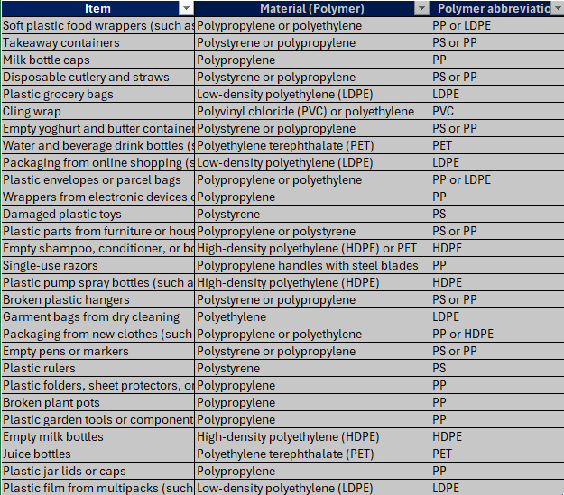


3.8 Creating a tally table in MS Excel
Select the entire table
Click on insert and select ‘Recommended Pivot Tables’
A new message box will open. Click ‘OK’. It will create a tally table in a new sheet
Notes:
Teacher notes:
Use the instructions in this slide to guide students in constructing a tally table
Select the entire survey data table.
Click on insert and select ‘Recommended Pivot Tables’ (see the red box in the slide)
A new message box will open. On the left-hand side, a preview of the tally table will be displayed (see the red box in the slide). Click ‘OK’. It will create a tally table in a new sheet.

Slide 119



3.8 Creating a column graph in MS Excel
Select the entire table created in the new sheet
Click on insert and select ‘Recommended Charts’
A new message box will open. Click ‘OK’. It will create a clustered column graph.
Change the selection to pie graph to create a pie graph.
Notes:
Teacher notes:
Use the instructions in this slide to guide students in constructing a tally table
Select the entire table created in the new sheet.
Click on insert and select ‘Recommended Charts’ (see the red boxes in the slide).
A new message box will open. On the right-hand side, a preview of the clustered column graph will be displayed (see the red box in the slide). Click ‘OK’. It will create a tally table in a new sheet.

Slide 120


3.8 Data visualisation – sample graphs
Notes:
Teacher notes:
This slide can be used to show students two different ways they may represent their survey data.

Slide 121
3.9 Is it biodegradable? (1 of 2)
Learning intentions and success criteria
We are learning | I can
to describe the use of polymers based on their physical and chemical properties | define biodegradable and compostable identify the properties of a biodegradable material describe the conditions required for a polymer to biodegrade
to communicate scientific arguments | identify evidence to support an argument about biodegradability use scientific terminology appropriately write a scientific report about the biodegradability of different plastics
Notes:
Teacher notes:
For more information See ⁠AITSL or the NSW Department of Education explicit teaching strategies, ⁠Sharing learning intentions and ⁠Sharing success criteria​
LISC is not necessarily presented at the beginning of the lesson. Teacher needs to consider most effectual time to introduce ​
LISC should be revisited during the lesson to support students' evaluation of their learning.

Slide 122
3.9 Is it biodegradable? (2 of 2)
Learning intentions and success criteria
We are learning | I can
to design a valid investigation. | identify risks and ensure safety in a practical investigation on biodegradability of polymers identify the types of data that can be collected to assess the biodegradability of polymers identify and implement appropriate controlled variables
to evaluate proposed solutions to identified problems | determine the biodegradability of different polymers evaluate claims using scientific knowledge and findings from the polymer investigation
Notes:
Teacher notes:
For more information See ⁠AITSL or the NSW Department of Education explicit teaching strategies, ⁠Sharing learning intentions and ⁠Sharing success criteria​
LISC is not necessarily presented at the beginning of the lesson. Teacher needs to consider most effectual time to introduce ​
LISC should be revisited during the lesson to support students' evaluation of their learning.

Slide 123
3.9 Life cycle of plastics
Crude oil sourced plastics
Biomass sourced plastics
Raw materials from crude oil
Raw materials from biomass
Polymerisation
Biodegrade
Polymerisation
Disposal
(in landfill or incineration) or recycle
Production of items
Use
Production of items
Disposal
(in landfill or incineration)
Use
Recycled
Recycled
Notes:
Teacher notes:
This slide contains animations.
Unpack the life cycles of crude oil-sourced plastics and biomass-sourced plastics, and emphasise the following points:
For plastics made from crude oil
Raw materials are derived from non-renewable crude oil (existing in finite quantity and takes millions of years to replenish)
After use, plastics made from crude oil end up in landfills or are incinerated (burned). In some cases, they are recycled to form new items.
For plant-based plastics
The raw materials are derived from plants that are renewable (a natural resource that is not depleted and can be replenished easily).
Examples of the raw materials include cellulose, starch and sugars.
Some raw materials go through a polymerisation process to make polymers, others like cellulose naturally already are polymers.
After use biomass sourced plastics, either biodegrade or end up in the landfill or are incinerated (burnt). In some cases, they are recycled to form new items. Not all bioplastics can be recycled however.

Slide 124
3.9 Biodegradable versus compostable polymers
Biodegradable polymers are materials that can decompose into water, carbon dioxide and biomass over a period with the help of micro-organisms, especially bacteria.
Compostable
Compostable polymers are biodegradable plastics that under standard conditions and timeframe. biodegrade
Biodegradable
All compostable plastics are biodegradable, but not all biodegradable plastics are compostable.
Notes:
Teacher notes:
This slide contains animations.
Explain the meaning of biodegradable and compostable.
Emphasise the fact that not all biodegradable plastics are compostable. This means that they cannot be placed in the green compost waste bin at home, nor can they be put in a home compost.

Slide 125
3.9 Bioplastics
What exactly is a bioplastic? And are they always good?
Bio-based feedstock
Bio-based feedstock
This means that the plastic is made from plant sources such as corn starch.
Plastics made from bio-based feedstock are called bioplastics… but are they all biodegradable?
Crude oil feedstock
Are made from crude oil sources such as ethene. But some plastics made from these fossil fuels are referred to as ‘bioplastics’ because they can be broken down (biodegrade) at the end of their lifecycle.
NOT BIODEGRADABLE
The bioplastics and conventional plastics outlined are not biodegradable. Bio-PET for example, is chemically the same as PET, even though the starting material is different. The end product has the same consequence for the environment.
BIODEGRADABLE
The bioplastics circled in green are biodegradable. This means they are broken into water, carbon dioxide and biomass at the end of their life cycle.
Bioplastics
Bio-PE, Bio-PET,
Bio-PA,
Bioplastics
PBAT, PLA, Starch blends
Crude oil feedstock
Conventional plastics
PE, PET, PP, PVC
Bioplastics
PBAT, PCL
Notes:
Teacher notes:
This slide is animated.
Click to bring up bio-based feedstock
The plastics listed here (Bio-polyethylene, bio-PET, bio-PA, PBAT, PLA, Starch blends) are all made from bio-based feedstocks.
CLICK to bring up crude oil feedstock
Crude oil can be used to make conventional plastics like polyethylene, PET, polypropylene and PVC, and it can also be used to make bioplastics such as PBAT and PCL!
So, this means a plastic called a bioplastic may in fact be made from a crude oil feedstock! This is because these plastics can biodegrade at the end of their lifecycle.
CLICK to highlight the plastics that are NOT biodegradable
The plastics outlined in red are not biodegradable, this means they will not break down into water, carbon dioxide and biomass at the end of their lifecycle. These plastics mostly end up in landfill and some are recycled.
CLICK to highlight the plastics that are biodegradable
The bioplastics outlined in green are biodegradable. This means that under the right conditions they will break down into water, carbon dioxide and biomass.

Slide 126
3.9 Checkpoint
Which of the following statements about biodegradable plastics is TRUE?
All bioplastics are biodegradable.
Biodegradable plastics will break down quickly in any environment.
Bioplastics and biodegradable plastics are the same thing.
Some biodegradable plastics require specific conditions, like industrial composting, to decompose.
Notes:
Teacher notes:
This slide is animated to highlight the correct answer.
Students complete the questions on mini whiteboards. Provide feedback and refer to the explanation below.
This slide includes animation.
This question targets the misconception that all bioplastics are biodegradable or that they break down easily in all environments.
Explanation for incorrect options
A. All bioplastics are biodegradable.
Not all bioplastics are biodegradable. For example, some bioplastics, such as bio-based polyethylene (PE), are chemically identical to conventional plastics and do not break down naturally. The term ‘bioplastic’ refers to plastics derived from biological sources, not necessarily their ability to biodegrade.
B. Biodegradable plastics will break down quickly in any environment.
Biodegradable plastics require specific environmental conditions, such as the presence of microorganisms, moisture, and oxygen. Many need industrial composting facilities with high temperatures to decompose effectively. They may not break down in landfills or natural environments, such as oceans.
C. Bioplastics and biodegradable plastics are the same thing.
Bioplastics are derived from renewable biological sources (such as starch, corn), but they are not necessarily biodegradable. Conversely, biodegradable plastics may be made from biological or fossil fuel-derived materials. The two terms refer to different characteristics and should not be used interchangeably.
D. Some biodegradable plastics require specific conditions, like industrial composting, to decompose.
This is correct because many biodegradable plastics, including some bioplastics, require controlled conditions such as high temperatures and humidity to decompose properly, which are not naturally present in most environments.

Slide 127
3.10 Microplastics
Learning intentions and success criteria
We are learning | I can
to explain the impact of polymers on the environment | define microplastics define bioaccumulation describe the harmful effects of microplastics
to communicate scientific arguments. | identify evidence to support an argument use scientific terminology appropriately communicate using different forms.
Notes:
Teacher notes:
For more information See ⁠AITSL or the NSW Department of Education explicit teaching strategies, ⁠Sharing learning intentions and ⁠Sharing success criteria​
LISC is not necessarily presented at the beginning of the lesson. Teacher needs to consider most effectual time to introduce ​
LISC should be revisited during the lesson to support students' evaluation of their learning.

Slide 128

3.10 What are microplastics
Microplastics are small particles of plastic in the environment, generally smaller than 5 millimetres in size. They:
result from both commercial product development (such as cosmetics and cleaning agents) and the breakdown of larger plastics.
have a variety of shapes, such as particles or fibres.
are pollutants in the environment.
Notes:
Teacher notes:
Define the term microplastics, using the information on the slide. Discuss where they come from.

Slide 129

3.10 Fate of microplastics
Microplastics Sources, Pathways and Fate Conceptual Diagram by Jeffrey L. Corbett, USGS on USGS Public Domain
Notes:
Teacher notes:
This slide has animations.
Sources of microplastics:
Draw students' attention towards the key: Click:
Red circle for the sources of microplastics,
Blue for the pathways (how do microplastics move through the environment)
Black circle for the fate of microplastics (where they end up)
Go through the sources of microplastics:
Small particles from the fishing lines and nets
Household products like shopping bags, cosmetics and hygiene products
Plastic pellets(resins) that are manufactured to produce different types of plastic items
Tyre dust (small particles that are released by the moving vehicles due to the friction between the road and the tyre)
Landfill containing plastic items
How do they enter the environment (soil and waterways)?
The common pathways are:
Microplastics in the air are dispersed with wind and washed with rain, thus leaching into the soil and entering waterways.
Additionally, urban agriculture stormwater run off and wastewater treatment plants discharge microplastics into waterways.
Where do microplastics end up?
In the soil
Waterways
Ingested by land and marine animals as they mistake them for food.

Slide 130

3.10 Bioaccumulation
Bioaccumulation (of a substance, especially a toxin) is the build-up of substances (especially toxins)
in an organism over time. It occurs by direct adsorption or through food chains.
Pathway of microplastics on springer under CC4.0
Notes:
Teacher notes:
Sources of microplastics:
Explain that microplastics can enter food chains through ingestion by small organisms like zooplankton, and larger animals then consume these smaller animals, resulting in bioaccumulation.
Explain that microplastics have toxic effects on all organisms (land and marine)
Oxidative stress is an imbalance of free radicals and antioxidants in your body that leads to cell damage.
Oxidative damage refers to the harm caused to cellular molecules such as DNA and lipids by reactive oxygen species (ROS), which can be generated by factors such as chemical agents

Slide 131
3.10 What is a case study
Scientific investigations
A scientific case study is a detailed investigation of a specific scientific phenomenon, event, organism, location or process examined within its real-world context. It employs scientific methods and data to investigate the causes, effects, or unique features of the case.
Key features
Focussed on 1 instance – It studies a particular example in depth (for example, a disease outbreak, an endangered species or a local pollution event).
Evidence-based – It draws on data such as observations, experiments, measurements or records.
Scientific reasoning – It applies analysis, interpretation, and evaluation to draw conclusions or generate new questions.
Notes:
Teacher notes:
Use this slide to define a case study as a type of scientific investigation and to outline the key features of a case study.

Slide 132

3.10 Poster content
The location and environment of the case study.
The role of microplastics in the ecosystem.
The effects of bioaccumulation on wildlife and humans.
Any solutions or actions proposed to address the issue.
Notes:
Teacher notes:
Students can design the posters individually or in groups. Pictures on the left is a sample poster template from CANVA. The intended poster content is outlined on the right of the slide.

Slide 133
3.10 Quality criteria for poster design
Engaging title – Make the title catchy and clear.
Logical flow – Organise the poster into sections that guide the viewer through the information.
Balance – Leave sufficient white space between sections to make the poster uncluttered and readable.
Concise content – Use bullet points or short paragraphs rather than long blocks of text.
Use high-quality images.
Use graphs or charts to present data.
Review and edit – proofread and seek feedback.
Notes:
Teacher notes:
This slide contains animations.
Engaging title: Make the title catchy and clear (e.g., "Microplastics in the food chain: A growing threat").
Logical flow: Organise the poster into sections that guide the viewer through the information
Balance: Leave sufficient white space between sections to keep the poster uncluttered and readable. Avoid overcrowding with too much text or visuals.
Concise content: Use bullet points or short paragraphs rather than long blocks of text. Aim to summarise key ideas. Key Terms: Bold or highlight important words or phrases for emphasis
Use high-quality images: Include relevant images, diagrams, or illustrations to make the poster visually appealing. Ensure visuals are high resolution and not pixelated.
Graphs and charts: Use graphs and charts to present data effectively. Label them clearly and include a brief caption. For example, use a bar chart for statistics or a diagram to illustrate processes such as bioaccumulation.
Colour coding: Use colours to differentiate sections or emphasise important content. Avoid using too many colours—stick to 2–3 complementary shades.
Call to action: Include a call to action or solution to engage your audience, such as ‘Reduce plastic use’

Slide 134
3.11 Sustainable alternatives
Learning intentions and success criteria
We are learning | I can
to assess the use of materials based on their properties to evaluate different approaches to solving problems | identify the alternative materials to conventional plastics describe the advantages and disadvantages of the alternative materials over conventional plastics describe the challenges in replacing conventional plastics with alternative materials make a judgement on the use of alternative materials
to communicate scientific arguments. | identify evidence to support an argument use scientific terminology appropriately communicate using different forms.
Notes:
Teacher notes:
For more information See ⁠AITSL or the NSW Department of Education explicit teaching strategies, ⁠Sharing learning intentions and ⁠Sharing success criteria​
LISC is not necessarily presented at the beginning of the lesson. Teacher needs to consider most effectual time to introduce ​
LISC should be revisited during the lesson to support students' evaluation of their learning.

Slide 135

3.11 Plastic use data
The global plastic use has increased exponentially (from nearly zero in 1950 to 460 million tonnes in 2019)
The projected estimate is
1231 million tonnes by 2060.
Source: OECD Global Plastics Outlook Database
Notes:
Teacher notes:
This slide includes animation.
Tell students that this data is from a reliable source (OECD - Organisation for Economic Co-operation and Development) of data and information.
Population growth and higher incomes have driven up global plastics production, which doubled between 2000 and 2019, soaring to 460 million tonnes (Mt) in 2019. In this same period, the growth of plastics has outpaced that of economic growth by almost 40%. In the absence of new policies, plastics use is projected to triple from its 2019 levels, increasing to 1231 Mt by 2060.
There are a total of 14 countries within the Pacific/Oceania region. These 14 countries include Australia, Papua New Guinea, New Zealand, Fiji, the Solomon Islands, Federated States of Micronesia, Vanuatu, Samoa, Kiribati, Tonga, the Marshall Islands, Palau, Tuvalu, and Nauru.
Paste this URL for into a web browser for an interactive view: https://web-archive.oecd.org/2022-08-18/620573-plastics-lifecycle-is-far-from-circular.htm

Slide 136

3.11 Plastic disposal
Source: OECD Global Plastics Outlook Database
Notes:
Teacher notes:
This slide contains animations.
Tell students that this data is from a reliable source (OECD- Organisation FOR Economic Cooperation and Development) of data and information.
Use the key to unpack the graph with students.
CLICK to highlight OECD Oceana and WORLD
The data shows that in 2019:
Globally only 9% of plastic waste was recycled in 2019. OECD Oceana, which includes Australia, recycled less than this.
Globally about 19% of plastics were incinerated and almost 50% went to landfill. The remaining 22% was disposed of in uncontrolled dumpsites, burned in open pits or leaked into the environment.
Oceana had much less mismanaged and uncollected litter than the world %.
Paste this URL into a browser to explore this data further: https://web-archive.oecd.org/2022-08-18/620573-plastics-lifecycle-is-far-from-circular.htm for the interactive map.

Slide 137
3.11 Alternative materials for polymers
List alternative materials for conventional plastics.
Divide your list into 2 categories
  Biodegradable materials
  Non-biodegradable but sustainable materials
Each group shares 1 material from their list with the class and explains why it might be a suitable alternative.
Notes:
Teacher notes:
Brainstorm
In pairs or small groups, list as many alternative materials for polymers as you can think of. Consider natural sources, such as plants, animals, or renewable resources.
Categorise
Divide your list into two categories:
Biodegradable materials (for example, PLA, starch-based plastics).
Non-biodegradable but sustainable materials (such as recycled plastics, composite materials).
Share
Each group shares one material from their list with the class and explains why it might be a good alternative.

Slide 138
3.11 Sample answer
Biodegradable Materials
  PLA (made from corn or sugarcane)
  Starch-based plastics (derived from potatoes
  Natural rubber (from rubber trees)
Non-Biodegradable but sustainable materials
  Recycled PET (from plastic bottles)
  Glass
  Aluminium (used as a reusable packaging material)
Example
Material – PLA (Polylactic acid)
PLA is made from renewable plant resources like corn or sugarcane, making it biodegradable under industrial composting conditions.
It can replace single-use plastics in items such as food packaging and cutlery, reducing reliance on crude oil-based plastics.
Notes:
Teacher notes:
This slide contains animations
Use this slide as a sample response for the questions outlined on the previous slide.

Slide 139
3.11 Checkpoint 1
Which of the following is a disadvantage of using alternative materials like glass, metal, or bamboo instead of conventional plastics?
They are lightweight and easy to transport.
They require more energy to produce and transport
They are completely non-toxic to the environment.
They are cheaper to manufacture than plastic
Notes:
Teacher notes:
This slide contains an animation that highlights the correct answer.
Students complete the questions on mini whiteboards. Provide feedback and refer to the explanation below.
This slide includes animation.
Answer:
The correct answer is B. They require more energy to produce and transport.
Feedback on the incorrect options
A. They are lightweight and easy to transport
Explanation: While this is true for some alternative materials (like bamboo), it does not apply to glass and metal, which are often heavier and more difficult to transport compared to plastic.
C. They are completely non-toxic to the environment
Explanation: While many alternative materials are less harmful than plastics, glass, and metal can still pose environmental risks if not disposed of properly. For example, broken glass can be hazardous to wildlife, and certain metals can leach into ecosystems under specific conditions.
D. They are cheaper to manufacture than plastic
Explanation: Generally, alternative materials like glass and metal are more expensive to produce than plastic, as plastic is cheaper and easier to mass-produce.

Slide 140
3.11 Checkpoint 2
        Which of the following is an advantage of using alternative materials like glass, metal, or bamboo instead of conventional plastics?
        They are always cheaper than plastic.
        They are biodegradable and decompose quickly
        They are typically stronger and more durable
        They can be recycled less easily than plastic
Notes:
Teacher notes:
This slide contains an animation that highlights the correct answer.
Students complete the questions on mini whiteboards. Provide feedback and refer to the explanation below.
This slide includes animations.
The correct answer is c) They are typically stronger and more durable.
Explanations for incorrect options
A. They are always cheaper than plastic
Explanation: Alternative materials, such as glass and metal, are often more expensive to produce and transport compared to plastic due to higher raw material costs and increased energy requirements.
B. They are biodegradable and decompose quickly
Explanation: While materials like bamboo are biodegradable, glass and metal are not. Glass and metal can take a long time to break down and are not biodegradable in the same manner as some plastics or organic materials.
D. They can be recycled less easily than plastic
Explanation: This is generally not true. Glass and metal are highly recyclable, often more so than plastic, which can degrade in quality with each recycling cycle. However, recycling infrastructure can affect how easily they are processed.

Slide 141
3.11 Steps for infographic
Identify the purpose and audience
Research and collect relevant information including data
Plan the infographic
layout
Create the infographic
Review and edit
Notes:
Teacher notes:
Students research the information on one of the alternative materials and design an infographic to communicate their findings
Identify the purpose and audience: Make sure the language, images and details are age-appropriate and visually engaging
Collect relevant information and data: Research your topic to gather information and data.
Plan the infographic layout: Organise information into headings and subheadings to have a logical flow of information
Create the infographic: Use the Canva infographic template or another template to create your infographic.
Proofreading and editing: proofread and check for errors, such as spelling and grammar, and make necessary edits. Check the reference list.

Slide 142
3.11 Structure of infographic
Use the stepwise process to identify the advantages and disadvantages of the alternative material.
Make a judgement
Introduction
  Provide a brief overview of the material and its intended use.
Environmental benefits
  Highlight how it reduces air, land, and water pollution, as well as its carbon footprint compared to plastics.
Challenges
  Address any limitations or drawbacks, such as land use, industrial composting requirements, or recyclability issues.
Data and References
  Include a simple comparison chart or graph between the chosen material and conventional plastics.
  Include references
Notes:
Teacher notes:
This slide includes animation.
Guiding questions for research
How does the production of this material impact air, water, and soil compared to conventional plastics?
Does its production release fewer greenhouse gases?
Is it biodegradable, compostable or recyclable? If yes, under what conditions?
Does its disposal cause environmental harm (such as toxic byproducts or residue)?
Does it reduce reliance on fossil fuels?
What data do you have to support your claims?
Do you have data to compare the reduced environmental impact of your material (such as greenhouse gas emissions) with that of conventional plastics?
Include a judgement; is this material replacing conventional plastics? Is its use increasing
Extension: In addition to the above questions, students should also include information on the following
Does your material support circular economy (make, use, reuse, recycle) over linear economy (make, use, dispose)?
Any government policies (such as a ban on single-use plastics) that align with the use of your material.

Slide 143
3.11 Quality criteria for an infographic
  Purpose
  Focus on conveying information, visually and concisely. The infographic should have a clear objective and focus, with all content aligned to its central theme.
  Information
  All information must be accurate, relevant, and clear, breaking down complex ideas into understandable parts.
  It should provide enough detail without overwhelming the audience. Use relevant data to support your claim.
  Visualisation
  Use data and visuals (such as bar charts, pie graphs, icons, flow charts) to accurately represent information, enhance understanding, and maintain a consistent style.
  Elements must be visually appealing, accessible, and avoid distracting from the message.
  Use shapes and symbols to help reduce text, making your infographic easier to read
  Layout
  The infographic must have a logical structure, with a clear hierarchy to guide attention. Balance spacing, align, and effectively use visuals, include some whitespace to create a polished, uncluttered design.
Notes:
Teacher notes:
Purpose
Focus on conveying information, visually and concisely. The infographic should have a clear objective and focus, with all content aligned to its central theme.
Information
All information must be accurate, relevant, and clear, breaking down complex ideas into understandable parts.
It should provide enough detail without overwhelming the audience. Use relevant data to support your claim.
Visualisation
Use data and visuals (such as bar charts, pie graphs, icons, flow charts) to accurately represent information, enhance understanding, and maintain a consistent style.
Elements must be visually appealing, accessible, and avoid distracting from the message.
Use shapes and symbols to help reduce text, making your infographic easier to read
Layout
The infographic must have a logical structure, with a clear hierarchy to guide attention. Balance spacing, align, and effectively use visuals, include some whitespace to create a polished, uncluttered design.

Slide 144
Resource templates

Slide 145
Frayer diagram
Definition
Facts/Characteristics
Term / Concept
Examples
Non-example
Notes:
Teacher notes:
Frayer diagrams are graphic organisers that help students develop or deepen awareness of unfamiliar concepts through defining the term and identifying examples and non-examples. They:​
support educators with introducing new words or concepts in the classroom​
activate students' prior knowledge of a topic and clarify potential misconceptions​
model what deep understanding of a term entails.​

Slide 146
Electron configuration template
Notes:
Teacher note:
This electron configuration template can be used to make a range of different atoms.

Slide 147
References (1 of 2)
This presentation contains NSW Curriculum and syllabus content. The NSW Curriculum is developed by the NSW Education Standards Authority. This content is prepared by NESA for and on behalf of the Crown in the right of the State of New South Wales. The material is protected by Crown copyright.
Please refer to the NESA Copyright Disclaimer for more information https://educationstandards.nsw.edu.au/wps/portal/nesa/mini-footer/copyright.
NESA holds the only official and up-to-date versions of the NSW Curriculum and syllabus documents. Please visit the NSW Education Standards Authority (NESA) website https://educationstandards.nsw.edu.au/wps/portal/nesa/home and the NSW Curriculum website https://curriculum.nsw.edu.au.
Science 7–10 (2023) © Syllabus NSW Education Standards Authority (NESA) for and on behalf of the Crown in right of the State of New South Wales, 2023.
Australian Broadcasting Corporation and Education (11 July 2022) Many uses of a kangaroo [video], ABC Education, ABC, accessed 19 December 2024.
Australian Broadcasting Corporation and Education (11 July 2022) Use for resin and sap [video], ABC Education, ABC, accessed 19 December 2024.
AITSL (Australian Institute for Teaching and School Leadership Limited) (n.d.) Learning intentions and success criteria [PDF 251 KB], AITSL, accessed 31 July 2024.
Cumpston Z (2024) Food, tools and medicine: 5 native plants that illuminate deep Aboriginal knowledge, COSMOS EDUCATION, accessed 19 December 2024.
Heinberg R (22 November 2007) MuseLetter #188: What Will We Eat as the Oil Runs Out? The Lady Eve Balfour Lecture. Richard Heinberg, accessed 18 June 2025.
Kuo G (May 2019) Why we should worry, MAHB, accessed 10 September 2024.
Lorenz A (30 Apr 2023) When will we run out of fossil fuels?, Read, Debate: Engage, Fair Planet, accessed 10 September 2024.

Slide 148
References (2 of 2)
Kamenev M (8 Feb 2011) Top 10 Indigenous bush medicines, Australian Geographic, 19 December 2024.
Victorian Government (3 December 2024) Aboriginal places and objects, First Peoples – State Relations, accessed 19 December 24.
World Wide Wattle (22 June 2023) Traditional Uses of Australian acacias, World Wide Wattle, accessed 19 December 24.
Wroth D (2024) Australian Aboriginal Ochre Painting, Japingka Aboriginal Art, accessed 19 December 24.

Slide 149
Copyright
© State of New South Wales (Department of Education), 2024
The copyright material published in this resource is subject to the Copyright Act 1968 (Cth) and is owned by the NSW Department of Education or, where indicated, by a party other than the NSW Department of Education (third-party material).
Copyright material available in this resource and owned by the NSW Department of Education is licensed under a Creative Commons Attribution 4.0 International (CC BY 4.0) license.
This license allows you to share and adapt the material for any purpose, even commercially.
Attribution should be given to © State of New South Wales (Department of Education), 2024.
Material in this resource not available under a Creative Commons license:
the NSW Department of Education logo, other logos and trademark-protected material
Material owned by a third party that has been reproduced with permission. You will need to obtain permission from the third party to reuse its material.
Links to third-party material and websites
Please note that the provided (reading/viewing material/list/links/texts) are a suggestion only and implies no endorsement, by the New South Wales Department of Education, of any author, publisher, or book title. School principals and teachers are best placed to assess the suitability of resources that would complement the curriculum and reflect the needs and interests of their students.
If you use the links provided in this document to access a third-party’s website, you acknowledge that the terms of use, including licence terms set out on the third-party’s website apply to the use which may be made of the materials on that third-party website or where permitted by the Copyright Act 1968 (Cth). The department accepts no responsibility for content on third-party websites.

