Slide 1
Instructions for use
This resource is not a teaching and learning program. It should be used in conjunction with the Environmental sustainability program and teacher resource books.
Classroom teachers are encouraged to add and adapt slides as required to meet the needs of their students.
Save a copy of the file to make changes to the slide deck. Go to File > Download a Copy (this downloads a copy to the computer to edit in the PowerPoint app).
To convert the PowerPoint to Google Slides:
  Upload the file into Google Drive and open it.
  Go to File > Save as Google Slides.
  (Note – conversion may cause formatting changes in the slides.)

Slide 2

Environmental sustainability
Stage 5
Supporting PowerPoint

Slide 3
Contents 1
TRB 1
1.1
Activating knowledge for environmental sustainability
1.6
Is there something natural about the greenhouse effect?
1.2
1.7
How is the greenhouse effect being enhanced?
What is sustainability?
1.3
Using science to solve sustainability problems
1.8
How can we reduce greenhouse gas emissions?
1.4
1.9
Cause and effect – industrialisation and global temperatures
How about this weather?
1.5
1.10
The consequences of climate change
What is the data telling us?
Notes:
Teacher notes:
Click lesson numbers to go to specific lessons
Interactive features can be viewed in slide show
Notes for vendors [to be removed after slide deck creation]:
Create hyperlinks to dividers that match lesson numbers by
Right click on the number>edit link>select slide in deck to connect to

Slide 4
Contents 2
TRB 1
1.11
2.4
Climate change and the water cycle
How do we recycle materials?
1.12
2.5
Satellites are on the job
Innovations in recycling
TRB 2
2.1
2.6
How has human activity caused environmental pollution?
Causes of environmental pollution
2.2
Sustainable harvesting
2.3
Reduce, reuse, recycle
Notes:
Teacher notes:
Click lesson numbers to go to specific lessons
Interactive features can be viewed in slide show
Notes for vendors [to be removed after slide deck creation]:
Create hyperlinks to dividers that match lesson numbers by
Right click on the number>edit link>select slide in deck to connect to

Slide 5
1. How can science help us understand Earth's changes over time and guide us toward a sustainable future?
Content in this section aligns with essential question 1 in the program of learning and Teacher resource book 1

Slide 6
1.1 Activating knowledge for environmental sustainability
Learning intentions and success criteria
We are learning to: | I can:
make connections in our learning. | recall information from previous science lessons that will be needed for this unit.
Notes:
Teacher notes:
Display this slide at the beginning of the learning activity. Revisit the slide where appropriate during lesson activities and encourage students to reflect on their progress.

Slide 7
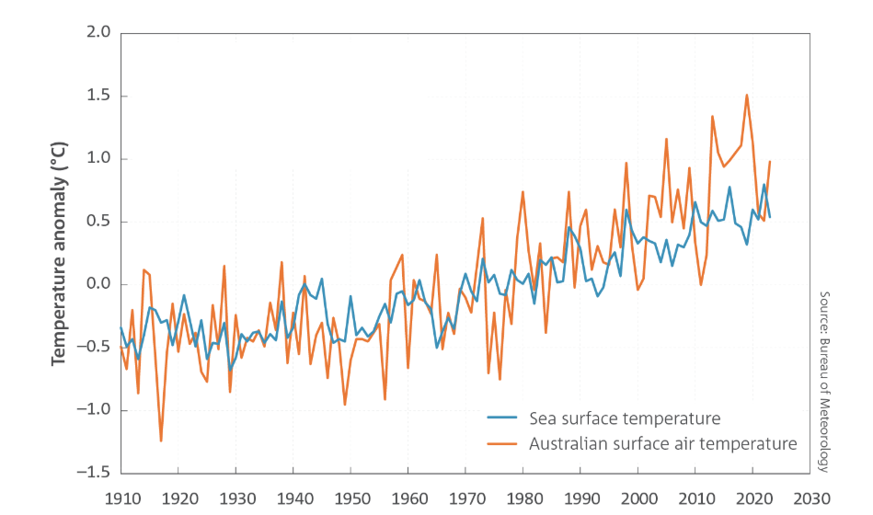
1.1 Analysing temperature anomaly data
Source – The Bureau of Meteorology: State of the Climate 2024 is reproduced by permission of the Bureau of Meteorology, © 2025 Commonwealth of Australia.
Notes:
Teacher notes:
This slide shows a graph from the student resource 1.1 in TRB1. Use the graph to unpack the questions with students.
a) What is the temperature anomaly (departure from the average) for 2024 for the sea's surface and air's surface (temperature in the air just above the ground)?
b) What is the trend in temperature anomalies for both measurements?
c) Predict what the temperature anomalies will be in 2040 for both measurements.
Sample responses:
air: 0.8 °C, sea: 0.5 °C
Both sea surface temperature and air temperature are increasing over time.
About 1.4 °C for both.

Slide 8
1.2 What is sustainability?
Learning intentions and success criteria
We are learning to: | I can:
identify the impact of human activity on the natural world. | define sustainability describe the 3 principles of sustainability identify how the UN’s sustainable development goals (SDGs) support sustainability using a case study.
Notes:
Teacher notes:
Display this slide at the beginning of the learning activity. Revisit the slide where appropriate during lesson activities and encourage students to reflect on their progress.

Slide 9
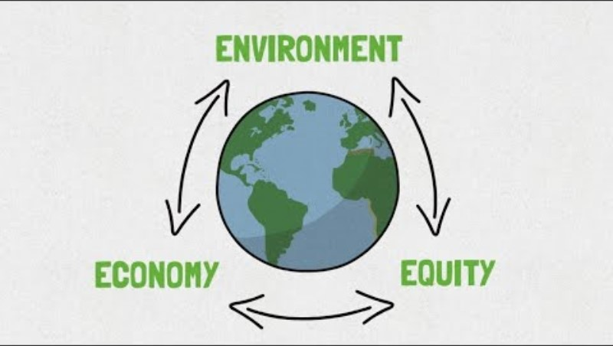
1.2 Setting the scene for sustainability
Video reflection
As you watch, reflect on the following:
What does sustainability mean to you?
Why is sustainability important?
What is Sustainability (3:06)
Notes:
Teacher notes:
This slide contains animations
While watching the video, students reflect on the two questions on the slide. Lead a discussion about the questions with the students.

Slide 10
1.2 Defining sustainability
The patterns of activities that meet the needs of the present generation without compromising the ability of future generations to meet their needs.
The three pillars or principles of sustainability:
Environment: protecting ecosystems, reducing pollution, and conserving resources.
Equity: promoting well-being, equity, and community development.
Economy: supporting economic growth without harming the environment or society.
Notes:
Teacher notes:
Key definitions needed for this focus area.
Discuss examples of how the three pillars can be applied in the student's local area. For example, identify potentially vulnerable local environments, highlight local business practices that are important to the local economy and identify potential local equity issues around basic needs (housing, food, well-being).

Slide 11
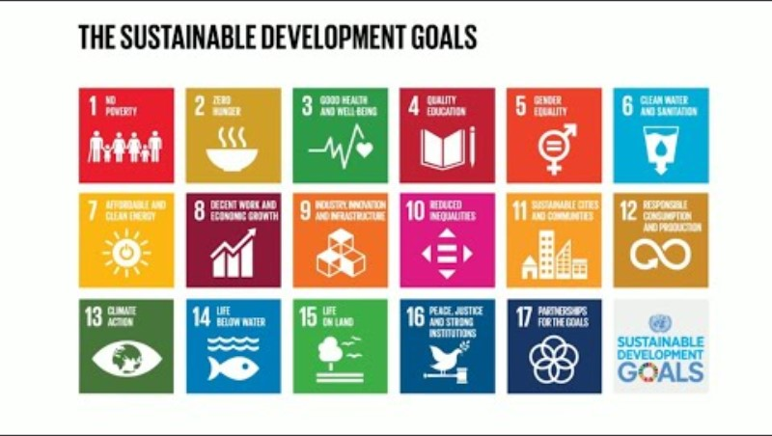
1.2 UN Sustainable Development Goals
Do you know all 17 STGs? (1:24)
Notes:
Teacher notes:
This slide contains animations
This short video introduces all 17 Sustainable Development Goals. This knowledge engages students to complete the sustainability case studies. The video may need to be paused to clarify how each goal aligns with sustainability.
Brief alignment of each United Nations Sustainable Development Goal (SDG) with sustainability:
No Poverty – Reduces inequality, builds resilient societies.
Zero Hunger – Promotes sustainable agriculture and food security.
Good Health and Well-being – Supports healthy, sustainable communities.
Quality Education – Building knowledge for sustainable futures.
Gender Equality – Ensures inclusive and fair opportunities.
Clean Water and Sanitation – Protects water resources and health.
Affordable and Clean Energy – Promotes renewable, low-carbon energy.
Decent Work and Economic Growth – Encourages sustainable economies.
Industry, Innovation and Infrastructure – Supports sustainable technology and systems.
Reduced Inequalities – Promotes fairness and social sustainability.
Sustainable Cities and Communities – Improves urban sustainability and resilience.
Responsible Consumption and Production – Reduces waste, promotes efficiency.
Climate Action – Mitigates climate change for long-term survival.
Life Below Water – Protects oceans and marine ecosystems.
Life on Land – Conserves biodiversity and ecosystems.
Peace, Justice and Strong Institutions – Builds stable, sustainable governance.
Partnerships for the Goals – Strengthens global cooperation for sustainability.

Slide 12
1.2 Case studies
Case studies
1. Solar power in rural communities
  A remote village in India has installed solar panels to generate electricity. This has reduced the
  use of kerosene lamps, which
  were harmful to health and the environment. The solar project created local jobs and allowed children to study at night. The community now has reliable and clean energy.
2. Plastic-free supermarket initiative
A supermarket chain has eliminated single-use plastic packaging. Customers now bring reusable containers or use biodegradable packaging. This change has reduced plastic waste significantly and encouraged sustainable habits.
3. Sustainable agriculture in Australia
A farm in NSW uses crop rotation and natural fertilisers to grow food without depleting the soil. They also collect rainwater for irrigation. Their produce is sold locally, reducing transport emissions.
Questions:
1. Identify the principles of sustainability that are addressed in the case studies.
2. How does this project align with any of the Sustainable Development Goals (SDGs)?
Notes:
Teacher notes:
Read through each case study with the class.
Students answer the two questions. They will need to refer to the three pillars and the SDGs in their notes. Divide the class into small groups and assign each a case study. In their groups, students use the UN SDG website to discuss and record:
Identify the principles of sustainability that are addressed in the case study.
How does this project align with any of the SDGs?
Sample responses:
Case study 1: solar power in rural communities
The project supports all 3 pillars of sustainability. It helps the environment by reducing pollution from kerosene lamps. It supports the economy by creating jobs for local people. It also supports social well-being by improving health and helping children study at night.
This project aligns with SDG 7 – Affordable and Clean Energy because it gives the village clean, reliable electricity. It also supports SDG 3 – Good Health and Well-being, because less air pollution means better health. SDG 8 – Decent Work and Economic Growth is also addressed because it creates local jobs.
Case study 2: plastic-free supermarket initiative
This project supports environmental sustainability by reducing plastic waste and using biodegradable packaging. It also supports social sustainability by encouraging people to change their habits and consider their impact on the planet. There is an economic benefit too, as reusable systems can save money over time.
This project aligns with SDG 12 – Responsible Consumption and Production, because it reduces waste and promotes sustainable packaging. It also supports SDG 13 – Climate Action by helping reduce pollution that contributes to environmental damage.
Case study 3: sustainable agriculture in Australia
This farm uses environmental sustainability by protecting soil health with crop rotation and natural fertilisers. Collecting rainwater also helps save water. Social and economic sustainability are demonstrated through the practice of selling produce locally, which supports the local community and reduces pollution from transportation.
This project supports SDG 2 – Zero Hunger, as it produces healthy food sustainably. It also connects with SDG 12 – Responsible Consumption and Production by using natural resources wisely, and SDG 13 – Climate Action, because it reduces emissions by selling food locally.

Slide 13
1.3 Using science to solve sustainability problems
Learning intentions and success criteria
We are learning to: | I can:
explain the impact of human activity on the natural world. | identify the threats to biodiversity describe the effect of a loss in biodiversity on environmental sustainability.
describe data from investigations to identify relationships. | describe the trend in biodiversity for 2 environments identify the validity of information on the threats and solutions to biodiversity from secondary sources.
describe a proposed solution to a problem. | use a cause-and-effect relationship to make predictions on sustainability.
Notes:
Teacher notes:
Display this slide at the beginning of the learning activity. Revisit the slide where appropriate during lesson activities and encourage students to reflect on their progress.

Slide 14


1.3 Checkpoint – quick quiz on previous content
Mini challenge
Challenge
Super challenge
Which of the following best describes the three main principles of sustainability?
environment, equity and economy
energy, equality and exploration
ecology, efficiency and education
emissions, enterprise and ethics
For the correct answer, provide an example of each principle.
Explain how one of the Sustainable Development Goals supports the environment.
Notes:
Teacher notes:
This slide contains animations
Check student understanding of the previous content by completing the checkpoint questions.
Sample responses:
MC: a) environment, equity and economy
C:
Environment: Reducing pollution in rivers
Equity: Promoting equal access to education and healthcare
Economy: Growing businesses without damaging ecosystems
SC: Goal 15: Life on Land. This goal focuses on protecting, restoring and promoting the sustainable use of ecosystems, managing forests sustainably, combating desertification and halting biodiversity loss.

Slide 15
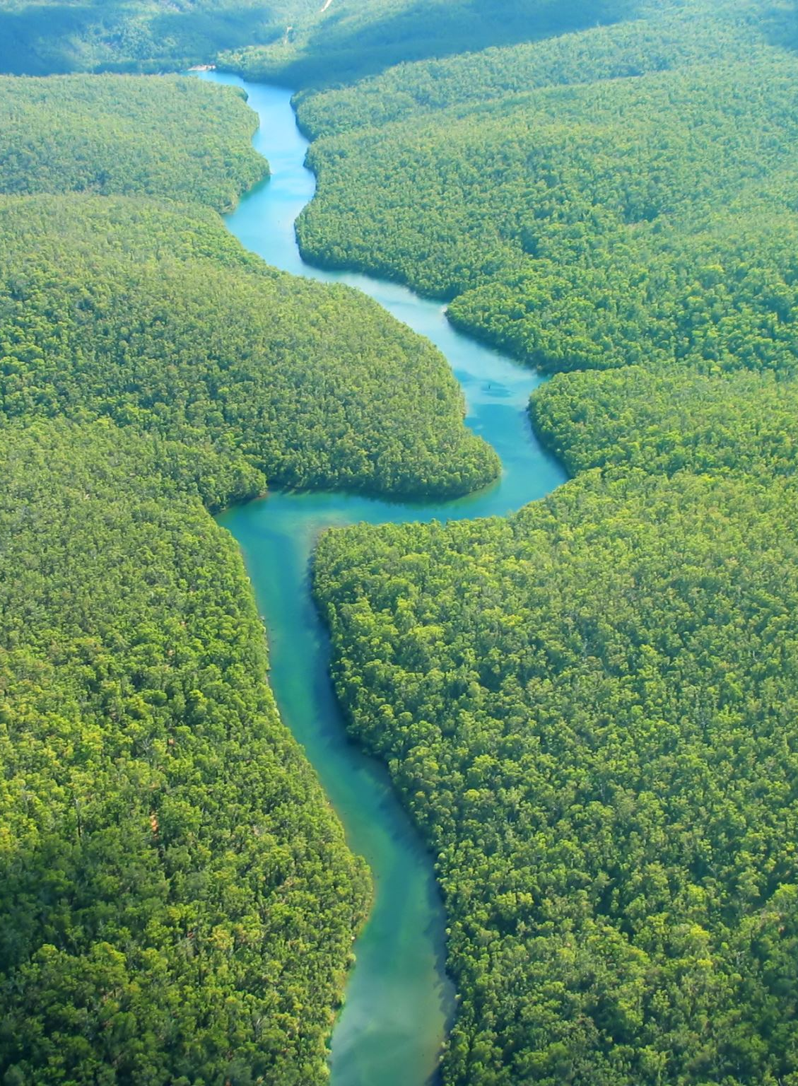
1.3 Key terms (1 of 3)
Nature
Nature can be defined as the entirety of the natural world, encompassing all living things (biodiversity) and non-living components (geodiversity) of the Earth.
This includes plants, animals, microorganisms, ecosystems, landforms, water, climate, and the dynamic processes that shape them.
Nature is a complex system where living organisms interact with non-living elements to sustain life on Earth.
Notes:
Teacher notes:
A definition of a key term that is needed to access future content in this focus area.

Slide 16
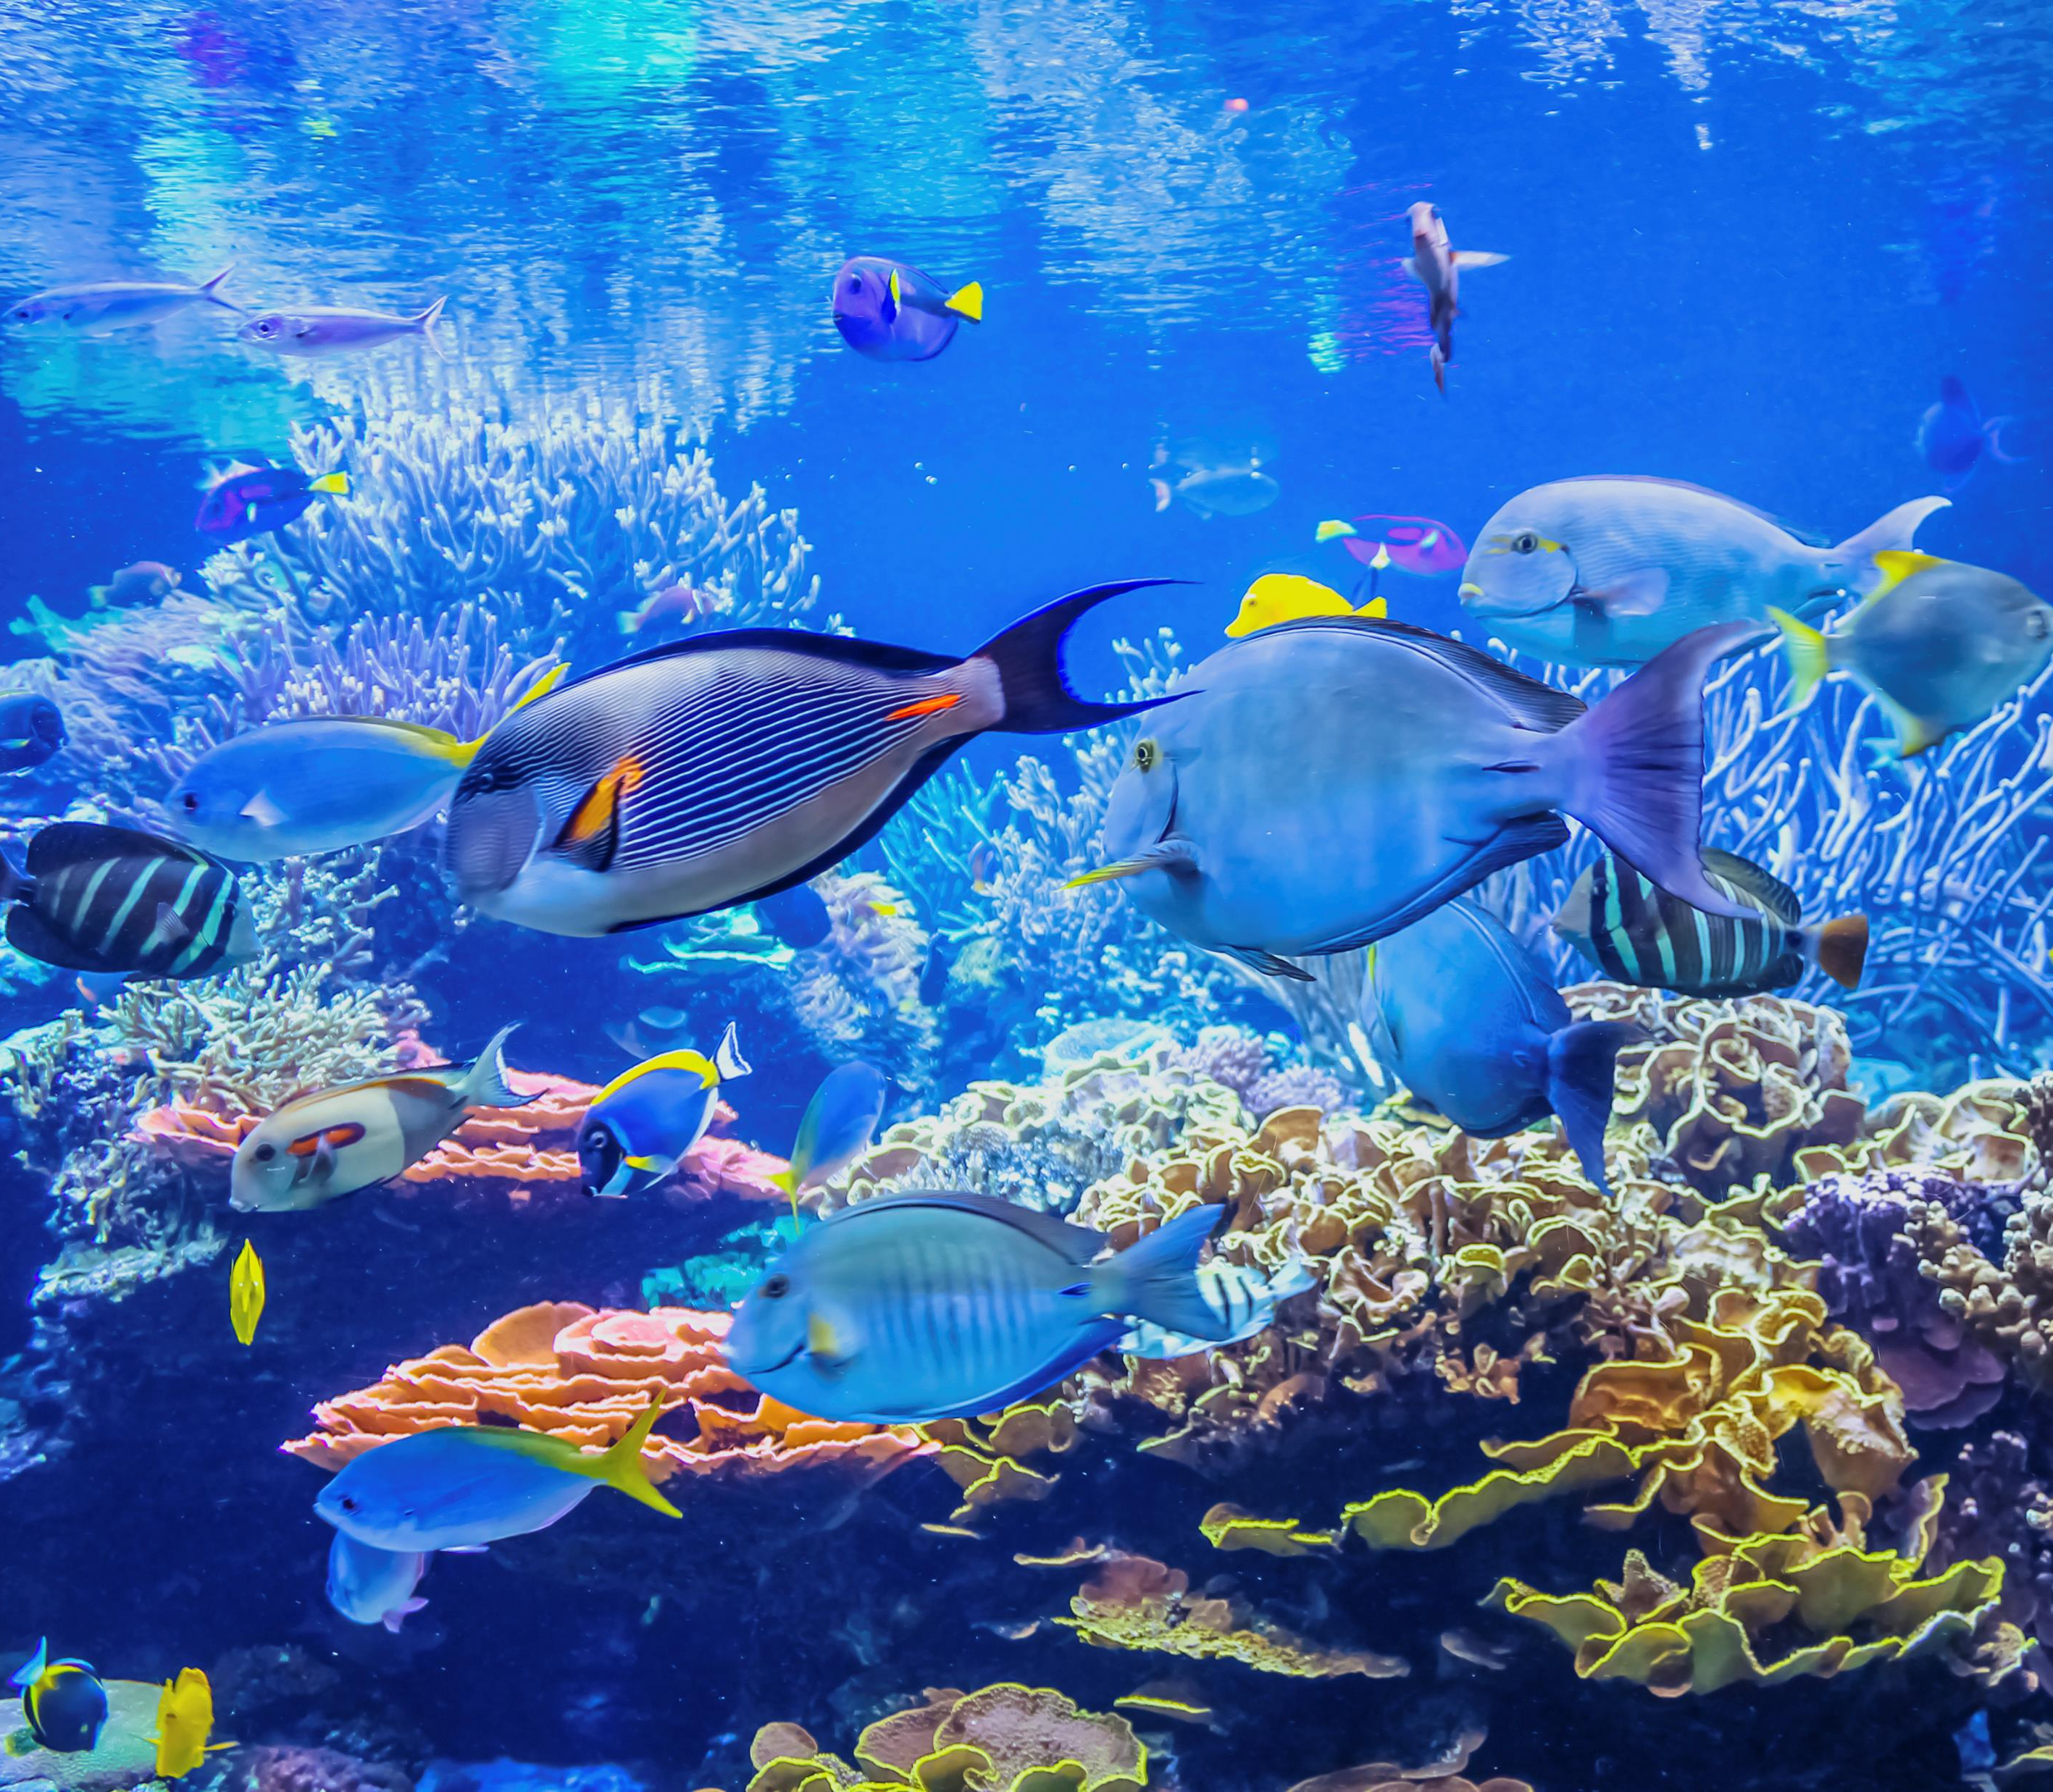
1.3 Key terms (2 of 3)
Biodiversity
The variety of all living organisms on Earth, including plants, animals, microorganisms, and the ecosystems they form.
It encompasses three main levels: genetic diversity (differences within species), species diversity (the variety of species in an area), and ecosystem diversity (the range of ecosystems in a region).
The simplest measure of biodiversity is the number of species in an area, and this measure is called species richness.
Notes:
Teacher notes:
A definition of a key term that is needed to access future content in this focus area.

Slide 17
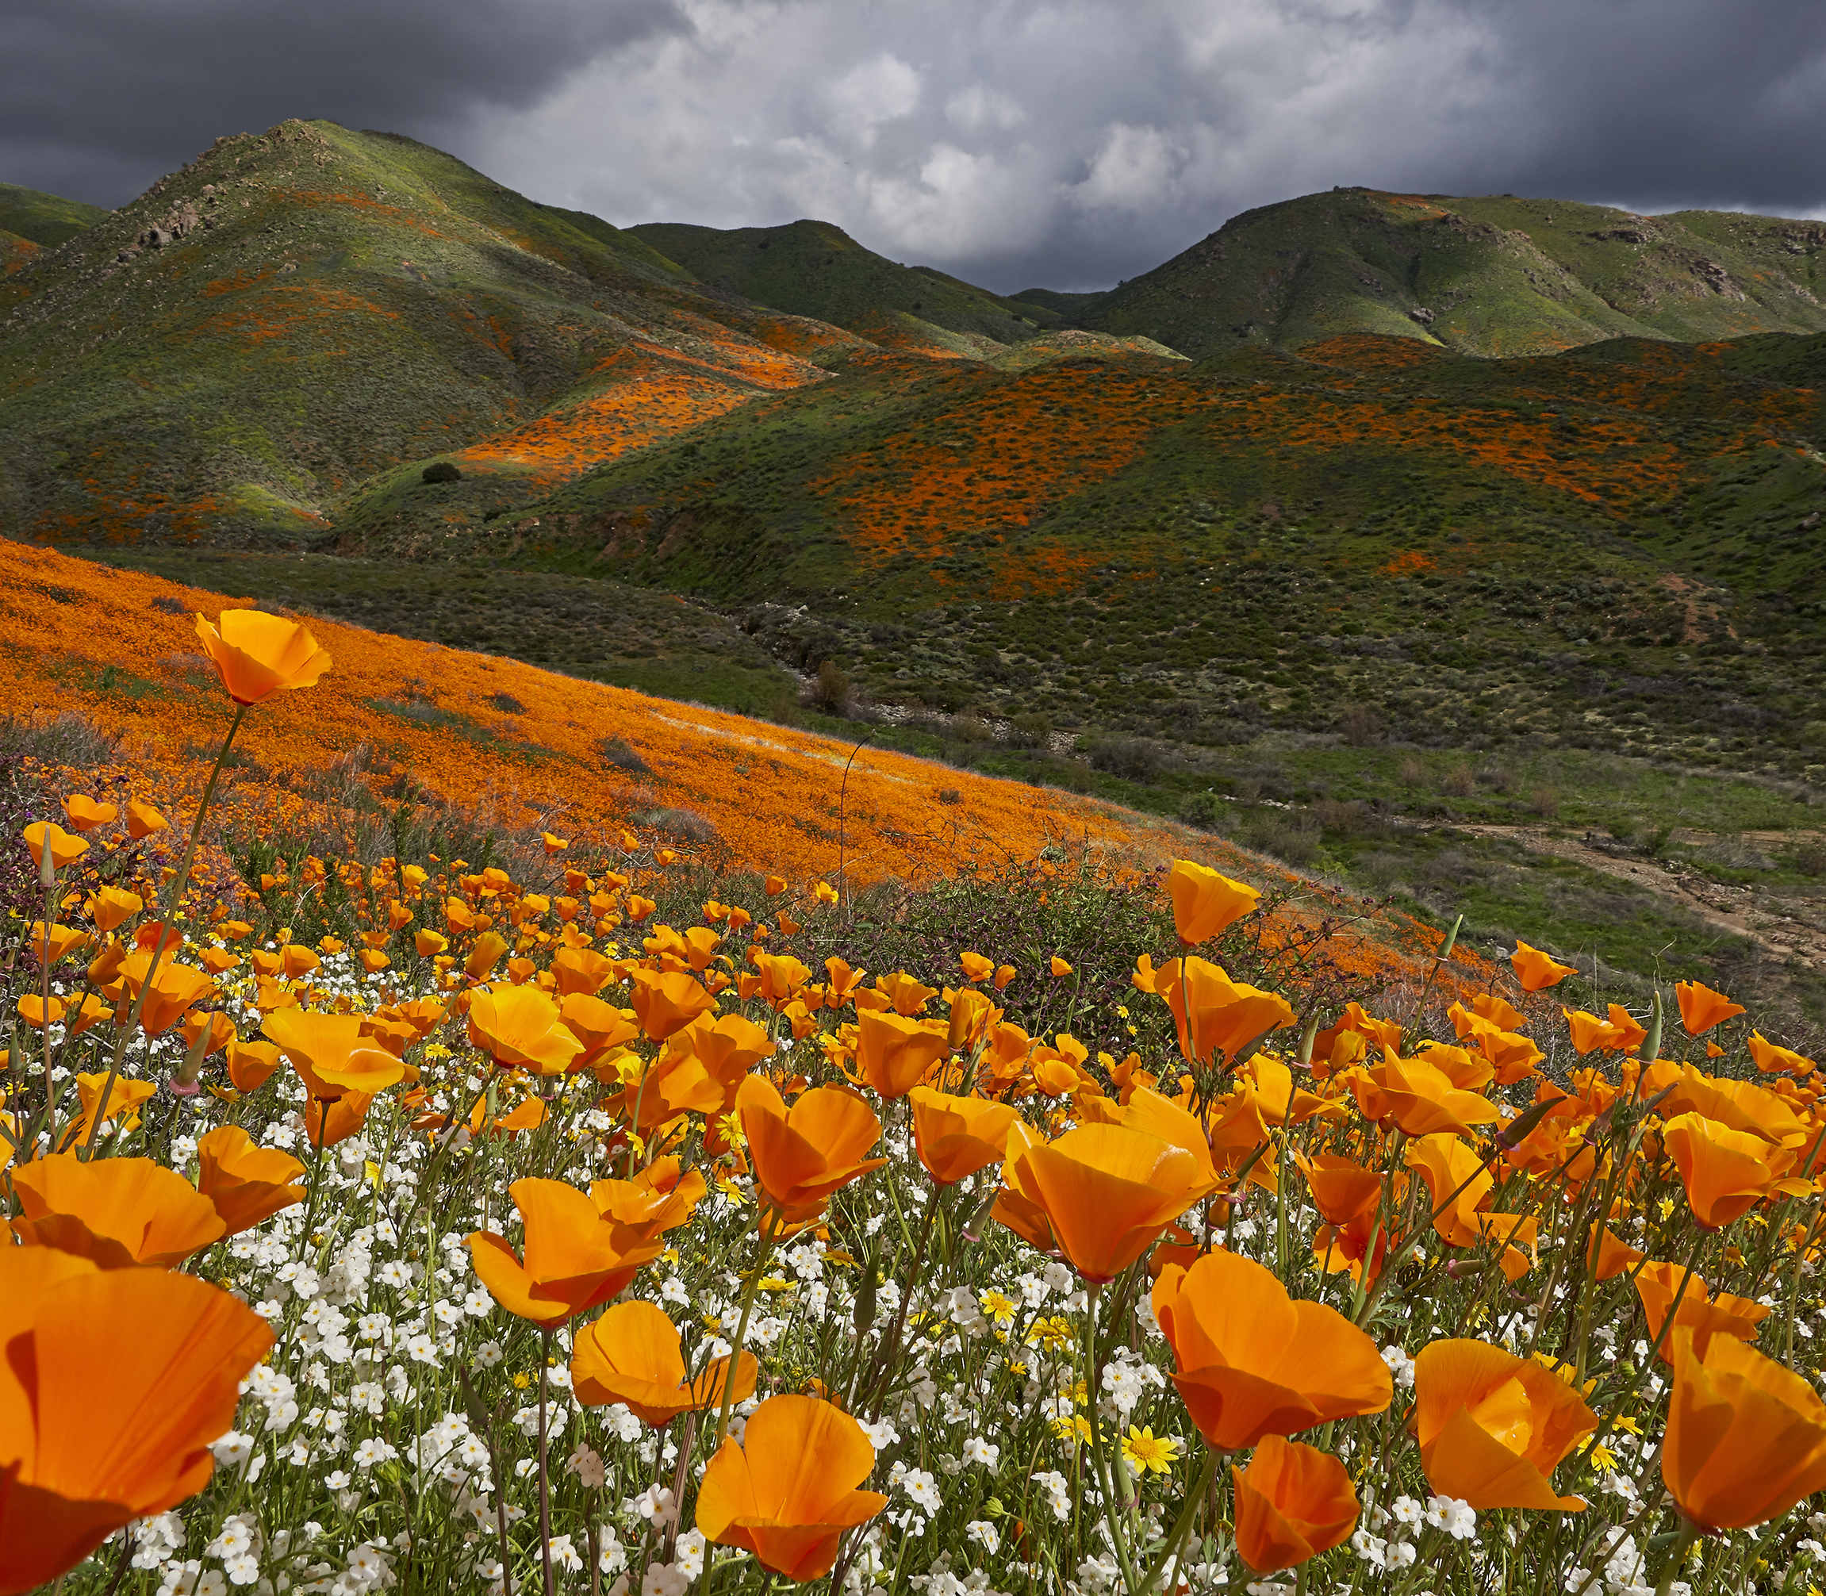
1.3 Key terms (3 of 3)
Ecosystem
An ecosystem is a community of living organisms (plants, animals, and microorganisms) interacting with each other and with their non-living environment (such as air, water, soil, and sunlight) in a specific area.
These interactions create a system where energy flows and nutrients cycle, sustaining life within the ecosystem.
Notes:
Teacher notes:
A definition of a key term that is needed to access future content in this focus area.

Slide 18
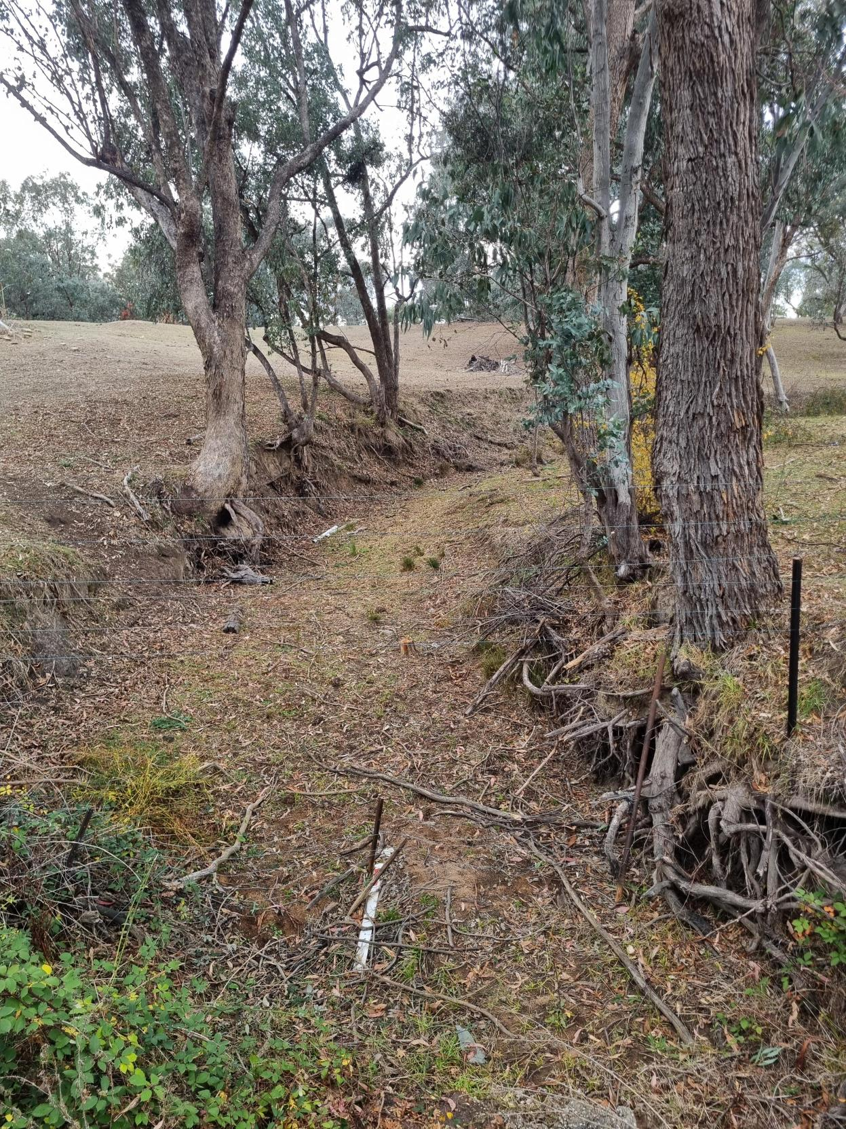
1.3 Images of biodiversity loss (1 of 2)
A terrestrial environment
What is the image of?
How does the image highlight a problem for biodiversity?
What can the image tell us about the effect of biodiversity on environmental sustainability?
Notes:
Teacher notes:
An image of land clearing, erosion and drought, which would have led to biodiversity loss in NSW, Australia. Sample discussion points include:
Loss of vegetation
Erosion and soil degradation
Drought and scarcity
Healthy soil and water cycles
Habitat and food sources

Slide 19
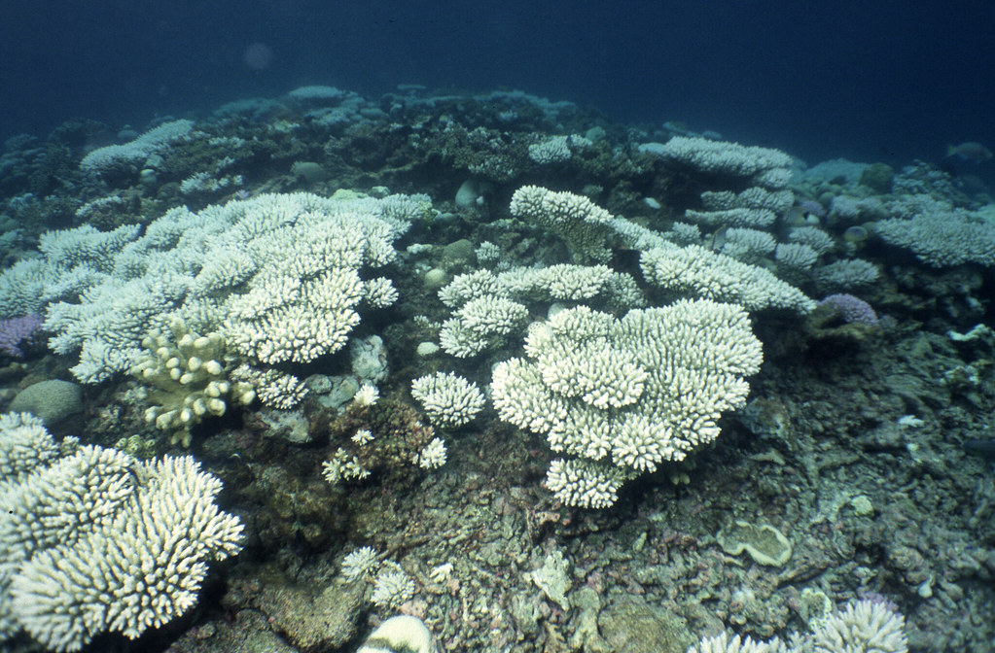
1.3 Images of biodiversity loss (2 of 2)
An aquatic environment
What is the image of?
How does the image highlight a problem for biodiversity?
What can the image tell us about the effect of biodiversity on environmental sustainability?
'Coral bleaching’ by Mark Spalding is licensed under CC BY-NC-SA 2.0
Notes:
Teacher notes:
An image of coral bleaching on the Great Barrier Reef due to increased ocean temperatures. Corals are a keystone species and vital for biodiversity in reefs.
Sample discussion points include:
ecosystem disruption
sustainability of fisheries

Slide 20
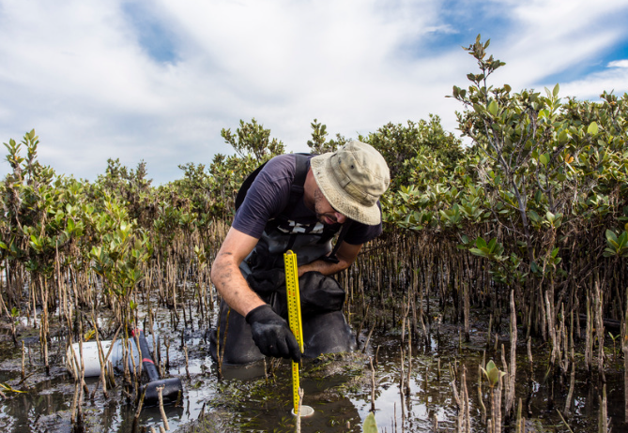
1.3 Images of protection of biodiversity (1 of 2)
What is the image of?
How does the image highlight a solution for biodiversity?
What can the image tell us about the effect of biodiversity on environmental sustainability?
Notes:
Teacher notes:
This image depicts a scientist monitoring conditions in a mangrove ecosystem, underscoring the crucial role of scientific research and conservation efforts in preserving biodiversity and promoting sustainability.
Mangroves as biodiversity hotspots: mangroves provide a unique habitat for a wide range of marine and terrestrial species, supporting fish nurseries, birds, and other wildlife. Protecting mangroves is crucial for the survival of many species.
Sustainable resource management: scientific research informs policies for sustainable fishing, tourism, and coastal development, ensuring that natural resources are used responsibly without harming the ecosystem.

Slide 21
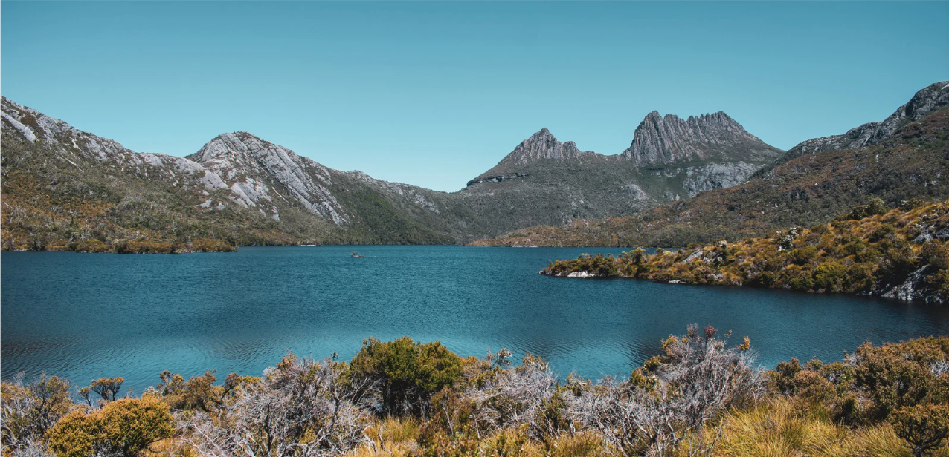
1.3 Images of protection of biodiversity (2 of 2)
A national park
What is the image of?
How does the image highlight a solution for biodiversity?
What can the image tell us about the effect of biodiversity on environmental sustainability?
Notes:
Teacher notes:
This image of Cradle Mountain – Lake St. Clair National Park represents the role of protected areas in conserving biodiversity and promoting environmental sustainability.
Conservation of native flora and fauna: national parks provide a safe habitat for a diverse range of species, including endangered plants and animals, ensuring their survival by reducing threats such as habitat destruction and human encroachment.
Sustainable tourism and education: national parks promote ecotourism and environmental education, raising awareness about biodiversity while supporting local economies without damaging the environment.

Slide 22
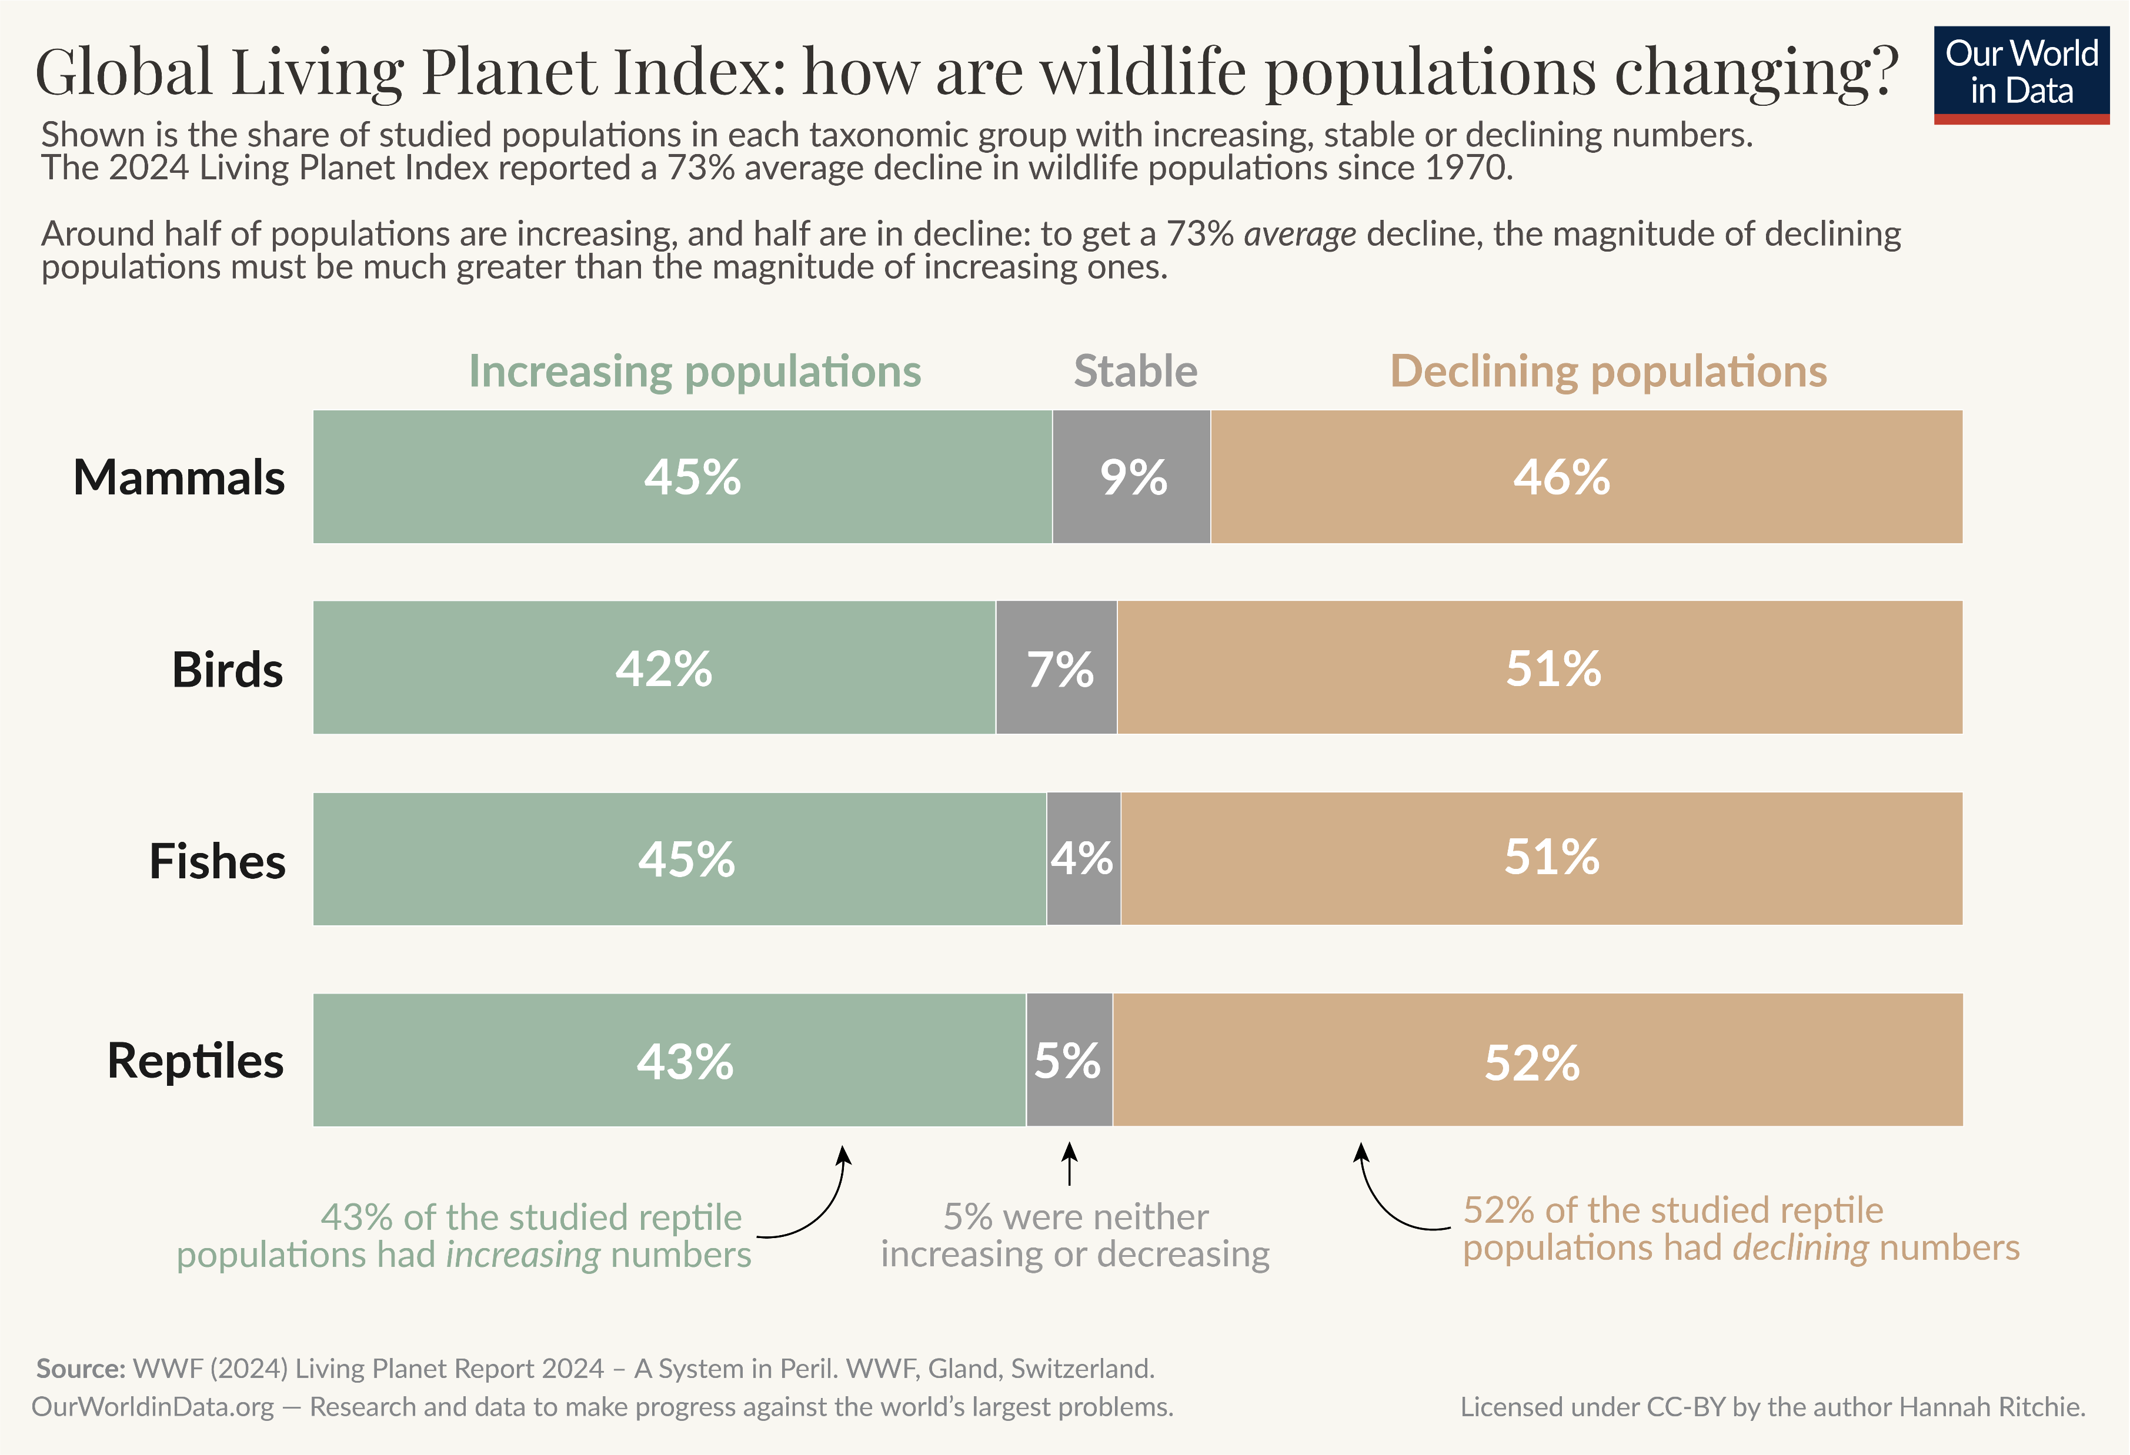
1.3 Do we have a biodiversity problem?
What does this data demonstrate in relation to the trend in biodiversity?
'Wildlife populations’ by Hannah Ritchie is licensed under CC BY 4.0
Notes:
Teacher notes:
Explain to students that scientific research enables us to identify the problems facing biodiversity and sustainability. Ask the class what this data demonstrates in relation to trends in biodiversity.
For this graphic, note the percentages of declining populations for the different types of animals. Students are to visualise and understand the data, saying there is a decline in biodiversity worldwide.
Sample response: The significant decline in animal populations, as this data shows, will result in a decrease in biodiversity. Reducing the population of 50% of animal species will result in fewer animal species in certain areas globally.

Slide 23
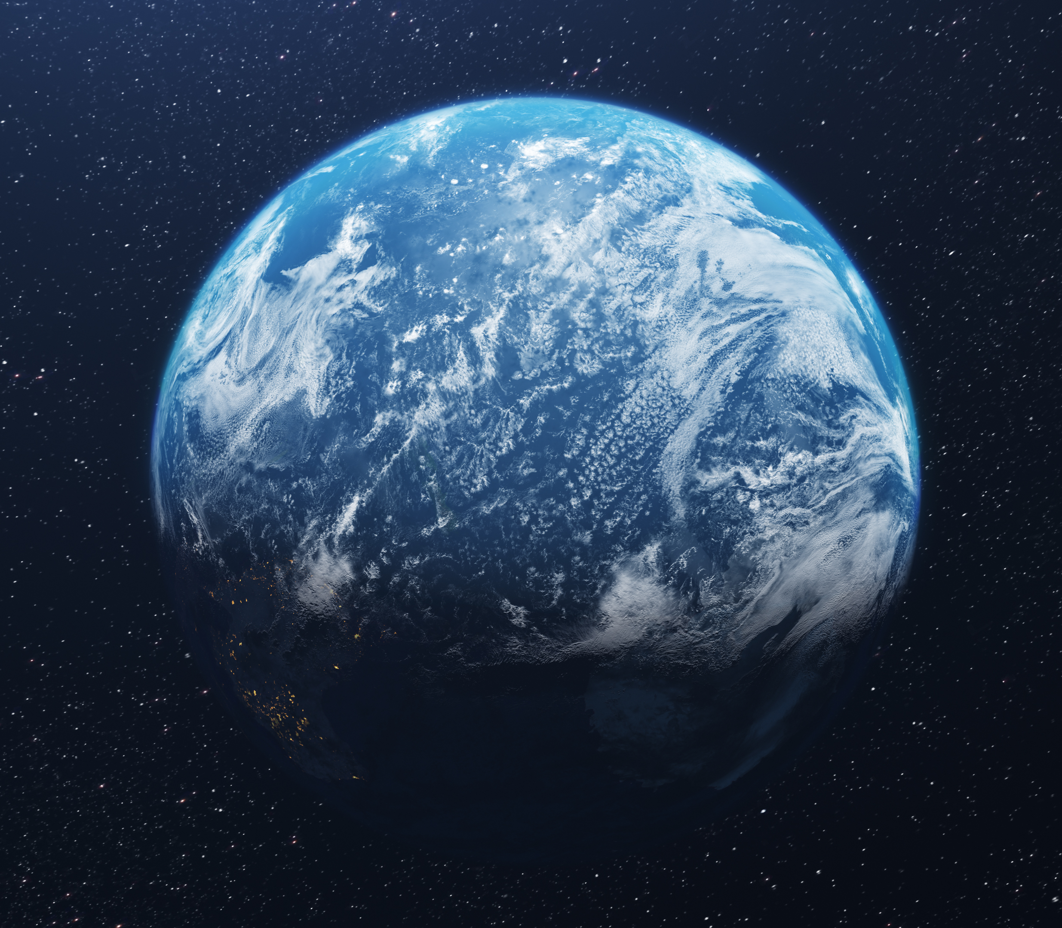





1.3 The 5 big threats to biodiversity
Changes in land and sea use (deforestation, urban expansion)
Overexploitation of resources (hunting, fishing, logging)
Climate change (rising temperatures, ocean acidification)
Pollution (plastics, harmful chemicals, air and water pollution)
Invasive species (introduced species disrupting ecosystems)
Notes:
Teacher notes:
Students to record the 5 big threats to biodiversity with local examples. All 5 will be covered in this focus area, however, this activity will focus only on changes in land use and overexploitation.

Slide 24
1.4 How about this weather?
Learning intentions and success criteria
We are learning: | I can:
analyse data to identify patterns. | define weather and climate describe the differences between weather and climate describe patterns in local weather and climate data.
Notes:
Teacher notes:
Display this slide at the beginning of the learning activity. Revisit the slide where appropriate during lesson activities and encourage students to reflect on their progress.

Slide 25
1.4 Checkpoint – quick quiz on previous content
Mini challenge
Challenge
Super challenge
What is biodiversity?
The number of forests in a country
The variety of different species of plants, animals and microorganisms in an area
The amount of pollution in the environment
The size of a single animal population
Give an example of a threat to biodiversity.
Why is this a threat?
Provide a solution to this threat.
Notes:
Teacher notes:
Sample responses
MC: B)
C: Invasive species prey on or outcompete native species. They have contributed to 60% of recorded extinctions, decreasing biodiversity.
SC: Preventing entry to a country by ensuring strict biosecurity measures at its borders. Along with strong community engagement on the risks of entering a country with an invasive species.

Slide 26
1.4 Defining weather and climate
Weather: Describes the day-to-day conditions of the atmosphere in a specific place. This includes factors such as temperature, rainfall, wind, cloud cover, humidity (the amount of moisture in the air), and atmospheric pressure.
Climate: Is the average pattern of weather in a particular region over a long period of time (usually 30 years or more). Climate tells us what the weather is usually like, not just what it’s like today or this week.
Notes:
Teacher notes:
This slide contains animations
Key definitions for this section of the focus area. This slide is animated so that the definitions are presented one at a time.
Introduce definitions for weather and climate.
*CLICK*
Weather: Describes the day-to-day conditions of the atmosphere in a specific place. This includes factors such as temperature, rainfall, wind, cloud cover, humidity (the amount of moisture in the air), and atmospheric pressure.
For example, it might be sunny and warm today, but rainy and cold tomorrow, that's a change in the weather.
*CLICK*
Climate: Is the average pattern of weather in a particular region over a long period of time (usually 30 years or more). Climate tells us what the weather is usually like, not just what it’s like today or this week.
For example, a tropical climate is typically characterised by hot and wet conditions, whereas hot and dry conditions generally characterise a desert climate.

Slide 27
1.4 The difference between weather and climate
Feature | Weather | Climate
Time scale | Short-term (minutes to months to years) | Long-term (decades, 30+ years).
Changes | Rapid and frequent | Slow and gradual
Measured by | Daily forecast, observations | Long-term data, averages.
Examples | Sunny morning with afternoon showers | Temperate, sub-tropical.
Notes:
Teacher notes:
Sample responses for students to check against their thinking.

Slide 28
1.5 What is the data telling us?
Learning intentions and success criteria
We are learning to: | I can:
analyse data to identify trends and relationships in climate data. | identify criteria and make a judgment on the validity of information from secondary sources describe the relationship between identified climate data variables, e.g. temperature over time extrapolate information from climate data.
Notes:
Teacher notes:
Display this slide at the beginning of the learning activity. Revisit the slide where appropriate during lesson activities and encourage students to reflect on their progress.

Slide 29
1.5 Checkpoint – quick quiz on previous content
Mini challenge
Challenge
What is the main difference between climate and weather?
a) Weather describes long-term patterns; climate describes daily conditions.
b) Climate describes long-term patterns; weather describes daily conditions.
c) Climate changes every hour; weather changes over decades.
d) Weather and climate mean the same thing.
What weather patterns are observed for your local area over a year?
Notes:
Teacher notes:
Sample responses
MC: B)
C: various answers, for example, average monthly maximum temperatures peak at about 28°C in January, and these drop to an average maximum temperature of 19°C in July.

Slide 30
1.5 What’s the state of Australia’s climate? (1 of 5)
Authority and expertise
CSIRO has authority as Australia's national science agency, with scientists conducting high-quality research across a wide range of scientific fields, including climate science, environmental management, and technology. BOM is the official national weather, climate, and water agency. Its meteorologists provide authoritative weather updates, forecasts, and long-term climate data.
Authority and expertise: Is the data collected, analysed and presented by qualified scientists?
Yes
Notes:
Teacher notes: This slide contains animations
Authority and expertise
*CLICK*
Read the question to the class. Discuss possible responses to the question.
*CLICK* *CLICK*
Display the sample response. Determine whether the CSIRO and BOM possess the necessary authority and expertise.
*CLICK* *CLICK*
Yes
Question and evidence on the authority and expertise of the CSIRO and the BOM. Students see that they are sources of valid and reliable information and data.

Slide 31
1.5 What’s the state of Australia’s climate? (2 of 5)
Scientific methodology
Both organisations follow rigorous scientific methods for data collection and analysis.
For example, CSIRO uses peer-reviewed research processes, while BOM uses standardised meteorological practices and validated climate models.
Use of scientific methods: Do both organisations follow rigorous scientific methods for data collection and analysis?
Yes
Notes:
Teacher notes: This slide contains animations.
Use of scientific methods
*CLICK*
Read the question to the class. Discuss possible responses to the question.
*CLICK* *CLICK*
Display the sample response. Determine whether the CSIRO and BOM employ scientific methods.
*CLICK* *CLICK*
Yes

Slide 32
1.5 What’s the state of Australia’s climate? (3 of 5)
Government affiliation and funding
As government agencies, they are publicly accountable and must follow national standards and protocols.
Their information is not driven by commercial interests, reducing the risk of bias.
Government affiliation and funding: Are the organisations publicly accountable and not driven by commercial interests?
Yes
Notes:
Teacher notes: This slide contains animations
Government affiliation and funding
*CLICK*
Read the question to the class. Discuss possible responses to the question.
*CLICK* *CLICK*
Display the sample response. Determine whether the CSIRO and BOM are public organisations accountable for their research.
*CLICK* *CLICK*
Yes

Slide 33
1.5 What’s the state of Australia’s climate? (4 of 5)
Transparency and peer review
CSIRO publishes research that is peer-reviewed and openly accessible.
BOM provides publicly available documentation explaining how its data is collected and processed (e.g., temperature trends, rainfall data).
Transparency and peer review: Is research peer-reviewed and publicly available?
Yes
Notes:
Teacher notes: This slide contains animations.
Transparency and peer review
*CLICK*
Read the question to the class. Discuss possible responses to the question.
*CLICK* *CLICK*
Display the sample response. Determine whether the CSIRO and BOM are public organisations accountable for their research.
*CLICK* *CLICK*
Yes

Slide 34
1.5 What’s the state of Australia’s climate? (5 of 5)
Up-to-date
BOM provides real-time weather alerts, radar images, and forecasts that are updated continuously.
CSIRO regularly updates reports on climate projections, greenhouse gas levels, and environmental monitoring.
Regular updates and real-time data: Are reports updated regularly, and is their real-time weather and climate data publicly available?
Yes
Notes:
Teacher notes: This slide contains animations
Regularly updated
*CLICK*
Read the question to the class. Discuss possible responses to the question.
*CLICK* *CLICK*
Display the sample response. Determine whether the CSIRO and BOM are public organisations accountable for their research.
*CLICK* *CLICK*
Yes

Slide 35
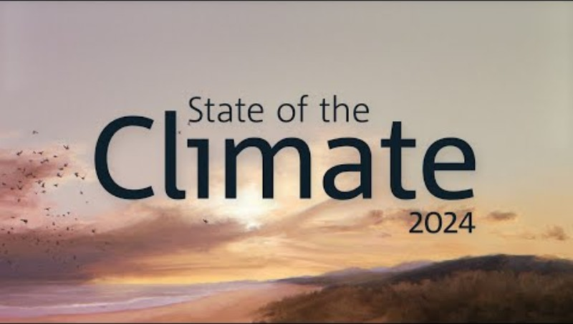
1.5 State of Australia’s climate 2024 - the data
As you watch:
List the data that would need to be collected, processed and analysed to determine the trends in Australia’s climate.
State of the Climate 2024 (2:15)
Notes:
Teacher notes: This slide contains animations
As the students watch the video, they should list the data that would need to be collected, processed and analysed to determine the trends in Australia’s climate. This list will guide the next activities. Sample list:
CO₂ gas concentrations in the atmosphere
temperature at the land and sea surfaces
frequency of extreme heat days
frequency of dangerous fire weather days
intensity of rainfall events
pH of oceans
frequency of marine heatwaves
sea levels

Slide 36
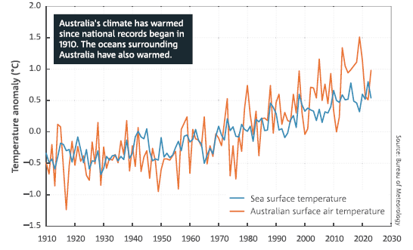
1.5 State of the climate 2024 (1 of 3)
Temperature anomalies
Changes from the average (1961–1990) in yearly sea surface temperature and land temperature in Australia.
Source – The Bureau of Meteorology: State of the Climate 2024 is reproduced by permission of the Bureau of Meteorology, © 2025 Commonwealth of Australia.
Notes:
Teacher notes:
Students analyse the graph of temperature data in Australia over time on land and on the sea surface.
Questions:
Describe what the graph or representation of the climate data is trying to show.
Is there a relationship between the two variables evident in the climate data? Describe this relationship. Is there a trend in this relationship? If so, what is the nature of this trend?
From the graph of the climate data, extrapolate what could happen in the future for this climate data.
Sample response:
The graph illustrates the changes in temperature anomalies (differences from the 1961–1990 average) of Australian surface air temperature anomalies and nearby sea surface temperature changes from 1910 to 2020, relative to the 1961–1990 average.
Yes, there is a clear relationship between two variables: Australian surface air temperature and sea surface temperature. Both variables exhibit a similar pattern over time – when one rises or falls, the other often follows suit.
Trend: both temperatures have generally increased since 1910. Although the land air temperature exhibits more short-term variation (with sharper rises and falls), both variables display a strong long-term warming trend.
c. If the current trend continues, both Australian surface air temperatures and sea surface temperatures are likely to continue rising in the future. This suggests that Australia will experience even warmer climates, with higher average temperatures over land and in the surrounding oceans.

Slide 37
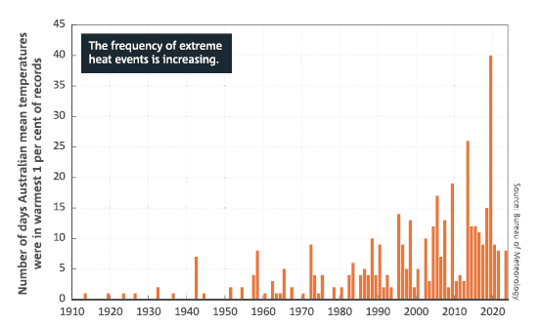
1.5 State of the climate 2024 (2 of 3)
Extreme heat events
Number of days each year when Australia’s average daily temperature for a month is extreme (is in the hottest 1%of days for each month) (1910 – 2023)
Source – The Bureau of Meteorology: State of the Climate 2024 is reproduced by permission of the Bureau of Meteorology, © 2025 Commonwealth of Australia.
.
Notes:
Teacher notes:
Students analyse this graph on the number of days each year where the average daily mean temperature for each month is extreme (warmest 1% of days).
Questions:
Describe what the graph or representation of the climate data is trying to show.
Is there a relationship between the two variables evident in the climate data? Describe this relationship. Is there a trend in this relationship? If so, what is the nature of this trend?
From the graph of the climate data, extrapolate what could happen in the future for this climate data.
Sample response:
The graph illustrates the number of days each year when Australia's daily mean temperature was in the warmest 1% of records for that month, from 1910 to 2023.
b. Yes, there is a relationship over time: as the years progress, the number of extreme heat days increases.
Trend: before 1950, extreme heat days were rare and low in number.
After 1970, the number of extreme heat days began to rise steadily.
There has been a sharp increase in recent decades (especially after 2000), with some years having over 30–40 extreme heat days.
c. If the current trend continues, Australia is likely to experience even more extreme heat days each year. The frequency of extreme heat events is expected to continue rising, leading to more prolonged and intense heat waves in the future.

Slide 38
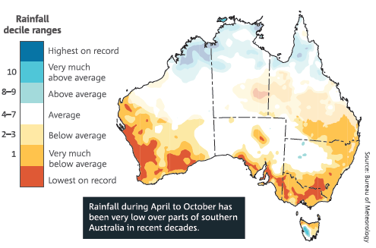
1.5 State of the climate 2024 (3 of 3)
Rainfall decline
This map indicates whether rainfall from April to October was above average, average or below average. Areas in northern and central Australia that receive less than 40% of the annual rain from during this period are shown with faded colouring.
Source – The Bureau of Meteorology: State of the Climate 2024 is reproduced by permission of the Bureau of Meteorology, © 2025 Commonwealth of Australia.
.
Notes:
Teacher notes:
Students analyse this graphic, which shows rainfall deciles for 30 years in Australia. Note the definition of a decile map.
Questions:
Describe what the graph or representation of the climate data is trying to show.
Is there a relationship between the two variables evident in the climate data? Describe this relationship. Is there a trend in this relationship? If so, what is the nature of this trend?
From the graph of the climate data, extrapolate what could happen in the future for this climate data.
Sample response:
The map illustrates rainfall patterns across Australia from April to October over the past 30 years (1994–2023), compared to historical records from 1900 to 1993.
Yes, there is a relationship between location and rainfall levels.
Trend: southern Australia, particularly parts of Western Australia, South Australia, and Victoria, has experienced a significant decrease in rainfall.
Most southern areas are coloured in shades of orange and red, indicating below-average to lowest-on-record rainfall.
In contrast, some parts of northern Australia experience average or above-average rainfall, although these areas are less widespread.
c. If the current trend continues, southern Australia is likely to experience drier conditions from April to October. This could lead to more frequent droughts, increased pressure on water resources, and impacts on agriculture and ecosystems in the region.

Slide 39
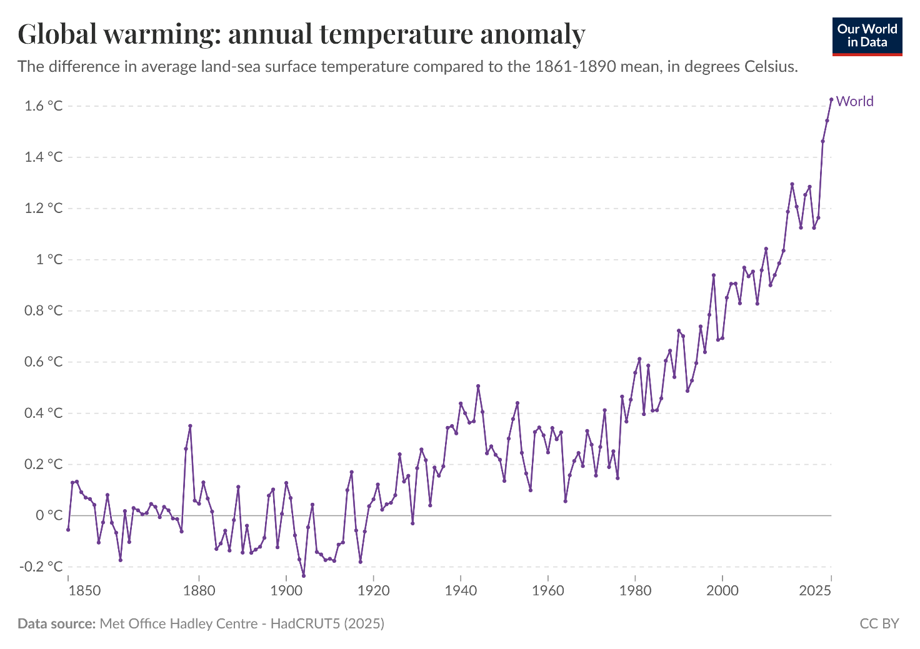
1.5 Our world data – Data catalogue (1 of 3)
Temperature anomalies
'Global warming: annual temperature anomaly' by Our World in Data is licensed under CC BY 4.0
Notes:
Teacher notes:
Graph of global warming over time. Note the analysis questions from the previous slide and in TRB1. A student worksheet can be found in TRB1.
Questions
Is the data from a valid secondary source? What criteria did you use to make this judgment?
Describe what the graph or representation of the climate data is showing.
Is there a relationship between the 2 variables evident in the climate data? If so, describe this relationship. Is there a trend in this relationship? If so, what is the nature of this trend?
From the graph of the climate data, extrapolate what could happen in the future for this climate data.
How does this world climate data compare to what is in the State of the Climate 2024 report? Note: this question should be omitted if similar data cannot be accessed.
Sample response:
a. Yes, the Met Office is the United Kingdom’s equivalent to the BOM. As a government agency, it is publicly accountable and must follow national standards and protocols.
Their information is not driven by commercial interests, reducing the risk of bias.
b. The difference in global average land-sea surface temperatures from 1850 to 2025, compared to the 1861-1890 mean.
c. Yes, there is a relationship between temperature anomaly and time. This is most evident from 1964 to 2025, when global temperature anomalies increased steadily.
d. Temperature anomalies are expected to continue rising, with significant consequences for environmental sustainability.
e. This is consistent with the data in the State of the Climate 2024 report, which shows how the temperature anomalies (differences from the 1961–1990 average) of Australian surface air temperatures and surrounding sea surface temperatures have increased from 1910 to 2020.

Slide 40
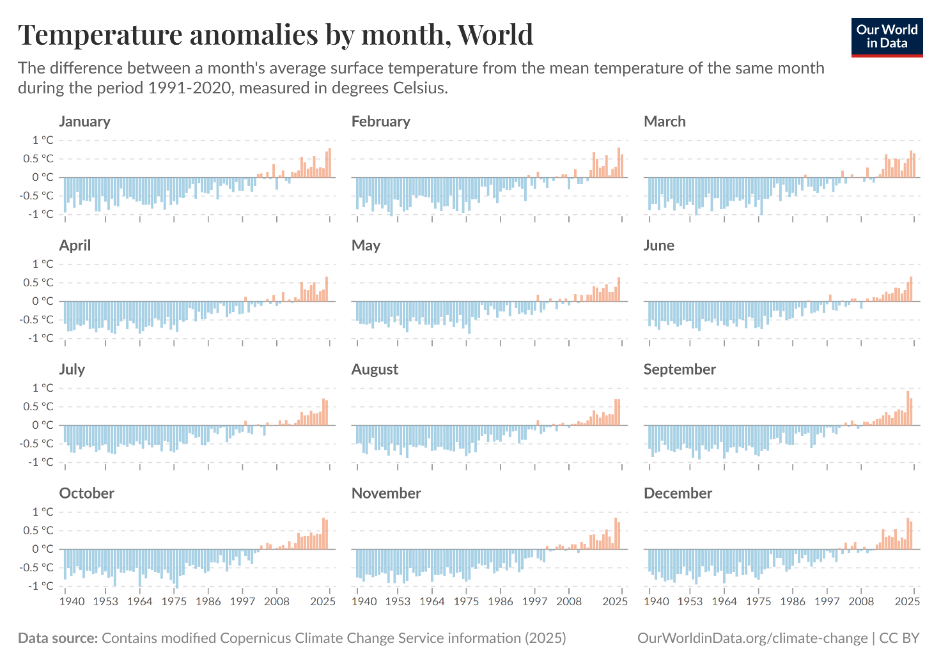
1.5 Our world data – Data catalogue (2 of 3)
Temperature anomalies by month
'Temperature anomalies by month, World’ by Our World in Data is licensed under CC BY 4.0
Notes:
Teacher notes:
Graphs of global temperature anomalies by month. Note the analysis questions from the previous slide and in TRB1. A student worksheet can be found in TRB1.
Questions
Is the data from a valid secondary source? What criteria did you use to make this judgment?
Describe what the graph or representation of the climate data is showing.
Is there a relationship between the 2 variables evident in the climate data? If so, describe this relationship. Is there a trend in this relationship? If so, what is the nature of this trend?
From the graph of the climate data, extrapolate what could happen in the future for this climate data.
How does this world climate data compare to what is in the State of the Climate 2024 report? Note: this question should be omitted if similar data cannot be accessed.
Sample response
a. Yes, the Copernicus Climate Change Service (C3S) is run on behalf of the European Union. Like CSIRO and BOM, it is staffed by expert climate scientists, meteorologists and data specialists.
b. Global temperature anomalies from the mean monthly temperature for the period 1991-2020, for each month of the year from 1940 to 2024.
c. Yes, each month shows a trend of increasing positive temperature anomalies over time.
d. The difference in monthly temperatures from the 1991-2020 average could continue to rise for each month of the year.
e. The State of the Climate 2024 report did not provide monthly temperature data.

Slide 41
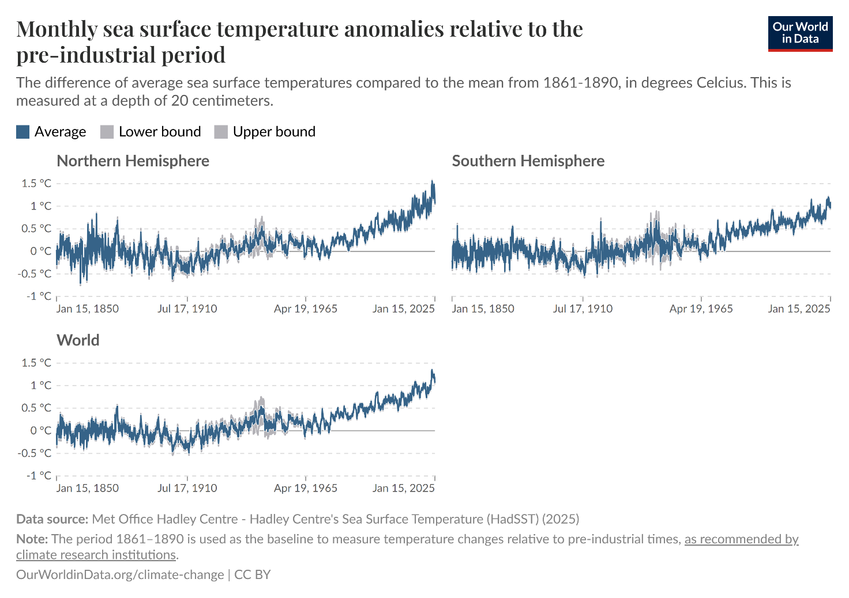
1.5 Our world data – Data catalogue (3 of 3)
Sea surface anomalies
'Monthly sea surface temperature anomalies relative to the pre-industrial period’ by Our World in Data is licensed under CC BY 4.0
Notes:
Teacher notes:
Graphs of sea surface temperature anomalies. Note the analysis questions from the previous slide and in TRB1. A student worksheet can be found in TRB1.
Questions
Is the data from a valid secondary source? What criteria did you use to make this judgment?
Describe what the graph or representation of the climate data is showing.
Is there a relationship between the 2 variables evident in the climate data? If so, describe this relationship. Is there a trend in this relationship? If so, what is the nature of this trend?
From the graph of the climate data, extrapolate what could happen in the future for this climate data.
How does this world climate data compare to what is in the State of the Climate 2024 report? Note: this question should be omitted if similar data cannot be accessed.
Sample response
a. Yes, like CSIRO, BOM, and C3S, the Hadley Centre uses high-quality scientific methods.
Advanced computer models are used to simulate climate systems. Observational data is gathered from satellites, weather stations and ocean buoys. Their research is published in peer-reviewed journals and is used in major climate assessments, such as the IPCC (Intergovernmental Panel on Climate Change) reports.
b. The average sea surface temperature (measured at a depth of 20 cm) anomalies (compared to baseline period 1861-1890) for the Northern Hemisphere, Southern Hemisphere and the world.
c. There is an evident relationship between global sea surface temperature anomalies and time. Sea surface temperature anomalies have increased since 1975 compared to baseline average temperatures from 1861-1890.
d. Sea temperature anomalies would continue to increase, leading to consequences for environmental sustainability.
e. This data is consistent with sea surface temperature anomalies as reported in the State of the Climate 2024 report. This is an evident increase in sea surface temperature anomalies compared to baseline data. However, the State of the Climate 2024 report uses data from 1961-1990 as the baseline average sea temperature data.

Slide 42
1.6 Is there something natural about the greenhouse effect?
Learning intentions and success criteria
We are learning to: | I can:
explain the impact of the greenhouse effect on the natural world. | define the natural greenhouse effect explain how the natural greenhouse effect influences climate explain how the natural greenhouse effect supports life on Earth.
explain data from investigations to identify relationships. | explain the relationship between the greenhouse effect and the temperature of the atmosphere.
use a suitable problem-solving strategy (scientific models). | use a model of the greenhouse effect to make predictions simplify complex ideas demonstrate relationships.
Notes:
Teacher notes:
Display this slide at the beginning of the learning activity. Revisit the slide where appropriate during lesson activities and encourage students to reflect on their progress.

Slide 43
1.6 Checkpoint – quick quiz on previous content
Mini challenge
Challenge
What makes the CSIRO a valid source of information and data?
What trend is evident in Australia’s climate data?
Notes:
Teacher notes:
Sample responses
MC: the CSIRO uses reliable scientific methods, expert researchers and peer-reviewed data to provide accurate and trustworthy information.
C: there is a clear trend of rising average temperatures, more frequent extreme weather events (like heatwaves, droughts, and bushfires), and changes in rainfall patterns with some regions becoming drier over time.

Slide 44

1.6 The natural greenhouse effect – definitions
Atmosphere: The layer of gases that surrounds a planet like a protective blanket. For Earth, the atmosphere is mostly made up of nitrogen (78%) and oxygen (21%), with small amounts of other gases like argon (0.934%), carbon dioxide (0.042%), methane (1.92 ppm), nitrous oxide (0.33 ppm) and ozone (0.07 ppm).
It supports life by providing oxygen for respiration, blocking harmful radiation from the Sun, keeping the planet warm through the greenhouse effect, and providing weather and climate patterns.
Greenhouse gases: Gases that trap heat in Earth's atmosphere. They allow sunlight radiation energy into the atmosphere but prevent some of the Earth's heat from escaping back into space, much like the greenhouse glass.
The primary greenhouse gases are carbon dioxide (CO₂), methane (CH₄), water vapour (H₂O), nitrous oxide (N₂O) and ozone (O₃).
Notes:
Teacher notes: This slide contains animations
Key definitions are needed to access future content in this focus area.
Speaker notes:
Outline the need for clear and concise definitions
*CLICK*
Define atmosphere
*CLICK*
Outline the importance of the atmosphere for life on Earth.
*CLICK*
Define greenhouse gases
*CLICK*
Outline the primary greenhouse gases, providing examples of the sources of primary greenhouse gases. For example,
Carbon dioxide is released through plant and animal respiration and human activities such as burning fossil fuels
Methane is released from agricultural activities such as livestock digestion and rice cultivation
Water vapour is due mainly to natural factors such as temperature and humidity
Nitrous oxide levels are increased by fertiliser use and industrial processes
Ozone formation in the lower atmosphere is linked to air pollution from substances such as nitrogen oxides and other compounds emitted from vehicles and industrial facilities.

Slide 45



1.6 The natural greenhouse effect – think-pair-share (1)
hink-Pair-Share
Think
Individual thinking time
Pair
Share your thoughts with a partner
Share
Share with a larger group or class
What would happen to Earth’s temperature if there were no atmosphere?
Notes:
Think-Pair-Share involves students thinking independently about a prompt or problem, pairing up and discussing their ideas with a classmate, and then sharing their combined knowledge with the class. It:
allows educators to change a traditional whole-class discussion into a more manageable and inclusive activity where all students are allowed to respond
promotes the development of students' speaking, listening and social skills
Sample response
If Earth didn’t have an atmosphere, the temperature would drop a lot. The Sun’s energy would still hit the surface during the day, but at night, all the heat would escape straight back into space. There’d be nothing to trap it. So, the planet would be extremely hot during the day and freezing cold at night – much like the Moon. It wouldn’t be a stable temperature, and life as we know it wouldn’t survive.

Slide 46
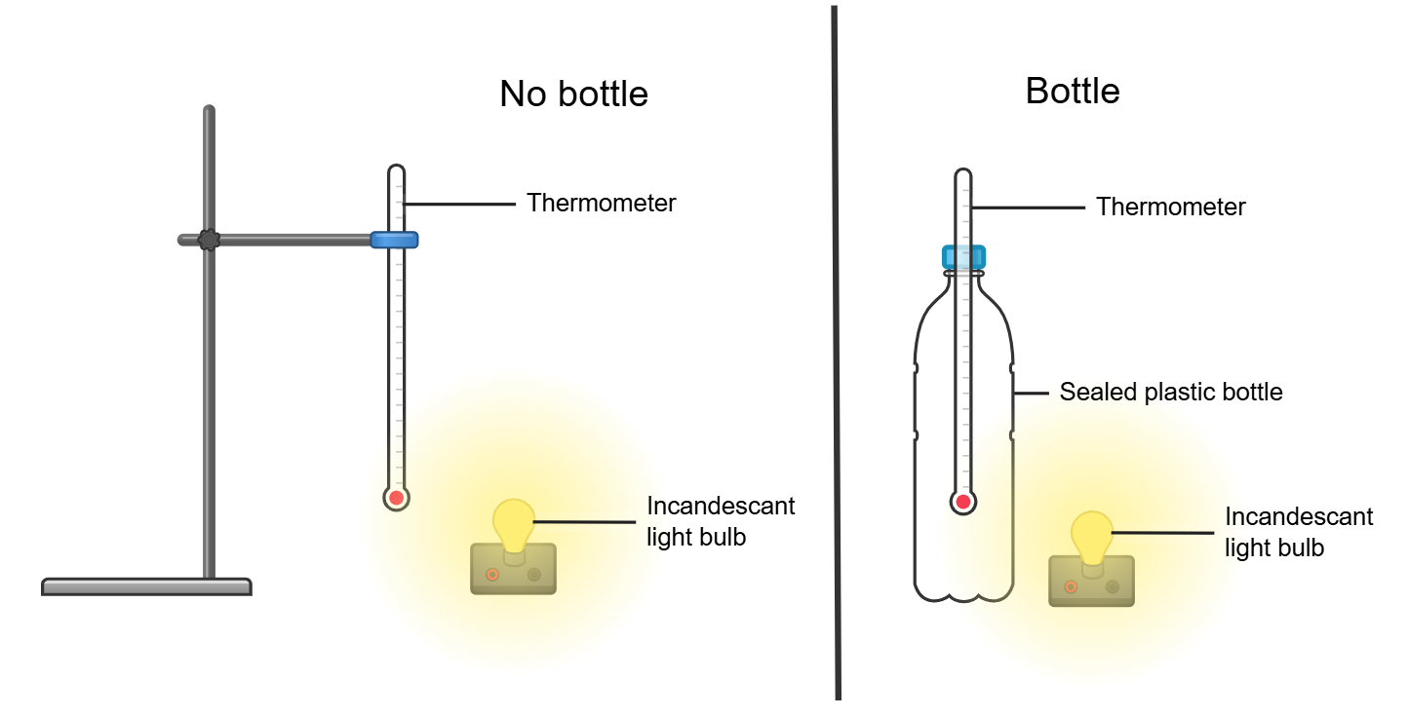
1.6 Modelling the natural greenhouse effect
Predict-observe-explain at each step
How does this model simplify a complex idea?
How does this model demonstrate a relationship?
Extension: What modifications could you make to this investigation to reflect the greenhouse effect on Earth more accurately?
This work has been generated using Chemix.
Notes:
Teacher notes:
Investigation to model the greenhouse effect.
Sample response
How does this model simplify a complex idea?
This model simplifies the complexity of the Earth's greenhouse effect by utilising just three basic components: a heat and light source (the Sun), an enclosed space (Earth’s atmosphere), and a thermometer. It isolates the role of "trapping heat" without needing to account for variables like cloud cover, atmospheric circulation, or different types of greenhouse gases.
How does this model demonstrate a relationship?
The model clearly illustrates the relationship between a heat source and a light source, the presence of an atmosphere-like barrier (the bottle), and the resulting increase in temperature. It visually demonstrates that when heat is trapped, the temperature rises, helping to understand the connection between greenhouse gases and global warming.
Extension: What modifications could you make to this investigation to reflect the greenhouse effect on Earth more accurately?
For example, water and/or plants can be added to the plastic bottle, greenhouse gases like carbon dioxide can be added, or smoke can be added to the bottle to model bushfires or clouds.

Slide 47
1.6 The natural greenhouse effect – think-pair-share (2)
Think
Individual thinking time
Pair
Share your thoughts with a partner
Share
Share with a larger group or class
How does the natural greenhouse effect influence global climate and support life?
Notes:
Think-Pair-Share involves students thinking independently about a prompt or problem, pairing up and discussing their ideas with a classmate, and then sharing their combined knowledge with the class. It:
allows educators to change a traditional whole-class discussion into a more manageable and inclusive activity where all students are allowed to respond
promotes the development of students' speaking, listening and social skills
Sample response:
The natural greenhouse effect helps maintain Earth’s climate by trapping some of the Sun’s heat in the atmosphere. Greenhouse gases like carbon dioxide, methane, and water vapour absorb and re-radiate heat energy, keeping the planet warm. Earth’s climate would be much colder and less stable without this effect. It creates the conditions needed for ecosystems and human societies to survive.

Slide 48
1.6 The natural greenhouse effect – Frayer diagram
Frayer diagram
Definition
Diagram sketch
Natural greenhouse effect
Examples of the effect
on climate
Non-examples
Notes:
Teacher notes:
Note that the student worksheet for this Frayer diagram is in TRB1. Sample responses are on the next slide.
Frayer diagrams are graphic organisers that help students develop or deepen awareness of unfamiliar concepts through defining the term and identifying examples and non-examples. They:
support educators in introducing new words or concepts in the classroom
activate students' prior knowledge of a topic and clarify potential misconceptions
model what a deep understanding of a term entails.

Slide 49




1.6 The natural greenhouse effect – Frayer diagram (sample response)
Definition
The natural greenhouse effect is the process where certain gases in Earth's atmosphere trap heat from the Sun, keeping the planet’s climate warm and stable enough to support life.
Diagram sketch
Natural greenhouse effect
Examples of the effect
on the climate
Earth’s average temperature is about 15°C instead of -18°C.
Stable climate that supports life.
Non-examples
Enhanced greenhouse effect (rapid climate changes caused by excessive human-added greenhouse gases).
Notes:
Teacher notes:
Sample responses for the Frayer diagram on the natural greenhouse effect.

Slide 50
1.7 How is the greenhouse effect being enhanced?
Learning intentions and success criteria
We are learning to: | I can:
analyse the impact of greenhouse gas emissions on the natural world. | explain what the enhanced greenhouse effect is explain the impact of the enhanced greenhouse effect on ecosystems.
analyse data from investigations to identify trends and relationships. | describe the relationship between greenhouse gas emissions and global mean temperatures analyse the validity of secondary source information and data’.
use a suitable problem-solving strategy (scientific models). | use a model to explain the greenhouse effect use a model to make predictions on cause and effect.
Notes:
Teacher notes:
Display this slide at the beginning of the learning activity. Revisit the slide where appropriate during lesson activities and encourage students to reflect on their progress.

Slide 51
1.7 Checkpoint – quick quiz on previous content
Mini challenge
Challenge
Super challenge
Why is the greenhouse effect important for life on Earth?
It makes the Earth colder and safer.
It traps heat, keeping the Earth warm enough to support life.
It blocks sunlight from reaching the Earth.
It causes all weather to stop.
Name 3 greenhouse gases.
How do greenhouse gases affect the climate?
Notes:
Teacher notes:
Sample responses
MC: B
C: carbon dioxide, methane, nitrous oxide.
SC: greenhouse gases trap heat in the Earth's atmosphere, making the planet warmer. This warming changes the climate by causing an increase in average long-term temperatures.

Slide 52
1.7 The enhanced greenhouse effect – definitions (1 of 2)
Enhanced greenhouse effect:
The enhanced greenhouse effect is the amplification of the natural greenhouse effect caused by the increased levels of greenhouse gases (like carbon dioxide, methane, and nitrous oxide) from human activities.
These extra greenhouse gases trap more heat in the Earth's atmosphere, leading to global warming and climate change.
Notes:
Teacher notes: This slide contains animations
Important terminology to support access to future content.
Introduce the topic ‘Enhanced Greenhouse Effect’
*CLICK*
Students record the definition for the enhanced greenhouse effect.
*CLICK*
Students record the impact of the enhanced greenhouse effect.

Slide 53
1.7 The enhanced greenhouse effect – definitions (2 of 2)
Parts per million (ppm) means one part in a million.
When measuring greenhouse gases, it shows how many molecules of a gas are present out of a million molecules of air.
For example, 419 ppm of CO₂ means there are 419 carbon dioxide molecules for every million air molecules.
Parts per billion (ppb) means one part in a billion.
It's used for gases found in much smaller amounts, like methane and nitrous oxide.
For example, 1919 ppb of methane means there are 1919 molecules of methane in every billion molecules of air.
Notes:
Teacher notes: This slide contains animations
Important terminology to support access to future content.
Students record the terminology: Parts per million (ppm)
*CLICK*
Students record notes on the meaning of parts per million means
*CLICK*
Students record an example
*CLICK*
Students record the terminology parts per billion (ppb)
*CLICK*
Students record the meaning of parts per billion.
*CLICK*
Students record an example.

Slide 54
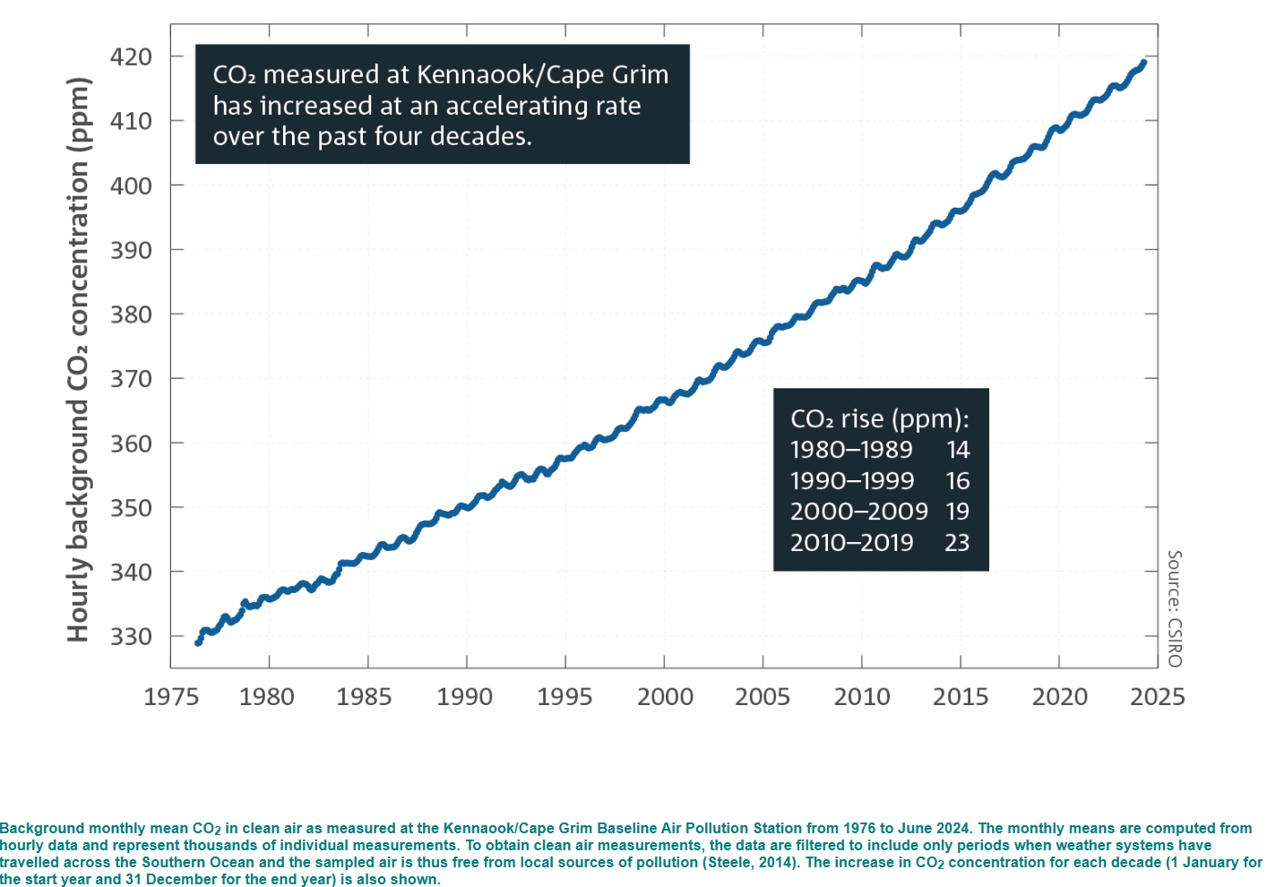
1.7 Analysing the data on global emissions and temperature
Carbon dioxide levels
‘Greenhouse gases’ © Copyright CSIRO.
Notes:
Teacher notes:
Graph of carbon dioxide levels over time measured in Australian territory. Students analyse the graph and answer question 3 in the Student resource – analysing the data on global emissions and temperature.
Questions
Describe the pattern in the data.
What is the relationship between the variables?
What is the evidence showing us?
Is the information valid?
Sample response:
The data show a steady increase in hourly background CO₂ concentration (in ppm) from around 330 ppm in 1976 to over 415 ppm by 2024. The increase is not linear — it accelerates over time, meaning the rate of increase grows larger each decade.
The variables are time (years) and CO₂ concentration (ppm). There is a positive, accelerating relationship — as time progresses, CO₂ levels consistently rise, and the rate of that rise becomes faster.
From 1980 to 1989, CO₂ rose by 14 ppm. From 1990 to 1999, it grew by 16 ppm. From 2000 to 2009, it rose by 19 ppm. From 2010 to 2019, it rose by 23 ppm.
This pattern of increasingly larger rises each decade shows clear evidence that CO₂ concentration is not only increasing but doing so at a faster and faster rate.
Yes, it is valid as the data comes from the CSIRO (Commonwealth Scientific and Industrial Research Organisation), a reputable scientific organisation.

Slide 55
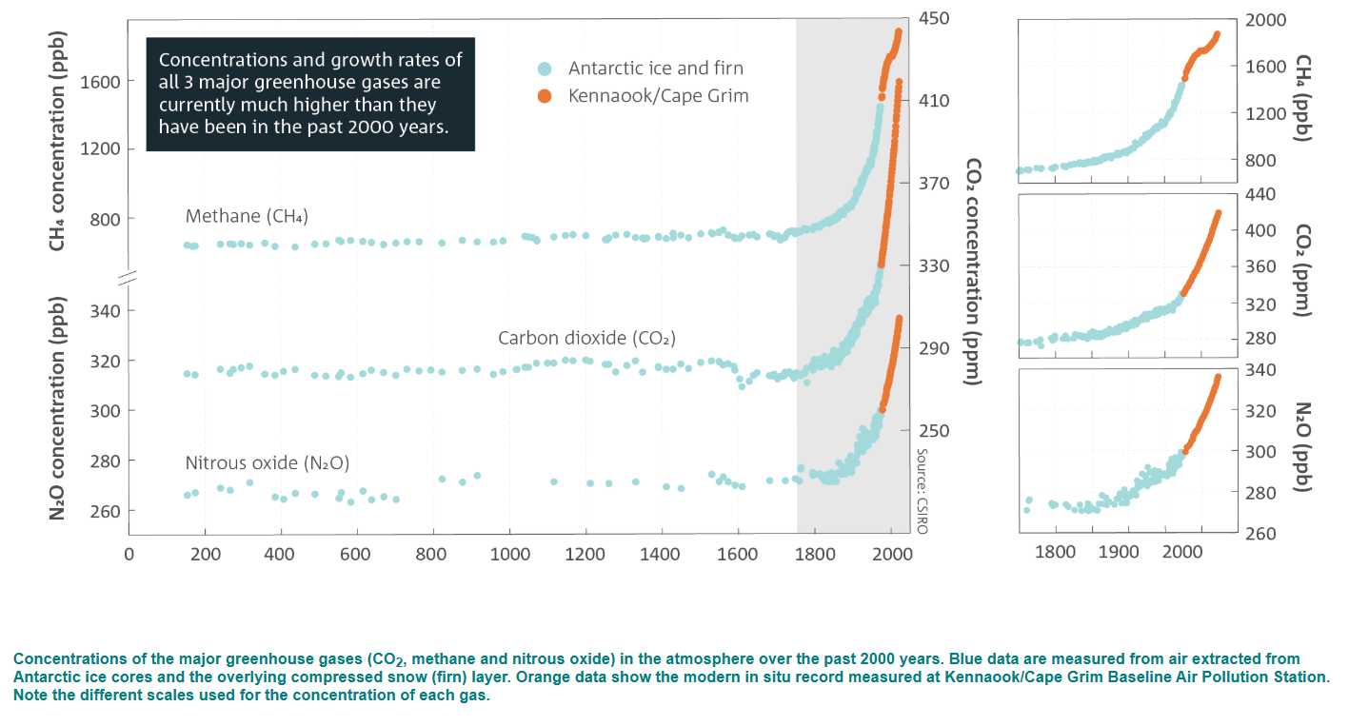
1.7 Major greenhouse gas levels
‘Greenhouse gases’ © Copyright CSIRO Australia.
Notes:
Teacher notes:
Graphs of greenhouse gas concentrations measured from the air and from ice core samples collected in Australian territory. Students analyse the graph and answer question 3 in the Student resource – analysing the data on global emissions and temperature. Sample responses are included in TRB1.
Questions
Describe the pattern in the data and the relationship between the variables.
What is the evidence showing us?
Is the information valid?

Slide 56
1.7 Carbon budget – definition
Carbon budget:
The maximum amount of carbon dioxide (CO₂) that can be emitted into the atmosphere while still having a good chance of limiting global warming to a specific temperature target, like 1.5 °C or 2 °C above pre-industrial levels.
It is like a ‘spending limit’ for CO₂ to avoid the worst impacts of climate change.
Notes:
Teacher notes:
Definition of a carbon budget for students to record and discuss in class.

Slide 57
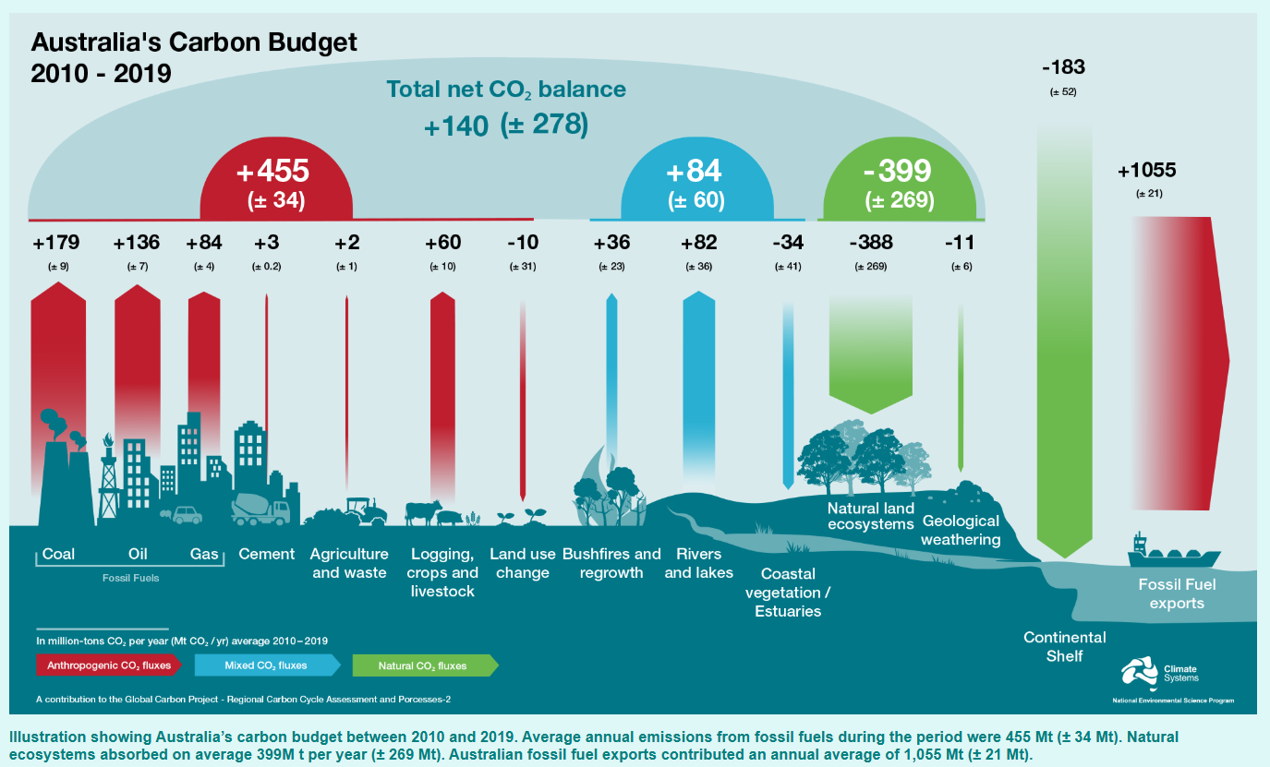
1.7 Australia’s carbon budget
List the emissions that contribute to the natural greenhouse effect.
List the emissions that contribute to the enhanced greenhouse effect.
List the ways the environment can absorb carbon dioxide.
Why are fossil fuel exports' emissions so significant, and why is it part of Australia’s carbon budget?
Why is there such a large uncertainty in Australia’s carbon budget?
‘Greenhouse gases’ © Copyright CSIRO Australia.
Notes:
Teacher notes:
Graphic showing Australia’s carbon budget from 2010 to 2019. Students analyse the graphic and answer question 5 in terms of temperature. Note that students may require initial support with unpacking the graphic.
Questions
List the emissions that contribute to the natural greenhouse effect.
List the emissions that contribute to the enhanced greenhouse effect.
List the ways the environment can absorb carbon dioxide.
Why are fossil fuel exports' emissions so significant, and why is it part of Australia’s carbon budget?
Why is there such a large uncertainty in Australia’s carbon budget?
Sample responses:
Bushfires, rivers and lakes.
Coal, oil, gas, cement, agriculture and waste, logging, crops and livestock.
Land use change, coastal vegetation/estuaries, natural land ecosystems, geological weathering and oceans.
Australia exports a significant amount of coal, oil, and gas. When these are combusted, they result in carbon dioxide emissions in various countries.
Australia's net annual carbon balance is highly variable from year to year, due to changes in the behaviour of natural CO₂ sinks (natural ecosystems). Australia can be a significant net source of CO₂ in one year (for example, due to numerous bushfires that year), then become carbon neutral in the next, and subsequently become a large net CO₂ sink in the following year.

Slide 58
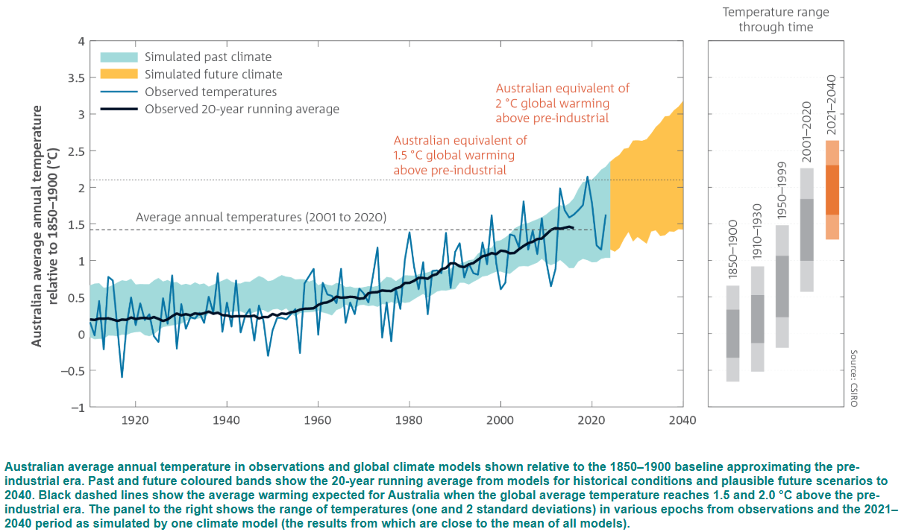
1.7 Australia’s average annual temperature
‘Future climate’ © Copyright CSIRO Australia.
Notes:
Teacher notes:
This is a graph of temperature levels over time measured in Australian territory. Students analyse the graph and answer question 6 in the Student resource – analysing the data on global emissions and temperature.
Questions
Describe the pattern in the data.
What is the relationship between the variables?
What is the 2040 temperature predicted to be like relative to 1850-1900?
Is the information valid?
Sample responses:
The graph shows that Australian average annual temperatures were relatively stable from 1910 to about 1970, with some fluctuations. From the 1970s onward, temperatures have risen steadily, with an increasingly steep upward trend. Based on climate models, this trend is projected to continue rising sharply into the future.
The graph shows the relationship between time (x-axis) and average annual temperature relative to 1850–1900 (y-axis). There is a positive correlation: as time moves forward, temperatures increase. The observed trend (dark blue and black lines) aligns with model predictions (shaded areas), indicating strong consistency between the data and climate models.
By 2040, the average annual temperature in Australia is projected to be about 2°C above pre-industrial levels. This corresponds with the orange-shaded area, which shows future climate simulations. It exceeds the 1.5°C warming threshold and reaches the 2°C global warming equivalent, marked on the graph.
Yes, the information is valid due to the following:
source – CSIRO, a trusted and authoritative scientific organisation
data and models – the observed data (from historical records) align well with climate model simulations
methodology – 20-year running averages and multiple models are used, increasing reliability
the range of uncertainty is also shown, giving transparency to the model projections.

Slide 59
1.8 How can we reduce greenhouse gas emissions?
Learning intentions and success criteria
We are learning to: | I can:
analyse the impact of greenhouse gas emissions on the natural world | explain the advantages and limitations of methods to reduce greenhouse gas emissions
analyse data to identify relationships | synthesise data to help explain the effect of transitioning to greenhouse gas emission reduction methods
analyse proposed solutions to a problem. | evaluate claims using the (C-E-R) scaffold.
Notes:
Teacher notes:
Display this slide at the beginning of the learning activity. Revisit the slide where appropriate during lesson activities and encourage students to reflect on their progress.

Slide 60
1.8 Checkpoint – quick quiz on previous content
Mini challenge
Challenge
Spot the pattern. Look at the following data:
What is the overall trend shown in the data?
Explain how increasing CO₂ levels contribute to changes in the global climate. Include one effect this may have on ecosystems.
Year | CO₂ concentration (ppm) | Global average temperature anomaly (°C)
1990 | 354 | +0.45
2000 | 370 | +0.52
2010 | 390 | +0.62
Notes:
Teacher notes:
Sample responses
MC: both CO₂ concentration and global average temperature anomaly are increasing over time.
C: rising CO₂ levels enhance the greenhouse effect by trapping more heat in the atmosphere, which leads to global warming. This can cause ecosystem disruptions, such as coral bleaching due to warmer ocean temperatures.

Slide 61
1.8 Transitioning to solar C-E-R scaffold
Claim
State an answer to the question or prompt.
Evidence
Provide reliable information from experiments, facts or a reliable source that supports the claim.
Reasoning
Explain how the evidence supports the claim.
Helpful hints
Use key words and ideas from the question as you write your claim.
Sentence starters
In the experiment …
The data shows …
One piece of evidence is …
Sentence starters
The evidence supports the claim because …
Based on this evidence, it can be concluded that …
Your response:
Your response:
Your response:
Notes:
Teacher notes: This slide contains animations.
This slide may be used to help students prepare an explanation or claim.
The slide provides a scaffold that the teacher may alter to add or remove support as needed, or sentence starters may be altered to suit the activity better.
Teachers may use the slide to model a response using a Think Aloud technique or during joint construction of responses.
Speaking notes:
*CLICK*
Define a claim
*CLICK*
Outline helpful hints to use when creating a claim.
*CLICK*
Define evidence and explain how reliable evidence can support a claim.
*CLICK*
Discuss possible sentence starters that may be used when describing evidence that supports or refutes a claim.
*CLICK*
Define reasoning and explain how it supports a claim.
*CLICK*
Discuss possible sentence starters that may be used when outlining the reasoning that supports or refutes a claim.

Slide 62
1.8 Transitioning to solar – the claim
Claim
State an answer to the question or prompt.
Evidence
Provide reliable information from experiments, facts or a reliable source that supports the claim.
Reasoning
Explain how the evidence supports the claim.
Question:
Will transitioning to household solar use in Australia reduce greenhouse gas emissions?
Claim:
Using solar energy for household electricity generation will reduce greenhouse gas emissions.
Notes:
Teacher notes: This slide contains animations
This scaffold will model and support students in evaluating a claim.
Introduce the first element of the CER scaffold – claim.
*CLICK*
Discuss the question and co-create a claim with the class.
*CLICK*
Display the sample claim.

Slide 63
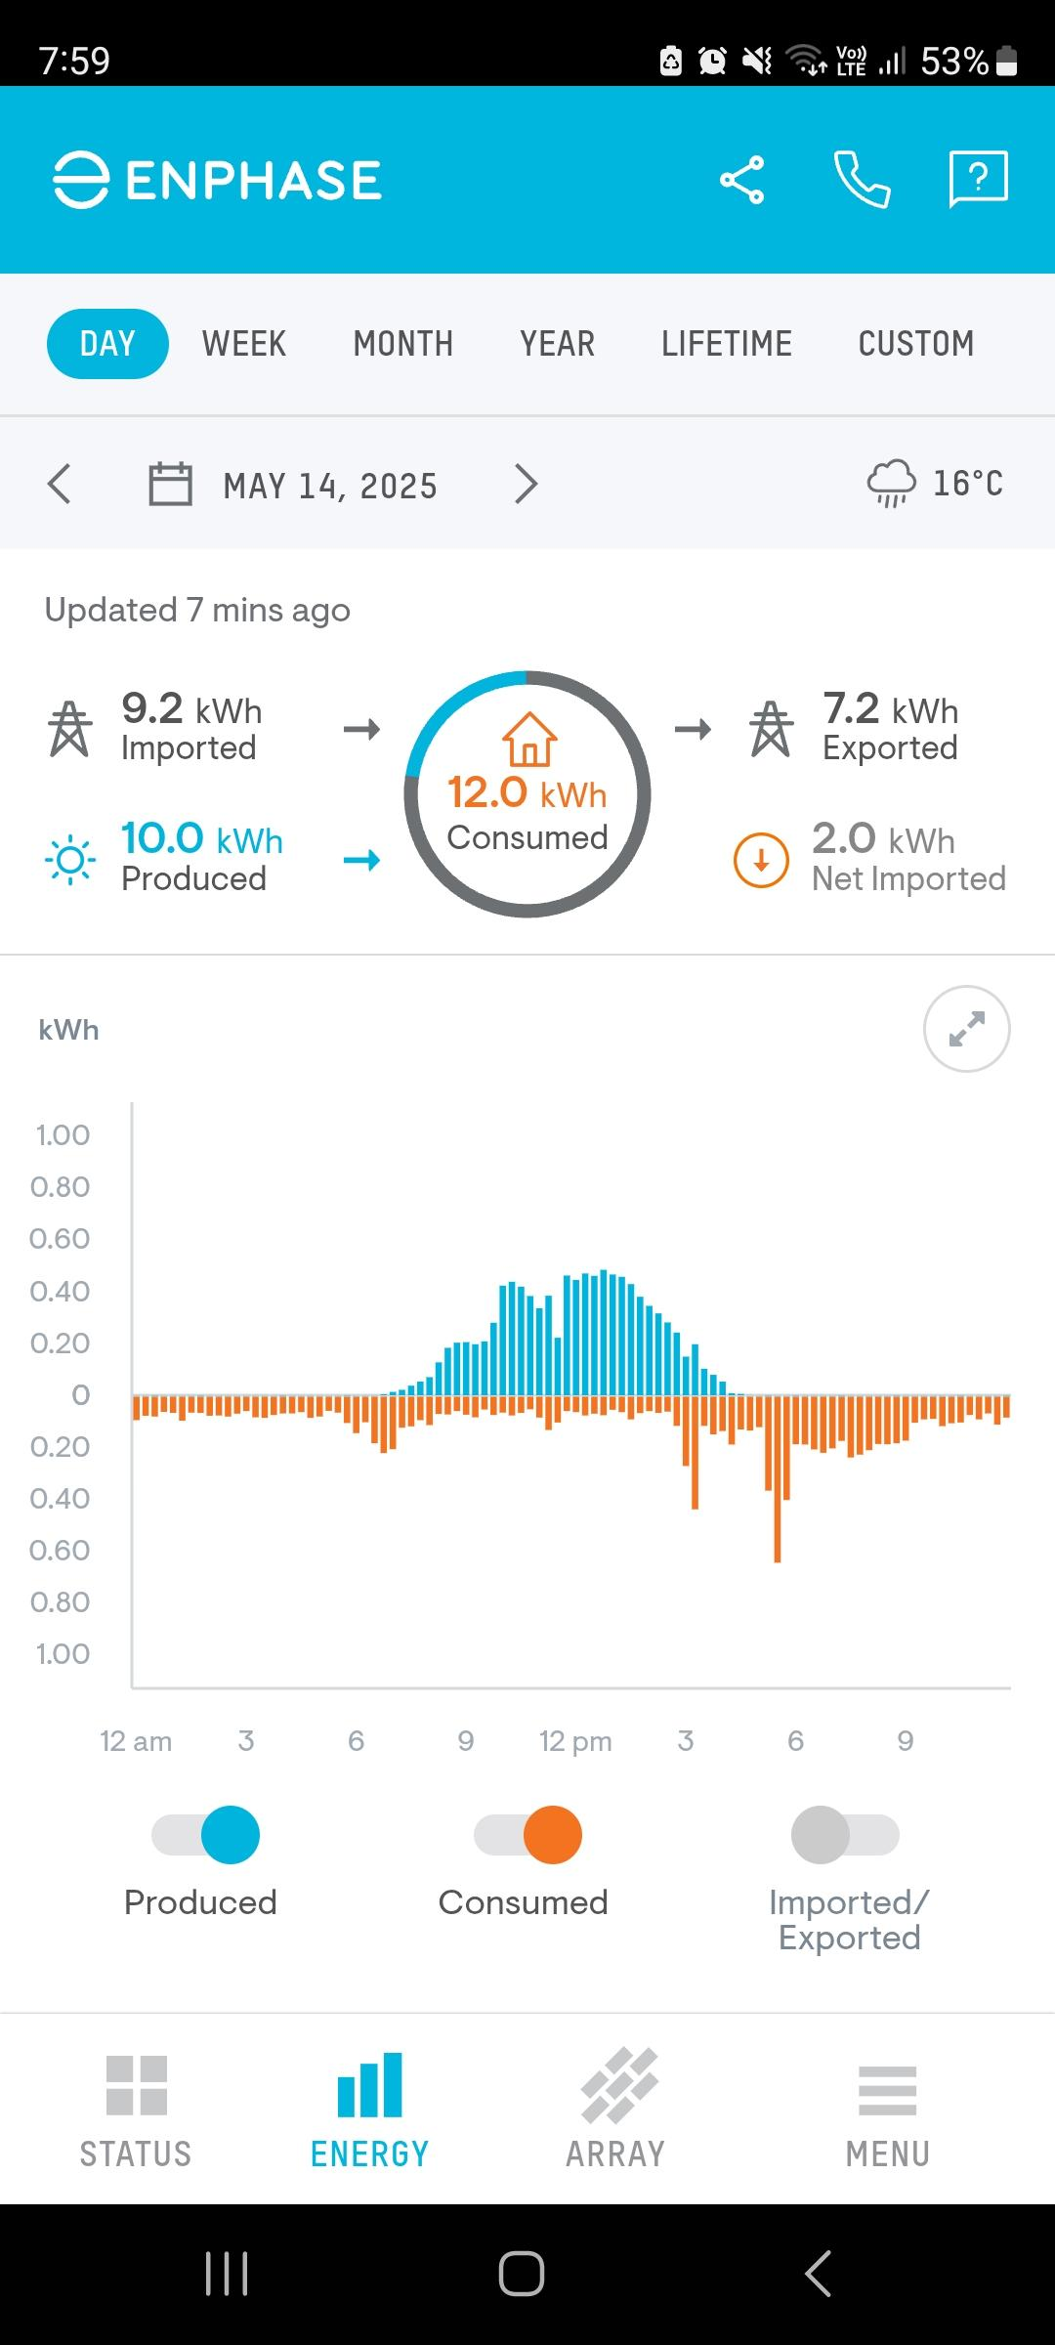
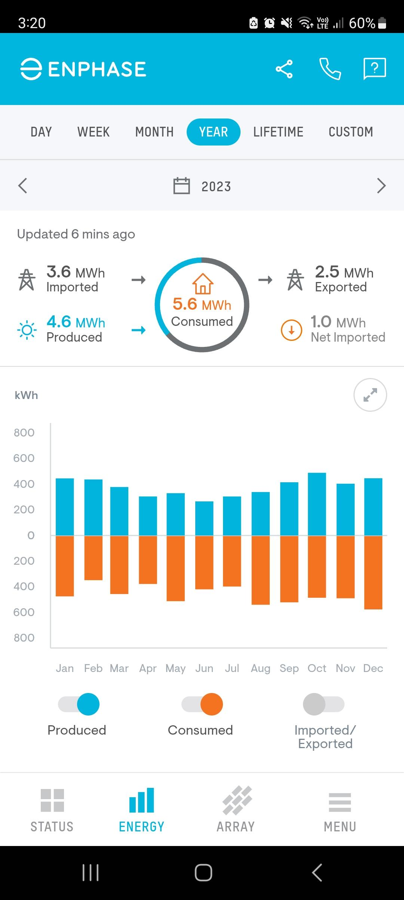
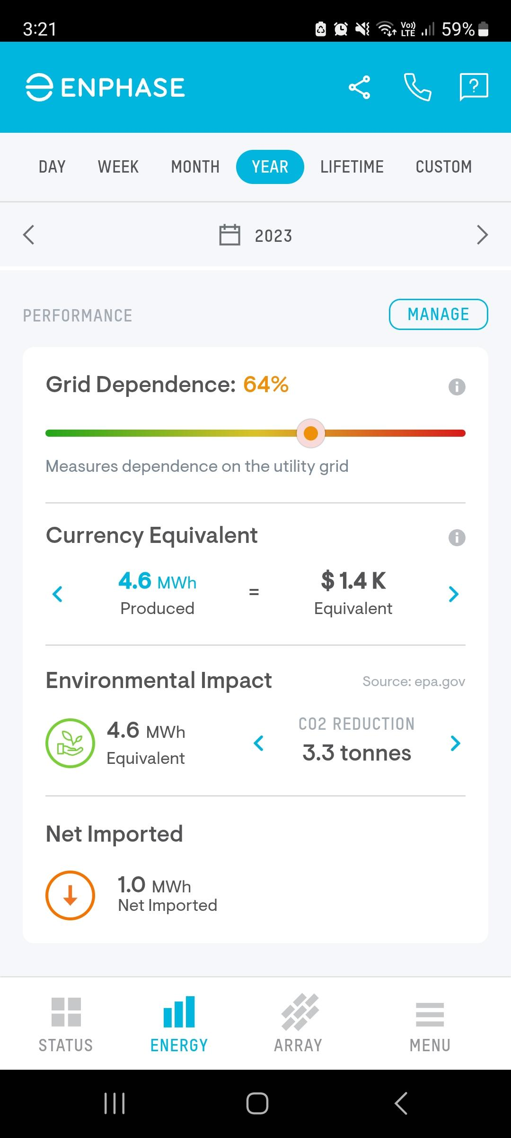
1.8 Transitioning to solar – the data
What does this home solar data show us?
Figure 1: One day of household solar data
Figure 2: One year of household solar data
Figure 3: Cost and environmental impact of using solar over a year
Notes:
Teacher notes:
Figure 1 shows the electricity produced from a 3kW (12-panel) solar energy system and electricity consumption for a five-person family household for a mostly sunny day. Note that electricity needs to be imported from the grid when the sun is not shining.
Figure 2 shows the monthly electricity produced from a 3kW (12-panel) solar system and electricity consumption for a five-person family household. This solar system demonstrates that it provides a significant amount of electricity needed for this household.
Figure 3 shows the potential cost savings and greenhouse gas reduction over the year for solar energy used for the household solar system mentioned in the previous figure.

Slide 64
1.8 Transitioning to solar – the evidence
Claim
State an answer to the question or prompt.
Evidence
Provide reliable information from experiments, facts or a reliable source that supports the claim.
Reasoning
Explain how the evidence supports the claim.
Australia is the world's 14th highest emitter, contributing just over 1% of global emissions.
Energy (burning fossil fuels to produce electricity) contributed 32.6% of Australia’s total emissions in 2023. Solar contributed 16% of total electricity generation in 2022-23 in Australia.
Australia is ranked 12th in the world for per-capita CO₂ emissions.
Using solar energy produces fewer emissions than coal, oil, and gas. However, it produces more (during panel production) than hydropower, wind and nuclear energy.
Solar energy is limited to daytime, sunny conditions, unless with battery storage.
Notes:
Teacher notes: This slide contains animations
This scaffold will model and support students in evaluating a claim.
Introduce the second element of the CER scaffold – evidence.
*CLICK*
Discuss the evidence and create a summary of the evidence with the class.
*CLICK*
Display the sample claim.

Slide 65
1.8 Transitioning to solar – reasoning
Claim
State an answer to the question or prompt.
Evidence
Provide reliable information from experiments, facts or a reliable source that supports the claim.
Reasoning
Explain how the evidence supports the claim.
Burning fossil fuels to generate electricity is a major source of greenhouse gas emissions, contributing 32.6% of Australia’s total emissions in 2023.
Since solar energy produces far fewer emissions than coal, oil, and gas, increasing the use of solar power for household electricity can significantly reduce these emissions. Although manufacturing solar panels does release some emissions, solar energy is still a cleaner option overall.
With Australia being one of the highest emitters per person, switching more households to solar power would help lower the country's total greenhouse gas output.
Notes:
Teacher notes: This slide contains animations
This scaffold will model and support students in evaluating a claim.
Introduce the last element of the CER scaffold – reasoning
*CLICK*
Discuss the evidence and co-create the reasoning with the class.
*CLICK*
Display the sample claim.

Slide 66
1.9 Cause and effect – industrialisation and global temperatures
Learning intentions and success criteria
We are learning to: | I can:
explain the impact of greenhouse gas emissions on the natural world. | analyse CO₂ data from the Keeling Curve analyse temperature data from NASA summarise the relationship between industrialisation and the rise in global temperatures.
explain data to identify trends, patterns and relationships. | describe the patterns and trends in global atmospheric CO₂ and temperature data over time describe the relationship between global atmospheric CO₂ and temperature levels use graphs to extrapolate data and draw conclusions.
Notes:
Teacher notes:
Display this slide at the beginning of the learning activity. Revisit the slide where appropriate during lesson activities and encourage students to reflect on their progress.

Slide 67
1.9 Checkpoint – quick quiz on previous content
Mini challenge
Challenge
Super challenge
List an advantage and a limitation to using solar energy to reduce greenhouse gas emissions.
How would you justify your reasoning when testing a claim? (Clue: What does CER stand for?)
Using evidence, write a brief recommendation to the Prime Minister on what the country should do to reduce Australia’s greenhouse gas emissions.
Notes:
Teacher notes:
Sample responses
MC: Advantage: solar energy is renewable and does not produce greenhouse gas emissions during electricity generation.
Limitation: solar energy depends on sunlight, so it may not produce power consistently during cloudy weather or at night.
C: I would use the CER framework to justify my reasoning:
C – Claim: Make a clear statement
E – Evidence: Support it with data or research
R – Reasoning: Explain how the evidence supports the claim using scientific principles.
SC: Dear Prime Minister,
I recommend substantially investing in solar energy infrastructure across urban and regional areas to reduce Australia's greenhouse gas emissions. Solar energy has become more affordable and provides clean electricity without harmful emissions. In addition, funding carbon capture and storage (CCS) technology for industries that still rely on fossil fuels could help lower emissions in the short term. Combining renewable energy with CCS gives us a balanced, evidence-based approach to tackling climate change.
Kind regards,
A Year 9 science student

Slide 68
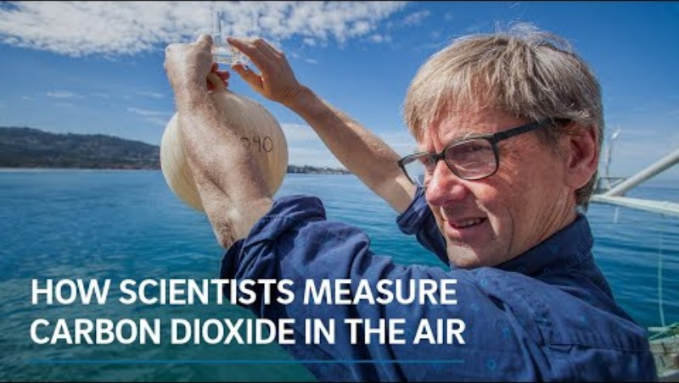
1.9 How scientists measure carbon dioxide in the air
How Scientists Measure Carbon Dioxide in the Air (2:24)
Notes:
Teacher notes:
2:24 min video. Supports understanding of the Keeling Curve. Watch this video with students and clarify any questions they may have.

Slide 69
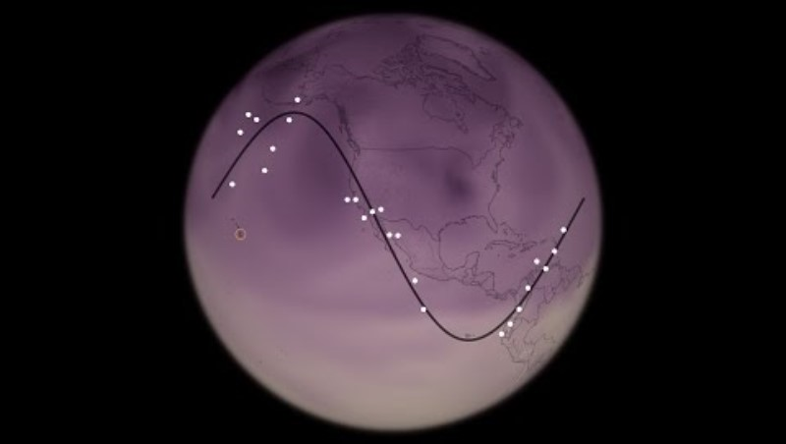
1.9 The Keeling curve – The story of CO₂
Science Bulletins: Keeling's Curve – The Story of CO2 (3:37)
Notes:
Teacher notes:
Video 3:37 min. Supports students thinking of the Keeling Curve and seasonal variations in CO₂ concentration in the atmosphere.

Slide 70
1.9 The Industrial revolution
‘Industrial’ refers to systems of producing manufactured goods on a large scale in factories, rather than through the previous smaller-scale systems of manufacture at home or in small workshops.
A ‘revolution’ involves a major change in the way people live and work.
The Industrial Revolution started around 1750.
This started the widespread adoption of coal, oil, and gas as fuel sources for factories, transportation, and heating.
As cities grew and industrialisation spread, vast amounts of forests were cleared to make way for new buildings and infrastructure and to provide wood for fuel.
Notes:
Teacher notes: This slide contains animations
Unpack the term ‘industrial revolution’ for students.

Slide 71
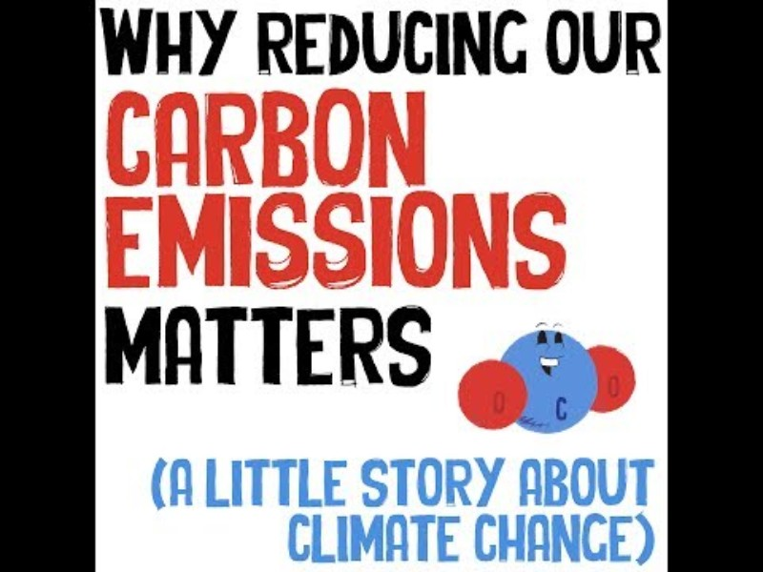
1.9 Why carbon emissions matter
Video: Why reducing our carbon emissions matters (a little story about climate change)
Questions:
What pattern is observed in global CO₂ and temperature levels since the Industrial Revolution?
What relationship is evident between global CO₂ and temperature levels?
If the current trend continues for global CO₂ and temperature levels, extrapolate what could occur in the next 10, 20 or even 100 years?
Why reducing our carbon emissions matters (a little story about climate change) (3:32)
Notes:
Teacher notes:
3:32 video on why reducing carbon emissions matters. As students watch, they are to answer the questions on the slide.
Sample responses:
- Since the Industrial Revolution (around 1750), CO₂ levels in the atmosphere have risen sharply due to human activities such as burning fossil fuels. At the same time, global average temperatures have also steadily increased, especially over the past 100 years.
- There is a strong link between CO₂ levels and global temperature. As CO₂ increases, it traps more heat in the atmosphere, causing the Earth's temperature to rise. This is known as the greenhouse effect.
- If current trends continue:
In 10–20 years, we may experience more frequent heat waves, rising sea levels, and stronger storms.
In 100 years, CO₂ levels could more than double compared to pre-industrial times, and global temperatures could rise by 2–4°C or more. This could lead to major changes in weather patterns, ecosystems, agriculture, and human health.

Slide 72
1.10 The consequences of climate change
Learning intentions and success criteria
We are learning to: | I can:
discuss the impact of climate change on the natural world. | identify the characteristics of climate change describe the consequences of climate change for people and the economy.
analyse data from investigations to identify relationships. | describe trends in ocean acidification data use ocean acidification data to make predictions describe the relationship between ocean acidification and impacts on shellfish.
analyse proposed solutions to a problem. | use data to make predictions about the pH of surface water evaluate claims using the claim-evidence-reasoning (C-E-R) scaffold.
Notes:
Teacher notes:
Display this slide at the beginning of the learning activity. Revisit the slide where appropriate during lesson activities and encourage students to reflect on their progress.

Slide 73
1.10 Checkpoint 1 – quick quiz on previous content
Mini challenge
Challenge
Super challenge
What events from the start of the Industrial Revolution that initiated climate change?
What does the Keeling Curve represent?
What is the relationship between global greenhouse gas emissions and global mean temperatures since the Industrial Revolution, compared to natural cycles?
Notes:
Teacher notes:
Sample responses
MC: the widespread burning of fossil fuels released large amounts of carbon dioxide, a greenhouse gas, into the atmosphere.
C: the Keeling Curve shows the ongoing rise of carbon dioxide levels in Earth's atmosphere since 1958.
SC: since the Industrial Revolution, global greenhouse gas emissions, especially carbon dioxide from human activities, have increased sharply, causing a significant rise in global mean temperatures. This recent warming is much faster and greater than changes seen in natural climate cycles over the past 800,000 years.

Slide 74
1.10 Climate change – definition
A long-term change in regional or global climate patterns, for example annual precipitation, frequency of weather events (NESA, 2023).
Notes:
Teacher notes:
Climate change is the long-term shift in the average patterns of temperature, rainfall, wind, and other aspects of the Earth’s climate system, mainly caused today by the increased concentration of greenhouse gases (like carbon dioxide and methane) from human activities such as burning fossil fuels, deforestation, and agriculture.
It is different from weather, which refers to short-term conditions. Climate change refers to changes measured over decades to centuries, not just days or weeks.

Slide 75
1.10 The characteristics of climate change (1 of 2)
Rising global temperatures
+
Rising sea levels
A volcanic eruption
Ozone layer depletion
A cold winter
Littering
Melting polar ice
Notes:
Teacher notes: This slide contains animations.
Ask students to identify whether each characteristic is an example (+) or non non-example (-). Click on each item, and the animations will move it to the correct box. Discuss the reasoning behind each classification.
More options on the next slide.

Slide 76
1.10 The characteristics of climate change (2 of 2)
An earthquake
+
Ocean acidification
Changing precipitation patterns
Ecosystem disruption and species migration
A hot December
A solar eclipse
A long-term trend in the weather
Notes:
Teacher notes: This slide contains animations.
Ask students to identify whether each characteristic is an example (+) or non non-example (-). Click on each item, and the animations will move it to the correct box. Discuss the reasoning behind each classification.

Slide 77
1.10 Checkpoint 2 – quick quiz on previous content
Mini challenge
Challenge
Super challenge
Which of the following defines the term climate?
Climate describes long-term patterns of atmospheric conditions.
Climate describes daily weather conditions.
Climate changes every hour.
Climate only refers to temperature, not rainfall or other weather elements.
What trends are evident in Australia’s climate data?
Name one way climate change effects people.
Notes:
Teacher notes:
This slide contains animations to reveal the correct answer for the mini challenge.
Sample responses
MC: A)
C: Australia’s climate data shows trends of higher temperatures (both surface and sea temperatures), and less average rainfall.
SC: Climate change causes an increase in severe weather events such as fire and flood. This causes damage to peoples homes, leading to financial and emotional distress.

Slide 78
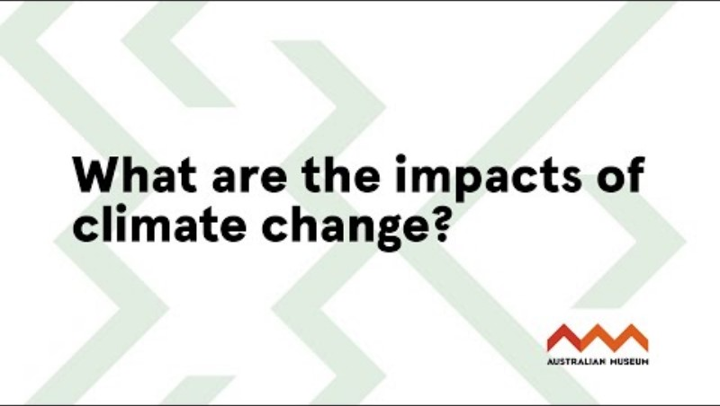
1.10 The impacts of climate change
Who is it impacting and how?
What are the impacts of climate change? (9:36)
Notes:
Teacher notes:
Climate change affects everything. It’s already putting pressure on our planet—on people and other living things, on economies and on governments.
Human communities around the world are increasingly losing habitable land, houses, and sites of cultural significance. Our sources of reliable food and fresh water are dwindling. Also, our health suffers from hotter summers, and the air quality gets worse during the bushfire seasons. But we’re not the only species being deeply impacted. The impacts of climate change affect all life on Earth. As the oceans warm, coral reefs bleach and die, which means many fish and other marine creatures lose their habitats. Animals and plants are also having to shift where they live to stay within comfortable living limits. Mammals, reptiles, fish, insects, plants, fungi and other species are maturing, reproducing, flowering or fruiting at different times now, to keep up with temperature changes. This means the food sources that each one relies on to feed themselves and their offspring are often not available when needed.
Climate change is damaging the Earth’s capacity to act as a life support system, for us and for Earth’s many other species.
Student questions:
a. Outline one way that humans are being affected by climate change
b. Outline one way that plants or animals are being affected by climate change
Sample response
a. Humans are being affected by climate change, as people who live in coastal or island homes are losing their land and homes due to sea level rise. This results in social and mental health issues.
b. As seasons such as spring are becoming shorter, this impacts a plant’s ability to flower, and the timing may be incorrect for the pollinating insects to complete pollination.

Slide 79
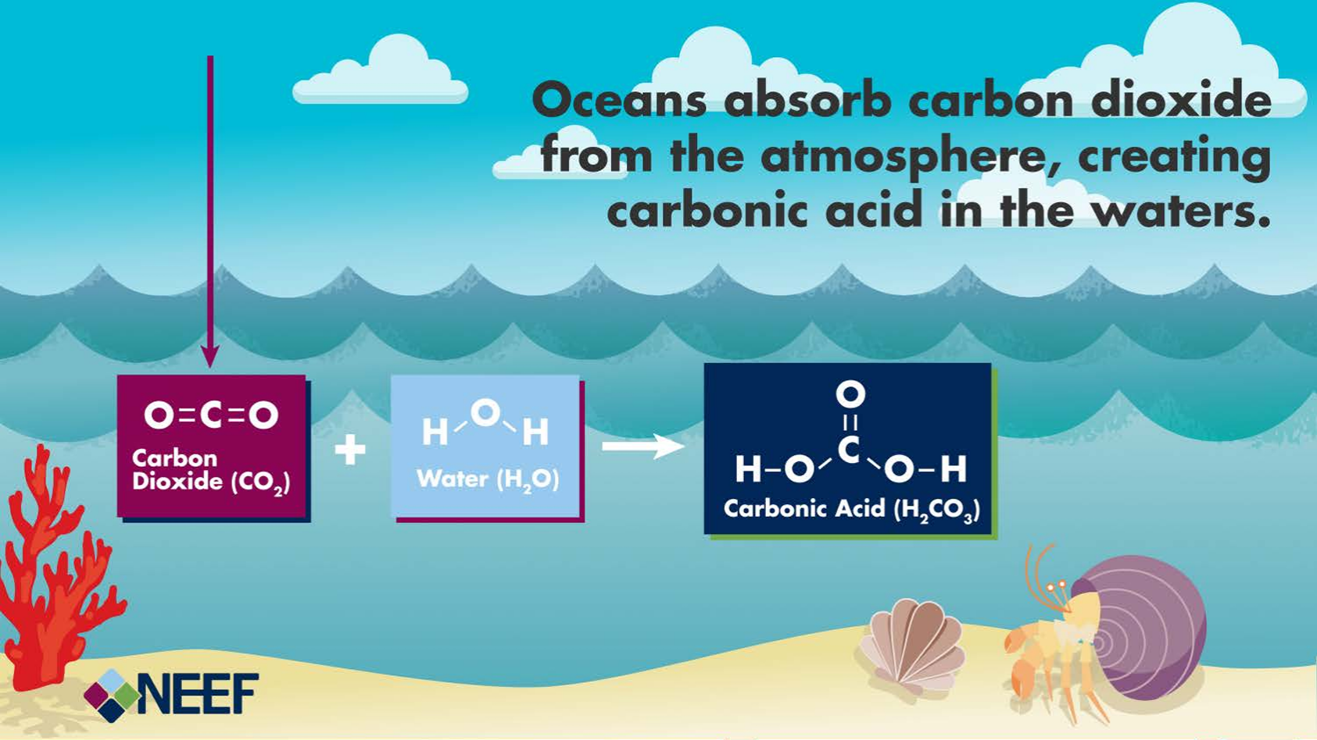
1.10 Ocean acidification
Carbon dioxide in water
Ocean acidification infographic by ASkalmusky. Used with permission from The National Environmental Education Foundation (NEEF), NEEFusa.org
Notes:
Teacher notes:
Rising atmospheric CO₂ levels increase the uptake of CO₂ by the oceans, which absorb 26% of annual global emissions. This affects the oceans’ carbonate chemistry and decreases their pH, a process known as ocean acidification. The pH changes in surface waters are primarily driven by increasing CO₂ in the atmosphere, causing the uptake of CO₂, which reacts with water, producing hydrogen ions and a pH decrease. It’s crucial to note that we’re talking about a shift towards acidity, not making the ocean actually acidic. The ocean is still alkaline, but becoming less alkaline.
The current rate of change of pH in open ocean surface waters is about 10 times faster than at any time in the past 65 million years, and the rate of acidification has grown in recent decades. Some ecosystems are now exposed to conditions outside the pH ranges experienced in the pre-industrial era before 1850.

Slide 80
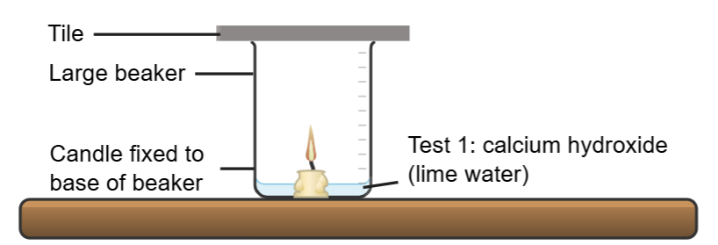
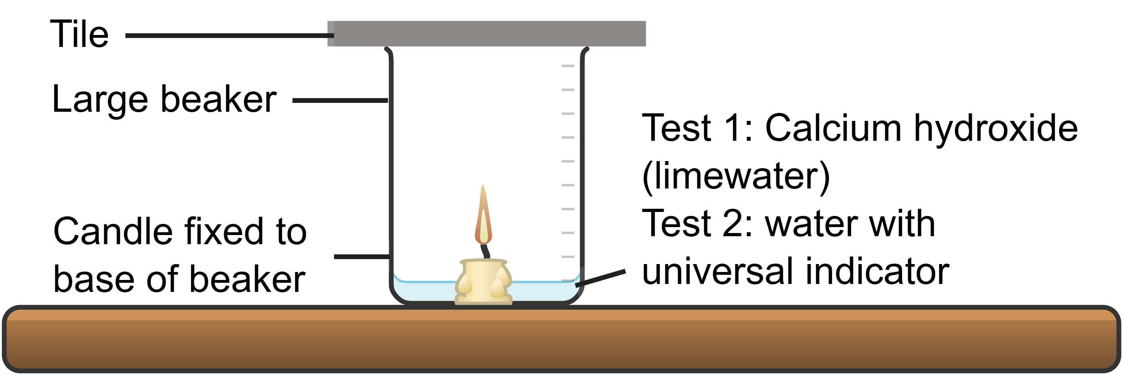
1.10 Test 1: testing for carbon dioxide
Observations
At the beginning of the test the calcium hydroxide (limewater) solution was ______________. After combusting the candle in the beaker, the calcium hydroxide changed to have ___________ appearance. Therefore, burning the candle produced ___________ ____________.
clear
cloudy
Carbon dioxide
This work has been generated using Chemix
WORD BANK
cloudy clear carbon dioxide
Notes:
Teacher notes:
This slide contains animations to bring up the correct answer.
Use the words in the word bank to complete the cloze passage as part of the background information for Investigation 1: Carbon dioxide and the pH of water.
Sample response:
When I exhale, I release carbon dioxide.
The water absorbs carbon dioxide and reacts with it to form carbonic acid.
The carbonic acid lowers the pH of the water, making it more acidic.

Slide 81
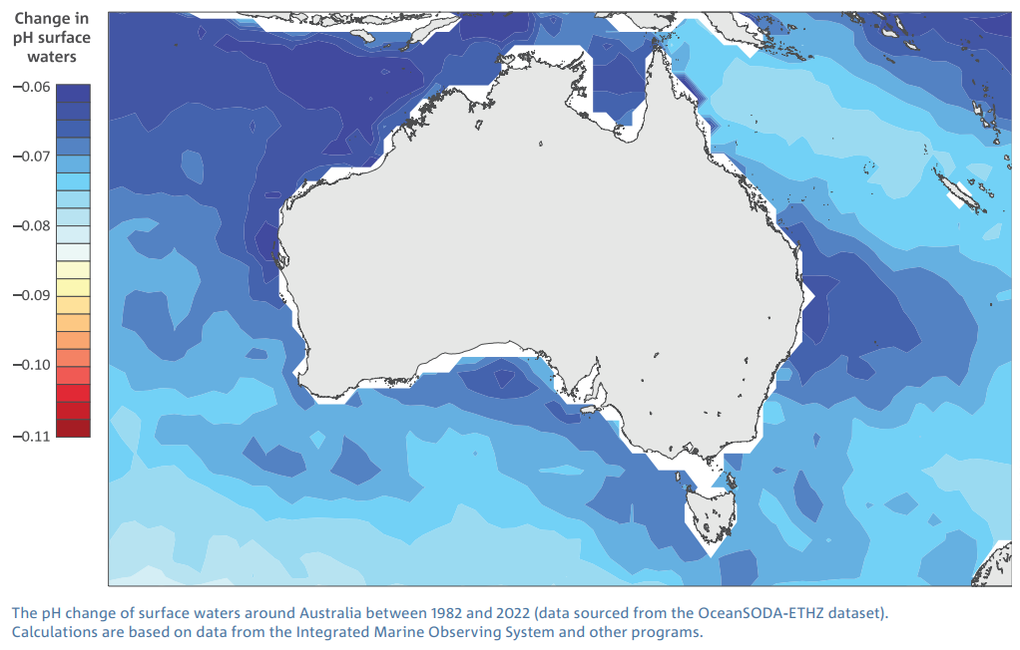
1.10 Ocean acidification data (1 of 2)
Prior to the industrial revolution, the average ocean pH was around 8.2. Since then, it has dropped to around 8.1, making it slightly alkaline.
The pH change of surface waters around Australia between 1982 and 2022 © Copyright CSIRO Australia is licensed under CC BY 4.0
Notes:
Teacher notes:
The ocean around Australia, like the global average, is naturally alkaline with a pH of around 8.1. Still, it’s becoming more acidic due to increased carbon dioxide in the atmosphere, causing ocean acidification.
Between the periods 1880–1889 and 2010–2019, the average pH of surface waters around Australia and globally is estimated to have decreased by about 0.12, corresponding to about a 30% increase in acidity*. There are regional variations in acidity increases; between 1982 and 2022, the most significant acidity increases have occurred in the Southern Ocean (21%) and in the Coral Sea (19%), with the smallest increases to the north-west of Australia (15%).
The pH changes tend to be greater at higher latitudes, where there is more total dissolved CO₂ in the surface waters, which reduces their capacity to buffer against pH change.
*Note: Being a logarithmic scale, a decrease in the pH of one unit translates to a 10-fold increase in acidity. Therefore, the acidity of surface waters around Australia has increased more than 30 per cent over the past 140 years.

Slide 82
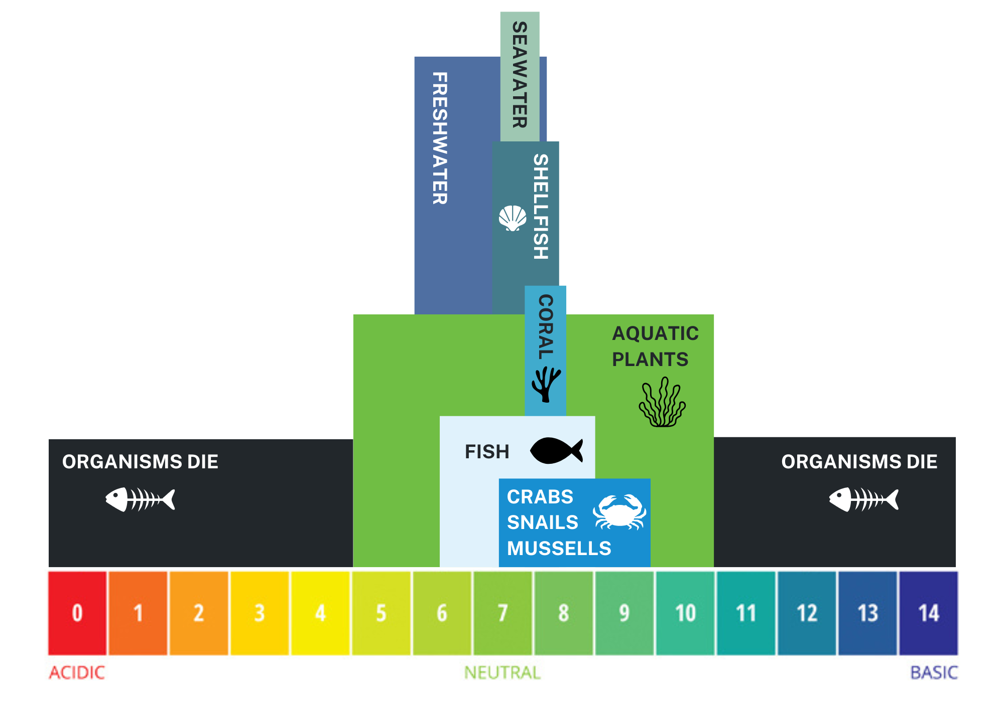
1.10 Ocean acidification data (2 of 2)
Many aquatic organisms can only survive within a narrow pH range.
Source: Adapted from Fondriest Environmental Learning Center is CC
Notes:
Teacher notes:
As the pH of the ocean becomes more acidic, it can have an impact on the organisms living within that ecosystem.
Many marine organisms have a specific, and often narrow, range of optimal pH.
Once the pH of the water moves beyond the organism’s optimal range, it can impact their growth, reproduction and even cause them to die.

Slide 83
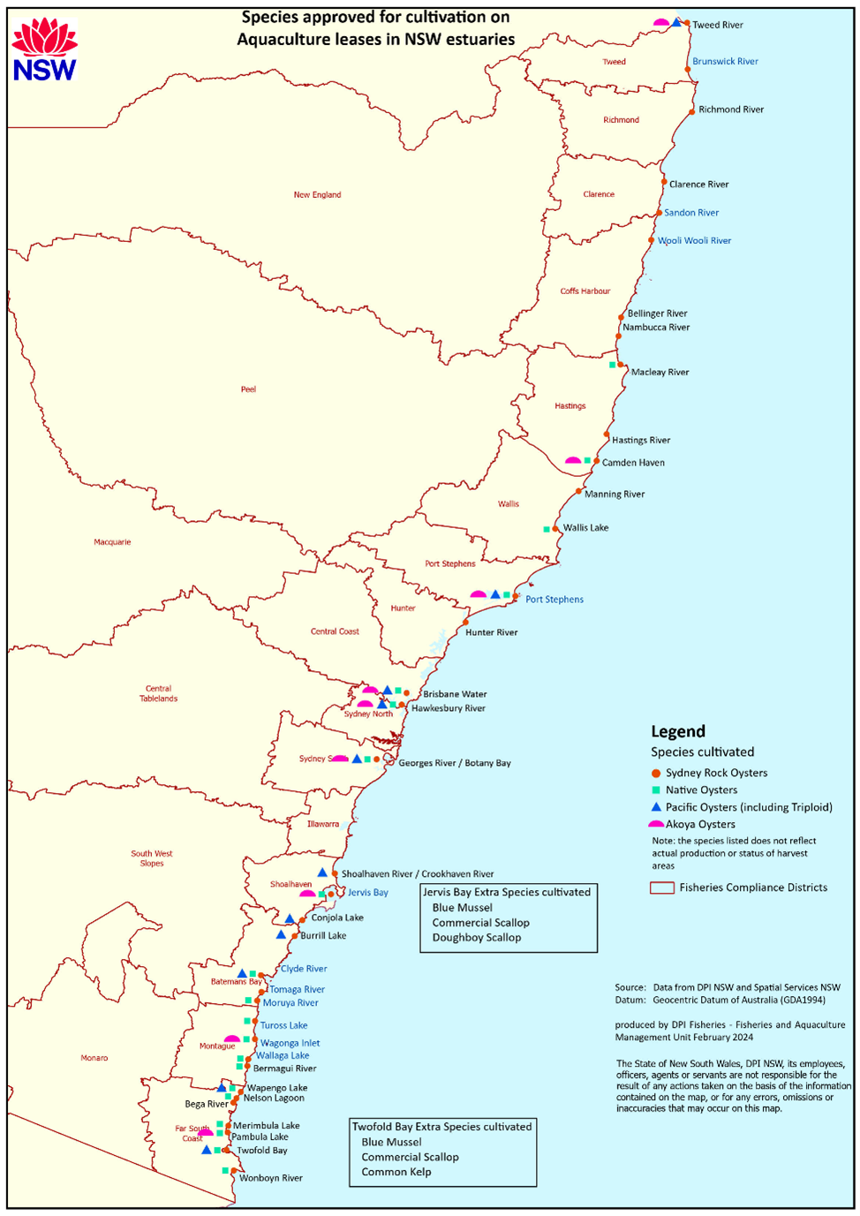

1.10 Shellfish industry in NSW
The NSW shellfish industry contributes significantly to the NSW economy, contributing over $113 million and employs over 2,321 people.
The industry also provides environmental benefits by removing nitrogen and phosphorus from the aquatic environment.
Pacific Oyster culture in NSW is licensed under CC BY 4.0 Source – © State of New South Wales. For current information go to www.nsw.gov.au
Notes:
Teacher notes:
The shellfish industry in NSW is a major contributor to the economy.
This industry contributes over $113 million to the economy and employs over 2,321 people in both full-time and part-time work.
Shellfish are farmed all along the NSW coastline. By economic value, oyster production is the main aquaculture activity in NSW. The oyster industry in 2022–2023 was worth $77.6 million.
The image here shows the location of oyster aquaculture areas currently in NSW estuaries spread along the entire length of the NSW coast from the Tweed River on the Queensland border to Wonboyn Lake adjacent to the Victorian border.
Show students the extent of oyster farms along the NSW coastline using the map. Note that you may need to zoom in or open the map on the webpage.

Slide 84
1.10 Impact on shellfish
For organisms that need to create calcium carbonate structures, it becomes more challenging to form and maintain their shells in acidified waters.
This is because of:
reduced calcification – the rate at which organisms can create calcium carbonate structures is significantly reduced. They need to expend more energy to create shells that are often thinner, smaller, and weaker than normal.
shell dissolution – in severely acidified waters, existing calcium carbonate shells can start to dissolve, a phenomenon known as shell dissolution. This can lead to weakened structures that are more susceptible to damage and breakage
vulnerability to predators – Thinner and weaker shells leave organisms more vulnerable to predators. They also become more susceptible to physical damage from waves, currents, and other environmental factors.
Notes:
Teacher notes:
Impacts of ocean acidification on marine ecosystems include changes in reproduction, organism growth and physiology, species composition and distributions, food web structure, nutrient availability, and reduced calcification rates. The latter is particularly important for species that produce shells or skeletons of calcium carbonate, such as corals and shellfish. Ocean acidification is occurring along with changes in ocean warming and deoxygenation, resulting in compounded stresses on the marine environment.
The changes are expected to reduce the capacity of coral reefs, including those of the Great Barrier Reef, to survive and grow. The growth of many carbonate-producing organisms along the southern Australian shelf, including commercially important shellfish, is also likely to be impacted in the future as acidification continues with rising atmospheric CO₂.

Slide 85
1.11 Climate change and the water cycle
Learning intentions and success criteria
We are learning to: | I can:
discuss the impact of climate change on the natural world. | identify that climate change causes changes to the water cycle describe the consequences of changes to the water cycle for ecosystems.
analyse data from investigations to identify relationships. | describe trends in global climate data use global climate data to make predictions describe the relationship between global temperature and impacts on ice sheet mass and sea level.
Notes:
Teacher notes:
Display this slide at the beginning of the learning activity. Revisit the slide where appropriate during lesson activities and encourage students to reflect on their progress.

Slide 86
1.11 Checkpoint – quick quiz on previous content
Mini challenge
Challenge
Super challenge
Which of the following are part of the water cycle?
rain, sun glaciers
the ocean, grass sun
glaciers, sun,grass
rain, the ocean glaciers
Define the term, ecosystem.
How do living things depend on water?
Notes:
Teacher notes:
Recall when we learned about ecosystems and the water cycle to answer these questions.
Sample responses
Mini-challenge: D
Challenge: a system formed by the interaction of all living organisms (plants, animals, humans) with each other and with the physical elements of the environment in which they live.
Super challenge: living things depend on water to survive because it is essential for processes like digestion, temperature regulation and transporting nutrients. Many organisms, such as fish and aquatic plants, also live in water, relying on it as their habitat. Without water, most life forms could not carry out basic biological functions.

Slide 87
1.11 Water cycle Frayer diagram
Definition
Facts or Characteristics
Water cycle
Examples
Non-examples
Notes:
Teacher notes:
Frayer diagrams are graphic organisers that help students develop or deepen awareness of unfamiliar concepts through defining the term and identifying examples and non-examples. They:
support educators in introducing new words or concepts in the classroom
activate students' prior knowledge of a topic and clarify potential misconceptions
model what a deep understanding of a term entails.

Slide 88
1.11 Water cycle Frayer diagram sentence starters
Definition
Facts or Characteristics
The water cycle is the continuous movement of…
It involves processes like…
Water cycle
Examples
Non-examples
Processes may involve water in some way, but are not steps in the water cycle itself such as:
Notes:
Teacher notes:
This slide may be used to support students complete a Frayer diagram summary of the water cycle.

Slide 89

1.11 Water cycle Frayer diagram sample response
Definition
Facts or Characteristics
It involves processes like evaporation, condensation, precipitation, and collection, which recycle water and help support all life on Earth.
The water cycle is the continuous movement of water through the Earth's atmosphere, biosphere, hydrosphere and lithosphere.
Water cycle
Examples
Non-examples
Processes that may involve water in some way, but are not steps in the water cycle itself, such as:
Photosynthesis
Respiration
Notes:
Teacher notes:
A sample response of the Frayer diagram completed for the water cycle.

Slide 90
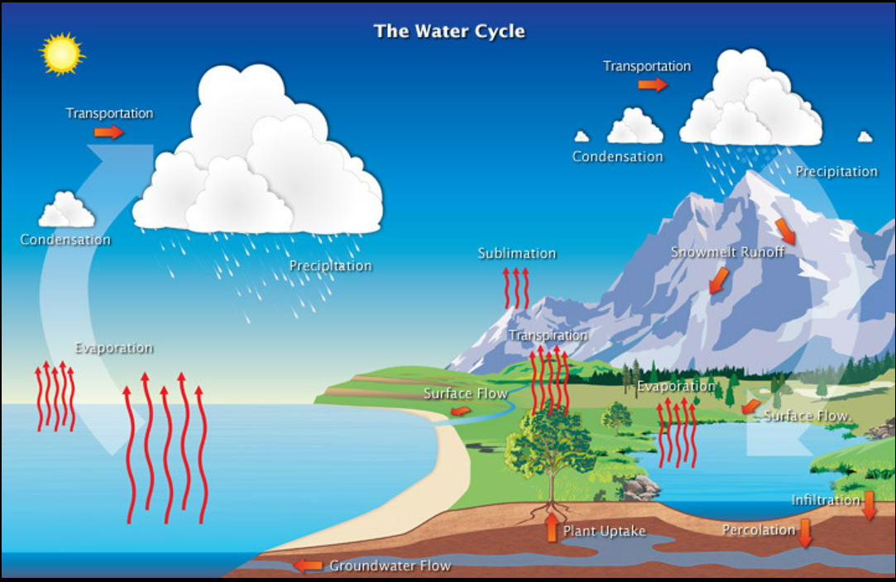
1.11 The water cycle
The water cycle by NOAA National Weather Service Jetstream is licensed under CC BY 2.0
Notes:
Teacher notes:
The water cycle is the continuous movement of water through the Earth's atmosphere, surface, and underground.
The water cycle is a connected system, so a change in one part can impact the rest. If one process is altered, such as the amount of water moving through the cycle, it can disrupt the balance and affect how water is stored, moved, or returned to the atmosphere. This can lead to changes in climate, ecosystems, and water availability.

Slide 91
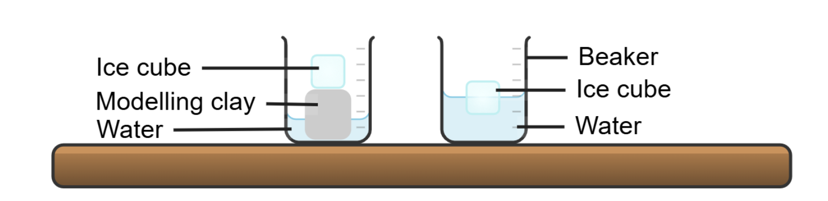
1.11 Predict–Explain–Observe–Explain (1 of 2)
As the ice melts, what will happen to the water level?
Beaker A Beaker B
Notes:
Teacher notes:
Outline the investigation that students will conduct and prompt them to complete the predict and explain components of a P-E-O-E scaffold.

Slide 92
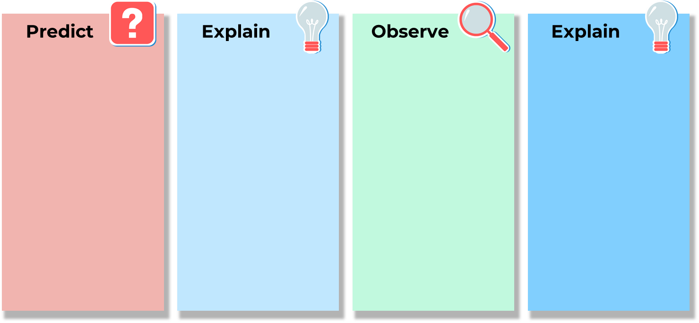
1.11 Predict–Explain–Observe–Explain (2 of 2)
As the ice melts, what will happen to the water level?
I predict that as the ice melts in both beaker A and beaker B, the water level will rise.
Ice is made of water, so when it melts, it turns into more liquid water. Since I am adding more liquid to the container, I think the water level will increase.
The ice melted completely, but the level of the water stayed the same in beaker B. The water level did rise in beaker A when the ice melted.
A floating object displaces a volume of water equal to its weight. When the ice melted in beaker B, it turned into the same amount of liquid water that it had already displaced, so the water level did not change.
The water level rose in beaker A as the water was not displaced by the ice already.
Notes:
Teacher notes:
This slide contains animations to bring up the sample response.
Students will first make a prediction about what they think will happen in the scenario presented on the previous slide and record it.
Students then explain their prediction. This step aims to ensure students are making predictions based on reasoning rather than just guessing the answer.
Come back to this slide to go through the sample answers after the investigation has been conducted. The sample responses are animated to come up as you click.

Slide 93
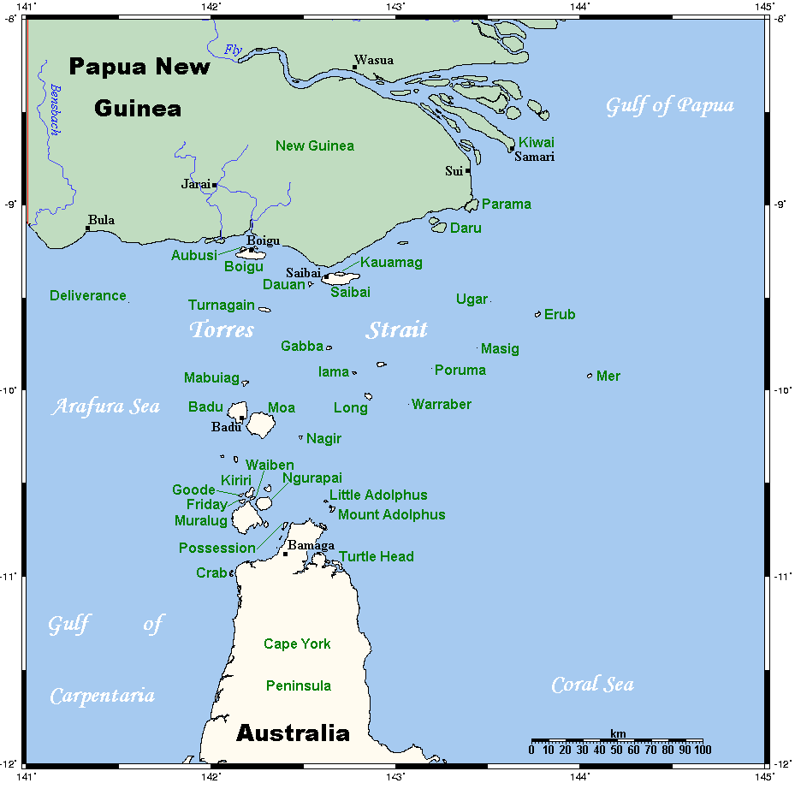
1.11 The effect of climate change on ecosystems (1 of 2)
Warraber – Torres Strait Islands
TorresStraitIslandsMap by Kelisi is licensed under BY-SA 3.0
Notes:
Teacher notes:
The Torres Strait Islands are a cluster of islands located between the tip of Queensland and Papua New Guinea.
Warraber Island is part of the Torres Strait Islands. It is positioned on a coral cay, 100km northeast of Thursday Island.
As many of the Torres Strait Islands are low-lying, the people, plants and animals are at great risk of the effects of climate change, particularly sea level rise.
Many Torres Strait Islander Peoples are working to protect the ecosystems of these islands from the effects of climate change.

Slide 94

1.11 The effect of climate change on ecosystems (2 of 2)
Warraber – Torres Strait Islands
We advise this resource may contain images, voices or names of deceased persons in photographs, film, audio recordings or historical content.
The race against the rising seas | Healing Country (5:03)
Notes:
Teacher notes:
Click on the video to play.
The Torres Strait Islands are a cluster of islands located between the tip of Queensland and Papua New Guinea.
Warraber Island is part of the Torres Strait Islands. It is positioned on a coral cay, 100km northeast of Thursday Island.
As many of the Torres Strait Islands are low lying, the people, plants and animals are at great risk of the effects of climate change, particularly sea level rise.
Many Torres Strait Islander Peoples are working to protect the ecosystems of these islands from the effects of climate change.

Slide 95
1.12 Satellites are on the job
Learning intentions and success criteria
We are learning to: | I can:
discuss the impact of climate change on the natural world. | describe how satellites collect climate data examine how satellite images can be used to evaluate the impact of climate change.
use data to draw conclusions. | use evidence to draw conclusions about the impact of climate change on ice cover.
develop evaluation criteria. | outline suitable criteria for evaluating ice cover data.
Notes:
Teacher notes:
Display this slide at the beginning of the learning activity. Revisit the slide where appropriate during lesson activities and encourage students to reflect on their progress.

Slide 96
1.12 Checkpoint – quick quiz on previous content
Mini-challenge
Challenge
Super challenge
Name 3 main components of the water cycle.
Describe one way climate change affects the water cycle.
Explain how rising ocean temperatures affect the mass of ice sheets.
96
Notes:
Teacher notes:
Checkpoint sample response
Mini-challenge (MC): evaporation, condensation, and precipitation.
Challenge (C): climate change raises global temperatures, which accelerates evaporation and can change rainfall patterns, leading to droughts in some regions and floods in others.
Super challenge (SC): as ocean temperatures increase, the warmer water causes ice sheets, like those in Antarctica and Greenland, to melt faster. This melting reduces the ice sheet mass and contributes to rising sea levels.

Slide 97
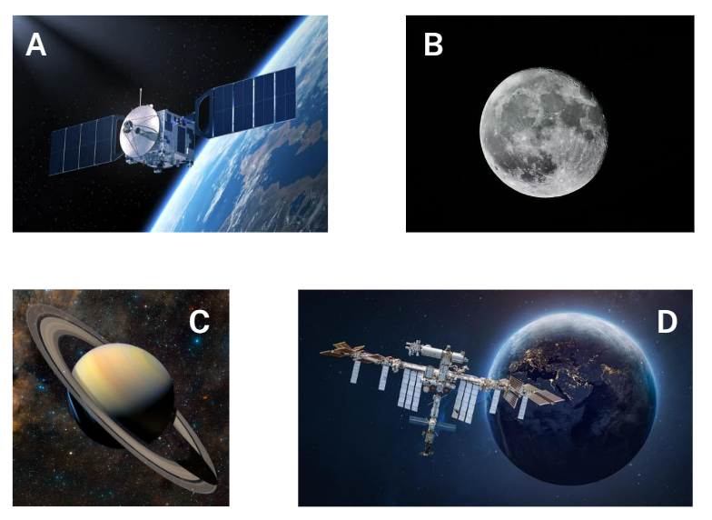
1.12 Satellites
Which of these are a satellite?
Notes:
Teacher notes:
Which of these is a satellite?
(pause for students to respond – many students will likely choose A or D.)
What if I told you that all of them are satellites?
A satellite is an object that orbits another celestial body or object in space. While Earth and the Moon are natural satellites, the term ‘satellite’ often refers to artificial satellites, or spacecraft, launched into orbit.
For this lesson, a satellite is defined as an artificial body placed in orbit around the Earth, the Moon or another planet to collect information or for communication.
These satellites are used for various purposes, including communication, weather forecasting, navigation, and Earth observation.

Slide 98
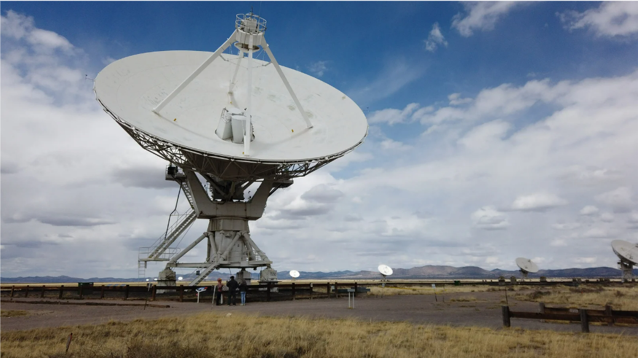
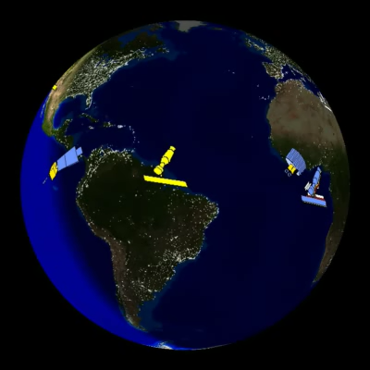
1.12 Collecting data
How do satellites collect data?
Satellites collect data using a process called remote sensing.
Satellites have various instruments, like cameras and sensors, that capture images and data.
These include infrared, laser, multi-spectral imagery and radar sensors.
That data is transmitted back to Earth via a dish for analysis.
Satellites: Paths and Positions (0:48)
Notes:
Teacher notes:
Satellites carry sensors, sometimes many of them, that read varying amounts of energy reflected from the Earth.
Satellites collect data using a process called remote sensing, which involves measuring the electromagnetic radiation reflected or emitted from the Earth's surface. This is done using various instruments like cameras and sensors that capture high-resolution images and data. The data is then transmitted back to Earth via these dishes for analysis.

Slide 99
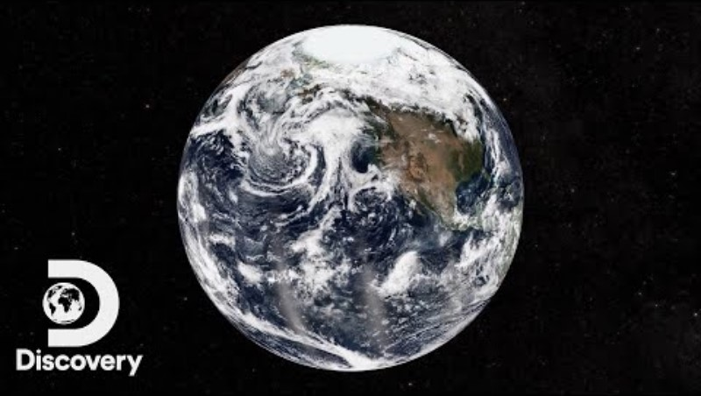
1.12 Satellite data to evaluate climate change
How scientists use satellite data
NASA's Research on Climate Change | Above and Beyond (6:03)
Notes:
Teacher notes:
Scientists use satellite data to understand climate change by collecting large amounts of information from all over the world multiple times a day over many years. This data helps them observe both small-scale weather events and long-term global climate trends. By combining multiple sets of satellite data, scientists can create complex models that show how different variables interact and how changes in one can affect others. These models allow scientists to understand past and present climate changes better. With this understanding, they can make predictions about future climate conditions. These predictions are essential for informing global decisions, including political policies and environmental laws.

Slide 100
2. What actions are we taking to support a more sustainable future?
Content in this section aligns with essential question 2 in the program of learning and Teacher resource book 2

Slide 101
2.1 Causes of environmental pollution
Learning intentions and success criteria
We are learning to: | I can:
discuss the impact of environmental pollution on the natural world. | define environmental pollution describe types and causes of environmental pollution discuss the implications of environmental pollution.
analyse data from investigations to identify relationships. | describe trends in air pollution data use air pollution data to make predictions describe the relationship between air pollution and impacts on human health and crop yields.
Notes:
Teacher notes:
Display this slide at the beginning of the learning activity. Revisit the slide where appropriate during lesson activities and encourage students to reflect on their progress.

Slide 102
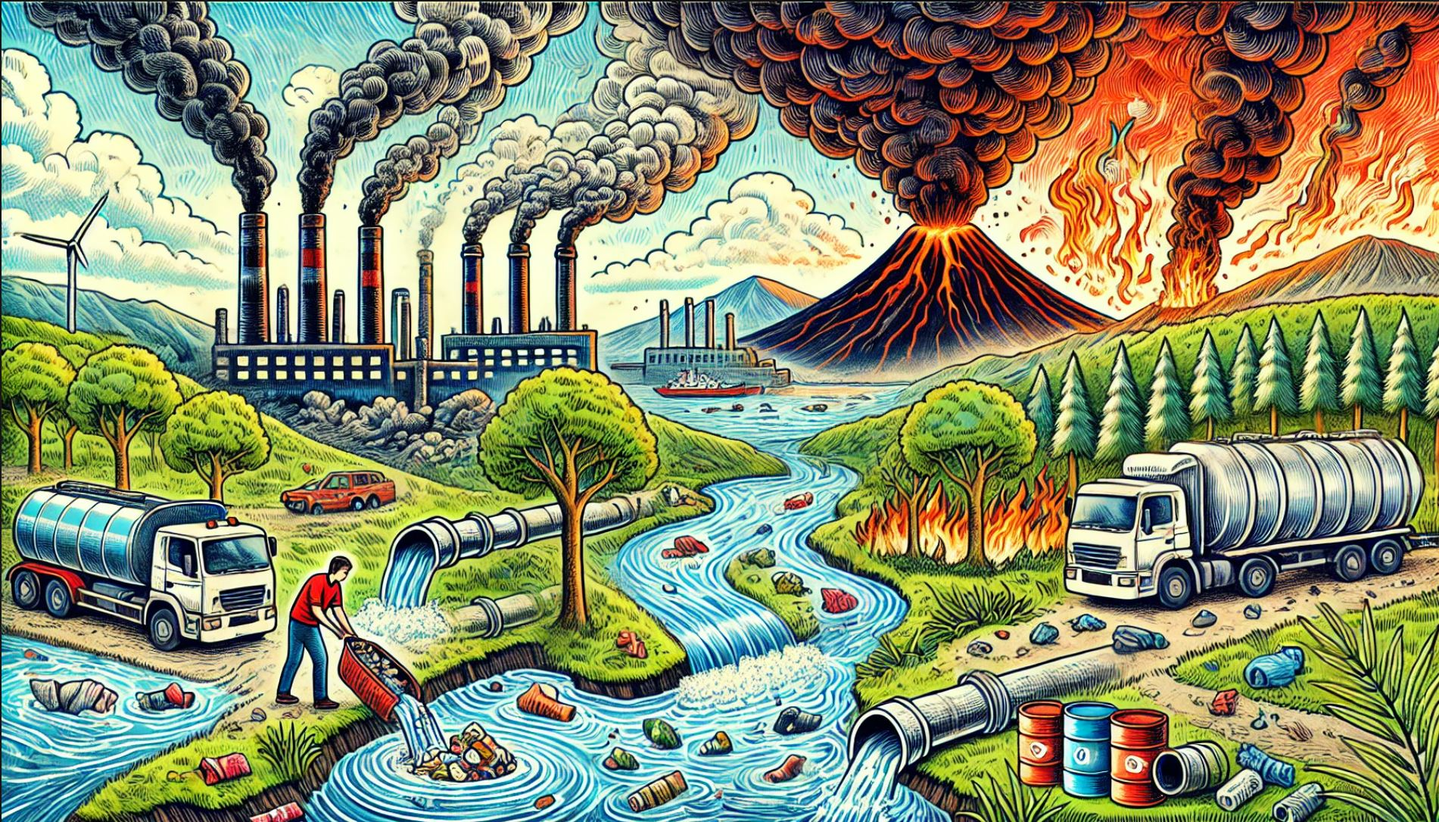
2.1 Environmental issues
Prior knowledge
This work has been generated using artificial intelligence. Any copyright subsisting in this work is owned by © State of New South Wales (Department of Education) 2025.
Notes:
Teacher notes:
Ask students to observe the image and answer the following questions:
1. What environmental issues can we see in this image?
2. What is the cause of the environmental issues?
3. What are the effects of these environmental issues?

Slide 103
2.1 Environmental pollution
Types of environmental pollution matching activity
Air pollution
The depositing of solid or liquid waste materials on land or underground in a manner that can contaminate the soil
Water pollution
The presence of chemical, physical or biological substances in the atmosphere that lowers air quality
The contamination of water bodies by harmful substances, like chemicals or microorganisms, that lowers water quality
Land pollution
Sound pollution
The presence of any unwanted, inappropriate, or excessive artificial lighting in an outdoor environment
Light pollution
Unwanted or excessive sound, measured as exceeding 65 decibels (dB). Can also be called noise pollution
Notes:
Teacher notes: This slide contains animations
Environmental pollution is defined as the addition of any substance, or any form of energy, such as heat, sound or radioactivity, to the environment at a rate faster than it can be dispersed, diluted, decomposed or recycled.
These harmful substances are called pollutants.
There are 5 main types of environmental pollution. As the teacher reads out each definition, students should try to match the correct definition to the type of environmental pollution.
*CLICK* the depositing of solid or liquid waste materials on land or underground in a manner that can contaminate the soil. *CLICK* (Land pollution)
*CLICK* the presence of chemical, physical or biological substances in the atmosphere that lowers air quality. *CLICK* (Air pollution)
*CLICK* the contamination of water bodies by harmful substances, like chemicals or microorganisms, that lowers water quality. *CLICK* (Water pollution)
*CLICK* the presence of any unwanted, inappropriate, or excessive artificial lighting in an outdoor environment. *CLICK* (Light pollution)
*CLICK* unwanted or excessive sound, measured as exceeding 65 decibels (dB). It can also be called noise pollution. *CLICK* (Sound pollution)

Slide 104
2.1 Causes of pollution
Causes of environmental pollution classification activity
Bushfire
Waste management
Transportation
Volcanic eruption
Industrialisation
Agriculture
HUMAN ACTIVITY
NATURAL
Notes:
Teacher notes: This slide contains animations.
There are several possible causes of environmental pollution, which can be divided into two subgroups: human activity and natural.
As the teacher reads each definition, students should try to categorise the causes of environmental pollution.
Industrialisation – the development of industries in a country or region on a wide scale. The use of chemicals and fuel in factories leads to environmental pollution through air and water contamination.
Is this human activity or natural? *CLICK*
Bushfire – An unplanned vegetation fire. Bushfires cause environmental pollution by releasing pollutants like smoke and ash into the atmosphere, impacting air and water quality.
Is this human activity or natural? *CLICK*
NOTE: Natural causes, such as lightning strikes or human activities such as out-of-control burns, may cause bushfires.
Agriculture – includes both growing and harvesting crops and raising animals, or livestock. Agriculture contributes to environmental pollution through various practices, including the use of fertilisers and pesticides, deforestation, water overuse, and greenhouse gas emissions from livestock and machinery.
Is this human activity or natural? *CLICK*
Waste management – the activities that include collecting, destroying and disposing of waste. Poor waste management practices, such as open dumping and inadequate disposal, lead to environmental pollution by contaminating soil, water, and air with harmful substances.
Is this human activity or natural? *CLICK*
Volcanic eruption – the expulsion of gases, rock fragments, and/or molten lava from within the Earth through a vent onto the Earth's surface or into the atmosphere. The release of sulfur dioxide gas and volcanic ash can lead to air pollution and the development of acid rain, impacting water systems.
Is this human activity or natural? *CLICK*
Transportation – the movement of people or goods from one place to another via cars, trucks, planes, boats, or trains. Transportation causes environmental pollution through the release of harmful gases and particles from vehicles, contributing to air pollution.
Is this human activity or natural? *CLICK*

Slide 105
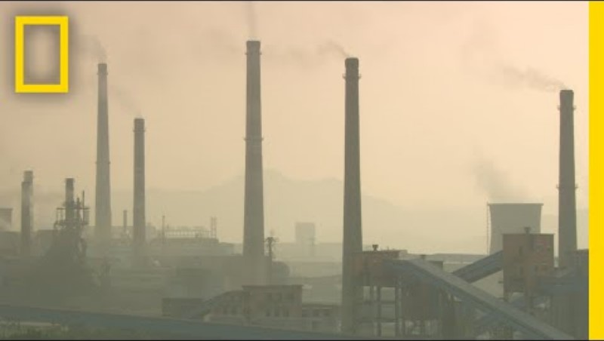
2.1 Implications of pollution
Air pollution and it’s impacts
Air Pollution 101 | National Geographic (3:52)
Notes:
Teacher notes:
More than 99% of the population lives in areas where the air pollution is above the World Health Organisation air quality guidelines, and is responsible for millions of deaths each year across the world.
It is important to understand the implications of air pollution, so that finding solutions to this problem is a priority.
Quick write prompt: What are the impacts of air pollution?
Air pollution can have adverse effects on both the environment and humans. Air pollution contributes to an increase in Earth’s atmospheric temperature. This can lead to more extreme weather events. Smog is a type of air pollution that reduces visibility and has serious health effects, such as irritated eyes and respiratory issues. Air pollution can increase other health concerns like cancer and congenital disabilities.

Slide 106
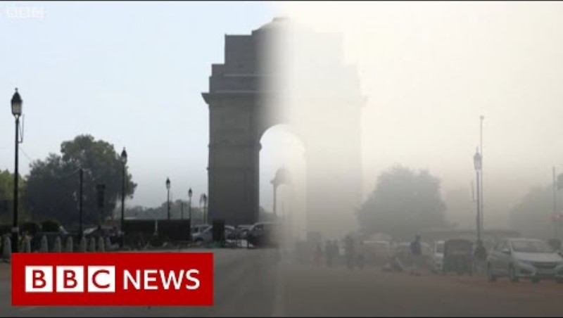
2.1 The world’s most polluted city
Air pollution in New Delhi
Coronavirus: Smog pollution in Delhi vanishes - BBC News (0:42)
Notes:
Teacher notes:
Air pollution is a key concern globally, but more so in some countries compared to others.
Delhi’s air pollution index had reached 418, which is defined as ‘severe’, on 14 November 2024, according to IQAir, a Swiss-based Air Quality Index monitoring group. A ‘good’ rating is between zero and 50. This makes New Delhi the most polluted capital city in the world.
New Delhi has long struggled with high levels of pollution. However, there was a brief period in recent years that saw a significant decrease in air pollution in New Delhi.
During the COVID-19 lockdowns, there were noticeable changes in air pollution in many countries.
When India imposed a countrywide lockdown on March 25, 2020, it encompassed 1.3 billion people, making it the world's largest lockdown.
What pattern did you see in the images presented?
What do you think caused the change in air quality?
What types of human activities changed or stopped during the lockdowns?
Students should identify the pattern of clearer skies during the COVID-19 lockdowns. Students should recognise the reduction of air pollution and smog during the COVID-19 lockdowns. Students may suggest that many pollution-causing human activities ceased during COVID-19, including vehicle use, factory work, and air travel.

Slide 107
2.2 Sustainable harvesting by Aboriginal and Torres Strait Islander Peoples
Learning intentions and success criteria
We are learning to: | I can:
describe the need for sustainable resource use to reduce impact on the natural world. | define sustainable harvesting practices explain how Aboriginal and Torres Strait Islander Peoples demonstrate deep ecological understandings.
identify trends in data to make predictions. | describe trends in data on the Murray Cod make predictions about the impact of cultural protocols on the Murray Cod population.
assess the validity of secondary sources. | select appropriate sources of information use criteria for evaluating the validity of secondary sources about Aboriginal and Torres Strait Islander Peoples
Notes:
Teacher notes:
Display this slide at the beginning of the learning activity. Revisit the slide where appropriate during lesson activities and encourage students to reflect on their progress.

Slide 108
2.2 Checkpoint – quick quiz on previous content
Mini-challenge
Challenge
Which of the following are examples of environmental pollution? (Select all that apply)
smoke released from factory chimneys into the air
leaves falling naturally from trees in autumn
chemicals leaking into a river from a nearby farm
the sound of birds singing in a forest
excessive outdoor lighting in a city at night
List 2 human activities that cause air pollution and describe how they contribute to it.
Notes:
Teacher notes:
This slide contains animations to bring up the correct answer for the mini-challenge.
Complete this quick quiz with students to recall their understanding of prior content.
Sample response:
Mini-challenge (MC) – A system formed by the interaction of all living organisms (plants, animals, humans) with each other and with the physical elements of the environment in which they live.
Challenge (C) – Two human activities that cause air pollution are industrialisation and transportation. Industrialisation releases harmful gases and chemicals into the atmosphere through factory emissions. Transportation also contributes to air pollution by releasing exhaust gases from cars, trucks, planes, and other vehicles, which contain pollutants like carbon monoxide and nitrogen oxides.

Slide 109

2.2 Kinship and Totems
Cultural protocols
We advise this resource may contain images, voices or names of deceased persons in photographs, film, audio recordings or historical content.
Aboriginal Kinship Presentation: Totems (3:51)
Notes:
Teacher notes:
Kinship is a system that determines how people relate to one another and their surroundings. It is a complex and sophisticated system of social organisations, encompassing responsibilities, roles, and reciprocal bonds that determine how people are related, who can marry whom, and who supports whom. Kinship systems vary between cultural groups across Australia and the Torres Strait Islands.
Totems are part of the kinship system. A totem is a natural object (like a plant or animal) that represents an Aboriginal or Torres Strait Islander Person’s identity and cultural obligations. Again, totems are varied across cultural groups, and even unique to the individual within that group. Each individual can have at least four totems, which represent their Nation, clan, family group and personal totem.
There are cultural protocols associated with Totems, including rules that prohibit a person from hunting and eating their Totems. They also have a responsibility to learn about, care for and protect the Totem organism and its environment.
We will now watch this video, and I would like you to answer the following questions:
What does a personal Totem recognise?
How do Totems guide Aboriginal people to balance the protection and consumption of resources?
Which Totem animal would all Aboriginal People from the Wiradjuri Country have in common? What type of Totem is this?

Slide 110
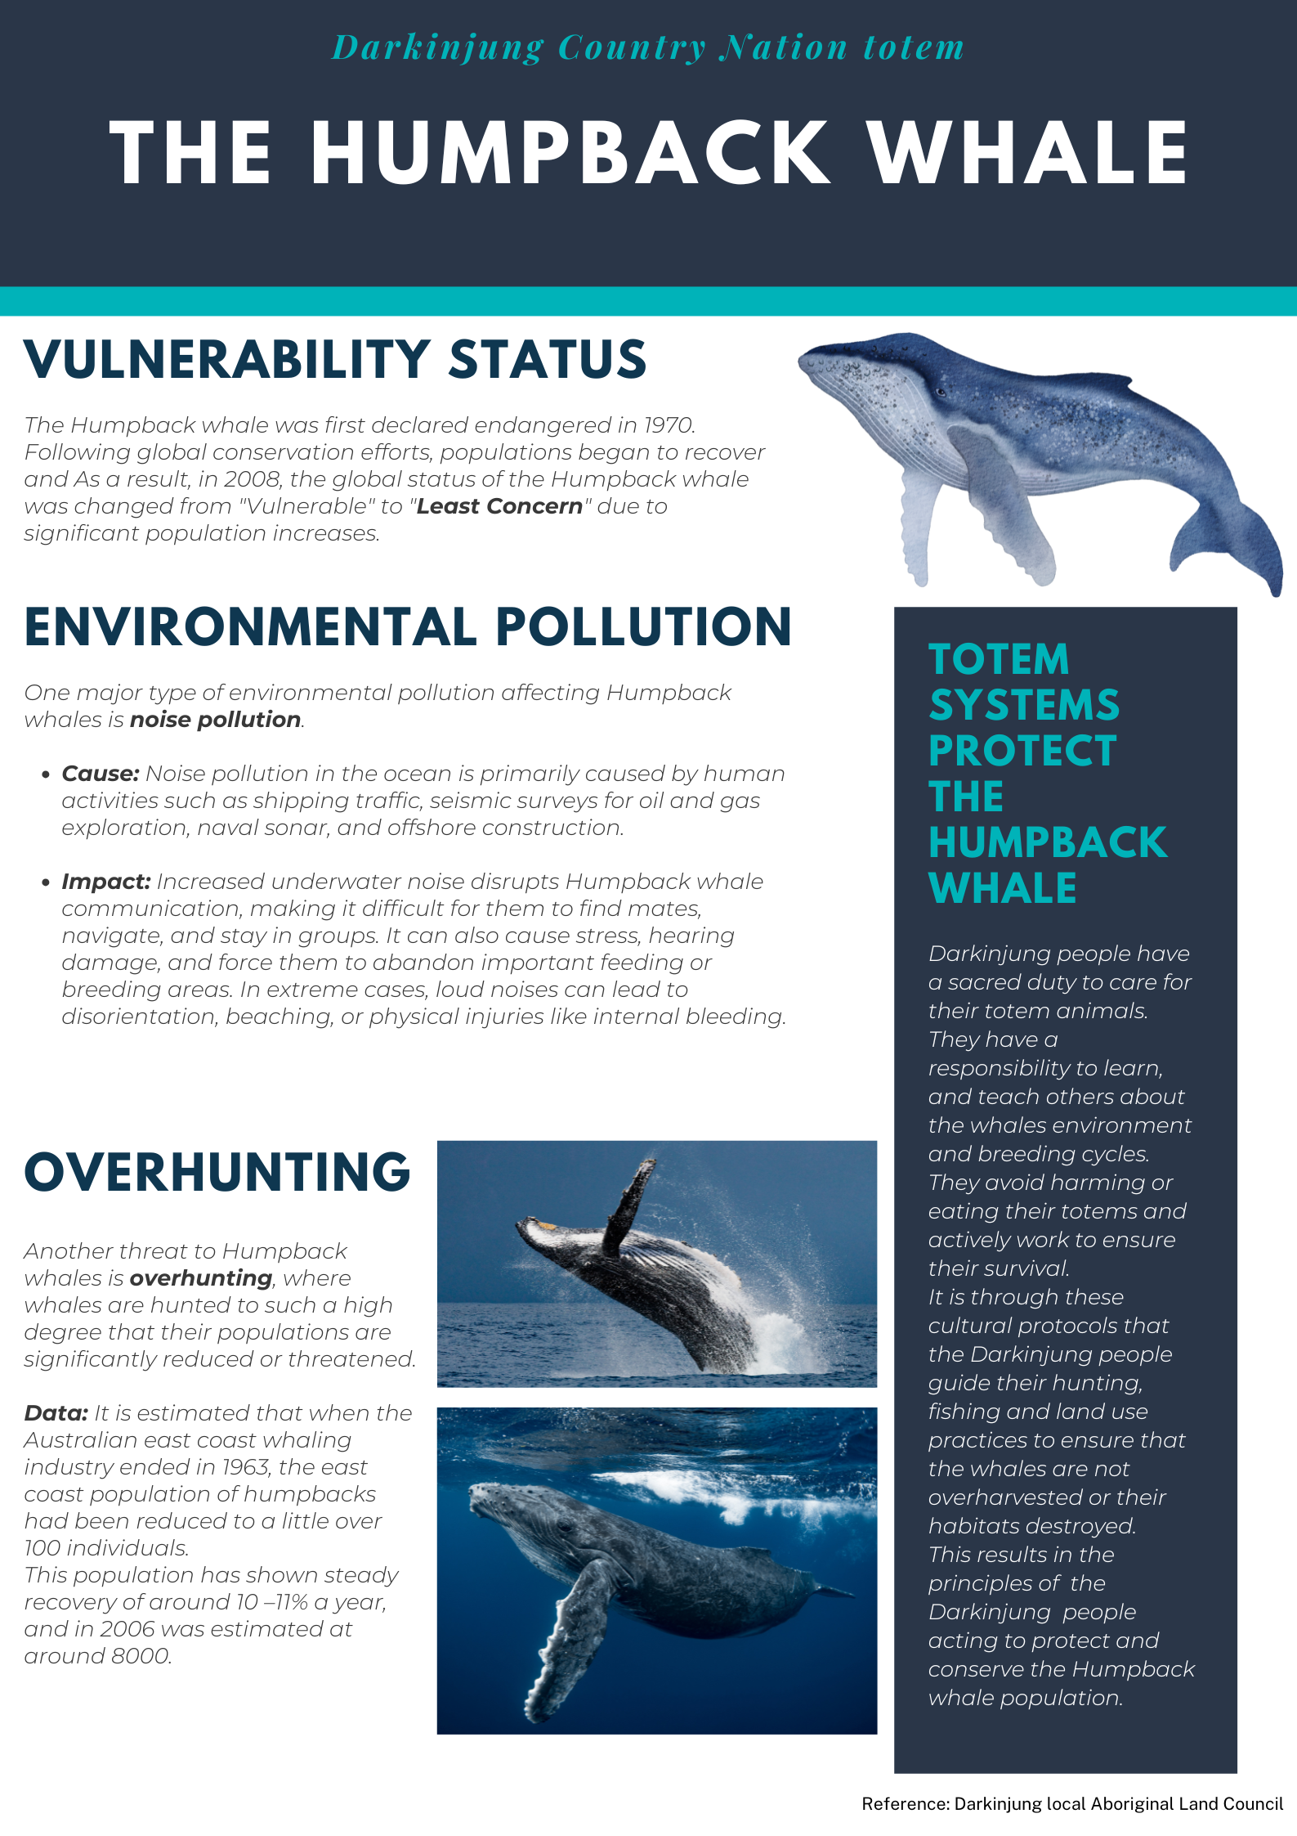
2.2 Nation Totem research
Nation totem research
The name of the Nation Totem, and the Aboriginal language name for the Totem, if available
An image of the Nation Totem
The Aboriginal Country of the Nation Totem
The vulnerability status of the Nation Totem
Identify at least one type of environmental pollution that is impacting the Nation Totem, outline the cause of the environmental pollutant and describe the impact it is having on the Nation Totem
Outline one other threat to the Nation Totems population and support this with data
Explain how the cultural protocols of the Totem system can protect and support the population of the Nation Totem.
Notes:
Teacher notes:
You are now going to complete some research and create a scientific poster on a Nation Totem from the Aboriginal Country that you choose. You might like to choose the country where you live, or go to school, or another Country that is important to you.
You will then create a scientific poster including the information shown here.

Slide 111
2.3 Reduce, reuse, recycle
Learning intentions and success criteria
We are learning to: | I can:
analyse the need for alternative resource use to reduce impact on the natural world. | define reduce, reuse and recycle identify strategies to reduce waste.
use data to draw conclusions. | outline trends in Australia’s waste use evidence to draw conclusions about Australia’s waste.
assess the validity of secondary sources. | define accuracy, reliability and validity assess the validity of information from secondary sources using relevant criteria.
Notes:
Teacher notes:
Display this slide at the beginning of the learning activity. Revisit the slide where appropriate during lesson activities and encourage students to reflect on their progress.

Slide 112
2.3 Checkpoint – quick quiz on previous content
Mini-challenge
Challenge
Super challenge
Burying our waste underground in a landfill is an example of which type of pollution?
air pollution
light pollution
land pollution
Define waste management.
Describe one implication of pollution.
Notes:
Teacher notes:
Complete this quick quiz with students to recall their understanding of the previous lesson.
Sample response:
Mini-challenge (MC): Multiple-choice question
Burying our waste underground in a landfill is an example of which type of pollution?
A) Air pollution
B) Light pollution
C) Land pollution
Challenge (C): the activities that involve collecting, destroying and disposing of waste. Poor waste management practices, such as open dumping and inadequate disposal, result in environmental pollution by contaminating soil, water and air with harmful substances.
Super challenge (SC): air pollution can aggravate respiratory health conditions, leading to death.

Slide 113
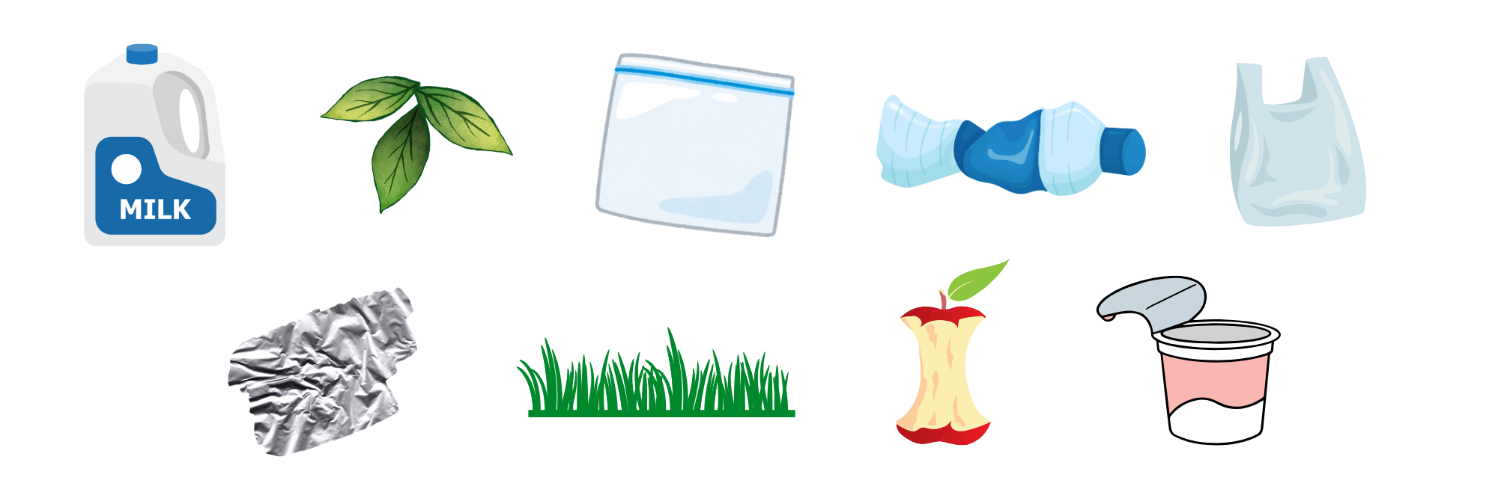



2.3 Organising our waste
Prior knowledge
Notes:
Teacher notes:
Discuss how we organise waste. Use the following questions as prompts:
Which bin should these items go in?
Do you have any other bins in your local council area? (example: blue lid bin for paper/cardboard)
What other ways can we dispose of waste? (example: return and earn for cans and bottles)

Slide 114

2.3 Australia’s waste problem
Waste crisis as landfills become dangerously full
Waste Crisis As Landfills Become Dangerously Full (7:24)
Notes:
Teacher notes:
What would happen if the council took all our red (waste) bins away and refused to collect them? How can we dispose of our rubbish? Would it change people’s behaviours in terms of how much waste they produce?
This video shows that it could be a possibility in the near future.
We are now going to take a look at some data on Australia’s waste production over the past few years.

Slide 115



2.3 The three R’s
Reduce, Reuse, Recycle
Reduce means to use, or make less waste.
Reuse means to use the same item more than once, rather than throwing it out.
Recycle means to collect waste materials and process them to become new products.
Notes:
Teacher notes:
The three Rs are – reduce, reuse and recycle. They are common strategies to minimise the amount of waste that is produced.
Reducing means using or making less waste. An example of reducing waste is by using a refillable water bottle instead of buying a new bottle of water every time you need a drink.
What are some other examples of how people reduce waste?
Reuse means to use the same item more than once, rather than throwing it out. An example of reusing an object could be to take an empty can or glass jar and reuse it as a pencil holder. This way, you are using the item again instead of letting it become waste, and you're also reducing waste since you didn't buy a new pencil holder that might have ended up in the trash later on.
What are some other examples of how we can reuse objects instead of letting them become waste?
Recycling involves collecting waste materials and processing them into new products. An example of this is collecting your empty cans and bottles and using a recycling scheme such as Return and Earn. This way, the bottles and cans are processed by the recycling facility to create new beverage bottles and other food-grade packaging.
What other ways can we recycle objects?
Some organisations have expanded the R’s to identify 5R’s and even up to 7R’s. These additional R’s offer numerous strategies for managing our waste. For example, another strategy could be to Refuse waste by declining single-use items like straws and disposable cutlery, or by having a ‘no junk mail’ sign on your letter box. Another example is to Rethink our approach to daily life that generates waste. For example, could you rethink buying your groceries from a major supermarket and instead, visit a farmers’ market where produce has much less packaging?

Slide 116

2.3 The waste hierarchy
This work has been generated using artificial intelligence. Any copyright subsisting in this work is owned by © State of New South Wales (Department of Education) 2025.
Notes:
Teacher notes:
Which ‘R’ is best? There is a hierarchy, or order of the most preferable approach to dealing with waste, down to the least preferable approach to dealing with waste.
The waste hierarchy is:
1. avoidance​ , including action to reduce the amount of waste generated by households, industry and all levels of government
2. resource​ recovery​ , including re-use, recycling, reprocessing and energy recovery, consistent with the most efficient use of the recovered resources
3. disposal​, including management of all disposal options in the most environmentally responsible manner.

Slide 117
2.4 How do we recycle materials?
Learning intentions and success criteria
We are learning to: | I can:
analyse the need effective management to reduce impact on the natural world. | outline how recyclable materials are sorted and processed complete a flowchart of the process to recycle materials Apply the pillars of sustainability to develop an evaluation criteria.
evaluate strategies proposed to solve problems. | develop criteria to evaluate the Return and Earn program make a judgement of the Return and Earn program.
Notes:
Teacher notes:
Display this slide at the beginning of the learning activity. Revisit the slide where appropriate during lesson activities and encourage students to reflect on their progress.

Slide 118
2.4 Checkpoint – quick quiz on previous content
Mini-challenge
Challenge
Which of the following waste reduction strategies is the most preferable?
recycle
refuse
reduce
Define recycling.
Notes:
Teacher notes:
Complete this quick quiz with students to recall their understanding of the previous lesson.
Sample response:
Mini-challenge (MC): Multiple-choice question
Which of the following waste reduction strategies is the most preferable?
A) Recycle
B) Refuse
C) Reduce
Challenge (C): define recycling
Recycling involves collecting waste materials and processing them into new products.

Slide 119

2.4 The recycling process
From waste to recycled product
What happens to your recycling on the Sunshine Coast? (6:10)
Notes:
Teacher notes:
Recycling is an important step in moving from a take, make and waste economy to a circular economy.
But what happens to your recycling once the bin truck picks it up?
This video will show you where the waste is taken, how it is sorted into different materials, and how it is processed to make new products.
As you watch the video, complete the blank parts of the flow chart.

Slide 120

2.4 Developing evaluation criteria
A good model or a bad model?
CRITERIA: Visual appeal
EVIDENCE:
Brightly coloured
Eye-catching
Uses interesting materials with different textures
JUDGEMENT: This is a good model
CRITERIA: Scientific accuracy
EVIDENCE:
Not to scale
Inaccurate colour scheme
Inaccurate representation of coral structures
JUDGEMENT: This is not a good model
This work has been generated using artificial intelligence. Any copyright subsisting in this work is owned by © State of New South Wales (Department of Education) 2025.
Notes:
Teacher notes: This slide contains animations
When you are asked to evaluate something, this requires you to make a judgement of it, based on some criteria.
It is very important that you are able to develop your own criteria and make a clear judgement based on them. However, the judgement that you make all depends on the criteria you develop.
If I asked you to make a judgement of this model of a coral reef, then the outcome of the judgement would be different depending on the criteria used to evaluate it.
*CLICK* If the criteria used to evaluate this model were visual appeal, then a judgement could be made that the model is a good model, supported by the evidence that it is brightly coloured, eye-catching and uses interesting materials.
*CLICK* However, if the criteria used to evaluate this model were scientific accuracy, then a judgment could be made that the model is not a good model as it is not to scale, it has not used accurate colours or materials and does not accurately represent various coral structures.
You can now see that it is important to develop strong criteria to make the correct judgement.

Slide 121


2.4 Return and Earn program
Is this a good solution to Australia’s waste problem?
Reverse vending machine for the NSW Container Deposit Scheme at the Kooringal Mall by Bidgee licensed under CC BY-SA 3.0
Notes:
Teacher notes:
The recycling of household waste is an important method to reduce landfill waste; however, only about 50% of all household waste is recycled through our garbage collection system. There are other methods used to recycle household waste, including programs such as Return and Earn for bottles and cans, B-cycle for recycling old batteries and MobileMuster for recycling electronics.
Litter is anything unwanted that has been thrown away, blown away or left in the wrong place. Common litter items are takeaway and beverage items, confectionery and snacks, drink containers (plastic and metal), cigarette butts, small pieces of paper, bottle caps, plastic straws, and pieces of glass bottles. Cleaning up this waste is expensive and takes up valuable time and resources that can be spent on other community needs.
However, since the start of the Return and Earn scheme in 2017, the volume of litter from these eligible containers has decreased by 52%.

Slide 122
2.5 Innovations in recycling
Learning intentions and success criteria
We are learning to: | I can:
analyse the need for alternative resource use to reduce impact on the natural world. | describe a recycling innovation explain the impact of the innovation on Australia’s waste.
analyse data from an investigation to identify relationships. | draw a conclusion based on evidence from collected data identify sources of uncertainty in an investigation.
evaluate strategies proposed to solve problems. | evaluate a claim about reduction in waste by an invertebrate evaluate a claim using the C-E-R scaffold.
Notes:
Teacher notes:
Display this slide at the beginning of the learning activity. Revisit the slide where appropriate during lesson activities and encourage students to reflect on their progress.

Slide 123
2.5 Checkpoint – quick quiz on previous content
Mini-challenge
Challenge
Super challenge
True or False? Recycled glass can be used in construction to make road base.
true
false
List 3 items that can be recycled at a Material Recovery Centre (MRC).
Describe the impact of a local recycling program.
Notes:
Teacher notes:
Complete this quick quiz with students to recall their understanding of the previous lesson.
Sample response:
Mini-challenge (MC): True or False question
A) True
Challenge (C): plastic punnet, metal can, plastic bottle. check
Super challenge (SC): the Return and Earn program reduces the amount of recyclable materials (bottles and cans) ending up in landfill, decreasing carbon dioxide emissions.

Slide 124

2.5 Women in Science: Veena Sahajwalla
Queen of waste
Recycling revolutionary Veena Sahajwalla turns old clothes into kitchen tiles | Australian Story (29:01)
Notes:
Teacher notes:
Veena Sahajwalla is an internationally recognised materials scientist, engineer and inventor revolutionising recycling science. She is renowned for pioneering the high-temperature transformation of waste in the production of a new generation of ‘green materials.’
This video will show us how she started this work and explore two of her greatest innovations to date – green steel and green ceramics.

Slide 125

2.5 A good news story
Create a news article
Choose one of Veena Sahajwalla’s recycling innovations, Green Steel or Green Ceramics
Research the innovation
Create a good news article including the following information:
  a catchy headline
  the name of the scientist
  the scientist’s qualifications
  the name of the innovation
  the year it was invented
  describe the innovation
  describe how the innovation can be used
  an explanation of the impact of the innovation on Australia’s waste
Notes:
Teacher notes: This slide contains animations
Choose one of Veena Sahajwalla’s inventions, Green Steel or Green Ceramics, to research and create a good news article.
Use the template provided and make sure you use a catchy headline and persuasive language.

Slide 126

2.5 Practical investigation – mealworms and polystyrene
A solution to our plastic problem
Stanford study shows mealworms can eat toxic plastic additives (1:27)
Notes:
Teacher notes:
What other recycling innovations might be a solution to Australia’s waste problem?
A report from Stanford University has claimed, ‘Mealworms could be the solution to our plastic problem.’ There are investigations underway to explore whether different types of insects, such as mealworms, can process plastic waste.
You will investigate whether mealworms can successfully eat polystyrene, a type of plastic, and then evaluate the claim from Stanford University.

Slide 127
2.6 How has human activity caused environmental pollution?
Learning intentions and success criteria
We are learning to: | I can:
discuss the impact of environmental pollution on the natural world. | describe human activities that damage the ozone layer outline the strategy used to solve the hole in the ozone layer discuss the link between food waste and environmental pollution.
analyse data from investigations to identify relationships. | analyse the relationship between human activities and the hole in the ozone layer and food waste.
analyse a proposed solution to a problem. | identify and analyse strategies to solve the problems of the hole in the ozone layer and food waste
Notes:
Teacher notes:
Display this slide at the beginning of the learning activity. Revisit the slide where appropriate during lesson activities and encourage students to reflect on their progress.

Slide 128
2.6 Checkpoint – quick quiz on previous content
Challenge
Super challenge
Describe how innovations such as green ceramics can improve sustainability.
Assess the importance of sustainable solutions to waste management, including the use of mealworms and green ceramics.
Notes:
Teacher notes:
Complete this quick quiz with students to recall their understanding of the previous lesson.
Sample response
Challenge (C): innovations like green ceramics improve sustainability by turning waste materials, such as old clothes and industrial waste, into useful products like kitchen tiles. This reduces the amount of waste sent to landfill, conserves natural resources by reducing the need for new raw materials, and lowers pollution from manufacturing processes.
Super challenge (SC): sustainability solutions like mealworms and Green ceramics are important because they offer new ways to reduce environmental pollution and manage waste more effectively. Mealworms can help break down plastics like polystyrene, which are difficult to recycle, potentially reducing plastic pollution. Green ceramics recycles textile and industrial waste into useful products, reducing landfill and conserving resources. However, while promising, these solutions need further development and research to understand their long-term impacts and how they can be scaled up. Overall, such innovations are crucial steps toward a more sustainable future.

Slide 129

2.6 CFCs and the hole in the ozone layer
How did humans cause it? How did humans fix it?
Whatever happened to the hole in the ozone layer? - Stephanie Honchell Smith (5:12)
Notes:
Teacher notes:
A major environmental pollution concern is the hole in the ozone layer. This is an issue that has global impacts.
It is also an example of how all countries can come together to find solutions for environmental issues successfully.
Human activities, mainly the production and use of a chemical called chlorofluorocarbons, or CFCs, have directly contributed to breaking down the ozone layer.
Once this was discovered, world leaders and scientists came together to create the Montreal Protocol, an agreement between countries that acted to put a stop to the production and use of CFCs.

Slide 130
2.8 Food waste in NSW public schools (1 of 2)
Summary of the data
The average food waste per NSW school student is 7 kg a year.
An average NSW Central Coast school wastes 23 kg of organic waste in one day (note that other areas of the state would have similar data).
4.6 tonnes of food waste per school per year is being sent to landfill.
9.66 tonnes of CO₂ equivalent greenhouse gases are going into our atmosphere per school per year.
Composting this food waste would avoid 6.9 tonnes of greenhouse gases by releasing only natural 2.76 tonnes of CO₂ equivalent greenhouse gases.
Source: NSW School Infrastructure
Notes:
Teacher notes: This slide contains animations
Data on school food waste in NSW public schools. This is also on the student worksheet in TRB2.
Key Message from this data:
Tackling food waste in schools through composting not only reduces the amount of rubbish going to landfill but also makes a big difference in lowering our greenhouse gas emissions and helping the environment.

Slide 131

2.8 Food waste in NSW public schools (2 of 2)
Summary of the data
NSW School Infrastructure - General teaching resources – SOW High School student presentation by NSW Government CC BY 4.0
Notes:
Teacher notes:
Photo of food waste collected in a NSW public school over one day. The graph highlights the type of waste and percentage found in bins in an average NSW public school.

Slide 132

2.8 Food waste – solving the problem of food waste
Solving the problem of food waste in schools
Process | Notes
Step 1 Define the problem
Step 2 Ideate and focus
Step 3 Prototype and pitch
Step 4 Evaluate
Notes:
Teacher notes:
Slide highlighting the innovation design thinking path and the table on which the student works. Note the table in the student resource in TRB2.
Step 1: define the problem.
Step 2: ideate and focus. Ideate or brainstorm solutions. Then, review the solutions and focus on one that has a high impact and low effort.
Step 3: prototype and pitch. Outline a procedure for implementing the solution and then design a pitch to the school’s Principal.
Step 4: evaluate. Reflect on how they will evaluate the solution to determine its success.
A sample response is provided in the TRB2 2.6 Food waste

Slide 133
References (1)
This presentation contains NSW Curriculum and syllabus content. The NSW Curriculum is developed by the NSW Education Standards Authority. This content is prepared by NESA for and on behalf of the Crown in the right of the State of New South Wales. The material is protected by Crown copyright.
Please refer to the NESA Copyright Disclaimer for more information https://educationstandards.nsw.edu.au/wps/portal/nesa/mini-footer/copyright.
NESA holds the only official and up-to-date versions of the NSW Curriculum and syllabus documents. Please visit the NSW Education Standards Authority (NESA) website https://educationstandards.nsw.edu.au/wps/portal/nesa/home and the NSW Curriculum website https://curriculum.nsw.edu.au.
Science 7–10 (2023) © Syllabus NSW Education Standards Authority (NESA) for and on behalf of the Crown in right of the State of New South Wales, 2023.
AITSL (Australian Institute for Teaching and School Leadership Limited) (n.d.) Learning intentions and success criteria [PDF 251 KB], AITSL, accessed 31 July 2024.
ABC News In-depth (2021) Recycling revolutionary Veena Sahajwalla turns old clothes into kitchen tiles | Australian Story, Australian Broadcasting Corporation, YouTube, accessed 26 May 2025.
American Museum of Natural History (2015) Science Bulletins: Keeling Curve – The Story of CO₂, American Museum of Natural History, YouTube, accessed 5 June 2025.
Australian Broadcasting Corporation (2022) The race against the rising seas | Healing Country, Australian Broadcasting Corporation, YouTube, accessed 26 May 2025.
Australian Museum (2021) What are the impacts of climate change?, Australian Museum, YouTube, accessed 5 June 2025.
BBC News (2020) Coronavirus: Smog pollution in Delhi vanishes, BBC, YouTube 26 May 2025.
BOM (Bureau of Meteorology) (2022) Future Climate, Bureau of Meteorology, accessed 26 May 2025.
BOM (Bureau of Meteorology) (2022) Greenhouse Gas Levels, Bureau of Meteorology, accessed 26 May 2025.

Slide 134
References (2)
BOM (Bureau of Meteorology) (2022) State of the Climate, Bureau of Meteorology, accessed 26 May 2025.
CSIRO (Commonwealth Scientific and Industrial Research Organisation) (2024) State of the Climate, CSIRO, accessed 26 May 2025.
MSC (Marine Stewardship Council) (2022) Sustainable fishing explained, MSC, accessed 26 May 2025.
MSC (Marine Stewardship Council) (2015) Sustainable seafood for the future: The three principles of the MSC Fisheries Standard, MSC, accessed 26 May 2025.
New South Wales Government School Infrastructure (n.d.) Solving Organic Waste Teaching Resources, New South Wales Government, accessed 26 May 2025.
Science On a Sphere (SOS) (n.d.) Satellites: Paths and Positions, SOS, accessed 5 June 2025.
National Geographic (2018) Air pollution 101, National Geographic, YouTube, accessed 26 May 2025.
Scripps Oceanography (2018) How Scientists Measure Carbon Dioxide in the Air, Scripps Institution of Oceanography, YouTube, accessed 5 June 2025
Smith, S. (2023) Whatever happened to the hole in the ozone layer?, Ted-Ed, accessed 26 May 2025.
Stanford University (2019) Mealworms Provide a Solution to Plastic Waste, Stanford University, accessed 26 May 2025.
Sunshine Coast Council (2024) What happens to your recycling on the Sunshine Coast?, Sunshine Coast Council, YouTube, accessed 5 June 2025.
The Conversation (2018) Why reducing our carbon emissions matters (a little story about climate change, The Conversation, YouTube, accessed 5 June 2025.
The Project (2024) Waste crisis as landfills become dangerously full, The Project, YouTube, accessed 26 May 2025.
UN (United Nations) (n.d.) Sustainable Development Goals, UN, accessed 26 May 2025.
University of Sydney (2015) Aboriginal Kinship Presentation: Totems, The University of Sydney, You Tube, accessed 5 June 2025.
UCLA (2021) What is sustainability?, UCLA, YouTube, accessed 26 May 2025UN (United Nations( (n.d.) About Us, United Nations, accessed 26 May 2025.

Slide 135
Copyright
© State of New South Wales (Department of Education), 2025
The copyright material published in this resource is subject to the Copyright Act 1968 (Cth) and is owned by the NSW Department of Education or, where indicated, by a party other than the NSW Department of Education (third-party material).
Copyright material available in this resource and owned by the NSW Department of Education is licensed under a Creative Commons Attribution 4.0 International (CC BY 4.0) license.
This license allows you to share and adapt the material for any purpose, even commercially.
Attribution should be given to © State of New South Wales (Department of Education), 2025.
Material in this resource not available under a Creative Commons license:
the NSW Department of Education logo, other logos and trademark-protected material
Material owned by a third party that has been reproduced with permission. You will need to obtain permission from the third party to reuse its material.
Links to third-party material and websites
Please note that the provided (reading/viewing material/list/links/texts) are a suggestion only and implies no endorsement, by the New South Wales Department of Education, of any author, publisher, or book title. School principals and teachers are best placed to assess the suitability of resources that would complement the curriculum and reflect the needs and interests of their students.
If you use the links provided in this document to access a third-party’s website, you acknowledge that the terms of use, including licence terms set out on the third-party’s website apply to the use which may be made of the materials on that third-party website or where permitted by the Copyright Act 1968 (Cth). The department accepts no responsibility for content on third-party websites.

