Slide 1
Instructions for use
This resource is not a teaching and learning program. It should be used in conjunction with Data Science 2 Part A program of learning.
Classroom teachers are encouraged to add and adapt slides as required to meet the needs of their students.
Save a copy of the file to make changes to the slide deck. Go to File > Download a Copy (this downloads a copy to the computer to edit in the PowerPoint app).
To convert the PowerPoint to Google Slides:
  Upload the file into Google Drive and open it.
  Go to File > Save as Google Slides.
  (Note – conversion may cause formatting changes in the slides.)

Slide 2

Data science 2
Part A
Stage 5
Supporting PowerPoint

Slide 3
Contents – Essential question 1
1.1
Investigable questions
1.2
Hypothesis testing
1.3
Evaluating online content
1.4
Claims that can be investigated scientifically
1.5
Evidence to support conclusions
Notes:
Teacher notes:
Click lesson numbers to go to specific lessons
Interactive features can be viewed in slide show

Slide 4
Contents – Essential question 2
2.1
2.5
Large datasets
Correlation and causation
2.2
2.6
Descriptive statistics techniques
Validating scientific findings
2.3
Understanding univariate and bivariate analysis of datasets
2.7
Making evidence-based decisions
2.4
Univariate and bivariate analysis of a large dataset
Notes:
Teacher notes:
Click lesson numbers to go to specific lessons
Interactive features can be viewed in slide show

Slide 5
Essential question 1
How do we structure investigations to evaluate a claim?
Notes:
Teacher notes:
Content in this section aligns with essential question 1 in the program of learning and Teacher resource book 1.

Slide 6
1.1 Investigable questions
Learning intentions and success criteria
We are learning: | I can:
to identify and evaluate scientific questions to determine whether they can be investigated using scientific evidence. | recall the qualities and features of a scientific question outline the features of investigable and non-investigable questions distinguish between investigable and non-investigable questions evaluate scientific questions using quality criteria to determine if they are investigable or non-investigable.
Notes:
Teacher notes:
Suggested learning intentions and success criteria for 1.1 Investigable questions.
Display this slide at the beginning of the learning activity. Revisit the slide where appropriate during lesson activities and encourage students to reflect on their progress.
Also, adapt this Learning Intentions and Success Criteria (LISC) slide to display only the learning intentions and success criteria that are the focus of the current lesson or activity. Additional learning intentions and success criteria can be introduced progressively as students move through the learning sequence.

Slide 7
1.1 Scientific questions
Which quadrant of the Frayer diagram does the statement belong?
Definition
A question that can be answered through observation, evidence, and systematic investigation.
Facts/Characteristics
The question is clear and focussed – you know exactly what to test.
Should people always recycle their plastic bottles?
How does fertiliser affect the amount of fruit produced?
Does adding weight to a paper aeroplane change the distance it can fly?
Are cats better than dogs?
The question can be answered by observation – not opinions or beliefs
The question is about the natural world – that is, things that we can measure and observe.
Examples
Non-examples
Scientific questions
Facts/Characteristics
Non-example
Example
Example
Non-example
Facts/Characteristics
Facts/Characteristics
Notes:
Teacher notes:
This slide contains animations to reveal the answer for each statement.
This Frayer diagram is being used to activate students’ prior knowledge on scientific questions from Data Science 1 in Stage 4.
For each statement all students should identify the quadrant that it belongs. This can be achieved using mini whiteboards or choral response.
Click to reveal the answer for each statement.

Slide 8
1.1 Frayer diagram – scientific questions
Definition
A question that can be answered through observation, evidence, and systematic investigation.
Facts/Characteristics
Asks about the natural world – that is, things we can observe or measure.
Can be answered by observation/evidence – not opinions or beliefs.
Clear and focused – you know exactly what to test
Scientific questions
Examples
Does adding weight to a paper aeroplane change the distance it flies?
How does fertiliser affect the amount of fruit produced.
Non-examples
Should people always recycle their plastic bottles?
Are cats better than dogs?
Notes:
Teacher notes:
This slide shows the completed Frayer diagram for scientific questions.

Slide 9
1.1 Check for understanding 1
Scientific questions
Which of these are scientific questions?
Do plants like sunlight or shade better?
Does exercising 3 times a week reduce resting heart rate in teenagers?
Which sport is the most exciting to play: soccer, cricket or basketball?
Which diet is the healthiest: vegetarian, keto or Mediterranean?
Can magnets attract objects through a layer of cardboard?
Should everyone recycle more to protect the planet?
Notes:
Teacher notes:
This slide has animations.
This pre-test assesses students’ familiarity with the concept of a scientific question. Students select the scientific questions from the list shown here.
(CLICK x2) to reveal the scientific questions.
Explanations:
Do plants like sunlight or shade better?
Not scientific (as it is written) – plants don’t have feelings or preferences, so the word ‘like’ makes it unscientific.
If rephrased as ‘Does plant growth differ between sunlight and shade?’, it becomes a scientific question as growth can be measured.
Does exercise three times a week reduce resting heart rate in teenagers?
Scientific – testable with measurable data. Heart rates can be recorded before and after an exercise program and compared.
Which sport is the most exciting to play: soccer, cricket or basketball? Not scientific – ‘most exciting’ is subjective and varies by personal opinion.
Which is the healthiest diet: vegetarian, keto or Mediterranean?
Not scientific – ‘healthiest’ is too broad and depends on how health is defined. Specific aspects (for example, cholesterol levels and blood pressure) can be studied scientifically, but the whole question is value-laden.
Can magnets attract objects through a layer of cardboard?
Scientific – directly testable by experiment. Observable and measurable.
Should everyone recycle more to protect the planet?
Not scientific – the word ‘should’ makes it a moral/ethical question. Science can provide evidence about recycling’s impact, but it cannot decide what people ought to do.

Slide 10
1.1 Investigable question
Definition and example
Investigable question:
A question that can be tested by collecting data through observation or experimentation, using variables that can be measured and controlled.
Example of an investigable question:
Does the amount of salt added to water affect how long it takes to boil?
Notes:
Teacher notes:
Read students the definition of an investigable question and unpack the key features that make the question investigable, as underlined above.
Then read the example of the investigable question and lead a class discussion on what makes the question investigable.
The question is investigable because it contains the following features:
It focuses on a clear and testable scientific concept that can be explored through experimentation
The independent variable (amount of salt) and dependent variable (boiling time) are clearly identified, allowing for measurable, quantitative data to be collected
Other factors such as the amount of water, type of container, and heat source can be controlled to ensure a fair test.
The investigation is safe, feasible with common school equipment (resources are available in schools to test this question), and can be repeated to confirm consistent results.

Slide 11
1.1 Non-investigable question
Definition and example
Non-investigable question:
A question that cannot be tested by collecting data through observation or experimentation or with available resources.
A question can be scientific, but non-investigable due to a lack of resources.
Example of a non-investigable question:
What will happen to Earth’s climate in 200 years?
Notes:
Teacher notes:
Read the definition of a non-investigable question to students and unpack the key features that make the question non-investigable, as underlined above.
Then read the example of the non-investigable question and lead a class discussion on what makes the question not investigable.
This question is not investigable because it contains the following features:
It is not scientific.
Is too broad, vague, or based on opinion or prediction rather than evidence.
Does not specify variables (what is changed or measured).
Cannot be tested or measured through observation or experimentation, thus not generating measurable data
May involve uncontrollable or large-scale factors (For example, weather, space, time periods). The topic involves uncontrollable global factors such as greenhouse gas emissions, volcanic activity, and human behaviour, which cannot be manipulated in an experiment.
Cannot be conducted safely or feasibly with available school resources.
Is not repeatable, meaning results can’t be checked or verified.

Slide 12
1.1 Refining our understanding of questions
Classifying questions using a quadrant chart
 | Scientific | Non-scientific
Investigable | Questions that are based on a scientific concept and can be answered through observations, measurements, data collection or experiments. Example: does temperature affect the rate at which sugar dissolves in water? | Questions that can be answered by collecting opinions, preferences or social data, but not through scientific testing. Example: What is the most popular music genre in Year 10 students?
Non-investigable | Questions that are based on a scientific concept that cannot be answered by an investigation because they are too large, too complex, unethical, impossible to test directly, or require historical evidence. Example: What is the composition of dark matter? | Questions based on personal beliefs, values, morals, aesthetics or preferences that cannot be objectively tested. Example: Is it wrong to keep animals in zoos?
Notes:
Teacher notes:
This slides will support the classification of questions as scientific or non-scientific, investigable or non-investigable.
For each case an example has been provided to support student understanding.

Slide 13
1.1 Quality criteria for an investigable scientific question
Is it investigable or not?
It is based on a scientific concept
It is testable
Identifies variables
Generates measurable data
Allows for control of variables
Feasible with resources being available to test the question
Repeatable
Notes:
Teacher notes:
This slide outlines a set of quality criteria to be presented to students to assist them to determine if a scientific question is investigable.
Teachers can outline each criterion with students using the following:
1. It is scientific and testable
The question is about a science concept.
2. It is testable
The question can be answered with evidence, not an opinion.
2. Identifies variables
It clearly shows what will be changed (independent variable) and what will be measured (dependent variable).
3. Generates measurable data
The results can be collected as numbers or observations and then analysed.
4. Allows for control of variables
Other factors that might affect the outcome can be identified and kept the same to make it a fair test.
5. Feasible
The investigation can be done safely, ethically, and with the resources/equipment and time available.
6. Repeatable
The investigation can be repeated to check the reliability of the results (consistency).

Slide 14
1.1 Check for understanding 2
Investigable and non-investigable scientific questions
Classify each question as investigable or non-investigable scientific questions
a) non-investigable
1. Does temperature affect how fast sugar dissolves?
2. What level of air pollution causes fatal respiratory disease?
b) investigable
Notes:
Teacher notes:
This slide has animations.
This is a quick check for understanding. Students can use mini whiteboards to match up each question to one of the categories on the screen.
The teacher can call on individual students to justify their choices before clicking to reveal each correct match. Click on the question tiles (in any order) to match it to its category.
Answer key:
b – investigable – it meets the checklist: scientific and testable, clear variables, measurable, controllable, feasible in school, and repeatable.
a – non-investigable – Non-investigable. Although it is based on a scientific concept, this question cannot be investigated practically because it is not ethical to test on this question on humans. If the question was reframed to analyse data on air pollution and compare it to data on respiratory disease, then it may be investigable.

Slide 15
1.2 Hypothesis testing
Learning intentions and success criteria
We are learning: | I can:
how scientific knowledge is verified through testing questions and claims | describe how scientific knowledge is verified and refined using peer review define ‘hypothesis’ and ‘hypothesis testing’ describe how new evidence can be used to revise hypotheses generate a scientific hypothesis from an investigable question identify the independent, dependent and controlled variables in an investigation and determine the data needed to verify a hypothesis test a hypothesis in an investigation
to analyse data from investigations. | determine if the data collected in an investigation supports or refutes a hypothesis draw an appropriate evidence-based conclusion to an investigation.
Notes:
Teacher notes:
Suggested learning intentions and success criteria for 1.2 Hypothesis testing
Display this slide at the beginning of the learning activity. Revisit the slide where appropriate during lesson activities and encourage students to reflect on their progress.
Also, adapt this Learning Intentions and Success Criteria (LISC) slide to display only the learning intentions and success criteria that are the focus of the current lesson or activity. Additional learning intentions and success criteria can be introduced progressively as students move through the learning sequence.

Slide 16

1.2 The peer review process (1 of 2)
Summarise the peer review process in 4 steps.
Describe how scientific knowledge is verified and refined using peer review,
Peer Review in 3 Minutes (3:15)
Notes:
Teacher notes:
This is a video (3:15) that introduces the peer review process.
Students extract and summarise information from the video to answer the questions on the slide:
Sample answers:
1. Answer is on the next slide.
2. Scientific knowledge is verified and refined through peer review when researchers submit a draft article describing their research and findings to a scholarly journal. The journal editor first checks whether the article is suitable for the journal. If it is, the editor sends the article to experts in the same research area, known as peers, to evaluate its quality. These reviewers assess the research by asking questions such as whether the study is interesting and important, whether the methodology is sound, whether the conclusions are logical, and whether the findings are original. Based on their evaluation, the reviewers recommend that the article be accepted, rejected, or revised. Authors usually have to make revisions based on the reviewers’ feedback, and the editor then makes the final decision about publication. This process checks the quality of the research and improves it before it becomes part of the scientific literature.
After watching the video, the class should discuss the significance of the peer review process. Discussion prompts are provided below.
Discussion prompts:
a) Why are scientific manuscripts peer-reviewed before they’re accepted?
b) How does peer review serve as a safeguard against incorrect or misleading scientific findings?
c) Why is it important that peer reviewers are usually experts in the same field?
d) How can feedback from peers help improve a piece of scientific work (for example, a hypothesis or a method)?
e) How does knowing a study has undergone peer review affect your trust in its results?
f) What might peer review miss or fail to detect? Why is scientific knowledge still provisional?
Sample responses:
Why do scientists send their work to peer review before it’s accepted?
Because peer review allows other experts to check the research for mistakes, weaknesses, or unfair claims before it gets published.
How does peer review act as a safeguard against incorrect or misleading scientific findings?
If something is wrong with the experiment or the way the data is explained, reviewers can point it out so the work doesn’t mislead other scientists or the public.
Why is it important that peer reviewers are usually experts in the same field?
Experts understand the methods, data, and background well enough to see problems or strengths that non-experts might miss.
How can feedback from peers help improve a piece of scientific work (for example, a hypothesis or method)?
Feedback can suggest clearer explanations, better controls for variables, or new ways to analyse the data, which makes the research stronger.
How does knowing a study has undergone peer review affect whether you trust its results?
It makes the study seem more trustworthy because it has been checked and approved by other scientists, not just the person who wrote it.
What might peer review miss or fail to catch? Why is scientific knowledge still provisional?
Peer review might miss small errors or bias, and sometimes even reviewers disagree. That’s why results need to be repeated and tested again — scientific knowledge is always open to being updated.

Slide 17
1.2 The peer review process (2 of 2)
Scientists submit their research report to a peer-reviewed journal
Experts in the field review it for accuracy and methods used
Feedback is provided either to accept, revise or reject the report
The report is published in the journal
Notes:
Teacher notes:
This slide has animations.
This slide summarises the peer review process in four simple steps to answer question 1 on the previous slide.
After watching the video, summarise the peer review process by saying:
Now that we’ve watched the video, remember that peer review is a quality check for scientific research. (CLICK) A scientist writes a report, which is then (CLICK) reviewed by experts who check the methods, data, and conclusions. (CLICK) Based on their feedback, the work may be accepted, revised, or rejected. (CLICK) Once it passes peer review, it can be published and the research can be trusted as evidence-based and reliable. This process helps ensure that scientific knowledge is accurate and continually improved.

Slide 18
1.2 Check for understanding 1
Peer review
Which of these is true of the peer review process? (Select all that apply)
Experts who peer-review scientific manuscripts work in the same field as the authors.
Peer review ensures the research is free from any mistakes.
Peer review happens before most research is published in journals.
Peer review can lead researchers to improve their methods or explanations.
Peer review means the public can comment on whether the research is useful.
Notes:
Teacher notes:
This slide has animations.
This is a quick check for understanding of the process of peer review.
(CLICK) to reveal the correct answers.
Correct answers: A, C, D
Explanations:
Peer review involves experts checking research in the same field. Correct: Experts in the same field of research conduct the review. Peer review means scientists with expertise in the same topic read and evaluate the work. Because they understand the methods and terminology, they are best placed to assess whether the research is valid and meaningful.
Peer review ensures the research is free from any mistakes. Incorrect: Peer review reduces errors but does not guarantee perfection. Reviewers may identify mistakes or weaknesses, yet science is always open to revision. Even peer-reviewed studies can later be shown to be incorrect or incomplete when more data is collected.
Peer review happens before most research is published in journals. Correct: It usually occurs before publication. For most scientific journals, peer review is a standard step before acceptance. This ensures the work has been checked for quality and accuracy before it is shared with the wider scientific community.
Peer review can lead researchers to improve their methods or explanations. Correct: Feedback often prompts revisions and improvements. Authors usually receive reviewer comments with suggestions to strengthen their work. They may need to revise their explanations, adjust their methods, or add more evidence before the research is accepted.
Peer review means the public can comment on whether the research is useful. Peer review is not like a social media post, where anyone can share an opinion. It is a formal process conducted by specialists selected by the journal or editor, ensuring the feedback is informed and constructive.

Slide 19
1.2 What is a hypothesis?
A hypothesis is a tentative explanation or idea based on available evidence that scientists test through investigation.
If, then, because hypothesis scaffold:
If the (independent variable) is (increased/decreased), then the (dependent variable) will (increase/decrease) because ________________________.
Notes:
Teacher notes:
This slide provides a simple definition of a hypothesis. The emphasis is on the notion that a hypothesis is only a tentative explanation and it is based on available evidence.
Teachers should emphasise that after a hypothesis is formulated, it is then tested through a scientific investigation.
A scaffold for how to construct a hypothesis has also been provided on the slide. Unpack this with students.

Slide 20
1.2 Check for understanding 2
Hypothesis
Which of these is a scientific hypothesis?
Dogs are friendlier than cats.
If plants receive more hours of sunlight each day, then they will grow taller.
Does increasing the temperature of water increase the solubility of salt?
If people travel to space, then they will find it more exciting than exploring the deep sea.
To investigate if adding more fertiliser to a plant will produce more leaves.
Notes:
Teacher notes:
This slide has animations.
This is a pre-test of student grasp of a scientific hypothesis. Students are asked to identify the hypothesis. They can use simple gestures (number of fingers) to indicate their choice.
(CLICK) to reveal the correct answer.
A student can be called upon to explain their choice prior to the teacher explaining why each option is or isn’t correct. Explanatory notes are provided below with the answer.
Correct answer: 2
Explanation:
Not a hypothesis – opinion-based, not measurable or testable.
Hypothesis – testable, measurable (height), variables can be controlled and repeated.
Not a hypothesis – this is a scientific, investigable question, but not a hypothesis.
Not a hypothesis– ‘exciting’ is subjective, not measurable or repeatable.
Not a hypothesis – This is a scientific aim, not a hypothesis.

Slide 21
1.2 Constructing a scientific hypothesis
Turning an investigable scientific question into a hypothesis
How does the temperature of water affect the time it takes for a sugar cube to dissolve?
independent variable dependent variable
If the temperature of water is increased, then the time it takes for a sugar cube to dissolve will decrease because the water particles have more kinetic energy and collide with the sugar more frequently, causing it to dissolve faster.
Notes:
Teacher notes:
This slide models the construction of a scientific hypothesis from an investigable scientific question.
The first step is to identify the independent and dependent variables
The scientific hypothesis is then written using an ‘If . . . then . . .because’ format. For example, in this case, the structure is that if the independent variable is changed (increased) then the dependent variable will decrease.

Slide 22
1.2 Check for understanding 3
Writing a hypothesis
Construct a scientific hypothesis for this investigable question.
Does the type of surface affect how high a ball bounces?
If the type of surface is changed, then the bounce height of the ball will change because different surfaces absorb and return different amounts of energy.
Notes:
Teacher notes:
This slide has animations.
This is a quick check for understanding. Students are asked to construct a scientific hypothesis. They can use mini whiteboards to quickly show their answers.
(CLICK) to reveal the sample response.
Sample response:
If the type of surface is changed, then the bounce height of the ball will change because different surfaces absorb and return different amounts of energy

Slide 23
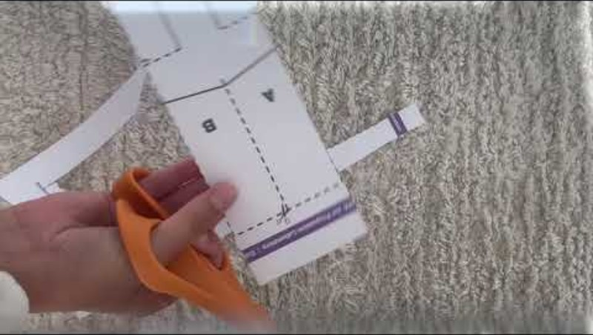
1.2 Making a paper helicopter
Paper Helicopter (Hopkins Engineering At Home) (1:41)
Use the template provided to construct the paper helicopter, following each step in the video.
Notes:
Teacher notes:
This video shows how a paper helicopter is made and used. Students follow step by step to construct a helicopter.

Slide 24
1.2 Constructing an investigable scientific question
Construct an investigable scientific question about the paper helicopter. Identify what you could change (independent variable), what you could measure (dependent variable), and what you would keep the same (controlled variables) to ensure a valid investigation.
Quality criteria – investigable scientific question
It is testable
Identifies variables
Generates measurable data
Allows for control of variables
Feasible in a school setting, with resources being available to test the question
Repeatable
Notes:
Teacher notes:
Ask students to construct an investigable question and use the quality criteria to evaluate the quality of their question
Answers could include:
Does the length of the rotor blades affect the time the helicopter takes to fall?
Change: Length of the rotor blades
Measure: Time taken to reach the ground
Keep the same: Drop height, paper type, and rotor width
Does the width of the rotor blades affect how fast the helicopter spins?
Change: Width of the rotor blades
Measure: Spin rate or number of spins before landing
Keep the same: Rotor length, paper type, and drop height
Does folding the rotor blades at different angles affect the direction of spin?
Change: Angle of rotor blade folds
Measure: Direction of spin (clockwise or anticlockwise)
Keep the same: Rotor length, paper type, and drop height
Does the thickness or type of paper (printer paper vs card vs recycled) affect how quickly the helicopter falls?
Change: Paper type or thickness
Measure: Time taken to reach the ground
Keep the same: Rotor size, drop height, and fold style
Does adding extra mass to the bottom (e.g. tape or folded paper) affect how quickly the helicopter falls?
Change: Amount of mass added
Measure: Time taken to reach the ground
Keep the same: Rotor size, paper type, and drop height
Does the height from which the helicopter is dropped affect the time it takes to reach the ground?
Change: Drop height
Measure: Time taken to reach the ground
Keep the same: Rotor design, paper type, and mass of helicopter
Does dropping the helicopter straight or on an angle affect how quickly it starts spinning?
Change: Drop angle
Measure: Time until helicopter begins spinning
Keep the same: Rotor design, drop height, and paper type
Does the shape of the rotor tips (square, rounded, pointed) affect the spin rate?
Change: Shape of rotor tips
Measure: Spin rate (spins per second or total spins)
Keep the same: Rotor length, paper type, and drop height

Slide 25
1.2 Constructing a scientific hypothesis (2)
Turning an investigable scientific question into a hypothesis
Does the length of the rotor blades affect the time the helicopter takes to fall?
independent variable dependent variable
If the ______________________ is decreased, then the __________________________ will also decrease because shorter blades create less air resistance (drag), so the helicopter falls faster.
length of the rotor blades
time the helicopter takes to fall
Notes:
Teacher notes:
This slide models the construction of a scientific hypothesis from an investigable scientific question.
The first step is to identify the independent and dependent variables
The scientific hypothesis is then written using an ‘If . . . then . . .because’ format. For example, in this case, the structure is that if the independent variable is changed (increased) then the dependent variable will also change (increase).
The slide shows how the independent variable and dependent variable are embedded in the hypothesis.

Slide 26
1.3 Evaluating online content
Learning intentions and success criteria
We are learning: | I can:
to assess the use of scientific data and information in verifying information | define reliability, accuracy and validity in the context of secondary sources develop and apply a set of criteria to evaluate the reliability and validity of a secondary source
to analyse data from investigations | identify the components of a valid secondary source of information or data
to develop criteria to solve problems. | develop and apply criteria to solve a given problem.
Notes:
Teacher notes:
Suggested learning intentions and success criteria for this learning sequence.
Display this slide at the beginning of the learning activity. Revisit the slide where appropriate during lesson activities and encourage students to reflect on their progress.
Also, adapt this Learning Intentions and Success Criteria (LISC) slide to display only the learning intentions and success criteria that are the focus of the current lesson or activity. Additional learning intentions and success criteria can be introduced progressively as students move through the learning sequence.

Slide 27
1.3 Reliability of secondary sources
When evaluating a secondary resource, ask these questions:
Who created it?
Is the author or organisation qualified to discuss the topic?
Do they have expertise in Science?
Is the information supported by evidence?
Does the resource provide facts, data, references, or links to scientific research?
Can the claims be checked against other sources?
Is the information current?
When was the resource published or updated?
Is the information still accurate?
Is the source objective?
Does the source present the information fairly?
Is it trying to inform, persuade, entertain or sell something?
Can the information be verified?
Do other reliable sources report similar information?
Notes:
Teacher notes:
Use this slide to unpack how to evaluate a secondary resources.
Emphasise that a reliable secondary resource should:
Be reputable
Have scientific backing
Be current and accurate
Should present information in a balanced way that is not trying to persuade the audience with dramatic language
Can be verified through other reputable sources such as reputable scientific journals.

Slide 28
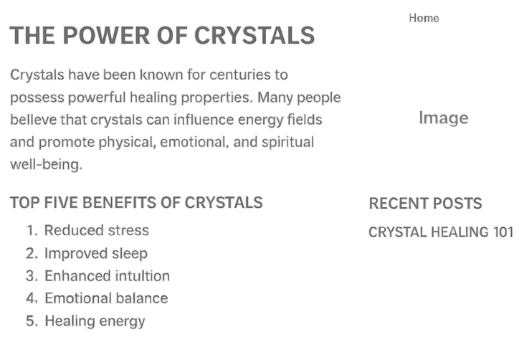
1.3 Reliability of secondary sources – red flags
Unscientific claim.
No author listed.
Vague terms used: ‘enhanced intuition’ ‘emotional balance’.
Attempt to persuade that it must be true.
No evidence or references provided.
No date provided.
Notes:
Teacher notes:
This slide has animations.
Speaker notes:
Before we believe anything online, we need to check whether the website can be trusted to see if the information being provided is reliable. Many sites look scientific or professional but are actually misleading.
Take a look at this sample website on the power of crystals.
We should always start by asking, ‘who wrote this?’ Reliable websites will clearly show who is responsible for the information. We should be looking at:
Is there an author?
Do they have qualifications or expertise?
Is there an ‘About’ page that explains who they are?
For some websites, some red flags could stand out – these are potential concerns that might mean we cannot trust the site. For example:
no author is listed
The author has fake-sounding titles or irrelevant qualifications
The website is attributed to mystery organisations that have no real-world presence – you can’t find them referenced anywhere else.
For this website, no author is mentioned at all.
Next we need to consider the purpose of the website. Every website has a motive. A reliable website aims to inform. An unreliable website often tries to sell something, persuade you or alarm you.
Things to watch for include:
An emotional or dramatic tone
Claims that are designed to scare or excite
Lots of links to products or donations
One-sided arguments
The attempt to sway your opinion by referring to what has apparently ‘been known for centuries’, is trying to convince you that what they’re saying must be right.
Really importantly in evaluating a website, we need to look at the evidence for what the site is claiming. Reliable websites back up claims with real references, not vague statements.
You should be looking for:
Are the sources of the information presented listed?
Are studies or articles linked?
Do graphs or images have labels?
Is the information provided aligned with other reliable sources?
Common red flags include:
Sweeping statements like ‘scientists say . . . ‘ without naming any scientists.
Broken links
Charts with no labels, strange scales, or unclear origin
Testimonies being provided instead of objective evidence
Unusual content that is unique to the website and not found anywhere else
This website here completely omits any references so the reader has no idea where the information is coming from. This makes it unreliable.
We should also be wary of fake scientific language. Some unreliable sites borrow scientific-sounding words to appear credible.
Watch for:
Buzzwords or jargon with no clear meaning
Misused scientific terms
Claims that break basic science
Invented terminology
This site here makes the unscientific claim that crystals influence energy fields, and references vague concepts like ‘enhanced intuition’ and ‘emotional balance’.
We also need to check for dates on websites. Reliable sites will usually include the date the information was published or updated. This site here does not provide dates at all.
Some final points to watch for are in the design of the website:
Lots of pop-ups or ads
Poor spelling or grammar
Fake awards or certifications and
Unprofessional layouts
can all hint at an unreliable website.

Slide 29

1.3 Solving a problem about secondary sources
Muhammad’s teacher has given him a research question that he must find reliable and valid online secondary sources to answer. The research question is ‘Does blue light from screens damage the retina of your eyes?’
His problem is that he needs to make sure that the online secondary sources he finds are both reliable and valid.
To do this, he is going to work with his teacher and class to develop criteria to determine whether the online sources he finds are reliable and valid.
He will then use these criteria to make a judgement about the sources he uses to answer the question.
Notes:
Teacher notes:
Outline the given scenario with students.
Identify the problem given as establishing whether online sources he uses for his research question are reliable, accurate and valid and therefore should be used to respond to his research question.

Slide 30
1.3 Defining key terms
Secondary source reliability, accuracy and validity
Reliability – This refers to the credibility of the source and the consistency of information with other reliable sources.
Accuracy – The information presented is correct, with information we know to be true.
Validity – This evaluates the appropriateness of the information for the topic under investigation, including its reliability and accuracy.
Notes:
Teacher notes:
Inform students that not all the sources that come up through the search will be reliable and valid. Define reliability, accuracy and validity using the definitions on the slide. Teach students what it means for a secondary source to be reliable, accurate and valid. There is a scaffold in the student resource, ‘Is the secondary source reliable, accurate and valid?

Slide 31
1.3 Developing evaluation criteria (1 of 14)
Reliability
Author
Domain (.gov)
Bias
Date published
Consistency of information
Accuracy
Scientific accuracy
Validity
Relevance to question or topic investigated
Reliable and accurate
The author or organisation is clearly named
The author has relevant qualifications or expertise in science
Notes:
Teacher notes:
Use this slide to introduce students to developing evaluation criteria.
To construct a set of evaluation criteria that we can use to evaluate online sources, we start with the list of characteristics that we want to consider – for example, this list on the screen.
We then take each of these points and write out one or more related criteria that we want to be able to use as a checklist to evaluate the website.
For example, the first point is ‘author’ – we can turn this into 2 criteria to use as a checklist Firstly, the author or organisation is clearly named, secondly, the author has relevant qualifications or expertise in science.
You then move onto the next item on our list, the date, and create criteria for that. It could be just one criterion or a few like we’ve just done.
It is now your turn to turn the list of characteristics you built into evaluation criteria. You can use Student resource – Developing evaluation criteria for this.

Slide 32
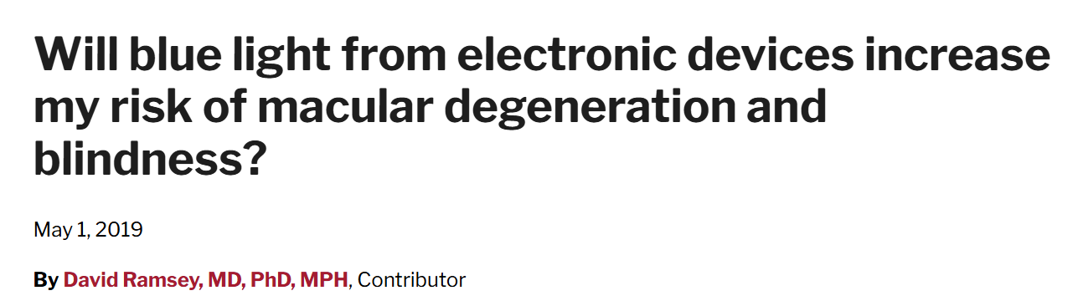
1.3 Developing evaluation criteria (2 of 14)
The author
Notes:
Teacher notes:
Use either the website, https://www.health.harvard.edu/blog/will-blue-light-from-electronic-devices-increase-my-risk-of-macular-degeneration-and-blindness-2019040816365, or the slide deck for the next few slides to do a live walkthrough and develop each criteria to evaluate the reliability, accuracy and validity of online sources.
Author
When looking at the author, we are looking to see if they have an appropriate scientific background and what qualifications their qualifications are in relation to the topic they have written about.
The author is typically found at the top of the page (under the heading) or near the bottom of the page, after the text or article
The author on this page is at the top of the page, his name is David Ramsey and you can see his qualifications next to his name.
Although he is an MD which stands for doctor of medicine and he has a high level of education, indicated by PhD (doctorate) and MPH- master of public health, we should dig a bit further to make sure that his qualifications are in relation to the field of blindness and macular degeneration (a chronic and painless disease of part of the eye, causing progressive vision loss and blindness) which is what the topic of this article is about. There are many fields of science and medicine so we should check that the author is an expert in the field they are reporting on.
When we scroll down further on the page, we can access the full biography of David Ramsey which is shown on the next slide.

Slide 33

1.3 Developing evaluation criteria (3 of 14)
The author
Notes:
Teacher notes:
Use either the website, https://www.health.harvard.edu/blog/will-blue-light-from-electronic-devices-increase-my-risk-of-macular-degeneration-and-blindness-2019040816365, or the slide deck for the next few slides to do a live walkthrough and develop each criteria to evaluate the reliability, accuracy and validity of online sources.
Author continued
When we scroll down further on the page, we can access the full biography of David Ramsey shown on the slide. If this does not appear on a page, we can sometimes Google the person and see if their qualifications come up that way.
Shown in blue boxes on the slide here is more information to tell us that David Ramsey specialises in retinal diseases with macular degeneration and has undertaken education at multiple levels for the topic he is talking about in the article.
Therefore, we can say that David Ramsey is an expert with the appropriate qualifications about the topic he is talking about.

Slide 34
1.3 Developing evaluation criteria (4 of 14)
The author – evaluation criteria: reliability
Has someone with an appropriate scientific background written the source? What are their qualifications?
Evaluation criteria (reliability): The source is written by someone with an appropriate scientific background, and the author’s qualifications or expertise relate to the topic in the text.
Notes:
Teacher notes:
Using the information discussed about the author in the previous two slides, co-construct the criteria. Example criteria is shown on the slide.

Slide 35
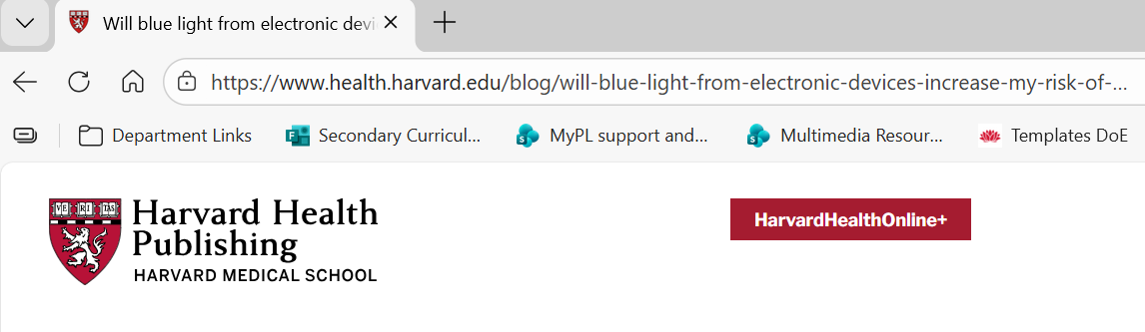
1.3 Developing evaluation criteria (5 of 14)
The domain
Notes:
Teacher notes:
Online resources have a domain.
The domain is the web address used to identify websites. For example, www.google.com.au
The domain can be an indicator of the reliability of the source.
This source is published on an educational website, on Harvard Health Publishing, which is associated with Harvard Medical School, a highly respected medical research institution. This is a reliable domain for the information to be published on.

Slide 36
1.3 Developing evaluation criteria (6 of 14)
Credible medium – evaluation criteria: reliability
Is the source published on a credible medium? For example, .edu
Evaluation criteria (reliability): The source is published on a credible medium, such as a recognised scientific organisation, university, government site, or reputable science publication.
Notes:
Teacher notes:
Using the information discussed about the domain in the previous slide, co-construct the criteria. The criteria is shown on the slide.

Slide 37
1.3 Developing evaluation criteria (7 of 14)
Bias – evaluation criteria: reliability
Does the source show any evidence of bias?
Evaluation criteria (reliability): The source shows little or no evidence of bias, such as strong opinions, selective information, or attempts to promote or sell a product.
Notes:
Teacher notes:
Bias
Bias is when information is presented in a one-sided, unfair, or inaccurate way, rather than being neutral and based strictly on evidence.
Bias arises when the research process is influenced by factors other than the data itself, such as researcher expectations, funding interests, or poor study design.
Bias can lead people to develop incorrect, unbalanced, or limited understandings of scientific concepts.
In this instance, engage with the whole text with students to unpack whether bias appears.
The article explains the science behind blue light and eye health and discusses research evidence. It does not promote specific products or services and acknowledges limitations in current research, suggesting minimal bias.

Slide 38
1.3 Developing evaluation criteria (8 of 14)
Date published
Notes:
Teacher notes:
Date published
When looking at the date published, we are looking to see the currency of the information. When looking at currency, it is important to consider the topic being investigated and the research currently being conducted in that field. We do not suggest generic guidelines such as ‘within 5 years’. The field of research needs to be taken into consideration. For example, is it a field where information is rapidly outdated due to the amount of research, or is it a field where we have understood a concept and there have been no changes in our understanding for 20 years?
In this case, the article was published in 2019. While this is relatively recent, research about blue light exposure and eye health is ongoing, so newer studies may exist.

Slide 39
1.3 Developing evaluation criteria (9 of 14)
Date published – evaluation criteria: reliability
When was the source published?
Evaluation criteria (reliability): The information is current, given the topic under investigation and the research currently being conducted in that field.
Notes:
Teacher notes:
Using the information discussed in the notes on the previous slide co-construct the evaluation criteria. An example is provided in the slide.

Slide 40
1.3 Developing evaluation criteria (10 of 14)
Consistency of information – evaluation criteria: reliability
Is the information in this source consistent with information in other reliable sources?
Evaluation criteria (reliability): The information is consistent with information found in at least two other reliable sources.
Notes:
Teacher notes:
Consistency of information
For the purpose of time, research to compare this source to two other reliable sources will not be conducted. However, it is important to inform students that information should be consistent with other reliable sources.
To determine if information in the source is consistent with other reliable sources, we should be able to research the information in this text and find it appearing in other reliable sources. If the information is consistent with unreliable sources, then that does not indicate this source is reliable, it needs to be consistent with other reliable sources.
Other reputable health organisations, such as American Academy of Ophthalmology and Wexner Medical Center at Ohio State University, also report that current evidence does not strongly support the idea that normal screen use causes eye disease, which is consistent with the information in this article.

Slide 41
1.3 Developing evaluation criteria (11 of 14)
Scientific accuracy – evaluation criteria: accuracy
Is the information in this source similar to accepted information or referenced values? (For example, information in peer-reviewed journal articles)
Evaluation criteria (accuracy): The information presented is similar to accepted scientific explanations, data, or referenced values (For example, in peer-reviewed journal articles).
Notes:
Teacher notes:
Use either the website, https://www.health.harvard.edu/blog/will-blue-light-from-electronic-devices-increase-my-risk-of-macular-degeneration-and-blindness-2019040816365, or the slide deck for the next few slides to do a live walkthrough and develop each criteria to evaluate the reliability, accuracy and validity of online sources.
Scientific accuracy
When we talk about scientific accuracy, we are talking about consistency of the information with what we know to be true, information that is accepted in science, for example information in peer-reviewed journal articles.
One way to check the scientific accuracy of the text is to search peer-reviewed journal articles and see if the information in the source is consistent with these journal articles.
The information on this website is consistent with that of two published peer-reviewed journal articles and so it is accurate.

Slide 42
1.3 Developing evaluation criteria (12 of 14)
Relevance to question or topic investigated – evaluation criteria: validity
Is the information in this source relevant to the topic or question being investigated?
Evaluation criteria (validity): The information is relevant to the question or topic being investigated.
Notes:
Teacher notes:
Use either the website, https://www.health.harvard.edu/blog/will-blue-light-from-electronic-devices-increase-my-risk-of-macular-degeneration-and-blindness-2019040816365, or the slide deck for the next few slides to do a live walkthrough and develop each criteria to evaluate the reliability, accuracy and validity of online sources.
Relevance to question or topic investigated
When conducing a secondary-source investigation, it is important to consider the validity of the information in the source. This refers to whether or not the information in there is relevant to what is being investigated. For example, in this instance here, the research question is about whether blue light is harmful to the retina of the eyes. If a source was used which contained information about the effect of blue light on skin, it is not a valid sources to use in the investigation because the information is not about the topic.
The Harvard article directly addresses the question of whether blue light from electronic devices harms the retina of the eyes, making it highly relevant to the research question.

Slide 43
1.3 Developing evaluation criteria (13 of 14)
Reliable and valid– evaluation criteria: validity
Is the source reliable and valid?
Evaluation criteria (validity): The information in the source is both reliable and accurate.
Notes:
Teacher notes:
When we talk about validity of a source, we also need to determine if the information in the source is reliable and accurate. Reliability and accuracy are a component of validity.
In this instance, the Harvard source is both reliable and accurate.

Slide 44
1.3 Developing evaluation criteria (14 of 14)
Reliability | Accuracy | Validity
The source is written by someone with an appropriate scientific background, and the author’s qualifications or expertise relate to the topic in the text. The source is published on a credible medium, such as a recognised scientific organisation, university, government site, or reputable science publication. The source shows minimal or no evidence of bias, such as strong opinions, selective information, or attempts to promote or sell a product. The information is current, considering the topic being investigated and the research currently being conducted in that field. The information is consistent with information found in at least two other reliable sources. | The information in this source is similar to accepted information or referenced values (For example, information in peer-reviewed journal articles). | The information is relevant to the question or topic being investigated. The information is reliable and accurate.
Notes:
Teacher notes:
This slide provides the evaluation criteria on the one slide to support students in completing the table in their student resource.

Slide 45
1.3 Check for understanding 1 (1 of 2)
Evaluating secondary sources
Is the criteria about reliability, accuracy or validity of online secondary sources?
The information is current, considering the topic being investigated and the research currently being conducted in that field. Reliability
The information is relevant to the question or topic being investigated. Validity
The source is written by someone with an appropriate scientific background, and the author’s qualifications or expertise relate to the topic in the text. Reliability
The information is consistent with information found in at least two other reliable sources. Reliability
The information in the source is both reliable and accurate. Validity
Notes:
Teacher notes:
This slide contains animations to reveal the answers one at a time.
Provide students with mini whiteboards to construct their response. Read each statement out to students, ask them to construct their response on the mini whiteboard and hold it up when asked (the correct response is below). Check students responses and repeat for all statements on this slide and the next slide.
CLICK to reveal the answers one at a time.
Sample responses
1. The information is current, considering the topic being investigated and the research currently being conducted in that field – reliability
2. The information is relevant to the question or topic being investigated – validity
3. The source is written by someone with an appropriate scientific background, and the author’s qualifications or expertise relate to the topic in the text– reliability
4. The information is consistent with information found in at least two other reliable sources – reliability
5. The information in the source is both reliable and accurate – validity

Slide 46
1.3 Check for understanding 1 (2 of 2)
Evaluating secondary sources
Is the criteria about reliability, accuracy or validity of online secondary sources?
The source is published on a credible medium, such as a recognised scientific organisation, university, government site, or reputable science publication. Reliability
The information presented is similar to accepted scientific explanations, data, or referenced values (For example, in peer-reviewed journal articles). Accuracy
The source shows minimal or no evidence of bias, such as strong opinions, selective information, or attempts to promote or sell a product. Reliability
Notes:
Teacher notes:
This slide contains animations to reveal the answers one at a time.
Provide students with mini whiteboards to construct their response. Read each statement out to students, ask them to construct their response on the mini whiteboard and hold it up when asked (the correct response is below). Check students responses and repeat for all statements on this slide and the next slide.
CLICK to reveal the answers one at a time.
Sample responses
6. The source is published on a credible medium, such as a recognised scientific organisation, university, government site, or reputable science publication – reliability
7. The information presented is similar to accepted scientific explanations, data, or referenced values (For example, in peer-reviewed journal articles) – accuracy
8. The source shows minimal or no evidence of bias, such as strong opinions, selective information, or attempts to promote or sell a product – reliability

Slide 47
1.3 Defining claim
An assertion that something is true.
What to consider when determining whether a claim on a published online source is true:
Where the claim is published
The evidence used to support or refute the claim
Notes:
Teacher notes:
Define claim using the slide.
Inform students that it is important to carefully consider whether the information published on an online source is trustworthy before accepting a claim as true. In science, claims should only be accepted when they are supported by reliable, accurate, and valid evidence. To do this, there are two things to consider:
Where the claim is published:
First, consider where the claim appears online. Some websites are more trustworthy than others because they follow strict standards for publishing information. For example, universities, government organisations, and reputable health or scientific organisations usually base their information on scientific research and expert review.
These sources are more likely to be reliable, accurate and valid. In contrast, claims found on personal blogs, social media posts, or websites designed mainly to attract attention may not check the accuracy of information before publishing it. This means the claim could be misleading, exaggerated, or unsupported by evidence.
Being mindful of where the claim is published helps determine whether the information is likely to be trustworthy.
The evidence used to support or refute the claim:
Even if a claim appears on a reliable website, we still need to examine the evidence used to support it.
Scientists rely on reliable, accurate, and valid sources when evaluating claims. When investigating a claim, scientists compare information from multiple credible sources to see whether the claim is supported by evidence.
Using reliable, accurate, and valid sources is important because scientific knowledge is based on evidence. If we rely on poor-quality sources, we may accept claims that are incorrect or misleading.
Evaluating sources carefully helps ensure that conclusions about whether a claim is true are based on trustworthy evidence rather than opinion or misinformation.

Slide 48
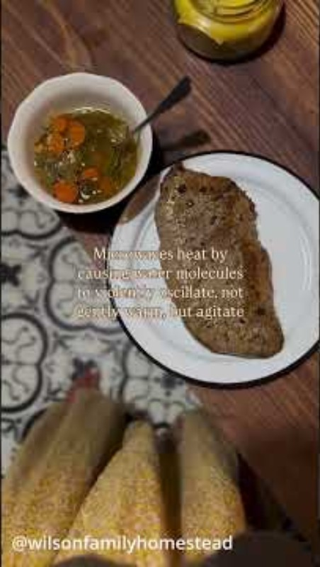

1.3 Microwaves and cancer
Your MICROWAVE Isn’t Convenient (1:38)
Notes:
Teacher notes:
This is a short clip (1:38) making claims about dangers of using microwave ovens. After viewing this, students should conduct some online research to ascertain or refute some of the claims made in the clip.

Slide 49
1.3 Think-Pair-Share
Do microwaves really cause cancer?
Think
Individual thinking time
Pair
Share your thoughts with a partner
Share
Share with a larger group or class
Notes:
Teacher notes:
Think-Pair-Share involves students thinking independently about a prompt or problem, pairing up and discussing their ideas with a classmate, and then sharing their combined knowledge with the class.
Following online research to investigate whether evidence supports microwaves causing cancer, students pair off to address the question ‘Do microwaves really cause cancer?’ using a think-pair-share, before sharing with the class.
Sample responses:
Think
“Microwaves heat food using non-ionising radiation, which does not damage DNA, so they cannot cause cancer.”
“Some people think standing too close to a microwave is dangerous, but the radiation levels are well below harmful limits.”
“Microwaves might change food nutrients slightly, but no more than boiling or frying does.”
Pair
Student A: “I used to believe microwaves were unsafe, but I found that the World Health Organization says they’re safe when used properly.”
Student B: “Yes, the Cancer Council also confirms that microwave ovens do not cause cancer. They only produce heat, not DNA-damaging radiation.”
Together: “It seems microwaves are safe to use, though damaged or leaky ovens should be avoided.”
Share
“Microwaves use non-ionising radiation, which cannot cause cancer. This is confirmed by WHO and FDA.”
“The main safety risks are burns from hot food or liquid, not radiation exposure.”
“Nutrient loss in microwaved food is similar to other cooking methods — sometimes even less, since microwaving is faster.”
“The myth that microwaves cause cancer is misinformation. Scientific evidence does not support it.”

Slide 50
1.3 Check for understanding 2
Claims
If you think the statement below is true, place your hands on your heads. If you think it is false, place your hands on your hips:
When determining whether a claim is true, it is important to assess both the credibility of the source where the claim is published and the reliability, accuracy, and validity of the evidence used to accept or reject it.
True
Notes:
Teacher notes:
This slide has animations.
Provide instructions for students to place their hands on their heads if they think the statement is true or place their hands on their hips if they think the statement is false.
Read out the statement, ask students to indicate whether then think if it is true or false then CLICK to reveal the answer.

Slide 51
1.4 Claims that can be investigated scientifically
Learning intentions and success criteria
We are learning: | I can:
to assess the use of scientific knowledge and data when testing claims. | define a claim that can be tested scientifically outline the criteria for a claim to be scientifically tested through investigation identify that a claim can be scientific but not scientifically testable assess if the given claims can be scientifically tested
to use scientific methods to evaluate claims | design an investigation to evaluate a claim collect data to investigate a claim represent and interpret data in a graph to show how it supports or refutes a claim draw an evidence-based conclusion from an investigation based on a claim.
Notes:
Teacher notes:
Suggested learning intentions and success criteria
Display this slide at the beginning of the learning activity. Revisit the slide where appropriate during lesson activities and encourage students to reflect on their progress.
Also, adapt this Learning Intentions and Success Criteria (LISC) slide to display only the learning intentions and success criteria that are the focus of the current lesson or activity. Additional learning intentions and success criteria can be introduced progressively as students move through the learning sequence.

Slide 52
1.4 Check for understanding 1 (1 of 2)
Distinguishing between a claim and an investigable question
Are these statements a claim or investigable question?
 | Is it a claim? | Why?
Plants need sunlight to grow.
Chocolate ice cream tastes better than vanilla.
Do plants need water to grow?
Notes:
Teacher notes:
Present this to students to review student understanding of what a claim is and what an investigable question is.
The sample responses are on the next slide.

Slide 53
1.4 Check for understanding 1 (2 of 2)
Distinguishing between a claim and an investigable question
Are these statements a claim or investigable question?
 | Is it a claim? | Why?
Plants need sunlight to grow. | Yes | It asserts something as true.
Chocolate ice cream tastes better than vanilla. | Yes | It asserts something as true.
Do plants need water to grow? | No | This is a question; it is not a statement asserting something to be true.
Notes:
Teacher notes:
Use this slide to check students understanding of identifying a claim.

Slide 54
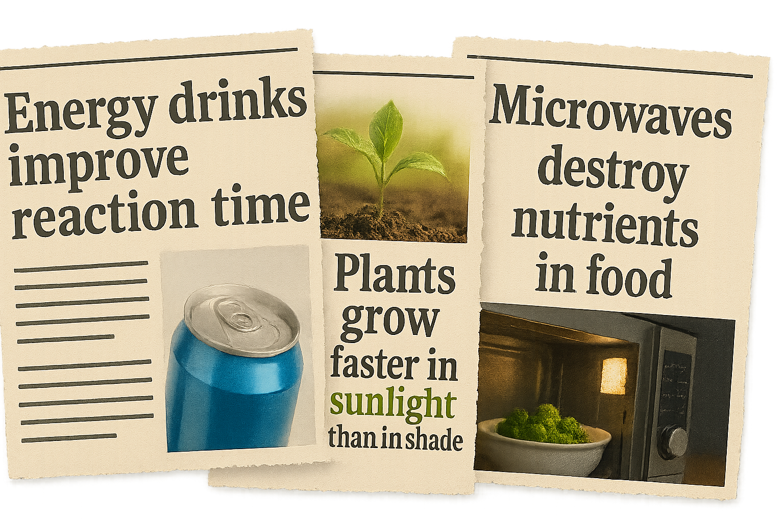
1.4 Everyday claims
Not every claim can be scientifically tested by investigation
A scientific claim is a statement about a scientific concept that can be examined by collecting measurable data through observation or experimentation.
Notes:
Teacher notes:
This slide introduces students to the idea of a claim that can be scientifically tested with investigation. At first students are presented with some everyday scientific claims: Energy drinks improve reaction time, plants grow faster in sunlight than in shade, and microwaves destroy nutrients in food. In addition to evaluating claims found in online sources, sometimes we might like to evaluate a claim by conducting an investigation or series of investigations. But not all claims can be investigated scientifically. (CLICK) to show the definition of a claim that can be scientifically tested by investigation is - A statement about a scientific concept that can be examined by collecting measurable data through observation or experimentation.
Claims based on opinion, belief or values are not testable (e.g. ‘chocolate is the best flavour’.)
Unpack the examples on the slide:
Energy drinks improve reaction time: this claim could be investigated through a practical investigation measuring reaction time before and after consuming an energy drink, or through secondary source research analysing existing studies on caffeine and reaction time. It would however, benefit from being more specific, such as drinking 250 mL of an energy drink decreases reaction time in a computer reaction test. Note that this investigation is not suitable for testing in a school setting.
Plants grow faster in sunlight than in shade: this could be tested through a practical investigation by growing plants under different light conditions and measuring growth over time. It would however, benefit from being more specific, such as bean plants grow taller when exposed to 8 hours of sunlight compared to 2 hours per day.
Microwaves destroy nutrients in food: this claim is not specific enough because nutrients include many different substances. To test the claim scientifically, a specific nutrient such as vitamin C would need to be identified and measured.
The next slide will go through some simple criteria that can be applied to determine if a claim is testable.

Slide 55
1.4 Criteria for claims that can be scientifically tested
How do we know a claim can be scientifically tested by investigation?
It is a statement that is asserting something to be true.
It is related to a scientific concept that can be measured objectively and not based on personal preference or opinion.
The independent and dependent variables have been clearly defined (that is, the variables are specific and not vague).
Valid data to support or refute the claim can be collected through secondary-source or practical investigation.
Temperature affects how fast sugar dissolves in water.
Sugar tastes better in hot drinks than cold ones.
Notes:
Teacher notes:
This slide outlines the criteria for a claim can be scientifically tested by investigation.
Speaker notes:
We’ve said that a claim is a statement that is made that is pitched as being true but in reality, it could be true or false. Not all claims can be tested using evidence so it’s important to be able to identify those that can be tested so we can apply scientific reasoning to make up our minds about them.
Unpack each example on the slide using the criteria:
‘Temperature affects how fast sugar dissolves in water’
Can be scientifically tested by investigation
It relates to the scientific concept of dissolving and rates of processes in chemistry.
The independent variable is temperature, and the dependent variable is how fast sugar dissolves (dissolving rate).
A practical investigation could measure the time taken for sugar to dissolve in water at different temperatures. Data from secondary sources could also be used to analyse how temperature affects dissolving rates.
‘Sugar tastes better in hot drinks than cold ones’
Cannot be scientifically tested by investigation
Although written as a statement, it only partially relates to a scientific concept about food and taste. However, the claim is based on personal preference rather than a clear scientific concept that can be measured objectively. Different people have different preferences, and there is no single, standard measurement for better taste. Even if we asked many people to try both drinks, the results would simply reflect individual likes and dislikes rather than measurable evidence.
The independent variable could be drink temperature, but the dependent variable (“tastes better”) is subjective and cannot be measured objectively. Because the dependent variable cannot be measured consistently or objectively, this claim cannot be scientifically tested.
While surveys could collect opinions, they would measure preferences rather than objective scientific data, so the claim cannot be scientifically tested in a reliable way.

Slide 56
1.4 Check for understanding 2
Claims
Categorise these claims as able or unable to be scientifically tested with investigation
Saltwater freezes at a lower temperature than fresh water
Can be scientifically tested
Listening to music makes you happier
Washing hands reduces the amount of germs
Cannot be scientifically tested
Cats are cuter than dogs
Notes:
Teacher notes:
This slide has animations.
Choral response can be used here for the students to call out whether each claim is testable or not testable. (CLICK) on each claim to move it into the correct container.
Explanation:
Salt water freezes at a lower temperature than fresh water
This claim is testable because it is a clear statement about a measurable scientific concept: freezing temperature. The independent variable (type of water) and the dependent variable (freezing temperature) are clearly defined, and other factors such as container, volume, and freezer can be controlled. Observations can be made with a thermometer, and the experiment can be repeated by anyone, enabling the collection of valid data.
Listening to music makes you happier
This claim is not testable. It cannot be tested scientifically because ‘happier’ is vague and subjective. While it is written as a statement, the dependent variable cannot be measured objectively, and the independent variable (listening to music) does not lead to a clearly defined measurable outcome. Without precise variables, valid and repeatable data cannot be collected, so the claim is not testable as written.
Washing hands reduces the amount of germs
This claim is testable because it is a clear statement about a measurable scientific concept: the number of germs. The independent variable (hand washing) and dependent variable (number of germs) are clearly defined, and other factors such as group size, exposure, and measurement method can be controlled. Observations can be made by counting microbes or tracking illness rates, and the experiment can be repeated to collect valid data.
Cats are cuter than dogs
This claim is not testable. It cannot be tested scientifically because ‘cuter’ is based on personal opinion and cannot be measured objectively. Although it is written as a statement, there are no clearly defined independent or dependent variables, and results would vary between people. Therefore, valid and repeatable data cannot be collected to support or refute this claim.

Slide 57
1.4 Think-Pair-Share investigating a claim
‘Black or dark coloured items heat up more then white or light-coloured items’
Think
Individual thinking time
Pair
Share your thoughts with a partner
Share
Share with a larger group or class
How will you investigate the claim?
How will you measure the dependent variable?
How frequently will you make measurements and for how long?
How will you control other variables?
Notes:
Teacher notes:
Display this slide to facilitate a think-pair-share where students come up with an investigation to test the claim ‘black/dark items heat up more than white/light coloured items in the sun’. Some prompt questions have been provided in the Think section.
Think-Pair-Share involves students thinking independently about a prompt or problem, pairing up and discussing their ideas with a classmate, and then sharing their combined knowledge with the class. It:
allows educators to change a traditional whole class discussion into a more manageable and inclusive activity where all students are given an opportunity to respond
promotes the development of students' speaking, listening and social skills

Slide 58
1.5 Evidence to support conclusions
Learning intentions and success criteria
We are learning: | I can:
to assess the use of scientific knowledge and data when testing claims | identify the evidence which supports a claim construct a written scientific argument about a claim
to use strategies to solve problems | evaluate a claim using scientific knowledge identify how evidence in scientific investigations can be used to support or refute a claim
to communicate scientific arguments. | use appropriate terminology to communicate evidence and reasoning identify the audience and purpose of an argument explain scientific concepts to support a written argument.
Notes:
Teacher notes:
Suggested learning intentions and success criteria.
Display this slide at the beginning of the learning activity. Revisit the slide where appropriate during lesson activities and encourage students to reflect on their progress.
Also, adapt this Learning Intentions and Success Criteria (LISC) slide to display only the learning intentions and success criteria that are the focus of the current lesson or activity. Additional learning intentions and success criteria can be introduced progressively as students move through the learning sequence.

Slide 59
1.5 Check for understanding
Scientific claims
Which statement best describes a scientific claim?
An opinion that cannot be tested
A statement about the natural world that can be supported or challenged using evidence
A question a scientist wants to investigate
A list of observations collected during an experiment
Notes:
Teacher notes:
This slide contains animations to reveal the correct answer.
Activate students prior knowledge about scientific claims using the multiple-choice question.
CLICK to reveal answer
Students can:
Recognise that scientific claims are statements rather than questions.
Distinguish between claims, evidence, and opinions.
Explain that scientific claims must be supported by evidence.
Understand that scientific claims can be revised when new evidence becomes available.
To deepen understanding, ask:
"Can you give an example of a scientific claim about plants, weather, or forces?"
"What evidence would you need to support that claim?"
"Could two scientists make different claims from the same evidence? Why or why not?"
"What is the difference between a claim and evidence?"

Slide 60
1.5 What is a scientific argument?
A scientific argument is a reasoned explanation that uses evidence from observations, experiments, or data to support a claim.
It explains why the evidence supports the claim, using scientific ideas, and may consider alternative explanations.
Notes:
Teacher notes:
This slide outlines what a scientific argument is, clarifying that it is different from an explanation in using evidence to support a claim and provides reasons for why the evidence supports the claim.

Slide 61
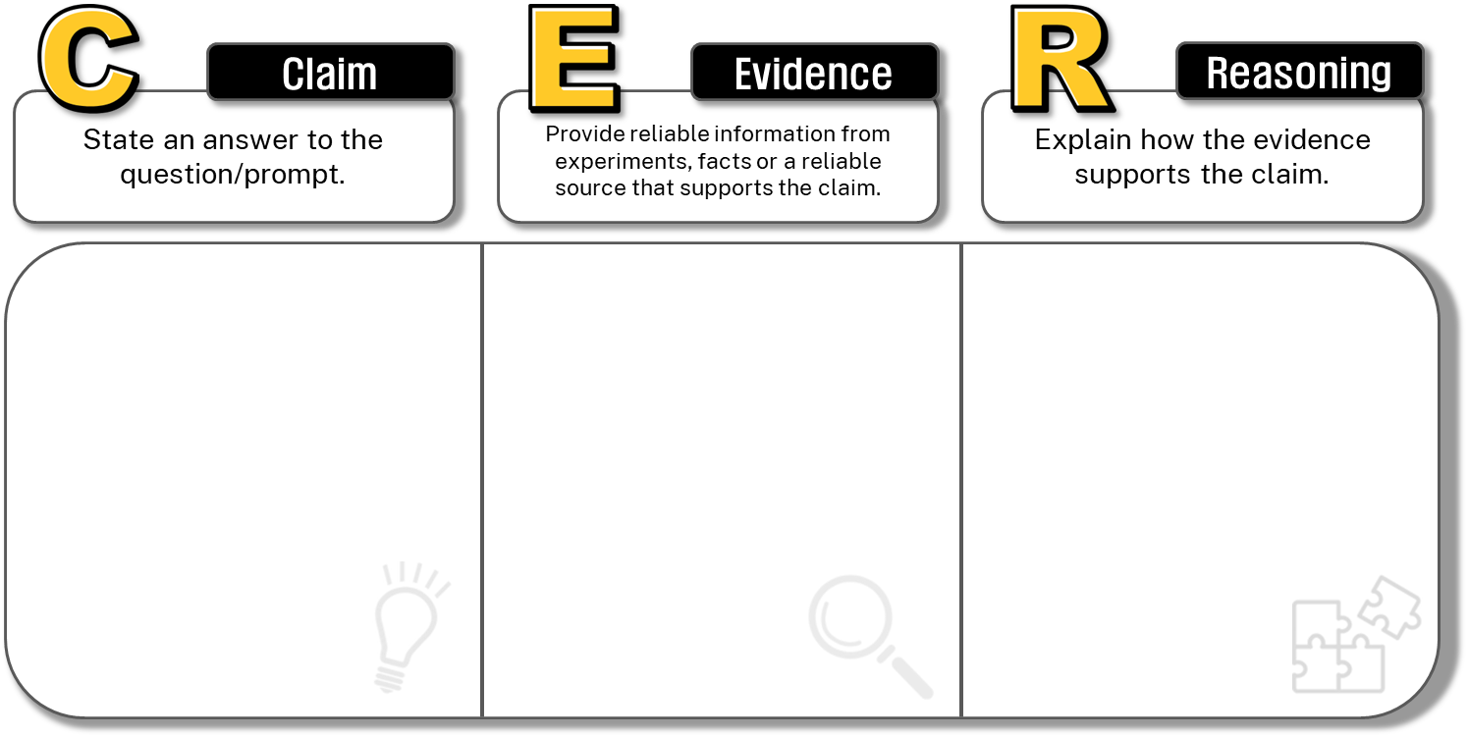
Plants grow better in nutrient-rich soil.
1.5 Claim–Evidence–Reasoning (CER)
In an experiment, plants grown in potting mix grew 15cm tall on average, while plants grown in sandy soil only grew 8 cm tall over the same time.
Different types of soil contain varying amounts of nutrients. Nutrient-rich soil such as potting mix contains more essential nutrients and retains water better than sandy soil. The plants in nutrient-rich soil grew taller because they had better access to nutrients and water needed for growth.
In Data Science 2 we are going deeper to ensure that we incorporate multiple sources of valid evidence in our scientific arguments.
Notes:
Teacher notes:
This slide contains animations.
Introduce Claim, Evidence, Reasoning as a scientific reasoning structure that can be used when looking at how evidence and reasoning support conclusions made about claims. CER helps students structure their scientific explanations so that they use investigation data (from practical or secondary-source investigations) as evidence and clearly explain the reasoning that links that evidence to a conclusion. The CER framework mirrors how scientists communicate conclusions. It teaches students to construct explanations from investigation data by explicitly separating a claim, evidence, and reasoning, ensuring conclusions are justified using valid and reliable data rather than simply stated.
Claim: the claim is the students response to the claim they are investigating or the conclusion drawn from the results of their investigation. It summarises what the data suggests.
Evidence: the data collected during the experiment or the secondary-source investigation, which supports the claim. Evidence is important because scientific claims must be supported by valid and reliable data rather than opinion.
Reasoning: the reasoning links the evidence to the claim using scientific concepts or principles. Reasoning is crucial because it explains how the data logically supports the conclusion and demonstrates conceptual understanding.
Unpack the example provided on the slide to show how the claim made has been supported using reliable information from an experiment and how the reasoning explains how the evidence supports the claim using understanding of scientific concepts related to the claim. In this case, about how nutrients support plant growth.
The conclusion that can be made from this is that the plants grew better in nutrient-rich soil.

Slide 62
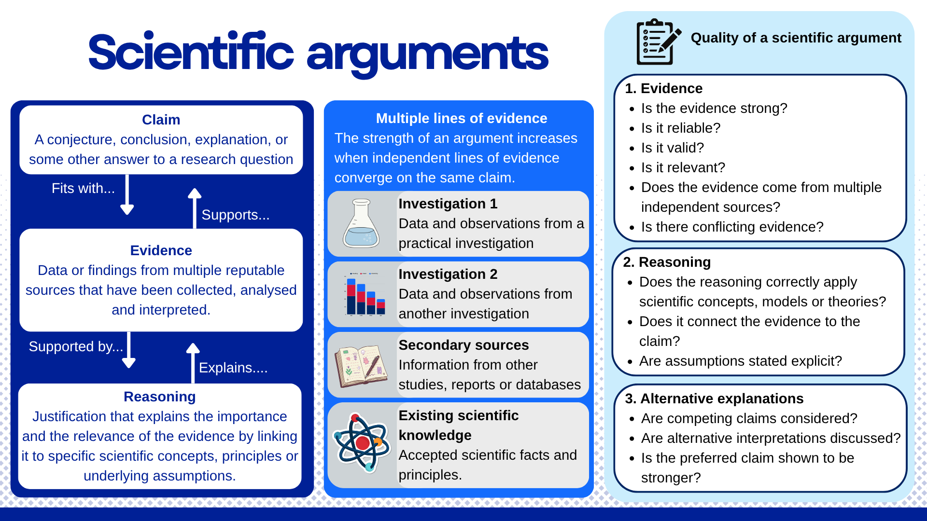
1.5 Scientific arguments
Images from Canva used in accordance with the Canva for Education licence for educational, non-commercial purposes.
Notes:
Teacher notes:
Use this scientific arguments poster to extend students understanding of scientific arguments to incorporate multiple sources of evidence, and unpack the features of a quality scientific argument. A link to the poster in CANVA is also provided in the Teacher Resource Book.

Slide 63
Essential question 2
How do we analyse large datasets to support scientific investigations?
Notes:
Teacher notes:
Content in this section aligns with essential question 2 in the program of learning and Teacher resource book 2

Slide 64
2.1 Large datasets
Learning intentions and success criteria
We are learning: | I can:
to describe how large data sets are used to investigate questions and claims. | define a large dataset and provide examples outline the features and benefits of using large datasets outline methods of collection and the uses and applications of large datasets.
Notes:
Teacher notes:
Suggested learning intentions and success criteria for 2.1 Large datasets.
Display this slide at the beginning of the learning activity. Revisit the slide where appropriate during lesson activities and encourage students to reflect on their progress.
Also, adapt this Learning Intentions and Success Criteria (LISC) slide to display only the learning intentions and success criteria that are the focus of the current lesson or activity. Additional learning intentions and success criteria can be introduced progressively as students move through the learning sequence.

Slide 65
2.1 Check for understanding 1
Datasets
Which statement best describes a dataset?
a single measurement taken during an investigation, such as the temperature of a beaker at one point in time.
a set of instructions for a computer to follow when processing data.
a collection of related data values typically organised in a specific format such as tables, graphs and spreadsheets for easy retrieval and analysis.
a simplified representation of a system or phenomenon, such as a diagram of the water cycle.
Notes:
Teacher notes:
Use this multiple-choice question to determine student prior knowledge of what a dataset is (learnt in Data Science 1). Students can respond using mini whiteboards or raising their hands.
This slide is animated to reveal the correct response, c.

Slide 66
2.1 How much data is enough?
Consider the following questions…
Would you trust a weather forecast based on data from 3 days?
Would you trust a climate trend based on data from 30 years?
Would you trust a medical study based on study with 5 people?
Would you trust a study based on 50000 people?
Notes:
Teacher notes:
Get students to consider the question ‘How much data is enough?’ Ask students some questions that make them consider the confidence that is instilled by large data sets.

Slide 67
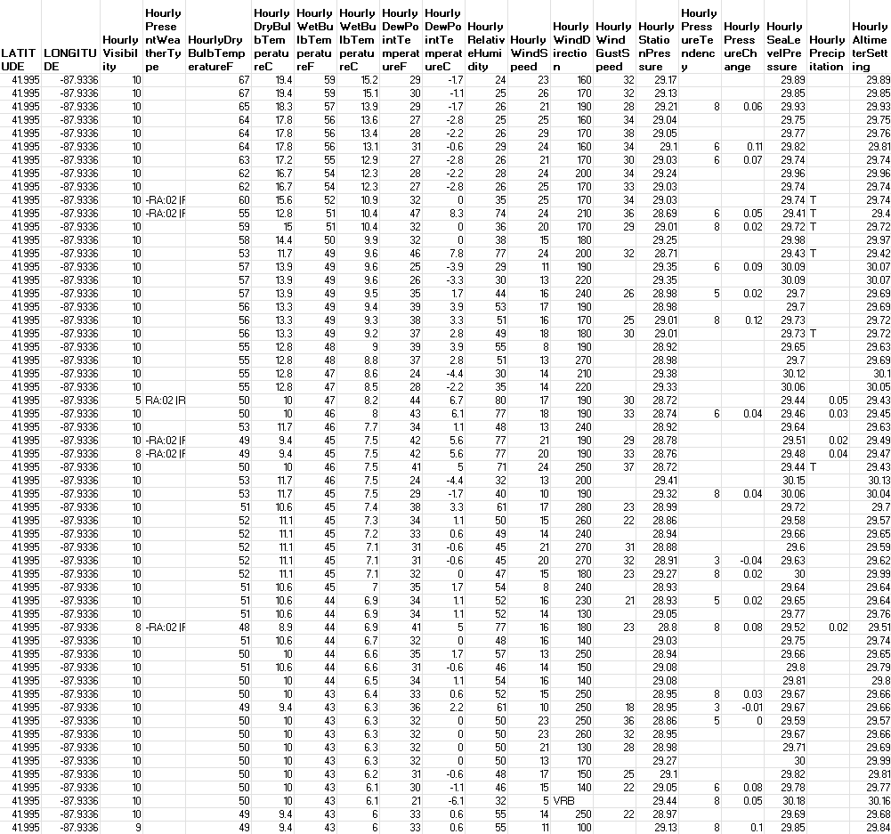
2.1 Defining large dataset
Large dataset: A dataset that must be of a size to be statistically reliable and require computational analysis to reveal patterns, trends and associations.
Climate Data Online: Dataset Discovery by NCEI, licensed under CC BY 4.0
Notes:
Teacher notes:
Read through the definition on the slide to define large dataset. The image on the slide shows a portion of a large dataset to show students the amount of data available. To further unpack the definition for students, use the information below:
the size of large datasets improves the statistical reliability of the data contained in them. Analytical tools can identify anomalies in large datasets and quantify errors accurately.
require computational analysis – the application of computer methods, tools, and algorithms to analyse data or models to reveal patterns, trends, and insights
Distinguish between small and large datasets by telling students that:
a small dataset has only a few data points, like measuring the height of 10 students in a class and is easy to manage, but may not show clear patterns
a large dataset contains many data points (hundreds to millions), such as daily temperature records for a whole term.
large datasets are more likely to reveal trends and patterns, produce more reliable conclusions, and allow scientists to make predictions.
Inform students that technological developments have allowed scientists to generate large volumes of data quickly and for a lower cost.
Note: it may be necessary to clarify the difference between a ‘big data’ and a ‘large dataset’. The terms ‘big’ and ‘large’ are often interchangeable, but there is a difference between the two types of datasets. Large datasets are simply datasets with a high volume of entries requiring computational analysis. At the same time, big data refers to datasets that are not only large but also complex, fast-moving and diverse and may require advanced tools and techniques to process effectively.

Slide 68
2.1 Features of large data sets
Many observations
Collected over time and/or across many locations
Multiple variables
Representative of a larger population or system
Organised and structured
Suitable for statistical analysis
Notes:
Teacher notes:
Unpack the features of large data sets.
Large datasets contain hundreds, thousands or even millions of data points, providing a substantial amount of evidence for analysis.
Data is often gathered repeatedly over long periods or from many different places, allowing scientists to investigate changes and compare locations.
Large datasets commonly include several related variables that can be analysed individually or compared to identify relationships.
The large number of observations provides a more representative sample, reducing the influence of unusual results and increasing confidence in conclusions.
Data is stored in tables or databases so it can be sorted, filtered, graphed and analysed efficiently using statistical tools.
Large datasets allow descriptive statistics, such as the mean, median and standard deviation, to be calculated to summarise and interpret the data.

Slide 69
2.1 Benefits of collecting and using large data sets
Reveal patterns and trends
Provides stronger evidence
Reduces the influence of unusual results
Allows comparisons
Supports statistical analysis
Supports evidence-based decision making
Enables predictions and forecasting
Notes:
Teacher notes:
Reveal patterns and trends – Large datasets allow scientists to identify long-term patterns, trends and cycles that may not be visible in smaller datasets. For example, detecting changes in average annual rainfall over the past 100 years.
Provides stronger evidence – A large number of observations gives scientists greater confidence that their conclusions are supported by evidence rather than a few isolated results. For example, comparing thousands of health records to investigate the spread of a disease.
Reduces the influence of unusual results – Outliers and random errors have less impact when conclusions are based on many observations instead of only a few. For example, determining the average daily temperature from many years of data rather than one week ensures that unusual results do not skew the data.
Allows comparisons – Data collected across different locations or time periods can be compared to identify similarities, differences and changes. For example, comparing rainfall between coastal and inland regions of Australia.
Supports statistical analysis – Large datasets allow descriptive statistics, such as the mean, median, range and standard deviation, to be calculated, helping summarise and interpret the data. For example, calculating the mean and variability of river water levels over several decades.
Supports evidence-based decision making – Reliable data helps governments, scientists and communities make informed decisions and plan for the future. For example, using long-term climate data to improve bushfire preparedness or water management.
Enables predictions and forecasting – Patterns identified in large datasets can be used to develop models that estimate future events or conditions. For example, forecasting seasonal weather or predicting the likelihood of flooding.

Slide 70
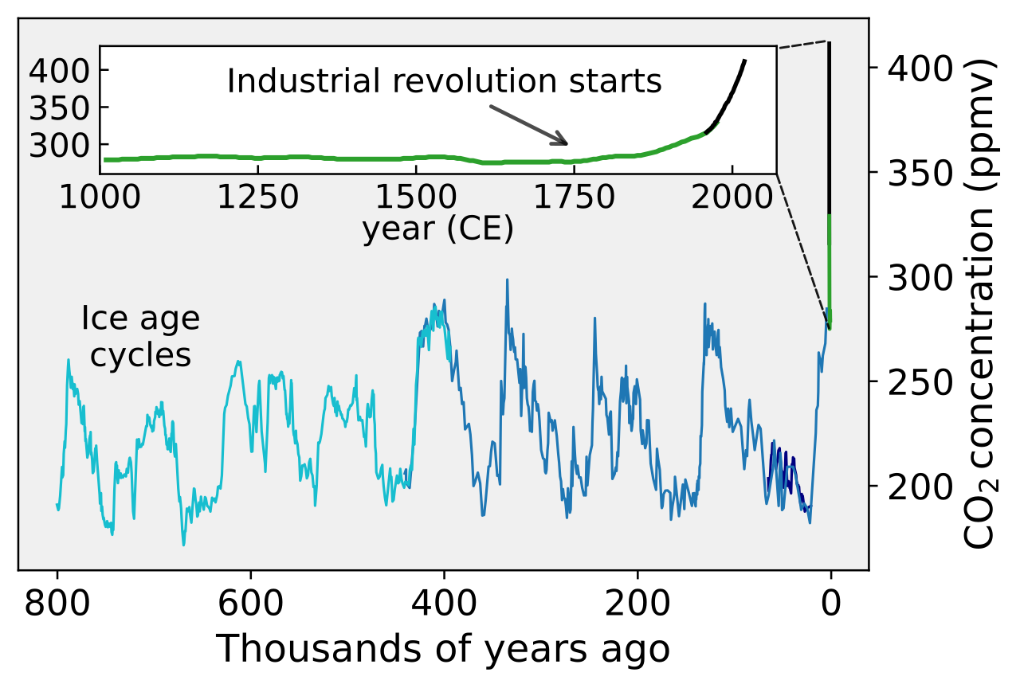
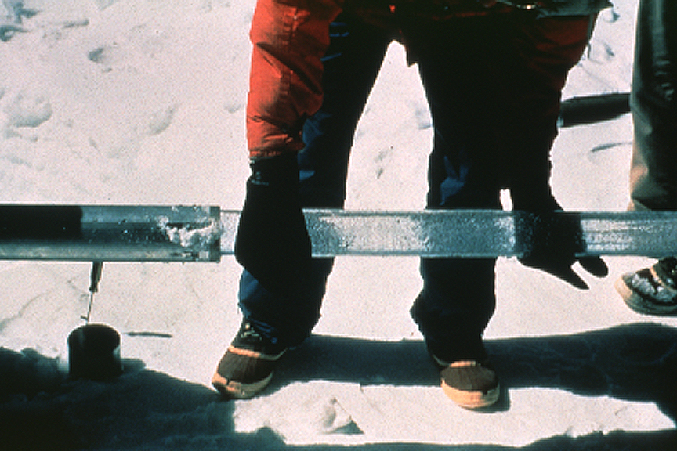
2.1 Uses of large datasets (1 of 5)
Identify patterns and trends
Monitor change
Scientists analyse many observations to detect patterns or changes over time that are not obvious in small datasets.
Repeated measurements allow scientists to track changes in natural or human systems over time.
Carbon Dioxide 800kyr by Femke Nijsse is licensed under CC BY-SA 3.0
Icecore 4 by Lonnie Thompson is in the public domain
Notes:
Teacher notes:
Scientists analyse many observations to detect patterns or changes over time that are not obvious in small datasets.
Data collected from ice cores in antarctica allowed a dataset to be collated on the amount of carbon dioxide in the atmosphere in the past.
The graph shows how carbon dioxide levels in the atmosphere have changed over the last 800, 000 years. For most of the past 800,000 years, atmospheric CO₂ concentration has cycled naturally between approximately 180 and 280 ppm. These repeated increases and decreases correspond with glacial (ice age) and interglacial cycles.Since the Industrial Revolution, circa 1800, the burning of fossil fuels has caused a rapid increase of CO₂ in the atmosphere, reaching levels unprecedented in the last million years. This can be seen in the blown-up section of the graph in white.

Slide 71
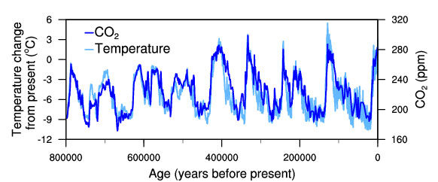
2.1 Uses of large datasets (2 of 5)
Investigate relationships
Scientists examine whether two or more variables are related.
Temperature-change-and-carbon-dioxide-change-measured-from-EPICA-Dome-C-ice-core0in-Antarctica by National Oceanic and Atmospheric Administration is in the public domain
Notes:
Teacher notes:
Scientists can use large data sets examine whether two or more variables are related.
Data collected from ice cores in antarctica allowed a dataset to be collated on the amount of carbon dioxide in the atmosphere in the past. In ice cores, they obtain two different pieces of evidence from the same sample:
Air bubbles tell us the concentration of greenhouse gases (such as CO₂ and methane).
The ice itself tells us the temperature when the snow originally fell because of the ratio of isotopes of oxygen and hydrogen.
The graph shows the correspondence between temperature and the concentration of carbon dioxide in the atmosphere observed during the glacial cycles of the past several hundred thousand years. This is evidence for the impact of greenhouse gases on climate, that is, when the CO₂ levels increase the temperature increases.

Slide 72
2.1 Uses of large datasets (3 of 5)
Evaluate scientific claims
Large datasets provide a substantial body of evidence to support or refute scientific claims.
Scientific claim: Increasing atmospheric CO₂ is associated with increasing global temperature.
Evidence for the claim | What scientists conclude
Ice core records show CO₂ and temperature have changed together over hundreds of thousands of years. | The long-term pattern supports the claim that the two variables are related.
Modern atmospheric measurements show CO₂ concentrations increasing rapidly since the Industrial Revolution. | Modern observations are consistent with the long-term evidence.
Notes:
Teacher notes:
Scientists compare evidence from multiple sources. The first dataset showed atmospheric CO₂ concentrations over the past 800 000 years. It reveals regular natural cycles, followed by a rapid increase in recent centuries. The second dataset compared carbon dioxide concentrations with reconstructed temperatures over the same period. The two variables show remarkably similar long-term patterns. Scientists do not rely on these datasets alone. They compare them with modern atmospheric measurements, satellite observations, direct temperature records and many other independent datasets. When different datasets collected using different methods all point toward the same conclusion, confidence in the scientific claim increases.

Slide 73
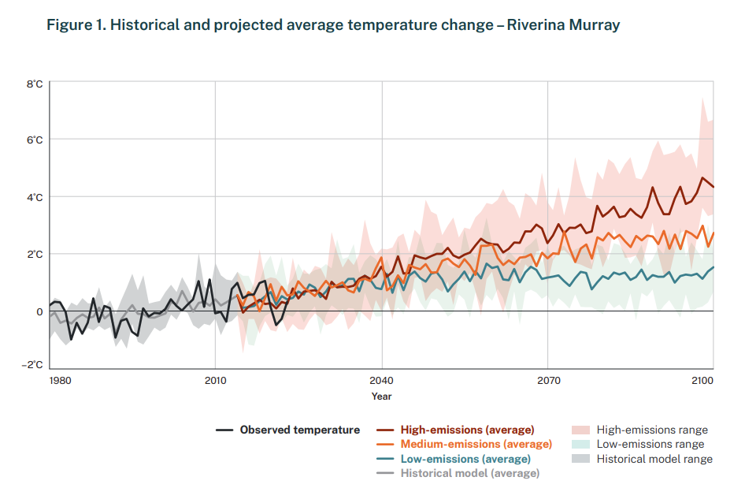
2.1 Uses of large datasets (4 of 5)
Make predictions
Patterns identified in historical data can be used to predict future events or conditions.
Support decision making
Governments, scientists and organisations use evidence from large datasets to inform policies and management decisions.
State of NSW and Department of Climate Change, Energy, the Environment and Water (DCCEEW) is licensed under CC-BY 4.0
Notes:
Teacher notes:
Large datasets can be used to make predictions. In this example NARCLIM2.0 modelling has been used to show the projected average temperature change for the Riverina Murray region in NSW. The model draws on large datasets
NARCliM is NSW’s regional climate modelling project. NARCliM combines carefully selected global and regional climate models through a process known as dynamical downscaling, to generate detailed, locally relevant climate projections. These simulate a range of plausible future climates. This data is intended to help the Riverina Murray communities understand and plan for the impacts of climate change on their infrastructure, environment and way of life; and to support informed planning, risk assessment and action.
This is an example of how governments, scientists and organisations use evidence from large datasets to inform policies and management decisions (supporting decision making).

Slide 74
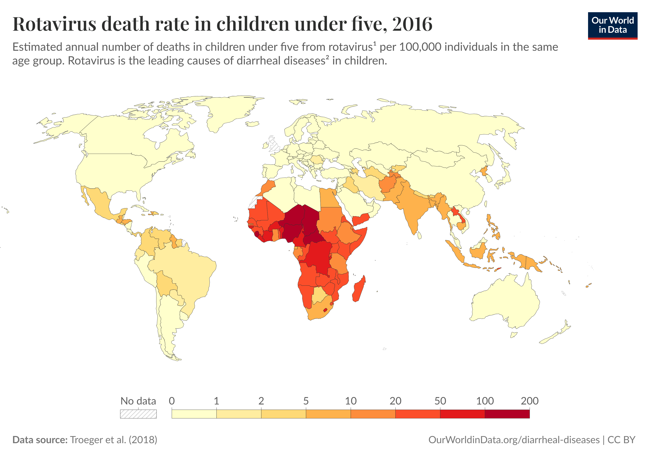
2.1 Uses of large datasets (5 of 5)
Compare data
Large datasets allow comparisons between different locations, time periods or groups.
Notes:
Teacher notes:
Large datasets allow comparisons between different locations, time periods or groups.
In the example on this slide ‘Our World in Data’ has created representations of data that it has accessed from other sources. This graphic show the Rotavirus death rate in children under 5 in 2016. Rotavirus is a contagious virus that can cause severe diarrhea. It is among one of the most common causes of death in children.
The representation shows a comparison of the number of deaths between different countries of the world using a colour code.

Slide 75
2.1 Check for understanding 2
Large datasets
Answer true or false for each statement.
Large datasets make scientific conclusions more reliable by reducing the influence of random errors.
Large datasets always prove that one variable causes another.
Large datasets can reveal patterns or trends that may not be evident in smaller ones.
Notes:
Teacher notes:
This slide contains animations to show one statement at a time.
Show students one statement at a time, ask students to indicate whether the statement is true or false by raising their hand or using mini whiteboards.
Sample responses
1 → True
2 → False – Large datasets can show strong correlations, but correlation does not prove causation because other variables may influence the results. A scientific investigation is needed to test whether one variable actually causes changes in another, while accounting for other influencing variables.
This is not clear. Why is there the need for an experimental design?
3 → True

Slide 76
2.1 Collection of data
Large datasets are created by collating many individual measurements
To ensure the data is reliable, scientists use standardised methods so that measurements collected by different people, instruments or locations can be accurately compared.
Data can be:
gathered automatically using sensors
collected by satellites
collected by scientists in field investigations
collected in laboratories with specialised instruments
collated in through reporting
collected by citizen scientists
Notes:
Teacher notes:
To ensure the data is reliable, scientists use standardised methods so that measurements collected by different people, instruments or locations can be accurately compared.
Data can be:
gathered automatically using sensors, for example:
Temperature sensors
Light sensors
Gas sensors
River height sensors
Air quality monitors
Weather stations
collected by satellites. Data collected by satellites includes:
Surface temperature
Cloud cover
Vegetation
collected by scientists in field investigations, for example:
Bird counts
Water quality testing such as turbidity
Quadrat sampling to measure abundance of organisms
Transect sampling to measure distribution of organisms
collected in laboratories with specialised instruments
Blood test results
Chemical composition of ice cores
Drinking water analysis
collated in through reporting, for example
Disease notifications
Vaccination data
Collected by citizen scientists
All of us can contribute to the collection of data through citizen science projects. An example is FrogID. FrogID is a nationwide citizen science project that uses a free smartphone app to capture frog calls, providing vital data for scientists to understand and conserve frog populations and their environments across Australia.

Slide 77
2.2 Descriptive statistics techniques
Learning intentions and success criteria
We are learning: | I can:
to describe how datasets are used to investigate questions and claims. | define descriptive statistics and descriptive analysis outline the benefits of descriptive statistical analysis techniques using examples outline the features of a box plot and the information they communicate
to process data from investigations | calculate the mean, median and standard deviation process data in a Microsoft Excel workbook
to analyse data from investigations. | interpret descriptive statistics to describe trends and patterns in a dataset. evaluate a claim using descriptive analysis.
Notes:
Teacher notes:
Learning intentions and success criteria for 2.2 Descriptive statistics techniques.
Display this slide at the beginning of the learning activity. Revisit the slide where appropriate during lesson activities and encourage students to reflect on their progress.
Also, adapt this Learning Intentions and Success Criteria (LISC) slide to display only the learning intentions and success criteria that are the focus of the current lesson or activity. Additional learning intentions and success criteria can be introduced progressively as students move through the learning sequence.

Slide 78
2.2 Check for understanding 1 (1 of 2)
Key terms
The most common value in a dataset.
The sum of values in a dataset divided by the total number of values in the dataset. Also called the average.
Word bank
Mean
Mode
Range
The difference between the highest and lowest values in a dataset.
Notes:
Teacher notes:
This slide has animations.
Click on the tiles under the Word bank (in any order) to match it to its meaning.
Ask students to match the term to the definition to determine their prior knowledge of what a mean, mode and range are.

Slide 79
2.2 Check for understanding 1 (2 of 2)
Excel calculations
Calculate the mean, mode and range in Microsoft Excel.
Day | Air temperature (°C)
1 | 22
2 | 24
3 | 23
4 | 26
5 | 24
6 | 21
7 | 24
8 | 25
9 | 22
10 | 23
Mean = 23.4 °C
Mode = 24 °C
Range = 5 °C
Notes:
Teacher notes:
This slide has animations.
Display this on the board while students are using Microsoft Excel to calculate the mean, mean, mode and range in Microsoft Excel. Dataset shows air temperature in degrees Celsius across a period of ten consecutive days.
Sample answers are provided on the slide, *CLICK* to reveal each answer one at a time for the mean, mode and range.

Slide 80
2.2 Defining descriptive statistics and descriptive analysis (1 of 2)
Descriptive statistics: statistics that quantitatively describe or summarise features of a collection of information.
For example:
mean
median
mode
range
Descriptive analysis: the analysis of statistics that quantitatively describe or summarise features of a collection of information.
For example:
the interpretation of the descriptive statistics
identifying trends and patterns
describing the variability
explaining what the statistics mean in context
Notes:
Teacher notes:
Define descriptive statistics and analysis using the definitions on the slide. To distinguish between the terms, inform students that descriptive statistics is the process or activity of describing data, the part where we do the calculations such as calculating the mean, median, mode, range, standard deviation etc. These are the calculated values that summarise data.
Descriptive analysis is the bigger picture, it is what we do with the numbers such as spotting patterns or explaining what the results mean. This is the explanation or interpretation of those statistics.

Slide 81
2.2 Defining descriptive statistics and descriptive analysis (2 of 2)
An example
Descriptive statistics for the heights of 100 Year 8 students at Sample High School
Descriptive analysis
The average height of the students is approximately 161 cm. The mean and median are very similar, suggesting the data are approximately symmetric. The standard deviation of 7.2 cm indicates moderate variation in student heights, with most students falling within a relatively narrow range. No unusually large gaps or extreme outliers are evident.
Descriptive statistic | Height (cm)
Mean | 161.4
Median | 160.8
Standard deviation | 7.2
Minimum | 145
Maximum | 178
Notes:
Teacher notes:
Use the examples on the slide to distinguish between descriptive statistics (the mean, standard deviation, P25% and median), and the descriptive analysis.

Slide 82
2.2 Defining the median
Median: the value in a set of ordered data that divides the data into two parts.
The median is:
frequently called the ‘middle value’
not affected by outliers (unlike the mean)
useful when the data is skewed or contains a few very high or low numbers (outliers)
calculated differently depending on whether there is an odd or even number of data points.
Notes:
Teacher notes:
Teach students that the median is and what it can tell them about a dataset using the information on the slide.

Slide 83
2.2 Determining the median
The median is determined differently depending on if the number of values is even or odd.
In a data set with an odd number of values the middle number in the ordered data set is the median.
Example:
1, 3, 3, 6, 7, 8, 9
In a data set with an even number of values the mean of the two numbers in the middle of the data set are the median.
Example:
2, 2, 3, 5, 6, 8, 8, 9,
The median is 5.5
Notes:
Teacher notes:
This slide contains animations.
Differentiate how the median is calculated depending on whether a dataset has an odd or even number of data points.
If the number of data points is odd, the median is the middle value.
The example contains 7 numbers, 7 is an odd number.
6 is the ‘middle number’ (CLICK to put a box around the middle number)
Therefore 6 is the median in this data set.
If the number of data points is even, the median is the mean of the middle 2 data points.
The example contains 8 numbers, 8 is an even number.
5 & 6 are the middle numbers (CLICK to put a box around the middle numbers)
We add these together and divide them by 2 to determine the median of this data set
There fore the median is 5.5. (CLICK to reveal the median)

Slide 84
2.2 Check for understanding 2
Calculating median
Calculate the median for each data set and write it on your mini whiteboard.
1. Student heights were recorded as 150, 145, 153, 161, 151 and 164.
Step 1: order the values
Step 2: find the median value
145, 150, 151, 153, 161, 164
Median = (151 + 153) ÷ 2
= 152
2. The highest daily temperature (°C) were recorded as 12, 15, 29, 18, 16, 20, 18
Step 1: order the values
Step 2: find the median value
12, 15, 16, 18, 18, 20, 29
Median = 18
Notes:
Teacher notes:
This slide has animations.
Use this check for understanding to check students have understood the two methods of determining the median of a data set.
CLICK to reveal the worked answer for question 1.
CLICK to reveal question 2.
CLICK to reveal the worked example for question 2.

Slide 85
2.2 Median vs mean as a descriptive statistic
Which descriptive statistic is more valuable in this scenario?
A biology class measured the number of seeds produced by 11 bean plants.
Plant | Seeds produced
1 | 18
2 | 80
3 | 19
4 | 25
5 | 20
6 | 24
7 | 20
8 | 23
9 | 21
10 | 22
11 | 22
Descriptive statistic | Seeds produced
Mean | 26.7
Median | 22
Notes:
Teacher notes:
Unpack the scenario on the slide with students:
A biology class measured the number of seeds produced by 11 bean plants.
Point out that the raw data shows the plant number and the number of seeds that it produced.
Draw students’ attention to the descriptive statistics for this data.
The mean is 26.7 seeds
The median is 22 seeds
Ask students which value do they think is more useful if you were advising a farmer about the yield (amount of seed produced) of this plant. Lead students realise that the mean is distorted by the outlier, plant 2, which produced 80 seeds.
Students will notice that most plants produced between 18 and 25 seeds, yet the mean suggests the "average" plant produced nearly 27 seeds. This occurs because one unusually productive plant (80 seeds) pulls the mean upwards. The median (22 seeds) better represents the centre of the data because it is not influenced by the outlier.

Slide 86
2.2 Defining standard deviation
Standard deviation: a measure of the variability or spread of a dataset.
The standard deviation:
gives an indication of the degree to which the individual data values are spread around their mean
is useful for comparing how consistent or variable different datasets are
helps detect if there are outliers or unusually large differences in the data.
A small standard deviation means the values are close to the mean and less spread out.
A large standard deviation means the values are more spread out.
Notes:
Teacher notes:
Teach students that the standard deviation is and what it can tell them about a dataset using the information on the slide.

Slide 87
2.2 Unpacking standard deviation
Number of steps taken in a day by different student groups
Day | Group A (steps) | Group B (steps)
1 | 5900 | 5600
2 | 6050 | 6200
3 | 6100 | 5900
4 | 5950 | 6100
5 | 6000 | 6200
Mean | 6000 | 6000
Standard deviation | 70.7 | 228.0
Notes:
Teacher notes:
Dataset for use when unpacking standard deviation. Points to discuss are below:
Both groups have the same mean of 6000 steps per day.
While the mean shows the typical daily steps, it does not reveal how consistent those steps are from one day to the next. Standard deviation provides this extra detail by showing how much individual values deviate from the mean.
Group A has a smaller standard deviation (70.7) than Group B (228.0).
The standard deviation for Group A is small relative to the mean, indicating that most days the number of steps taken is close to the mean of 6000. This shows there is little variation, and the dataset is consistent.
The standard deviation for Group B is much larger relative to the mean, indicating that most days the number of steps taken can vary widely. Some days they may walk far fewer steps that the average of 6000, while other times they may walk far more. This shows there is more variation, and the dataset is less consistent.

Slide 88
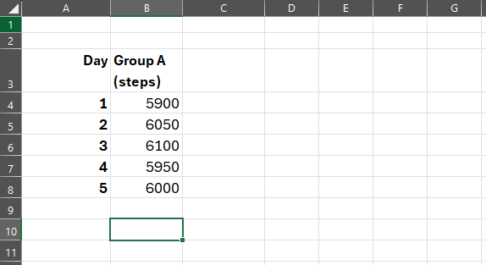
2.2 How to calculate standard deviation in Microsoft Excel (1 of 4)
Step 1
Select an empty cell beneath the data
Notes:
Teacher notes:
Step 1 of 5 for demonstrating how to calculate standard deviation of a dataset in Microsoft Excel.

Slide 89
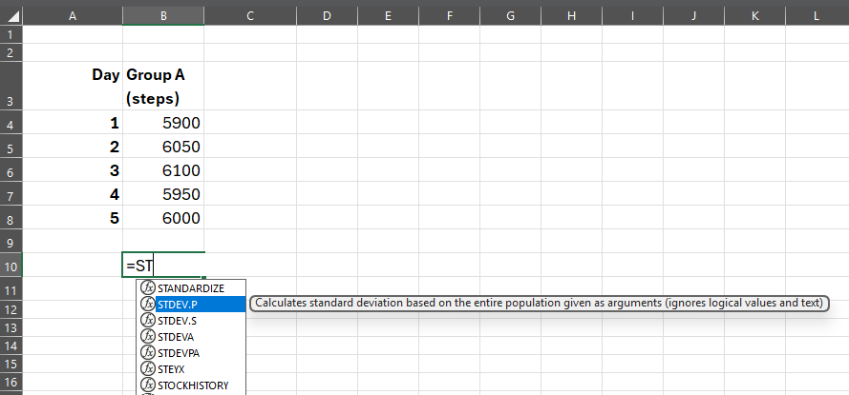
2.2 How to calculate standard deviation in Microsoft Excel (2 of 4)
Steps 2 and 3
Type ‘=’ to bring up the formula list
Select ‘STDEV.P’ from the drop-down list
Notes:
Teacher notes:
Steps 2 and 3 of 5 for demonstrating how to calculate standard deviation of a dataset in Microsoft Excel.

Slide 90
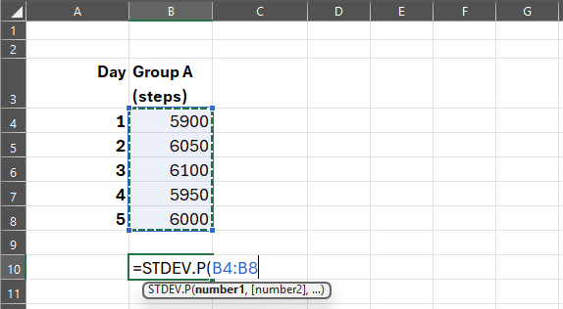
2.2 How to calculate standard deviation in Microsoft Excel (3 of 4)
Step 4
Highlight the cells containing the data to be analysed to select them
Notes:
Teacher notes:
Step 4 of 5 for demonstrating how to calculate standard deviation of a dataset in Microsoft Excel.

Slide 91
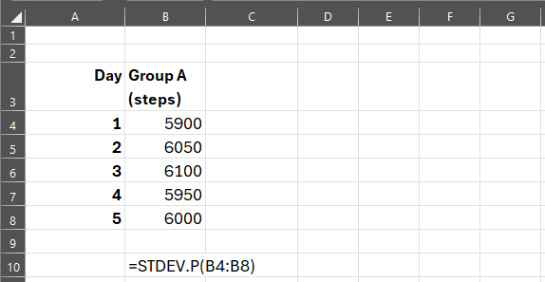
2.2 How to calculate standard deviation in Microsoft Excel (4 of 4)
Step 5
Type ‘)’ to confirm your selection and press enter
Notes:
Teacher notes:
Step 5 for demonstrating how to calculate standard deviation of a dataset in Microsoft Excel.

Slide 92
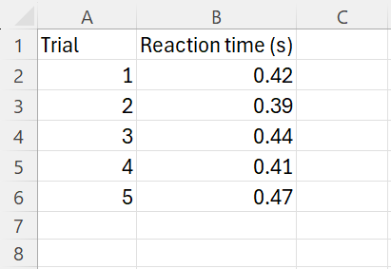
2.2 Check for understanding 3
Standard deviation Excel formula
Which of the following formulas could be used in Microsoft Excel to calculate the standard deviation of the dataset?
A. =STDEV.P(B1:B6)
B. =STDEV.P(B2:B6)
C. =STDEV.P(A2:A6)
D. =STDEV.S(B1:B6)
E. =STDEV.S(B2:B6)
Notes:
Teacher notes:
This slide contains animations to reveal the correct answer.
A → incorrect – includes cell B1 in the formula
B → correct
C → incorrect – uses cells from column A in the formula rather than column B
D → incorrect – uses STDEV.S rather than STDEV.P and includes cell B1 in the formula
E → incorrect – uses STDEV.S rather than STDEV.P

Slide 93
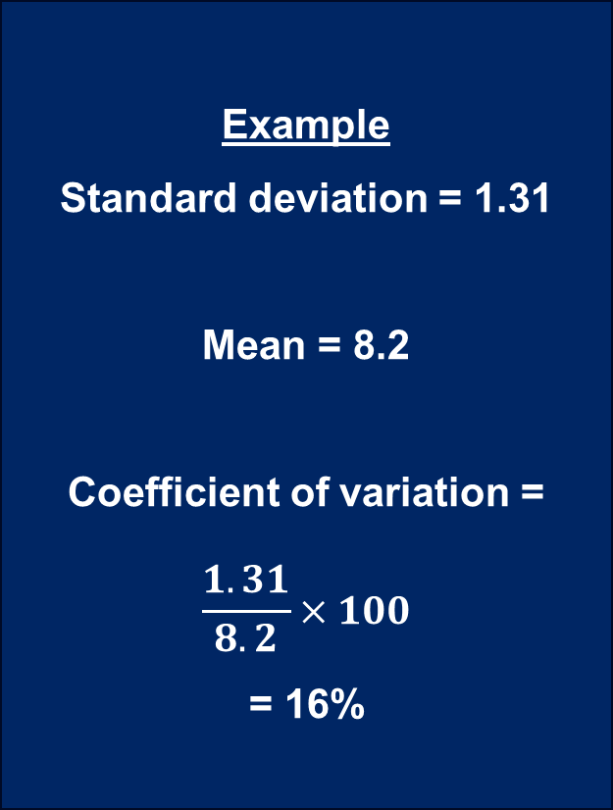
2.2 Coefficient of Variation
The Coefficient of Variation is a number that shows how much the data varies compared to the mean.
It is calculated by dividing the standard deviation by the mean and then multiplying by 100 to get a percentage.
A low Coefficient of Variation means the data points are close to the average (less spread out), while a high Coefficient of Variation means the data varies a lot (more spread out).
Example
Standard deviation = 1.31
Mean = 8.2
Coefficient of variation =
$$\frac{1.31}{8.2}×100$$
= 16%
16%
less spread out
73%
more spread out
Notes:
Teacher notes:
This slide has animations
This slide is included as a differentiation opportunity to extend students. Please see additional detail in the Teacher Resource Book.
Identify that the Coefficient of Variation is a number that shows how much the data varies compared to the mean.
Explain that it is calculated by dividing the standard deviation by the mean and then multiplying by 100 to get a percentage using the example on the slide.
(CLICK) Explain that a low Coefficient of Variation means the data points are pretty close to the mean (less spread out), while a high Coefficient of Variation means the data varies a lot (more spread out), using the two values in the light blue box as support.

Slide 94
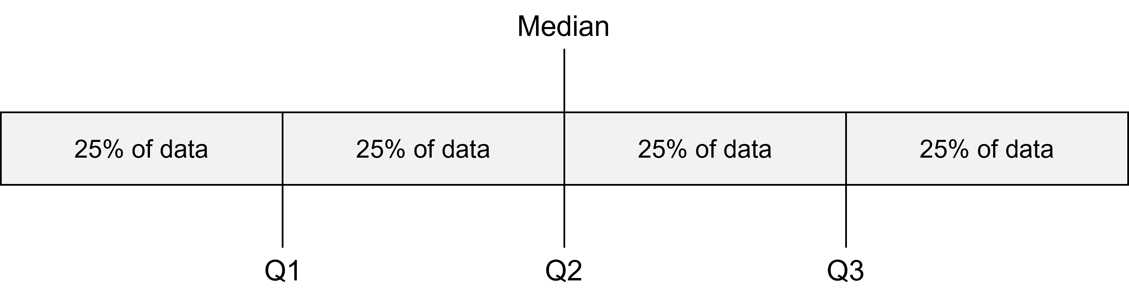
2.2 Quartiles
Quartiles in a dataset
Quartiles are numerical values that divides a rank-ordered dataset into four equal parts.
Quartiles act as boundary points that highlight the distribution and spread of data, rather than just the centre.
Notes:
Teacher notes:
Define quartile by reading the information on the slide. Inform students that quartiles act as boundary points that highlight the distribution and spread of data, rather than just the centre.
Diagram demonstrating the quartiles in a dataset. Point to highlight are below:
Q1 – Lower quartile
The value that marks the end of the first quarter of the dataset.
The middle number between the minimum value and the median.
Highlights where the lowest 25% of the data values stop.
Q2 – Median
The middle number of the entire dataset.
Divides the dataset in half, so 50% of the data values are above it and 50% are below.
Q3 – Upper quartile
The value that marks the end of the third quarter of the dataset.
The middle number between the maximum value and the median.
Highlights where the top 25% of the data values begin.

Slide 95
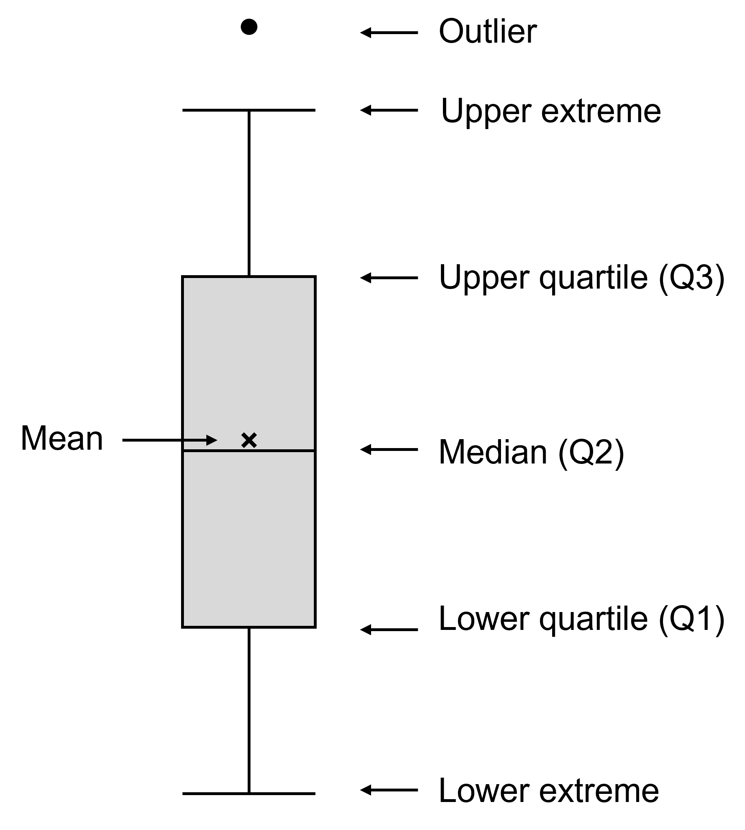
2.2 Components of a box plot
A box-and-whisker plot is a graphical representation of a dataset that summarises its distribution using the five-number summary:
minimum
lower quartile (Q1)
median (Q2)
upper quartile (Q3)
maximum
Notes:
Teacher notes:
This slide contains an animation to show how an outlier is represented in a box and whisker plot.
Define box and whisker plot using the information on the slide and the image.
Unpack the components of a box and whisker plot. Points to highlight are below:
Q1 – Lower quartile
The value that marks the end of the first quarter of the dataset.
The middle number between the minimum value and the median.
Highlights where the lowest 25% of the data values stop.
Q2 – Median
The middle number of the entire dataset.
Divides the dataset in half, so 50% of the data values are above it and 50% are below.
Q3 – Upper quartile
The value that marks the end of the third quarter of the dataset.
The middle number between the maximum value and the median.
Highlights where the top 25% of the data values begin.
Upper extreme
The highest value in the dataset that is not considered to be an outlier.
Also known as the maximum value.
Lower extreme
The lowest value in the dataset that is not considered to be an outlier.
Also known as the minimum value.
Outlier
Data points that sit outside the expected range of the dataset.
CLICK to show how an outlier is represented in a box and whisker plot.
Sometimes there are outliers in data. An outlier is a data value that is unusually different from the rest of the data. It lies much farther away from the other values than would normally be expected.
Outliers are not part of the box plot itself. Instead, they are shown as individual points (dots) beyond the whiskers of the box plot.

Slide 96
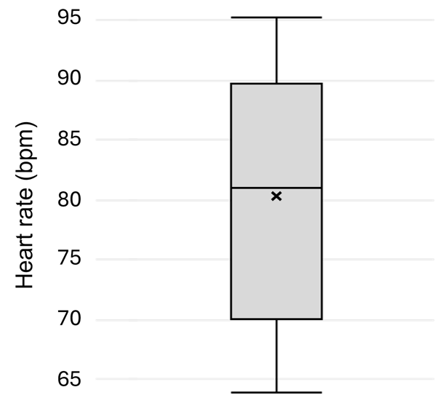
2.2 Unpacking a box plot (1 of 2)
Maximum = 95
Median = 81
Mean = 80.5
Minimum = 64
Notes:
Teacher notes:
This slide has animations.
This slide can be used to identify features of the box plot. Points to highlight are below:
CLICK Mean = 80.5 (indicated by the x)
CLICK Median = 81 (indicated by the line in the middle of the box)
CLICK Maximum = 95 (indicated by the top whisker)
CLICK Minimum = 64 (indicated by the bottom whisker)
The remaining points are unpacked on the next slide.

Slide 97
2.2 Unpacking a box plot (2 of 2)
Range = maximum – minimum
= 95 – 64
= 31
Interquartile range = Q3 – Q1
= 90 – 70
= 20
Notes:
Teacher notes:
This slide has animations.
This slide can be used to support students to calculate descriptive statistics using the box plot. Points to highlight are below:
CLICK Range = maximum – minimum = 95 – 64 = 31
CLICK Interquartile range = Q3 – Q1 = 90 – 70 – 20

Slide 98
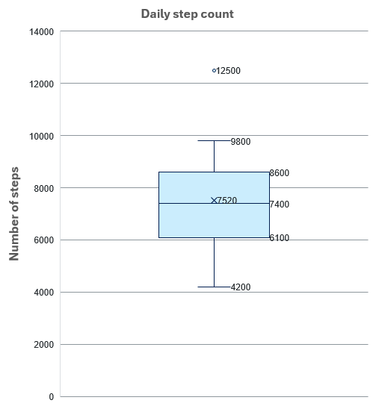
2.2 Check for understanding 4
Interpreting box plots
This is a box plot of the daily step count for 15 students. Answer the following questions by interpreting the plot:
What is the mean of the data? 7,520 steps
What is the median? 7,400 steps
What value is the outlier? 12,500 steps
What is Q1 or the lower quartile? 6,100 steps
What is the upper extreme? 9,800 steps
What is the interquartile range (the middle 50% of the data between Q1 to Q3)? 2,500 steps
50% of the data
Notes:
Teacher notes:
This slide has animations.
CLICK to reveal each answer. Note that answers are approximate, and some difference might be evident with aligning the axis.
The mean is 7520 steps.
The median is 7400 steps.
The outlier is 12500 steps.
Q1 is 6100 steps.
The upper extreme is 9800 steps.
Interquartile range is 2500.

Slide 99
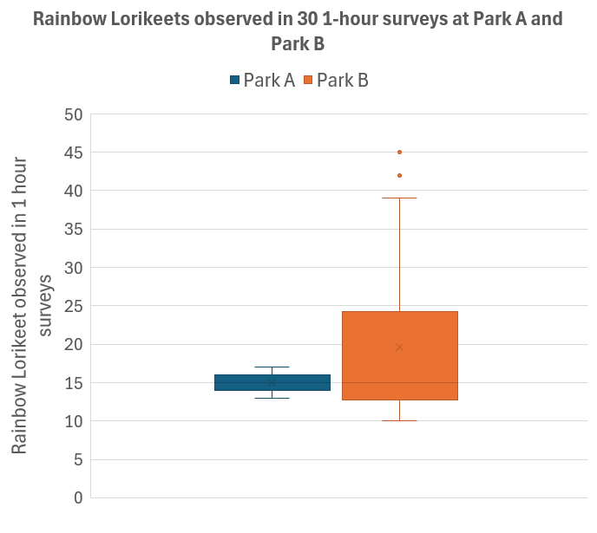
2.2 Comparing data using box plots
Comparing datasets using box-and-whisker plots (box plots) allows us to quickly compare the distribution of data without needing to examine every individual value. We can:
compare the spread
assess consistency
compare the range
identify skewness
compare the overlap in datasets
Notes:
Teacher notes:
On this slide we can see two separate box plots. Both box plots represent the number of Rainbow Lorikeets observed in 30 1-hour surveys, but at different parks.
By displaying the boxplots on the same graph like this, we can compare the data between different groups of data, in this case, park A and park B (Refer to notes on the slide).
A table of additional questions and discussion prompts has been provided in the Teacher resource book to further support analysis of the data displayed on the slide.

Slide 100
2.3 Univariate and bivariate analysis(1 of 2)
Learning intentions and success criteria
We are learning: | I can:
to analyse how data is used to investigate questions and claims | outline the features of univariate and bivariate analysis identify questions that can be investigated with a univariate analysis conduct a univariate analysis to answer a question identify questions that can be investigated with a bivariate analysis conduct a bivariate analysis to answer a question
to process data from investigations | identify when to use a histogram or boxplot for univariate analysis. construct a histogram and a box plot in Microsoft Excel construct a scatter plot in Microsoft Excel
Notes:
Teacher notes:
Learning intentions and success criteria for 2.4 Univariate and bivariate analysis of large datasets.
Display this slide at the beginning of the learning activity. Revisit the slide where appropriate during lesson activities and encourage students to reflect on their progress.
Also, adapt this Learning Intentions and Success Criteria (LISC) slide to display only the learning intentions and success criteria that are the focus of the current lesson or activity. Additional learning intentions and success criteria can be introduced progressively as students move through the learning sequence.

Slide 101
2.3 Univariate and bivariate analysis (2 of 2)
Learning intentions and success criteria
We are learning: | I can:
to analyse data from investigations. | describe and analyse patterns and trends in data interpret a histogram and a box plot interpret a scatter plot interpolate and extrapolate information from a line of best fit to make predictions use evidence to construct a conclusion to respond to an investigable question
to solve problems using data | select suitable descriptive statistics and/or representations to conduct a univariate analysis select a suitable representation to conduct a bivariate analysis.
Notes:
Teacher notes:
Learning intentions and success criteria for 2.4 Univariate and bivariate analysis of large datasets.
Display this slide at the beginning of the learning activity. Revisit the slide where appropriate during lesson activities and encourage students to reflect on their progress.
Also, adapt this Learning Intentions and Success Criteria (LISC) slide to display only the learning intentions and success criteria that are the focus of the current lesson or activity. Additional learning intentions and success criteria can be introduced progressively as students move through the learning sequence.

Slide 102
2.3 Univariate and bivariate analysis of datasets
Feature | Univariate analysis | Bivariate analysis
Number of variables | Involving a single variable | Involving 2 variables
Purpose | Describe the data (distribution, central tendency, and other characteristics). | Investigate the relationship or association between two variables.
Focus | Central tendency – mean, mode, median. Dispersion – range, variance, max, min, quartiles, standard deviation. Frequency distribution | Comparison Correlation or trends between variables.
Common questions | What is the typical value of…? How much does the data vary? Is there a normal distribution? | Is there a relationship between…? How strong is the relationship between…? What is the difference between different groups?
Common representations | Histogram, box and whisker plot | Line graph, scatter plot,
Notes:
Teacher notes:
Use the table on this slide to unpack the features of univariate analysis and bivariate analysis of a dataset for students.

Slide 103
2.3 Scientific questions
Do these questions require univariate or bivariate analysis to answer them?
Question | Type of analysis | Reason
What was the mean rainfall in Sydney in 2026? | Univariate | One variable (rainfall) is analysed
Does rainfall increase with elevation? | Bivariate | Two variables are analysed (rainfall is compared with elevation).
How variable is the pH of Lake Cargelligo? | Univariate | pH in one location is being analysed.
How does pH vary across NSW lakes? | Bivariate | pH in multiple locations is being compared.
Is there a relationship between vaping and lung disease? | Bivariate | Two variables are being analysed to see if there is relationship.
How many months does it take avocado plants to produce fruit? | Univariate | There is only one variable, time taken to produce fruit.
Notes:
Teacher notes:
Show students a range of investigable scientific questions using the examples on the slide and unpack how each one would involve a univariate or a bivariate analysis. Unpack the reasoning for each question.

Slide 104
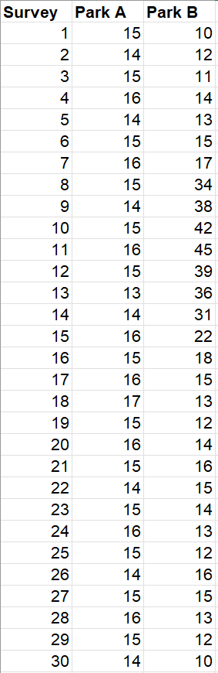
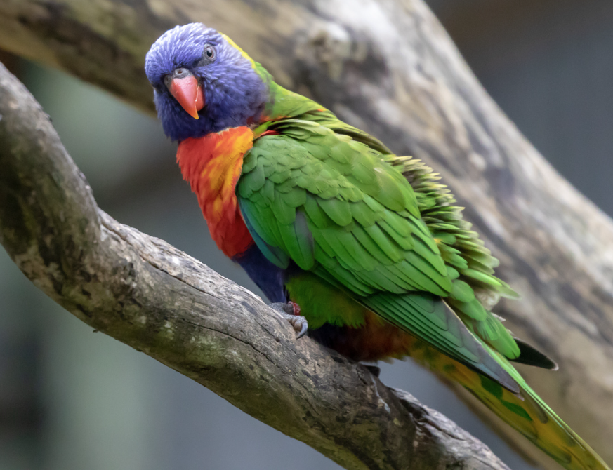
2.3 Univariate analysis of a dataset
Rainbow Lorikeet observations
Scientific question: how many Rainbow Lorikeets are typically observed at Park B?
Which statistics can help us answer this question? Mean, median and standard deviation.
What types of representations could we use to summarise this information? A histogram or a box plot.
Images from Canva used in accordance with the Canva for Education licence for educational, non-commercial purposes.
Notes:
Teacher notes:
Remind students that they calculated descriptive statistics for rainbow lorikeets surveyed at two parks.
This data set has multiple sets of data, however, depending on the question we are investigating we can either do a univariate or bivariate analysis.
If we ask the question how many Rainbow Lorikeets are typically observed at park A, we are investigating one variable, so it requires a univariate analysis.
The statistics that can help us answer this question include the mean, median and standard deviation.
There a many representation that can be used to represent data for a univariate analysis. A histogram shows us the spread of the data, making it easy to determine the frequency of the number of birds observed. A box plot will give us the 5 number summary which also shows us the spread of the data, the mean and the median.

Slide 105
2.3 Bivariate analysis of a dataset
Rainbow Lorikeet observations
Scientific questions:
How do the number of Rainbow Lorikeets observed change between parks?
How did the number of Rainbow Lorikeets observed change over time and Park B?
What type of statistics would be useful to answer the first question?
Comparing the descriptive statistics for each park
What types of representations could we use to summarise this information?
A column graph could be used to show the mean sightings at each park.
A scatter plot or line graph could be used to show the sightings over 30 days.
Notes:
Teacher notes:
The same dataset can be used for a bivariate analysis. It just depends on the question we are answering and if we are looking at 2 variables, we are conducting a bivariate analysis.
The two questions shown on the slide are examples that could be investigated through a bivariate analysis.
For the question, ‘how do the number of Rainbow Lorikeets observed change between parks’ we are looking at the independent variable as the park location, and the dependent variable as the number of Rainbow Lorikeets observed. We can use descriptive statistics on each park to compare the parks.
For the question ‘How did the number of Rainbow Lorikeets observed change over time at Park B?’ we need to pair the data from the survey day to the Park B observations. We need to look for a trend over the 30 days, and a good way to do this is graph the data in a scatter plot or a line graph.

Slide 106
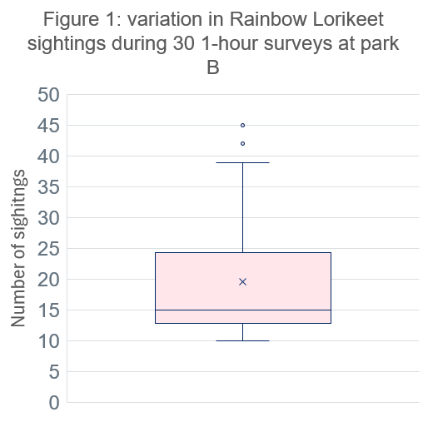
2.3 Comparing a univariate and bivariate analysis
What question can be answered using these data representations?
Notes:
Teacher notes:
Use the representations on this slide to emphasise the difference between a univariate and bivariate analysis of a dataset.
Speaker notes:
Figure 1 shows a box and whisker plot. This box-and-whisker plot is an example of a univariate analysis because it investigates one variable only. In this dataset, the single variable is the number of Rainbow Lorikeets observed during a 1-hour survey. Although the data were collected over 30 days at Park B, we are not analysing time or comparing different locations. Instead, each survey provides one observation of the same variable – how many lorikeets were seen.
Our goal is to understand the characteristics of this single set of values. Notice that the box plot summarises the data rather than displaying every individual observation. It helps us answer questions such as:
What is a typical number of lorikeets seen during a survey? (the median and mean)
How much do the sightings vary from one survey to another? (the interquartile range and overall range)
Are the sightings spread evenly or clustered around certain values?
Are there any unusual observations? (the outliers)
These are all questions about one variable, which is why this is a univariate analysis.
Figure 2 shows how the number of Rainbow Lorikeets sighted changed over 30 days.
Unlike the box-and-whisker plot, which summarised only the sightings, this graph asks a different question: How do Rainbow Lorikeet sightings change over time? Because we are examining how one variable changes in relation to another, this is a bivariate analysis. Notice that every point on the graph represents a pair of values: a day on which the survey was conducted, and the number of Rainbow Lorikeets observed on that day.
A bivariate analysis allows us to ask questions such as:
Does the number of Rainbow Lorikeets change over time?
When were the highest and lowest numbers of sightings recorded?
Is there an increasing, decreasing or cyclical trend?
Are there periods where the number of sightings remains relatively stable?
It is important to recognise that not all bivariate analyses investigate cause and effect. In this example, the graph shows a relationship between time and sightings, but it does not explain why the number of sightings changed. Additional variables, such as temperature, rainfall or food availability, would need to be investigated to explain the observed pattern. In this example, there were gum trees flowering from day 8 to day 16 providing a food source for the Rainbow Lorikeets.

Slide 107
2.3 Check for understanding 1
Univariate analysis
A scientist collected data on 200 Eucalyptus trees. The dataset includes tree height, trunk diameter, canopy width and location.
Which investigation is an example of univariate analysis?
Investigating whether taller trees have wider trunks.
Comparing tree height with the canopy width.
Describing the typical heigh and variation in height of eucalyptus trees.
Investigating whether the trunk diameter differs between locations.
Notes:
Teacher notes:
This slide contains animations to reveal the correct answer.
Use mini whiteboards or choral response to collect responses from all students.
This is incorrect because it investigates the relationship between two variables.
This is incorrect because it investigates the relationship between two variables.
This is the correct answer. Only one variable, tree height, is being analysed. The scientist could describe its centre, spread, shape and any unusual values.
d) This is incorrect because it investigates the relationship between two variables.

Slide 108
2.3 Check for understanding 2
Selecting appropriate data representations
A scientist collected the body masses of 200 brush tail possums living in a national park. Which method would be most appropriate for investigating each question? Select from the following methods:
Mean and median
Range and standard deviation
Histogram
Box plot
What is the typical body mass of the possums?
Mean and median, or a box and whisker plot which also shows mean and median.
2. How much does possum body mass vary?
Calculate the range and standard deviation, or use a box and whisker plot which can show the range and IQR.
3. What is the distribution of possum body masses?
A histogram shows the frequency distribution and overall shape of the data.
4. Are there any possums with unusually high or low masses?
A box and whisker plot makes it easy to identify the spread and outliers.
Notes:
Teacher notes:
This slide contains animations to reveal the correct answers for each question.
Use this check for understanding question to check students understanding of the appropriate descriptive statistics and representations that can be used to investigate questions that require univariate analysis. Students should respond with a, b. c and/or d on mini whiteboards so that all students can be checked for understanding.

Slide 109
2.3 Check for understanding 3
Bivariate analysis
A scientists monitors a creek ecosystem at 40 different sites. At each site they record:
Water temperature (°C)
Dissolved oxygen concentration (mg/L)
Water depth (cm)
Number of aquatic insect species
pH of the water
Which THREE questions could be answered using a bivariate analysis?
What was the typical dissolved oxygen concentration across the creek sites?
Does dissolved oxygen concentration change as water temperature increases?
Is there a relationship between water depth and the number of aquatic insect species?
How much did pH vary between the sampling sites?
Do sites with higher pH have more aquatic insect species?
Notes:
Teacher notes:
This slide contains animations to reveal the correct answers.
Read the scenario to students and have them respond with mini-whiteboards or another way to collect responses from all Students.
Students should select the three questions which refer to two variables, which indicates that a bivariate analysis is required, that is, B, C and E.
This question requires a univariate analysis because it looks at only one variable: dissolved oxygen concentration.
This response is correct. The question investigates the relationship between two variables.
This response is correct. The question investigates the relationship between two variables.
This question investigates only one variable: the variation in pH.
This response is correct. The question seeks to investigate the relationship between two variables.

Slide 110
2.4 Univariate and bivariate analysis of large datasets (1 of 2)
Learning intentions and success criteria
We are learning: | I can:
to analyse how data is used to investigate questions and claims | develop and test an investigable scientific question using a large dataset conduct a univariate analysis of a variable in a large dataset conduct a bivariate analysis of two variables in a large dataset construct a conclusion to the investigable question
to process data in a large dataset | calculate a range of descriptive statistics, including mean and standard deviation select and construct an appropriate graph to represent data
Notes:
Teacher notes:
Learning intentions and success criteria for 2.4 Developing and testing questions.
Display this slide at the beginning of the learning activity. Revisit the slide where appropriate during lesson activities and encourage students to reflect on their progress.
Also, adapt this Learning Intentions and Success Criteria (LISC) slide to display only the learning intentions and success criteria that are the focus of the current lesson or activity. Additional learning intentions and success criteria can be introduced progressively as students move through the learning sequence.

Slide 111
2.4 Univariate and bivariate analysis of large datasets (2 of 2)
Learning intentions and success criteria
We are learning: | I can:
to analyse data from investigations. | describe trends and patterns in a large dataset describe the impact of missing and inconsistent data on descriptive analysis draw evidence-based conclusions from a dataset to answer a question
Notes:
Teacher notes:
Learning intentions and success criteria for 2.4 Developing and testing questions.
Display this slide at the beginning of the learning activity. Revisit the slide where appropriate during lesson activities and encourage students to reflect on their progress.
Also, adapt this Learning Intentions and Success Criteria (LISC) slide to display only the learning intentions and success criteria that are the focus of the current lesson or activity. Additional learning intentions and success criteria can be introduced progressively as students move through the learning sequence.

Slide 112

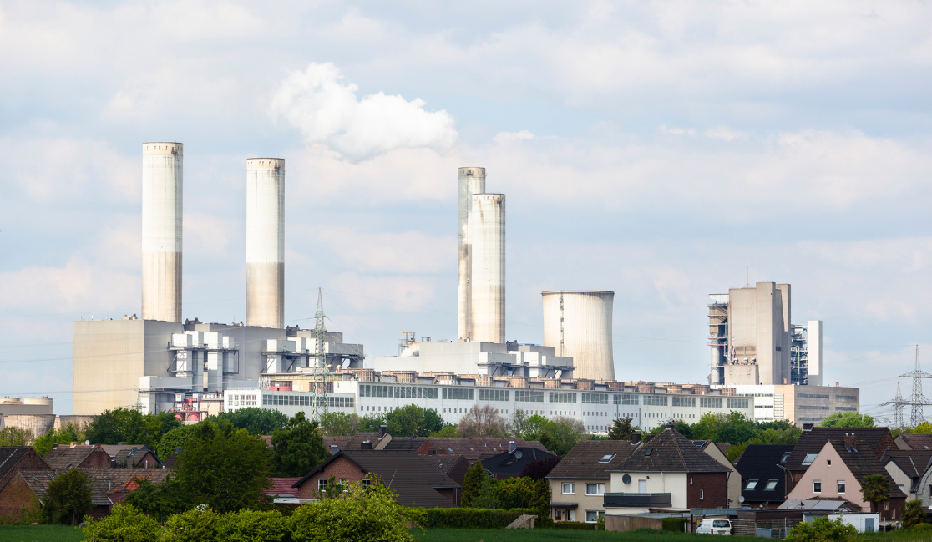
2.4 Air quality in Newcastle (1 of 2)
Unpacking the scenario
Air pollution can be impacted by location, season, weather events and human activity.
Fine particles (like black carbon, smoke, and sulfates) can affect both human health and environmental quality.
The dataset contains monthly measurements of fine particle concentrations in Mayfield, NSW over a 22-year period.
Images from Canva, used in accordance with the Canva for Education licence for educational, non‐commercial purposes.
Notes:
Teacher notes:
Unpack the scenario presented in the secondary source investigation, highlighting the following:
Air pollution can be impacted by location, season, weather events and human activity.
Fine particles (like black carbon, smoke, and sulfates) can affect both human health and environmental quality
The dataset contains monthly measurements of fine particle concentrations in Mayfield, NSW over a 22-year period.

Slide 113
2.4 Air quality in Newcastle (2 of 2)
Abbreviations, units and symbols
Abbreviation, unit or chemical symbol | Name
(NH₄)₂SO₄ | ammonium sulfate
OMH | organic matter from hydrogen
BC | black carbon
H | hydrogen
Na | sodium
Al | aluminium
Si | silicon
S | sulfur
Abbreviation, unit or chemical symbol | Name
K | potassium
Ca | calcium
Ti | titanium
Mn | manganese
Fe | iron
Zn | zinc
Pb | lead
ng/m³ | nanograms per cubic metre
Notes:
Teacher notes:
Display this slide to support students by providing a summary of abbreviations, units and symbols used in column headings of the student activity.
Detailed information on how each substance contributes to the air quality has been provided in the Teacher resource book. This should be used to help students understand the data.

Slide 114
2.5 Correlation and causation
Learning intentions and success criteria
We are learning: | I can:
to explain how data is used to investigate questions and claims | explain the difference between correlation and causation outline the condition that must be met to determine causation
to analyse data from investigations | identify patterns in a dataset identify instances of positive, negative and no correlation in a dataset use data to draw conclusions suggest improvement to an investigation that would improve the quality of a conclusion.
Notes:
Teacher notes:
Learning intentions and success criteria for 2.5 Correlation and causation.
Display this slide at the beginning of the learning activity. Revisit the slide where appropriate during lesson activities and encourage students to reflect on their progress.
Also, adapt this Learning Intentions and Success Criteria (LISC) slide to display only the learning intentions and success criteria that are the focus of the current lesson or activity. Additional learning intentions and success criteria can be introduced progressively as students move through the learning sequence.

Slide 115
2.5 Correlation
Correlation shows that two variables are connected in some way, but it does not mean one is responsible for the change in the other.
Notes:
Teacher notes:
Introduce the concepts of causation and correlation, highlighting the following:
A correlational relationship measures the strength of interdependence of two variables, without implying that one causes the other.
Unpack the example to explain that it is common for sunglasses sales and visits to the beach to increase in the summer/warmer months of the year, however, this does not indicate that one has caused the other. There are other factors which may influence these factors such as temperature increases.

Slide 116
2.5 Causation
Causation is when a change in one variable causes a change in another variable.
Notes:
Teacher notes:
Introduce the concepts of causation and correlation, highlighting the following:
A causal relationship indicates that one event directly causes another, or that a change in one variable produces a change in another.
Correlation does not imply causation; even if two variables are correlated, it does not necessarily mean that one causes the other.
Unpack the example to explain that as a person exercises more intensely, their heart rate increases because the body needs to deliver more oxygen to working muscles. In this case, the increase in exercise directly causes the increase in heart rate, so this is a causal relationship rather than just a correlation. The graph alone though, does not prove causation. There is additional scientific evidence that this may be causal; increasing exercise intensity increases the muscles' demand for oxygen and nutrients. In response, the heart beats faster to increase blood flow to the working muscles. Therefore, increasing exercise intensity causes heart rate to increase. Scientists can provide stronger evidence for this causal relationship by conducting a controlled experiment in which exercise intensity is deliberately changed, heart rate is measured, and other factors that could affect heart rate are controlled.

Slide 117
2.5 Correlation coefficient (1 of 3)
The r value
The r value (called the correlation coefficient) is a number that tells us:
        direction of the relationship (positive or negative)
        strength of the relationship (weak or strong)
The coefficient's numerical value ranges from +1.0 to –1.0, which provides an indication of the strength and direction of the relationship.
Interpreting r values
        Below 0 (a negative value): indicates a negative relationship between the variables.
        Above 0 (a positive value): indicates a positive relationship between the variables.
        Equal to 0 indicates no relationship between the variables.
      Correlation coefficient is limited in that it only measures a linear relationship
Notes:
Teacher notes:
Teach students about the r value using the information on the slide and notes below:
The r value (called the correlation coefficient) is a number that tells us:
Direction of the relationship (positive or negative)
Strength of the relationship (weak or strong)
Instead of just saying “this looks like a strong positive correlation”, we can measure it numerically.
It is widely used to identify trends but does not imply causation.
An r value below 0 (a negative value) indicates a negative relationship between the variables. his means that the variables move in opposite directions (ie when one increases the other decreases, or when one decreases the other increases).
An r value above 0 (a positive value) indicates a positive relationship between the variables. This means that both variables move in tandem, i.e. as one variable decreases the other also decreases, or when one variable increases the other also increases.
An r value equal to 0 indicates no relationship between the variables.
While the correlation coefficient is a useful measure, it has its limitations: Correlation coefficients are usually associated with measuring a linear relationship.

Slide 118
2.5 Correlation coefficient (2 of 3)
Guidelines interpreting the strength of an r value
r value | Description of strength of relationship
1.00 | Perfect
Approximately 0.8 – 0.99 | Very strong
Approximately 0.6 – 0.79 | Strong
Approximately 0.4 – 0.59 | Moderate
Approximately 0.2 – 0.39 | Weak
Approximately 0.00 – 0.19 | No correlation (0) to very weak
The + or - indicates direction. A positive value means a positive correlation (as one value increases so does the other) and negative value means a negative correlation (as one value increases the other decreases).
Notes:
Teacher notes:
Use this slide to teach students how to interpret the r value to determine the strength and type (negative, positive or no correlation) of correlation.

Slide 119
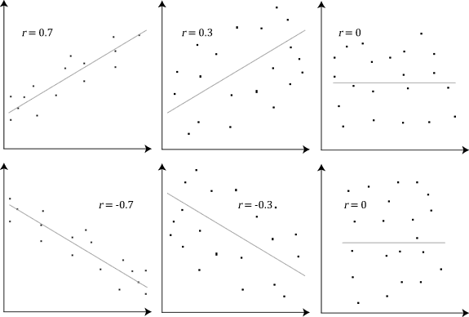
2.5 Correlation coefficient (3 of 3)
Interpreting the r value in the graphs below to determine the strength and type of correlation.
Pearson Correlation Coefficient and associated scatter plots by Laerd Statistics on Wikimedia Commons.
Notes:
Teacher notes:
Model, jointly construct or have students independently interpret the r value of the graph to determine the strength and type of relationship shown.
Sample responses (Graphs numbered from left to right)
Graph 1: Strong positive correlation. The points have very little scatter and follow a clear line in an upwards direction.
Graph 2: Weak positive correlation. There is a slight upward trend, but the relationship is not strong, the points are more spread out.
Graph 3: No correlation. The points are randomly scattered.
Graph 4: Strong negative correlation. The points have very little scatter and follow a clear line in a downwards direction.
Graph 5: Weak negative correlation. There is a slight downwards trend, but the relationship is not strong, the points are more spread out.
Graph 6: No correlation. The points are randomly scattered.

Slide 120
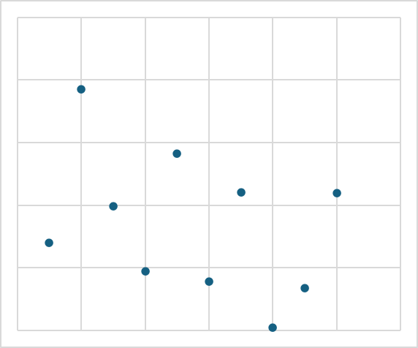
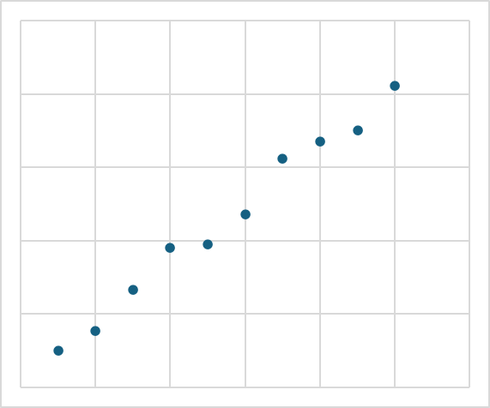
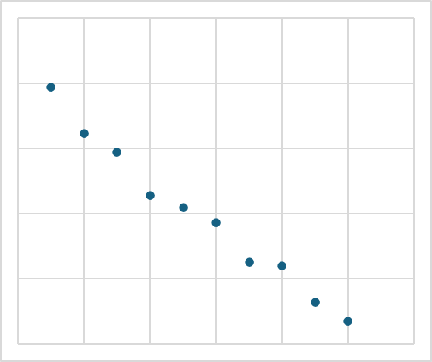
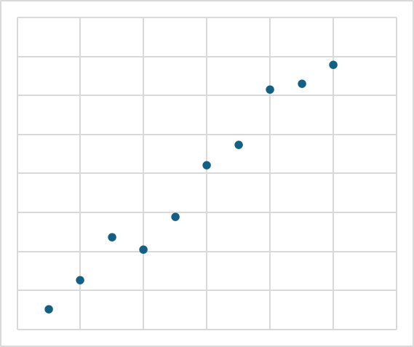
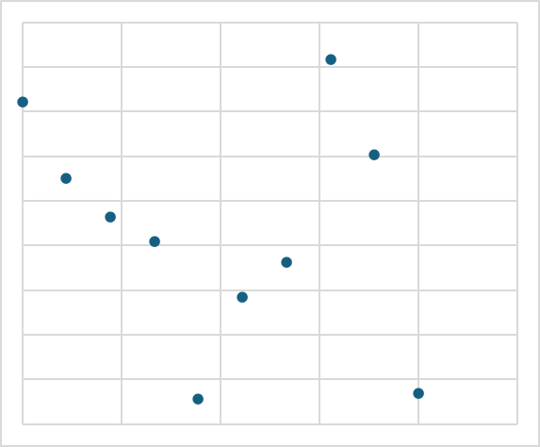
2.5 Check for understanding 1
positive
correlation
Types of correlation
Do the datasets shown in the plots below demonstrate a positive correlation, a negative correlation, or no correlation?
positive
correlation
negative
correlation
no
correlation
no
correlation
Graph 1
Graph 2
Graph 3
Graph 4
Graph 5
Notes:
Teacher notes:
This slide has animations.
Instruct students to match each scatter plot to the correct type of correlation and indicate their response on mini whiteboards. Encourage students to justify their choices by describing the trend of the data points.
CLICK to match the correct type of correlation to the graph
Graph 1 → no correlation. The points are scattered randomly with no clear relationship.
Graph 2 → positive correlation. The points closely follow an upward trend (as x increases, y increases).
Graph 3 → negative correlation. The points follow a clear downward trend (as x increases, y decreases).
Graph 4 → positive correlation. There is a general upward trend, though slightly more spread than Graph 2.
Graph 5 → no correlation. The points are widely scattered with no clear relationship.

Slide 121
2.5 Check for understanding 2
Interpreting a line graph
Identify the two variables in the dataset.
Describe the relationship shown in the graph.
Interpolate the battery life at 65%.
Can we say that increasing brightness causes battery life to decrease? Explain whether this is a fair conclusion based on the data.
Notes:
Teacher notes:
Provide students with mini whiteboards and ask them to respond to each question.
Sample answers:
Screen brightness and battery life
Negative relationship. As the screen brightness increases, the battery life decreases.
Approximately 8.25 hours
No. It suggests a relationship, but does not prove causation (other factors may affect battery life).

Slide 122
2.6 Validating scientific findings
Learning intentions and success criteria
We are learning: | I can:
to assess the use of data when verifying the legitimacy of claims | outline the role of large datasets and statistics in validating scientific findings explain why large datasets are more reliable than smaller datasets identify how statistical analysis help scientists make sense of data and measure uncertainty
Notes:
Teacher notes:
Learning intentions and success criteria for 2.6 Validating scientific findings and making informed decisions.
Display this slide at the beginning of the learning activity. Revisit the slide where appropriate during lesson activities and encourage students to reflect on their progress.
Also, adapt this Learning Intentions and Success Criteria (LISC) slide to display only the learning intentions and success criteria that are the focus of the current lesson or activity. Additional learning intentions and success criteria can be introduced progressively as students move through the learning sequence.

Slide 123
2.6 Check for understanding
Validating scientific findings
What does it mean to validate a scientific finding?
A. To prove a result is true beyond any doubt
B. To collect as much data as possible, regardless of trend
C. To support or confirm a result using additional evidence
D. To show that one unusual result is significant
Notes:
Teacher notes:
This slide has animations.
Display the multiple choice question on the slide and instruct students to engage with the question and respond with a show of hands to indicate their response.
CLICK to highlight correct response
A → Incorrect – science does not claim absolute certainty; instead, results are supported by evidence rather than proven beyond all doubt.
B → Incorrect – validation is not just about quantity of data, it is about confirming consistency and reliability.
C → Correct
D → Incorrect – a single unusual result might be an outlier, not a validation of a finding.

Slide 124
2.7 Making evidence-based decisions (1 of 2)
Learning intentions and success criteria
We are learning: | I can:
to assess the use of scientific knowledge and large datasets in making evidence-based decisions | make evidence-based decisions on vaccine timing using data from large datasets assess the implications of the proposed decision
to identify and evaluate proposed solutions to problems. | identify the D.E.C.I.D.E framework as a structured process to solve problems create evaluation criteria for the proposed solutions to the problem of timing and prioritising target groups of the influenza vaccination assess proposed solutions to the problem using the developed evaluation criteria outline the limitations of a decision suggest additional data that could improve the quality of a recommendation.
Notes:
Teacher notes:
Learning intentions and success criteria for 2.7 Making evidence-based decisions.
Display this slide at the beginning of the learning activity. Revisit the slide where appropriate during lesson activities and encourage students to reflect on their progress.
Also, adapt this Learning Intentions and Success Criteria (LISC) slide to display only the learning intentions and success criteria that are the focus of the current lesson or activity. Additional learning intentions and success criteria can be introduced progressively as students move through the learning sequence.

Slide 125

2.7 Problem statement
The influenza vaccine
A Sydney pharmacy must decide when to begin advertising the influenza vaccination and which groups to prioritise. Beginning too early may waste resources and beginning too late may reduce protection before cases rise. The pharmacy has asked you to use influenza and temperature data to solve this problem.
Notes:
Teacher notes:
Display this slide to introduce the problem statement with students.
Inform students that temperature data is used to inform the timing of flu vaccinations because influenza virus transmission is highly sensitive to environmental conditions, particularly cold, dry air, which increases the likelihood of outbreaks. By analysing ambient temperature and humidity trends, public health officials can predict when the flu virus will begin to spread rapidly, ensuring vaccination efforts occur just before the peak, allowing sufficient time for immunity to build.

Slide 126
2.7 D.E.C.I.D.E framework
A problem-solving framework
Define the problem – what needs solving?
Examine data – what patterns and evidence matter?
Create/Choose evaluation criteria - how will we judge whether a solution will be effective?
Identify possible solutions – what are our options?
Decide using evidence – which solution best fits the criteria?
Evaluate impacts and refine – what are the implications, limitations and possible improvements?
Notes:
Teacher notes:
Introduce students to the DECIDE framework as a means of problem solving.
Unpack each part of the framework using the information on the slide and below:
D - Clearly articulate the core issue. Define the scope (what is included), constraints and success measures.
E - Gather relevant quantitative (data, facts) and qualitative evidence to understand the root cause.
C – Establish or select a pre-existing criteria to evaluate the solutions to the problem fairly and consistently.
I – Come up with solutions to the problem considering the criteria created in the previous step.
D – Using data as evidence and the criteria, select the most suitable solution.
E - Determine if the solution worked, if it needs adjustment, if there are limitations, if new problems were created, the implications of the decision and how we could make improvements.

Slide 127
2.7 Check for understanding (1 of 2)
Evidence based decisions
Write a number from 1 to 4 on a mini whiteboard to indicate which of the statements below are evidence-based decisions.
We should start the influenza vaccination campaign in June because it feels like that’s when people start getting sick.
The vaccination program should begin earlier in the year because scientific data show influenza cases usually increase during colder months, so starting earlier helps protect people before the risk rises.
We should start the influenza vaccination campaign in June because the data show influenza cases start rising from August, especially in younger age groups, and this increase occurs as the mean minimum and maximum temperatures drop.
We should only vaccinate adults because they can book appointments more easily.
Notes:
Teacher notes:
Provide students with mini whiteboards. Display the questions to students and ask them to respond using mini whiteboards, indicating which sheet in the spreadsheet contains the data outlined.
Sample responses are on the next slide.

Slide 128
2.7 Check for understanding (2 of 2)
Evidence based decisions
Write a number from 1 to 4 on a mini whiteboard to indicate which of the statements below are evidence-based decisions.
We should start the influenza vaccination campaign in June because it feels like that’s when people start getting sick – not evidence based.
The vaccination program should begin earlier in the year because scientific data show influenza cases usually increase during colder months, so starting earlier helps protect people before the risk rises – evidence-based.
We should start the influenza vaccination campaign in June because the data show influenza cases start rising from August, especially in younger age groups, and this increase occurs as the mean minimum and maximum temperatures drop – not evidence-based.
We should only vaccinate adults because they can book appointments more easily – evidence-based.
Notes:
Teacher notes:
1 → Not evidence-based – this statement is based on personal opinion or feeling rather than data. It does not refer to any evidence, patterns, or analysis to justify the decision.
2 → Evidence-based – this statement refers to scientific data and uses a known pattern (higher influenza cases in colder months) to justify the decision. The reasoning links evidence to the timing of the campaign.
3 → Evidence-based – this statement uses specific evidence from data (timing of case increases, affected age groups, and temperature trends) and clearly explains how this information supports the decision.
4 → Not evidence-based – this statement is based on convenience rather than scientific data. It does not use evidence about influenza risk, case patterns, or population vulnerability to support the decision.

Slide 129
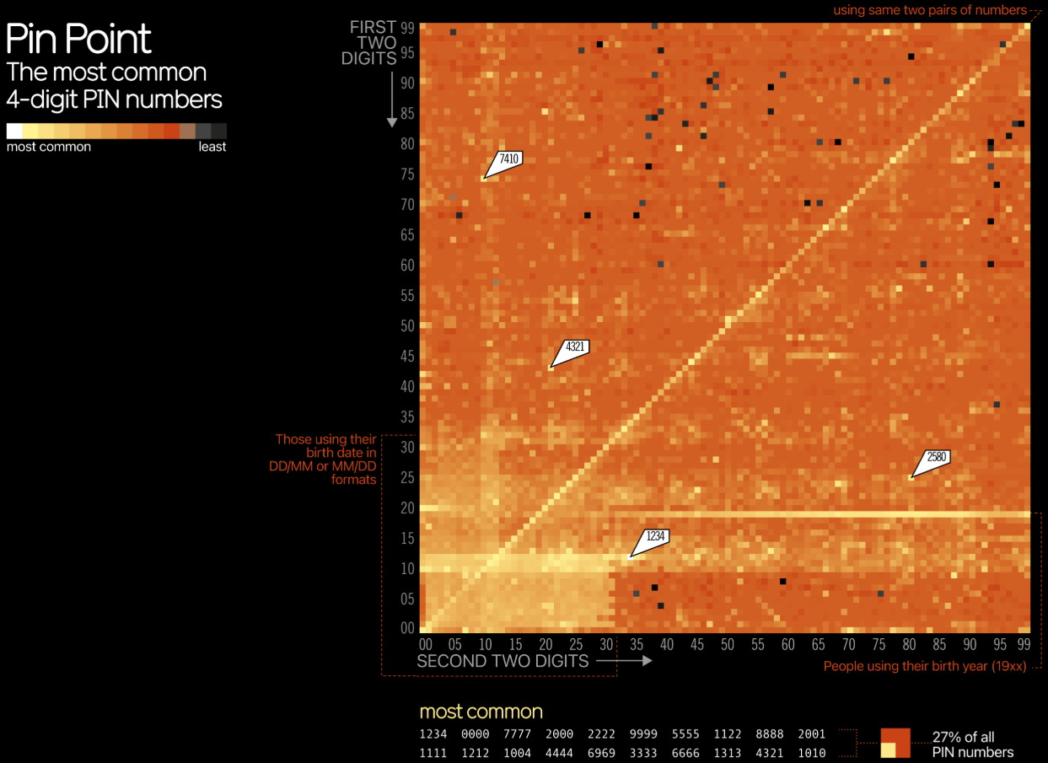
2.8 Assessment task preparation (1 of 2 slides)
Heat map graph
This is an example of a heat map graph.
The following questions will help you extract data and information from this type of graph:
What variable is represented on each axis?
What does a white coloured square represent?
How would pin 4321 be located on the heat map?
Identify one pattern.
Most Common PIN Codes by David McCandless is licensed under CC BY
Notes:
Teacher notes
Use this slide to demonstrate how to extract information from a heat map graph. After answering the 4 questions time could be spent determining other data, information and patterns.
Sample responses.
1. What variable is represented on each axis? The vertical axis represents the first two digits of the PIN. The horizontal axis represents the second two digits.
2. What does a white coloured square represent? A light-coloured square represents a PIN that is used more commonly.
3. How would pin 4321 be located on the heat map? Find 43 on the vertical axis for the first two digits, then 21 on the horizontal axis for the second two digits.
4. Identify one pattern.
Example 1: A light-coloured diagonal line runs from the bottom-left towards the top-right. It shows that PINs made by repeating the same pair of digits are relatively common, such as 1212, 3535 or 7474.
Example 2: A light horizontal band at 19 on the vertical axis suggests that many PINs begin with 19. These could represent birth years from the 1900s, such as 1975 or 1990.

Slide 130
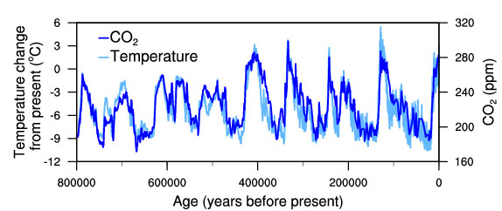
2.8 Assessment task preparation (2 of 2 slides)
Multivariate graph
This is an example of a multivariate graph.
The following questions will help you extract data and information from this type of graph:
What variable is displayed on each axis?
Which line presents temperature change?
What does a temperature value of −6°C mean?
Describe the overall pattern in temperature over the past 800000 years.
Temperature-change-and-carbon-dioxide-change-measured-from-EPICA-Dome-C-ice-core0in-Antarctica by National Oceanic and Atmospheric Administration is in the public domain
Notes:
Teacher notes
Use this graph to show to demonstrate how data, information and trends can be extracted or interpreted from a multivariate line graph. Note the three variables are age (years before present), temperature change from present, CO₂ (ppm). It is specifically a dual-axis, multivariate time-series graph.
Sample responses
What variable is displayed on each axis? Age (years before present), temperature change from present (°C), CO₂ (ppm) concentration.
Which line presents temperature change? The light blue line.
What does a temperature value of −6°C mean? The temperature at that time was approximately 6°C lower than the present temperature.
Describe the overall pattern in temperature over the past 800000 years.
The temperature repeatedly rises and falls in cycles, alternating between colder and warmer periods.

Slide 131
References
This presentation contains NSW Curriculum and syllabus content. The NSW Curriculum is developed by the NSW Education Standards Authority. This content is prepared by NESA for and on behalf of the Crown in the right of the State of New South Wales. The material is protected by Crown copyright.
Please refer to the NESA Copyright Disclaimer for more information https://educationstandards.nsw.edu.au/wps/portal/nesa/mini-footer/copyright.
NESA holds the only official and up-to-date versions of the NSW Curriculum and syllabus documents. Please visit the NSW Education Standards Authority (NESA) website https://educationstandards.nsw.edu.au/wps/portal/nesa/home and the NSW Curriculum website https://curriculum.nsw.edu.au.
Science 7–10 (2023) © Syllabus NSW Education Standards Authority (NESA) for and on behalf of the Crown in right of the State of New South Wales, 2023.
All references supporting the content in the Data science 2 resources are listed in the 'Supporting Information' section of the relevant lesson library.

Slide 132
Copyright
© State of New South Wales (Department of Education), 2026
The copyright material published in this resource is subject to the Copyright Act 1968 (Cth) and is owned by the NSW Department of Education or, where indicated, by a party other than the NSW Department of Education (third-party material).
Copyright material available in this resource and owned by the NSW Department of Education is licensed under a Creative Commons Attribution 4.0 International (CC BY 4.0) license.
This license allows you to share and adapt the material for any purpose, even commercially.
Attribution should be given to © State of New South Wales (Department of Education), 2026.
Material in this resource not available under a Creative Commons license:
the NSW Department of Education logo, other logos and trademark-protected material
Material owned by a third party that has been reproduced with permission. You will need to obtain permission from the third party to reuse its material.
Links to third-party material and websites
Please note that the provided (reading/viewing material/list/links/texts) are a suggestion only and implies no endorsement, by the New South Wales Department of Education, of any author, publisher, or book title. School principals and teachers are best placed to assess the suitability of resources that would complement the curriculum and reflect the needs and interests of their students.
If you use the links provided in this document to access a third-party’s website, you acknowledge that the terms of use, including licence terms set out on the third-party’s website apply to the use which may be made of the materials on that third-party website or where permitted by the Copyright Act 1968 (Cth). The department accepts no responsibility for content on third-party websites.

