Slide 1
Instructions for use
This resource is not a teaching and learning program. It should be used in conjunction with Cells and classification program of learning.
Classroom teachers are encouraged to add and adapt slides as required to meet the needs of their students.
Save a copy of the file to make changes to the slide deck. Go to File > Download a Copy (this downloads a copy to the computer to edit in the PowerPoint app).
To convert the PowerPoint to Google Slides:
  Upload the file into Google Drive and open it.
  Go to File > Save as Google Slides.
  (Note – conversion may cause formatting changes in the slides.)

Slide 2
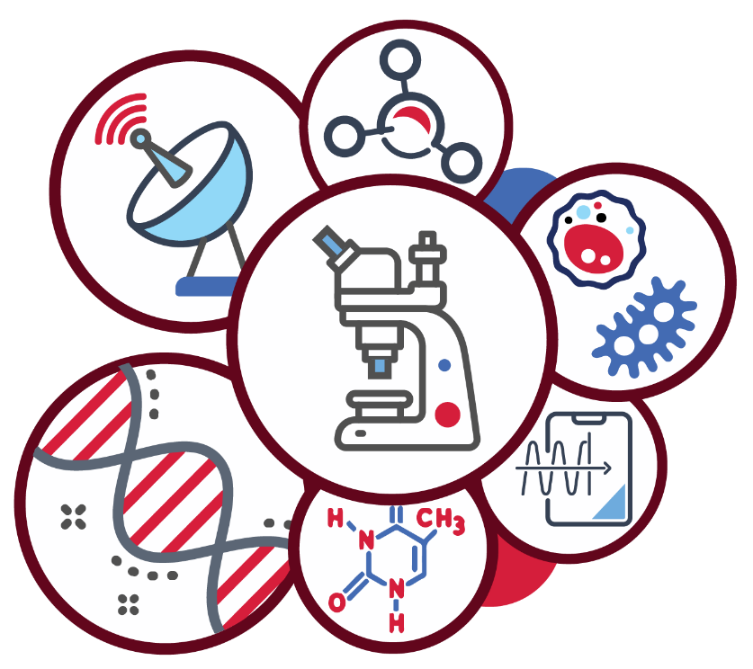
Cells and classification
Stage 4
Supporting PowerPoint
Notes:
Teacher notes:
This slide deck supports the delivery of the Cells and classification focus area for the Science 7–10 Syllabus. It should be used in conjunction with the Cells and classification program of learning and Teacher Resource Books 1 and 2.

Slide 3
Contents 1
Characteristics of living things
Aboriginal and Torres Strait Islander Peoples classification of plants and animals
1.1
1.5
TRB 1
Why do we classify living things ?
Dichotomous keys
1.2
1.6
Classification systems
Adaptations in Australian organisms
1.3
1.7
Classification of organisms
1.4
Notes:
Teacher notes:
Click lesson numbers to go to specific lessons
Interactive features can be viewed in slide show

Slide 4
Contents 2
2.1
What are cells?
2.4
Single-celled organisms
TRB 2
2.2
Cells have different structures
2.5
Multicellular organisms
2.3
Cellular processes
2.6
Cells in the Kingdom of life
Notes:
Teacher notes:
Click lesson numbers to go to specific lessons
Interactive features can be viewed in slide show

Slide 5
Essential question 1
How does biological classification help in understanding the diversity of life on Earth?
Notes:
Teacher notes:
Content in this section aligns with essential question 1 in the program of learning and Teacher resource book 1.

Slide 6
1.1 Characteristics of living things
Learning intentions and success criteria
We are learning | I can
to describe how characteristics can be used to classify organisms. | distinguish between living and non-living things list the 7 characteristics of living things justify objects or things as living or non-living using the characteristics of living things.
to make scientific observations using our senses. | make scientific observations of objects and things compare the similarities and differences between living and non-living things.
Notes:
Teacher notes:
Display this slide at the beginning of the learning sequence. Revisit the slide where appropriate during lesson activities and encourage students to reflect on their progress.

Slide 7
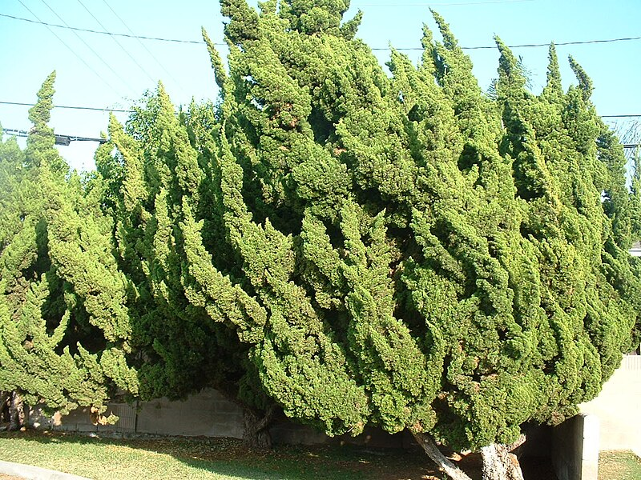
1.1 Alive, dead or never been alive (1 of 4)
Prior knowledge
Newport Beach tree by Renjishino, licensed under CC BY 3.0
Notes:
Teacher notes:
Ask students to identify the object on the slide as alive, dead, or never been alive.
This slide shows an evergreen tree. This plant is alive because it exhibits the characteristics of living things. Students should be able to recognise that the tree grows and reproduces at this stage of the learning.

Slide 8
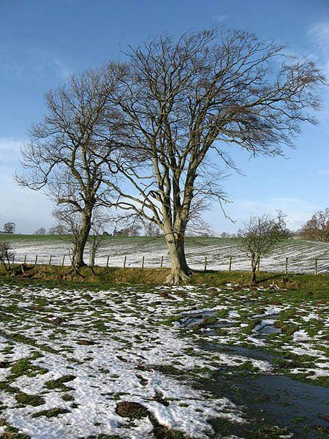
1.1 Alive, dead or never been alive (2 of 4)
Prior knowledge
Deciduous trees - geograph.org.uk – 649795 by Walter Baxter licensed under CC BY-SA 2.0
Notes:
Teacher notes:
Use this slide to show students an example of objects in the natural world. Ask students to identify the object on the slide as alive, dead, or never been alive.
Students may think that this tree is dead because it has lost its leaves. This slide shows a deciduous tree. Although deciduous trees become dormant over winter and lose their foliage (leaves), they are still very much alive. In the spring the tree will grow new leaves and flowers.

Slide 9

1.1 Alive, dead or never been alive (3 of 4)
Prior knowledge
High mountain range by Adipalande licensed under CC BY-SA 4.0
Notes:
Teacher notes:
Use this slide slides to show students an example of objects in the natural world. Ask students to identify the object on the slide as alive, dead, or never been alive.
This slide shows a mountain range. Although the mountains may exhibit some features which make it appear as alive, the rocks and snow which make up this range have never been alive.

Slide 10
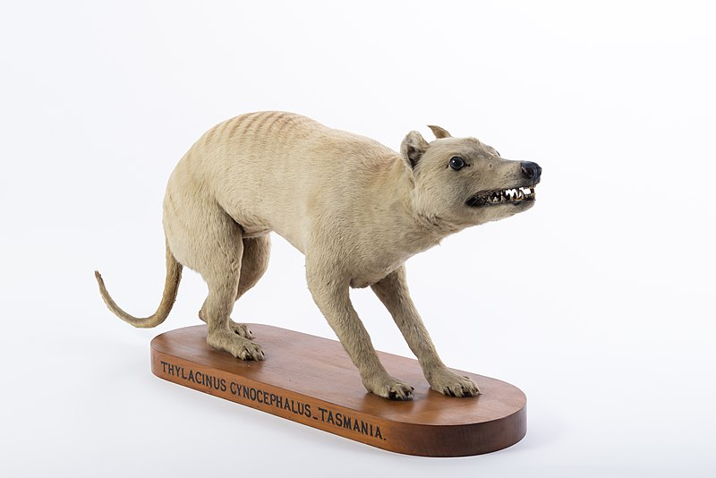
1.1 Alive, dead or never been alive (4 of 4)
Prior knowledge
Otago Museum Thylacine - OMNZVT2607 02 by Kane Fleury licensed under CC BY 4.0
Notes:
Teacher notes:
Use this slide slides to show students an example of objects in the natural world. Ask students to identify the object on the slide as alive, dead, or never been alive.
This slide shows a preserved specimen of a Tasmanian tiger (Thylacine). This taxidermy of an extinct species held at the Otago museum in New Zealand is an example of something which was alive at one point, but is now dead.

Slide 11

1.1 What is life? (1 of 2)
Problematic thinking
A human being is…
Living
Non-living
Dead
Explain your choice.
This image and activity is from ‘Big Idea: The cellular basis of life’ by University of York Science Education Group and is licensed under CC BY-NC.
Notes:
Teacher notes:
A human is a living thing because they carry out all the life processes that define living organisms. These include:
Movement – Humans can move their entire bodies using muscles and joints.
Respiration – Humans carry out cellular respiration to release energy from food, using oxygen.
Sensitivity (Response to stimuli) – Humans can detect and respond to changes in their environment using their senses (sight, sound, touch, etc.).
Growth – Humans grow from a single cell into a fully developed adult, increasing in size from a baby to an adult.
Reproduction – Humans can reproduce to create offspring.
Excretion – Humans remove waste products from the body, such as carbon dioxide (through breathing), sweat, and urine.
Nutrition – Humans eat food to obtain energy and nutrients needed for survival.

Slide 12
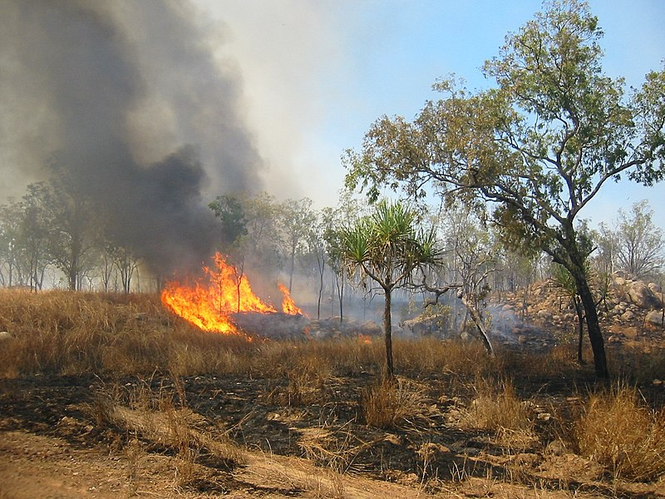
1.1 What is life? (2 of 2)
Problematic thinking
Fire is very common in the Australian environment.
Does fire:
Move?
Respire?
Sense?
Grow?
Reproduce?
Excrete wastes?
Consume nutrients?
Bushfire Australia by Thomas Schoch licensed under CC BY-SA 2.5
Notes:
Teacher notes:
This slide is for the teacher to unpack a problematic example, fire, and how it can meet the requires of MRS GREN.
How does a fire…….?
Move: Fire spreads to other areas.
Respire: Fire consumes oxygen from the air as it burns, releasing energy from the fuel it burns
Sense: When the wind blows on fire, it changes direction
Grow: Fires get bigger over time
Reproduce: One fire can start another fire
Excrete: Fire produces smoke
Obtain Nutrients: Fire needs fuel, combustible material to burn

Slide 13
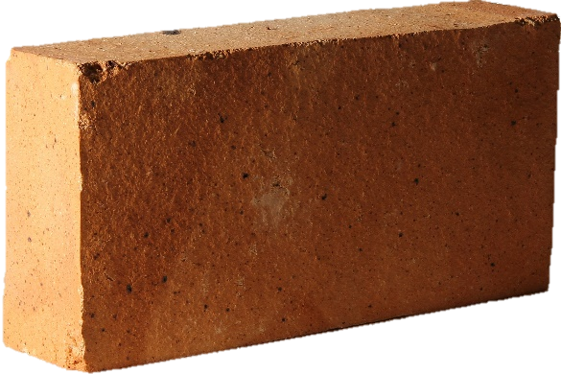
1.1 Checkpoint (1 of 3)
Problematic thinking
A brick is…
Living
Non-living
Once living
Explain your choice.
This image and activity is from ‘Big Idea: The cellular basis of life’ by University of York Science Education Group and is licensed under CC BY-NC.
Notes:
Teacher notes:
A brick is non-living, none of the features of living things can be attributed to it.

Slide 14
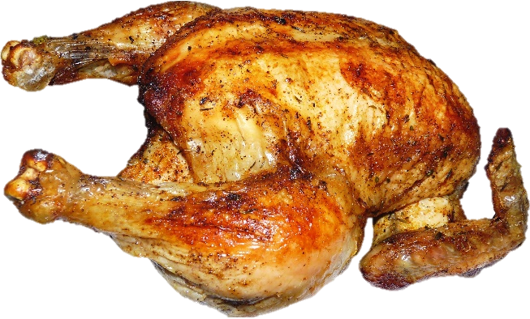
1.1 Checkpoint (2 of 3)
Problematic thinking
A roast chicken is…
Living
Non-living
Once living
Explain your choice.
This image and activity is from ‘Big Idea: The cellular basis of life’ by University of York Science Education Group and is licensed under CC BY-NC.
Notes:
Teacher notes:
A roast chicken was once living. It is dead and this food material no longer shares the features of living things.

Slide 15
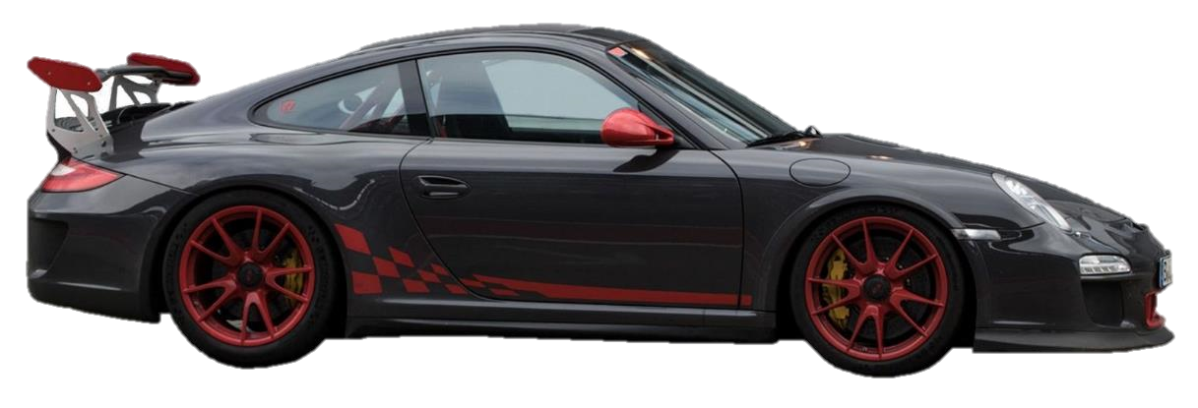
1.1 Checkpoint (3 of 3)
Problematic thinking
A car is…
Living
Non-living
Dead (once living)
Explain your choice.
This activity is from ‘Big Idea: The cellular basis of life’ by University of York Science Education Group and is licensed under CC BY-NC.
Notes:
Teacher notes:
A car can exhibit some of the features of living things artificially (nutrients as fuel and excrete as exhaust). A car is non-living as it does not exhibit all of the characteristics of living things, for example, it cannot reproduce or grow.

Slide 16
1.2 Why do we classify living things?
Learning intentions and success criteria
We are learning | I can
to describe how structural features can be used to classify organisms. | describe how to use and improve classification systems describe the use of classification in everyday life describe the role of classification in science identify the need for classification systems to describe the similarities between organisms identify the need for classification systems to describe the variety of life on Earth.
Notes:
Teacher notes:
Display this slide at the beginning of the learning sequence. Revisit the slide where appropriate during lesson activities and encourage students to reflect on their progress.

Slide 17
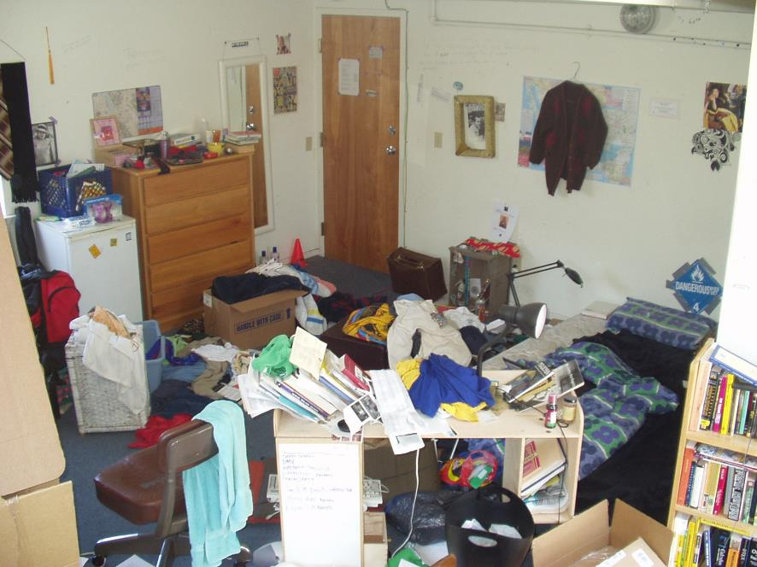
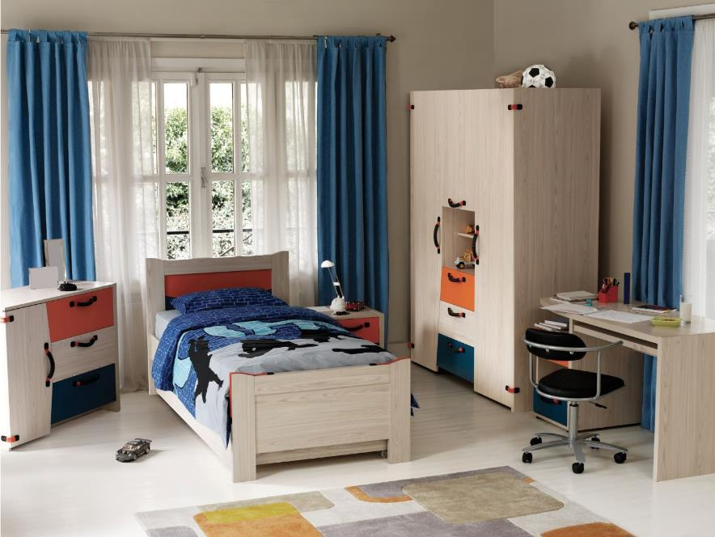
1.2 Organisation
Prior knowledge
our very messy room by Tobin licensed under CC BY-SA 2.0
Notes:
Teacher notes:
This slide contains animations
Show this slide to students and ask them:
How do you find anything in this messy space?
Explain that the mess makes it very hard to use this space efficiently. Finding your favourite pair of jeans may be difficult when your room is disorganised and messy.
CLICK to bring up an image of an organised bedroom.
Discuss how the organisation makes it easier to locate things because everything has its place.

Slide 18
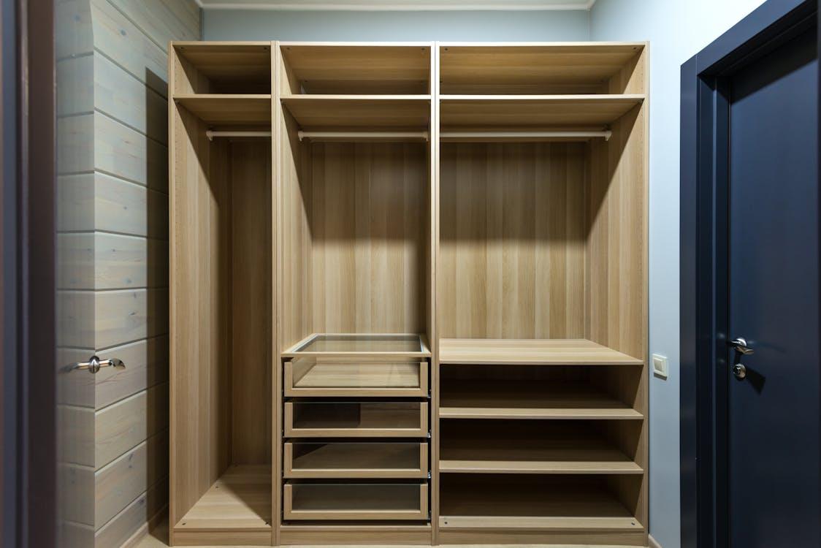









1.2 The role of classification – wardrobe
Allocating bedroom wardrobe storage
Brown Wooden Shelves by Max Vakhtbovycn this image is in the public domain.
Notes:
Teacher notes:
Outline that personal preference plays a significant role in choosing storage locations for clothing in a bedroom wardrobe. When we organise our wardrobe, it makes it easier to find and access the clothes we need.
Ask students to look at the picture of the wardrobe, then the articles of clothing on the right side of the Students think and answer:
Where does each item go? How do you decide?
Is it important we all use the same classification/organisation system?
What are the main features of an effective organisation system in your wardrobe?

Slide 19
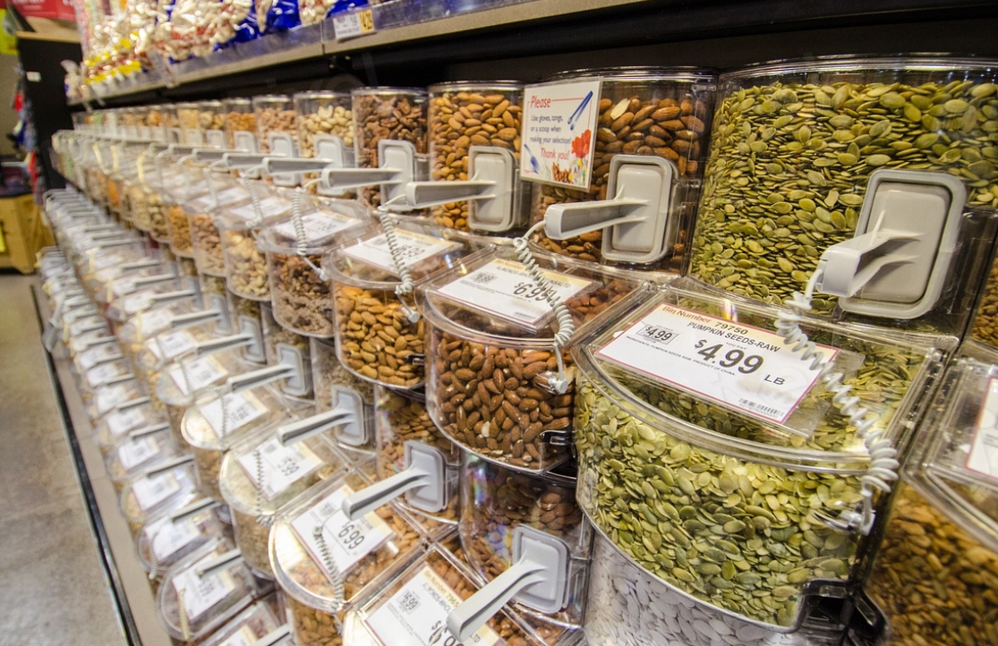
1.2 The role of classification – supermarket (1 of 2)
Shopping aisles
110303_CNPP_LSC_0316 by USDA this image is in the public domain.
Notes:
Teacher notes:
The teacher outlines that supermarkets use a rigorous process to organise products into categories of similar use. This makes it easier to locate the product we are searching for. Similar products are also grouped together to facilitate easier comparison of brands within the same product category. Show students the image and ask them:
What do these products have in common that leads them to be placed in the same location?
How does this make it easier for customers?
The image shows nuts and seeds in the shopping aisle.
Ask students, if you are seeking a specific product, how would you organise these similar products to make the customer’s experience easier?
Alphabetically? Common colours? Use of the nuts and seeds?
What would the benefits and limitations be for each method of organising this group of products?

Slide 20
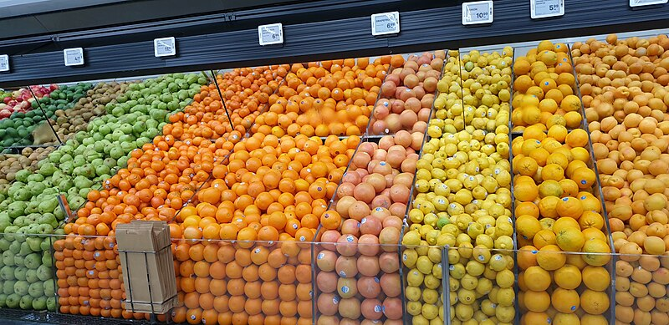
1.2 The role of classification – supermarket (2 of 2)
Shopping aisles
Citrus fruits for sale in a New Zealand supermarket by Grouffles licensed under CC BY-SA 4.0
Notes:
Teacher notes:
Show students the image and ask them:
What do these products have in common that leads them to be placed in the same location?
How does this make it easier for customers?
This image shows fruits in the shopping aisle.
If you are seeking a specific product, how would you organise these similar products to make the customers experience easier?
Alphabetically? Common colours? Use of the fruit?
What would the benefits and limitations be for each method of organising this group of products?

Slide 21
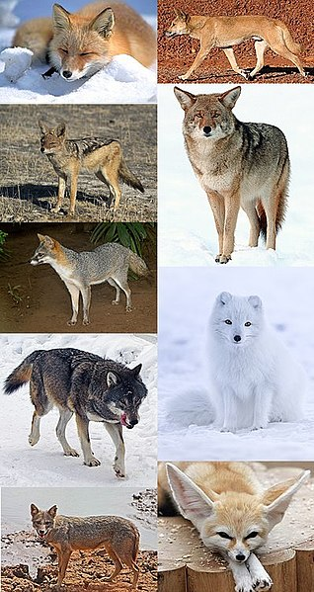
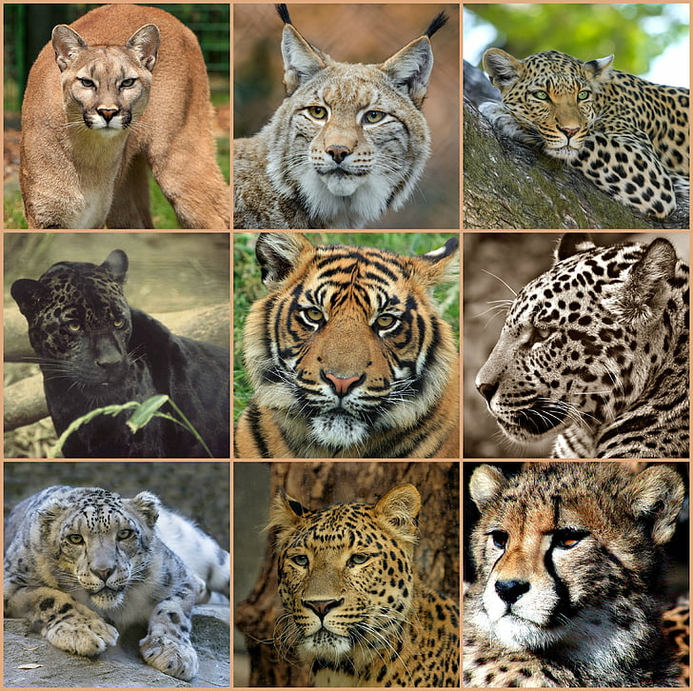
1.2 Diversity of life on Earth
Comparing the features of felines and canines
Photo of types of wild cats collage, public domain.
Nine Subfamily Caninae Species and Subspecies
by LACM 20609, licensed under CC BY-SA 4.0
Notes:
Teacher notes:
Show students this slide to compare how felines are organised as one ‘category’ and canines are organised in a different ‘category’ due to their similarities.
The slide shows some of the big cats. These animals all live in a variety of places around the world, yet share some very similar features:
Top left – Cougar, found across North America and South America
Top middle – Lynx, several subspecies found across North America and Europe
Top right – Leopard, several subspecies found across Africa, Asia and the Middle East
Middle left – Panther, (technically a black leopard/jaguar variant) found across South America, with a variety of other sightings across the world (typically as cryptozoological descriptions)
Middle – Tiger, several subspecies found across Asia
Middle right – Jaguar, found across Central America and South America
Bottom left – Snow leopard, found in selected high-altitude locations of Asia
Bottom middle – another example of a Leopard
Bottom right – Cheetah (cub), found in Africa
The images on the right-hand side of the slide show some of the wild canine species. These animals all live in a variety of places around the world, yet share some very similar features:
(down the left side, then down the right side)
(top) Left 1 – Red fox, found across North America, Europe and Asia (also an introduced pest species in Australia)
Left 2 – Coyote, found across North America
Left 3 – Crab-eating fox, found in selected locations of South America
Left 4 – Eurasian wolf, found across the cooler climates of Europe and Asia
(bottom) Left 5 – Jackal, various subspecies found across Africa, the Middle East, western Europe and Asia
(top) Right 1 – Dingo, found in Australia
Right 2 – another example of a Coyote
Right 3 – Arctic fox, found across the Arctic regions of Canada and Europe
(bottom) Right 4 – Fennec fox, found in Africa

Slide 22
1.2 Characteristics of felines and canines (1 of 2)
Felines and canines are groups of organisms with similar features.
They are both vertebrates (they have a backbone and a spinal cord)
They are both types of mammals (they have fur/hair, are warm blooded, and produce milk to feed their offspring).
Both belong to the Carnivora order
They have well-developed canine teeth for grasping and tearing the flesh of their prey
They both hunt prey
They both walk on the toes of their 4 limbs which enhances their speed and agility.
Notes:
Teacher notes:
Display this slide to discuss the similarities between felines and canines.

Slide 23
1.2 Characteristics of felines and canines (2 of 2)
Felines and canines have some key differences
Feature | Felines | Canines
Claws | Retractable claws (except the Cheetah which has semi-retractable claws) | Non-retractable claws
Spine | Highly flexible spine, allowing excellent agility | Less flexible spine
Skull | Specialised skull that allows for strong jaw muscles for delivering a killing bite | Skull structure with a long snout accommodating more teeth adapted for holding and tearing prey
Social behaviour | Often have a more solitary lifestyle | Often social animals that hunt and kill in packs
Movement | Generally, more agile in climbing and jumping | Often have longer legs adapted for endurance running.
Notes:
Teacher notes:
Display this slide to discuss the differences between felines and canines.
Felines typically possess retractable claws, with the notable exception of the cheetah, which has non-retractable claws. They also have more flexible spines and a specialised skull structure that allows for a powerful bite. Additionally, felines tend to lead more solitary lifestyles and are generally more agile when it comes to climbing and jumping. Apart from their smaller size, pet cats owned by students exhibit many of these same characteristics. In total, forty-one species of felines share these common features, all of which are organised in a similar structure.
Canines have non-retractable claws, a less flexible spine, and a different skull structure, which is suited for endurance and social behaviours. They often have longer legs and a more pronounced sense of smell. In many ways, students’ pet dogs also share many of these characteristics. Thirty-seven species share these common features, and all share a similar organisational structure.
Similarities between felines and canines – both are carnivorous animals that primarily feed on other living things, are covered in fur and give birth to live young.
Key differences of canines to felines – canines have non-retractable claws (except for the cheetah, which is similar in this way), and canines have an elongated snout compared to felines.

Slide 24
1.3 Classification systems
Learning intentions and success criteria
We are learning | I can
to classify living things based on their structural features | identify the hierarchy of taxa in the Linnean classification system as Kingdom, Phylum, Class, Order, Family, Genus and Species justify the classification of organisms based on their structural features outline the use of the binomial naming system in classification distinguish between vertebrates and invertebrates using structural features outline the features of various groups of organisms, such as reptiles.
to extract and process information from secondary sources. | extract relevant information from a video to respond to questions use a mnemonic to recall information.
Notes:
Teacher notes:
Display this slide at the beginning of the learning sequence. Revisit the slide where appropriate during lesson activities and encourage students to reflect on their progress.

Slide 25
1.3 The Linnean system (1 of 8)
Hierarchy of taxa
Kingdom
Phylum
Class
Order
Family
Genus
Species
Increasing similarity in organisms as you move down the hierarchy.
The number of organisms at each level decreases until you get one organism at species level
The genus and species is used to name a scientific organism. For example, Canis familiaris is the scientific name for all domestic dogs
Notes:
Teacher notes:
This slide contains animations.
The hierarchy of taxa within the Linnean system of classification has 7 levels.
Kingdoms
All living things fit into one of the 6 Kingdoms – animalia, plantae, fungi, protista, archaea, and bacteria
Phyla
Each kingdom can be broken into phyla
The animal kingdom, for example, can be broken into many phyla such as:
Chordates (animals that have a spinal cord)
Arthropods (invertebrate animals that have an exoskeleton)
Class
Each Phylum can be broken down into Classes.
Order
Each class can be broken into smaller groups called Orders.
Family
Each order can be broken down further into groups called Families.
Genus
Each family can be broken down into groups called Genera (singular: Genus).
Species
The genus level can be broken down into species, but there is only one organism in each group at the species level.
Organisms receive their scientific names from the genus and species groups to which they belong. The first part of the name is the genus, for example, Canis for a domestic dog, and then familiaris is the species name. Other types of dogs belong to the Canis genus, but they will have a different scientific species name.
For example, within the kingdom Animalia, there exist all animals, irrespective of how they are classified in the subsequent taxa below it. A single species, representing one specific type of living thing, will sit within its own genus, family, order, class, phylum and kingdom. As we move up from species to kingdom, each taxon includes a greater number and variety of living things.

Slide 26
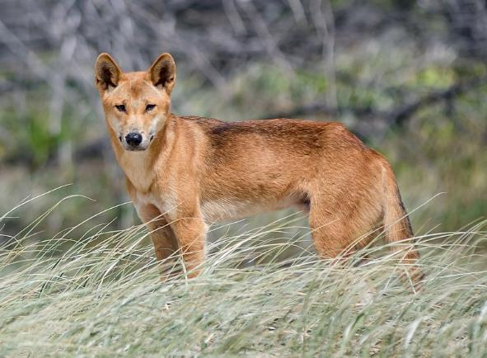
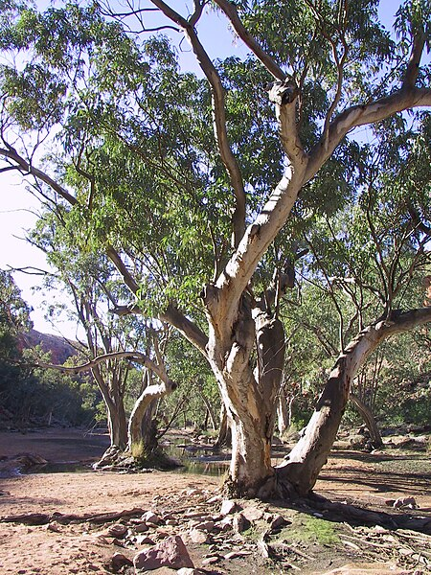
1.3 The Linnean system (2 of 8)
Kingdoms
Animalia
Life
Plantae
(others)
Dingo of Fraser Island-20170215-092336 by Newretreads licenced under CC BY-SA 4.0
A gum tree on the Finke River along the Larapinta trail, West MacDonnell Ranges, Northern Territory, Australia by Felix Dance licenced under CC BY-SA 4.0
Notes:
Teacher notes:
Animals are organised within the ‘Animalia’ biological kingdom, including the Dingo pictured on this slide. Animals obtain energy from other organisms, rather than producing their own food like plants do.
Plants are not animals and are organised within their own biological kingdom ‘Plantae’.
There are also three other kingdoms, which we won’t focus on for now.

Slide 27
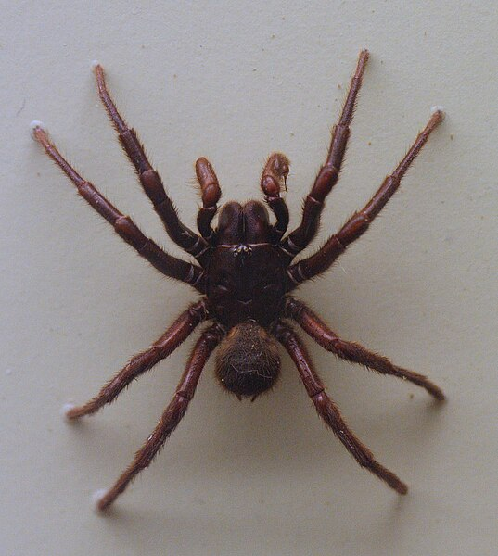
1.3 The Linnean system (3 of 8)
Phylum
Chordata
Arthropoda
Animalia
Annelida
(others)
Dingo of Fraser Island-20170215-092336 by Newretreads licenced under CC BY-SA 4.0
AustralianMuseum spider specimen 11 by Toby Hudson, licenced under CC BY-SA 3.0 AU
Notes:
Teacher notes:
The animalia kingdom is broken into many phyla.
The Dingo is from the phylum Chordata. All organisms in the Chordata phylum have a backbone and a spinal cord.
We call organisms with a spinal cord and spine vertebrates; any organism without a spinal cord and spine is an invertebrate.
Spiders are not chordates and are organised within their own phylum ‘Arthropoda’ (‘arthro’ for jointed, ‘-poda’ for leg/foot). Arthropods have segmented bodies, an exoskeleton and jointed limbs.

Slide 28
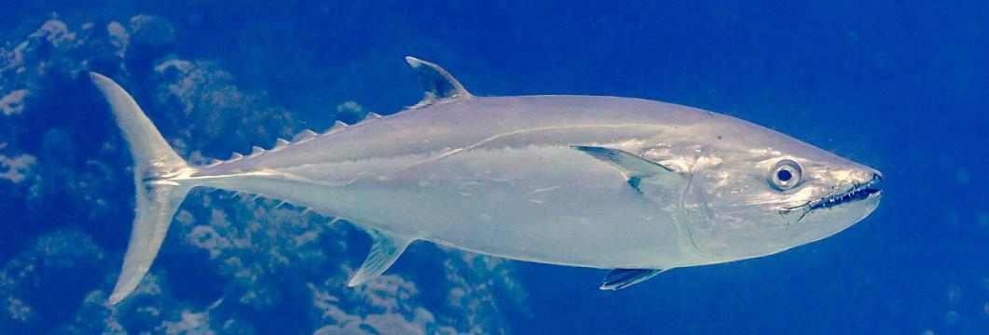
1.3 The Linnean system (4 of 8)
Class
Dingo of Fraser Island-20170215-092336 by Newretreads licenced under CC BY-SA 4.0
Mammalia
Osteichthyes
Chordata
Amphibia
Casarte ojón (Gymnosarda unicolor), mar Rojo, Egipto, 2023-04-17, DD 85 by Diego Delso, licenced under CC BY-SA 4.0
(others)
Notes:
Teacher notes:
Chordates are organised into several classes, some of which are outlined here.
The Dingo is a mammal in the class Mammalia. All mammals have hair or fur, give birth to live young, produce milk for their young, and are warm-blooded. The dingo has fur on its body and has all the other characteristics of a mammal.
Tuna are not mammals and are organised within the class ‘Osteichthyes’ (‘Osteo-’ for bony and ‘–ichthyes’ for fish), which organises the species commonly referred to as fish.
Organisms in this class have bony skeletons, a swim bladder, which is an internal gas-filled organ that helps them control their buoyancy in the water, scales, and a bony plate that protects their gills.
Other classes within the phylum Chordata include Amphibia, which consists of the amphibians.

Slide 29
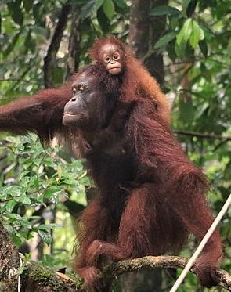
1.3 The Linnean system (5 of 8)
Order
Carnivora
Primates
Mammalia
Rodentia
(others)
Dingo of Fraser Island-20170215-092336 by Newretreads licenced under CC BY-SA 4.0
Orangutan Pongo pygmeus pygmeus by Sabar Minsyah, licenced under CC BY-SA 4.0
Notes:
Teacher notes:
Mammals are organised into several orders; the Dingo is in the order Carnivora. Carnivora are generally adapted for eating other animals, though there are some exceptions to this rule. Carnivora have well-developed, sharp canine teeth for hunting and tearing meat, and they typically have strong, sharp claws.
Orangutans are organised within the order Primates. Primates are a distinct order of mammals characterised by features such as opposable thumbs, which enable them to grasp objects like branches. They have nails instead of claws, forward-facing eyes, and large brains relative to their body size.
Other orders within the class Mammalia include Rodentia, which comprises rodents (many species of rats, mice, and others).

Slide 30
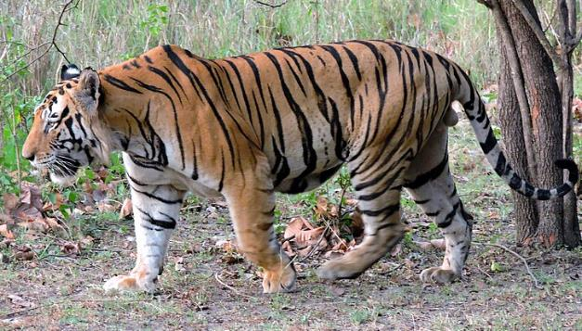
1.3 The Linnean system (6 of 8)
Family
Canidae
Felidae
Carnivora
Ursidae
Adult male Royal Bengal tiger by Seemaleena, licenced under CC BY-SA 4.0
(others)
Dingo of Fraser Island-20170215-092336 by Newretreads licenced under CC BY-SA 4.0
Notes:
Teacher notes:
Carnivora are organised into several families.
The Dingo is a canine in the order Canidae. It includes wolves, foxes, jackals, coyotes, and other similar mammals. Members in this order typically have long snouts, sharp teeth, strong legs for running, and are adept at both smelling and hearing.
Bengal tigers are not canines and are organised within the family Felidae, which organises the species commonly referred to as ‘cats’, including all domestic cat breeds. Organisms in the Felidae order have retractable claws, large canine teeth for killing prey, and excellent vision and smell to aid them in solitary hunting (except for lions, which hunt in prides).
Other families within the order Carnivora include Ursidae, which consists of the bears.
We are seeing many more similarities between the Dingo and Tiger; both have a very similar body structure and move similarly. The key differences here are behavioural, where Tigers are typically solitary animals, and the Dingo is a pack animal like other canines. The tiger has retractable claws whereas the Dingo has permanently extended claws.

Slide 31
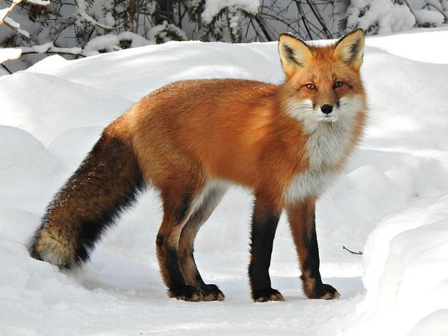
1.3 The Linnean system (7 of 8)
Genus
Canis
Canidae
Vulpes
(others)
Dingo of Fraser Island-20170215-092336 by Newretreads licenced under CC BY-SA 4.0
Vulpes vulpes ssp fulvus by Joanne Redwood, licenced under CC0 1.0
Notes:
Teacher notes:
Canines are organised into several genera.
The Dingo is in the genus Canis. Organisms in the Canis genus are medium to large-sized mammals with robust bodies and long legs, built for endurance running. They have strong jaws for capturing and consuming prey. Canid organisms (like the dingo) are social animals that hunt in packs and mark their territories.
The Red fox is organised within the genus Vulpes, which includes several species commonly referred to as a ‘fox’. Vulpes are small to medium-sized and are known for their pointed features (long nose) and bushy tails. They are primarily solitary hunters.
We are seeing many more similarities between the Dingo and Red fox; both have a very similar body structure and move similarly. There are very few differences between these genera, as they are closely related and share a common ancestor in their family trees.

Slide 32
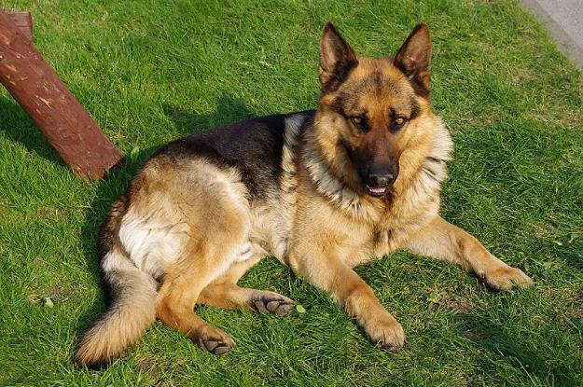
1.3 The Linnean system (8 of 8)
Species
Lupus
Canis
Familiaris
(others)
Dingo of Fraser Island-20170215-092336 by Newretreads licenced under CC BY-SA 4.0
20110425 German Shepherd Dog 8505 by Jakub Hałun, licenced under CC BY-SA 4.0
Notes:
Teacher notes:
Canis are organised into a few species; the Dingo is one example within this genus, grouped as a subspecies of the Grey Wolf. The domestic dog breeds are organised within their own species, Familiaris. All breeds of domestic dogs are the same species.
We now see many similar features between the Dingo and domestic dog that it is difficult to tell them apart; this is one of the many complications of taxonomy, where we are seeking a scientific model that is fine-tuned enough to isolate every type of living thing on Earth.

Slide 33
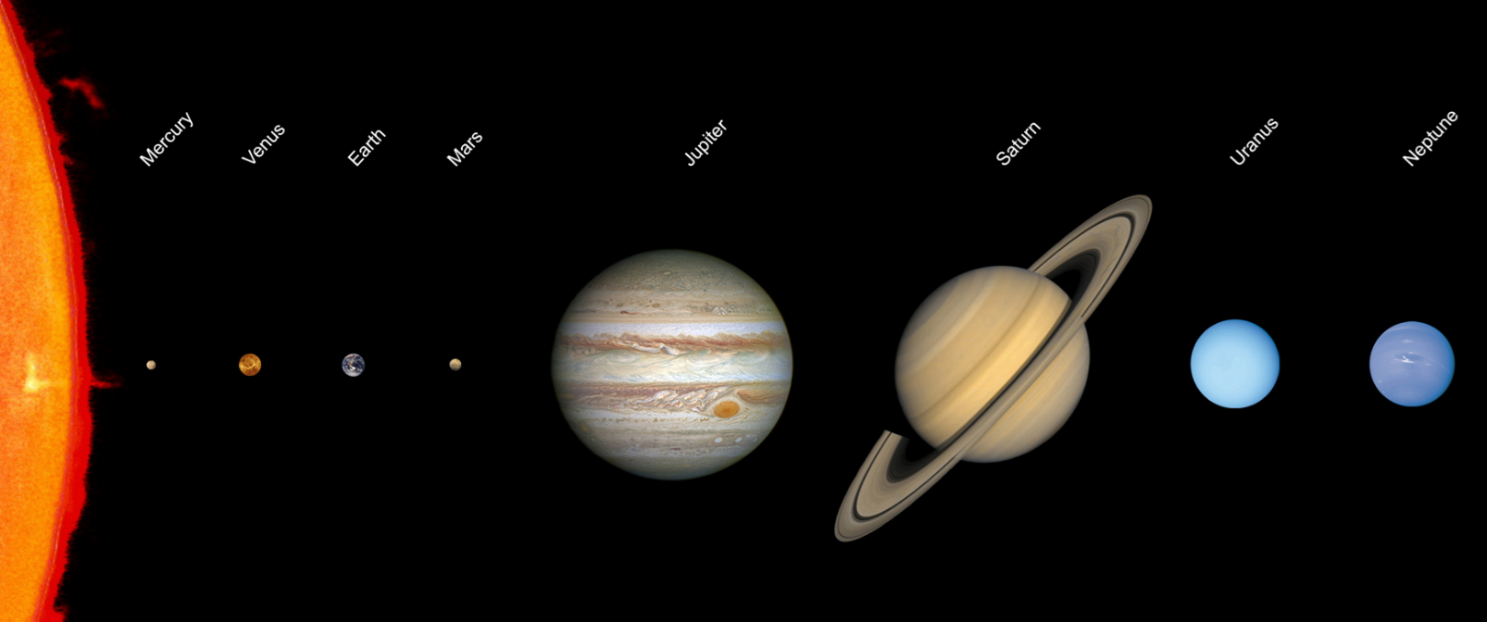
1.3 Mnemonics (1 of 3)
Planets
Solar system scale edit by JCPagc2015, licenced under CC BY-SA 4.0
Notes:
Teacher notes:
Use this set of slides to teach students about mnemonics as a memory technique.
My Very Easy Method Just Speeds Up Naming Planets – this mnemonic allows us to recall the order of the planets in our solar system (Mercury, Venus, Earth, Mars, Jupiter, Saturn, Uranus, Neptune).
We no longer include Pluto in these diagrams or mnemonics as it was demoted from being a planet in 2006 after the definition of a planet was updated.

Slide 34
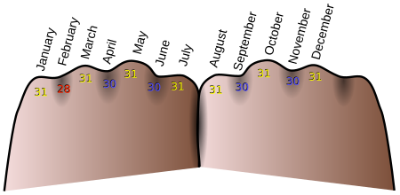
1.3 Mnemonics (2 of 3)
Months
Month - Knuckles (en) by Tijmen Stam, licenced under CC BY-SA 3.0
Notes:
Teacher notes:
The knuckles of each hand can be used as a physical mnemonic to remember the number of days in each month of the year, with the knuckle representing 31-day months and the gap between knuckles representing the 30-day months (notable exception of February which has 28 or 29 days depending on if it is a leap year).

Slide 35
1.3 Mnemonics (3 of 3)
Example for the Linnean Classification system
Taxon | Letter | Mnemonic segment
Kingdom | K | Keith
Phylum | P | Plays
Class | C | Cricket
Order | O | On
Family | F | Friday and
Genus | G | Gets
Species | S | Sixes
Notes:
Teacher notes:
This simple example mnemonic for the Linnean Classification system utilises a straightforward sentence (mnemonic) to remember the first letters and the correct sequence for each taxon. Many more can be created, and you may find that an example you produce or one produced by a peer is easier to memorise.
Students could have a go at creating their own to remember the taxonomic levels in order.

Slide 36
1.3 Binomial naming system
Unique names for each species
Each organism has 2 names:
Genus (first letter is always capitalised)
Species (always lowercase)
The genus name can be abbreviated to just the capital letter, followed by a period and the species name. For example, H. sapiens
Why is it useful?
Used all over the world – no confusion
Helps scientists communicate clearly
Shows how organisms are related
Examples
Macropus rufus (Red kangaroo)
Macropus giganteus (Eastern grey kangaroo)
Notes:
Teacher notes:
Binomial names are scientific terms and have a defined structure. Encourage students to use proper capitalisation for the genus and lowercase for the species name, with the whole binomial name in italics – Genus species. When a shorter form is desired, the genus can be reduced to an initial, followed by the species name – G. species.

Slide 37

1.3 Mountain chicken (Leptodactylus fallax)
Draw a diagram of what you think a mountain chicken might look like
Notes:
Teacher notes:
This activity highlights the need for scientific naming conventions to be useful in communicating features about an organism.
Ask students to draw what they think a mountain chicken looks like.
Google image search Leptodactylus genus and show the student all the different species that fit into this genus. (It is a type of frog!).
Ask students if their pictures have any similar features to the organisms in the genus Leptodactylus.
There will be a specific image of this species to compare to on the coming slides.

Slide 38

1.3 Naming species (1 of 4)
Common v’s scientific names
Panthera
tigris
Genus
Species
Common name – Bengal Tiger
Adult male Royal Bengal tiger by Seemaleena, licenced under CC BY-SA 4.0
Notes:
Teacher notes:
The Bengal Tiger, Panthera Tigris. This binomial name is derived from the genus Panthera, which they share with other ‘big cats’ and the species Tigris.
This species of Tiger can be found in ‘Bengal’, which is a historical geographical term referring to a region in the eastern part of the Indian subcontinent at the apex of the Bay of Bengal.

Slide 39
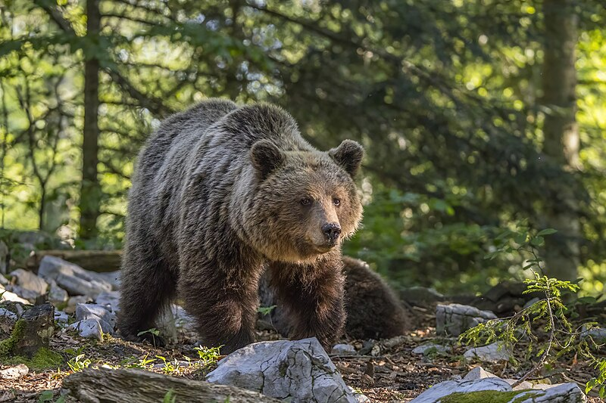
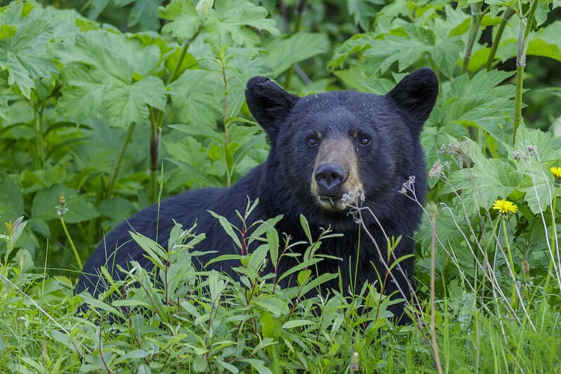
1.3 Naming species (2 of 4)
Common v’s scientific names
Brown bear (Ursus arctos)
Black bear (Ursus americanus)
Eurasian brown bear (Ursus arctos arctos) female 1 by
Charles J. Sharp, licenced under CC BY-SA 4.0
American black bear (Ursus americanus) - Jasper National Park 08 by Thomas Fuhrmann, licenced under CC BY-SA 4.0
Notes:
Teacher notes:
This slide contains animations.
What image comes to mind when you think about the animal being described as a Brown Bear?
CLICK
What about a black bear?
CLICK
These common names are reasonable shortcuts for their respective binomial names, as both species belong to the genus Ursus, which they share with all bears (note that a Panda is not actually a bear).

Slide 40
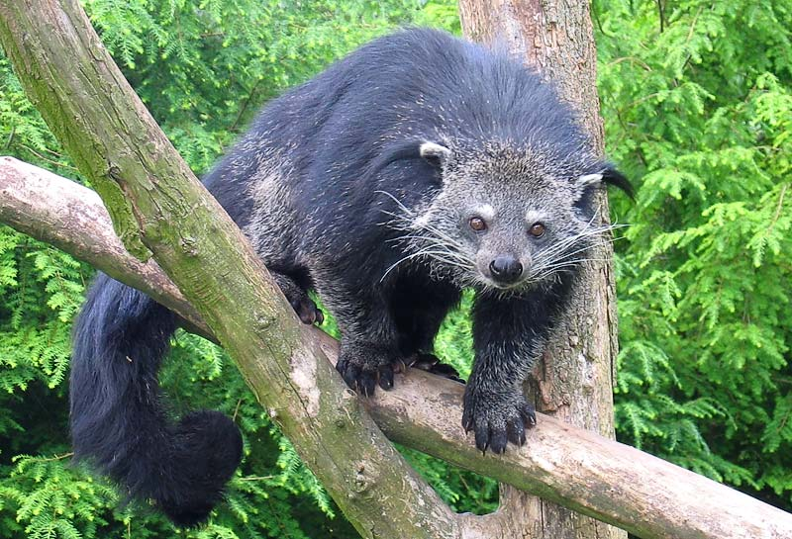
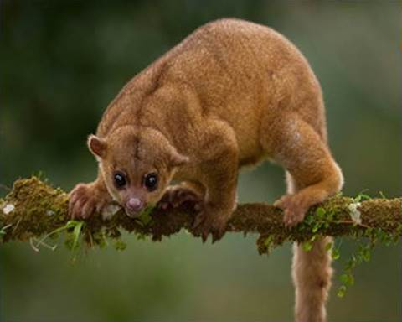
1.3 Naming species (3 of 4)
Common v’s scientific names
Bearcat (Arctictis binturong)
Honey bear (Potos flavus)
Binturong in Overloon by Thomas Fuhrmann, licenced under CC BY-SA 4.0
Potos flavus (22985770100) by Kalamazoo Public Library, licenced under CC BY-SA 4.0
Notes:
Teacher notes:
This slide contains animations.
This slide highlights some common names that can be confusing for organisms.
The Bearcat is also known as the Binturong.
CLICK
In this instance, it does somewhat resemble a bear’ish cat (or cat’ish bear) with its thick furry body, claws, and long hairy tail. The use of 'bearcat' in the common name does not mean that it fits into a similar classification group to bears and cats.
CLICK
Sticking with the ‘bear’ theme, what does a Honey bear look like? You would be forgiven for thinking of Winnie the Pooh.
CLICK
This species is related to raccoons and lives in the trees of Central and South America. It is not closely related to bears, despite its name, nor to primates, despite its tree-dwelling nature.

Slide 41
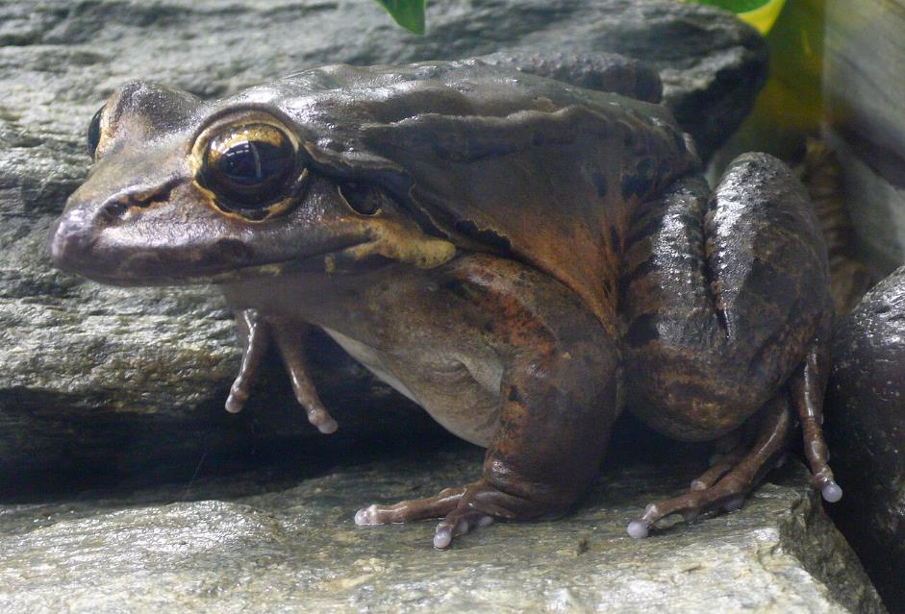
1.3 Naming species (4 of 4)
Confusing common names
Mountain chicken (Leptodactylus fallax)
Leptodactylus fallax (1) by TimVickers, this image is in the public domain.
Notes:
Teacher notes: This slide contains animations.
Students can compare their drawing of the ‘mountain chicken’ to this image of one.
CLICK
A frog is certainly not what anyone would have been expecting. This is a good example of where someone has a nickname that is not derived from their actual name. This species of frog has this common name as it is found in the mountains of the Caribbean islands, and apparently, it tastes like chicken!
Although this common name is not invalid, it does make communication about the exact species a little more difficult.

Slide 42
1.3 Scientific names of Australian species
Research the binomial names of these organisms
Common name | Binomial name
Red kangaroo
Koala
Emu
Platypus
Tasmanian devil
Common brushtail possum
Kookaburra
River red gum
Waratah
Blue gum
Common name | Binomial name
Red kangaroo | Macropus rufus
Koala | Phascolarctos cinereus
Emu | Dromaius novaehollandiae
Platypus | Ornithorhynchus anatinus
Tasmanian devil | Sarcophilus harrisii
Common brushtail possum | Trichosurus vulpecula
Kookaburra | Dacelo novaeguineae
River red gum | Eucalyptus camaldulensis
Waratah | Telopea speciosissima
Blue gum | Eucalyptus globulus
Which organisms in this list are the most closely related based on their classification?
Notes:
Teacher notes:
This slide contains animations that display the binomial names of the listed organisms.
Students research the binomial names of the organisms listed on the slide.
CLICK to bring up the binomial names
CLICK to bring up a question.
Ask students to identify the organism in this list that is most closely related based on its classification.
Students should recognise that the river red gum and the blue gum are from the same genus, Eucalyptus. This means that they are closely related and will have more similar features than those of another species of plant from a different genus.

Slide 43
1.4 Classification of organisms (1 of 2)
Learning intentions and success criteria
We are learning | I can
to classify living things based on their structural features. | identify structural features of organisms that allow them to be grouped make observations of living things to classify them into groups identify the distinguishing features of organisms classified as Insecta, Arachnida, Crustacea and Myriapoda compare the features of organisms from the same genus in a Venn diagram compare the features of organisms from the same family in a triple Venn diagram.
Notes:
Teacher notes:
Display this slide at the beginning of the learning sequence. Revisit the slide where appropriate during lesson activities and encourage students to reflect on their progress.

Slide 44
1.4 Classification of organisms (2 of 2)
Learning intentions and success criteria
We are learning | I can
to make observations of living things using the senses. | identify distinguishing features of invertebrate organisms identify structural features of a range of organisms.
to undertake a secondary source investigation. | locate and select relevant websites to find information on organisms identify the title, author and URL of a webpage extract and summarise relevant information from websites.
Notes:
Teacher notes:
Display this slide at the beginning of the learning sequence. Revisit the slide where appropriate during lesson activities and encourage students to reflect on their progress.

Slide 45
1.4 Species investigation (1 of 8)
Step 1 – identify an organism
Common name | Binomial name | Why I chose this organism
American bison | Bison bison | This species used to roam over large parts of the mainland USA and was nearly hunted to extinction. They still exist in small pockets of protected national parks. This species is often called a buffalo in the USW even though it is not a buffalo.
Notes:
Teacher notes:
These slides (CLS PPT 1.4 Species Investigation) are a worked example of the student resource in TRB1. Use these slides to guide students through the activity, using the examples outlined in the slides. Students will conduct research on different organisms to complete the student resource.

Slide 46
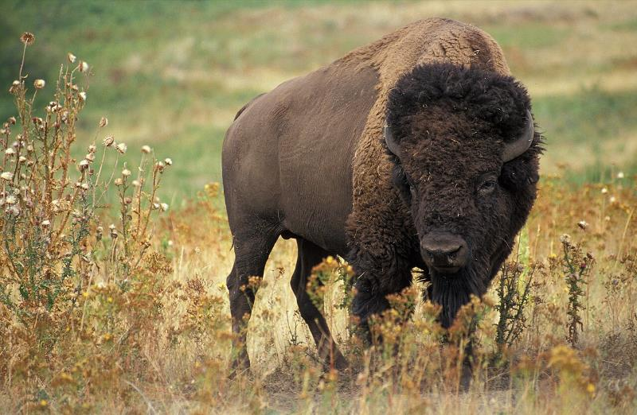
1.4 Species investigation (2 of 8)
Step 1 – identify an organism
Image of chosen organism | Taxonomy
 | Kingdom – Animalia Phylum – Chordata Class – Mammalia Order – Artiodactyla Family – Bovidae Genus – Bison Species – bison
American bison k5680-1 by Uwe Schmidt, this image is in the public domain.
Notes:
Teacher notes:
These slides (CLS PPT 1.4 Species Investigation) are a worked example of the student resource in TRB1. Use these slides to guide students through the activity, using the examples outlined in the slides. Students will conduct research on different organisms to complete the student resource.

Slide 47
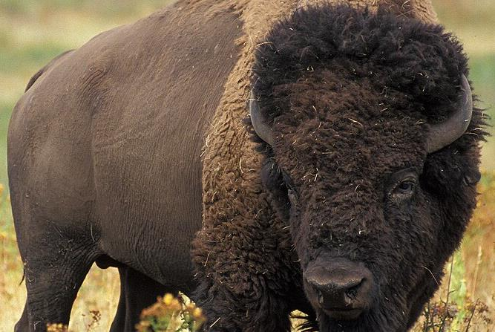
1.4 Species investigation (3 of 8)
Structural feature | Image
Long brown hair on forelegs, head and shoulders but shorter dense hair over the rest of their bodies. They develop a thicker coat during cold winter months.
American bison k5680-1 by Uwe Schmidt, this image is in the public domain.
Notes:
Teacher notes:
Structural features of an organism encompass the characteristics of its body, including its shape, size, body parts, and physical arrangement. These features often contribute to the organism's survival, reproduction or role in the ecosystem.
A key defining feature of an American bison is the long hair on the front section of the animal, with shorter hair on the rest of the animal.

Slide 48
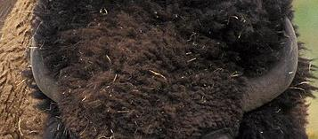
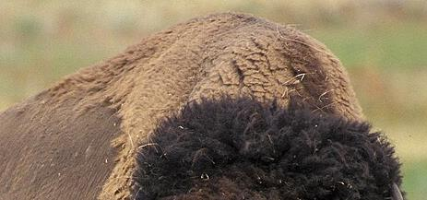
1.4 Species investigation (4 of 8)
Structural features
Structural feature | Image
Short horns that curve upward.
A large protruding shoulder hump which holds large shoulder and neck muscles.
American bison k5680-1 by Uwe Schmidt, this image is in the public domain.
Notes:
Teacher notes:
A key defining features of an American bison are the short horns on the skull.
Key defining features of an American bison are the large hump on its back, which is the attachment point for a set of very large muscles in the shoulder and neck.

Slide 49
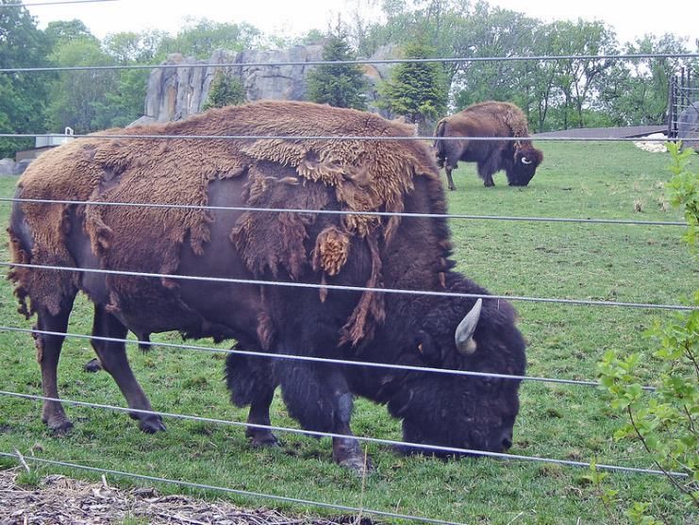
1.4 Species investigation (5 of 8)
Structural feature | Image
Heavy winter coats are shed in the spring which falls off in globs.
Buffalo/ Bison ~ 3 of 4 photos by Mary Anne Enriquez, licenced under CC BY-NC-ND 2.0
Notes:
Teacher notes:
A key defining feature of an American bison is the winter coat, which sheds in the warmer months in clumps or globs, leaving the animal patchy during the transition phase.

Slide 50
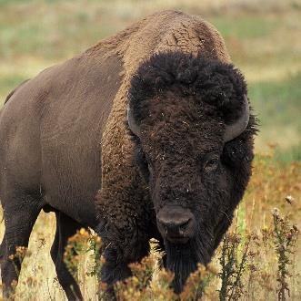
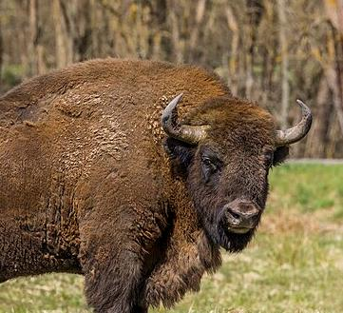
1.4 Species investigation (6 of 8)
American bison k5680-1 by Uwe Schmidt, this image is in the public domain.
European bison (Bison bonasus) male Białowieza by Charles J. Sharp, licenced under CC BY-SA 4.0
American bison (Bison bison)
European bison (Bison bonasus)
Large muscular neck hump
Thick brown hair particularly shaggy on the front half of the body
Cloven hooves
Similar shaped head
Horns
Longer hair on the top of the head
The horns point forward
Coat is more consistent (shaggy all over)
Horns point up
Face darker than the body
Sleeker hair on hindquarters
Notes:
Teacher notes:
This Venn diagram shows the comparison of the American bison to its closely related species (within the same genus, Bison), the European bison.

Slide 51

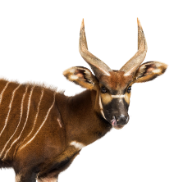

1.4 Species investigation (7 of 8)
Comparing genus and family
American bison (Bison bison)
Lots of hair on the head
Bongo antelope (Tragelaphus eurycerus)
Horns point up
Height >1.5 m
Head shape
Weigh >700kg
Thick coats with scruffy forequarter
Uniform colour
Shoulder humps
Striped coat
Twisted horns
Colour variation
in coat
Small head with large ears
Weigh <400kg
Height <1.3 m
Longer neck
Horns
Have hair
Cloven hooves
European bison (Bison bonasus)
The horns point forward
American bison k5680-1 by Uwe Schmidt, this image is in the public domain.
European bison (Bison bonasus) male Białowieza by Charles J. Sharp, licenced under CC BY-SA 4.0
Notes:
Teacher notes:
This Venn diagram illustrates the comparison of the American bison and the European Bison (from the same genus), with another organism from a different genus but still within the same family – the bongo antelope.
Tell students that the middle section shows that all of these organisms have horns, have hair, and they all have the same type of hooves. This is because these features are characteristic of the Bovidae family to which they all belong.
Draw students' attention to the number of similarities between the two types of Bison. These organisms are from the same genus, so we expect to see greater similarities as shown. There are a lot more differences between the Bongo antelope and the two bison species.

Slide 52
1.4 Species investigation (8 of 8)
Bibliography
Title | Author | Date accessed | URL
Bison Ecology | US National Parks Service | 25 February 2025 | https://www.nps.gov/yell/learn/nature/bison.htm
American Bison | National Geographic | 25 February 2025 | https://www.nationalgeographic.com/animals/mammals/facts/american-bison
European Bison | iNaturalist | 25 February 2025 | https://www.inaturalist.org/taxa/42407-Bison-bonasus
Bison bonasus European bison | Kassaondra Hendricks (University of Michigan Museum of Zoology) | 25 February 2025 | https://animaldiversity.org/accounts/Bison_bonasus/
Bongo | African Wildlife Foundation | 20 May 2026 | https://www.awf.org/wildlife-conservation/bongo
Tragelaphus eurycerus bongo | Julie Brensike (University of Michigan Museum of Zoology) | 20 May 2026 | https://animaldiversity.org/accounts/Tragelaphus_eurycerus/
Notes:
Teacher notes:
The worked example provided contained information sourced and adapted from the listed websites, all accessed on the date shown at the link shown. This bibliography demonstrates our use of as many reliable sources as possible, including government agencies, international non-governmental organisations, and educational institutions or websites maintained by these institutions.

Slide 53
1.5 Aboriginal and Torres Strait Islander peoples’ classification of plants and animals
Learning intentions and success criteria
We are learning | I can
how the features and uses of living things can be used to classify organisms. | describe how Aboriginal Peoples use observations to name organisms explain how Aboriginal knowledge was used to name animals based on their characteristics construct a Venn diagram that classifies plants into classification groups used by Aboriginal People, showing how some plants fit into multiple groups.
to make observations using our senses. | make observations about an organism’s physical appearance, the sounds they make and their behaviours.
Notes:
Teacher notes:
Display this slide at the beginning of the learning sequence. Revisit the slide where appropriate during lesson activities and encourage students to reflect on their progress.

Slide 54
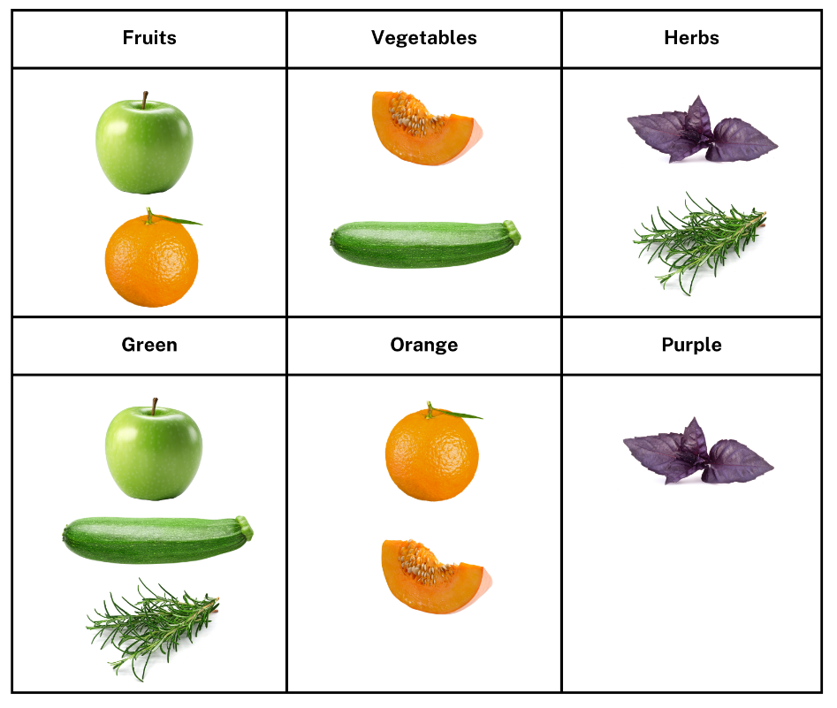
1.5 Different classification systems
Prior knowledge
Notes:
Teacher notes:
Recall that the purpose of classification is to identify and organise living things.
Discuss how the way things are organised may differ depending on preference or the characteristics used to group them.
Explain to students that these six items can be grouped in different ways using various systems. First, they can be classified by categories such as vegetables, fruits, and herbs, or grouped by colour.
Grouping by colour can help indicate the types of nutrients each has, as the colour can suggest which food chemicals are present.
One way is not more correct than the other; they are simply different.
Aboriginal and Torres Strait Islander Peoples use different systems to classify Country, including the plants and animals that surround them.

Slide 55
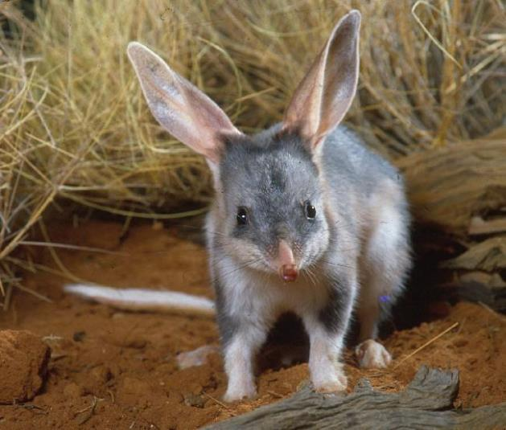
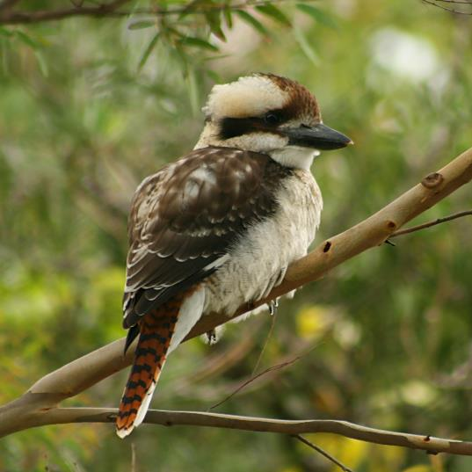
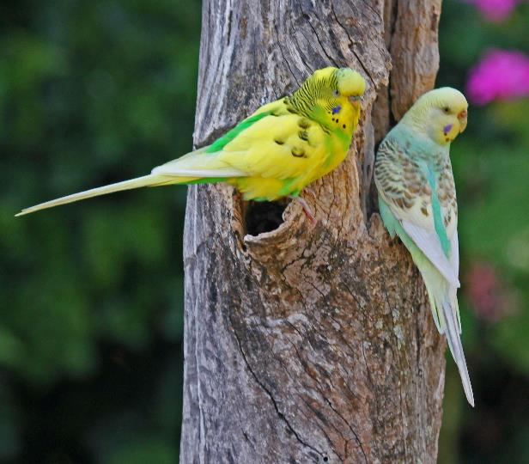
1.5 Traditional naming of animals
Traditional names for animals
Macrotis lagotis 1 by Queensland Government is licenced under
CC BY 4.0
Laughing Kookaburra Juvenile by Toby Hudson is licenced under CC BY-SA 3.0
Budgerigar RWD by Dick Daniels is licenced under CC BY-SA 3.0
Notes:
Teacher notes:
When identifying organisms, Aboriginal people often use the characteristics of the organisms to name them. These characteristics include the way that they look, sound or even taste.
Here are some examples of Australian animals whose names originate in the Aboriginal language due to their distinctive features.
Bilby
The form bil-bi has been recorded in Yuwaalaraay, the language of central and northern New South Wales.
It means ‘long-nosed rat’.
Kookaburra
The word "kookaburra" comes from the Wiradjuri (Weir-rad-jury) people of central-western New South Wales. Their word for kookaburra was guuguubarra (doesn’t that sound like the call of the kookaburra?).
Budgerigar
This name was reported as coming from the Gamilarray (Ga-mill-a-ray) language of central and northern New South Wales. It was actually a mispronunciation of the word gidjirrigaa. It means ‘good eating’.

Slide 56
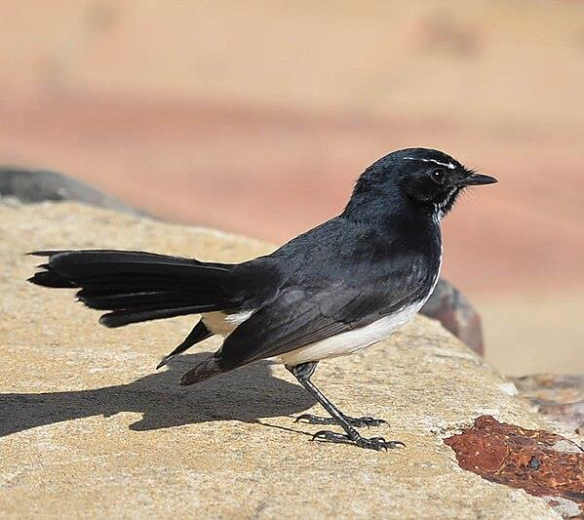
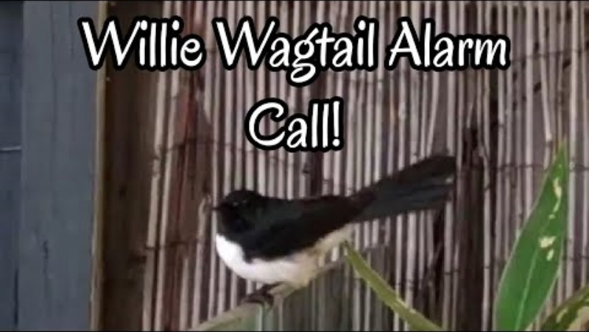
1.5 The Willie Wagtail
Where did its name come from?
Willie wagtail by Josve05a is licenced under CC BY 2.0
Notes:
Teacher notes:
This slide contains animations.
The Willie Wagtail is a common bird found across most of Australia.
The Wiradjuri (Weir-rad-jury) word for the willie wagtail is dyirridyirri (pronounced jee-ree jee-ree)
In the Noongar language dialects of the South-West of Western Australia, the Willie Wagtail is known as the Djiti-Djiti (pronounced Chitti-chitti).
Students are to make observations about the Willie Wagtail, including its appearance, sounds it makes, and behaviour.

Slide 57
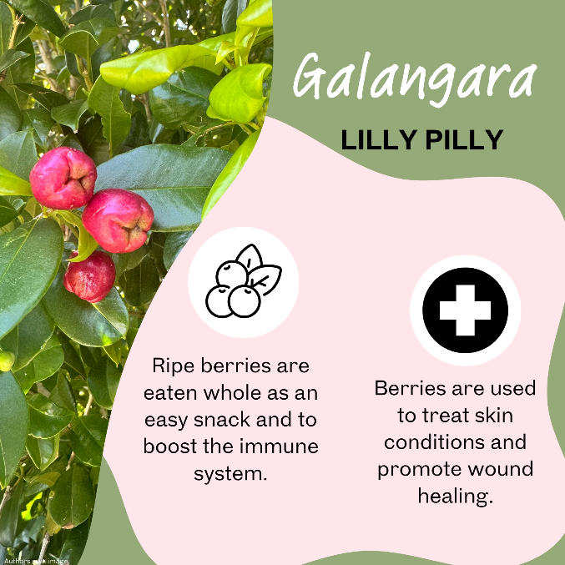
1.5 Dhurug people’s classification of plants
Traditional uses for plants
Dharug name for plant.
Image of plant.
Common name for plant.
Dharug uses for plant including for food, medicinal or as tools and weapons.
Notes:
Teacher notes:
This slide contains animations.
Aboriginal and Torres Strait Islander Peoples have a deep and longstanding connection to native plants, valuing them not only as part of the natural environment but also as essential resources for daily life. They classify plants based on their use, ensuring that each plant is understood and respected for its various purposes. Embedded within their culture are strong values of sustainability, which means they strive to use as much of each plant as possible to avoid waste. Many native plants serve multiple functions, fitting into more than one category. For example, a single plant might provide food, have medicinal properties, and be useful for making tools or weapons.
The Dharug people, the Traditional Custodians of the Sydney region, possess extensive knowledge of the plants found in their area. The Galangara, also known as Lily Pilly, was used for both food and medicinal purposes. When ripe, the berries of the Lily Pilly can be eaten as a snack, but they can also be mashed and applied to the skin to help promote wound healing due to their natural antibacterial properties.

Slide 58
1.5 Traditional classification of plants Venn diagram
Food
Medicine
Tools/Weapons
Notes:
Teacher notes:
Use the information provided on the Traditional Plant Use cards to classify each plant on the Venn diagram. You may like to include the Dharug name, as well as the common name for each plant.
As you work through the task, you might observe that many plants fit into multiple categories. This highlights how classification systems are not always rigid but can be flexible depending on the characteristics of the objects being classified.

Slide 59
1.6 Dichotomous keys
Learning intentions and success criteria
We are learning | I can
to classify living things based on their structural features | group things logically to allow efficient identification apply a ‘branching dichotomous key’ to identify organisms apply a ‘paired statement dichotomous key’ to identify organisms outline the distinguishing characteristics of mammals
to make observations of living things | identify observable features of an organism use observations to identify an organism using a key
to extract information from secondary sources | identify observable features of organisms in a photograph extract information from texts about the features of organisms use a dichotomous key to identify organisms correctly
Notes:
Teacher notes:
Display this slide at the beginning of the learning sequence. Revisit the slide where appropriate during lesson activities and encourage students to reflect on their progress.

Slide 60
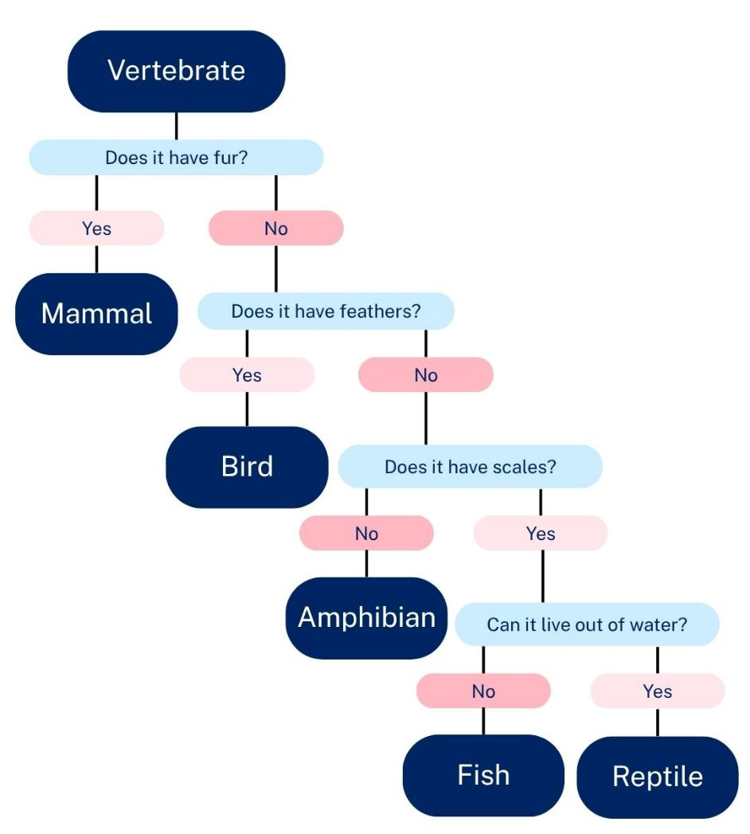
1.6 Classification using a key
1. Does it have fur?
a) Yes…………….. Mammal.
b) No……………... Go to question 2.
2. Does it have feathers?
a) Yes…………….. Bird
b) No……………... Go to question 3.
3. Does it have scales?
a) Yes…………..... Go to question 4.
b) No …………….. Amphibian
4. Can it live out of water?
a) Yes …………… Reptile
b) No …………..... Fish
Dichotomous keys
Dichotomous keys consist of a series of statements that offer 2 choices of observable traits/characteristics at each step, progressively guiding users to the correct identification.
They can be represented in:
a branching flow chart
a series of paired statements
Notes:
Teacher notes:
This slide contains animations.
Use this slide to define a dichotomous key and demonstrate the two different types using an example.
CLICK to bring up the branching flow chart for classifying vertebrates into groups
This version illustrates the division of vertebrates into two groups at each step, using a distinguishing feature to separate the organisms.
CLICK to bring up the series of paired statements, a dichotomous key

Slide 61
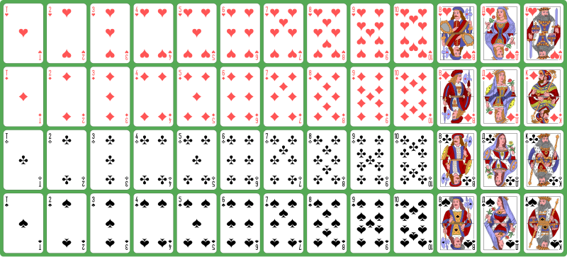
1.6 Sorting a deck of cards
Deck of playing cards
Atlasnye playing cards deck by Dmitry Fomin, licenced under CC0
Notes:
Teacher notes: This slide contains animations.
Display this slide to show students a standard deck of playing cards.
A standard deck of playing cards, showing all 52 cards, including the numeral and face cards of all 4 suits.
4 suits – clubs (♣), diamonds (♦), hearts (♥) and spades (♠)
12 face cards – jack, queen and king
40 numeral cards – ace (one) and 2 through 10.
For this example, we will select the Jack of Diamonds as our card.
CLICK
Is your card a face card? This would include the Jack, Queen, and King of all suits and exclude all numeral cards.
CLICK
In this one move, we have eliminated 77% of the population in our search for the selected card.
If we had picked a number card, however, we would have only eliminated 33% of the deck. When you formulate your questions, consider how much of the population you can eliminate with each one.

Slide 62
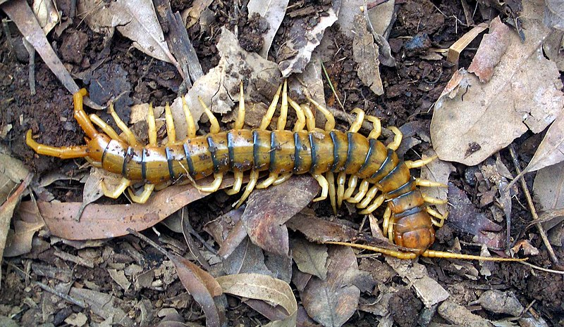
1.6 Australian invertebrates (1 of 8)
Ethmostigmus rubripes
Ethmostigmus rubripes by John E. Hill, licenced under CC BY-SA 3.0
Notes:
Teacher notes:
Students observe the insect and use the provided classification key to determine its type of invertebrate.
Looking at this invertebrate, what features does it show?
More than 8 legs
Long, thin body
1 pair of legs per segment
Answer: This would be identified as a centipede.

Slide 63
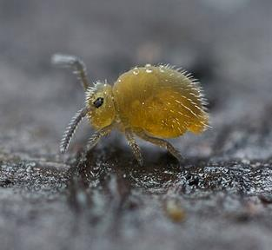
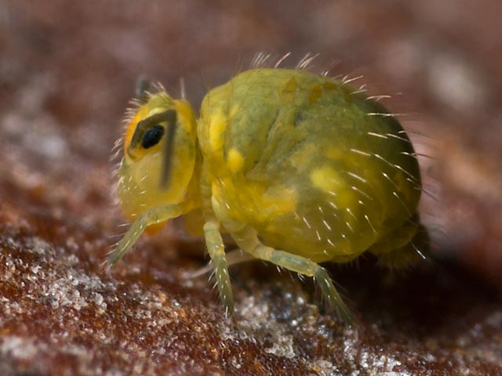
1.6 Australian invertebrates (2 of 8)
Katianna sp.
Katianna sp. by Andy Murray, licensed under CC BY-SA 2.0
Katianna cf. pescotti by Anthony Daley, Used with permission from the author.
Notes:
Teacher notes:
Students observe the insect and use the provided classification key to determine its type of invertebrate.
Looking at this invertebrate, what features does it show?
It has 6 legs (one half visible in the image)
It has antennae
It has a small appendage at its rear
Answer: This organism is a springtail.

Slide 64

1.6 Australian invertebrates (3 of 8)
Cercophonius squama
Cercophonius squama by Noodle snacks, licenced under CC BY-SA 3.0
Notes:
Teacher notes:
Students observe the insect and use the provided classification key to determine its type of invertebrate.
Looking at this invertebrate, what features does it show?
It has 8 legs
It has pincers
It has a tail
Answer: This would be identified as a scorpion.

Slide 65

1.6 Australian invertebrates (4 of 8)
Phyllotocus macleayi
Phylloctocus macleaya used with permission of the author Kristi Ellingsen
Notes:
Teacher notes:
Students observe the insect and use the provided classification key to determine its type of invertebrate.
Looking at this invertebrate, what features does it show?
It has 6 legs
It has antennae (look closely near the head)
It has a hard shell (and wings underneath, but we cannot see this in the image)
The hard shell has a division down the middle.
Answer: This organism is a type of beetle.

Slide 66

1.6 Australian invertebrates (5 of 8)
Balaustium medicagoense
CSIRO ScienceImage 18 The Balaustium mite Balaustium medicagoense by CSIRO, licenced under CC BY 3.0
Notes:
Teacher notes:
Looking at this invertebrate, what features does it show?
8 legs or less (only 7 are visible in the image)
No pincers
One main body part
Answer: This organism is a mite.

Slide 67

1.6 Australian invertebrates (6 of 8)
Apachyus peterseni
Apachyus peterseni by iNaturalist Australia user: tjeales, licenced under CC BY-SA 4.0
Notes:
Teacher notes:
Looking at this invertebrate, what features does it show?
8 legs or less
6 legs and antennae
Appendage at the rear
2 appendages
This would be identified as an earwig.

Slide 68

1.6 Australian invertebrates (7 of 8)
Nysius spp.
Nysius spp. Used with permission of the author Kristi Ellingsen
Notes:
Teacher notes:
Looking at this invertebrate, what features does it show?
8 legs or less
6 legs and antennae
No appendage at rear
1st pair of wings overlapping
This would be identified as a bug

Slide 69

1.6 Australian invertebrates (8 of 8)
Omophaena taeniata
Omophaena cf. taeniata Used with permission of the author Kristi Ellingsen
Notes:
Teacher notes:
Looking at this invertebrate, what features does it show?
8 legs or less
6 legs and antennae
No appendage at the rear
A hard shell protects wings (they cannot be seen in the image).
This would be identified as a beetle.

Slide 70

1.6 Pamishan aliens
Taxonomy, Classification, and Dichotomous Keys, licenced under CC-BY-NC-SA.
Notes:
Teacher notes:
Use this slide to introduce the Pamishan aliens activity. Students will use a dichotomous key to identify the binomial name of each organism and then answer some questions.

Slide 71

1.6 Classifying terrestrial mammals (1 of 5)
Acrobates pygmaeus
This organism is the smallest gliding marsupial known to exist in the world. It has a grey/brown back and white belly. It lives in trees. It measures approximately 8 cm in length and features a unique tail that resembles a feather, which it uses as a rudder during gliding.
Notes:
Teacher notes:
These slides are used in conjunction with the Classifying Terrestrial Mammals activity in TRB1. Students make observations of the photographed organism and use these observations along with the text to work their way through a dichotomous key and identify the common name of each organism.
Answer: This organism is a Feathertail glider

Slide 72

1.6 Classifying terrestrial mammals (2 of 5)
Petaurus breviceps
This organism has a greyish-brown coat with a paler, cream or white belly. It has darker brown to black markings around the eyes and the centre of the head, as well as down its back. It has prominent gliding membranes between its forearms and hind legs. It lives in trees.
Notes:
Teacher notes:
These slides are used in conjunction with the Classifying Terrestrial Mammals activity in TRB1. Students make observations of the photographed organism and use these observations along with the text to work their way through a dichotomous key and identify the common name of each organism.
Answer: This organism is a sugar glider

Slide 73

1.6 Classifying terrestrial mammals (3 of 5)
Trichosurus vulpecula
This organism is large compared to other possums. It has a bushy tail with a prehensile tip. It has grey fur with a dark band across its nose and a darker tail. It has sharp claws. Its belly ranges from white to yellowish brown.
Notes:
Teacher notes:
These slides are used in conjunction with the Classifying Terrestrial Mammals activity in TRB1. Students make observations of the photographed organism and use these observations along with the text to work their way through a dichotomous key and identify the common name of each organism.
Answer: This organism is a Common brushtail possum

Slide 74

1.6 Classifying terrestrial mammals (4 of 5)
Pseudocheirus perigrinus
This organism lives in trees, rarely leaving them, and is about the size of a cat. It has a long, white-tipped, prehensile tail (capable of grasping). Its fur is grey-brown and it has a white belly.
Notes:
Teacher notes:
These slides are used in conjunction with the Classifying Terrestrial Mammals activity in TRB1. Students make observations of the photographed organism and use these observations along with the text to work their way through a dichotomous key and identify the common name of each organism.
Answer: This organism is a Common ringtail possum.

Slide 75

1.6 Classifying terrestrial mammals (5 of 5)
Phascogale tapoatafa
This organism is a carnivorous marsupial. It has a body length of approximately 20 cm, with a characteristic black, bushy tail that resembles a bottle brush. It has grey to dark grey fur with a paler belly. It has an elongated snout. It has sharp teeth for biting and cutting.
Notes:
Teacher notes:
These slides are used in conjunction with the Classifying Terrestrial Mammals activity in TRB1. Students make observations of the photographed organism and use these observations along with the text to work their way through a dichotomous key and identify the common name of each organism.
Answer: This organism is a Brush-tailed phascogale.

Slide 76
1.7 Adaptations in Australian organisms (1 of 2)
Learning intentions and success criteria
We are learning | I can
to describe how organisms in an Australian habitat are adapted to their environment. | define the terms adaptation, structural adaptation and behavioural adaptation identify structural and behavioural adaptations of organisms in an Australian habitat relate the structural and behavioural adaptations of the organisms to their survival in their environment.
to undertake a secondary source investigation | identify and use reliable secondary sources to collect information about adaptations of organisms use an appropriate referencing technique to acknowledge sources
Notes:
Teacher notes:
Display this slide at the beginning of the learning sequence. Revisit the slide where appropriate during lesson activities and encourage students to reflect on their progress.

Slide 77
1.7 Adaptations in Australian organisms (2 of 2)
Learning intentions and success criteria
We are learning | I can
to communicate scientific ideas in a scientific information report | write a scientific information report using relevant scientific terms use subheadings to structure a scientific information report write a scientific report suitable for the target audience and purpose use quality criteria to assess a scientific information report and provide feedback to a peer.
Notes:
Teacher notes:
Display this slide at the beginning of the learning sequence. Revisit the slide where appropriate during lesson activities and encourage students to reflect on their progress.

Slide 78

1.7 Defining key terms
Adaptations
Adaptation – the features of an organism which help it survive in its habitat.
Structural adaptation – a physical structure of an organism which supports survival in its environment.
Behavioural adaptation – a behaviour that an animal does to help it survive in its environment.
Fur that is brown, tanned or greyish in colour.
Short legs with sharp claws.
Backward facing pouch.
Vombatus ursinus -Maria Island National Park by JJ Harrison., licensed under CC BY-SA 4.0
Notes:
Teacher notes: This slide contains animations.
Define the terms adaptation, structural adaptation and behavioural adaptation by reading the information from the slide.
Read the following information to students to familiarise them with the habitat of the wombat:
There are three species of wombat. The image on the slide shows one of the species, the bare-nosed wombat, also known as the common wombat.
Bare-nosed wombats live in a variety of places, including
Forests and woodlands: The soil here is loose and moist. There is dense vegetation that provides food (in the form of grasses, roots, and bark) and protection from predators.
Grasslands and open plains provide plenty of food; however, they offer less natural shelter to protect them from predators.
Mountain regions: Winters are harsh, cold and snowy. The area is quite rocky.
Coastal areas: These areas have soft, sandy soil and a mild climate.
The slide is animated to bring up some of the structural adaptations of the bare-nosed wombat. Support students in linking these adaptations to how they enable bare-nosed wombats to survive in their environment.
Their short, powerful legs and sharp claws help them dig extensive burrow networks.
Their pouches face backwards to protect wombat joeys from being sprayed with dirt while their mother digs in the ground.
The colour of their fur helps them blend in with their environment, making them less visible to predators.
Some of the behavioural adaptations that bare-nosed wombats have to support them in surviving in their environment include:
Nocturnal behaviour to avoid the heat of the day and support the bare-nosed wombat in conserving energy and water.
Burrowing behaviour protects from predators such as dogs and eagles and keeps them cool in summer and warm in winter.
When sitting in their burrows, they position their backs to the exit, ready to use their rump to block access to the burrow from unwanted guests.
Inform students that the bare-nosed wombat has many more adaptations to help it survive in its environment.

Slide 79






1.7 Australian animals
What features or behaviours do you think help these animals survive in their environment?
Macropus giganteus - Brunkerville by JJ Harrison, licensed under CC BY-SA 4.0
Wild shortbeak echidna by Fir0002, licensed under CC BY-NC 4.0
Duck-billed platypus (Ornithorhynchus anatinus) diving Scottsdale by Charles J. Sharp, licensed under CC BY-SA 4.0
Sa-sleeping-koala by Sanjay ach, licensed under CC BY-SA 4.0
Saltwater crocodile by fvanrenterghem, licensed under CC BY-SA 4.0
Laughing kookaburra by Charles J. Sharp,, licensed under CC BY-SA 4.0
Notes:
Teacher notes:
Instruct students to Think-Pair-Share to respond to the question. A printed copy of the animals can be obtained from the student resource in TRB1 for students. Facilitate class discussion for the share component of the Think-Pair-Share.
Sample responses:
A kangaroo has a long tail to help it balance when jumping. It has strong back legs that enable it to jump, allowing it to travel long distances. They are mostly active at dawn and dusk to avoid extreme heat.
An echidna has sharp spines for protection from its predators. It has strong claws for digging burrows and finding food. They burrow into the ground to escape heat or cold.
A platypus has webbed feet to help it swim better. They dig burrows in riverbanks to protect themselves from predators.
Koalas have thick fur to provide insulation from the heat and cold. They have sharp claws and strong limbs to help them climb and grip trees. They sleep up to 20 hours per day to conserve energy.
A crocodile has hard, scaly skin to protect itself against predators and injury. Their eyes, ears, and nostrils are positioned on top of their head, allowing them to stay almost fully submerged in water while watching their prey. They can remain underwater for extended periods to avoid detection.
Kookaburra has a strong, sharp beak for catching and killing its prey. They have brown and white feathers to help them blend into trees. They have a laughing call to mark their territory and communicate.

Slide 80

1.7 Telopea speciosissima
The waratah
Telopea speciosissima Ingar Falls crop by Casliber, licensed under CC BY-SA 4.0
Notes:
Teacher notes:
Show this slide to students to familiarise them with the waratah.
The waratah is an Australian plant that produces very distinct red flowers. It is a shrub that grows 3-4 meters high and about 2 meters wide. The flowers attract possums, birds and insects.
It is used as the emblem for New South Wales. The name waratah comes from the Eora Aboriginal people of the Sydney region.

Slide 81

1.7 Definition and criteria for secondary source reliability
Reliability – refers to the consistency of information with other reliable sources.
Reliability
Has someone with an appropriate scientific background written the source? What are their qualifications? Is the source published on a credible medium? (For example, .edu, .gov) Is the information current? (consider the topic being investigated and research being conducted in the field) Is information consistent with at least 2 other reliable sources?
Notes:
Teacher notes:
Inform students that not all sources that appear in the search results will be reliable. Define reliability using the definition on the slide. Teach students what it means for a secondary source to be reliable. There is a scaffold in the Student Resource – Conducting Secondary-Source Research.
The checklist on the slide is for students who can assess the reliability of sources (without the scaffold in the student resource).
Please note that for the following point, “Is the information current? (consider the topic being investigated and research being conducted in the field)”, We do not suggest generic guidelines such as ‘within 5 years’. The field of research needs to be taken into consideration. For example, is it a field where information is rapidly outdated due to the volume of research, or is it a field where we have a well-understood concept and there have been no changes in our understanding for 20 years?

Slide 82
1.7 Audience and purpose of texts
Audience | Purpose
This is who reads, listens or engages with the text. | Refers to the reason for communicating the information in that text.
To identify the audience, consider components of the text such as the images used, the vocabulary used and the subject matter. | To understand the purpose of a text, consider whether the author wants to inform, persuade or entertain their audience.
Who is the audience of the scientific reports about the waratah and
bare-nosed wombat?
What is the purpose of the reports?
Notes:
Teacher notes:
Read through the information about what the audience and purpose of a text are and how to identify them.
Facilitate a class discussion to identify the audience and purpose of scientific reports about the waratah and the bare-nosed wombat. Ask students how they identified the audience and purpose.
Sample responses
Audience: Year 7 science students and their teacher.
Purpose: To inform the audience.
Audience: Year 7 science students and their teacher would be the target audience.
Text: Scientific language is used throughout both reports to convey scientific understanding.
Purpose: The text is informative because it provides objective facts about the classification and adaptations of the waratah and bare-nosed wombat.

Slide 83
1.7 Checkpoint
Which of the following is the most appropriate way to describe an adaptation of Telopea speciosissima in a scientific report?
The waratah looks pretty and grows tall so that everyone can see it.
The waratah has bright red flowers that attract birds, which helps with pollination, increasing reproductive success.
This plant is red, so it stands out and makes the environment look nice.
Waratahs are super cool because they grow back after bushfires.
Notes:
Teacher notes:
This slide contains animations
Display this slide to check students understanding of formal scientific writing that is appropriate for a scientific report.
CLICK to highlight the correct answer.

Slide 84
Essential question 2
What are the features of cells, and how does their structure relate to their function?
Notes:
Teacher notes:
Content in this section aligns with essential question 2 in the program of learning and Teacher resource book 2.

Slide 85
2.1 What are cells?
Learning intentions and success criteria
We are learning | I can
to describe the unique features of cells in living things | define cells as the most basic unit of life outline cell theory recognise that that advances in technology have increased our understanding of cells.
to extract and summarise information from secondary sources | identify key points in a text about cell theory and the developments in microscope technology summarise key points in my own words to respond to comprehension questions.
Notes:
Teacher notes:
Display this slide at the beginning of the learning activity. Revisit the slide where appropriate during lesson activities and encourage students to reflect on their progress.

Slide 86


2.1 Moving from the macro world to the micro world
MACRO
MICRO
This work has been generated using BioRender.com. Any copyright subsisting in this work is owned by © State of New South Wales (Department of Education) 2024.
Notes:
Teacher notes:
Lead a discussion about moving from the macroscopic to the microscopic world.
Macro means large scale or overall view
Micro means small scale or detailed view.
Outline what students have learnt so far about classification and how it provides a broad perspective, offering an understanding of the diversity of life. Describe that this is the macro world.
To understand organisms fully and how they are classified, we need to zoom in on the microscopic world. We will examine cells in the next part of this unit.

Slide 87


2.1 Zooming in to the micro world
Zoom on an animal cell (duration 1:03)
Notes:
Teacher notes:
This video has no sound, so it does not require closed captions or a transcript.
Show the video to students, then ask them the questions, and facilitate a class discussion about this topic.

Slide 88


2.1 Scientific equipment for magnifying objects
Playing with a magnifying glass by Casey Fleser, licensed under CC BY 4.0
This work has been generated using BioRender.com.
Any copyright subsisting in this work is owned by
© State of New South Wales (Department of Education) 2024.
Notes:
Teacher notes:
Use this slide to explain to students how tools with special lenses can be used to magnify objects, allowing us to see details at the ‘micro level’.
Let us start with the magnifying glass. This is a simple tool that uses a convex lens to make objects appear larger. It is great for examining things that are just slightly too small to see clearly with the naked eye, such as the details on a leaf, an insect’s body, or the texture of a rock.
Next is the microscope. Microscopes are much more powerful. They allow us to see things that are completely invisible to the naked eye, like cells, bacteria, or even the tiny structures inside those cells. There are different types of microscopes, but in school we usually use a light microscope.
Both tools help scientists observe the world more closely: the magnifying glass for a closer look at surface details, and the microscope for exploring the hidden microscopic world.

Slide 89




2.1 Using scientific equipment to make observations
Naked eye
Magnifying glass
Light microscope
Electron microscope
2020 year. Herbarium. Ranunculus acris by Dmitry Makee, licensed under CC BY-SA 4.0
High-resolution photo of grass, plant, licensed under CC0
Elodea leaf, wet mount, 40x objective. by Dave Thomas, licensed under CC BY-NC 4.0
Leaf 123 by D Manraj, licensed under CC BY 4.0
Notes:
Teacher notes:
Show students the pictures above. Ask them to outline what they notice about the details observed as the scientific equipment to magnify objects improved.
Sample student response:
As the scientific equipment used to magnify objects improves, the level of detail observed increases significantly. With the naked eye, we can see the general shape and structure of the leaf, including the arrangement of its leaves and their edges. Using a magnifying glass, we can start to see finer details, such as the texture of the leaf surface and small veins. When we observe the leaf under a light microscope, even more detail becomes visible, such as the individual cells and patterns on the leaf's surface. Finally, with an electron microscope, we can see extremely fine details, such as the surface structures of individual cells and tiny features like stomata, as well as even smaller components at the cellular level. The increase in magnification allows us to observe things that are invisible to the naked eye or less powerful tools.
Explain to students how the development of scientific technology has led to our increased understanding of the smallest, basic unit of life. Cells are responsible for all the processes that sustain life. Ensure you point out what a cell can look like in the light microscope image.

Slide 90

2.1 Development of scientific understanding over time
Watch the video to extract and summarise key points related to the video below.
Identify the person who invented the first microscope. Outline their observations.
Identify the scientist who observed the first living organism under a microscope. Outline the developments in the microscope that allowed him to do this.
The History of the Microscope (duration 3:07)
Notes:
Teacher notes:
This video has closed captions and a transcript.
Show the video to students, then ask them the questions, and facilitate a class discussion about their responses.
Sample responses:
Robert Hooke developed the first microscope in 1665. He was able to observe that plant tissue (cork) was made up of many tiny individual building blocks. He named these building blocks cells.
The first person to observe a live cell under a microscope was Anton Van Leeuwenhoek. He was able to develop glass lenses that could magnify objects by several 100 times. A screw was used to adjust the focus of the view.

Slide 91

2.1 Checkpoint 1
Looking at tiny structures
The picture shows cells that make up the root of an onion plant. What tool would you use to see these tiny structures in the onion root?
a magnifying glass
a microscope
a telescope
my eyes
Topic 1: cells, key concept 3, cell shape and size, seeing cells by BEST, licensed under CC BY-NC 4.0
Notes:
Teacher notes:
This slide is animated to bring up the correct response b) a microscope.

Slide 92



2.1 Defining key terms
Organism – A living thing that can function on its own.
Cell and organism
Cell – the smallest, basic unit of life that is responsible for all of life's processes.
This work has been generated using BioRender.com. Any copyright subsisting in this work is owned by © State of New South Wales (Department of Education) 2024.
Eukaryota diversity 2 by Vojtech Dostal, licensed under CC BY-SA 4.0
Notes:
Teacher notes:
When starting the ‘foundations of life’ activity, use this slide to define a cell and an organism.
The images under the cell definition are of a general plant cell and a general animal cell. The show the variety of internal structures that they contain, some of which students will learn about in the upcoming lessons.
Relate the definition of an organism to the variety of life that students learnt about in the classification component of this unit (i.e. the relationship between an organism and its species, genus, etc).

Slide 93

2.1 Cell theory
Watch the video to extract and summarise key points related to the video below.
Outline cell theory.
Outline the discoveries that led to cell theory.
The wacky history of cell theory – Lauren Royal-Woods (duration 6:11)
Notes:
Teacher notes:
Show the video to students, then ask them the questions to facilitate a class discussion.
Sample answers:
All organisms are composed of one or more cells. The cell is the basic unit of life. All cells come from pre-existing cells.
In the 1600s, a scientist developed the first microscope. Many scientists experimented with lenses to create various microscopes. This led to the discovery of bacteria (called animalcules at the time) and the realisation that plants and animals are composed of cells. Robert Hooke coined the term "cell," as he believed the cork cells he observed resembled the cells in which monks lived. Matthias Schleiden recognised that all plants were made of cells, and Theodore Schwann recognised that all animals were made of cells. This consolidated that the cell is the basic unit of life, and later that all cells come from pre-existing cells was confirmed by Rudolf Virchow (taken from the work of Robert Remack).

Slide 94

2.1 Checkpoint 2 (1 of 2)
Alien invasion
Imagine that an alien spaceship is firing death rays at Earth:
The death rays will destroy everything composed of cells.
Things that are not made of cells will not be affected.
On the next slide, you need to determine if the items listed will be:
Destroyed
Not destroyed
Topic 1: cells, key concept 3, cell shape and size, seeing cells by BEST, licensed under CC BY-NC 4.0
Notes:
Teacher notes:
Use this slide to check students understanding of what things are living or once living (made of cells).

Slide 95
2.1 Checkpoint 2 (2 of 2)
Alien invasion
No. | Statement | Is the statement correct? | Why?
1 | People will be destroyed.
2 | Brick walls will be destroyed.
3 | Plants will be destroyed.
4 | Very small organisms will not be destroyed.
5 | Dead bodies will be destroyed.
6 | Bacteria will be destroyed.
People are organisms/living things. All organisms/living things are made up of cells.
Yes
A brick wall is not a living thing and therefore is not made up of cells.
No
Plants are organisms/living things. All organisms/living things are made up of cells.
Yes
Very small organisms are still organisms/living things, despite the fact they are tiny. All organisms/living things, regardless of their size, are made up of cells.
Yes
Dead bodies were once organisms/living things, therefore they are made up of cells. There is a difference between being dead and non-living.
Yes
Bacteria are organisms/living things. All organisms/living things are made up of cells.
Yes
Notes:
Teacher notes:
This slide is animated to facilitate class discussion of Checkpoint 2, ‘Alien Invasion’.
Use this slide to check students’ understanding of what things are living or once living (made of cells).
CLICK once to bring up a statement, have students write Yes or No (to ‘is the statement correct) on a mini whiteboard to check individual understanding, then CLICK again to bring up the answer.
CLICK again to bring up the reasoning.
Reasons for incorrect responses
Students who choose incorrectly for statements 2 and 6 may have the misunderstanding that some organisms are too small to be made of cells.
Students who choose incorrectly for statements 4 and 6 may have the misunderstanding that only animals are made of cells.
Students who choose incorrectly for statements 3 and 5 may have the misunderstanding that material that was once living but is now dead ceases to be made of cells.
If students have misunderstandings about which types or sizes of organisms are made up of cells, they may benefit from looking at different types of cells from other organisms using a light microscope.

Slide 96
2.2 Cells have different structures
Learning intentions and success criteria
We are learning | I can
to describe the unique features of cells in living things | label the organelles in plant and animal cells identify common cell structures and organelles in plant and animal cells outline the similarities and differences in the structure of plant and animal cells describe the function of the cell membrane, nucleus, chloroplast, cytoplasm and mitochondria identify and label the organelles in a plant and animal cell
how to communicate scientific information in a written text. | deconstruct an exam-style question using the Verb, Content, Focus, Singular (VCFS) strategy construct a written response to ‘compare and contrast’ plant cells and animal cells use correct and precise scientific terminology use connectives/cohesive devices to create cohesion.
Notes:
Teacher notes:
Display this slide at the beginning of the learning activity. Revisit the slide where appropriate during lesson activities and encourage students to reflect on their progress.

Slide 97


2.2 Plant and animal cell structure and function (1 of 8)
Plant and animal cells
Plant and animal cells share some common organelles, while others are unique to each.
These differences in organelles can be used to classify an organism into the various kingdoms, in this case, the plant and animal kingdoms.
This work has been generated using BioRender.com. Any copyright subsisting in this work is owned by © State of New South Wales (Department of Education) 2025.
Notes:
Teacher notes:
Students will learn about the structure and function of organelles found in plant and animal cells over the next few slides. By the end of this activity, they will be able to identify which cell represents a plant cell and an animal cell and describe the features that distinguish them.

Slide 98
2.2 Plant and animal cell structure and function (2 of 8)
Cell membrane
The cell membrane is a thin outer layer that surrounds the cell.
It protects the cell and controls what enters and leaves, such as nutrients, oxygen and waste products.
This work has been generated using BioRender.com. Any copyright subsisting in this work is owned by © State of New South Wales (Department of Education) 2025.
Notes:
Teacher notes:
Use the information on the slide to outline the structure and function of the cell membrane.
Ask students, “Is the cell membrane present in both Cell A and Cell B?”
Answer: Yes

Slide 99
2.2 Plant and animal cell structure and function (3 of 8)
Cell wall
Cell walls are a strong, rigid layer that surrounds the cell membrane in plant cells.
It gives the cell extra support and helps maintain the plant’s shape.
This work has been generated using BioRender.com. Any copyright subsisting in this work is owned by © State of New South Wales (Department of Education) 2025.
Notes:
Teacher notes:
Use the information on the slide to outline the structure and function of the cell wall in plant cells. Note that animal cells do not have a cell wall.
Ask students, “Is the cell wall present in both Cell A and Cell B?”
Answer: No, it is only present in the rectangle-shaped cell, which is a plant cell according to the information on this slide.

Slide 100
2.2 Plant and animal cell structure and function (4 of 8)
Cytoplasm
A thick jelly-like substance that fills the space inside cells.
It holds the organelles in place. It is the site of many chemical reactions that keep the cell alive. It helps materials move around the cell.
It is not an organelle, but it is a very important part of the cell.
This work has been generated using BioRender.com. Any copyright subsisting in this work is owned by © State of New South Wales (Department of Education) 2025.
Notes:
Teacher notes:
Use the information on the slide to outline the structure and function of the cytoplasm.
Ask students, “Is the cytoplasm present in both Cell A and Cell B?”
Answer: Yes

Slide 101


2.2 Plant and animal cell structure and function (5 of 8)
Nucleus
The nucleus is often called the control centre of the cell, because it controls all the cell’s activities.
It contains genetic material called DNA, which holds the instructions for how the cell grows, functions and reproduces.
This work has been generated using BioRender.com. Any copyright subsisting in this work is owned by © State of New South Wales (Department of Education) 2025.
Notes:
Teacher notes:
Use the information on the slide to outline the structure and function of the nucleus.
Ask students, “Is the nucleus present in both Cell A and Cell B?”
Answer: Yes

Slide 102

2.2 Plant and animal cell structure and function (6 of 8)
Mitochondria
These kidney-shaped organelles produce energy for the cell.
They take nutrients that the cell receives and break them down to release energy in a form that the cell can use. This process is called cellular respiration.
This work has been generated using BioRender.com. Any copyright subsisting in this work is owned by © State of New South Wales (Department of Education) 2025.
Notes:
Teacher notes:
Use the information on the slide to outline the structure and function of the mitochondria.
Ask students, “Are mitochondria present in both Cell A and Cell B?”
Answer: Yes
Ask students, “Why would plant and animal cells need energy?”
Answer: To carry out cell processes so that they can divide (growth, repair and reproduction).

Slide 103

2.2 Plant and animal cell structure and function (7 of 8)
Chloroplast
Chloroplasts contain a green pigment called chlorophyll, which allows the plant to carry out photosynthesis. This is the process by which plants use sunlight, water and carbon dioxide to make their own food.
This work has been generated using BioRender.com. Any copyright subsisting in this work is owned by © State of New South Wales (Department of Education) 2025.
Notes:
Teacher notes:
Use the information on the slide to outline the structure and function of chloroplasts, which are found in plant cells.
Ask students, “Are chloroplasts present in both Cell A and Cell B?”
Answer: No, they are only present in plant cells as they need to carry out photosynthesis to make their own food.

Slide 104
2.2 Plant and animal cell structure and function (8 of 8)
Vacuole
In plant and animal cells vacuoles store water, nutrients and waste products.
In plant cells, vacuoles are usually large and help maintain the cell’s shape.
This work has been generated using BioRender.com. Any copyright subsisting in this work is owned by © State of New South Wales (Department of Education) 2025.
Notes:
Teacher notes:
Use the information on the slide to outline the structure and function of the vacuole.
Ask students, “Is there a vacuole present in both Cell A and Cell B?’
Answer: Yes.
Ask students, “Is there a difference in the vacuole?”
Answer: Yes, the vacuole in a plant cell is significantly larger.

Slide 105

2.2 Identifying an unknown cell 1
This work has been generated using BioRender.com. Any copyright subsisting in this work is owned by © State of New South Wales (Department of Education) 2025.
Cell A
mitochondria
chloroplast
cell membrane
nucleus
cell wall
cytoplasm
vacuole
Cell A is a plant cell because it contains a cell wall and chloroplasts which are unique to plant cells.
Notes:
Teacher notes:
This slide is animated to support discussion of student responses.
Points for discussion
Rigid, rectangular-like structure due to the presence of a cell wall
Contains chloroplasts for photosynthesis

Slide 106

2.2 Identifying an unknown cell 2
This work has been generated using BioRender.com. Any copyright subsisting in this work is owned by © State of New South Wales (Department of Education) 2025.
Cell B
nucleus
cell membrane
vacuole
mitochondria
cytoplasm
Cell B is an animal cell because it does not have a cell wall or chloroplasts. Animal cells are flexible and more irregular in shape because of the lack of a cell wall
Notes:
Teacher notes:
This slide is animated to support discussion of student responses.
Points for discussion
Flexible and irregular shape due to the absence of a cell wall
Animal cells can have many smaller vacuoles.
Does not contain chloroplasts because animals do not perform photosynthesis

Slide 107
2.2 Organelle functions
Match the organelle with its function
Controls all cell processes. It contains DNA, which holds the instructions for how a cell grows, functions and reproduces.
Word bank
chloroplast
Takes nutrients the cell receives and breaks them down to release energy in a form the cell can use (cellular respiration).
Cell membrane
Controls what enters and leaves the cell. Provides a barrier between the interior of the cell and its exterior.
Nucleus
Contains chlorophyll, which is the site of photosynthesis, the process by which plants make their own food.
Cytoplasm
Holds the organelles in place, provides a medium for transporting chemicals and is the site of many chemical reactions.
Mitochondria
Notes:
Teacher note:
This slide includes animations. Click on the tiles under the Word Bank (in any order) to match them to their meanings.
Students may write out the organelles with their matching function, or they could be tested using mini whiteboards.
Go through each organelle and unpack its function with the class.

Slide 108



2.2 Checkpoint 1
 | Statement | I am sure this is right | I think this is right | I think this is wrong | I am sure this is wrong
1 | A single cell can take in food and other nutrients.
2 | A single cell can get energy from food.
3 | A single cell can get rid of waste.
4 | A single cell can make new cells.
5 | A single cell can respond to its surroundings.
6 | A single cell is a living thing.
A single cell can……
The drawing shows a single cell.
Parts of the cell have been cut away so that you can see inside the cell and its structures.
Look at the statements in the table. How confident are you that each statement is right or wrong?
Topic 1: cells, key concept 3, cell shape and size, seeing cells by BEST, licensed under CC BY-NC 4.0
Notes:
Teacher notes:
Project this on the board when students are doing their checkpoint.
Allow students time to complete the checkpoint, then discuss using answers which are on the next slide

Slide 109
2.2 Checkpoint 1 sample answer
A single cell can……
No. | Statements | Correct or incorrect
1 | A single cell can take in food and other nutrients.
2 | A single cell can get energy from food.
3 | A single cell can get rid of waste.
4 | A single cell can make new cells.
5 | A single cell can respond to its surroundings.
6 | A single cell is a living thing.
correct
correct
correct
correct
correct
correct
Notes:
Teacher notes:
This slide is animated to facilitate class discussion of the Checkpoint 4, a single cell can…. Students correct their work as the teacher discusses the responses for each statement.

Slide 110


2.2 Checkpoint 2
Plant and animal cell structures
Access the Cells Unit: Modeling Cell Structure and Function simulation
Follow the instructions in the online model and those provided by your teacher to complete the checkpoint independently.
Discuss the double Venn diagram as a class.
Notes:
Teacher notes:
Project this on the board when students are doing their checkpoint. The completed double Venn diagram is on the next slide.
Allow students time to complete the checkpoint in the student resource, then discuss using the sample answers on the next slide.

Slide 111

2.2 Checkpoint 2 sample answer
Plant and animal cell structures double Venn diagram
Notes:
Teacher notes:
This is a sample response of the double Venn diagram from the ‘Modelling cell structure and function’ checkpoint. Project the double Venn diagram on the board when identifying the common and different organelles in plants and animals.
Check student understanding of vacuoles (the number in each cell and size) and the structure of each of the cells.

Slide 112
2.2 Unpacking the VCFS strategy
Abbreviation | Term | Explanation
V | Verb | Identify the key verb(s) in the question (circle them) This helps to determine the requirements of the response. For example, is a judgement needed? Strengths? Weaknesses?
C | Content | Underline the key words that relate to the content you have learnt Annotate with your understanding of the content
F | Focus | Highlight the focus of the question, does it: Relate to a particular context? Refer to a stimulus? Refer to a relationship such as ‘how’ or ‘why’?
S | Singular or Plural | Identify if words are singular or plural: determine how many examples need to be provided.
Notes:
Teacher notes:
Display this on the board when unpacking the VCFS strategy from the student resource, Table 1: Requirements for Deconstructing a Question Using VCFS.
Use this slide further to explain some of the points from the student resource. Students should annotate their resource to add this information.

Slide 113

2.2 Annotated example of VCFS
Verbs
Focus
Content/Keyword
Plural
Compare and contrast the structure of prokaryotic and eukaryotic cells, using examples.
Criteria
Identify the verb/s and the requirements of the verb
Identify the content
  Circle and annotate keywords that relate to what you have learnt. Identify which topic/focus area that it has come from
Outline the focus of the question
  Are there relationships (how and why)?
  Is it related to a particular context or stimulus?
Identify if words are singular or plural
Focus
Plural
Notes:
Teacher notes:
Use the VCFS strategy table and the sample annotations above to model for students if and how the provided example has been appropriately deconstructed.
When writing a response to compare and contrast, remind students to compare features that are ‘like for like’. For example, a prokaryotic cell is typically smaller, measuring 1–5 µm, whereas eukaryotic cells are typically larger, ranging from 10 to 100 µm. Another example is that a prokaryotic cell has no membrane-bound organelles. In contrast, eukaryotic cells contain membrane-bound organelles such as the mitochondria.

Slide 114
2.2 Compare and contrast question
Use a strategy such as VCFS to deconstruct this question.
Compare and contrast the structures in plant cells and animal cells. In your response, provide 2 similarities and 2 differences that highlight key features of the cells.
(4 marks)
Notes:
Teacher notes:
Students have a go at unpacking the question above using VCFS.
If students require further practice, deconstruct it as a class.
Discuss the deconstruction of the question using VCFS. Link the points below to planning a response.
First, look at the verb/s. Compare means to show how things are similar or different. Contrast means to show how things are different or opposite; therefore, our response needs to focus on both similarities and differences.
The content identified is plant cells and animal cells. This means we will need to make statements comparing the similarities and differences between plant cells and animal cells.
The focus has been identified as structure and organelles. This means we are examining the structure and organelles in both plant cells and animal cells.
The words given have been plural. For example, the use of ‘and’ between plant cells and animal cells and the use of an ‘s’ after cells indicate you must talk about both types of cells in your response. The question also specifies that you should provide two similarities and two differences.
Model how to plan your response, taking into consideration the points above.
Identify the structures and organelles that can be compared between plant cells and animal cells.
Determine if they are similar or different (You will need 2 similarities and 2 differences as specified in the question).
Write a statement for each that outlines the similarity/difference in the. Remember, you are comparing and contrasting ‘like for like’.

Slide 115
2.2 Compare and contrast question marking criteria
Marks | Criteria
4 | Compares and contrasts the structures of plant cells and animal cells, highlighting their similarities and differences. Constructs a cohesive written response that effectively utilises connectives to illustrate comparison and contrast. Effective use of correct and precise scientific terminology to provide detail and show understanding of structures and organelles in plant cells and animal cells.
3 | Compares and contrasts the structures in plant cells and animal cells by providing a similarity and difference(s). Constructs a written response that includes the effective use of connectives to illustrate comparison and contrast. Use of correct scientific terminology to provide detail.
2 | Compares the structures in plant cells and animal cells by providing a similarity or difference OR Outlines features of plant cells and/or animal cells.
1 | Outlines a feature of plant cells and/or animal cells.
Notes:
Teacher notes:
Deconstruct the marking criteria with students (they have a copy in the student resource in TRB 2), asking them to annotate any points discussed.
These marking criteria are going to be used to deconstruct the provided sample responses.

Slide 116
2.2 Sample response 1
Plant and animal cells are similar because they both have a nucleus, which controls the cell’s activities, and a cell membrane, which regulates what enters and leaves the cell. Similarly, both types of cells have cytoplasm, where chemical reactions occur. However, plant cells have a cell wall that provides structure and support, unlike animal cells, which lack cell walls, resulting in their irregular shape. Plant cells contain chloroplasts, which are organelles used for photosynthesis, while animal cells lack these structures.
Notes:
Teacher notes:
Deconstruct ‘Sample response 1’ as a class against the marking criteria on the previous slide and in the student resource in TRB 2.
Annotate how the response does and does not meet the marking criteria.
Highlight where cohesive words have been used to indicate a similarity or difference and highlight where scientific terminology has been used.

Slide 117
2.2 Sample response 1 annotated
Plant and animal cells are similar because they both have a nucleus, which controls the cell’s activities, and a cell membrane, which regulates what enters and leaves the cell. Similarly, both types of cells have cytoplasm, where chemical reactions occur. However, plant cells have a cell wall that provides structure and support, unlike animal cells, which lack cell walls, resulting in their irregular shape. Plant cells contain chloroplasts, which are organelles used for photosynthesis, while animal cells lack these structures.
Key
Yellow highlighting – words to indicate similarity or difference
Blue words – scientific terminology
Notes:
Teacher notes:
This is an annotated sample of where connectives (cohesive words) have been used, indicated by the yellow highlighter, and blue text indicates where scientific terminology has been used.
This response would have achieved full marks.
The student has provided two relevant similarities and two relevant differences between plant cells and animal cells.
The response is cohesive and effectively utilises connectives, as demonstrated by the words highlighted in yellow.
The student has effectively and extensively used relevant scientific terminology to add detail to their response and demonstrate their understanding of structures in organelles in both plant and animal cells. This is indicated by the words written in blue in the response.

Slide 118
2.2 Sample response 2
Plant cells have a nucleus, a cell membrane, a cell wall, and chloroplasts. Animal cells have a nucleus and a cell membrane.
Notes:
Teacher notes:
Deconstruct ‘Sample response 2’ as a class against the marking criteria on the previous slide and in the student resource in TRB 2.
Annotate how the response does and does not meet the marking criteria.
Highlight where cohesive words have been used to indicate a similarity or difference.

Slide 119
2.2 Sample response 2 annotated
Plants have a nucleus, a cell membrane, a cell wall, and chloroplasts. Animals have a nucleus and a cell membrane.
Note – Although this response uses scientific terminology, the terms have merely been been listed. The student does not demonstrate the same level of understanding as the student who wrote sample response 1.
Key
Yellow highlighting – words to indicate similarity or difference
Blue words – scientific terminology
Notes:
Teacher notes:
This is an annotated sample of where connectives (cohesive words) have been used, indicated by the yellow highlighter, and blue text indicates where scientific terminology has been used.
This response would have achieved two marks.
The student has not compared the structure and organelles in plant cells and animal cells; they have not written the similarities or differences.
The student has outlined more than one feature of both plant cells and animal cells, earning them 2 marks.

Slide 120
2.2 Improving written responses
Cohesive words for comparing and
contrasting
Scientific terminology
Similar | Different
Like | Unlike
Similar to | Compared to
Also | In contrast
Similarly | Contrasted with
In the same way | On the contrary
Likewise | However
Like | Conversely
Are both | While
Cell
Nucleus
Cell membrane
Cytoplasm
Chemical reaction
Cell wall
Chloroplast
Organelle
Photosynthesis
Structure
Function
Notes:
Teacher notes:
Show students this list of connectives (cohesive words) that can be used to indicate similarity or difference.
This will be used when Sample response 2 is jointly constructed as a class (next slide).
Show students this list of scientific terminology that can be incorporated to demonstrate depth of understanding. Inform students that it must also be used correctly, in the appropriate context, to demonstrate understanding. Inform students that there is also a distinction between reciting scientific terminology and applying it to demonstrate understanding.
This will be used when Sample response 2 is jointly constructed as a class (next slide).

Slide 121
2.2 Rewriting sample response 2
Compare and contrast the structure and organelles in plant cells and animal cells. In your response, provide 2 similarities and 2 differences that highlight key features of the cells.
(4 marks)
Notes:
Teacher notes:
Use the plan constructed with students to jointly develop an improved response based on the feedback annotated on Sample Response 2. This should be similar to sample response 1.
Highlight where connectives (cohesive words) and correct and precise scientific terminology have been used.

Slide 122
2.3 Cellular processes
Learning intentions and success criteria
We are learning | I can
to describe the unique features of cells in living things | define cellular respiration and photosynthesis identify the specialised organelles where respiration and photosynthesis take place outline the processes of respiration and photosynthesis outline the importance of these processes for organisms.
to extract and summarise information from secondary sources | Skim and scan a text to extract relevant information to answer questions about cellular respiration and photosynthesis Summarise key information in short response questions.
Notes:
Teacher notes:
Display this slide at the beginning of the learning activity. Revisit the slide where appropriate during lesson activities and encourage students to reflect on their progress.

Slide 123

2.3 Defining cellular processes (1 of 2)
Defining cellular respiration
Cellular respiration – The process by which a cells break down organic molecules (glucose) to release energy.
Cellular Respiration Simple by Christine L Miller, licensed under CC BY-SA 4.0
Notes:
Teacher notes:
Define cellular respiration and photosynthesis for students using the information on the slide.
Cellular respiration
- The mitochondria are specialised to release energy through cellular respiration
Photosynthesis:
- The chloroplasts are specialised to capture sunlight and produce food for the plant (glucose) through photosynthesis.

Slide 124

2.3 Defining cellular processes (2 of 2)
Defining photosynthesis
Photosynthesis – A chemical process that uses sunlight to convert carbon dioxide and water into sugars, oxygen and water.
Photosynthesis by At09kg, licensed under CC BY-SA 4.0
Notes:
Teacher notes:
Define cellular respiration and photosynthesis for students using the information on the slide.
Cellular respiration
- The mitochondria are specialised to release energy through cellular respiration
Photosynthesis:
- The chloroplasts are specialised to capture sunlight and produce food for the plant (glucose) through photosynthesis.

Slide 125
2.4 Single-celled organisms (1 of 2)
Learning intentions and success criteria
We are learning | I can
to describe the unique features of cells in living things | define single-celled organisms and multicellular organisms describe how single-celled organisms embody the characteristics of living things
to use scientific equipment to make accurate observations. | make accurate observations of single-celled organisms draw scientific diagrams of cells calculate the magnification used to view cells
Notes:
Teacher notes:
Display this slide at the beginning of the learning activity. Revisit the slide where appropriate during lesson activities and encourage students to reflect on their progress.

Slide 126
2.4 Single-celled organisms (2 of 2)
Learning intentions and success criteria
We are learning | I can
to follow a procedure to undertake a safe investigation using microscopes | identify the parts of a microscope identify the correct sequence of steps to use a microscope use a microscope safely focus the microscope to view clear images of cells manage any risks as they occur
to communicate scientific ideas in diagrams and descriptions of living things | identify components of a quality scientific cell diagram draw scientific cell diagrams using observations of cells under the microscope use scientific terms to describe observations of cells under the microscope.
Notes:
Teacher notes:
Display this slide at the beginning of the learning activity. Revisit the slide where appropriate during lesson activities and encourage students to reflect on their progress.

Slide 127

2.4 Defining key terms (1 of 2)
Single-celled organism
An organism that is made up of one cell.
A green paramecium by Frank Fox, licensed under CC BY-SA 4.0
Notes:
Teacher notes:
Use this slide to define single-celled organisms and multicellular organisms for students.
Examples of single-celled organisms
bacteria
yeast
Examples of multicellular organisms
plants
animals

Slide 128


2.4 Defining key terms (2 of 3)
Multicellular organism
An organism that is made up of more than one cell, with groups of cells specialising to take on specific functions.
Multicellular organisms by Cowfire, licensed under CC BY-SA 4.0
Multicellular organisms by Ryan Kitko, licensed under CC BY-SA 4.0
Notes:
Teacher notes:
Use this slide to define single-celled organisms and multicellular organisms for students.
Examples of single-celled organisms
bacteria
yeast
Examples of multicellular organisms
plants
animals

Slide 129


2.4 Paramecium
A single-celled organism
A Paramecium is a single-celled protist that is typically found in fresh water.
They are typically oblong in shape and are covered by short, hairy structures called cilia.
A paramecium by fickleandfreckled, licensed under CC BY 4.0
Paramecium under the microscope (duration 0:27)
Notes:
Teacher notes:
Show this to students when you introduce them to the Paramecium activity.

Slide 130
2.4 Is a single-celled Paramecium living?
Characteristic of living thing | Does a Paramecium do this? | An example of how the Paramecium does this.
Move
Respire
Sense
Grow
Reproduce
Excrete
Nutrients
Yes
Their cilia rhythmically beat to move the Paramecium.
Using products of digested food and oxygen from their surroundings, they generate energy for the cell.
Yes
It can sense when it has hit something which triggers it to move in a different direction.
Yes
Paramecia take in nutrients to help them grow rapidly from a small cell to a fully grown organism.
Yes
Yes
A fully grown cell will split into 2 identical smaller cells.
Yes
Food wastes are removed through the anal pore.
Yes
It takes in nutrients by eating foods such as bacteria and algae.
Notes:
Teacher notes: This table has been animated to facilitate discussion during the activity, where students determine if a single-celled paramecium is alive.
After they have filled out this table, ask them to ‘Justify if the single-celled paramecium is a living thing.’ For their response, first ask students to draw a conclusion about whether the paramecium is living or not, and then ask them to provide a reason or reasons to support their conclusion.
Read this out to students.
Single-celled organisms are the smallest organisms capable of independent life. As single-celled organisms are composed of a single cell, this cell must be able to carry out all the life functions. We have just examined how the paramecium performs this function; however, the way single-celled organisms accomplish these basic functions may differ according to their structure and habitat.

Slide 131
2.4 Justify whether the Paramecium is a living thing
Cloze passage sample response
Word bank
Energy
Nutrition
Bacteria
Waste
Movement
Living
Growth
Dividing
living
movement
A Paramecium is a _________ thing because it carries out all of the basic life functions: ___________, respiration, sensing, ___________, reproduction, excretion, and __________. It moves using cilia, undergoes cellular respiration to generate _________, reproduces by __________ into 2 identical cells, excretes __________ through an anal pore, and eats food like __________ and algae for nutrition.
growth
nutrition
energy
dividing
waste
bacteria
Notes:
Teacher notes: This slide is animated, allowing it to be used as a sample response for students.
A cloze passage to support students in justifying whether the single-celled paramecium is a living thing.

Slide 132

2.4 Parts of a microscope
This work has been generated using BioRender.com. Any copyright subsisting in this work is owned by © State of New South Wales (Department of Education) 2024.
eyepiece
nosepiece
arm
objective lenses
stage clip
stage
diaphragm
fine focus knob
light source
coarse focus knob
base
light brightness control
light switch
Notes:
Teacher notes:
This slide is animated for class discussion about the labelled components of the microscope. Use this alongside the physical microscope to show students the parts and teach them about their functions.
Function of the parts of a microscope
Eyepiece: the lens at the top that you look through. This also has magnifying power, usually 10X
Nosepiece: holds the objective lenses; this part rotates to change which objective lens is in use.
Objective lenses: provide different magnification powers. Tell students the ones that they have in the school microscope.
Stage clip: located on the stage, it holds the slide in place.
Diaphragm: this controls the amount of light passing through the specimen. It allows you to adjust the brightness and contrast of samples for best viewing.
Light source: located at the base of the microscope, it directs light upwards to illuminate the object on the slide.
Base: the bottom of the microscope, which is used for support.
Arm: joins the base to the top (head) of the microscope and the eyepiece tube to the base. It is also used for carrying the microscope.
Stage: Where the specimen is placed for observation. This can be moved upwards and downwards using knobs for focusing.
Fine focus knob: This knob, located inside the coarse adjustment knob, is used to bring the specimen into sharp focus under low power and for all focusing when using high-power lenses.
Coarse focus knob: used for focusing when using the low-power objective lens, it allows for large adjustments to the specimen's focus. When you turn the coarse focus knob, it moves the stage up or down. This allows you to quickly bring the specimen into rough focus by adjusting its distance from the objective lens.
Light brightness control: regulates the power supplied to the light bulb and adjusts its brightness.
Light switch: used to turn the light source off and on.

Slide 133

2.4 Conducting the investigation safely
Using a microscope safely
Safe work practice – directions on how work is to be carried out safely
Hazard – a situation or thing that could cause harm to people, property, or the environment
Risk – the potential to cause harm to someone.
Risk assessment – a process to identify potential hazards, the risks they pose and control/prevention measures to mitigate the risks.
Microscope by Unknown, licensed under CC0
Notes:
Teacher notes:
Discuss safe work practices, risks and hazards in the microscope investigation by reading the points below.
Some students may have allergies to plants or other biological specimens, especially if working with leaves or pond water. (Before the lesson, check for known allergies) Adapt the experiment for students with allergies as needed (for example, by using gloves or limiting exposure).
Ensure microscopes are plugged into power outlets safely, without cords trailing across the floor where they could pose tripping hazards. This is evident in the image on the slide, where the cord is positioned behind the microscope on the bench.
Students keep their workspace tidy and free from hazards, such as tangled cords or spills. This is visible in the image on the slide where the cords are arranged neatly behind the microscope, and there are no other hazards on the bench.
Avoid touching the lenses and the light source with your fingers.
Discuss the risk of eye strain and how to mitigate it by maintaining a comfortable light intensity and taking regular breaks as needed.
Handle slides with care to avoid breaking glass and cuts. If there is a slide that is cracked or broken, inform the teacher.
It is essential to wash your hands after handling biological specimens, such as leaves and pond water, before eating or touching your face.

Slide 134

2.4 How to use a microscope (1 of 9)
Step 1
Turn the nosepiece so that the lowest power objective lens (it will be the shortest lens) is clicked into position.
This work has been generated using BioRender.com. Any copyright subsisting in this work is owned by © State of New South Wales (Department of Education) 2024.
Notes:
Teacher notes:
Model how to use a microscope using the steps on the next few slides. Ensure you read out one step and model the step on the school microscope to show how it is done.
When students have each collected their microscope, ensuring they are holding it by the base and arm, and taken it to their bench, go through these slides again to teach students how to use the microscope with a slide. Walk around as each step is done to ensure students are using it correctly.

Slide 135
2.4 How to use a microscope (2 of 9)
Step 2
Place the microscope slide onto the stage and secure it with stage clips.
This work has been generated using BioRender.com. Any copyright subsisting in this work is owned by © State of New South Wales (Department of Education) 2024.
Notes:
Teacher notes:
Read out the step and model it for students using the school microscope.
When students are using their own microscopes, read the steps, allow them to follow, walk around, and ensure they are on the right track.

Slide 136
2.4 How to use a microscope (3 of 9)
Step 3
Turn on the light switch and adjust the brightness using the light brightness control.
This work has been generated using BioRender.com. Any copyright subsisting in this work is owned by © State of New South Wales (Department of Education) 2024.
Notes:
Teacher notes:
Read out the step and model it for students using the school microscope.
When students use their own microscopes, read the steps aloud, allow them to follow, walk around, and ensure they are on the right track.

Slide 137


2.4 How to use a microscope (4 of 9)
Step 4
Look at the objective lens and the stage from the side , and turn the coarse focus knob so that the stage moves upward as far as it can go without the objective lens touching the slide.
This work has been generated using BioRender.com. Any copyright subsisting in this work is owned by © State of New South Wales (Department of Education) 2024.
Notes:
Teacher notes:
Read out the step and model it for students using the school microscope.
When students use their own microscopes, read the steps aloud, allow them to follow, walk around, and ensure they are on the right track.

Slide 138
2.4 How to use a microscope (5 of 9)
Step 5
Look through the eyepiece and adjust the coarse focus knob until the image comes into focus.
This work has been generated using BioRender.com. Any copyright subsisting in this work is owned by © State of New South Wales (Department of Education) 2024.
Notes:
Teacher notes:
Read out the step and model it for students using the school microscope.
When students use their own microscopes, read the steps aloud, allow them to follow, walk around, and ensure they are on the right track.

Slide 139

2.4 How to use a microscope (6 of 9)
Step 6
If required, move the slide around until the sample is centred in the field of view (the area visible through the eyepiece).
An example of the field of view observed through the eyepiece of a microscope.
This work has been generated using BioRender.com. Any copyright subsisting in this work is owned by © State of New South Wales (Department of Education) 2024.
Amoeba.microscope of life by GreenBlueRed., licensed under Public Domain (PD).
Notes:
Teacher notes:
Read out the step, model it for students on the school microscope.
When students are using their own microscope, read the step, allow students to follow, walk around and ensure students are on the right track.

Slide 140
2.4 How to use a microscope (7 of 9)
Step 7
Use the fine focus knob to bring the sample into focus.
This work has been generated using BioRender.com. Any copyright subsisting in this work is owned by © State of New South Wales (Department of Education) 2024.
Notes:
Teacher notes:
Read out the step and model it for students using the school microscope.
When students use their own microscopes, read the steps aloud, allow them to follow, walk around, and ensure they are on the right track.

Slide 141

2.4 How to use a microscope (8 of 9)
Step 8
Adjust the diaphragm under the stage to control the amount of light passing through the specimen. This can help enhance the contrast and clarity of the image.
This work has been generated using BioRender.com. Any copyright subsisting in this work is owned by © State of New South Wales (Department of Education) 2024.
Notes:
Teacher notes:
Read out the step and model it for students using the school microscope.
When students use their own microscopes, read the steps aloud, allow them to follow, walk around, and ensure they are on the right track.

Slide 142

2.4 How to use a microscope (9 of 9)
Step 9
When you have a clear image of your sample with the lowest power objective, you can change it to the next objective lenses using the nosepiece. You may need to adjust the fine focus knob and diaphragm to achieve a sharp image focus.
This work has been generated using BioRender.com. Any copyright subsisting in this work is owned by © State of New South Wales (Department of Education) 2024.
Notes:
Teacher notes:
Read out the step and model it for students using the school microscope.
When students use their own microscopes, read the steps aloud, allow them to follow, walk around, and ensure they are on the right track.

Slide 143
2.4 Checkpoint
Determining magnification of microscopes
Complete the table by calculating the missing values.
Eyepiece | Objective lens magnification | Total magnification
10x | 100x
 | 10x | 100x
10x | 4x
10x |  | 400x
1000x
10x
40x
40x
Notes:
Teacher notes: This slide contains animations.
A checkpoint question to assess students’ ability to determine the magnification of microscopes. Ask students to draw the table in their book and calculate the missing values.
The slide is animated to bring up the answers. Facilitate class discussion, addressing any errors that students made.
Most school microscopes will have 4x, 10x, and 40x objective lenses, along with an eyepiece that has a power of 10x.

Slide 144
2.5 Multicellular organisms (1 of 3)
Learning intentions and success criteria
We are learning | I can
to describe the unique features of cells in living things | describe the characteristics of multicellular organisms outline the organisation of life from cell to organism describe the role of specialised cells in a multicellular organism identify examples of specialised cells and their related tissues and organs in a plant and animal example describe how the structure of specialised cells is related to their function explain the need for specialised cells in a multicellular organism
Notes:
Teacher notes:
Display this slide at the beginning of the learning activity. Revisit the slide where appropriate during lesson activities and encourage students to reflect on their progress.

Slide 145
2.5 Multicellular organisms (2 of 3)
Learning intentions and success criteria
We are learning | I can
to use scientific equipment to make accurate observations. | make accurate observations of multicellular organism tissues draw scientific diagrams of cells and tissues calculate the magnification used to view multicellular tissues measure the surface area of root hair cells.
to follow a procedure to undertake a safe investigation using microscopes | identify the correct sequence of steps to use a microscope use a microscope safely focus the microscope to view clear images of cells manage any risks as they occur
Notes:
Teacher notes:
Display this slide at the beginning of the learning activity. Revisit the slide where appropriate during lesson activities and encourage students to reflect on their progress.

Slide 146
2.5 Multicellular organisms (3 of 3)
Learning intentions and success criteria
We are learning | I can
to communicate scientific ideas as diagrams using relevant scientific terms. | identify components of a quality scientific cell diagram draw scientific cell diagrams using observations of cells under the microscope use scientific terms to describe observations of cells under the microscope.
Notes:
Teacher notes:
Display this slide at the beginning of the learning activity. Revisit the slide where appropriate during lesson activities and encourage students to reflect on their progress.

Slide 147


2.5 Multicellular organisms
Multicellular organism – An organism that is made up of more than one cell, with groups of cells specialising to take on specific functions.
Six organisms by Cowfire, licensed under CC BY-SA 4.0
Diversity of plants (Streptophyta) version 1 by Ryan Kitko, licensed under CC BY-SA 4.0
Notes:
Teacher notes:
Use this slide to define multicellular organisms for students.

Slide 148

2.5 Characteristics of multicellular organisms (1 of 7)
The key characteristics of multicellular organisms include
Made of more than one cell
Cell specialisation
Organisation of cells
Larger size
Division of labour
Cells rely on each other – they cannot survive on their own
Multicellular organisms grow through cell division
This work has been generated using BioRender.com. Any copyright subsisting in this work is owned by © State of New South Wales (Department of Education) 2025.
Notes:
Teacher notes:
This slide provides an overview of the characteristics of multicellular organisms. The following slides provide more detailed explanations of each.
The key characteristics of multicellular organisms include:
Made of many cells
Cell Specialisation
Different cells have different structures and functions (e.g. muscle cells for movement, nerve cells for communication).
Specialised cells form tissues, which then form organs and organ systems.
Organisation of Cells
Cells → Tissues → Organs → Organ Systems → Organism
This hierarchical structure allows for complex functions.
Multicellular organisms can perform more complex tasks than unicellular organisms.
Larger Size
Multicellular organisms can grow much larger than unicellular ones because they are made of many cells.
Division of Labour
Different cells perform specific tasks, increasing efficiency and survival
Interdependence of Cells
Cells rely on each other to function.
No single cell can survive on its own in a multicellular organism.
Longer Lifespan (Generally)
Damage to individual cells does not usually result in the death of the organism, allowing for repair and regeneration.

Slide 149

2.5 Characteristics of multicellular organisms (2 of 7)
They are made up of more than one cell that work together to form the organism
This work has been generated using BioRender.com. Any copyright subsisting in this work is owned by © State of New South Wales (Department of Education) 2025.
Notes:
Teacher notes:
Use this set of slides to teach students about the characteristics of multicellular organisms. Students do not need to know each of the tissues in the plant, but they do need to recognise that there are different cells and tissues.
Multicellular organisms are made up of more than one cell. These cells work together to carry out the processes of life.
The images on the slide show a magnified cross-section of the leaf. We can see that this small section of the leaf is composed of many cells.

Slide 150


2.5 Characteristics of multicellular organisms (3 of 7)
Cells are specialised for specific functions
This work has been generated using BioRender.com. Any copyright subsisting in this work is owned by © State of New South Wales (Department of Education) 2025.
Stem cell differentiation by Haileyfournier, licensed under CC BY-SA 4.0
Notes:
Teacher notes:
Cells are specialised for specific functions (For example, muscle cells for movement), improving their efficiency.
The images on the slide show the specialised cells in humans (left-hand image) and in some plants (right-hand image).
These images illustrate the various types of cells in multicellular organisms that are specialised for specific functions. It also illustrates how different types of cells have distinct structures and functions.
These specialised cells allow multicellular organisms to perform specific tasks, increasing the organism's overall efficiency. Specialisation enables cells to focus on one function, becoming highly efficient at it, rather than trying to perform multiple functions. This division of labour means that each cell type can optimise its processes, leading to better overall performance for the organism. For example, muscle cells work together to facilitate movement, while red blood cells transport oxygen, ensuring that every part of the body receives what it needs to function properly.
There are also different cells in the leaf. These specialised cells perform specific roles to help the plant survive.
In a previous lesson, we learnt about photosynthesis. In this diagram, we can see the specialised cells called ‘guard cells’ which open and close a pore in the leaf to let gases in and out of the leaf.
This is how carbon dioxide enters the leaf. It then enters the spongy mesophyll or palisade mesophyll cells. These cells contain numerous chloroplasts — the organelle where the photosynthesis reaction occurs.
The lower and upper epidermis tissue is made up of another type of cell, which protects the internal cells of the leaf from the external environment. These cells produce the waxy cuticle, which protects the plant.

Slide 151

2.5 Characteristics of multicellular organisms (4 of 7)
Different types of cells depend on each other to perform functions, they cannot survive on their own
Electrical Signals Propogate Down the Neuron by Unknown, licensed under CC BY-4.0
Notes:
Teacher notes:
Different types of cells depend on each other to perform their functions; they cannot survive independently.
In multicellular organisms, no cell type can function independently of the others. They are part of a larger system, working together to ensure survival. For instance, muscle cells in animals cannot survive without oxygen from red blood cells, and red blood cells cannot function without receiving oxygen from cells in the lungs. Similarly, in plants, root cells supply water to cells in the leaves, and cells in the leaves provide sugars to the roots and stem.
If specialised cells in a multicellular organism are isolated from the rest of the body, they cannot perform their functions properly because they rely on other cells for survival and efficient functioning. For example, muscle cells. Muscle cells depend on red blood cells to deliver oxygen for processes that generate energy. If isolated from blood circulation, muscle cells cannot create the energy needed to function, leading to fatigue and, eventually, cell death. Muscle cells need nerve impulses to function. Without input from neurons (nerve cells), muscles cannot move, because the electrical signal required for movement would not be triggered. This is shown in the image above.
Because specialised cells in multicellular organisms are not equipped to function independently, they will likely not survive if isolated from the multicellular organism. They rely on other cells for specific functions, such as nutrient supply, oxygen transport, and waste removal.

Slide 152





2.5 Characteristics of multicellular organisms (5 of 7)
Specialised cells are organised into tissues, which form organs, which then make up organ systems which make up organisms.
Cell
Tissue
Organ
System
Organism
Organization levels mouse by LadyofHats, licensed under CC0 1.0
Notes:
Teacher notes:
Specialised cells are organised into tissues, which form organs, which then make up organ systems, which make up organisms.
This level of organisation reflects the level of complexity and specialisation needed for multicellular organisms. The organisation into tissues, organs, and systems allows different cells and structures to work together, each contributing to the organism's survival.
The image illustrates the organisation of life, beginning with the smallest level of cells and progressing to tissues, organs, systems, and ultimately, the organism.
Cell:
The smallest functional unit of life.
The image shows a single cell, which is specialised to perform a particular function. For example, muscle cells, nerve cells or red blood cells.
Tissue:
Groups of specialised cells working together to perform a specific function make a tissue.
The image shows a tissue layer in the stomach where similar cells are organised to work collectively.
Organ:
Tissues work together to form organs.
The stomach is shown as an example of an organ, composed of different tissues that work together to perform digestion.
System:
Many organs work together to form systems that carry out broader functions in the body.
The digestive system is illustrated, which includes the stomach and other organs that process food.
Organism:
The final level of organisation is where systems combine to form a fully functional living organism.
The image represents a mouse, which is an organism that relies on cells, tissues, organs, and systems to survive.
This organisation illustrates the interdependence of each level, where cells form tissues, tissues comprise organs, organs make up systems, and systems collectively maintain the life of the organism.

Slide 153

2.5 Characteristics of multicellular organisms (6 of 7)
Multicellular organisms grow by increasing the number of cells through cell division
This work has been generated using BioRender.com. Any copyright subsisting in this work is owned by © State of New South Wales (Department of Education) 2025.
Notes:
Teacher notes:
Multicellular organisms grow by increasing the number of cells through cell division.
Multicellular organisms are typically larger than unicellular organisms because they can grow through the specialisation and organisation of many cells into tissues, organs, and systems. The larger size provides several advantages, such as:
Increased capacity for survival: Larger organisms often have more complex structures and can occupy diverse habitats, making them more resilient.
More complex life processes: Being multicellular allows organisms to have specialised structures and systems that enable them to perform a wide range of tasks simultaneously. This enables more sophisticated functions, such as movement, digestion, and reproduction, which would be difficult or impossible in a single-celled organism.
However, the larger size also presents challenges. As organisms grow larger, the demand for resources such as oxygen, nutrients, and waste removal increases. To overcome this, multicellular organisms develop specialised systems (like circulatory systems or respiratory systems) that allow for efficient transport of materials to and from cells, supporting the organism's size and complexity.

Slide 154


2.5 Characteristics of multicellular organisms (7 of 7)
Multicellular organisms are typically larger than single-celled organism
Baby meerkats by Francis C. Franklin, licensed under CC BY-SA 4.0
Escherichia coli electron microscopy is in Public domain
Notes:
Teacher notes:
Multicellular organisms are typically larger than single-celled organisms.
Multicellular organisms are composed of many cells, which can grow to be larger than those of single-celled organisms. However, this is not always the case; some multicellular organisms are smaller than some single-celled organisms. Generally, multicellular organisms are larger than their single-celled counterparts, as can be seen in the image of the baby meerkats, which are born the size of a jelly bean and mature at between 24 and 29 centimetres. The image on the right is of a single-celled organism, called E. coli, which ranges in length from approximately 1 to 2 µm. That is 0.0001 to 0.0002 cm!

Slide 155

2.5 Am I made up of one or more cells?
I am made up of one cell, so I am a single-celled organism.
I am made up of many cells, so I am a multicellular organism.
Happy – kids by United Way of the Lower Mainland, licensed under CC BY-NC 4.0
Notes:
Teacher notes:
Ask students to move to the side of the classroom that they think is correct. Ask them to give a reason for why they believe a human is made up of one cell or multiple cells.
Tell students that they are composed of many cells of different shapes and sizes with specific roles, such as skin cells, muscle cells, and blood cells. This is different to single-celled organisms, where one cell has to do all life processes. While single-celled organisms are highly versatile, they are limited by their small size and relative simplicity. A single cell can only grow to a certain size and perform a limited number of functions before it becomes inefficient. If a single cell tries to do too many things, it may not do any of them well and, therefore, not be able to survive.

Slide 156

2.5 Checkpoint (1)
Is it a single-celled or multicellular organism?
Multicellular organism
Mushrooms - bottom up, by Srinivasan G, licensed under CC BY-SA 4.0
Notes:
Teacher notes: This slide is animated to show the correct response.
Give students mini whiteboards and ask them to indicate whether the organisms on the next slides are single-celled or multicellular. Show students the image, give them time to discuss in groups, and ask them to write their response.
Discuss each response.

Slide 157

2.5 Checkpoint (2)
Is it a single-celled or multicellular organism?
Multicellular organism
Angry Ant (Explored) from Wikimedia Commons, licensed under CC BY-SA 4.0
Notes:
Teacher notes: This slide is animated to show the correct response.
Give students mini whiteboards and ask them to indicate whether the organism on the slide is single-celled or multicellular. Show students the image, give them time to discuss in groups, and ask them to write their response.
Discuss each response. This slide is animated to show the correct response.

Slide 158

2.5 Checkpoint (3)
Is it a single-celled or multicellular organism?
Single-celled organism
Euglena at 400x by Marc Perkins, licensed under CC BY-SA 4.0
Notes:
Teacher notes: This slide is animated to show the correct response.
Give students mini whiteboards and ask them to indicate whether the organism on the slide is single-celled or multicellular. Show students the image, give them time to discuss in groups, and ask them to write their response.
Discuss each response. This slide is animated to show the correct response.

Slide 159


2.5 Root systems in plants
What do you notice about the plant's roots? How do they compare in size to the rest of the plant?
Why do you think plants have such extensive root systems?
The root system of a plant is made up of many roots. Do you think the roots are made of just one type of tissue, or are there different types? Why?
This work has been generated using BioRender.com. Any copyright subsisting in this work is owned by © State of New South Wales (Department of Education) 2024.
Notes:
Teacher notes:
Ask students to sketch the images below in their books. Support students in identifying the roots of the plant, informing them that the zoomed-in image on the right is the roots.
Recall the organisation of life with the organism being the largest, which is made up of systems, in this image, a root system. The next level is the roots, an organ; multiple roots are shown on the right-hand side in the zoomed-in image.
Facilitate class discussion for the following (sample responses have been provided to guide discussion):
What do you notice about the plant's roots? How do they compare in size to the rest of the plant?
The roots are long and spread out, and they appear almost as large or larger than the part of the plant above the soil. They seem to reach far to cover a great deal of ground.
Why do you think plants have such extensive root systems?
Plants need roots to absorb water and nutrients from the soil. A large root system helps them collect more water.
The root system of a plant is made up of many roots. Do you think the roots are made of just one type of tissue, or are there different types? Why?
The root system is composed of various types of tissues, each with a distinct function, to enable the root to function effectively. The root has to perform different functions, such as absorbing water and distributing it to the rest of the plant, so there are likely other types of tissue that serve these specific purposes.

Slide 160

2.5 Arrangement of specialised cells in roots
Cell – root hair cell
Tissue (made up of green cells) – epidermis
Organ – root
This work has been generated using BioRender.com. Any copyright subsisting in this work is owned by © State of New South Wales (Department of Education) 2025.
Notes:
Teacher notes:
This slide contains animations to bring up the labels for an organ, tissue and cell.
Students will have a printed copy of the root shown above. This is in the student resource – arrangement of specialised cells in the root (TRB2).

Slide 161
2.5 Checkpoint 2
Specialised cells
Which of the following statements about specialised cells is correct?
A) Specialised cells can perform multiple functions at once to maintain their functions.
B) Specialised cells are found only in single-celled organisms.
C) Specialised cells have a specific structure that helps them perform a particular function.
D) Specialised cells are always identical to each other, regardless of their function
Notes:
Teacher notes:
This slide is animated to bring up the correct answer.
Use this checkpoint to assess student understanding of specialised cells.

Slide 162

2.5 Multicellular organisms as a city (1 of 2)
Sydney skyline at dusk - Dec 2008 by Diliff,, licensed under CC BY-SA 4.0
Notes:
Teacher notes:
This slide can be displayed after completing the extension activity ‘Multicellular organisms as a city’.
Ask students to ‘Think of a big city. What makes a city function smoothly? What are some important parts of the city, and what do they do?’. Ask students to ‘List key parts of a city. How do these parts work together to keep the city running?’
Roads and public transport – allow efficient movement across the city
Hospitals treat people who are sick
Waste disposal (rubbish trucks) – remove waste to a location out of the city. Recycle things that can be reused.
Supermarkets contain storage facilities for food.
Ask students ‘What would happen if one of these parts stopped working? For example, if the people disappeared, the roads were blocked, or the schools were shut down.’
If the people in the city were to disappear, nothing in the city would function. There would be no workers to run hospitals, clean the streets, teach in schools, or operate power stations.
If the roads were blocked or there were no roads, transport would be disrupted. Emergency vehicles could not reach people in need, shops wouldn’t get deliveries, and workers might not be able to get to their jobs.
If schools were to disappear, young people would not receive an education, and as a result, there would be no trained workers to sustain the city in the future.
Analogy discussion
A multicellular organism is like a big city where each part has a different job, just like specialised cells do in the body. In a city, the power station supplies energy, much like mitochondria generate energy for the cell. The roads and transport systems are like the cell membrane, controlling what comes in and out. The city’s control centre, like the town hall or government office, is similar to the nucleus, which controls the cell’s activities and holds important instructions. Each worker or building in the city has a special role, just as each cell in a multicellular organism is specialised to do a certain function. If one part of the city stops functioning, it affects everything, just as if one type of cell isn’t working properly, it can impact the entire organism. All the different parts must work together to keep the city and the organism functioning properly.

Slide 163
2.5 Multicellular organisms as a city (2 of 2)
muscle cell
fat cell
sperm cell
root hair cell
bone cell
nerve cell
white blood cell
photosynthetic cell
red blood cell
egg cell
ciliated cell
conducting cell
Notes:
Teacher notes: This slide can be displayed if completing the extension activity ‘Multicellular organisms as a city’. The specialised cells above are allocated to students.

Slide 164
2.6 Cells in the Kingdoms of life
Learning intentions and success criteria
We are learning | I can
to describe the unique features of cells in living things | identify the organelles present in different types of cells outline the similarities and differences between plant, animal, bacteria and fungi cells relate the differences in structure to the different functions of organisms and their classification.
how to make observations to compare cells that make up different types of living things. | make observations of structures in cells using images of cells under a light and electron microscope identify similar and unique structures in plant, animal, bacteria, and fungi cells using observations.
Notes:
Teacher notes:
Display this slide at the beginning of the learning activity. Revisit the slide where appropriate during lesson activities and encourage students to reflect on their progress.

Slide 165




2.6 Think-pair-share – What do all cells share?
Plant cells, animal cells, bacteria and fungi cells
Do you think these different cells have anything in common? Why/Why not?
Plant
Animal
Bacteria
Fungi
Differences between simple animal and plant cells (blank), by domdomegg, licensed under CC BY 4.0
Simple diagram of bacterium (blank) by domdomegg, licensed under CC BY 4.0
Simple diagram of yeast cell (blank) by domdomegg, licensed under CC BY 4.0
Notes:
Teacher notes:
Show this slide to students. Ask students to think-pair-share to answer the given question. Facilitate class discussion for the share component.
Read the information below to introduce students to the idea that all cells have the same basic structure.
All cells, despite their diversity in size, shape, and function, share the same basic structural components that reflect their common origin and fundamental roles in sustaining life. For example:
All cells are surrounded by a cell membrane, a protective barrier that regulates the movement of substances in and out of the cell. This membrane is crucial for maintaining a stable internal environment and facilitating communication between the cell and its surroundings.
Inside all cells is a jelly-like substance called the cytoplasm, which houses the cell's internal components and provides a site for many biochemical reactions. It acts as the medium that supports the cell's functions.
Every cell contains genetic material that carries the instructions for building and maintaining life.
Cells need energy to function. While the mechanisms differ, all cells have structures that facilitate energy production and conversion.
At their core, all cells are built upon a shared foundation of structures and processes, making them the basic unit of life. Whether in plants, animals, fungi, or bacteria, these similarities underscore how all living things are interconnected and share a common ancestor.

Slide 166
2.6 Comparing cells in the Kingdoms of life
Observing similarities and differences
Key
Y = Yes
N = No
Feature | Bacteria | Fungi | Plant | Animal
Cell membrane
Cell wall
Cytoplasm
Nucleus
Mitochondria
Chloroplasts
Y
Y
Y
Y
Y
Y
Y
N
Y
Y
Y
Y
N
Y
Y
Y
N
Y
Y
Y
N
N
Y
N
Notes:
Teacher notes:
This slide is animated to facilitate class discussion, comparing the similarities and differences between cells in the Kingdoms of life.

Slide 167
2.6 Checkpoint
Cells in the Kingdoms of life
Instructions – Fill in the blanks using the appropriate terms from the word bank.
Word Bank
nucleus
cell wall
mitochondria
cell membrane
chloroplasts
vacuole
All cells have a ________________ because it controls what enters and exits the cell.
Fungi, plant and most bacterial cells have a _____________ to provide structural support, but animal cells do not.
Plant cells have _____________ because they perform photosynthesis.
All cells except bacteria have _______________ because they need to efficiently generate energy.
Bacteria do not have a _____________ because their DNA is free-floating in the cytoplasm.
cell membrane
cell wall
Algae also have chloroplasts, but they are not from the plant kingdom! They are in the kingdom Protista
chloroplasts
mitochondria
nucleus
Notes:
Teacher notes: This slide contains animations.
Instruct students to use the word bank provided to fill in the blanks for each of the statements by writing it in their books. Note that there is an additional word in the bank.
This slide is animated to facilitate class discussion for each of the statements. Students mark their responses during class discussion.

Slide 168
References (1)
This presentation contains NSW Curriculum and syllabus content. The NSW Curriculum is developed by the NSW Education Standards Authority. This content is prepared by NESA for and on behalf of the Crown in the right of the State of New South Wales. The material is protected by Crown copyright.
Please refer to the NESA Copyright Disclaimer for more information https://educationstandards.nsw.edu.au/wps/portal/nesa/mini-footer/copyright.
NESA holds the only official and up-to-date versions of the NSW Curriculum and syllabus documents. Please visit the NSW Education Standards Authority (NESA) website https://educationstandards.nsw.edu.au/wps/portal/nesa/home and the NSW Curriculum website https://curriculum.nsw.edu.au.
Science 7–10 (2023) © Syllabus NSW Education Standards Authority (NESA) for and on behalf of the Crown in right of the State of New South Wales, 2023.
Acretalaf (10 February 2017) Interactive 5.1 Zoom on an Animal Cell [video], Acretalaf, Vimeo, accessed 22 July 2024.
AIATSIS (2022) AIATSIS Guide to evaluating and selecting education resources, AIATSIS website, accessed 2 August 2024.
AITSL (Australian Institute for Teaching and School Leadership Limited) (n.d.) Learning intentions and success criteria [PDF 251 KB], AITSL, accessed 31 July 2024.
Australian Museum (2024), Dingo, Australian museum, accessed 25 February 2025.
BEST (Best Evidence Science Teaching) (2024) Big idea: The cellular basis of life, University of York Science Education, accessed 25 September 2024.
BioNinja (n.d.) Functions of life, BioNinja, accessed 15 October 2024.

Slide 169
References (2)
Britannica Kids (2025b) dingo, Encyclopaedia Britannica, accessed 25 February 2025.
BYJU’S (2019) Difference between Unicellular and Multicellular Organisms, BYJU’s, accessed 14 January 2025.
Dewey T & Smith J (2020) Canis lupus, University of Michigan, accessed 25 February 2025.
Joao’s Lab (29 February 2024) Cell theory: definition and principles [video], Joao’s Lab, YouTube, accessed 24 July 2024.
Khan Academy (n.d) Intro to eukaryotic cells, Khan Academy, Accessed 13 January 2025
Khan Academy (n.d.) Prokaryotic cells, Khan Academy, accessed 13 January 2025.
LSG Science (3 October 2016) The History of the Microscope [video], LSG Science, YouTube, accessed 22 July 2024.
National Geographic kids (n.d.) 10 facts about wombats, National Geographic, accessed 29 January 2025.
NSW Department of Education (2024) Digital Learning Selector, NSW Government, accessed 22 July 2024.
Pink Lemonade Social (2022) Everything You Need to Know About Wombats, Bonorong Wildlife Sanctuary, accessed 29 January 2025.
San Diego Zoo Wildlife Alliance (n.d.) Meerkat, San Diego Zoo, accessed 14 January 2025.
Vidyasagar A (2022) Paramecium: Characteristics, biology and reproduction, Live Science, accessed 15 October 2024.

Slide 170
Copyright
© State of New South Wales (Department of Education), 2025
The copyright material published in this resource is subject to the Copyright Act 1968 (Cth) and is owned by the NSW Department of Education or, where indicated, by a party other than the NSW Department of Education (third-party material).
Copyright material available in this resource and owned by the NSW Department of Education is licensed under a Creative Commons Attribution 4.0 International (CC BY 4.0) license.
This license allows you to share and adapt the material for any purpose, even commercially.
Attribution should be given to © State of New South Wales (Department of Education), 2024.
Material in this resource not available under a Creative Commons license:
the NSW Department of Education logo, other logos and trademark-protected material
Material owned by a third party that has been reproduced with permission. You will need to obtain permission from the third party to reuse its material.
Links to third-party material and websites
Please note that the provided (reading/viewing material/list/links/texts) are a suggestion only and implies no endorsement, by the New South Wales Department of Education, of any author, publisher, or book title. School principals and teachers are best placed to assess the suitability of resources that would complement the curriculum and reflect the needs and interests of their students.
If you use the links provided in this document to access a third-party’s website, you acknowledge that the terms of use, including licence terms set out on the third-party’s website apply to the use which may be made of the materials on that third-party website or where permitted by the Copyright Act 1968 (Cth). The department accepts no responsibility for content on third-party websites.

