Slide 1
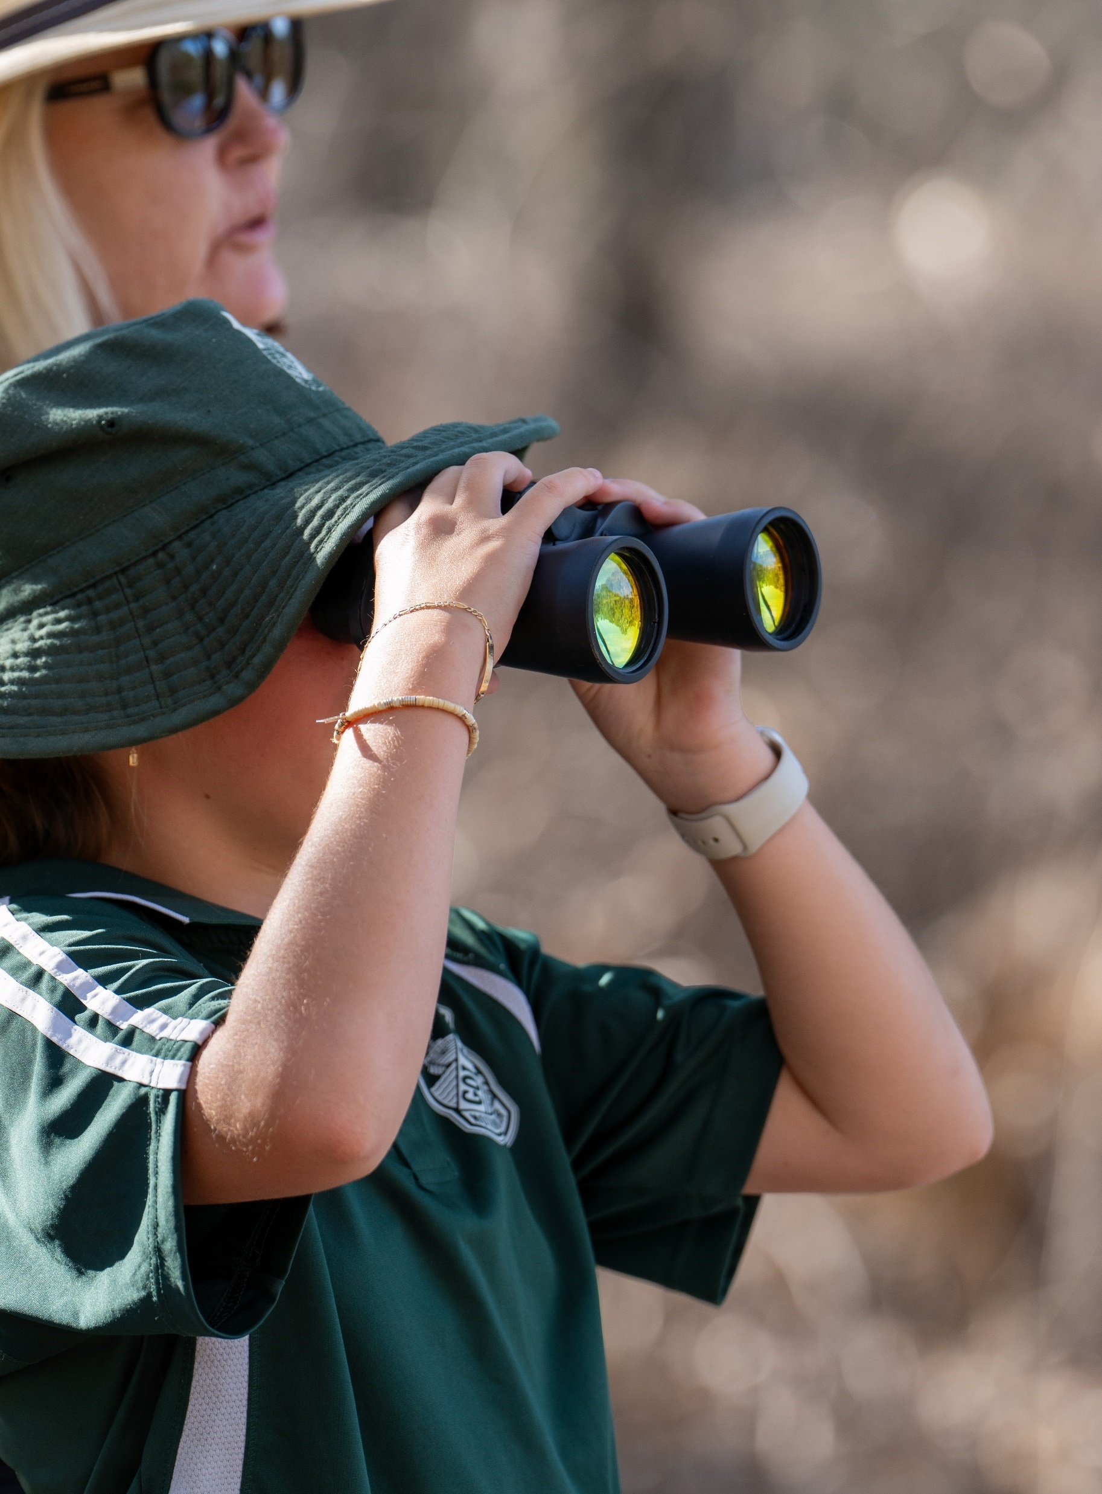
Science and Technology K–6
Familiarisation resource

Slide 2
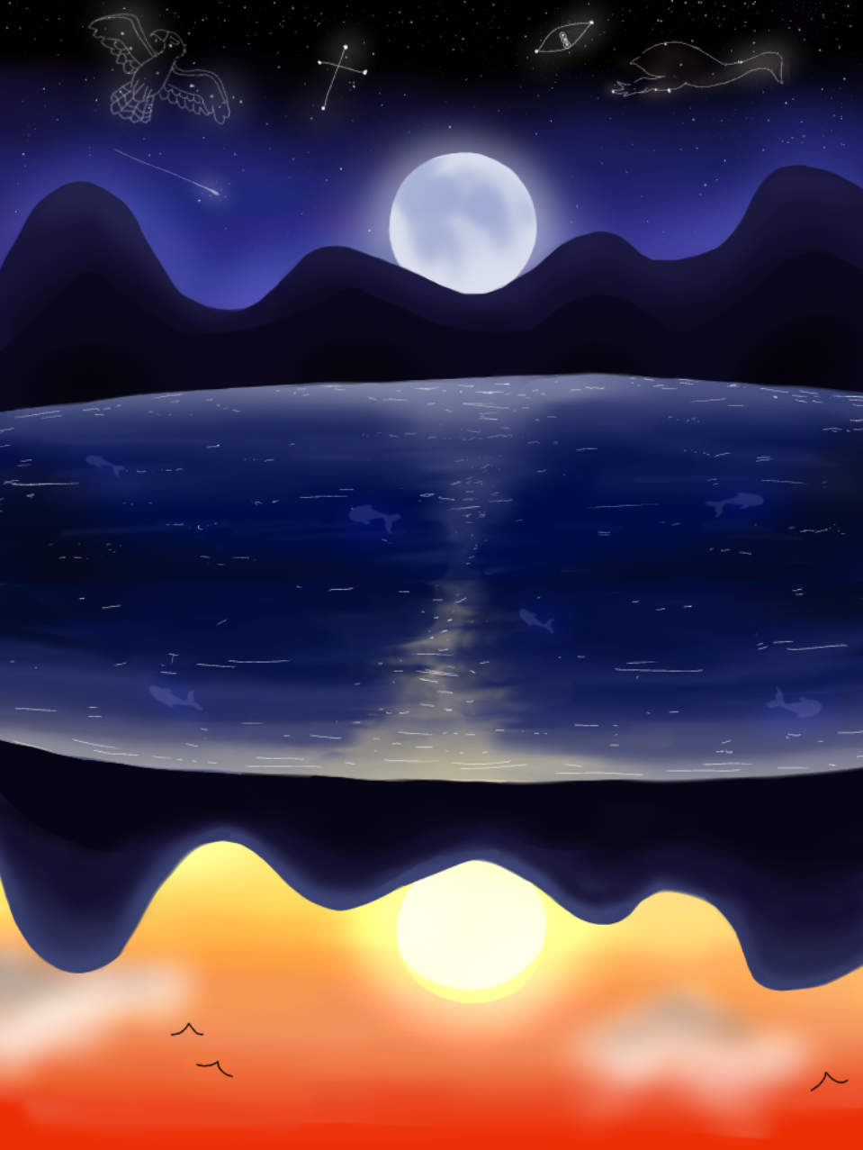
Acknowledgement of Country
We recognise the Ongoing Custodians of the lands and waterways where we work and live. We pay respect to Elders past and present as ongoing teachers of knowledge, songlines and stories. We strive to ensure every Aboriginal and Torres Strait Islander learner in NSW achieves their potential through education.
‘Reflections’ created by Zara Marulanda from Blaxland High School as part of the 2021 Schools Reconciliation Challenge.

Slide 3
Science and Technology...​
"…intends to build on students’ natural curiosity and inventiveness, providing opportunities to explore the natural and designed world, test ideas, and make decisions based on data and evidence."
NESA, 2024
3
Notes:
NESA emphasises the importance of providing opportunities for students to investigate and invent, to explore the natural and designed world around them, to build an understanding of natural phenomena, to test ideas and make decisions based on data and evidence.

Slide 4
Research and the syllabus
New knowledge broken down into 'meaningful components' and introduced sequentially 'can support all pupils to learn scientific concepts' (Ofsted 2021).
Making connections between concepts and processes paves the way for a learner to apply their learning to new situations. This progression of learning encompasses the development of knowledge from a foundational level to understanding and then application (Almarode et al. 2018).
Knowledge about science includes learning 'ways of scientific thinking and working' (practices) and 'understanding the nature of science' (Anders et al. 2018).
https://curriculum.nsw.edu.au/learning-areas/science/science-and-technology-k-6-2024/teaching-and-learning
4
Notes:
Read through the rationale and aim of the new Science and Technology K-6 syllabus.
Consider the research on this slide and discuss how the rationale and aim are influenced by the research.
NESA Teaching and Learning advice page.
https://curriculum.nsw.edu.au/learning-areas/science/science-and-technology-k-6-2024/teaching-and-learning

Slide 5
Reflective questions
Use the reflective questions to guide discussion in your teams:
To what extent do staff understand the new syllabus?
What syllabus content professional learning is needed?
How will the new syllabus affect classroom practice?
How will stage planning accommodate the requirements of the new syllabus?
What new resources are required to implement the new syllabus?
5
Notes:
Reflect on your current teaching of Science and Technology. To foster a knowledge-rich environment that promotes curiosity in the world around us, consider the questions on the slide.

Slide 6
References
This presentation contains NSW Curriculum and syllabus content. The NSW Curriculum is developed by the NSW Education Standards Authority. This content is prepared by NESA for and on behalf of the Crown in the right of the State of New South Wales. The material is protected by Crown copyright.
Please refer to the NESA Copyright Disclaimer for more information https://educationstandards.nsw.edu.au/wps/portal/nesa/mini-footer/copyright.
NESA holds the only official and up-to-date versions of the NSW Curriculum and syllabus documents. Please visit the NSW Education Standards Authority (NESA) website https://educationstandards.nsw.edu.au/wps/portal/nesa/home and the NSW Curriculum website https://curriculum.nsw.edu.au.
Science and Technology K–6 © Syllabus NSW Education Standards Authority (NESA) for and on behalf of the Crown in right of the State of New South Wales, 2024.
Almarode JT, Fisher D, Frey N and Hattie J (2018) Visible Learning for Science, Grades K–12: What Works Best to Optimize Student Learning, 1st edn, Corwin.
Anders Y, Hardy I, Pauen S, Ramseger J, Sodian B and Steffensky M (2018) Early science education – goals and process-related quality criteria for science teaching, 'Haus der kleinen Forscher' Foundation (ed), Barbara Budrich Publishers, Opladen, doi:10.3224/84740127. https://library.oapen.org/handle/20.500.12657/47414
Ofsted (Office for Standards in Education, Children's Services and Skills) (2021) Research review series: science, Ofsted, accessed 26 July 2021.
Notes:
Script points:

Slide 7
Copyright
© State of New South Wales (Department of Education), 2024
The copyright material published in this resource is subject to the Copyright Act 1968 (Cth) and is owned by the NSW Department of Education or, where indicated, by a party other than the NSW Department of Education (third-party material).
Copyright material available in this resource and owned by the NSW Department of Education is licensed under a Creative Commons Attribution 4.0 International (CC BY 4.0) license.
This license allows you to share and adapt the material for any purpose, even commercially.
Attribution should be given to © State of New South Wales (Department of Education), 2024.
Material in this resource not available under a Creative Commons license:
the NSW Department of Education logo, other logos and trademark-protected material
Material owned by a third party that has been reproduced with permission. You will need to obtain permission from the third party to reuse its material.
Links to third-party material and websites
Please note that the provided (reading/viewing material/list/links/texts) are a suggestion only and implies no endorsement, by the New South Wales Department of Education, of any author, publisher, or book title. School principals and teachers are best placed to assess the suitability of resources that would complement the curriculum and reflect the needs and interests of their students.
If you use the links provided in this document to access a third-party’s website, you acknowledge that the terms of use, including licence terms set out on the third-party’s website apply to the use which may be made of the materials on that third-party website or where permitted by the Copyright Act 1968 (Cth). The department accepts no responsibility for content on third-party websites.

