Slide 1
Instructions for use
This resource is not a teaching and learning program. It should be used in conjunction with Year 9 relationship realities teaching and learning program.
Classroom teachers are encouraged to add and adapt slides as required to meet the needs of their students.
Save a copy of the file to make changes to the slide deck. Go to File > Download a Copy (this downloads a copy to the computer to edit in the PowerPoint app).
To convert the PowerPoint to Google Slides:
  Upload the file into Google Drive and open it.
  Go to File > Save as Google Slides.
  (Note – conversion may cause formatting changes in the slides.)

Slide 2
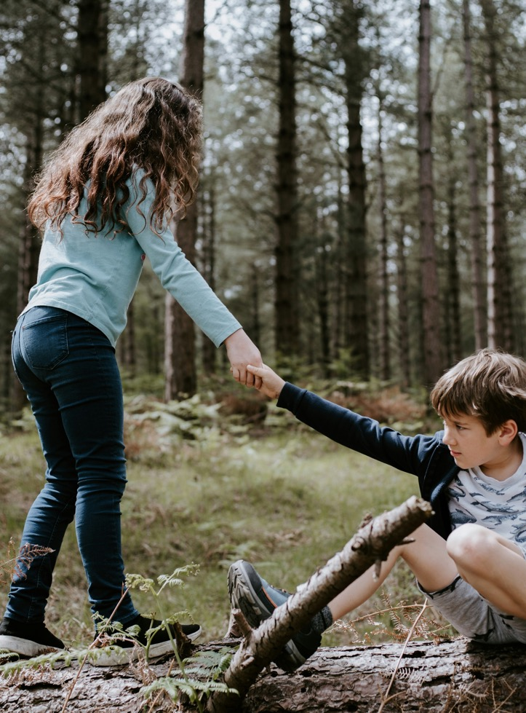
Relationship Realities
PDHPE
Stage 5 – Year 9
Term 2
Photo by Annie Spratt on Unsplash

Slide 3
Learning sequences
1
Building the foundations for healthy, respectful relationships
2
Positive communication for healthy, respectful relationships
3
Understanding power and respect
4
How media shapes our understanding of respectful relationships
Notes:
Teacher notes:
Click lesson numbers to go to specific lessons
Interactive features can be viewed in slide show
Notes for vendors [to be removed after slide deck creation]:
Create hyperlinks to dividers that match lesson numbers by
Right click on the number>edit link>select slide in deck to connect to

Slide 4
Learning sequence 1 – building the foundations for healthy, respectful relationships

Slide 5
Learning intentions and success criteria
We are learning to
explain the characteristics of inclusive, equal, safe and respectful relationships
explain how ethical behaviour can build and maintain respectful relationships.
I can
describe what makes relationships inclusive, equal, safe, and respectful
identify and explain how ethical behaviour helps build and maintain respectful relationships
compare respectful relationships online and offline, including their benefits and risks
describe the rights and responsibilities that support healthy, respectful relationships
Notes:
Notes for teachers:
Learning intentions and success criteria are best co-constructed with students. Adapt the learning intention as required and add matching success criteria.
For more information See ⁠AITSL or the NSW Department of Education explicit teaching strategies, ⁠Sharing learning intentions and ⁠Sharing success criteria
LISC is not necessarily presented at the beginning of the lesson. Teacher needs to consider most effectual time to introduce
LISC should be revisited during the lesson to support students' evaluation of their learning

Slide 6
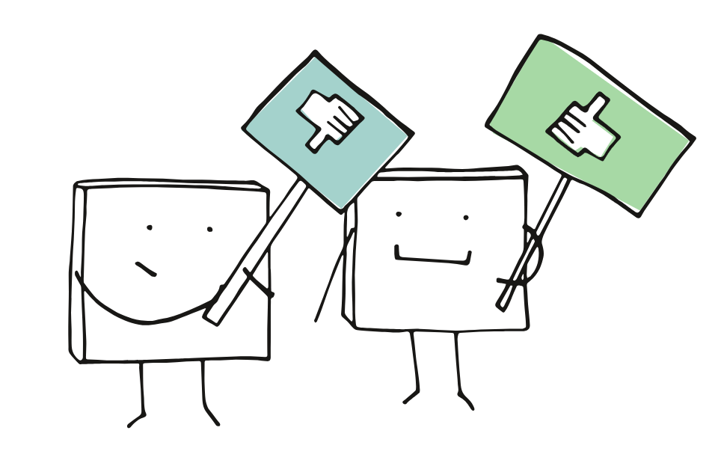
What is a respectful relationship? (1)
Introduction of terms
Inclusivity means ensuring that everyone is treated with dignity and fairness, regardless of their background, identity, or beliefs.
Equality is the principle of ensuring that all individuals have the same rights, opportunities, and treatment, regardless of their differences. It is about creating a level playing field where everyone is treated fairly and without discrimination.
Respect is recognising and valuing the worth, feelings, rights, and opinions of others.
Image by Manfred Steger from Pixabay

Slide 7
What is a respectful relationship? (2)
Think - A respectful relationship ...
Feels like
Looks like
Sounds like

Slide 8

What is a respectful relationship? (3)
Pair – What qualities are necessary to promote inclusivity, equality, safety and respect?
Highlight responses from the Y chart that support inclusivity, equality, safety and respect
Using the building respectful relationships activity cards discuss the qualities of respectful relationships
Add relevant qualities to your Y chart.
Image by Manfred Steger from Pixabay
Notes:
Image by Sly from Pixabay

Slide 9

What is a respectful relationship (4)
Share - Class discussion
How do respectful relationships in our life shape our identity?
How do respectful relationships in our life influence our sense of belonging?
Why are positive, respectful relationships important to your life, health and wellbeing?
Image by Sly from Pixabay
Notes:
Image by Sly from Pixabay

Slide 10
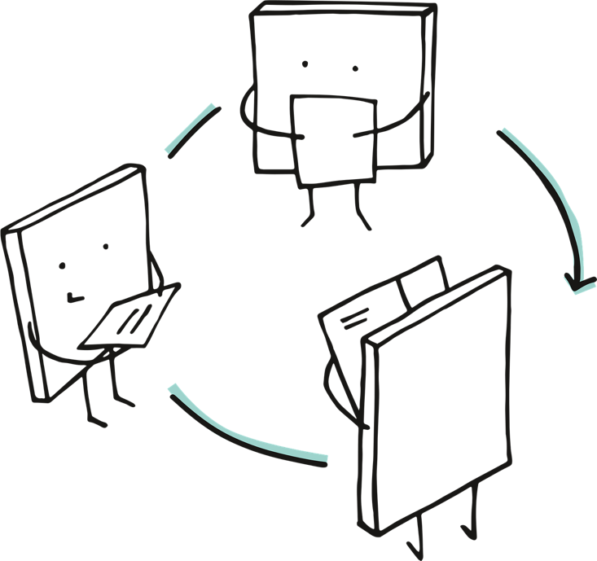
Characteristics of a respectful relationship (1)
Group activity
In your group:
review and discuss each characteristic and feature of a respectful relationship on your set of cards
work together to agree on how to order the characteristics/ features from highest to lowest importance in a relationship
share your top 5 characteristics/ features with the rest of the class.
Image by Manfred Steger from Pixabay
Notes:
Image by Manfred Steger from Pixabay

Slide 11
Characteristics of a respectful relationship (2)
Class discussion
      What similarities or differences did you notice between your group’s top five and other groups’ lists?
      Why do you think certain characteristics were considered more important than others?
      How might the “most important” characteristics change depending on the type of relationship?
Image by Sly from Pixabay
Notes:
Image by Sly from Pixabay

Slide 12
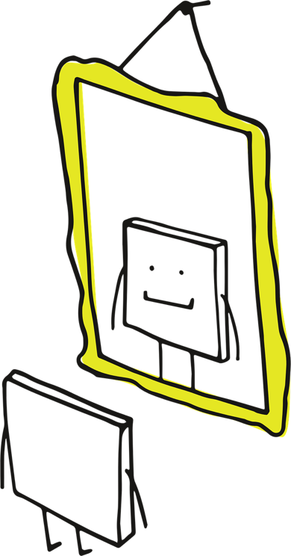
Characteristics of a respectful relationship (3)
Individual reflection
Reflect on your ordered characteristics and features of a respectful relationship, and your answers on your Y-chart, to identify someone in your life who you have a strong positive and respectful relationship with.
Write a letter to your chosen person to explain how they have impacted your life in a positive way, telling them about the positive qualities of your relationship.
Image by Manfred Steger from Pixabay
Notes:
Image by Manfred Steger from Pixabay

Slide 13

The language of relationships
Relationships glossary
Throughout this term we will refer to a glossary with a range of words relating to relationships. It is important that we have a shared understanding of what these words mean.
Work individually or in a pair to match the glossary words with the correct definition.
Image by Pixaline from Pixabay

Slide 14
Respectful relationships online and offline (1)
Features
The way we interact with others and the relationships that we form online can be different to those in person. This can impact how we engage in relationships with others in these environments.
Complete a list of features for both online and offline relationships.
Use a highlighter to annotate the positive and negative aspects of both online and offline relationships.
Online relationships | Offline relationships

Slide 15
Respectful relationships online and offline (2)
Class discussion
What are the main benefits of online relationships?
What are some of the risks associated with online relationships?
What are the benefits of in-person relationships?
What are some of the risks associated with in-person relationships?
Do the characteristics of respectful relationships look the same or different online compared to in-person?
Image by Sly from Pixabay
Notes:
Image by Sly from Pixabay

Slide 16
Relationship rights and responsibilities
Healthy and respectful relationships are the right and responsibility of everyone.
Rights:
are things people are entitled to. E.g right to be safe, to have their bodies, thoughts, and feelings respected, and to be treated fairly.
Responsibilities:
are a role or task which is yours to do. Carrying out responsibilities can ensure that rights are met.
Individually, write a list of rights and responsibilities that foster healthy, respectful relationships.

Slide 17

Co-constructing a code of conduct
During this program, you will learn about:
relationships
respect
power
sex and other topics that can be considered sensitive.
To make sure everyone feels safe and valued, we will create a class code of conduct.
These are shared agreements that guide how we talk and listen to each other.
Image by Manfred Steger from Pixabay

Slide 18
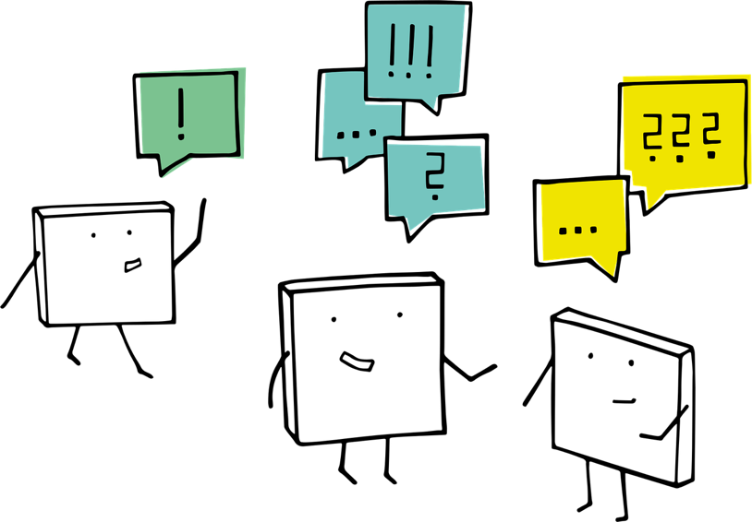
Co-constructing a code of conduct activity
Individually: write down 3-4 points about what makes you feel safe, respected, and able to share in class discussions.
In your small group: share your ideas and decide on your groups top 3-4 points. You will share this with the class.
As a class: we will identify the key themes that have emerged and develop a code of conduct that represents the class values.
Image by Manfred Steger from Pixabay
Notes:
Image by Manfred Steger from Pixabay

Slide 19
Values, morals and ethics
Turn and talk: what do each of these words mean?
Values
Morals
Ethics
Your ideas will be used to develop class definitions.
Image by Manfred Steger from Pixabay
Individually, write down 2 or more examples of your personal values, morals and ethics and how they influence your thoughts and feelings.
Notes:
Image by Manfred Steger from Pixabay
Values are what we believe is important.
Morals are beliefs about right and wrong behaviour.
Ethics are rules or principles that guide what is considered right or wrong behaviour.

Slide 20
Values, morals and ethics discussion
Class discussion
How are values, morals and ethics related?
Image by Sly from Pixabay
Notes:
Image by Sly from Pixabay

Slide 21
Ethics in action
Sometimes ethical choices can be straightforward, but they often they involve difficult situations where there isn’t a clear “right” answer. When faced with these choices, we rely on information including past experiences, values and morals to inform our decisions.
Understanding ethics helps us think carefully about our actions and consider the impact on others.
In pairs, read the ethical dilemma you have been allocated and annotate the scenario with the following:
What values and morals are relevant in the scenario?
What makes the choice difficult?

Slide 22
Ethics in action discussion
Think, pair, share
How does behaving in an ethical way impact relationships?
Image by Sly from Pixabay
Notes:
Image by Sly from Pixabay

Slide 23
Learning sequence 2 – positive communication for healthy, respectful relationships

Slide 24
Learning intentions and success criteria (1)
We are learning to
understand personal boundaries including physical, emotional, social, and digital and how they can change in different situations and relationships.
understand consent, how it connects to boundaries, and how our values influence respectful relationships.
communicate our needs and boundaries assertively and respectfully in everyday, intimate, and sexual relationships.
I can
identify my own boundaries and explain how they may change depending on the relationship or situation.
explain consent and connect it to personal values and respectful relationships.
understand and demonstrate the skills of assertive communication to express my feelings, needs, and boundaries clearly and respectfully
Notes:
Notes for teachers:
Learning intentions and success criteria are best co-constructed with students. Adapt the learning intention as required and add matching success criteria.
For more information See ⁠AITSL or the NSW Department of Education explicit teaching strategies, ⁠Sharing learning intentions and ⁠Sharing success criteria
LISC is not necessarily presented at the beginning of the lesson. Teacher needs to consider most effectual time to introduce
LISC should be revisited during the lesson to support students' evaluation of their learning

Slide 25
Exploring boundaries (1)
Boundaries are the limits we set for ourselves about what we are comfortable with and what we are not. They are an important part of respectful relationships. Everyone’s boundaries can be different and that’s okay. It is important to know where our own limits are, and to respect other people’s limits as well. These boundaries can also change over time and can be influenced by a range of factors.

Slide 26
Exploring boundaries (2)
Draw the following brainstorm on a piece of paper and add your responses:
Physical
Emotional
for example. I do not like being hugged by non-family members
Social
Digital
for example. I want to check photos of me before others share them online

Slide 27
Defining my boundaries (1)
Consider a good friend and decide where the following fit for you in your boundaries:
sharing stationary
sharing a password
hugging
letting them look at your phone
Never ok
Sometimes ok
Always ok

Slide 28

Defining my boundaries (2)
Class discussion
How would your boundaries change if:
        the person was a close family member instead of a friend?
        the person was someone you didn’t know well?
        you were in a romantic relationship with that person?
What other factors might influence your boundaries to shift?
Why do different people have different boundaries?
What can we do to ensure we are respecting other people’s boundaries?
What can we do to ensure that other people understand our boundaries?
Image by Sly from Pixabay
Notes:
Image by Sly from Pixabay

Slide 29

Exploring boundaries and values (1)
Select 3 to 5 of the ‘never ok’ examples from the boundaries worksheet and match what this is connected to, for example, privacy, honesty, respect .
Create a list of rights and responsibilities regarding your boundaries (using your previous rights and responsibilities list).
For example, my boundary is not sharing my password with my friends. This links to the value of privacy which aligns with my right to not share personal information. I then have a responsibility to not request the passwords of others.
Image by Manfred Steger from Pixabay

Slide 30
Exploring boundaries and values (2)
Class discussion
Discuss your responses
Consider how rights and responsibilities and ethical behaviour can enhance respectful relationships.
Image by Sly from Pixabay
Notes:
Image by Sly from Pixabay

Slide 31
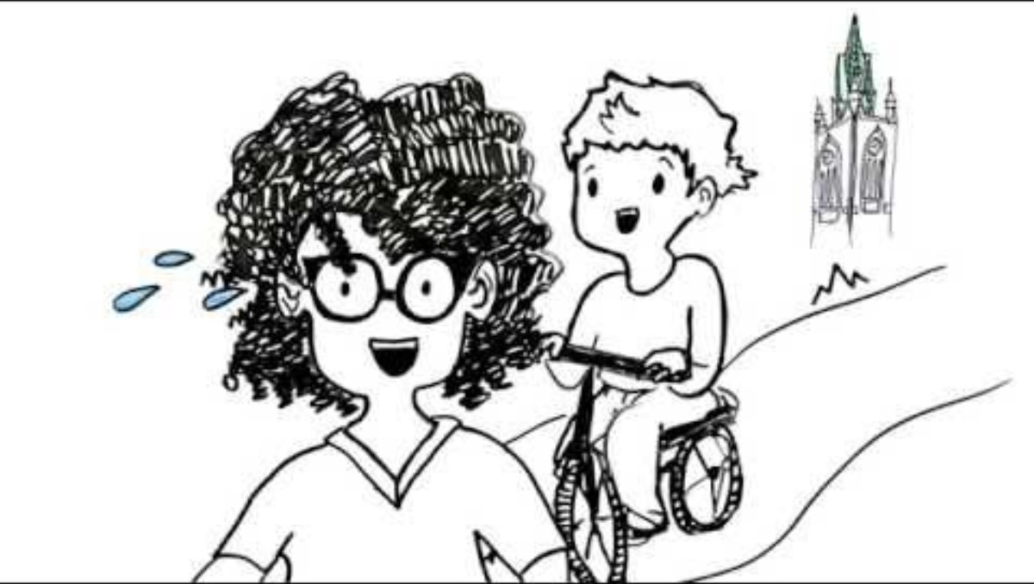
Understanding consent (1)
Cycling through consent
Notes:
Video link: https://youtu.be/-JwlKjRaUaw?si=Ro8ErvxEITuYwByD

Slide 32
Understanding consent (2)
Providing or not providing consent is a way that we can ensure that we have a shared understanding of one another’s boundaries.
Consent is an “informed and freely given agreement to engage in an activity, or for a specific thing to happen. Consent is denied when someone does not have the capacity to give consent.” (PDHPE 7-10 Syllabus, NESA)

Slide 33
Understanding consent (3)
Y-Chart
Feels like
Looks like
Sounds like

Slide 34
Understanding consent – true or false? (1)
Consent means agreeing to something freely and willingly.
If someone is silent or doesn’t say “no,” that means they are giving consent.
You can withdraw your consent at any time, even after saying yes.
Consent needs to be clear and enthusiastic, not just a quiet “okay.”
If someone is under the influence of alcohol or drugs, they can still give valid consent.
You should always ask for consent before touching someone, even in casual situations like hugs.
Once you say “yes” to something, you cannot change your mind later.
Consent can be given verbally or through clear actions, but not through body language alone.
It is okay to pressure someone into saying yes if you really want them to agree.
Only people in romantic relationships need to worry about consent.
Notes:
NOTE: Answers can be found in the teaching and learning program: 9PDHPE-relationship realities-program, appendix 5 – is it consent? Could these be numbered instead of bulleted to make reference to questions easier.

Slide 35
Understanding consent – true or false? (2)
You should respect a “no” without trying to persuade or argue.
Consent for one activity automatically means consent for other activities.
It’s important to check in with someone regularly to make sure they still consent.
If someone agrees to something because they are scared or feel pressured, that is true consent.
You don’t have to ask for consent if you have done the activity before with the same person.
Consent is a continuous process, not a one-time question.
It’s okay to share someone’s personal information or photos if they didn’t explicitly say no.
If someone is asleep or unconscious, they cannot give consent.
Consent applies only to physical touch, not to things like sharing personal stories or photos.
You should always listen and respect boundaries even if you don’t understand them.

Slide 36
Understanding consent – true or false? (3)
If someone says “maybe,” it means they are still deciding and you should wait for a clear answer.
If someone changes their mind and says “stop,” you must stop immediately.
Consent is only necessary for sexual activities.
Non-verbal cues like pulling away or avoiding eye contact can indicate a lack of consent.
It is okay to guess what someone wants if they don’t clearly say no.
Asking for consent shows respect and care for other people’s feelings and boundaries.
Consent means that both people feel comfortable and safe with the situation.
It’s okay to continue if someone looks unsure but doesn’t say no out loud.
You should talk about consent and boundaries openly with friends and partners.

Slide 37
Understanding consent discussion
Class discussion
What should you do if you are unsure whether consent has been given?
How is consent linked to boundaries?
What might influence how comfortable someone is when it comes to asking for consent?
What might influence how comfortable someone is in not giving consent?
Image by Sly from Pixabay
Notes:
Image by Sly from Pixabay

Slide 38
Intimate and sexual relationships
Class discussion
Are there any differences in the rights and responsibilities of platonic, intimate and sexual relationships?
Why or why not?
Image by Sly from Pixabay
Notes:
Image by Sly from Pixabay

Slide 39
Intimate and sexual relationships compared
Platonic
Triple Venn Diagram
Features of platonic
Platonic relationships are relationships that are close, caring, and affectionate but non-romantic and non-sexual. For example, friends, teammates.
Intimate relationships are relationships where people share emotional closeness, trust, and personal connection, and may involve romantic feelings or sexual attraction, but intimacy doesn’t always include sexual activity.
Sexual relationships are relationships that include sexual activity or sexual expression between people and often involved emotional or romantic connection.
Intimate
Features of intimate
Features of sexual
Sexual

Slide 40
Intimate and sexual relationships discussion
Class discussion
Why is it important to set boundaries in sexual relationships?
What might influence people to have different ideas about what they consider to be sexual behaviours?
How can a clear understanding of the sexual behaviours and personal boundaries help someone negotiate consent assertively?
What verbal and non-verbal ways can someone use to clearly show they don’t give consent? (for example, tone, body language, facial expression, distancing, lack of a response)
Image by Sly from Pixabay
Notes:
Image by Sly from Pixabay

Slide 41
Intimate and sexual relationships – rights and responsibilities
Add to your rights and responsibilities list from the previous lesson to include rights and responsibilities in intimate or sexual relationships. For example:
Rights:
to say yes or no to any sexual activity
to change your mind at any time
to be treated with respect and without pressure
to privacy and confidentiality
to feel safe emotionally and physically.
Responsibilities:
to gain clear consent every time
to respect boundaries and stop immediately if consent changes
to communicate openly and honestly
to look after your partner’s wellbeing and your own
to avoid pressure, coercion or manipulation.

Slide 42

Sex and consent
Notes:
Video link: https://youtu.be/daH5T6KS9pk?si=gjWq2Ga2inecZnIF

Slide 43
Sex and consent – the law
While there are no laws about when you can start to have a relationship with someone else, there are laws about when you can start to have sex.
If you are 12 to 15 years of age, a person can’t have sex with you, touch you sexually or perform a sexual act in front of you if they are more than two years older than you – even if you agree. And that means two years exactly. If they are two years and four days older, it is still against the law.
At 16 to 17 years of age, a person who is caring for you or supervising you, like a teacher, youth worker or foster carer, can’t have sex with you, sexually touch you or perform a sexual act in front of you – even if you agree – unless they are married to you.
As well as imposing age limits, the law says that two people can’t have sex unless they both agree (consent) to. If you don’t agree and someone threatens you or touches you sexually they are breaking the law. If someone has sex with you or touches you sexually when you are asleep, unconscious or so affected by alcohol or drugs that you are not able to agree, it is still sexual assault.

Slide 44
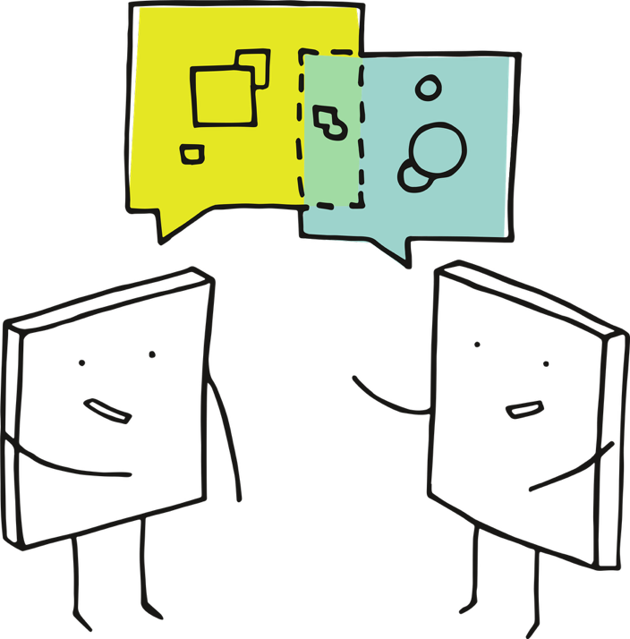
Assertive communication (1)
Communicating effectively is critical in all relationships.
Brainstorm the types of things that need to be communicated in any type of relationship in addition to consent e.g. communicating about contributing to a group project.
Image by Manfred Steger from Pixabay
Notes:
Image by Mohamed Hassan from Pixabay

Slide 45
Assertive communication (2)
Passive communication
"I guess it’s fine if you don’t show up. We’ll manage somehow."
The way we communicate is also critical to fostering positive relationships.
Consider the example of communicating about contributing to a group project.
Aggressive communication
"Oh, it’s cool that you’re so busy doing ‘other things’ instead of helping us."
Assertive communication
"I’ve noticed you haven’t been able to attend our group meetings, and I feel concerned because we need everyone’s input to finish the project. Can we talk about how you can contribute moving forward."

Slide 46
Assertive communication – “I” statements
A way to assertively communicate and express your feelings and needs clearly and respectfully is by using "I" statements.
“I feel [emotion] when [situation] because [reason]. I would like [desired outcome].”
For example:
"I feel upset when my ideas are ignored because I want to contribute to the group. I would like us to listen to everyone’s thoughts."
"I feel stressed when assignments are left until the last minute because it’s hard to do my best work. I would like us to plan ahead together."

Slide 47
Assertive communication – “I” statement scenarios
In pairs, choose one or two scenarios at school or with friends that might make you feel upset, frustrated, or uncomfortable and write an “I” statement to communicate your feelings.
Image by Manfred Steger from Pixabay
Notes:
Image by Manfred Steger from Pixabay

Slide 48
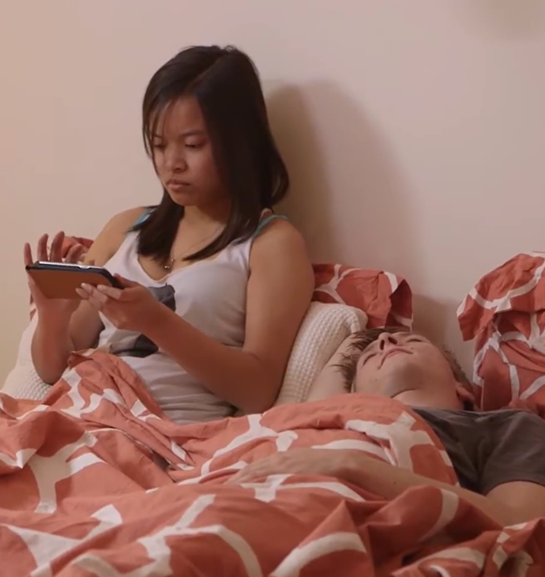
Communicating assertively
Revisit the consent video – learning the Law featuring Carla and Jimmy
Construct a script for a pre-screen conversation where Carla and Jimmy communicate their physical boundaries and clearly give consent for the sexual behaviours, they are willing to share.
Image from Consent video – Victorian Legal Aid

Slide 49
Communicating boundaries and consent
Class discussion
What can make it hard to communicate assertively? For example, when communicating with someone older than you, or communicating about things when you have a difference of opinion to someone.
Image by Sly from Pixabay
Notes:
Image by Sly from Pixabay

Slide 50
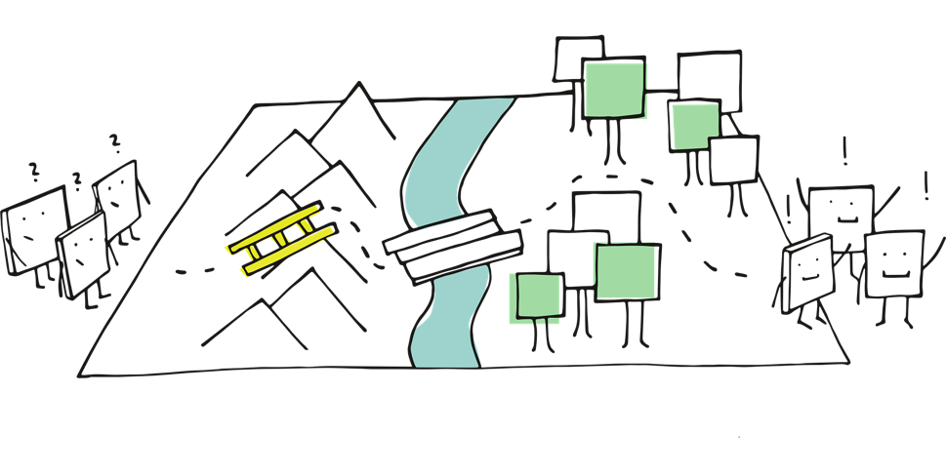
Communicating boundaries and consent – role play
Group work
In your group:
you will be provided with two different scenarios which require assertive communication skills.
work together to create a role play of each of the scenarios demonstrating assertive communication skills.
Image by Manfred Steger from Pixabay

Slide 51

Communicating boundaries and consent – discussion
Class discussion
What are the real-life challenges in communicating assertively in different scenarios?
What personal strengths support us in communicating assertively to maintain our boundaries and communicate our needs?
What strategies can we develop to support ourselves in communicating assertively to maintain our boundaries and communicate our needs?
If we feel uncomfortable communicating assertively, what are other options we can use to maintain our boundaries or remove ourselves from potentially unsafe situations?
Notes:
Image by Sly from Pixabay

Slide 52
Learning sequence 3 – understanding power and respect

Slide 53
Learning intentions and success criteria (2)
We are learning to
understand power in relationships, including how it can be used positively or negatively, and how it affects communication, boundaries, and consent.
recognise unhealthy or abusive behaviours and understand which support services are available and when to use them.
identify support networks and services and how to seek help in different situations.
I can
explain what power is, identify who holds power in a situation, and describe how it affects communication, boundaries, and consent.
recognise signs of unhealthy or abusive behaviour and implement protective strategies to keep myself and others safe
identify and assess trusted people, support services and recommend appropriate sources of help to keep myself and others safe.
Notes:
Notes for teachers:
Learning intentions and success criteria are best co-constructed with students. Adapt the learning intention as required and add matching success criteria.
For more information See ⁠AITSL or the NSW Department of Education explicit teaching strategies, ⁠Sharing learning intentions and ⁠Sharing success criteria
LISC is not necessarily presented at the beginning of the lesson. Teacher needs to consider most effectual time to introduce
LISC should be revisited during the lesson to support students' evaluation of their learning

Slide 54
Support networks
Your support network includes the trusted people who you can go to for advice or support. Some examples of these support network individuals may include friends, parents, extended family, family friends, teachers, school counsellors, coaches.
The person you may want support from can change depending on the scenario. Reflect on who you would go to is you were experiencing an issue with a:
Friend at school
Teacher
Partner
Parent
Boss
Coach
Turn and talk to a partner to share your answers.

Slide 55

Understanding power in relationships
Power is the ability to influence or control what happens.
Class brainstorm: what are roles and positions where people have power?
Turn and talk: what gives someone power?
Class discussion: how do you know when you have power in a relationship with someone?
Image by Manfred Steger from Pixabay
Notes:
Image by Manfred Steger from Pixabay

Slide 56
Understanding power in relationships – types of power
In pairs: match each type of power with the definition and examples provided on your worksheet.
Image by Manfred Steger from Pixabay
Notes:
Image by Manfred Steger from Pixabay

Slide 57
Understanding power in relationships – think pair share
How power can be used:
Positive | Negative

Slide 58
Understanding power in relationships discussion
Class discussion
How does the use of power relate to values and ethical behaviour?
Image by Sly from Pixabay
Notes:
Image by Sly from Pixabay

Slide 59
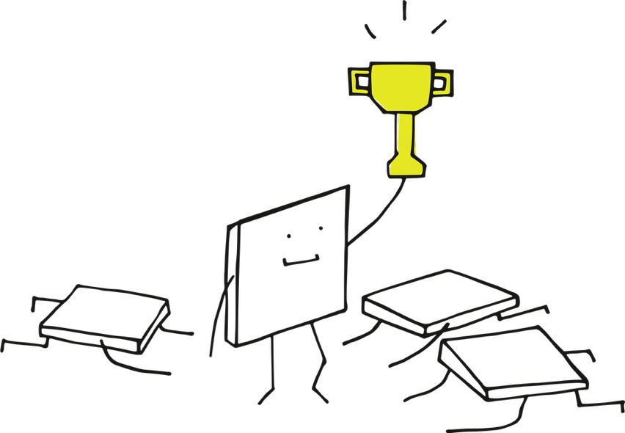
Power in relationships scenarios
In pairs, analyse the scenarios on your worksheet and answer the following questions
Who has power?
What type of power is being used?
Is it being used in a positive or negative way? How?
If the scenario shows the negative use of power, how does this impact someone communicating their boundaries? and what strategies could be employed to address power imbalances?
Image by Manfred Steger from Pixabay
Notes:
Image by Manfred Steger from Pixabay

Slide 60
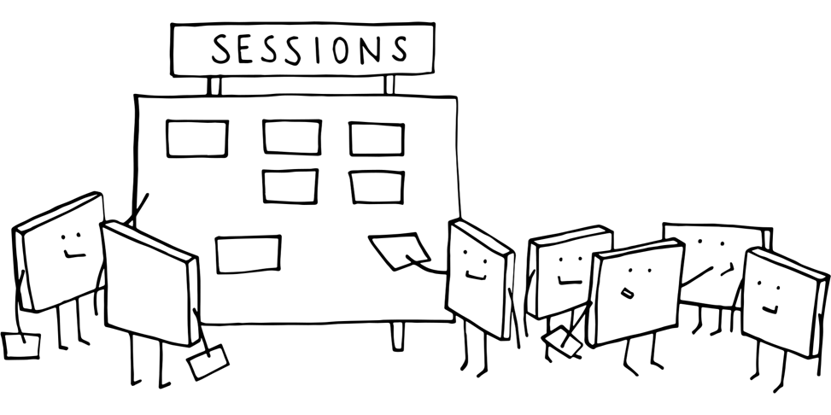
Power in relationships
Class discussion
Share your thinking and collate responses .
Create a list of strategies that could address power imbalance and display this within the classroom.
For example, use assertive communication, clearly communicate personal boundaries …
Image by Manfred Steger from Pixabay
Notes:
Image by Sly from Pixabay

Slide 61
Power – true or false?
Hands on head for true, hands on hips for false
Power imbalances can make it harder for someone to say no or give true consent.
When one person has more authority (like a teacher, coach, or older peer), they must be especially careful to respect boundaries.
People might say “yes” because they feel pressured by someone with more power, even if they don’t want to.
It’s okay to use your position of power to get someone to agree to something.
Friends should never pressure each other to do things they’re uncomfortable with.
People in a relationship with unequal power (age, money, fame) have the same ability to give free consent as those with equal power.
If someone feels scared or intimidated, their consent is not freely given.
It’s important to recognise when power is being misused to influence decisions or boundaries.
Power can affect how comfortable someone feels communicating their boundaries.
People with less power should avoid expressing their boundaries to prevent conflict.
Notes:
NOTE: Answers can be found in the teaching and learning program: 9PDHPE-relationship realities-program, appendix 10 – power true or false statements

Slide 62
Power – discussion (1)
What strategies can we use to address the impact of power imbalances or the negative use of power when communicating our boundaries and providing consent?
What could you do if you feel pressured by someone who has more power, such as age, status, authority or confidence?
How can practicing assertive communication help you express your boundaries in situations where power feels uneven?
If you recognise that you have more power in a situation, what can you do to make sure the other person feels safe and able to give true consent?
Notes:
Image by Sly from Pixabay

Slide 63
Power – discussion (2)
What are some questions or check-in statements people can use to reduce pressure and make sure consent is mutual? For example, “Are you comfortable?”, “It’s completely okay to say no,” “We can stop anytime.”
What role do trusted adults such as teachers, counsellors, or family play when power is being misused, and how can someone seek support safely?
What might be a safe ‘exit plan’ someone could use if they feel pressured or unsafe? For example, calling a friend, leaving the space, messaging someone for help.
Notes:
Image by Sly from Pixabay

Slide 64
Violence and abuse
Sometimes relationships can be unhealthy or harmful. Violence and abuse can happen in any kind of relationship. It is never okay. It is important to understand what abuse looks like so we can recognise it, know how it affects people, and learn how to respond safely and supportively. Abuse can take many forms, not just physical, but emotional, verbal, sexual, and even digital.

Slide 65

Violence and abuse – card activity
Pair activity
You will be provided with a set of cards listing different types of abuse with their definition, and another set or cards that identify behaviours that are associated with that type of abuse
Work in pairs to match the type of abuse with the behaviours.
Image by Manfred Steger from Pixabay
Notes:
Image by Manfred Steger from Pixabay

Slide 66

Relationship support services
In pairs, complete a PMI chart for 3 of the following support services:
Relationships Australia
White ribbon
1800 respect
Domestic violence NSW
Kids helpline
Image by Manfred Steger from Pixabay

Slide 67
Relationship support services – PMI
In pairs, complete a PMI chart for 3 relationship support services. Consider the following questions:
How easy to access is this support service?
Who is this support service aimed at?
What is provided by this support service?
+
?
Plus
Minus
Interesting

Slide 68
Relationship support services discussion
Class discussion
What makes a support service purposeful and relevant?
Why is it important to have a range of support services available?
Image by Sly from Pixabay
Notes:
Image by Sly from Pixabay

Slide 69
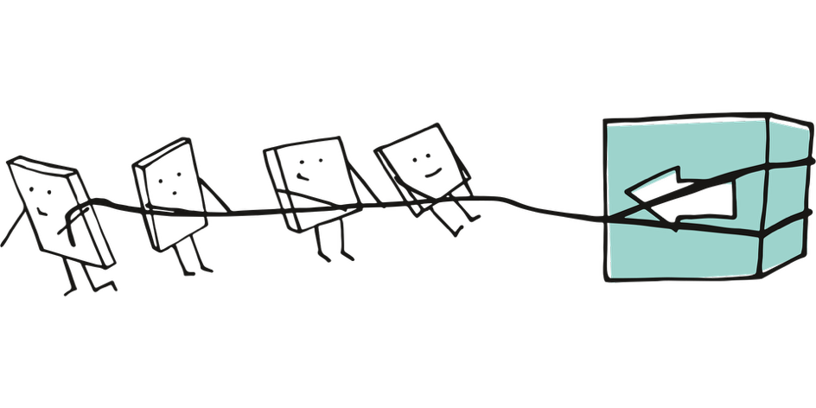
Support networks scenarios
Work in pairs to review the scenarios provided to answer the following questions:
What is the type of abuse experienced by the individual?
What are the risks to the individual?
What support service would you recommend?
Provide a justification for your choice of support service using the information from your completed support service PMI chart.
Image by Manfred Steger from Pixabay
Notes:
Image by Manfred Steger from Pixabay

Slide 70
Support networks discussion
Class discussion
When do you need to access support more specialised than someone in your support network?
How can we support a friend to access a support network if they are relying too heavily on us for support?
What barriers might someone face when trying to access support services, and how can these be overcome?
Why is it important to recognise the risks involved in these situations?
How can we protect our own emotional health when supporting friends who are going through tough situations?
How can schools and communities create safer environments for students to speak up and ask for help?
Notes:
Image by Manfred Steger from Pixabay

Slide 71
Learning sequence 4 – how media shapes our understanding of respectful relationships

Slide 72
Learning intentions and success criteria (3)
We are learning to
understand key terms about identity and use accurate inclusive language to recognise diversity and challenge assumptions.
analyse and explore how media including pornography shapes our ideas about respectful and consensual relationships.
recognise harmful stereotypes and communicate our expectations and boundaries respectfully.
I can
define key terms, identify stereotypes, and use respectful, inclusive language
explore how media including social media and pornography can shape our ideas about relationships, gender and sexuality
identify harmful stereotypes and explain the importance of speaking up respectfully about our boundaries, values and expectations.
Notes:
Notes for teachers:
Learning intentions and success criteria are best co-constructed with students. Adapt the learning intention as required and add matching success criteria.
For more information See ⁠AITSL or the NSW Department of Education explicit teaching strategies, ⁠Sharing learning intentions and ⁠Sharing success criteria
LISC is not necessarily presented at the beginning of the lesson. Teacher needs to consider most effectual time to introduce
LISC should be revisited during the lesson to support students' evaluation of their learning

Slide 73
Gender, sex and sexuality
Review the following terms from your glossary:
Sex (biological)
Gender
Sexuality
Gender stereotypes
Femininity
Masculinity
LGBTIQA+

Slide 74
Gender, sex and sexuality quiz – question 1
Which of the following best describes sexuality?
The clothes someone wears
Who a person is emotionally, romantically or sexually attracted to
The biological differences between male and female bodies
How a person expresses themselves socially
Answer: b. Who a person is emotionally, romantically or sexually attracted to
Explanation: sexuality is about attraction (romantic, emotional, physical). It’s not the same as gender or expression.
Notes:
NOTE: Each question slide will animate with the answer and explanation

Slide 75
Gender, sex and sexuality quiz – question 2
Which statement is correct?
Only men can be attracted to women
Gender and sexuality are fixed and never change
Gender is about identity and social roles, while sex is about biology
You can guess someone’s sexuality by the way they look or act
Answer: c. Gender is about identity and social roles, while sex is about biology
Explanation: Gender is a social and personal identity, sex is biological. The other options are myths or stereotypes.
Notes:
NOTE: This question slide will animate with the answer and explanation

Slide 76
Gender, sex and sexuality quiz – question 3
True or False:
Everyone’s gender identity matches the sex they were assigned at birth.
Answer: False
Explanation: some people are transgender or non-binary, meaning their gender identity does not match their assigned sex.
Notes:
NOTE: This question slide will animate with the answer and explanation

Slide 77
Gender, sex and sexuality quiz – question 4
True or False:
Using someone’s correct pronouns shows respect for their gender identity.
Answer: True
Explanation: respecting pronouns is important for validating a person’s identity.
Notes:
NOTE: This question slide will animate with the answer and explanation

Slide 78
Gender, sex and sexuality quiz – question 5
True or False:
Gender stereotypes, like “boys don’t cry,” can harm everyone by limiting how people express themselves.
Answer: True
Notes:
NOTE: This question slide will animate with the answer and explanation

Slide 79
Gender, sex and sexuality quiz – question 6
Which term describes a person who is attracted to people of the same gender?
Gay or Lesbian
Asexual
Pansexual
Cisgender
Answer: a. Gay or Lesbian
Notes:
NOTE: This question slide will animate with the answer and explanation

Slide 80
Gender, sex and sexuality quiz – question 7
Which of the following is NOT true?
Some people identify as non-binary
There are different sexual orientations such as bisexual, pansexual, and heterosexual
People’s understanding of their identity may change over time
Everyone experiences attraction in the same way
Answer: d. Everyone experiences attraction in the same way
Explanation: Not everyone experiences attraction in the same way. People may identify across many orientations, and their understanding of themselves may evolve.
Notes:
NOTE: This question slide will animate with the answer and explanation

Slide 81
Gender, sex and sexuality quiz – question 8
What does the term “non-binary” mean?
Someone who doesn’t identify exclusively as male or female
Someone who identifies strictly as male or female
Someone who is attracted to all genders
Someone who doesn’t have a gender
Answer: a. Someone who doesn’t identify exclusively as male or female
Notes:
NOTE: This question slide will animate with the answer and explanation

Slide 82
Gender, sex and sexuality quiz – question 9
True or False:
Sexual orientation can be changed through therapy or treatment.
Answer: False
Explanation: sexual orientation is a natural part of who a person is and cannot be changed.
Notes:
NOTE: This question slide will animate with the answer and explanation

Slide 83
Gender, sex and sexuality quiz – question 10
What is an “ally”?
Someone who identifies as LGBTQ+
Someone who supports and stands up for LGBTQ+ people
A medical professional
A person who disagrees with LGBTQ+ rights
Answer: b. Someone who supports and stands up for LGBTQ+ people
Notes:
NOTE: This question slide will animate with the answer and explanation

Slide 84
Gender, sex and sexuality quiz – question 11
Which of the following is a way to support a friend exploring their gender or sexuality?
Listen without judgement
Respect their privacy
Use the name and pronouns they choose
All of the above
Answer: d. All of the above
Notes:
NOTE: This question slide will animate with the answer and explanation

Slide 85
Relationships: expectations vs. reality brainstorm
Class discussion
Brainstorm all the different forms of media that show relationships. Write all responses on the board
Image by Sly from Pixabay
Notes:
NOTE: it is important to highlight that pornography falls into this category
Image by Sly from Pixabay

Slide 86
Relationships: expectations vs. reality reflection
Reflect and think of specific relationships that you have seen reflected in the media (consider TV shows, books, social media, other content) that you think demonstrates ideal relationships. These can be family, friend or romantic relationships.
Write a list of qualities that you see portrayed in that relationship.
Now, consider relationships that you think demonstrate negative relationships.
Write a list of qualities that you see portrayed in that relationship.
Image by Manfred Steger from Pixabay
Notes:
Image by Manfred Steger from Pixabay

Slide 87
Relationships: expectations vs. reality discussion
Class discussion
How does what we see in the media influence our understanding of positive and negative relationships?
What personal strengths and skills can help to deconstruct misleading messages and promote respectful relationships?
What personal strengths and skills can empower us to communicate our personal expectations and boundaries?
Image by Sly from Pixabay
Notes:
Image by Sly from Pixabay

Slide 88

Challenging stereotypes
A stereotype is a simplified, idea, belief or assumption about a group of people
As a class: brainstorm stereotypes that exist about sex, gender, sexuality and relationships
Individually: categorise each stereotype as masculinity stereotype, femininity stereotype or applies to people of any gender.
Image by Clker-Free-Vector-Images from Pixabay
Notes:
Image by Clker-Free-Vector-Images from Pixabay

Slide 89
Challenging stereotypes discussion
Class discussion
Where do these stereotypes come from?
In what way can stereotypes be harmful or misleading?
How can stereotypes limit the way people express themselves?
How might stereotypes affect friendships or romantic relationships?
What pressure might young people feel because of these expectations?
Image by Sly from Pixabay
Notes:
Image by Sly from Pixabay

Slide 90
Challenging stereotypes reflection
Choose one of the stereotypes from the earlier brainstorm and complete a short reflection to challenge it. Include:
What the stereotype says.
Why it is inaccurate or harmful.
Create a healthier, more inclusive message that challenges it. For example, ‘anyone can show emotions as it is a sign or strength’.
Image by Manfred Steger from Pixabay
Notes:
Image by Manfred Steger from Pixabay

Slide 91
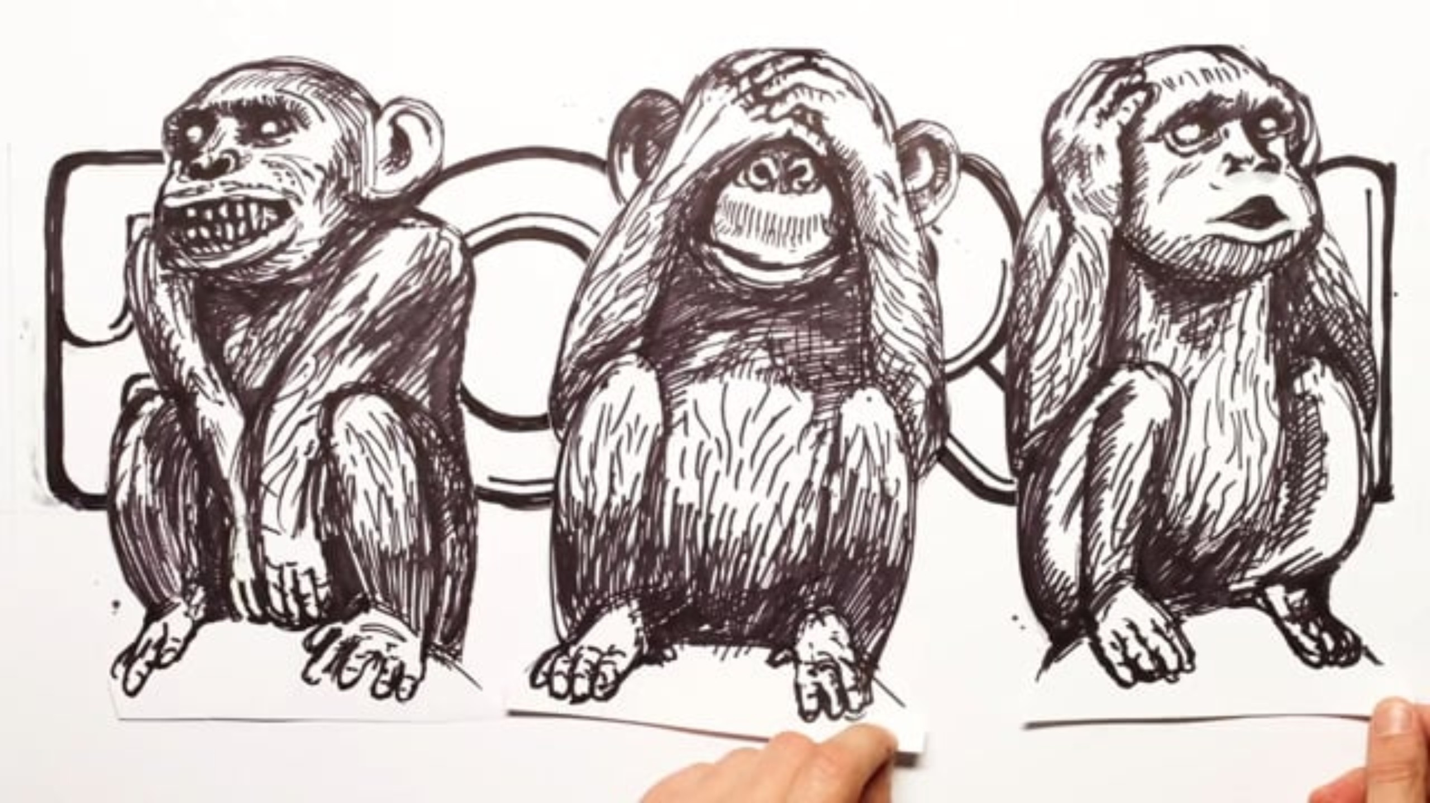
The impact of pornography
Notes:
Please review the suitability of the following tasks for your context.
Video link: https://vimeo.com/155736291?fl=pl&fe=vl

Slide 92
The impact of pornography – video reflection
Reflect on the video you just watched and individually complete the following table:
I see… | I think… | I wonder…

Slide 93
The impact of pornography discussion
Class discussion
What are the harms associated with viewing pornography at a young age?
How can we reduce young people’s exposure to pornography?
How does media and pornography influence people’s opinions about what to do in intimate relationships?
Image by Sly from Pixabay
Notes:
Image by Sly from Pixabay

Slide 94
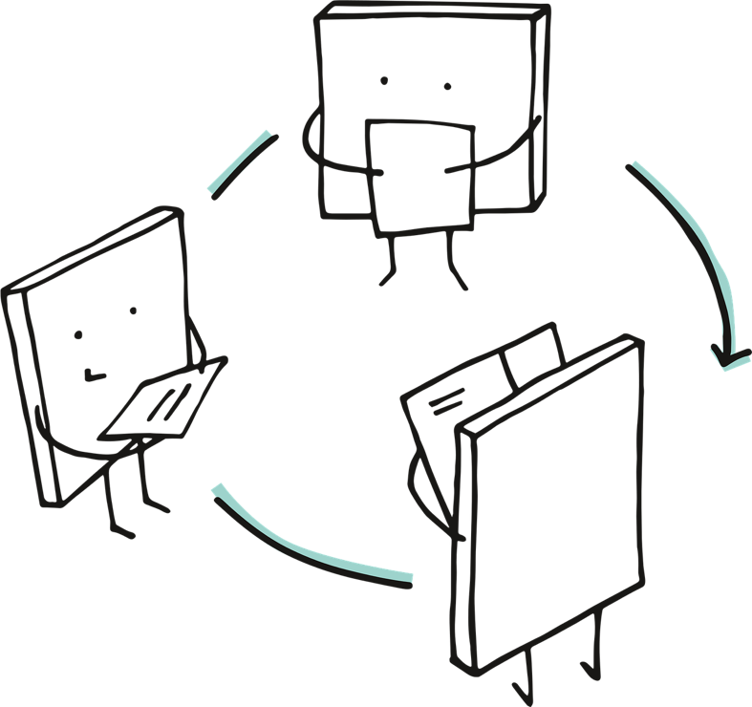
The impact of pornography research findings group activity
Group work
In your group review the Adolescent encounters with online pornography research findings from the eSafety Commission and discuss:
What did you already know?
What have you learnt?
What surprises you?
Image by Manfred Steger from Pixabay

Slide 95
Understanding the influences group activity
Group work
In your group:
Read the short scenarios provided
Discuss each scenario and give a rating of its impact from -5 (negative) to +5 (positive).
In groups of 3, brainstorm what negative media influences looks like, sounds like and feels like.
Share your responses
Image by Manfred Steger from Pixabay

Slide 96
Understanding the influences discussion
Class discussion
How can an individual identify if they are being influenced negatively by media messages?
What strategies can we employ when we become aware of these influences.
Image by Sly from Pixabay
Notes:
Image by Sly from Pixabay

Slide 97
Reflecting on media influences
Complete a short, written reflection to explore how media, including pornography might influence your ideas about relationships and sexuality.
Consider aspects such as:
representation of gender roles
power dynamics
consent and communication
emotional connection
Image by Manfred Steger from Pixabay
Notes:
Image by Manfred Steger from Pixabay

Slide 98
Promoting respectful relationships reflection
Take a moment to reflect on what has been learnt throughout the program.
In small groups, create a positive relationships message this should promote kindness, respect, consent, equity or healthy communication. This can be communicated via an affirmation wall poster, website banner or slide show.
For example:
respect makes every relationship stronger
everyone’s boundaries matter
kindness and empathy help relationships grow
everyone deserves to feel safe and heard
Image by Manfred Steger from Pixabay
Notes:
Image by Manfred Steger from Pixabay

Slide 99
Promoting respectful relationships group activity
Group work
In your group, create a positive respectful relationships message that can be displayed in the school community.
Examples could include: an affirmation wall, poster, website banner, or slide show.
The messages should promote kindness, respect, consent, equality or healthy communication.
Image by Manfred Steger from Pixabay

Slide 100
Personal reflections of respectful relationships
Take time to review the messages of other classmates and self-reflect on its meaning by answering the following:
A positive relationship is built when I use my strength of … by …
Examples could include:
‘A positive relationship is built when I use my strength of empathy by checking in on my friends.’
‘A positive relationship is built when I use my strength of honesty by speaking up respectfully about my boundaries.’
Image by Manfred Steger from Pixabay

Slide 101
References
This presentation contains NSW Curriculum and syllabus content. The NSW Curriculum is developed by the NSW Education Standards Authority. This content is prepared by NESA for and on behalf of the Crown in the right of the State of New South Wales. The material is protected by Crown copyright.
Please refer to the NESA Copyright Disclaimer for more information https://educationstandards.nsw.edu.au/wps/portal/nesa/mini-footer/copyright.
NESA holds the only official and up-to-date versions of the NSW Curriculum and syllabus documents. Please visit the NSW Education Standards Authority (NESA) website https://educationstandards.nsw.edu.au/wps/portal/nesa/home and the NSW Curriculum website https://curriculum.nsw.edu.au.
Personal Development, Health and Physical Education 7–10 Syllabus © NSW Education Standards Authority (NESA) for and on behalf of the Crown in right of the State of New South Wales, 2024.
NESA (2024), Glossary – Personal Development, Health and Physical Education 7–10 Syllabus, NSW Education Standards Authority (NESA) website, accessed 26 March 2026.
1800RESPECT (n.d.) Violence and abuse, 1800RESPECT website, accessed 26 March 2026.
AMAZE Org (21 December 2018) ‘Gender Roles and Stereotypes’ [video], AMAZE Org, YouTube, accessed 8 December 2025.
Australian Research Centre in Sex, Health and Society, La Trobe University (2015) ‘Porn – what you should know. For Yrs 8 and up from The Practical Guide to Love, Sex and Relationships’ [video], Australian Research Centre in Sex, Health and Society, Vimeo, accessed 8 December 2025.
Relationships Australia NSW (2024) The Different Types of Domestic Violence, Relationships Australia NSW website, accessed 26 March 2026.

Slide 102
References (2)
Victoria Legal Aid (23 May 2017) ‘Consent’ [video], Victoria Legal Aid, YouTube, accessed 8 December 2025.
Western University (7 October 2015) ‘Cycling Through Consent’ [video], Western University, YouTube, accessed 8 December 2025.
Youth Law Australia (2021) Consent, Youth Law Australia Website, accessed 26 March 2026.

Slide 103
Copyright
© State of New South Wales (Department of Education), 2026
The copyright material published in this resource is subject to the Copyright Act 1968 (Cth) and is owned by the NSW Department of Education or, where indicated, by a party other than the NSW Department of Education (third-party material).
Copyright material available in this resource and owned by the NSW Department of Education is licensed under a Creative Commons Attribution 4.0 International (CC BY 4.0) license.
This license allows you to share and adapt the material for any purpose, even commercially.
Attribution should be given to © State of New South Wales (Department of Education), 2026.
Material in this resource not available under a Creative Commons license:
the NSW Department of Education logo, other logos and trademark-protected material
Material owned by a third party that has been reproduced with permission. You will need to obtain permission from the third party to reuse its material.
Links to third-party material and websites
Please note that the provided (reading/viewing material/list/links/texts) are a suggestion only and implies no endorsement, by the New South Wales Department of Education, of any author, publisher, or book title. School principals and teachers are best placed to assess the suitability of resources that would complement the curriculum and reflect the needs and interests of their students.
If you use the links provided in this document to access a third-party’s website, you acknowledge that the terms of use, including licence terms set out on the third-party’s website apply to the use which may be made of the materials on that third-party website or where permitted by the Copyright Act 1968 (Cth). The department accepts no responsibility for content on third-party websites.

