Slide 1
Instructions for use
This resource is not a teaching and learning program. It should be used in conjunction with Thriving in health and wellness teaching and learning program.
Classroom teachers are encouraged to add and adapt slides as required to meet the needs of their students.
Save a copy of the file to make changes to the slide deck. Go to File > Download a Copy (this downloads a copy to the computer to edit in the PowerPoint app).
To convert the PowerPoint to Google Slides:
  Upload the file into Google Drive and open it.
  Go to File > Save as Google Slides.
  (Note – conversion may cause formatting changes in the slides.)

Slide 2
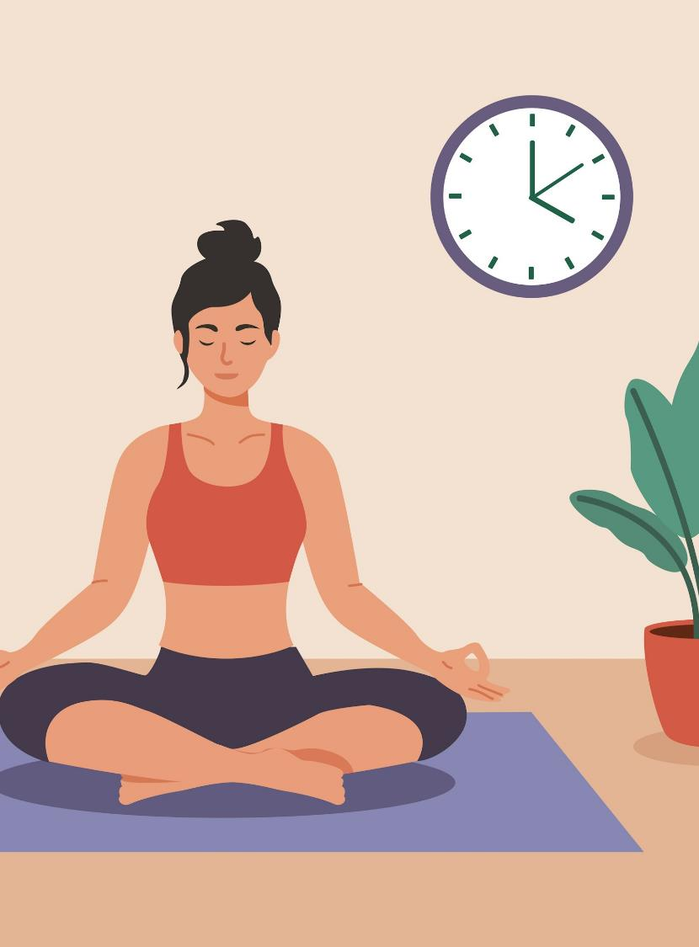
Thriving in health and wellness
PDHPE – Stage 5 – Year 9
Term 3
Illustration by Salman Ahmad on Unsplash

Slide 3
Lessons
1
Holistic health habits
2
Fueling for health
3
A positive state of mind
4
Navigating risk – drugs and alcohol
Notes:
Teacher notes:
Click lesson titles t to go to specific lessons
Interactive features can be viewed in slide show

Slide 4
Holistic health habits

Slide 5
Learning intentions and success criteria (1)
We are learning to
explore the holistic, interrelated nature of health and the connection between the five dimensions
investigate how social, cultural, and economic factors shape health behaviours and wellbeing.
We can
describe the dimensions of health and explain the ways in which the dimensions of health influence and connect with each other
recognise and categorise social, cultural, and economic factors that influence health behaviours in various contexts.
Notes:
Notes for teachers:
Learning intentions and success criteria are best co-constructed with students. Adapt the learning intention as required and add matching success criteria.
For more information See ⁠AITSL or the NSW Department of Education explicit teaching strategies, ⁠Sharing learning intentions and ⁠Sharing success criteria
LISC is not necessarily presented at the beginning of the lesson. Teacher needs to consider most effectual time to introduce
LISC should be revisited during the lesson to support students' evaluation of their learning

Slide 6

Activity – what is health?
Pair activity – turn and talk
‘Health is a state of complete physical, mental and social well-being and not merely the absence of disease or infirmity’
World Health Organisation (WHO)
Instructions
With your partner, consider what you like about this definition and what you wonder about this definition.
Image by Htc Erl from Pixabay
Notes:
Image by Htc Erl from Pixabay

Slide 7
Activity – what is wellbeing?
Venn Diagram
WELLBEING
HEALTH

Slide 8







Activity – dimensions of health
SOCIAL
Whole-class discussion
EMOTIONAL
Consider
What words come to mind when you think of each dimension?
What are examples of health promoting behaviours for each dimension?
What are examples of negative health behaviours for each dimension?
What is one example of how health in one dimension of impacts health in another dimension?
PHYSICAL
MENTAL
SPIRITUAL

Slide 9
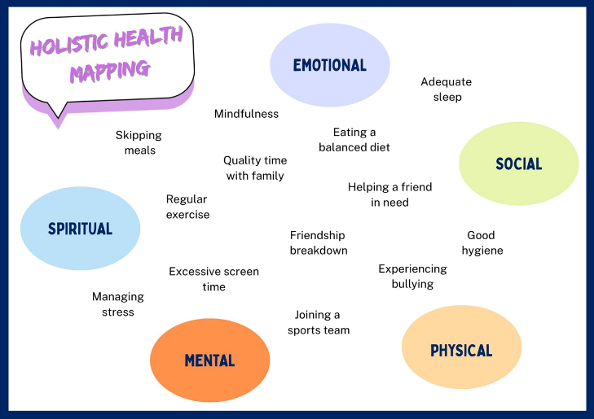
Activity – holistic health impacts (1)
Group activity
Instructions
Work together to discuss each health behaviour and use coloured pens to connect each behaviour to the dimension/s of health that it impacts.
For example:
‘regular exercise’ might connect to physical health and mental health
‘friendship breakdown’ might connect to social and emotional health.
Image by Zizitom from Pixabay

Slide 10
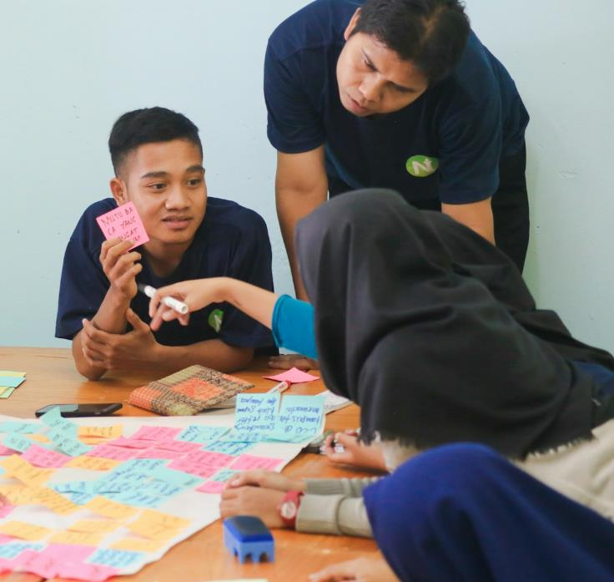
Activity – holistic health impacts (2)
Scenario analysis
Sample scenario
Alex broke his leg playing basketball and how now must take a break from sports for several months. Alex feels frustrated because his social life revolves around the basketball team.
Being unable to play, Alex notices he’s gaining weight and feels more tired during the day. His mood has also been low, and he’s finding it harder to focus on schoolwork.
Photo by Zainul Yasni on Unsplash

Slide 11
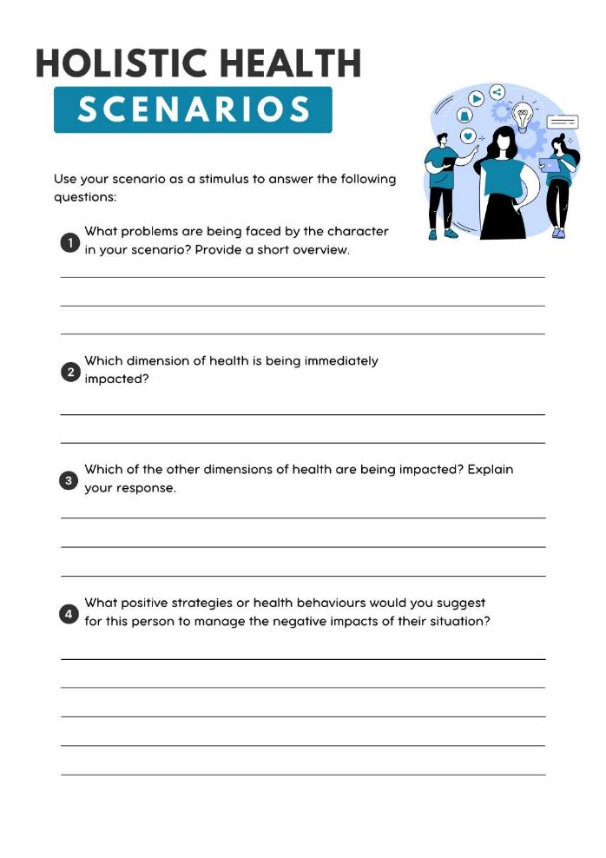
Activity – holistic health scenarios
Individual analysis
Instructions
Review your holistic health scenario.
Use the scenario as a stimulus to respond to the questions on your worksheet.
Compare and contrast your responses with someone who analysed the same scenario.

Slide 12
Activity – my health over time
Sentence starters
Although it may seem as though the dimensions of health are separate, the truth is…
One clear example of how one dimension of health influences another is seen through…
If a person’s… health declines, the impact on their… health could be…
For many people, improving… dimension of health can also lead to a significant improvement in…
Individual activity – written reflection
Instructions
Consider and develop a short, written reflection in response to the following stimulus
To what extent can a change in one dimension of health influence the other dimensions of health?
Sentence starters have been provided to assist you.

Slide 13

Activity – lifestyle behaviours (1)
Individual activity – pie chart
Instructions
Consider a typical week and add up the time you spend on:
Sleeping
Exercising
Sedentary activities (not including screen time)
Using a device/screen
Socialising
Using Microsoft Excel, develop a pie chart to show the allocation of time.
Image by Mohamed Hassan from Pixabay

Slide 14

Activity – lifestyle behaviours (2)
Individual activity – written reflection
Instructions
Reflect on your pie chart and propose 5 ways you could achieve a more balanced lifestyle.
Or, if your lifestyle is already balanced, propose 5 ways you could ensure you are able to maintain your current balance.
For each strategy or recommendation, list the barriers which may prevent you from achieving or maintaining a balanced lifestyle.
Image by Clker-Free-Vector-Images from Pixabay

Slide 15
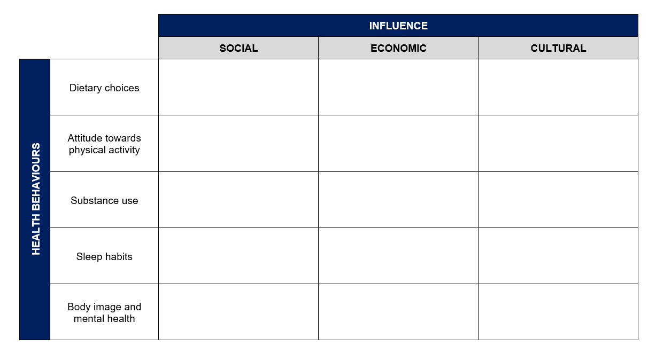
Activity – health influences table
Individual activity
Use your worksheet to record examples of how social, cultural, and economic factors may shape decision-making for each of the listed health behaviours. Remember to consider both positive and negative influences!

Slide 16

Activity – from surviving to thriving
Group activity – research task
Instructions
Each member of the group must research one support service from the list provided and complete a PMI chart, recording the positive elements (plus), limitations (minus), and any surprising aspects of the service (interesting).
Reconvene as a group and take turns to share an overview of your service.
As a group, evaluate and rank the services in order of which would be most effective and suitable for young people.
Image by OpenClipart-Vectors from Pixabay

Slide 17
Fuelling for health

Slide 18
Learning intentions and success criteria (2)
We are learning to
explore the factors that influence food choices and understand how nutrition impacts health and wellbeing
evaluate the credibility and reliability of different sources of nutritional information
deepen our understanding of the Australian dietary guidelines and the nutritional needs of different groups
We can
identify the factors that influence food choices and describe the role of nutrition in shaping our health and wellbeing
assess the credibility and reliability of nutritional information sources
apply the Australian dietary guidelines to plan and adapt meals to suit the needs of different groups
Notes:
Notes for teachers:
Learning intentions and success criteria are best co-constructed with students. Adapt the learning intention as required and add matching success criteria.
For more information See ⁠AITSL or the NSW Department of Education explicit teaching strategies, ⁠Sharing learning intentions and ⁠Sharing success criteria
LISC is not necessarily presented at the beginning of the lesson. Teacher needs to consider most effectual time to introduce
LISC should be revisited during the lesson to support students' evaluation of their learning

Slide 19
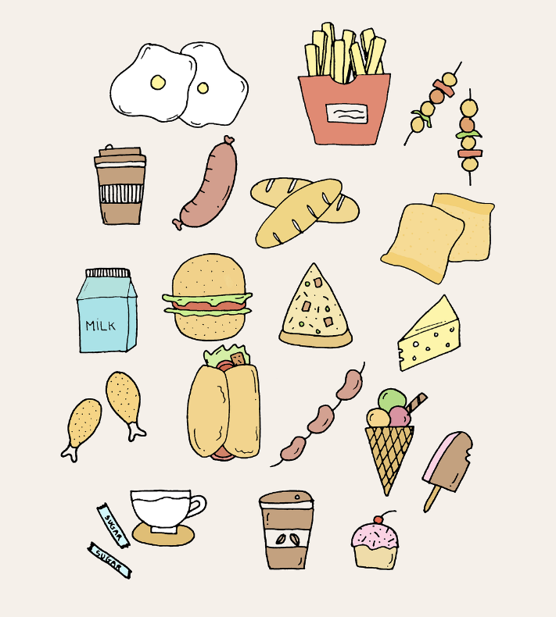
Activity – introduction to nutrition and food choices
KWLH – activating prior knowledge
Instructions
Record what you already know about nutrition and health eating, including definitions, examples and personal experiences, in the K column of the chart.
Record what you would like to learn about these key terms, and any curiosities or questions that you have, in the W column of the chart.
Image by Nhi Nguyễn Tường from Pixabay

Slide 20
KWLH
What do I know? | What do I want to know? | What have I learned? | How can I learn more?
K
What do I know?
W
What do I want to know?
L
What have I learned?
H
How can I learn more?

Slide 21
Sources of nutritional information
Individual activity
Complete the table by providing a judgement as to the accuracy of each source and clear reasoning to support your judgement.
Source | Accurate (Yes/No) | Reasoning
Parent(s) or Carer(s)
Siblings
Friends
Sports coach
PDHPE teacher
Nutritionist
Doctor

Slide 22

Activity – clickbait, or credible?
Individual activity – written reflection
Instructions
Develop a short, written response to each of the following questions:
Which sources of nutritional information do you trust most? Has your opinion on certain sources changed as a result of today’s activities?
How could unreliable nutritional information affect the health of young people?
What strategies could you use to check if nutritional information is credible before acting on it?
Image by fotografierende from Pixabay

Slide 23
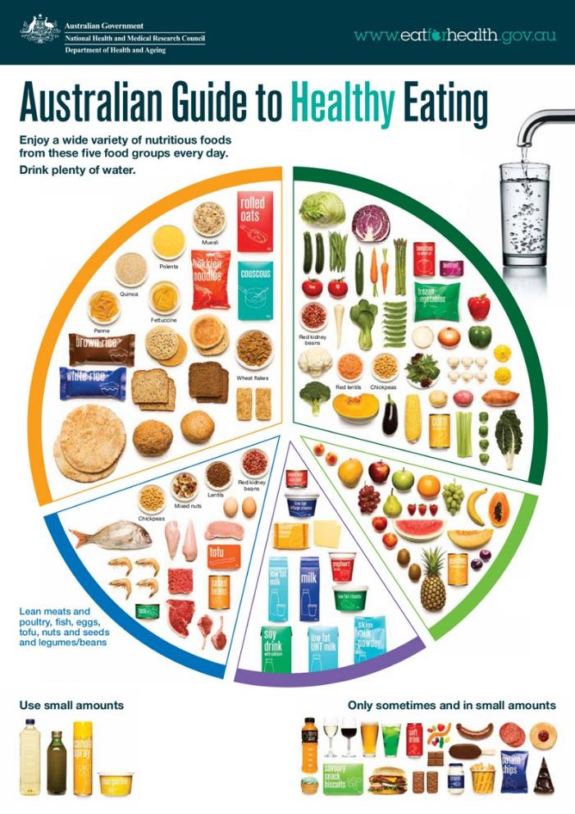
Australian Guide to Healthy Eating
Image sourced from https://www.eatforhealth.gov.au/guidelines/australian-guide-healthy-eating

Slide 24
Activity – ‘quick quiz’ (1)
Australian guide to healthy eating
Why is it important to eat a variety of different coloured vegetables and legumes each day?
Because different colours provide different nutrients
Because colour makes food taste better
Because only green vegetables are healthy
Because legumes are high in sugar

Slide 25
Activity – ‘quick quiz’ (2)
Australian guide to healthy eating
Which of the following is the best way to include more fruit in your diet?
Drink fruit juice every day
Eat fresh fruit whole or cut up as a snack
Only eat canned fruit with syrup
Eat fruit only once a week

Slide 26
Activity – ‘quick quiz’ (3)
Australian guide to healthy eating
Which type of grain food is recommended by the Australian Guide to Healthy Eating?
Refined white bread and pasta
Wholegrain or high-fibre breads and cereals
Pastries and cakes
Fried rice

Slide 27
Activity – ‘quick quiz’ (4)
Australian guide to healthy eating
Which of the following is a plant-based source of protein recommended in the Australian Guide to Healthy Eating?
Chicken
Tofu
Cheese
Fish

Slide 28
Activity – ‘quick quiz’ (5)
Australian guide to healthy eating
What is a healthy choice in the dairy group?
Full cream milk and cream-based desserts only
Reduced-fat milk, yoghurt, and cheese options
Avoid dairy completely
Only eat cheese

Slide 29
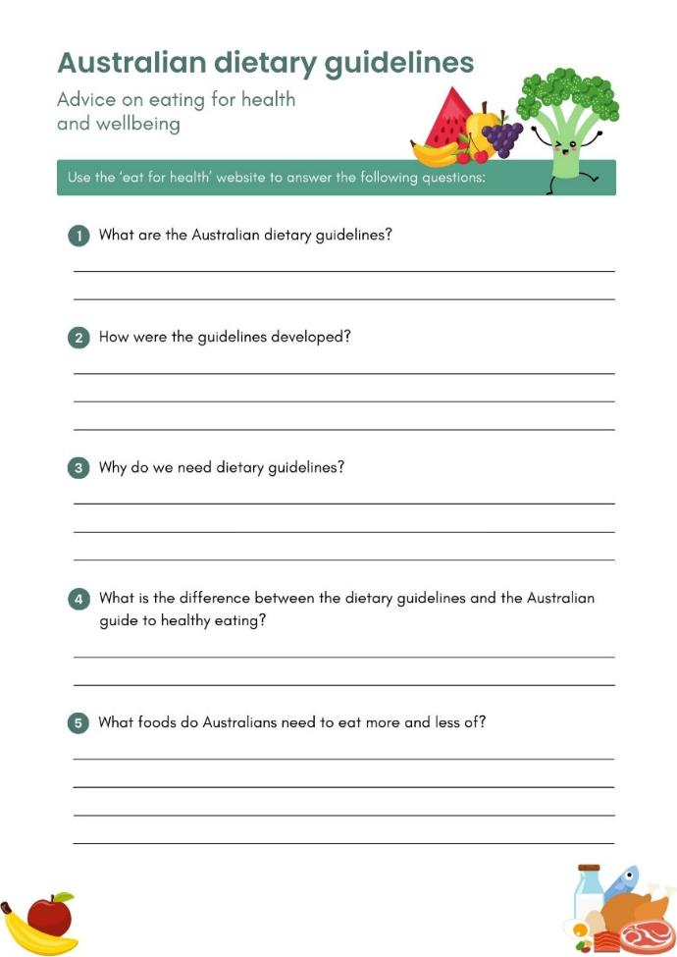
Activity – Australian dietary guidelines
Individual activity – research task
Instructions
Access the eat for health website.
Research the background, purpose and function of the Australian dietary guidelines and complete the relevant questions on your worksheet.
Share your responses with a partner and discuss the key similarities and differences in your answers.

Slide 30
Activity – factors influencing nutrition (1)
Class activity – brainstorm
Instructions
Brainstorm the specific influences on our food habits which you believe relate to each category.
ECONOMIC
SOCIAL
CULTURAL

Slide 31
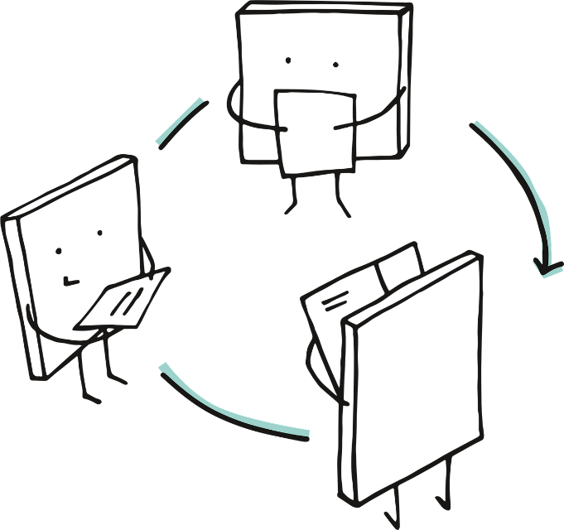
Activity – factors influencing nutrition (2)
Group activity – scenario analysis
Instructions
Read each scenario and identify the key influences that may be impacting the person’s food choices.
Classify these influences under the appropriate category (social, cultural or economic).
Make some realistic suggestions for the individual in each scenario to make more positive or health-promoting food choices.
Image by Manfred Steger from Pixabay

Slide 32
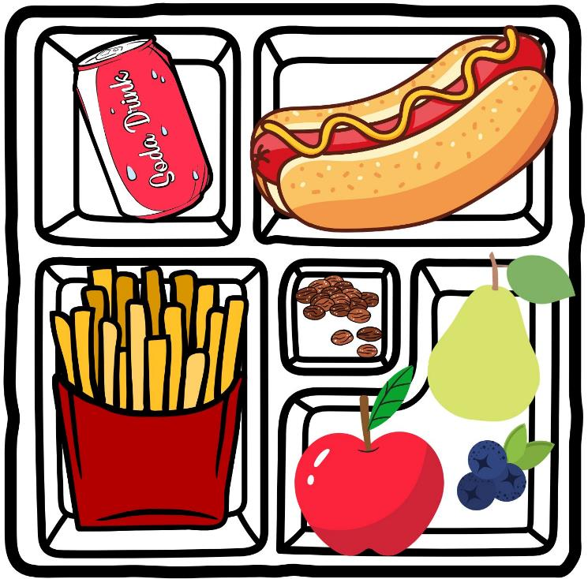
Activity – lunchbox audit
Pair activity – the Australian dietary guidelines in action
Instructions
Assess the contents of the lunchbox against the first three of the Australian dietary guidelines. For each guideline:
allocate a score on a scale of 1–5 for how well the contents of the lunchbox align with the guideline
provide a short, written justification explaining your score and the reasons behind your judgement.

Slide 33

Activity – a range of nutritional needs
Individual activity – research task
Instructions
Prepare a 1-page report or fact sheet which summarises the following:
the specific nutritional needs of your group
the common challenges or barriers these individuals face
suitable strategies or adaptations that could help them in maintaining a balanced diet.
Image by poli_ from Pixabay

Slide 34
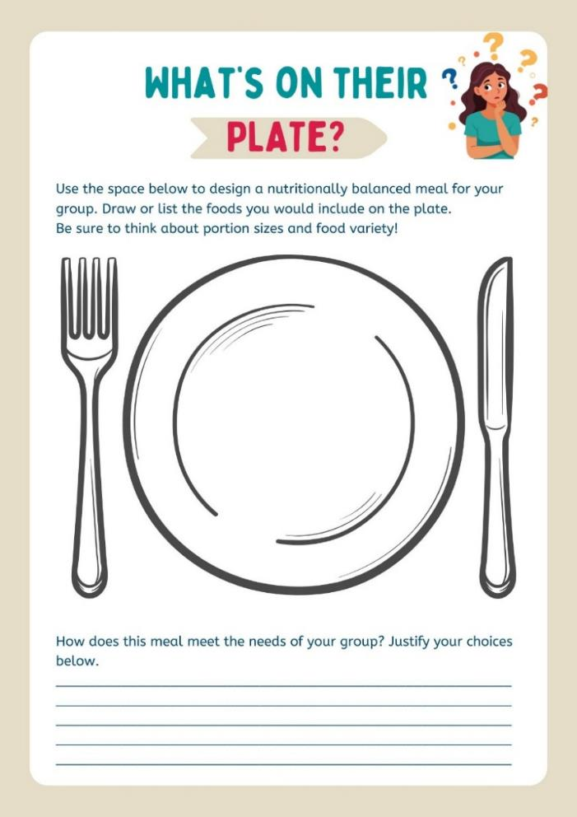
Activity – what’s on their plate?
Individual activity – design task
Instructions
Use the space on your worksheet to design a balanced meal that is nutritionally appropriate for the specific needs of your group. Remember to consider portion sizes!
Provide a justification for your choices in the space provided.

Slide 35

Illegal Energy Drinks - Behind the News (3:53)

Slide 36
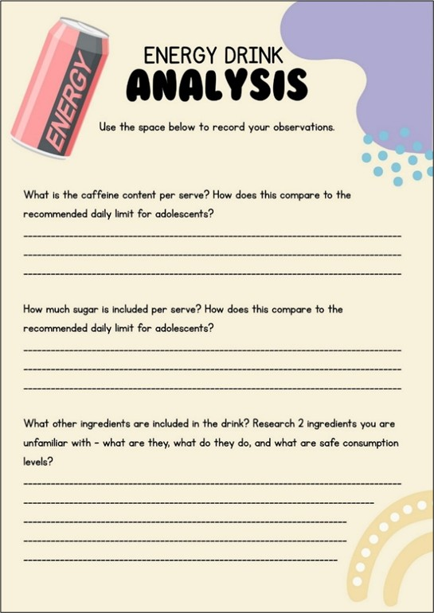
Activity – energy drink case study (1)
Individual activity – research task
Instructions
Use the space on your worksheet to record the findings of your investigation into your selected energy drink.
Find a partner who researched a different energy drink and compare your responses.

Slide 37

Activity – energy drink case study (2)
Whole-class discussion
Questions to consider
Which energy drink had the highest caffeine or sugar content?
How do these products generally compare to the recommended daily limits for adolescents?
How might regular consumption of energy drinks influence someone’s health?
Would you recommend that young people consume these drinks? Why?
Image by Arya W from Pixabay

Slide 38

Activity – persuasive writing
Individual activity – letter to the student advisory group
Instructions
Your school’s canteen is considering selling energy drinks. You’ve been asked to join a student advisory group who is providing feedback to the canteen operators about the proposal. What is your recommendation?
Develop a response which clearly states your position, includes at least three reasons to support your point of view, and uses evidence from the Australian dietary guidelines or other credible sources to justify your arguments.
Illustration by Aditya Sahu on Unsplash

Slide 39
Persuasive techniques
Letter to the student advisory group
Persuasive – to convince, influence, or motivate the audience to act, feel, or buy
Technique | Purpose | Example
Overall structure | Present a clear and cohesive argument | Clear introduction, body paragraphs and conclusion. The idea is introduced clearly and sustained throughout.
Facts and statistics | Provide evidence and credibility | Numbers, percentages, comparisons, tables, charts.
Emotive language | Appeal to a reader's feelings and perceptions | Words with strong positive/negative connotations (e.g. life-changing, heartbreaking, vile, unacceptable).
Rhetorical questions | Have the reader consider and agree with your point | ’How long can we continue to ignore our own health?’
Authoritative tone | Shows ownership and confidence in the argument | Created through the use of the imperative verb form (e.g. Save the dolphins!) and high modality language (e.g. 'must', 'will' as opposed to 'should' or 'might').
Repetition | Make ideas memorable | Repeating words, slogans, or key phrases
Call to action | Encourage a decision or action | ‘Take a stand against bullying – report it when you see it!’

Slide 40
Sentence stems
Letter to the student advisory group
I strongly believe that our canteen should/should not sell energy drinks because…
According to the Australian dietary guidelines, young people…
Allowing energy drinks to be sold at school would mean that…
For these reasons, I recommend that…
Notes:
I strongly believe that our canteen should/should not sell energy drinks because…
According to the Australian dietary guidelines, young people…
Allowing energy drinks to be sold at school would mean that…
For these reasons, I recommend that…

Slide 41
A positive state of mind

Slide 42
Learning intentions and success criteria (3)
We are learning to
understand how our emotions can influence our thoughts and behaviours
identify strategies that can support positive mental health and wellbeing
build confidence in using support networks to maintain positive mental health.
We can
identify and describe different emotions and how they influence my thoughts and actions
recognise and apply strategies that support positive mental health and wellbeing
identify trusted people and services I can turn to for help and describe how to access support when needed.
Notes:
Notes for teachers:
Learning intentions and success criteria are best co-constructed with students. Adapt the learning intention as required and add matching success criteria.
For more information See ⁠AITSL or the NSW Department of Education explicit teaching strategies, ⁠Sharing learning intentions and ⁠Sharing success criteria
LISC is not necessarily presented at the beginning of the lesson. Teacher needs to consider most effectual time to introduce
LISC should be revisited during the lesson to support students' evaluation of their learning

Slide 43

Activity – understanding our emotions (2)
Group activity – scenario analysis
Instructions
Review each scenario.
Discuss the range of emotions which are likely to be felt in each instance.
Use the language from ‘feelings wheel’ to identify each emotion correctly and record this information on the back of the scenario.
Illustration by Deep on Unsplash

Slide 44

Activity – understanding our emotions (3)
Individual activity – written reflection
Instructions
Complete a short, written reflection for one scenario which responds to the following:
What emotions or feelings would I have in this situation?
How might these emotions or feels impact my thinking and behaviour?
What strategies could I use to respond in a positive way?
Photo by Fa Barboza on Unsplash

Slide 45
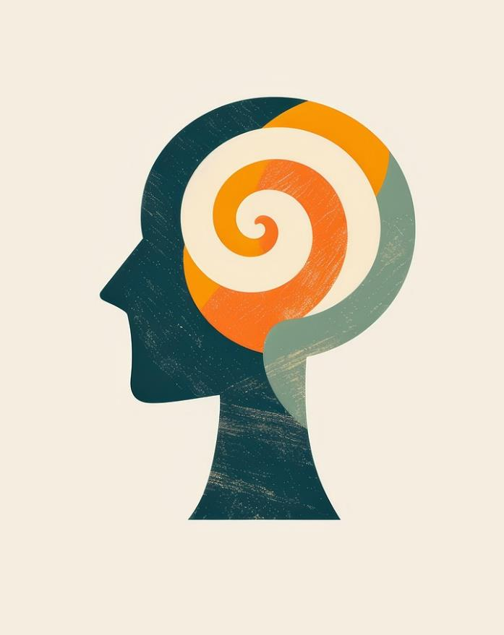
Activity – unpacking mental health (1)
Whole-class discussion
‘Mental health is a state of mental well-being that enables people to cope with the stresses of life, realise their abilities, learn well and work well, and contribute to their community.’
World Health Organisation (WHO)
Image by Shawn Suttle from Pixabay

Slide 46
Activity – unpacking mental health (2)
Individual activity – the mental health continuum
Instructions
Draw a continuum in your workbooks and label one end ‘languishing’, the middle ‘surviving’ and the other end ‘thriving’.
Brainstorm as many behaviours as you can think of for each point on the continuum.
SURVIVING
LANGUISHING
THRIVING

Slide 47
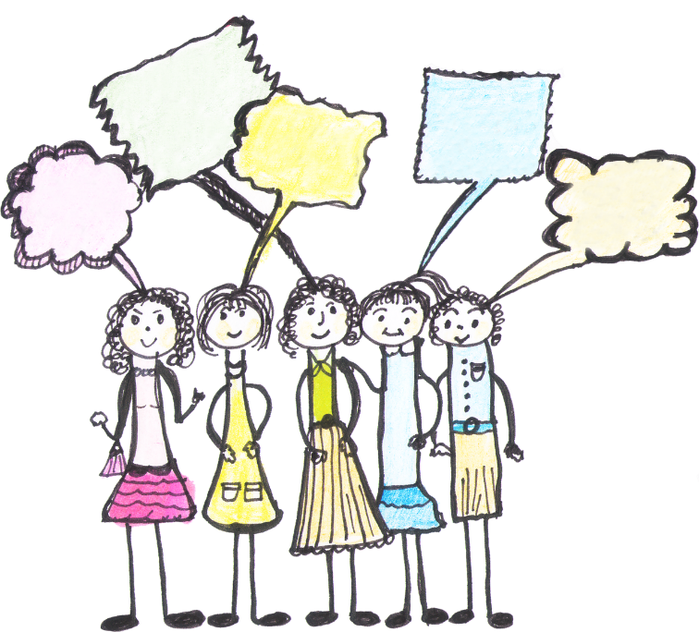
Activity – unpacking mental health (3)
Whole-class discussion
Questions to consider
Is our mental health a fixed state, or is it constantly shifting?
For behaviours that are towards the ‘languishing’ end of the continuum, what would some realistic, practical coping or support strategies be?
For behaviours that are towards the ‘flourishing’ end of the continuum, what could we do to sustain and support them?
Image by Zizitom from Pixabay

Slide 48
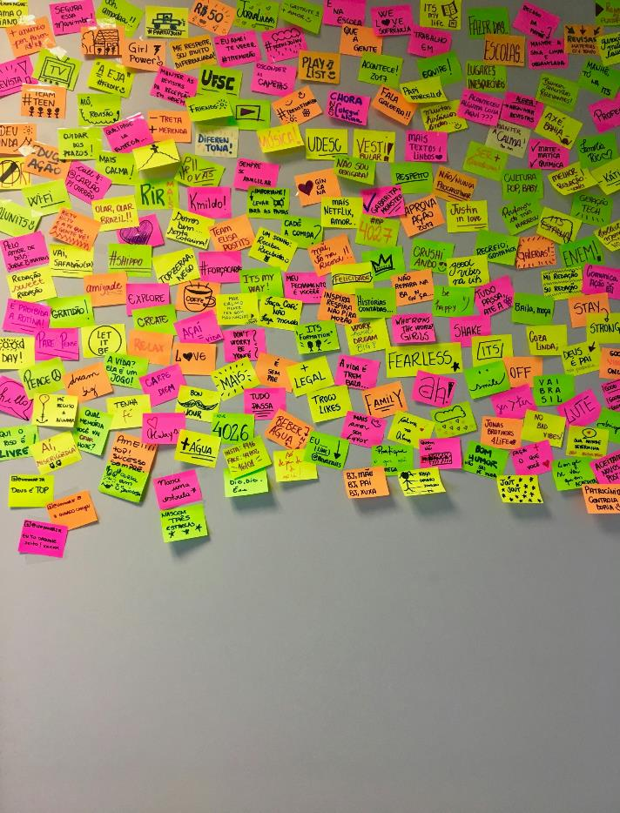
Activity – body image
Class activity – brainstorm
Instructions
Brainstorm the various influences you can think of that might affect our body image, including where we get ideas about what bodies should look like.
Turn to a partner to share your thinking.
Share your ideas with the class and work together to develop a list of the seven most common influences.
Photo by Nathália Rosa on Unsplash

Slide 49
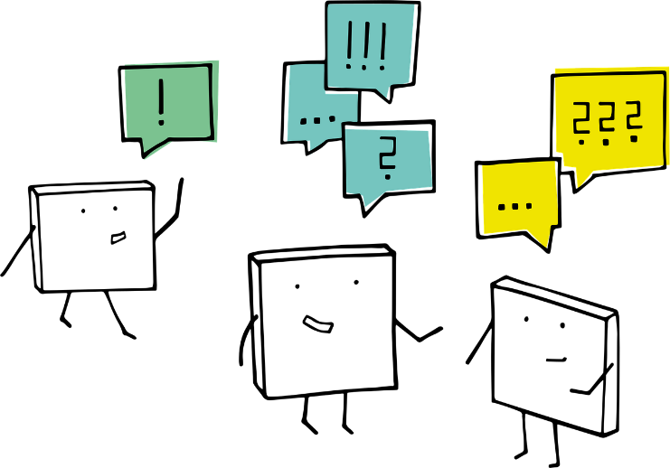
Activity – how perceptions of body image affect us (1)
Pair activity – effects of body image
‘Body image is more than just how we look – it influences how we feel, how we think, how we act, and how we connect with others.’
Instructions
In your pairs, complete the ripple effect worksheet by recording examples of the emotions, thoughts and behaviours associated with both positive and negative body image.
Image by Manfred Steger from Pixabay

Slide 50
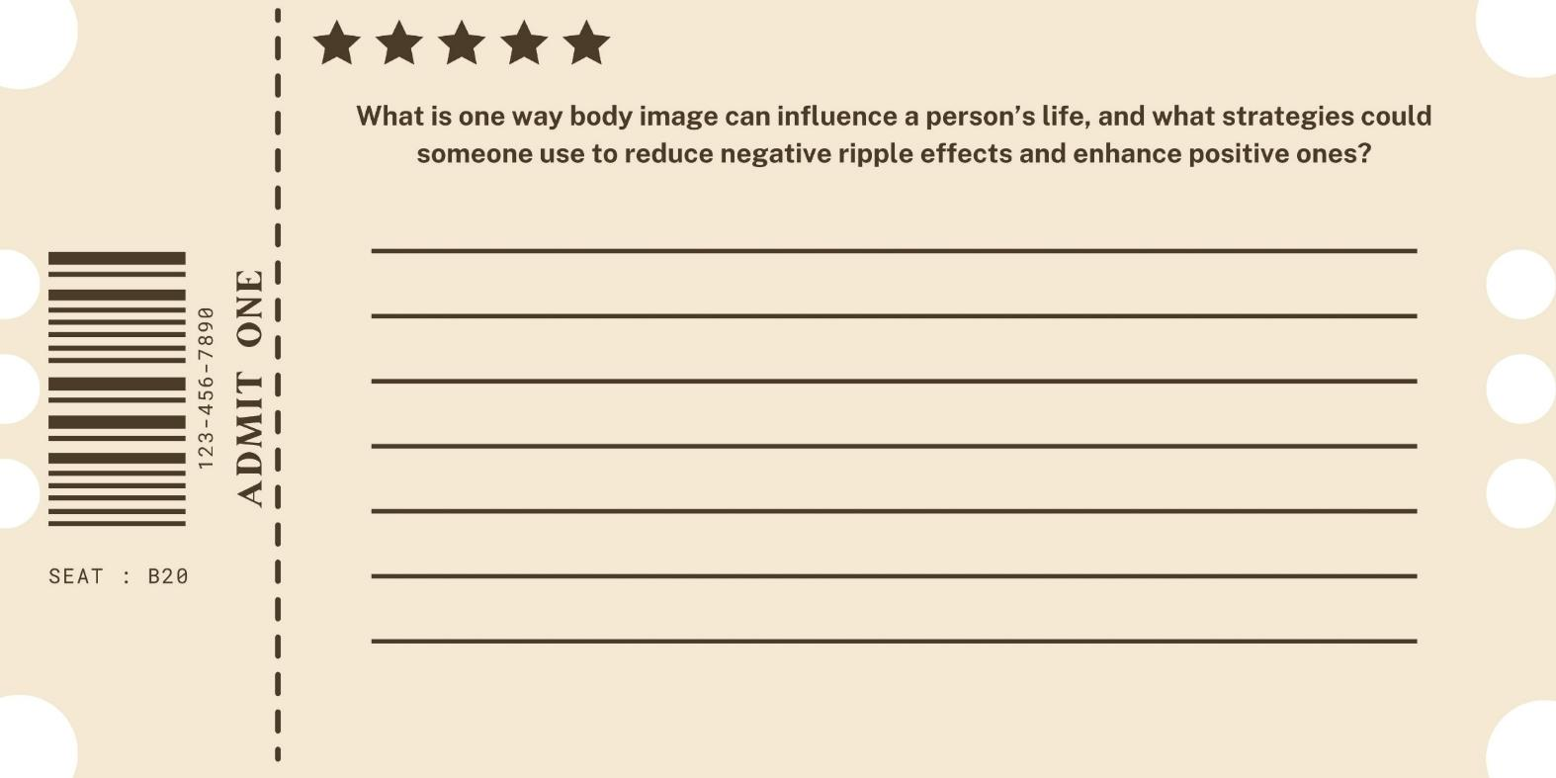
Activity – how perceptions of body image affect us (2)

Slide 51
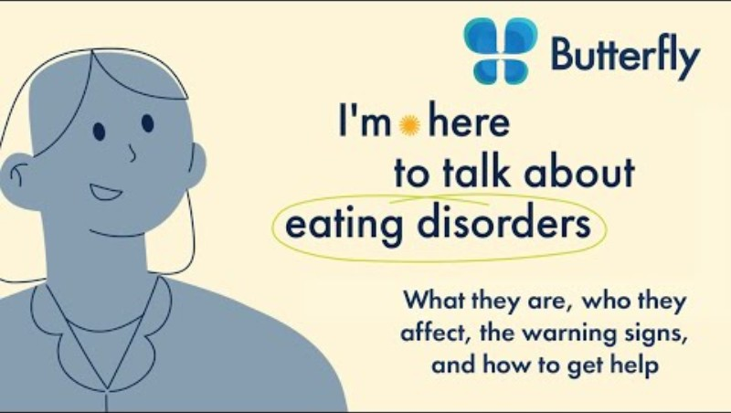
Let's Talk Eating Disorders (4:56)

Slide 52


Activity – eating disorders – fact vs. fiction (1)
Group activity
Instructions
Consider each of the eating disorder statement cards that have been provided.
Sort each of the statements into piles labelled ‘True’, ‘Untrue’ or ‘Not sure’.
Image by Muhammad Naufal Subhiansyah from Pixabay

Slide 53
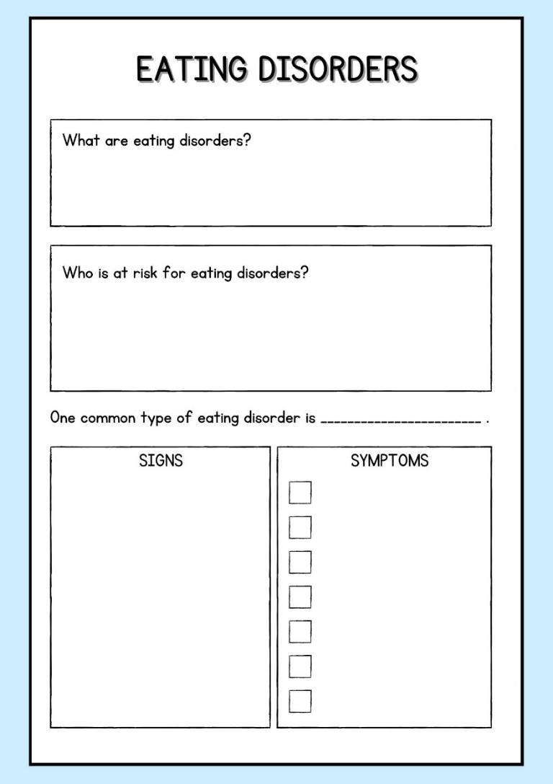
Activity – eating disorders – deepening our understanding (1)
Individual activity
Instructions
Access and explore the HealthDirect Eating disorders website.
Use the information from the website to create a summary on your worksheet which details what eating disorders are, who is at risk, and the specific signs and symptoms of one type of eating disorder.

Slide 54
Activity – eating disorders – deepening our understanding (2)
Instructions
Working individually, complete a short, written reflection on your learning. Use the following prompts to guide your response.
How can an eating disorder affect a person’s health? Consider the holistic nature of health in your response.
What are some factors that might increase a person’s risk of developing an eating disorder, and how could understanding these risk factors help in prevention or early intervention?
Why is it important to recognise the signs and symptoms of an eating disorder early, and how could this knowledge help you support someone who may be struggling?

Slide 55
Activity – eating disorders – fact vs. fiction (2)
Group activity
Instructions
Analyse your case study and identify the following:
Warning signs (e.g. the physical, psychological or behavioural signs that the person may be at risk of an eating disorder).
Risk factors (e.g. the social-cultural, personal and psychological risk factors that might increase the person’s vulnerability)
Support strategies (e.g. the actions or resources could help this person. Consider trusted adults, school counsellors, health professionals or support services).

Slide 56
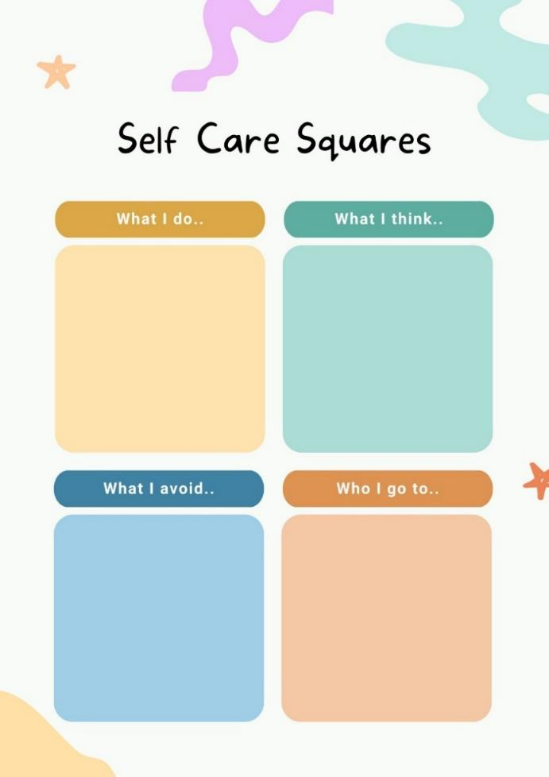
Activity – supporting positive body image
Group activity – debate
Instructions
The four squares represent different ways we can support positive body image, mental health and wellbeing. Record as many ideas as you can for each one
What I do – daily actions, habits or activities.
What I think – beliefs, attitudes or perspectives.
What I avoid – behaviours, thoughts and influences.
Who I talk to – people and support structures.

Slide 57

Activity – understanding mental illness
Group activity – research task
Instructions
For your assigned mental health illness, prepare a 1-page report or fact sheet which summarises the following:
the signs and symptoms of the condition
the causes
the effects
specific support services and treatment options.
Image by Venita Oberholster from Pixabay

Slide 58
Activity – the role of resilience
Individual activity – resilience toolkit
Instructions
In the ‘My Strengths’ section, identify three personal qualities that help you cope with challenges.
In the ‘My Supports’ section, identify three trusted people or networks you can turn to when you need help.
In the ‘My Strategies’ section, identify three coping techniques that you could use when facing a challenge.
In the ‘My Reminders’ section, identify three short affirmations or quotes which help you stay positive when things are tough.

Slide 59
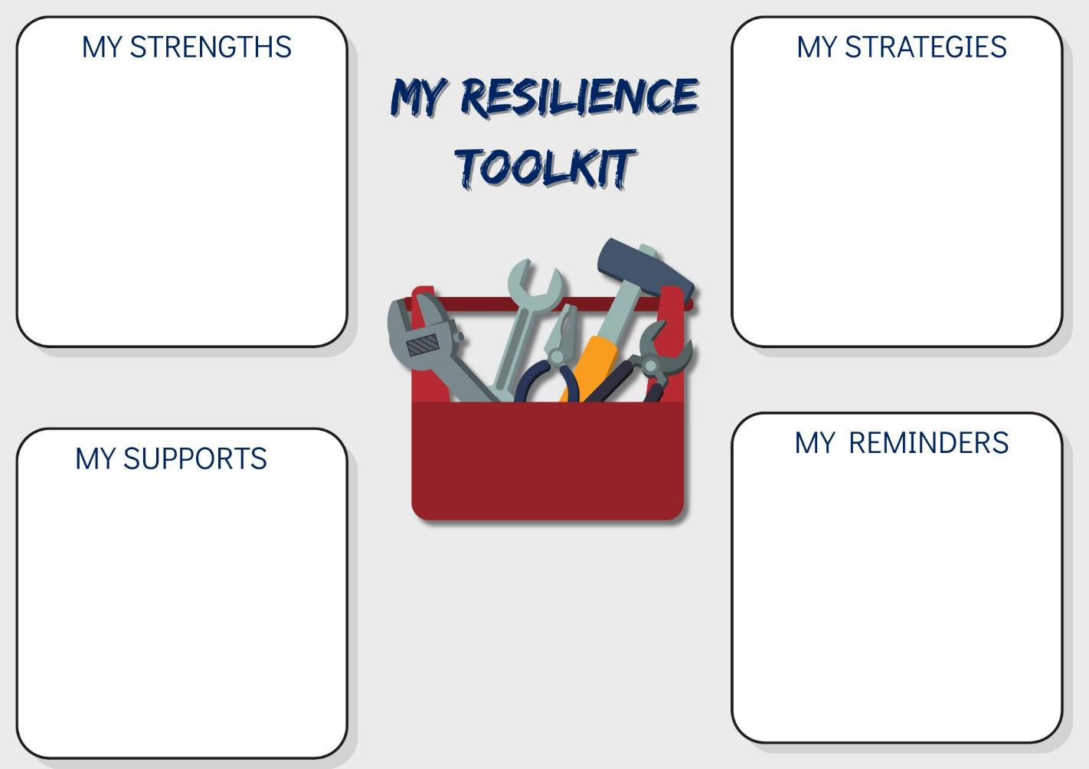
My Resilience Toolkit

Slide 60

Activity – staying mentally fit
Sentence starters
Instructions
Reflect on the coping strategies and support services that we have learnt about, and complete the following sentences:
If I am feeling stressed about schoolwork, I can…
If I am feeling sad and have a low mood, I can…
If I am feeling frustrated about a friendship situation, I can…
If I notice I am engaging in negative self-talk, I can…
Image by nugroho dwi hartawan from Pixabay

Slide 61
Activity – ‘ask the expert’
Group activity – research and design task
Instructions
Create a health promotion resources, such as an infographic, poster, short video or article, which communicates key information about your service.
Your design must be relevant and engaging for young people, and include:
A specific overview of at least two programs or avenues of support offered by the service.
A breakdown of the costs involved in accessing the service.
Clear guidance for young people on how to access the service, including opening hours, contact details and locations.

Slide 62
Navigating risk – drugs and alcohol

Slide 63
Learning intentions and success criteria (4)
We are learning to
investigate the factors that influence decision-making and risk-taking behaviours related to drugs and alcohol
examine the nature, cause and cost of addiction and explore strategies to support ourselves and others
develop practical skills in decision-making and communication to make positive, safe choices in situations involving drugs and alcohol.
We can
identify and analyse the factors that influence the decision-making and risk-taking behaviours of young people
explain the nature, cause and cost of addiction and propose strategies to support health and wellbeing
apply practical skills in decision-making, communication and assertiveness to make safe and responsible choices in situations involving drugs and alcohol.
Notes:
Notes for teachers:
Learning intentions and success criteria are best co-constructed with students. Adapt the learning intention as required and add matching success criteria.
For more information See ⁠AITSL or the NSW Department of Education explicit teaching strategies, ⁠Sharing learning intentions and ⁠Sharing success criteria
LISC is not necessarily presented at the beginning of the lesson. Teacher needs to consider most effectual time to introduce
LISC should be revisited during the lesson to support students' evaluation of their learning

Slide 64
Activity – myths and misconceptions (1)
Class activity
Instructions
For each of the following statements, consider your position and:
stand if you believe the statement is true
OR
remain seated if you believe it is false.
Image by Muhammad Naufal Subhiansyah from Pixabay

Slide 65
Activity – myths and misconceptions (2)
Most teenagers in Australia drink alcohol regularly.
Nicotine is addictive whether it comes from a vape or a cigarette.
Everyone experiments with drugs at some point – it’s a normal part of growing up.
You can’t get addicted to cannabis like you can with other drugs.
Not everyone who drinks alcohol or tries drugs will develop a problem – but your risk increases with use.
Saying 'no' to drugs and alcohol is actually more common among teenagers in Australia than saying 'yes'.
Illegal drugs are always more dangerous than legal ones.
Most young people either smoke, vape or drink alcohol.
Education, and support from friends, family or professionals, can help young people make positive choices.
Having one or two drinks when you’re underage is fine.
People who don’t drink or experiment with drugs are boring.

Slide 66
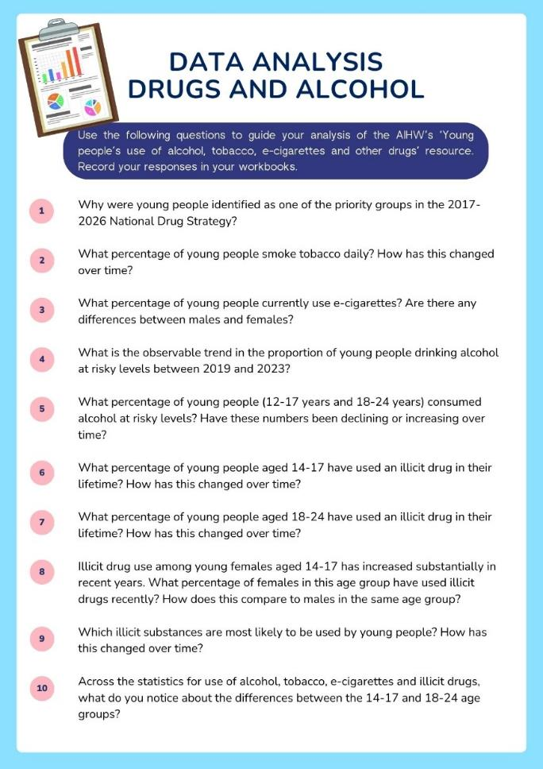
Activity – facts and figures (1)
Individual activity – statistical analysis
Instructions
Access the AIHW’s Young people’s use of alcohol, tobacco, e-cigarettes and other drugs resource and use the questions from your worksheet to guide your analysis of the data relating to substance use amongst young people.
Record your responses to the questions in your workbooks.

Slide 67
Activity – facts and figures (2)
Individual activity – written reflection
Instructions
Complete a short, written reflection using the following prompts:
Which statistic or piece of data surprised you the most? Why?
What does the evidence suggest about the majority of young people’s choices and behaviours?
How do the results of your analysis compare with some of the common myths and misconceptions that we discussed earlier?
Why do you think the overwhelming majority of young people are choosing to make health decisions related to drug and alcohol use?
Notes:
Image by OpenClipart-Vectors from Pixabay

Slide 68
Activity – revisiting and extending prior knowledge
CONSIDER
What is your position on the statement? Are you for or against it?
What evidence from your initial research and mind map supports your point of view?
Are there any risks or harms that can’t be addressed through protective behaviours and harm-minimisation strategies?
What is your threshold for ‘safe’ drug use?
Are there any drug classifications where these strategies might be more or less effective?
Individual activity – persuasive text
Instructions
Develop a half-page argument for or against the following statement
Harm-minimisation strategies and protective behaviours can make drug use safe for young people.

Slide 69

Drug, alcohol and smoking addiction costing Australia billions, new report shows | ABC News (1:54)

Slide 70

Activity – what influences our decision-making?
Individual activity – short story analysis
Instructions
Analyse the story and make short annotations which identify:
each of the decisions being made by the characters in the story
the factors that you believe are influencing the decision-making process.
Share a summary of your story and an overview of your annotations with a partner.
Image by YeriLee from Pixabay

Slide 71
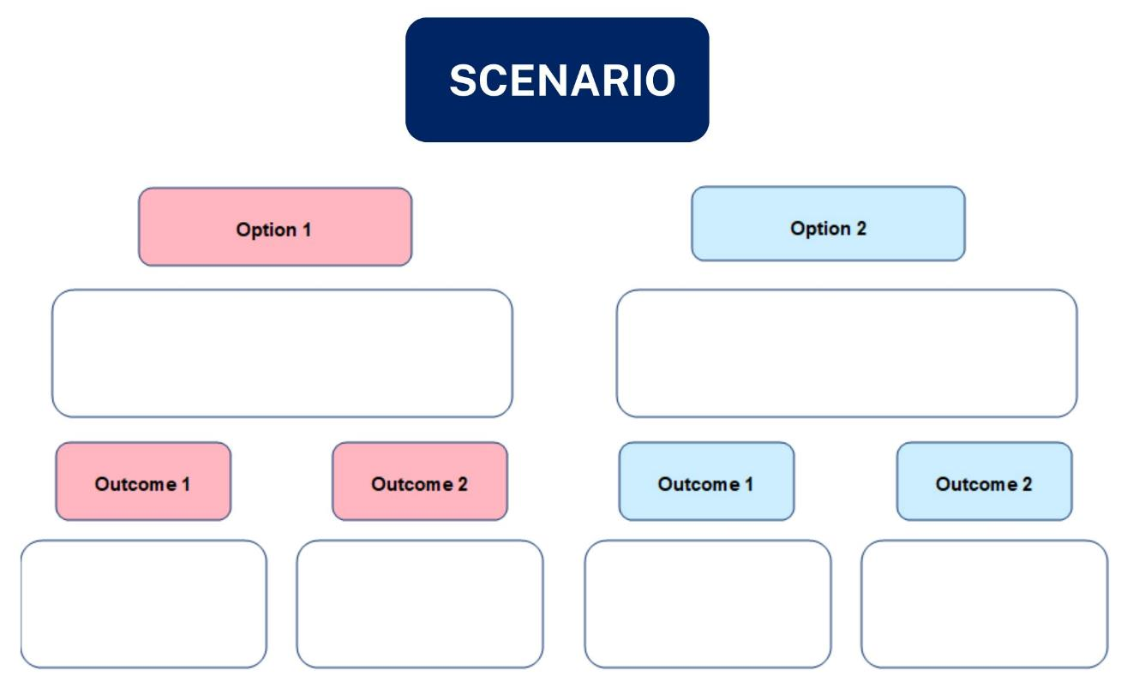
Activity – decision-making tree (1)
A practical tool

Slide 72

Activity – decision-making tree (2)
Individual activity – scenario analysis
Instructions
Consider your scenario.
Identify the ‘decision point’ and the various options available to the characters.
Complete both sides of the decision-making tree, outlining the specific details of each choice and the potential outcomes that may follow.
Image by Gerd Altmann from Pixabay

Slide 73
References (1)
This presentation contains NSW Curriculum and syllabus content. The NSW Curriculum is developed by the NSW Education Standards Authority. This content is prepared by NESA for and on behalf of the Crown in the right of the State of New South Wales. The material is protected by Crown copyright.
Please refer to the NESA Copyright Disclaimer for more information https://educationstandards.nsw.edu.au/wps/portal/nesa/mini-footer/copyright.
NESA holds the only official and up-to-date versions of the NSW Curriculum and syllabus documents. Please visit the NSW Education Standards Authority (NESA) website https://educationstandards.nsw.edu.au/wps/portal/nesa/home and the NSW Curriculum website https://curriculum.nsw.edu.au.
Personal Development, Health and Physical Education 7–10 Syllabus © NSW Education Standards Authority (NESA) for and on behalf of the Crown in right of the State of New South Wales, 2024.
Australian Government Department of Health, Disability and Ageing (2021). Types of drugs. Accessed July 30, 2025, from https://www.health.gov.au/topics/drugs/about-drugs/types-of-drugs
Australian Government Department of Health, Disability and Ageing (n.d.). Australian Guide to Healthy Eating. Accessed August 1, 2025, from https://www.eatforhealth.gov.au/guidelines/australian-guide-healthy-eating
Australian Government Department of Health, Disability and Ageing (n.d.). The guidelines. Accessed August 5, 2025, from https://www.eatforhealth.gov.au/guidelines/guidelines

Slide 74
References (2)
Australian Institute of Health and Welfare (2021). Australia’s youth: Nutrition. Accessed August 4, 2025, from https://www.aihw.gov.au/reports/children-youth/nutrition
Australian Institute of Health and Welfare (2024). Young people’s use of alcohol, tobacco, e-cigarettes and other drugs. Accessed August 5, 2025, from https://www.aihw.gov.au/reports/children-youth/young-people-alcohol-smoking-drugs
Calm (n.d.). Feelings wheel. Accessed August 1, 2025, from https://www.calm.com/s/Feelings-Wheel-Download-ables.pdf
Cancer Council NSW (n.d.). Lunch box builder. Accessed July 30, 2025, from https://www.eatforhealth.gov.au/guidelines/guidelines
HealthDirect (2023). Eating disorders. Accessed August 13, 2025 from https://www.healthdirect.gov.au/eating-disorders
Healthdirect (2025). What is addiction? Accessed August 11, 2025, from https://www.healthdirect.gov.au/what-is-addiction
NSW Health (2017). Energy drinks and caffeine. Retrieved July 28 2025, from https://www.health.nsw.gov.au/aod/resources/Factsheets/energy-drinks-and-caffeine.pdf
The Butterfly Foundation (n.d.) Eating disorders and body image. Accessed August 13, 2025 from https://butterfly.org.au/eating-disorders-body-image/
World Health Organization (n.d.). Constitution of the World Health Organization. Accessed July 30, 2025, from https://www.who.int/about/governance/constitution

Slide 75
Copyright
© State of New South Wales (Department of Education), 2025
The copyright material published in this resource is subject to the Copyright Act 1968 (Cth) and is owned by the NSW Department of Education or, where indicated, by a party other than the NSW Department of Education (third-party material).
Copyright material available in this resource and owned by the NSW Department of Education is licensed under a Creative Commons Attribution 4.0 International (CC BY 4.0) license.
This license allows you to share and adapt the material for any purpose, even commercially.
Attribution should be given to © State of New South Wales (Department of Education), 2025.
Material in this resource not available under a Creative Commons license:
the NSW Department of Education logo, other logos and trademark-protected material
Material owned by a third party that has been reproduced with permission. You will need to obtain permission from the third party to reuse its material.
Links to third-party material and websites
Please note that the provided (reading/viewing material/list/links/texts) are a suggestion only and implies no endorsement, by the New South Wales Department of Education, of any author, publisher, or book title. School principals and teachers are best placed to assess the suitability of resources that would complement the curriculum and reflect the needs and interests of their students.
If you use the links provided in this document to access a third-party’s website, you acknowledge that the terms of use, including licence terms set out on the third-party’s website apply to the use which may be made of the materials on that third-party website or where permitted by the Copyright Act 1968 (Cth). The department accepts no responsibility for content on third-party websites.

