Slide 1
Instructions for use
This resource is not a teaching and learning program. It should be used in conjunction with The real MVPs – behind the scenes in sport teaching and learning program.
Classroom teachers are encouraged to add and adapt slides as required to meet the needs of their students.
Save a copy of the file to make changes to the slide deck. Go to File > Download a Copy (this downloads a copy to the computer to edit in the PowerPoint app).
To convert the PowerPoint to Google Slides:
  Upload the file into Google Drive and open it.
  Go to File > Save as Google Slides.
  (Note – conversion may cause formatting changes in the slides.)

Slide 2
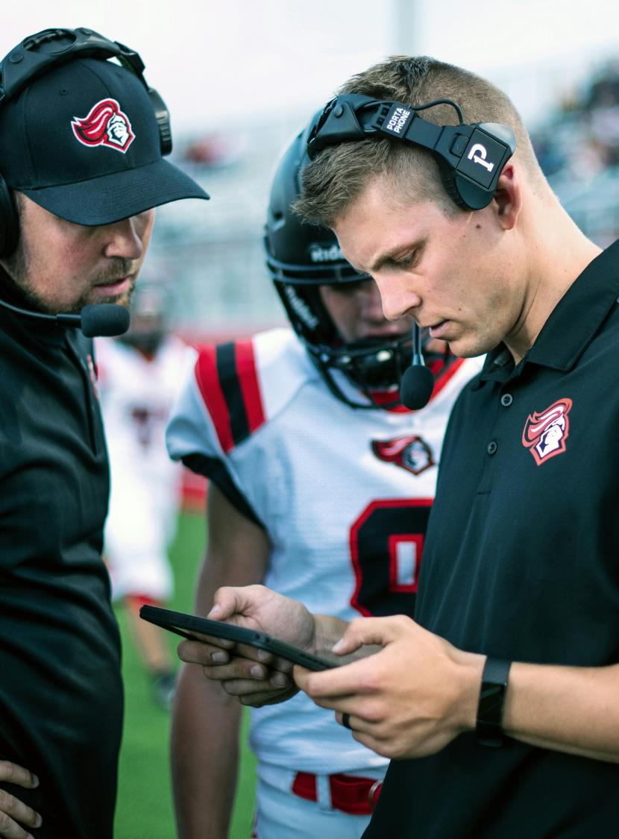
The real MVPs – behind-the-scenes in sport
PDHPE – Year 9
Term 4
Photo by Tim Mossholder on Unsplash

Slide 3
Learning sequences
1
Unpacking roles in Ultimate
5
Analysing sports performance
2
Collaborating for performance
6
Administering sports events
3
Strength and conditioning and coaching
7
Event planning and implementing
4
Rule of the referee
Notes:
Teacher notes:
Click lesson numbers to go to specific lessons
Interactive features can be viewed in slide show

Slide 4
Learning sequence 1– unpacking roles in Ultimate

Slide 5
Learning intentions and success criteria (1)
We are learning to
take on and understand different roles and understand how they help the game run smoothly
use teamwork, communication, and our personal strengths to improve how we play and support others
apply strategies like positive self-talk and encouragement to stay motivated and build resilience during skill practice and games.
We can
demonstrate different roles during Ultimate activities and explain how each role supports fair and organised gameplay
work effectively with my team by communicating clearly, using my strengths, and helping create a positive playing environment
use strategies such as encouragement and positive self-talk to stay focused, improve my skills, and support my teammates when challenges arise.
Notes:
Notes for teachers:
Learning intentions and success criteria are best co-constructed with students. Adapt the learning intention as required and add matching success criteria.
For more information See ⁠AITSL or the NSW Department of Education explicit teaching strategies, ⁠Sharing learning intentions and ⁠Sharing success criteria
LISC is not necessarily presented at the beginning of the lesson. Teacher needs to consider most effectual time to introduce
LISC should be revisited during the lesson to support students' evaluation of their learning

Slide 6
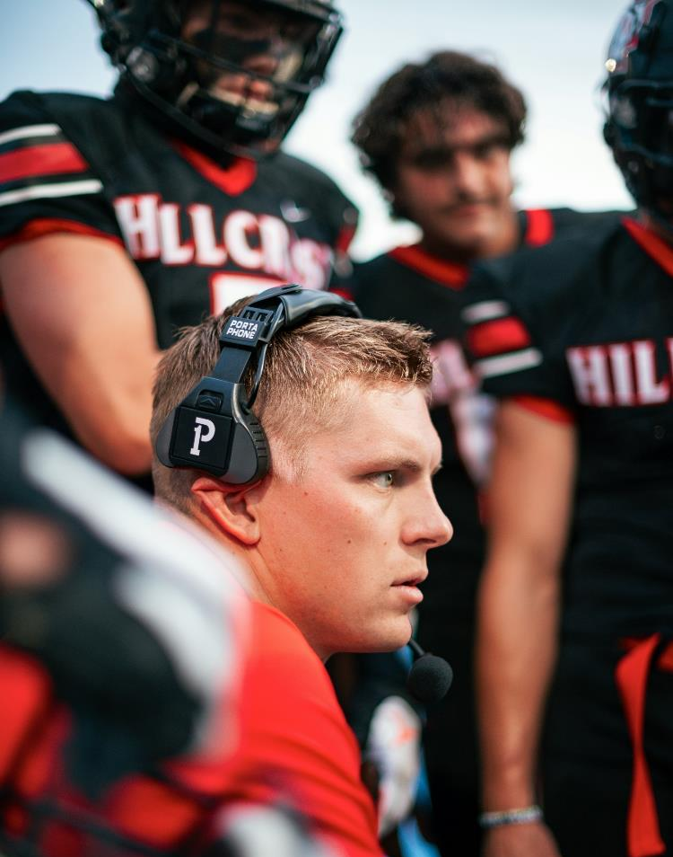
Introduction
Discussion
In groups of 3–4, discuss and record ideas on butcher’s paper to the following question:
Think about the last time you played or watched a sport. What different jobs or roles were people doing to make the game happen?
Photo by Tim Mossholder on Unsplash

Slide 7
Role roulette (1)
Definitions
Player – takes part in the game by using skills, following rules, and working with teammates to achieve success.
Referee – makes sure the game is fair, safe, and follows the rules by making decisions and managing play.
Coach – teaches skills and tactics, gives feedback, and guides the team to improve performance.
Strength and Conditioning Coach – prepares players physically through fitness training, injury prevention, and recovery support.
Analyst – collects and interprets performance data to help teams improve tactics and strategies.
Sports Administrator – organises schedules, venues, equipment, and safety measures to ensure games and events run smoothly.

Slide 8
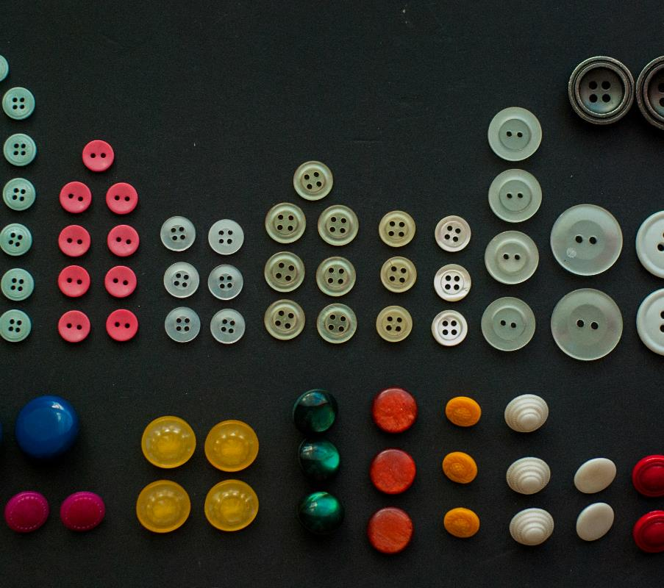
Role roulette (2)
Group work
Work in groups of 3–4 to complete a graphic organiser. Your group will receive a set of role scenarios (e.g. 'keeps the score sheet accurate,' 'gives players feedback,' 'calls a foul,' 'designs training drills,' 'plans the venue and draw').
Read each scenario carefully and decide which role it belongs to. Then, write it under the correct heading in your organiser.
Photo by Olga Kovalski on Unsplash

Slide 9
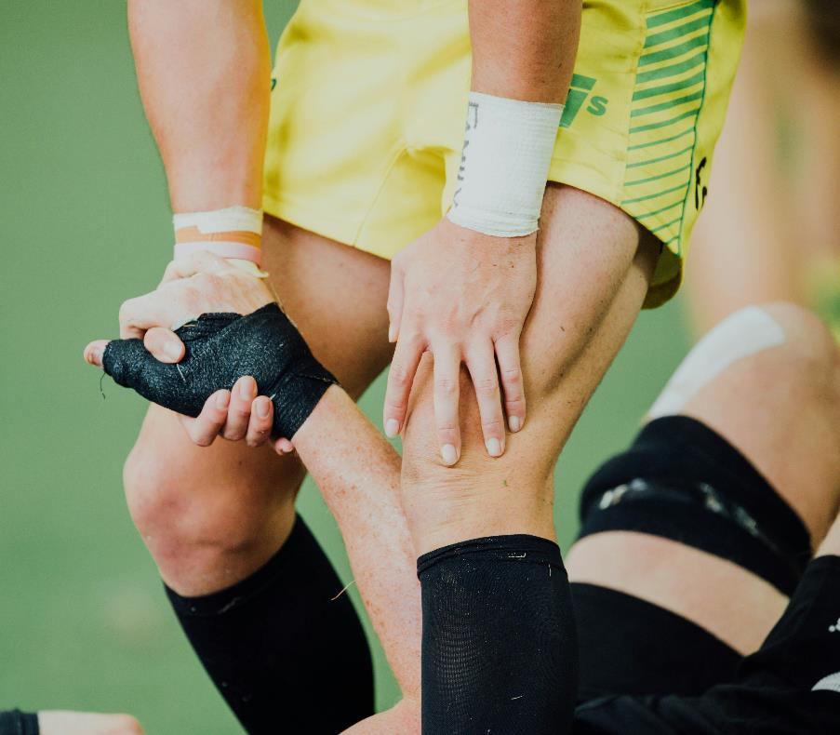
Sporting scenarios
Group work
Step 1 – Form groups of 3–4.
Step 2 – As a group, discuss the scenario and complete the related questions on the butcher’s paper.
Step 3 – Each group presents their scenario and responses to the class.
Photo by CHUTTERSNAP on Unsplash
Notes:
Students present their scenarios back to the class. Facilitate a class discussion

Slide 10

Sporting scenarios reflection
Individual reflection
Write a short paragraph in your workbooks to the following question:
Explain how teamwork and communication between different roles can influence the success of a sporting event?
Photo by Jan Kahánek on Unsplash

Slide 11

Discovering Ultimate
Video questions
In groups, students answer the following questions:
What key skills and movements do players use in this game?
Which rules can you identify while watching the game, and how do they affect play?
How do the elements of teamwork, communication, and fair play in this game compare to other territory games you know?

Slide 12
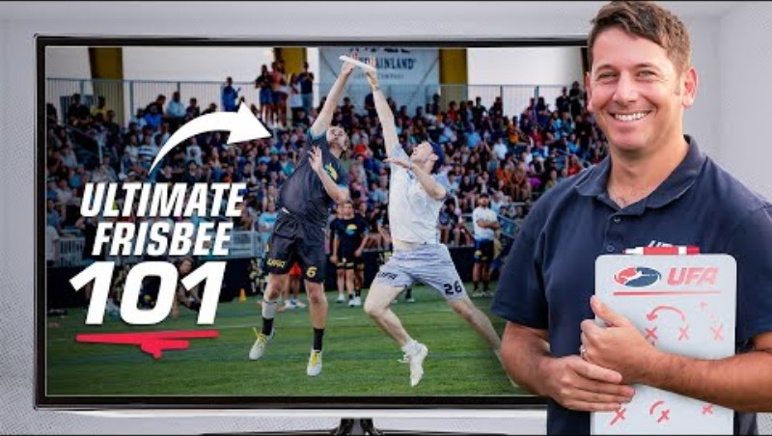
Basics of Ultimate (1)
Video – How To Play Ultimate Frisbee

Slide 13
Basics of Ultimate (2)
Discussion
Discussion points:
passing and catching as the primary form of movement
players cannot run with the disc, requiring teamwork and passing
the creation and use of space is central to success
the absence of referees, with players responsible for upholding Spirit of the Game.

Slide 14
Basics of Ultimate (3)
Video questions
What is the main aim of Ultimate?
What is the key movement rule players must follow when holding the disc?
What happens when the disc is dropped, intercepted, or goes out of bounds?
How does play start at the beginning of the game?
How does play restart after a turnover or when a point is scored?
How are fouls or disputes resolved during the game?
What skills are most important for successfully passing the disc to teammates?
Which of these rules do you think will be hardest to get used to when playing Ultimate? Why?

Slide 15

Core skills of Ultimate
Think, pair, share
Player – What skills does a player need?
Coach – How would I teach this skill?
Referee – What rules or fairness issues might come up?
Strength and Conditioning – What physical qualities are needed?
Analyst – What could I measure to check effectiveness?
Sports Administrator – What logistics or equipment are needed?
Photo by Vitaly Gariev on Unsplash

Slide 16

Reflection activity
Exit ticket
Complete the exit ticket by answering the following:
name one Ultimate rule you learned today.
identify one key skill needed to succeed.
pose one question you still have about the game.
Photo by Andrew Teoh on Unsplash

Slide 17

Reflection activity (1)
Discussion points
What would happen to a game of Ultimate if one role didn’t do its job, if the coach gave no direction or the players didn’t follow the rules?
How would that affect the game?
Photo by Andrew Teoh on Unsplash

Slide 18
Learning sequence 2– collaborating for performance

Slide 19
Learning intentions and success criteria (2)
We are learning to
understand the importance of collaboration in sporting contexts
explore the roles and responsibilities of different people involved in sport
recognise our own strengths and how they can contribute to effective teamwork in sporting and group settings
We can
explain why collaboration is important in sport and give examples of when it is needed.
describe the key responsibilities of different sporting roles (coach, referee, sports analyst, strength and conditioning coach, and event planner).
identify my own strengths and explain how it helps me work effectively in a team.
Notes:
Notes for teachers:
Learning intentions and success criteria are best co-constructed with students. Adapt the learning intention as required and add matching success criteria.
For more information See ⁠AITSL or the NSW Department of Education explicit teaching strategies, ⁠Sharing learning intentions and ⁠Sharing success criteria
LISC is not necessarily presented at the beginning of the lesson. Teacher needs to consider most effectual time to introduce
LISC should be revisited during the lesson to support students' evaluation of their learning

Slide 20
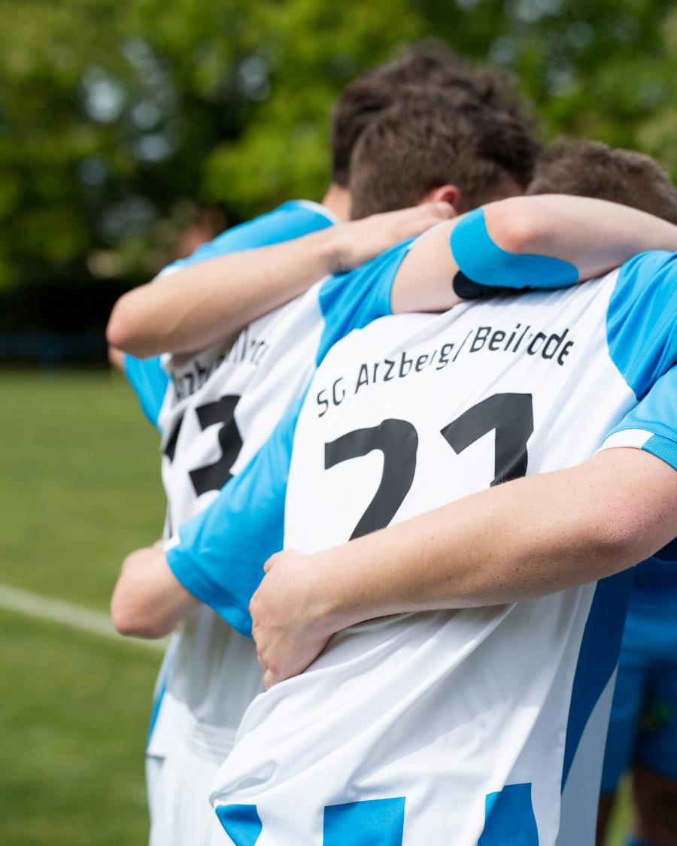
Collaboration in sport
Discussion
Why is collaboration in a sport setting important?
How does teamwork help players on the field?
What happens if coaches, referees and even organisers don’t work together?
How do different roles (coach, referee, analyst, strength coach, event manager) support each other?
What are the risks if collaboration is missing? For example, safety, fairness, confusion, poor performance.
Photo by Maximilian Muller on Unsplash

Slide 21
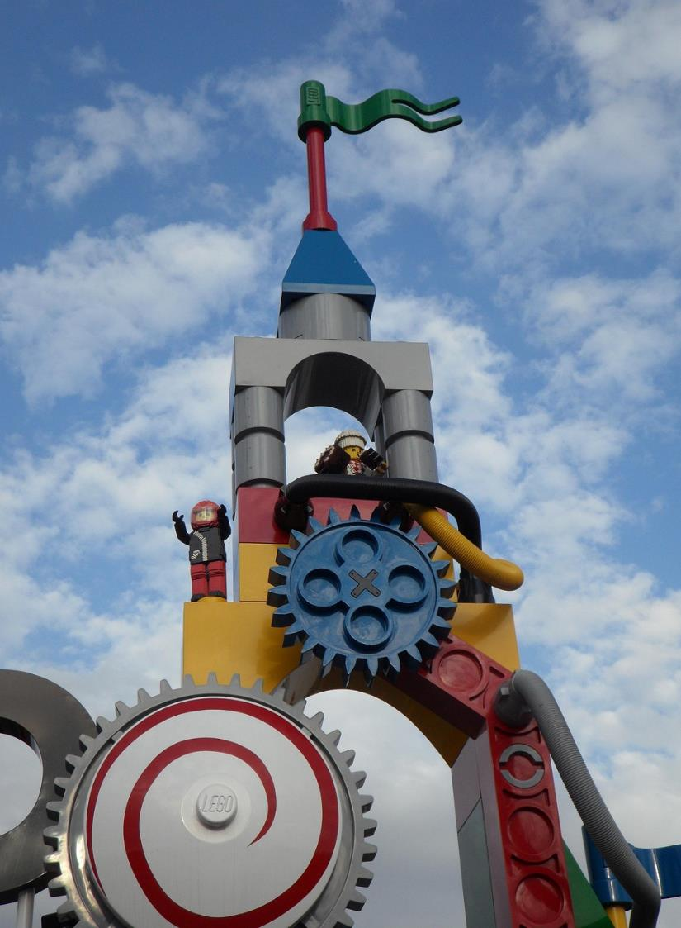
Tower challenge
Group work
Form groups of 3–4
Work together as a group with the materials provided to build the tallest free-standing tower that can support a flag at the top
15 minutes to plan, construct and complete your structure
Photo by Efraimstochter on Pixabay
Notes:
Provide each group with materials such as straws, paper, tape, marshmallows or blocks.
Students form groups of 3-4. Provide each group with materials such as straws, paper, tape, marshmallows or blocks.
Students are to work together to build the tallest free-standing tower that can support a paper flag or marshmallow at the top.
Students are given 15minutes to plan, construct and complete their structures with the tallest tower at the end of the activity being the winner.

Slide 22

Tower challenge reflection (1)
Individual self reflection
What was your role in the group?
What is one strength you brought to the group, and how do you think it will helped complete the task?
How well did you listen and communicate with your teammates?
What challenges did your group face?
Photo by Jan Kahánek on Unsplash
Notes:
At the conclusion of the activity, students individually self-reflect on their contributions to the group task, considering their role and involvement, how they communicated, and how they helped solve problems. Reflection questions include:
What was your role in the group? For example, builder, idea-sharer, leader
What is one strength you brought to the group, and how do you think it will helped complete the task?
How well did you listen and communicate with your teammates?
What challenges did your group face (for example, no clear leader, poor planning, conflict, people dominating, poor communication) and how did the challenge affect the group outcome and feelings within the team?

Slide 23

Tower challenge reflection (2)
Group reflection
Forming – What did your team do first? How did you decide on a plan?
Storming – Did your group face any disagreements or challenges? How were they resolved?
Norming – What helped your team begin working more effectively together?
Performing – What teamwork behaviours contributed to your group’s success?
Adjourning – How did your team feel when the challenge ended? What would you approach differently
Photo by StockSnap on Pixabay

Slide 24
Roles and responsibilities
Individual activity
Different sporting roles require different responsibilities and attributes to be successful. Using the roles and responsibilities table:
create a short description of each sporting role responsibility
identify the ideal attributes and strengths needed by a person in that role
Role | Responsibilities | Necessary attributes
Coach
Referee
Strength and conditioning
Sports analyst
Event planner

Slide 25

Strengths reflection
Reflection
Using your Strengths force field worksheet, reflect on the top four strengths you bring to a group setting.
Share your strengths with a partner and a sporting example where you have used that strength
Refer back to your Roles and responsibilities table and reflect on how well your strengths align with the rresponsibilities and attributes required for each role.
Photo by Logan Voss on Unsplash
Notes:
Students begin by reflecting on the top four strengths they bring to a group setting using Appendix 4 – strengths force field. Encourage them to think about qualities such as communication, problem-solving, organisation, leadership, empathy, and adaptability, and to record each strength inside its own energy hexagon in the force field.
Note: to support students in identifying strengths, the VIA character strengths survey provides a good stimulus.

Slide 26
Learning sequence 3 – strength and conditioning and coaching

Slide 27
Learning intentions and success criteria (3)
We are learning to
design and lead warm-ups that prepare players to participate safely and perform well in Ultimate
use coaching skills like cueing, feedback, and leadership to help others improve their throwing, catching, pivoting and movement
create and run modified activities that make Ultimate more inclusive, enjoyable, and challenging for everyone
We can
plan and lead a warm-up that targets key fitness components and prepares players for Ultimate safely
give clear cues and helpful feedback that improve my teammates’ skills and understanding during activities
design and run a modified Ultimate activity that includes everyone, builds confidence, and helps players develop their skills
Notes:
Notes for teachers:
Learning intentions and success criteria are best co-constructed with students. Adapt the learning intention as required and add matching success criteria.
For more information See ⁠AITSL or the NSW Department of Education explicit teaching strategies, ⁠Sharing learning intentions and ⁠Sharing success criteria
LISC is not necessarily presented at the beginning of the lesson. Teacher needs to consider most effectual time to introduce
LISC should be revisited during the lesson to support students' evaluation of their learning

Slide 28
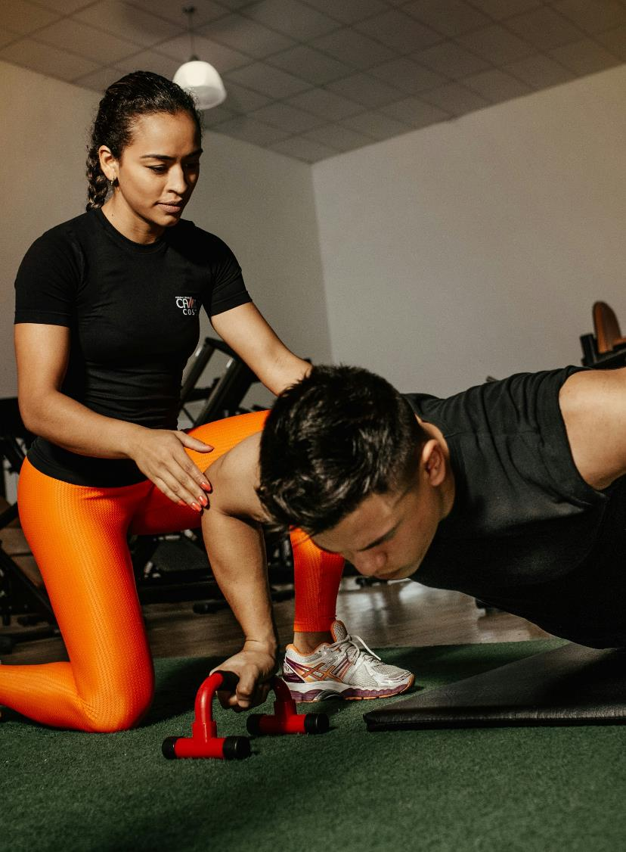
Strength and Conditioning coach
Think, pair share
Think about a time you played sport or physical activity. What made it hard to keep going physically? Endurance, strength, or something else?
Photo by Jonathan Borba on Unsplash

Slide 29
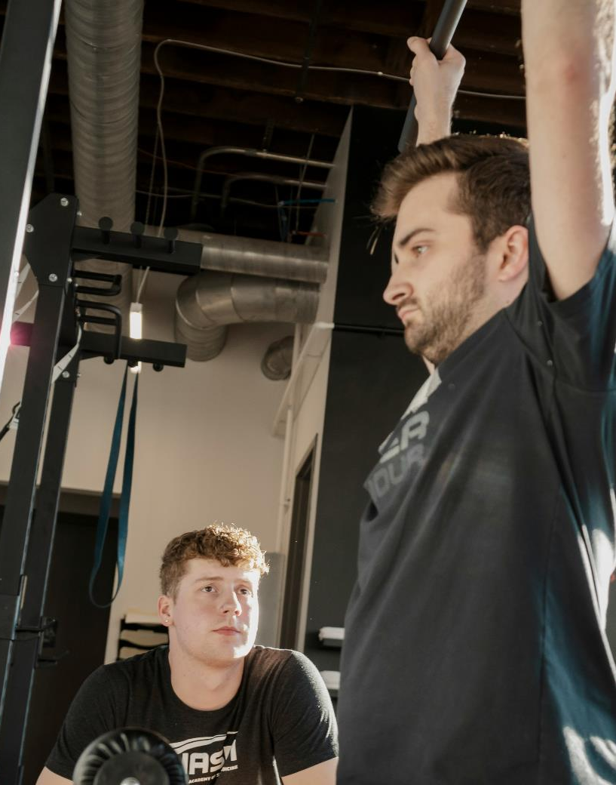
Introduction to the role
Role of Strength and Conditioning coach:
keeps players fit and ready for competition.
builds strength, speed, and endurance.
helps prevent injuries by warming up and cooling down properly
Photo by Crosby Hinze on Unsplash
29

Slide 30
Components of fitness – mix, match and rate (1)
Group work
As a group, compare and discuss and match each component with:
its definition
an example of how it applies in Ultimate
Example
agility – the ability to change direction quickly – dodging an opponent to get free for a pass
Notes:
Revisit a portion of the video from learning sequence 1, France vs. Australia | Mixed Bronze Medal Match | 2024 World Ultimate Championships (1:58:55). and discuss:
-Which fitness components are most relevant in this sport?

Slide 31
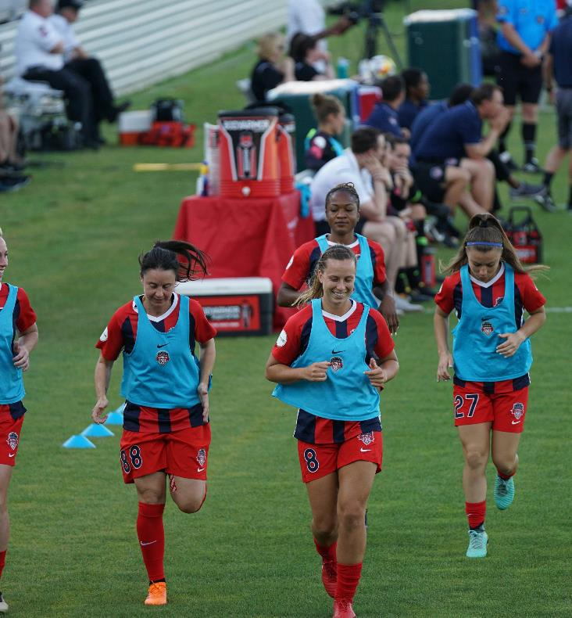
Components of fitness – mix, match and rate (2)
Whole class discussion
how could the focus of training different fitness components change depending on whether it’s pre-season, during the season, or off-season?
how might a player’s role on the field (handler, cutter, defender) change which fitness components are most critical?
which components might a defender prioritise versus a deep cutter?
would you change your priorities if it was on game day?
Photo by Jeffrey F Lin on Unsplash

Slide 32
Designing a warm-up activity
Group work
Create a 10–15 minute warm-up for an Ultimate team. You must:
include exercises or activities that target at least 3 different fitness components (for example, endurance, agility, flexibility).
include movements that reflect Ultimate skills (throwing, catching, pivoting, moving into space).
Examples could include:
quick pivot drills or activities to improve agility and footwork
dynamic arm swings and shoulder rotations to prepare throwing muscles
short catching activities to focus on coordination and reaction time

Slide 33
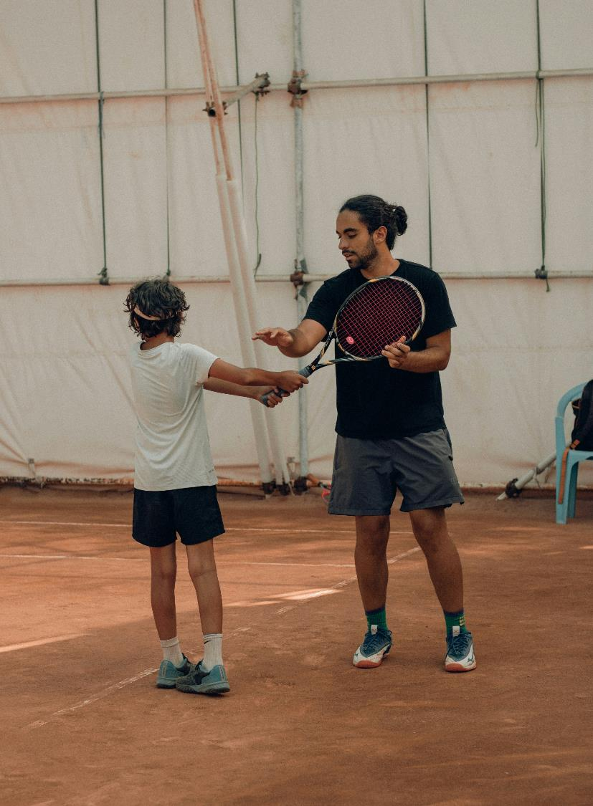
Effective coaching (1)
Reflection
Individually reflect on an effective coach or teacher:
What qualities made them effective, and what did they do that helped you improve?
Photo by Rezli on Unsplash

Slide 34
Effective coaching (2)
Key concepts
Coaching principles – the key ideas that guide how a coach works with players.
Cueing – the use of short, clear words, phrases, or actions to remind players how to perform a skill correctly.
Feedback – information given to players about their performance that helps them improve.
Leadership – the ability to guide, motivate, and support others while making decisions that help the team or group succeed.

Slide 35
Effective coaching (3)
Categorise examples
Coaching principles | Cueing | Feedback | Leadership

Slide 36
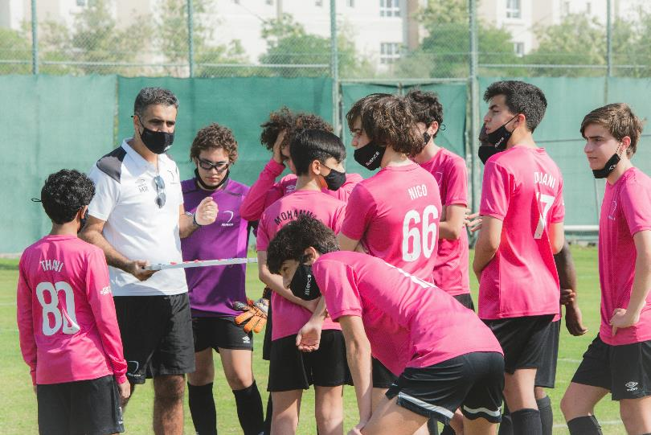
Providing feedback
Reflection
Why is it important to match the type of feedback to the situation?
How does the timing of feedback impact learning?
Photo by Alliance Football Club on Unsplash

Slide 37
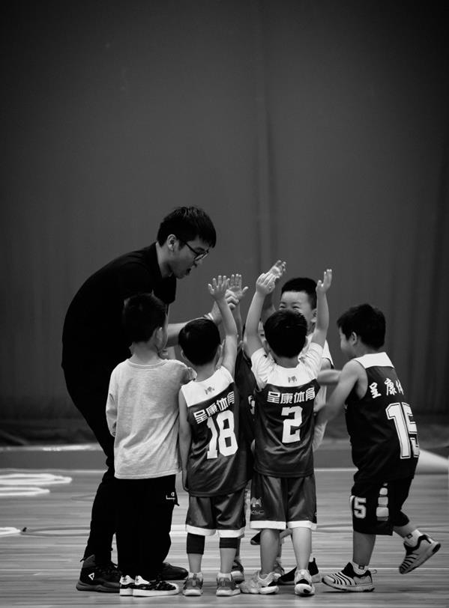
Leadership in coaching
Small group reflection
Reflect on what makes an effective leader in one of the following coaching situations:
A player is frustrated
the team is unmotivated
one player is dominating the activity.
Photo by Dong Xie on Unsplash

Slide 38
Designing a skill development activity (1)
Group work
Working in groups, plan a skill development activity for Ultimate:
identify the skill focus
      define learning outcomes
      plan the activity
      develop cueing points
      feedback you could use
      leadership and engagement strategies

Slide 39

Designing a skill development activity (2)
Group work
Record and review questions:
How will you know players are improving?
Are your cues clear and easy to remember?
Does the activity provide enough challenge but remain achievable?
How will you encourage players to apply feedback during the activity?
Photo by Markus Winkler on Unsplash

Slide 40
Learning sequence 4 – rule of the referee

Slide 41
Learning intentions and success criteria (4)
We are learning to
understand the role of a referee in different sports and how players can self-officiate in Ultimate
apply self-management, communication, and interpersonal skills to make self-officiating work effectively during games
examine and follow rules and procedures that keep players safe while promoting fairness, inclusivity, and enjoyment
We can
demonstrate different roles during games and explain how my actions support safe, fair, and organised play
use honesty, clear communication, and teamwork to resolve disputes and self-officiate successfully
identify rules and safety procedures in Ultimate and apply them during gameplay to protect myself and others
Notes:
Notes for teachers:
Learning intentions and success criteria are best co-constructed with students. Adapt the learning intention as required and add matching success criteria.
For more information See ⁠AITSL or the NSW Department of Education explicit teaching strategies, ⁠Sharing learning intentions and ⁠Sharing success criteria
LISC is not necessarily presented at the beginning of the lesson. Teacher needs to consider most effectual time to introduce
LISC should be revisited during the lesson to support students' evaluation of their learning

Slide 42

Referee ‘Ref’-lection (1)
Brainstorm
In a sports you know, such as basketball, soccer, rugby league or netball, what does the ref do?
Photo by Patrick Perkins on Unsplash

Slide 43
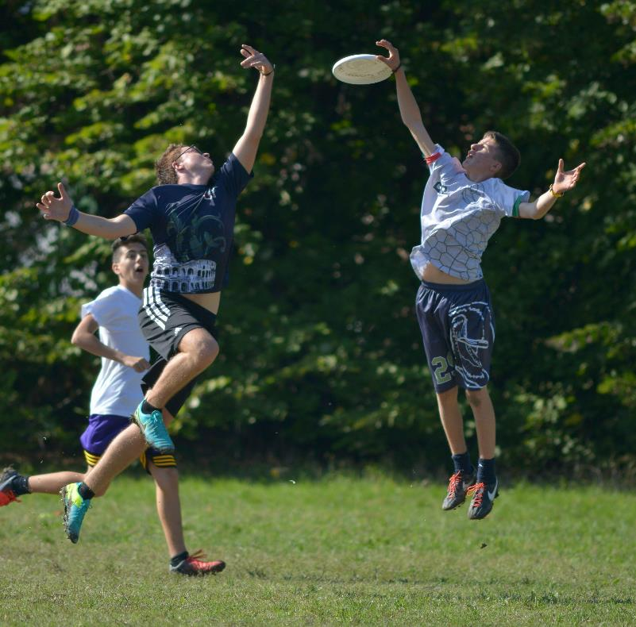
Referee ‘Ref’-lection (2)
Self officiated model
Players are responsible for calling their own fouls and rule infringements.
Disputes must be resolved respectfully between players rather than by an authority figure.
Greater emphasis is placed on honesty, integrity, and the 'Spirit of the Game.'
Players must communicate clearly and cooperate to maintain fairness and safety.
The pace of play may change, as resolving disputes takes teamwork and negotiation
Photo by Stefano Zocca on Unsplash

Slide 44
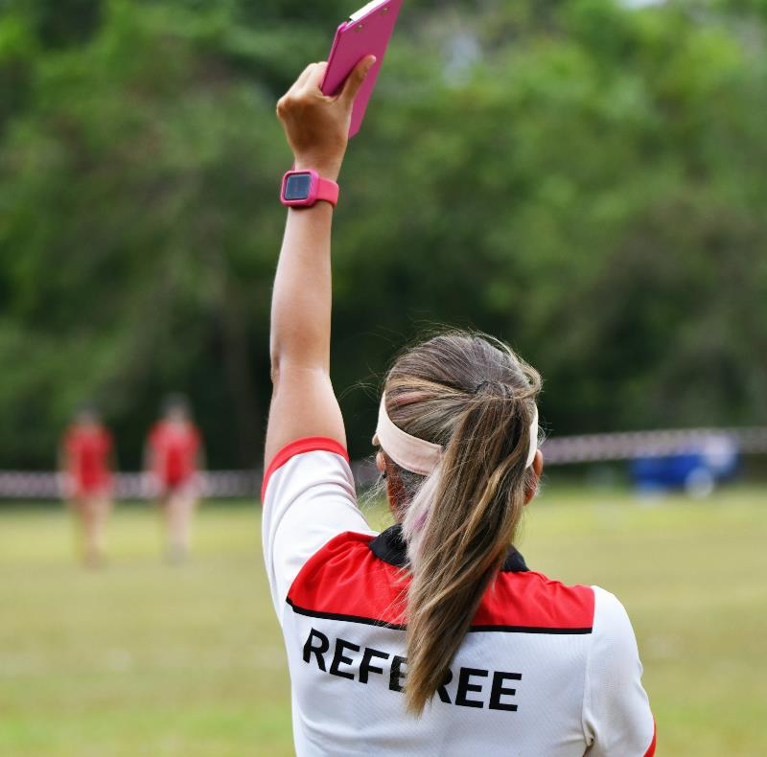
Referee 'Ref'-lection (3)
Written reflection
Individually, complete a short-written reflection on the following questions:
What personal qualities and skills are needed to make self-officiating work well?
How does the playing with spirit policy assist in the safe participation of Ultimate?
Photo by CFPhotosin Photography on Unsplash

Slide 45

To referee or self-referee, that is the question (1)
Rule recap
score by catching the disc in the other team’s end zone.
each point begins with a ‘pull’ (throw-off) between teams.
you can’t run with the disc – pivot and throw within 10 seconds.
the other team gets the disc if it’s dropped, intercepted, goes out, or the thrower stalls.
1 point is awarded for catching the disc in the end zone.
Ultimate is a non-contact sport, avoid physical contact.
spirit of the game, players self-officiate and show honesty and respect.
Photo by William Warby on Unsplash

Slide 46
To referee or self-referee that is the question (2)
Scenarios
a defender makes contact with the thrower’s arm while they are releasing the disc.
the disc lands right near the sideline, and it is unclear if the receiver caught it in or out.
two players both dive and grab the disc at the same time.
a team takes a long time to check the disc in and restart play after a foul call.
Provide a written response for each of the scenarios answering:
What would happen if players were self-officiating?
What would happen if a referee was officiating?

Slide 47
Design the rulebook
Group work
In groups, you will create a mini rulebook for a new version of Ultimate to play in an upcoming practical lesson.
Decide how your game will run – self-officiated or referee-officiated?
Set your guiding principles – promote safety, encourage inclusivity, keep the game fair, add challenge
Create your rules – how teams score points, how the game starts and restarts, what counts as a foul and how fouls are managed.
Add at least two unique rules to make your version stand out
Be creative and work together as your rulebook may guide how your class plays the new version of Ultimate.

Slide 48
Learning sequence 5 – analysing sports performance

Slide 49
Learning intentions and success criteria (5)
We are learning to
observe and analyse player performance in Ultimate using key performance indicators (KPIs)
record and interpret data to identify strengths and areas for improvement in skills and strategies
provide and apply feedback to improve team performance and individual movement skills
We can
accurately track throwing, catching, pivoting, and movement into space during games
identify patterns in performance and suggest ways to improve skills and tactics
give clear, constructive feedback to players or teams to support better outcomes
Notes:
Notes for teachers:
Learning intentions and success criteria are best co-constructed with students. Adapt the learning intention as required and add matching success criteria.
For more information See ⁠AITSL or the NSW Department of Education explicit teaching strategies, ⁠Sharing learning intentions and ⁠Sharing success criteria
LISC is not necessarily presented at the beginning of the lesson. Teacher needs to consider most effectual time to introduce
LISC should be revisited during the lesson to support students' evaluation of their learning

Slide 50
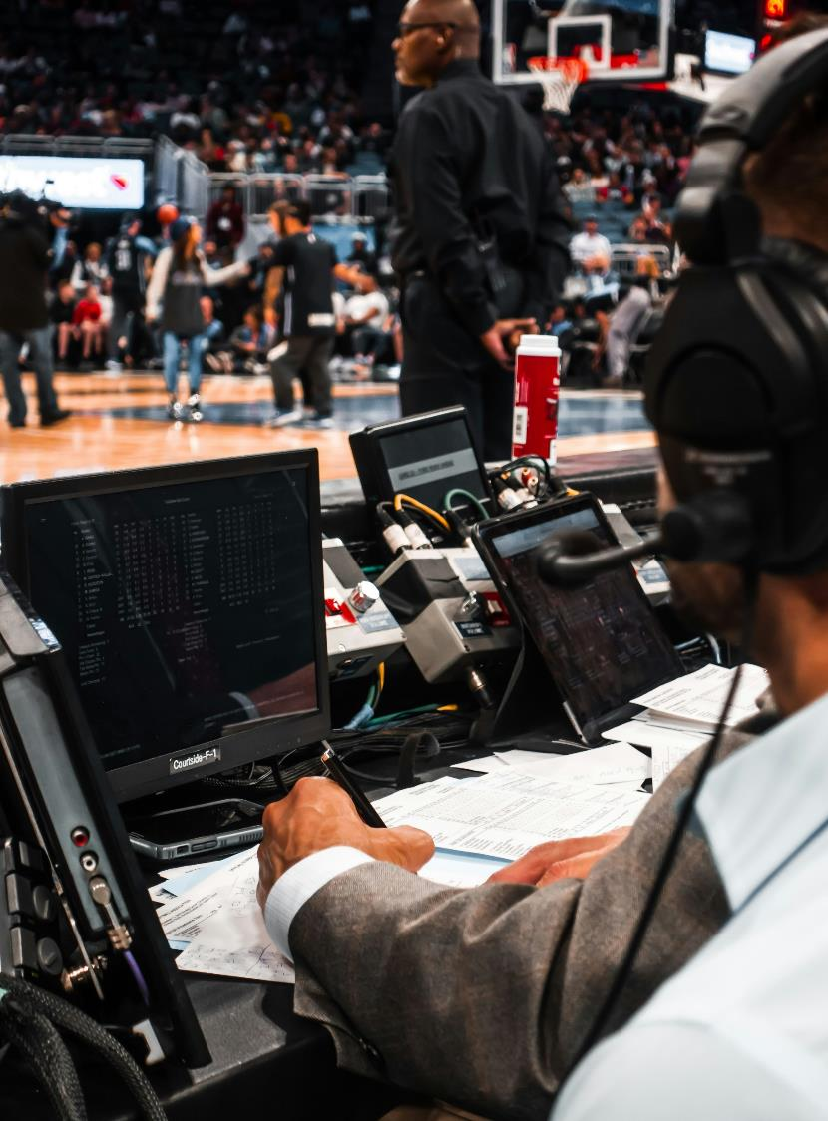
Sports analyst (1)
Discussion
Think about when you watch sport on TV, YouTube, TikTok highlights, or even live at a game. What do commentators or analysts usually point out?
Photo by William Warby on Unsplash
Notes:
Photo by Emanuel Ekström on Unsplash

Slide 51
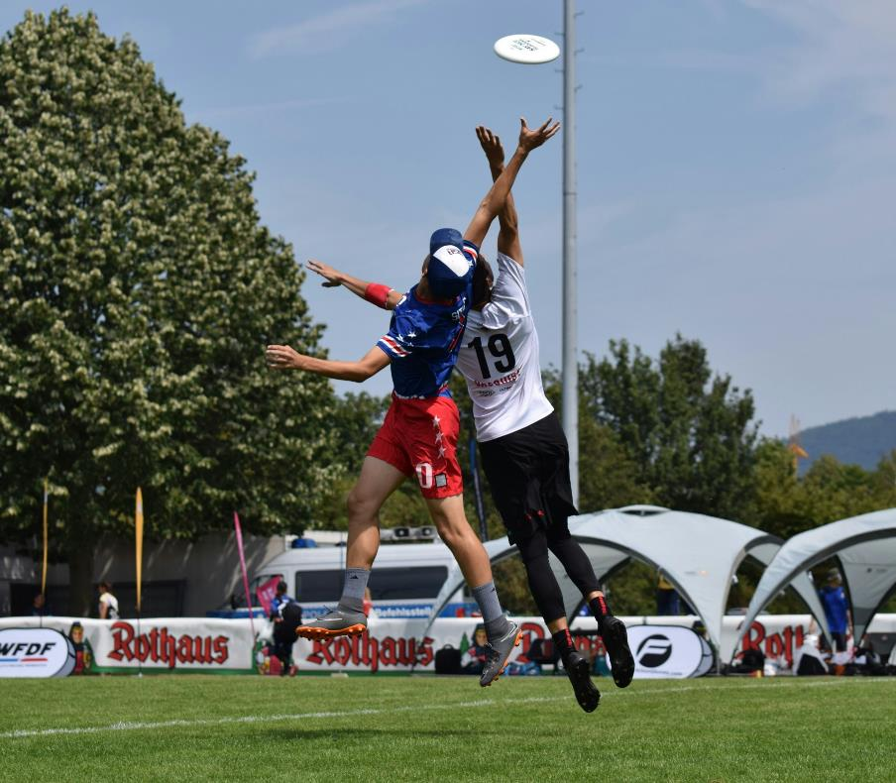
Sports analyst (2)
Individual reflection
Why do teams pay attention to these statistics?
How do commentators know what to say?
If you were analysing a game of Ultimate, what things would you focus on?
Photo by John Kofi on Unsplash

Slide 52
Ultimate Key Performance Indicators (KPIs)
Class discussion
Ultimate Key Performance Indicators (KPIs) include:
Throwing – Accuracy – Did the throw reach the intended teammate without being intercepted or hitting the ground?
Catching – Catch Rate – Did the player successfully catch the disc using correct technique?
Pivoting – Effective Pivot – Did the player pivot to create space or a passing lane without traveling?
Moving into Space – Use of Space – Did the player move into open space away from defenders to receive a pass?
Why is accurate throwing so important for team performance?
How does effective pivoting support both offence and defence?
Why is moving into space as a player essential for maintaining possession and creating scoring opportunities?
How could observing these KPIs help a coach improve player performance?

Slide 53
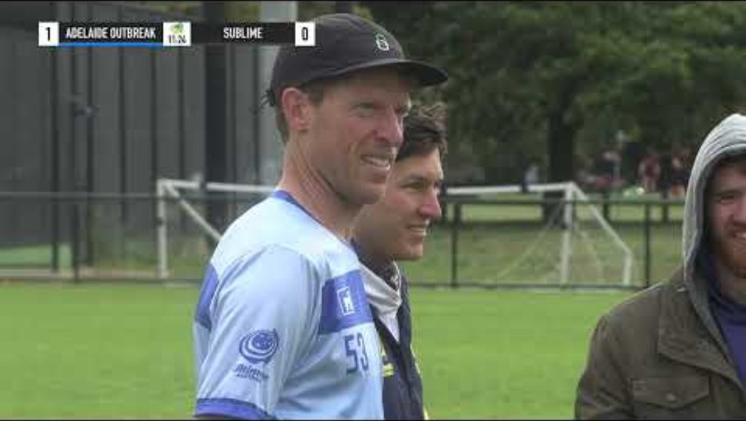
Video analysis
Statistics and observations

Slide 54
Learning sequence 6 – administering sports events

Slide 55
Learning intentions and success criteria (6)
We are learning to
plan and organise a mini Ultimate tournament, including schedules, venue setup, and equipment
identify and manage risks to ensure safety, fairness, and smooth event operation
work collaboratively to lead, make decisions, and support enjoyable participation for all involved
We can
create a clear event plan that shows how teams will compete and how the venue will be set up
identify potential hazards, suggest control measures, and assign responsibilities to reduce risk
contribute to group planning, demonstrate leadership, and explain how my decisions support fun, safe, and fair participation
Notes:
Notes for teachers:
Learning intentions and success criteria are best co-constructed with students. Adapt the learning intention as required and add matching success criteria.
For more information See ⁠AITSL or the NSW Department of Education explicit teaching strategies, ⁠Sharing learning intentions and ⁠Sharing success criteria
LISC is not necessarily presented at the beginning of the lesson. Teacher needs to consider most effectual time to introduce
LISC should be revisited during the lesson to support students' evaluation of their learning

Slide 56
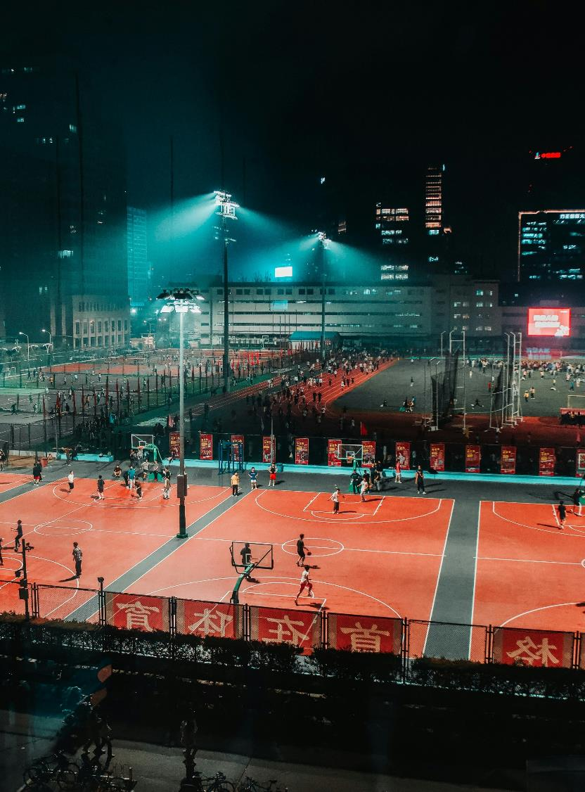
Introduction to sports event administration
Roles
Plan events – decide type, objectives and equipment.
Create draws and schedules – ensure fairness and clear match order.
Set up venues – mark fields, arrange equipment.
Manage risks – identify hazards and plan for emergencies.
Follow policy – uphold safety, inclusivity, fair play, and school/sport rules.
Photo by Christian Lue on Unsplash

Slide 57
Creating a mini event plan
Small group activity
Use butchers paper to design a mini-event plan for a Year 9 Ultimate tournament.
Each group should consider:
Draw and Schedule – How teams will compete fairly and rotate through matches.
Venue Setup – How fields will be marked, where equipment will be positioned, where spectators and first aid stations will be located.
Policy Application – Explain how rules, inclusivity, and safety policies will be applied during the tournament.

Slide 58
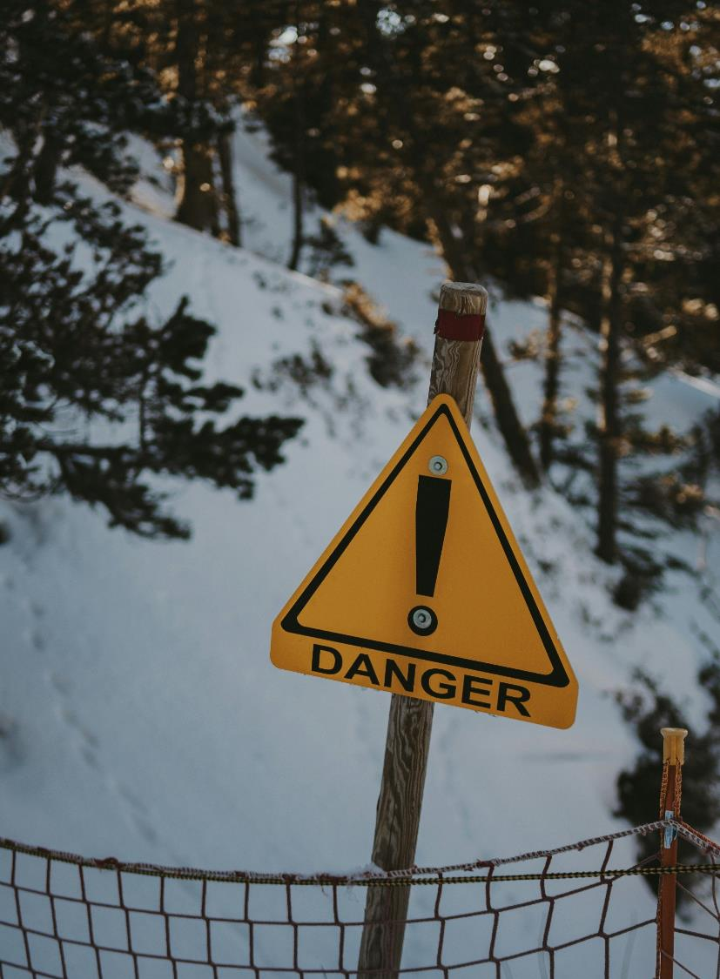
Risk assessment
Small group activity
Identify potential risks in your event plan. Examples might include wet fields, collisions during play, insufficient warm-up, or equipment failure. For each hazard:
Identify who might be affected (players, spectators, officials).
Rate the level of risk (High, Medium, Low).
Describe strategies to reduce the risk.
Assign responsibility for each control measure (event administrator, coach, players).
Photo by Maëva Vigier on Unsplash

Slide 59
Reflection and class discussion
Reflect individually
consider:
Which part of event administration do you feel most confident about.
Which element you would focus on improving in future events.
Share one insight with the class and discuss how these skills can be applied to school, community, or professional sporting events.

Slide 60
Learning sequence 7– event planning and implementing

Slide 61
Learning intentions and success criteria (7)
We are learning to
take on a specific role in planning and running an Ultimate tournament and understand its responsibilities
collaborate with other committees to ensure the event runs smoothly, safely, and fairly
reflect on how our contributions and teamwork impact the success, enjoyment, and engagement of the event
We can
plan and carry out tasks for my assigned role, including preparation, coaching, officiating, or event management
communicate and work effectively with other committees to coordinate schedules, rules, and activities
evaluate my own performance and teamwork, and explain how my actions helped make the tournament safe, fun, and well-organised
Notes:
Notes for teachers:
Learning intentions and success criteria are best co-constructed with students. Adapt the learning intention as required and add matching success criteria.
For more information See ⁠AITSL or the NSW Department of Education explicit teaching strategies, ⁠Sharing learning intentions and ⁠Sharing success criteria
LISC is not necessarily presented at the beginning of the lesson. Teacher needs to consider most effectual time to introduce
LISC should be revisited during the lesson to support students' evaluation of their learning

Slide 62
Role briefing (1)
Roles and outcomes
Coaches – Plan coaching strategies, pre-game preparation for players, and skill development activities to ensure players are ready for the tournament.
        Outcome – A written game plan and coaching focus sheet to guide match-day support.
Strength and Conditioning Coaches – Design warm-ups, stretching routines, and conditioning activities to enhance player performance and prevent injuries.
        Outcome – A warm-up and cool-down plan to be implemented before and after games.
Sports Analysts – Identify key performance indicators (KPIs) for players and teams, plan observation strategies, and prepare reporting templates for feedback.
        Outcome – An observation and feedback plan ready for use during games.

Slide 63
Role briefing (2)
Roles and outcomes
Referees – Review rules and policies for the event, plan how to manage fouls, conflicts, and ensure fair play.
        Outcome – A referee handbook to guide in-game decisions and ensure fair play.
Sports Event Administrators – Develop the tournament schedule, draw format, venue setup, equipment checklists, and risk management strategies.
        Outcome – A complete event plan that ensures smooth, safe, and inclusive delivery.

Slide 64
References
This presentation contains NSW Curriculum and syllabus content. The NSW Curriculum is developed by the NSW Education Standards Authority. This content is prepared by NESA for and on behalf of the Crown in the right of the State of New South Wales. The material is protected by Crown copyright.
Please refer to the NESA Copyright Disclaimer for more information https://educationstandards.nsw.edu.au/wps/portal/nesa/mini-footer/copyright.
NESA holds the only official and up-to-date versions of the NSW Curriculum and syllabus documents. Please visit the NSW Education Standards Authority (NESA) website https://educationstandards.nsw.edu.au/wps/portal/nesa/home and the NSW Curriculum website https://curriculum.nsw.edu.au.
Personal Development, Health and Physical Education 7–10 Syllabus © NSW Education Standards Authority (NESA) for and on behalf of the Crown in right of the State of New South Wales, 2024.

Slide 65
Copyright
© State of New South Wales (Department of Education), 2024
The copyright material published in this resource is subject to the Copyright Act 1968 (Cth) and is owned by the NSW Department of Education or, where indicated, by a party other than the NSW Department of Education (third-party material).
Copyright material available in this resource and owned by the NSW Department of Education is licensed under a Creative Commons Attribution 4.0 International (CC BY 4.0) license.
This license allows you to share and adapt the material for any purpose, even commercially.
Attribution should be given to © State of New South Wales (Department of Education), 2024.
Material in this resource not available under a Creative Commons license:
the NSW Department of Education logo, other logos and trademark-protected material
Material owned by a third party that has been reproduced with permission. You will need to obtain permission from the third party to reuse its material.
Links to third-party material and websites
Please note that the provided (reading/viewing material/list/links/texts) are a suggestion only and implies no endorsement, by the New South Wales Department of Education, of any author, publisher, or book title. School principals and teachers are best placed to assess the suitability of resources that would complement the curriculum and reflect the needs and interests of their students.
If you use the links provided in this document to access a third-party’s website, you acknowledge that the terms of use, including licence terms set out on the third-party’s website apply to the use which may be made of the materials on that third-party website or where permitted by the Copyright Act 1968 (Cth). The department accepts no responsibility for content on third-party websites.

