Slide 1
Instructions for use
This resource is not a teaching and learning program. It should be used in conjunction with the PDHPE Year 7 – exploring my strengths and identity – teaching and learning program.
Classroom teachers are encouraged to add and adapt slides as required to meet the needs of their students.
Save a copy of the file to make changes to the slide deck. Go to File > Download a Copy (this downloads a copy to the computer to edit in the PowerPoint app).
To convert the PowerPoint to Google Slides
  Upload the file into Google Drive and open it.
  Go to File > Save as Google Slides.
  (Note – conversion may cause formatting changes in the slides.)

Slide 2

Exploring my strengths and identity
PDHPE
Stage 4 – Year 7
Term 1

Slide 3

Learning sequence
Who am I?
Celebrating diversity
Goal setting
Team building
Our class’s strengths
Working as a team
The groups where I belong
Assessment lesson
Connecting for wellbeing
Who I am
Notes:
Teacher notes:
Click lesson numbers to go to specific lessons
Interactive features can be viewed in slide show
Notes for vendors [to be removed after slide deck creation]:
Create hyperlinks to dividers that match lesson numbers by
Right click on the number>edit link>select slide in deck to connect to

Slide 4
Who am I?

Slide 5
Learning intentions and success criteria – Who am I?
We are learning to
identify personal strengths, characteristics and other factors that shape personal identity
We can
explain how personal identity is shaped by a range of personal, environmental and social factors
Notes:
Notes for teachers:
Learning intentions and success criteria are best co-constructed with students. Adapt the learning intention as required and add matching success criteria.
For more information See ⁠AITSL or the NSW Department of Education explicit teaching strategies, ⁠Sharing learning intentions and ⁠Sharing success criteria
LISC is not necessarily presented at the beginning of the lesson. Teacher needs to consider most effectual time to introduce
LISC should be revisited during the lesson to support students' evaluation of their learning

Slide 6

Class bingo
In our class we each share many similarities, but we are all also very different.
Fill out the class bingo worksheet by walking around the room, finding someone who shares a similarity with you and writing their name into the box. Try to fill as many boxes as possible.
See how many different names you can get on your sheet!
Notes:
Photo by Joana Abreu on Unsplash

Slide 7

Bingo learnings
Class discussion
Were any similarities surprising to you?
Were there any boxes where you didn’t find someone, if so, how does this make you unique?
What are the key similarities across the whole class? Why do you think these exist?

Slide 8
My identity
My strengths
Individual brainstorm
Your identity is who you are.
It is a complex mix of characteristics you’re born with, and those that you acquire from your environment and experiences.
Brainstorm as many factors as possible that shape your identity.
Other factors that shape me
My talents
My identity
My dislikes
My personality traits
My likes

Slide 9
Personal profile advertisement
Using your brainstorm, create a personal profile advertisement that could be used to introduce yourself to the class.
This should be a persuasive writing piece, encouraging your audience to see all of your best qualities.
Be prepared for your classmates to view your advertisement.
Persuasive writing tips
Hook your audience in with a strong, catchy statement
Explain your point of view
Use strong, convincing language

Slide 10

Personal profile gallery walk
Set up your profile gallery advertisement around the room.
Walk around to read/preview the profile of your classmates to discuss these questions
what have you learned about your classmates?
have you learned anything about yourself?
what could our class motto be to represent the diversity in our class?
Notes:
Image by Gordon Johnson from Pixabay

Slide 11
Goal setting (1)

Slide 12
Learning intentions and success criteria – Goal setting
We are learning to
assess the effectiveness of teamwork, cooperation and problem-solving when working in a team.
explain how our personal strengths influence our actions and behaviours.
We can
set meaningful SMART goals to work towards in PDHPE
explain how personal strengths influence our actions and behaviours in individual and group environments
Notes:
Notes for teachers:
Learning intentions and success criteria are best co-constructed with students. Adapt the learning intention as required and add matching success criteria.
For more information See ⁠AITSL or the NSW Department of Education explicit teaching strategies, ⁠Sharing learning intentions and ⁠Sharing success criteria
LISC is not necessarily presented at the beginning of the lesson. Teacher needs to consider most effectual time to introduce
LISC should be revisited during the lesson to support students' evaluation of their learning

Slide 13
Practical lesson review
Team tabloid reflection
Reflect on your individual performance, effort and attitude in the last practical lesson during the team tabloid activities.
What were your greatest strengths?
Why do you think you were good at these things?
What were your main areas for improvement?
What actions could you take to improve?

Slide 14

Goal setting (2)
Goal setting is important for focusing your effort, increasing motivation, and achieving the things you want to achieve. Goal setting can help us shape our identity, feel a sense of accomplishment and improve our wellbeing.

Slide 15

SMART goals
A SMART goal is:
Specific
Measurable
Achievable
Relevant
Time-bound
Making it easy to know what you want to achieve and when you want to achieve it by!

Slide 16

My SMART goals
Write 2–3 individual SMART goals for what you would like to achieve in PDHPE lessons this term.
For example
By the end of this term, I would like to improve my hand eye coordination by increasing my score in the ‘paddle bat hits’ station to 30.
Notes:
Photo by Mason Tuttle: https://www.pexels.com/photo/ping-pong-paddle-and-ball-17299533/

Slide 17

Class strengths
Class discussion
Every person has different strengths and these can shape our personal identity.
Why is it good to have a variety of strengths in a group?
Notes:
Photo by Yulia Matvienko on Unsplash

Slide 18
Your character strengths
Choose 5 words that describe your greatest character strengths either from the list on screen, or your own choice.
Write a sentence on how each of these strengths are beneficial to you individually and when working with others.
Kind
Courageous
Wise
Artistic
Honest
Humorous
Optimistic
Fun
Forgiving
Trustworthy
Loyal
Enthusiastic
Resilient
Reliable
Intelligent
Creative
Trusting
Passionate
Generous
Assertive
Friendly
Brave
Rational
Innovative

Slide 19
Our class’s strengths

Slide 20
Learning intentions and success criteria – Our class’s strengths
We are learning to
recognise and appreciate the nature and benefits of diversity within our classroom
communicate and share our thoughts about the value of diversity
We can
contribute to class activities to show an appreciation of class diversity
recognise how difference can be beneficial in supporting teamwork
Notes:
Notes for teachers:
Learning intentions and success criteria are best co-constructed with students. Adapt the learning intention as required and add matching success criteria.
For more information See ⁠AITSL or the NSW Department of Education explicit teaching strategies, ⁠Sharing learning intentions and ⁠Sharing success criteria
LISC is not necessarily presented at the beginning of the lesson. Teacher needs to consider most effectual time to introduce
LISC should be revisited during the lesson to support students' evaluation of their learning

Slide 21


Practical lesson reflection (1)
Sprints and long jump
Complete ‘Two stars and a wish’ for your participation in the lesson.
Rate your athletic performance from the last practical lesson from 1-developing to 5-highly skilled.
Provide reasons for your rating.
What did you do during the lesson to continue to work towards your SMART goals?

Slide 22
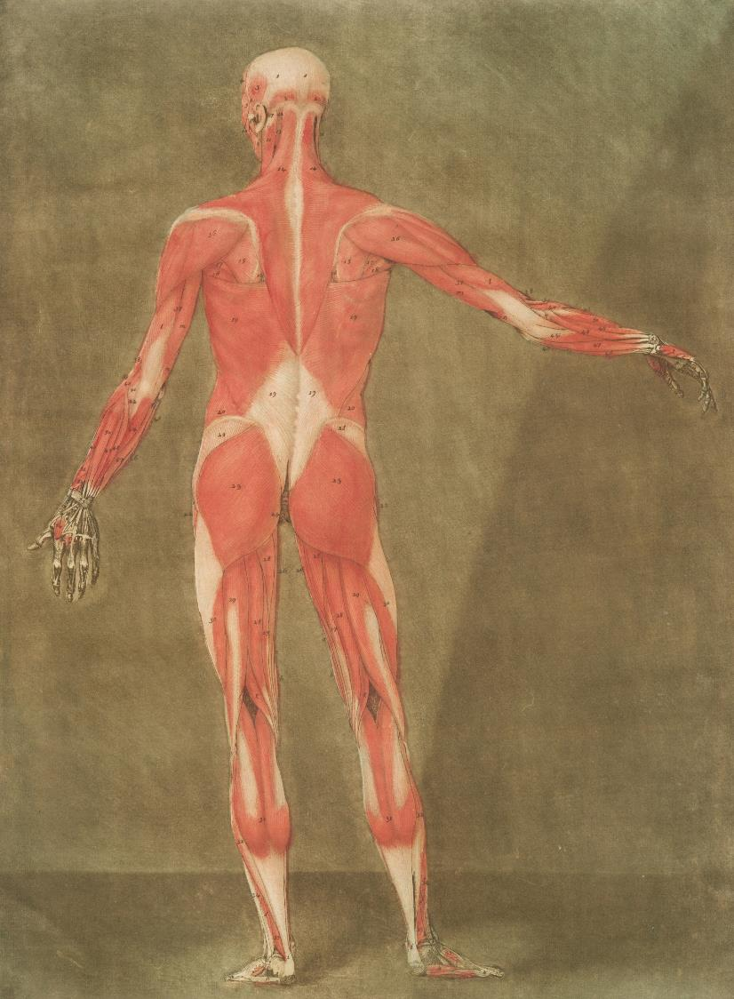
Weekly anatomy spotlight
Anatomy is the study of the different parts of the human body, including bones, muscles, and organs. It helps us understand how our bodies are built and how they work.
When we do physical activity such as like running, jumping, or playing sports, anatomy helps us understand which body parts are being used, how they move, and how to keep them strong and healthy.
Knowing about anatomy can help us move better, avoid injuries, and improve our performance in sports and exercise.
Notes:
Photo by The New York Public Library on Unsplash

Slide 23
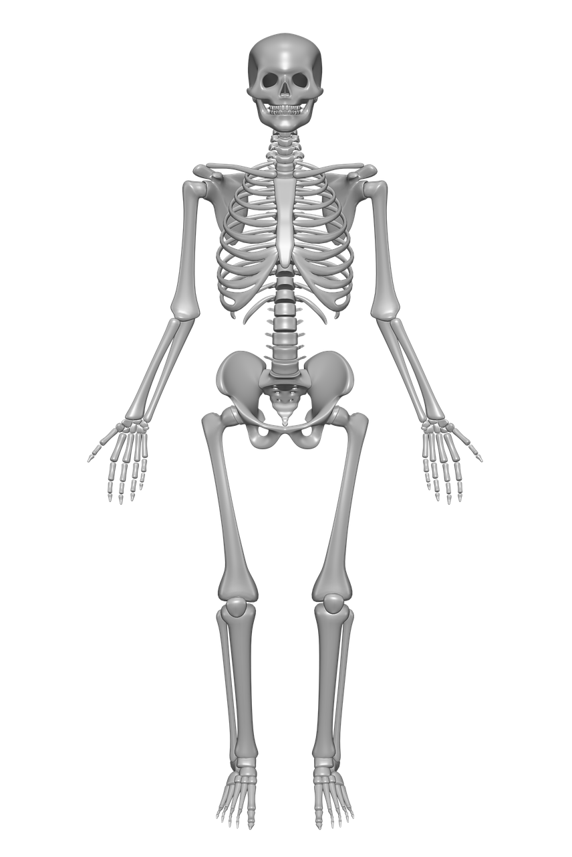
Anatomy spotlight (1)
Sprinting and long jump
Examine your labelled skeletal system and muscular system diagrams.
During the activities in the last practical lesson:
Which bones were used?
Which muscles were used?
Notes:
Image by Tymon Oziemblewski from Pixabay

Slide 24

Group strengths
Group discussion
In your allocated groups, discuss the following questions:
What were your 5 strengths individually?
How will each person’s strengths help you work well together as a team?
What might be some weaknesses that you have as a group when working together?
You will now complete some team challenge activities.
Notes:
Image by re ggobi from Pixabay

Slide 25
Activities reflection
Group discussion
Reflecting on your individual and team performance in the challenge activities:
What was your groups greatest strength? Was it what you expected?
What were your greatest weaknesses as a group? How could you address these?
Notes:
Image by re ggobi from Pixabay

Slide 26
Group activities reflection
Class discussion
Reflecting on your individual and group performance in the initiative activities, and your small group discussion:
Why is it good to have a range of strengths in a group?
What is a strength you saw in a classmate that you really appreciated when completing a challenge?

Slide 27

Class posters
What makes our class special
Characteristics
        physical skills, capabilities, qualities, values
Culture
        family backgrounds, traditions followed at home, holidays or places you have travelled
Interests
        what you like to do outside of school, hobbies and sports

Slide 28

Concentric circle discussion
What do our class posters say about our class?
What do these posters tell us about the students in the class?
What is your favourite part of being part of this class?
How can the diversity and difference in the class make the class a good group to belong to?
How can we work as a class more effectively utilising our collective strengths and interests?

Slide 29
Venn Diagram
Show the similarities and differences of your class
Complete a Venn diagram showing how your classmates are similar and also different to you
Myself
My classmates
Characteristics that are unique
Similarities
Characteristics that are unique

Slide 30
The groups where I belong

Slide 31
Learning intentions and success criteria – The groups where I belong
We are learning to
recognise the role of groups in promoting social wellbeing
appreciate the characteristics of different groups in supporting our needs and identity
We can
understand how different groups promote a sense of belonging
recognise the qualities of being connected to a group to promote our personal identity
Notes:
Notes for teachers:
Learning intentions and success criteria are best co-constructed with students. Adapt the learning intention as required and add matching success criteria.
For more information See ⁠AITSL or the NSW Department of Education explicit teaching strategies, ⁠Sharing learning intentions and ⁠Sharing success criteria
LISC is not necessarily presented at the beginning of the lesson. Teacher needs to consider most effectual time to introduce
LISC should be revisited during the lesson to support students' evaluation of their learning

Slide 32
Practical lesson reflection (2)
High jump
Complete ‘Two stars and a wish’ for your participation in the lesson.
Rate your athletic performance from the last practical lesson from 1-developing to 5-highly skilled.
Provide reasons for your rating.
What did you do during the lesson to continue to work towards your SMART goals?

Slide 33
Anatomy spotlight (2)
High jump
Examine your labelled skeletal system and muscular system diagrams.
During the activities in the last practical lesson:
Which bones were used?
Which muscles were used?
Notes:
Image by Tymon Oziemblewski from Pixabay

Slide 34

Belonging
Belonging is the feeling of fitting in or feeling comfortable as a member of a group.
As a class, complete a Y-chart for what belonging looks like, feels like and sounds like.
Brainstorm all of the groups where you feel a sense of belonging, this could include your family, the class, a sports team, a hobby group and so on.

Slide 35
Belonging and Identity
Class discussion
What is the best part of belonging to a group?
What kind or roles or responsibilities come with groups that you belong to?
What do the groups that you belong to indicate about your identity?
To what extent do groups you belong to shape your identity?
To what extent does your identity shape the groups that you belong to?

Slide 36

Belonging and identity reflection
Writing task
Select 3 different groups that you belong to (from your brainstorm) and complete a written reflection answering the following:
who is in the groups? (this can be general, for example, other students from the school, people my age who play soccer, my family members)
what do you like about belonging to the groups?
what do you have to do to belong to the groups?
how does belonging to these groups shape your identity?

Slide 37
Promoting a group you belong to
Poster creation
You have been asked by one of the groups that you belong to, to create a poster that can be displayed on a local noticeboard to advertise the group to the community.
Your poster should visually represent what the group is about and clearly demonstrate:
who might be interested in being a part of this group
what the group offers individuals
any responsibilities that come with being in this group
additional reasons why it is great to be part of this group
what the best parts are about being in this group.
Posters will be displayed in the next theory lesson

Slide 38
Connecting for wellbeing

Slide 39
Learning intentions and success criteria – Connecting for wellbeing
We are learning to
explore the benefits of group connection to support our sense of belonging
investigate ways in which you can join a group
We can
understand the benefits of being in a group to support a sense of belonging and overall wellbeing
develop the skills and understanding of how to join a group
Notes:
Notes for teachers:
Learning intentions and success criteria are best co-constructed with students. Adapt the learning intention as required and add matching success criteria.
For more information See ⁠AITSL or the NSW Department of Education explicit teaching strategies, ⁠Sharing learning intentions and ⁠Sharing success criteria
LISC is not necessarily presented at the beginning of the lesson. Teacher needs to consider most effectual time to introduce
LISC should be revisited during the lesson to support students' evaluation of their learning

Slide 40
Practical lesson reflection (3)
Discus and shot put
Complete ‘Two stars and a wish’ for your participation in the lesson.
Rate your athletic performance from the last practical lesson from 1-developing to 5-highly skilled.
Provide reasons for your rating.
What did you do during the lesson to continue to work towards your SMART goals?

Slide 41
Anatomy spotlight (3)
Discus and shot put
Examine your labelled skeletal system and muscular system diagrams.
During the activities in the last practical lesson:
Which bones were used?
Which muscles were used?
Notes:
Image by Tymon Oziemblewski from Pixabay

Slide 42
SMART goal check in
Review the SMART goals that you wrote earlier in the unit and answer the following reflection questions:
What progress have you made towards your goals?
Were your goals appropriately challenging?
What has helped you in working towards achieving your goals?
What barriers have got in the way of achieving your goals?
What can you do to reduce the impact of these barriers?
Do you need to adjust any of your goals? If so, why and how?

Slide 43
SMART goal feedback
Group discussion
In your groups present and explain your goals to your peers including:
How the goal is a SMART goal.
Why they chose this goal.
What they are doing to achieve this goal.
Each person should then provide their feedback in the form of a feedback sandwich – an idea for an improvement, sandwiched between 2 positive points.
Notes:
Image by re ggobi from Pixabay

Slide 44
Joining new groups
Class brainstorm and discussion
Why might you want to join a new group?
What makes it hard to join a new group?
What makes it easier to join a new group?
When you are in a group, what are the benefits of welcoming new members to the group?

Slide 45

How to join new groups
Role play activity
In your groups, create 2 role plays:
For joining a group where you do not know anyone.
For joining a new friendship group at school.

Slide 46
Role play reflections
Class discussion
What behaviours did you see in the role plays that demonstrated inclusivity?
What might make these role plays difficult to achieve in real life?
What are some of the reasons that individuals might want to change friendship groups?

Slide 47

Wellbeing is
“
Wellbeing is
A sustainable state characterised by predominantly positive feelings, attitudes and relationships. It involves resilience, self-efficacy and a high level of satisfaction with self.
NESA, 2024
PDHPE 7–10 Syllabus

Slide 48

Groups and wellbeing reflection
Writing task
How does belonging to groups enhance an individual’s wellbeing?
Prompts:
What are the emotional benefits of feeling a sense of belonging?
How does being in a group support my mental and physical health?
How does my friendship group make me feel better about myself?
What are the benefits of belonging to a range of different groups?
How do I support the wellbeing of others in my group?
How do different perspectives, backgrounds, and experiences in a group create opportunities for personal growth and mutual respect?

Slide 49
Celebrating diversity

Slide 50
Learning intentions and success criteria – Celebrating diversity
We are learning to
demonstrate inclusivity by supporting diversity in others
recognise how diverse qualities enhance personal identity
We can
show acceptance of diverse qualities
demonstrate inclusive practices to support belonging and wellbeing of diverse individuals.
Notes:
Notes for teachers:
Learning intentions and success criteria are best co-constructed with students. Adapt the learning intention as required and add matching success criteria.
For more information See ⁠AITSL or the NSW Department of Education explicit teaching strategies, ⁠Sharing learning intentions and ⁠Sharing success criteria
LISC is not necessarily presented at the beginning of the lesson. Teacher needs to consider most effectual time to introduce
LISC should be revisited during the lesson to support students' evaluation of their learning

Slide 51
Practical lesson reflection (4)
Javelin
Complete ‘Two stars and a wish’ for your participation in the lesson.
Rate your athletic performance from the last practical lesson from 1-developing to 5-highly skilled.
Provide reasons for your rating.
What did you do during the lesson to continue to work towards your SMART goals?

Slide 52
Anatomy spotlight (4)
Javelin
Examine your labelled skeletal system and muscular system diagrams.
During the activities in the last practical lesson:
Which bones were used?
Which muscles were used?
Notes:
Image by Tymon Oziemblewski from Pixabay

Slide 53
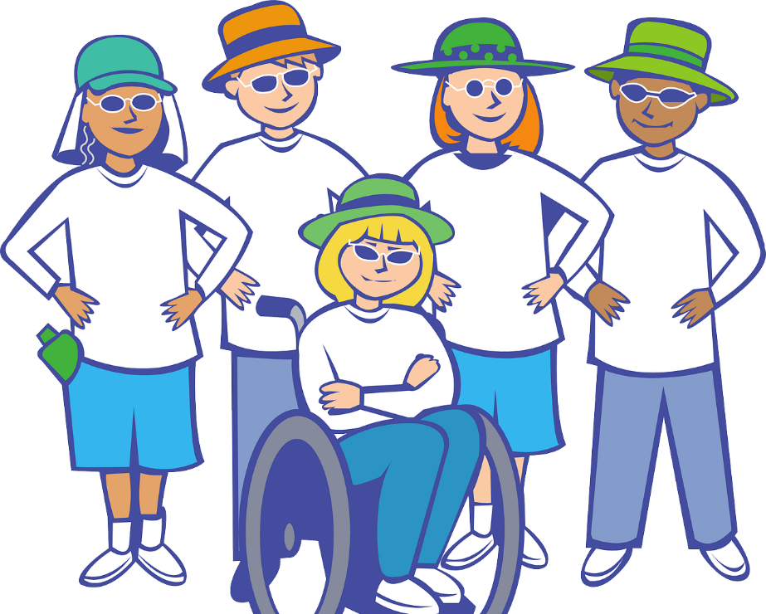
Diversity
The differences that exist between people
In what ways can people be diverse?
Notes:
Image by OpenClipart-Vectors from Pixabay

Slide 54
Diversity refers to
“
Diversity refers to
Differences that exist within a group, for example, age, sex, gender, gender expression, sexuality, ethnicity, ability/disability, body shape and composition, culture, religion/spirituality, learning differences, socioeconomic background, values and experiences.
NESA, 2024
PDHPE 7–10 Syllabus

Slide 55
Opportunities and challenges
Group discussion
With a partner, discuss and list all of the opportunities and challenges that are posed by diversity in groups of people.
Opportunities
Challenges
Notes:
Image by re ggobi from Pixabay

Slide 56
Inclusion and diversity
Class discussion
What is inclusion and what does it look like in a diverse group of people?

Slide 57
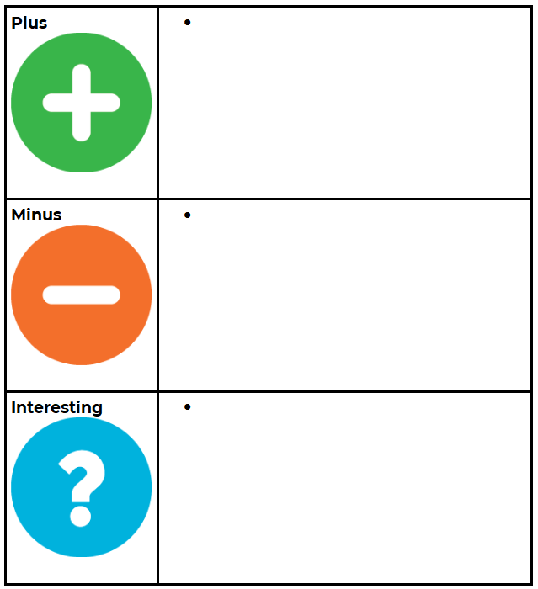
Harmony week
Class discussion
In pairs, review the promotional materials and resources for Harmony Week available on the government website.
Analyse these materials using a Plus, Minus, Interesting chat.
Notes:
Image licensed under Unsplash Content License.

Slide 58

Promoting inclusion and diversity
Class discussion
Create your own piece of promotional material that could be used to promote inclusion and celebrate diversity in Australia. Consider aspects such as:
an inclusive slogan or motto
representation of diversity
colours and language that promote inclusivity
how the material will achieve inclusiveness.
Notes:
Image by OpenClipart-Vectors from Pixabay

Slide 59
Team building

Slide 60
Learning intentions and success criteria – Team building
We are learning to
recognise the strength and value of being in a team to support common goals
Investigate a range of strategies that promote inclusivity, teamwork and a sense of belonging
We can
offer ideas and embrace the contributions of others to develop team goals and aspirations
identify our own personal strengths and the strengths of our team to enhance my own sense of belonging.
Notes:
Notes for teachers:
Learning intentions and success criteria are best co-constructed with students. Adapt the learning intention as required and add matching success criteria.
For more information See ⁠AITSL or the NSW Department of Education explicit teaching strategies, ⁠Sharing learning intentions and ⁠Sharing success criteria
LISC is not necessarily presented at the beginning of the lesson. Teacher needs to consider most effectual time to introduce
LISC should be revisited during the lesson to support students' evaluation of their learning

Slide 61
Practical lesson reflection (5)
End ball
Complete ‘Two stars and a wish’ for your participation in the lesson.
Rate your athletic performance from the last practical lesson from 1-developing to 5-highly skilled.
Provide reasons for your rating.
What did you do during the lesson to continue to work towards your SMART goals?

Slide 62
Anatomy spotlight (5)
End ball
Examine your labelled skeletal system and muscular system diagrams.
During the activities in the last practical lesson:
Which bones were used?
Which muscles were used?
Notes:
Image by Tymon Oziemblewski from Pixabay

Slide 63
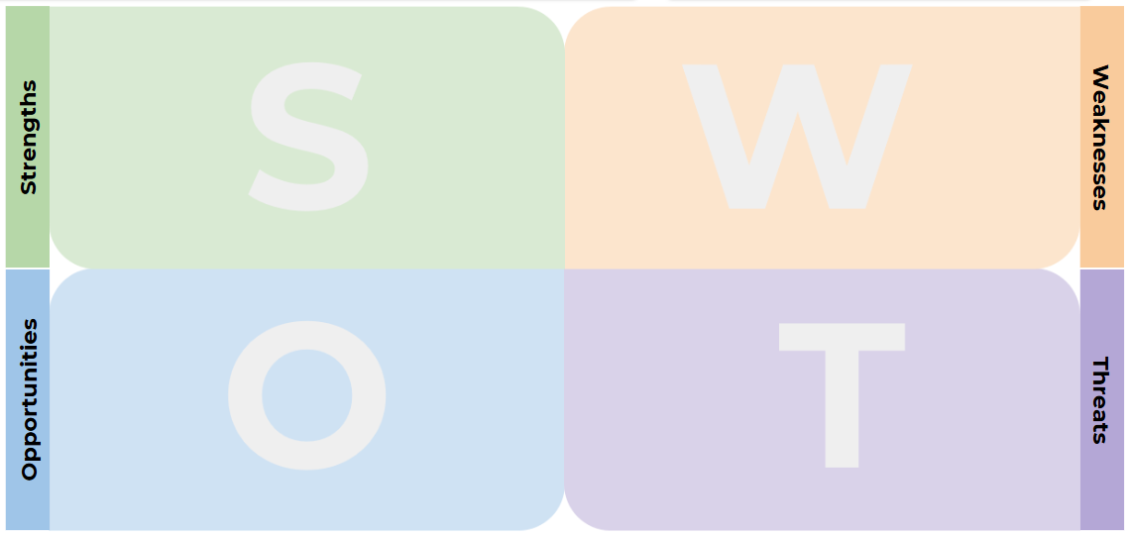
Reflecting on our team
As a team, reflect on your performance from our last practical lesson.
Complete a SWOT analysis to analyse your team’s:
Strengths
Weaknesses
Opportunities
Threats

Slide 64
SWOT debrief
Group discussion
As a team:
How do we maximise the impact of our strengths and opportunities?
How do we reduce the impact of our weaknesses and threats?
Notes:
Image by re ggobi from Pixabay

Slide 65
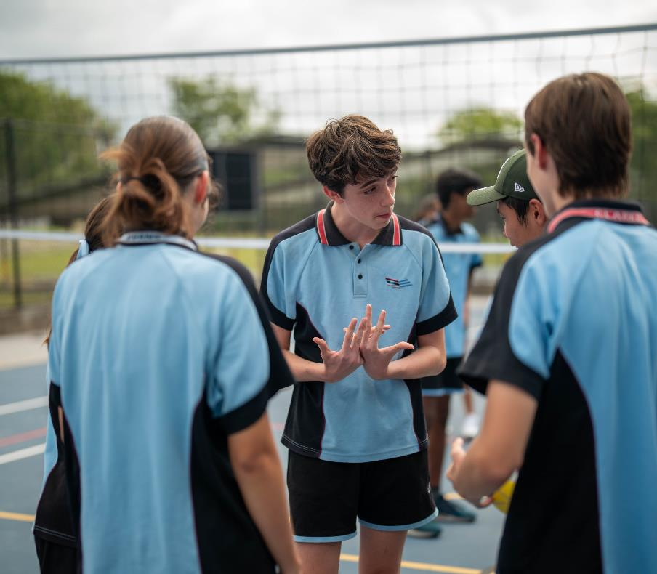
Building our team identity
In your teams:
devise a team name
devise a team motto
devise a team mascot
write a brief bio for your team that explains the choice of team motto and mascot
create player profiles for each team member
create a team code of conduct.

Slide 66
Working as a team

Slide 67
Learning intentions and success criteria – Working as a team
We are learning to
work effectively with our team mates to overcome challenges to achieve success
recognise how to use team strengths for positive team outcomes.
We can
make positive contributions to my team demonstrating effective teamwork skills
utilise the strengths of my team mates to enjoy success in teamwork activities.
Notes:
Notes for teachers:
Learning intentions and success criteria are best co-constructed with students. Adapt the learning intention as required and add matching success criteria.
For more information See ⁠AITSL or the NSW Department of Education explicit teaching strategies, ⁠Sharing learning intentions and ⁠Sharing success criteria
LISC is not necessarily presented at the beginning of the lesson. Teacher needs to consider most effectual time to introduce
LISC should be revisited during the lesson to support students' evaluation of their learning

Slide 68
Practical lesson reflection (6)
Kick tennis
Complete ‘Two stars and a wish’ for your participation in the lesson.
Rate your athletic performance from the last practical lesson from 1-developing to 5-highly skilled.
Provide reasons for your rating.
What did you do during the lesson to continue to work towards your SMART goals?

Slide 69
Anatomy spotlight (6)
Kick tennis
Examine your labelled skeletal system and muscular system diagrams.
During the activities in the last practical lesson:
Which bones were used?
Which muscles were used?
Notes:
Image by Tymon Oziemblewski from Pixabay

Slide 70
Assessment lesson

Slide 71
Learning intentions and success criteria – Assessment lesson
We are learning to
assess our skill progress and ability to contribute to teamwork
address our SMART goal by reflecting on our success or areas that require further improvement.
We can
evaluate our own skill progress and performance
reflect our own smart goals showing strengths and understand how to improve our skill base.
Notes:
Notes for teachers:
Learning intentions and success criteria are best co-constructed with students. Adapt the learning intention as required and add matching success criteria.
For more information See ⁠AITSL or the NSW Department of Education explicit teaching strategies, ⁠Sharing learning intentions and ⁠Sharing success criteria
LISC is not necessarily presented at the beginning of the lesson. Teacher needs to consider most effectual time to introduce
LISC should be revisited during the lesson to support students' evaluation of their learning

Slide 72
Practical lesson reflection (7)
Team tabloid 2
Write reflection on the last team tabloid lesson including:
What did I enjoy most in the lesson?
What activities was I good at and why?
What activities could I still improve on?
What strategies did my team use to work together effectively?
How did I personally contribute to my team’s success?
Were there any challenges working together as a team? If so, what were they?

Slide 73
Who I am

Slide 74
Learning intentions and success criteria – Who I am
We are learning to
reflect on our SMART goal for physical activity and unit journey celebrating effort, perseverance and success
acknowledge the strengths of our peers to overcome team challenges to enhance success.
We can
value our personal achievements and the achievements of others.
participate in class activities to show our peers and team mates how they promote a sense of belonging.
Notes:
Notes for teachers:
Learning intentions and success criteria are best co-constructed with students. Adapt the learning intention as required and add matching success criteria.
For more information See ⁠AITSL or the NSW Department of Education explicit teaching strategies, ⁠Sharing learning intentions and ⁠Sharing success criteria
LISC is not necessarily presented at the beginning of the lesson. Teacher needs to consider most effectual time to introduce
LISC should be revisited during the lesson to support students' evaluation of their learning

Slide 75
Practical lesson reflection (8)
Kick tennis
Complete ‘Two stars and a wish’ for your participation in the lesson.
Rate your athletic performance from the last practical lesson from 1-developing to 5-highly skilled.
Provide reasons for your rating.
What did you do during the lesson to continue to work towards your SMART goals?

Slide 76
Anatomy spotlight (7)
Kick tennis
Examine your labelled skeletal system and muscular system diagrams.
During the activities in the last practical lesson:
Which bones were used?
Which muscles were used?
Notes:
Image by Tymon Oziemblewski from Pixabay

Slide 77
Team reflection
Group discussion
Your team sits in a circle, and each person completes the following sentences:
When we worked together, I enjoyed…
I appreciate our team for…
The teamwork skills that I have improved are…
In trying to achieve my SMART goals I discovered that …
A class member who surprised me was… because they…
While completing this unit, I have discovered that…
Notes:
Image by re ggobi from Pixabay

Slide 78




Personal portrait
In this unit you have explored your strengths, identity and sense of belonging in a variety of contexts. Some of these aspects are visible, and others are not.
Create a self-portrait to represent these aspects using a medium that suits you (physical or digital). The portrait can be realistic or abstract.
Notes:
Image by u_tqm083tet4 from Pixabay
Image by Garik Barseghyan from Pixabay
Image by OpenClipart-Vectors from Pixabay
Image by Gordon Johnson from Pixabay

Slide 79

Reflection
Write one final reflection for PDHPE this term answering the following questions:
The main thing I learnt in this unit this term was…
This term I have improved in…
I am proud of myself for…
One of the most interesting things I learnt was…
I would like to learn more about…
Notes:
Photo by Mathilda Khoo on Unsplash

Slide 80
Copyright
© State of New South Wales (Department of Education), 2024
The copyright material published in this resource is subject to the Copyright Act 1968 (Cth) and is owned by the NSW Department of Education or, where indicated, by a party other than the NSW Department of Education (third-party material).
Copyright material available in this resource and owned by the NSW Department of Education is licensed under a Creative Commons Attribution 4.0 International (CC BY 4.0) license.
This license allows you to share and adapt the material for any purpose, even commercially.
Attribution should be given to © State of New South Wales (Department of Education), 2024.
Material in this resource not available under a Creative Commons license:
the NSW Department of Education logo, other logos and trademark-protected material
Material owned by a third party that has been reproduced with permission. You will need to obtain permission from the third party to reuse its material.
Links to third-party material and websites
Please note that the provided (reading/viewing material/list/links/texts) are a suggestion only and implies no endorsement, by the New South Wales Department of Education, of any author, publisher, or book title. School principals and teachers are best placed to assess the suitability of resources that would complement the curriculum and reflect the needs and interests of their students.
If you use the links provided in this document to access a third-party’s website, you acknowledge that the terms of use, including licence terms set out on the third-party’s website apply to the use which may be made of the materials on that third-party website or where permitted by the Copyright Act 1968 (Cth). The department accepts no responsibility for content on third-party websites.

