Slide 1
Instructions for use
This resource is not a teaching and learning program. It should be used in conjunction with Safety never takes a holiday teaching and learning program.
Classroom teachers are encouraged to add and adapt slides as required to meet the needs of their students.
Save a copy of the file to make changes to the slide deck. Go to File > Download a Copy (this downloads a copy to the computer to edit in the PowerPoint app).
To convert the PowerPoint to Google Slides:
  Upload the file into Google Drive and open it.
  Go to File > Save as Google Slides.
  (Note – conversion may cause formatting changes in the slides.)

Slide 2

Safety never takes a holiday
PDHPE – Stage 4 / Year 7
Term 4

Slide 3
Lessons
1
Understanding risk, responsibility and safety
2
Water wise
3
Road smart – safety in motion
4
Navigating online spaces
5
Health help – support and information you can trust
Notes:
Teacher notes:
Click lesson titles t to go to specific lessons
Interactive features can be viewed in slide show

Slide 4
Understanding risk, responsibility and safety

Slide 5
Learning intentions and success criteria (1)
We are learning to
develop an understanding of risk, responsibility and safety
explore the concepts of protective behaviours and harm-minimisation strategies
develop an understanding of basic first aid principles and emergency response procedures.
We can
explain the concepts of risk, responsibility, and safety
propose protective behaviours and harm-minimisation strategies and evaluate their effectiveness in managing risk.
explain the basic principles of first aid and the importance of the DRSABCD emergency response procedure.
Notes:
Notes for teachers:
Learning intentions and success criteria are best co-constructed with students. Adapt the learning intention as required and add matching success criteria.
For more information See ⁠AITSL or the NSW Department of Education explicit teaching strategies, ⁠Sharing learning intentions and ⁠Sharing success criteria
LISC is not necessarily presented at the beginning of the lesson. Teacher needs to consider most effectual time to introduce
LISC should be revisited during the lesson to support students' evaluation of their learning

Slide 6
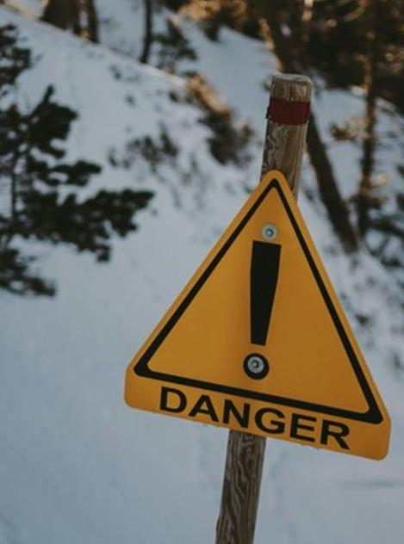
Activity – introduction to risk, responsibility and safety (1)
Pair activity – turn and talk
Instructions
In your pairs, consider the following questions:
Who is responsible for keeping us safe in different environments?
What kinds of risks are okay to take, and which ones should we avoid?
How can we support our friends to make safe and responsible choices?
Photo by Maëva Vigier on Unsplash

Slide 7

Activity – understanding risk, responsibility and safety (2)
KWLH – activating prior knowledge
Instructions
Record what you already know about risk, responsibility and safety, including definitions, examples and personal experiences, in the K column of the chart.
Record what you would like to learn about these key terms, and any curiosities or questions that you have, in the W column of the chart.
Image by Mohamed Hassan from Pixabay

Slide 8
KWLH
What do I know? | What do I want to know? | What have I learned? | How can I learn more?
K
What do I know?
W
What do I want to know?
L
What have I learned?
H
How can I learn more?

Slide 9
Activity – risky, riskier, riskiest! (1)
Individual activity – the risk continuum
Instructions
After hearing each statement, take up a position along the continuum which you think best reflects the level of risk in each scenario.
LOW RISK
HIGH RISK

Slide 10

Activity – Risky, riskier, riskiest! (2)
Whole-class discussion
Questions to consider
Was there a risk that everyone seemed to agree on? Why do you think that is?
Did talking with someone else change your mind about where you stood for any of the risks? Why?
Were your reasons for standing at different points on the line determined more by facts and knowledge, or feelings?
Image by Zizitom from Pixabay

Slide 11

Activity – The relationship between risk, responsibility and safety (1)
Group activity
Instructions
Write your scenario at the top of your paper
Brainstorm the potential risks associated with the scenario and write these below.
Brainstorm the responsible actions to mitigate the risks. Record these below the risks.
Draw a circle at the bottom of the page and label it ‘Safety;.
Draw lines from each responsible action to the circle.
Image by OpenClipart-Vectors from Pixabay

Slide 12

Activity – The relationship between risk, responsibility and safety (2)
Individual activity – written reflection
Instructions
Write a short paragraph explaining how safe behaviours can be used to minimise the risks associated with your group’s scenario.
Include a reflection on the importance of taking responsibility to manage risk and enhance safety in everyday situations.
Image by Arya W from Pixabay

Slide 13

Activity – protective behaviours and harm-minimisation
Pair activity – think, pair, share
Questions
What do you think a ‘protective behaviour’ is? Can you think of an example of one from your everyday life?
What does the term ‘harm-minimisation strategy’ mean to you? What are some common examples of harm-minimisation strategies?
Image by poli_ from Pixabay

Slide 14
Protective behaviours and harm-minimisation strategies
Key terms
Protective behaviours and harm-minimisation strategies are both important for managing risk and improving the safety and wellbeing of ourselves and others.
Protective behaviours place an emphasis upon proactive actions which prevent the risk of harm by eliminating or avoiding risky behaviours and scenarios all together.
Harm-minimisation strategies are those actions and behaviours which can limit the potential for harm or negative consequences in risky situations. They focus on reducing harm rather than eliminating risk entirely.

Slide 15

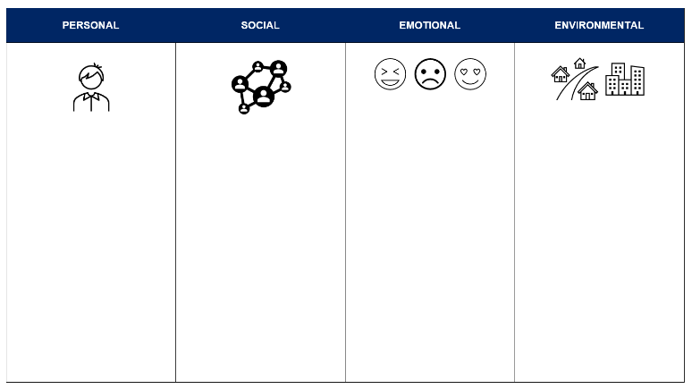
Activity – factors influencing our decision-making (1)
Individual activity – worksheet
Instructions
Brainstorm the specific influences on our decision-making which you believe relate to each category.
Image by Clker-Free-Vector-Images from Pixabay

Slide 16
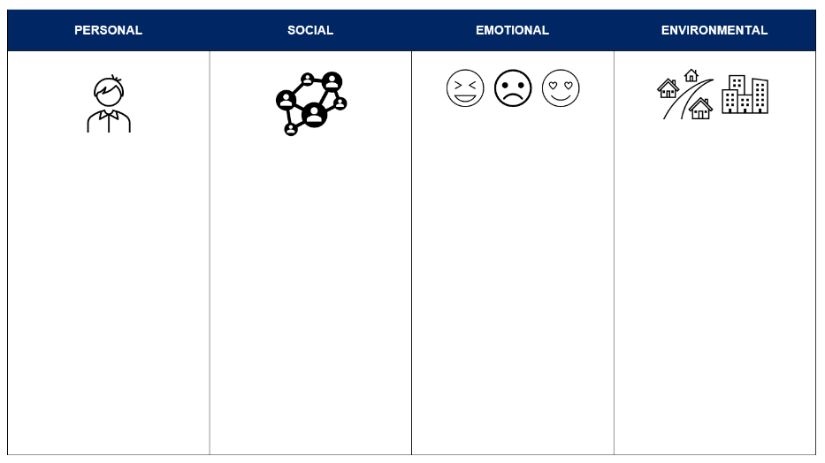
Activity – factors influencing our decision-making (2)
Key terms
Personal factors refer to individual characteristics such as age, gender and previous experiences.
Social factors include societal norms and expectations, and influences from our peers, friends and family.
Emotional factors are the feelings which influence our thinking, such as excitement, stress and anxiety.
Environmental factors include things such as the physical location and our proximity to support and resources.

Slide 17
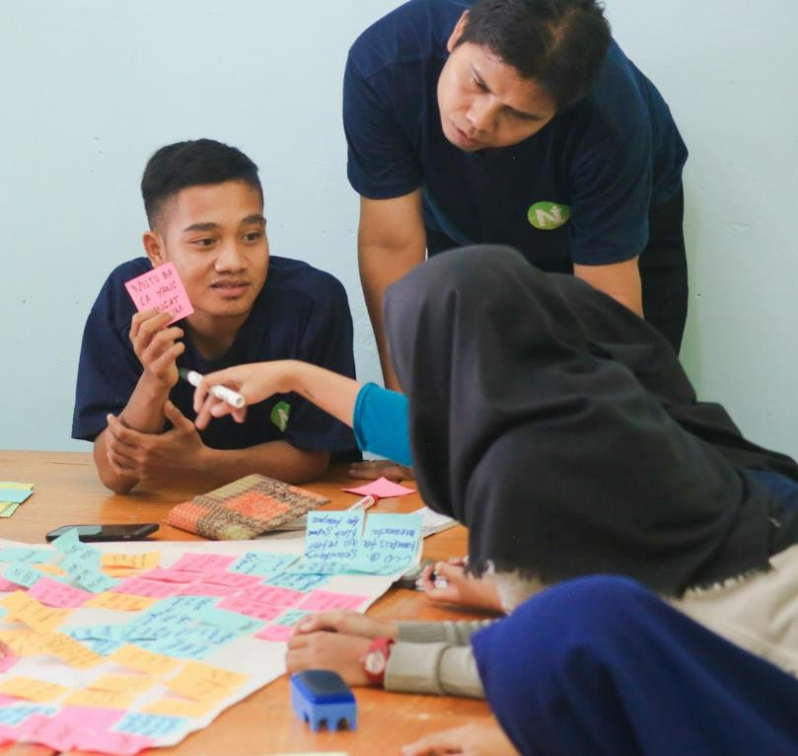
Activity – factors influencing our decision-making (3)
Group activity – scenario analysis
Instructions
Analyse your case study and identify the personal, social, emotional and environmental factors which have influenced the decision-making of the characters.
Brainstorm a range of protective behaviours and harm-minimisation strategies which could minimise or eliminate the risk of harm.
Rank these in order of how likely you would be to use them in a real-life situation.
Photo by Zainul Yasni on Unsplash

Slide 18

Activity – factors influencing our decision-making (4)
Individual activity – written reflection
Instructions
Write an alternate ending to your assigned scenario.
Use the protective behaviours and harm-minimisation strategies you identified with your group to develop a different outcome for the characters in the story.
Image by fotografierende from Pixabay

Slide 19
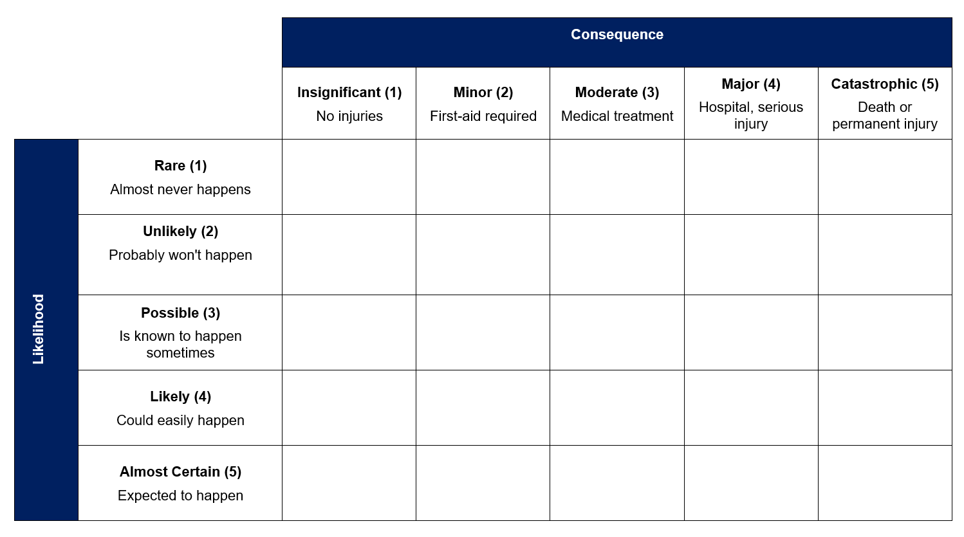
Activity – risk matrix (1)
Pair activity – scenario risk assessment
Instructions
Evaluate each scenario for the likelihood of an incident occurring, and the severity of the potential consequences.
Plot each scenario on the risk assessment matrix.

Slide 20
Activity – risk matrix (2)
Pair activity – scenario risk assessment
Instructions
Calculate a risk score for each scenario using the ‘likelihood score multiplied by consequence score’ formula.
Propose harm-minimisation strategies and/or protective behaviours for each scenario
Re-plot the scenarios on the risk matrix and re-calculate the risk scores for each one based on the integration of your protective behaviours and/or harm-minimisation strategies.
Calculate the percentage change in risk score following your risk management intervention.

Slide 21
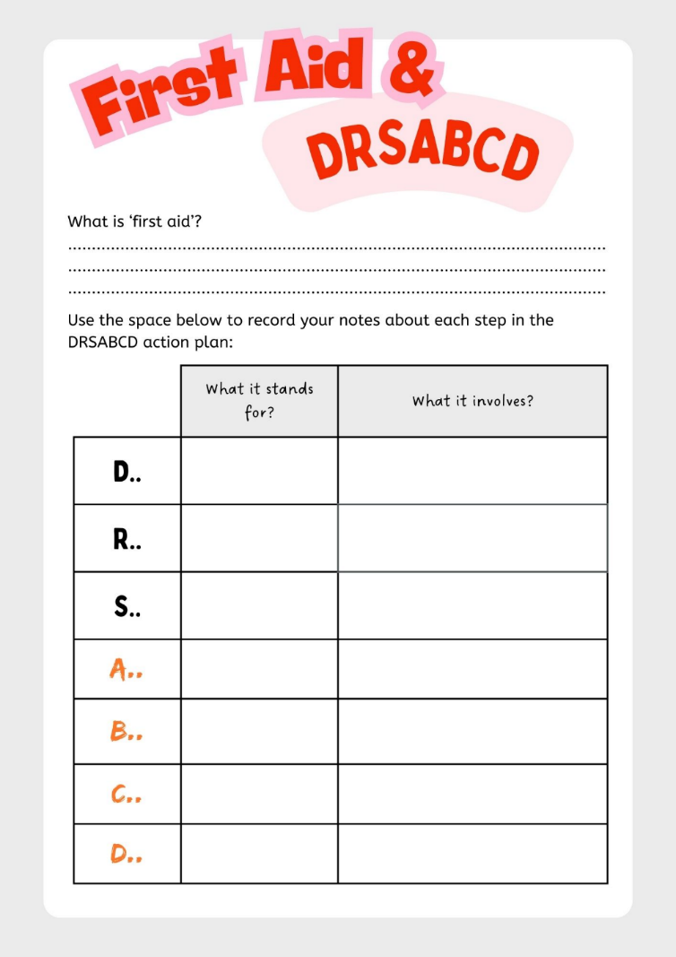
Activity – introduction to first aid (1)
Group activity – brainstorm
Instructions
Brainstorm what you already know about first aid, including what first aid involves, everyday situations where first aid might be needed and who might be involved in providing it.
Develop a group definition of the term ‘first aid’ and be prepared to share your ideas with the class.
Record the class definition of ‘first aid’ on your worksheet.

Slide 22
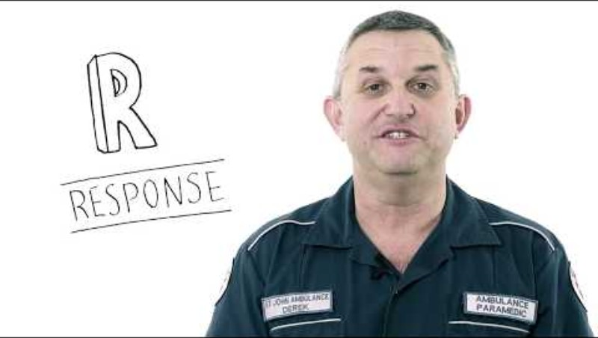
DRSABCD action plan explained! | Education | St John WA (2:47)

Slide 23
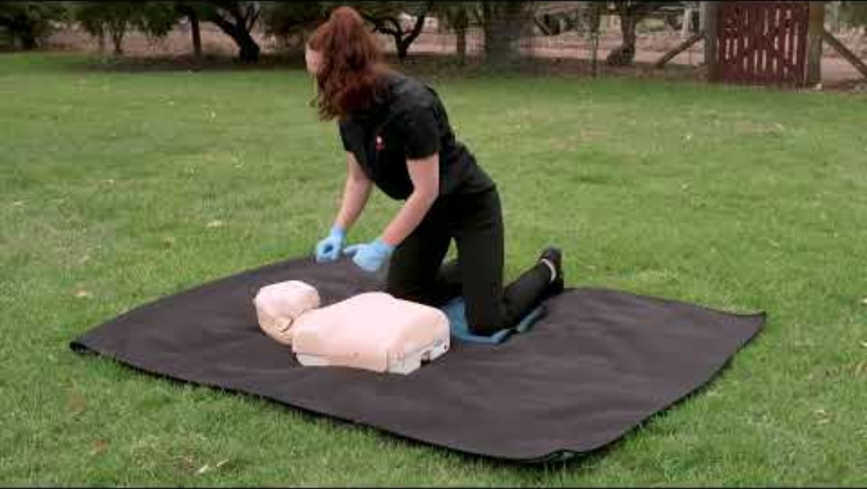
First Aid Facts: CPR(2:09)

Slide 24
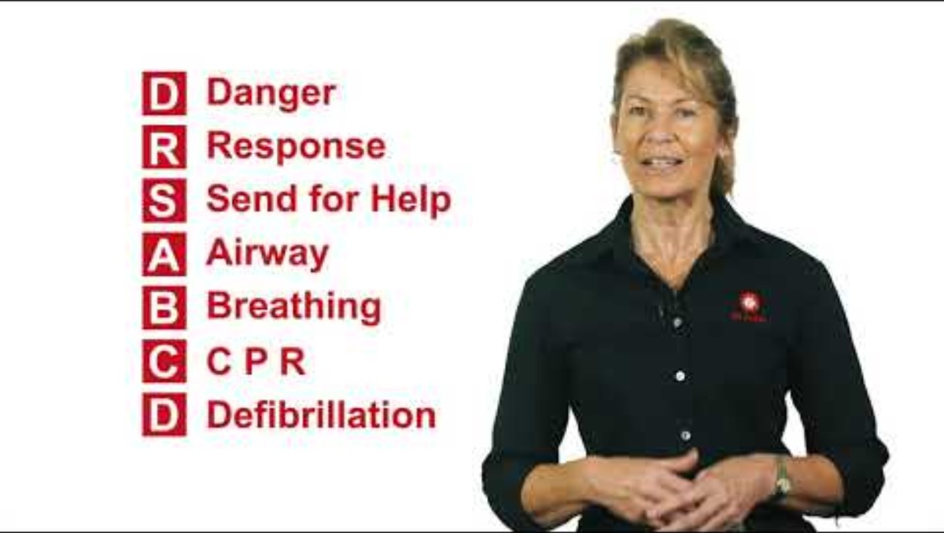
How to do CPR and use a defibrillator | St John WA(3:53)

Slide 25
Activity – introduction to first aid (2)
Whole-class discussion
Questions to consider
Why is it helpful to have a clear plan to follow in case of an emergency?
How can understanding the DRSABCD action plan help you keep yourself and others safe?
If you could only teach one part of the action plan to someone else, which part would it be? Why?

Slide 26
Water wise

Slide 27
Learning intentions and success criteria (2)
We are learning to
identify and respond to common risks and hazards in a variety of water-based environments.
apply our knowledge of the DRSABCD action plan and principles of first aid to a realistic emergency scenario.
We can
assess hazards and risks in water-based environments and propose suitable protective behaviours and harm-minimisation strategies to keep myself and others safe.
use my knowledge of the DRSABCD action plan and principles of first aid to respond appropriately to an emergency scenario.
Notes:
Notes for teachers:
Learning intentions and success criteria are best co-constructed with students. Adapt the learning intention as required and add matching success criteria.
For more information See ⁠AITSL or the NSW Department of Education explicit teaching strategies, ⁠Sharing learning intentions and ⁠Sharing success criteria
LISC is not necessarily presented at the beginning of the lesson. Teacher needs to consider most effectual time to introduce
LISC should be revisited during the lesson to support students' evaluation of their learning

Slide 28

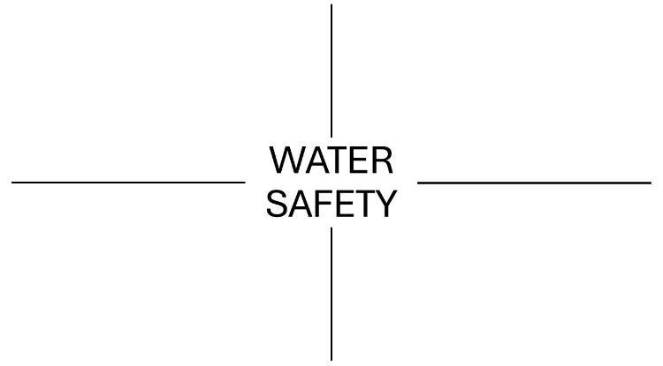
Activity – introduction to water safety (1)
Activating prior knowledge
Instructions
Divide your blank paper into four quadrants.
Write the words 'WATER SAFETY' in the middle of the page.
Image by Arya W from Pixabay

Slide 29
Activity – introduction to water safety (2)
Activating prior knowledge
Instructions
Record a response to each question in a separate quadrant:
What are three things you know about water safety?
What are three risks we might encounter in and around different water environments?
How might safety rules change depending on where you are, such as a swimming pool versus the beach?
What water activities do you enjoy? What safety considerations are important for those activities?

Slide 30

Activity – ‘four corners’
Group activity – debate
Instructions
After hearing each statement, move to the corner of the room which best reflects your view – strongly agree, agree, disagree or strongly disagree.
Discuss your response and opinions with others in the same corner to develop a shared point of view.
Select a representative to share the group’s thoughts with the whole class.
Image by Mohamed Hassan from Pixabay

Slide 31
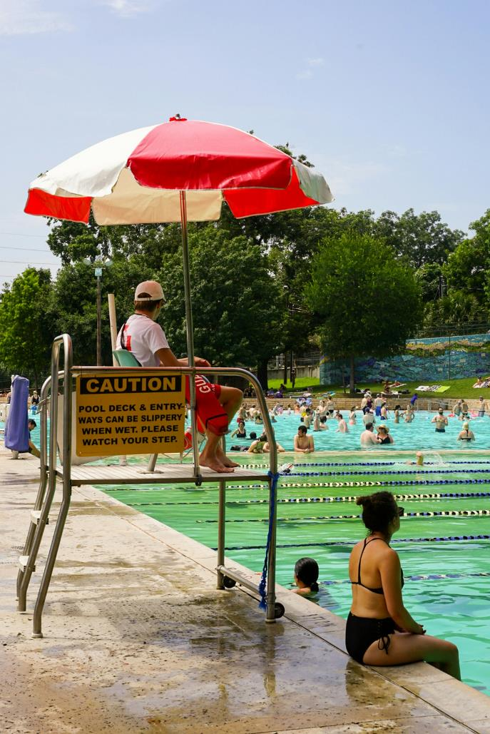
Activity – hazard identification
Group activity
Instructions
In your groups, brainstorm a list of hazards and potential risks associated with your specific water environment.
After viewing the School Sport Unit’s ‘How to stay safe in and around water’ (3:57) video, add any additional risks and hazards to your original brainstorm.
Photo by Megan Bucknall on Unsplash

Slide 32
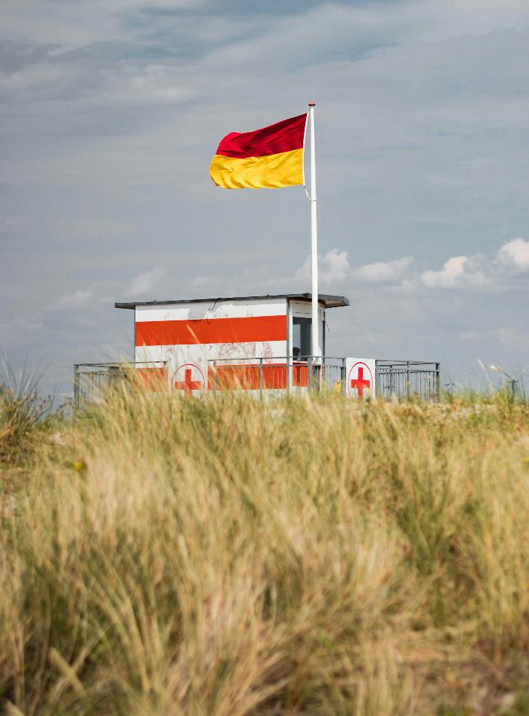
Activity – building a beach profile
Individual activity – beach safety
Instructions
Create your own ‘beach profile’ using the BeachSafe website.
Include:
the name and location of the beach
information about patrols, facilities, local regulations and known hazards
a current weather report, including air and water temperature, the UV index and swell size.
Photo by Alexandru Bogdan on Unsplash

Slide 33

Activity – how to spot a rip (1)
Pair activity – beach safety
Instructions
Examine each of the following images and decide, with your partner, where the safest place to swim would be and why.

Slide 34
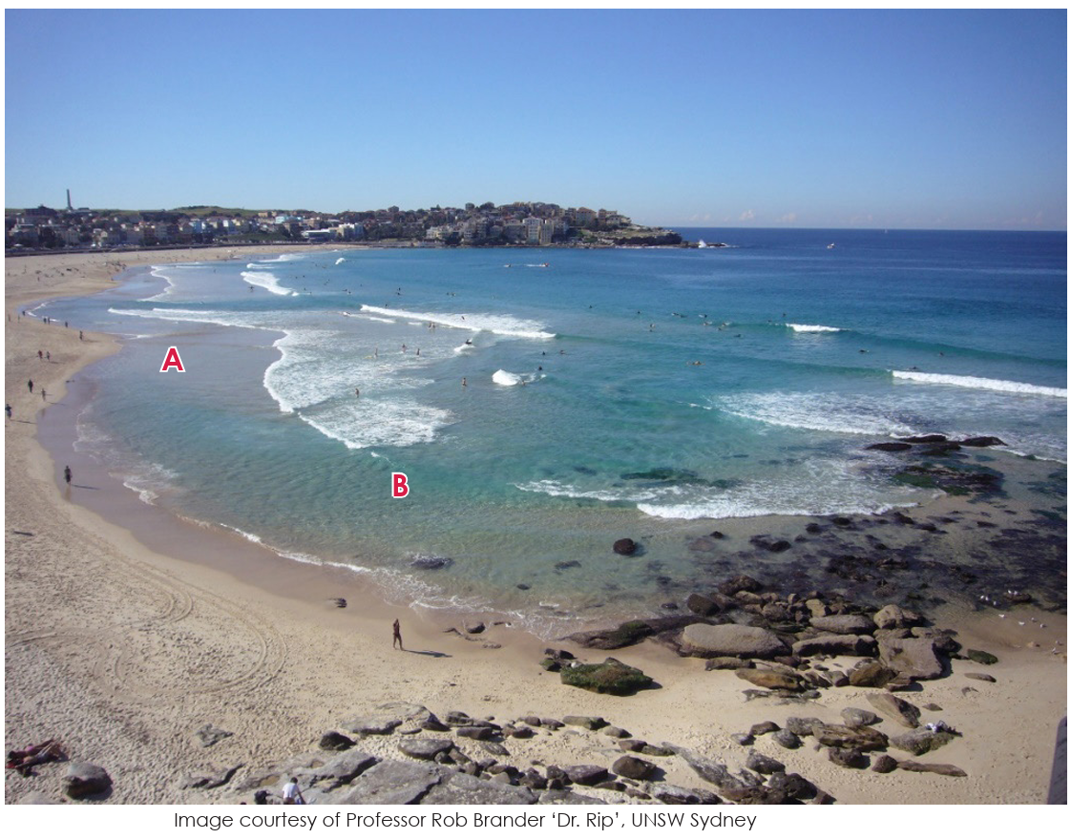
‘Dr Rip’ (1)

Slide 35
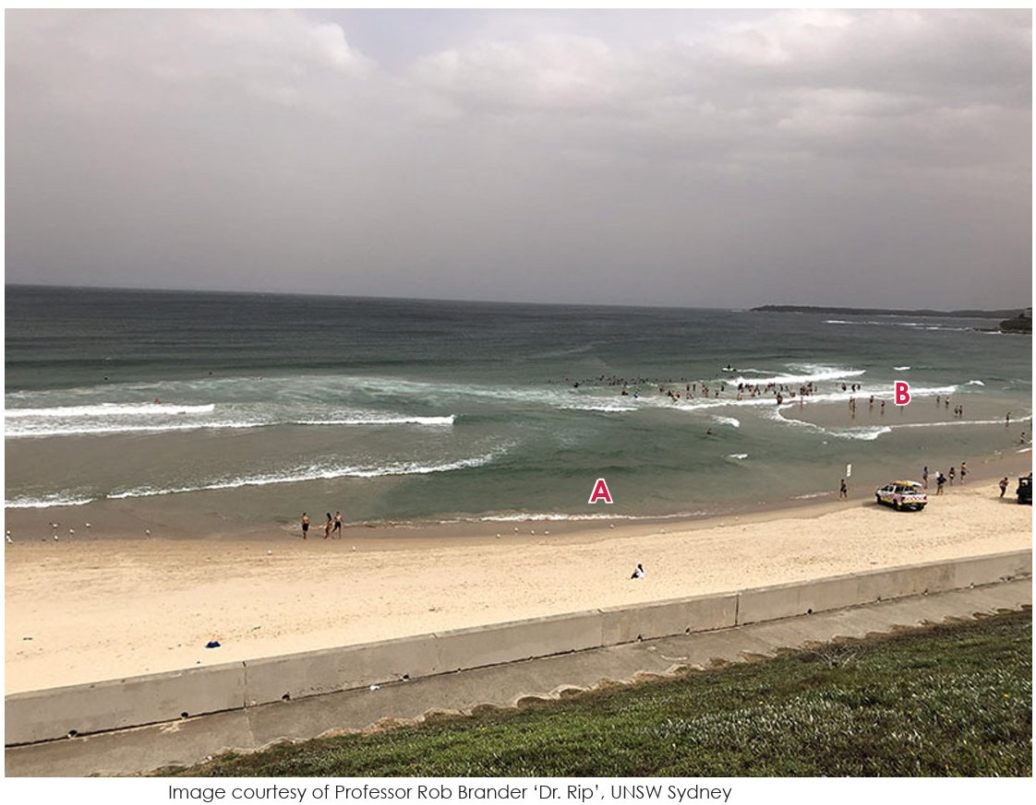
‘Dr Rip’ (2)

Slide 36
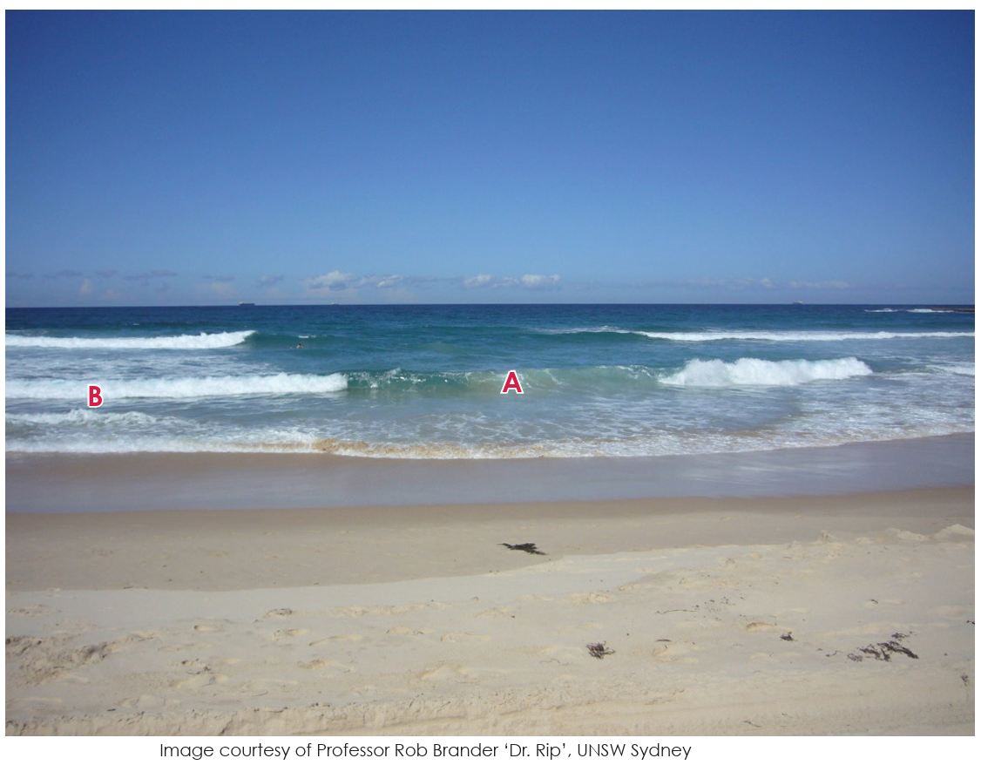
‘Dr Rip’ (3)

Slide 37
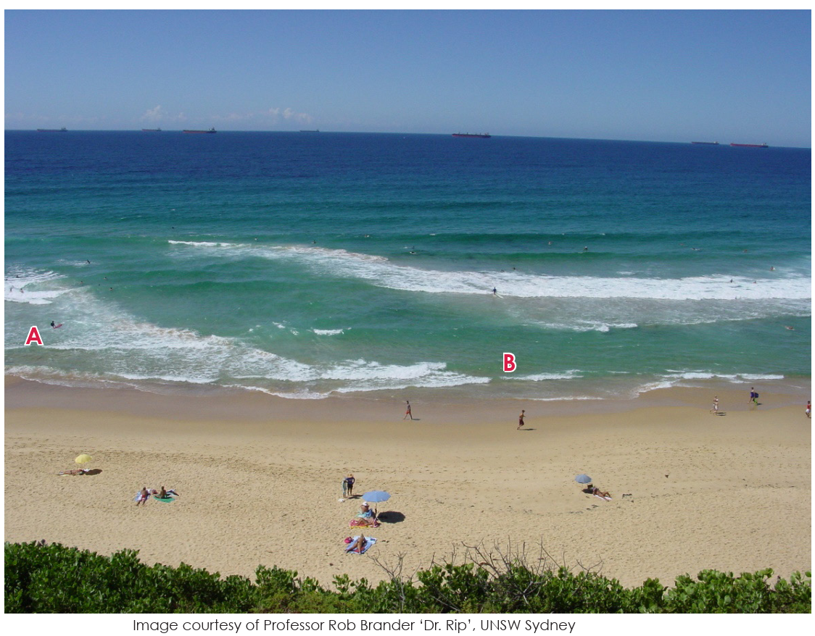
‘Dr Rip’ (4)

Slide 38
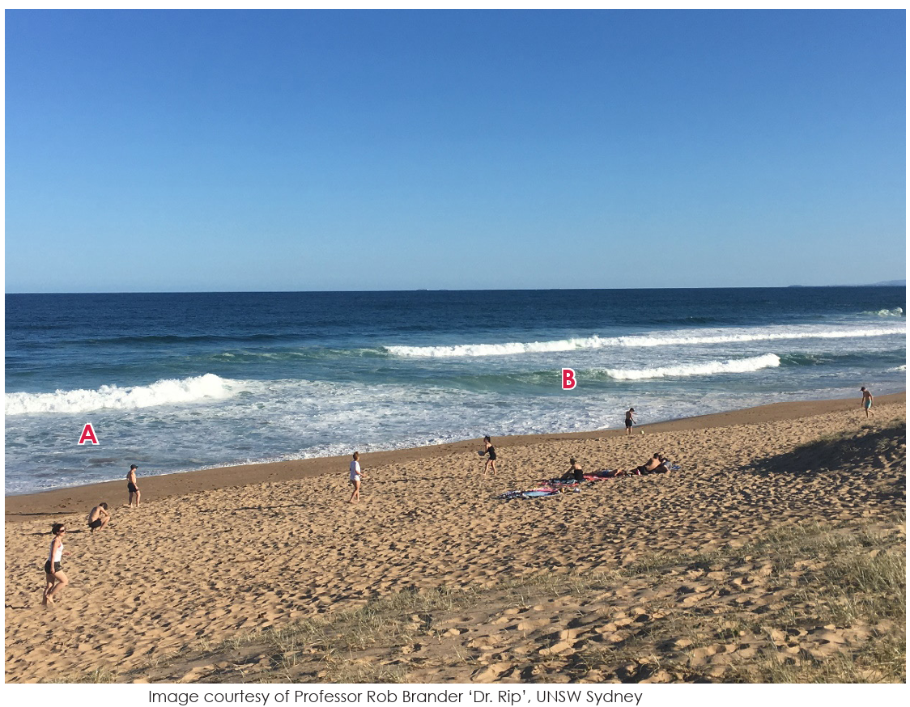
‘Dr Rip’ (5)

Slide 39
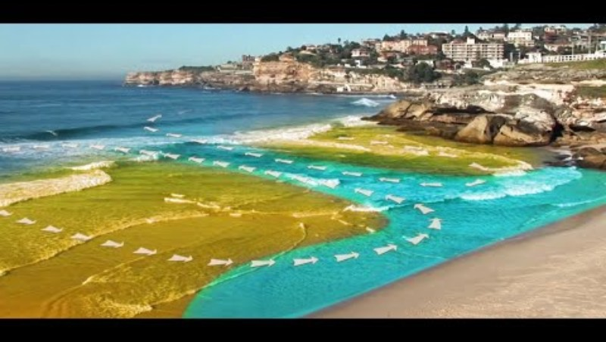
How to spot a rip (4:24)

Slide 40

Activity – how to spot a rip (2)
Whole-class discussion
Instructions and questions to consider
View the five beach images again. For each image, consider:
What are the signs of a rip current in this image? What clues did you miss the first time?
What does the water look like where the rip is? How is it different from the rest of the beach?
What would you say to someone who thought the rip current area looked like the safest spot?
Would you feel confident advising a friend or family member where to swim based on what you know now?
Illustration by Deep on Unsplash

Slide 41
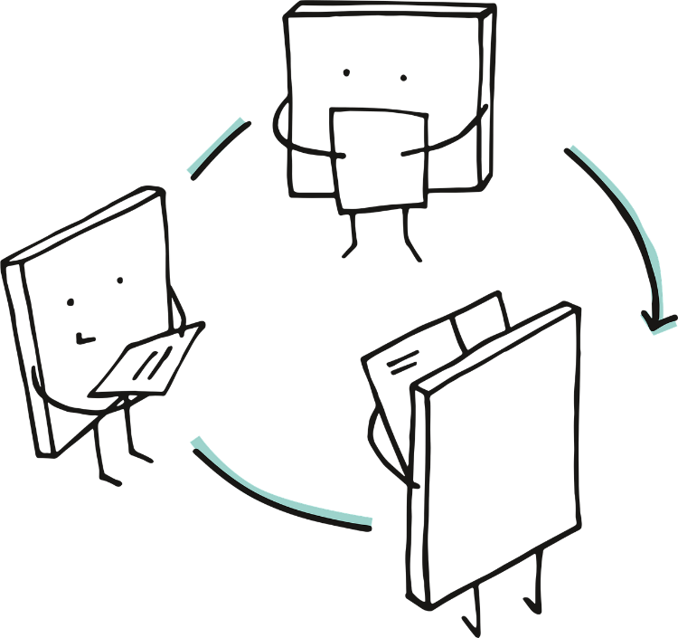
Activity – how to escape a rip (3)
Individual activity and whole-class discussion
Instructions
View the How to escape a rip NSW Ed (4:58) video resource, which unpacks a number of escape strategies for getting out of different types of rip currents.
Consider the protective behaviours and harm-minimisation strategies that could be used to manage the risks associated with rip currents.
Image by Manfred Steger from Pixabay

Slide 42
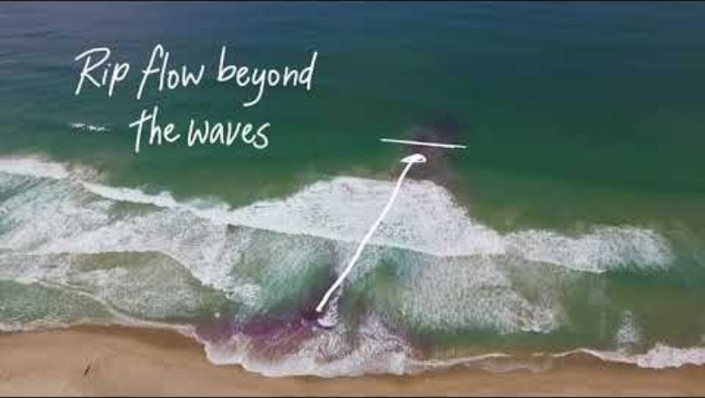
How to escape a rip NSW Ed (4:58)

Slide 43
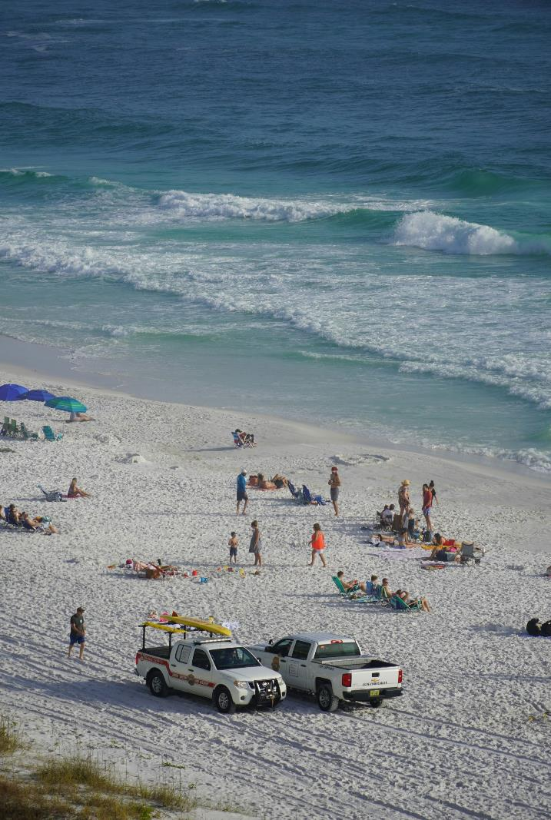
Activity – DRSABCD (1)
Individual activity – brain dump!
Instructions
On a blank piece of paper, ‘brain dump’ everything you remember about the DRSABCD process and responding to emergencies from our previous lessons.
Include the meaning of each letter in the acronym, as well as the important considerations for each step, and any specific considerations you think may be relevant if you were responding to an emergency in a water-based environment.
Photo by Sid Suratia on Unsplash

Slide 44
Activity – DRSABCD (2)
Whole-class discussion
Questions to consider
Which steps in the DRSABCD process might look slightly different when we are around water? Why?
How might the dangers be different in a water environment compared to other environments?
Which parts of the process stay the same regardless of where we are? Why are they still important?
How do we protect ourselves against disease transmission when administering first aid? For example, when someone is bleeding.
Photo by Sid Suratia on Unsplash
Notes:
Image by Arya W from Pixabay

Slide 45
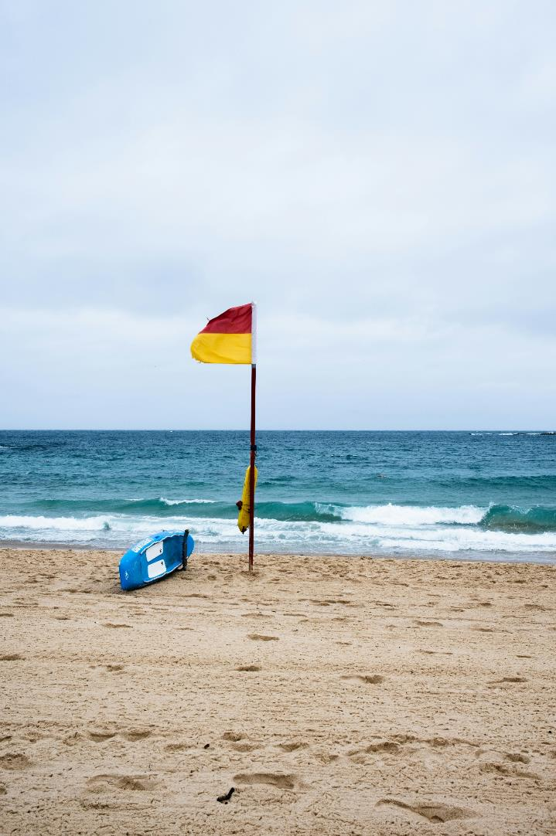


Activity – Water rescues
Thumbs up or thumbs down?
Instructions
After hearing each statement, respond using thumbs up if you agree with the statement and feel it is true, and a thumbs down if you don’t agree and feel it is untrue.
Photo by Raathi Kugan on Unsplash

Slide 46
Activity – emergency response (1)
Group activity – short stories
Instructions
Review your water-based emergency scenario.
Record the nature and details of the first aid concern, the steps to follow in responding effectively to the situation, and what the next steps for the casualty will be.
Be sure to consider if further assistance is needed, and what information emergency services would require if so.
You may wish to inform your responses using the resources available via the St John Ambulance First Aid Facts website.

Slide 47
Road smart – safety in motion

Slide 48
Learning intentions and success criteria (3)
We are learning to
identify and respond to common risks and hazards in a variety of road and transport environments.
apply our knowledge of the DRSABCD action plan and principles of first aid to a realistic emergency scenario.
We can
assess hazards and risks in road-based environments and propose suitable protective behaviours and harm-minimisation strategies to keep ourselves and others safe.
use our knowledge of the DRSABCD action plan and principles of first aid to respond appropriately to an emergency scenario.
Notes:
Notes for teachers:
Learning intentions and success criteria are best co-constructed with students. Adapt the learning intention as required and add matching success criteria.
For more information See ⁠AITSL or the NSW Department of Education explicit teaching strategies, ⁠Sharing learning intentions and ⁠Sharing success criteria
LISC is not necessarily presented at the beginning of the lesson. Teacher needs to consider most effectual time to introduce
LISC should be revisited during the lesson to support students' evaluation of their learning

Slide 49
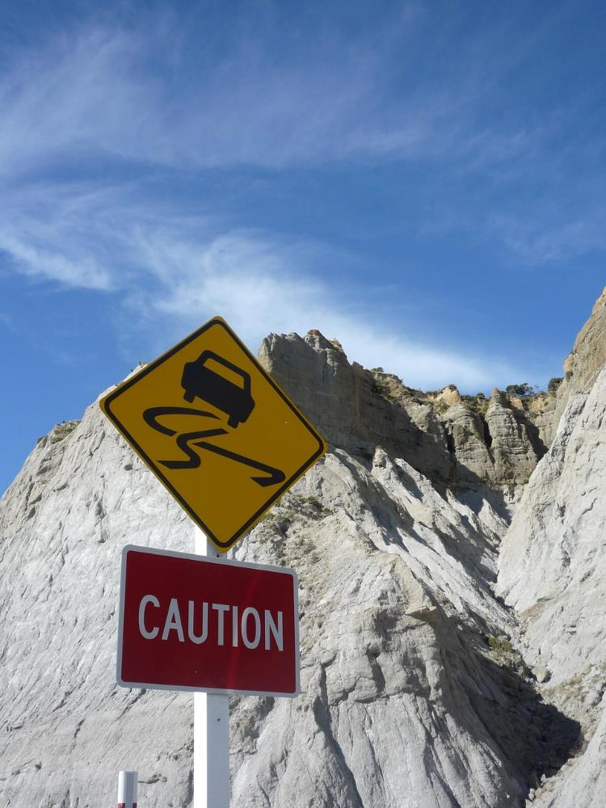
Activity – round robin (1)
Group activity – 5 W’s
Instructions
Working individually, consider the following:
WHAT – What is road safety?
WHO – Who does road safety apply to?
WHEN – When is road safety awareness important?
WHERE – What environments does road safety apply to?
WHY – Why is road safety awareness important?
Image by Julian Allom from Pixabay

Slide 50
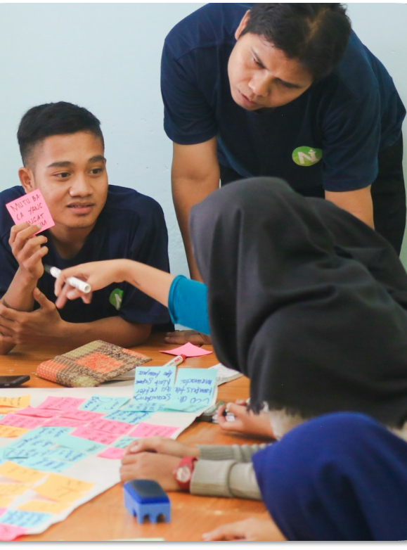
Activity – round robin (2)
Group activity – 5 W’s
Starting with the first ‘W’, everyone takes a turn to contribute their thoughts and ideas. Remember to add new ideas to one another’s responses, provide counter arguments, or ask questions.
The process is then repeated for each of the five W’s.
Pick someone new to share first for each question.
Photo by Zainul Yasni on Unsplash

Slide 51
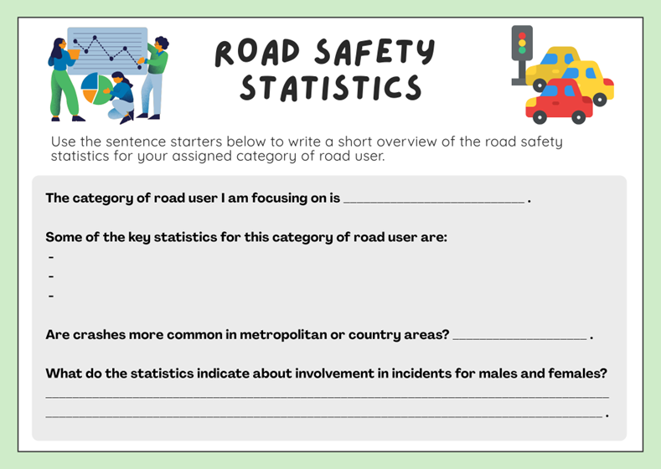
Activity – statistics deep dive (1)
Individual activity – ‘Hot Seat’
Instructions
Access the Big Picture Animated Statistics resource via the On The Move website.
Answer the questions on your worksheet for your category of road user – ‘Passengers’, ‘Pedestrians’, ‘Cyclists’, ‘Drivers’ or ‘Local Government Area’.
You can also access and utilise the Transport for NSW interactive crash statistics website.

Slide 52
Activity – statistics deep dive (2)
Individual activity – ‘Hot Seat’
Guiding questions – passengers, pedestrians, cyclists and drivers
What are the key road safety statistics for this category?
Do more crashes occur in metro or country areas?
Does a person’s age or gender make them more or less likely to be involved in an incident?
What do you think might be behind some of these patterns and trends in the data?

Slide 53
Activity – statistics deep dive (3)
Individual activity – ‘Hot Seat’
Guiding questions – Local Government Area
What does the data reveal about road safety in our local area?
Who is most at risk? Which group of road uses are most impacted by incidents in this community?
Are there any patterns regarding the age and gender of those involved?
What do you think might be behind some of these patterns and trends in the data?

Slide 54
Activity – safe travel
Group activity – Y-Chart
Instructions
Turn and talk with those around you and consider the following:
What does safe travel look, sound and feel like?
Record your thoughts using a Y-Chart template.
Be prepared to share your thinking and reasoning with the class.
Image by OpenClipart-Vectors from Pixabay

Slide 55
Y chart
Sounds like
Looks like
Feels like

Slide 56
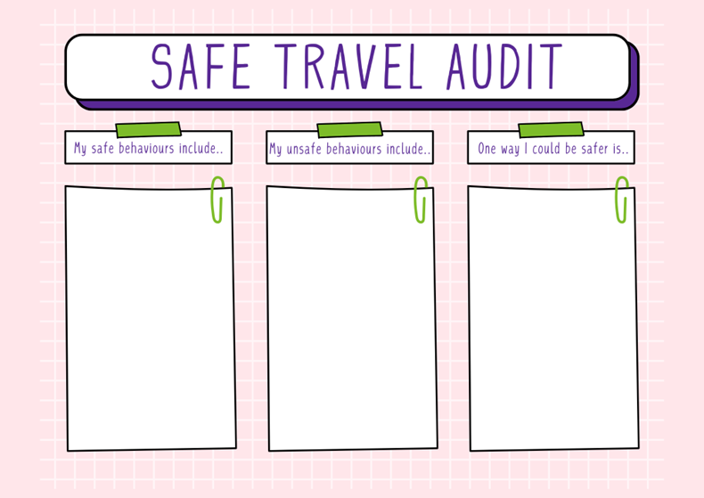
Activity – safe travel audit
Individual activity
Instructions
Complete the 'safe' and 'unsafe' behaviour columns on your safe travel audit worksheet.
Consider the harm-minimisation strategies or protective behaviours that could be implemented to mitigate your unsafe behaviours.
Record these strategies and behaviours in the ‘One way I could be safer is..’ column.

Slide 57
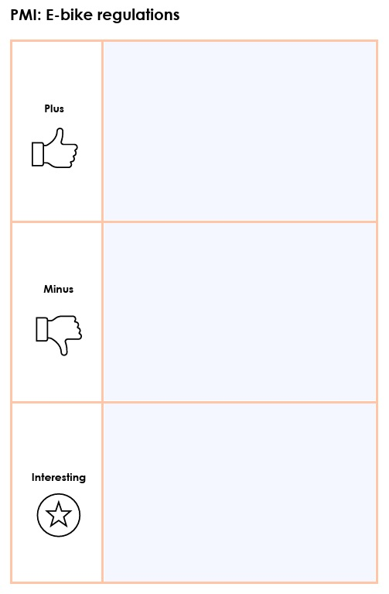
Activity – e-bikes and e-scooters
Individual activity – PMI chart
Instructions
Access the ‘Road rules for bicycle riders’ webpage and ‘Bikes, e-bikes and scooters’ resource. Review the current rules and regulations for e-bikes and e-scooters and complete each section of the PMI chart.
Write a brief paragraph to summarise:
one key idea you learned about e-bike or e-scooter safety
one question or concern you still have about the rules
how you can apply what you have learned, or the advice you would give to others.

Slide 58
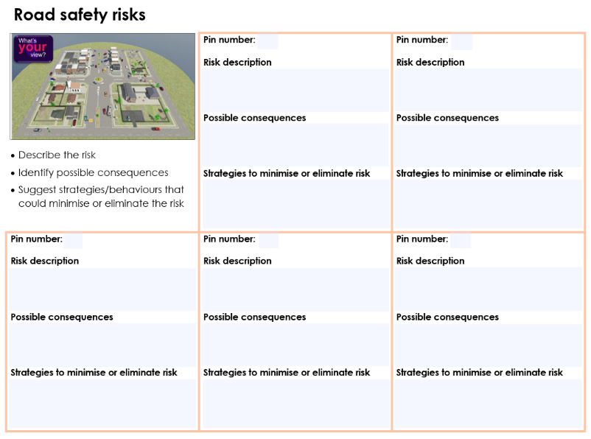
Activity – what’s your view?
Individual activity – Hazard identification
Instructions
Access the What’s your view? animated village via the On The Move website.
When you identify a potential hazard or risky situation, drop a numbered pin in the app and record the details on your worksheet.
For each one, provide a clear description of the risk, identify the potential consequences for those involved, and suggest strategies to minimise or eliminate the risk.
https://onthemove.nsw.edu.au/pdhpe-activites/whats-your-view

Slide 59
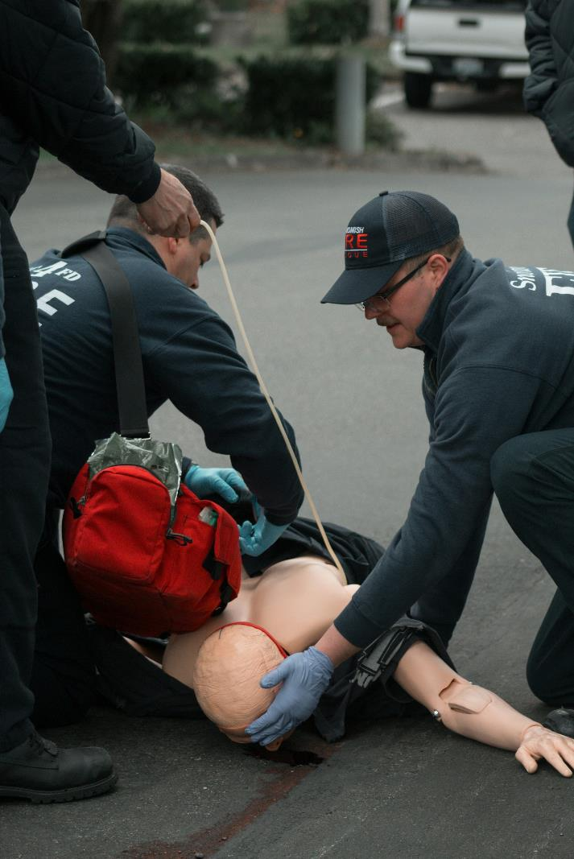
Activity – DRSABCD (3)
Individual activity – brain dump!
Instructions
On a blank piece of paper, ‘brain dump’ everything you remember about the DRSABCD process and responding to emergencies from our previous lessons.
Include the meaning of each letter in the acronym, as well as the important considerations for each step, and any specific considerations you think may be relevant if you were responding to an emergency in a water-based environment.
Photo by Jay Heike on Unsplash

Slide 60
Activity – DRSABCD (4)
Whole-class discussion
Questions to consider
Which steps in the DRSABCD process might look slightly different when we are around roads? Why?
How might the dangers be different in a road-based environment compared to other environments?
Which parts of the process stay the same regardless of where we are? Why are they still important?
How do we protect ourselves against disease transmission when administering first aid? For example, when someone is bleeding.
Image by Mohamed Hassan from Pixabay

Slide 61
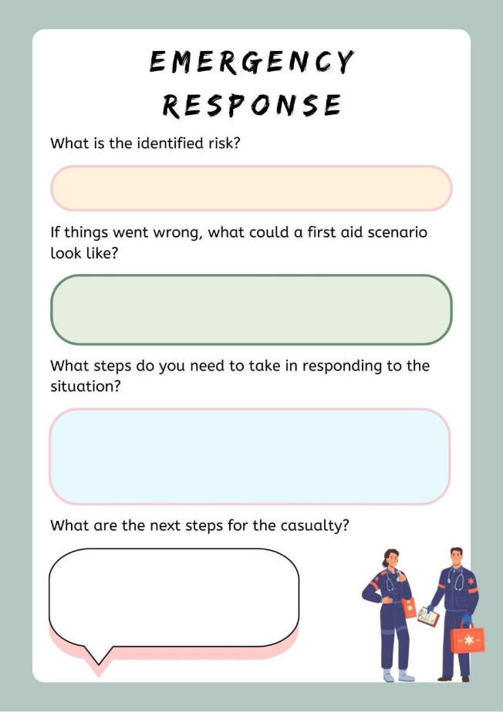
Activity – emergency response (2)
Group activity – scenarios
Instructions
Review your road safety risks worksheet from earlier. Select one hazard or risk scenario from the animated village to use as a stimulus.
On your emergency response worksheet, record the nature and details of the first aid concern, the steps to follow in responding effectively to the situation, and what the next steps for the casualty will be.
You may wish to inform your responses using the resources available via the St John Ambulance First Aid Facts website.

Slide 62
Navigating online spaces

Slide 63
Learning intentions and success criteria (4)
We are learning to
make safe, respectful, and informed choices when communicating online.
identify and reflect on our behaviours, experiences, and exposure to risks in online spaces.
collaborate respectfully with others to develop shared expectations for positive online behaviours.
We can
explain how our online behaviour impacts ourselves and others, including the long-term implications of our digital footprint.
assess risks and propose protective behaviours and harm-minimisation strategies to manage privacy, screen time and wellbeing in digital environments.
work with others to create shared guidelines for safe and respectful online behaviour.
Notes:
Notes for teachers:
Learning intentions and success criteria are best co-constructed with students. Adapt the learning intention as required and add matching success criteria.
For more information See ⁠AITSL or the NSW Department of Education explicit teaching strategies, ⁠Sharing learning intentions and ⁠Sharing success criteria
LISC is not necessarily presented at the beginning of the lesson. Teacher needs to consider most effectual time to introduce
LISC should be revisited during the lesson to support students' evaluation of their learning

Slide 64
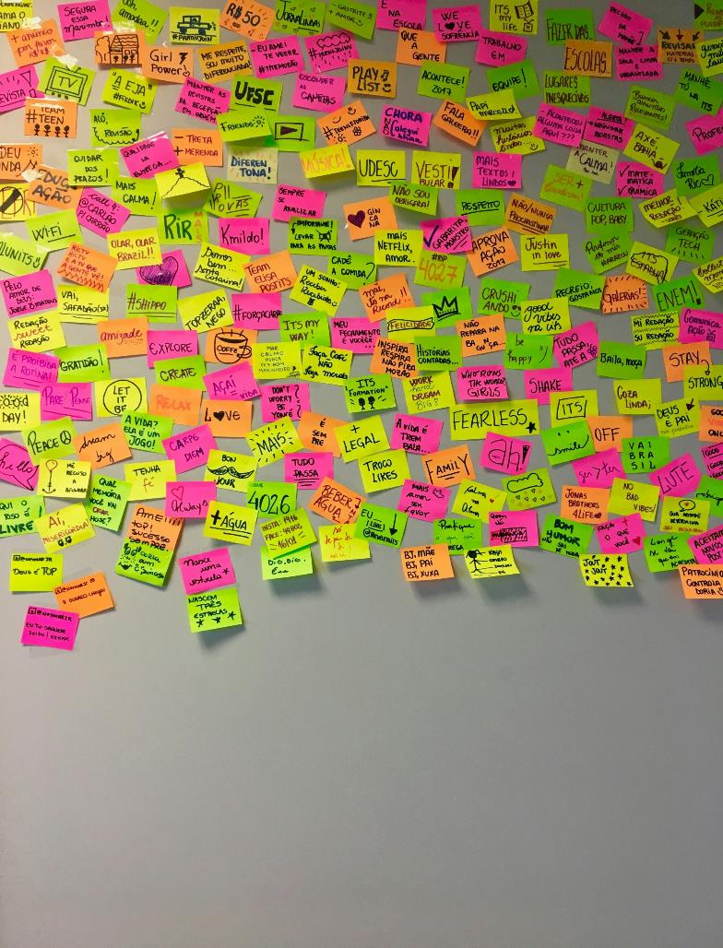
Activity – brainstorm
Group activity – online behaviours
Instructions
On a separate sticky note, write down:
'Something you do online'
'Something you enjoy online'
'Something that could be risky online'.
Place your sticky notes on the board under the matching heading.
Photo by Nathália Rosa on Unsplash

Slide 65

Activity – digital footprints (1)
Individual activity – understanding our online behaviours
Instructions
Divide your digital footprint template into 3 sections.
In the first section, add images or words which reflect how you spend most of your time online.
In the second section, add images or words which reflect your favourite online activities.
In the third section, write down the ways you act responsibly online.

Slide 66

Activity – digital footprints (2)
Individual activity – written reflection
Instructions
Reflect on what you have discussed and learned about digital footprints and responsible online behaviours.
Working individually, prepare a response to the following sentence starters:
One thing I learned about digital footprints is…
A responsible choice I admire in someone else’s footprint is…
One way I will act more responsibly online is…
Photo by Fa Barboza on Unsplash

Slide 67

Activity – privacy settings
Whole-class discussion
Questions to consider
Why do you think websites and apps offer us privacy settings?
What could happen if our privacy settings aren’t enabled or aren’t strict enough?
How can you check or change privacy settings on apps or websites you use?
Are privacy settings enough for us stay in control of our online identity, or do we also need to act responsibly with the sharing of personal information?
Image by Manfred Steger from Pixabay

Slide 68
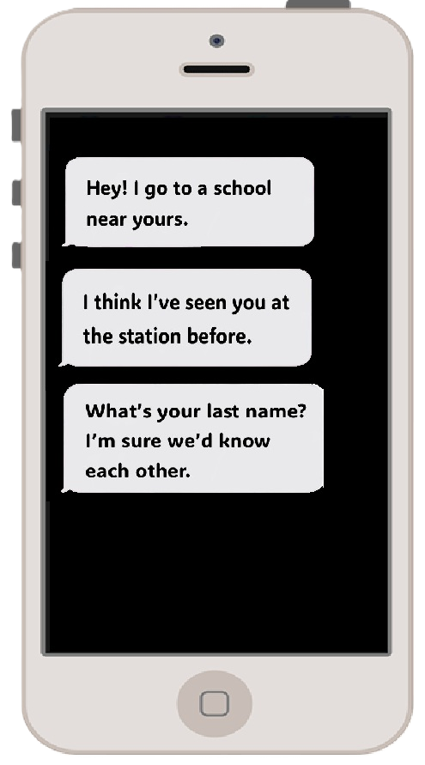
Activity – spot the risk (1)
Individual activity
Instructions
Consider this fictional text message:
Hey, I go to a school near yours. I think I’ve seen you at the station before. What’s your last name? I’m sure we would know each other.
What parts of this message feel potentially unsafe or concerning?
What could you do to keep yourself safe in this situation?
Original image by sasanqua camellia from Pixabay

Slide 69

Activity – spot the risk (2)
Group work activity
Instructions
Examine each of your fictional online messages.
For each message:
Identify which parts of the message feel unsafe or concerning.
Propose a suitable action in response which will keep you safe.
Image by Peggy und Marco Lachmann-Anke from Pixabay

Slide 70

Activity – online safety
Group activity – developing an ‘app profile’
Instructions
Visit the eSafety Commissioner’s eSafety Guide and develop an ‘app profile’ for your assigned app.
The profile must include:
the name of the app or online platform
potential risks associated with using the app or online platform
steps for reporting harmful content or other safety concerns
recommended privacy settings for users to check
three key safety tips for new users.
Image by sasanqua camellia from Pixabay

Slide 71
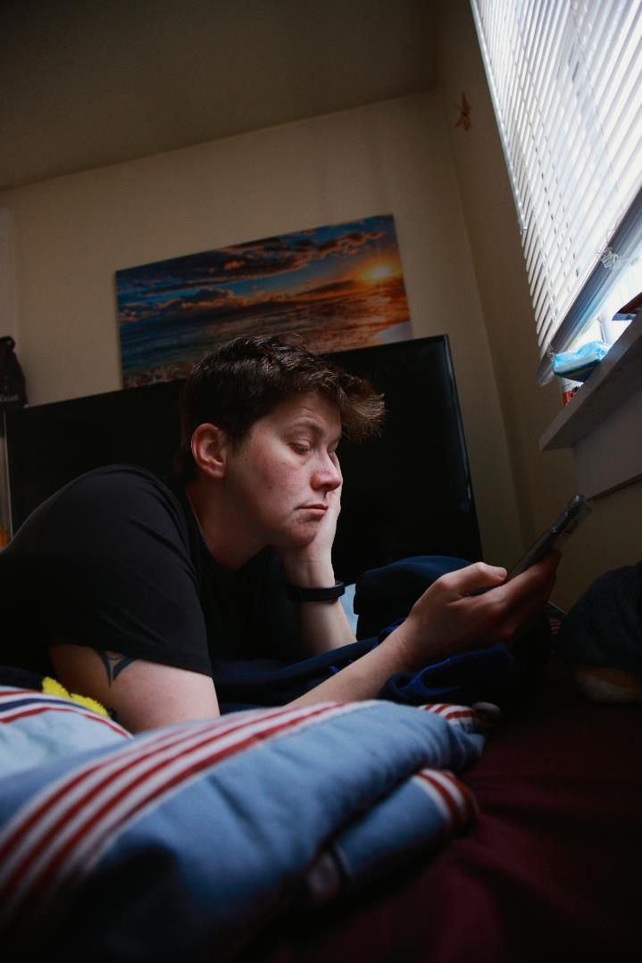
Activity – screen time (1)
Group activity – strategy ranking
Instructions
Access the eSafety Commissioner’s How to manage your screen time webpage.
Review the key points, recommendations and practical strategies for managing screen time.
In your groups, rank each of these according to their practicality and usefulness for young people.
Photo by Shane on Unsplash

Slide 72
Activity – screen time (2)
Individual activity – scenarios
Instructions
Review your ‘screen time scenario’ and develop a short, written response to the following questions:
What is the issue in this scenario?
What is the impact of the behaviour – both for the individual and for others involved?
What could be done differently? Identify and explain possible protective behaviours or harm-minimisation strategies that would support a more positive outcome.
Image by fotografierende from Pixabay

Slide 73
Activity – ‘walk the line’
Individual activity – the values continuum
Instructions
After hearing each statement, take up a position along the continuum which you think best reflects your opinion and values.
NEUTRAL
STRONGLY AGREE
STRONGLY DISAGREE

Slide 74
Health help – support and information you can trust

Slide 75
Learning intentions and success criteria (5)
We are learning to
understand the concept of health literacy and the role it plays in helping us make informed health decisions.
identify the key features of reliable and credible sources of health information.
apply our health literacy skills to real-life situations to support the health and safety of ourselves and others.
We can
explain what health literacy is and describe how it helps us make informed decisions.
access and assess health information sources and explain why some are more reliable than others
use my knowledge of reliable health information to respond to real-life situations with helpful, accurate advice.
Notes:
Notes for teachers:
Learning intentions and success criteria are best co-constructed with students. Adapt the learning intention as required and add matching success criteria.
For more information See ⁠AITSL or the NSW Department of Education explicit teaching strategies, ⁠Sharing learning intentions and ⁠Sharing success criteria
LISC is not necessarily presented at the beginning of the lesson. Teacher needs to consider most effectual time to introduce
LISC should be revisited during the lesson to support students' evaluation of their learning

Slide 76

Activity – ‘Quiz master’ (1)
Individual activity – literacy task
Instructions
Access the Consumer Healthcare Products Australia article, Australia’s digital ‘health literacy’ dilemma.
Colour-code or highlight, using different colours, any:
statistics and facts
definitions and explanations
interesting or surprising points.
Image by YeriLee from Pixabay

Slide 77
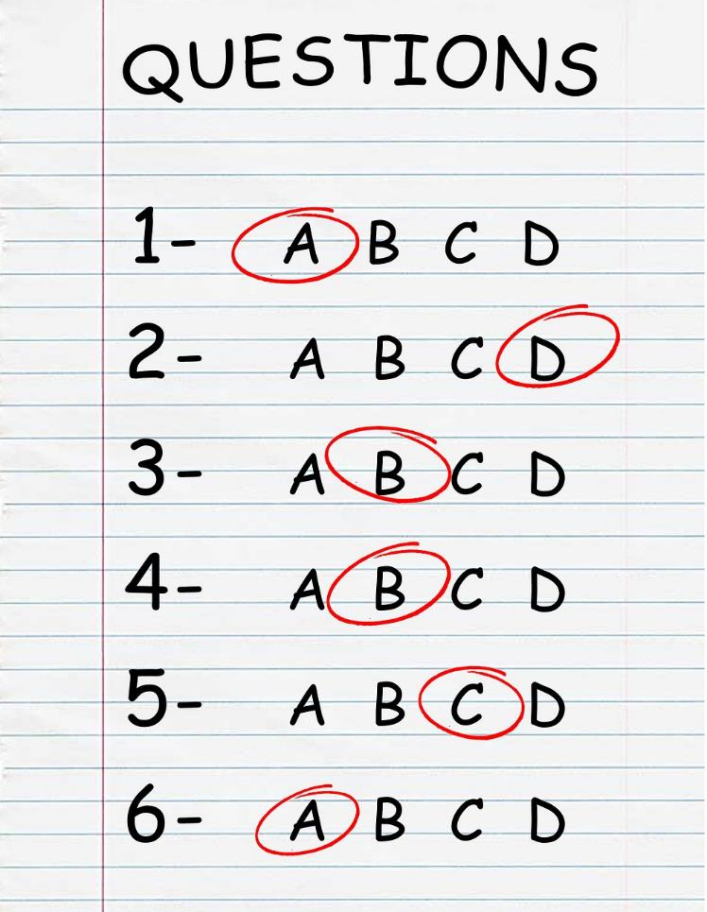
Activity – ‘Quiz master’ (2)
Individual activity – literacy task
Instructions
At the end of each paragraph, add short notes, comments or questions to the document to show your thinking. For example:
This section is mainly about...
I think the author wants us to know that...
A question I have about this is…
Develop 3-4 short-answer ‘quiz’ questions drawing on the content from the article. Swap your questions with a partner and have a go at answering them!
Image by eslfuntaiwan from Pixabay

Slide 78
Activity – trustworthy or not? (1)
Individual activity – continuum
Instructions
After seeing each potential source of health information, decide whether you would or would not trust it as a reliable and credible source of information.
Move to the side of the continuum which best reflects your thoughts and opinion.
Yeah, I’d trust that
Nah, I wouldn’t trust that

Slide 79
Activity – trustworthy or not? (2)
Whole-class discussion
Questions to consider
What patterns did we notice in the types of sources people trusted or didn’t trust?
What makes a health information source reliable? What makes it unreliable?
What do we need to look for when deciding if we can trust a source?
Why is it important to be careful about where we get our health information from?
Illustration by Deep on Unsplash

Slide 80
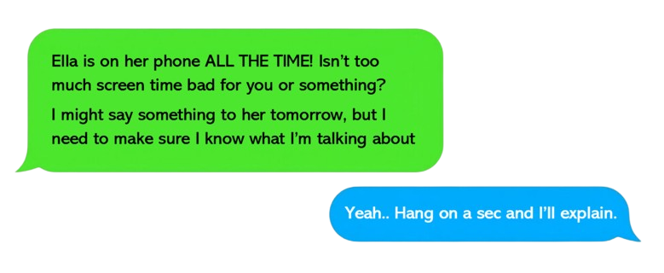

Activity – helping a friend
Group activity – text-message response
Instructions
Read, discuss and respond to each text-message scenario. For each message, you must:
identify the type of help or support the person requires
outline where to find reliable and accurate information or support
compose a short, clear reply message to offer advice and suggest a trusted source of further information.

Slide 81

Activity – design task
Individual activity – health promotion resource
Instructions
Create a health promotion resource which focuses on one of the key safety topics explored throughout the unit – road safety, water safety, or online safety.
Your design must include:
at least three pieces of practical safety advice
at least two valid and reliable sources of information
clear guidance for others to follow when verifying the reliability and credibility of sources.
Image by poli_ from Pixabay

Slide 82
References (1)
This presentation contains NSW Curriculum and syllabus content. The NSW Curriculum is developed by the NSW Education Standards Authority. This content is prepared by NESA for and on behalf of the Crown in the right of the State of New South Wales. The material is protected by Crown copyright.
Please refer to the NESA Copyright Disclaimer for more information https://educationstandards.nsw.edu.au/wps/portal/nesa/mini-footer/copyright.
NESA holds the only official and up-to-date versions of the NSW Curriculum and syllabus documents. Please visit the NSW Education Standards Authority (NESA) website https://educationstandards.nsw.edu.au/wps/portal/nesa/home and the NSW Curriculum website https://curriculum.nsw.edu.au.
Personal Development, Health and Physical Education 7–10 Syllabus © NSW Education Standards Authority (NESA) for and on behalf of the Crown in right of the State of New South Wales, 2024.
Consumer Healthcare Products Australia (2022). Australia’s digital ‘health literacy’ dilemma. Accessed July 21, 2025, from https://www.chpaustralia.com.au/News-and-Events/Latest-News/2022/Australia019s-digital-018health-literacy019-dilemma
eSafety Commissioner (2024). Digital footprint. Accessed July 15, 2025, from https://www.esafety.gov.au/young-people/digital-footprint
eSafety Commissioner (2024). Balancing your time online. Accessed July 15, 2025, from https://www.esafety.gov.au/young-people/balancing-your-time-online
eSafety Commissioner (2024). Manage your screen time. Accessed July 15, 2025, from https://www.esafety.gov.au/key-topics/digital-wellbeing/manage-your-screen-time
eSafety Commissioner (n.d.). The eSafety Guide. Accessed July 15, 2025, from https://www.esafety.gov.au/key-topics/esafety-guide

Slide 83
References (2)
NSW Department of Education (n.d.). School swimming and water safety. Accessed July 2, 2025, from https://app.education.nsw.gov.au/sport/swimming-and-water-safety
NSW Department of Education (2025). Promoting safe travel. Accessed July 2, 2025, from https://education.nsw.gov.au/teaching-and-learning/curriculum/road-safety-education/safe-travel
Royal Life Saving Australia (2019). Dry Rescue Award Guide. Accessed July 3, 2025, from https://www.royallifesaving.com.au/__data/assets/pdf_file/0003/37677/RLS_DryRescue_AwardGuide.pdf
St John Ambulance Australia (n.d.). First aid fact sheets. Accessed July 3, 2025, from https://stjohn.org.au/resources/fact-sheets/
Surf Life Saving Australia (n.d.). Beachsafe. Accessed July 4, 2025, from https://beachsafe.org.au/
Transport for NSW (2023). Bikes, e-bikes and e-scooters. Accessed July 10, 2025, from https://www.transport.nsw.gov.au/system/files/media/documents/2024/crs_bikes_e-bikes_e-scooters.pdf
Transport for NSW (n.d.). Interactive crash statistics. Accessed July 10, 2025, from https://www.transport.nsw.gov.au/roadsafety/statistics/interactive-crash-statistics
Transport for NSW (n.d.). Road rules for bicycle riders. Accessed July 10, 2025, from https://www.transport.nsw.gov.au/roadsafety/bicycle-riders/road-rules-for-bicycle-riders
Transport for NSW & NSW Department of Education (n.d.). On the move. Accessed July 2, 2025, from https://onthemove.nsw.edu.au/

Slide 84
Copyright
© State of New South Wales (Department of Education), 2025
The copyright material published in this resource is subject to the Copyright Act 1968 (Cth) and is owned by the NSW Department of Education or, where indicated, by a party other than the NSW Department of Education (third-party material).
Copyright material available in this resource and owned by the NSW Department of Education is licensed under a Creative Commons Attribution 4.0 International (CC BY 4.0) license.
This license allows you to share and adapt the material for any purpose, even commercially.
Attribution should be given to © State of New South Wales (Department of Education), 2025.
Material in this resource not available under a Creative Commons license:
the NSW Department of Education logo, other logos and trademark-protected material
Material owned by a third party that has been reproduced with permission. You will need to obtain permission from the third party to reuse its material.
Links to third-party material and websites
Please note that the provided (reading/viewing material/list/links/texts) are a suggestion only and implies no endorsement, by the New South Wales Department of Education, of any author, publisher, or book title. School principals and teachers are best placed to assess the suitability of resources that would complement the curriculum and reflect the needs and interests of their students.
If you use the links provided in this document to access a third-party’s website, you acknowledge that the terms of use, including licence terms set out on the third-party’s website apply to the use which may be made of the materials on that third-party website or where permitted by the Copyright Act 1968 (Cth). The department accepts no responsibility for content on third-party websites.

