Slide 1
Instructions for use
This resource is not a teaching and learning program. It should be used in conjunction with PDHPE Year 7 - creating my toolkit for change teaching and learning program.
Classroom teachers are encouraged to add and adapt slides as required to meet the needs of their students.
Save a copy of the file to make changes to the slide deck. Go to File > Download a Copy (this downloads a copy to the computer to edit in the PowerPoint app).
To convert the PowerPoint to Google Slides:
  Upload the file into Google Drive and open it.
  Go to File > Save as Google Slides.
  (Note – conversion may cause formatting changes in the slides.)

Slide 2
Controversial issues in PDHPE
Content within this unit of work may be considered controversial. Please review the teachers notes regarding controversial issues within the teaching program on page 6, before commencing any work.

Slide 3

Creating my toolkit for change
PDHPE – Stage 4/Year 8
Term 3
Notes:
Image: changing leaves by Sarena on Unsplash

Slide 4
Lessons
1
Changing times, changing me
2
Signaling change: the role of hormones
3
Stronger than yesterday: mastering your mind and mood
4
Communication, conflict and respectful relationships
Notes:
Teacher notes:
Click lesson numbers to go to specific lessons
Interactive features can be viewed in slide show

Slide 5
Changing times, changing me

Slide 6
Learning intentions and success criteria – changing times, changing me (1)
We are learning to
understand the nature of change during adolescence and the impact this can have on relationships
recognise emotional responses to change.
I can
identify how relationships may can change over time
explain how common activities may change over time with growing independence
outline how changes associated with puberty may impact relationships
identify a range of emotions that may be felt when navigating change.
Notes:
Notes for teachers:
Learning intentions and success criteria are best co-constructed with students. Adapt the learning intention as required and add matching success criteria.
For more information See ⁠AITSL or the NSW Department of Education explicit teaching strategies, ⁠Sharing learning intentions and ⁠Sharing success criteria
LISC is not necessarily presented at the beginning of the lesson. Teacher needs to consider most effectual time to introduce
LISC should be revisited during the lesson to support students' evaluation of their learning

Slide 7
Activity – what’s changed?
Group activity
Copy the table onto your A3 sheet:
Infancy (0-5 years) | Childhood (6-11 years) | Adolescence (12-18) | Adulthood (18+ years)
Consider significant relationships you have.
Outline changes in relationships at each key stage of development.

Slide 8
Activity – time traveller
Individual activity
Selecting clothing
Going to the movies/
shopping
Personal hygiene
Completing homework
Going to a birthday party
Decision-making
Packing school bag
Packing own lunch
How have these common activities changed over time?
How could growing independence also impact how these activities change in the future?

Slide 9

Adolescent development – the art of growing up
Video
Notes:
Video source: https://www.youtube.com/watch?v=0BJFoGK5GlY

Slide 10
Activity – physical, social and emotional changes (1)
Group activity
Instructions
Review the character snapshots on puberty, then highlight or code examples of:
physical changes
emotional responses
social relationship changes.

Slide 11
Activity – physical, social and emotional changes (2)
Class discussion
Questions
What experiences were the same for all characters?
How do physical changes sometimes lead to emotional or social challenges?
Why is it important to understand that everyone experiences these changes at different times?

Slide 12
Activity – the impact of changes on relationships
Cause and effect table
Change | Think/act/feel | Impact on relationships

Slide 13
Reflecting on the success criteria – changing times, changing me (1)
Individual activity
Instructions
Consider the extent to which you have met the following success criteria.
I can
outline how changes associated with puberty may impact relationships
identify a range of emotions that may be felt when navigating change.

Slide 14
Reflecting on the success criteria – changing times, changing me (2)
Individual activity
Instructions
Consider the extent to which you have met the following success criteria.
I can
identify a range of emotions that may be felt when navigating change
apply realistic and appropriate self-management skills to manage change.

Slide 15
Signalling change – the role of hormones

Slide 16
Learning intentions and success criteria – signalling change: the role of hormones (1)
We are learning to
understand how hormones cause changes during puberty, including the role in the reproductive system
select appropriate strategies to manage and support change during puberty.
I can
outline the relationship between hormones and physical, emotional and social changes during puberty
identify reproductive organs and outline their function
describe the process of menstruation and fertilisation/conception
select realistic strategies to support myself and others in a range of complex situations.
Notes:
Notes for teachers:
Learning intentions and success criteria are best co-constructed with students. Adapt the learning intention as required and add matching success criteria.
For more information See ⁠AITSL or the NSW Department of Education explicit teaching strategies, ⁠Sharing learning intentions and ⁠Sharing success criteria
LISC is not necessarily presented at the beginning of the lesson. Teacher needs to consider most effectual time to introduce
LISC should be revisited during the lesson to support students' evaluation of their learning

Slide 17
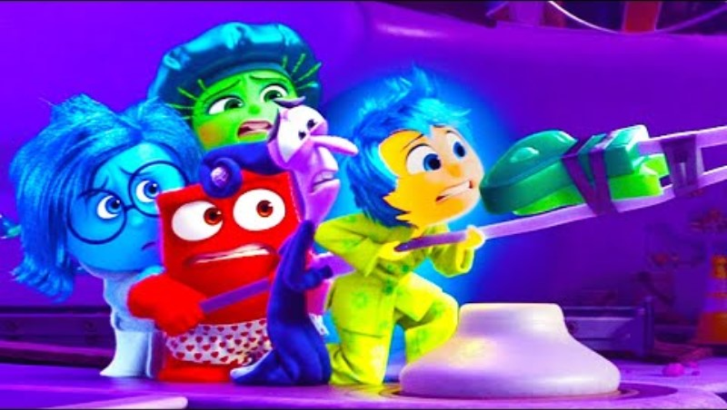
Inside Out 2 – puberty alarm scene
Video
Notes:
Video source: https://www.youtube.com/watch?v=WsegDnZ10FQ

Slide 18
Hormone hustle
Gland | Hormone it releases
The pituitary gland The master gland Location: base of the brain | Growth Hormone – helps you grow taller, muscle development Follicle-Stimulating Hormone (FSH) – starts puberty, tells ovaries/testes to make reproductive hormones Luteinising Hormone (LH) – helps release eggs in females, tells testes to make testosterone in males
The ovaries The female gland Location: female lower abdomen | Estrogen – develops breasts, hips widen, periods begin Progesterone – controls periods and prepares for pregnancy As well as producing hormones, the ovaries also house and release the eggs (ova)
The testes The male gland Location: in the scrotum (male) | Testosterone – deepens voice, facial hair, growth spurt, grows muscles, starts sperm production As well as producing hormones, the testes also produce sperm
Notes:
Images sourced from Canva.

Slide 19
Activity – hormone hustle
Hormones and puberty
Instructions
In your small groups:
consider the change that is read out to you
hold up the hormone card you think is responsible for the change
Discuss
Where in the body does this hormone come from?
Is this hormone active in males, females or both?
Notes:
Image: Reproductive body parts by Sexual Health Victoria. https://shvic.org.au/assets/resources/Grade_5and6_Reproductive-body-parts.pdf

Slide 20

Hormone hustle recap
Hormones are chemical messengers in our body that work together and can influence change during puberty in the following ways:
Type of change | Description
Physical Changes | Hormones signal body parts (e.g., ovaries, testicles) to produce hormones that trigger physical and reproductive changes.
Emotional Changes | Hormones affect brain chemicals involved in emotions; combined with ongoing brain development, this can cause stronger or unpredictable emotional responses.
Social Changes | Hormones impact brain development in areas related to decision-making, risk-taking, and social awareness, leading to changes in friendships and relationships.

Slide 21
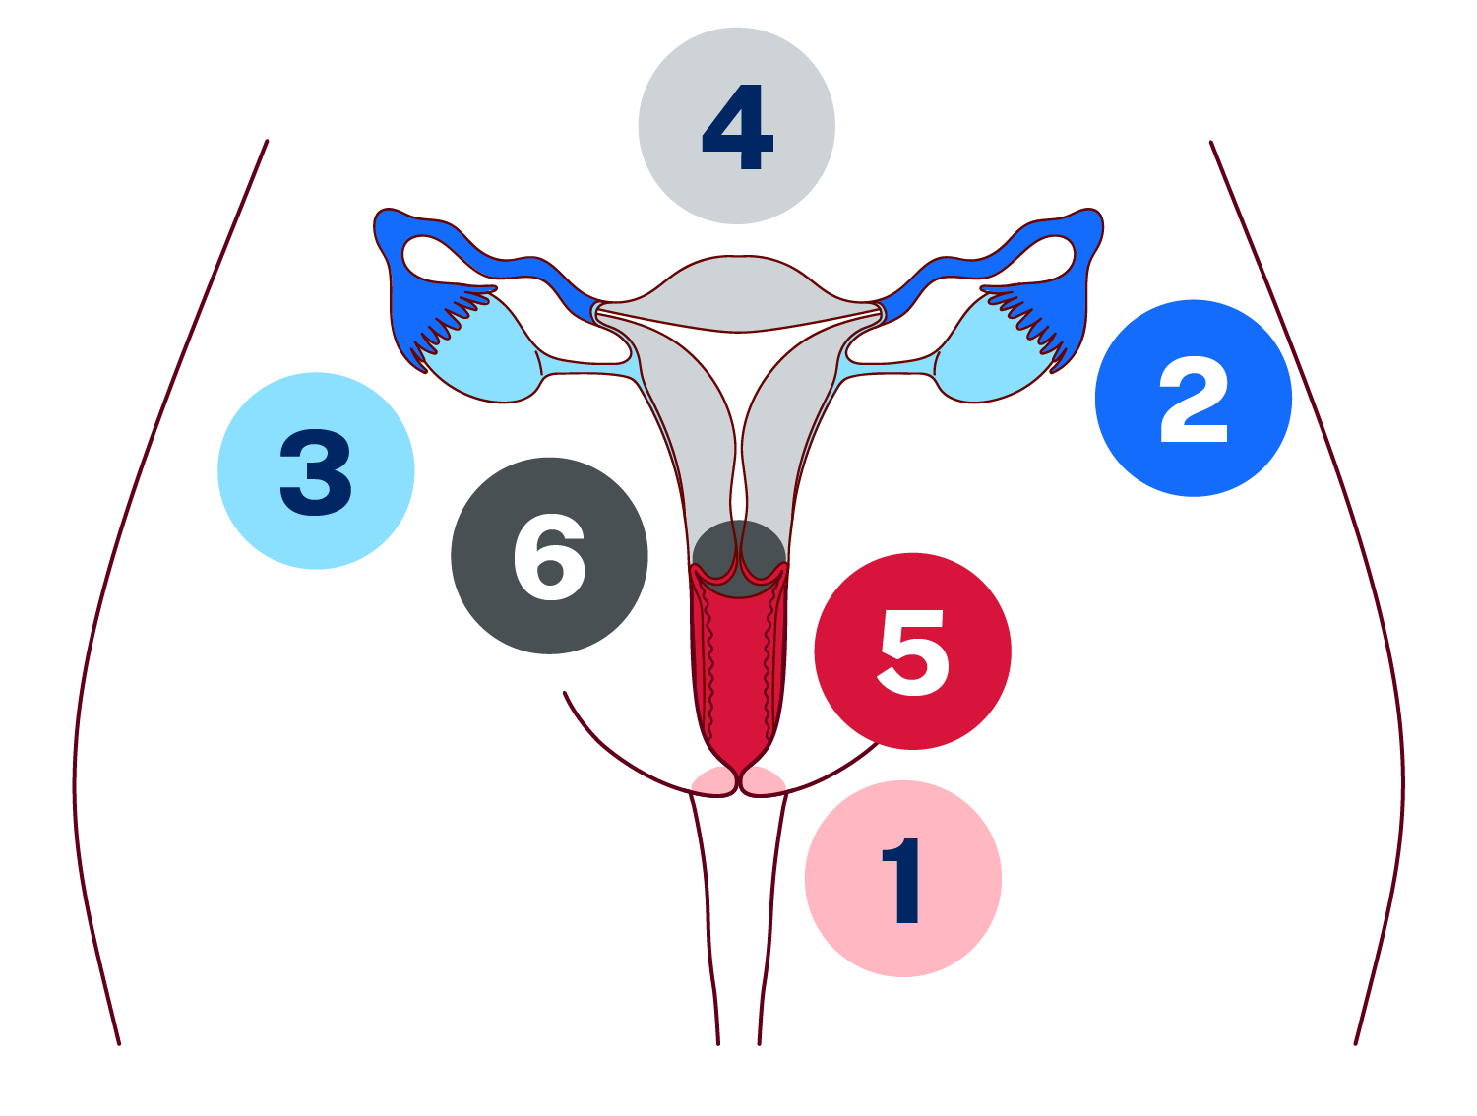
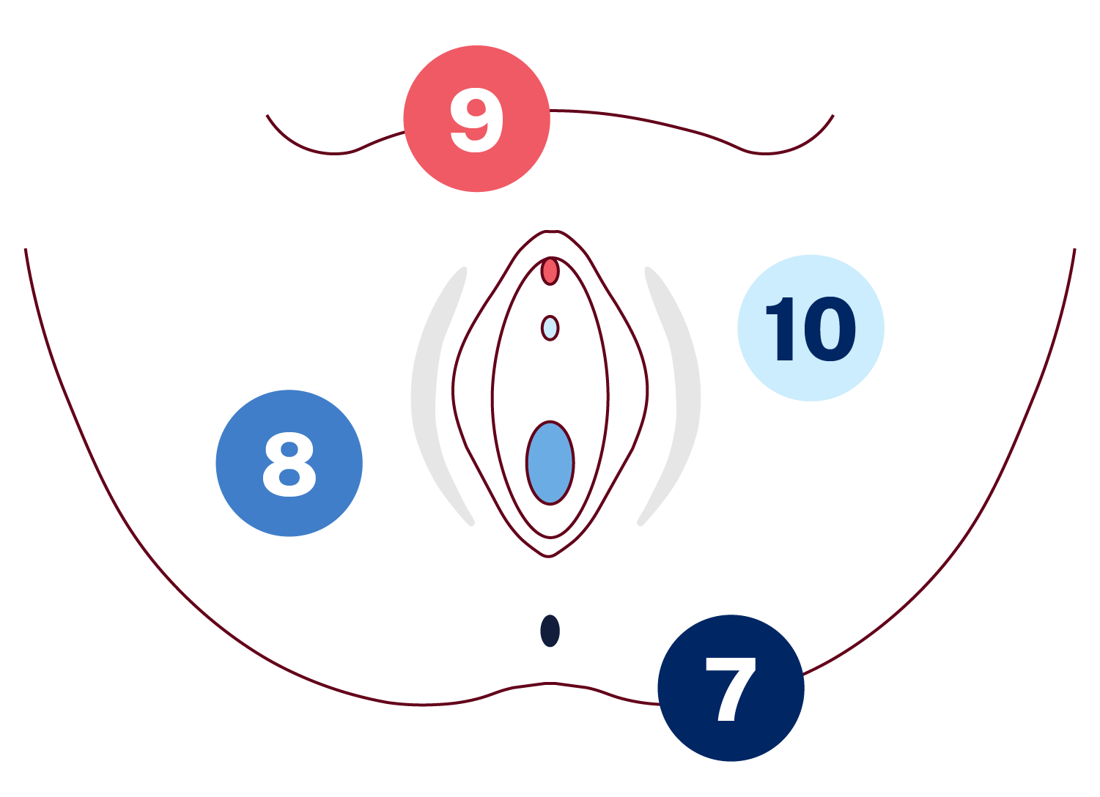
Activity – the reproductive system (1)
Female reproductive system activity answers
Part | Number
Cervix | 6
Uterus | 4
Fallopian tubes | 2
Vagina | 5
Ovary | 3
Vulva | 1
Clitoris | 9
Urethra | 10
Anus | 7
Vagina | 8
Notes:
Image: Reproductive body parts by Sexual Health Victoria. https://shvic.org.au/assets/resources/Grade_5and6_Reproductive-body-parts.pdf

Slide 22
Activity – the reproductive system (2)
Female reproductive system activity answers
Part | Function
Vagina | A muscular tube that connects the outside of the body to the cervix. It is sometimes called the birth canal.
Cervix | This is found in the lower part of the uterus that opens into the vagina. It helps keep the uterus closed during pregnancy and allows menstrual fluid to exit the body.
Ovary | Two small organs about the size and shape of an almond that produce eggs (ova) and hormones like oestrogen. During puberty the eggs start to mature, and a dominant egg is released each month during a menstrual cycle.
Uterus | A hollow, muscular organ where a fertilised egg can grow and develop into a baby during pregnancy. It also sheds its lining each month if pregnancy does not occur, resulting in menstruation.
Fallopian tube | These are two of these thin tubes that connect the ovaries to the uterus. They are the place where fertilisation happens when a sperm meets an egg.
Uterine lining | Also known as the endometrium, this tissue thickens every month in preparation for a possible pregnancy. If the egg is not fertilised, this tissue (including blood) is shed during menstruation.
Vulva | Often called vagina in error. It is the name for all the outside body parts between a female’s legs.

Slide 23
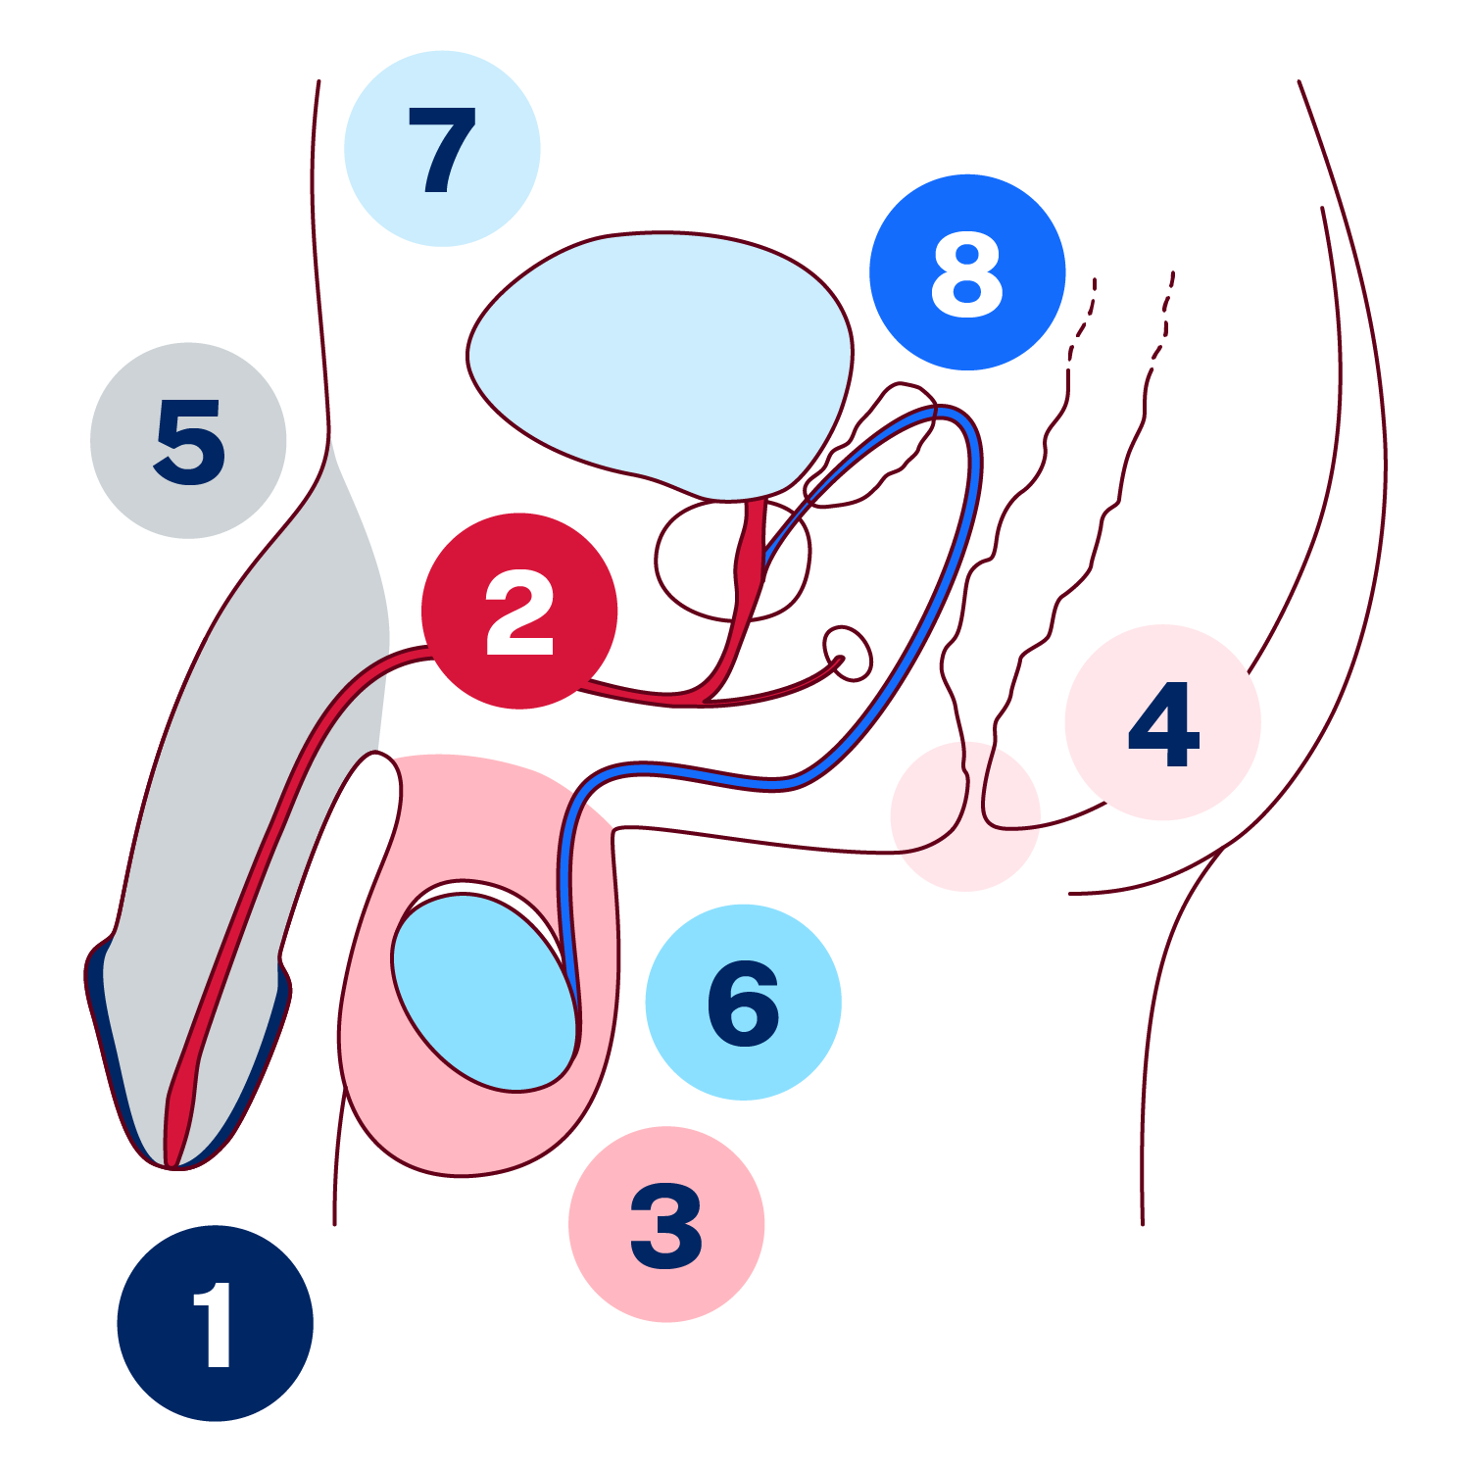
Activity – the reproductive system (3)
Male reproductive system activity answers
Part | Number
Penis | 5
Scrotum | 3
Testicles | 6
Urethra | 2
Foreskin | 1
Anus | 4
Vas deferens | 8
Bladder | 7
Notes:
Image: Reproductive body parts by Sexual Health Victoria. https://shvic.org.au/assets/resources/Grade_5and6_Reproductive-body-parts.pdf

Slide 24
Activity – the reproductive system (4)
Male reproductive system activity answers
Part | Function
Penis | This is the external organ between the males’ legs. It is used for sexual intercourse and for the release of urine from the body. When a man is sexually aroused or excited, blood rushes here, which stands up and out from the body. This is called an erection.
Scrotum | This is a pouch of skin that holds and protects the testicles, helping to keep them at the right temperature for producing sperm.
Testicles | Males have two of these. They are small organs that produce sperm and hormones like testosterone, which is important for male development. They need to be at the right temperature for producing healthy sperm.
Urethra | This is a tube that carries urine from the bladder out of the body and also carries sperm during ejaculation. Both semen and urine cannot come out at the same time, as a valve near the bladder shuts off this tube when a male has an erection.
Foreskin | This is the fold of skin that covers the tip of the penis. It can be removed in a procedure called circumcision. Some boys are circumcised (foreskin is removed at birth, when young or in their teens) for cultural/religious/medical reasons.

Slide 25
Activity – the reproductive system (5)
Male reproductive system activity answers
Part | Function
Anus | This is the opening at the end of the digestive tract where solid waste leaves the body.
Vas deferens | This is a tube that carries sperm from the testicles to the urethra, where it can be expelled during ejaculation as semen.
Bladder | This is a hollow organ that stores urine until it is released from the body through the urethra.

Slide 26
Reflecting on the success criteria – signalling change: the role of hormones (1)
Individual activity
Instructions
Consider the extent to which you have met the following success criteria.
I can
identify reproductive organs and outline their function
describe the process of menstruation and fertilisation/conception.

Slide 27
Activity – applying strategies to manage change
Gallery walk
Instructions
In your small groups:
move around the room and consider each scenario
discuss the questions attached to the scenario.

Slide 28
Reflecting on the success criteria – signalling change: the role of hormones (2)
Individual activity
Instructions
Consider the extent to which you have met the following success criteria.
I can
select realistic strategies to support myself and others in a range of complex situations.

Slide 29
Stronger than yesterday – mastering your mind and mood

Slide 30
Learning intentions – stronger than yesterday: mastering your mind and mood
We are learning to
identify and develop attitudes and behaviours that foster resilience, adaptability, and persistence in the face of challenges
refine skills to effectively manage and adapt to changing roles and responsibilities, demonstrating flexibility and growth
explore strategies to support self and others to enhance emotional well-being during periods of stress, loss, or grief, promoting mental readiness
Notes:
Notes for teachers:
Learning intentions and success criteria are best co-constructed with students. Adapt the learning intention as required and add matching success criteria.
For more information See ⁠AITSL or the NSW Department of Education explicit teaching strategies, ⁠Sharing learning intentions and ⁠Sharing success criteria
LISC is not necessarily presented at the beginning of the lesson. Teacher needs to consider most effectual time to introduce
LISC should be revisited during the lesson to support students' evaluation of their learning

Slide 31
Success criteria – stronger than yesterday: mastering your mind and mood
I can
describe positive – attitudes that allow me to cope with changes or challenges
recognise the strategies that allow me to stay calm in stressful situations
describe how I responded to change by adjusting my thinking or behaviour
recognise appropriate strategies for dealing with stress or loss and help support others.
Notes:
Notes for teachers:
Learning intentions and success criteria are best co-constructed with students. Adapt the learning intention as required and add matching success criteria.
For more information See ⁠AITSL or the NSW Department of Education explicit teaching strategies, ⁠Sharing learning intentions and ⁠Sharing success criteria
LISC is not necessarily presented at the beginning of the lesson. Teacher needs to consider most effectual time to introduce
LISC should be revisited during the lesson to support students' evaluation of their learning

Slide 32
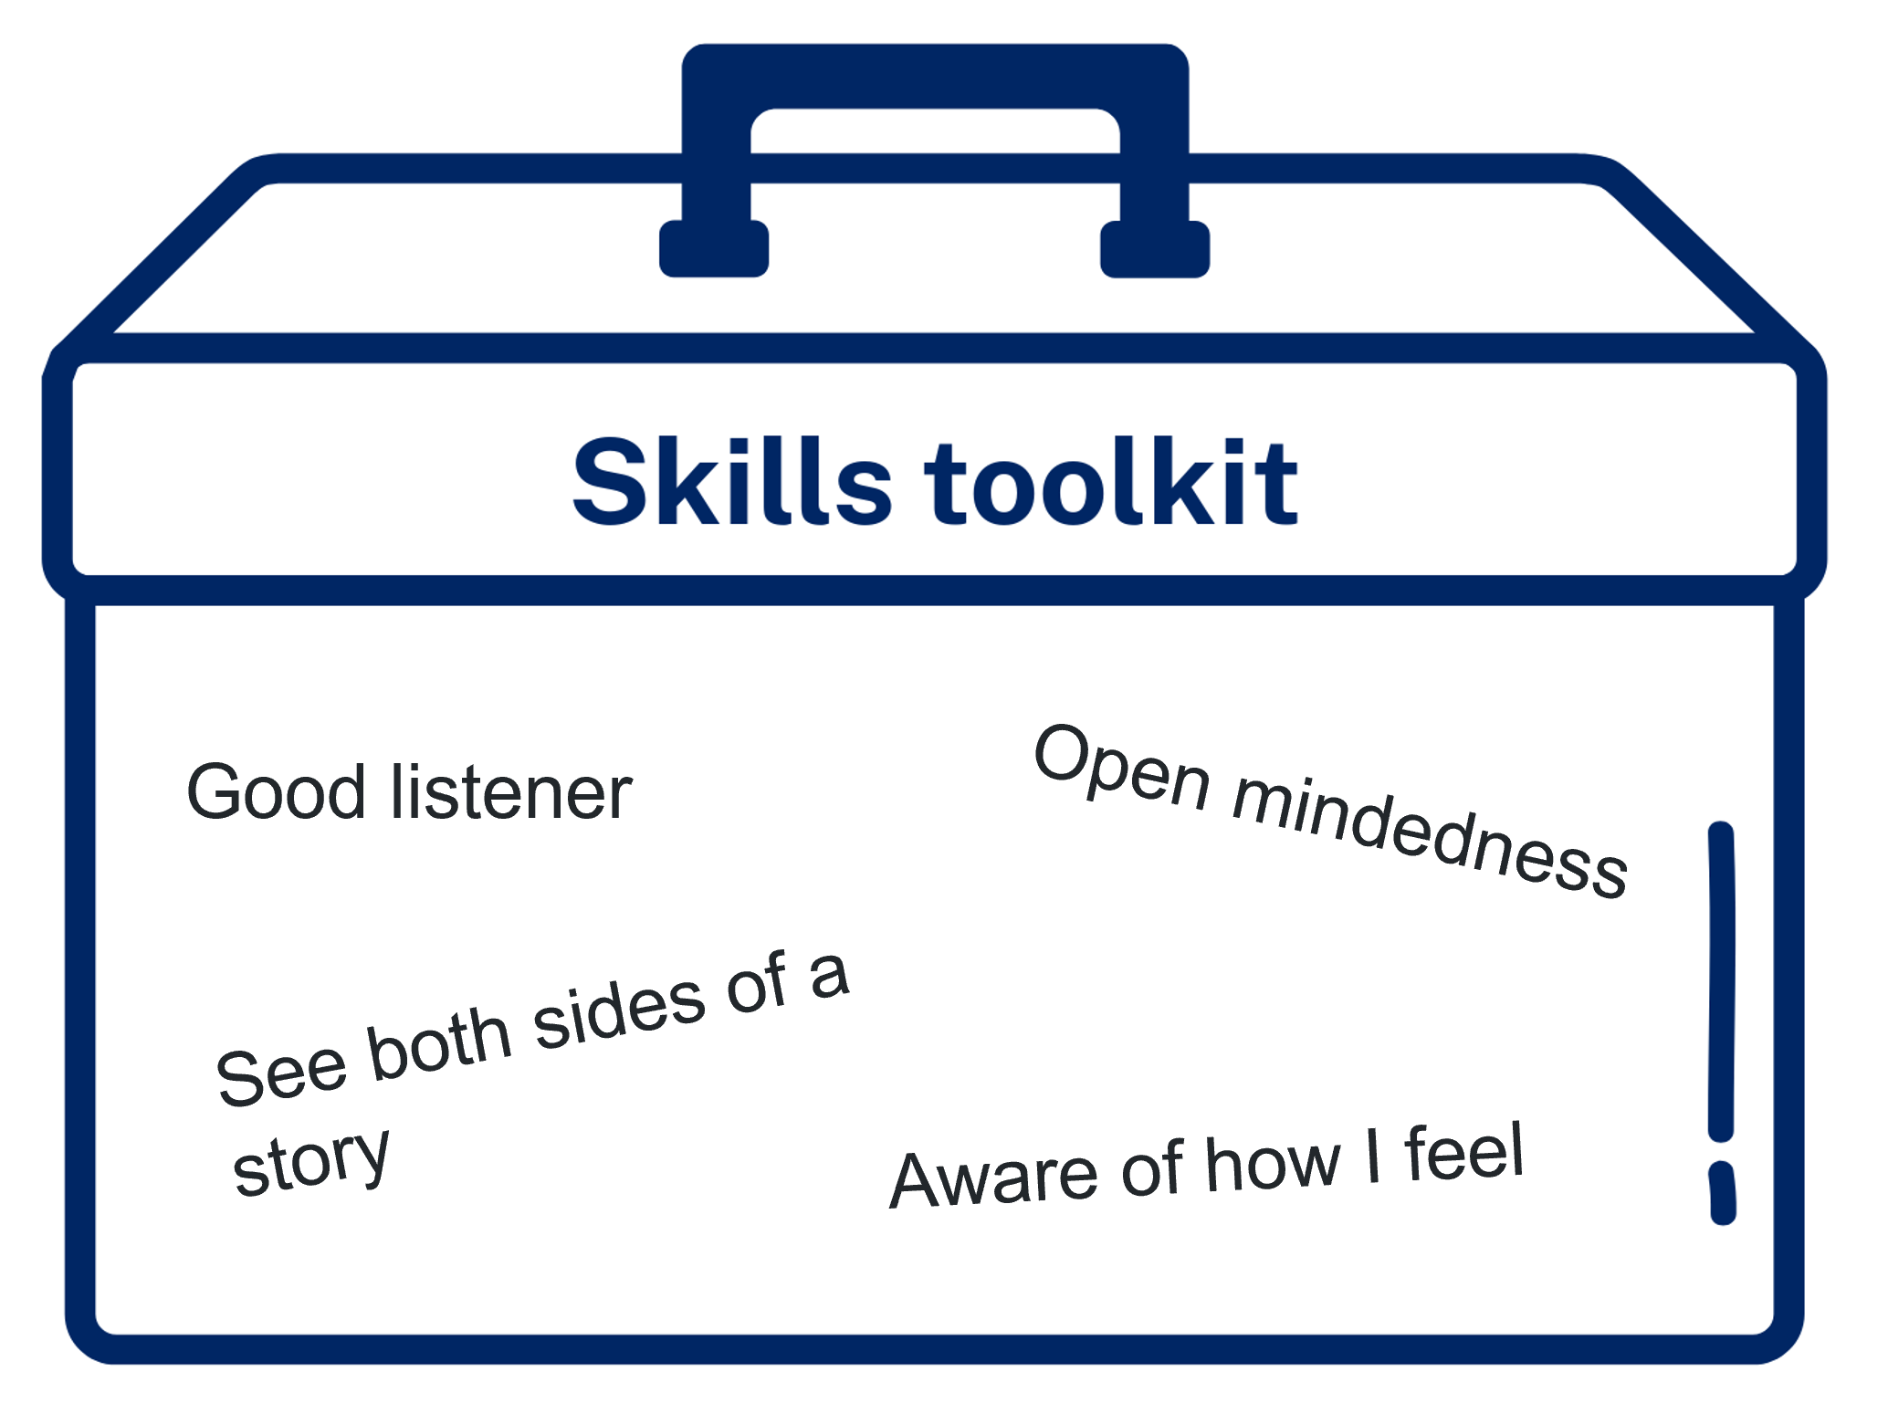
Activity – How full is my toolkit?
Individual reflection activity
Instructions
On the toolkit image provided record the skills you already have that could help you manage change.

Slide 33
Activity – resilience (1)
Class discussion
Questions
What do you think resilience means?
What does it mean to ‘bounce back’ from a difficult situation?
How can keeping going (perseverance) help when things get hard?
What are some situations where you might need to show resilience?
Why might resilience be required to navigate some of the changes we have talked about in this program of learning so far?

Slide 34
Activity – resilience (2)
Written reflection
Instructions
Write a short reflection on resilience by answering the following questions:
When was a situation that you were resilient?
What did you do to demonstrate resilience?
Is there anything else you would do differently next time?

Slide 35
Activity – What to do?
Group activity
Instructions
In your small groups:
read the scenario provided
consider the toolkit skills cards
select which skills might support the character in the scenario to respond appropriately and effectively
discuss the questions attached to the scenario.

Slide 36
Activity – wrap up
Recap
Skill area | Other skills needed | How it can help
Communication skills | active listening clear expression respect | reduces misunderstandings builds trust helps solve problems together
Building positive relationships | empathy negotiation conflict resolution | strengthens friendships encourages respect and cooperation build trust
Emotional awareness and self-management | self-regulation resilience problem-solving | helps manage stress and emotions supports positive coping build confidence in managing change

Slide 37
Activity – Support networks (1)
Individual activity
Instructions
Trace your hand on a piece of paper. Identify a support for the following:
thumb – a family member
pointer finger – a trusted adult who is not immediate family
middle finger – a friend
ring finger – a community or cultural connection
pinkie finger – a professional support service

Slide 38

Activity – Support networks (2)
Individual activity
A friend
A trusted adult
A community connection
A professional service
A family member

Slide 39
Activity – Support networks (3)
Think-pair-share
Questions
Why is it important to have different kinds of people in our support network?
Who could you talk to if you were feeling overwhelmed or unsure about something?

Slide 40
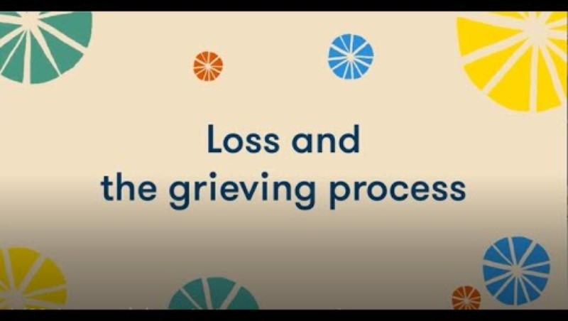
Unpacking loss and grief
Video
Notes:
Video source: https://www.youtube.com/watch?v=jJrs51lYGX0

Slide 41
Activity – unpacking loss and grief
Think-pair-share
Questions
What is the difference between ‘loss coping’ and ‘restoration coping’?
Why are both important?
What strategies could be used in the restoration loss phase of grief?

Slide 42
Activity – loss and grief skills application
Gallery walk
Instructions
In your small groups:
move around the room and consider each scenario
discuss the questions attached to the scenario.

Slide 43
Communication, conflict and respectful relationships

Slide 44
Learning intentions – communication, conflict and respectful relationships
We are learning to
understand and apply the elements of effective communication in varied contexts
explore the nature and impact of conflict and evaluate strategies to resolve it effectively
reflect on the roles and shared responsibilities within respectful relationships, and the skills that support these connections.
Notes:
Notes for teachers:
Learning intentions and success criteria are best co-constructed with students. Adapt the learning intention as required and add matching success criteria.
For more information See ⁠AITSL or the NSW Department of Education explicit teaching strategies, ⁠Sharing learning intentions and ⁠Sharing success criteria
LISC is not necessarily presented at the beginning of the lesson. Teacher needs to consider most effectual time to introduce
LISC should be revisited during the lesson to support students' evaluation of their learning

Slide 45
Success criteria – communication, conflict and respectful relationships
I can
identify, explain and apply effective verbal and non-verbal communication skills and adapt communication strategies to suit different audiences and situations
select and apply decision-making, problem-solving, and negotiation skills to manage conflict and maintain respectful relationships with others
identify and reflect on personal strengths and skills and explain how they can be used to adapt to current and future challenges and changes.
Notes:
Notes for teachers:
Learning intentions and success criteria are best co-constructed with students. Adapt the learning intention as required and add matching success criteria.
For more information See ⁠AITSL or the NSW Department of Education explicit teaching strategies, ⁠Sharing learning intentions and ⁠Sharing success criteria
LISC is not necessarily presented at the beginning of the lesson. Teacher needs to consider most effectual time to introduce
LISC should be revisited during the lesson to support students' evaluation of their learning

Slide 46
Activity – communication
Activating prior knowledge
What do I already know? | What do I want to know? | What did I learn? | How can I learn more?

Slide 47
Activity – role play scenarios
Class discussion
Questions
What communication skills did you utilise as part of your role play? Did you draw upon the skills we have explored previously?
Were there any challenges faced when deciding on your communication approach? How were these overcome?
How did your group adapt the communication style to fit the situation? Why was this necessary?
Would you communicate the same way if a different person was involved?

Slide 48
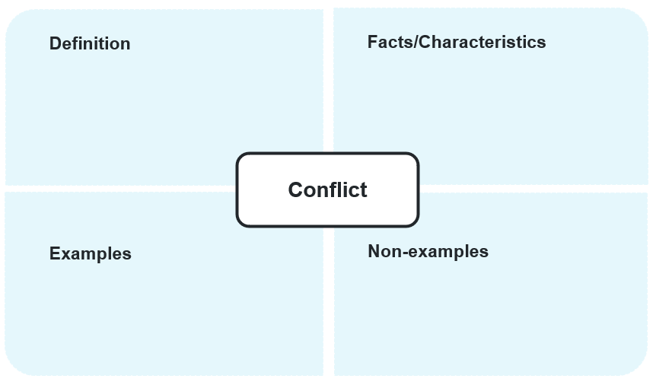
Activity – understanding conflict
Frayer diagram

Slide 49
Activity – decision-tree (1)
Teacher modelling
Conflict Scenario
Option 1
Option 2
Outcome 1
Outcome 2
Outcome 1
Outcome 2

Slide 50
Understanding conflict
What is Conflict?
Conflict is a disagreement or struggle between people or groups that occurs when their needs, goals, or values clash.
Types
Causes
Resolving conflict
intrapersonal
interpersonal
group
poor communication
differing values
personality clashes
bullying or jealousy
stress
Avoiding
Accommodating
Compromising
Competing
collaborating

Slide 51
Activity – decision-tree (2)
Class discussion
Questions
How did annotating your decision tree enhance your understanding of the conflict?
Did recognising and categorising the cause of the conflict change your perspective on the situation?
Which conflict resolution style do you think you naturally gravitate towards? Do you think it is effective? Why or why not?
If you were asked to select another conflict resolution style for the same conflict, what style would you choose and why?

Slide 52
Activity – respectful relationships
Y-chart
Looks like
Sounds like
Feels like

Slide 53
Rights, responsibilities and roles
Every relationship involves different rights, responsibilities and roles that each party must fulfil and uphold in order to create and foster respectful relationships.
Rights
Responsibilities
Roles
Rights are things that every person is entitled to. In relationships, this includes:
respect
safety
privacy
choice
equality
Responsibilities are things you are expected to do to help the relationship stay healthy and respectful. They include:
respecting others
being honest and kind
listening when others speak
taking responsibility when you hurt someone’s feelings
Roles are the part(s) you play in a relationship — and this can change as you grow. Your role can shift depending on:
age and maturity
the type of relationship life situations
Which responsibilities do we all share, no matter the relationship?
Why are these responsibilities essential for respectful relationships?

Slide 54
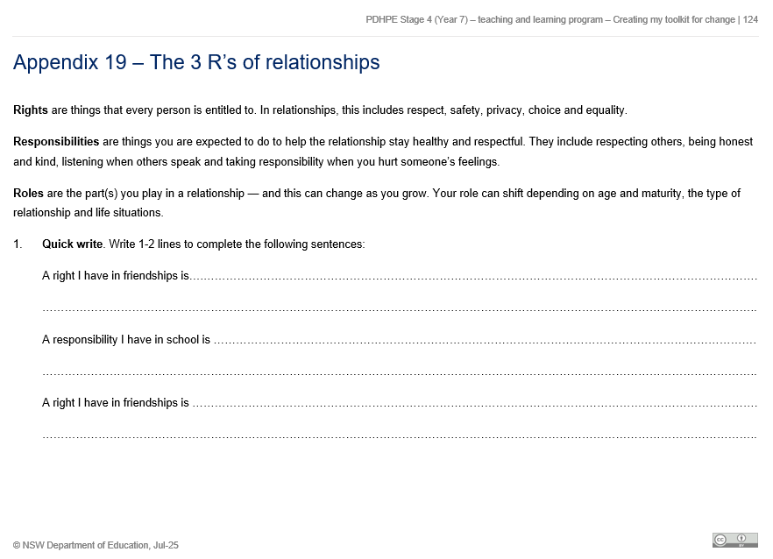
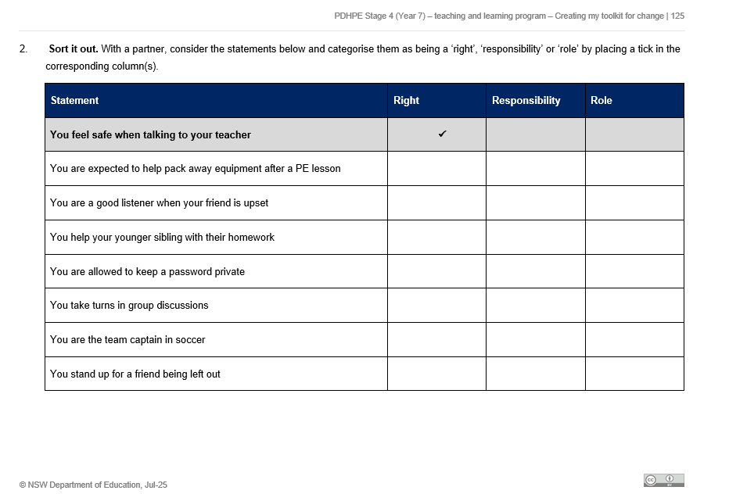
Activity – rights, responsibilities and roles (1)
The R’s of relationships worksheet
Instructions
Complete worksheet questions 1 (individually) and 2 (in pairs).

Slide 55
Activity – rights, responsibilities and roles (2)
The 3 R’s of relationships worksheet answers
Statement | Right | Responsibility | Role
You feel safe when talking to your teacher | ✅
You are expected to help pack away PE equipment |  | ✅ | ✅
You are a good listener when your friend is upset |  | ✅ | ✅
You help your younger sibling with their homework |  | ✅ | ✅
You are allowed to keep a password private | ✅
You take turns in group discussions |  | ✅
You are the team captain in soccer |  |  | ✅
You stand up for a friend being left out |  | ✅ | ✅

Slide 56
Activity – rights, responsibilities and roles (3)
Group activity
How might our roles in relationships change as we grow through adolescence?
Consider things like:
organising friendship catch-ups
selecting clothes
helping with chores
cleaning your bedroom

Slide 57
Activity – rights, responsibilities and roles (4)
Group activity
What is one thing you’re allowed or expected to do now that you weren’t allowed or expected to do in Year 5 or 6?
Share your response with your group.
Discuss the following questions:
How can you see responsibilities shift as roles start to change?
What are some expectations that become more important as we get older?
How might self-identity influence relationship roles with family or friends?

Slide 58
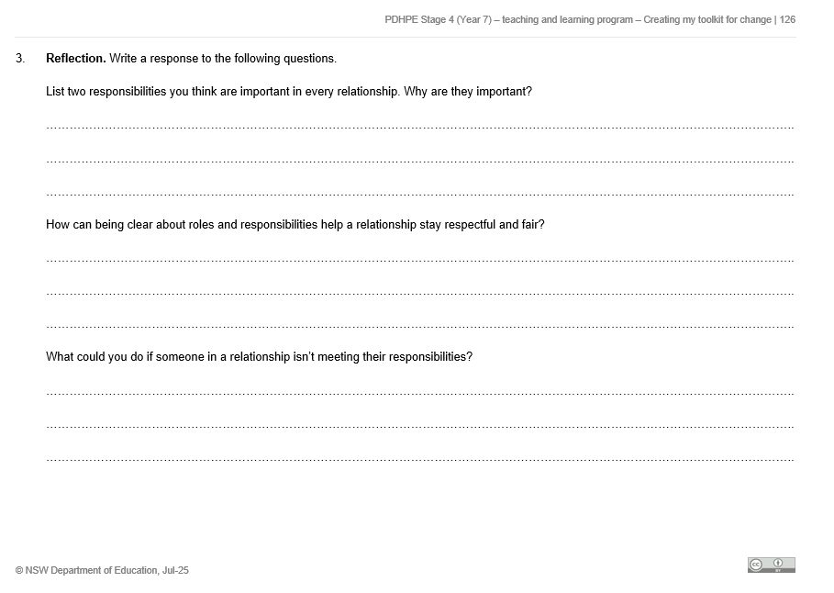
Activity – rights, responsibilities and roles (5)
The R’s of relationships worksheet
Instructions
Complete worksheet questions 3 (individually).

Slide 59
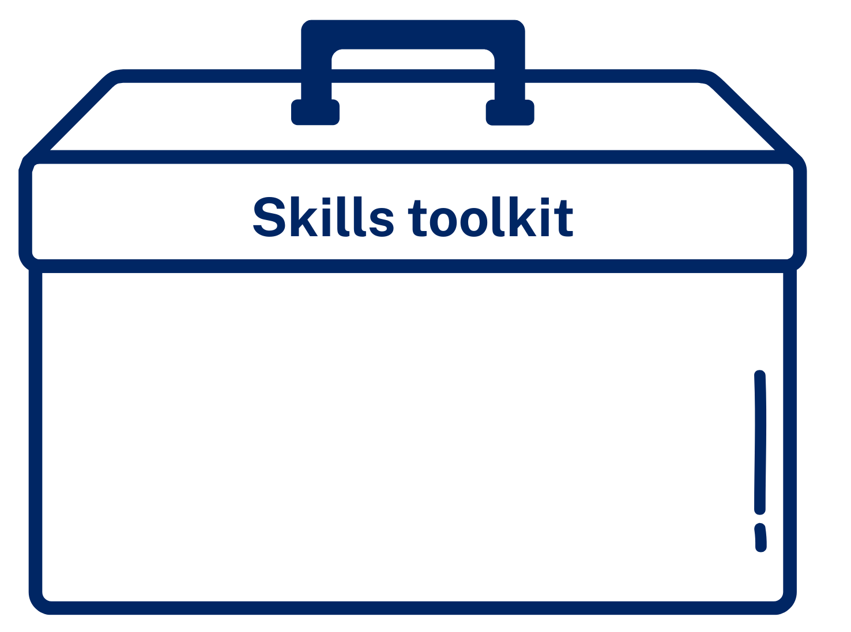
Toolkit reflection – skills for respectful relationships
Individual reflection
How can the skills in your toolkit help you create and maintain respectful relationships?
identify three self-management or interpersonal skills
explain how each skill could support you to establish and maintain respectful relationships across a variety of contexts.

Slide 60
References
This presentation contains NSW Curriculum and syllabus content. The NSW Curriculum is developed by the NSW Education Standards Authority. This content is prepared by NESA for and on behalf of the Crown in the right of the State of New South Wales. The material is protected by Crown copyright.
Please refer to the NESA Copyright Disclaimer for more information https://educationstandards.nsw.edu.au/wps/portal/nesa/mini-footer/copyright.
NESA holds the only official and up-to-date versions of the NSW Curriculum and syllabus documents. Please visit the NSW Education Standards Authority (NESA) website https://educationstandards.nsw.edu.au/wps/portal/nesa/home and the NSW Curriculum website https://curriculum.nsw.edu.au.
Personal Development, Health and Physical Education 7–10 © Syllabus NSW Education Standards Authority (NESA) for and on behalf of the Crown in right of the State of New South Wales, 2024.

Slide 61
Copyright
© State of New South Wales (Department of Education), 2025
The copyright material published in this resource is subject to the Copyright Act 1968 (Cth) and is owned by the NSW Department of Education or, where indicated, by a party other than the NSW Department of Education (third-party material).
Copyright material available in this resource and owned by the NSW Department of Education is licensed under a Creative Commons Attribution 4.0 International (CC BY 4.0) license.
This license allows you to share and adapt the material for any purpose, even commercially.
Attribution should be given to © State of New South Wales (Department of Education), 2025.
Material in this resource not available under a Creative Commons license:
the NSW Department of Education logo, other logos and trademark-protected material
Material owned by a third party that has been reproduced with permission. You will need to obtain permission from the third party to reuse its material.
Links to third-party material and websites
Please note that the provided (reading/viewing material/list/links/texts) are a suggestion only and implies no endorsement, by the New South Wales Department of Education, of any author, publisher, or book title. School principals and teachers are best placed to assess the suitability of resources that would complement the curriculum and reflect the needs and interests of their students.
If you use the links provided in this document to access a third-party’s website, you acknowledge that the terms of use, including licence terms set out on the third-party’s website apply to the use which may be made of the materials on that third-party website or where permitted by the Copyright Act 1968 (Cth). The department accepts no responsibility for content on third-party websites.

