Slide 1
Instructions for use
This resource is not a teaching and learning program. It should be used in conjunction with PDHPE Year 7 – building a balanced and healthy lifestyle – teaching and learning program.
Classroom teachers are encouraged to add and adapt slides as required to meet the needs of their students.
Save a copy of the file to make changes to the slide deck. Go to File > Download a Copy (this downloads a copy to the computer to edit in the PowerPoint app).
To convert the PowerPoint to Google Slides:
  Upload the file into Google Drive and open it.
  Go to File > Save as Google Slides.
  (Note – conversion may cause formatting changes in the slides.)

Slide 2

Building a balanced and healthy lifestyle
PDHPE – Stage 4/Year 7
Term 3
Photo by Mae Mu on Unsplash

Slide 3
Lessons
1
Understanding health and wellbeing
2
Balanced lifestyles
3
Recommendations for a balanced and healthy lifestyle
4
Influences on health choices
5
Understanding sources of health information
Notes:
Teacher notes:
Click lesson numbers to go to specific lessons
Interactive features can be viewed in slide show

Slide 4
Understanding health and wellbeing

Slide 5
Learning intentions and success criteria – understanding health and wellbeing
We are learning to
understand health and wellbeing as a dynamic, multidimensional and culturally influenced concepts.
I can
identify and describe the five dimensions of health and how they impact overall wellbeing
discuss how health and wellbeing can change over time and in different situations
recognise how cultural perspectives shape people’s understanding of health and wellbeing.
Notes:
Notes for teachers:
Learning intentions and success criteria are best co-constructed with students. Adapt the learning intention as required and add matching success criteria.
For more information See ⁠AITSL or the NSW Department of Education explicit teaching strategies, ⁠Sharing learning intentions and ⁠Sharing success criteria
LISC is not necessarily presented at the beginning of the lesson. Teacher needs to consider most effectual time to introduce
LISC should be revisited during the lesson to support students' evaluation of their learning

Slide 6

Activity – what is health?
Partner activity
Consider the question ‘What does it mean to be healthy?’
Discuss with your partner and record your ideas on the paper or whiteboard provided.
Share your ideas with the class.

Slide 7
Activity – Dimensions of health
Class discussion
Dimensions of Health
Physical | Mental | Emotional | Spiritual | Social
Notes:
Images sourced from Canva.

Slide 8
Activity – how do the dimensions work together? (1)
Partner activity
Develop a scenario that demonstrates how the dimensions of health are interrelated and work together.
Join another pair to make a group of four.
One pair reads their scenario without telling the other pair which dimensions of health have been included. The other pair identifies which dimensions of health are in the scenario, giving reasons for their answers.
Swap roles and repeat the process.

Slide 9
Activity – how do the dimensions work together? (2)
Class discussion
Discuss the following:
Did you find that multiple dimensions of health were evident in the example you looked at?
What does this tell us about how the dimensions of health work together?

Slide 10
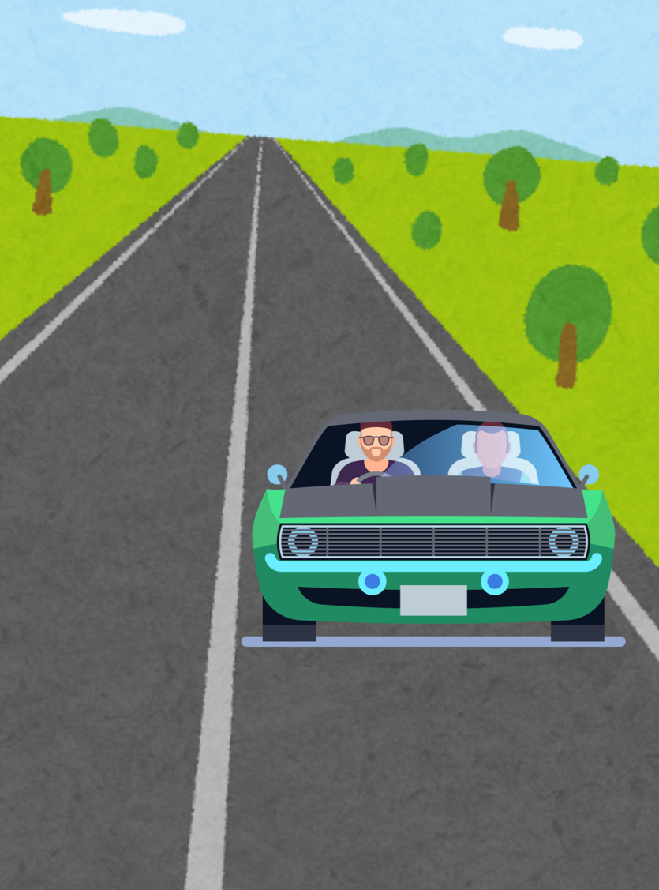
Health and Wellbeing
Car analogy
Health is like the different parts of a car working together:
the engine (physical)
the steering (mental)
the dashboard lights (emotional)
the passengers you share the ride with (social)
and the reason you’re driving somewhere (spiritual).
Wellbeing is like how smoothly the whole car runs and how much you enjoy the journey.
Notes:
Image: Canva

Slide 11
Activity – health and wellbeing scenarios (1)
Priya is 12 years old and in Year 7. She lives with her mum and younger brother, and her grandparents live close by. Priya loves dancing, baking, performing and hanging out with her friends. She sometimes feels nervous in new situations but is always willing to try something new.
Group activity
In your small groups:
listen to events that have happened for Priya over the last term
identify and discuss as a group the dimension of health evident for this event. Hold up the corresponding ‘dimensions of health’ cards to indicate your groups response
be ready to share your reasons with the class.

Slide 12
Activity – health and wellbeing scenarios (2)
Group activity
In your small groups, discuss the following:
During this activity, did any of the events match to more than one dimension? Why do you think that could be?
What does this tell us about how health works?
Be ready to share your reasons with the class.

Slide 13
Activity – health and wellbeing scenarios (3)
OPTION 1
Original event: catches a cold.
What if…. Priya needed to get treatment in hospital for a few days for her illness.
Group activity
In your small groups:
select ONE ‘what if’
discuss how changing a variable in one event can change the dimensions of heath impacted for Priya.
Find another group and compare your responses.
OPTION 2
Original event: has an argument with her best friend.
What if…. Priya’s friend apologised that afternoon?

Slide 14
Activity – health and wellbeing scenarios (4)
Group activity
Event | Impact on wellbeing
First day of term
Announced as the lead role in a school musical
Catches a cold
Has an argument with her best friend
Learns how to cook a traditional dish
Completes 3 assignments all due in the same week
Goes on a weekend away with her family
Discuss the impact the event might have on Priya’s wellbeing. Use the following gestures to indicate your response:
thumbs up – positive influence
thumbs down – negative influence
thumbs to the side – mixed influence

Slide 15
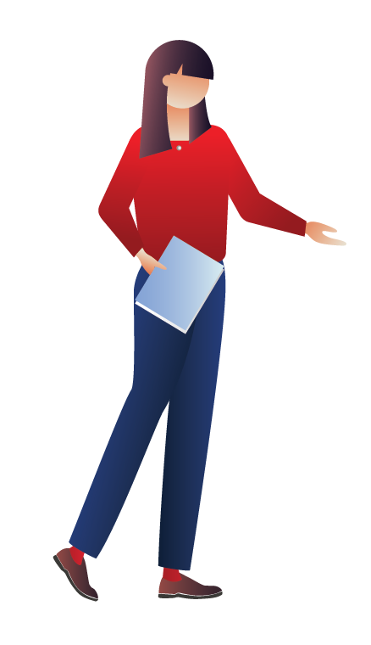
Activity – wrap up
Health and wellbeing are always changing.
The dimensions of health are interconnected.
The same event can affect people in different ways because everyone has unique experiences, perspectives, and circumstances.
Understanding the different dimensions of health helps us to recognise diverse perspectives of health and respond with empathy and respect.

Slide 16
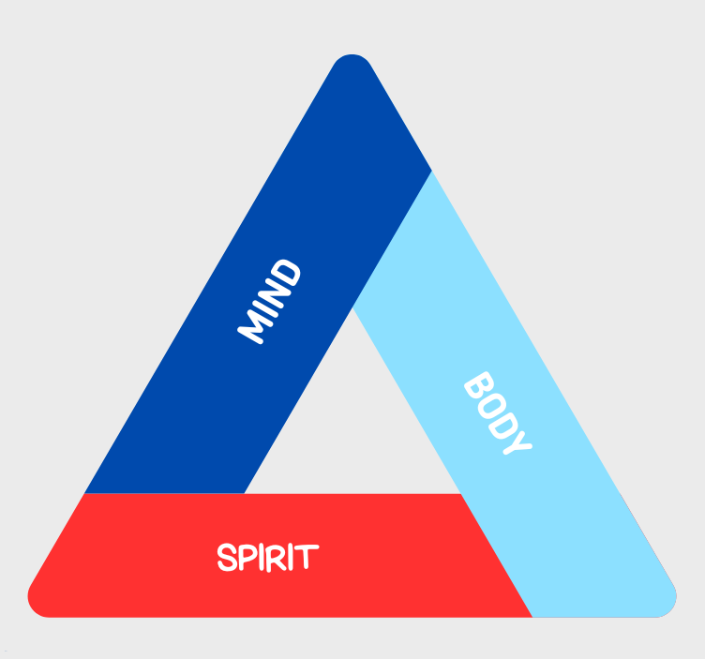
Mind, body, spirit
A model of health
Element | Description
Mind | Your thoughts, feelings, and how your brain works to process information and make decisions.
Body | How well your body works, including your fitness, nutrition, sleep, and how your organs and systems function.
Spirit | A person’s sense of purpose, meaning, and connection to people, culture, or the world around you.

Slide 17
Activity – mind, body and spirit carousel
Group activity
In your small groups:
move around the room and the stimulus at each station
use the discussions prompts to share knowledge and ideas.
Repeat at the next station when it is time to move on.

Slide 18
Activity – perceptions of health reflection
Individual activity
Engage in a written reflection by completing the following sentences :
I used to think health was...
Now I think health is...
Something that influences how I feel about health is...
Different people can have a different perception of health because...

Slide 19
Activity – Yarning Circle
Group activity
Participate in a Yarning Circle to share perspectives on discuss ‘why health is viewed differently by different people?’.
Protocols:
speak from the heart
listen from the heart
confidentiality - do not share or discuss what other people have shared once the yarning circle is finished.
show respect for others’ contributions.

Slide 20



Activity – Yarning Circle reflection
Individual activity
Use the following prompts to reflect on the Yarning circle activity:
What is something you found interesting when listening to others today?
What is something you came to appreciate from hearing different perspectives?
What is your view of health now, after the Yarning Circle?

Slide 21
Wrap up
Recap
Health is always changing and can mean different things to different people.
What we think about health is shaped by our own experiences, important events in our lives, and the values of the people and communities around us.
Becoming health-literate involves understanding and respecting these diverse perspectives while being able to selectively access and critically analyse information, navigate community services and resources, and take action to promote personal health and the health of others.

Slide 22

Exit ticket– understanding health and wellbeing
Individual activity
Complete an exit ticket by responding to the following prompts:
3 things I learned about health.
2 ideas about health I hadn’t thought about before…
1 way the culture can influence the way a person understands health and wellbeing…
Links with learning sequence 1 success criteria:
I can recognise how cultural perspectives shape people’s understanding of health and wellbeing.

Slide 23
Balanced lifestyles

Slide 24
Learning intentions and success criteria – balanced lifestyles
We are learning to
identify and explain the components of a balanced lifestyle and how they support our health and wellbeing.
I can
describe the key components of a balanced lifestyle
explain how each component influences health and wellbeing
Notes:
Notes for teachers:
Learning intentions and success criteria are best co-constructed with students. Adapt the learning intention as required and add matching success criteria.
For more information See ⁠AITSL or the NSW Department of Education explicit teaching strategies, ⁠Sharing learning intentions and ⁠Sharing success criteria
LISC is not necessarily presented at the beginning of the lesson. Teacher needs to consider most effectual time to introduce
LISC should be revisited during the lesson to support students' evaluation of their learning

Slide 25
Components of a balanced lifestyle
Pair activity
Components of a balanced lifestyle can include:
nutrition
physical activity
sleep
social interactions
activities outside
screen time.
In pairs:
match the component of a balanced lifestyle to the description by drawing a line to connect the two items.

Slide 26

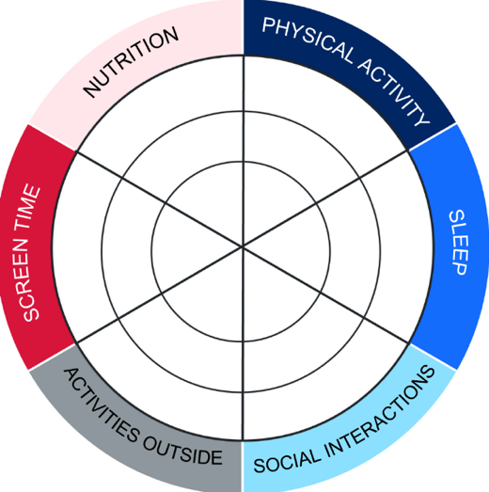
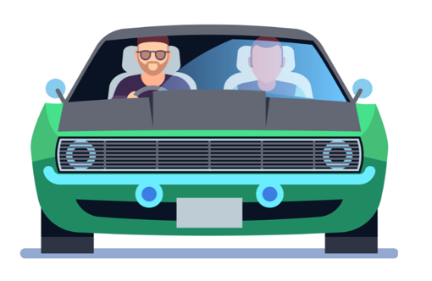
The balanced lifestyle wheel
Car analogy revisited
Health = the different parts of the car working together.
Wellbeing = how smoothly the whole car runs and how much you enjoy the journey.
Balanced lifestyle = are the wheels that make the car move smoothly and reliably when inflated and balanced, but bumpy and harder to control when flat.

Slide 27
Balanced lifestyle snapshots – modelled example (1)
Priya’s lifestyle snapshot
Read the character snapshot
        Priya is 13 years old and in Year 7. She loves computer games and spends about 3 hours gaming on most afternoons. Even though that is a lot of screen time, she also plays basketball twice a week and has training after school 3 days a week. She sometimes forgets to eat breakfast, but usually eats fruit, sandwiches and snacks during the day and has dinner with her family.
        Priya sometimes stays up late on weekends, but she gets 8 hours of sleep on most school nights. She hangs out with her basketball friends and her cousins on most weekends, and when she feels stressed, she chats with her older sister.
Underline or highlight text that demonstrates a component of a balanced lifestyle and write which specific component it is.

Slide 28
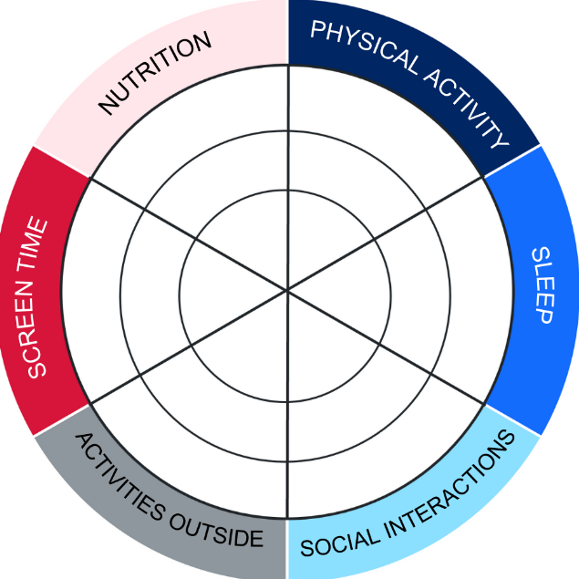
Balanced lifestyle snapshots – modelled example (2)
Priya’s lifestyle snapshot
Co-construct a criteria for each lifestyle component based on the categories ‘balanced achieved’, ‘almost there’ and ‘not there yet’.
Lifestyle component | Balanced achieved Inner to outer circle | Almost there Inner to middle circle | Not there yet Inner circle only
Nutrition
Physical activity
Sleep
Social interactions
Activities outside
Moderating screen time
Notes:
Teacher note: you may choose to provide the criteria for your student and pre-fill it in rather than co-constructing it.

Slide 29
Balanced lifestyle snapshots – modelled example (3)
Priya’s lifestyle snapshot
Shade each component of the balanced lifestyle wheel using the co-constructed criteria.
Answer the following questions:
Which components of the characters lifestyle are strong?
Which components could be more balanced?
What impact could the current state of balance have on the characters wellbeing?

Slide 30
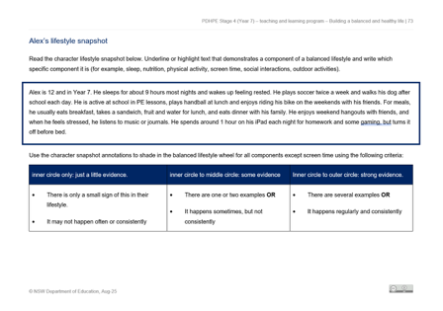
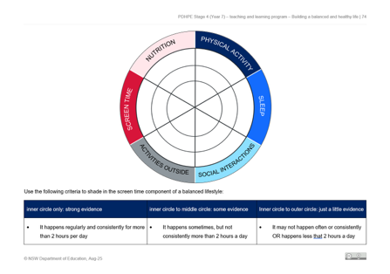
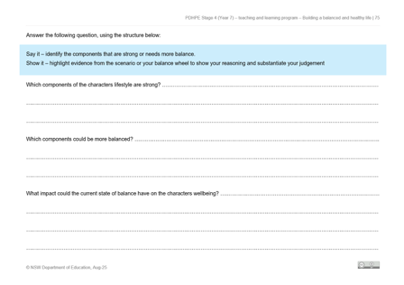
Balanced lifestyle snapshots
Character profiles
In pairs:
read through your assigned lifestyle snapshot
underline or highlight text that demonstrates a component of a balanced lifestyle. Indicate the component
shade the balanced lifestyle wheel to reflect the character snapshot using the co-constructed criteria
discuss and respond to the questions attached to the lifestyle snapshot.

Slide 31
Recommendations for a balanced and healthy lifestyle

Slide 32
Learning intentions and success criteria – Recommendations for a balanced and healthy lifestyle
We are learning to
use health information to make informed choices and propose strategies to support a healthy lifestyle
I can
identify features of credible health information
use credible health information to evaluate health behaviours and choices related to a balanced lifestyle
propose strategies to support a balanced and healthy lifestyle.
Notes:
Notes for teachers:
Learning intentions and success criteria are best co-constructed with students. Adapt the learning intention as required and add matching success criteria.
For more information See ⁠AITSL or the NSW Department of Education explicit teaching strategies, ⁠Sharing learning intentions and ⁠Sharing success criteria
LISC is not necessarily presented at the beginning of the lesson. Teacher needs to consider most effectual time to introduce
LISC should be revisited during the lesson to support students' evaluation of their learning

Slide 33
Nutrition – activating prior learning (1)
Individual activity
Complete the first two columns of the KWLH chart.
(K) What I know | (W) What I want to know | (L) What I have learnt | (H) How can I learn more?
Name the 5 food groups. Give one example of a food item in each food group. What does “balanced eating” mean? What are some foods we should eat “less of”? What are the benefits of drinking water for your body?

Slide 34
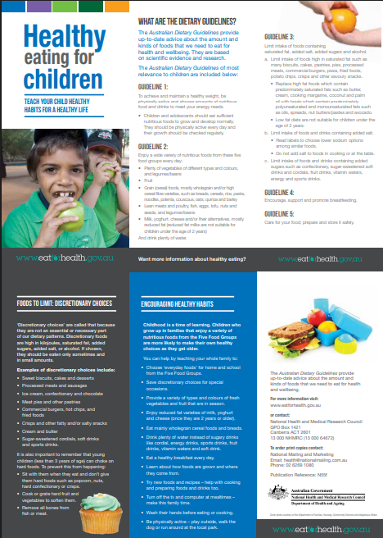
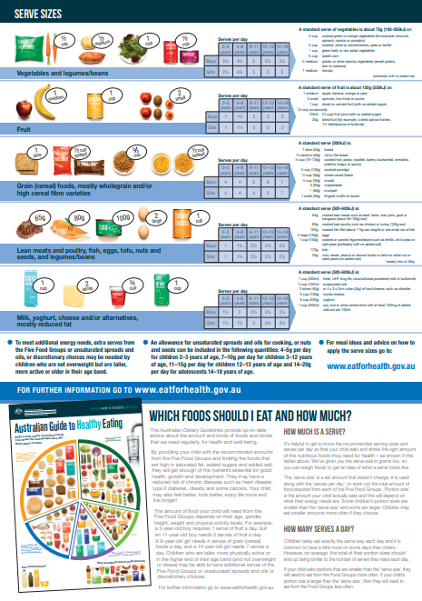
Nutrition – healthy eating for children (1)
Sources of health information
Read through the brochure.
Discuss:
Who created this brochure?
Why might the government publish a resource like this?
Can we trust the information in this brochure?
What makes this brochure different from information we might find on social media or a blog?
What are the limitations of this brochure?
Where else could you go to double-check this information?
https://www.eatforhealth.gov.au/guidelines/guidelines
Notes:
Image: https://www.nsw.gov.au/sites/default/files/noindex/resources/Healthy-eating-for-children-brochure.pdf

Slide 35
Healthy eating for children jigsaw activity (1)
Group work
In groups:
review the question card
discuss the questions
formulate a response with clear reasoning
share response with the class.

Slide 36
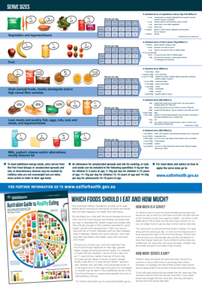
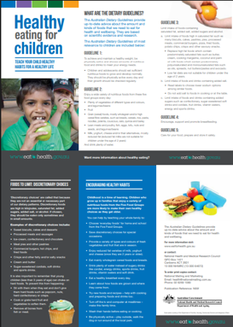
Healthy eating for children
Class discussion
In groups, discuss the following:
Why might a 9-year-old girl need 4 serves of grain (cereal) foods a day, but a 14-year-old girl needs 7 serves a day?
https://www.eatforhealth.gov.au/guidelines/guidelines
Notes:
Image: https://www.eatforhealth.gov.au/guidelines/guidelines

Slide 37
Meals and daily nutritional requirements
Partner activity
Alex ate one bowl of whole-grain cereal with milk, and one mixed berries for breakfast.
In pairs:
identify the food groups included in this meal
discuss what impact skipping breakfast might have on meeting his nutritional requirements?

Slide 38
Balanced meal scenario activity
Maya’s meals
In pairs:
review the meals Maya consumed yesterday
indicate how many serves of each food group are reflected in her meals
discuss the questions attached to the activity and write a response in the space provided.

Slide 39
Balanced meal reflection activity
Individual reflection
Individually:
record the meals you consumed yesterday
indicate how many serves of each food group were met
write a response in the space provided.

Slide 40
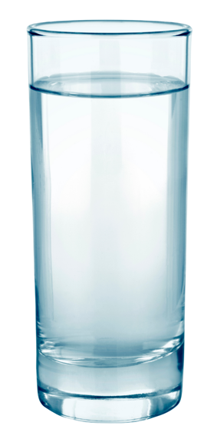
Hydration
More than just thirst
Water is vital for every system in your body. Staying hydrated helps with:
cellular function
focus and concentration
energy and performance
temperature
digestion
mood regulation.
Did you know?
Plain water is the best choice for hydration
Milk can contribute to overall intake in moderation
Soft drinks, energy drinks and fruit juice should be limited
Notes:
Image: Canva

Slide 41
Hydration requirements
Individual reflection
Consider the hydration guidelines below:
Age group | Boys | Girls
9-13 years | 1.6L (6 cups) | 1.4L (5-6 cups)
14-18 years | 1.9L (7-8 cups) | 1.6L (6 cups)
Do you think you meet the recommended hydration amounts for your age range?
What is one small change you could make to meet your hydration goals more effectively?
Why do you think that boys and girls have different hydration requirements?

Slide 42
Drink choice decisions activity
Partner work
In pairs:
rank the drinks in order from the most to least supportive health choice
provide reasons to justify your rankings.
Whole class discussion:
What criteria did you use to make your judgements?

Slide 43
Being a label detective
Making informed food and drink choices
What do we consider?
Health star rating
Ingredients list
rating system from ½ to 5 stars.
more stars = generally healthier choice
allows quick comparison between similar products
Listed in descending order by weight
First three ingredients are most important
sugars, syrups, oils = possible less health choice
Nutritional information
Context
Shows per 100ml/gm or per serve
Key focus for drinks are sugars, proteins and energy.
Why is this food being considered? For example: post-exercise, brain fuel, daily fuel or hydration, athletic performance, manage a health condition etc.
We can use this information to make judgements about how supportive to our health a food or drink choice may be.
Notes:
Image: https://www.nsw.gov.au/sites/default/files/noindex/resources/Healthy-eating-for-children-brochure.pdf

Slide 44

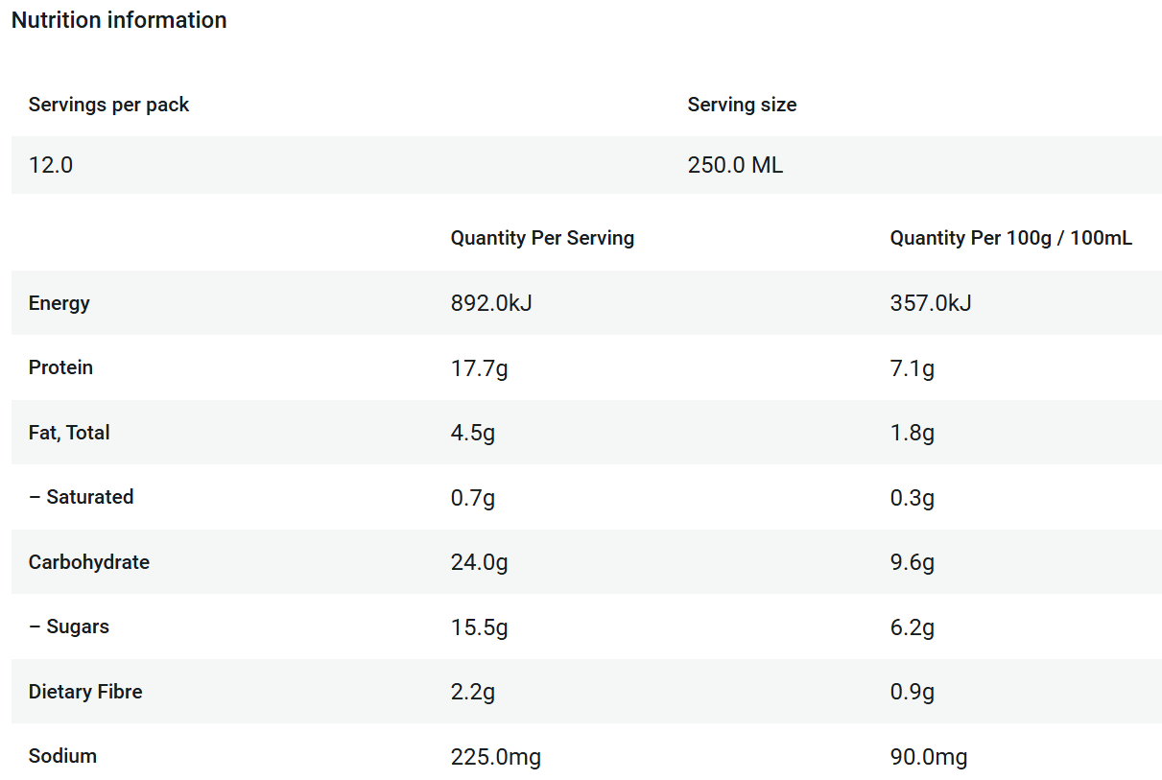
Label detectives – modelled example
Making informed food and drink choices
Ingredients: Water, skim milk powder, soy protein, wheat maltodextrin, cane sugar, milk protein concentrate, vegetable oils (sunflower, canola), plant fibre, fructose, flavours, acidity regulator (potassium citrate), vegetable gums (460, 466, 407), mineral (calcium), stabiliser (452), vitamins (C, B3, A, D2, B2, B1, B12, B6), salt.
Notes:
Image: https://www.nsw.gov.au/sites/default/files/noindex/resources/Healthy-eating-for-children-brochure.pdf

Slide 45
Label detectives activity
Partner work
Revisit your rankings of drinks from the previous activity.
In pairs:
reconsider the drink choices and rank them again using your knowledge of health start ratings, ingredients lists, nutritional information and context.
provide reasons to justify your rankings.
Whole class discussion:
Did your rankings change this time around? What accounted for this?

Slide 46
Nutrition – activating prior learning (2)
Individual activity
Complete the last two columns of the KWLH chart.
(K) What I know | (W) What I want to know | (L) What I have learnt | (H) How can I learn more?

Slide 47
Nutrition recap
      Good nutrition gives your body energy, helps you grow, and keeps your mind and body healthy.
      Eating a variety of foods from all 5 food groups gives your body the nutrients it needs.
      A balanced diet helps you stay a healthy weight and reduces the risk of illness.
      Many people eat too many discretionary foods (junk foods), which can harm health.
      Drinking water is the best way to stay hydrated and helps your body work properly.
      You can make healthier choices by looking at the Health Star Rating, ingredients, and nutrition panel.

Slide 48
Physical activity and exercise guidelines
Partner activity
Individually:
read the Australian Governments physical activity and exercise guidelines for children and young people.
In pairs:
review the questions on your worksheet
discuss your ideas
record your response.

Slide 49
Physical activity, screen time and sleep graffiti walk
Individual activity
Individually:
review the station card
respond to the question posed
move to the next station and complete the process above until you have visited all stations.

Slide 50
Physical activity, screen time and sleep self reflection
Individual activity
Individually:
review the worksheet
respond to the reflective question posed
propose strategies to strengthen your physical activity, screen time and sleep practices and consider the benefits it may have to your health and wellbeing.

Slide 51
Balanced and healthy lifestyles wrap up
Wellbeing is influenced by the everyday lifestyle choices we make—what we eat, how we move, how we rest, and how we connect with others.
Developing a balanced lifestyle requires more than knowing what is “healthy”. It involves understanding how to make small, informed choices regularly to build daily habits that can enhance health and wellbeing across components including:
nutrition
physical activity
sleep
social interactions
activities outside
screen time.
Understanding where to find and interpret health information can support our decision making and the habits we form.

Slide 52
Exit ticket – recommendations for a balanced and healthy lifestyle
Individual activity
Complete an exit ticket by responding to the following prompts:
3 things I learned about balanced lifestyles
2 strategies or actions I can take to support my lifestyle balance
1 question I still have about balanced lifestyle.

Slide 53
Influences on health choices

Slide 54
Learning intentions and success criteria – influences on health choices
We are learning to
understand how different factors can influence lifestyle choices.
I can
describe factors that influence lifestyle choices
explain how these factors can make healthy choices easier or harder
propose strategies to support a balanced and healthy lifestyle.
Notes:
Notes for teachers:
Learning intentions and success criteria are best co-constructed with students. Adapt the learning intention as required and add matching success criteria.
For more information See ⁠AITSL or the NSW Department of Education explicit teaching strategies, ⁠Sharing learning intentions and ⁠Sharing success criteria
LISC is not necessarily presented at the beginning of the lesson. Teacher needs to consider most effectual time to introduce
LISC should be revisited during the lesson to support students' evaluation of their learning

Slide 55
Explain this…. modelled example
Explain how sleep can impact school achievement?
Steps:
show how one thing leads to another
provide the how and why
back it up with an example
repeat above process using an alternate viewpoint.

Slide 56
Explain this….
Partner and group activity
Explain how money may influence a family’s ability to meet their recommended serves of fruit and vegetables per day?
Steps:
show how one thing leads to another
provide the how and why
back it up with an example
repeat above process using an alternate viewpoint.
join with another pair and compare responses. Refine your response based on what you hear.
Key word – Explain
Relate cause and effect.
Make the relationships between things evident.
Provide why and/or how.

Slide 57
Factors that influence our choices
Context matters
Contextual factors are the different things in your life and environment that affect the decisions you make, the choices you have, and how easy or hard it is to be healthy. They include a range of influences which affect people in different ways and can make some healthy choices easier and others harder.
Time
Money
Family
How much time you have for exercise, sleep, or cooking healthy meals
What you can afford to buy, like healthy food or gym memberships
Routines, rules, or support at home that influence your habits.
Culture
Access
Media
Traditions, values, or beliefs that guide what you eat or how you stay active.
What’s nearby or available, like shops, transport, parks, or sports facilities.
Messages from social media, influencers and other media can shape choices.

Slide 58
Factors that impact health choices
Group activity
In groups:
review the scenario
identify the contextual factors in the scenario, indicating if they are positive or negative influences on choices
provide evidence to substantiate the judgements made
suggest one way the character could overcome a barrier and make a healthier choice.

Slide 59
Contextual factors reflection
Individual activity
Individually, think about the following questions:
One thing that makes healthy choices easier for me is…
One thing that makes it harder is…

Slide 60
Contextual factors recap
Contextual factors are the background conditions in our lives (time, money, family, culture, access, influences) that make healthy choices easier or harder.
The same factor can be positive or negative depending on the situation.
We can use strategies and supports to overcome barriers to healthy choices.
Understanding these influences helps us to propose realistic strategies that support balanced and healthy lifestyles.

Slide 61
Understanding sources of health information

Slide 62
Learning intentions and success criteria – understanding sources of health information
We are learning to
understand the concept of health literacy and the role it plays in helping us make informed health decisions
identify the key features of reliable and credible sources of health information.
I can
explain what health literacy is and describe how it helps us make informed decisions
access and assess health information sources and explain why some are more reliable than others
identify the purpose of heath information and specific techniques used to achieve it.
Notes:
Notes for teachers:
Learning intentions and success criteria are best co-constructed with students. Adapt the learning intention as required and add matching success criteria.
For more information See ⁠AITSL or the NSW Department of Education explicit teaching strategies, ⁠Sharing learning intentions and ⁠Sharing success criteria
LISC is not necessarily presented at the beginning of the lesson. Teacher needs to consider most effectual time to introduce
LISC should be revisited during the lesson to support students' evaluation of their learning

Slide 63
Investigating health information
Health information checklist
Criteria | Meets the Criteria | Partially Meets | Does Not Meet
Currency | The information is current (within the last 5 years). | No date provided or unclear when it was created. | The information is not current (more than 5 years old).
Relevance | The information is clearly relevant to my age, health needs, or context. | The information is somewhat relevant to my age but only partially applies to my situation. | The information is not relevant for your my or health needs.
Authority | The source is a credible expert or official organisation (e.g., government, health professional). | The source is unclear, but it cites statistics or information from other credible sources. | The source is written by someone whose expertise is not quantified.
Accuracy | The information is supported by evidence, facts, or research and can be verified. | Some evidence or facts provided, but it is incomplete or unclear. | The information is opinion-based and cannot be verified.
Purpose | The information is created to inform or educate, without bias or commercial intent. | The purpose is unclear or partially persuasive. | The information is designed to sell, persuade, or manipulate, rather than inform.

Slide 64
Activity – evaluating health information (1)
Group activity
In groups:
review each piece of health information
consider the criteria of the ‘health information checklist’
discuss and a group and evaluate each piece of health information by completing the checklist.

Slide 65
Activity – evaluating health information (2)
Room walk
Consider the following questions:
Which piece of health information is best?
Which piece of information might not help you make informed health choices?
Each corner of the room represents a different piece of health information. Based on the question posed, move to the corner of the room that best represents your answer.
Discuss your reasons with other students in your corner.

Slide 66
Activity – informative or persuasive?
Group activity
In groups:
discuss your response to the question posed by the teacher
identify the relevant ABCD cards and hold up the card(s) that answer the question. Each ABCD card corresponds with a piece of information.

Slide 67
Health information recap
Health literacy means being able to find, understand, and use health information to make good choices.
We can check if health information is trustworthy by looking at who wrote it, if it’s up to date, accurate, and why it was made.
Health information can be informative (facts) or persuasive (trying to convince or sell something) – sometimes it’s both.
Being health literate can help us make more informed choices that support our health.

Slide 68
Activity – learning reflection
Individual activity
Individually:
reflect on their learning during this unit using a thinking routine
optional – share responses with a partner

Slide 69
References
This presentation contains NSW Curriculum and syllabus content. The NSW Curriculum is developed by the NSW Education Standards Authority. This content is prepared by NESA for and on behalf of the Crown in the right of the State of New South Wales. The material is protected by Crown copyright.
Please refer to the NESA Copyright Disclaimer for more information https://educationstandards.nsw.edu.au/wps/portal/nesa/mini-footer/copyright.
NESA holds the only official and up-to-date versions of the NSW Curriculum and syllabus documents. Please visit the NSW Education Standards Authority (NESA) website https://educationstandards.nsw.edu.au/wps/portal/nesa/home and the NSW Curriculum website https://curriculum.nsw.edu.au.
Personal Development, Health and Physical Education 7–10 Syllabus © NSW Education Standards Authority (NESA) for and on behalf of the Crown in right of the State of New South Wales, 2024.

Slide 70
Copyright
© State of New South Wales (Department of Education), 2025
The copyright material published in this resource is subject to the Copyright Act 1968 (Cth) and is owned by the NSW Department of Education or, where indicated, by a party other than the NSW Department of Education (third-party material).
Copyright material available in this resource and owned by the NSW Department of Education is licensed under a Creative Commons Attribution 4.0 International (CC BY 4.0) license.
This license allows you to share and adapt the material for any purpose, even commercially.
Attribution should be given to © State of New South Wales (Department of Education), 2025.
Material in this resource not available under a Creative Commons license:
the NSW Department of Education logo, other logos and trademark-protected material
Material owned by a third party that has been reproduced with permission. You will need to obtain permission from the third party to reuse its material.
Links to third-party material and websites
Please note that the provided (reading/viewing material/list/links/texts) are a suggestion only and implies no endorsement, by the New South Wales Department of Education, of any author, publisher, or book title. School principals and teachers are best placed to assess the suitability of resources that would complement the curriculum and reflect the needs and interests of their students.
If you use the links provided in this document to access a third-party’s website, you acknowledge that the terms of use, including licence terms set out on the third-party’s website apply to the use which may be made of the materials on that third-party website or where permitted by the Copyright Act 1968 (Cth). The department accepts no responsibility for content on third-party websites.

