Slide 1

PDHPE
May 2025
Notes:
1. Purpose: PDHPE title slide
Time: 15 sec
Presenter notes:
We are looking forward to working with you today to build knowledge and understanding of the NSW PDHPE K-6 (2024) syllabus.
To further develop our understanding of the PDHPE K-6 Syllabus we will engage with the research, explore the organisation and sequencing of content and understand how the syllabus supports connecting content across focus areas.
[NEXT SLIDE]
Presentation timing
Content- 21 minutes 30 seconds
Activity- 37 minutes
Total timing- 58 minutes 30 seconds

Slide 2

Acknowledgement of Country
We recognise the Ongoing Custodians of the lands and waterways where we work and live. We pay respect to Elders past and present as ongoing teachers of knowledge, songlines and stories. We strive to ensure every Aboriginal and Torres Strait Islander learner in NSW achieves their potential through education.
‘Kariong – Our meeting place’ created by Stella Haynes from Cammeray Public School on Eora Country as part of the 2022 Calendar for cultural diversity.
Notes:
2. Purpose: Acknowledgement of Country
Time: 30 sec
Presenter notes:
I would like to pay my respect and acknowledge the Ongoing Custodians of the lands on which we meet. I pay respect to Elders past and present and extend that respect to other Aboriginal and Torres Strait people with us here today.

Slide 3
Australian Professional Standards for Teachers
Standard descriptors
6.2 – Engage in professional learning and improve practice
6.2.2 – Participate in learning to update knowledge and practice, targeted to professional needs and school and/or system priorities.
6.3 – Engage with colleagues and improve practice
6.3.2 – Contribute to collegial discussions and apply constructive feedback from colleagues to improve professional knowledge and practice
Notes:
3. Purpose: To outline the teaching standards addressed in this professional learning.
Time: 15 sec
Presenter notes:
Here are the Australian Professional Standards for Teachers that today’s presentation will address. Please take a moment to read through them.
Pause 10 seconds
[NEXT SLIDE]

Slide 4


Learning intentions and success criteria
Learning intention
Success criteria
I will be successful if I can
We are learning to deepen our understanding of PDHPE K–6 syllabus content.
explain the organisation, sequencing and connecting content in the PDHPE K–6 Syllabus
Notes:
4. Purpose: To outline the learning intention and success criteria for the workshop
Time: 30 sec
Presenter notes:
We are learning to deepen our understanding of PDHPE K-6 syllabus content.
By the end of this workshop, we will be successful if we can:
understand the research underpinning the PDHPE K-6 Syllabus and explain the organisation, sequencing and connecting content
[NEXT SLIDE]

Slide 5


Activity 1 – energiser example
Yes
No
Have you used energisers in your daily classroom practice?
Are you aware of the time allocated to PDH and PE in the delivery of the new syllabus?
Does learning about financial literacy contribute to overall student wellbeing?
Notes:
5. Purpose: To re-engage participants and determine existing knowledge of the PDHPE K-6 Syllabus.
Time: 4 mins (2 mins content 2 mins activity)
Presenter notes:
We are going to begin with a quick energiser.
Could everyone please stand?
I am going to read out 3 statements.
If you answer YES, please complete high knees (or your own modified version).
If you answer NO, please complete side lunges (or your own modified version).
[CLICK] Have you used energisers in your daily classroom practice? YES/NO
Pause 10 secs
Presenter reads explanation:
Energisers are short, sharp physical activities of 5-6 minutes designed to encourage students to move away from their desks and refocus on their learning.
[CLICK] Are you aware of the time allocated to PDH and PE in the delivery of the syllabus? YES/NO
Pause 10 secs
Presenter reads NESA advice:
The total time allocated is evenly distributed between Personal Development and Health (PDH) and Physical Education (PE) in the syllabus.
[CLICK] Does learning about financial literacy contribute to overall student wellbeing? YES/NO
Pause 10 secs
Presenter reads explanation:
Financial wellbeing relates to feeling secure and confident to make choices with money. When a person has the knowledge and understanding to make good financial decisions, independence and wellbeing are enhanced.
Thank you please take your seats.
[NEXT SLIDE]

Slide 6

Organisation and sequencing of the syllabus
Notes:
6. Purpose: To explore the organisation and sequencing of content in the syllabus.
Time: 10 sec
Presenter notes:
We will now explore the organisation and sequencing of content in the syllabus.
[NEXT SLIDE]

Slide 7
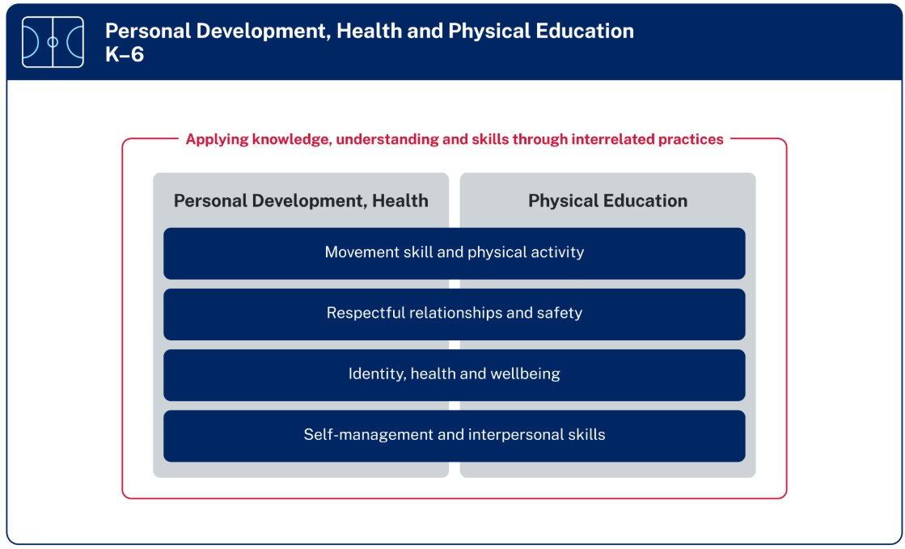
Organisation of PDHPE K–6 Syllabus
Notes:
7. Purpose: Show organisation of syllabus.
Time: 1 min
Presenter notes:
This figure shows the organisation of PDHPE K-6 Syllabus under 4 focus areas:
Movement skill and physical activity
Respectful relationships and safety
Identity, health and wellbeing, and
Self-management and interpersonal skills
Each of the focus areas provides essential content applicable to both the Personal Development and Health and the Physical Education elements of the syllabus.
The PDHPE K-6 Syllabus is organised to support students with the knowledge, understanding and skills to learn the essential content through meaningful, contextually relevant and authentically connected learning.
Schools can deliver the essential content in a manner reflective of their school context and needs of their students.
[NEXT SLIDE]

Slide 8
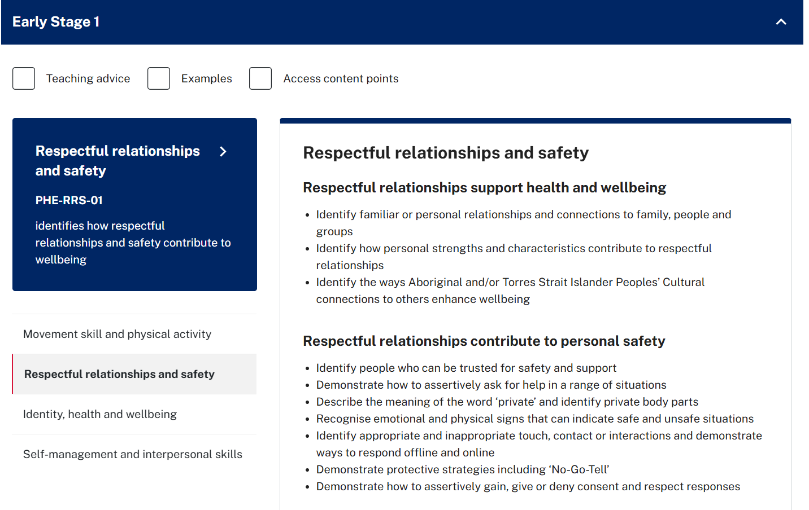
How do these content points show progression of learning? (1)
Notes:
8. Purpose: Show sequencing of content in the syllabus.
Time: 5 mins (3 mins content 2 mins discussion)
Presenter notes:
The content in the syllabus is sequenced and builds on knowledge and skills as the stages progress.
We will now model an example of sequenced consent content from the Respectful relationships and safety focus area. Please note the teaching of consent in K-6 focuses on permission, boundaries, bodily autonomy, help-seeking, protective strategies and support networks. Sexual consent is addressed in the PDHPE 7-10 Syllabus.
To select the consent content:
[CLICK] open the syllabus and select
[CLICK] ES1
[CLICK] select the focus area Respectful relationships and safety
[CLICK] go to the respectful relationships contribute to personal safety content group
[CLICK] find the content point, demonstrate how to assertively gain, give or deny consent and respect responses.
These steps would then be repeated to identify the respective content points for S1, S2 and S3.
The content points identified are:
[CLICK] ES1 - Demonstrate how to assertively gain, give or deny consent and respect responses
[CLICK] S1 - Demonstrate strategies to assertively gain, give or deny consent and respect responses
[CLICK] S2 - Describe and apply strategies to assertively gain, give or deny consent and respect responses, and
[CLICK] S3 - Explain and demonstrate communication strategies to assertively gain, give or deny consent and respect responses
We would now like you to consider. How do these content points show progression of learning? Please discuss this question with the people at your table.
[Online option: participants consider progression of learning individually.]
Pause 2 mins
Let’s now take a look at how the verbs at the beginning of each content point show progression.
ES1 and S1 begin with the verb ‘demonstrate’. This indicates that students are expected to show basic understanding through actions and examples.
S2 begins with ‘describe and apply’. This suggests a deeper level of understanding and students can articulate their knowledge in different contexts.
S3 begins with ‘explain and demonstrate’. It is expected that students understand and communicate underlying concepts and put this into practice.
Notice how ‘strategies’ and ‘communication strategies’ are additional wording in some of the content points. As students' progress through each stage, you will also notice the examples provided become more complex.
Additional notes for presenters only
If participants ask for examples of what each content point might look like, provide the following and explain that examples can be found in the online syllabus:
ES1 - Example(s): Before joining a game or sharing a toy.
S1 - Example(s): Gain consent before touching something that belongs to someone else.
S2 - Example(s): Gain consent before touching another person’s belongings, sending photos, images or videos; respond clearly, use the ‘No-Go-Tell’ strategy and tell a trusted adult.
S3 - Example(s): Use the ‘No-Go-Tell’ strategy: assertively say ‘no’, move away from the situation, if possible, tell an adult. Share where you were, who you were with, what happened and what help you need
No-Go-Tell strategy can be found in https://education.nsw.gov.au/content/dam/main-education/teaching-and-learning/curriculum/key-learning-areas/pdhpe/media/documents/pdhpe-cpe-es1-keeping-myself-safe.pdf
[NEXT SLIDE]

Slide 9
How do these content points show progression of learning? (2)
ES1 – Demonstrate how to assertively gain, give or deny consent and respect responses
S1 – Demonstrate strategies to assertively gain, give or deny consent and respect responses
S2 – Describe and apply strategies to assertively gain, give or deny consent and respect responses
S3 – Explain and demonstrate communication strategies to assertively gain, give or deny consent and respect responses
Notes:
9. Purpose: Show sequencing of content in the syllabus.
Time: 5 mins (3 mins content 2 mins discussion)
Presenter notes:
The content in the syllabus is sequenced and builds on knowledge and skills as the stages progress.
We will now model an example of sequenced consent content from the Respectful relationships and safety focus area. Please note the teaching of consent in K-6 focuses on permission, boundaries, bodily autonomy, help-seeking, protective strategies and support networks. Sexual consent is addressed in the PDHPE 7-10 Syllabus.
To select the consent content:
[CLICK] open the syllabus and select
[CLICK] ES1
[CLICK] select the focus area Respectful relationships and safety
[CLICK] go to the respectful relationships contribute to personal safety content group
[CLICK] find the content point, demonstrate how to assertively gain, give or deny consent and respect responses.
These steps would then be repeated to identify the respective content points for S1, S2 and S3.
The content points identified are:
[CLICK] ES1 - Demonstrate how to assertively gain, give or deny consent and respect responses
[CLICK] S1 - Demonstrate strategies to assertively gain, give or deny consent and respect responses
[CLICK] S2 - Describe and apply strategies to assertively gain, give or deny consent and respect responses, and
[CLICK] S3 - Explain and demonstrate communication strategies to assertively gain, give or deny consent and respect responses
We would now like you to consider. How do these content points show progression of learning? Please discuss this question with the people at your table.
[Online option: participants consider progression of learning individually.]
Pause 2 mins
Let’s now take a look at how the verbs at the beginning of each content point show progression.
ES1 and S1 begin with the verb ‘demonstrate’. This indicates that students are expected to show basic understanding through actions and examples.
S2 begins with ‘describe and apply’. This suggests a deeper level of understanding and students can articulate their knowledge in different contexts.
S3 begins with ‘explain and demonstrate’. It is expected that students understand and communicate underlying concepts and put this into practice.
Notice how ‘strategies’ and ‘communication strategies’ are additional wording in some of the content points. As students' progress through each stage, you will also notice the examples provided become more complex.
[NEXT SLIDE]
Additional notes for presenters only:
If participants ask for examples of what each content point might look like, provide the following and explain that examples can be found in the online syllabus:
ES1 - Example(s): Before joining a game or sharing a toy.
S1 - Example(s): Gain consent before touching something that belongs to someone else.
S2 - Example(s): Gain consent before touching another person’s belongings, sending photos, images or videos; respond clearly, use the ‘No-Go-Tell’ strategy and tell a trusted adult.
S3 - Example(s): Use the ‘No-Go-Tell’ strategy: assertively say ‘no’, move away from the situation, if possible, tell an adult. Share where you were, who you were with, what happened and what help you need
No-Go-Tell strategy can be found in https://education.nsw.gov.au/content/dam/main-education/teaching-and-learning/curriculum/key-learning-areas/pdhpe/media/documents/pdhpe-cpe-es1-keeping-myself-safe.pdf

Slide 10

Activity 2 – identifying sequenced content
Your turn
  In this activity you will:
  open the digital PDHPE K–6 Syllabus
  select the content tab, click ES1 and a focus area
  identify a content point in ES1 and copy into the workbook
  click to S1 and identify the next sequenced content point
  repeat for S2 and S3.
Notes:
10. Purpose: Identify sequenced content can support participants context.
Time: 5 mins (1 min content, 4 mins activity)
Presenter notes:
Now that you have seen an example and have an understanding of sequenced content, it is your turn to identify a thread of content.
In this activity you will:
open the digital PDHPE K-6 Syllabus
select the content tab, click to open ES1 and select a focus area
identify a content point in ES1 and copy into the workbook
click open S1 and identify the next sequenced content point
repeat for both S2 and S3.
In the afternoon planning hour you could consider how this sequenced content can be applied in your school context.
Provide participants 4 mins to complete the task before regrouping.
If you did not complete the task and would like to continue there is an hour planning time later in the session.
[NEXT SLIDE]
Additional notes for presenters only:
This information does not need to be shared however, if presenters are questioned about child protection, possible questions and responses include:
-Can schools still use the existing child protection units? Existing child protection units align with the PDHPE K-10 Syllabus (2018). Each unit of work is designed as a sequence of learning which can be used in their entirety, or sections of the unit inserted into existing units to complement learning. It is recommended that learning is of adequate duration to allow students the opportunity to build in-depth knowledge, understanding, and skills.
-Are there new child protection units being developed to align with new syllabus? The Respectful Relationship team are developing updated resources for Child Protection Education and these resources are due for release at the end of 2025. Schools will then be able to use at the commencement of 2026. As per current advice, these are optional materials for schools to use.

Slide 11

Engaging with the research
Notes:
11. Purpose: Title slide to introduce engaging with a research article underpinning the PDHPE K-6 Syllabus.
Time: 10 sec
Presenter notes:
To continue to develop our understanding of the PDHPE K-6 Syllabus, we will engage with a research article that outlines the benefits of connecting content across focus areas to support student learning.
[NEXT SLIDE]

Slide 12

Activity 3 – engaging with the research
Your turn
  In this activity you will:
  individually read the EduChat summary Personal and social development in physical education and sports: A review study by Opstoel et al (2019)
  highlight any key words or phrases
  share messages that resonated with you.
Notes:
12. Purpose: To engage with a piece of research underpinning the PDHPE K-6 Syllabus.
Time: 10 mins (2 mins content, 8 mins activity)
Presenter notes:
The PDHPE K-6 Syllabus was informed by a range of current research. In this activity we are going to take some time to engage with one research article.
You will have 6 minutes to individually read an EduChat summary of the 2019 article Personal and social development in physical education and sports: A review study by Opstoel (pronounced op-stole) et al. As you read the summary, please highlight any key words or phrases that stand out for you. You will find this summary on the next page in the workbook, please go to this page now. You will have 6 minutes reading and highlighting time.
After 5 minutes give a 1 minute warning
After another minute
We will now have time to reflect on the key words or messages from the article that resonated with you.
Presenter to ask 2 or 3 people to share responses back to the group. 2 minutes.
Thank you everyone for engaging with the research article.
[NEXT SLIDE]

Slide 13
Research summary – Opstoel et al (2019)
Common themes identified:
goal setting
decision-making
problem-solving
responsibility
cooperation
social interactions
communication.
Positive Relationships: most studies reported that participation in PE and sports positively develops:
work ethic (discipline and initiative)
control and management skills (resilience, time management)
goal-setting practices
social interactions and prosocial behaviours (respect, empathy).
Notes:
13. Purpose: To provide an overview of a piece of research underpinning the PDHPE K-6 Syllabus.
Time: 1 min 30 sec
Presenter notes:
Let’s take a final look at the key messages from this article.
[CLICK] Some of the common themes have been listed and these are represented within the content of the PDHPE K-6 Syllabus (2024). I will give you a moment to review the list.
Pause 10 seconds
[CLICK] Another key component of the article was positive relationships, it was reported that participation in PE and sports positively develops:
work ethic for example discipline and initiative
control and management skills including resilience and time management
goal-setting practices, and
social interactions and prosocial behaviours including respect and empathy.
Opstoel (pronounced op-stole)-et al (2019) highlights why connecting content across focus areas in PDH and PE is important, as it promotes a holistic learning experience, helping students understand the relationship between personal and social skills and overall wellbeing.
[NEXT SLIDE]

Slide 14

Connecting content across focus areas
Notes:
14. Purpose: Introduce the topic of connecting content
Time: 10 sec
Presenter notes:
We will now explore connecting content across focus areas in the PDHPE syllabus.
[NEXT SLIDE]

Slide 15
Why do we connect content across focus areas in PDHPE?
Connectedness of concepts across PDHPE
Promotes the use of transferable skills
Combining knowledge and skills in multiple meaningful contexts supports deeper understanding and long-term retention by reducing cognitive load.
Students develop stronger, more adaptable PDHPE skills when they have opportunities to practice them across multiple connected learning contexts.
Notes:
15. Purpose: Connect content across focus areas within the PDHPE syllabus.
Time: 2 mins
Presenter notes:
As highlighted in the research we explored, the PDHPE K–6 Syllabus offers valuable opportunities to connect content across the various focus areas.
[CLICK] Combining knowledge and skills in multiple meaningful contexts supports deeper understanding and long-term retention by reducing cognitive load. When students make connections across contexts, it lessens the strain on working memory and promotes the transfer of learning. This integrated approach encourages critical thinking and conceptual understanding, allowing students to store and retrieve information more effectively. Revisiting content through varied, relevant applications strengthens memory pathways, making learning more durable and meaningful over time.
[CLICK] Students develop stronger, more adaptable PDHPE skills when they have opportunities to practise them across multiple connected learning contexts. When physical, social, and emotional skills are reinforced in varied and meaningful situations, students are more likely to understand their relevance and apply them flexibly. This repetition across different settings strengthens skill development by helping students make connections, transfer knowledge, and build confidence. It also promotes deeper engagement, supports diverse learning needs, and encourages students to see PDHPE not as a standalone subject, but as a set of lifelong skills that are useful in many areas of their lives.
[NEXT SLIDE]

Slide 16

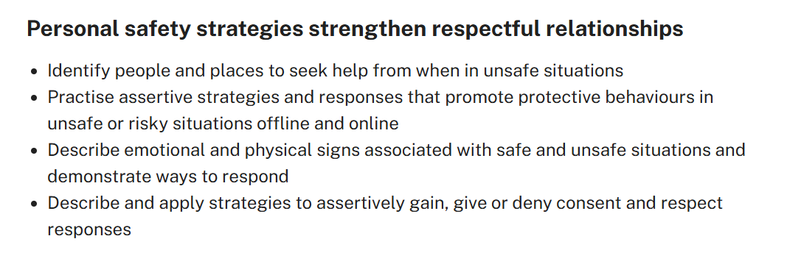
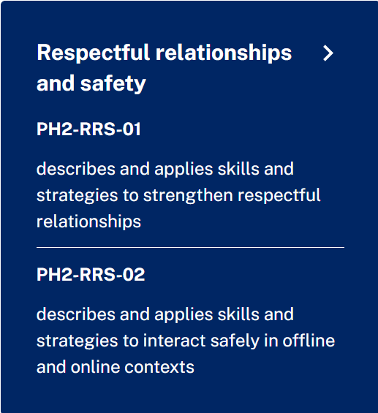
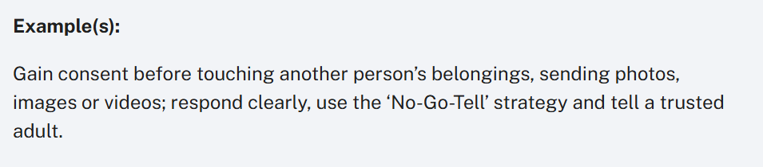
How do we connect content?
Notes:
16. Purpose: Provide example of connected content in PDHPE syllabus stage 2
Time: 1 min 30 sec
Presenter notes:
Within the PDHPE syllabus, content can be connected in a variety of ways to suit students learning needs and context. When planning PDHPE programs, we can connect content across focus areas in ways that make sense for our students.
In the syllabus, consent is identified as essential content in the focus area of Respectful relationships and safety. We will explore this focus area in the syllabus looking at [CLICK] Stage 2.
We have identified the;
[CLICK] Focus area: Respectful relationships and safety
[CLICK] Content group: Personal safety strategies strengthen respectful relationships
[CLICK] Content point: describe and apply strategies to assertively gain, give or deny consent and respect responses
[CLICK] Examples: gain consent before touching another person’s belongings, sending photos, images or videos; respond clearly, use the ‘No-Go-Tell’ strategy and tell a trusted adult.
Now we will connect this essential content to other areas of the PDHPE syllabus.
[NEXT SLIDE]
Additional notes for presenters only:
No-Go-Tell strategy can be found in https://education.nsw.gov.au/content/dam/main-education/teaching-and-learning/curriculum/key-learning-areas/pdhpe/media/documents/pdhpe-cpe-es1-keeping-myself-safe.pdf

Slide 17
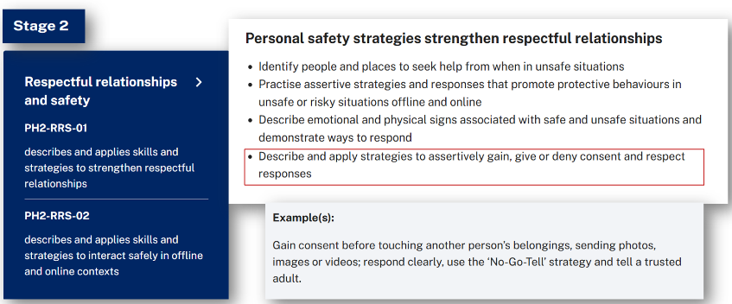
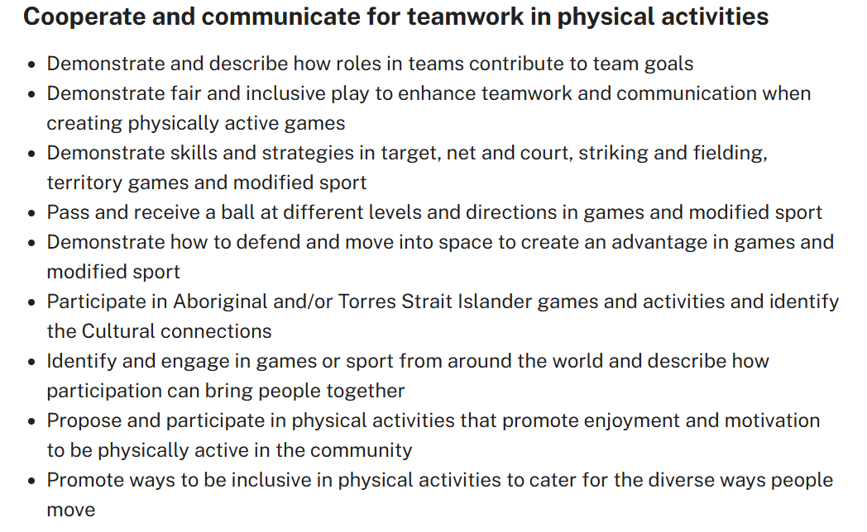

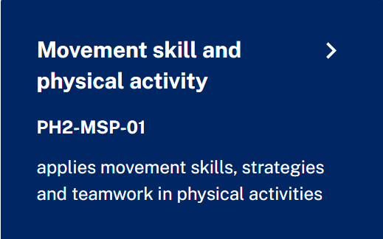
Connecting content (1)
Notes:
17. Purpose: Provide modelled example of connecting content in PDHPE syllabus stage 2.
Time: 2 mins
Presenter notes:
Consider our content on consent from the focus area respectful relationships and safety. What does this look like when connected to other essential content from the Movement skill and physical activity focus area?
Pause 10 secs
A teacher investigates what students need to know about consent from the syllabus. The stage 2 students are learning to assertively give or deny consent. This can be connected to movement skill and physical activity, where essential content is to learn to demonstrate fair and inclusive play when communicating in physically active games.
Essential content on consent can be connected to and developed through the;
[CLICK] Focus area: Movement skill and physical activity
[CLICK] Content group: Cooperate and communicate for teamwork in physical activities
[CLICK] Content point: Demonstrate fair and inclusive play to enhance teamwork and communication when creating physically active games.
[CLICK] [brings up arrow]
For example, a class of stage 2 students are learning to play a modified version of soccer.
The teacher can apply multiple essential content points into their plan for this lesson including fair and inclusive play, teamwork and communication and assertively giving or denying consent.
This could be demonstrated by a student who has been tasked to defend the goal, another student asks if they would like to swap positions on the field. The child defending the goal will communicate their consent. The teacher has been able to observe both students demonstrating skills for the essential content we have explored.
Let’s look at another modelled example of connecting content.
[NEXT SLIDE]

Slide 18
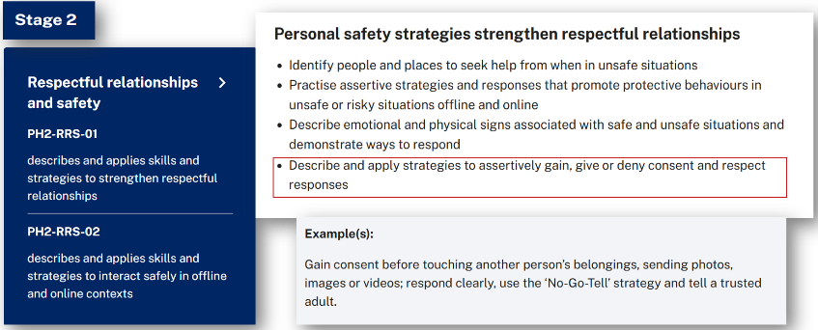
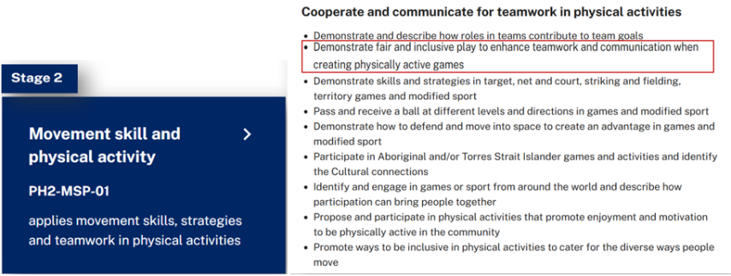

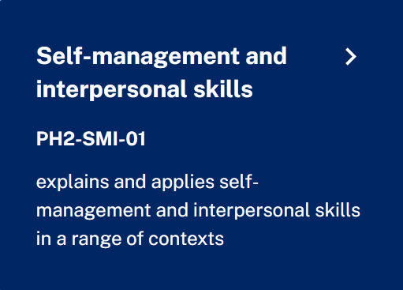
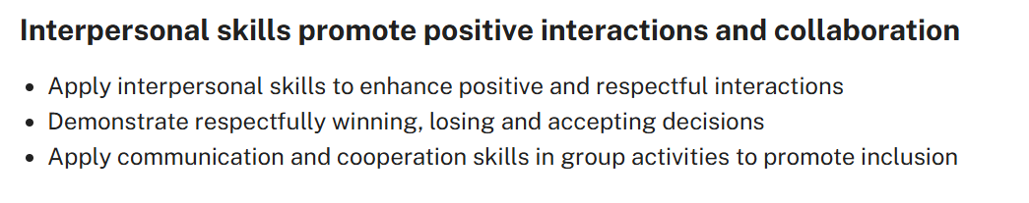
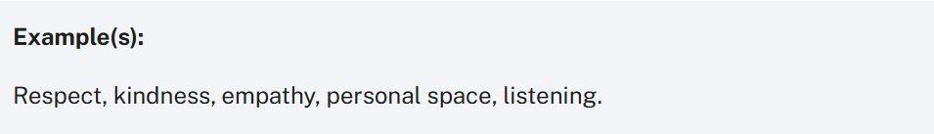
Connecting content (2)
Notes:
18. Purpose: Provide modelled example of connecting content in PDHPE syllabus stage 2.
Time: 1 min 30 sec
Presenter notes:
The focus area Self-management and interpersonal skills also connects to students understanding of consent.
[CLICK] Focus area: Self-management and interpersonal skills
[CLICK] Content group: Interpersonal skills promote positive interactions and collaboration
[CLICK] Content point: Apply interpersonal skills to enhance positive and respectful interactions
[CLICK] Examples: Respect, kindness, empathy, personal space, listening.
[CLICK] [brings up arrow]
Building on our previous connected content. Students demonstrate respect, kindness and empathy when gaining consent and acting according to the responses from other students. They apply communication skills such as active listening, turn taking and body language communication when giving or denying consent.
The focus area Self-management and interpersonal skills rather than being taught in isolation, is best developed in the context of the other focus areas, enabling students to apply them meaningfully in a range of contexts. This integrated approach ensures that self-management and interpersonal capabilities are not only taught, but consistently practiced, supporting students’ overall development and their ability to form respectful relationships, make responsible decisions and navigate real-life challenges.
[NEXT SLIDE]

Slide 19
Why is connecting content across the focus areas important for student understanding when teaching the PDHPE K–6 Syllabus?
Supports deeper learning
Promotes holistic development
Empowers students
Encourages critical thinking
Strengthens engagement and relevance
Notes:
19. Purpose: Reflect on the learning around connecting content in the PDHPE syllabus.
Time: 1 min 30 sec
Presenter notes:
Through the research and our modelled examples, we have explored why connected content is important for student learning and how a teacher can connect content in using the PDHPE K-6 Syllabus (2024).
Take a moment and consider this question: Why is connecting content across the focus areas important for student understanding when teaching PDHPE?
I will pause now for you to reflect.
Pause 10 secs
You may have considered how this:
[CLICK] Supports deeper learning by allowing students to practice and transfer key skills across multiple contexts, leading to stronger understanding and confidence
[CLICK] Promotes holistic development by integrating physical, cognitive, social, and emotional skills which are essential for lifelong learning and wellbeing
[CLICK] Empowers students to make informed decisions that positively influence their own and others’ safety, health and wellbeing
[CLICK] Encourages critical thinking in response to changing health and physical activity contexts, helping students adapt to evolving challenges and
[CLICK] Strengthens engagement and relevance by valuing movement and showing how PDHPE knowledge and skills apply in real-world scenarios.
[NEXT SLIDE]

Slide 20
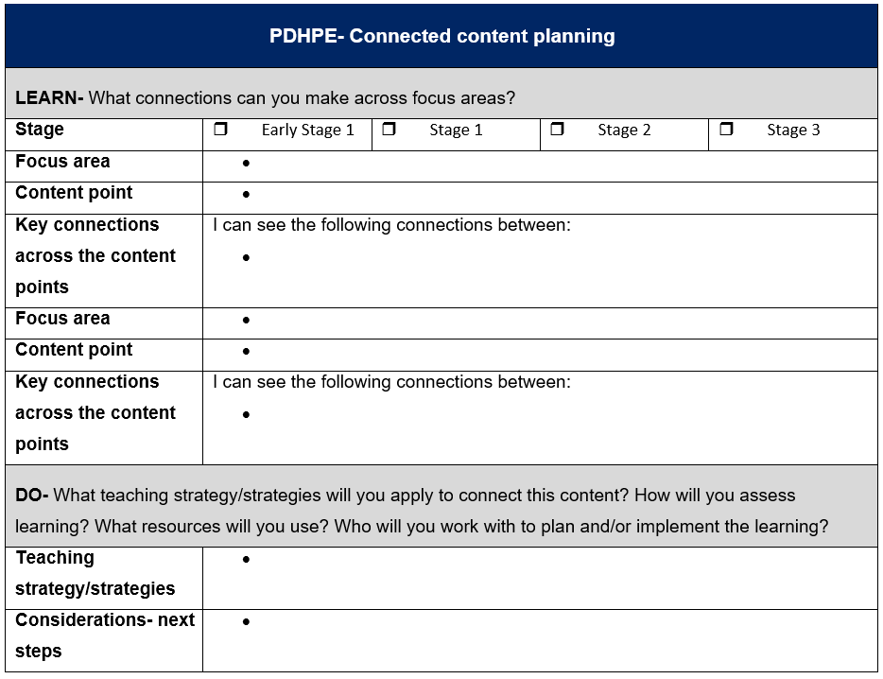

Activity 4 – connecting content
Your turn
  In this activity you will complete the ‘Connected
  content planning’ template in the workbook:
  Learn
  select a stage and one content point
  identify connected content in at least one of the
  other 3 focus areas and explain its connection
  Do
  consider the teaching and learning for your context.
Notes:
20. Purpose: Identify opportunities to connect content across focus areas.
Time: 22 mins (2 mins content, 20 mins activity)
Presenter notes:
Now that we have modelled an example, it is time for you to have the opportunity to identify connected content.
This activity can be completed individually or as part of a group.
In your workbook you will see this planning template, this is one way of planning for connected content. This template will be used to support you during this activity. I will give you a moment to go to the workbook now and find the planning template.
Pause 10 secs to allow participants to open the workbook
[CLICK] During this activity you will:
Select a stage and one content point. If you have not previously engaged with the PDHPE K-6 Syllabus, we suggest looking at the focus area of Respectful Relationships and Safety and the content group personal safety.
Refer to the syllabus to identify connected content in at least one other focus area and explain its connection.
After identifying connected content, consider teaching activities that align with the selected content.
There will be time at the end of the day to continue to plan using this template to support connecting content across focus areas in your school context.
[CLICK] You will now have 20 mins to work on this task.
[CLICK] to START 20-minute timer
[NEXT SLIDE]

Slide 21

Key takeaways (2)
Consider:
the key research underpinning the PDHPE K–6 Syllabus
the organisation of content in the syllabus
how to sequence and connect content across focus areas and why it is important.
Notes:
21. Purpose: To reflect on the key takeaways of the PDHPE presentation.
Time: 1 min
Presenter notes:
We ask you now to reflect on today's presentation of the PDHPE K-6 Syllabus.
Pause 10 secs
Consider:
the key research underpinning the syllabus
organisation of content in the syllabus
how to sequence and connect content across focus areas and why it is important.
If you have any further enquiries, please go to the Primary Curriculum Statewide Staffroom PDHPE channel. On the top menu tab we have a collection of the most frequently asked PDHPE-related questions or you can post a question in the chat and our PDHPE Project Pod will respond.
[NEXT SLIDE]

Slide 22

Contact us
Primary Curriculum Statewide Staffroom
primarycurriculum@det.nsw.edu.au
Notes:
22. Purpose: Contact details for the Primary Curriculum team
Time: 30 sec
Presenter notes:
If you have any questions or would like to reach out to the Primary Curriculum team, please contact us via this email address, or through the Statewide Staffroom.
This QR code takes you to the enrolment page to join the statewide staffroom.
[NEXT SLIDE]

Slide 23
Copyright
© State of New South Wales (Department of Education), 2025
The copyright material published in this resource is subject to the Copyright Act 1968 (Cth) and is owned by the NSW Department of Education or, where indicated, by a party other than the NSW Department of Education (third-party material).
Copyright material available in this resource and owned by the NSW Department of Education is licensed under a Creative Commons Attribution 4.0 International (CC BY 4.0) license.
This licence allows you to share and adapt the material for any purpose, even commercially.
Attribution should be given to © State of New South Wales (Department of Education), 2025.
Material in this resource not available under a Creative Commons licence:
the NSW Department of Education logo, other logos and trademark-protected material
Material owned by a third party that has been reproduced with permission. You will need to obtain permission from the third party to reuse its material.
Links to third-party material and websites
Please note that the provided (reading/viewing material/list/links/texts) are a suggestion only and implies no endorsement, by the New South Wales Department of Education, of any author, publisher, or book title. School principals and teachers are best placed to assess the suitability of resources that would complement the curriculum and reflect the needs and interests of their students.
If you use the links provided in this document to access a third party’s website, you acknowledge that the terms of use, including licence terms set out on the third-party’s website apply to the use which may be made of the materials on that third-party website or where permitted by the Copyright Act 1968 (Cth). The department accepts no responsibility for content on third-party websites.

