Slide 1
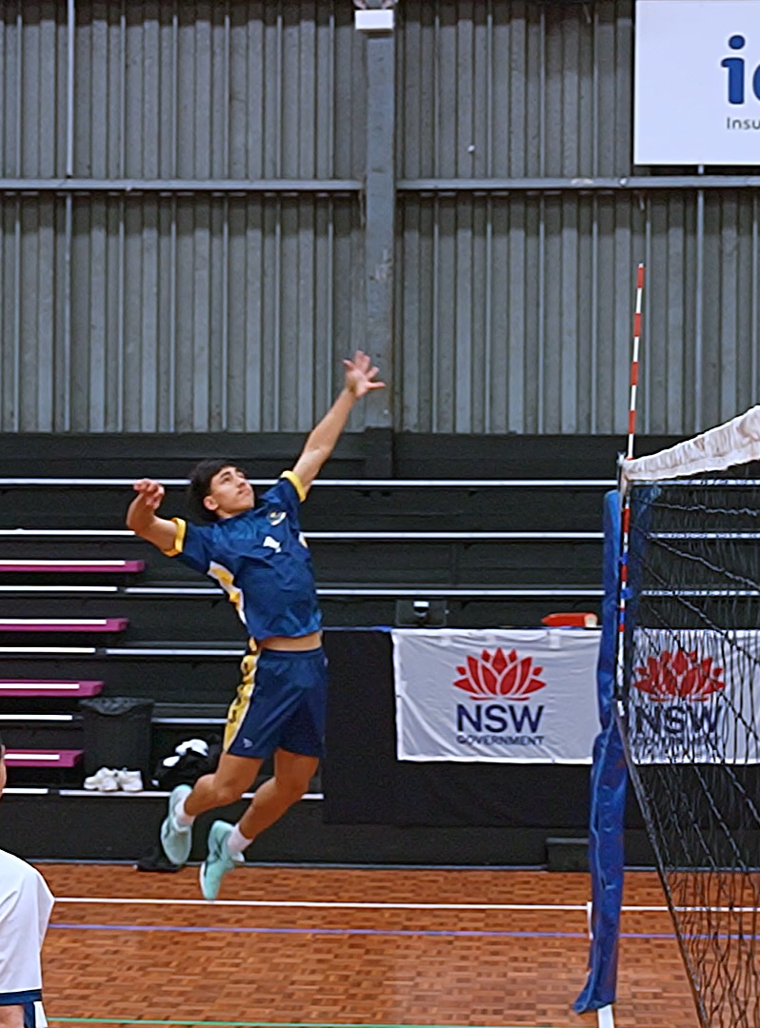
Biomechanics for sustained movement and performance – learning sequence support
Health and Movement Science 11–12 Syllabus
Focus area 2 – Training for improved performance

Slide 2
Learning intentions and success criteria
Through these activities, students will:
understand the basic biomechanical principles involved in an effective spiking action in volleyball
recognise key factors contributing to sustained and efficient spiking.

Slide 3
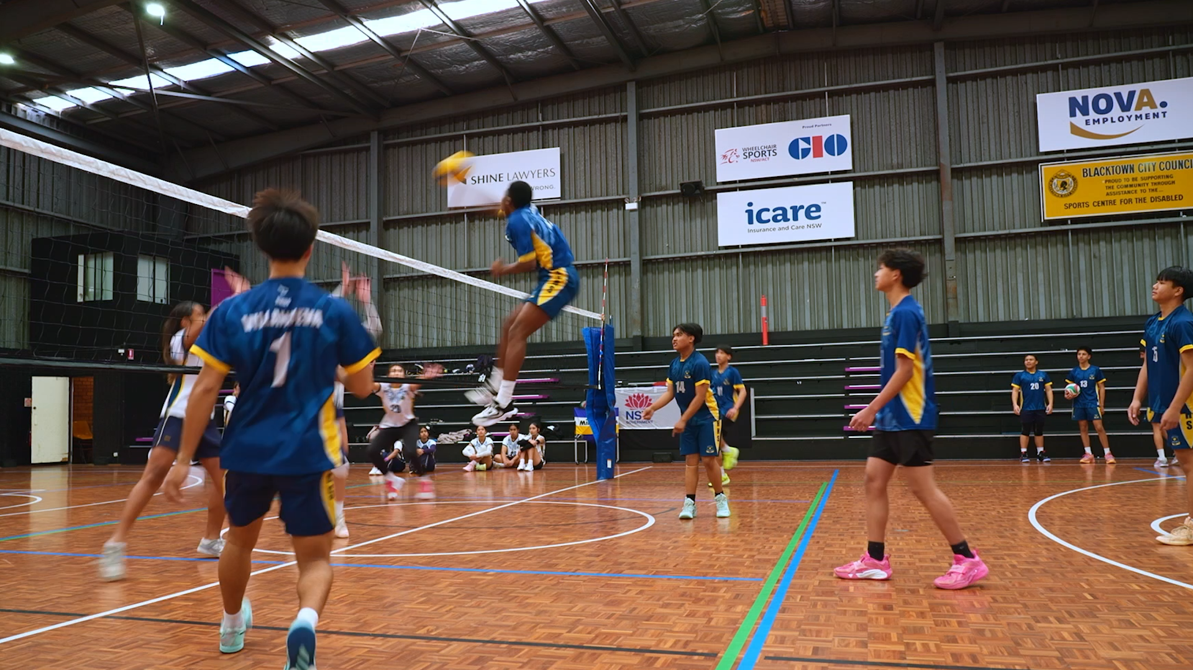
Biomechanics of a volleyball spike
This video breaks down the execution of a spike into phases and considers the biomechanical principles of each phase.
Answer the following questions related to the video to build understanding for further application.
(05:58)
Notes:
Students view Biomechanics of a volleyball spike (5.47)
This video breaks down the execution of a spike into phases and considers the biomechanical principles of each phase.
Students answer the following questions related to the video to build understanding for further application.

Slide 4
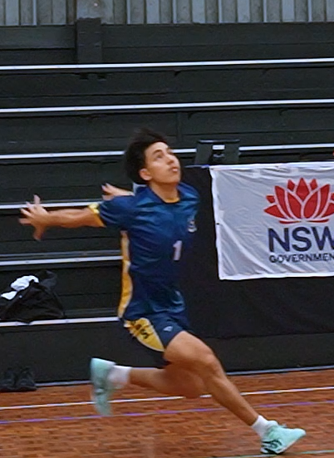
Phase 1 – the approach
How does Newton’s third law of motion help the athlete start running towards the ball?
How does the athlete use the momentum gained from running to jump effectively?
Notes:
Phase 1 – the approach (0:47–1:44)
The first phase is the approach. As the player runs toward the ball, they build momentum, which is the product of mass and velocity — and that sets them up for the jump.
The legs apply force by pushing into the ground. According to Newton’s third law, the ground pushes back with equal force. This is known as propulsive force, and it helps the player overcome inertia, which is the body’s natural resistance to movement.
As the player accelerates, they gain kinetic energy — energy due to motion — which will be transferred into the jump.
Questions and sample answers
1. How does Newton’s third law of motion help the athlete start running towards the ball?
Sample answer - Newton’s third law of motion states that for every action, there is an equal and opposite reaction. When the athlete pushes their legs into the ground, the ground pushes back with an equal force in the opposite direction. This propulsive force helps the athlete overcome inertia, allowing them to accelerate and start running toward the ball.
2. How does the athlete use the momentum gained from running to jump effectively?
Sample answer - As the athlete runs toward the ball, they build momentum, which is the product of their mass and velocity. This momentum gives the athlete kinetic energy — energy due to motion — which can be transferred into the jump. By converting this forward motion into upward and forward force, the athlete can jump more effectively, reaching greater height and distance.

Slide 5
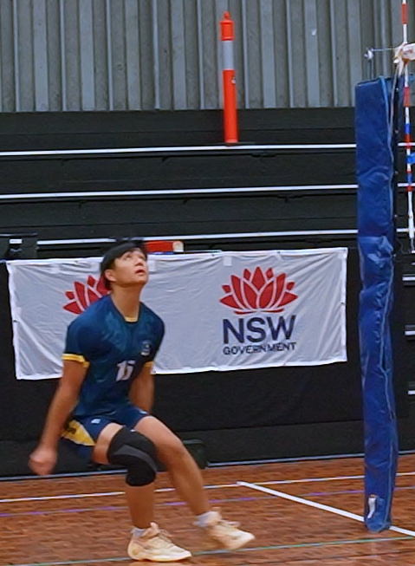
Phase 2 – the jump
How does lowering the centre of mass help an athlete jump higher?
Notes:
Phase 2 – the jump (1:45 – 2:20)
Before take-off, the player lowers their centre of mass — the point where gravity acts on the body. By bending their knees, they can store potential energy in their muscles.
As the athlete pushes off the ground, this stored energy is released and turned into vertical momentum— speed in an upward direction — helping them jump higher.
Question and sample answer
1. How does lowering the centre of mass help an athlete jump higher?
Sample answer – Lowering the centre of mass helps the athlete jump higher by allowing them to bend their knees and store potential energy in their muscles. This stored energy can then be released when they push off the ground, converting into vertical momentum that increases the height of the jump

Slide 6
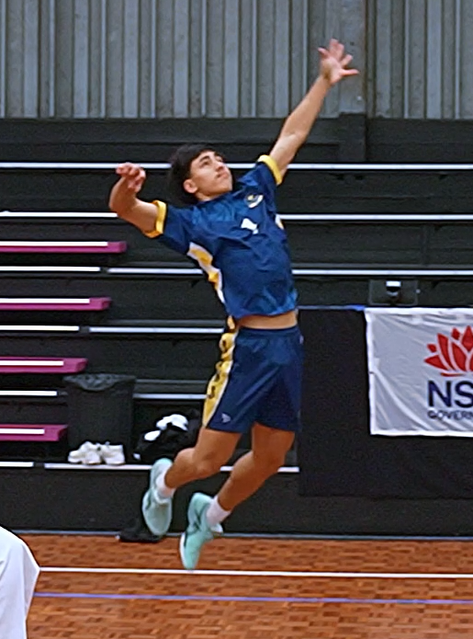
Phase 3 – How does the arm swing
How does the movement of the arms and spine during the wind-up action help in generating power for a hit?
Notes:
Phase 3 – the arm swing (2:21 – 3:09)
As the player prepares to strike, they twist their torso in the same direction as their hitting arm.
The non-hitting arm moves downward while the hitting arm lifts providing balance. This motion helps generate angular momentum
The entire body acts as a chain — legs, hips, torso, and arms working together — to build and transfer energy for the hit. This is known as the summation of forces. The coordination of this movement requires each body part to perform its movement at just the right time.
Note: a similar action is seen in overarm bowling action in cricket and a tennis serve.
Question and sample answer
1. How does the movement of the arms and spine during the wind-up action help in generating power for a hit?
Sample answer - The movement of the arms and spine during the wind-up helps generate power because it builds angular momentum and sets up the summation of forces. As the player twists their spine and torso in the same direction as the hitting arm, the body begins to rotate, creating stored rotational energy. The non-hitting arm moves down while the hitting arm lifts, helping the player stay balanced and allowing a smooth transfer of energy. When each body part moves in the correct order — legs, hips, torso, then arms — the force builds and travels through the whole body, creating a more powerful hit.

Slide 7
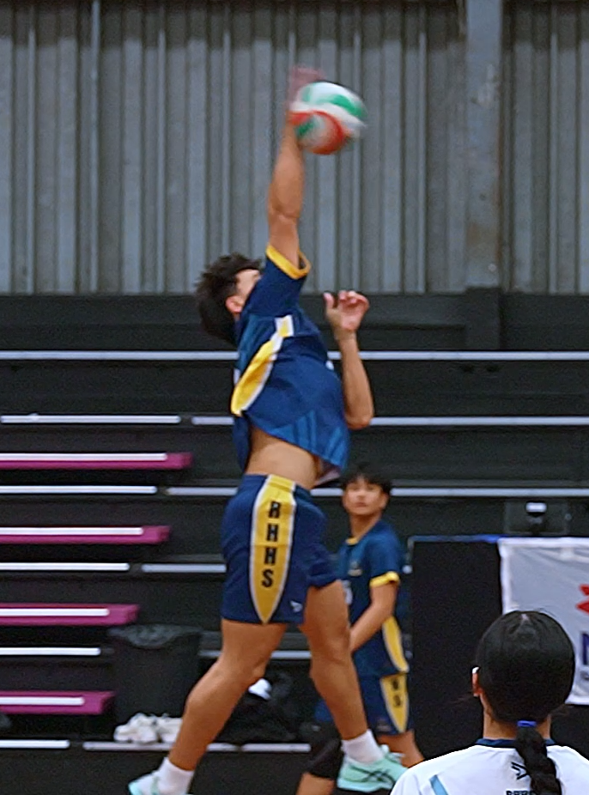
Phase 4 – hitting the ball
Why is it important to extend your arms at the elbow when taking a shot?
Notes:
Phase 4 – hitting the ball (3:10 – 3:38)
Energy flows smoothly through the chain of movements. As the arm rotates and extends at the elbow, it creates angular velocity — the speed of rotation — just before contact.
This energy is transferred as a propulsive force, sending the ball downward with speed and power.
Question and sample answer
Why is it important to extend your arms at the elbow when taking a shot?
Sample answer - It is important to extend your arms at the elbow because this completes the chain of movement and allows all the energy built up in the body to be transferred to the ball. When the arm extends, the force created by the legs, hips, torso, and shoulder can flow smoothly through to the hand. This full extension increases the propulsive force, helping the player send the ball downward with greater speed and power.

Slide 8
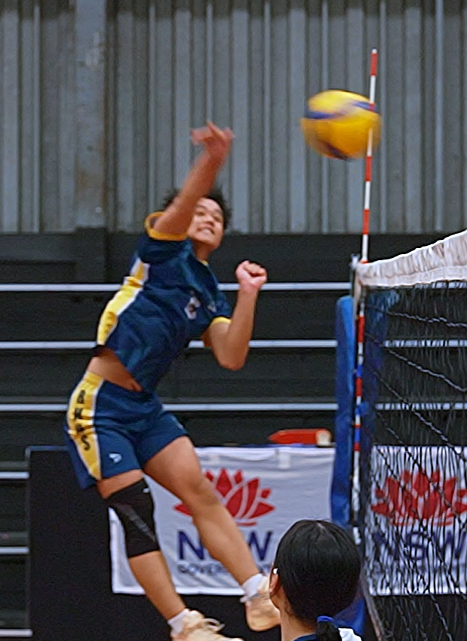
Phase 5 – the wrist snap
How does striking the ball above its centre create topspin?
Why does the Magnus effect make a top spinning ball move downward faster?
Notes:
Phase 5 – the wrist snap (3:39 – 4:19)
Just before contact, the player flexes their wrist and strikes the ball slightly above its centre of mass. This creates topspin — a forward spin on the ball. This is known as the Magnus effect.
Because of the Magnus effect, this spin changes how the air flows around the ball. Air pressure becomes lower on top and higher on the bottom, pushing the ball downward faster and helping it dip into the court.
Question and sample answer
1. How does striking the ball above its centre create topspin?
Sample answer – Hitting the ball slightly above its centre of mass while flexing the wrist makes the ball spin forward. This forward rotation is called topspin.
2. Why does the Magnus effect make a top spinning ball move downward faster?
Sample answer – Topspin changes how air moves around the ball. The air pressure becomes lower on the top and higher on the bottom, creating a force that pushes the ball downward more quickly. This makes the ball dip into the court faster.

Slide 9
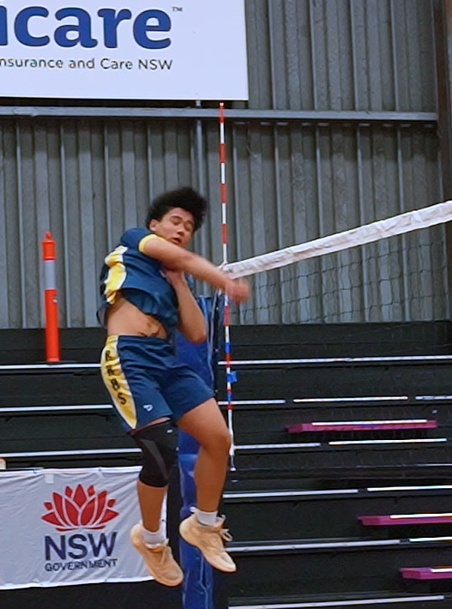
Phase 6 – the spike follow-through
Why is it important for the body to continue moving smoothly after hitting the volleyball?
Notes:
Phase 6 – the follow-through (4:20 – 5:58)
After the hit, the body continues moving — this is the follow-through.
It helps guide the ball’s direction and allows the body’s momentum to safely dissipate, instead of being absorbed by the joints. This reduces the risk of injury and improves movement efficiency — using the least energy for the best result.
Question and answer
1. Why is it important for the body to continue moving smoothly after hitting the volleyball?
Sample answer - Continuing to move smoothly after hitting the volleyball, known as the follow-through, is important because it guides the ball’s direction and allows the body’s momentum to dissipate safely. This reduces stress on the joints, lowers the risk of injury, and improves movement efficiency by using the least energy for the best result.

Slide 10
Matching spiking action to biomechanical principles
Add the terms to the table:
absorption of force
Newton’s third law of motion
motion
Magnus effect
linear motion
propulsive force
summation of force
balance
stability
force
Newton’s second law of motion
Phase | Biomechanical principle
The approach
The jump
The arm swing
Hitting the ball
The wrist snap
The spike follow through
Notes:
Table 1

Slide 11
References
This presentation contains NSW Curriculum and syllabus content. The NSW Curriculum is developed by the NSW Education Standards Authority. This content is prepared by NESA for and on behalf of the Crown in the right of the State of New South Wales. The material is protected by Crown copyright.
Please refer to the NESA Copyright Disclaimer for more information https://educationstandards.nsw.edu.au/wps/portal/nesa/mini-footer/copyright.
NESA holds the only official and up-to-date versions of the NSW Curriculum and syllabus documents. Please visit the NSW Education Standards Authority (NESA) websitehttps://educationstandards.nsw.edu.au/ and the NSW Curriculum website https://curriculum.nsw.edu.au.
Health and Movement Science 11–12 Syllabus © NSW Education Standards Authority (NESA) for and on behalf of the Crown in right of the State of New South Wales, 2023.

Slide 12
Copyright
© State of New South Wales (Department of Education), 2024
The copyright material published in this resource is subject to the Copyright Act 1968 (Cth) and is owned by the NSW Department of Education or, where indicated, by a party other than the NSW Department of Education (third-party material).
Copyright material available in this resource and owned by the NSW Department of Education is licensed under a Creative Commons Attribution 4.0 International (CC BY 4.0) license.
This license allows you to share and adapt the material for any purpose, even commercially.
Attribution should be given to © State of New South Wales (Department of Education), 2024.
Material in this resource not available under a Creative Commons license:
the NSW Department of Education logo, other logos and trademark-protected material
Material owned by a third party that has been reproduced with permission. You will need to obtain permission from the third party to reuse its material.
Links to third-party material and websites
Please note that the provided (reading/viewing material/list/links/texts) are a suggestion only and implies no endorsement, by the New South Wales Department of Education, of any author, publisher, or book title. School principals and teachers are best placed to assess the suitability of resources that would complement the curriculum and reflect the needs and interests of their students.
If you use the links provided in this document to access a third party’s website, you acknowledge that the terms of use, including licence terms set out on the third-party’s website apply to the use which may be made of the materials on that third-party website or where permitted by the Copyright Act 1968 (Cth). The department accepts no responsibility for content on third-party websites.

