Slide 1
Instructions for use
This resource is not a teaching and learning program. It should be used in conjunction with Focus area 2 depth study – improving performance in football (soccer).
Access the HMS Improving performance in football depth study video stimulus suite to support teaching of the Year 12 depth study – improving performance in football (soccer).
Classroom teachers are encouraged to add and adapt slides as required to meet the needs of their students.
Save a copy of the file to make changes to the slide deck. Go to File > Download a Copy (this downloads a copy to your computer to edit in the PowerPoint app).
To convert the PowerPoint to Google Slides:
  Upload the file into Google Drive and open it.
  Go to File > Save as Google Slides.
  (Note – conversion may cause formatting changes in the slides.)
Notes:
Access the Year 12 Focus area 2 – depth study – improving performance in football (soccer) on the Planning, programming and assessing PDHPE 11–12 curriculum webpages.

Slide 2
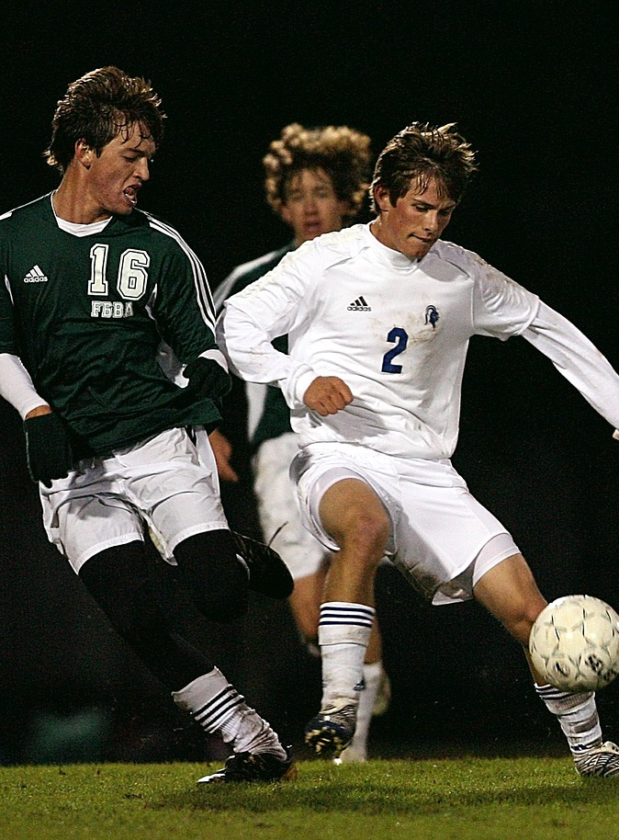
Depth study – How does an elite football (soccer) team maximise performance?
Stage 6
Notes:
Image licensed under Pixabay Content License.

Slide 3
Topics
1
5
The coaches and trainers
The biomechanist
2
6
The nutritionist
The sports scientist
3
7
The sports psychologist
Assessment task
4
The team and physiotherapist
doctor
Notes:
Teacher notes:
Click topic numbers to go to specific topics
Interactive features can be viewed in slide show

Slide 4
Learning intentions and success criteria
We are learning to:
understand how factors including training, nutrition, supplementation, sports psychology, biomechanical principles, technology and sports medicine impact movement and performance in football
analyse how an annual team training program is planned and structured to improve performance in football
critically analyse the relationships between, and implications of, a range of factors including training, nutrition, supplementation, sports psychology, biomechanical principles, technology and sports medicine to influence performance in football
propose and evaluate solutions to complex issues relating to improving performance in football.
Notes:
Notes for teachers:
Learning intentions and success criteria are best co-constructed with students. Adapt the learning intentions as required and add matching success criteria.
For more information see ⁠AITSL or the NSW Department of Education explicit teaching strategies, ⁠Sharing learning intentions and ⁠Sharing success criteria.
LISC is not necessarily presented at the beginning of the lesson. Teacher needs to consider most effectual time to introduce.
LISC should be revisited during the lesson to support students' evaluation of their learning.

Slide 5
Learning intentions and success criteria
We can:
[classroom teacher to insert co-constructed success criteria]
[classroom teacher to insert co-constructed success criteria]
[classroom teacher to insert co-constructed success criteria].
Notes:
Notes for teachers:
Learning intentions and success criteria are best co-constructed with students. Adapt the learning intentions as required and add matching success criteria.
For more information see ⁠AITSL or the NSW Department of Education explicit teaching strategies, ⁠Sharing learning intentions and ⁠Sharing success criteria.
LISC is not necessarily presented at the beginning of the lesson. Teacher needs to consider most effectual time to introduce.
LISC should be revisited during the lesson to support students' evaluation of their learning.

Slide 6
How does an elite football team maximise performance?
A-League depth study
Successful performance of an elite sports team requires an extensive team of professionals working together to plan and implement the most effective training and nutrition. Throughout the season, individual athlete needs must be catered for, injuries must be addressed and adjustments may need to be made if the plan isn’t achieving the desired goals.
Throughout the depth study, you will work in groups and assume the role of different professionals involved with an elite A-League men’s team who are aiming to maximise their performance.

Slide 7
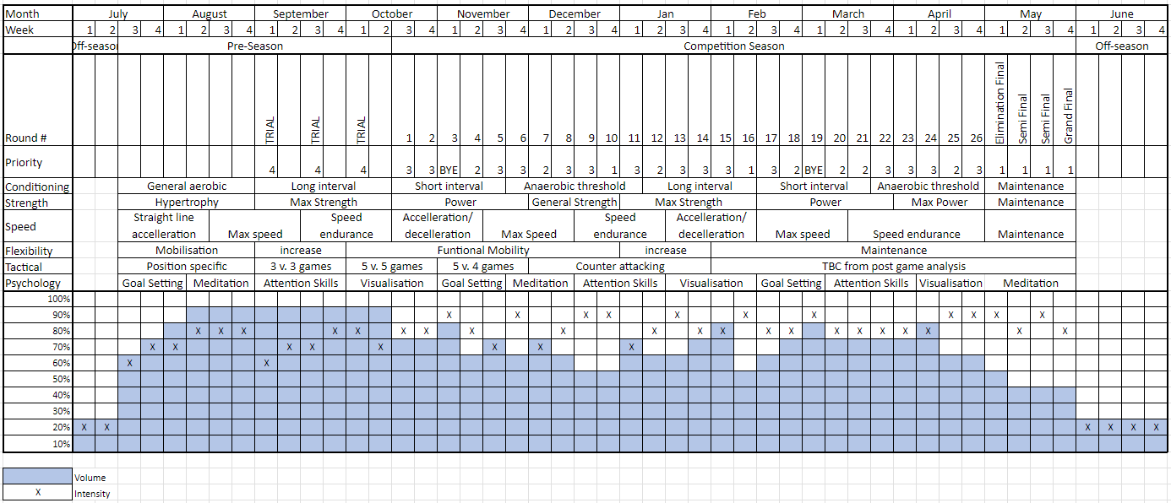
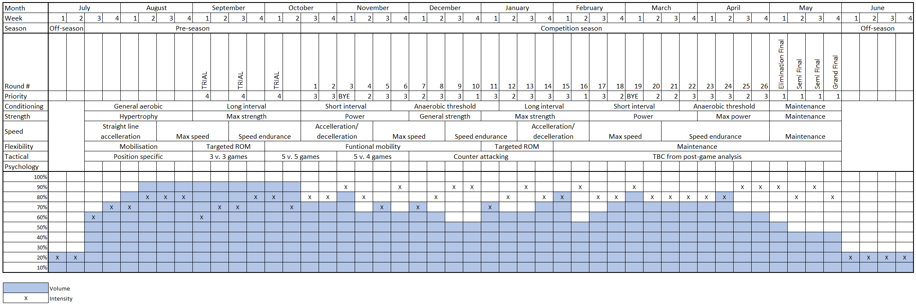
A-League men’s yearly training program
Access and review your copy

Slide 8
The coaches and trainers

Slide 9
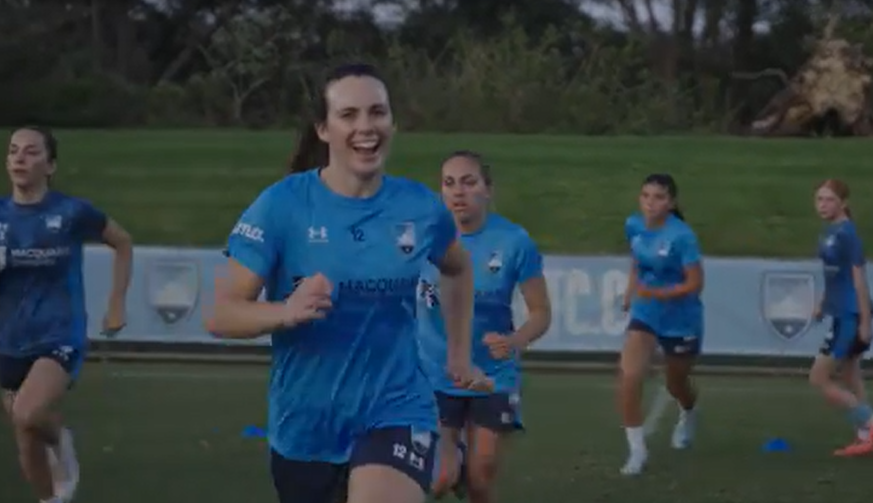
The coaches
Video – Coaching
Access the stimulus Video – Coaching (7:01) which highlights the importance of coaching and training in supporting an elite A-League football team to maximise performance.

Slide 10
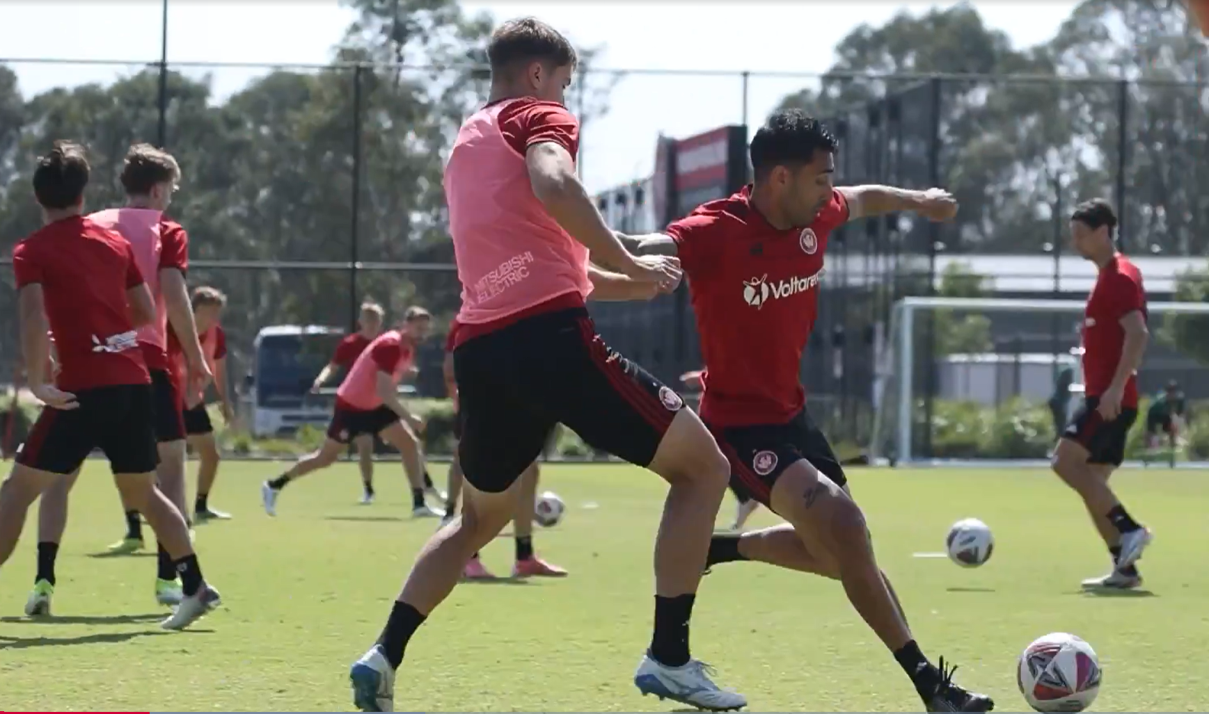
The trainers
Video – Strength and Conditioning
Access the stimulus Video – Strength and Conditioning (6:45) which highlights the importance of strength and conditioning in supporting an elite A-League football team to maximise performance.

Slide 11
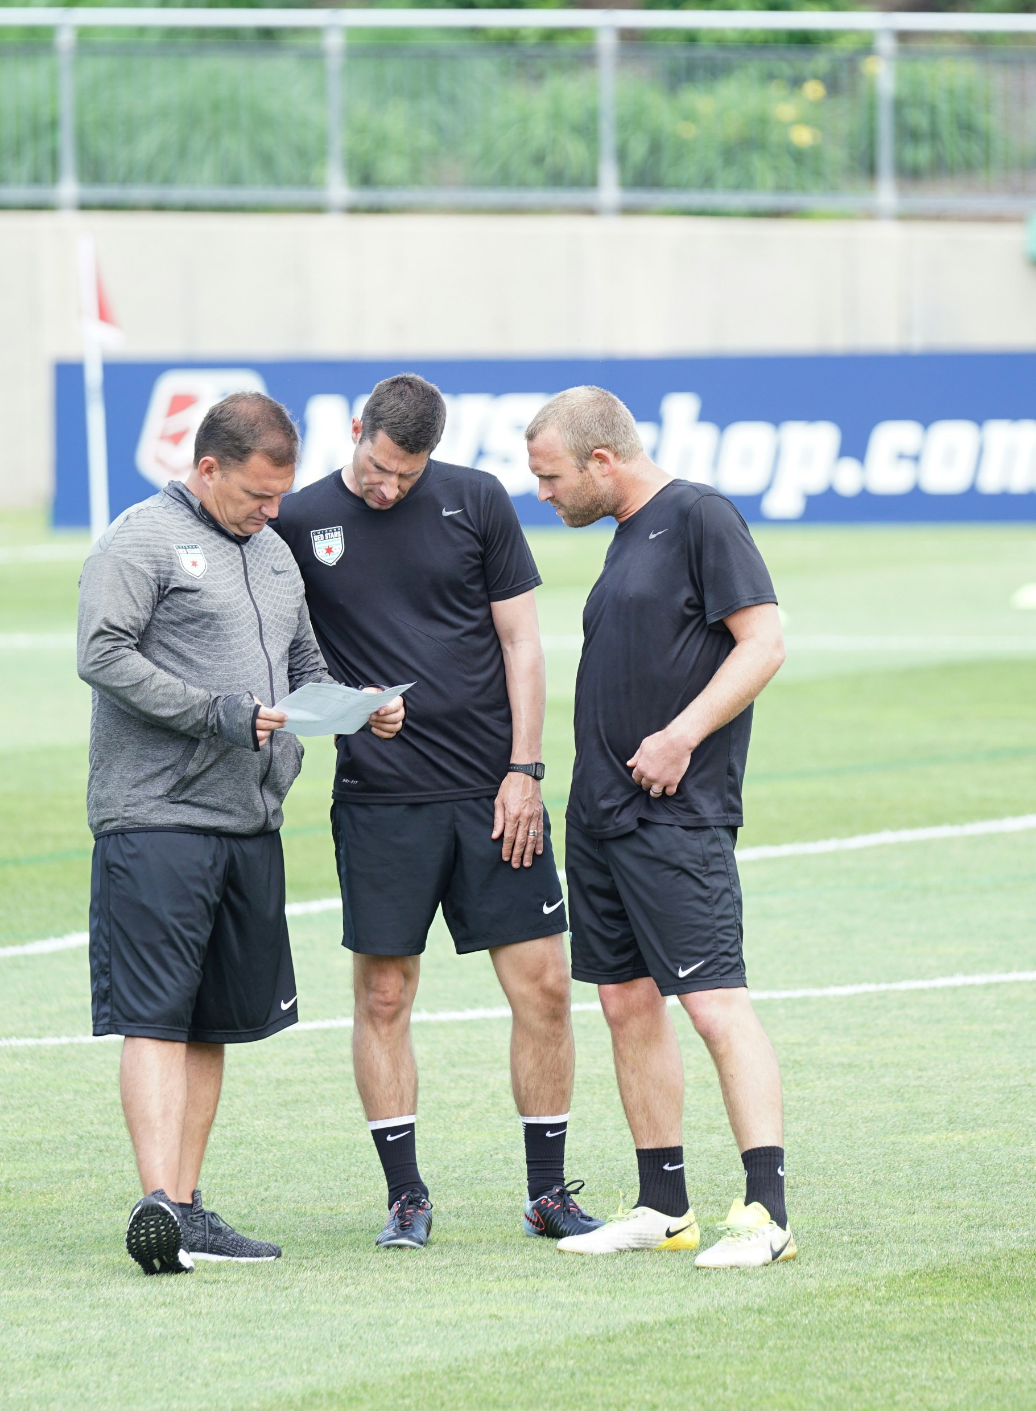
The coaches and trainers
The role
As a member of the coaching or strength and conditioning staff, you have been asked to review the team’s yearly training program to understand its purpose and goals, and to design training and recovery schedules and sessions for the team.
Notes:
Image licensed under Unsplash License.

Slide 12
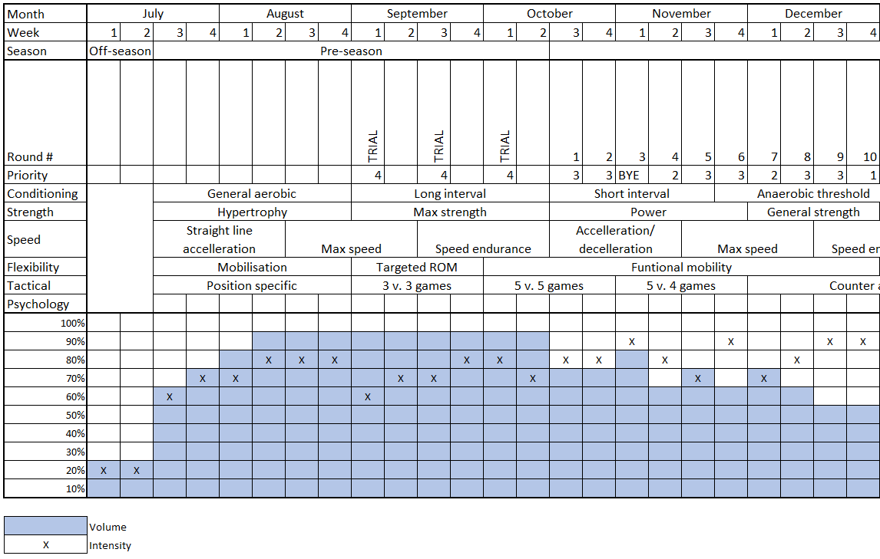
The coaches and trainers
Group activities
Discuss and annotate the yearly training program with potential reasons for
        the progression of phases for different components of fitness
        changes in intensity and volume of training.
Propose (add in to the yearly training program) and justify, which weeks fitness testing should be conducted, and which tests should be completed, throughout the year.

Slide 13
The coaches and trainers
Group activities
3a. Develop examples of training and recovery session schedules for the following timings during the season:
        2 x pre-season
        1 x in-season
        1 x finals series schedule.
Demonstrate consideration of the following:
for training sessions, include length of sessions, focus of sessions (components of fitness), intensity of sessions
recovery sessions with activities
include the game day (if relevant)
principles of training.

Slide 14
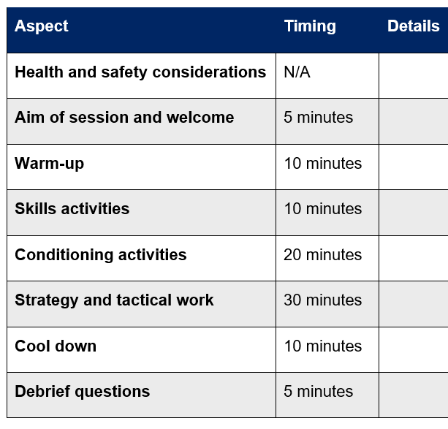
The coaches and trainers
Group activities
3b. Develop one example team training session from each of the schedules from the previous step. Include
health and safety considerations
overview or aim of the session (goal specific)
warm-up and cool-down
skill instruction and practise
conditioning
strategies and tactics
athlete reflection and/or coach evaluation.

Slide 15

The coaches and trainers
Individual task
4. Complete the following questions individually
        Justify the types of training and training methods incorporated in each training session from Step 3, with reference to the point in the season and desired physiological adaptations.
        Justify how the recovery strategies that have been included will promote improved and sustained movement and performance.
        Justify the application of relevant principles of training evidenced in the schedules and training sessions with reference to the point in the season and desired physiological adaptations.

Slide 16
The nutritionist

Slide 17
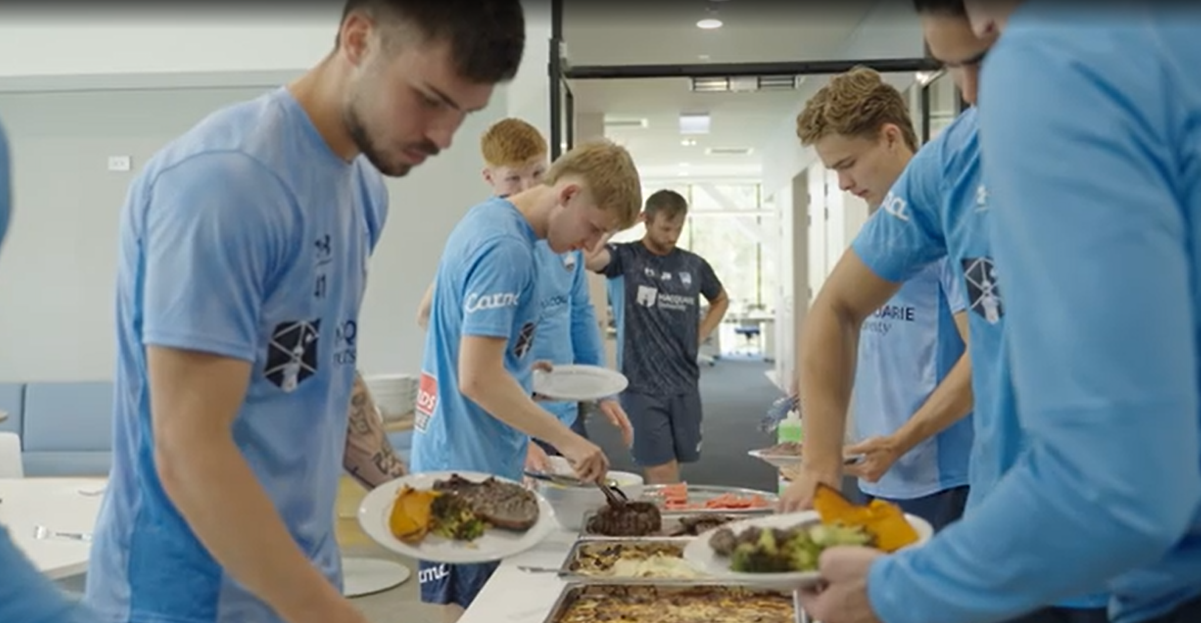
The nutritionist
Video – Nutrition
Access the Video – Nutrition (5:44) which highlights the importance of nutrition in supporting an elite A-League football team to maximise performance.

Slide 18

The nutritionist
The role
As the team’s nutritionist, you must design dietary plans for the athletes to support their nutrient and energy needs so that they are able to perform. These plans must align to changes in training loads, climatic conditions and individual dietary needs.
Notes:
Image licensed under Unsplash License.

Slide 19
The nutritionist
Group activities
Review the yearly training program and annotate any points where there may need to be adjustments or changes in diet and hydration.
Brainstorm the nutritional requirements of a football player for training and pre-, during- and post-games. (Access Sports Dieticians Australia Food for soccer factsheet if required.)
Create 2 nutrition plans for the team that align with 2 of the training weeks from Step 3a of the coaches and trainers section. Include the following
        one pre-season week and one competition-season week, including game day nutrition
        vegetarian options
        any supplements that may be considered
        hydration.

Slide 20

The nutritionist
Individual task
Complete the following questions individually
        Analyse the dietary requirements of an A-League football player pre-, during- and post-performance in a competition game.
        Assess the use of supplementation in improving performance in A-League football.

Slide 21
The sports psychologist

Slide 22
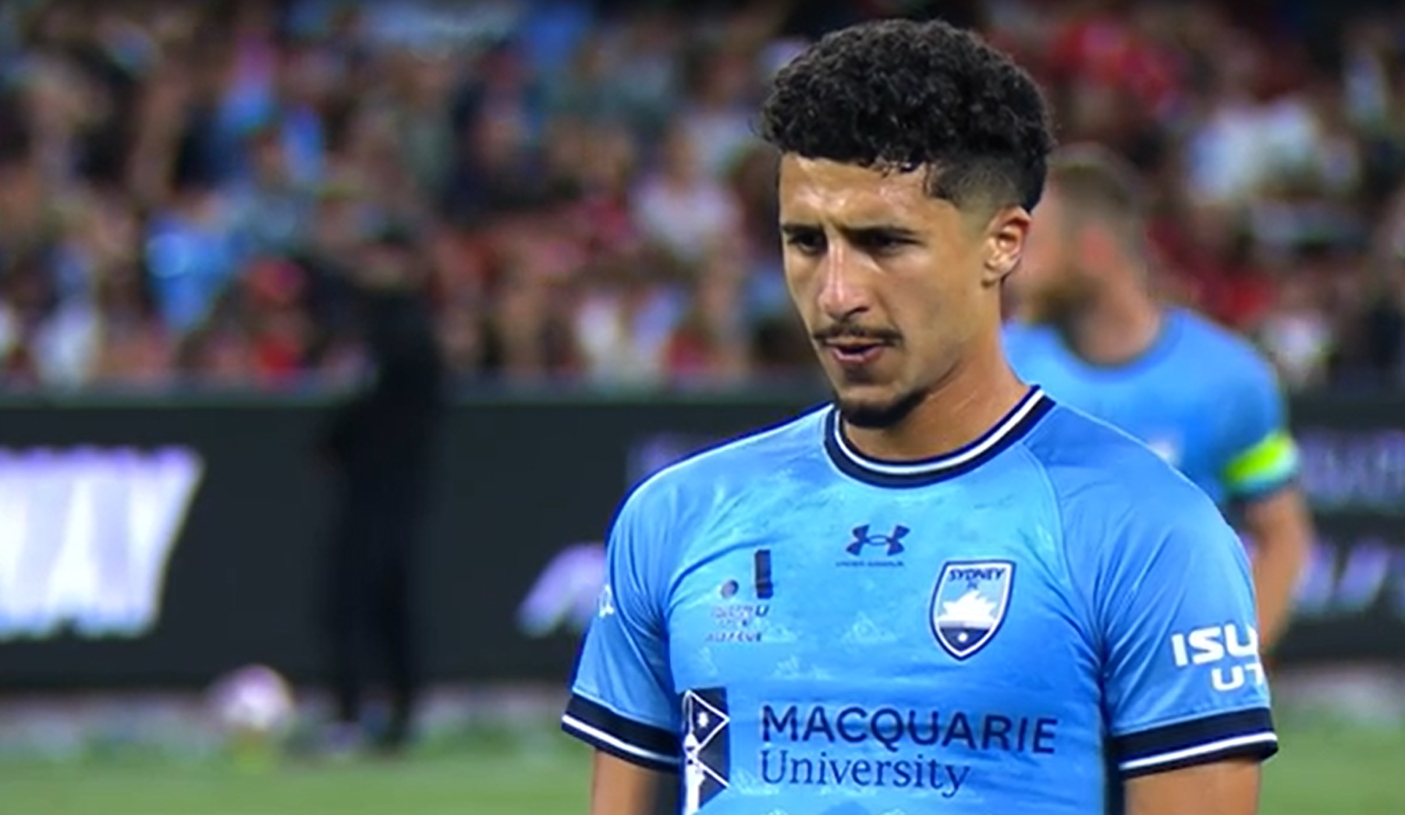
The sport psychologist
Video – Sports psychology
Access the Video – Sports psychology (5:16) which highlights the importance of sport psychology in supporting an elite A-League football team to maximise performance.

Slide 23

The sports psychologist
The role
As the sports psychologist for the team, you play a critical role in teaching the athletes how to manage their stress, anxiety and motivation throughout the season. This is imperative to maximising performance individually, particularly in high-stress situations, to support the team’s success.
Notes:
Image licensed under Unsplash License.

Slide 24
The sports psychologist
Group activities
Review the yearly training program and design a plan for introducing and practising psychological strategies across the season to optimise arousal, manage stress and anxiety, and improve participation and performance.
Brainstorm scenarios where the A-League players may experience higher degrees of stress and anxiety.
Read the following 3 case studies.
Group discussion: propose the most effective psychological strategies for each athlete and why.

Slide 25
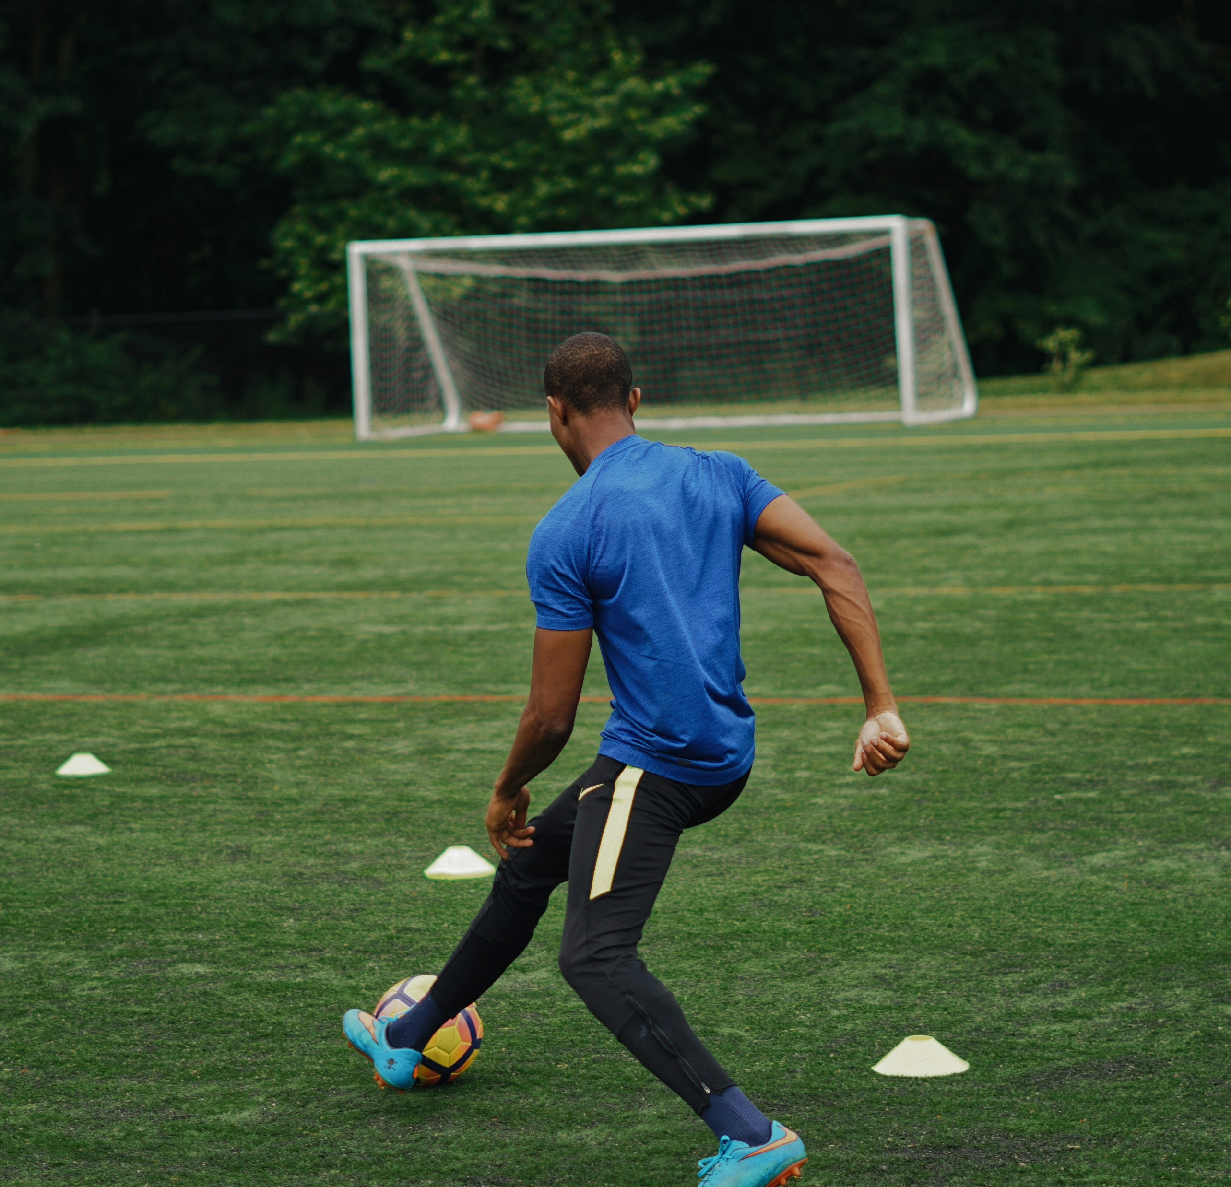
The sports psychologist
Case study 1 – Jose
Jose is a highly experienced member of the team who has played for the club for the past 7 years. He predominantly plays midfield, however, is occasionally moved to the wing. Around the midpoint of the season, Jose was turning up to training late and his lack of effort was noted by the coaching staff. He was overheard complaining to teammates that he’s just not feeling very inspired or motivated. His performance in strength and conditioning sessions in the gym had also been declining and his average meters covered in competition games was showing a downward trend.
Notes:
Image licensed under Unsplash License.

Slide 26
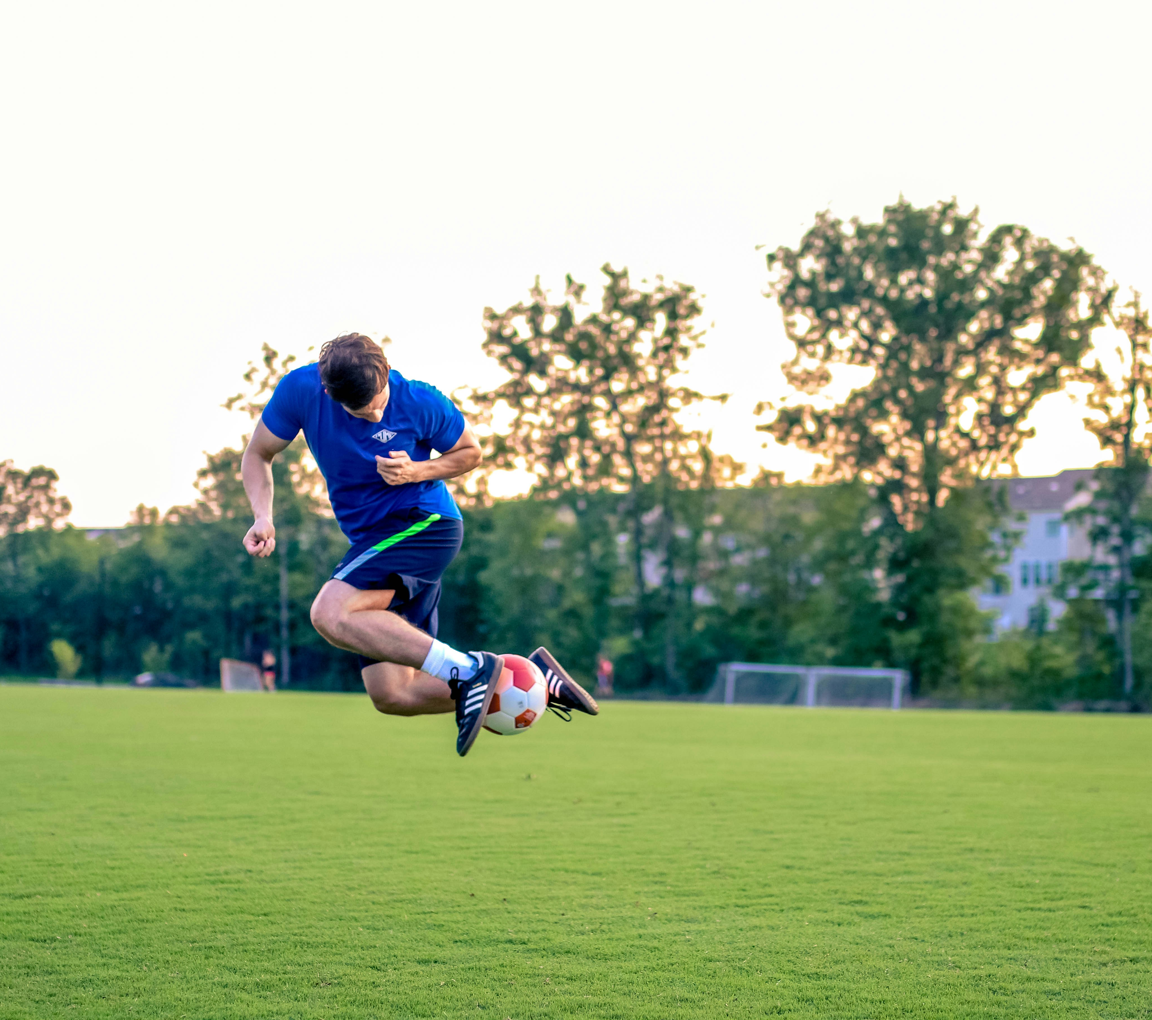
The sports psychologist
Case study 2 – Adam
Adam is a new recruit into the team from the U21s squad where he was a very successful striker, winning the U21s golden boot award for most goals in the season for the past 2 years. In the first 3 games of the competition season, Adam positioned himself extremely well for strikes on goal during games, however when it came to scoring, he was missing the goal significantly, even when it seemed like a very easy shot. He had also missed 3 penalty shots which was uncharacteristic for him.
Notes:
Image licensed under Unsplash License.

Slide 27
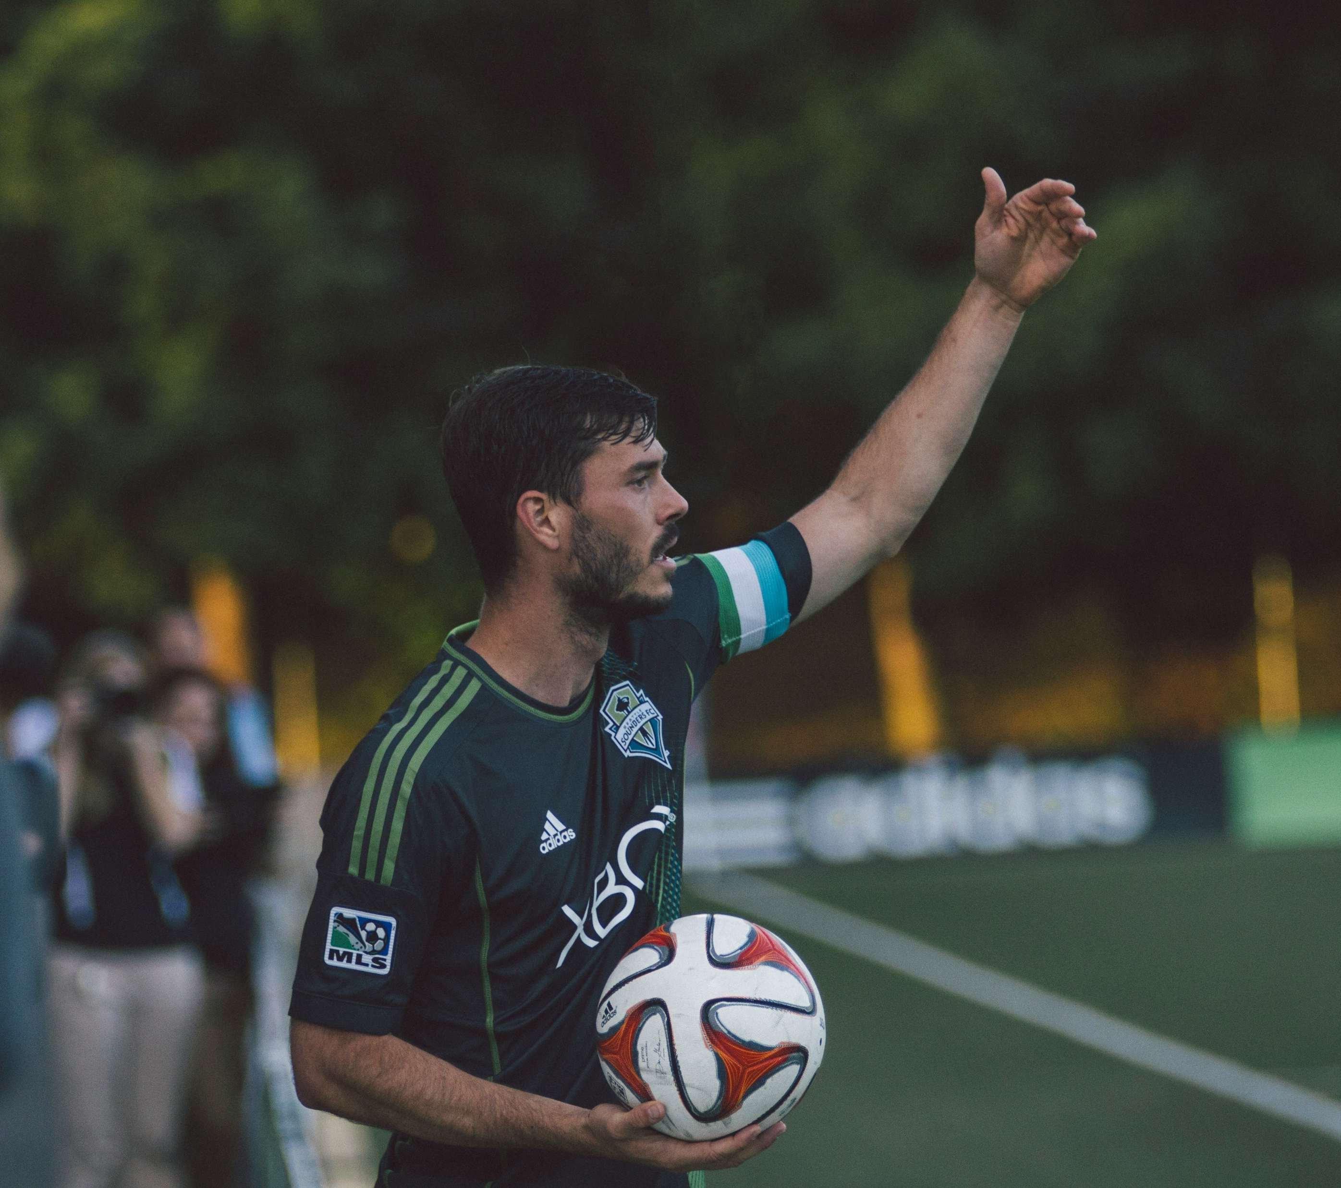
The sports psychologist
Case study 3 – Malik
Malik is a centre back who has been in the team for 2 years. He trains hard and holds other people's opinion of his performance very highly, consistently working to address any weaknesses. On game days Malik becomes incredibly nauseous prior to playing and finds it difficult to concentrate due to the butterflies in his stomach. He finds that this feeling impacts how he plays for the first 10 minutes of the game, and he is likely to make mistakes in the opening plays, until he becomes more relaxed while he is out on the pitch.
Notes:
Image licensed under Unsplash License.

Slide 28
The sports psychologist
Individual task
Complete the following question individually:
Critically analyse the importance of applying psychological strategies in optimising arousal, managing stress and anxiety, and improving participation and performance in football.

Slide 29
The team doctor and physiotherapist

Slide 30
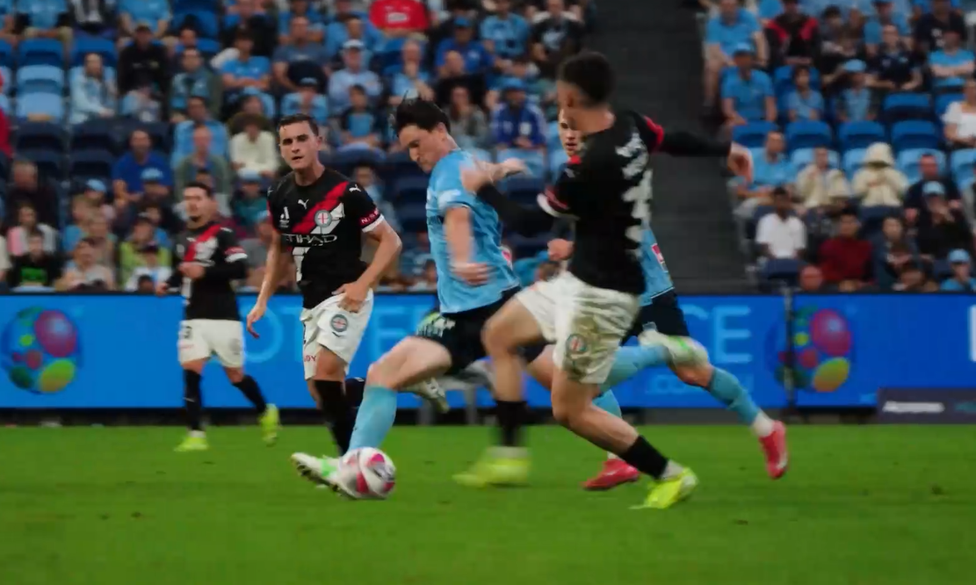
The team doctor and physiotherapist
Video – Physiotherapy and sports medicine
Access the Video – Physiotherapy and sports medicine (6:13) which highlights the importance of physiotherapy in supporting an elite A-League football team to maximise performance.

Slide 31
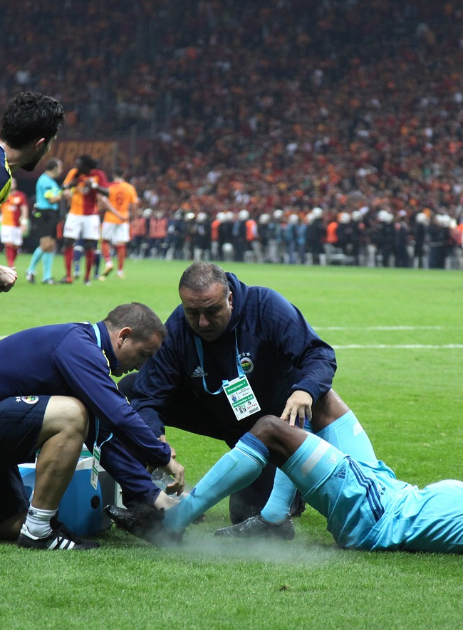
The team doctor and physiotherapist
The role
Despite the best physical preparation and precautionary actions, injuries regularly occur in sport. As the medic, it is your job to quickly assess and manage injuries to avoid causing any further damage and support the wellbeing of the player. Additionally, effective rehabilitation post-injury is critical to ensuring athletes can return to play successfully, which is your role as the team physiotherapist.
Notes:
Image licensed under Pixabay Content License.

Slide 32
The team doctor and physiotherapist
Group activities
Research the most common injuries sustained in football. Select 3 common injuries, one minor injury (requiring minor first aid, and return to play within a week) and 2 different major injuries (requiring multiple weeks or months recovery).
For each injury, discuss
        the classification
        effective assessment and management of the injury.

Slide 33
The team doctor and physiotherapist
Group activities
For each major injury, design a rehabilitation and return to play plan, detailing
        the timing of different rehabilitation procedures including progressive mobilisation, graduated exercise, training, use of heat and cold
        indicators during recovery that progress the rehabilitation procedures (for example, reduced swelling, pain free, normal range of motion).

Slide 34
The team doctor and physiotherapist
Individual task
Complete the following questions individually
        Propose and justify the rehabilitation procedures for one major injury experienced in the sport of football.
        Justify the return to play procedures for an athlete that has experienced a major injury while playing football.

Slide 35
The biomechanist

Slide 36
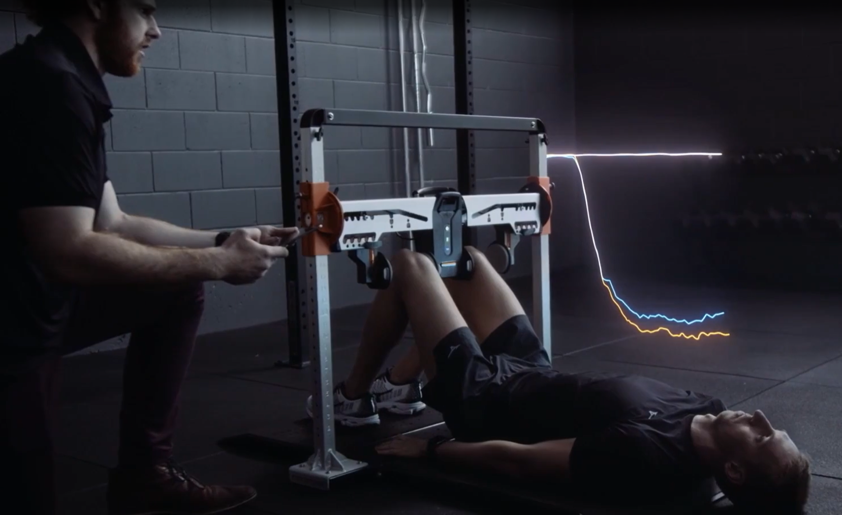
The biomechanist
Video – Biomechanics and sports science
Access the Video – Biomechanics and sports science (7:51) which highlights the importance of biomechanics in supporting an elite A-League football team to maximise performance.

Slide 37
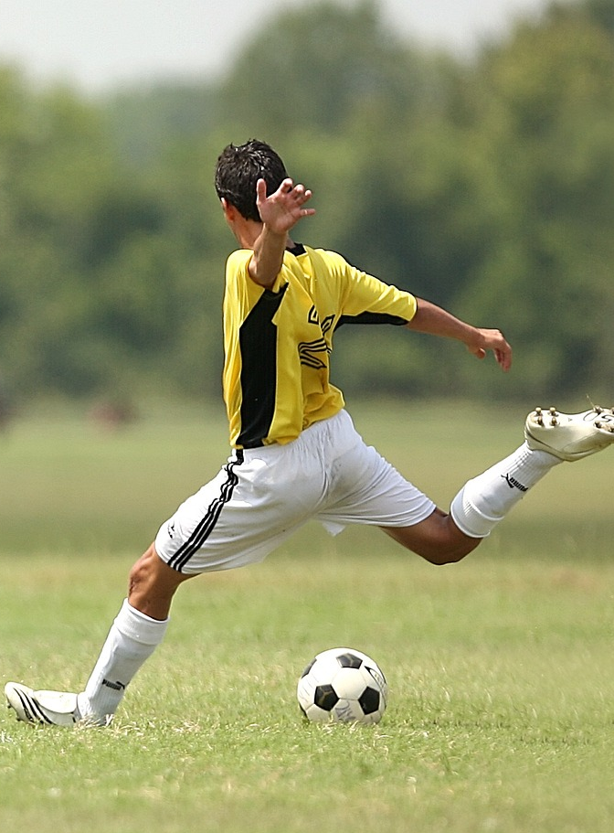
The biomechanist
The role
As a biomechanist working with the team, it is your role to analyse and assess how the athletes are physically moving to enhance performance and reduce injuries. In football, it encompasses analysing the best technique when running, kicking, dribbling and defending the ball to ensure athletes know how to most effectively apply and absorb force on the ball and the ground, and to understand how the ball travels through the air.
Notes:
Image licensed under Pixabay Content License.

Slide 38
The biomechanist
Group activities
Revise the most common injuries experienced in football (from Step 1 of the team doctor and physiotherapist section). Brainstorm the role of biomechanics in potentially reducing the occurrence of these injuries.

Slide 39
The biomechanist
Group activities
Team statistics collected from the previous year have identified 2 key areas for improvement for this season. These are:
        Area 1: Striking the ball when making an attempt at goal. On average, when players in this team are striking the ball for an attempt at goal, their strike has 3% less power than opposing teams. In your groups, discuss and answer
          What impact does this have on the motion of the ball?
          What implications does this have on performance?
          How can biomechanics be used to improve this aspect of performance?

Slide 40
The biomechanist
Group activities
Area 2: Stopping and controlling an airborne ball that has been struck from a distance. When stopping and controlling an airborne ball that has travelled over 20 m, players are making an error and losing possession of the ball 35% of the time. In your groups, discuss and answer
        What biomechanical principles need to be considered when stopping and controlling a ball that is being received?
        What strategies would you recommend to improve the team’s performance in this aspect of the game?

Slide 41
The biomechanist
Group activities
Another area for improvement identified by the offensive coach in his post season notes was the players ability to ‘bend’ (travel in a curved path) the ball around when striking a free kick.
        Discuss the benefit of causing the ball to bend when striking at goal.
        Draw a diagram that could be used to help the athletes understand how the Magnus effect will cause a ball to ‘bend’ when it is struck.

Slide 42
The biomechanist
Group activities
The team physiotherapist identified that during the pre-season last year there was an abnormally high proportion of players presenting with signs and symptoms of plantar fasciitis and/or Achilles pain about halfway through the pre-season.
        What biomechanical factors may have influenced this statistic?
        What recommendations could you make to the training staff to reduce the occurrence of this for the following season?

Slide 43
The biomechanist
Individual task
Complete the following question individually:
Propose ways in which biomechanics can be used to develop efficient movements for sustained movement and improved performance in football.

Slide 44
The sports scientist

Slide 45
The sport scientist
Video – Biomechanics and sports science
Access the Video – Biomechanics and sports science (7:51) which highlights the importance of sport science in supporting an elite A-League football team to maximise performance.

Slide 46
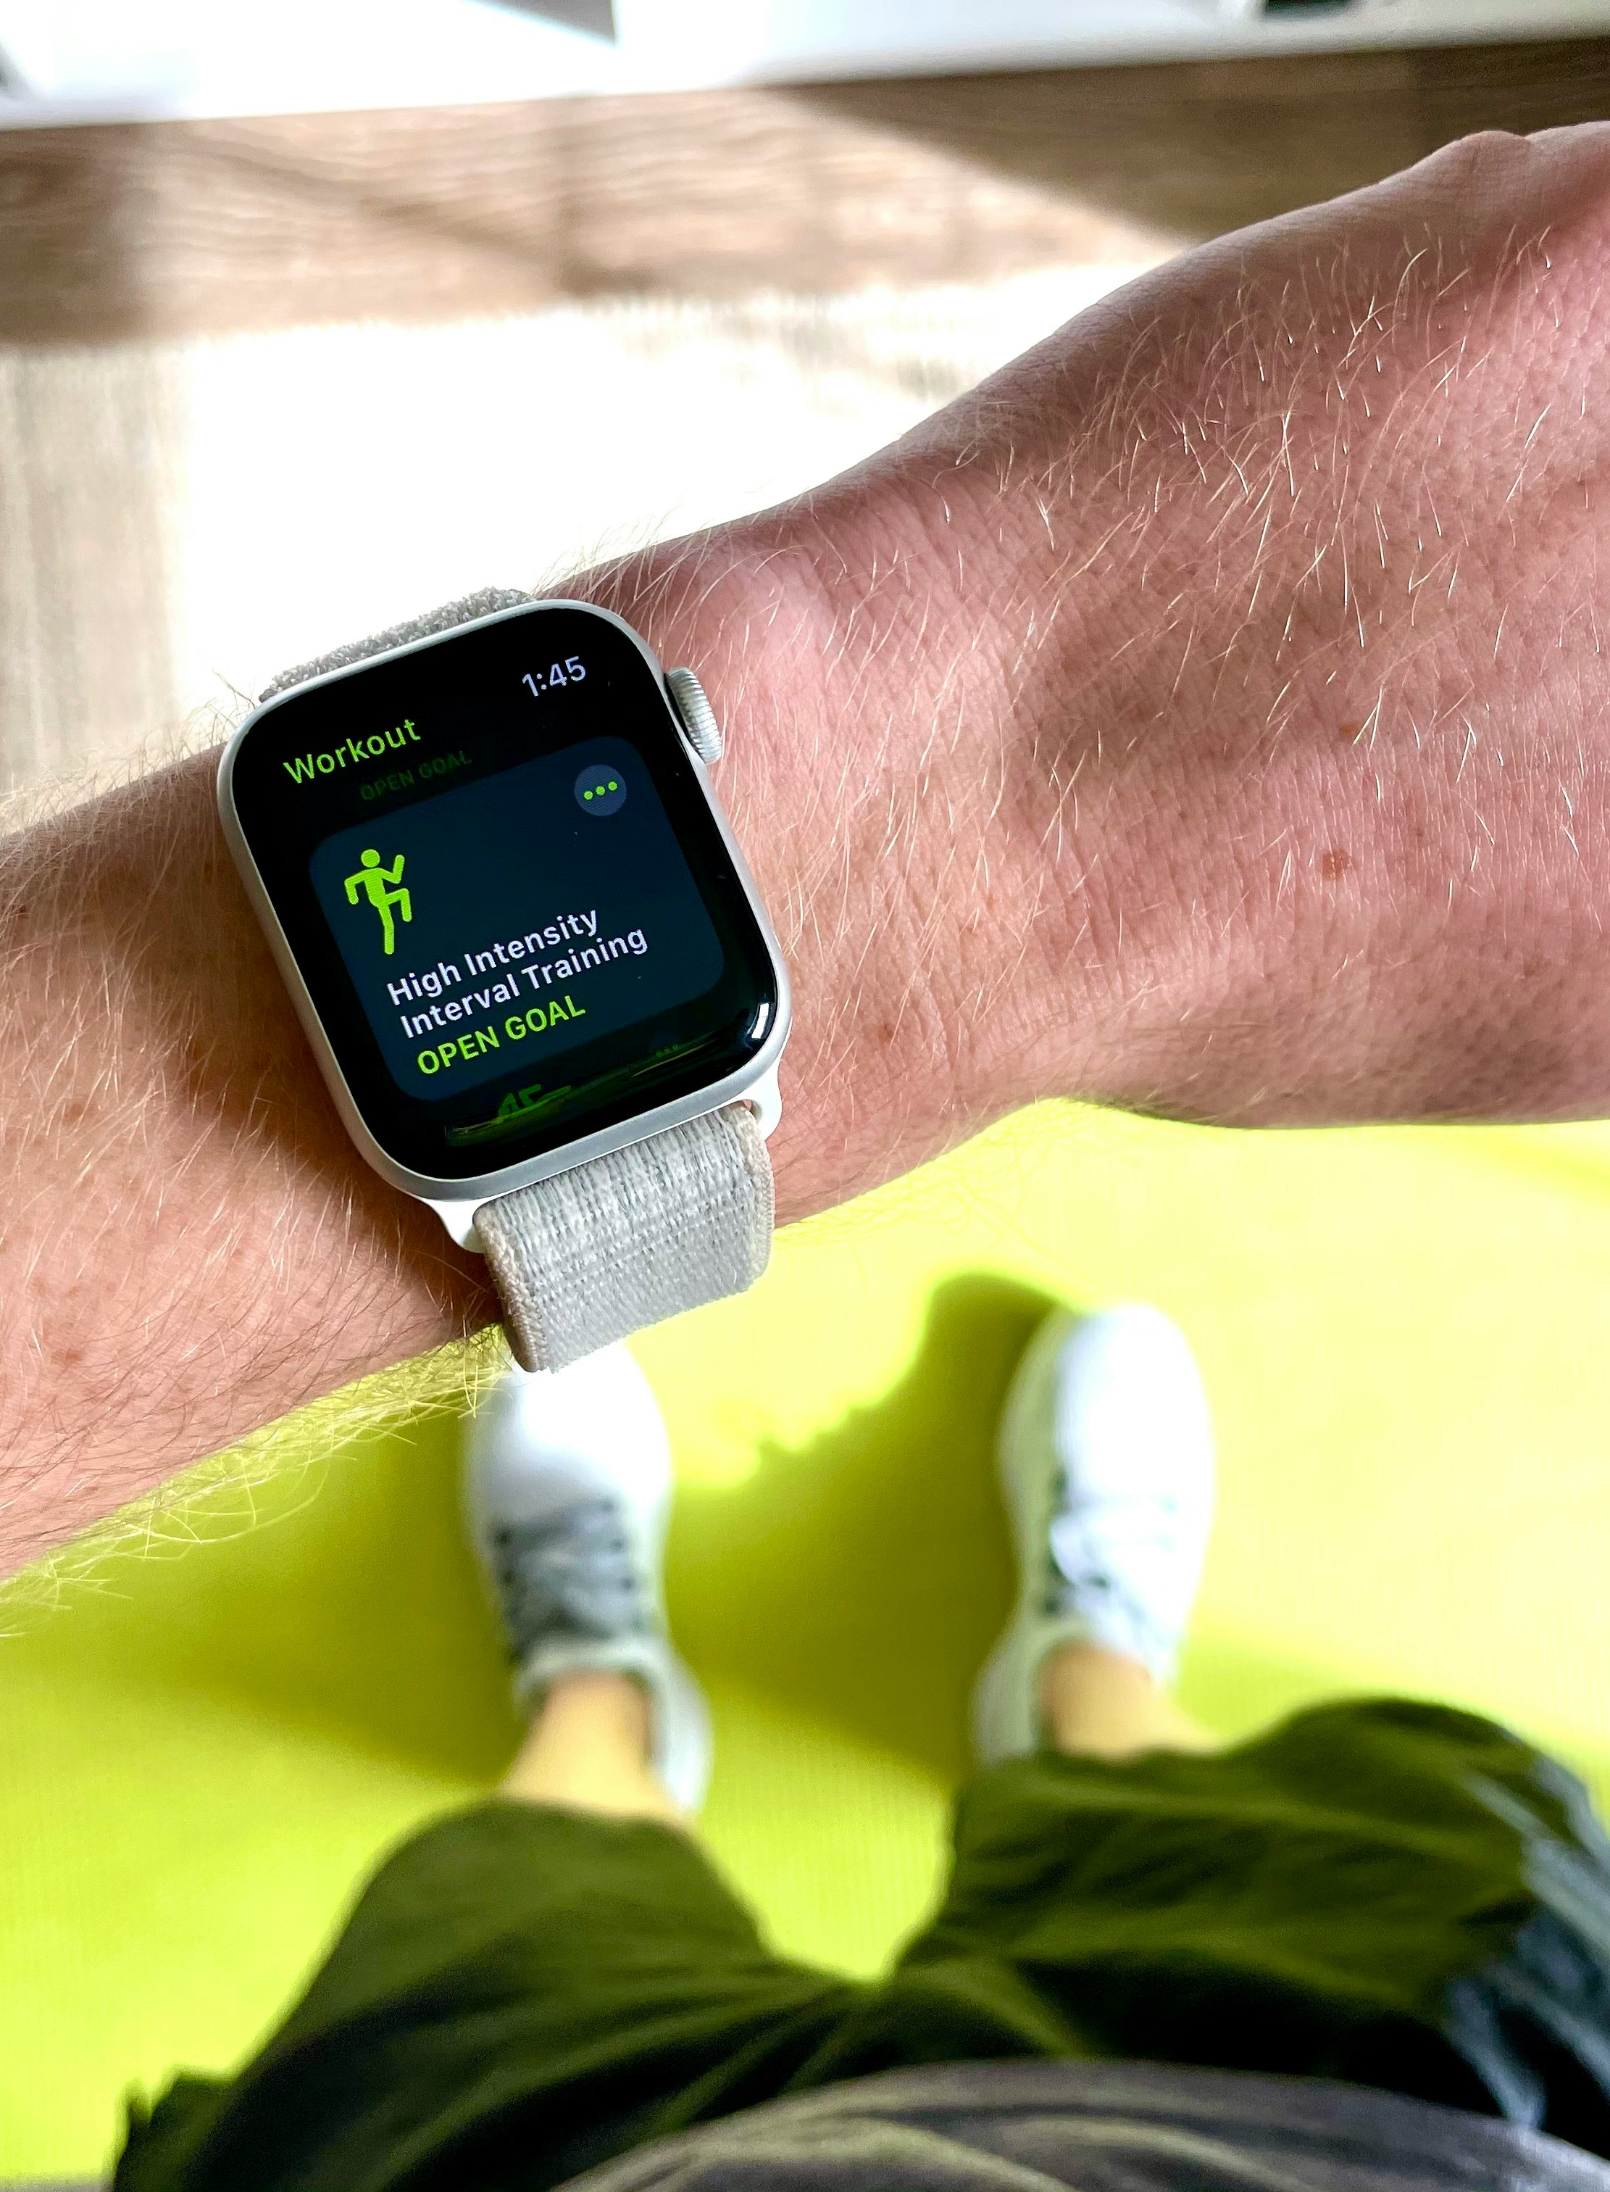
The sports scientist
The role
In elite sport, ensuring that you are using the most technologically advanced equipment, software and training innovations is imperative to success. As the sports scientist working with the team, you have been asked to seek out 3 potential contemporary technologies that the team could invest funding in to improve performance.
Notes:
Image licensed under Unsplash License.

Slide 47
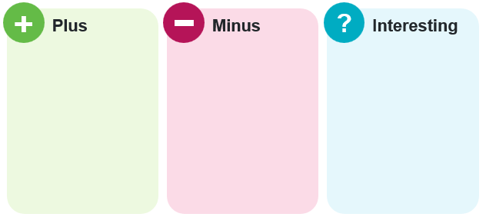
The sports scientist
Group activities
Research 3 new or emerging technologies that could be used by an elite football team to improve performance. In your group, complete a Plus-Minus-Interesting chart to evaluate the effectiveness of each technology for the team.

Slide 48
PMI
+
?
Plus
Minus
Interesting

Slide 49
The sports scientist
Individual task
Complete the following question individually:
Evaluate emerging technologies that could be used by an elite football team to improve performance.

Slide 50
Assessment task

Slide 51

The task
Context
You have been working as an intern with an A-League team for the past year in one of the following roles: coaching staff, nutritionist, psychologist, physiotherapist, biomechanist or sports scientist, and as your internship has finished you would like to apply for a full-time role with a new A-League football team.
Notes:
Image licensed under Pixabay Content License.

Slide 52
The task
Task information
You are to write a one-page cover letter applying for a job to work with an A-League football team in your field of expertise. The application should demonstrate a clear understanding of the responsibilities of the role (which has been established through the completion of the depth study) and must detail specific examples of their successful work in this field. It must also demonstrate how they would work in collaboration with at least one other professional in a different role to enhance the success of a football team.

Slide 53
Submission requirements
You must submit:
A one-page cover letter applying for a job with an A-League team detailing the following:
the position you are applying for
an understanding of the responsibilities of the role
an understanding of how the role impacts individual/team performance
specific examples of successful work in this position (this should be directly related to activities completed in the depth study)
examples of how they have worked with at least one colleague from a different profession in the team (coaching staff, nutritionist, psychologist, physiotherapist, biomechanist or sports scientist) to achieve team success.

Slide 54
Submission requirements
You must submit:
An attached piece of work that evidences an example of the work you have produced during your internship (this should be sourced from the activities in the depth study, for example, a training schedule, nutrition plan, rehabilitation plan, notes detailing successful psychological strategy interventions) this should be referred to in the cover letter.

Slide 55
References
This presentation contains NSW Curriculum and syllabus content. The NSW Curriculum is developed by the NSW Education Standards Authority. This content is prepared by NESA for and on behalf of the Crown in the right of the State of New South Wales. The material is protected by Crown copyright.
Please refer to the NESA Copyright Disclaimer for more information https://educationstandards.nsw.edu.au/wps/portal/nesa/mini-footer/copyright.
NESA holds the only official and up-to-date versions of the NSW Curriculum and syllabus documents. Please visit the NSW Education Standards Authority (NESA) website https://educationstandards.nsw.edu.au/ and the NSW Curriculum website https://curriculum.nsw.edu.au.
Heath and Movement Science 11–12 Syllabus © Syllabus NSW Education Standards Authority (NESA) for and on behalf of the Crown in right of the State of New South Wales, 2023.

Slide 56
Copyright
© State of New South Wales (Department of Education), 2024
The copyright material published in this resource is subject to the Copyright Act 1968 (Cth) and is owned by the NSW Department of Education or, where indicated, by a party other than the NSW Department of Education (third-party material).
Copyright material available in this resource and owned by the NSW Department of Education is licensed under a Creative Commons Attribution 4.0 International (CC BY 4.0) license.
This license allows you to share and adapt the material for any purpose, even commercially.
Attribution should be given to © State of New South Wales (Department of Education), 2024.
Material in this resource not available under a Creative Commons license:
the NSW Department of Education logo, other logos and trademark-protected material
Material owned by a third party that has been reproduced with permission. You will need to obtain permission from the third party to reuse its material.
Links to third-party material and websites
Please note that the provided (reading/viewing material/list/links/texts) are a suggestion only and implies no endorsement, by the New South Wales Department of Education, of any author, publisher, or book title. School principals and teachers are best placed to assess the suitability of resources that would complement the curriculum and reflect the needs and interests of their students.
If you use the links provided in this document to access a third-party’s website, you acknowledge that the terms of use, including licence terms set out on the third-party’s website apply to the use which may be made of the materials on that third-party website or where permitted by the Copyright Act 1968 (Cth). The department accepts no responsibility for content on third-party websites.

