Slide 1
Instructions for use
This resource is not a teaching and learning program. It should be used in conjunction with 12HMS-FA1- healthy ageing and SDGs learning program from the Planning, programming and assessing PDHPE 11-12 webpage.
Classroom teachers are encouraged to add and adapt slides as required to meet the needs of their students.
Save a copy of the file to make changes to the slide deck. Go to File > Download a Copy (this downloads a copy to the computer to edit in the PowerPoint app).
To convert the PowerPoint to Google Slides:
  Upload the file into Google Drive and open it.
  Go to File > Save as Google Slides.
  (Note – conversion may cause formatting changes in the slides.)

Slide 2
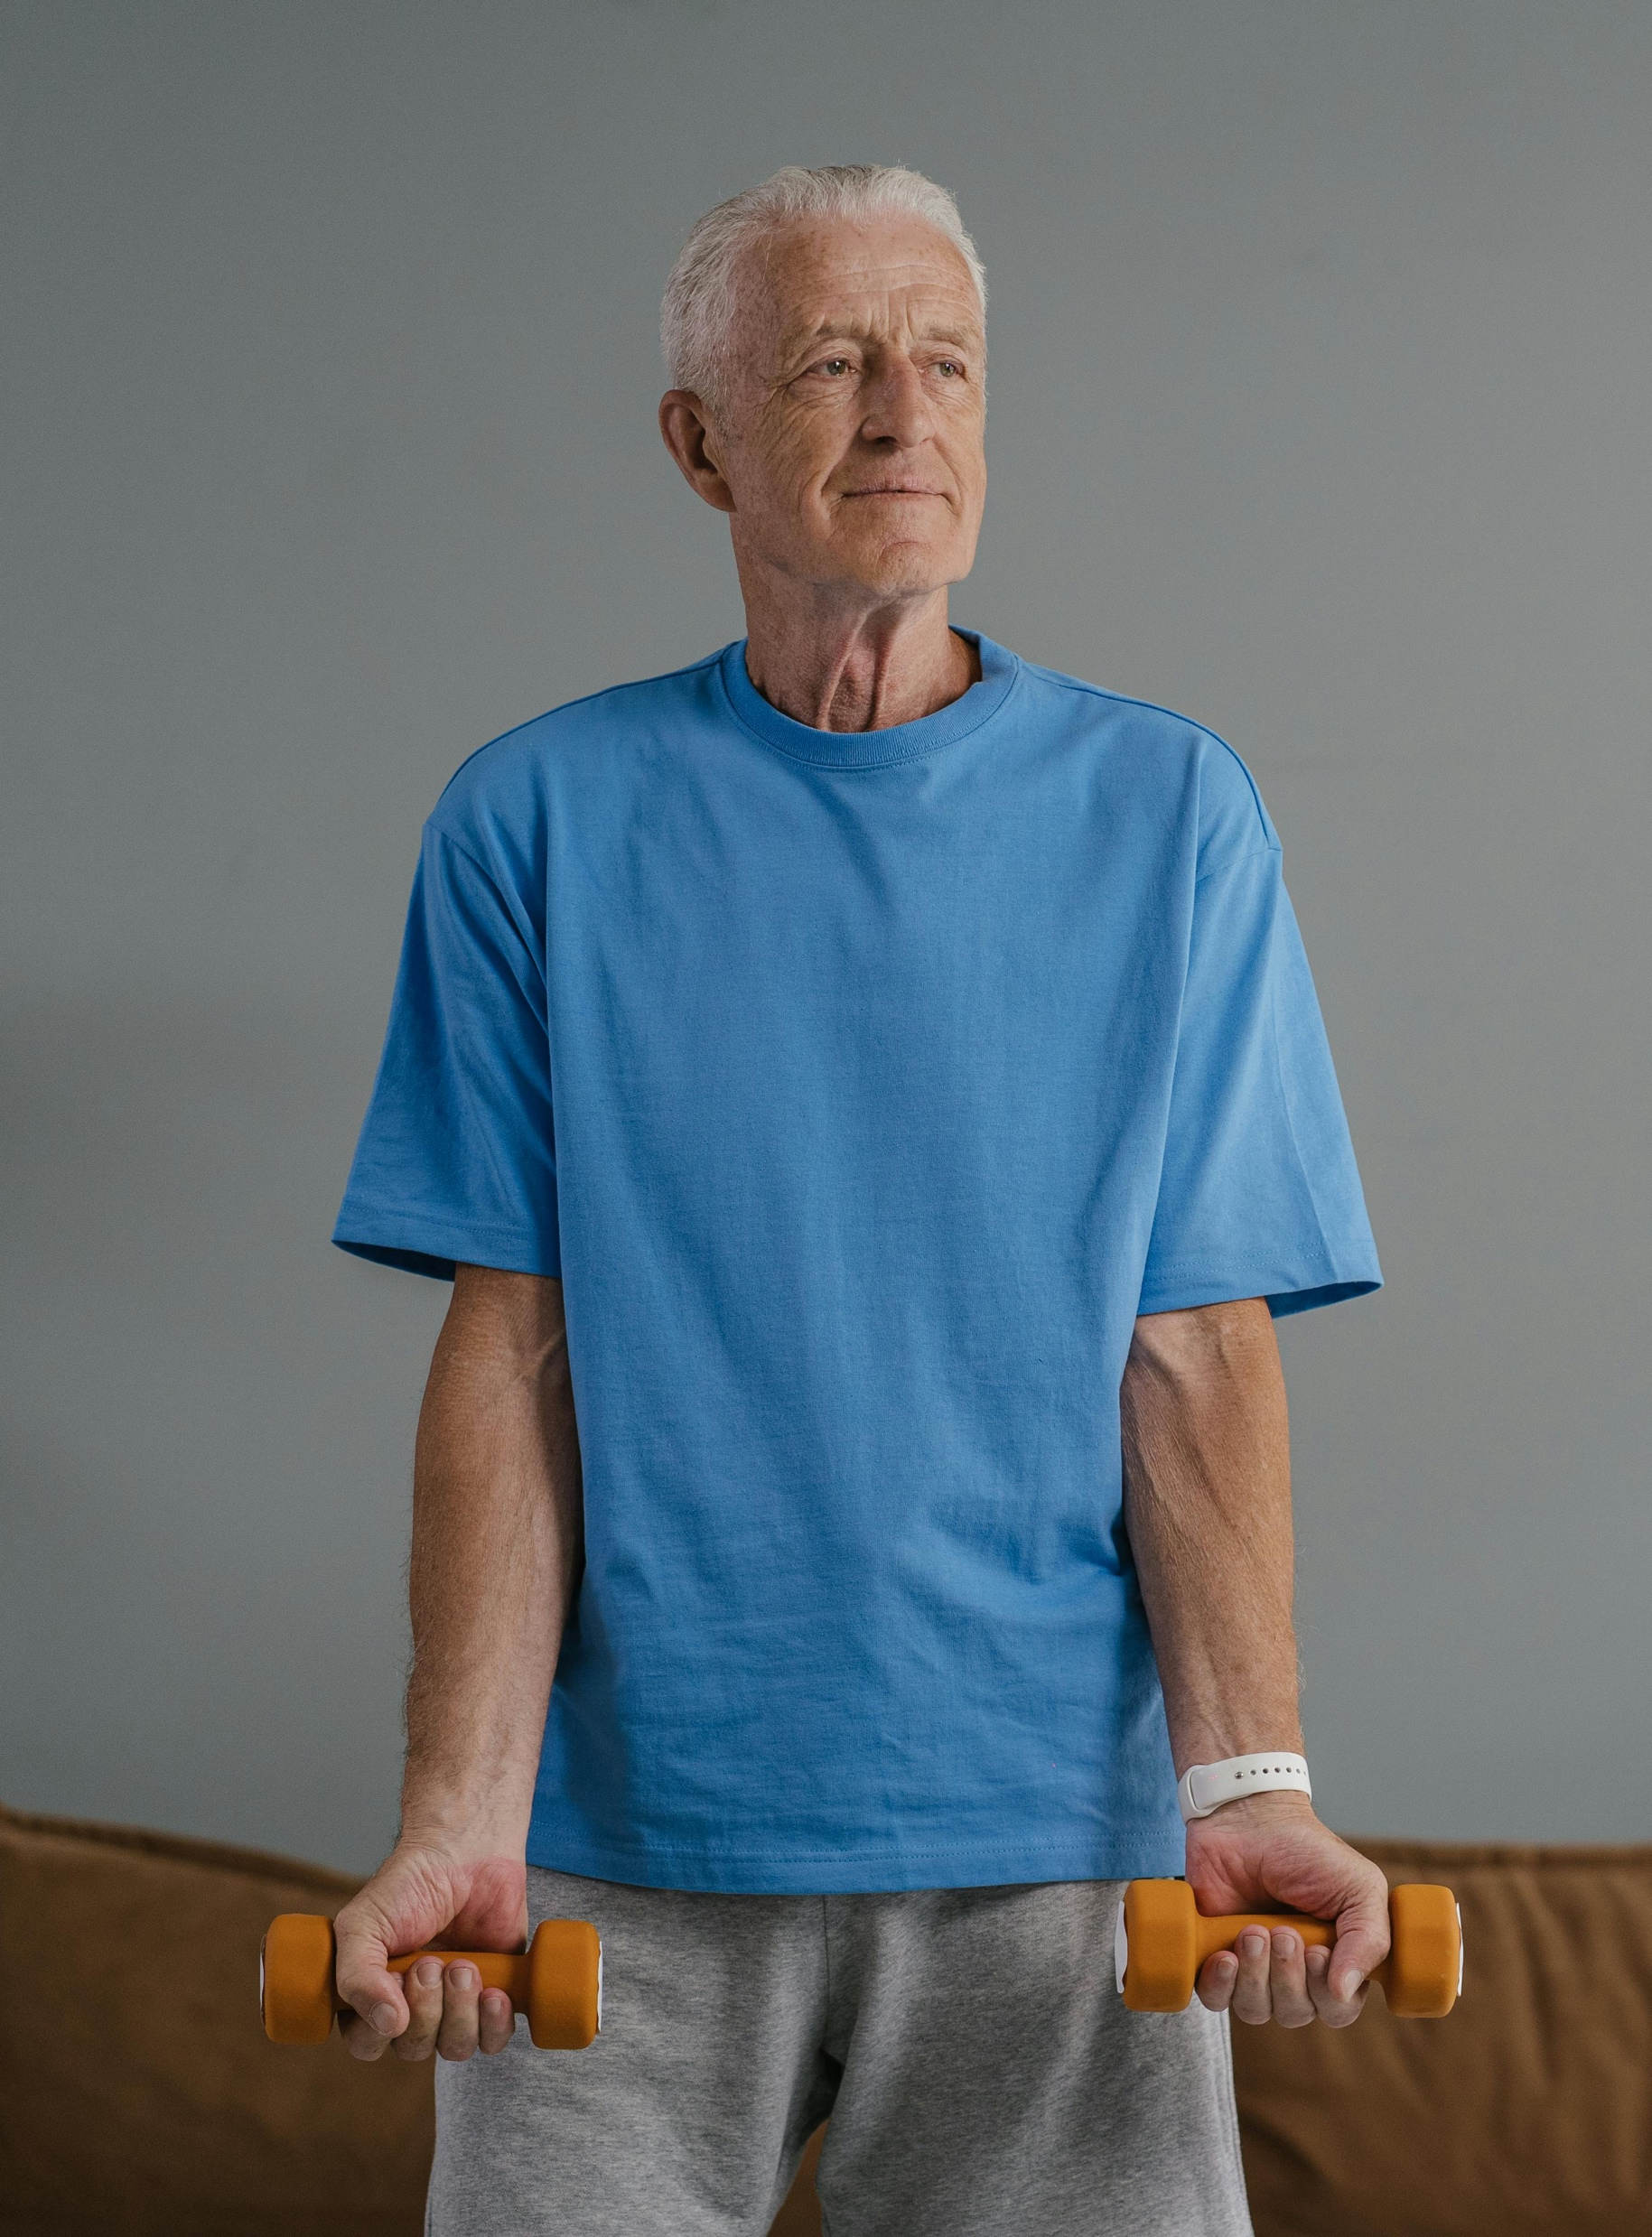
Applying the SDGs to improve older Australian’s health
Focus area 1
Health in an Australian and global context
Notes:
Photo by SHVETS production: https://www.pexels.com/photo/an-elderly-man-in-blue-shirt-holding-a-dumbbells-8899509/

Slide 3
Lessons
1
4
The Sustainable Development Goals (SDGs)
What is healthy ageing?
2
5
Case studies
Strategies for healthy ageing
3
6
Data snapshot
Strategy and SDGs alignment
Notes:
Teacher notes:
Click lesson numbers to go to specific lessons
Interactive features can be viewed in slide show

Slide 4
Learning intentions and success criteria
We are learning to:
develop an understanding of healthy ageing and the opportunities and challenges for an ageing population
create a case study for an ‘ageing Australian’ and compare to the broader data set around the growing and ageing population
evaluate health promotion initiatives and their alignment to the SDGs and suggest improvements
propose, develop and justify a health promotion strategy aimed at educating older people on the benefits of healthy ageing.
We can:
[classroom teacher to insert co-constructed success criteria]
[classroom teacher to insert co-constructed success criteria]
[classroom teacher to insert co-constructed success criteria].
Notes:
Notes for teachers:
Learning intentions and success criteria are best co-constructed with students. Adapt the learning intentions as required and add matching success criteria.
For more information see ⁠AITSL or the NSW Department of Education explicit teaching strategies, ⁠Sharing learning intentions and ⁠Sharing success criteria.
LISC is not necessarily presented at the beginning of the lesson. Teacher needs to consider most effectual time to introduce.
LISC should be revisited during the lesson to support students' evaluation of their learning.

Slide 5
What is healthy ageing?

Slide 6
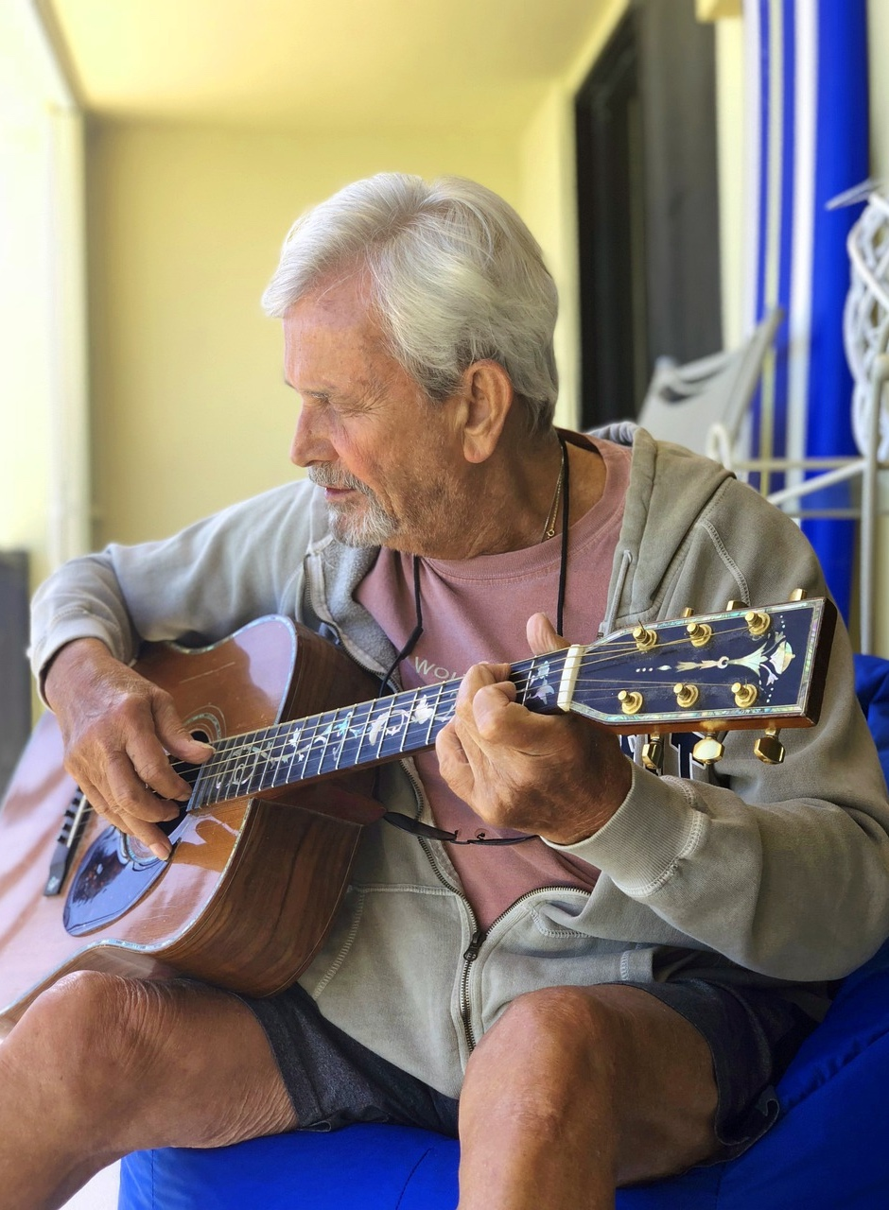
Healthy ageing
Class discussion
What behaviours through earlier life stages, impact how healthy you are as you get older?
How do dietary choices and physical activity levels during childhood and adolescence influence health outcomes in older age?
What long-term impacts do habits such as smoking or alcohol consumption in your younger years have on health as you age?
Notes:
Image licensed under Pixabay Content License.
Teacher notes: explain to students that while early life behaviours significantly impact health as we age, it's important to recognise that there are numerous strategies and choices that can help older adults age healthily. Through this sequence of activities, we will explore some of these strategies. However, like other population groups, older Australians are a diverse group, encompassing a wide range of ages, socioeconomic backgrounds, life experiences and lifestyles. These variations significantly influence the ageing process, impacting their health and wellbeing in different ways.

Slide 7
Y chart
Brainstorm what healthy ageing looks like, sounds like and feels like
Healthy ageing looks like
Healthy ageing sounds like
Healthy ageing feels like

Slide 8
Quality of life for older Australians
Influential factors
On your Y-chart diagram, use highlighters to categorise these into the following factors that may influence the quality of life for older Australians.
Physical factors
Mental health factors
Social health factors
Healthcare access

Slide 9
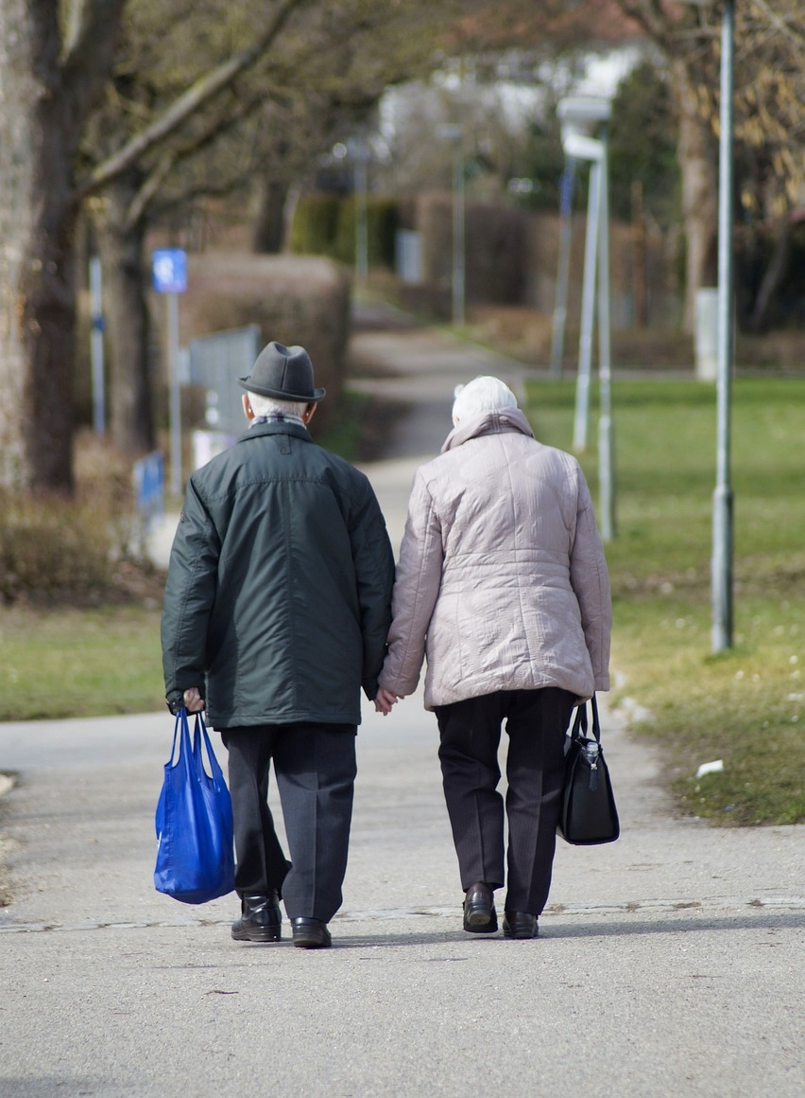
Definition
What is healthy ageing?
Watch the video 1-Live Well (1:35) on healthy ageing.
Individual activity:
write your own definition of healthy ageing.
Note: this definition will be refined as your knowledge and understanding develops.
Notes:
Image licensed under Pixabay Content License.

Slide 10
Case studies

Slide 11
Experiences of healthy ageing
Case studies
Watch these case studies of older Australians and answer the questions.
Australian’s getting better with age Ep 7 – Anne Birt (8:05)
Australian’s getting better with age Ep 6 Margaret Aurisch (10:23)
Happy 100th Birthday Edna (1:56)
NSW Active and Healthy webpage
Active & Healthy NSW – Terry’s Story (2:09)
Senior Australian of the Year Award videos
Questions:
How are people in these case studies leading active and healthy lives in their older age?
What motivates them to lead a healthy lifestyle?
What support structures do they have in place to support their lifestyle?

Slide 12

Interview
Home activity
Conduct an interview with an older person and create a profile about their health. You must cover the following main areas in your profile:
physical health and activity
mental health
social health
healthcare access
reflections and advice.
Note: you will use this profile to compare to the broader data set around the growing and ageing population.
Notes:
Photo by SHVETS production: https://www.pexels.com/photo/woman-psychologist-taking-notes-on-clipboard-while-talking-with-client-7176291/

Slide 13
What influences healthy ageing?
Interview discussions
In pairs or small groups, discuss your older person profile using the following questions:
What are the similarities or differences between the profiles of different group members?
Is your profile an example of healthy ageing. Why or why not? What improvements would you recommend?
What can be determined as significant influences in shaping the quality of life for older Australians? Why?
Individual task:
return to your original definition of ‘healthy ageing’ and refine it.
Notes:
Suggested answer:
What can be determined as significant influences in shaping the quality of life for older Australians? Why?
For example, maintaining good physical health, maintaining good mental health, social connections, access to healthcare, financial stability and having supportive living environments, cultural practices, personal attitudes and societal support systems.

Slide 14
Data snapshot

Slide 15
What does the data tell us?
Ageing population of Australia
Create an infographic on the health status and behaviours of older people in Australia. Include data relating to:
common causes of morbidity and mortality
leading causes of burden of disease
top lifestyle related risk factors, for example, physical activity, nutrition, obesity, smoking, alcohol
health service use and resources accessed, for example, GP, pharmaceuticals
living environment and aged care support, for example, aged care, residential, home support, home care
social support and connections, for example, volunteering, carers, social engagement, family and community support
employment, for example, working arrangements, retirement.
Notes:
Links to resources are available in Appendix 1.

Slide 16

Data sharing
Infographic feedback
Group activity:
Present your infographic to group members.
Write warm and cool feedback on a sticky note (positive feedback on one side and areas for improvement on the other).
Use the feedback received to refine your infographic.
Notes:
Image licensed under Pixabay Content License.

Slide 17
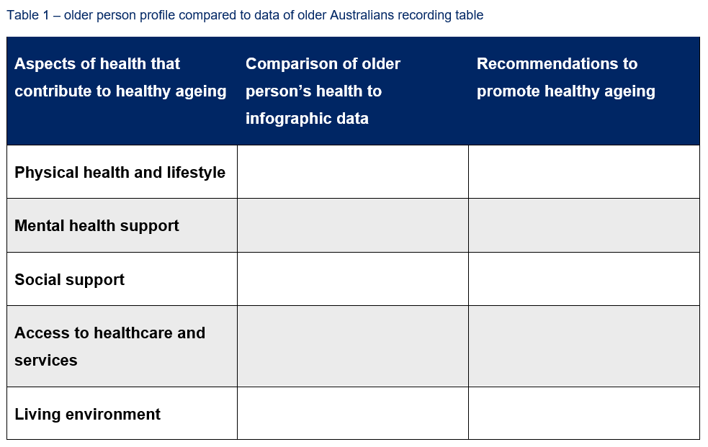
Comparing the data
Infographic to older person profile
Group activity:
Compare the data collected in your infographic to your older person profile.
Complete the table to support your reflection.
Note: questions are provided on the next slide to support your reflection.

Slide 18
Comparing the data continued
Reflection
How does the physical health of your older person’s profile compare to the general health data of older Australians? Are there specific health conditions mentioned in your profile that are common among older Australians?
How does the social life of your older person profile compare to the average social connections of older Australians?
Are there any barriers to healthcare mentioned in your profile that are common among older Australians?
How does the living situation in your older person profile reflect the typical living environments of older Australians?
What are the challenges and opportunities for ageing Australians regarding their health?
What recommendations would you make to older Australians to improve their health and ensure healthy ageing? Students should consider the physical, mental and socials aspects that contribute to healthy ageing.

Slide 19
The Sustainable Development Goals (SDGs)

Slide 20

Sustainable Development Goals (SDGs)
The Sustainable Development Goals (SDGs) are a set of 17 interconnected global objectives designed to achieve a better and more sustainable future for all.
Adopted by all United Nations Member States in 2015, the SDGs are part of the 2030 Agenda for Sustainable Development, which provides a shared blueprint for peace and prosperity for all people and the planet.
They act as a strategic framework to create a better and more sustainable future for everyone. They address global challenges such as poverty, inequality, climate change, environmental degradation, peace and justice.
Each goal includes specific targets to be accomplished by 2030, forming a comprehensive and ambitious plan to transform the world.
Notes:
'Colour wheel' by United Nations Department of Global Communications is licensed under Copyright © United Nations

Slide 21

Sustainable Development Goals
Watch the video Transitioning from the MDGs to the SDGs (3:02).
Brainstorm what you know about SDGs 3, 4, 10 and 11 and write a small summary for each.
Notes:
'SDG poster' by United Nations Department of Global Communications is licensed under Copyright © United Nations.

Slide 22
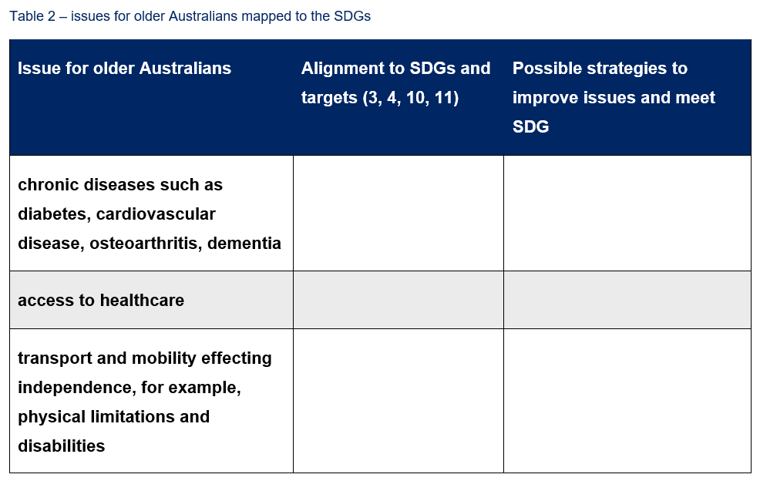
Issues affecting older people
Mapping to SDGs
Group activity:
Complete a Think-Pair-Share using the table to develop an understanding of the issues affecting older people.
Share your ideas with a partner.
How do these issues link to the SDGs and targets?
Develop some strategies to support older Australians to live out healthy lives.
Notes:
Suggested answers may include:
chronic diseases, for example, diabetes, cardiovascular disease, osteoarthritis and dementia
access to healthcare
transport and mobility effecting independence, for example, physical limitations and disabilities
access nutritious food and regular physical activity
accessing technology
mental health conditions, for example, dementia, depression
limited income
social isolation and loneliness.

Slide 23
Strategies for healthy ageing

Slide 24
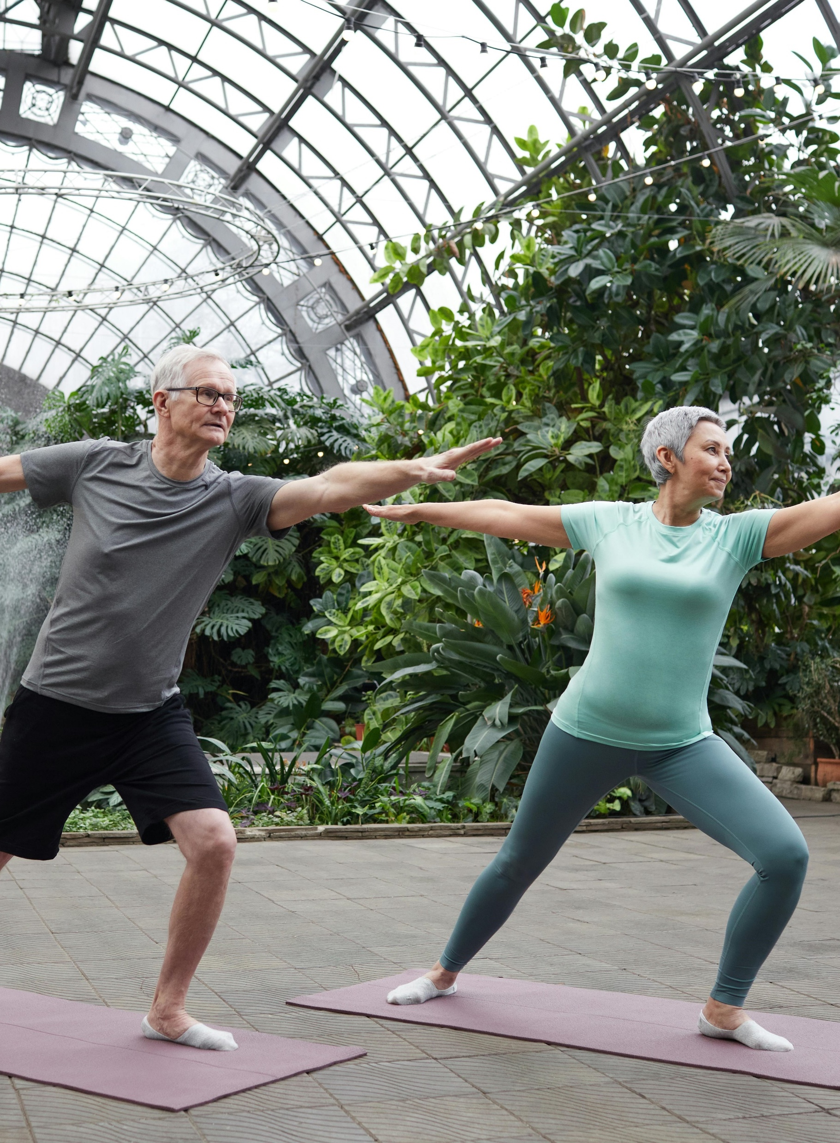
Healthy aging strategies
There are a variety of health promotion strategies aimed at improving the health and wellbeing of older Australians.
Brainstorm
What services, local health promotion strategies and resources are currently available in their local area or community to support older people in healthy ageing?
Task
Investigate one of these services and one other provided using the questions and table on the next slide.
Notes:
Links to resources are available in Appendix 2.
Couple Practicing Yoga' by Marcus Aurelius is available in the public domain

Slide 25
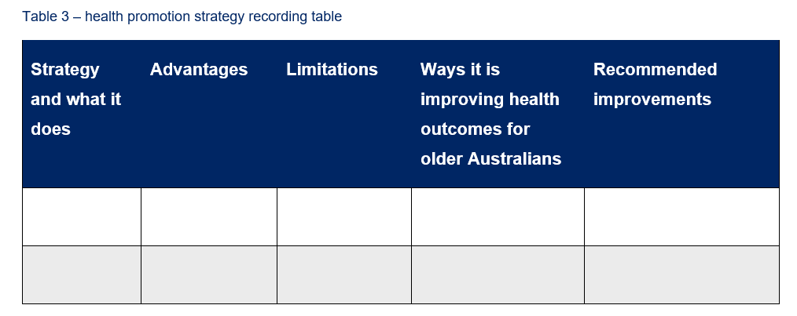
Health promotion strategies
Strategy analysis
Conduct an analysis of your health promotion strategy by answering the following questions and collating in the table.
What does the program or strategy do?
What are the advantages of the program/strategy?
What are the limitations of the program/strategy?
What improvements can be made?
How has the program/strategy been used to improve the health outcomes for older people? Provide examples.

Slide 26
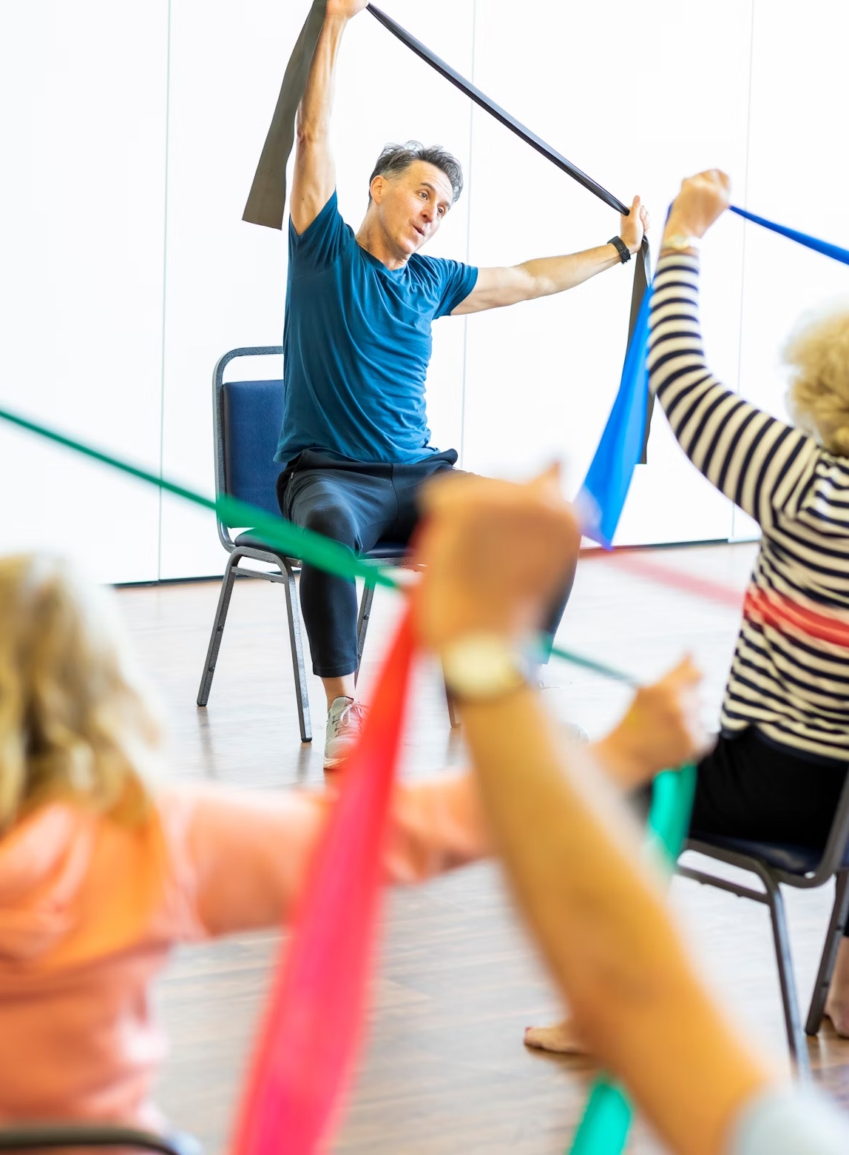
Health promotion comparison
Task – written response
Write a half page response to the question:
        Compare the effectiveness of 2 health promotion strategies in improving the health outcomes for older Australians.
Notes:
Image licensed under Unsplash License.

Slide 27
Health promotion strategies and SDGs alignment

Slide 28
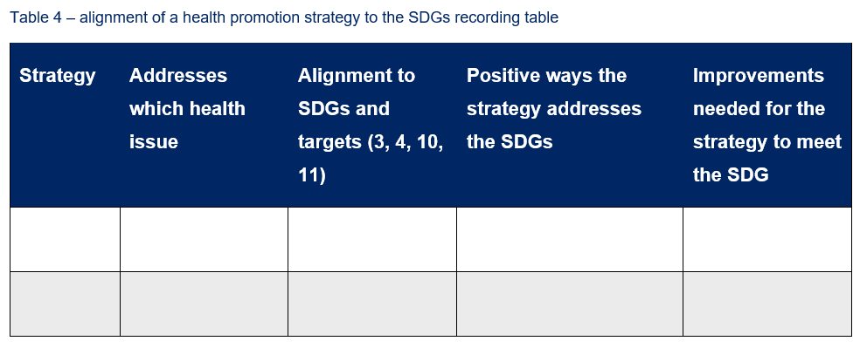
Align each strategy to the SDGs
Answer the questions using Table 4 to make a judgement on each health promotion strategy’s ability to meet the SDGs.
  What health issues does the strategy address?
  How effective has the strategy been in addressing the issues related to healthy ageing for older Australians? Why?
  How does the local health promotion program or strategy align to the SDGs?
  What are the positive ways that the strategy is addressing the SDGs?
  What further improvements could be made to the strategy to advocate and support older people in your local area or community?

Slide 29
Health promotion resource
Design complementary health promotion materials
Task
Develop a resource that could be added to your strategy, for example, a pamphlet, poster or radio advertisement, to educate older people in your local area on the benefits of healthy ageing.
Justify how your resource does this by answering the following questions:
How will the resource further promote the health of older people in their community?
How will you know if the strategy is effective or successful? For example, what will the short- and long-term outcomes be?
How would success be measured and evaluated?

Slide 30
Written response
To demonstrate your knowledge and understanding gathered from exploring the data surrounding older Australians, the health promotion initiatives and how they link to the SDGs, complete an extended response answer to the question below.
Question
To what extent do health promotion strategies focusing on addressing Sustainable Development Goal 3: Good Health and Wellbeing and Sustainable Development Goal 4: Quality Education, assist in improving the health status of older Australians? Use examples of a health promotion strategy to support your answer.

Slide 31
Appendix 1 – infographic resources
Australian Institute of Health and Welfare (AIHW) – Older Australians
Australian Human Rights Commission – Face the facts: Older Australians (infographic example)
Australian Government – Department of Health and Aged Care – Physical activity and exercise guidelines for older Australians
World Health Organisation – Ageing and health

Slide 32
Appendix 2 – strategies for healthy ageing resources
Australian Government – Department of Health and Aged Care
        Positive ageing
        Choose health, be active – a physical activity guide for older Australians
        Physical activity and exercise guidelines for all Australians
        Commonwealth Home Support Program (CHSP)
        Eatforhealth.gov.au – Healthy eating when you’re older
LiveUp program
Uniting – Senior Health Hub
Active Ageing Australia
NSW Government – Active and healthy program
City of Melville – Age Friendly Melville program
PHN: South Western Sydney – Live Well healthy ageing program
Australian Human Rights Commission – Centenarian Portrait project by teenagers.

Slide 33
References
This presentation contains NSW Curriculum and syllabus content. The NSW Curriculum is developed by the NSW Education Standards Authority. This content is prepared by NESA for and on behalf of the Crown in the right of the State of New South Wales. The material is protected by Crown copyright.
Please refer to the NESA Copyright Disclaimer for more information https://educationstandards.nsw.edu.au/wps/portal/nesa/mini-footer/copyright.
NESA holds the only official and up-to-date versions of the NSW Curriculum and syllabus documents. Please visit the NSW Education Standards Authority (NESA) website https://educationstandards.nsw.edu.au/ and the NSW Curriculum website https://curriculum.nsw.edu.au.
Health and Movement Science 11–12 Syllabus © NSW Education Standards Authority (NESA) for and on behalf of the Crown in right of the State of New South Wales, 2023.
Slides 2, 12. Photos by SHVETS production
Slides 6, 9, 16. Images licensed under Pixabay Content License.
Slide 20. 'Colour wheel' by United Nations Department of Global Communications is licensed under Copyright © United Nations
Slide 21. 'SDG poster' by United Nations Department of Global Communications is licensed under Copyright © United Nations.
Slide 24. Couple Practicing Yoga' by Marcus Aurelius is available in the public domain
Slide 26. Image licensed under Unsplash License.

Slide 34
Copyright
© State of New South Wales (Department of Education), 2024
The copyright material published in this resource is subject to the Copyright Act 1968 (Cth) and is owned by the NSW Department of Education or, where indicated, by a party other than the NSW Department of Education (third-party material).
Copyright material available in this resource and owned by the NSW Department of Education is licensed under a Creative Commons Attribution 4.0 International (CC BY 4.0) license.
This license allows you to share and adapt the material for any purpose, even commercially.
Attribution should be given to © State of New South Wales (Department of Education), 2024.
Material in this resource not available under a Creative Commons license:
the NSW Department of Education logo, other logos and trademark-protected material
Material owned by a third party that has been reproduced with permission. You will need to obtain permission from the third party to reuse its material.
Links to third-party material and websites
Please note that the provided (reading/viewing material/list/links/texts) are a suggestion only and implies no endorsement, by the New South Wales Department of Education, of any author, publisher, or book title. School principals and teachers are best placed to assess the suitability of resources that would complement the curriculum and reflect the needs and interests of their students.
If you use the links provided in this document to access a third-party’s website, you acknowledge that the terms of use, including licence terms set out on the third-party’s website apply to the use which may be made of the materials on that third-party website or where permitted by the Copyright Act 1968 (Cth). The department accepts no responsibility for content on third-party websites.

