Slide 1
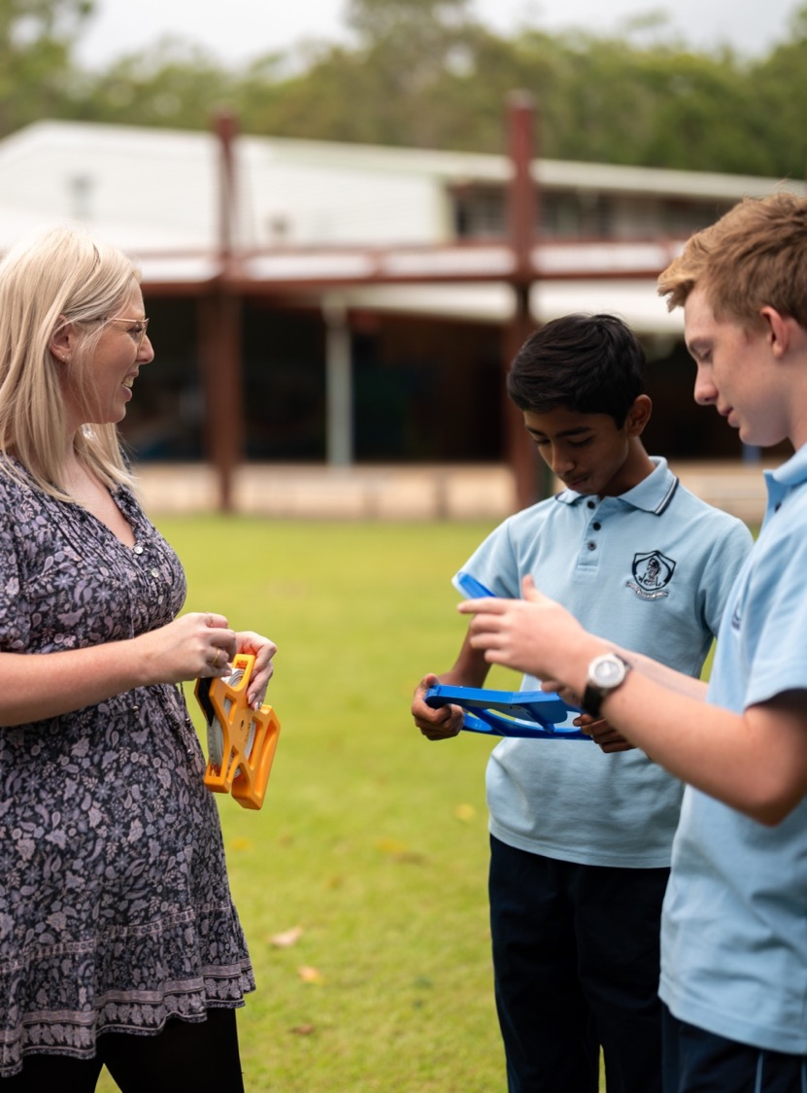
International travel
Mathematics Standard – Stage 6 (Year 11)
Unit 5 – Going places

Slide 2
Learning intentions and success criteria
Learning intentions
To learn to analyse and interpret network maps and time schedules to solve problems
Success criteria
I can use travel times and time differences to calculate and compare possible travel plans.
I can use network diagrams with time elapsed to solve problems.
I can calculate the arrival or departure time using UTC and the travel time.

Slide 3
Activating prior knowledge

Slide 4
Same Surface Different Deep
A train trip lasts 1 hour and 17 minutes. If Chris leaves at 4:25 pm and travels without stopping, what time will he arrive? | A train leaves at 9:37 am and arrives at 11:15 am. How long did Chris travel for?
A train trip lasts 1 hour and 17 minutes. If Chris travels the same trip continually, how many times could he complete the trip in 24 hours? | A train trip lasts 1 hour and 17 minutes. If Chris arrives at 9:55 pm and travelled without stopping, what time did he leave?

Slide 5
Connecting learning

Slide 6
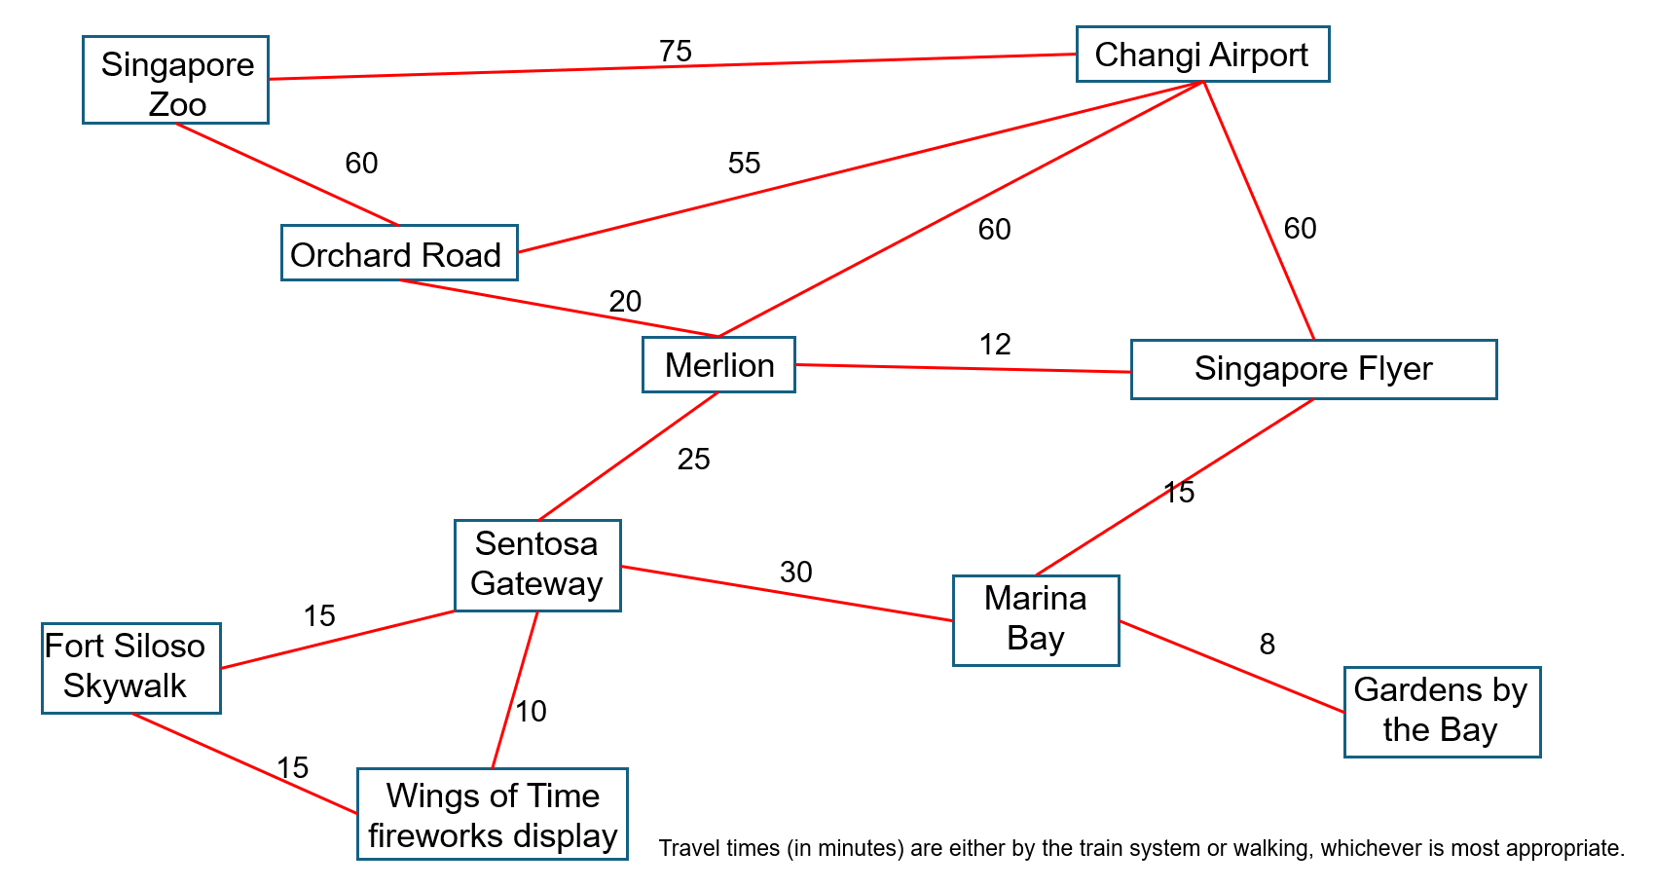
Singapore tourist network

Slide 7
Releasing responsibility

Slide 8
Comparative examples (1)
Mason will travel from Tokyo (UTC +9) to Buenos Aires (UTC −3). The flight from Tokyo to Buenos Aires will take 20 hours. The flight will arrive in Buenos Aires at 3 pm on Wednesday 20 July.
On what day and at what time will Mason leave Tokyo?
Method 1 – change time zone first | Method 2 – add travel times first | Method 3 – time difference
3 pm Wednesday + 12 hours = 3 am Thursday in Tokyo + Flight time = 3 am Thursday - 20 hours = 7 am Wednesday | 3 pm Wednesday - 20 hours = 7 pm Tuesday Time change 7 pm +12 hours = 7 am Wednesday | 12-hour – 20-hour flight = - 8 hours - 8 hours from 3 pm Wednesday = 7 am Wednesday
3 pm
Wed
3 am
Thurs
-20 hrs
+9
+12 hours
-3
12 - 20 = 8 hrs
+12 hours
-20 hrs
7 am
Wed
3 pm
Wed
7 am
Wed
3 pm
Wed
7 am
Wed
7 pm
Tues

Slide 9
Comparative examples – Your turn (1)
William will travel from Perth (UTC+8) to Fernando de Noronha (UTC-2). The flight from Perth will take 19 hours. The flight will arrive at Fernando de Noronha at 4 pm on Tuesday.
On what day and at what time will William leave Perth?
Method 1 – change time zone first | Method 2 – add travel times first | Method 3 – time difference
4 pm Tuesday + 10 hours = 2 am Wednesday in Perth 19 hrs Flight time = 7 am Tuesday | 4 pm Tuesday - 19 hours = 9 pm Monday in Fernando de Noronha. Time change 9 pm Monday +10 hours = 7 am Tuesday | 10-hour – 19-hour flight = - 9 hours - 9 hours from 4 pm Tuesday = 7 am Tuesday

Slide 10
Comparative examples (2)
Jacob will travel from Cairo (UTC+2) to Beijing (UTC+8). The flight from Cairo to Beijing will take 10 hours. The flight will arrive in Beijing at 6 pm on Friday.
On what day and at what time will Jacob leave Cairo?
Method 1 – change time zone first | Method 2 – add travel times first | Method 3 – time difference
6 pm Friday – 6 hours = 12 pm Friday 12 pm Friday - 10 hours travel = 2 am Friday | 6 pm Friday - 10 hours travel = 8 am Friday 8 am Friday – 6-hour time difference = 2 am Friday | 6-hour time difference + 10 hours travel time = 16 hours 16 hours before 6 pm Friday = 2 am Friday.

Slide 11
Comparative examples – Your turn (2)
Steve will travel from Dubai (UTC+4) to New York (UTC-5). The flight from Dubai to New York will take 18 hours. The flight will arrive in Dubai at 11 am Monday.
On what day and at what time will Steve leave New York?
Method 1 – change time zone first | Method 2 – add travel times first | Method 3 – time difference
11 am Monday – 9 hours = 2 am Monday in New York 18 hrs flight time = 8 am Sunday | 11 am Monday - 18 hours = 5 pm Sunday Time change 5 pm Sunday - 9 hours = 8 am Sunday | -9 hour – 18-hour flight = - 27 hours - 27 hours from 11 am Monday = 8 am Sunday

Slide 12
Independent practice

Slide 13

Approaching questions scaffold

Slide 14
References
This presentation contains NSW Curriculum and syllabus content. The NSW Curriculum is developed by the NSW Education Standards Authority. This content is prepared by NESA for and on behalf of the Crown in the right of the State of New South Wales. The material is protected by Crown copyright.
Please refer to the NESA Copyright Disclaimer for more information https://educationstandards.nsw.edu.au/wps/portal/nesa/mini-footer/copyright.
NESA holds the only official and up-to-date versions of the NSW Curriculum and syllabus documents. Please visit the NSW Education Standards Authority (NESA) website https://educationstandards.nsw.edu.au/wps/portal/nesa/home and the NSW Curriculum website https://curriculum.nsw.edu.au.
Mathematics Standard 11–12 Syllabus © NSW Education Standards Authority (NESA) for and on behalf of the Crown in right of the State of New South Wales, 2024.

Slide 15
Copyright
© State of New South Wales (Department of Education), 2026
The copyright material published in this resource is subject to the Copyright Act 1968 (Cth) and is owned by the NSW Department of Education or, where indicated, by a party other than the NSW Department of Education (third-party material).
Copyright material available in this resource and owned by the NSW Department of Education is licensed under a Creative Commons Attribution 4.0 International (CC BY 4.0) license.
This license allows you to share and adapt the material for any purpose, even commercially.
Attribution should be given to © State of New South Wales (Department of Education), 2026.
Material in this resource not available under a Creative Commons license:
the NSW Department of Education logo, other logos and trademark-protected material
Material owned by a third party that has been reproduced with permission. You will need to obtain permission from the third party to reuse its material.
Links to third-party material and websites
Please note that the provided (reading/viewing material/list/links/texts) are a suggestion only and implies no endorsement, by the New South Wales Department of Education, of any author, publisher, or book title. School principals and teachers are best placed to assess the suitability of resources that would complement the curriculum and reflect the needs and interests of their students.
If you use the links provided in this document to access a third-party’s website, you acknowledge that the terms of use, including licence terms set out on the third-party’s website apply to the use which may be made of the materials on that third-party website or where permitted by the Copyright Act 1968 (Cth). The department accepts no responsibility for content on third-party websites.

