Slide 1
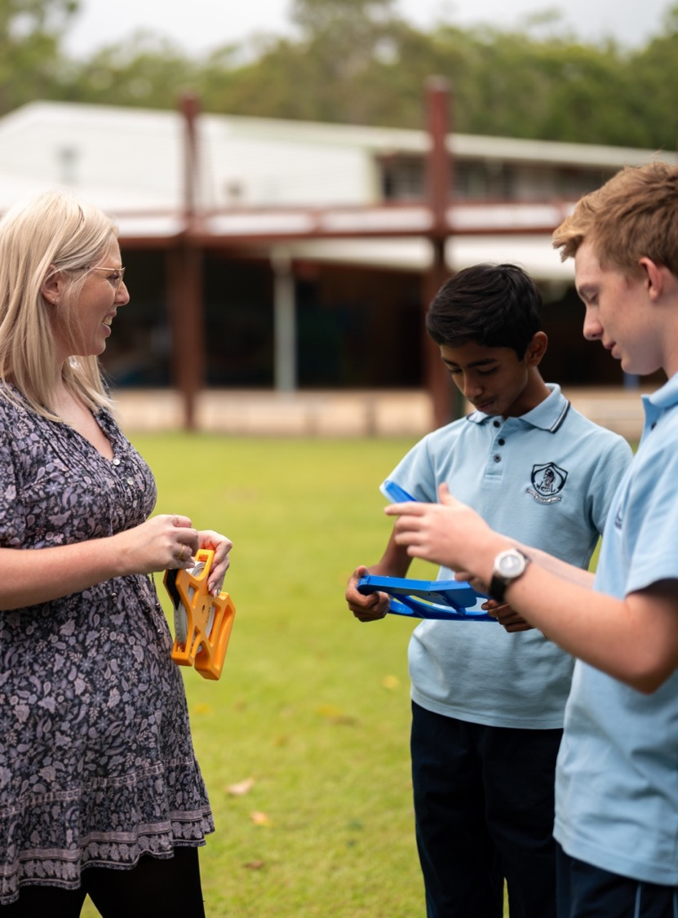
International time zones
Mathematics Standard – Stage 6 (Year 11)
Unit 5 – Going places

Slide 2
Learning intentions and success criteria
Learning intentions
To know how to calculate the time difference between 2 locations using Coordinated Universal Time (UTC).
Success criteria
I can use UTC to consider the relative position of locations.
I can calculate the time difference between 2 locations using UTC.

Slide 3
Activating prior knowledge

Slide 4
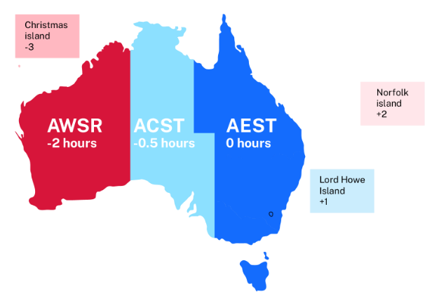
Australian time zones

Slide 5
Connecting learning

Slide 6
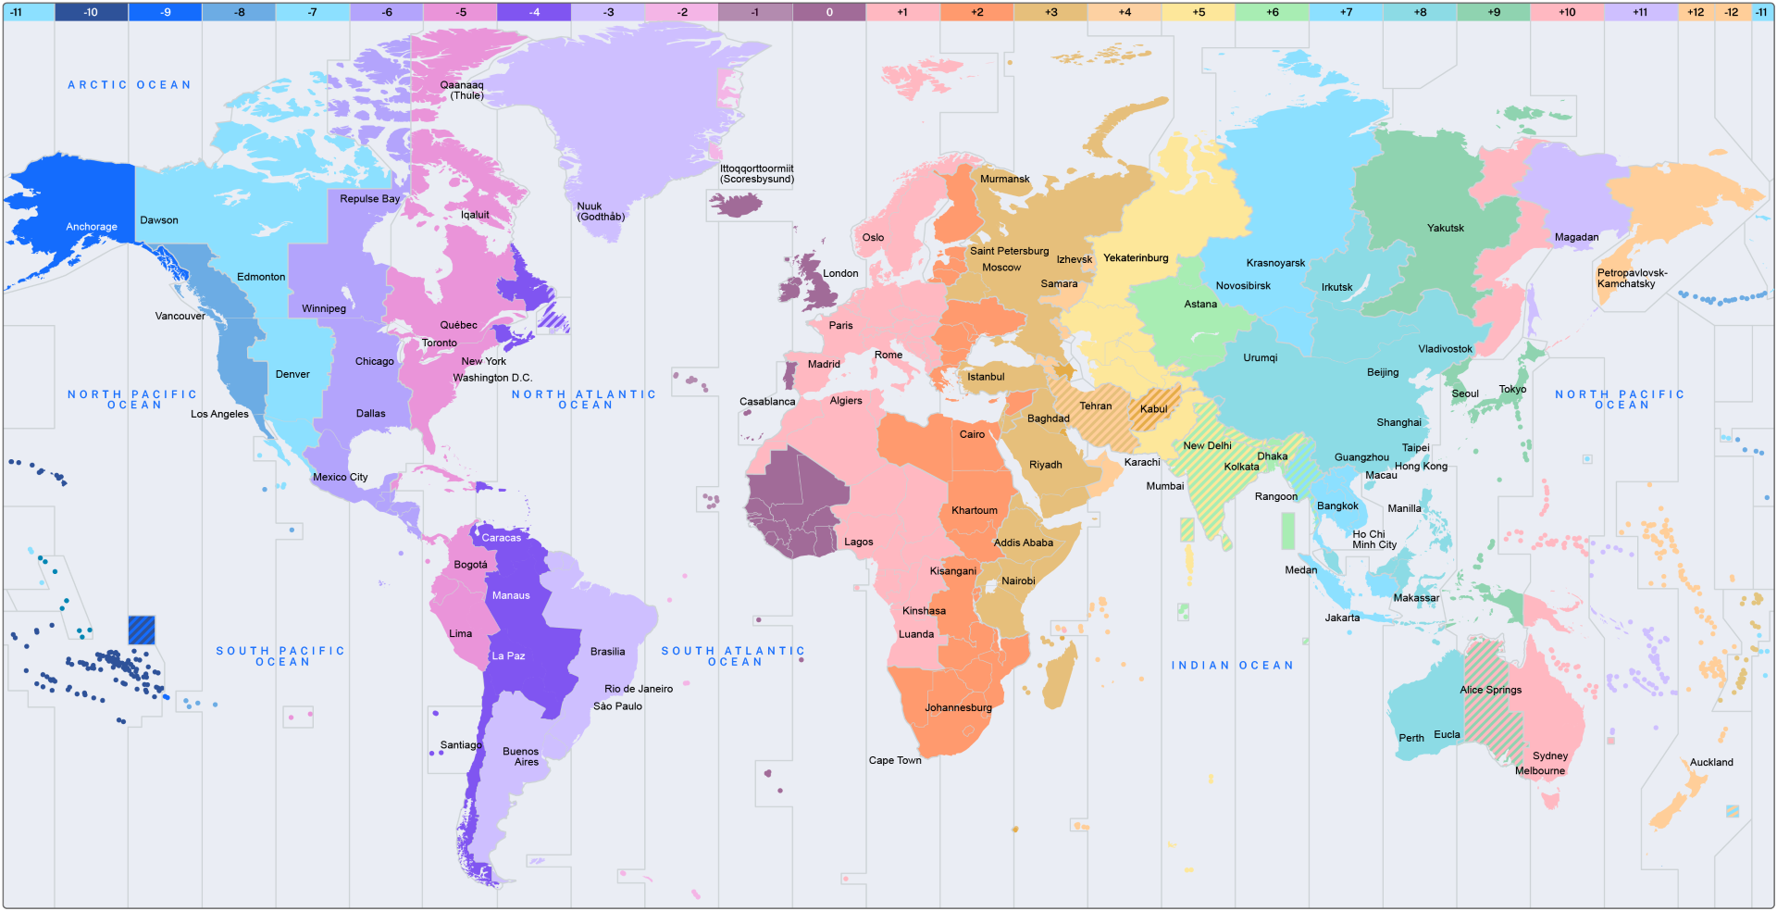
World map with time zones

Slide 7
Releasing responsibility

Slide 8
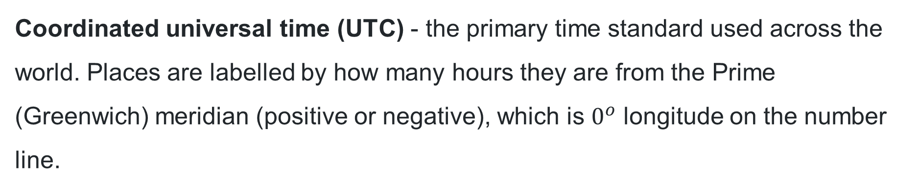
Coordinated Universal Time (UTC)
Coordinated universal time (UTC) - the primary time standard used across the world. Places are labelled by how many hours they are from the Prime (Greenwich) meridian (positive or negative), which is $0^{o}$ longitude on the number line.
International date line
Prime (Greenwich) Meridian
International date line
-12
0
+12
180°W
0°
180°E

Slide 9
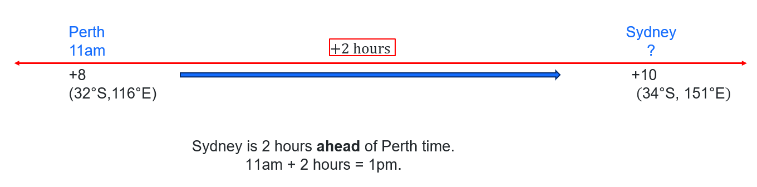
Sydney – Perth
Perth (UTC +8) is 2 hours behind Sydney (UTC +10). The time in Perth is $\text{11}\text{am}$.
What time is it in Sydney?

Slide 10
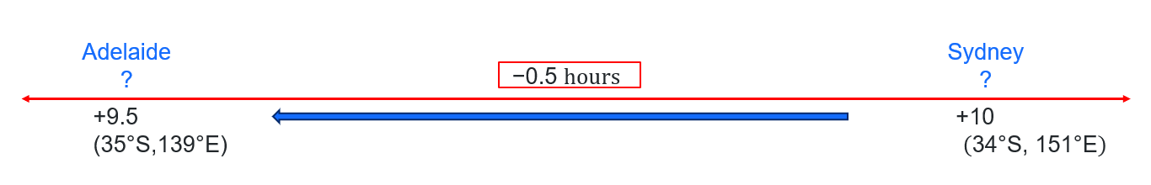
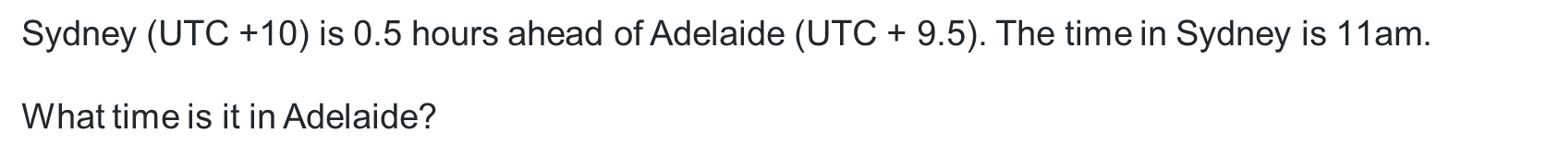
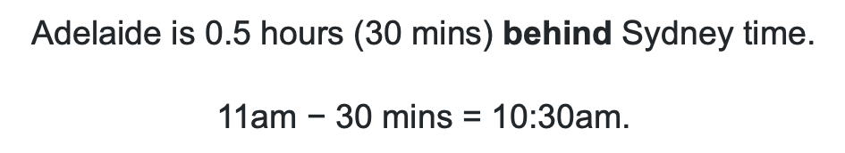
Sydney – Adelaide
Sydney (UTC +10) is 0.5 hours ahead of Adelaide (UTC + 9.5). The time in Sydney is $\text{11}\text{am}$.
What time is it in Adelaide?
Adelaide is $\text{0}\text{.5} \text{hours}\text{ (30 }\text{mins}\text{) }$behind Sydney time.
$$\text{11}\text{am} \text{−} \text{30 }\text{mins}\text{ = 1}\text{0:30}\text{a}\text{m}\text{.}$$

Slide 11
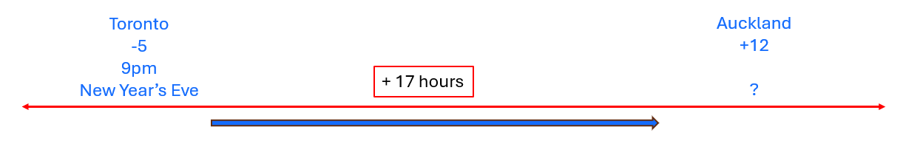
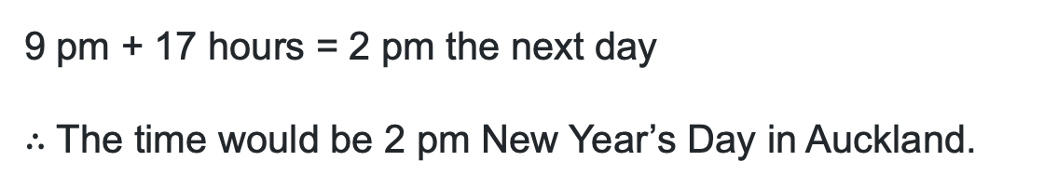
UTC (1)
Worked example
If it is 9 pm in Toronto, Canada (UTC -5) on New Years Eve, what time and day is it in Auckland, New Zealand (UTC + 12)?
Where does the 17 hours come from?
9 pm + 17 hours = 2 pm the next day
$∴$ The time would be 2 pm New Year’s Day in Auckland.
Why is it the next day?

Slide 12
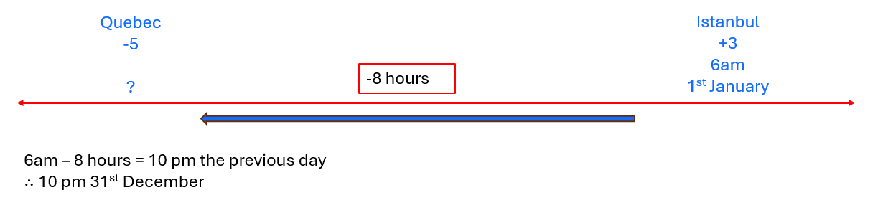
UTC (2)
Your turn – Question 1
If it is 6 am, 1st January, in Istanbul, Turkey (UTC +3), what time is it in Quebec, Canada (UTC -5)?

Slide 13
Independent practice

Slide 14

Approaching questions scaffold

Slide 15
References
This presentation contains NSW Curriculum and syllabus content. The NSW Curriculum is developed by the NSW Education Standards Authority. This content is prepared by NESA for and on behalf of the Crown in the right of the State of New South Wales. The material is protected by Crown copyright.
Please refer to the NESA Copyright Disclaimer for more information https://educationstandards.nsw.edu.au/wps/portal/nesa/mini-footer/copyright.
NESA holds the only official and up-to-date versions of the NSW Curriculum and syllabus documents. Please visit the NSW Education Standards Authority (NESA) website https://educationstandards.nsw.edu.au/wps/portal/nesa/home and the NSW Curriculum website https://curriculum.nsw.edu.au.
Mathematics Standard 11–12 Syllabus © NSW Education Standards Authority (NESA) for and on behalf of the Crown in right of the State of New South Wales, 2024.

Slide 16
Copyright
© State of New South Wales (Department of Education), 2026
The copyright material published in this resource is subject to the Copyright Act 1968 (Cth) and is owned by the NSW Department of Education or, where indicated, by a party other than the NSW Department of Education (third-party material).
Copyright material available in this resource and owned by the NSW Department of Education is licensed under a Creative Commons Attribution 4.0 International (CC BY 4.0) license.
This license allows you to share and adapt the material for any purpose, even commercially.
Attribution should be given to © State of New South Wales (Department of Education), 2026.
Material in this resource not available under a Creative Commons license:
the NSW Department of Education logo, other logos and trademark-protected material
Material owned by a third party that has been reproduced with permission. You will need to obtain permission from the third party to reuse its material.
Links to third-party material and websites
Please note that the provided (reading/viewing material/list/links/texts) are a suggestion only and implies no endorsement, by the New South Wales Department of Education, of any author, publisher, or book title. School principals and teachers are best placed to assess the suitability of resources that would complement the curriculum and reflect the needs and interests of their students.
If you use the links provided in this document to access a third-party’s website, you acknowledge that the terms of use, including licence terms set out on the third-party’s website apply to the use which may be made of the materials on that third-party website or where permitted by the Copyright Act 1968 (Cth). The department accepts no responsibility for content on third-party websites.

