Slide 1
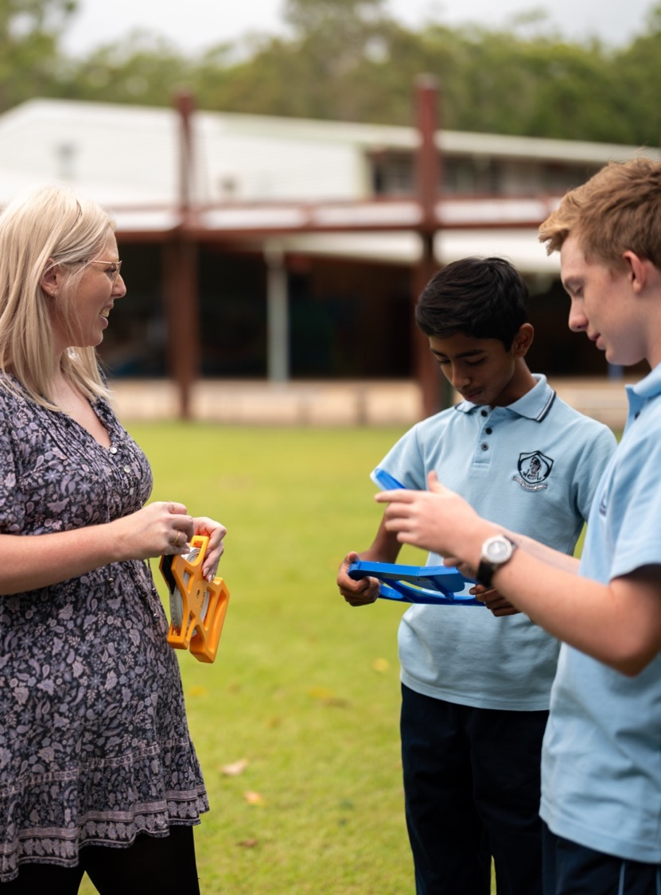
Australian time zones
Mathematics Standard – Stage 6 (Year 11)
Unit 5 – Going places

Slide 2
Learning intentions and success criteria
Learning intentions
To be able to calculate the time difference between 2 places in Australia using time zones.
To be able to perform time calculations using 12-hour and 24-hour time.
Success criteria
I can convert between 12-hour and 24-hour time.
I can solve problems using Australian time zones including daylight savings time.

Slide 3
Connecting learning

Slide 4
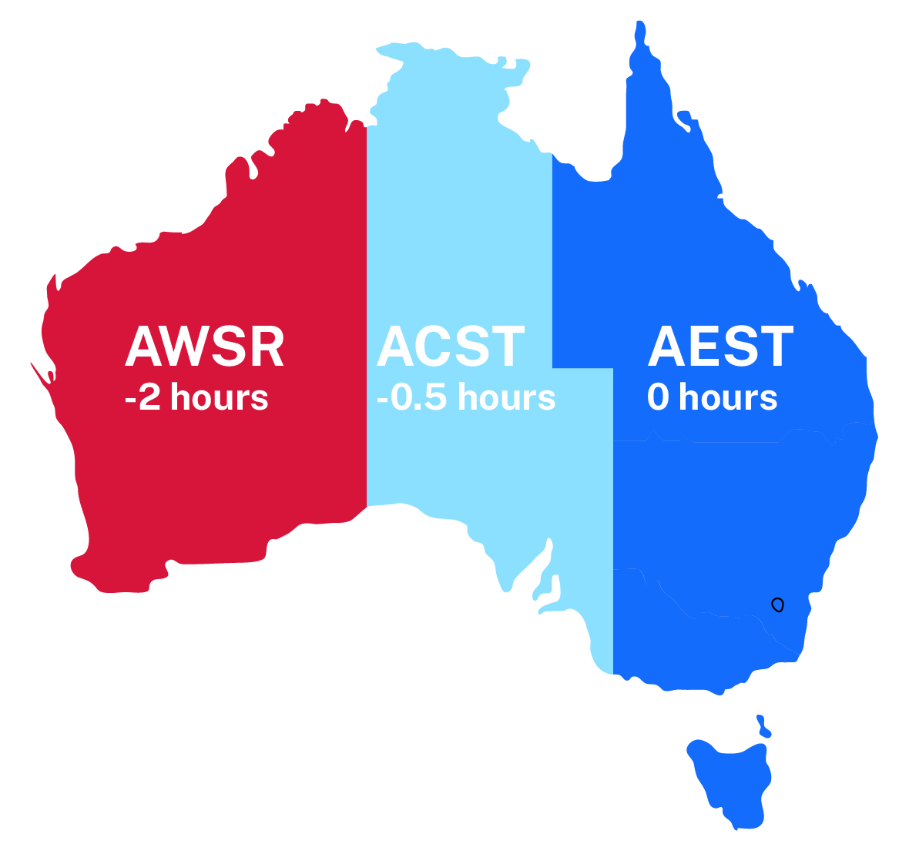
Main Australian time zones
AEST – Australian Eastern Standard Time (0)
ACST – Australian Central Standard Time (-0.5 hour)
AWST – Australian Western Standard Time (-2 hours)

Slide 5
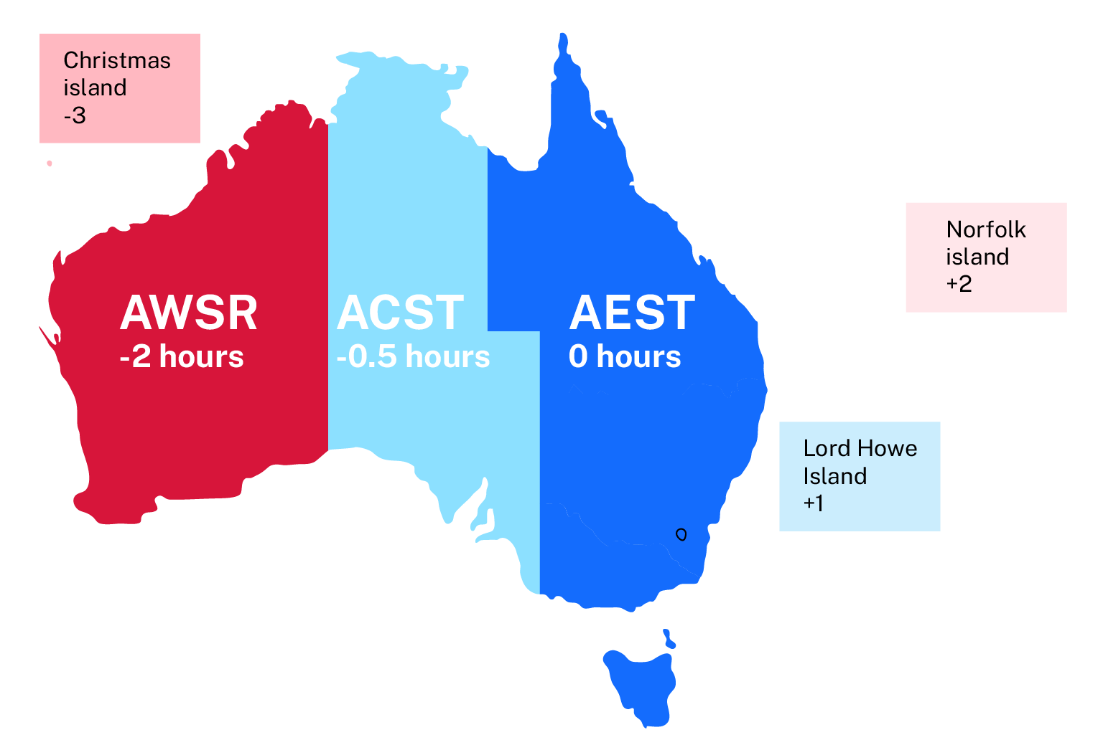
All Australian time zones

Slide 6
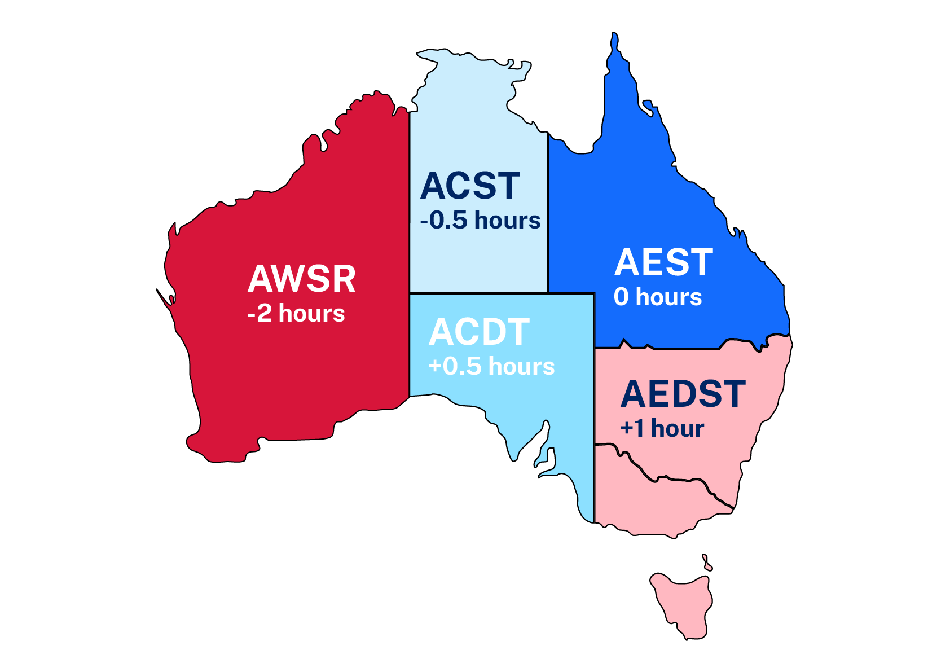
Daylight savings time zones
AEST – Australian Eastern Standard Time (0)
ACST – Australian Central Standard Time (-0.5 hour)
AWST – Australian Western Standard Time (-2 hours)
AEDT – Australian Eastern Daylight Time (+ 1 hour)
ACDT – Australian Central Daylight Time (+0.5 hour)
What is the time difference between Sydney and Perth during daylight savings time?
What if Perth was at 0 hours? How would the numbers change?

Slide 7
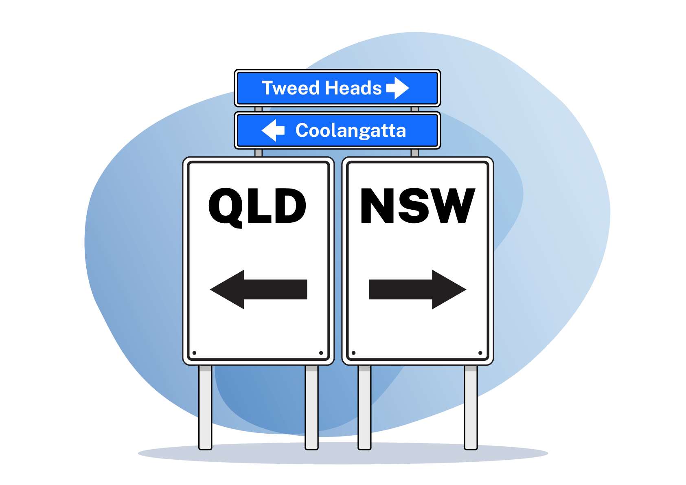
Tweed Heads and Coolangatta

Slide 8
Releasing responsibility

Slide 9
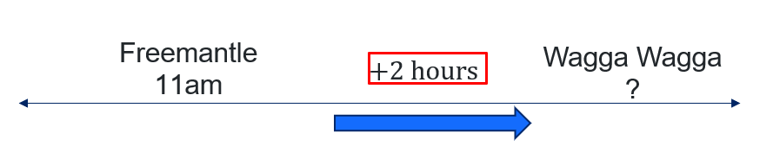
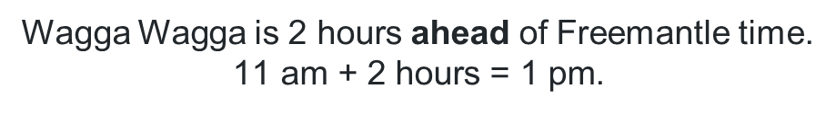
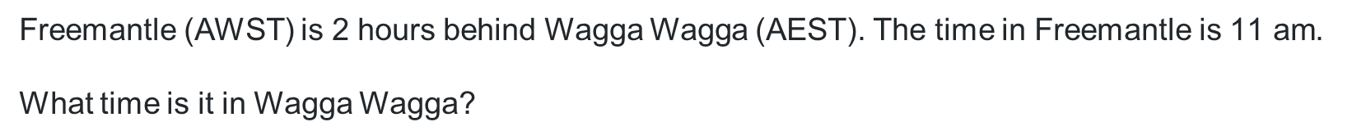
Australian time zones (1)
Worked example 1
Freemantle (AWST) is 2 hours behind Wagga Wagga (AEST). The time in Freemantle is $\text{11} \text{am}$.
What time is it in Wagga Wagga?
How do we know to add rather than subtract?
Why are Freemantle and Wagga Wagga in this order on the number line?
Wagga Wagga is $\text{2 }\text{hours}$ahead of Freemantle time.
$$\text{11} \text{am}\text{ + 2 }\text{hours}\text{ = 1 }\text{pm}\text{.}$$

Slide 10
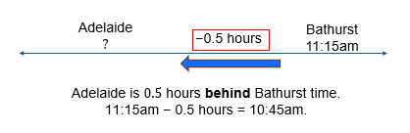
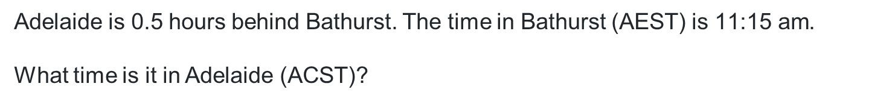
Australian time zones (2)
Your turn – question 1
Adelaide is 0.5 hours behind Bathurst. The time in Bathurst (AEST) is $\text{11:15} \text{am}$.
What time is it in Adelaide (ACST)?

Slide 11
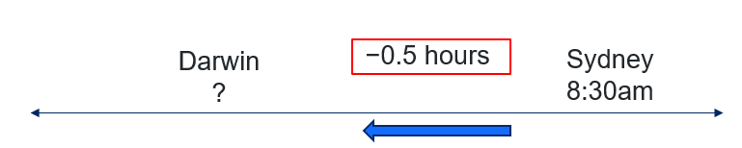
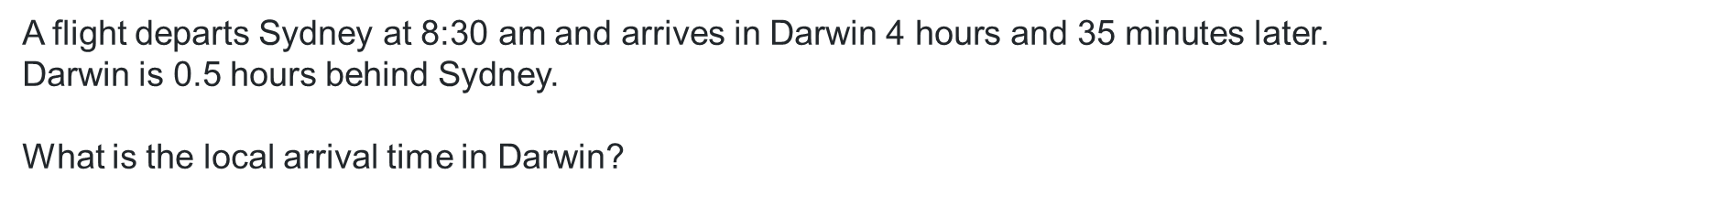
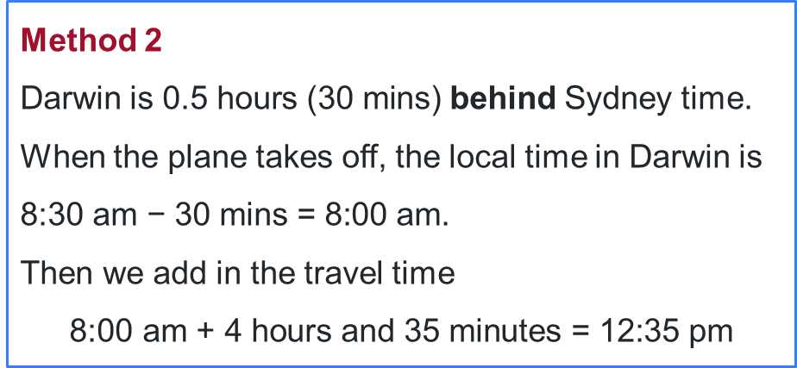
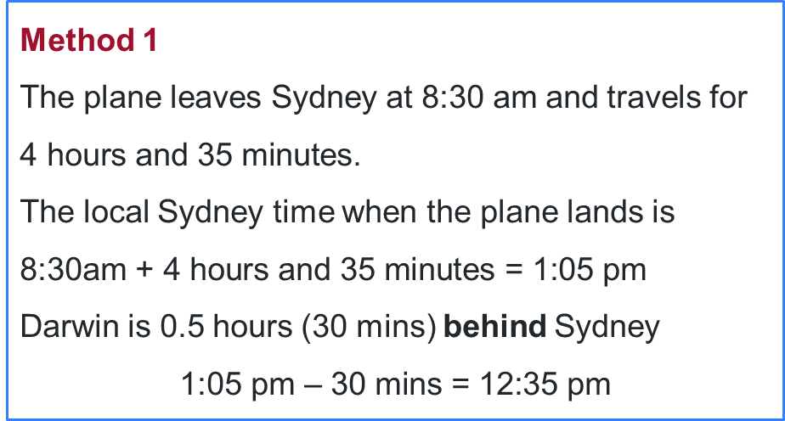
Australian time zones(3)
Worked example 2
A flight departs Sydney at $\text{8:30} \text{am}$ and arrives in Darwin $\text{4 }\text{hours} \text{and}\text{ 35 }\text{minutes}$later.
Darwin is 0.5 hours behind Sydney.
What is the local arrival time in Darwin?
Why are we subtracting here?
Why are there 2 methods? How are they different?
Method 1
The plane leaves Sydney at $\text{8:30} \text{am}$ and travels for $\text{4 }\text{hours} \text{and}\text{ 35 }\text{minutes}$.
The local Sydney time when the plane lands is $\text{8:30}\text{am}\text{ + 4 }\text{hours} \text{and}\text{ 35 }\text{minutes}\text{ = 1:05 }\text{pm}$
Darwin is 0.5 hours (30 mins) behind Sydney
$$\text{1:05 }\text{pm}\text{ – 30 }\text{mins}\text{ = 12:35 }\text{pm}$$
Method 2
Darwin is $\text{0.5 }\text{hours}\text{ (30 }\text{mins}\text{) }$behind Sydney time.
When the plane takes off, the local time in Darwin is $\text{8:30} \text{am}\text{ − 30 }\text{mins}\text{ = 8:00 }\text{am}$.
Then we add in the travel time
$$\text{8:00 }\text{am}\text{ + 4 }\text{hours} \text{and}\text{ 35 }\text{minutes}\text{ = 12:35 }\text{pm}$$

Slide 12
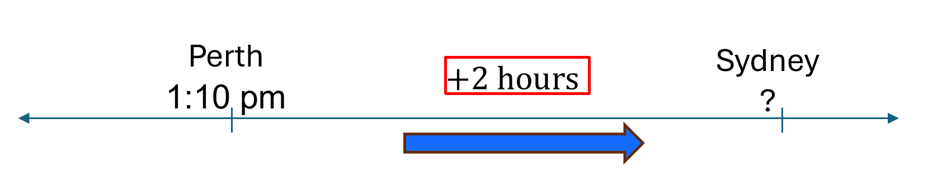
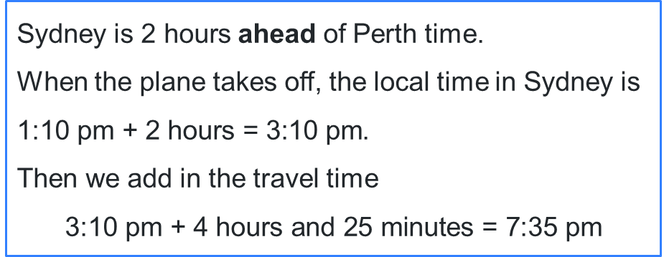
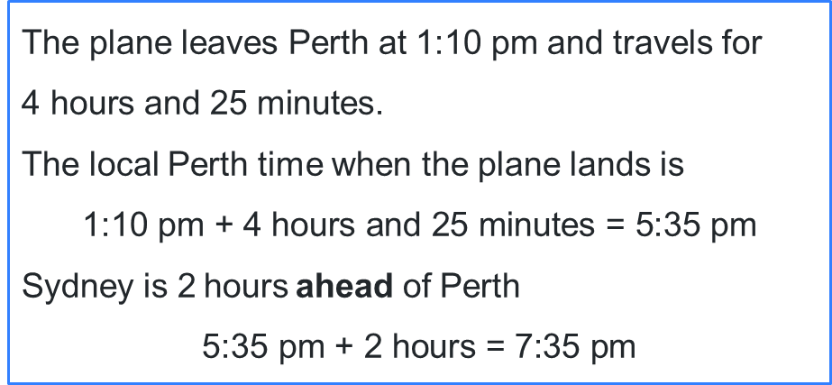
Australian time zones (4)
Your turn – question 2
A flight departs Perth at $\text{1:10} \text{pm}$ and the flight takes $\text{4 }\text{hours} \text{and}\text{ 25 }\text{minutes}$. Perth is 2 hours behind Sydney.
What is the local time in Sydney when the plane lands?
The plane leaves Perth at $\text{1:10} \text{pm}$ and travels for
$\text{4 }\text{hours} \text{and}\text{ 25 }\text{minutes}$.
The local Perth time when the plane lands is
$$\text{1:10 }\text{pm}\text{ + 4 }\text{hours} \text{and}\text{ 25 }\text{minutes}\text{ = 5:35 }\text{pm}$$
Sydney is $\text{2} \text{hours}$ahead of Perth
$$\text{5:35 }\text{pm}\text{ + 2 }\text{hours}\text{ = 7:35 }\text{pm}$$
Sydney is $\text{2 }\text{hours}$ahead of Perth time.
When the plane takes off, the local time in Sydney is $\text{1:10} \text{pm}\text{ + 2 }\text{hours}\text{ = 3:10 }\text{pm}$.
Then we add in the travel time
$$\text{3:10 }\text{pm}\text{ + 4 }\text{hours} \text{and}\text{ 25 }\text{minutes}\text{ = 7:35 }\text{pm}$$

Slide 13
Independent practice

Slide 14

Approaching questions scaffold

Slide 15
References
This presentation contains NSW Curriculum and syllabus content. The NSW Curriculum is developed by the NSW Education Standards Authority. This content is prepared by NESA for and on behalf of the Crown in the right of the State of New South Wales. The material is protected by Crown copyright.
Please refer to the NESA Copyright Disclaimer for more information https://educationstandards.nsw.edu.au/wps/portal/nesa/mini-footer/copyright.
NESA holds the only official and up-to-date versions of the NSW Curriculum and syllabus documents. Please visit the NSW Education Standards Authority (NESA) website https://educationstandards.nsw.edu.au/wps/portal/nesa/home and the NSW Curriculum website https://curriculum.nsw.edu.au.
Mathematics Standard 11–12 Syllabus © NSW Education Standards Authority (NESA) for and on behalf of the Crown in right of the State of New South Wales, 2024.

Slide 16
Copyright
© State of New South Wales (Department of Education), 2026
The copyright material published in this resource is subject to the Copyright Act 1968 (Cth) and is owned by the NSW Department of Education or, where indicated, by a party other than the NSW Department of Education (third-party material).
Copyright material available in this resource and owned by the NSW Department of Education is licensed under a Creative Commons Attribution 4.0 International (CC BY 4.0) license.
This license allows you to share and adapt the material for any purpose, even commercially.
Attribution should be given to © State of New South Wales (Department of Education), 2026.
Material in this resource not available under a Creative Commons license:
the NSW Department of Education logo, other logos and trademark-protected material
Material owned by a third party that has been reproduced with permission. You will need to obtain permission from the third party to reuse its material.
Links to third-party material and websites
Please note that the provided (reading/viewing material/list/links/texts) are a suggestion only and implies no endorsement, by the New South Wales Department of Education, of any author, publisher, or book title. School principals and teachers are best placed to assess the suitability of resources that would complement the curriculum and reflect the needs and interests of their students.
If you use the links provided in this document to access a third-party’s website, you acknowledge that the terms of use, including licence terms set out on the third-party’s website apply to the use which may be made of the materials on that third-party website or where permitted by the Copyright Act 1968 (Cth). The department accepts no responsibility for content on third-party websites.

