Slide 1
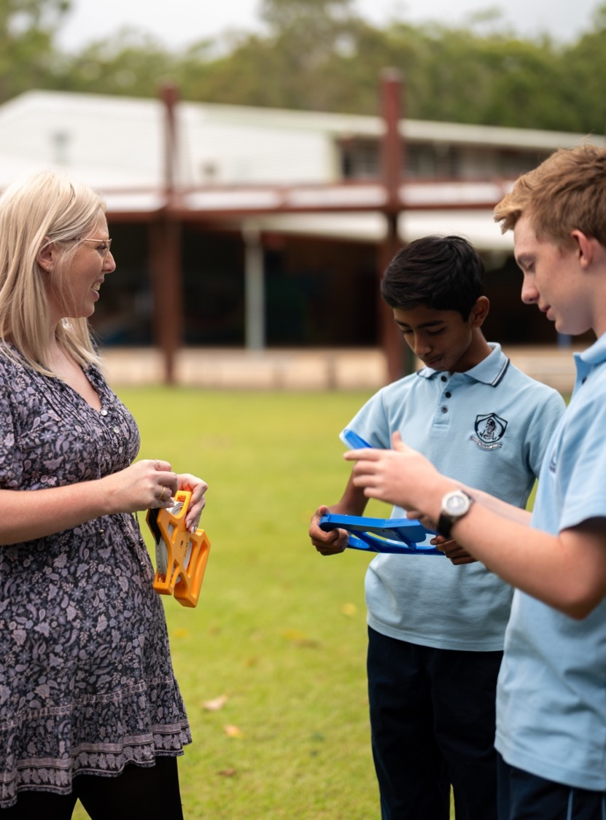
Latitude and longitude
Mathematics Standard – Stage 6 (Year 11)
Unit 5 – Going places

Slide 2
Learning intentions and success criteria
Learning intentions
To understand how latitude and longitude are used to locate places on Earth.
To understand the relationship between longitude and time.
Success criteria
I can identify locations using latitude and longitude.
I can identify whether a place is ahead or behind another place in time.
I can calculate the time differences between locations using longitude.

Slide 3
Retrieval practice

Slide 4
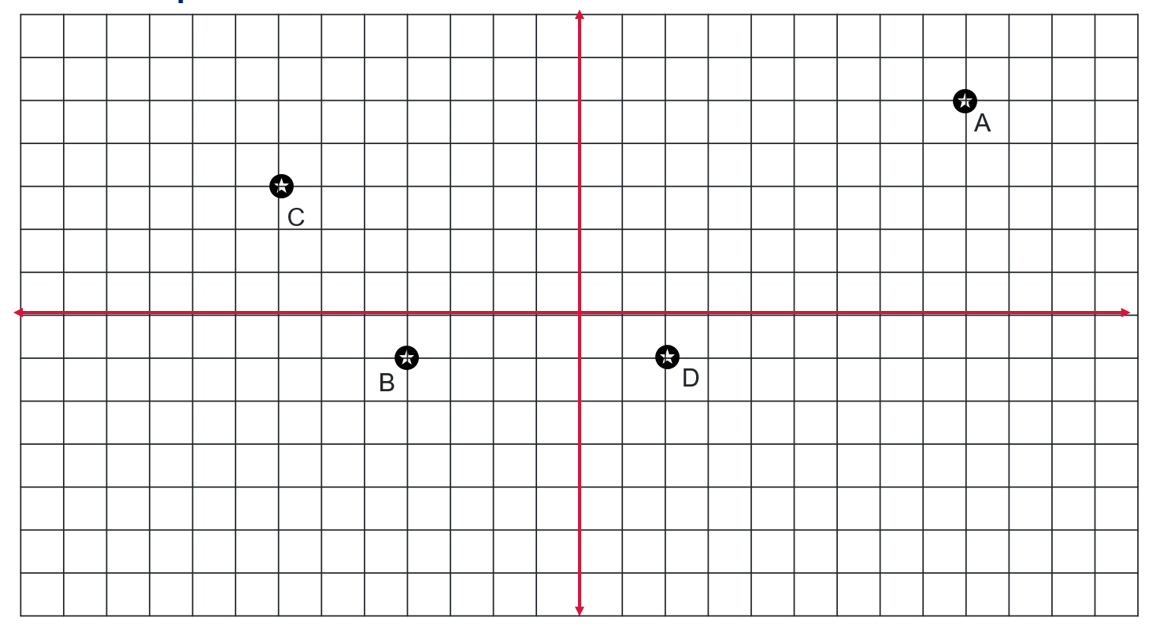
Cartesian plane

Slide 5
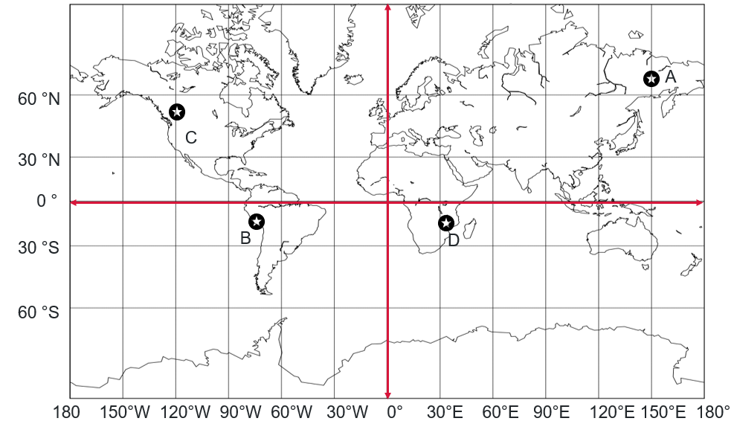
World map with Cartesian plane

Slide 6
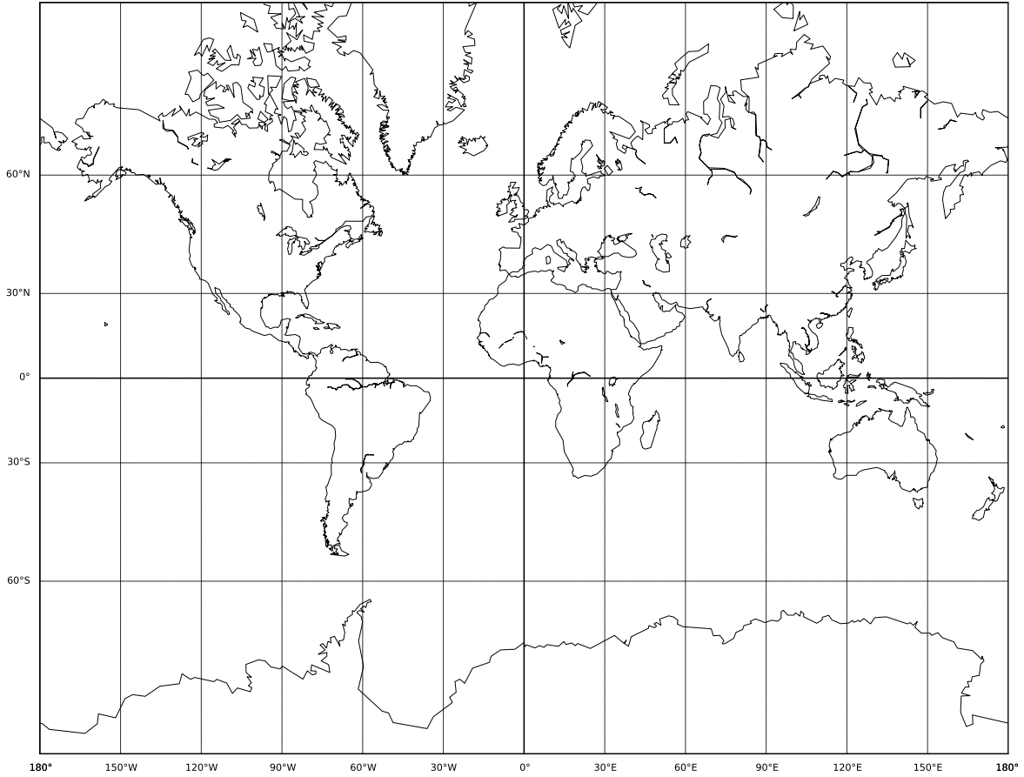
Latitude and Longitude map
Lines of latitude are the north/south lines and are horizontal.
This point is
(60°N, 90 °E)
60 °N
30 °N
0 °
30 °S
60 °S
The north/south coordinate is given first
Lines of longitude are the east/west lines and are vertical.
180 150°W 120°W 90°W 60°W 30°W 0° 30°E 60°E 90°E 120°E 150°E 180°

Slide 7
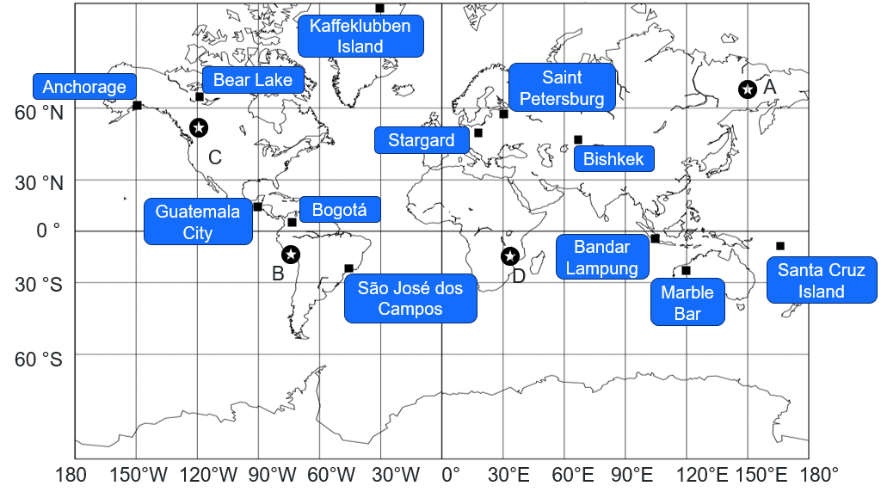
World map

Slide 8
Activating prior knowledge

Slide 9

Nedd’s location
Nedd’s app said that his location was as shown.

Slide 10
Connecting learning

Slide 11
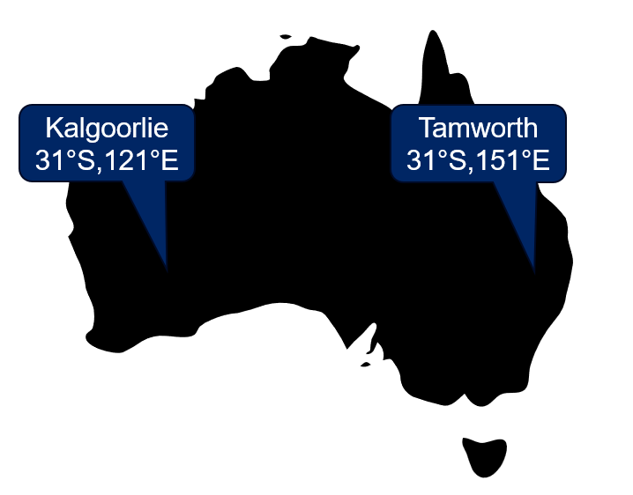
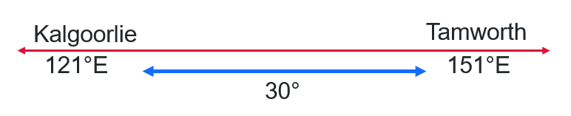
Time difference (1)

Slide 12
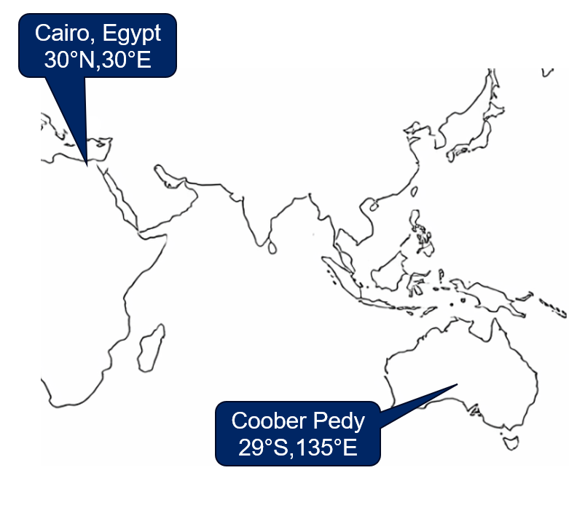
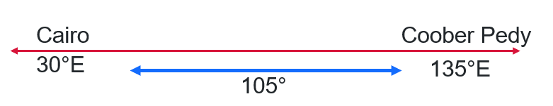
Time difference (2)

Slide 13
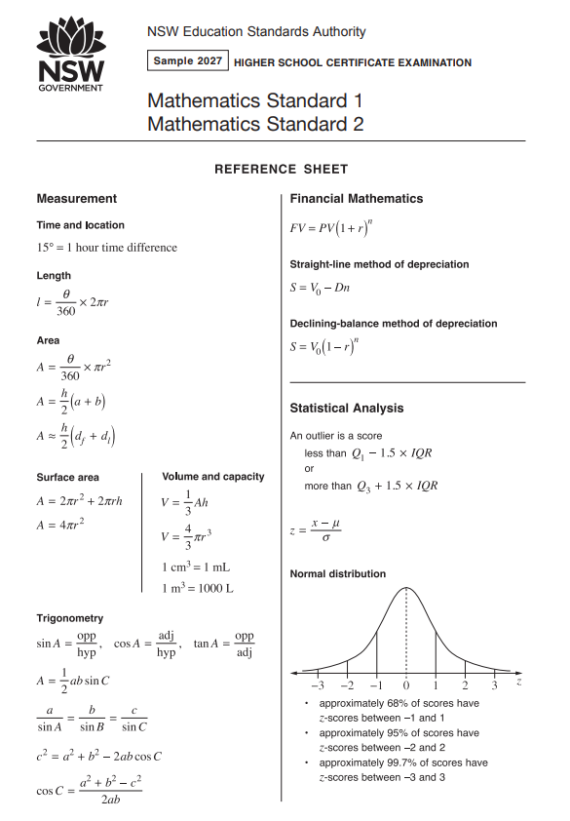
Reference sheet

Slide 14
Releasing responsibility

Slide 15
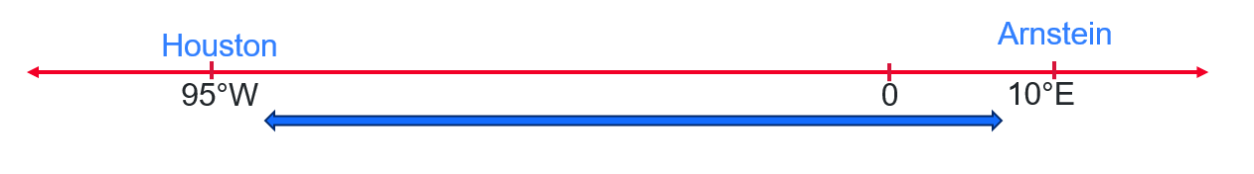
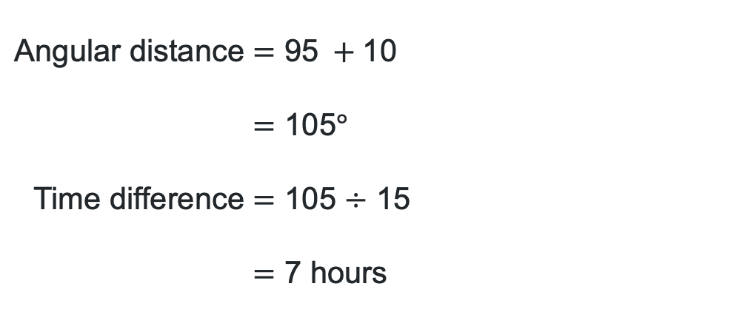
Latitude and longitude (1)
Worked example 1
What is the time difference between Houston, USA (30°N, 95°W) and Arnstein, Germany
$\text{(}\text{50}\text{°}\text{N}\text{, }\text{10}\text{°}\text{E}\text{)}$?
$$\text{Angular} \text{distance}=\text{95} +\text{10} \\ =\text{105}\text{°} \\ \text{Time} \text{difference}=\text{105 }\text{÷} \text{15} \\ =\text{7 }\text{hours}$$
What is meant by angular distance?
Why are we adding here?
Why are we dividing by 15?

Slide 16
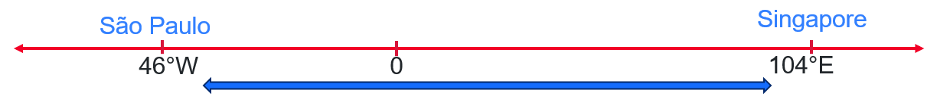
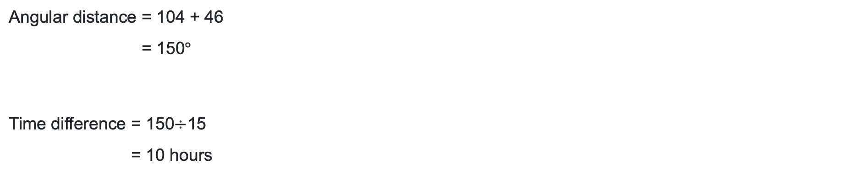
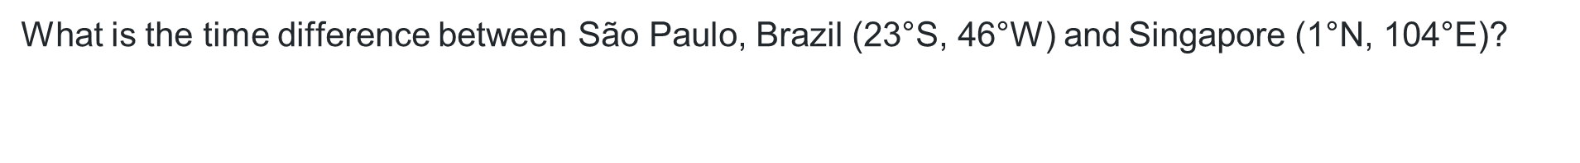
Latitude and longitude (2)
Your turn – Question 1
What is the time difference between São Paulo, Brazil (23°S, 46°W) and Singapore $\text{(}\text{1}\text{°}\text{N}\text{, 104°}\text{E}\text{)}$?
$$\text{Angular} \text{distance} \text{=}\text{ 104 + 46} \\ \text{=}\text{ 150}\text{°}$$
$$\text{Time} \text{difference} \text{=}\text{ 150}\text{÷}\text{15} \\ \text{=}\text{ 10 }\text{hours}$$

Slide 17
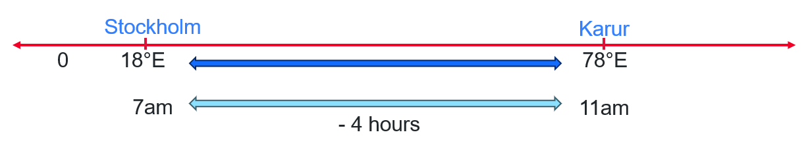
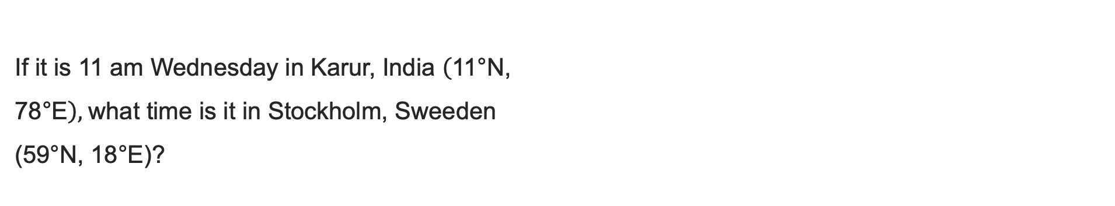
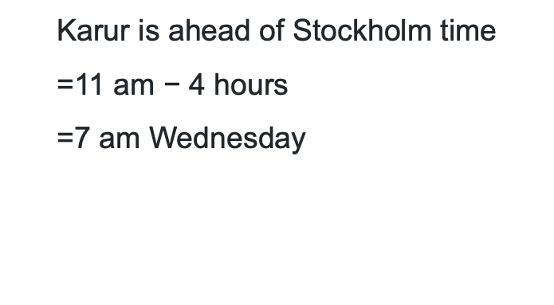
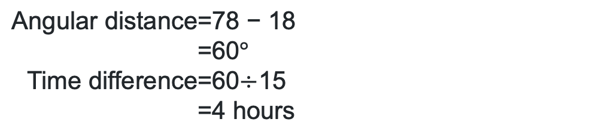
Latitude and longitude (3)
Worked example 2
If it is 11 am Wednesday in Karur, India $\left(\text{11}\text{°}\text{N}\text{, }\text{78}\text{°}\text{E}\right),$what time is it in Stockholm, Sweeden
$\text{(}\text{59}\text{°}\text{N}\text{, }\text{18}\text{°}\text{E}\text{)}$?
$$\text{Karur} \text{is} \text{ahead} \text{of} \text{Stockholm} \text{time} \\ \text{=}\text{11 }\text{am} \text{−} \text{4 }\text{hours} \\ \text{=}\text{7 }\text{am} \text{Wednesday}$$
$$\text{Angular} \text{distance}\text{=}\text{78 }\text{− }\text{18} \\ \text{=}\text{60}\text{°} \\ \text{Time} \text{difference}\text{=}\text{60}\text{÷}\text{15} \\ \text{=}\text{4 }\text{hours}$$
Why are these angles being subtracted?
How do we subtract time?

Slide 18
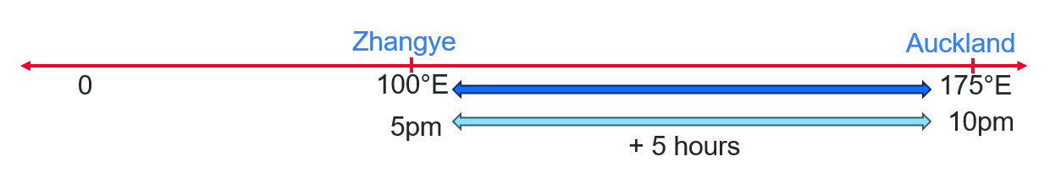
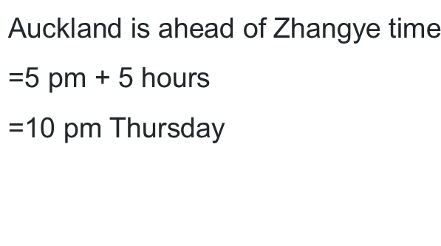
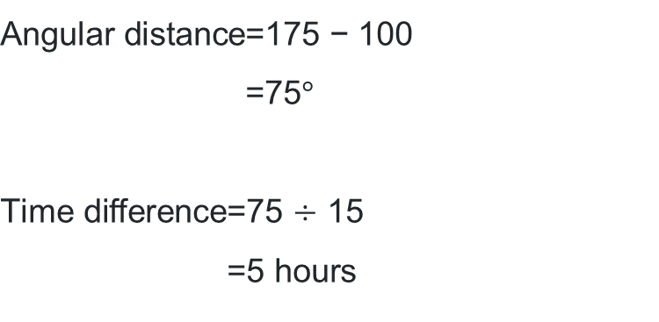
Latitude and longitude (4)
Your turn – Question 2
If it is 5 pm Thursday in Zhangye, China $\left(\text{40}\text{°}\text{N}\text{, }\text{100}\text{°}\text{E}\right),$what time is it in Auckland, New Zealand $\text{(}\text{37}\text{°}\text{S}\text{, }\text{175}\text{°}\text{E})$?
$$\text{Angular} \text{distance}\text{=}\text{1}\text{75 }\text{− }\text{100} \\ \text{=}\text{75}\text{°}$$
$$\text{Time} \text{difference}\text{=}\text{75 }\text{÷} \text{15} \\ \text{=}\text{5 }\text{hours}$$
$$\text{A}\text{uckland} \text{is} \text{ahead} \text{of} \text{Zhangye} \text{time} \\ \text{=}\text{5 }\text{pm}\text{ + }\text{5 }\text{hours}$$
$\text{=}\text{10 }\text{pm} \text{Thursday}$

Slide 19
Independent practice

Slide 20

Approaching questions scaffold

Slide 21
References
This presentation contains NSW Curriculum and syllabus content. The NSW Curriculum is developed by the NSW Education Standards Authority. This content is prepared by NESA for and on behalf of the Crown in the right of the State of New South Wales. The material is protected by Crown copyright.
Please refer to the NESA Copyright Disclaimer for more information https://educationstandards.nsw.edu.au/wps/portal/nesa/mini-footer/copyright.
NESA holds the only official and up-to-date versions of the NSW Curriculum and syllabus documents. Please visit the NSW Education Standards Authority (NESA) website https://educationstandards.nsw.edu.au/wps/portal/nesa/home and the NSW Curriculum website https://curriculum.nsw.edu.au.
Mathematics Standard 11–12 Syllabus © NSW Education Standards Authority (NESA) for and on behalf of the Crown in right of the State of New South Wales, 2024.

Slide 22
Copyright
© State of New South Wales (Department of Education), 2026
The copyright material published in this resource is subject to the Copyright Act 1968 (Cth) and is owned by the NSW Department of Education or, where indicated, by a party other than the NSW Department of Education (third-party material).
Copyright material available in this resource and owned by the NSW Department of Education is licensed under a Creative Commons Attribution 4.0 International (CC BY 4.0) license.
This license allows you to share and adapt the material for any purpose, even commercially.
Attribution should be given to © State of New South Wales (Department of Education), 2026.
Material in this resource not available under a Creative Commons license:
the NSW Department of Education logo, other logos and trademark-protected material
Material owned by a third party that has been reproduced with permission. You will need to obtain permission from the third party to reuse its material.
Links to third-party material and websites
Please note that the provided (reading/viewing material/list/links/texts) are a suggestion only and implies no endorsement, by the New South Wales Department of Education, of any author, publisher, or book title. School principals and teachers are best placed to assess the suitability of resources that would complement the curriculum and reflect the needs and interests of their students.
If you use the links provided in this document to access a third-party’s website, you acknowledge that the terms of use, including licence terms set out on the third-party’s website apply to the use which may be made of the materials on that third-party website or where permitted by the Copyright Act 1968 (Cth). The department accepts no responsibility for content on third-party websites.

