Slide 1
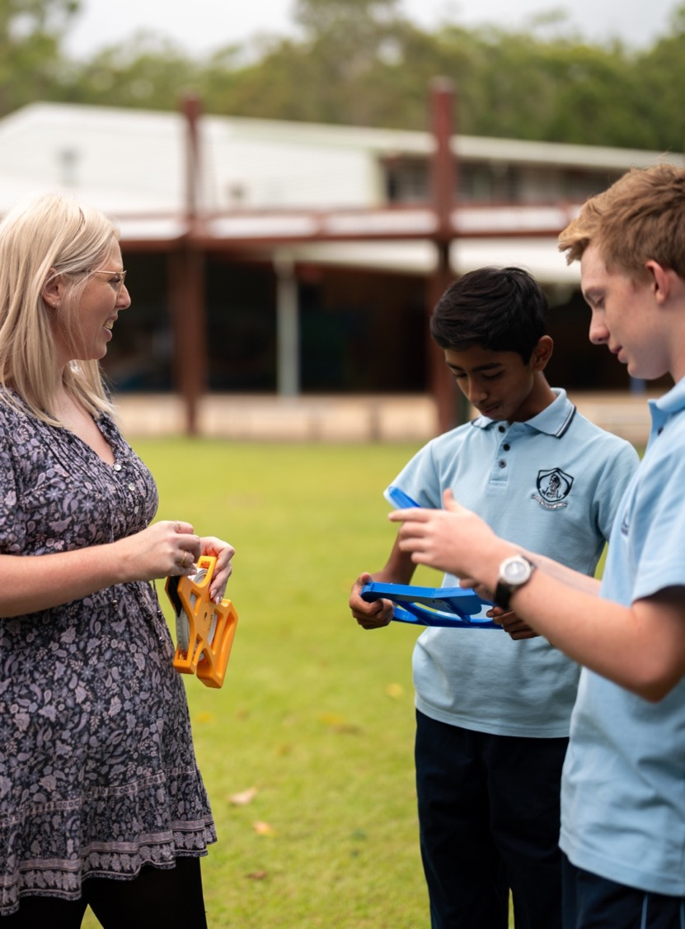
Constructing networks from a map
Mathematics Standard – Stage 6 (Year 11)
Unit 5 - Going places

Slide 2
Learning intentions and success criteria
Learning intentions
• To understand how networks are used to model real-world situations.
• To be able to use information from a map to construct a network diagram.
Success criteria
• I can compare 2 networks and explain whether they represent the same information.
• I can construct a weighted network diagram from a map.
• I can construct a directed network diagram from a map.
• I can analyse a network diagram to solve problems.

Slide 3
Connecting learning

Slide 4
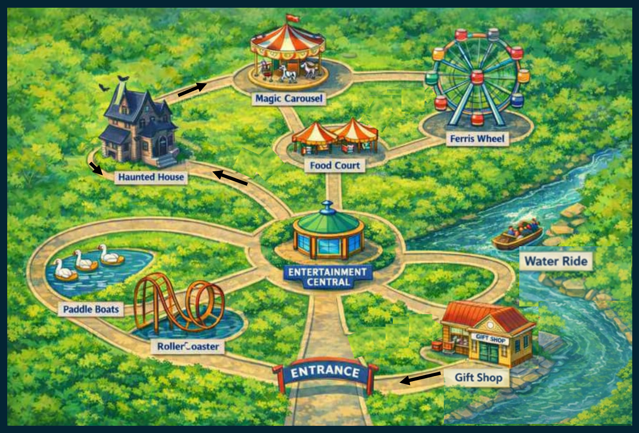
Theme Park
Image generated using Microsoft Copilot (2026)

Slide 5
Releasing responsibility

Slide 6
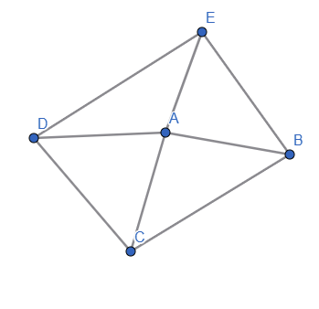
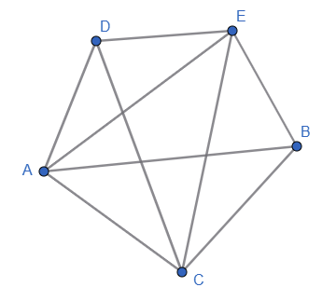
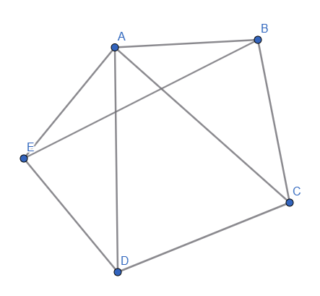
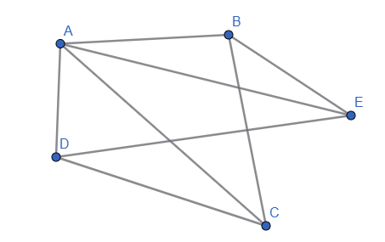
Which one is different?

Slide 7
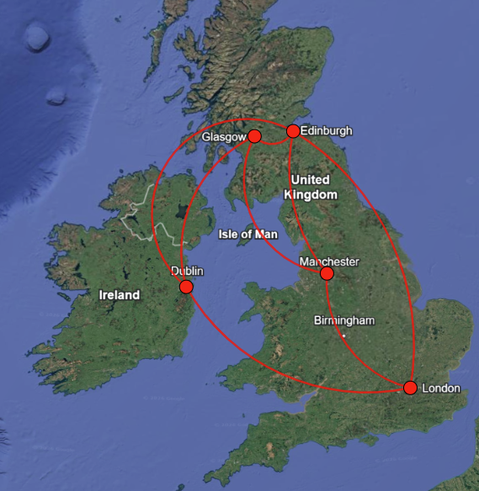
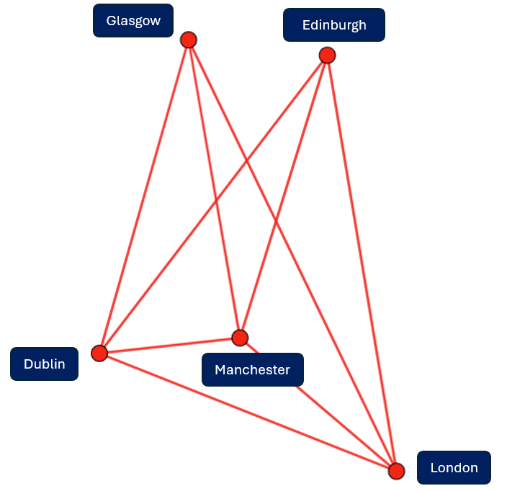
Incorrect worked example (1)
The map on the left correctly shows flight paths in the United Kingdom
Source: Google maps (accessed March 2026):
Map data © Google. https://www.google.com/maps

Slide 8
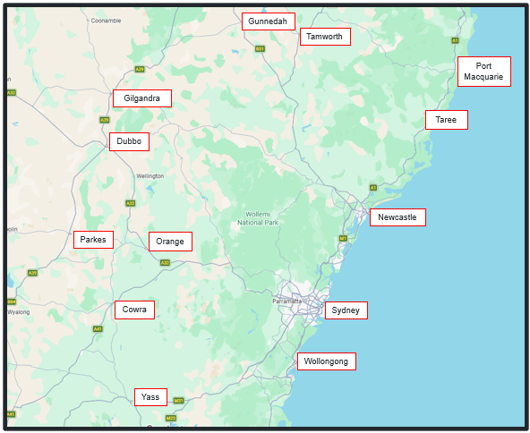
Yass to Tamworth
Source Google maps (accessed March 2026): Map data © Google https://www.google.com/maps

Slide 9
Independent practice

Slide 10

Approaching questions scaffold

Slide 11
References
This presentation contains NSW Curriculum and syllabus content. The NSW Curriculum is developed by the NSW Education Standards Authority. This content is prepared by NESA for and on behalf of the Crown in the right of the State of New South Wales. The material is protected by Crown copyright.
Please refer to the NESA Copyright Disclaimer for more information https://educationstandards.nsw.edu.au/wps/portal/nesa/mini-footer/copyright.
NESA holds the only official and up-to-date versions of the NSW Curriculum and syllabus documents. Please visit the NSW Education Standards Authority (NESA) website https://educationstandards.nsw.edu.au/wps/portal/nesa/home and the NSW Curriculum website https://curriculum.nsw.edu.au.
Mathematics Standard 11–12 Syllabus © NSW Education Standards Authority (NESA) for and on behalf of the Crown in right of the State of New South Wales, 2024.

Slide 12
Copyright
© State of New South Wales (Department of Education), 2026
The copyright material published in this resource is subject to the Copyright Act 1968 (Cth) and is owned by the NSW Department of Education or, where indicated, by a party other than the NSW Department of Education (third-party material).
Copyright material available in this resource and owned by the NSW Department of Education is licensed under a Creative Commons Attribution 4.0 International (CC BY 4.0) license.
This license allows you to share and adapt the material for any purpose, even commercially.
Attribution should be given to © State of New South Wales (Department of Education), 2026.
Material in this resource not available under a Creative Commons license:
the NSW Department of Education logo, other logos and trademark-protected material
Material owned by a third party that has been reproduced with permission. You will need to obtain permission from the third party to reuse its material.
Links to third-party material and websites
Please note that the provided (reading/viewing material/list/links/texts) are a suggestion only and implies no endorsement, by the New South Wales Department of Education, of any author, publisher, or book title. School principals and teachers are best placed to assess the suitability of resources that would complement the curriculum and reflect the needs and interests of their students.
If you use the links provided in this document to access a third-party’s website, you acknowledge that the terms of use, including licence terms set out on the third-party’s website apply to the use which may be made of the materials on that third-party website or where permitted by the Copyright Act 1968 (Cth). The department accepts no responsibility for content on third-party websites.

