Slide 1
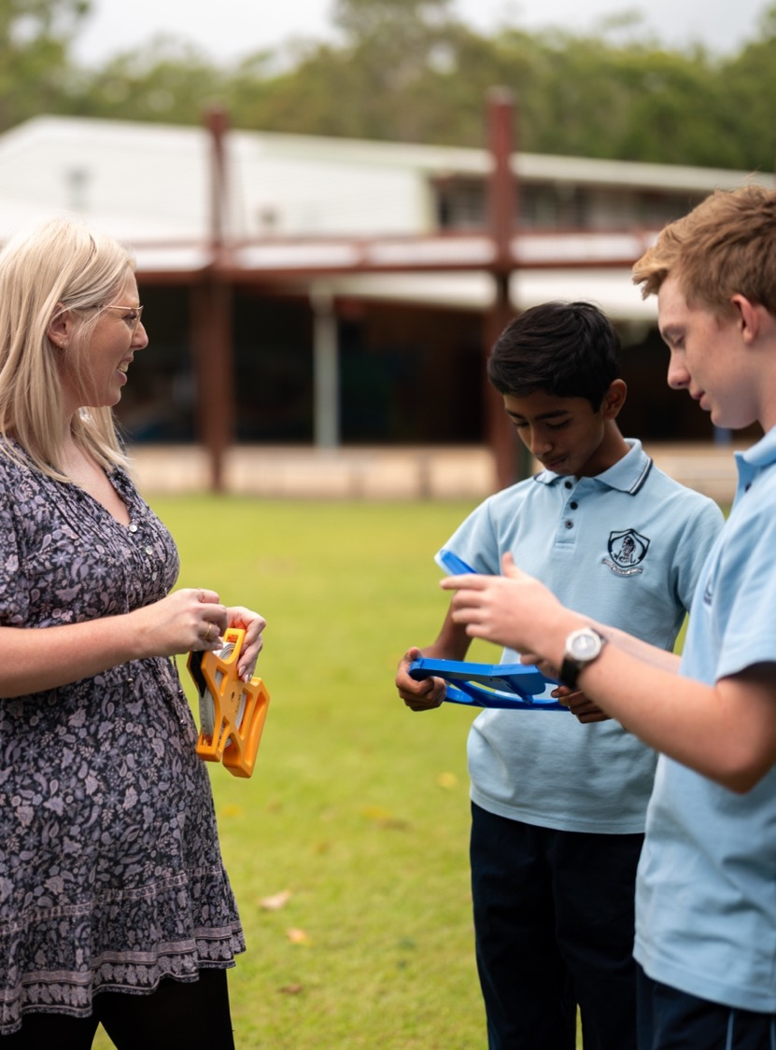
Introduction to networks
Mathematics Standard – Stage 6 (Year 11)
Unit 5 - Going places

Slide 2
Learning intentions and success criteria
Learning intentions
To understand the purpose of network diagrams.
To be able to describe and use the key terminology associated with network diagrams.
Success criteria
I can identify the vertices and edges in a network diagram.
I can recognise when a network diagram is directed or has weighted edges.
I can solve a problem in a network diagram in a real-world application.

Slide 3
Activating prior knowledge

Slide 4
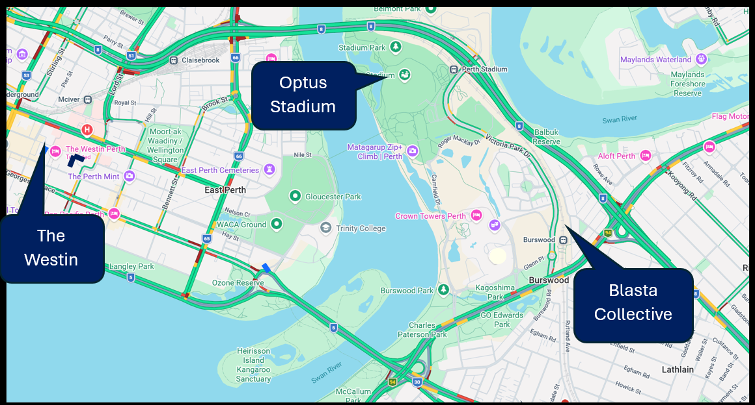
Perth city map (1)
Google Maps. Map data © Google. https://www.google.com/maps

Slide 5
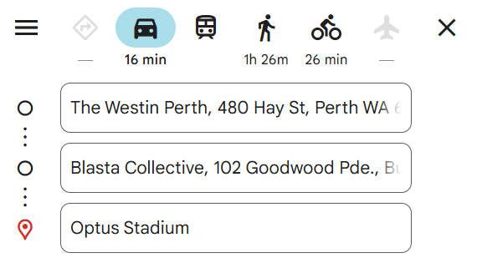
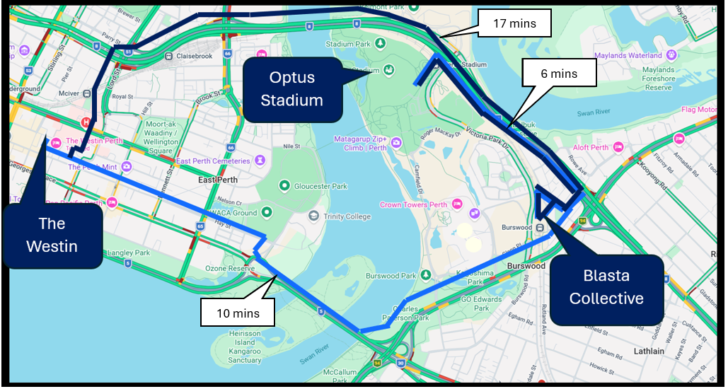
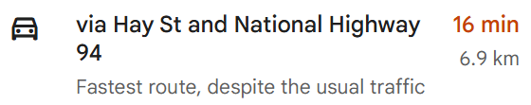
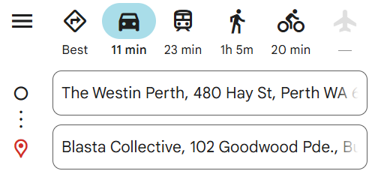

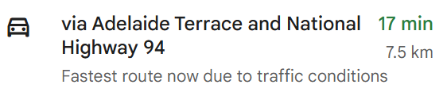
Perth city map (2)
Google Maps. Map data © Google. https://www.google.com/maps

Slide 6
Connecting learning

Slide 7
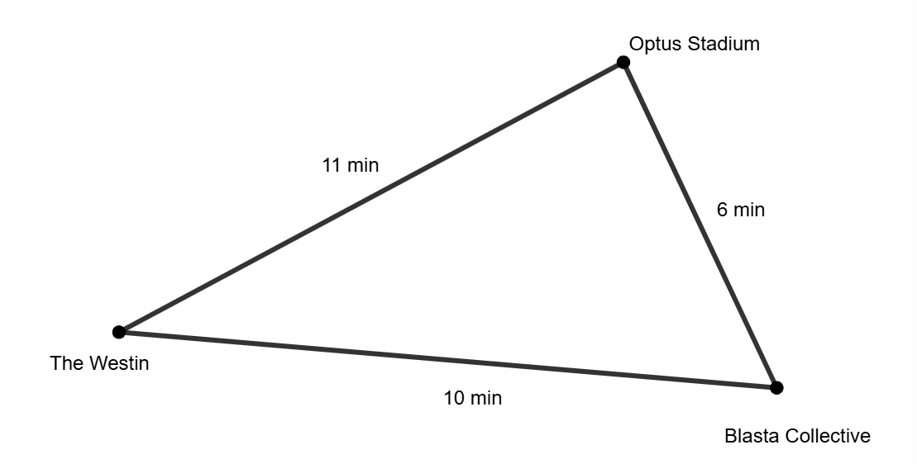
Perth city network

Slide 8
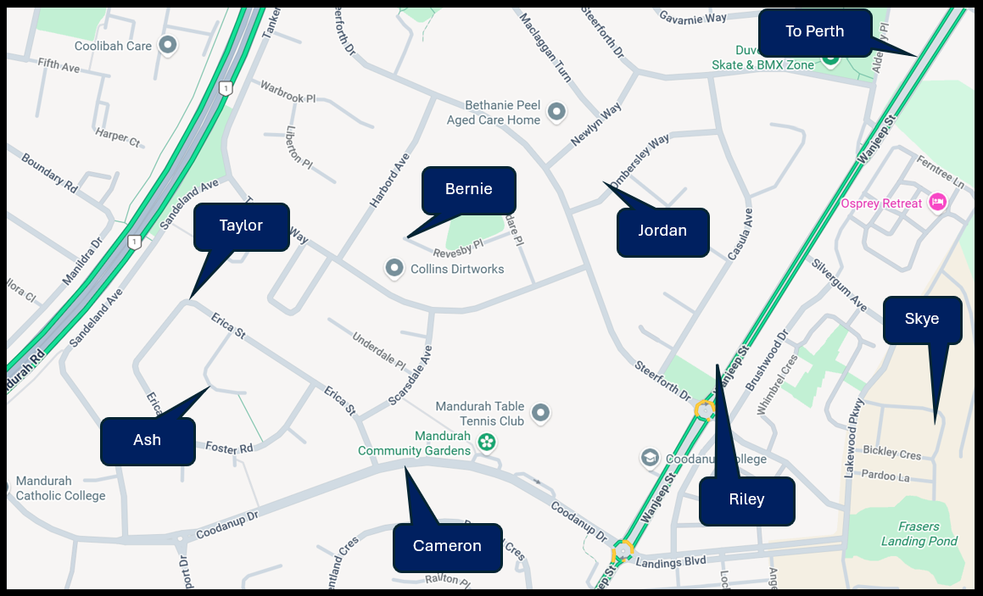
Friends map – Coodanup
Google Maps. Map data © Google. https://www.google.com/maps

Slide 9
Releasing responsibility

Slide 10
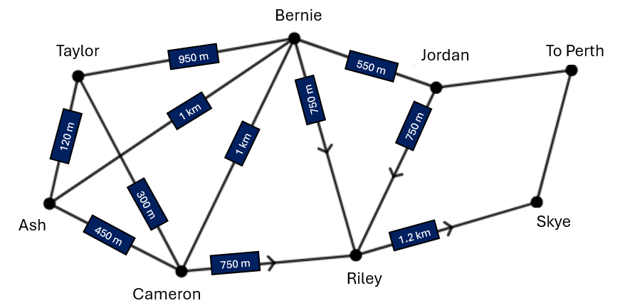
Friends network diagram – Coodanup
Vertex (node)
Weighted edge
Edge
Degree = 4

Slide 11
NESA definitions (1)
Network | A set of points (vertices or nodes) some of which are joined by lines or curves (edges) that sometimes enclose regions (faces). For example, road networks, a family tree or the edges lining a tennis court.
Vertex | A vertex is a point in a network diagram at which lines of pathways (called edges) intersect or branch. Also called a node.
Edge | A line that joins vertices to each other in a network diagram.

Slide 12
NESA definitions (2)
Weighted edges | A weighted edge is an edge of a network diagram that has a number assigned to it, which implies some numerical value, such as cost, distance or time.
Directed network | A network whose edges have arrows and travel is only possible in the direction of the arrows.
Degree | The degree of a vertex is the number of edges that end at that vertex.

Slide 13
Independent practice

Slide 14
Sprouts
How many vertices are present at the end of the game?
How many edges were drawn?
Who won the game, the first or second player?

Slide 15
References
This presentation contains NSW Curriculum and syllabus content. The NSW Curriculum is developed by the NSW Education Standards Authority. This content is prepared by NESA for and on behalf of the Crown in the right of the State of New South Wales. The material is protected by Crown copyright.
Please refer to the NESA Copyright Disclaimer for more information https://educationstandards.nsw.edu.au/wps/portal/nesa/mini-footer/copyright.
NESA holds the only official and up-to-date versions of the NSW Curriculum and syllabus documents. Please visit the NSW Education Standards Authority (NESA) website https://educationstandards.nsw.edu.au/wps/portal/nesa/home and the NSW Curriculum website https://curriculum.nsw.edu.au.
Mathematics Standard 11-12 Syllabus © NSW Education Standards Authority (NESA) for and on behalf of the Crown in right of the State of New South Wales, 2024.

Slide 16
Copyright
© State of New South Wales (Department of Education), 2026
The copyright material published in this resource is subject to the Copyright Act 1968 (Cth) and is owned by the NSW Department of Education or, where indicated, by a party other than the NSW Department of Education (third-party material).
Copyright material available in this resource and owned by the NSW Department of Education is licensed under a Creative Commons Attribution 4.0 International (CC BY 4.0) license.
This license allows you to share and adapt the material for any purpose, even commercially.
Attribution should be given to © State of New South Wales (Department of Education), 2026.
Material in this resource not available under a Creative Commons license:
the NSW Department of Education logo, other logos and trademark-protected material
Material owned by a third party that has been reproduced with permission. You will need to obtain permission from the third party to reuse its material.
Links to third-party material and websites
Please note that the provided (reading/viewing material/list/links/texts) are a suggestion only and implies no endorsement, by the New South Wales Department of Education, of any author, publisher, or book title. School principals and teachers are best placed to assess the suitability of resources that would complement the curriculum and reflect the needs and interests of their students.
If you use the links provided in this document to access a third-party’s website, you acknowledge that the terms of use, including licence terms set out on the third-party’s website apply to the use which may be made of the materials on that third-party website or where permitted by the Copyright Act 1968 (Cth). The department accepts no responsibility for content on third-party websites.

