Slide 1
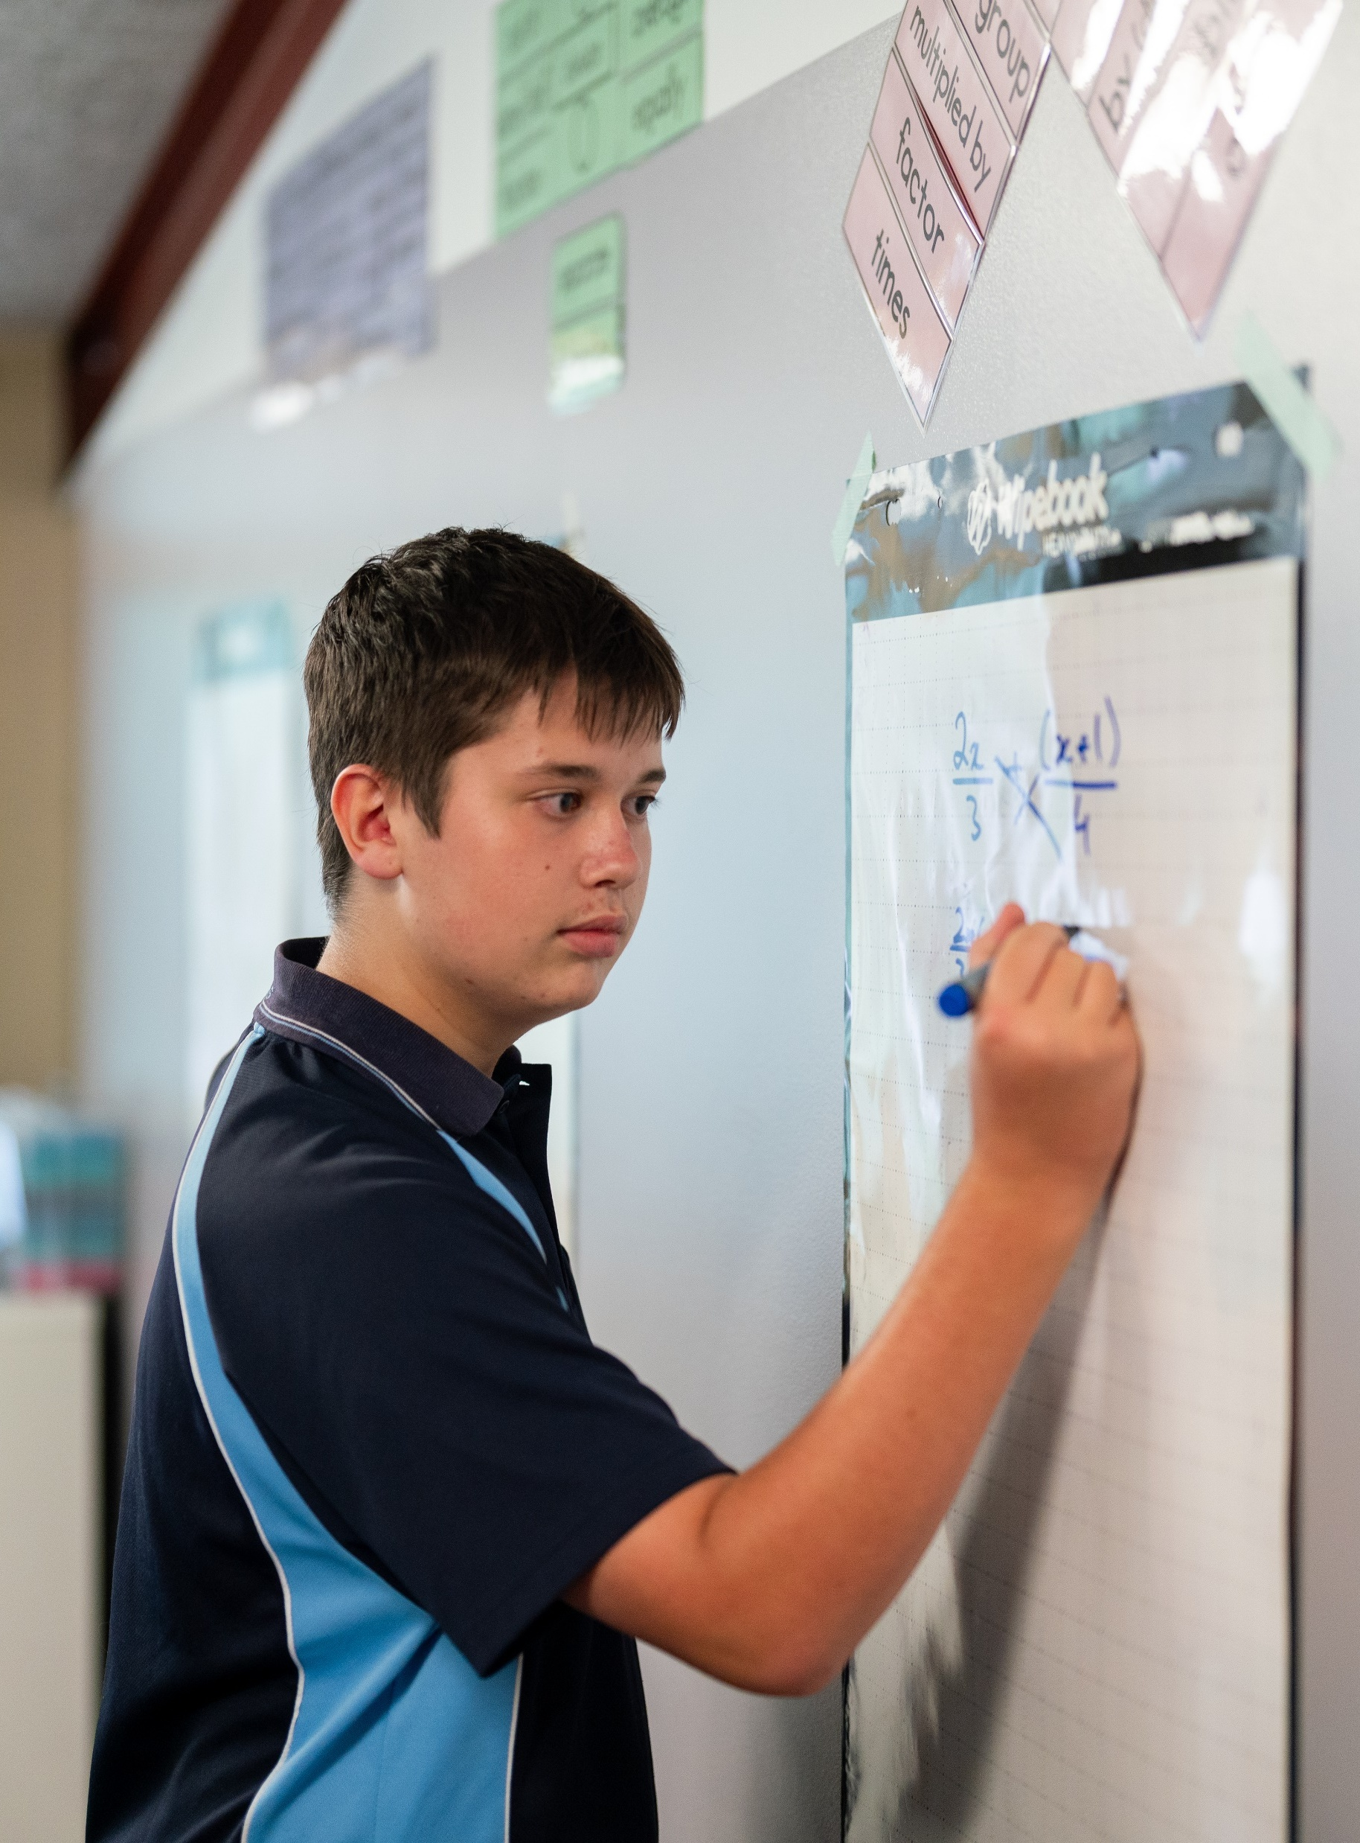
Applications of the BAC formula
Mathematics Standard – Stage 6 (Year 11)
Unit 4 –Driving Safely

Slide 2
Retrieval practice

Slide 3
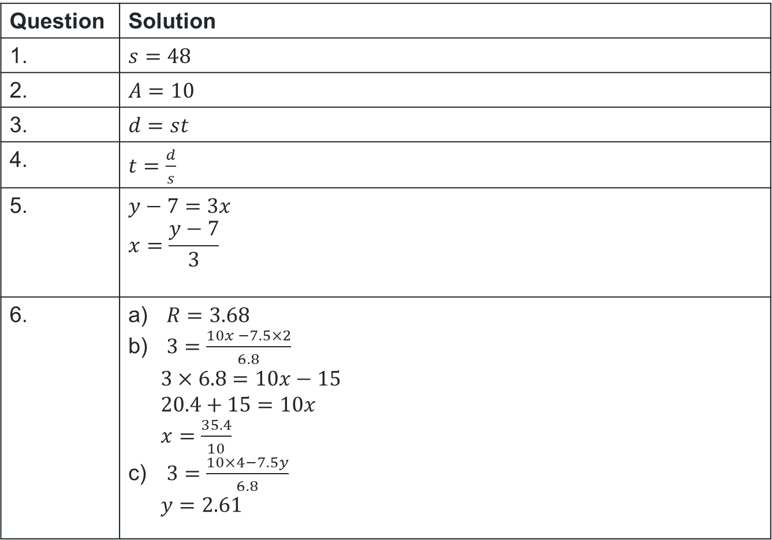
Retrieval practice solutions
Question | Solution
1. | $s=48$
2. | $A=10$
3. | $d=st$
4. | $t=\frac{d}{s}$
5. | $$y−7=3x \\ x=\frac{y−7}{3}$$
6. | $R=3.68$ $3=\frac{10x −7.5×2}{6.8}$ $3×6.8=10x−15$ $20.4+15=10x$ $x=\frac{35.4}{10}$ $3=\frac{10×4−7.5y}{6.8}$ $y=2.61$
Solutions

Slide 4
Activating prior knowledge

Slide 5
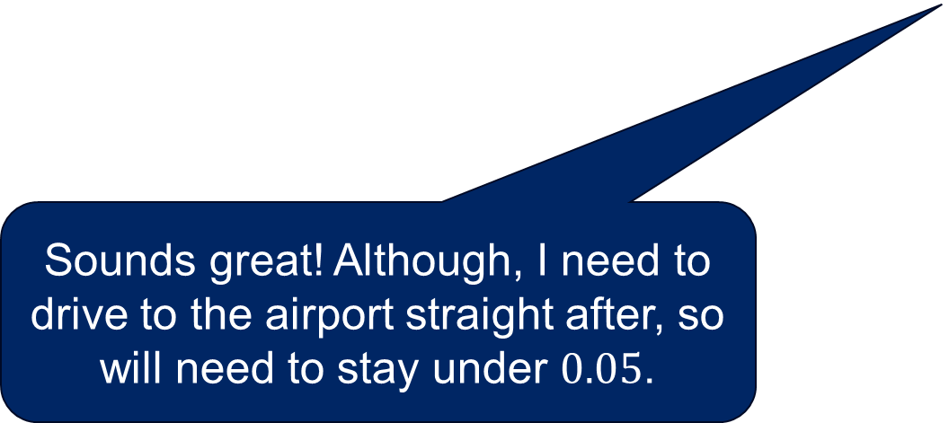
Activating prior knowledge
Want to come around to my place from 3pm – 6pm to watch the footy? We can have food and some drinks.
Sounds great! Although, I need to drive to the airport straight after, so will need to stay under $0.05$.
Brock
Nathan

Slide 6
Learning intentions and success criteria
Learning intentions
To understand how to apply and rearrange the BAC formulas to solve contextual problems.
To be able to interpret real-life drinking scenarios and determine BAC values or time to reach zero BAC.
Success criteria
I can substitute values into the BAC formulas and calculate BAC accurately.
I can rearrange a BAC formula to solve for a required variable.
I can interpret my calculated values to determine whether a person is under 0.05 or when they will reach zero BAC.

Slide 7
Connecting learning

Slide 8
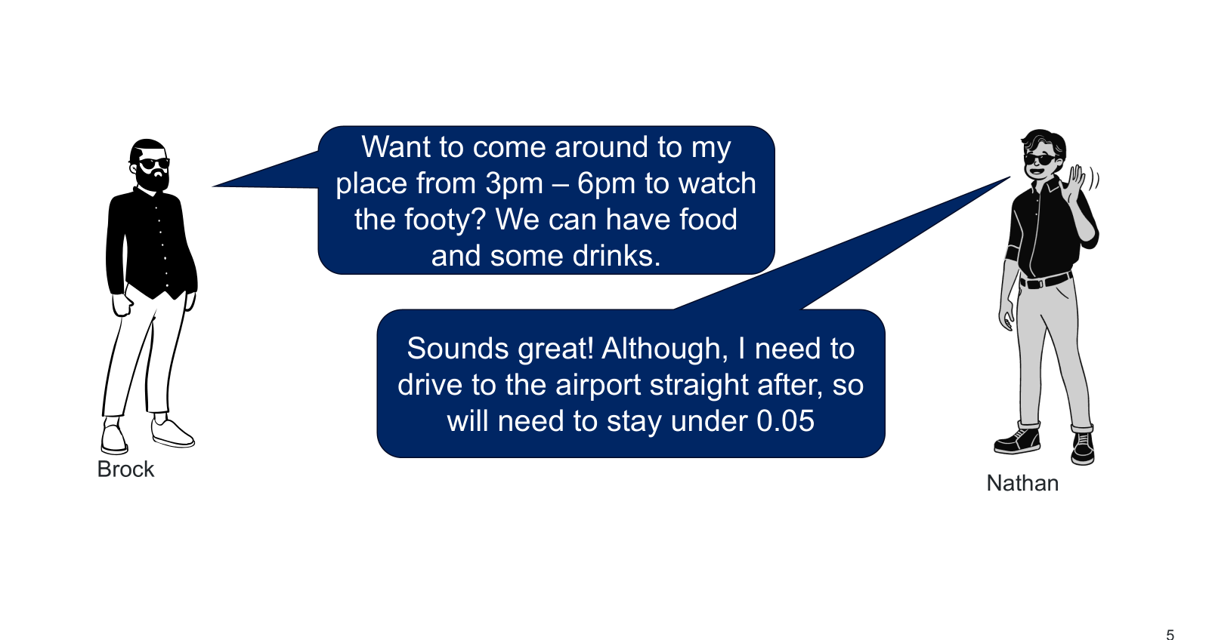
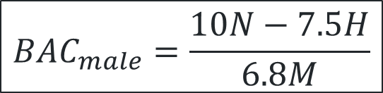
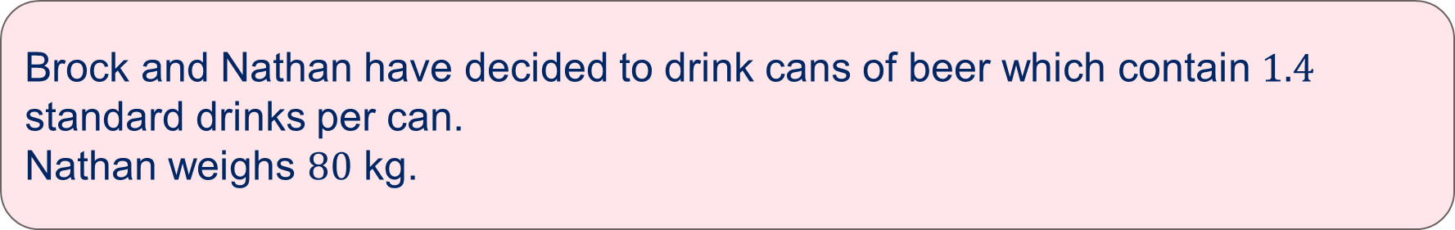
Calculating number of standard drinks
$${BAC}_{male}=\frac{10N−7.5H}{6.8M}$$
Brock and Nathan have decided to drink cans of beer which contain $1.4$ standard drinks per can.
Nathan weighs $80$ kg.

Slide 9

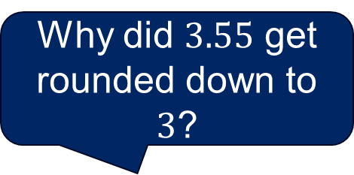

Comparative solutions (1)
Will’s solution
Jim’s solutions
$${BAC}_{male}=\frac{10N−7.5H}{6.8M} \\ 0.05=\frac{10N −7.5×3}{6.8×80} \\ 0.05=\frac{10N −22.5}{544} \\ \left(0.05×544\right)=10N−22.5 \\ 27.2+22.5=10N \\ 49.7=10N \\ N=4.97$$
However, each drink is $1.4$ standard drinks therefore,
$$N=4.97÷1.4 \\ N=3.55$$
Hence, to stay under $0.05$, the person can have a maximum of $3$ full cans of beer
$${BAC}_{male}=\frac{10N−7.5H}{6.8M} \\ 0.05=\frac{10×1.4×N−7.5×3}{6.8×80} \\ 0.05=\frac{14×N −22.5}{544} \\ \left(0.05×544\right)=14N−22.5 \\ 27.2+22.5=14N \\ 49.7=14N \\ N=3.55$$
Hence, to stay under $0.05$, the person can have a maximum of $3$ full cans of beer
What is the difference between these solutions?
Why did $3.55$ get rounded down to $3$?

Slide 10

Calculating time
After Nathan leaves, Brock uses his personal breathalyser. It registers a BAC of $0.015$.
Brock has $3$ beers remaining.
What is the shortest amount of time (to the nearest minute) that Brock can take to consume these beers, so that his BAC remains under $0.05$? Note: Brock weighs $90 kg$, started drinking at $12 pm$ and each can of beer is $1.4$ standard drinks.

Slide 11
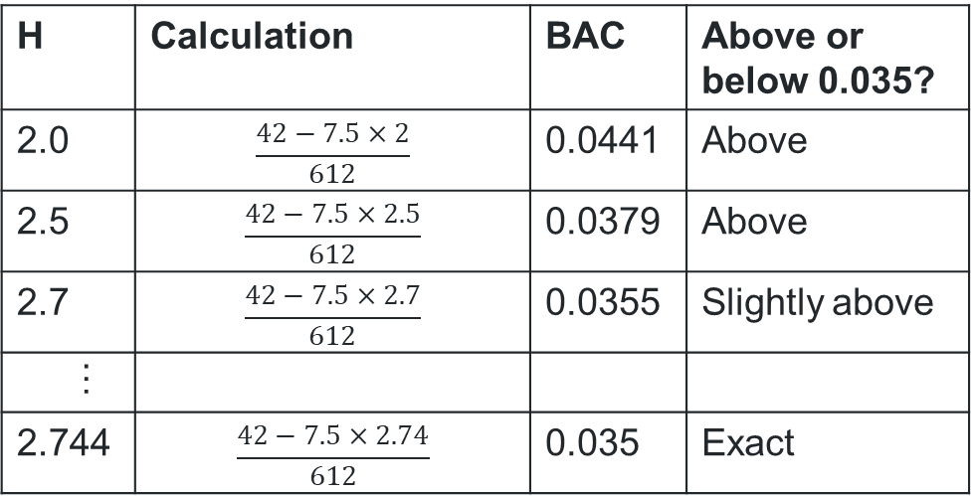
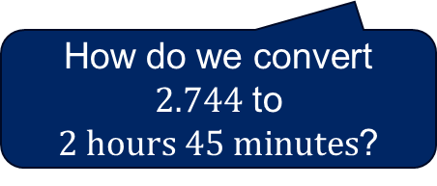
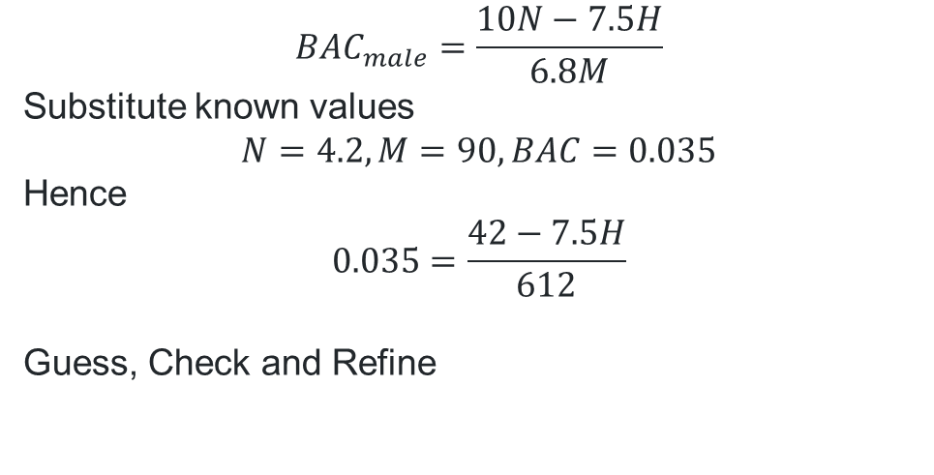
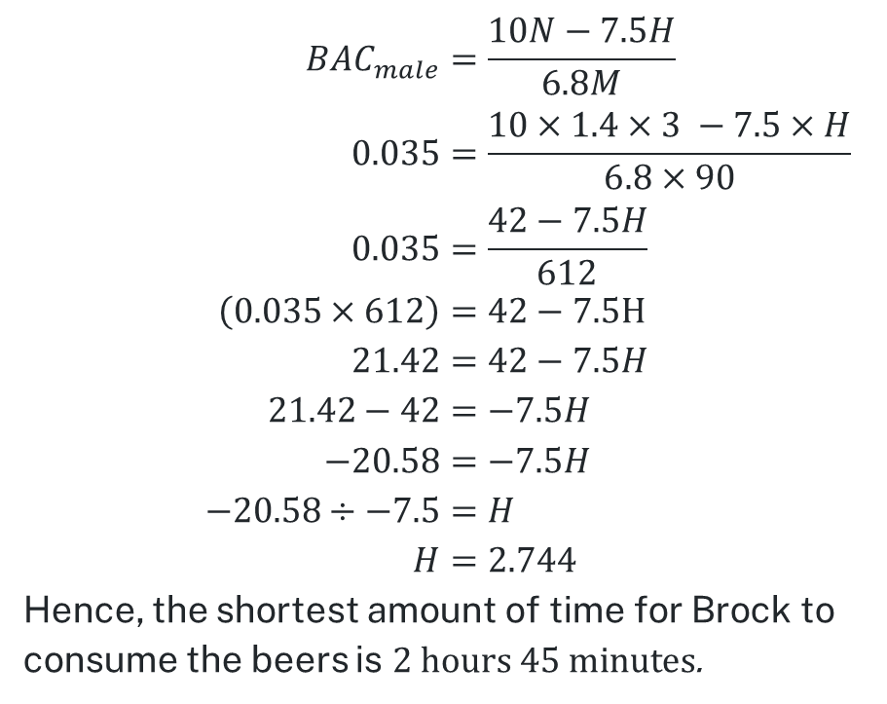
Comparative solutions (2)
Matt’s solution
What is the pros and cons of each method?
Jordan’s solutions
$${BAC}_{male}=\frac{10N−7.5H}{6.8M} \\ 0.035=\frac{10×1.4×3 −7.5×H}{6.8×90} \\ 0.035=\frac{42−7.5H}{612} \\ \left(0.035×612\right)=42−7.5H \\ 21.42=42−7.5H \\ 21.42−42=−7.5H \\ −20.58=−7.5H \\ −20.58÷−7.5=H \\ H=2.744$$
Hence, the shortest amount of time for Brock to consume the beers is $2 \text{hours} 45 \text{minutes}$.
$${BAC}_{male}=\frac{10N−7.5H}{6.8M}$$
Substitute known values
$$N=4.2, M=90, BAC=0.035$$
Hence
$$0.035=\frac{42−7.5H}{612}$$
Guess, Check and Refine
H | Calculation | BAC | Above or below 0.035?
2.0 | $$\frac{42−7.5×2}{612}$$ | 0.0441 | Above
2.5 | $$\frac{42−7.5×2.5}{612}$$ | 0.0379 | Above
2.7 | $$\frac{42−7.5×2.7}{612}$$ | 0.0355 | Slightly above
…
2.744 | $$\frac{42−7.5×2.74}{612}$$ | 0.035 | Exact
How do we convert $2.744$ to $2 \text{hours} 45 \text{minutes}$?

Slide 12
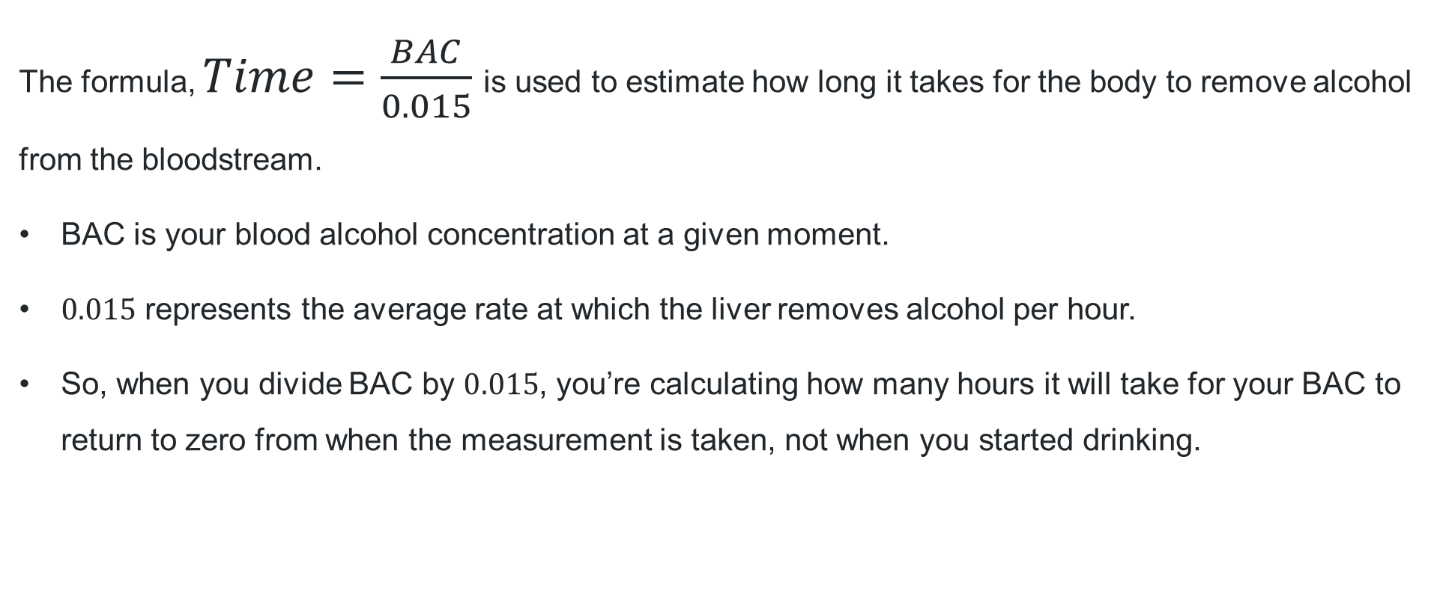
Returning BAC to 0 (1)
The formula, $Time=\frac{BAC}{0.015}$is used to estimate how long it takes for the body to remove alcohol from the bloodstream.
BAC is your blood alcohol concentration at a given moment.
$0.015$ represents the average rate at which the liver removes alcohol per hour.
So, when you divide BAC by $0.015$, you’re calculating how many hours it will take for your BAC to return to zero from when the measurement is taken, not when you started drinking.

Slide 13

Returning BAC to 0 (2)
BAC = $0.359$
$$Time=\frac{BAC}{0.015} \\ Time=\frac{0.359}{0.015} \\ Time=23.93… \\ Time=23 hours and 56 minutes$$

Slide 14
Releasing responsibility

Slide 15
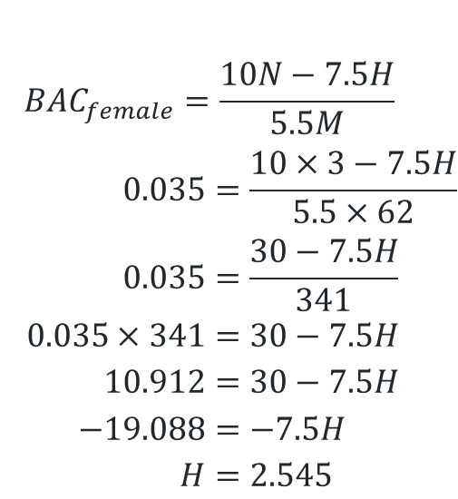
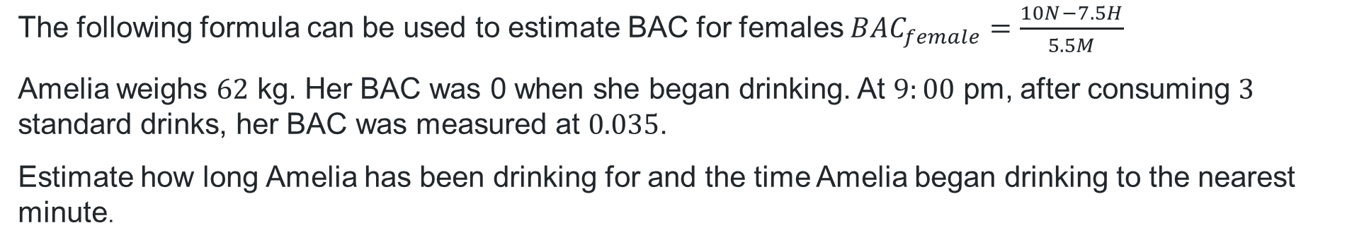
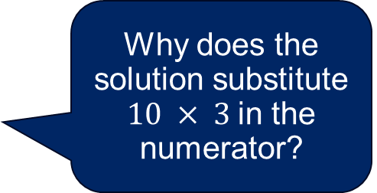
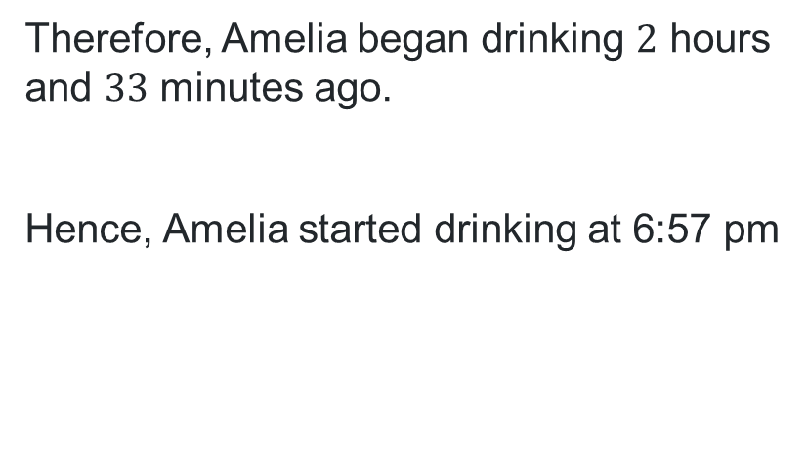
Worked example (1)
The following formula can be used to estimate BAC for females ${BAC}_{female}=\frac{10N−7.5H}{5.5M}$
Amelia weighs $62$ kg. Her BAC was 0 when she began drinking. At $9:00$ pm, after consuming $3$ standard drinks, her BAC was measured at $0.035$.
Estimate how long Amelia has been drinking for and the time Amelia began drinking to the nearest minute.
$${BAC}_{female}=\frac{10N−7.5H}{5.5M}$$
$$0.035=\frac{10×3−7.5H}{5.5×62} \\ 0.035=\frac{30−7.5H}{341} \\ 0.035×341=30−7.5H \\ 10.912=30−7.5H \\ −19.088=−7.5H \\ H=2.545$$
Why does the solution substitute $10 × 3$in the numerator?
Therefore, Amelia began drinking $2$ hours and $33$ minutes ago.
Hence, Amelia started drinking at 6:57 pm
How do I know that my solution for H is correct?
Is the final calculated start time reasonable given the BAC?

Slide 16
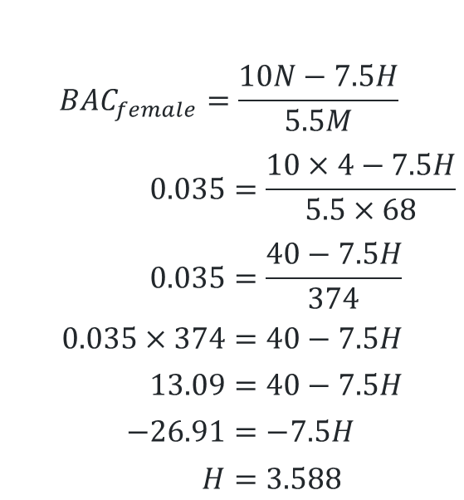
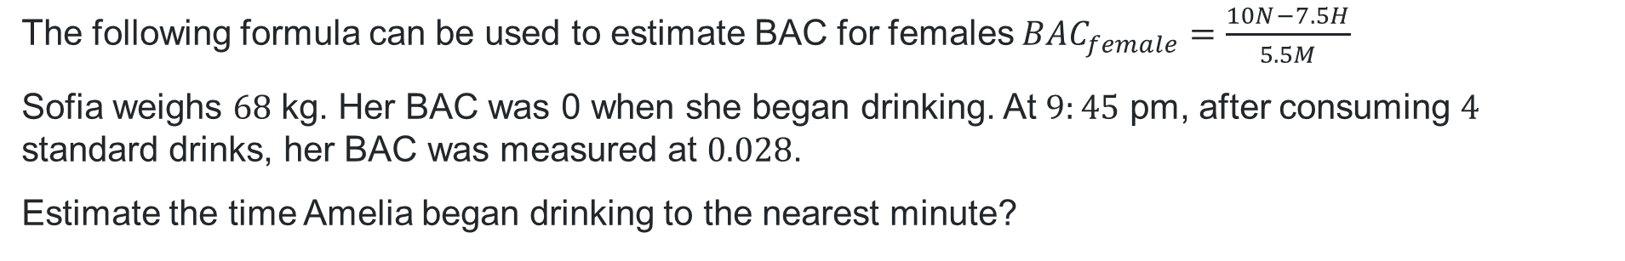
Your turn (1)
The following formula can be used to estimate BAC for females ${BAC}_{female}=\frac{10N−7.5H}{5.5M}$
Sofia weighs $68$ kg. Her BAC was 0 when she began drinking. At $9:45$ pm, after consuming $4$ standard drinks, her BAC was measured at $0.028$.
Estimate the time Amelia began drinking to the nearest minute?
$${BAC}_{female}=\frac{10N−7.5H}{5.5M}$$
$$0.035=\frac{10×4−7.5H}{5.5×68} \\ 0.035=\frac{40−7.5H}{374} \\ 0.035×374=40−7.5H \\ 13.09=40−7.5H \\ −26.91=−7.5H \\ H=3.588$$
Therefore, Sofia began drinking for 3 hours 35 minutes ago.
Hence, Sofia started drinking at 6:10 pm

Slide 17
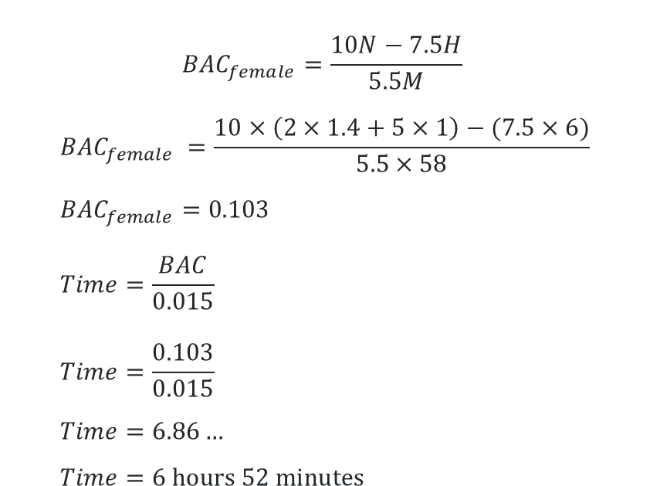
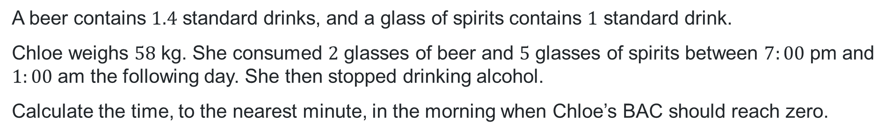
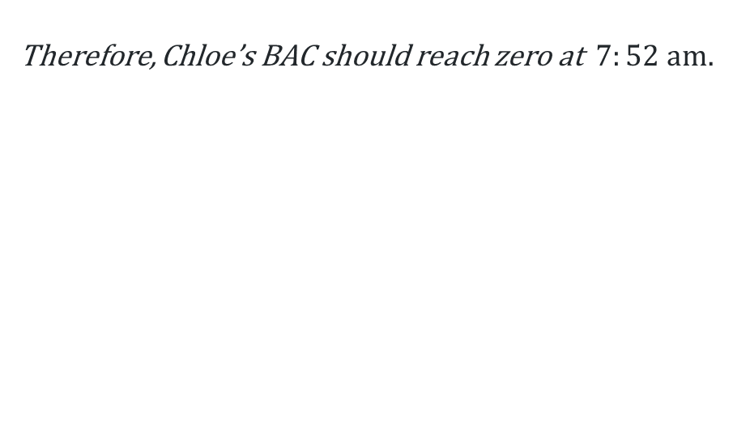
Worked example (2)
A beer contains $1.4$ standard drinks, and a glass of spirits contains $1$ standard drink.
Chloe weighs $58$ kg. She consumed $2$ glasses of beer and $5$ glasses of spirits between $7:00$ pm and $1:00$ am the following day. She then stopped drinking alcohol.
Calculate the time, to the nearest minute, in the morning when Chloe’s BAC should reach zero.
$${BAC}_{female}=\frac{10N−7.5H}{5.5M}$$
$${BAC}_{female} =\frac{10×\left(2×1.4+5×1\right)−(7.5×6)}{5.5×58} \\ {BAC}_{female}=0.103 \\ Time=\frac{BAC}{0.015} \\ Time=\frac{0.103}{0.015} \\ Time=6.86… \\ Time=6 hours 52 minutes$$
Therefore, Chloe’s BAC should reach zero at $7:52$ am.
Why does the solution calculate BAC before calculating the time to reach zero?
How does the solution show the total number of standard drinks?

Slide 18



Your turn (2)
A glass of cider contains $1.6$ standard drinks, and a glass of spirits contains $1$ standard drink.
Emily weighs $64$ kg. She consumed $3$ glasses of cider and 5 glasses of spirits between $6:45$ pm and $11:15$ pm. She then stopped drinking alcohol.
Calculate the time, to the nearest minute, in the morning when Emily’s BAC should reach zero.
$${BAC}_{female}=\frac{10N−7.5H}{5.5M} \\ {BAC}_{female} =\frac{10×\left(3×1.6+5×1\right)−(7.5×4.5)}{5.5×64} \\ {BAC}_{female}=0.183 \\ Time=\frac{BAC}{0.015} \\ Time=\frac{0.183}{0.015} \\ Time=12.17… \\ Time=12 hours and 10 minutes$$
Therefore, Chloe’s BAC should reach zero at $11:25$ am

Slide 19
Independent practice

Slide 20
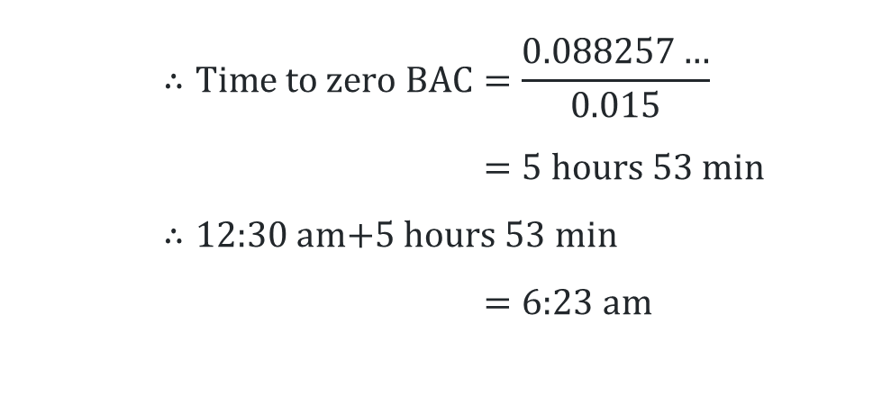
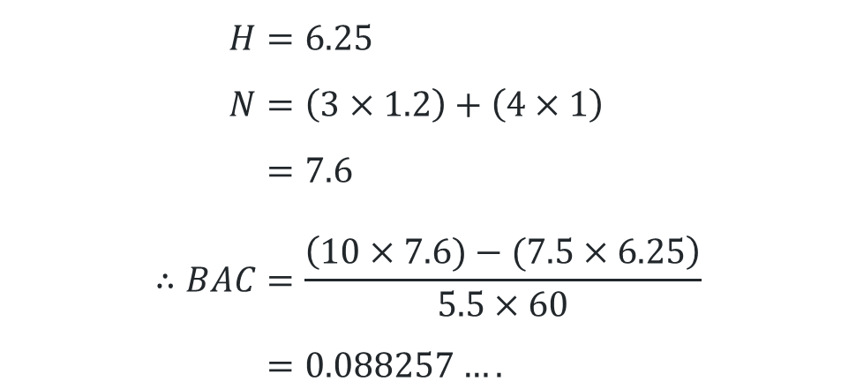
2019 Question 28
Marking criteria
Criteria | Marks
Provides correct answer with appropriate calculations | 4
Calculates the correct length of time for BAC to reach zero, or equivalent merit | 3
Calculates the correct BAC, or correct numerical expression | 2
Provides correct value for N or H, or equivalent merit | 1
$$H=6.25 \\ N=\left(3×1.2\right)+\left(4×1\right) \\ =7.6 \\ ∴BAC=\frac{\left(10×7.6)−(7.5×6.25\right)}{5.5×60} \\ =0.088257….$$
$$∴\text{Time} \text{to} \text{zero} \text{BAC}=\frac{0.088257…}{0.015} \\ =\text{5 }\text{hours}\text{ 53 }\text{min} \\ ∴\text{12:30 }\text{am}\text{+5 }\text{hours}\text{ 53 }\text{min} \\ =\text{6:23 }\text{am}$$

Slide 21
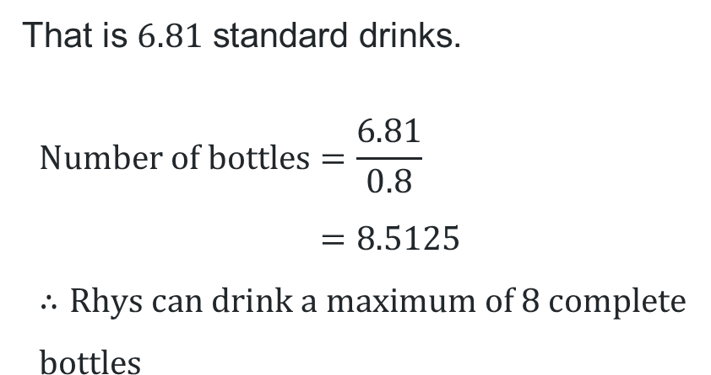
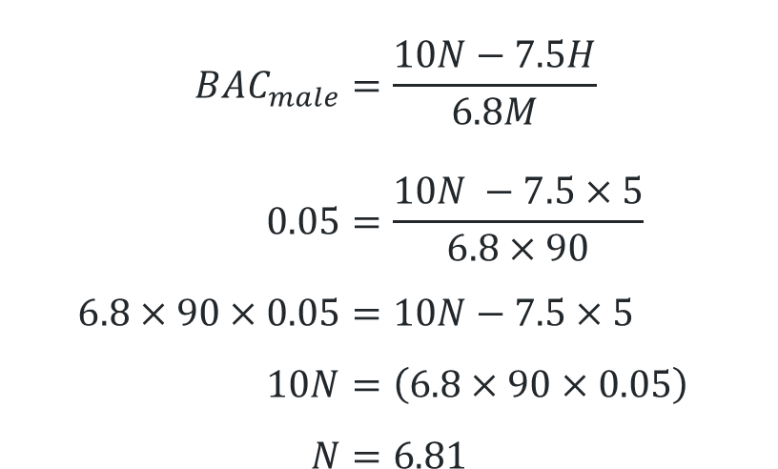
2017 Question 27(e)
Marking criteria
Criteria | Marks
Provides correct solution | 4
Attempts to determine the maximum number of bottles based on the number of standard drinks (N) | 3
Solves for N, or equivalent merit | 2
Substitutes into correct formula, or equivalent merit | 1
$${BAC}_{male}=\frac{10N−7.5H}{6.8M} \\ 0.05=\frac{10N −7.5×5}{6.8×90} \\ 6.8×90×0.05=10N−7.5×5 \\ 10N=\left(6.8×90×0.05\right)+\left(7.5×5\right) \\ N=6.81$$
That is $6.81$ standard drinks.
$$\text{Number} \text{of} \text{bottles}=\frac{6.81}{0.8} \\ =8.5125 \\ ∴\text{Rhys} \text{can} \text{drink} \text{a} \text{maximum} \text{of}\text{ 8 }\text{complete} \text{bottles}$$

Slide 22
References
This presentation contains NSW Curriculum and syllabus content. The NSW Curriculum is developed by the NSW Education Standards Authority. This content is prepared by NESA for and on behalf of the Crown in the right of the State of New South Wales. The material is protected by Crown copyright.
Please refer to the NESA Copyright Disclaimer for more information https://educationstandards.nsw.edu.au/wps/portal/nesa/mini-footer/copyright.
NESA holds the only official and up-to-date versions of the NSW Curriculum and syllabus documents. Please visit the NSW Education Standards Authority (NESA) website https://educationstandards.nsw.edu.au/wps/portal/nesa/home and the NSW Curriculum website https://curriculum.nsw.edu.au.
Mathematics Standard Stage 11-12 Syllabus © NSW Education Standards Authority (NESA) for and on behalf of the Crown in right of the State of New South Wales, 2024.
.

Slide 23
Copyright
© State of New South Wales (Department of Education), 2026
The copyright material published in this resource is subject to the Copyright Act 1968 (Cth) and is owned by the NSW Department of Education or, where indicated, by a party other than the NSW Department of Education (third-party material).
Copyright material available in this resource and owned by the NSW Department of Education is licensed under a Creative Commons Attribution 4.0 International (CC BY 4.0) license.
This license allows you to share and adapt the material for any purpose, even commercially.
Attribution should be given to © State of New South Wales (Department of Education), 2025.
Material in this resource not available under a Creative Commons license:
the NSW Department of Education logo, other logos and trademark-protected material
Material owned by a third party that has been reproduced with permission. You will need to obtain permission from the third party to reuse its material.
Links to third-party material and websites
Please note that the provided (reading/viewing material/list/links/texts) are a suggestion only and implies no endorsement, by the New South Wales Department of Education, of any author, publisher, or book title. School principals and teachers are best placed to assess the suitability of resources that would complement the curriculum and reflect the needs and interests of their students.
If you use the links provided in this document to access a third-party’s website, you acknowledge that the terms of use, including licence terms set out on the third-party’s website apply to the use which may be made of the materials on that third-party website or where permitted by the Copyright Act 1968 (Cth). The department accepts no responsibility for content on third-party websites.

