Slide 1
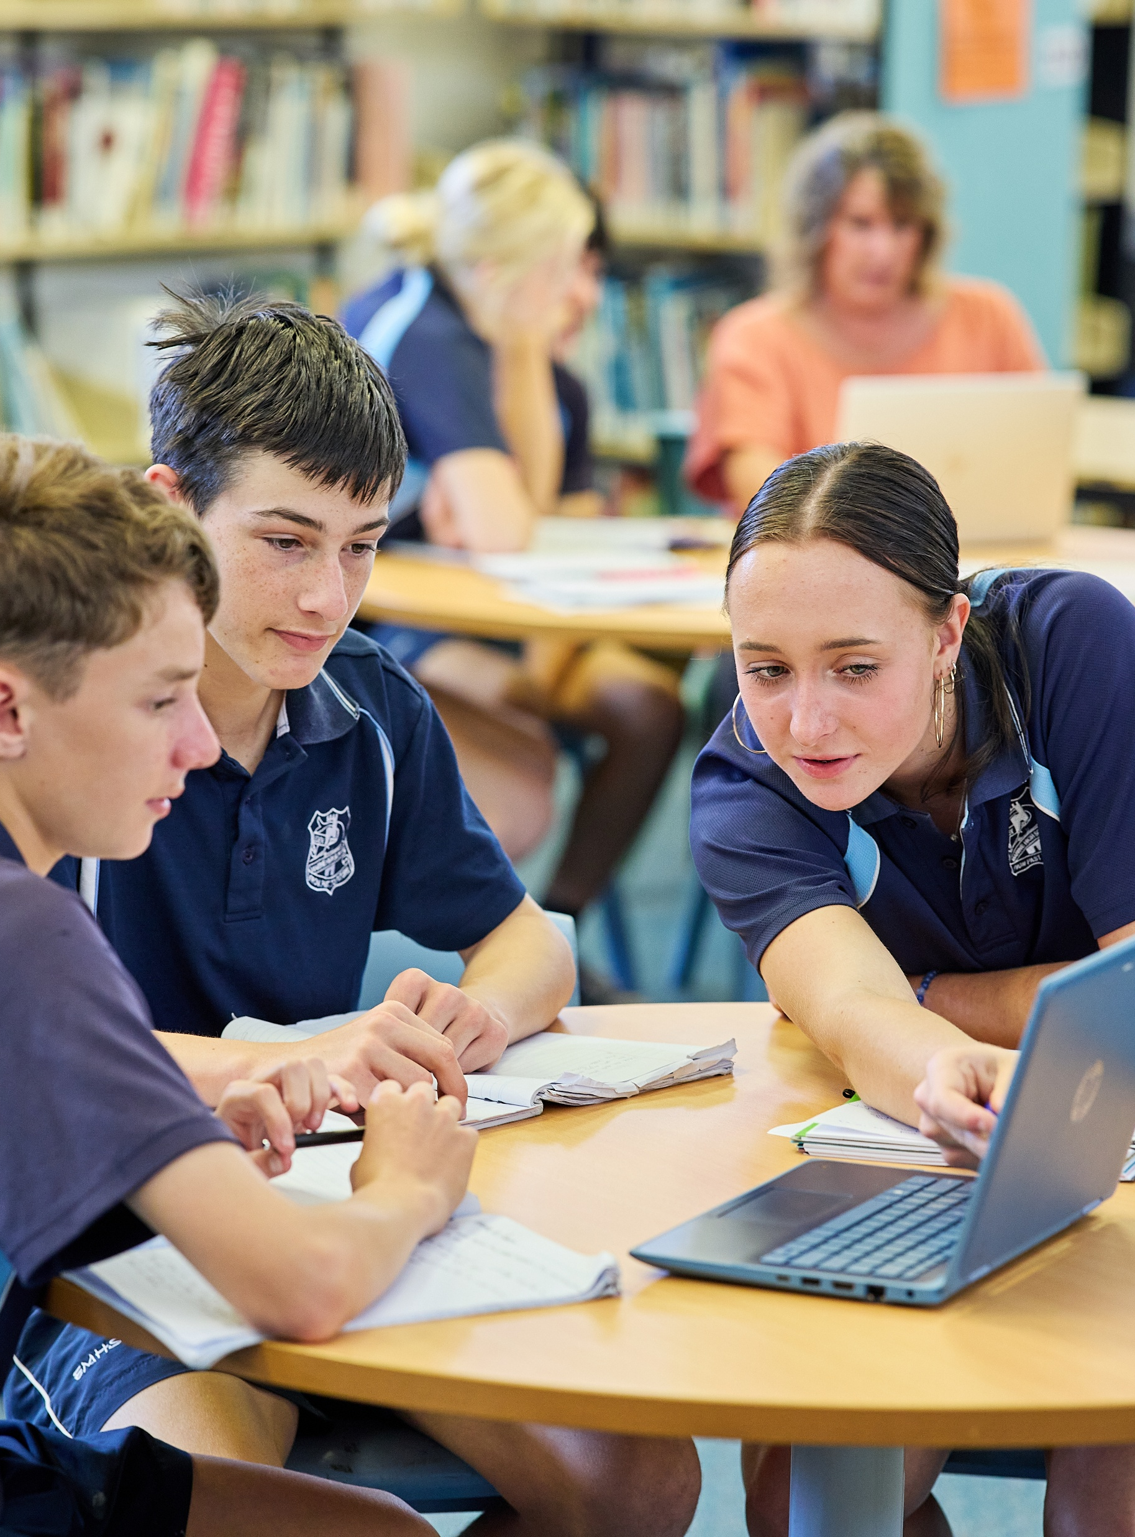
Blood alcohol content
Mathematics Standard – Year 11 (Stage 6)
Unit 4 –Driving Safely

Slide 2
Learning intentions and success criteria
Learning intentions
To know what blood alcohol content (BAC) represents.
To be able to use the BAC formula to model real situations.
Success criteria
I can calculate BAC for given scenarios using the formula.
I can describe factors that influence a person’s BAC.
I can explain the limitations of methods used to estimate BAC

Slide 3
Activating prior knowledge

Slide 4
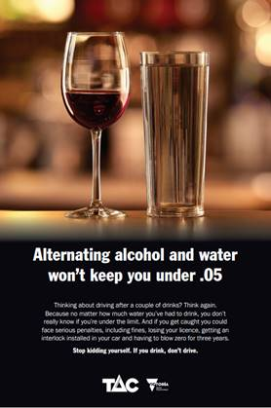
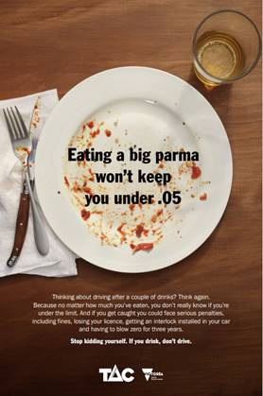
Notice and wonder
Image: TAC Drink Drive Campaign, NRSPP
Image: TAC Drink Drive Campaign, NRSPP

Slide 5
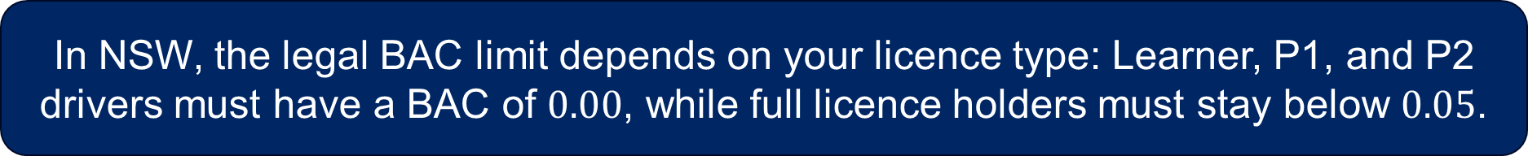

Blood alcohol content (BAC)
NESA definition
NESA definition: A measure of the amount of alcohol present in the bloodstream which may be used for legal purposes.
Additional information: BAC is measured in grams of alcohol per 100 millilitres of blood ($g/100ml$). For example, a BAC of $0.05$ means there are 0.05 grams of alcohol in every 100 millilitres of blood.
In NSW, the legal BAC limit depends on your licence type: Learner, P1, and P2 drivers must have a BAC of $0.00$, while full licence holders must stay below $0.05$.

Slide 6
Connecting learning

Slide 7



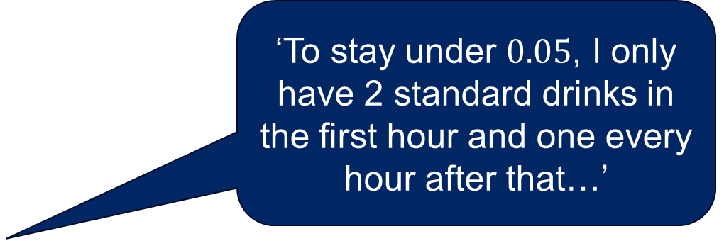
Estimating BAC (1)
‘To stay under $0.05$, I only have 2 standard drinks in the first hour and one every hour after that…’
Name: Brian
Sex: Male
Weight:105 kg
No. of standard drinks: 4
Hours spent drinking: 3
Name: Hayley
Sex: Female
Weight: 60 kg
No. of standard drinks: 4
Hours spent drinking: 3

Slide 8
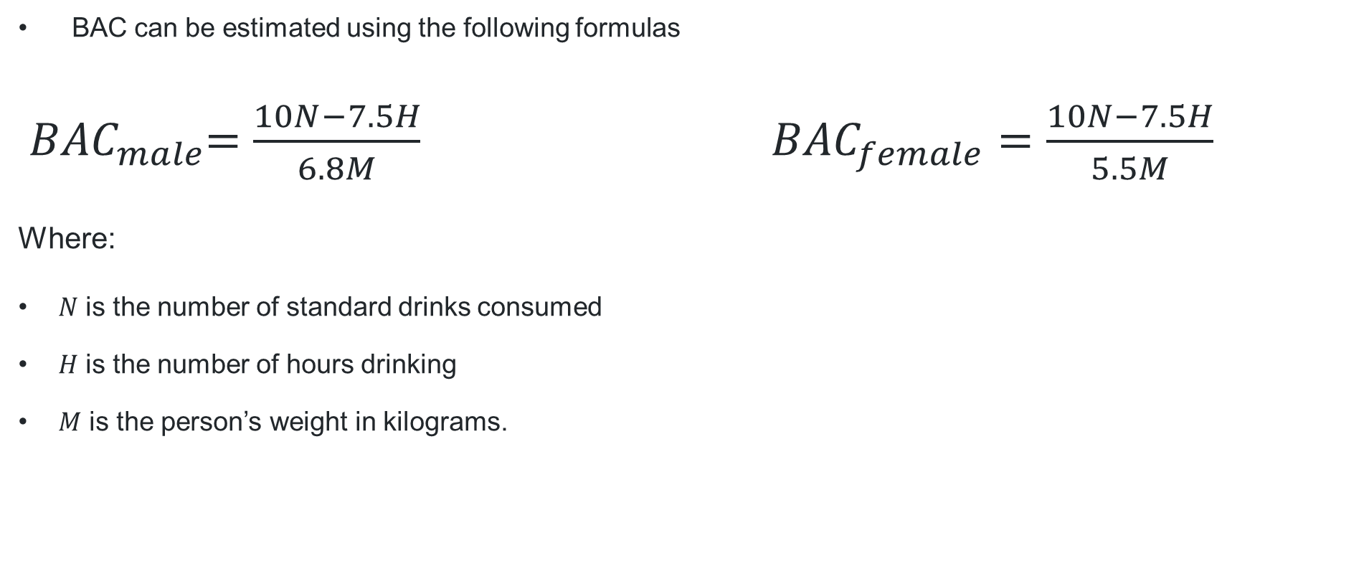
Blood Alcohol Content (1)
Formula
BAC can be estimated using the following formulas
${ BAC}_{male}=\frac{10N−7.5H}{6.8M}$ ${BAC}_{female}=\frac{10N−7.5H}{5.5M}$
Where:
      $N$ is the number of standard drinks consumed
      $H$ is the number of hours drinking
      $M$ is the person’s weight in kilograms.

Slide 9
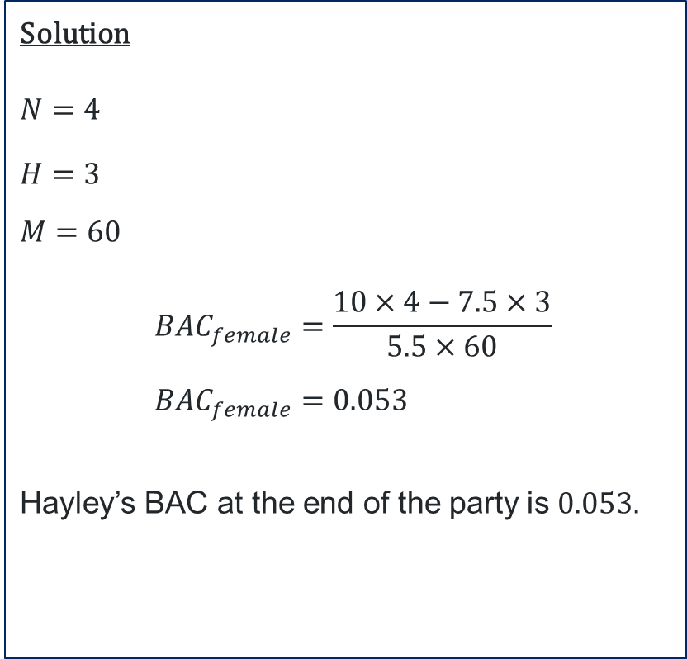
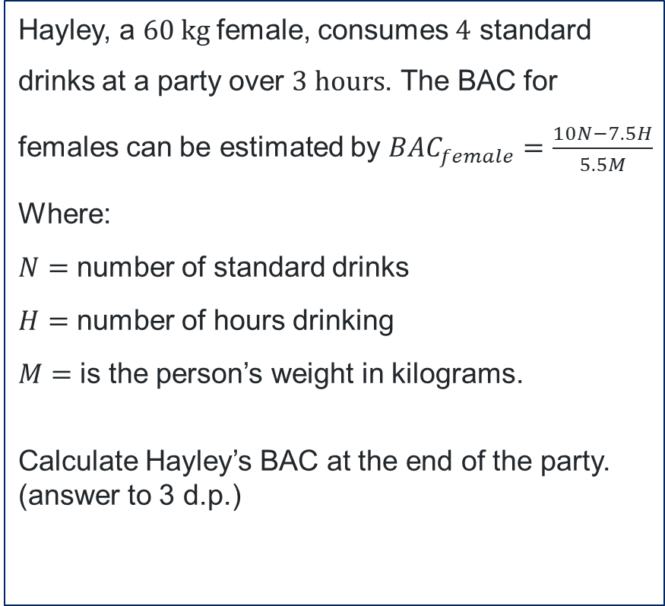
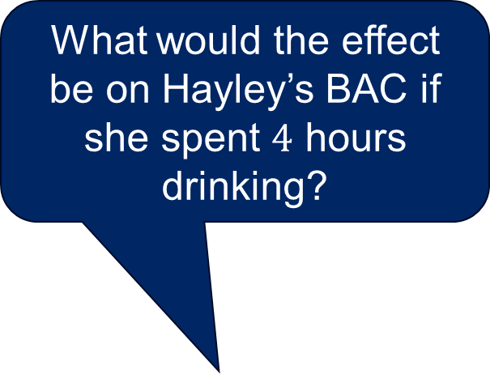
Blood Alcohol Content (2)
What would the effect be on Hayley’s BAC if she spent $4$ hours drinking?
Worked example
Hayley, a $60 kg$female, consumes $4$ standard drinks at a party over $3 hours$. The BAC for females can be estimated by ${BAC}_{female}=\frac{10N−7.5H}{5.5M}$
Where:
$N=$ number of standard drinks
$H=$ number of hours drinking
      $M=$ is the person’s weight in kilograms.
      Calculate Hayley’s BAC at the end of the party. (answer to 3 d.p.)
Solution
$N=$ $4$
$H=$ $3$
      $M=$ $60$
      $${BAC}_{female}=\frac{10×4−7.5×3}{5.5×60} \\ {BAC}_{female}=0.053$$
      Hayley’s BAC at the end of the party is $0.053.$
Why is BAC rounded to 3 decimal places?
If Hayley has her full licence, can she legally drive?

Slide 10
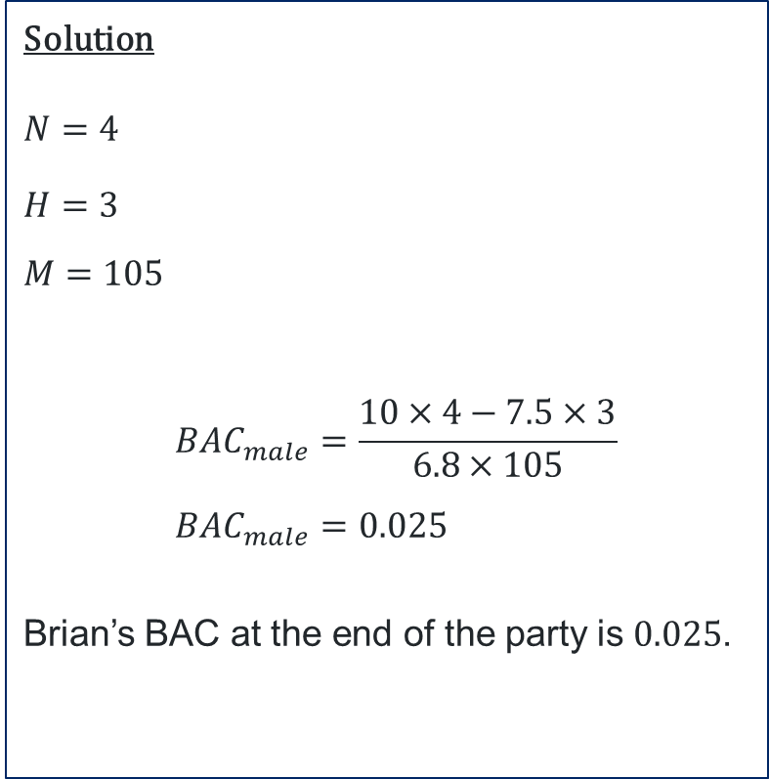
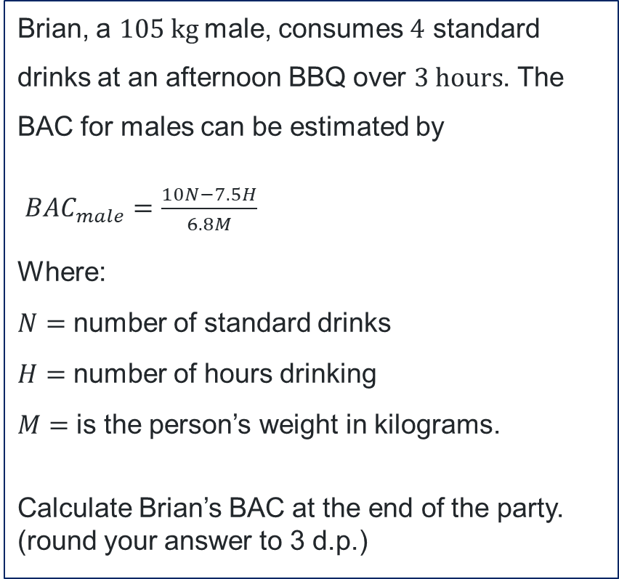
Blood Alcohol Content (3)
Your turn
Brian, a $105 kg$male, consumes $4$ standard drinks at an afternoon BBQ over $3 hours$. The BAC for males can be estimated by
${BAC}_{male}=\frac{10N−7.5H}{6.8M}$
Where:
$N=$ number of standard drinks
$H=$ number of hours drinking
      $M=$ is the person’s weight in kilograms.
      Calculate Brian’s BAC at the end of the party. (round your answer to 3 d.p.)
Solution
$N=$ $4$
$H=$ $3$
      $M=$ $105$
      $${BAC}_{male}=\frac{10×4−7.5×3}{6.8×105} \\ {BAC}_{male}=0.025$$
      Brian’s BAC at the end of the party is $0.025$.

Slide 11
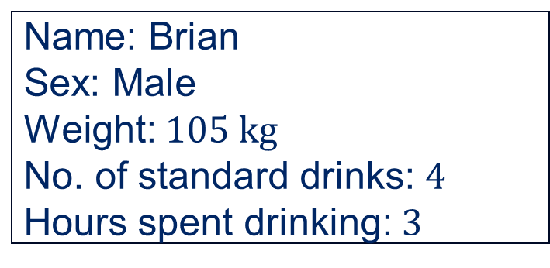


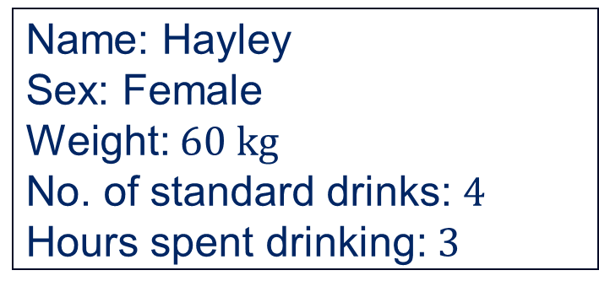
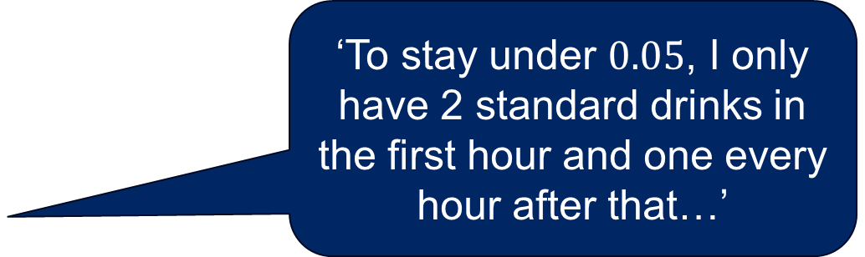
Estimating BAC (2)
‘To stay under $0.05$, I only have 2 standard drinks in the first hour and one every hour after that…’
Name: Brian
Sex: Male
Weight: $105 kg$
No. of standard drinks: $4$
Hours spent drinking: $3$
Name: Hayley
Sex: Female
Weight: $60 kg$
No. of standard drinks: $4$
Hours spent drinking: $3$
BAC: $0.025$
BAC: $0.053$

Slide 12




What’s in a standard drink? (1)
Wine
Beer
Champagne
Cocktail

Slide 13
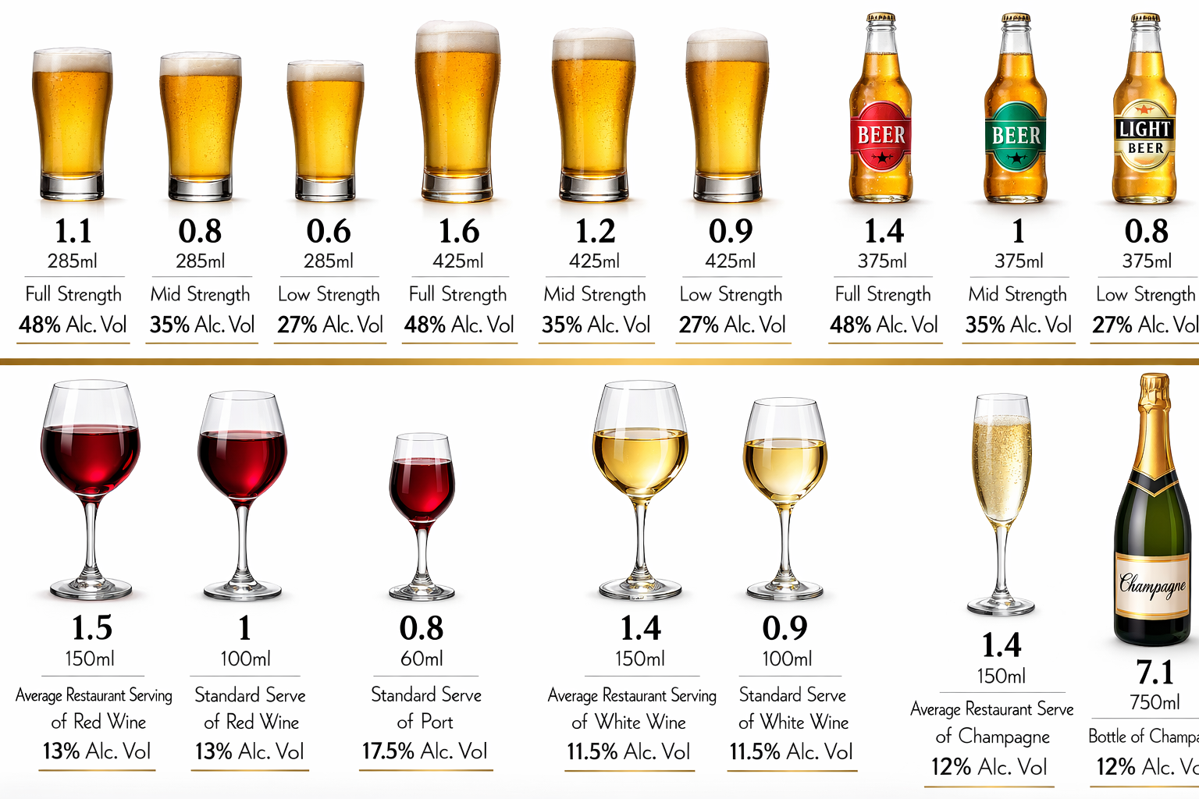
What’s in a standard drink? (2)
No. of std drinks
No. of std drinks
Notes:
https://mypolice.qld.gov.au/sunshinecoast/2016/03/10/drink-rite-not-standard-nambour-rotary-night/

Slide 14
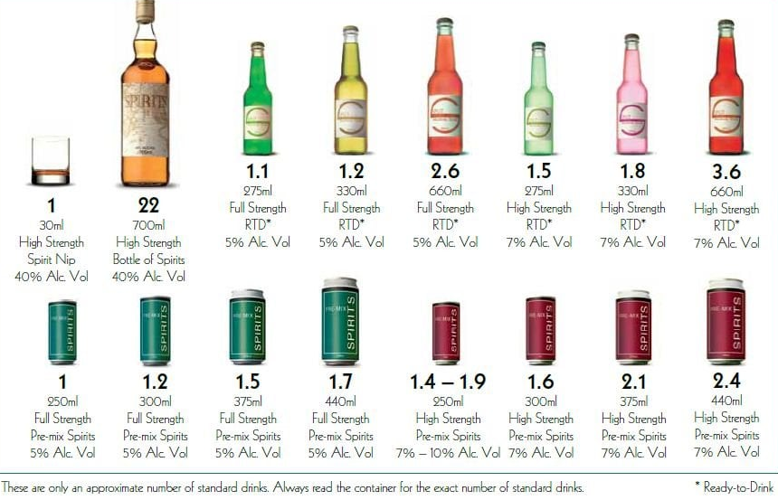
What’s in a standard drink? (3)
No. of std drinks
No. of std drinks
Image: Queensland Police Service, What’s Your Limit? campaign
Notes:
https://mypolice.qld.gov.au/bundaberg/2015/03/24/whats-limit/

Slide 15
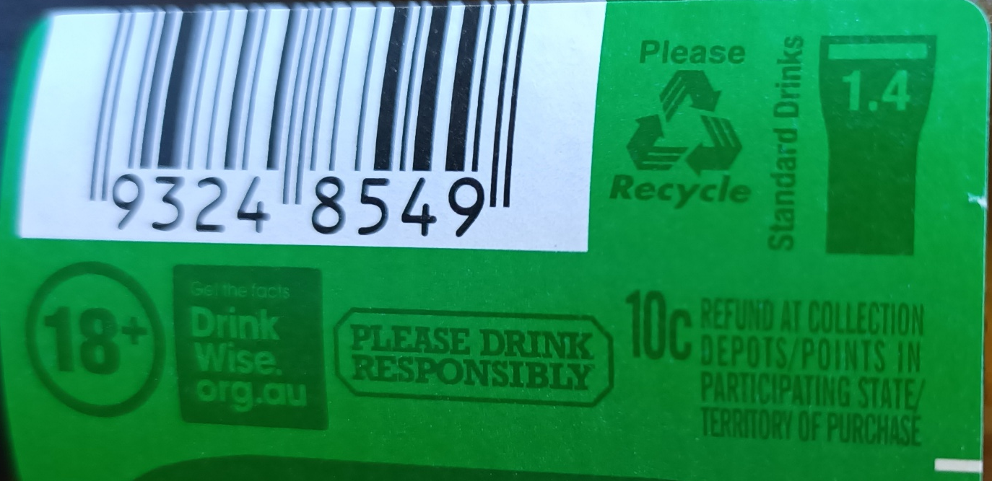

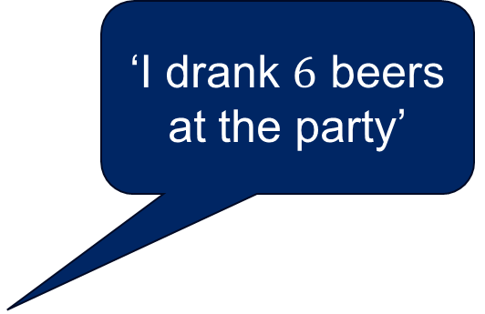
Standard drinks calculations (1)
‘I drank $6$ beers at the party’
Image supplied by Mathematics Curriculum Team

Slide 16
Standard drinks calculations (2)
Chris is a male who weighs 84 kg. One evening he has dinner and drinks at a bar, arriving at 5 pm and leaving at 11:30 pm. The table below outlines what Chris drank.
Type of drink | No. of standard drinks | No. of drinks consumed
Mid strength beer | 1.1 | 2
Pre-mix spirit | 1.4 | 3
Serve of port | 0.8 | 1

Slide 17

Standard drinks calculations (3)
Solution
$${BAC}_{male}=\frac{10N−7.5H}{6.8M} \\ H=6.5 \\ M=84 \\ N=2×1.1+1.4×3+0.8=7.2 \\ {BAC}_{male}=\frac{10×7.2−7.5×6.5}{6.8×84} \\ {BAC}_{male}=0.041$$

Slide 18
References
This presentation contains NSW Curriculum and syllabus content. The NSW Curriculum is developed by the NSW Education Standards Authority. This content is prepared by NESA for and on behalf of the Crown in the right of the State of New South Wales. The material is protected by Crown copyright.
Please refer to the NESA Copyright Disclaimer for more information https://educationstandards.nsw.edu.au/wps/portal/nesa/mini-footer/copyright.
NESA holds the only official and up-to-date versions of the NSW Curriculum and syllabus documents. Please visit the NSW Education Standards Authority (NESA) website https://educationstandards.nsw.edu.au/wps/portal/nesa/home and the NSW Curriculum website https://curriculum.nsw.edu.au.
Mathematics Standard Stage 11- 12 Syllabus © NSW Education Standards Authority (NESA) for and on behalf of the Crown in right of the State of New South Wales, 2024.
NESA (NSW Education Standards Authority (2024) ‘Glossary’, Mathematics Standard 11–12 (2024), NESA website, accessed 23 January 2026.

Slide 19
Copyright
© State of New South Wales (Department of Education), 2026
The copyright material published in this resource is subject to the Copyright Act 1968 (Cth) and is owned by the NSW Department of Education or, where indicated, by a party other than the NSW Department of Education (third-party material).
Copyright material available in this resource and owned by the NSW Department of Education is licensed under a Creative Commons Attribution 4.0 International (CC BY 4.0) license.
This license allows you to share and adapt the material for any purpose, even commercially.
Attribution should be given to © State of New South Wales (Department of Education), 2025.
Material in this resource not available under a Creative Commons license:
the NSW Department of Education logo, other logos and trademark-protected material
Material owned by a third party that has been reproduced with permission. You will need to obtain permission from the third party to reuse its material.
Links to third-party material and websites
Please note that the provided (reading/viewing material/list/links/texts) are a suggestion only and implies no endorsement, by the New South Wales Department of Education, of any author, publisher, or book title. School principals and teachers are best placed to assess the suitability of resources that would complement the curriculum and reflect the needs and interests of their students.
If you use the links provided in this document to access a third-party’s website, you acknowledge that the terms of use, including licence terms set out on the third-party’s website apply to the use which may be made of the materials on that third-party website or where permitted by the Copyright Act 1968 (Cth). The department accepts no responsibility for content on third-party websites.

