Slide 1
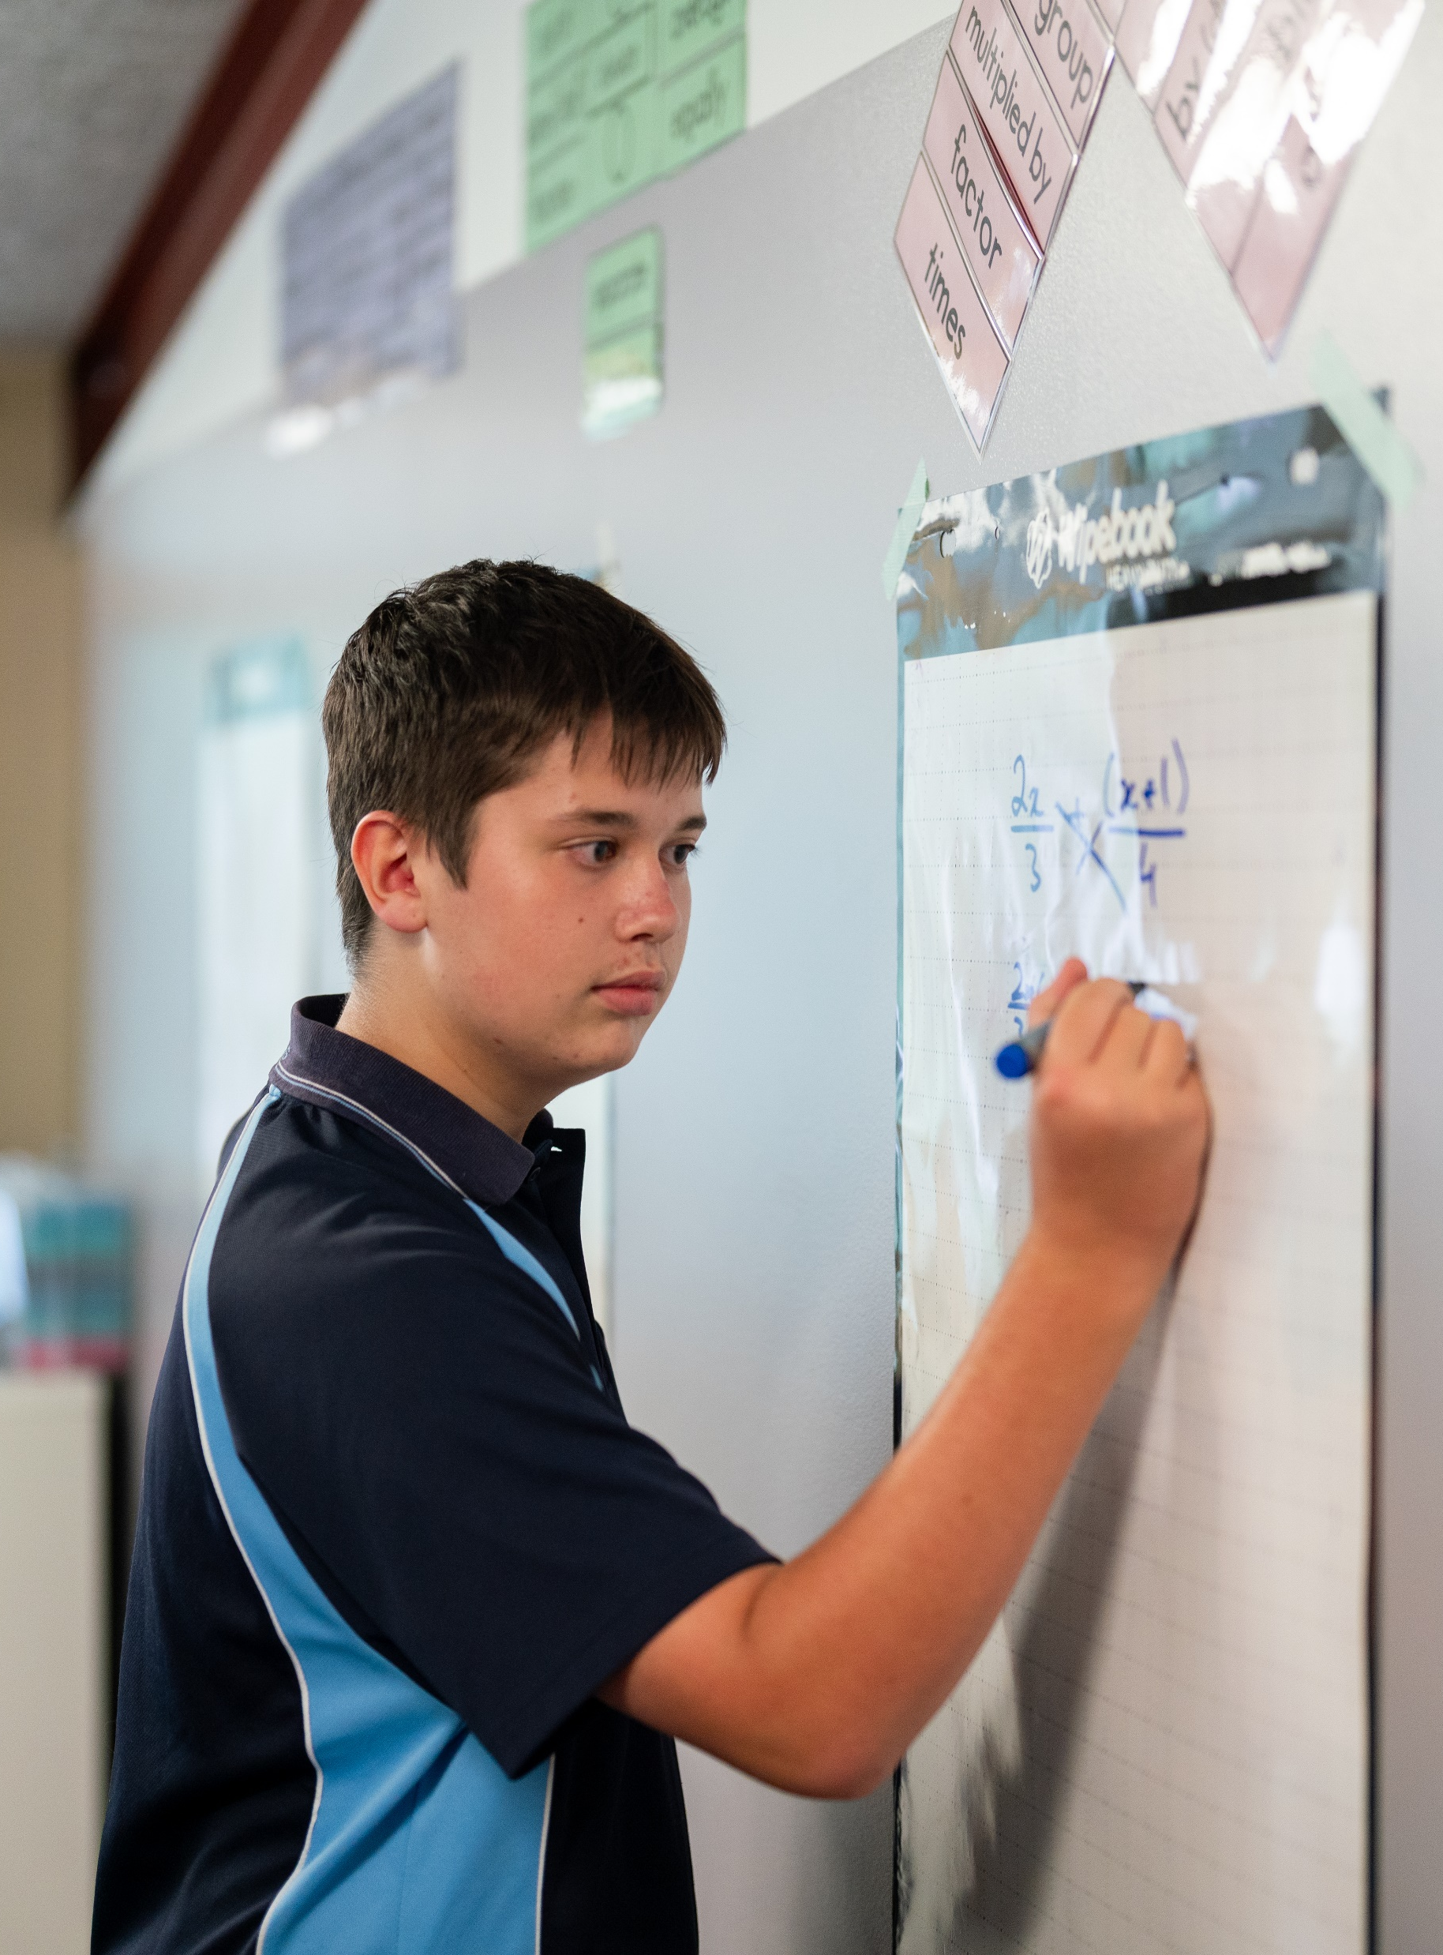
Infographics
Mathematics Standard – Year 11 (Stage 6)
Unit 4 – Driving Safely

Slide 2
Learning intentions and success criteria
Learning intentions
To understand how data can be represented effectively in an infographic.
To be able to evaluate and choose effective graphs for presenting data in an infographic.
Success criteria
I can interpret trends and key messages from an infographic.
I can recreate selected data using different graph types suitable for the dataset.
I can explain how the choice of graph influences the meaning or message conveyed.
I can justify my choice of graphs and suggest improvements for clearer data representations.

Slide 3
Connecting learning

Slide 4
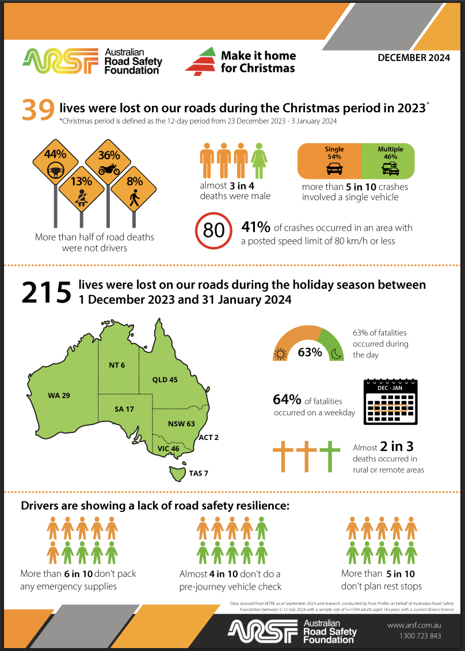
slide
Identify the types of graphs that have been used on this infographic.
Select 2–3 graphs from the infographic and recreate each using a different type of graph
Why might the designer have chosen these graph types?
How well do the different graphs in the infographic communicate the information?

Slide 5
Releasing responsibility

Slide 6
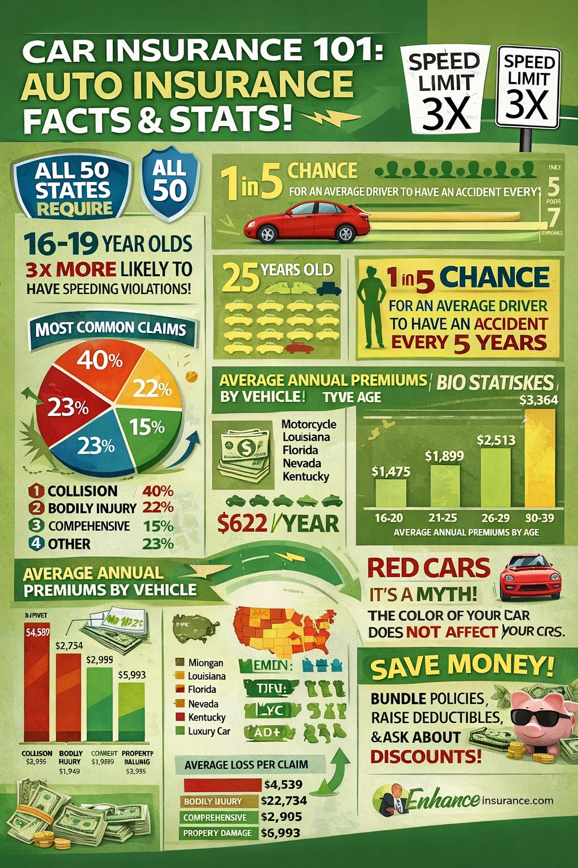
Infographic
Is this infographic clear to a viewer?
Why or why not?

Slide 7
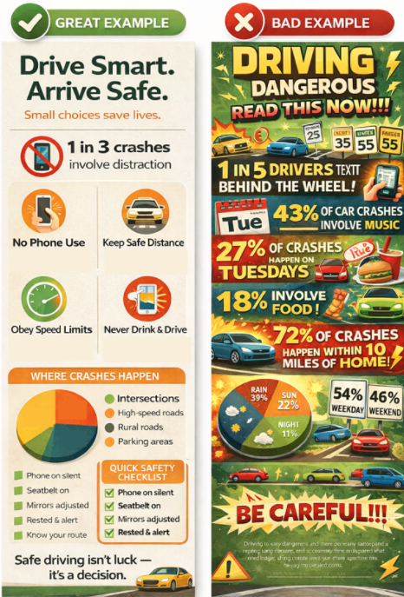
Example and non example

Slide 8
Independent practice

Slide 9
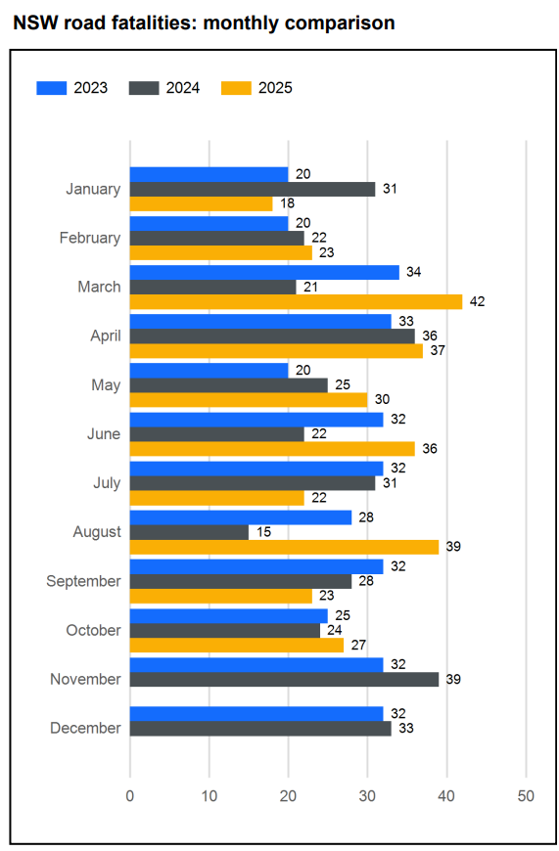
When are you most at risk on the road?
Create an infographic
Your infographic must include:
at least 2 graphs.
a clear layout for your audience.
Justify your choices:
explain why you chose each graph.
explain how your design communicates your message clearly.
Transport for NSW, Road Safety Statistics Reports. Available at: https://www.transport.nsw.gov.au/roadsafety/statistics/reports (accessed 11.12.25).

Slide 10
References
This presentation contains NSW Curriculum and syllabus content. The NSW Curriculum is developed by the NSW Education Standards Authority. This content is prepared by NESA for and on behalf of the Crown in the right of the State of New South Wales. The material is protected by Crown copyright.
Please refer to the NESA Copyright Disclaimer for more information https://educationstandards.nsw.edu.au/wps/portal/nesa/mini-footer/copyright.
NESA holds the only official and up-to-date versions of the NSW Curriculum and syllabus documents. Please visit the NSW Education Standards Authority (NESA) website https://educationstandards.nsw.edu.au/wps/portal/nesa/home and the NSW Curriculum website https://curriculum.nsw.edu.au.
Mathematics Standard Stage 11-12 Syllabus © NSW Education Standards Authority (NESA) for and on behalf of the Crown in right of the State of New South Wales, 2024.

Slide 11
Copyright
© State of New South Wales (Department of Education), 2026
The copyright material published in this resource is subject to the Copyright Act 1968 (Cth) and is owned by the NSW Department of Education or, where indicated, by a party other than the NSW Department of Education (third-party material).
Copyright material available in this resource and owned by the NSW Department of Education is licensed under a Creative Commons Attribution 4.0 International (CC BY 4.0) license.
This license allows you to share and adapt the material for any purpose, even commercially.
Attribution should be given to © State of New South Wales (Department of Education), 2025.
Material in this resource not available under a Creative Commons license:
the NSW Department of Education logo, other logos and trademark-protected material
Material owned by a third party that has been reproduced with permission. You will need to obtain permission from the third party to reuse its material.
Links to third-party material and websites
Please note that the provided (reading/viewing material/list/links/texts) are a suggestion only and implies no endorsement, by the New South Wales Department of Education, of any author, publisher, or book title. School principals and teachers are best placed to assess the suitability of resources that would complement the curriculum and reflect the needs and interests of their students.
If you use the links provided in this document to access a third-party’s website, you acknowledge that the terms of use, including licence terms set out on the third-party’s website apply to the use which may be made of the materials on that third-party website or where permitted by the Copyright Act 1968 (Cth). The department accepts no responsibility for content on third-party websites.

