Slide 1

Quadratic formulas
Mathematics Standard – Stage 6 (Year 11)
Unit 4 –Driving Safely

Slide 2
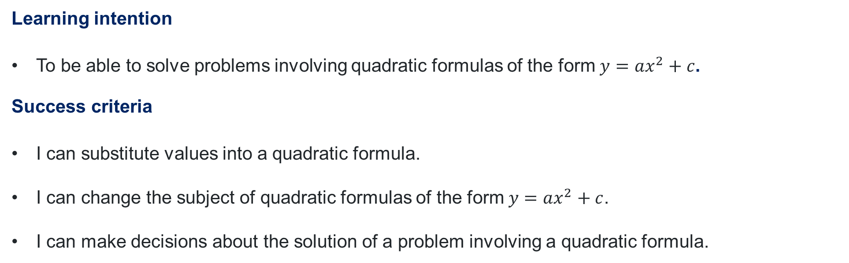
Learning intention and success criteria
Learning intention
To be able to solve problems involving quadratic formulas of the form $y=ax^{2}+c$.
Success criteria
I can substitute values into a quadratic formula.
I can change the subject of quadratic formulas of the form $y=ax^{2}+c$.
I can make decisions about the solution of a problem involving a quadratic formula.
Notes:
Notes for teachers:
Learning intentions and success criteria are best co-constructed with students. Adapt the learning intention as required and add matching success criteria.
For more information See ⁠AITSL or the NSW Department of Education explicit teaching strategies, ⁠Sharing learning intentions and ⁠Sharing success criteria
LISC is not necessarily presented at the beginning of the lesson. Teacher needs to consider most effectual time to introduce
LISC should be revisited during the lesson to support students' evaluation of their learning

Slide 3
Activating prior knowledge

Slide 4
















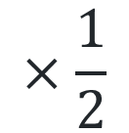

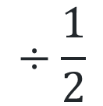

Inverse operations
Write the inverse operation
$$+3$$
$$−3$$
$$+x$$
$$−x$$
$$−3$$
$$+3$$
$$+3x$$
$$−3x$$
$$×3$$
$$÷3$$
$$÷\frac{1}{2}$$
$$×\frac{1}{2}$$
$$÷3$$
$$×3$$
$$x^{2}$$
$$\sqrt{x}$$
$$3^{2}$$
$$\sqrt{3}$$
$$\sqrt{3x}$$
$${\left(3x\right)}^{2}$$

Slide 5
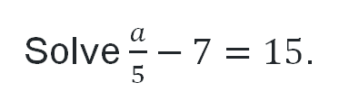
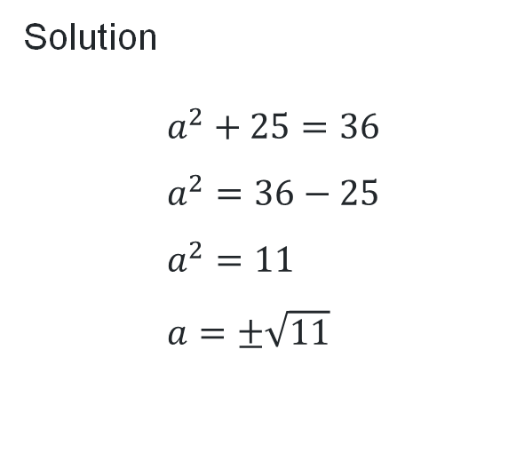
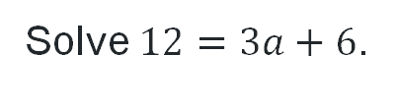
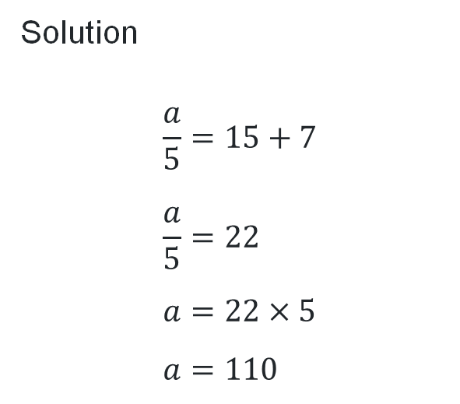
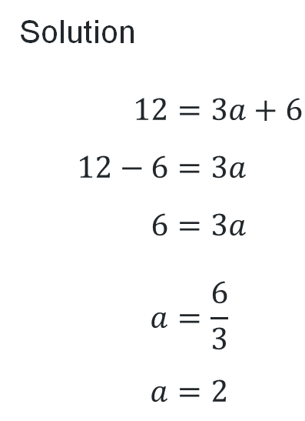
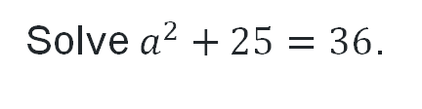
Solving two step equations
Solve $12=3a+6$.
Solve $\frac{a}{5}−7=15$.
Solve $a^{2}+25=36$.
Why would you subtract 6 first?
Solution
$$12=3a+6 \\ 12−6=3a \\ 6=3a \\ a=\frac{6}{3} \\ a=2$$
Why did we add 7 first?
Solution
$$\frac{a}{5}=15+7 \\ \frac{a}{5}=22 \\ a=22×5 \\ a=110$$
Solution
$$a^{2}+25=36 \\ a^{2}=36−25 \\ a^{2}=11 \\ a=±\sqrt{11}$$
Why do we divide by 3 here?
Why are there 2 answers?

Slide 6
Sign of the solution
For each situation, write on your mini-whiteboard whether the answer could be positive, zero, or negative.
The speed of a runner in a race.
The temperature change compared to yesterday.
The distance your headlights shine in front of your car.
Your bank balance after spending more than you have.

Slide 7
Connecting learning

Slide 8
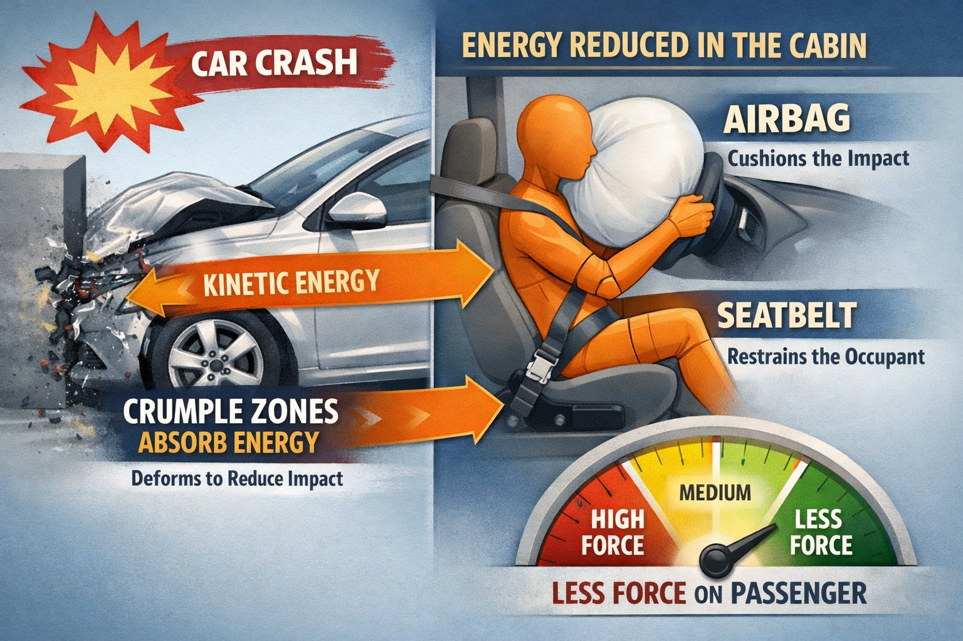
Kinetic energy (1)
What is Kinetic energy and where does it go?

Slide 9
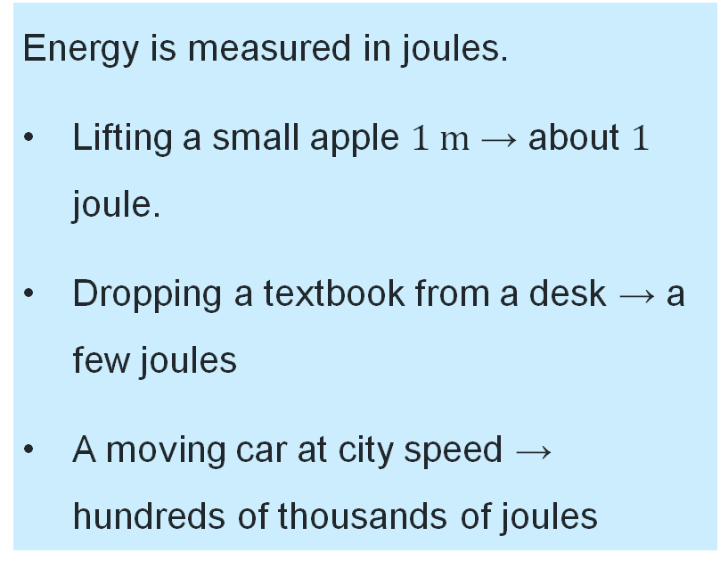
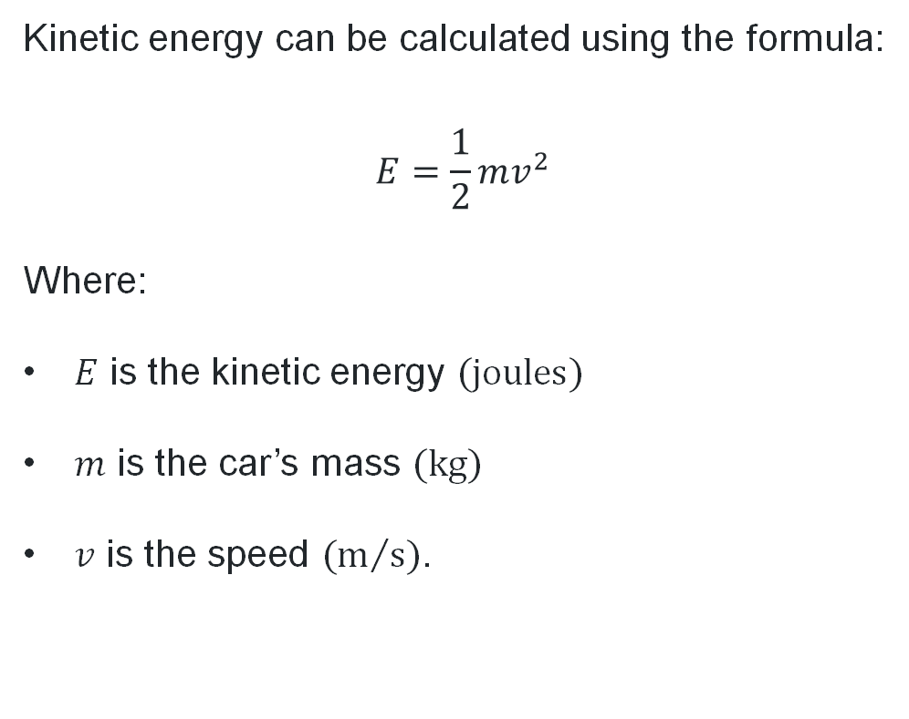
Kinetic energy (2)
A mathematical model
Kinetic energy can be calculated using the formula:
$$E=\frac{1}{2}mv^{2}$$
Where:
$E$ is the kinetic energy $(\text{joules})$
$m$ is the car’s mass $(\text{kg})$
$v$ is the speed $({\text{m}}/{\text{s}})$.
Energy is measured in joules.
Lifting a small apple $1 \text{m}$ → about $1$ joule.
Dropping a textbook from a desk → a few joules
A moving car at city speed → hundreds of thousands of joules

Slide 10

Kinetic energy (3)
Calculating kinetic energy
A small car, which weighs approximately $1200 \text{kg}$, is travelling in a school zone at a speed of $40 \text{km}\text{/}\text{h}$ ($11.111… {\text{m}}/{\text{s}})$.
Using the formula $E=\frac{1}{2}mv^{2}$, find the car’s Kinetic energy.
Solution:
$$E=\frac{1}{2}mv^{2} \\ =\frac{1}{2}×1200×{11.111}^{2} \\ ≈74 072 \text{joules}$$
A car travelling in a school zone at 40km/h has approximately 74 000 joules of kinetic energy.

Slide 11
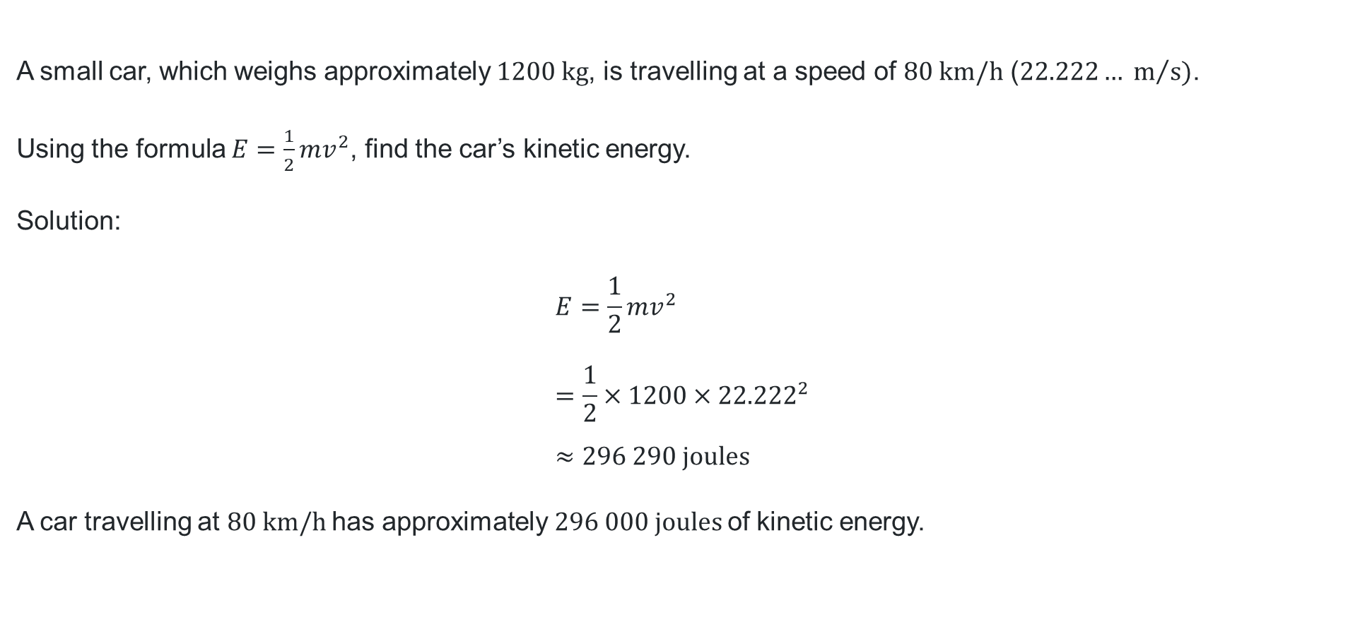
Kinetic energy (4)
Calculating kinetic energy
A small car, which weighs approximately $1200 \text{kg}$, is travelling at a speed of $80 \text{km}\text{/}\text{h}$ ($22.222… m/s)$.
Using the formula $E=\frac{1}{2}mv^{2}$, find the car’s kinetic energy.
Solution:
$$E=\frac{1}{2}mv^{2} \\ =\frac{1}{2}×1200×{22.222}^{2} \\ ≈296 290 \text{joules}$$
A car travelling at $80 \text{km}\text{/}\text{h}$has approximately $296 000 joules$of kinetic energy.

Slide 12
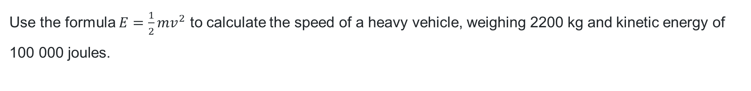

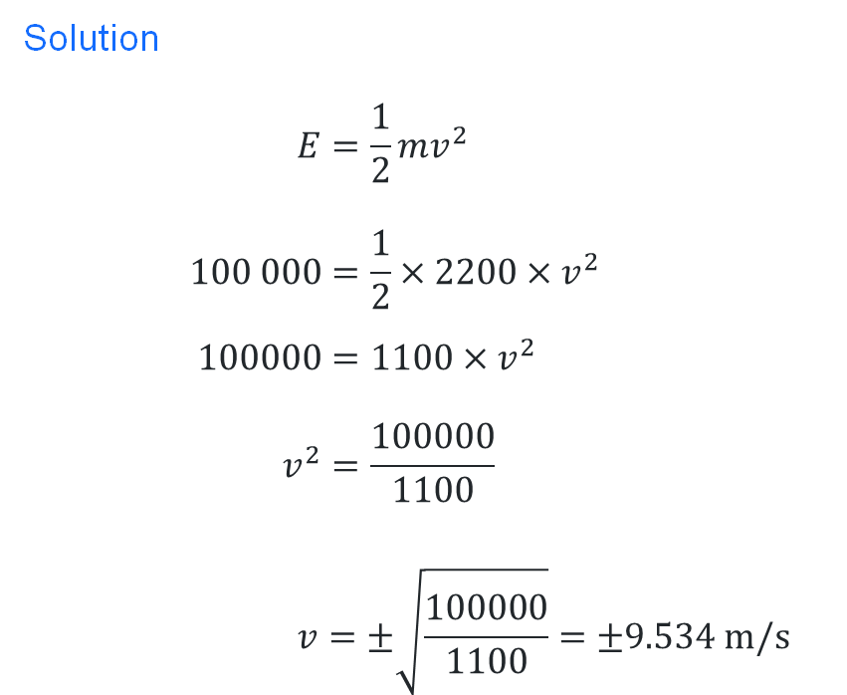
Kinetic energy (5)
Calculating speed
Use the formula $E=\frac{1}{2}mv^{2}$ to calculate the speed of a heavy vehicle, weighing $\text{2200 }\text{kg}$ and kinetic energy of $\text{100 000 }\text{joules}$.
Solution
$$E=\frac{1}{2}mv^{2} \\ 100 000=\frac{1}{2}×2200×v^{2} \\ 100000=1100×v^{2} \\ v^{2}=\frac{100000}{1100} \\ v=±\sqrt{\frac{100000}{1100}}=±9.534 m/s$$
The speed of a vehicle weighing $2200 kg$with kinetic energy of $100 000 J$is $9.534 \text{m}\text{/}\text{s}$.
What happened to the negative answer?

Slide 13
Releasing responsibility

Slide 14
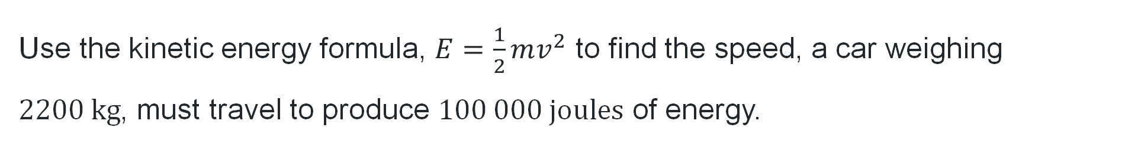
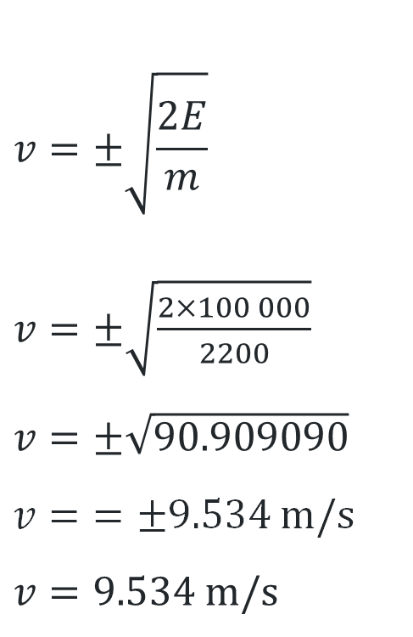
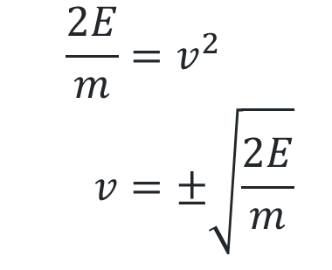
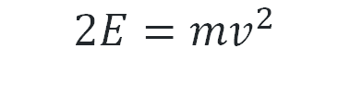
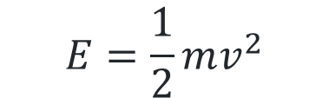
Alternate method
Changing the subject
Use the kinetic energy formula, $E=\frac{1}{2}mv^{2}$ to find the speed, a car weighing $2200 kg$, must travel to produce $100 000 \text{joules}$ of energy.
$$v=±\sqrt{\frac{2E}{m}}$$
$v=$ $±\sqrt{\frac{2×100 000}{2200}}$
$v=$ $±\sqrt{90.909090}$
$v=$ $=±9.534 m/s$
$$v=9.534 m/s$$
$$E=\frac{1}{2}mv^{2}$$
$$2E=mv^{2}$$
$$\frac{2E}{m}=v^{2} \\ v=±\sqrt{\frac{2E}{m}}$$

Slide 15
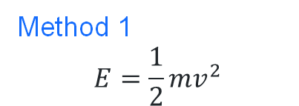
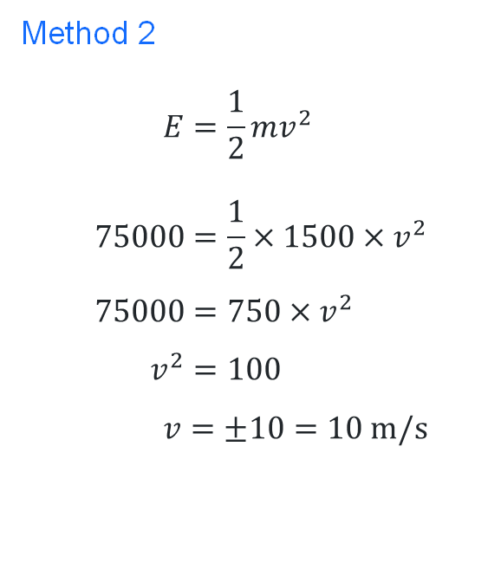
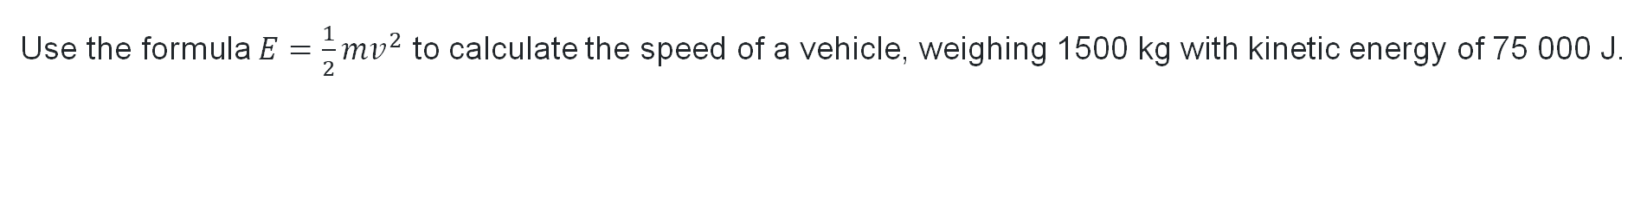



Comparing method
Changing the subject
Use the formula $E=\frac{1}{2}mv^{2}$ to calculate the speed of a vehicle, weighing 1500 kg with kinetic energy of 75 000 J.
$$v=±\sqrt{\frac{2E}{m}} \\ v=±\sqrt{\frac{2×75000}{1500}} \\ v=±\sqrt{100} \\ v=±10=10 m/s$$
Method 2
$$E=\frac{1}{2}mv^{2} \\ 75000=\frac{1}{2}×1500×v^{2} \\ 75000=750×v^{2} \\ v^{2}=100 \\ v=±10=10 m/s$$
Method 1
$$E=\frac{1}{2}mv^{2}$$
$$2E=mv^{2}$$
$$\frac{2E}{m}=v^{2} \\ v=±\sqrt{\frac{2E}{m}}$$

Slide 16

Solving quadratic equations of the form $y=ax^{2}+c (1)$
Worked example 1
The average force on a passenger wearing a seatbelt is modelled by:
$$F=0.8v^{2}+500$$
where:
$F=$force on the passenger $(\text{N})$
$v=$ speed $({\text{km}}/{\text{h}})$
Doctors say forces above $5000 \text{N}$greatly increase the risk of severe injury.
Calculate the speed of the car to achieve a force of $5000 \text{N}$.

Slide 17
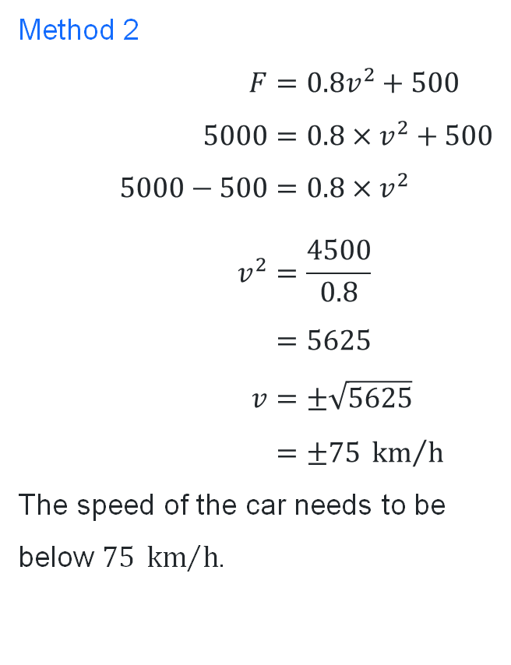

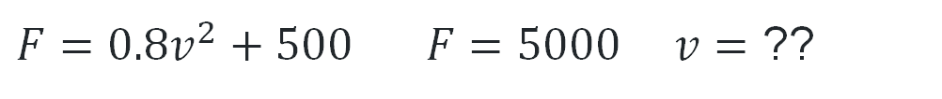
Solving quadratic equations of the form $y=ax^{2}+c$(2)
Worked example 2
$F=0.8v^{2}+500 F=5000$ $v=$ ??
Method 2
$$F=0.8v^{2}+500 \\ 5000=0.8×v^{2}+500 \\ 5000−500=0.8×v^{2} \\ v^{2}=\frac{4500}{0.8} \\ =5625 \\ v=±\sqrt{5625} \\ =±75 {\text{km}}/{\text{h}}$$
The speed of the car needs to be below $75 {\text{km}}/{\text{h}}$.
Where did these numbers come from?
Method 1
$$F=0.8v^{2}+500 \\ F−500=0.8v^{2} \\ \frac{F−500}{0.8}=v^{2} \\ v=±\sqrt{\frac{F−500}{0.8}}$$
$v=\sqrt{\frac{5000−500}{0.8}}$=$75$ $\text{km}\text{/}\text{h}$
Why do we have 2 answers?
Why can we ignore one answer?

Slide 18

Solving quadratic equations of the form $y=ax^{2}+c$(3)
Question 1 - Your turn
The average force on a passenger wearing a seatbelt is modelled by:
$$F=0.3v^{2}+500$$
where:
$F=$force on the passenger $(N)$
$v=$ speed $({km}/h)$
Doctors say forces above 5000 N greatly increase the risk of severe injury.
Calculate the speed of the car to achieve this force.

Slide 19
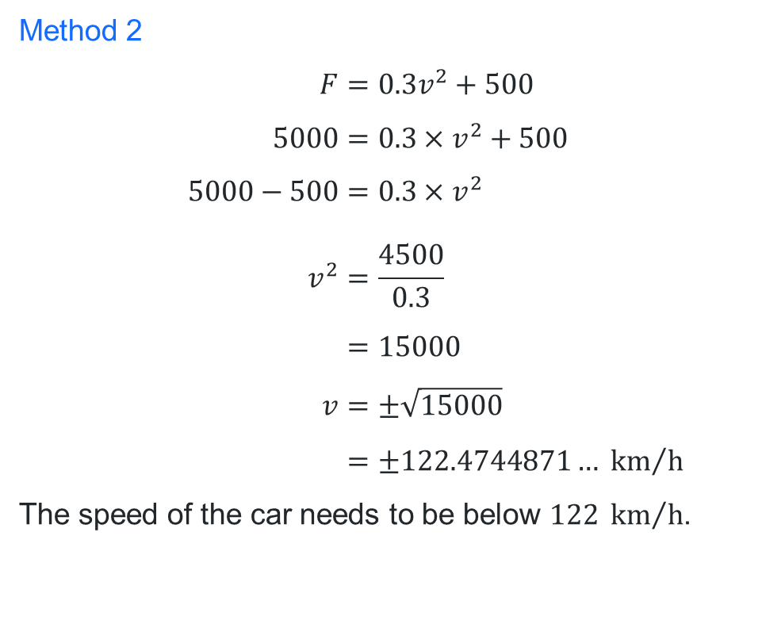
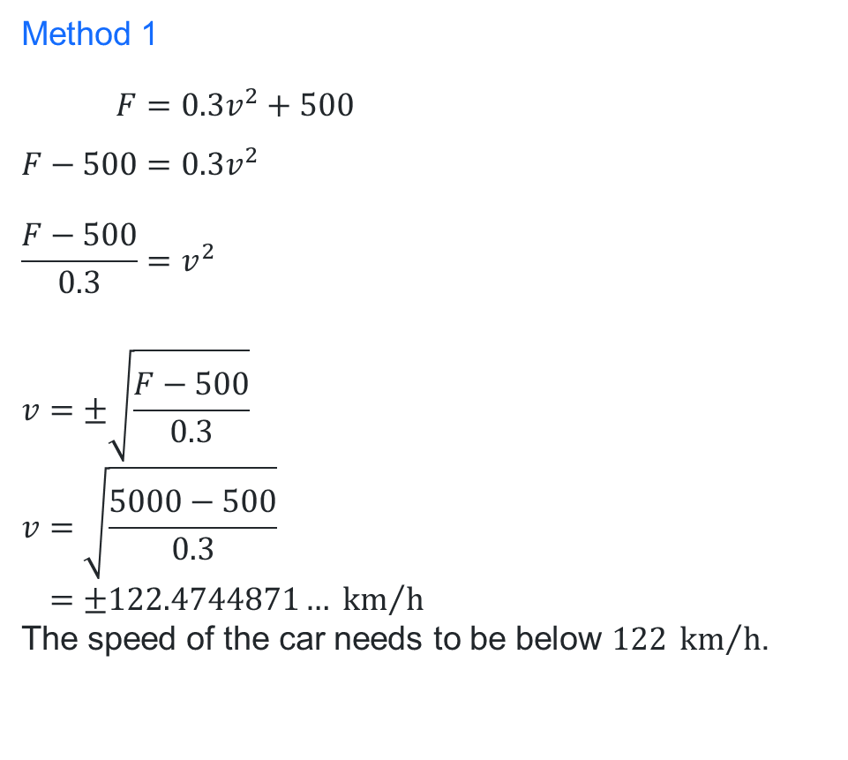
Solving quadratic equations of the form $y=ax^{2}+c$(4)
Question 1 - Your turn
$F=0.3v^{2}+500 F=5000$ $v=$ ??
Method 1
$$F=0.3v^{2}+500 \\ F−500=0.3v^{2} \\ \frac{F−500}{0.3}=v^{2}$$
$$v=±\sqrt{\frac{F−500}{0.3}} \\ v=\sqrt{\frac{5000−500}{0.3}} \\ =±122.4744871… {km}/h$$
The speed of the car needs to be below $122 {km}/h$.
Method 2
$$F=0.3v^{2}+500 \\ 5000=0.3×v^{2}+500 \\ 5000−500=0.3×v^{2} \\ v^{2}=\frac{4500}{0.3} \\ =15000 \\ v=±\sqrt{15000} \\ =±122.4744871… {km}/h$$
The speed of the car needs to be below $122 {km}/h$.

Slide 20
References
This presentation contains NSW Curriculum and syllabus content. The NSW Curriculum is developed by the NSW Education Standards Authority. This content is prepared by NESA for and on behalf of the Crown in the right of the State of New South Wales. The material is protected by Crown copyright.
Please refer to the NESA Copyright Disclaimer for more information https://educationstandards.nsw.edu.au/wps/portal/nesa/mini-footer/copyright.
NESA holds the only official and up-to-date versions of the NSW Curriculum and syllabus documents. Please visit the NSW Education Standards Authority (NESA) website https://educationstandards.nsw.edu.au/wps/portal/nesa/home and the NSW Curriculum website https://curriculum.nsw.edu.au.
Mathematics Standard Stage 6 Syllabus © NSW Education Standards Authority (NESA) for and on behalf of the Crown in right of the State of New South Wales, 2024.

Slide 21
Copyright
© State of New South Wales (Department of Education), 2026
The copyright material published in this resource is subject to the Copyright Act 1968 (Cth) and is owned by the NSW Department of Education or, where indicated, by a party other than the NSW Department of Education (third-party material).
Copyright material available in this resource and owned by the NSW Department of Education is licensed under a Creative Commons Attribution 4.0 International (CC BY 4.0) license.
This license allows you to share and adapt the material for any purpose, even commercially.
Attribution should be given to © State of New South Wales (Department of Education), 2026.
Material in this resource not available under a Creative Commons license:
the NSW Department of Education logo, other logos and trademark-protected material
Material owned by a third party that has been reproduced with permission. You will need to obtain permission from the third party to reuse its material.
Links to third-party material and websites
Please note that the provided (reading/viewing material/list/links/texts) are a suggestion only and implies no endorsement, by the New South Wales Department of Education, of any author, publisher, or book title. School principals and teachers are best placed to assess the suitability of resources that would complement the curriculum and reflect the needs and interests of their students.
If you use the links provided in this document to access a third-party’s website, you acknowledge that the terms of use, including licence terms set out on the third-party’s website apply to the use which may be made of the materials on that third-party website or where permitted by the Copyright Act 1968 (Cth). The department accepts no responsibility for content on third-party websites.

