Slide 1
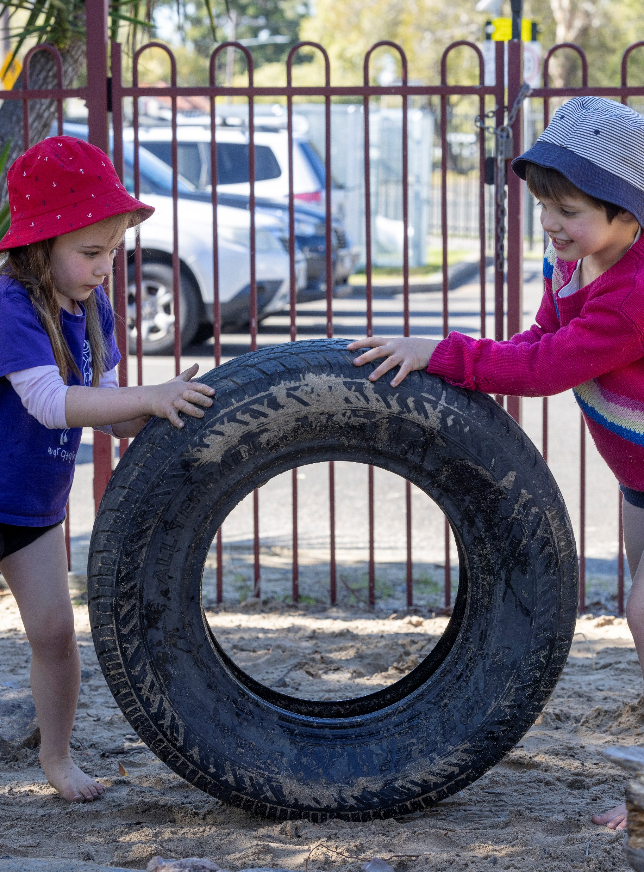
Stopping distance
Mathematics Standard – Stage 6 (Year 11)
Unit 4 –Driving Safely

Slide 2
Learning intentions and success criteria
Learning intentions
To understand how distance, speed and time are connected in practical situations.
To be able to apply the stopping-distance formula to real-world problems.
Success criteria
I can calculate distance, speed and time.
I can convert common units involving distance and time.
I can use the stopping distance formula to solve problems.
I can explain the components of stopping distance and how different factors influence it.
Notes:
Notes for teachers:
Learning intentions and success criteria are best co-constructed with students. Adapt the learning intention as required and add matching success criteria.
For more information See ⁠AITSL or the NSW Department of Education explicit teaching strategies, ⁠Sharing learning intentions and ⁠Sharing success criteria
LISC is not necessarily presented at the beginning of the lesson. Teacher needs to consider most effectual time to introduce
LISC should be revisited during the lesson to support students' evaluation of their learning

Slide 3
Activating prior knowledge

Slide 4
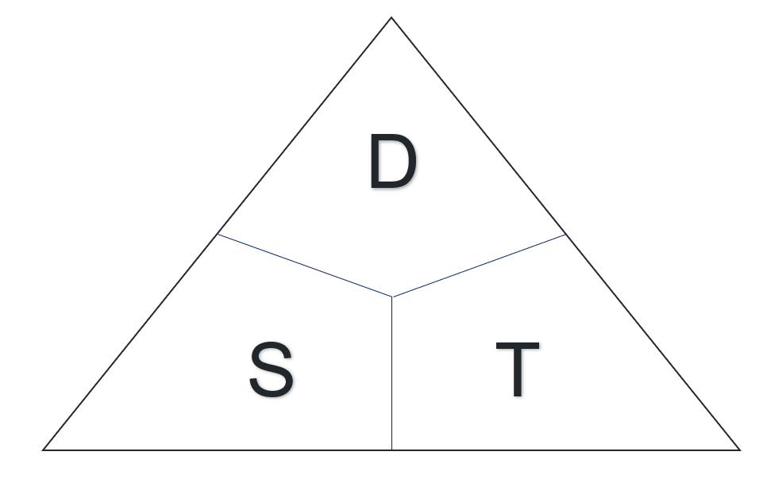
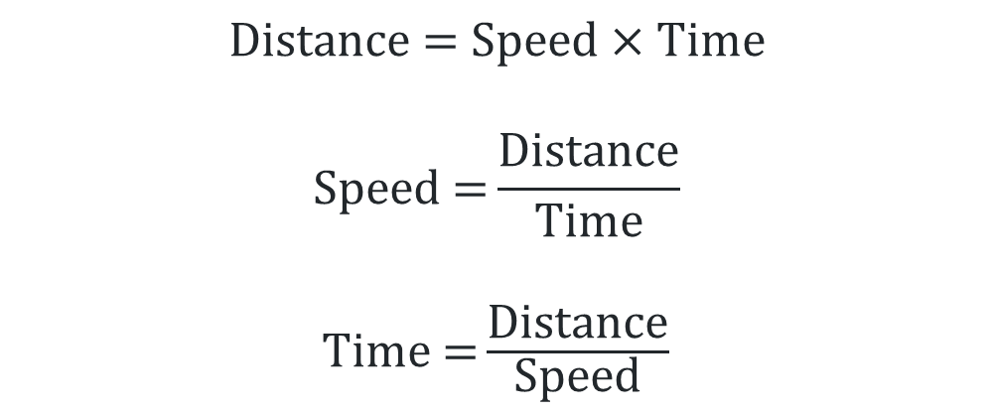
Distance, speed, time (1)
What do the letters D, S and T stand for?
What does this visual help us determine?
$$\text{Distance}\text{ = }\text{Speed} \text{×} \text{Time}$$
$$\text{Speed} \text{=}\frac{\text{Distance}}{\text{Time}}$$
$\text{Time}\text{ =}\frac{\text{Distance}}{\text{Speed}}$

Slide 5
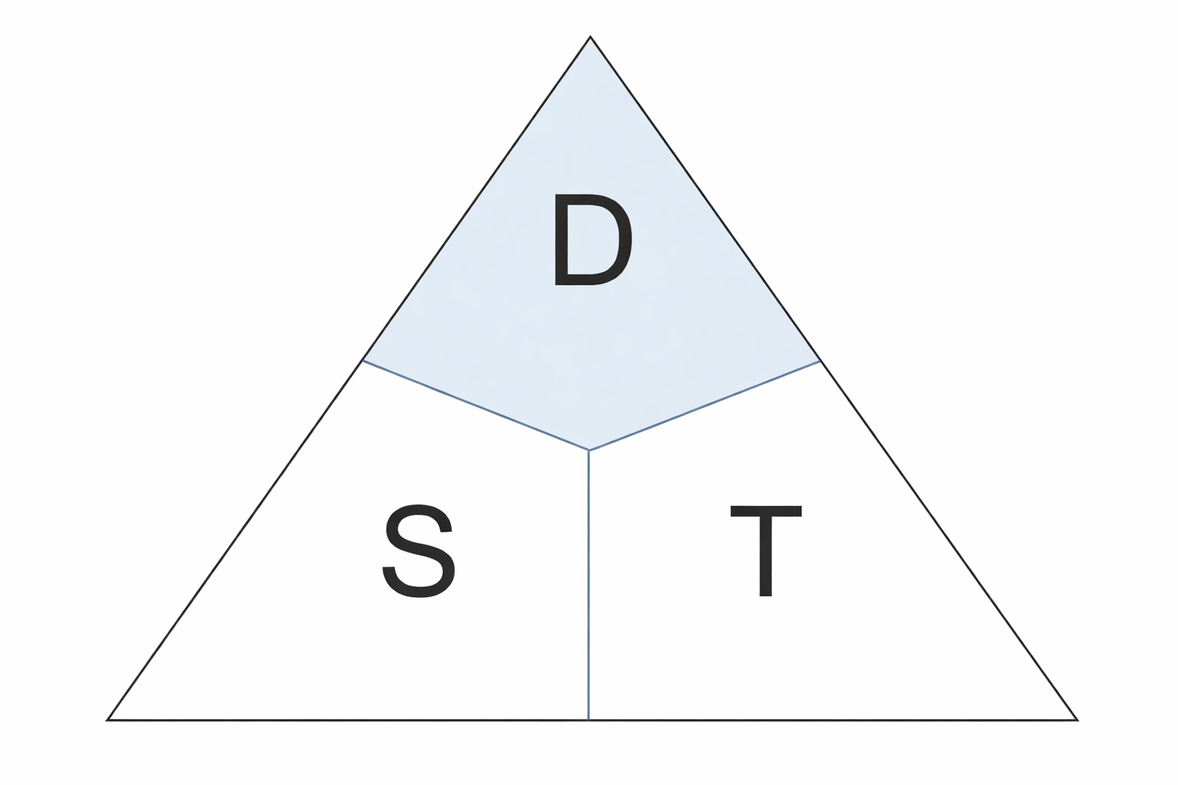
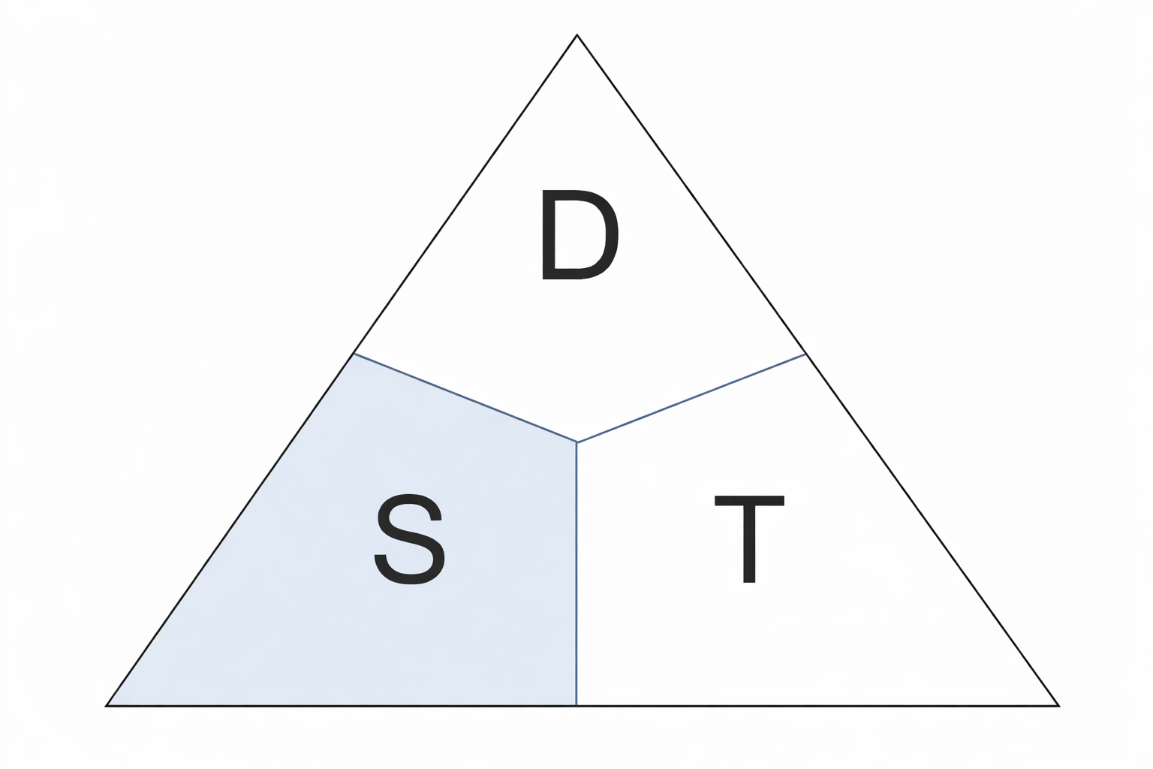
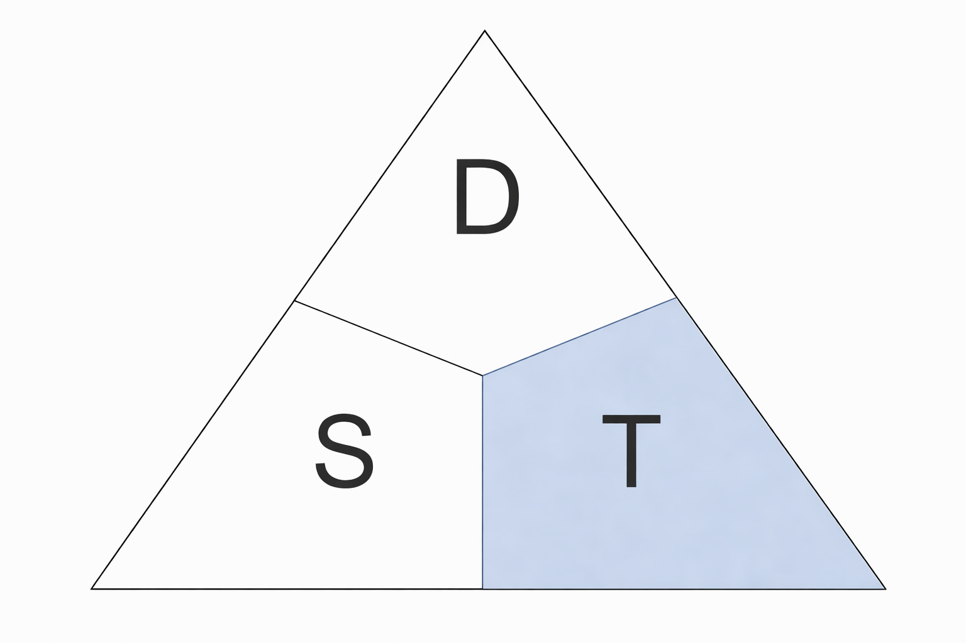
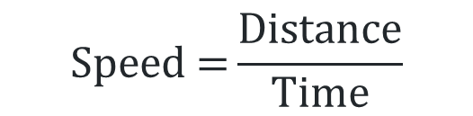



Distance, speed, time (2)
$$×$$
$$\text{Distance}\text{ = }\text{Speed} \text{×} \text{Time}$$
$$\text{Speed} \text{=}\frac{\text{Distance}}{\text{Time}}$$
$\text{Time}\text{ =}\frac{\text{Distance}}{\text{Speed}}$
Images generated using ChatGPT (OpenAI).

Slide 6
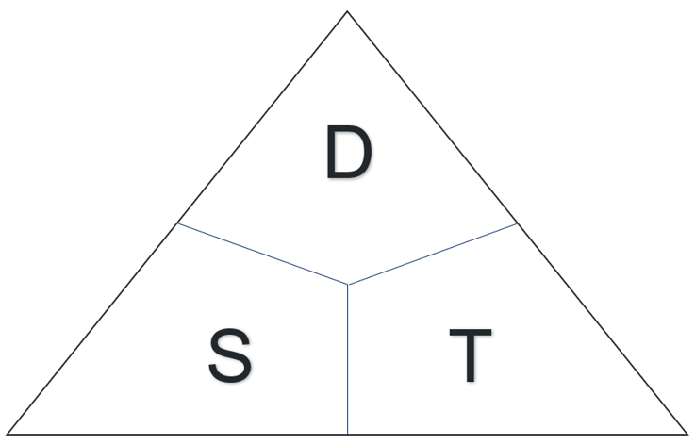
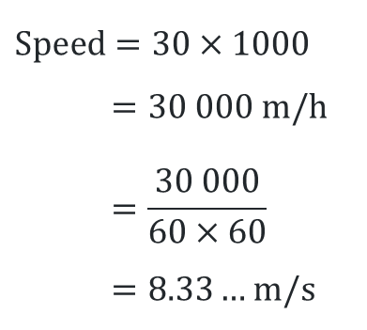
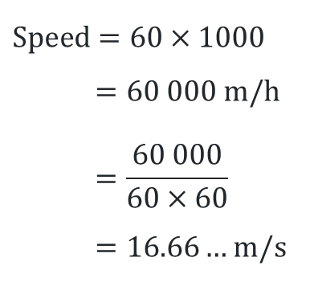
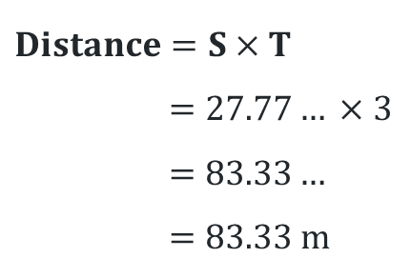
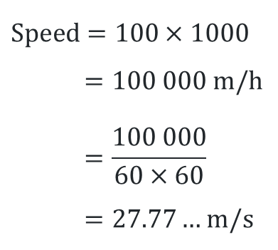
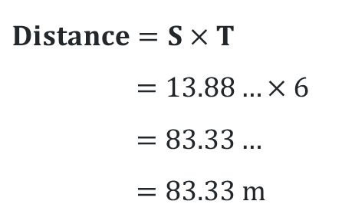
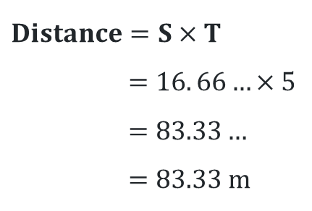
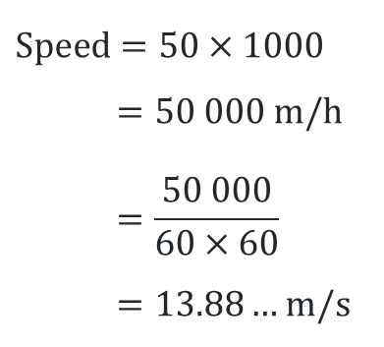
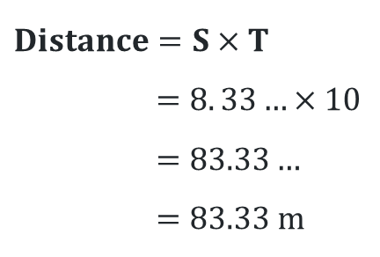
Which vehicle would travel the furthest?
1. A car driving 60 km/h for 5 secs
3. A motorcycle travelling 30 km/h for 10 secs
$$\text{Speed}=60×1000$$
$$=60 000 m/h$$
$$=\frac{60 000}{60×60}$$
$=16.66…$ m/s
$$Distance=S×T$$
$$=16. 66…×5$$
$$=83.33…$$
$=83.33$m
$$\text{Speed}=30×1000$$
$$=30 000 m/h$$
$$=\frac{30 000}{60×60}$$
$=8.33…$ m/s
$$Distance=S×T$$
$$=8. 33…×10$$
$$=83.33…$$
$=83.33$m
2. A truck travelling 100 km/h for 3 secs
4. A ute travelling 50 km/h for 6 secs
$$\text{Speed}=100×1000$$
$$=100 000 m/h$$
$$=\frac{100 000}{60×60}$$
$=27.77…$ m/s
$$Distance=S×T$$
$$=27.77… ×3$$
$$=83.33…$$
$=83.33$m
$$\text{Speed}=50×1000$$
$$=50 000 m/h$$
$$=\frac{50 000}{60×60}$$
$=13.88…$ m/s
$$Distance=S×T$$
$$=13.88…×6$$
$$=83.33…$$
$=83.33$m

Slide 7
Connecting learning

Slide 8
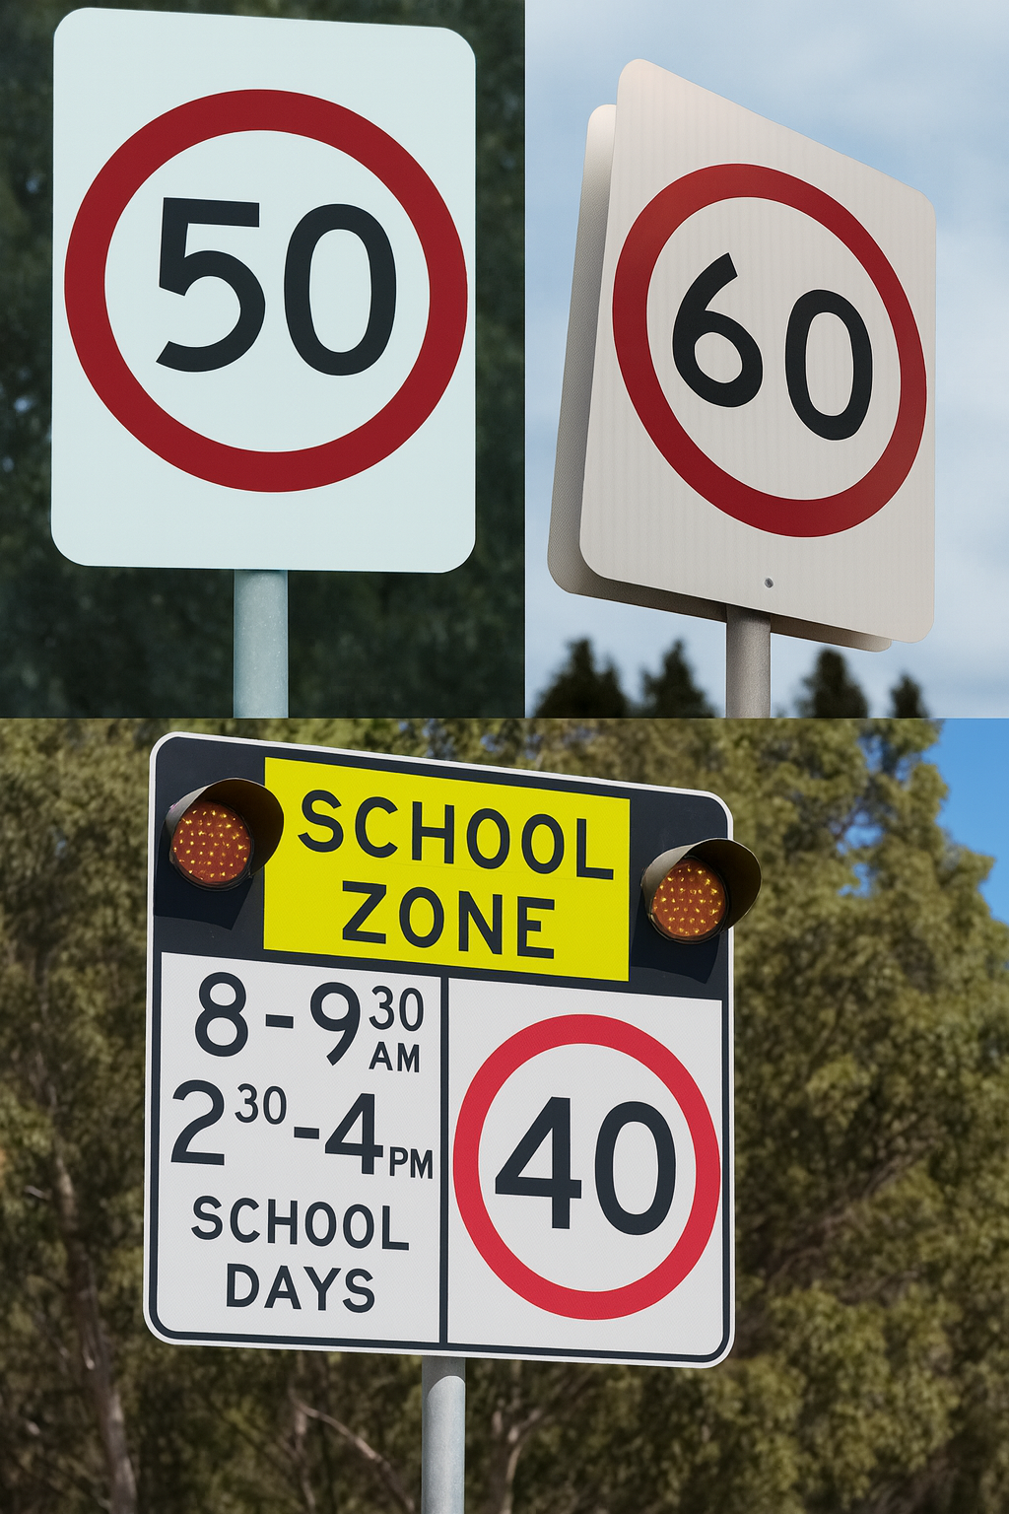
School zones
In 2003 most residential streets in NSW had their speed limit reduced from 60 km/h to 50 km/h.
Also in 2003, school zones were introduced, reducing the speed limit around schools to 40 km/h at certain times of the day.
Why do you think the government reduced residential speed zones and introduced school zones?
Is 40 km/h slow enough for a school zone?
Images generated using ChatGPT (OpenAI).

Slide 9
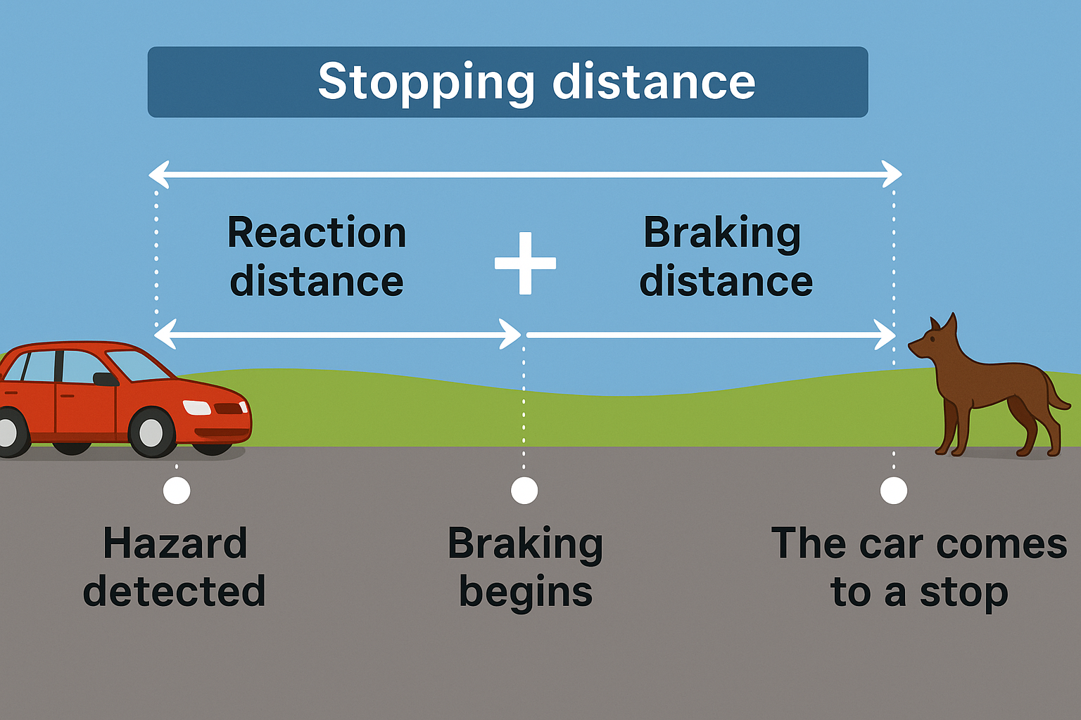
Formula
$\text{s}\text{topping} \text{distance}\text{ = }\text{reaction} \text{distance}\text{ + }\text{braking} \text{distance}$
Images generated using ChatGPT (OpenAI).

Slide 10
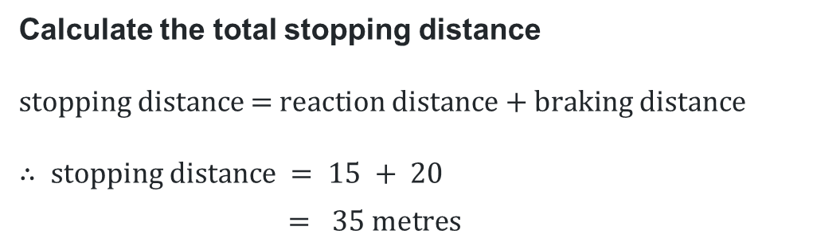
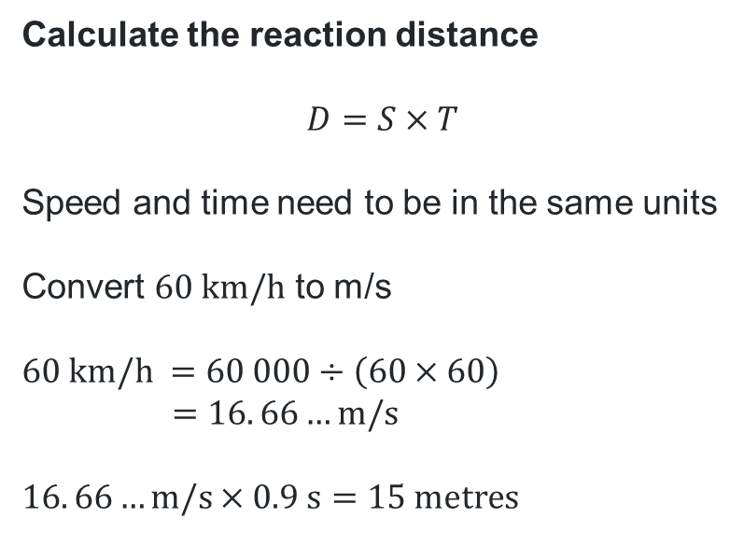
The stopping distance formula (1)
Worked example 1
Finley is driving a car at a speed of 60 km/h when he sees a hazard on the road ahead. It takes him 0.9 seconds to apply the brakes, and his braking distance is 20 metres.
Calculate the reaction distance
$$D=S×T$$
Speed and time need to be in the same units
Convert $60 \text{km}\text{/}\text{h}$ to m/s
$$60 \text{km}\text{/}\text{h} =60 000÷\left(60×60\right)$$
$$=16. 66…m/s$$
$$16. 66…\text{m}\text{/}\text{s}×0.9 \text{s}=15 \text{metres}$$
Calculate the total stopping distance
$$\text{stopping} \text{distance}\text{ = }\text{reaction} \text{distance}\text{ + }\text{braking} \text{distance}$$
$$∴ \text{stopping} \text{distance} = 15 + 20$$
$$= 35 \text{metres}$$
What does the answer of 35 metres represent in this scenario?
How would you explain each of part of this line of working?

Slide 11
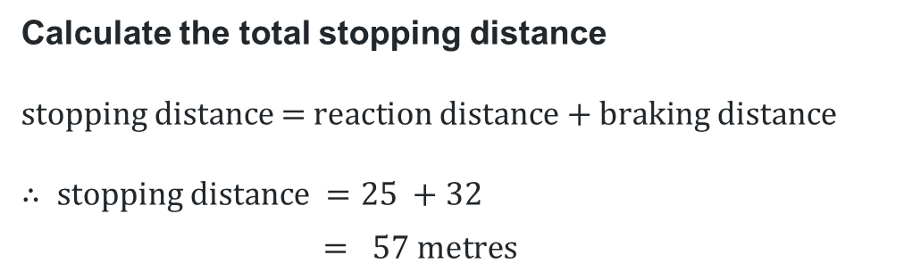
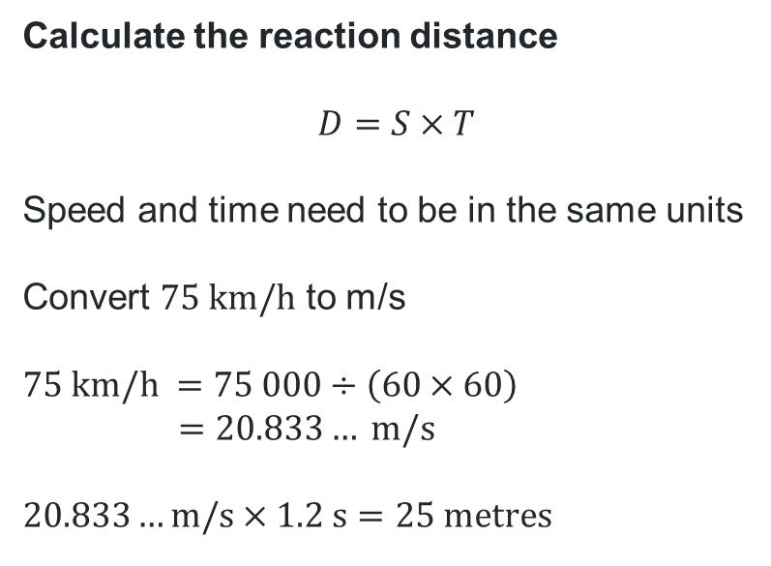
The stopping distance formula (2)
Your turn 1
Hayden is driving a car at a speed of 75 km/h when he sees a dog run out on the road ahead. It takes him 1.2 seconds to apply the brakes, and his braking distance is 32 metres.
Calculate the reaction distance
$$D=S×T$$
Speed and time need to be in the same units
Convert $75 \text{km}\text{/}\text{h}$ to m/s
$$75 \text{km}\text{/}\text{h} =75 000÷\left(60×60\right)$$
$$=20.833… m/s$$
$$20.833…\text{m}\text{/}\text{s}×1.2 \text{s}=25 \text{metres}$$
Calculate the total stopping distance
$$\text{stopping} \text{distance}\text{ = }\text{reaction} \text{distance}\text{ + }\text{braking} \text{distance}$$
$$∴ \text{stopping} \text{distance} =25 +32$$
$$= 57 \text{metres}$$

Slide 12
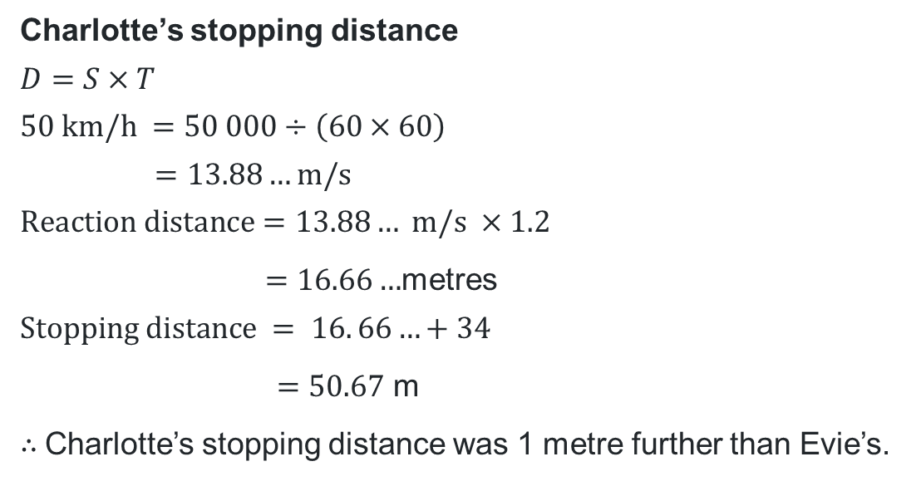
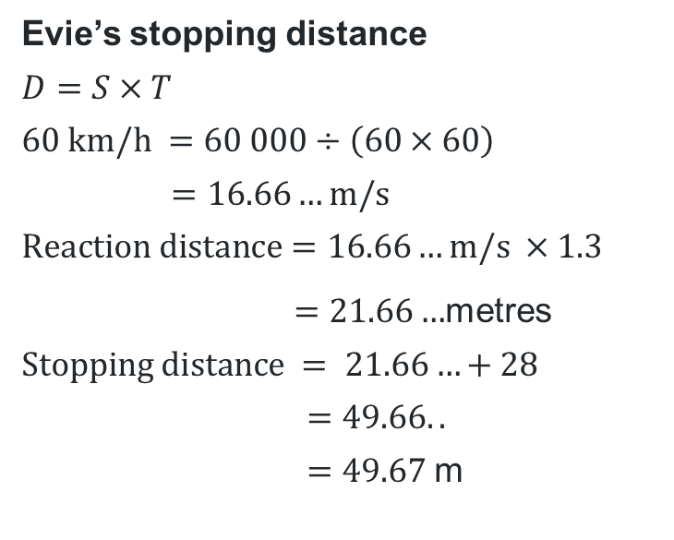
The stopping distance formula (3)
Worked example 2
Evie was driving at 60 km/h in dry conditions, her reaction time was 1.3 seconds and her braking distance was
28 m. In rainy conditions, Charlotte was driving at 50 km/h, her reaction time was 1.2 seconds and her braking distance was 34 m. Which person had the greater stopping distance and by how much?
Evie’s stopping distance
$$D=S×T$$
$$60 \text{km}\text{/}\text{h} =60 000÷\left(60×60\right)$$
$$=16.66…m/s$$
$$Reaction distance=16.66…\text{m}\text{/}\text{s} ×1.3$$
$=21.66…$metres
$$\text{Stopping} \text{distance} = 21.66…+28$$
$$=49.66..$$
$=49.67$m
Charlotte’s stopping distance
$$D=S×T$$
$$50 \text{km}\text{/}\text{h} =50 000÷\left(60×60\right)$$
$$=13.88…m/s$$
$$Reaction distance=13.\text{88}… \text{m}\text{/}\text{s} ×1.2$$
$=16.66…$metres
$$\text{Stopping} \text{distance} = 16. 66…+34$$
$=50.67$ m
$∴$Charlotte’s stopping distance was 1 metre further than Evie’s.
If Charlotte’s road was dry, how might the result change?
How does 49.67 m help us understand Evie’s safety in this situation?

Slide 13
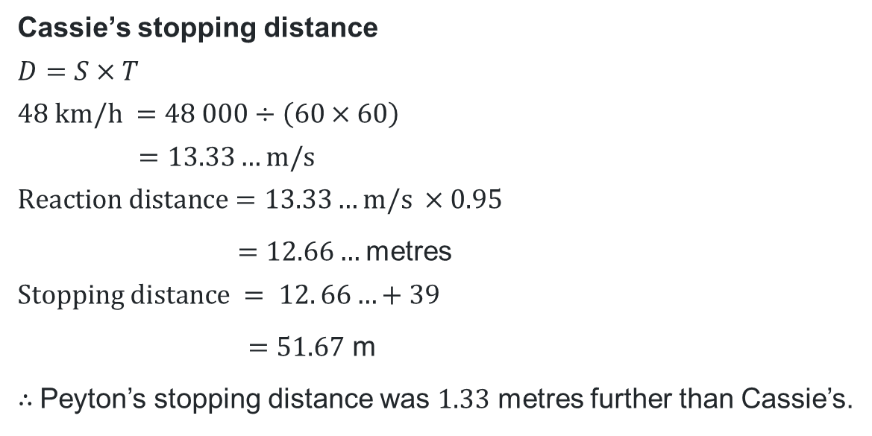
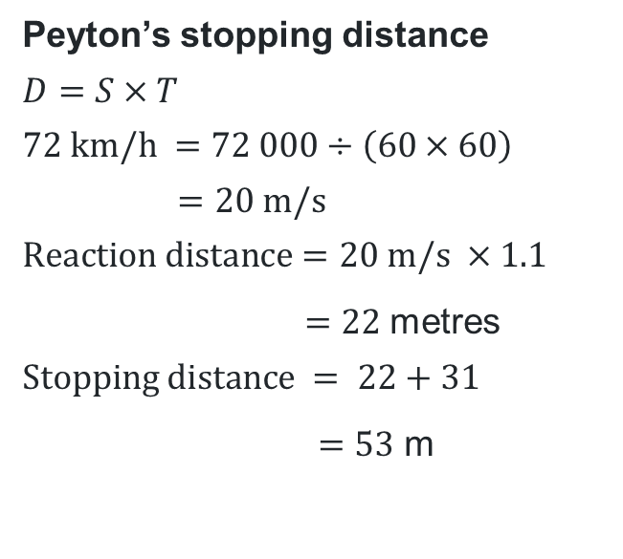
The stopping distance formula (4)
Your turn 2
Peyton was driving at 72 km/h in dry conditions, her reaction time was 1.1 seconds and her braking distance was 31 m. In rainy conditions, Cassie was driving at 48 km/h, her reaction time was 0.95 seconds and her braking distance was 39 m. Which person had the greater stopping distance and by how much?
Peyton’s stopping distance
$$D=S×T$$
$$72 \text{km}\text{/}\text{h} =72 000÷\left(60×60\right)$$
$$=20 m/s$$
$$Reaction distance=20 \text{m}\text{/}\text{s} ×1.1$$
$=22$metres
$$\text{Stopping} \text{distance} = 22+31$$
$=53$ m
Cassie’s stopping distance
$$D=S×T$$
$$48 \text{km}\text{/}\text{h} =48 000÷\left(60×60\right)$$
$$=13.33…m/s$$
$$Reaction distance=13.33…\text{m}\text{/}\text{s} ×0.95$$
$=12.66…$metres
$$\text{Stopping} \text{distance} = 12. 66…+39$$
$=51.67$ m
$∴$Peyton’s stopping distance was $1.33$ metres further than Cassie’s.

Slide 14
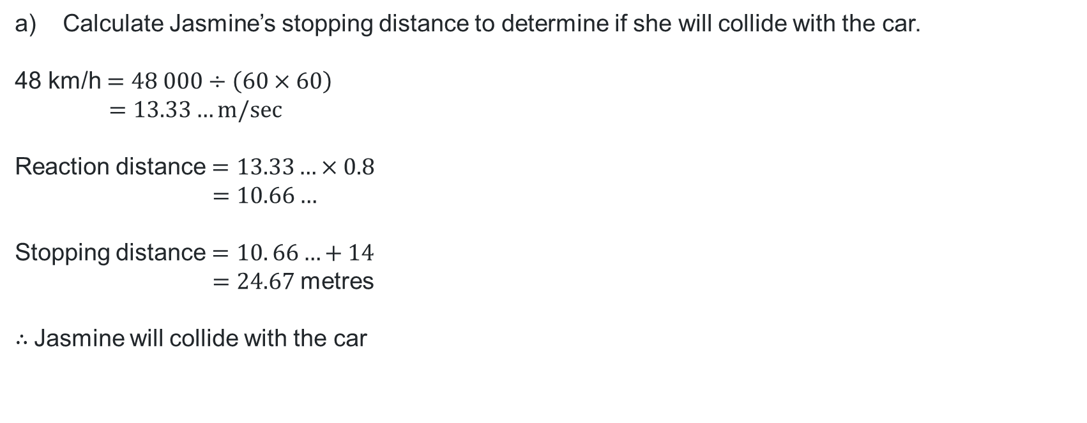
Example question 1 – part a)
Jasmine is driving a car at a speed of 48 km/h whilst in a school zone where the speed limit is 40 km/h.
A car suddenly pulls out of a side street 21 metres ahead, Jasmine slams her brake with a reaction time of 0.8 seconds. Her braking distance is 14 metres.
Calculate Jasmine’s stopping distance to determine if she will collide with the car.
48 km/h $=48 000÷\left(60×60\right)$
$$=13.33…m/sec$$
Reaction distance $=13.33…×0.8$
$$=10.66…$$
Stopping distance $=10. 66…+14$
$=24.67$metres
$∴$Jasmine will collide with the car

Slide 15
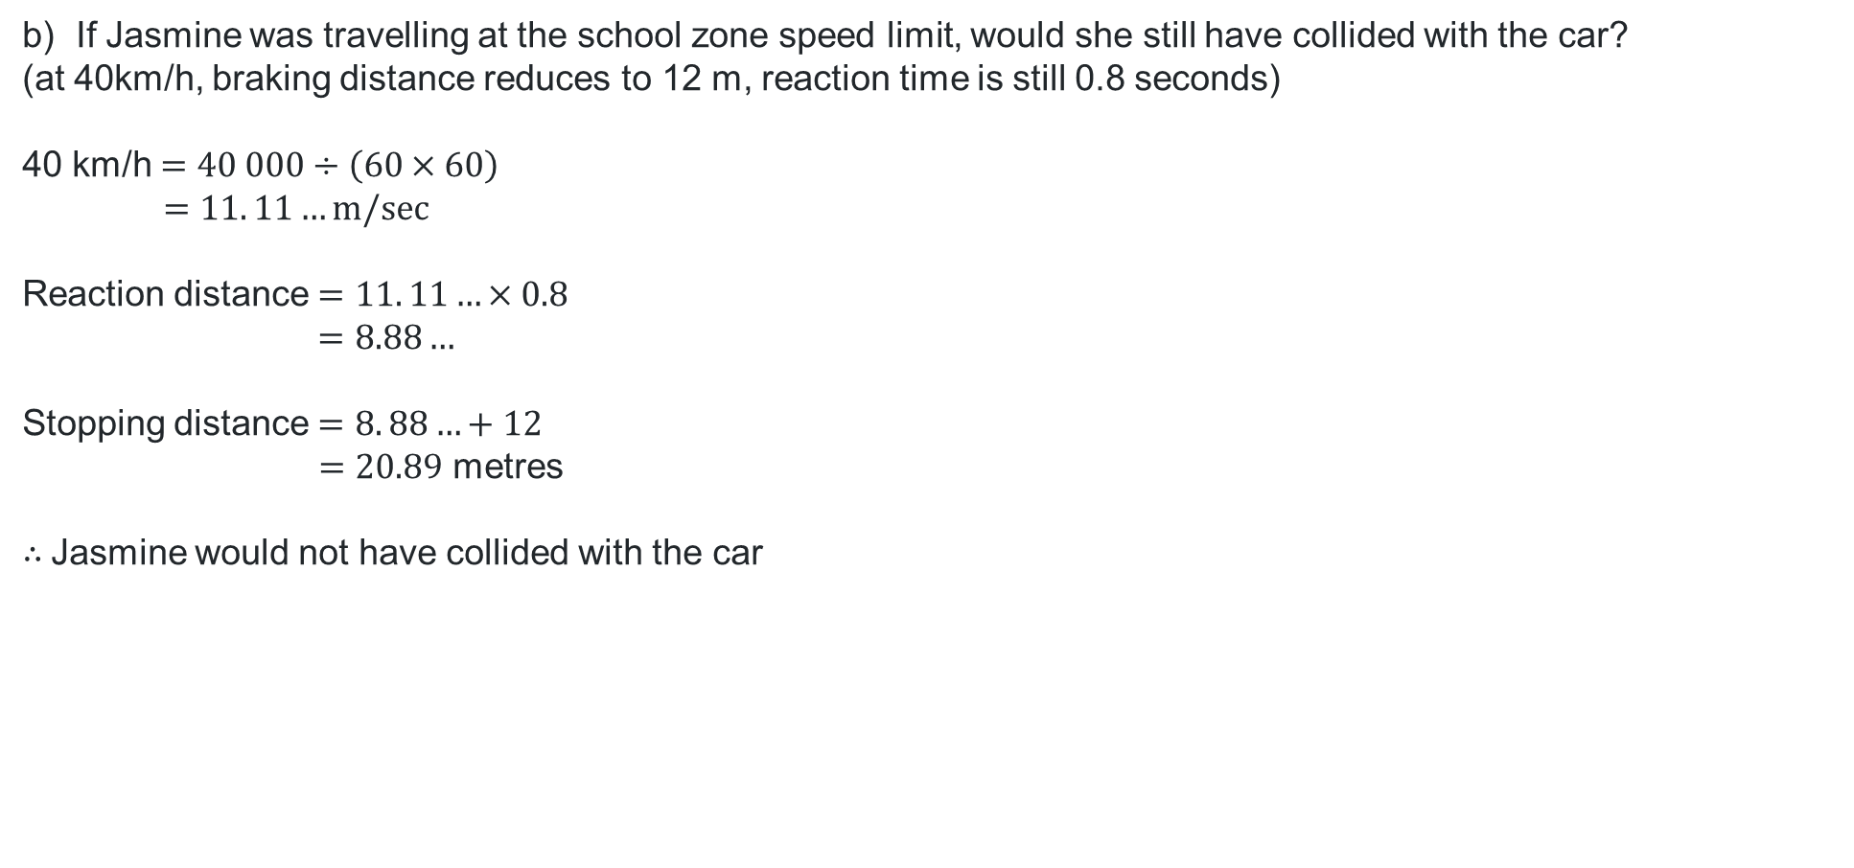
Example question 1 – part b)
If Jasmine was travelling at the school zone speed limit, would she still have collided with the car?
(at 40km/h, braking distance reduces to 12 m, reaction time is still 0.8 seconds)
40 km/h $=40 000÷\left(60×60\right)$
$$=11. 11…m/sec$$
Reaction distance $=11. 11…×0.8$
$=8.88…$
Stopping distance $=8. 88…+12$
$=20.89$ metres
$∴$Jasmine would not have collided with the car

Slide 16
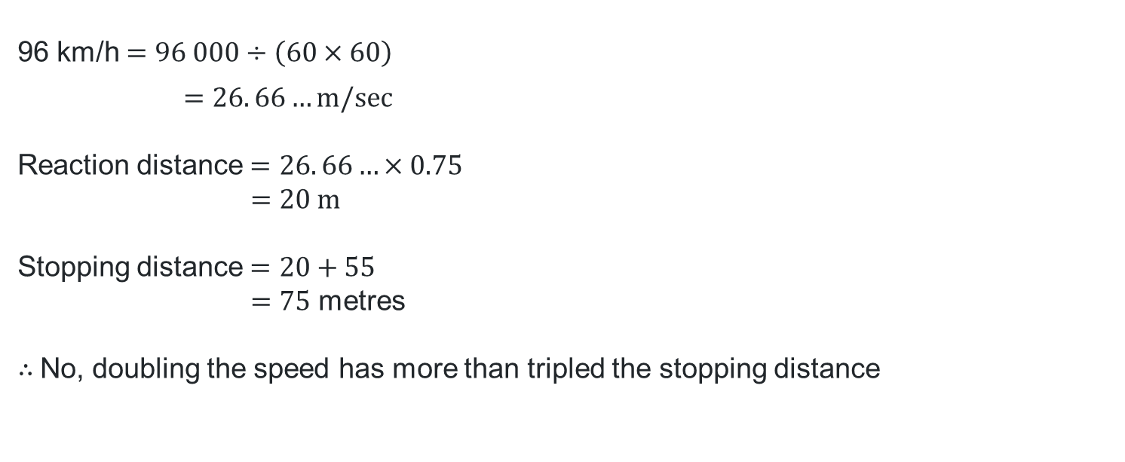
Example question 2
When driving at 48 km/h, the braking distance is 14 m and stopping distance is approximately 24 metres (reaction time 0.75 seconds). If a car doubles its speed (to 96 km/h), it’s braking distance changes to 55 m.
Does doubling speed, double stopping distance?
96 km/h $=96 000÷\left(60×60\right)$
$$=26. 66…m/sec$$
Reaction distance $=26. 66…×0.75$
$$=20 \text{m}$$
Stopping distance $=20+55$
$=75$ metres
$∴$No, doubling the speed has more than tripled the stopping distance

Slide 17
School zones and braking distance
The average reaction time for a driver who sees a hazard on the road is 1.3 seconds.
The average braking distance at the following speeds are:
a) 60 km/h = 25 m
b) 50 km/h = 17 m
c) 40 km/h = 12 m
d) 30 km/h = 8 m
Calculate the stopping distance for each speed.
What should the speed limit be in school zones and why?
Images generated using ChatGPT (OpenAI).

Slide 18
Independent practice

Slide 19
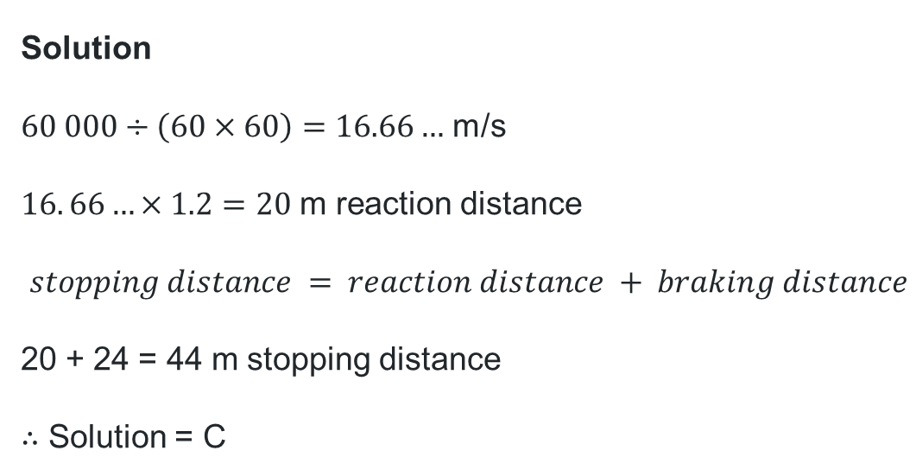

HSC style questions – solution (1)
Question 1
A car travels at 60 km/h. The driver’s reaction time is 1.2 s. The braking distance is 24 m.
What is the total stopping distance to one decimal place?
A. 12.2 m
B. 40.7 m
C. 44.0 m
D. 74.0 m
Solution
$60 000÷\left(60×60\right)=16.66…$ m/s
$16. 66…×1.2=20$ m reaction distance
$$stopping distance = reaction distance + braking distance$$
20 + 24 = 44 m stopping distance
$∴$ Solution = C

Slide 20


HSC style questions – solution (2)
Question 2
A driver has a reaction time of 0.9 s. The car travels at 72 km/h and has a braking distance of 36 m.
What is the reaction distance to the nearest metre?
A. 18 m
B. 29 m
C. 45 m
D. 54 m
Solution
$72 000÷\left(60×60\right)=20$ m/s
$20×0.9=18$ m reaction distance
$∴$ Solution = A

Slide 21
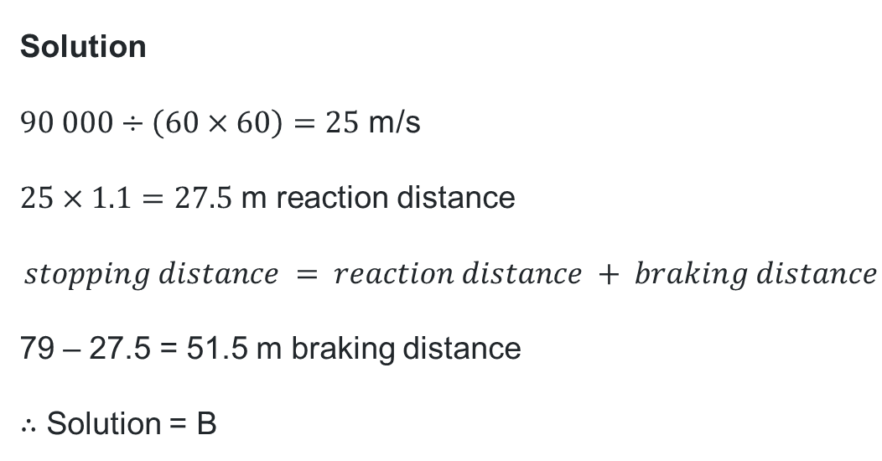

HSC Style questions – solution (3)
Question 3
A car is travelling at 90 km/h and the driver has a reaction time of 1.1 s. The stopping distance is 79 m.
What is the braking distance?
A. 27.5 m
B. 51.5 m
C. 55.0 m
D. 106.5 m
Solution
$90 000÷\left(60×60\right)=25$ m/s
$25×1.1=27.5$ m reaction distance
$$stopping distance = reaction distance + braking distance$$
79 – 27.5 = 51.5 m braking distance
$∴$ Solution = B

Slide 22
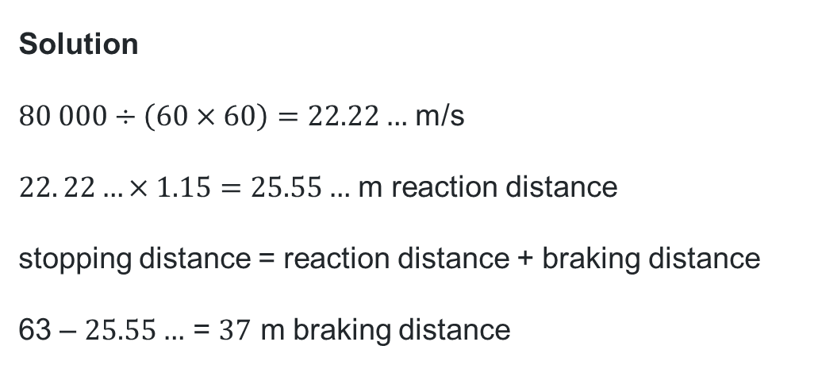
HSC style questions – solution (4)
Question 4 - (2 marks)
Henry’s vehicle has a total stopping distance of 63 m.
It was travelling at 80 km/h and Henry’s reaction time of 1.15 s.
Calculate the braking distance to the nearest metre.
Solution
$80 000÷\left(60×60\right)=22.22…$ m/s
$22. 22…×1.15=25.55…$ m reaction distance
stopping distance = reaction distance + braking distance
63 – $25.55…$ = $37$ m braking distance

Slide 23

HSC style questions – solution (5)
Question 5 - (3 marks)
A car travelling at 60 km/h has a braking distance of 22 m in dry conditions.
In rainy conditions, the braking distance increases by 30 percent.
The driver’s reaction time is 1.1 s.
Calculate the stopping distance in rainy conditions to 3 significant figures.
Solution
$60 000÷\left(60×60\right)=16.66…$ m/s
$16. 66…×1.1=18.33…$ m reaction distance
Braking distance in rainy conditions $=$ $22×130\%=28.6$m
Stopping distance = reaction distance + braking distance
$18. 33…+28.6=46.933…$m stopping distance
$=46.9$ m (3 sig fig)

Slide 24
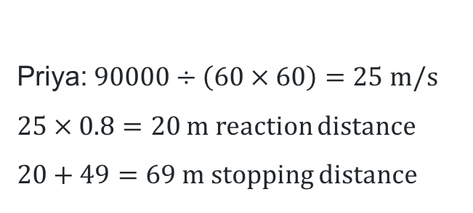
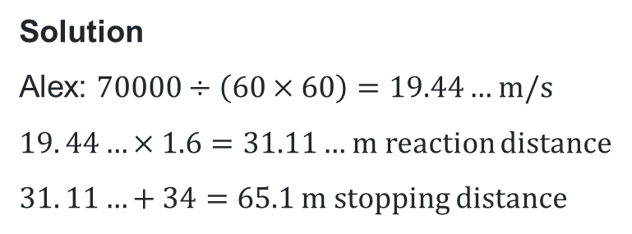
HSC style questions – solution (6)
Question 6 (3 marks)
Two drivers, Alex and Priya, react to a hazard at the same time.
Alex is travelling at 70 km/h with a reaction time of 1.6 s and a braking distance of 34 m.
Priya is travelling at 90 km/h with a reaction time of 0.80 s and a braking distance of 49 m.
Priya argues that because her reaction time was half of Alex’s, her car will stop more quickly.
Justify with calculations, if Priya’s statement is correct.
Solution
Alex: $70000÷\left(60×60\right)=19.44…$ m/s
$19. 44…×1.6=31.11…$ m reaction distance
$31. 11…+34=65.1$ m stopping distance
Priya: $90000÷\left(60×60\right)=25$ m/s
$25×0.8=20$ m reaction distance
$20+49=69$m stopping distance
$∴$ Priya is incorrect as she take $3.9$ metres further than Alex to stop, despite her superior reaction time.

Slide 25
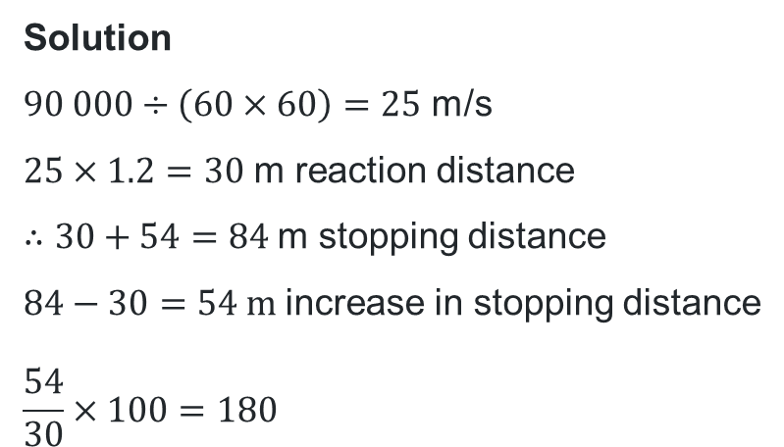
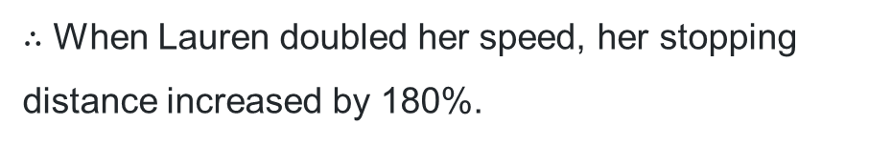
HSC style questions – solution (7)
Question 7 (3 marks)
When Lauren was driving at a speed of 45 km/h, she had a reaction time of 1.2 seconds and her total stopping distance was 30 metres.
When she doubled her speed to 90km/h, her reaction time remained the same, however her braking distance was 54 metres. When she doubled her speed, what was the percentage increase in her stopping distance?
Solution
$90 000÷\left(60×60\right)=25$ m/s
$25×1.2=30$ m reaction distance
$∴30+54=84$m stopping distance
$84−30=54$ m increase in stopping distance
$$\frac{54}{30}×100=180$$
$∴$ When Lauren doubled her speed, her stopping distance increased by 180%.

Slide 26
References
This presentation contains NSW Curriculum and syllabus content. The NSW Curriculum is developed by the NSW Education Standards Authority. This content is prepared by NESA for and on behalf of the Crown in the right of the State of New South Wales. The material is protected by Crown copyright.
Please refer to the NESA Copyright Disclaimer for more information https://educationstandards.nsw.edu.au/wps/portal/nesa/mini-footer/copyright.
NESA holds the only official and up-to-date versions of the NSW Curriculum and syllabus documents. Please visit the NSW Education Standards Authority (NESA) website https://educationstandards.nsw.edu.au/wps/portal/nesa/home and the NSW Curriculum website https://curriculum.nsw.edu.au.
Mathematics Standard Stage 11-12 Syllabus © NSW Education Standards Authority (NESA) for and on behalf of the Crown in right of the State of New South Wales, 2024.
.

Slide 27
Copyright
© State of New South Wales (Department of Education), 2026
The copyright material published in this resource is subject to the Copyright Act 1968 (Cth) and is owned by the NSW Department of Education or, where indicated, by a party other than the NSW Department of Education (third-party material).
Copyright material available in this resource and owned by the NSW Department of Education is licensed under a Creative Commons Attribution 4.0 International (CC BY 4.0) license.
This license allows you to share and adapt the material for any purpose, even commercially.
Attribution should be given to © State of New South Wales (Department of Education), 2025.
Material in this resource not available under a Creative Commons license:
the NSW Department of Education logo, other logos and trademark-protected material
Material owned by a third party that has been reproduced with permission. You will need to obtain permission from the third party to reuse its material.
Links to third-party material and websites
Please note that the provided (reading/viewing material/list/links/texts) are a suggestion only and implies no endorsement, by the New South Wales Department of Education, of any author, publisher, or book title. School principals and teachers are best placed to assess the suitability of resources that would complement the curriculum and reflect the needs and interests of their students.
If you use the links provided in this document to access a third-party’s website, you acknowledge that the terms of use, including licence terms set out on the third-party’s website apply to the use which may be made of the materials on that third-party website or where permitted by the Copyright Act 1968 (Cth). The department accepts no responsibility for content on third-party websites.

