Slide 1

Grouped data
Mathematics Standard – Stage 6 (Year 11)
Unit 4 –Driving Safely

Slide 2
Learning intentions and success criteria
Learning intentions
To understand how grouped data can be used to organise, summarise and describe large datasets.
To be able to interpret and compare statistical information to make and justify decisions.
Success criteria
I can complete grouped data frequency tables with and without using digital tools.
I can use a spreadsheet to calculate measures of centre and spread for large datasets.
I can interpret cumulative frequency histograms and polygons and use these displays to estimate the median.
Notes:
Notes for teachers:
Learning intentions and success criteria are best co-constructed with students. Adapt the learning intention as required and add matching success criteria.
For more information See ⁠AITSL or the NSW Department of Education explicit teaching strategies, ⁠Sharing learning intentions and ⁠Sharing success criteria
LISC is not necessarily presented at the beginning of the lesson. Teacher needs to consider most effectual time to introduce
LISC should be revisited during the lesson to support students' evaluation of their learning

Slide 3
Activating prior knowledge

Slide 4
Raw data
The data below shows the number of cars that drove past a road marker each hour in a 3-day period.
Day 1
12, 9, 7, 6, 5, 8, 14, 22, 30, 36, 41, 48, 52, 55, 58, 56, 49, 45, 39, 32, 28, 24, 20, 16
Day 2
11, 8, 6, 5, 4, 7, 15, 23, 31, 38, 44, 47, 51, 54, 57, 55, 50, 46, 40, 34, 29, 25, 19, 17
Day 3
13, 10, 8, 7, 6, 5, 12, 21, 29, 35, 42, 49, 53, 56, 59, 58, 52, 47, 41, 33, 27, 23, 18, 15
Is this data easy to interpret?
How could you organise this data to make it easier to work with?

Slide 5
Frequency table
Cars | Frequency
4 | 1
5 | 3
6 | 3
7 | 3
8 | 3
9 | 1
10 | 1
11 | 1
12 | 2
13 | 1
14 | 1
15 | 2
16 | 1
17 | 1
Cars | Frequency
18 | 1
19 | 1
20 | 1
21 | 1
22 | 1
23 | 2
24 | 1
25 | 1
26 | 0
27 | 1
28 | 1
29 | 2
30 | 1
31 | 1
Cars | Frequency
32 | 1
33 | 1
34 | 1
35 | 1
36 | 1
37 | 0
38 | 1
39 | 1
40 | 1
41 | 2
42 | 1
43 | 0
44 | 1
45 | 1
Cars | Frequency
46 | 1
47 | 2
48 | 1
49 | 2
50 | 1
51 | 1
52 | 2
53 | 1
54 | 1
55 | 2
56 | 2
57 | 1
58 | 2
59 | 1
Is this data easier to interpret than the list?
How can you make the data easier to read and to find key statistics?

Slide 6
Grouped frequency table
Cars | Frequency
1 – 10 | 15
11 – 20 | 12
21 – 30 | 11
31 – 40 | 9
41 – 50 | 12
51 – 60 | 13
What are some advantages and disadvantages of grouping the data?
What do we notice about the size of each interval?

Slide 7
Connecting learning

Slide 8
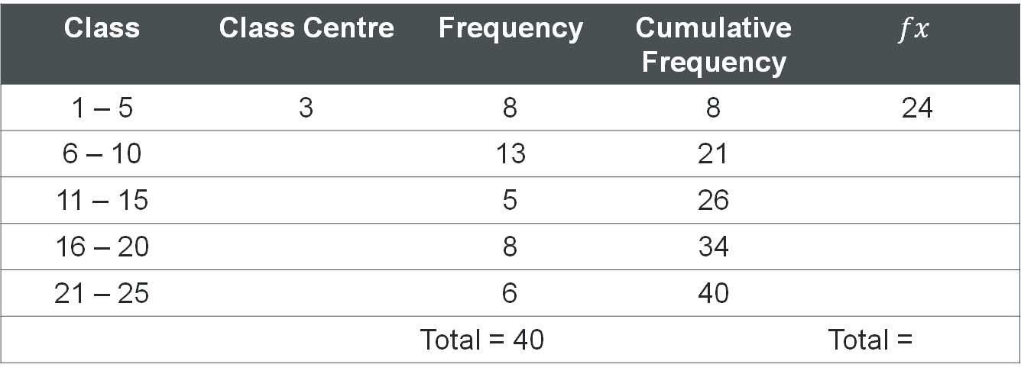
Statistics with grouped data (1)
Class | Class Centre | Frequency | Cumulative Frequency | $$fx$$
1 – 5 | 3 | 8 | 8 | 24
6 – 10 |  | 13 | 21
11 – 15 |  | 5 | 26
16 – 20 |  | 8 | 34
21 – 25 |  | 6 | 40
 |  | Total = 40 |  | Total =
Multiply class centre by frequency
Average of lower and upper class limits

Slide 9
Statistics with grouped data (2)
Class | Class Centre | Frequency | Cumulative Frequency | fx
1 – 5 | 3 | 8 | 8 | 24
6 – 10 | 8 | 13 | 21 | 104
11 – 15 | 13 | 5 | 26 | 65
16 – 20 | 18 | 8 | 34 | 144
21 – 25 | 23 | 6 | 40 | 138
 |  | Total = 40 |  | Total = 475
Multiply frequency by class centre
Mean of lower and upper class limits

Slide 10
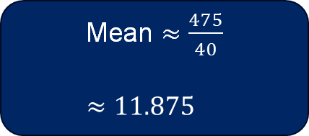
Grouped data - table
Class | Class Centre | Frequency | Cumulative Frequency | fx
1 – 5 | 3 | 8 | 8 | 24
6 – 10 | 8 | 13 | 21 | 104
11 – 15 | 13 | 5 | 26 | 65
16 – 20 | 18 | 8 | 34 | 144
21 – 25 | 23 | 6 | 40 | 138
 |  | Total = 40 |  | Total = 475
Modal class = 6 – 10
Median class = 6 – 10
Mean $≈\frac{475}{40}$
$$≈11.875$$

Slide 11
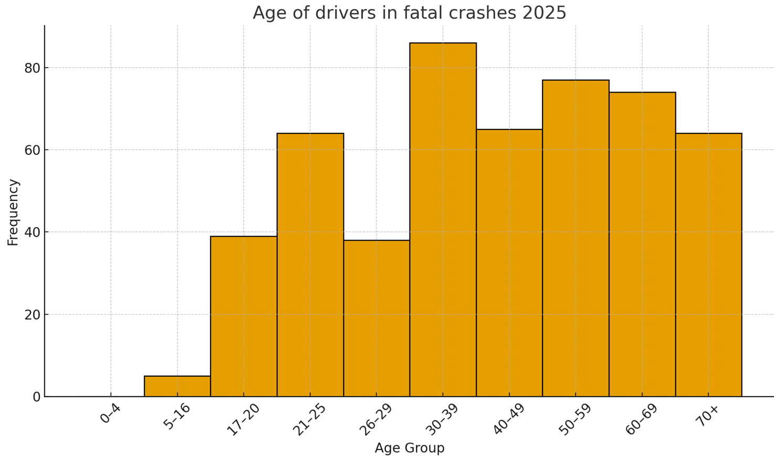
Notice and wonder
Monthly bulletin of preliminary traffic crash data October 2025
This table shows the number of NSW drivers involved in fatal crashes for 12 months ending October 2025 by age.
Age | Frequency
0 – 4 | 0
5 – 16 | 5
17 – 20 | 39
21 – 25 | 64
26 – 29 | 38
30 – 39 | 86
40 – 49 | 65
50 – 59 | 77
60 – 69 | 74
70+ | 64
NSW transport reports and publications by NSW Centre for Road Safety

Slide 12
Releasing responsibility

Slide 13
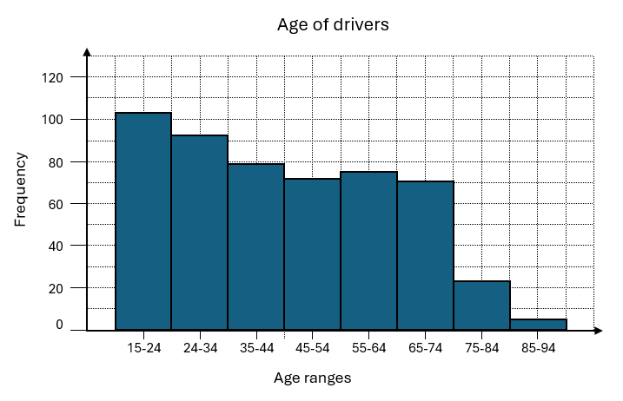
Comparing histograms

Slide 14
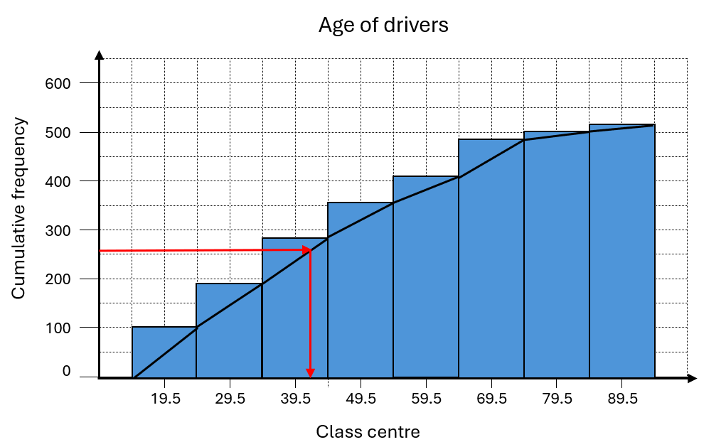
Finding the median
For this question, divide 512 by 2 and use 256 as the middle position.

Slide 15
References
This presentation contains NSW Curriculum and syllabus content. The NSW Curriculum is developed by the NSW Education Standards Authority. This content is prepared by NESA for and on behalf of the Crown in the right of the State of New South Wales. The material is protected by Crown copyright.
Please refer to the NESA Copyright Disclaimer for more information https://educationstandards.nsw.edu.au/wps/portal/nesa/mini-footer/copyright.
NESA holds the only official and up-to-date versions of the NSW Curriculum and syllabus documents. Please visit the NSW Education Standards Authority (NESA) website https://educationstandards.nsw.edu.au/wps/portal/nesa/home and the NSW Curriculum website https://curriculum.nsw.edu.au.
Mathematics Standard Stage 11-12 Syllabus © NSW Education Standards Authority (NESA) for and on behalf of the Crown in right of the State of New South Wales, 2024.
.

Slide 16
Copyright
© State of New South Wales (Department of Education), 2026
The copyright material published in this resource is subject to the Copyright Act 1968 (Cth) and is owned by the NSW Department of Education or, where indicated, by a party other than the NSW Department of Education (third-party material).
Copyright material available in this resource and owned by the NSW Department of Education is licensed under a Creative Commons Attribution 4.0 International (CC BY 4.0) license.
This license allows you to share and adapt the material for any purpose, even commercially.
Attribution should be given to © State of New South Wales (Department of Education), 2025.
Material in this resource not available under a Creative Commons license:
the NSW Department of Education logo, other logos and trademark-protected material
Material owned by a third party that has been reproduced with permission. You will need to obtain permission from the third party to reuse its material.
Links to third-party material and websites
Please note that the provided (reading/viewing material/list/links/texts) are a suggestion only and implies no endorsement, by the New South Wales Department of Education, of any author, publisher, or book title. School principals and teachers are best placed to assess the suitability of resources that would complement the curriculum and reflect the needs and interests of their students.
If you use the links provided in this document to access a third-party’s website, you acknowledge that the terms of use, including licence terms set out on the third-party’s website apply to the use which may be made of the materials on that third-party website or where permitted by the Copyright Act 1968 (Cth). The department accepts no responsibility for content on third-party websites.

