Slide 1

Shape of a distribution
Mathematics Standard – Stage 6 (Year 11)
Unit 4 – Driving safely

Slide 2
Learning intentions and success criteria
Learning intentions
To know how to interpret a variety of graphical displays in context.
To understand how the shape of a distribution can be used to describe datasets.
Success criteria
I can describe the shape of a dataset as symmetrical, positively skewed, or negatively skewed.
I can interpret back-to-back stem-and-leaf plots to compare 2 datasets.
I can use measures of centre and spread to support comparisons between groups.
I can justify my conclusions in context using mathematical reasoning.
Notes:
Notes for teachers:
Learning intentions and success criteria are best co-constructed with students. Adapt the learning intention as required and add matching success criteria.
For more information See ⁠AITSL or the NSW Department of Education explicit teaching strategies, ⁠Sharing learning intentions and ⁠Sharing success criteria
LISC is not necessarily presented at the beginning of the lesson. Teacher needs to consider most effectual time to introduce
LISC should be revisited during the lesson to support students' evaluation of their learning

Slide 3
Activating prior knowledge

Slide 4

Comparing insurance quotes
2025 Toyota Corolla, 5D hatchback, Ascent sport hybrid
Category 1
Male
Date of birth: 1 March 2008
Category 2
Female
Category 3
Category 4
Female
Date of birth: 1 March 1989
Male
Date of birth: 1 March 1989
Date of birth: 1 March 2008

Slide 5
Connecting learning

Slide 6
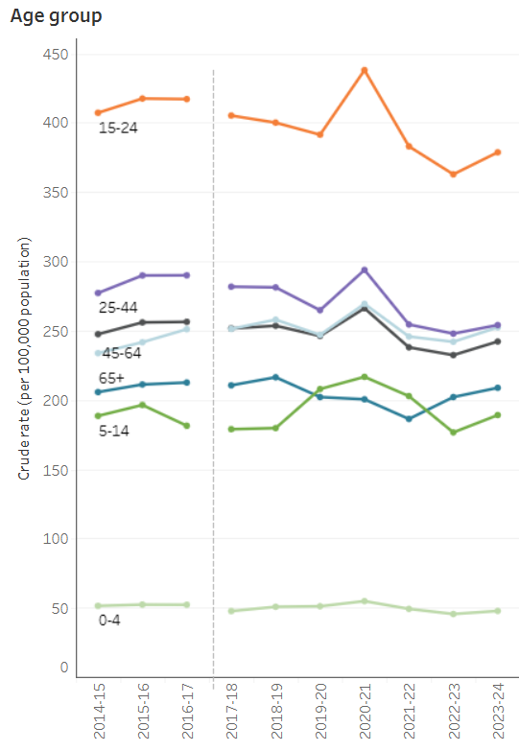

Transport accidents (1)
Age group
What do you notice and wonder?
Transport accidents – Age group by Australian Institute of Health and Welfare

Slide 7
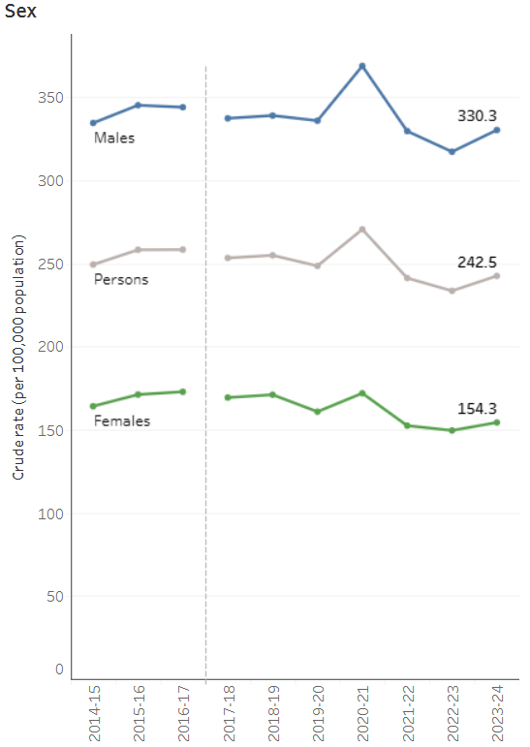

Transport accidents (2)
Sex
What do you notice and wonder?
Transport accidents – sex by Australian Institute of Health and Welfare

Slide 8
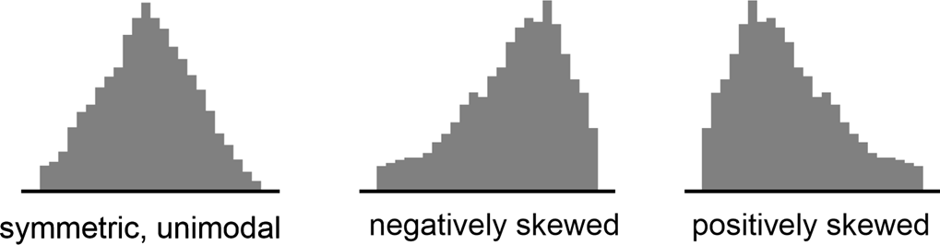
Shape of a distribution definitions
NESA glossary definitions
Symmetrical distribution
When the 2 sides of the distribution are a mirror image of each other.
Negatively skewed
A distribution is negatively skewed when its tail is on the left side.
Positively skewed
A distribution is positively skewed when its tail is on the right side.
Examples from Data Analysis, Mathematics K–10 Syllabus (2022)

Slide 9
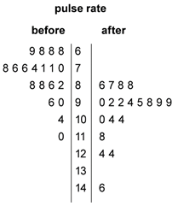
Back-to-back stem-and-leaf plot
NESA Glossary definition
A back-to-back stem-and-leaf plot is a method for comparing 2 data distributions by attaching 2 sets of 'leaves' to the same 'stem'; for example, the stem-and-leaf plot below displays the distribution of pulse rates of 19 students before and after gentle exercise.
Why might we use a back-to-back plot instead of 2 separate stem-and-leaf plots?
Age of the drivers listed as the Top 10 highest speeds recorded
2014 |  | 2015
 | 1 | 9
9 8 6 5 3 2 2 2 | 2 | 0 2 3 5 6 9
4 4 3 1 | 3 | 0 2
 | 4
 | 5 | 0
How are the 2 sets of data positioned in relation to the stem?

Slide 10
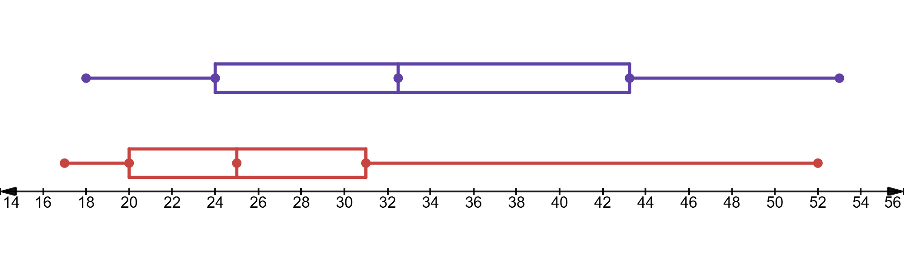
NSW Compulsory third-party insurance claims
By age and gender
NSW Compulsory third-party insurance claims
Males |  | Females
9 8 7 7 | 1 | 8 9
9 8 7 5 3 3 1 0 | 2 | 0 2 4 4
8 6 4 1 | 3 | 0 2 2 3 7 9
8 6 0 | 4 | 1 4 7 8
2 | 5 | 0 3
Females
Males

Slide 11
Independent practice

Slide 12
Comparing two datasets (1)
NESA past HSC question – 2016 Mathematics General 2 Question 29 (c) 3 marks
The ages of members of a dance class are shown in the back-to-back stem-and-leaf plot.
Sample answer:
Women
Median = 55
Negatively skewed
Men
Median = 45
Positively skewed
Women |  | Men
2 | 3 | 4 6
4 2 | 4 | 2 2 5 6 8
8 8 5 4 0 0 | 5 | 3
9 4 3 3 | 6 | 3
Pat is correct since the women’s median age (55) is higher than the men’s median age (45) and there are more women in the older age group (negatively skewed)
Pat claims that the women who attend the dance class are generally older than the men.
Is Pat correct? Justify your answer by referring to the median and skewness of the two sets of data.

Slide 13
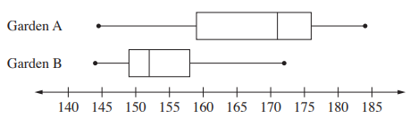
Comparing two datasets (2)
NESA HSC exam Mathematics Standard 2 2024 Question 28 3 marks
Flowers were planted in two gardens (Garden A and Garden B).
On a particular day, 25 flowers were randomly selected from each garden and their heights measured in millimetres. The data are represented in parallel box plots.
Compare the two datasets by examining the skewness of the distributions, and the measures of central tendency and spread.

Slide 14
Comparing two datasets (3)
HSC Markers feedback
In better responses, students were able to:
explicitly compare the skewness, central tendency, and spread of the data from each garden
interpret the box plots to use specific values for median, range or interquartile range to support their comparisons
Use specific language to describe the shape of a distribution, for example, ‘positively skewed’ or ‘negatively skewed’.
Areas for students to improve include:
Ensuring that the 3 areas of skewness, central tendency, and spread were addressed in their response.
Recognising that the median is the only measure of central tendency that can be deduced from a box plot
Identifying positive and negative skew in data and understanding the difference between the 2.

Slide 15
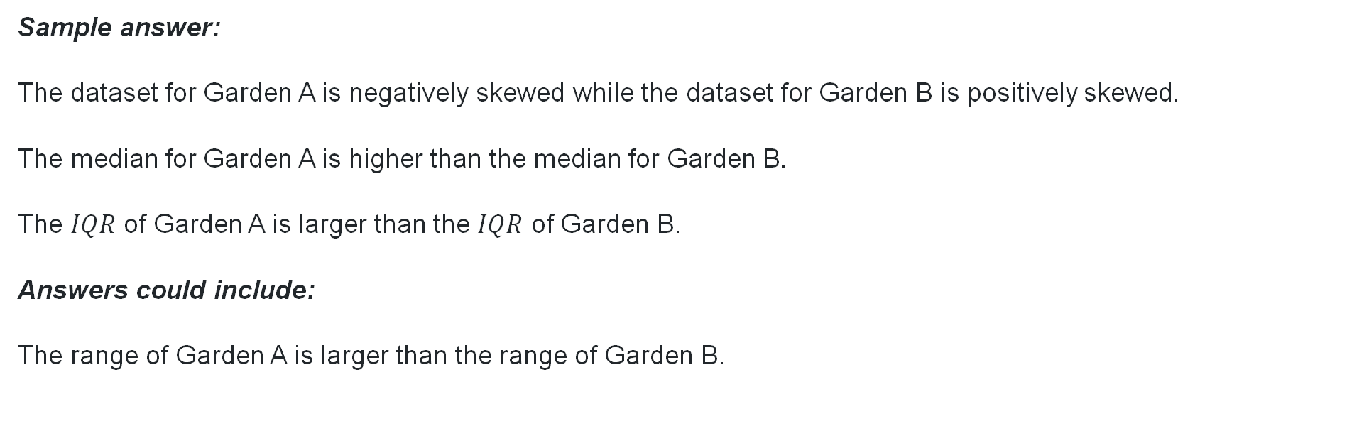
Comparing two datasets (4)
Criteria | Marks
Compares the two datasets on skewness, central tendency and spread | 3
Compares two of the measures of centre and spread and skewness for the two gardens, or equivalent merit | 2
Compares skewness, measures of centre or spread for the two gardens, or equivalent merit | 1
Sample answer:
The dataset for Garden A is negatively skewed while the dataset for Garden B is positively skewed.
The median for Garden A is higher than the median for Garden B.
The $IQR$ of Garden A is larger than the $IQR$ of Garden B.
Answers could include:
The range of Garden A is larger than the range of Garden B.

Slide 16
References
This presentation contains NSW Curriculum and syllabus content. The NSW Curriculum is developed by the NSW Education Standards Authority. This content is prepared by NESA for and on behalf of the Crown in the right of the State of New South Wales. The material is protected by Crown copyright.
Please refer to the NESA Copyright Disclaimer for more information https://educationstandards.nsw.edu.au/wps/portal/nesa/mini-footer/copyright.
NESA holds the only official and up-to-date versions of the NSW Curriculum and syllabus documents. Please visit the NSW Education Standards Authority (NESA) website https://educationstandards.nsw.edu.au/wps/portal/nesa/home and the NSW Curriculum website https://curriculum.nsw.edu.au.
Mathematics Standard Stage 6 Syllabus © NSW Education Standards Authority (NESA) for and on behalf of the Crown in right of the State of New South Wales, 2024.

Slide 17
Copyright
© State of New South Wales (Department of Education), 2026
The copyright material published in this resource is subject to the Copyright Act 1968 (Cth) and is owned by the NSW Department of Education or, where indicated, by a party other than the NSW Department of Education (third-party material).
Copyright material available in this resource and owned by the NSW Department of Education is licensed under a Creative Commons Attribution 4.0 International (CC BY 4.0) license.
This license allows you to share and adapt the material for any purpose, even commercially.
Attribution should be given to © State of New South Wales (Department of Education), 2026.
Material in this resource not available under a Creative Commons license:
the NSW Department of Education logo, other logos and trademark-protected material
Material owned by a third party that has been reproduced with permission. You will need to obtain permission from the third party to reuse its material.
Links to third-party material and websites
Please note that the provided (reading/viewing material/list/links/texts) are a suggestion only and implies no endorsement, by the New South Wales Department of Education, of any author, publisher, or book title. School principals and teachers are best placed to assess the suitability of resources that would complement the curriculum and reflect the needs and interests of their students.
If you use the links provided in this document to access a third-party’s website, you acknowledge that the terms of use, including licence terms set out on the third-party’s website apply to the use which may be made of the materials on that third-party website or where permitted by the Copyright Act 1968 (Cth). The department accepts no responsibility for content on third-party websites.

