Slide 1

Ongoing costs
Mathematics Standard – Stage 6 (Year 11)
Unit 4 –Driving Safely

Slide 2
Activating prior knowledge

Slide 3
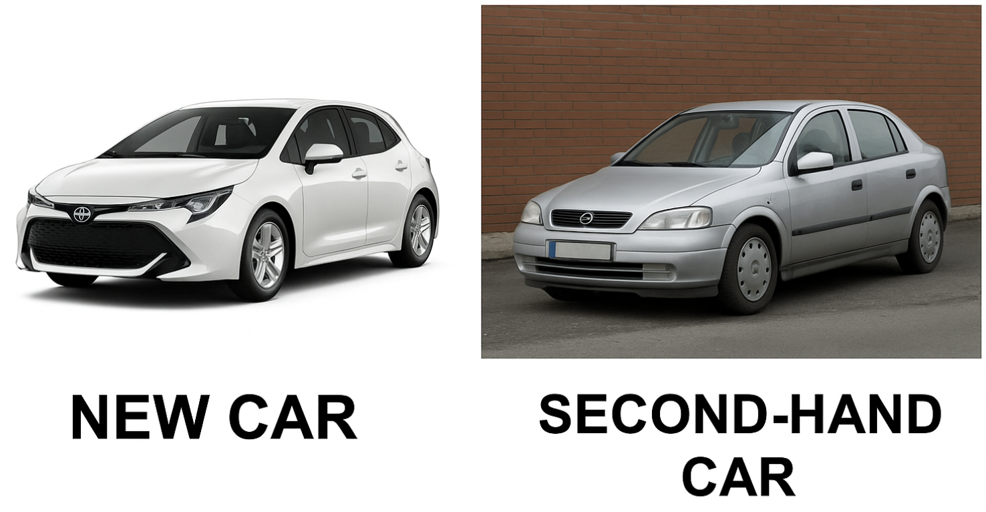
Would you rather? (1)
Which car should you buy?
Image generated using ChatGPT (OpenAI).

Slide 4
Learning intentions and success criteria
Learning intentions
To understand the ongoing costs of running a vehicle.
To be able to model the ongoing costs of running a vehicle.
Success criteria
I can define registration, compulsory and non-compulsory third-party insurance and comprehensive insurance.
I can compare different methods of calculating the running costs of a vehicle.
I can use a spreadsheet to model the running costs of a car.
Notes:
Notes for teachers:
Learning intentions and success criteria are best co-constructed with students. Adapt the learning intention as required and add matching success criteria.
For more information See ⁠AITSL or the NSW Department of Education explicit teaching strategies, ⁠Sharing learning intentions and ⁠Sharing success criteria
LISC is not necessarily presented at the beginning of the lesson. Teacher needs to consider most effectual time to introduce
LISC should be revisited during the lesson to support students' evaluation of their learning

Slide 5
Connecting learning

Slide 6
What is Compulsory Third-Party insurance?
When? | Before you can register any vehicle in NSW
What does it do? | Protects drivers from liability if they cause injury or death to others in a motor crash
What is covered? | The driver and all third parties involved
What is NOT covered? | Cost of repairing or replacing your vehicle or the costs of repair or replace other property in the vehicle at the time of the crash
What does ‘liability’ mean?
What is a third party?

Slide 7
Types of insurance
Which type of insurance costs the most?
Third-party versus comprehensive insurance
 | Third-party property damage | Third-party fire and theft | Comprehensive
What does it do? | Covers damage to other people’s property (including cars) if an accident is your fault | Covers property damage and your car if stolen or damaged by fire (up to $10 000) | Covers repairs to your car and others, even if the accident is your fault
What is covered? | Other people’s cars and property | Other people’s cars and property. Your car (theft/fire) up to $10 000 | Your car and other cars. Your car if stolen or damaged by fire, flood or vandalism
What is NOT covered? | Your own car | Damage to your car in other accidents

Slide 8
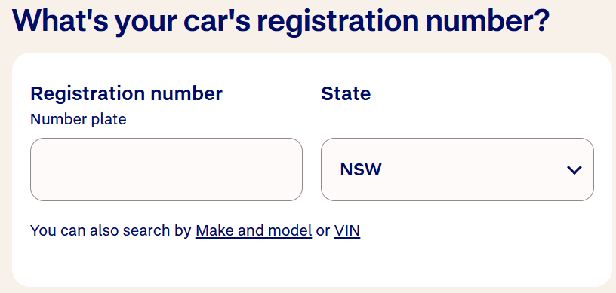
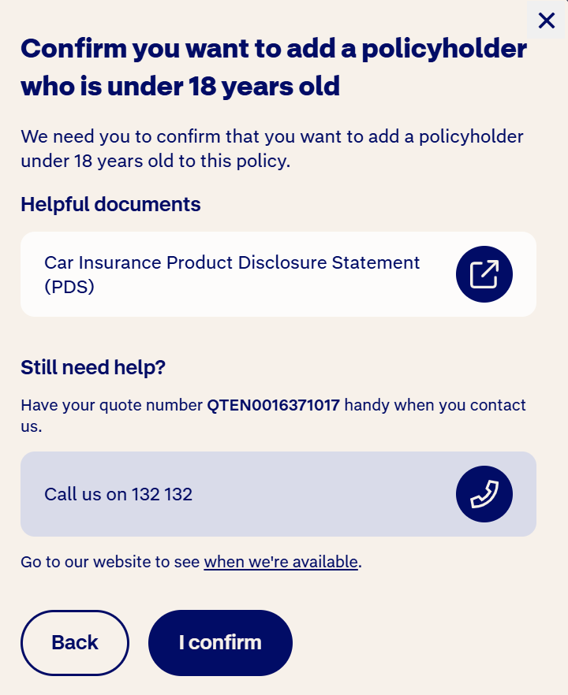
NRMA car insurance quote
Registration and policyholder confirmation screens” from NRMA Insurance (Online Car Insurance Quote). Accessed from the NRMA online quote tool on 24 November 2025

Slide 9
How your car is valued?
Agreed versus market value
With comprehensive insurance, you can choose how your car is valued. The value is the amount you will get if your car is written off or stolen:
Agreed value – a fixed amount that is decided between you and your insurer.
Market value – the amount your car would have sold for, at the time of the accident.
If you use the market value, you do not know how much you will get if you claim, and you can not change the amount. If you use an agreed value, you will pay a higher premium.

Slide 10
What is excess?
An excess is the amount you pay when you make a claim. The amount of excess you pay depends on the incident and who was driving at the time.

Slide 11
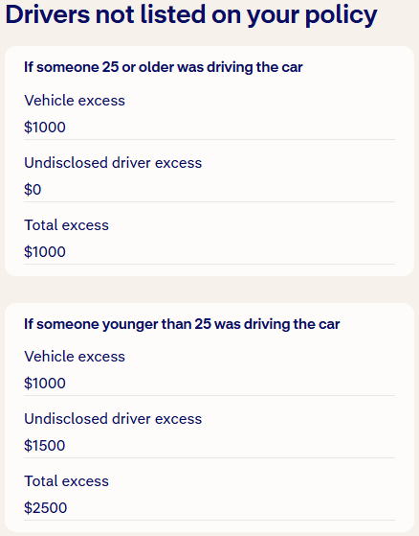
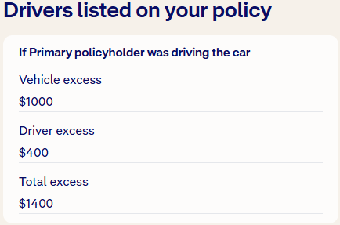
Excess
The excess you might need to pay if you make a claim
Could this excess be zero? If so, when?
Why is the excess for someone not listed on the policy but over 25 cheaper than the driver listed on the policy?

Slide 12
Check for understanding
Jordan is 19 years old and has purchased third party property damage car insurance. The following excesses apply to claims for at-fault motor vehicle accidents:
How much would Jordan be required to pay as excess if he made a claim as the driver at fault in a car accident?
Basic excess of $1000 for each claim
An additional age excess of $1800 for drivers under 25 years of age
An additional age excess of $600 for drivers 25 years of age or over with no more than 2 years driving experience
A. $\$1000$ | B. $\$1800$ | C. $\$1000+\$1800$ | D. $\$1000+\$1800+\$600$

Slide 13
Vehicle safety inspection
Vehicles more than 5 years old require a safety inspection report, commonly known as a Pink Slip, before they can be registered in NSW.
These cost $51 per inspection (as of November 2025)

Slide 14

Cost of fuel (1)
Worked example
A car is driven 1200km in a month. The fuel consumption of the car is 7.5L/100km and the average fuel price is $1.95 per litre. Calculate the monthly fuel cost for this car.
$$\text{Monthly} \text{fuel}=7.5×12 \\ =90 \\ \text{Cost} \text{per} \text{L}=\$1.95 \\ \text{Total} \text{cost}=90×\$1.95 \\ =\$175.50$$
Why is each bar worth 100km?
$$1200\text{km}$$
$$100$$ | $$100$$ | $$100$$ | $$100$$ | $$100$$ | $$100$$ | $$100$$ | $$100$$ | $$100$$ | $$100$$ | $$100$$ | $$100$$
Why was 100km replaced by 7.5L?
$$7.5\text{L}$$ | $$7.5\text{L}$$ | $$7.5\text{L}$$ | $$7.5\text{L}$$ | $$7.5\text{L}$$ | $$7.5\text{L}$$ | $$7.5\text{L}$$ | $$7.5\text{L}$$ | $$7.5\text{L}$$ | $$7.5\text{L}$$ | $$7.5\text{L}$$ | $$7.5\text{L}$$
How do we know to multiply by 12?
How would you solve this question if the car drove 1180km?

Slide 15

Cost of fuel (2)
Your turn
A car is driven 1500 km in a month. The fuel consumption of the car is 6.8L/100km and the average fuel price $1.90 per litre. Calculate the monthly fuel cost for this car.
$$1500\text{km}$$
$$100$$ | $$100$$ | $$100$$ | $$100$$ | $$100$$ | $$100$$ | $$100$$ | $$100$$ | $$100$$ | $$100$$ | $$100$$ | $$100$$ | $$100$$ | $$100$$ | $$100$$
$$6.8\text{L}$$ | $$6.8\text{L}$$ | $$6.8\text{L}$$ | $$6.8\text{L}$$ | $$6.8\text{L}$$ | $$6.8\text{L}$$ | $$6.8\text{L}$$ | $$6.8\text{L}$$ | $$6.8\text{L}$$ | $$6.8\text{L}$$ | $$6.8\text{L}$$ | $$6.8\text{L}$$ | $$6.8\text{L}$$ | $$6.8\text{L}$$ | $$6.8\text{L}$$
$$\text{Monthly} \text{fuel}=6.8×15 \\ =102 \\ \text{Cost} \text{per} \text{L}=\$1.90 \\ \text{Total} \text{cost} \text{=}\text{102}×\$1.90 \\ =\$193.80$$

Slide 16
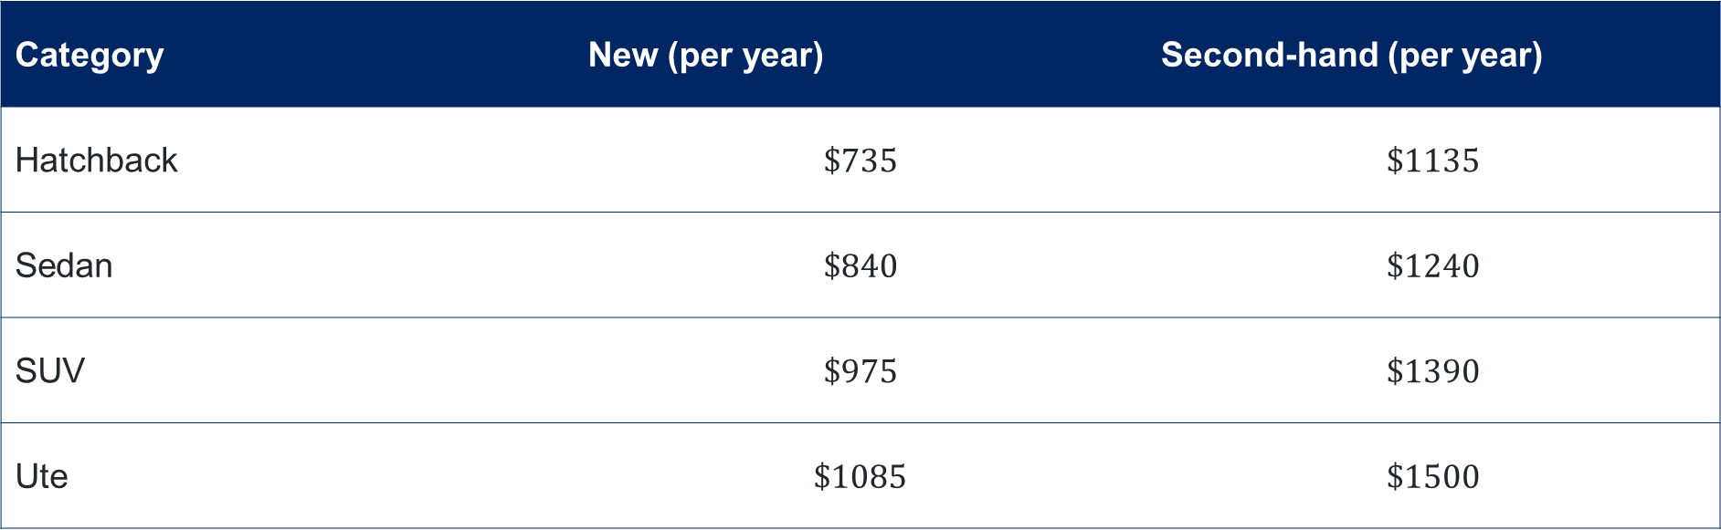
Cost of servicing and tyres
Category | New (per year) | Second-hand (per year)
Hatchback | $$\$735$$ | $$\$1135$$
Sedan | $$\$840$$ | $$\$1240$$
SUV | $$\$975$$ | $$\$1390$$
Ute | $$\$1085$$ | $$\$1500$$

Slide 17
Releasing responsibility

Slide 18
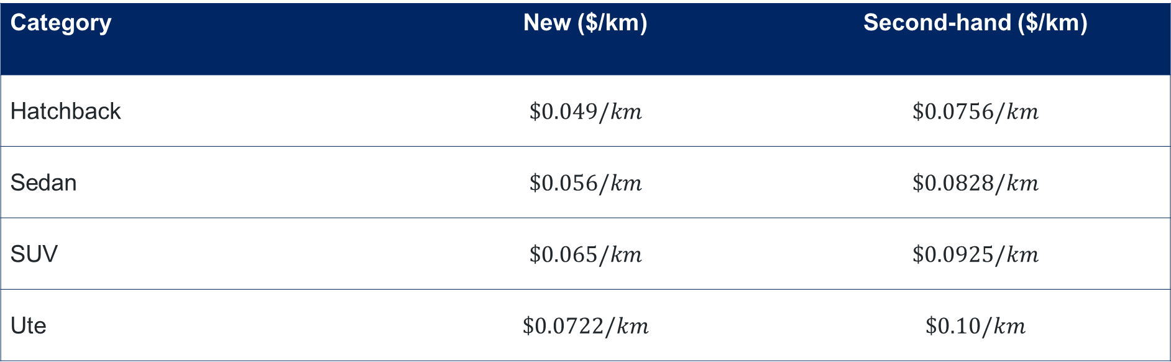
Cost of servicing and tyres per kilometre
Category | New ($/km) | Second-hand ($/km)
Hatchback | $$\$0.049/km$$ | $$\$0.0756/km$$
Sedan | $$\$0.056/km$$ | $$\$0.0828/km$$
SUV | $$\$0.065/km$$ | $$\$0.0925/km$$
Ute | $$\$0.0722/km$$ | $$\$0.10/km$$

Slide 19
Independent practice

Slide 20
Would you rather? (2)
Job 1: Delivery driver
$27.25 / hour
25 hours / week
Drive 200 km / week
Job 2: Retail cashier
$26.20 / hour
25 hours / week (5 day week)
Commute 5 km each way
Vehicle and running costs
Registration and insurance $56.51 / week
Fuel efficiency is 8.7L/100km
Service and tyres is $0.0877/km
Fuel is $1.71 per litre

Slide 21
References
This presentation contains NSW Curriculum and syllabus content. The NSW Curriculum is developed by the NSW Education Standards Authority. This content is prepared by NESA for and on behalf of the Crown in the right of the State of New South Wales. The material is protected by Crown copyright.
Please refer to the NESA Copyright Disclaimer for more information https://educationstandards.nsw.edu.au/wps/portal/nesa/mini-footer/copyright.
NESA holds the only official and up-to-date versions of the NSW Curriculum and syllabus documents. Please visit the NSW Education Standards Authority (NESA) website https://educationstandards.nsw.edu.au/wps/portal/nesa/home and the NSW Curriculum website https://curriculum.nsw.edu.au.
Mathematics Standard Stage 6 Syllabus © NSW Education Standards Authority (NESA) for and on behalf of the Crown in right of the State of New South Wales, 2024.
.

Slide 22
Copyright
© State of New South Wales (Department of Education), 2026
The copyright material published in this resource is subject to the Copyright Act 1968 (Cth) and is owned by the NSW Department of Education or, where indicated, by a party other than the NSW Department of Education (third-party material).
Copyright material available in this resource and owned by the NSW Department of Education is licensed under a Creative Commons Attribution 4.0 International (CC BY 4.0) license.
This license allows you to share and adapt the material for any purpose, even commercially.
Attribution should be given to © State of New South Wales (Department of Education), 2026.
Material in this resource not available under a Creative Commons license:
the NSW Department of Education logo, other logos and trademark-protected material
Material owned by a third party that has been reproduced with permission. You will need to obtain permission from the third party to reuse its material.
Links to third-party material and websites
Please note that the provided (reading/viewing material/list/links/texts) are a suggestion only and implies no endorsement, by the New South Wales Department of Education, of any author, publisher, or book title. School principals and teachers are best placed to assess the suitability of resources that would complement the curriculum and reflect the needs and interests of their students.
If you use the links provided in this document to access a third-party’s website, you acknowledge that the terms of use, including licence terms set out on the third-party’s website apply to the use which may be made of the materials on that third-party website or where permitted by the Copyright Act 1968 (Cth). The department accepts no responsibility for content on third-party websites.

