Slide 1

Purchasing a car
Mathematics Standard
Unit 4 –Driving Safely

Slide 2
Activating prior knowledge

Slide 3



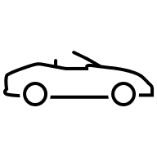

Which car would you purchase?

Slide 4
Costs of purchasing a car
Compulsory costs
  Stamp duty
  Registration (rego)
  Compulsory third party insurance (CTP or Green slip)
Likely Costs
  Vehicle safety inspection (pink slip)
  Number plates (new car or custom number plates)
  Transfer fee (second-hand car)
Optional costs
  Comprehensive insurance
  Financing costs
  Extended warranty

Slide 5
Learning intentions and success criteria
Learning intentions
To understand how finance options and stamp duty affect the total cost of a car.
To be able to calculate deposits, repayments, interest, and stamp duty.
Success criteria
I can explain the key costs of buying a car and why they matter.
I can evaluate how finance options affect the overall cost of a car.
I can calculate the total purchase cost of a car, including deposit, repayments, and stamp duty.
Notes:
Notes for teachers:
Learning intentions and success criteria are best co-constructed with students. Adapt the learning intention as required and add matching success criteria.
For more information See ⁠AITSL or the NSW Department of Education explicit teaching strategies, ⁠Sharing learning intentions and ⁠Sharing success criteria
LISC is not necessarily presented at the beginning of the lesson. Teacher needs to consider most effectual time to introduce
LISC should be revisited during the lesson to support students' evaluation of their learning

Slide 6
Connecting learning

Slide 7

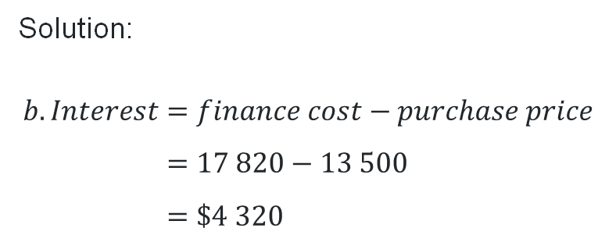
Financing a car (1)
Worked example
Tony wishes to purchase a car for $13 500. Finance is available with a 20% deposit and monthly repayments of $420 for 3 years. Calculate:
the total cost of the finance
the interest that Tony pays
Solution:
$Finance cost=Deposit+repayments$
$$Deposit=20\%×13 500 \\ =\$2 700$$
$$Repayments=420×3×12 \\ =\$15 120$$
$$Finance cost=Deposit+repayments \\ =2 700+15 120 \\ =\$17820$$
Solution:
$$b. Interest=finance cost−purchase price \\ =17 820−13 500 \\ =\$4 320$$
Why are we multiplying by 12?
Why is the purchase price subtracted?

Slide 8

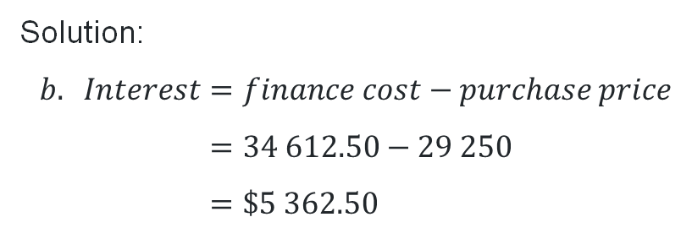
Financing a car (2)
Your turn
Paulie wishes to purchase a car for $29 250. Finance is available with a 25% deposit and monthly repayments of $455 for 5 years. Calculate:
the total cost of the finance
the interest that Paulie pays
Solution:
$Finance cost=Deposit+repayments$
$$Deposit=25\%×29 250 \\ =\$7 312.50$$
$$Repayments=455×5×12 \\ =\$27 300$$
$$Finance cost=deposit+repayments \\ =7 312.50+27 300 \\ =\$34 612.50$$
Solution:
$$b. Interest=finance cost−purchase price \\ =34 612.50−29 250 \\ =\$5 362.50$$

Slide 9
Would you rather?
Stamp duty
Stamp duty: A tax payable to the government for transactions and documents, such as motor vehicle registrations and transfers, insurance policies and mortgages.
Pay a flat rate of $1 500 stamp duty on any car purchase?
Pay 3% of the value of the purchase price of the car?
OR

Slide 10
Part thereof
‘Part thereof’ means that even if the value doesn’t make up a full $100, you still must pay stamp duty as if it did.
In NSW, Stamp duty is calculated at $3 per $100, or part thereof, of the vehicle's value.
For example: If the vehicle cost $250, that is 2 full lots of $100 and part of another $100, so duty is charged on 3 lots = $9
$100
$100
$50
$50
$3
$3
$3

Slide 11
Releasing responsibility

Slide 12
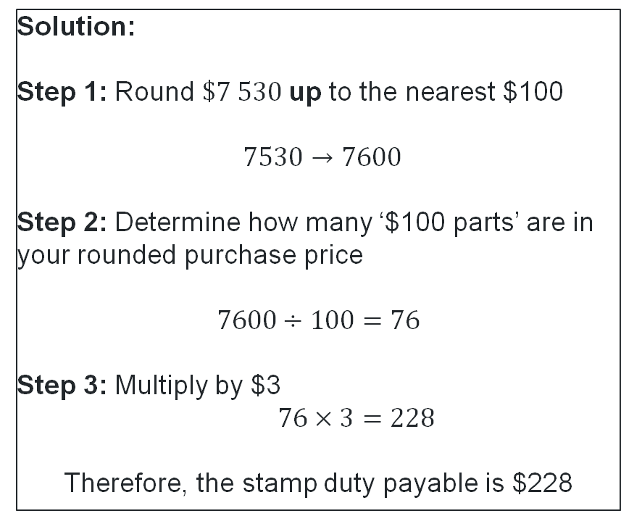
Calculating stamp duty (1)
Worked example
A used car was purchased for $\$7 530.$ Calculate the stamp duty payable if the charge is $3 per $100 or part thereof.
Solution:
Step 1: Round $\$7 530$up to the nearest $100
$7530→7600$
Step 2: Determine how many ‘$100 parts’ are in your rounded purchase price
$$7600÷100=76$$
Step 3: Multiply by $3
$76×3=228$
Therefore, the stamp duty payable is $228
Why was this rounded to 7600?
Why have we divided?
What does the 76 represent?
If the stamp duty payable was $231, what could the cost of the car be?

Slide 13
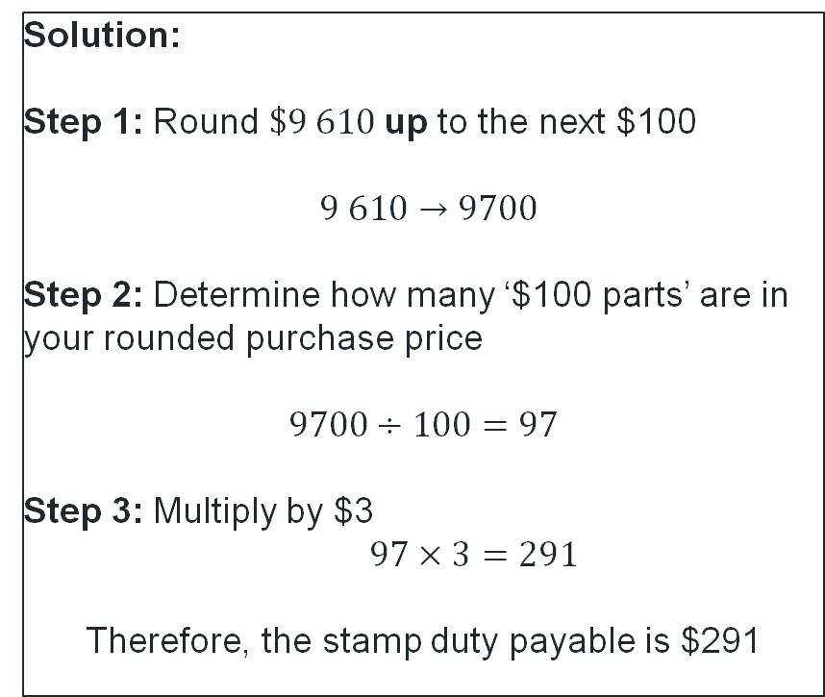
Calculating stamp duty (2)
Your turn
A used car was purchased for $\$9 610.$ Calculate the stamp duty payable if the charge is $3 per $100 or part thereof.
Solution:
Step 1: Round $\$9 610$up to the next $100
$9 610→9700$
Step 2: Determine how many ‘$100 parts’ are in your rounded purchase price
$$9700÷100=97$$
Step 3: Multiply by $3
$97×3=291$
Therefore, the stamp duty payable is $291

Slide 14
References
This presentation contains NSW Curriculum and syllabus content. The NSW Curriculum is developed by the NSW Education Standards Authority. This content is prepared by NESA for and on behalf of the Crown in the right of the State of New South Wales. The material is protected by Crown copyright.
Please refer to the NESA Copyright Disclaimer for more information https://educationstandards.nsw.edu.au/wps/portal/nesa/mini-footer/copyright.
NESA holds the only official and up-to-date versions of the NSW Curriculum and syllabus documents. Please visit the NSW Education Standards Authority (NESA) website https://educationstandards.nsw.edu.au/wps/portal/nesa/home and the NSW Curriculum website https://curriculum.nsw.edu.au.
Mathematics Standard Stage 6 Syllabus © NSW Education Standards Authority (NESA) for and on behalf of the Crown in right of the State of New South Wales, 2024.

Slide 15
Copyright
© State of New South Wales (Department of Education), 2026
The copyright material published in this resource is subject to the Copyright Act 1968 (Cth) and is owned by the NSW Department of Education or, where indicated, by a party other than the NSW Department of Education (third-party material).
Copyright material available in this resource and owned by the NSW Department of Education is licensed under a Creative Commons Attribution 4.0 International (CC BY 4.0) license.
This license allows you to share and adapt the material for any purpose, even commercially.
Attribution should be given to © State of New South Wales (Department of Education), 2025.
Material in this resource not available under a Creative Commons license:
the NSW Department of Education logo, other logos and trademark-protected material
Material owned by a third party that has been reproduced with permission. You will need to obtain permission from the third party to reuse its material.
Links to third-party material and websites
Please note that the provided (reading/viewing material/list/links/texts) are a suggestion only and implies no endorsement, by the New South Wales Department of Education, of any author, publisher, or book title. School principals and teachers are best placed to assess the suitability of resources that would complement the curriculum and reflect the needs and interests of their students.
If you use the links provided in this document to access a third-party’s website, you acknowledge that the terms of use, including licence terms set out on the third-party’s website apply to the use which may be made of the materials on that third-party website or where permitted by the Copyright Act 1968 (Cth). The department accepts no responsibility for content on third-party websites.

