Slide 1
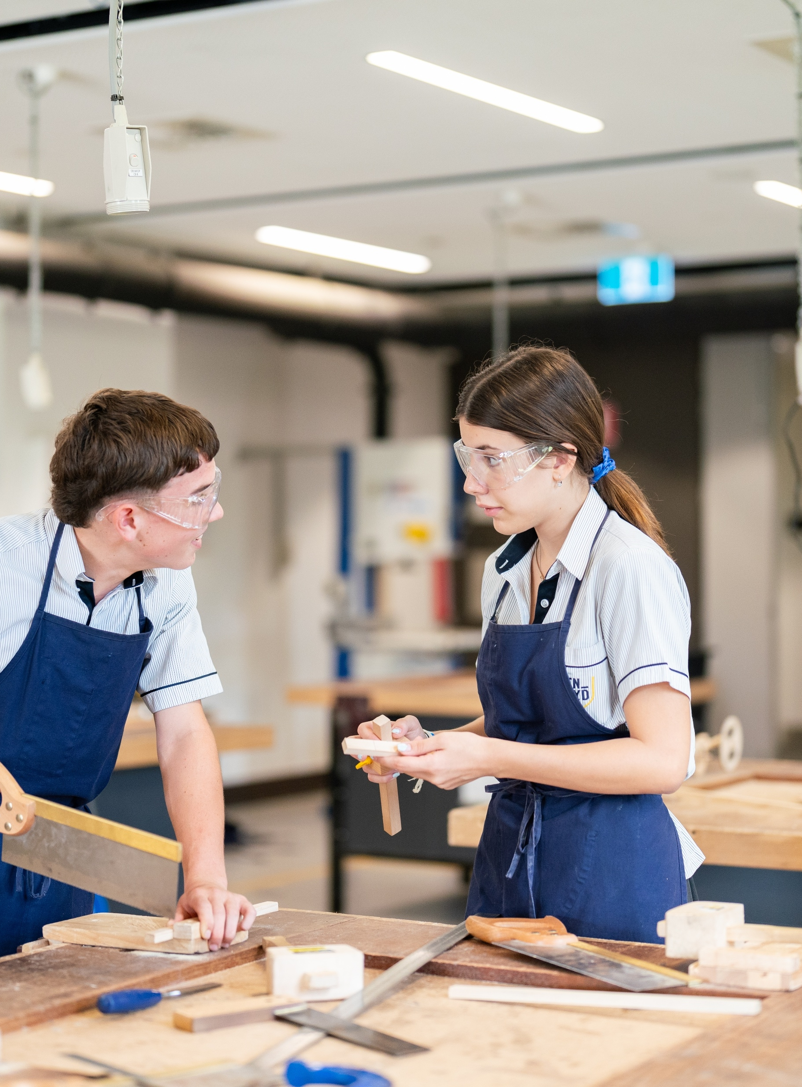
Volume and surface area of spheres
Mathematics Standard – Stage 6 (Year 11)
Making things

Slide 2
Learning intentions and success criteria
Learning intention
To be able to solve practical problems involving the surface area and volume of spheres.
Success criteria
I can calculate the volume of a sphere.
I can calculate the surface area of a sphere.
I can convert between metric units of volume.
I can convert between metric units of mass.
I can solve routine and non-routine problems involving spheres.
Notes:
Notes for teachers:
Learning intentions and success criteria are best co-constructed with students. Adapt the learning intention as required and add matching success criteria.
For more information See ⁠AITSL or the NSW Department of Education explicit teaching strategies, ⁠Sharing learning intentions and ⁠Sharing success criteria
LISC is not necessarily presented at the beginning of the lesson. Teacher needs to consider most effectual time to introduce
LISC should be revisited during the lesson to support students' evaluation of their learning

Slide 3
Activating prior knowledge

Slide 4
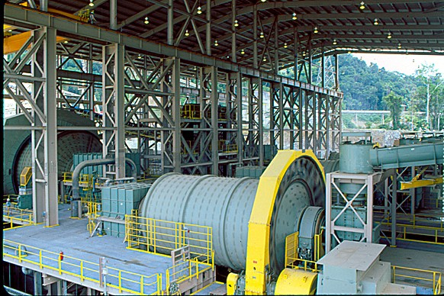
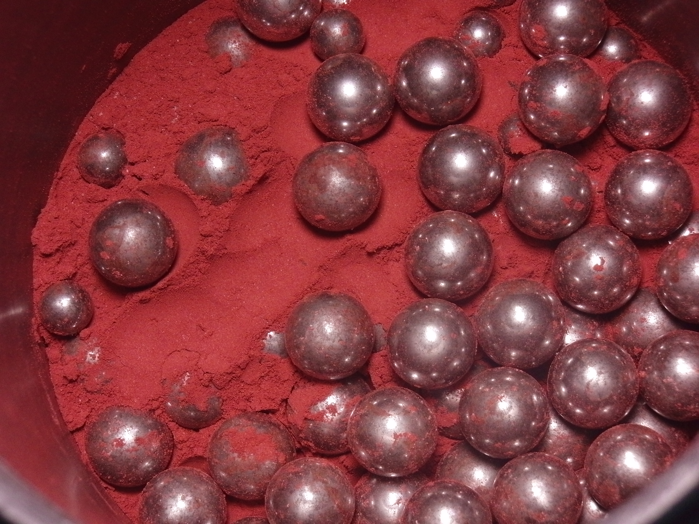
Crushing coal
‘SAG & Ball Mills.jpg’ by pjriccio2006 is licensed under CC BY-NC-SA 2.0.
‘Ball mill with steel ball’ by GOKLuLe 盧樂 is licensed under CC BY-SA 3.0.

Slide 5
Connecting learning

Slide 6
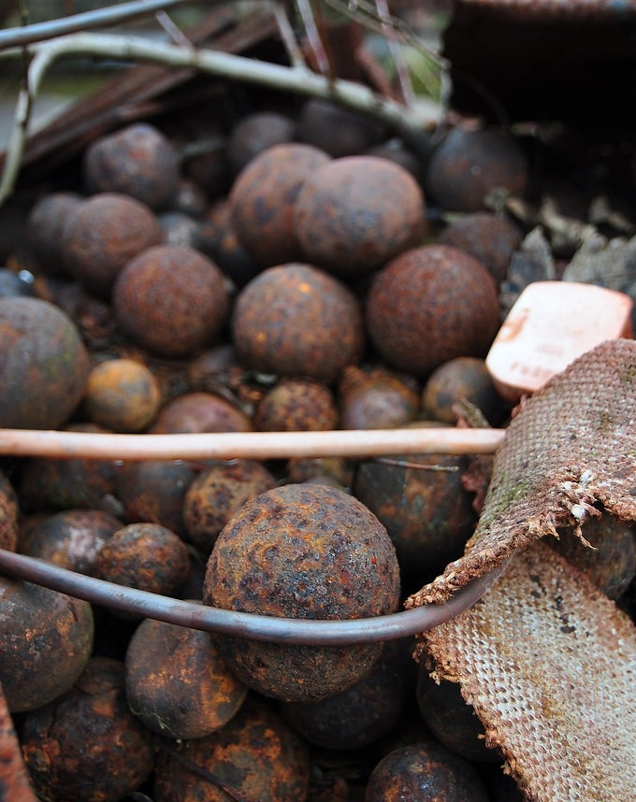
Steel balls
Notice and wonder
What do you wonder?
What do you notice?
‘Steel balls’ by b3tarev3 is marked with Public Domain Mark 1.0.

Slide 7
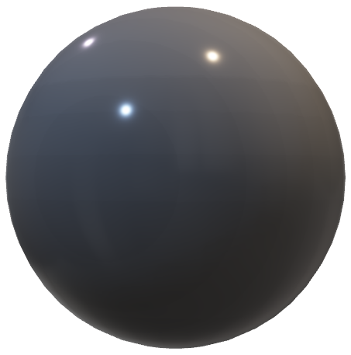
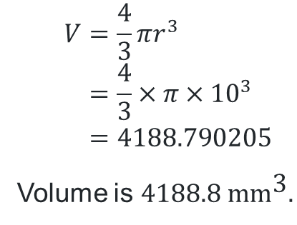

Volume of a sphere
Steel balls
Calculate the volume of the steel ball.
Volume of a sphere:
$$V=\frac{4}{3}πr^{3} \\ =\frac{4}{3}×π×{10}^{3} \\ =4188.790205$$
Volume is $4188.8 {\text{mm}}^{\text{3}}.$
What do you notice?
$$20 \text{mm}$$
What does this represent?

Slide 8
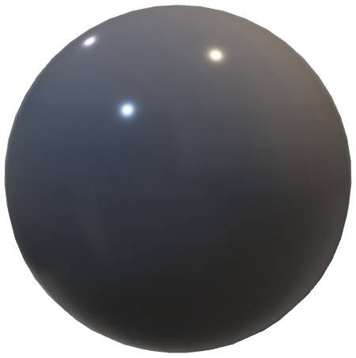
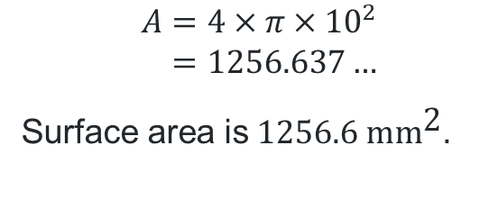
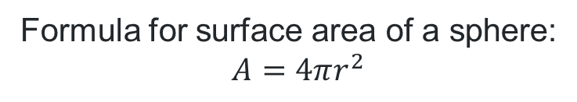
Surface area of a sphere
Steel balls
Calculate the surface area of the steel ball.
Formula for surface area of a sphere:
$$A=4πr^{2}$$
$$A=4×π×{10}^{2} \\ =1256.637…$$
Surface area is$1256.6 {\text{mm}}^{\text{2}}.$
Why was 10 substituted into the formula?
$$20 \text{mm}$$

Slide 9
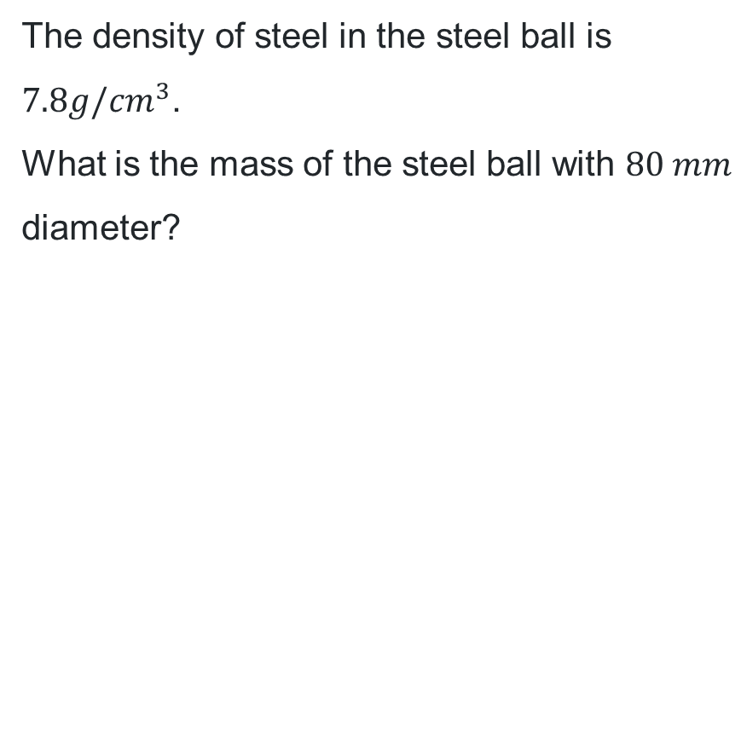
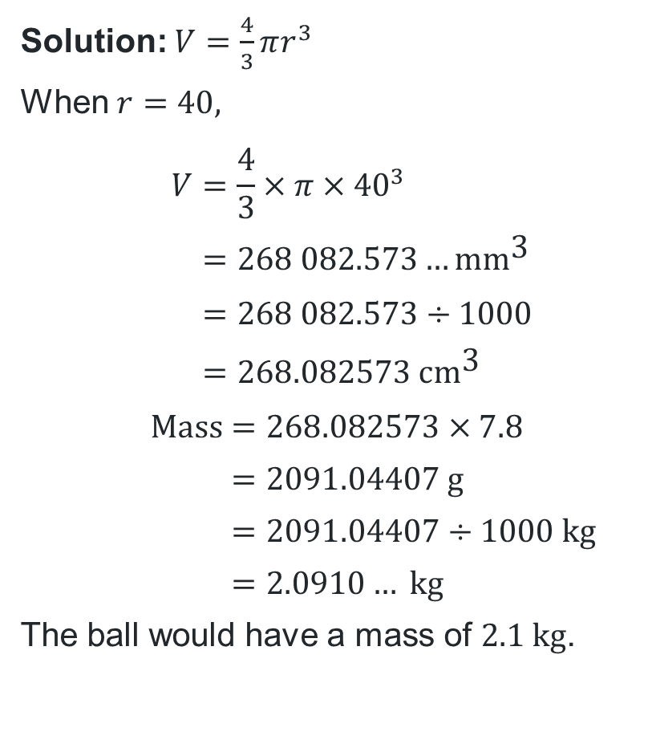

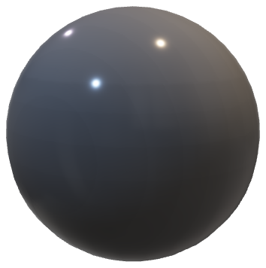
Worked example (your turn) (1)
What information is given in the question to help us know we need to use this formula?
Example 1
Solution: $V=\frac{4}{3}πr^{3}$
When $r=40,$
$$V=\frac{4}{3}×π×{40}^{3} \\ =268 082.573…\text{m}{\text{m}}^{\text{3}} \\ =268 082.573÷1000 \\ =268.082573 {\text{cm}}^{\text{3}}$$
$$\text{Mass}=268.082573×7.8 \\ =2091.04407 \text{g} \\ =2091.04407÷1000 \text{kg} \\ =2.0910… \text{kg}$$
The ball would have a mass of $2.1 \text{kg}$.
The density of steel in the steel ball is $7.8g/{cm}^{3}$.
What is the mass of the steel ball with $80 mm$ diameter?
Why do we divide by 1000?
How would you explain this line of working?
$$80 \text{mm}$$

Slide 10
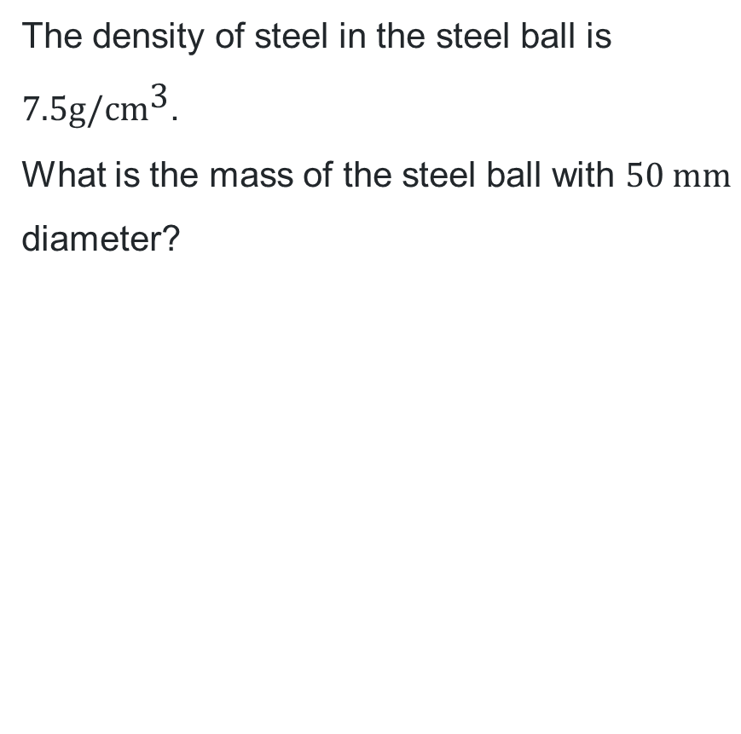
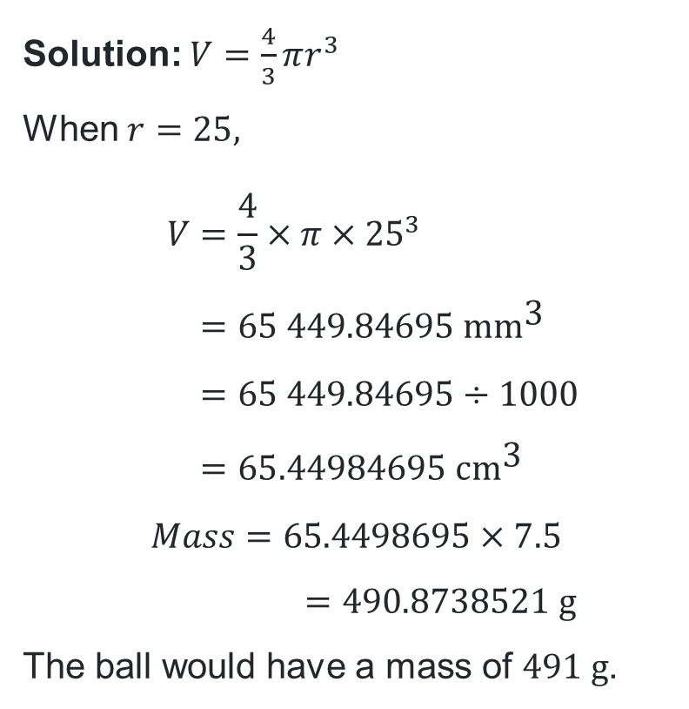

Worked example (your turn) (2)
Your turn – Question 1
Solution: $V=\frac{4}{3}πr^{3}$
When $r=25,$
$$V=\frac{4}{3}×π×{25}^{3} \\ =65 449.84695 {\text{mm}}^{\text{3}} \\ =65 449.84695÷1000 \\ =65.44984695 {\text{cm}}^{\text{3}}$$
$$Mass=65.4498695×7.5$$
$$=490.8738521 \text{g}$$
The ball would have a mass of $491 \text{g}$.
The density of steel in the steel ball is $7.5\text{g}\text{/}{\text{cm}}^{\text{3}}$.
What is the mass of the steel ball with $50 \text{mm}$ diameter?
$$50 \text{mm}$$

Slide 11
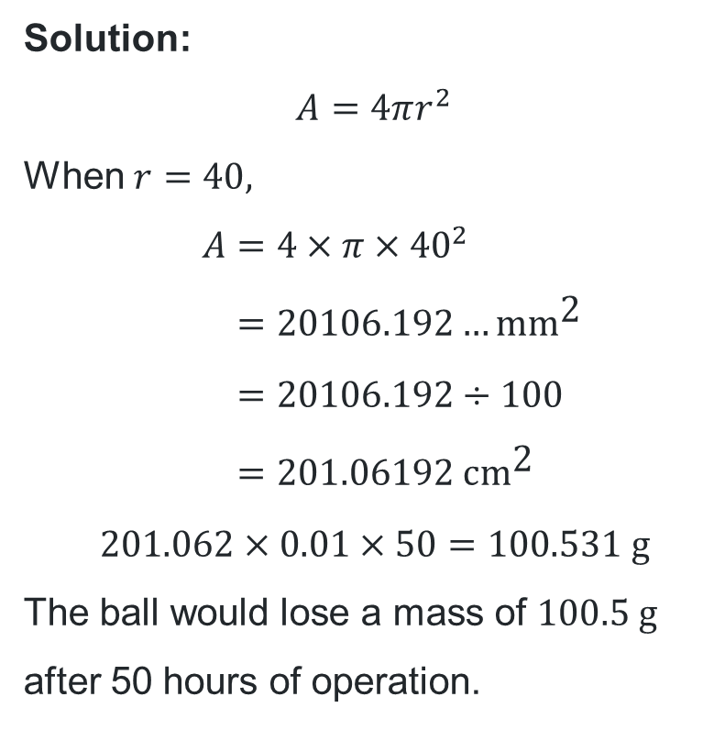
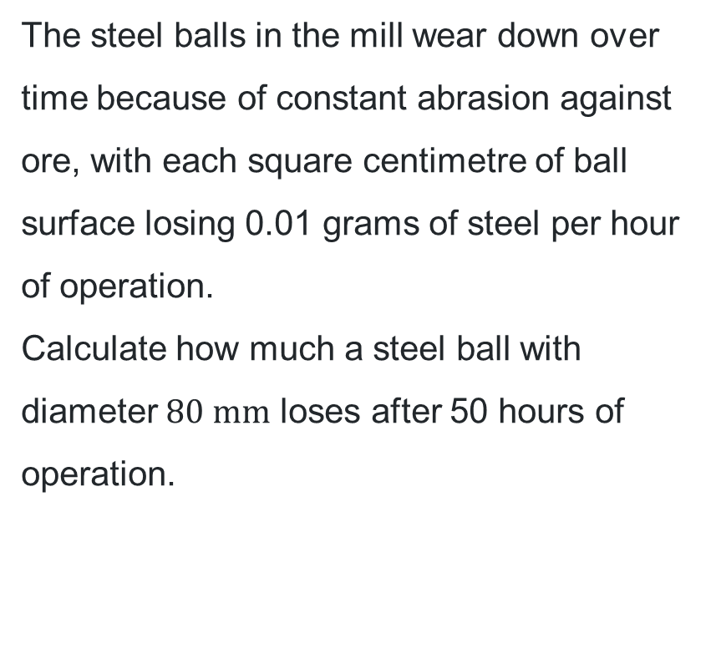
Worked example (your turn) (3)
What information is given in the question to help us know we need to use this formula?
Example 2
Solution:
$$A=4πr^{2}$$
When $r=40,$
$$A=4×π×{40}^{2} \\ =20106.192…\text{m}{\text{m}}^{\text{2}} \\ =20106.192÷100 \\ =201.06192 {\text{cm}}^{\text{2}}$$
$$201.062×0.01×50=100.531 \text{g}$$
The ball would lose a mass of $100.5 \text{g}$ after 50 hours of operation.
The steel balls in the mill wear down over time because of constant abrasion against ore, with each square centimetre of ball surface losing 0.01 grams of steel per hour of operation.
Calculate how much a steel ball with diameter $80 \text{mm}$ loses after 50 hours of operation.
Why do we divide by 100?
How would you explain this line of working?

Slide 12
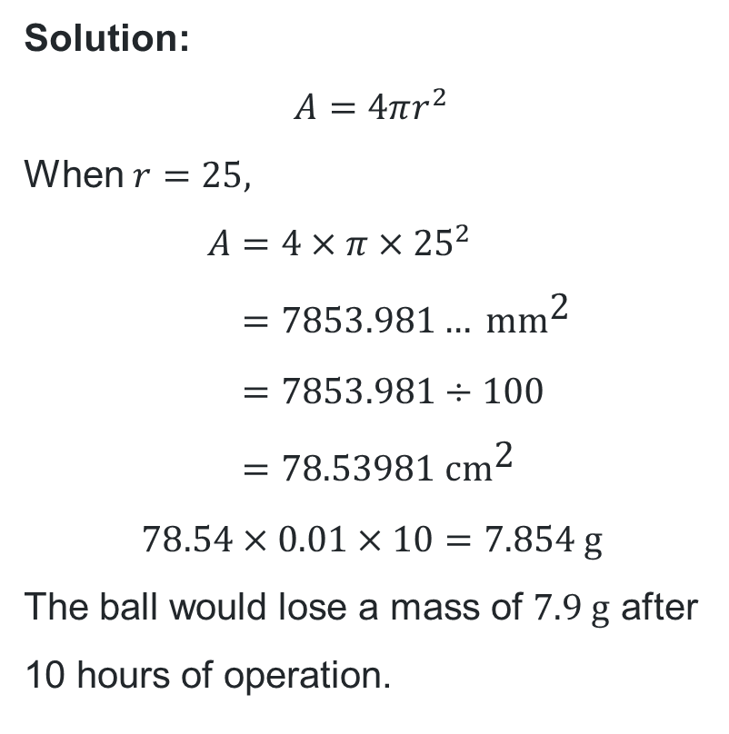
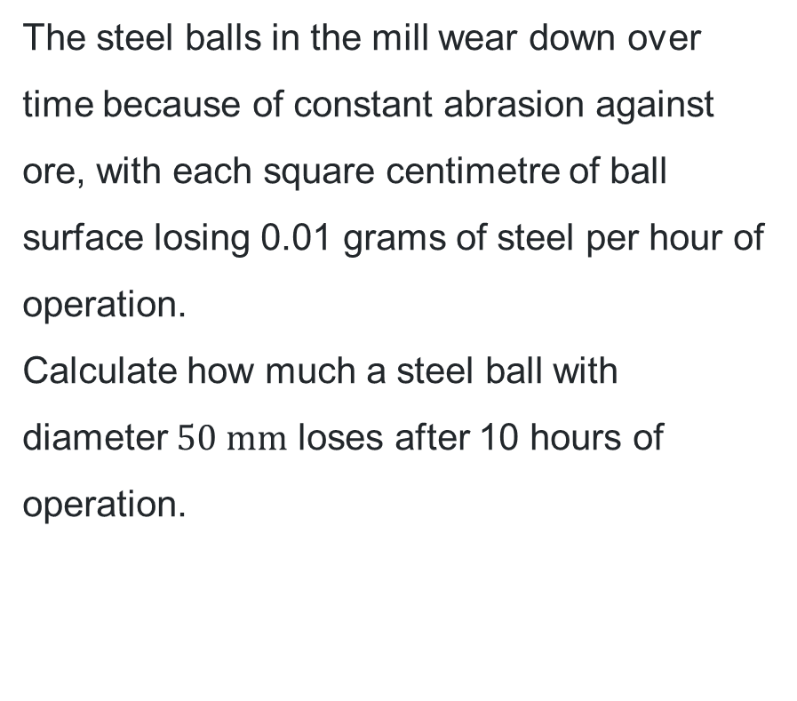
Worked example (your turn) (4)
Your turn – Question 2
The steel balls in the mill wear down over time because of constant abrasion against ore, with each square centimetre of ball surface losing 0.01 grams of steel per hour of operation.
Calculate how much a steel ball with diameter $50 \text{mm}$ loses after 10 hours of operation.
Solution:
$$A=4πr^{2}$$
When $r=25,$
$$A=4×π×{25}^{2} \\ =7853.981… {\text{mm}}^{\text{2}} \\ =7853.981÷100 \\ =78.53981 {\text{cm}}^{\text{2}}$$
$$78.54×0.01×10=7.854 \text{g}$$
The ball would lose a mass of $7.9 \text{g}$ after 10 hours of operation.

Slide 13
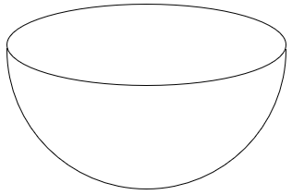
What is a hemisphere?
It’s half of a sphere.
How is the volume affected, when a sphere is cut in half?
Many faces does a hemisphere have?
How does this circle affect the calculation of the surface area of a hemisphere?
How is the surface are affected, when a sphere is cut in half?

Slide 14
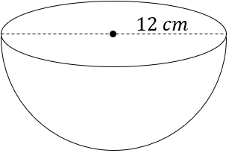
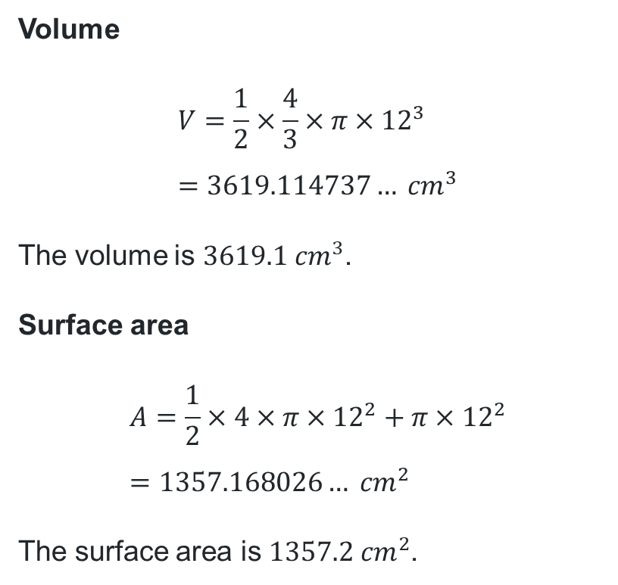
Volume and surface area of a hemisphere
The closed hemisphere below has a radius of $12 cm$.
What is the volume and surface area of the hemisphere?
Volume
$$V=\frac{1}{2}×\frac{4}{3}×π×{12}^{3} \\ =3619.114737… {cm}^{3}$$
The volume is $3619.1 {cm}^{3}$.
Surface area
$$A=\frac{1}{2}×4×π×{12}^{2}+π×{12}^{2} \\ =1357.168026… {cm}^{2}$$
The surface area is $1357.2 {cm}^{2}$.

Slide 15
Independent practice

Slide 16

Approaching questions scaffold

Slide 17
References
This presentation contains NSW Curriculum and syllabus content. The NSW Curriculum is developed by the NSW Education Standards Authority. This content is prepared by NESA for and on behalf of the Crown in the right of the State of New South Wales. The material is protected by Crown copyright.
Please refer to the NESA Copyright Disclaimer for more information https://educationstandards.nsw.edu.au/wps/portal/nesa/mini-footer/copyright.
NESA holds the only official and up-to-date versions of the NSW Curriculum and syllabus documents. Please visit the NSW Education Standards Authority (NESA) website https://educationstandards.nsw.edu.au/wps/portal/nesa/home and the NSW Curriculum website https://curriculum.nsw.edu.au.
Mathematics Standard Stage 6 Syllabus © NSW Education Standards Authority (NESA) for and on behalf of the Crown in right of the State of New South Wales, 2024.

Slide 18
Copyright
© State of New South Wales (Department of Education), 2026
The copyright material published in this resource is subject to the Copyright Act 1968 (Cth) and is owned by the NSW Department of Education or, where indicated, by a party other than the NSW Department of Education (third-party material).
Copyright material available in this resource and owned by the NSW Department of Education is licensed under a Creative Commons Attribution 4.0 International (CC BY 4.0) license.
This license allows you to share and adapt the material for any purpose, even commercially.
Attribution should be given to © State of New South Wales (Department of Education), 2026.
Material in this resource not available under a Creative Commons license:
the NSW Department of Education logo, other logos and trademark-protected material
Material owned by a third party that has been reproduced with permission. You will need to obtain permission from the third party to reuse its material.
Links to third-party material and websites
Please note that the provided (reading/viewing material/list/links/texts) are a suggestion only and implies no endorsement, by the New South Wales Department of Education, of any author, publisher, or book title. School principals and teachers are best placed to assess the suitability of resources that would complement the curriculum and reflect the needs and interests of their students.
If you use the links provided in this document to access a third-party’s website, you acknowledge that the terms of use, including licence terms set out on the third-party’s website apply to the use which may be made of the materials on that third-party website or where permitted by the Copyright Act 1968 (Cth). The department accepts no responsibility for content on third-party websites.

