Slide 1
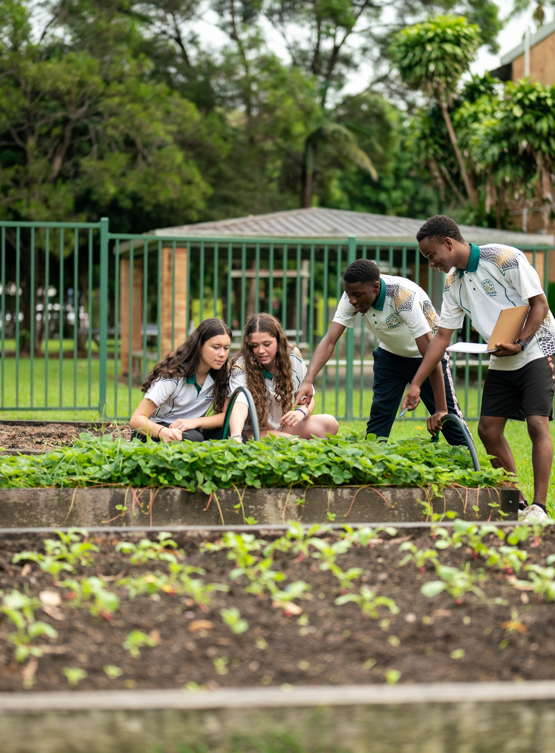
Volume of pyramids and cones
Mathematics Standard – Stage 6 (Year 11)
Making things

Slide 2
Learning intentions and success criteria
Learning intentions
To be able to solve problems involving the volume of pyramids and cones.
Success criteria
I can apply appropriate strategies to calculate the volume of a pyramid or cone.
I can use Pythagoras’ theorem to calculate the perpendicular height of a pyramid or cone.
I can describe the relationship between the volume of a prism or cylinder and the volume of a pyramid or cone with the same base area and perpendicular height.
Notes:
Notes for teachers:
Learning intentions and success criteria are best co-constructed with students. Adapt the learning intention as required and add matching success criteria.
For more information See ⁠AITSL or the NSW Department of Education explicit teaching strategies, ⁠Sharing learning intentions and ⁠Sharing success criteria
LISC is not necessarily presented at the beginning of the lesson. Teacher needs to consider most effectual time to introduce
LISC should be revisited during the lesson to support students' evaluation of their learning

Slide 3
Activating prior knowledge

Slide 4
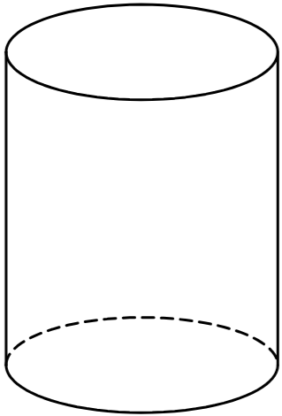
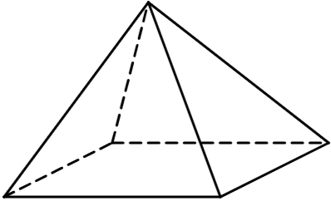
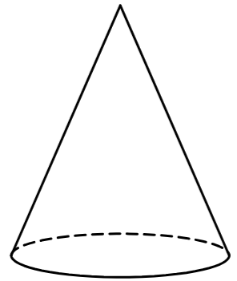
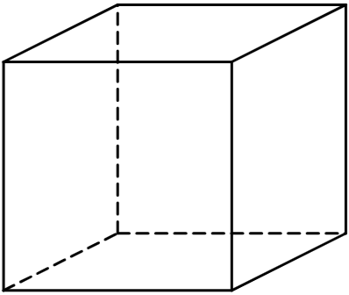
Same, same, but different (1)
They have the same shape at the base

Slide 5
Connecting learning

Slide 6

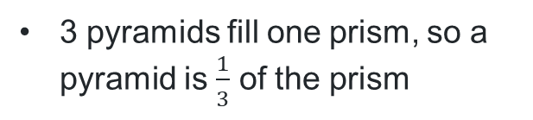
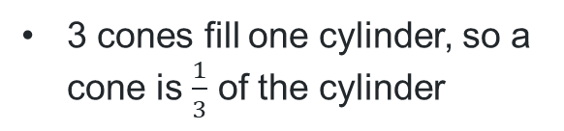
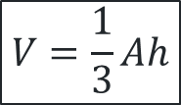
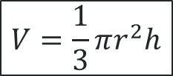

Three into one
same size base
same perpendicular height
3 pyramids fill one prism, so a pyramid is $\frac{1}{3}$ of the prism
$$V=Ah$$
$$V=\frac{1}{3}Ah$$
same size base
same perpendicular height
3 cones fill one cylinder, so a cone is $\frac{1}{3}$ of the cylinder
$$V=\frac{1}{3}πr^{2}h$$
$$V=πr^{2}h$$

Slide 7
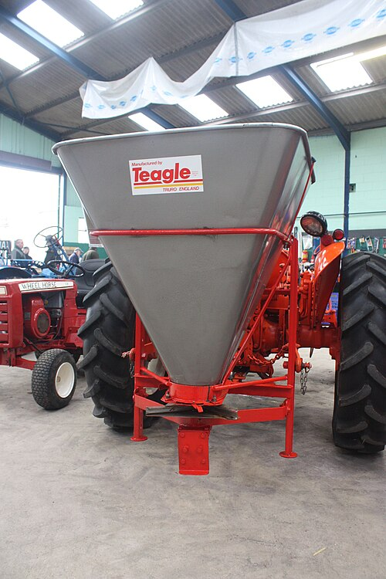
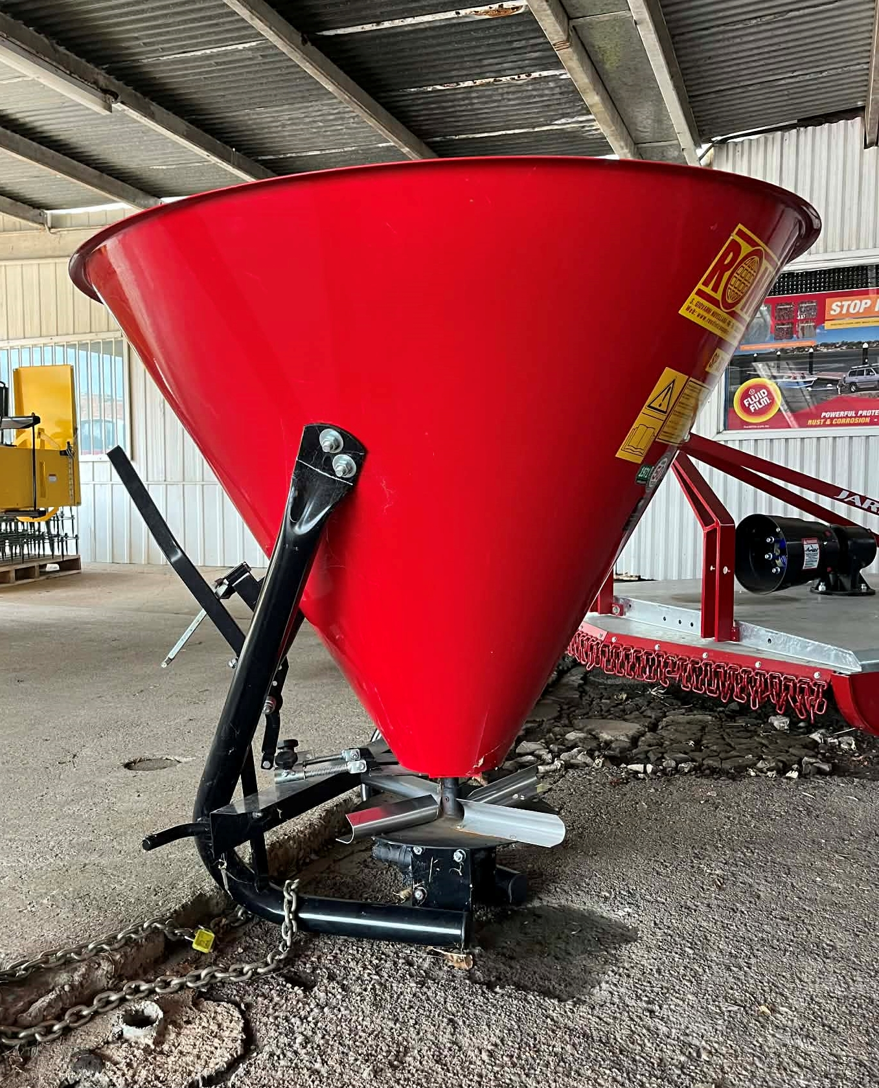
What do you notice? What do you wonder?
"Teagle fertiliser spreader on BMC tractor at Bath 2011 - 8264" by BulldozerD11 is licensed under CC BY-SA 3.0.

Slide 8
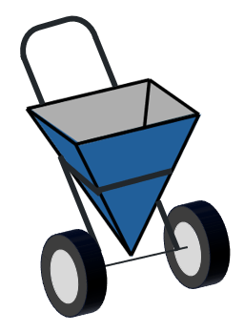
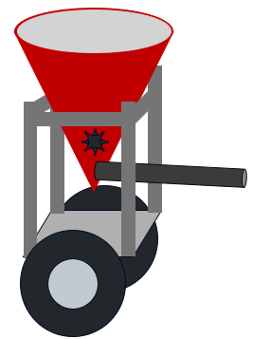





Volume of a pyramid
Fertiliser spreader
Farmwell
Our new spreader holds more, to help you save time!
Spreadwell
Maximum volume and convenience!
$$30 \text{cm}$$
$$30 \text{cm}$$
$$30 \text{cm}$$
$$60 \text{cm}$$
$$60 \text{cm}$$

Slide 9
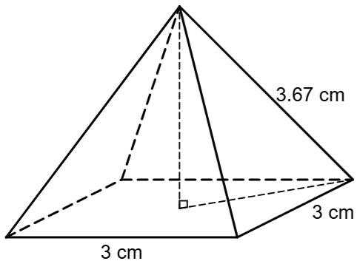
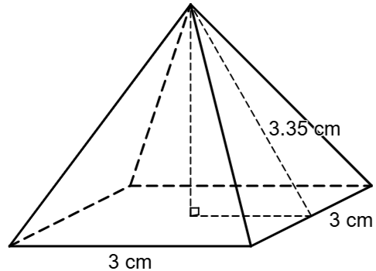
Height of a square-based pyramid
How would you calculate the height?
Pyramid A
Pyramid B
What else do we need to know to find the height of this pyramid?
What else do we need to know to find the height of this pyramid?
Why is the slant height of Pyramid A different to the slant height of Pyramid B?

Slide 10
Releasing responsibility

Slide 11
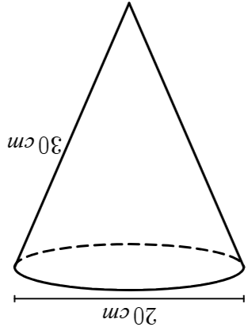
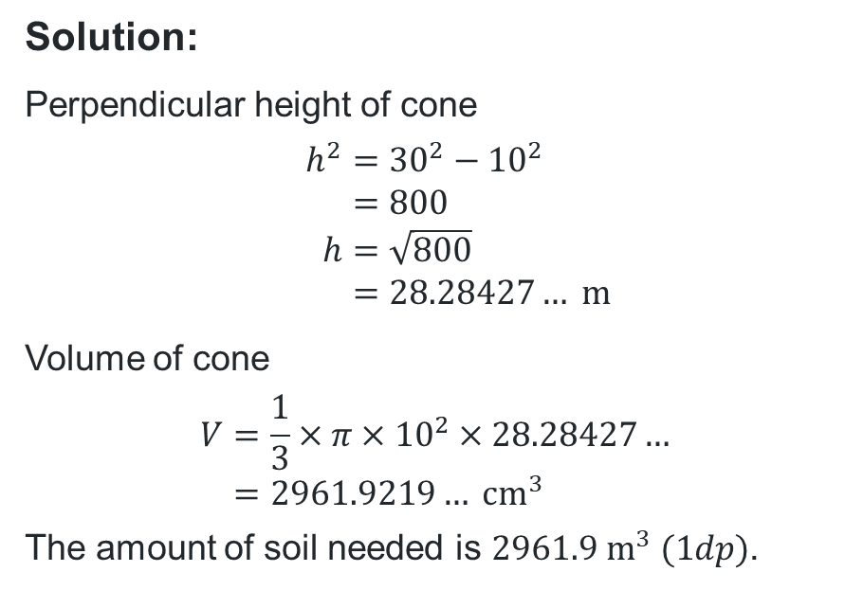
Volume of a cone or pyramid (1)
Example 1
A garden feature, in the shape of an inverted cone, needs to be filled with garden soil.
Calculate the volume of soil needed.
Solution:
Perpendicular height of cone
$$h^{2}={30}^{2}−{10}^{2} \\ =800 \\ h=\sqrt{800} \\ =28.28427… \text{m}$$
Volume of cone
$$V=\frac{1}{3}×π×{10}^{2}×28.28427… \\ =2961.9219… {\text{cm}}^{3}$$
The amount of soil needed is $2961.9 {\text{m}}^{3} (1dp)$.
Why was this calculation necessary?
How might we achieve a more accurate answer?

Slide 12
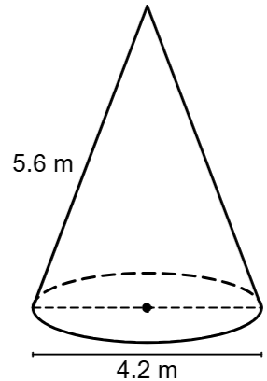
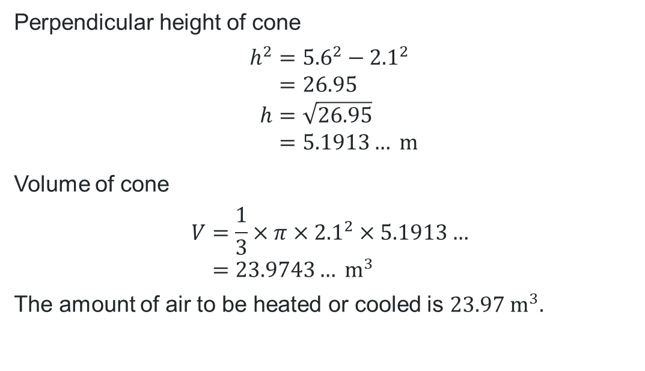
Volume of a cone or pyramid (2)
Your turn – Question 1
A glamping tipi, in the shape of a cone with a slant height of 5.6 m and a base diameter of 4.2 m, is being constructed.
Calculate the volume of air which needs to be heated or cooled.
Perpendicular height of cone
$$h^{2}={5.6}^{2}−{2.1}^{2} \\ =26.95 \\ h=\sqrt{26.95} \\ =5.1913… \text{m}$$
Volume of cone
$$V=\frac{1}{3}×π×{2.1}^{2}×5.1913… \\ =23.9743… {\text{m}}^{3}$$
The amount of air to be heated or cooled is $23.97 {\text{m}}^{3}.$

Slide 13
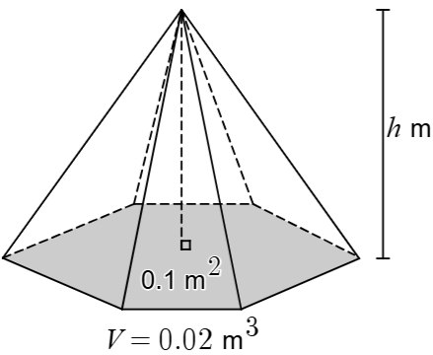
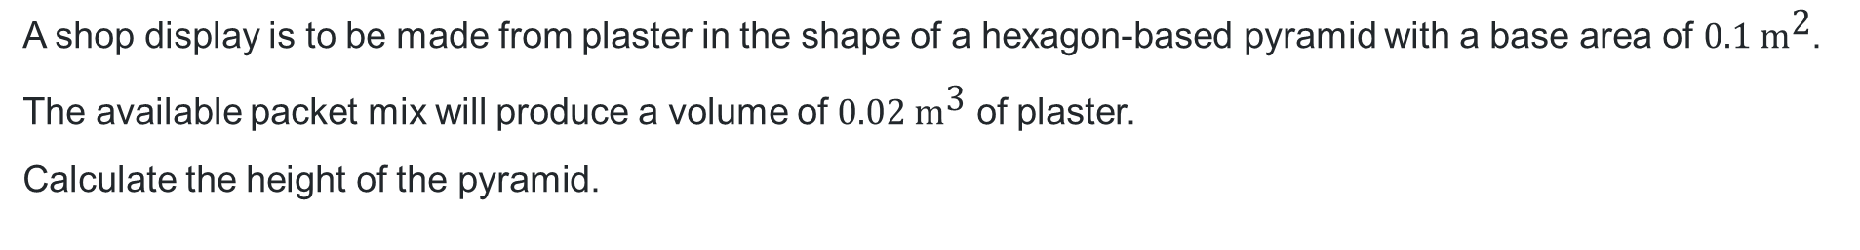
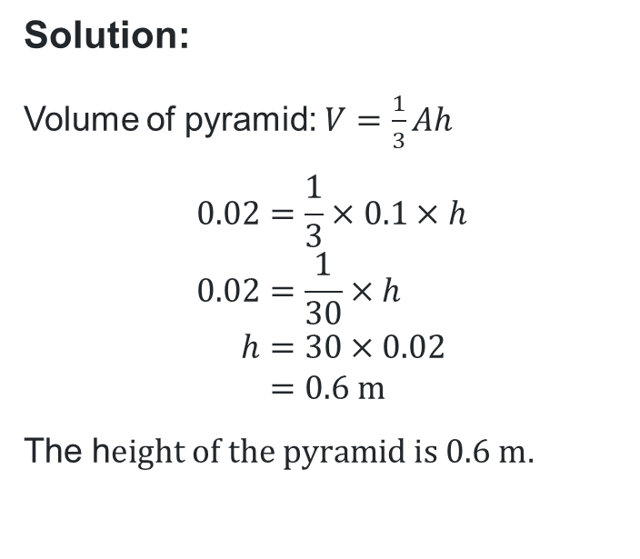
Volume of a cone or pyramid (3)
Example 2
A shop display is to be made from plaster in the shape of a hexagon-based pyramid with a base area of $0.1 {\text{m}}^{\text{2}}$.
The available packet mix will produce a volume of $0.02 {\text{m}}^{\text{3}}$ of plaster.
Calculate the height of the pyramid.
Solution:
Volume of pyramid: $V=\frac{1}{3}Ah$
$$0.02=\frac{1}{3}×0.1×h \\ 0.02=\frac{1}{30}×h \\ h=30×0.02 \\ =0.6 \text{m}$$
The h$eight of the pyramid is 0.6 \text{m}$.
Where did these numbers come from?
How could we explain what happened here?

Slide 14
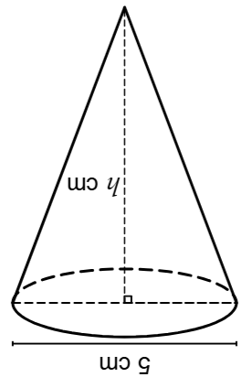
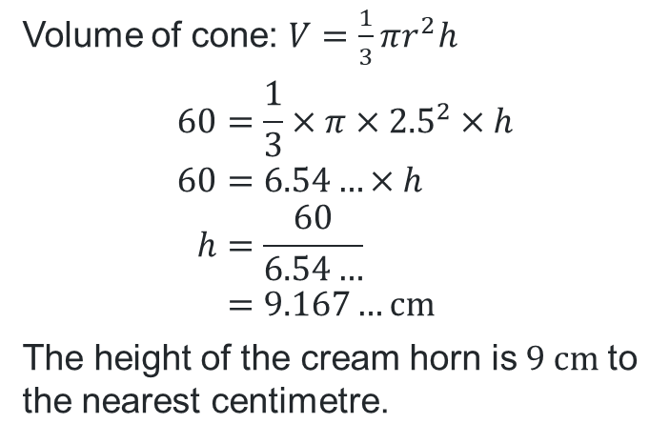
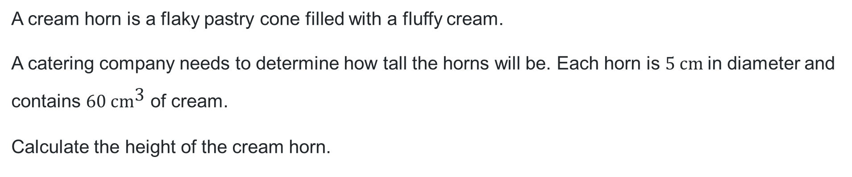
Volume of a cone or pyramid (4)
Your turn – Question 2
A cream horn is a flaky pastry cone filled with a fluffy cream.
A catering company needs to determine how tall the horns will be. Each horn is $5 \text{cm}$in diameter and contains $60 {\text{cm}}^{\text{3}}$ of cream.
Calculate the height of the cream horn.
Volume of cone: $V=\frac{1}{3}πr^{2}h$
$$60=\frac{1}{3}×π×{2.5}^{2}×h \\ 60=6.54…×h \\ h=\frac{60}{6.54…} \\ =9.167…\text{cm}$$
The height of the cream horn is$9 \text{cm}$ to the nearest centimetre.

Slide 15
Independent practice

Slide 16

16
…..

Slide 17
References
This presentation contains NSW Curriculum and syllabus content. The NSW Curriculum is developed by the NSW Education Standards Authority. This content is prepared by NESA for and on behalf of the Crown in the right of the State of New South Wales. The material is protected by Crown copyright.
Please refer to the NESA Copyright Disclaimer for more information https://educationstandards.nsw.edu.au/wps/portal/nesa/mini-footer/copyright.
NESA holds the only official and up-to-date versions of the NSW Curriculum and syllabus documents. Please visit the NSW Education Standards Authority (NESA) website https://educationstandards.nsw.edu.au/wps/portal/nesa/home and the NSW Curriculum website https://curriculum.nsw.edu.au.
Mathematics Standard Stage 6 Syllabus © NSW Education Standards Authority (NESA) for and on behalf of the Crown in right of the State of New South Wales, 2024.

Slide 18
Copyright
© State of New South Wales (Department of Education), 2026
The copyright material published in this resource is subject to the Copyright Act 1968 (Cth) and is owned by the NSW Department of Education or, where indicated, by a party other than the NSW Department of Education (third-party material).
Copyright material available in this resource and owned by the NSW Department of Education is licensed under a Creative Commons Attribution 4.0 International (CC BY 4.0) license.
This license allows you to share and adapt the material for any purpose, even commercially.
Attribution should be given to © State of New South Wales (Department of Education), 2026.
Material in this resource not available under a Creative Commons license:
the NSW Department of Education logo, other logos and trademark-protected material
Material owned by a third party that has been reproduced with permission. You will need to obtain permission from the third party to reuse its material.
Links to third-party material and websites
Please note that the provided (reading/viewing material/list/links/texts) are a suggestion only and implies no endorsement, by the New South Wales Department of Education, of any author, publisher, or book title. School principals and teachers are best placed to assess the suitability of resources that would complement the curriculum and reflect the needs and interests of their students.
If you use the links provided in this document to access a third-party’s website, you acknowledge that the terms of use, including licence terms set out on the third-party’s website apply to the use which may be made of the materials on that third-party website or where permitted by the Copyright Act 1968 (Cth). The department accepts no responsibility for content on third-party websites.

