Slide 1
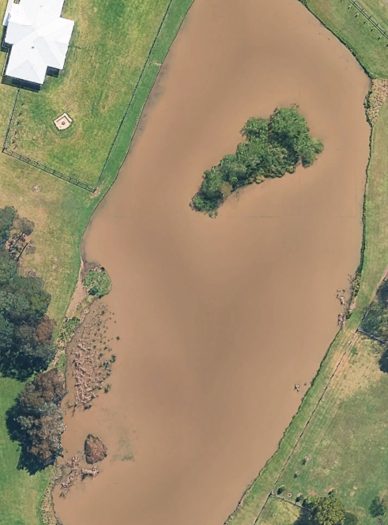
Volume and capacity with the Trapezoidal rule
Mathematics Standard – Stage 6 (Year 11)
Making things

Slide 2
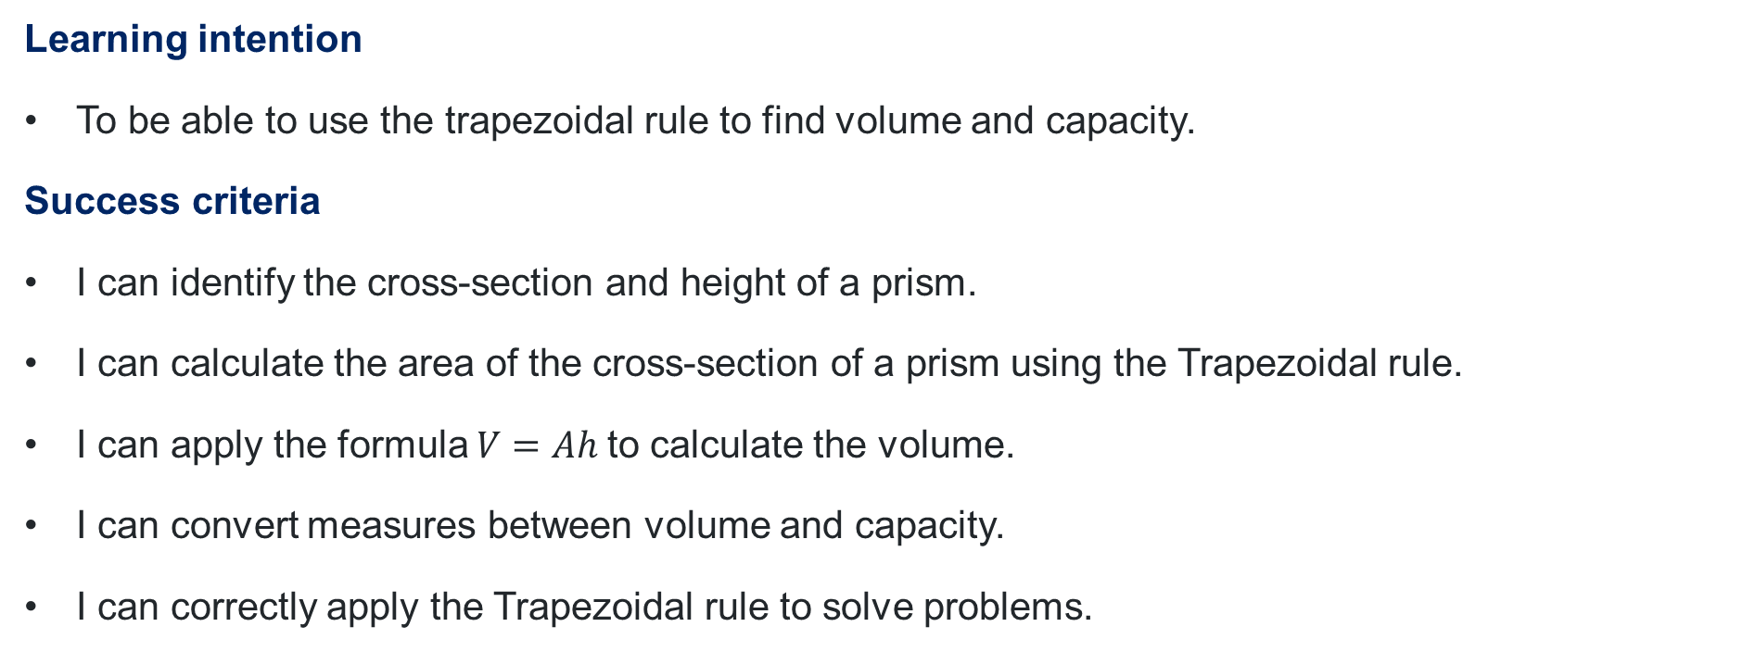
Learning intentions and success criteria
Learning intention
To be able to use the trapezoidal rule to find volume and capacity.
Success criteria
I can identify the cross-section and height of a prism.
I can calculate the area of the cross-section of a prism using the Trapezoidal rule.
I can apply the formula $V=Ah$to calculate the volume.
I can convert measures between volume and capacity.
I can correctly apply the Trapezoidal rule to solve problems.
Notes:
Notes for teachers:
Learning intentions and success criteria are best co-constructed with students. Adapt the learning intention as required and add matching success criteria.
For more information See ⁠AITSL or the NSW Department of Education explicit teaching strategies, ⁠Sharing learning intentions and ⁠Sharing success criteria
LISC is not necessarily presented at the beginning of the lesson. Teacher needs to consider most effectual time to introduce
LISC should be revisited during the lesson to support students' evaluation of their learning

Slide 3
Retrieval practice

Slide 4
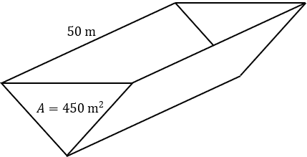
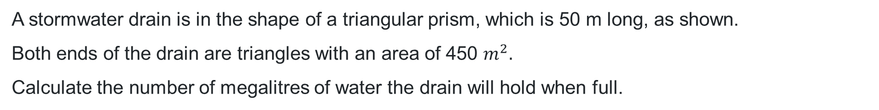
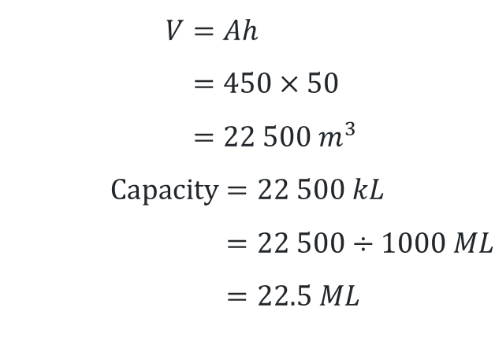
Capacity of a dam
How many megalitres?
A stormwater drain is in the shape of a triangular prism, which is 50 m long, as shown.
Both ends of the drain are triangles with an area of 450 $m^{2}.$
Calculate the number of megalitres of water the drain will hold when full.
$$V=Ah \\ =450×50 \\ =22 500 m^{3}$$
$$\text{Capacity}=22 500 kL \\ =22 500÷1000 ML \\ =22.5 ML$$

Slide 5
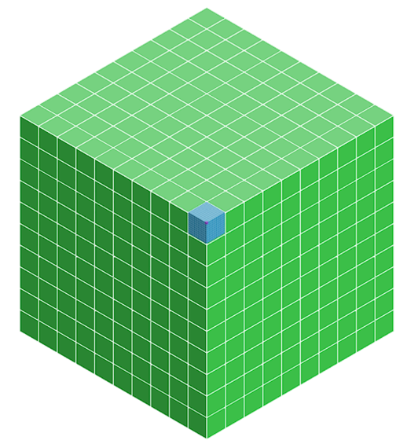
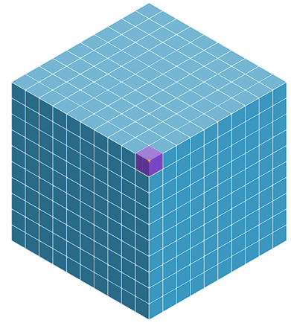
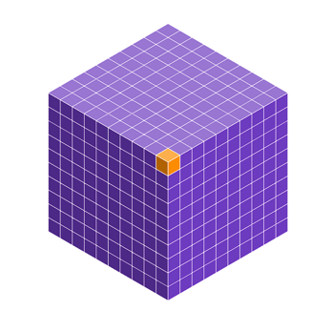





Conversions
millilitres (mL), litres (L), kilolitres (kL) and megalitres (ML)
$$1 {\text{cm}}^{3}=1 \text{mL}$$
$$1000 {\text{cm}}^{3}=1 \text{L}$$
$$1{ \text{m}}^{3}=1000 \text{L}=1 \text{kL}$$
$$1000{ \text{m}}^{3}=1000 \text{k}\text{L}=1 \text{ML}$$

Slide 6
Activating prior knowledge

Slide 7
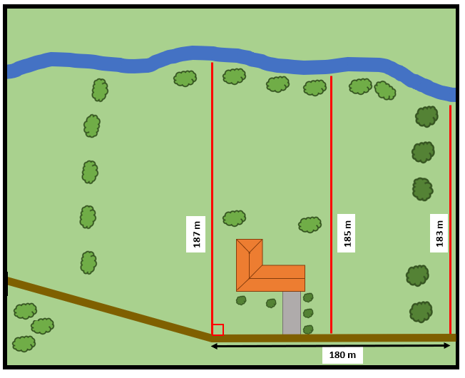
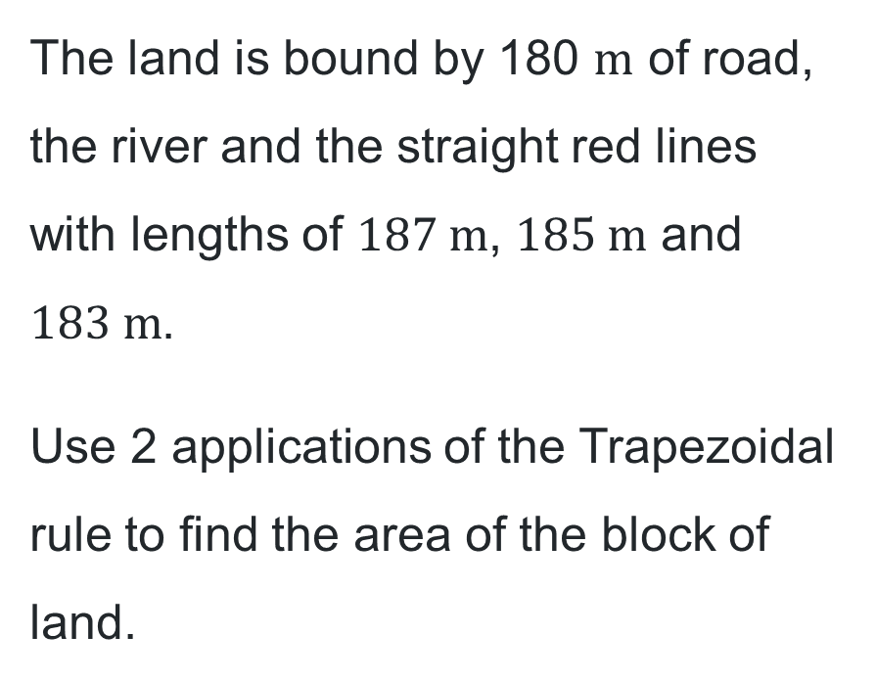
Trapezoidal rule
The land is bound by 180 $\text{m}$ of road, the river and the straight red lines with lengths of $187 \text{m}$, $185 \text{m}$ and $183 \text{m}$.
Use 2 applications of the Trapezoidal rule to find the area of the block of land.

Slide 8
Connecting learning

Slide 9
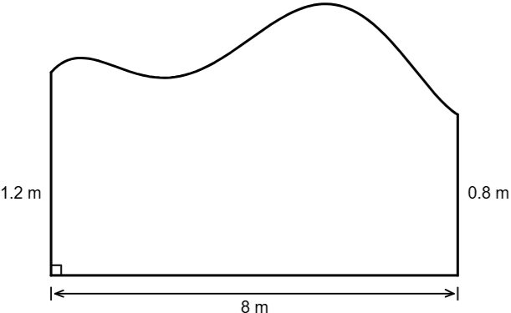
Making a garden (1)
Oscar’s new measurements
Oscar has made a garden in his backyard. The diagram shows an overhead view of the outline of the garden and some measurements made by Oscar.
Oscar decided he should take further measurements of the garden to try to improve his estimate.

Slide 10
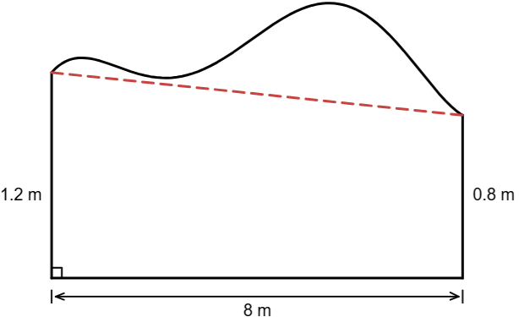
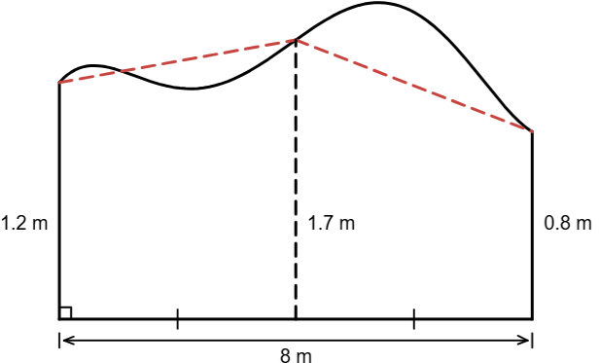
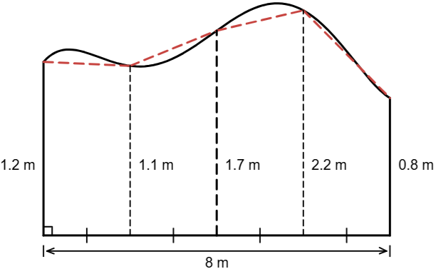
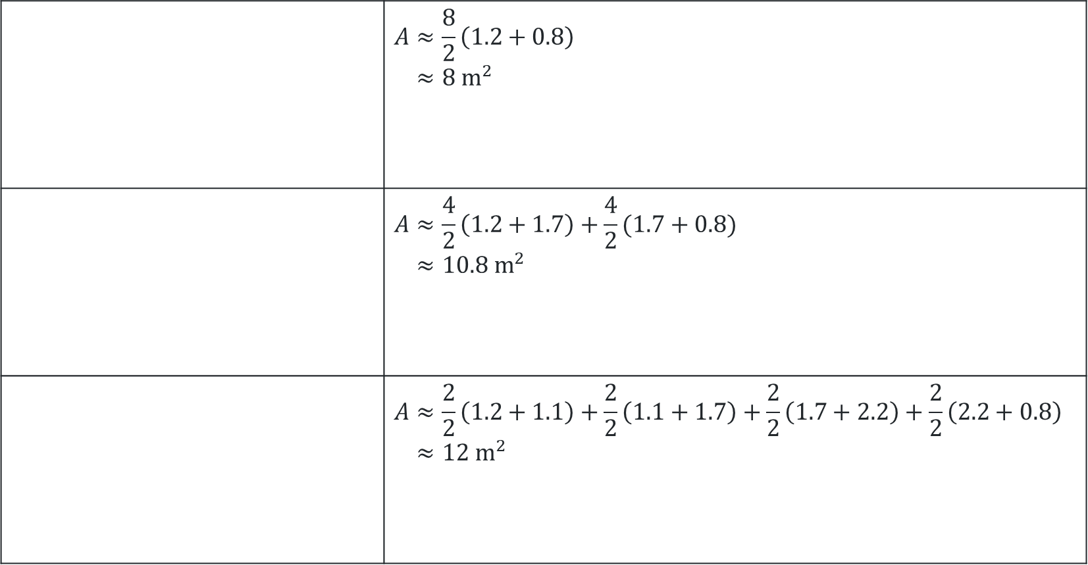
Making a garden (2)
Oscar’s new measurements
What do you notice?
 | $$A≈\frac{8}{2}\left(1.2+0.8\right) \\ ≈8 {\text{m}}^{2}$$
 | $$A≈\frac{4}{2}\left(1.2+1.7\right)+\frac{4}{2}(1.7+0.8) \\ ≈10.8 {\text{m}}^{2}$$
 | $$A≈\frac{2}{2}\left(1.2+1.1\right)+\frac{2}{2}\left(1.1+1.7\right)+\frac{2}{2}\left(1.7+2.2\right)+\frac{2}{2}\left(2.2+0.8\right) \\ ≈12 {\text{m}}^{2}$$
What do you wonder?

Slide 11

Making a garden (3)
More measurements
Oscar has used the measurements to calculate the volume of the garden to determine how much soil he needs to fill the garden to a depth of $40 \text{cm}$.
$$A≈\frac{2}{2}\left(1.2+1.1\right)+\frac{2}{2}\left(1.1+1.7\right)+\frac{2}{2}\left(1.7+2.2\right)+\frac{2}{2}\left(2.2+0.8\right) \\ =12 {\text{m}}^{2}$$
$$V=12×0.4 \\ =4.8 {\text{m}}^{3}$$
Volume of soil needed is $4.8 {\text{m}}^{3}$.

Slide 12
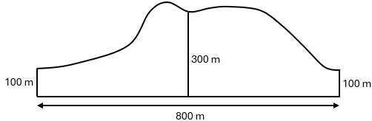
Reservoir
Estimating area
The diagram shows an outline from above of a man-made reservoir.
During a storm, 20 mm of rain falls on the reservoir.
Estimate the amount of water in the reservoir immediately after the storm, with the aid of two applications of the trapezoidal rule. Assume that all rain that falls over the reservoir is stored.
Give your answer in cubic metres.

Slide 13
Releasing responsibility

Slide 14
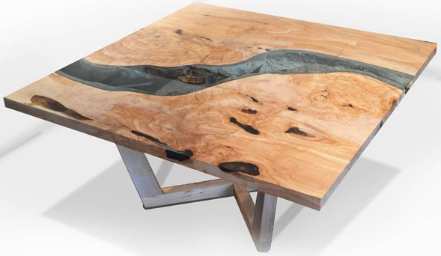
River resin table
What do you notice?
What do you wonder?
Figured Maple Burl & blue resin river coffee table | Untreated Art: www.untreatedart.com/product/figured-maple-burl-blue-resin-river-coffee-table-173/53

Slide 15
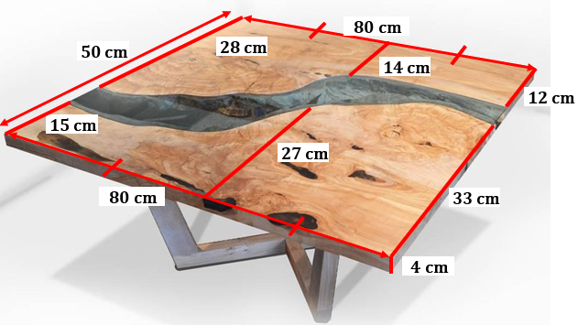
Estimating the amount of resin
Calculate the volume of resin used in the table.
10 Top River Table Designs You Have to See?– Artisan Born
https://artisanborn.com/blogs/design/10-top-river-table-designs

Slide 16
Independent practice

Slide 17
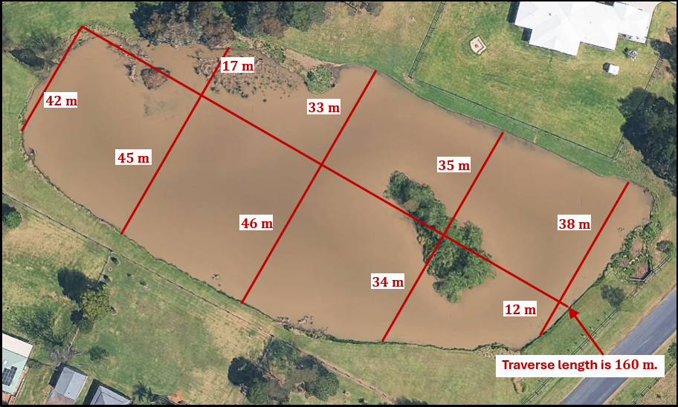
Dam with measurements
Untitled map - Google Earth: earth.google.com/web/@32.77257705,151.55023838,6.28291454a,440.72803165d,35y,0h,0t,0r/data=CgRCAggBMikKJwolCiExVU40Uk1uaFVKbFdjT0R4RHI4aXB3cmpteWVpMklBc2wgAToDCgEwQgIIAEoICP2c-dABEAE

Slide 18
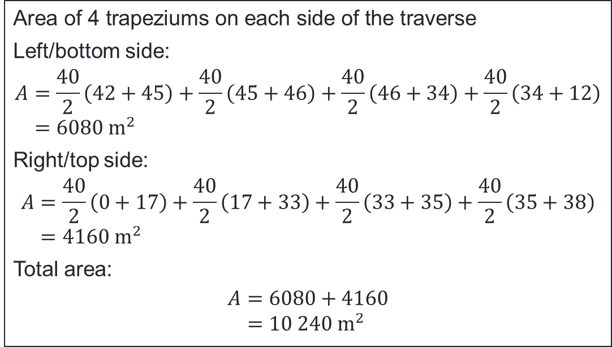
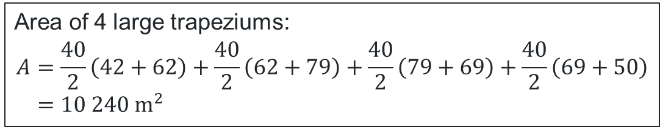
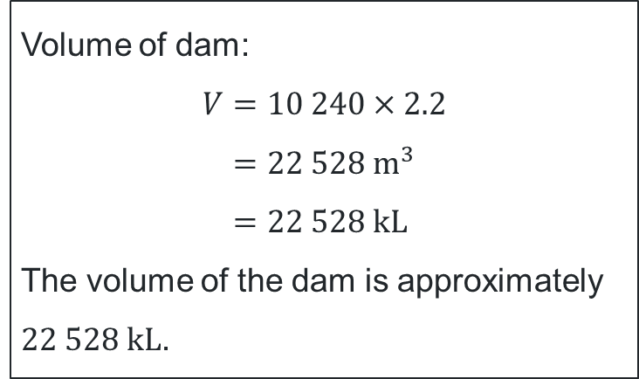
Volume of the dam
Area of 4 large trapeziums:
$$A=\frac{40}{2}\left(42+62\right)+\frac{40}{2}\left(62+79\right)+\frac{40}{2}\left(79+69\right)+\frac{40}{2}\left(69+50\right) \\ =10 240 {\text{m}}^{2}$$
Volume of dam:
$$V=10 240×2.2 \\ =22 528 {\text{m}}^{3} \\ =22 528 \text{kL}$$
The volume of the dam is approximately $22 528 \text{kL}$.
$$\text{Area} \text{of}\text{ 4 }\text{trapeziums} \text{on} \text{each} \text{side} \text{of} \text{the} \text{traverse}$$
Left/bottom side:
$$A=\frac{40}{2}\left(42+45\right)+\frac{40}{2}\left(45+46\right)+\frac{40}{2}\left(46+34\right)+\frac{40}{2}\left(34+12\right) \\ =6080 {\text{m}}^{2}$$
Right/top side:
$$A=\frac{40}{2}\left(0+17\right)+\frac{40}{2}\left(17+33\right)+\frac{40}{2}\left(33+35\right)+\frac{40}{2}\left(35+38\right) \\ =4160 {\text{m}}^{2}$$
Total area:
$$A=6080+4160 \\ =10 240 {\text{m}}^{2}$$

Slide 19

Approaching questions framework

Slide 20
References
This presentation contains NSW Curriculum and syllabus content. The NSW Curriculum is developed by the NSW Education Standards Authority. This content is prepared by NESA for and on behalf of the Crown in the right of the State of New South Wales. The material is protected by Crown copyright.
Please refer to the NESA Copyright Disclaimer for more information https://educationstandards.nsw.edu.au/wps/portal/nesa/mini-footer/copyright.
NESA holds the only official and up-to-date versions of the NSW Curriculum and syllabus documents. Please visit the NSW Education Standards Authority (NESA) website https://educationstandards.nsw.edu.au/wps/portal/nesa/home and the NSW Curriculum website https://curriculum.nsw.edu.au.
Mathematics Standard 11-12 Syllabus (2024) © NSW Education Standards Authority (NESA) for and on behalf of the Crown in right of the State of New South Wales, 2024.

Slide 21
Copyright
© State of New South Wales (Department of Education), 2026
The copyright material published in this resource is subject to the Copyright Act 1968 (Cth) and is owned by the NSW Department of Education or, where indicated, by a party other than the NSW Department of Education (third-party material).
Copyright material available in this resource and owned by the NSW Department of Education is licensed under a Creative Commons Attribution 4.0 International (CC BY 4.0) license.
This license allows you to share and adapt the material for any purpose, even commercially.
Attribution should be given to © State of New South Wales (Department of Education), 2026.
Material in this resource not available under a Creative Commons license:
the NSW Department of Education logo, other logos and trademark-protected material
Material owned by a third party that has been reproduced with permission. You will need to obtain permission from the third party to reuse its material.
Links to third-party material and websites
Please note that the provided (reading/viewing material/list/links/texts) are a suggestion only and implies no endorsement, by the New South Wales Department of Education, of any author, publisher, or book title. School principals and teachers are best placed to assess the suitability of resources that would complement the curriculum and reflect the needs and interests of their students.
If you use the links provided in this document to access a third-party’s website, you acknowledge that the terms of use, including licence terms set out on the third-party’s website apply to the use which may be made of the materials on that third-party website or where permitted by the Copyright Act 1968 (Cth). The department accepts no responsibility for content on third-party websites.

