Slide 1

Linear modelling
Mathematics Standard – Stage 6 (Year 11)
Making things

Slide 2
Learning intentions and success criteria
Learning intentions
To be able to model linear relationships.
To be able to interpret the features of linear relationships in a variety of contexts.
Success criteria
I can determine the 𝑦-intercept and gradient from the equation of a straight line.
I can construct a straight-line graph from an equation.
I can identify the 𝑦-intercept of the graph of a straight line.
I can identify the gradient of the graph of a straight line.
I can represent a scenario with an equation or a graph of a straight line.

Slide 3
Activating prior knowledge

Slide 4
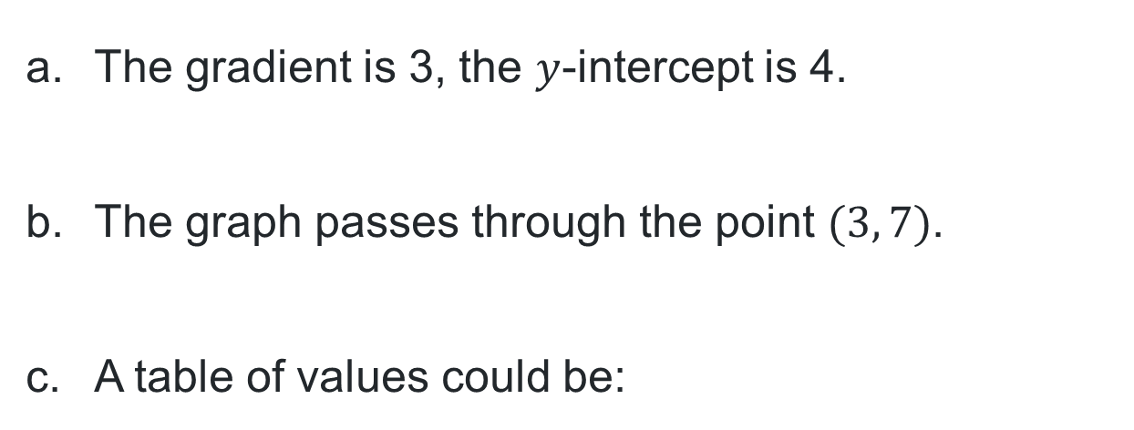
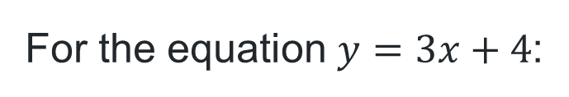
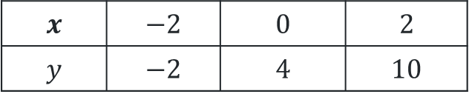
Two truths and a lie
Identify the lie
For the equation $y=3x+4$:
The gradient is 3, the $y$-intercept is 4.
The graph passes through the point $(3, 7)$.
A table of values could be:
$$x$$ | $$−2$$ | $$0$$ | $$2$$
$$y$$ | $$−2$$ | $$4$$ | $$10$$

Slide 5
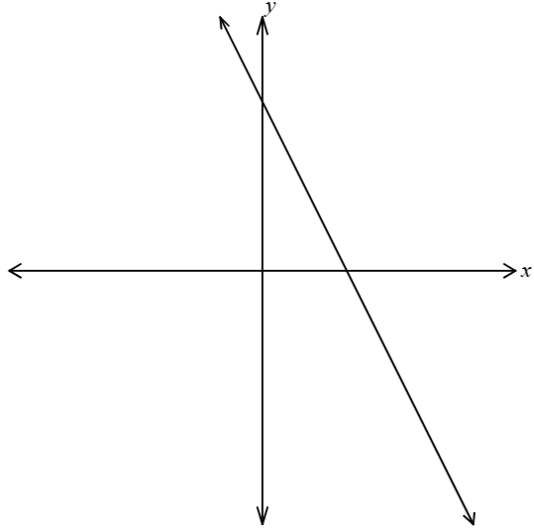
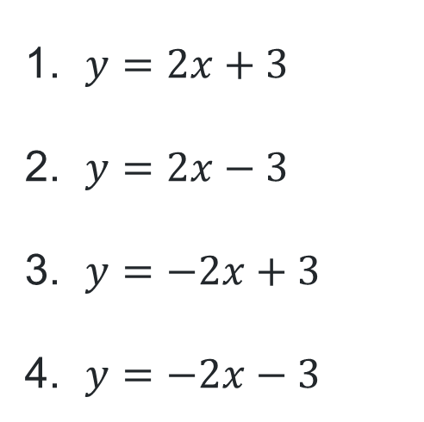
Equation of a line
Consider the function shown.
Which of the following could be the equation of this function?
$y=2x+3$
$y=2x−3$
$y=−2x+3$
$y=−2x−3$

Slide 6
Connecting learning

Slide 7
Pool Bright (1)
Cost of a pool
Jo is the manager of Pool Bright, a pool installation company. When potential customers enquire about the cost of installing a pool, Jo tells them that an approximate cost can be found by multiplying the length of the pool by $3000 and adding $10 000.

Slide 8
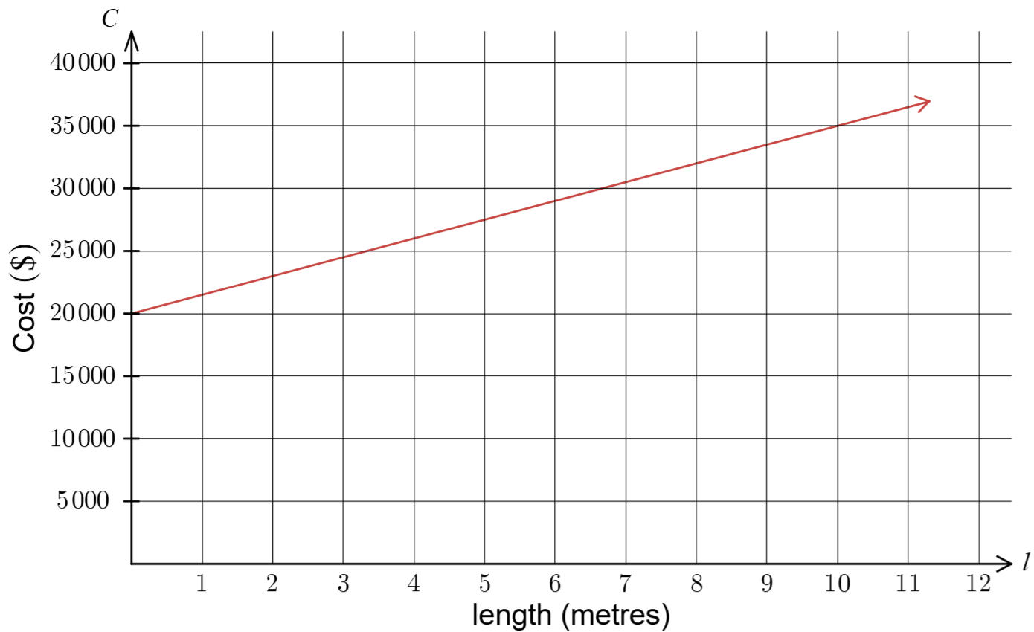
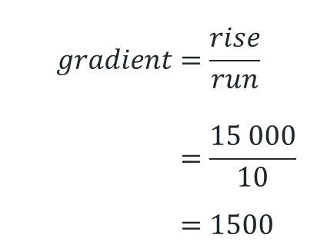



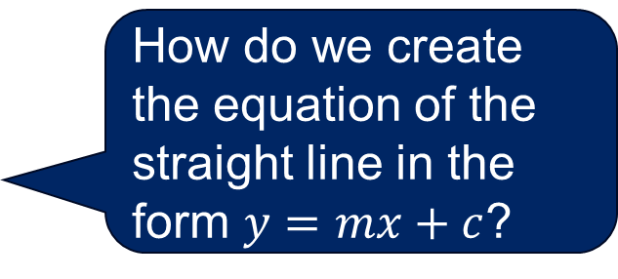
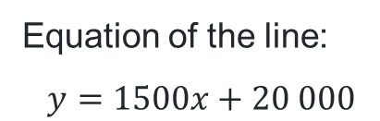
Aqua Pools
Why was this point chosen?
How can we use the graph to find the gradient?
Cost of a pool
Equation of the line:
$$y=1500x+20 000$$
$$gradient=\frac{rise}{run} \\ =\frac{15 000}{10} \\ =1500$$
$$rise=15 000$$
The $y$-intercept is $20 000$
$$run=10$$
What does this point represent?
How do we create the equation of the straight line in the form $y=mx+c$?

Slide 9
Pool Bright (2)
Increased cost of materials
The cost of materials to install the pool has increased and Jo, the manager of Pool Bright, needs to pass the costs on to the customer.
Potential customers are now told that an approximate cost can be found by multiplying the length of the pool they’d like by $4000 and adding $10 000.

Slide 10
Definitions
Drawing information from a graph
Interpolate/interpolation
Making predictions between known data values.
For example, working between 2 known points on a graph to predict a value in between these points.
Extrapolate/extrapolation
Occurs when the fitted model, such as a line of best fit, is used to make predictions using values that are outside the range of the original data upon which the fitted model was based.

Slide 11
Releasing responsibility

Slide 12
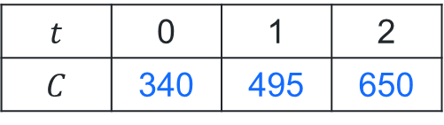
Worked example (1)
Example 1
Mark is a sole trader of a pottery business. A quote for digital marketing includes a set-up cost of $340 and then an on-going cost of $155 per month.
Complete the table of values and draw a graph to represent the costs.
How was the table completed?
$$t$$ | 0 | 1 | 2
$$C$$ | 340 | 495 | 650

Slide 13
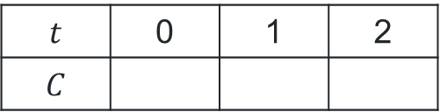
Your turn (1)
Question 1
Shay is setting up a new kiln. Shay pays an initial installation fee of $1200 and then incurs monthly operating costs of $120 for electricity and maintenance.
Complete the table of values and draw a graph to represent the costs over a 12-month period.
$$t$$ | 0 | 1 | 2
$$C$$
1200
1320
1440

Slide 14
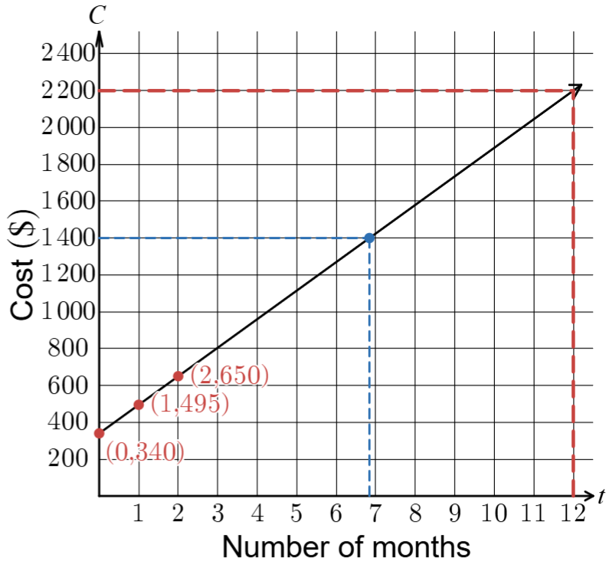
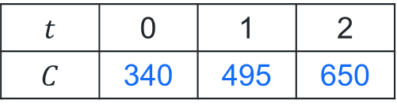
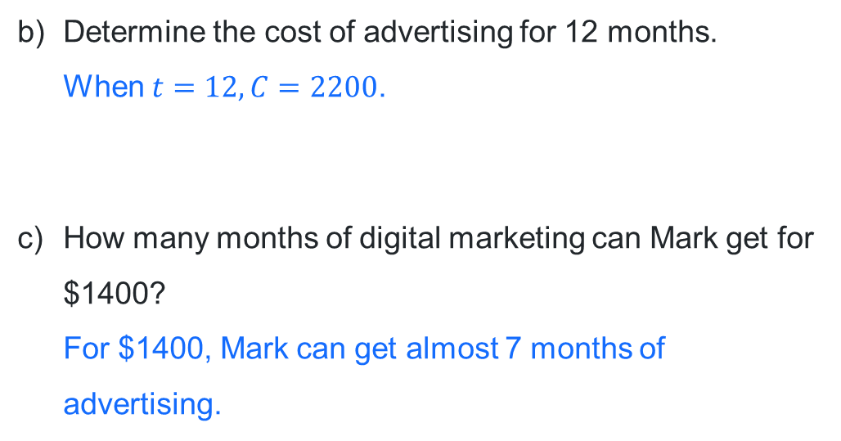
Worked example (2)
How do the dotted lines identify the solutions?
Example 1
Set-up cost = $340 On-going cost = $155 per month.
$$t$$ | 0 | 1 | 2
$$C$$ | 340 | 495 | 650
Determine the cost of advertising for 12 months.
When $t=12, C=2200$.
How many months of digital marketing can Mark get for $1400?
For $1400, Mark can get almost 7 months of advertising.
How was the graph drawn?

Slide 15
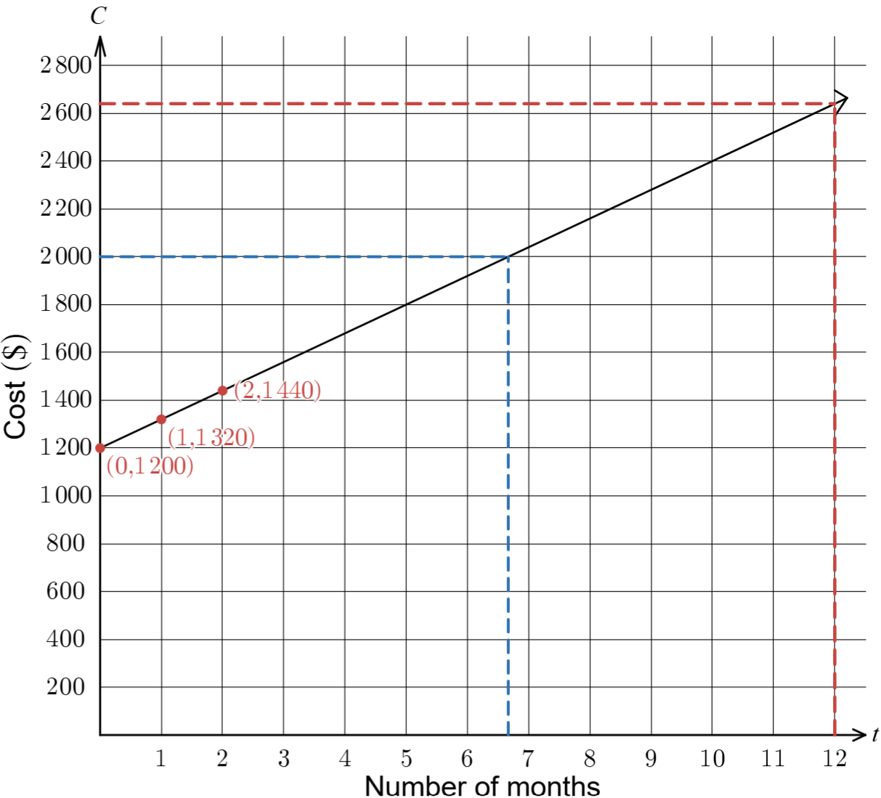
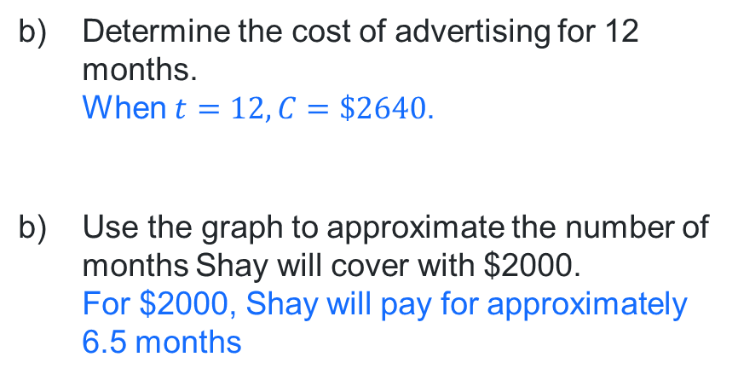
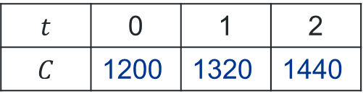
Your turn (2)
Question 1
Installation fee = $1200 monthly operating costs = $120.
$$t$$ | 0 | 1 | 2
$$C$$ | 1200 | 1320 | 1440
Determine the cost of advertising for 12 months.
When $t=12, C=\$2640$.
Use the graph to approximate the number of months Shay will cover with $2000.
For $2000, Shay will pay for approximately 6.5 months

Slide 16
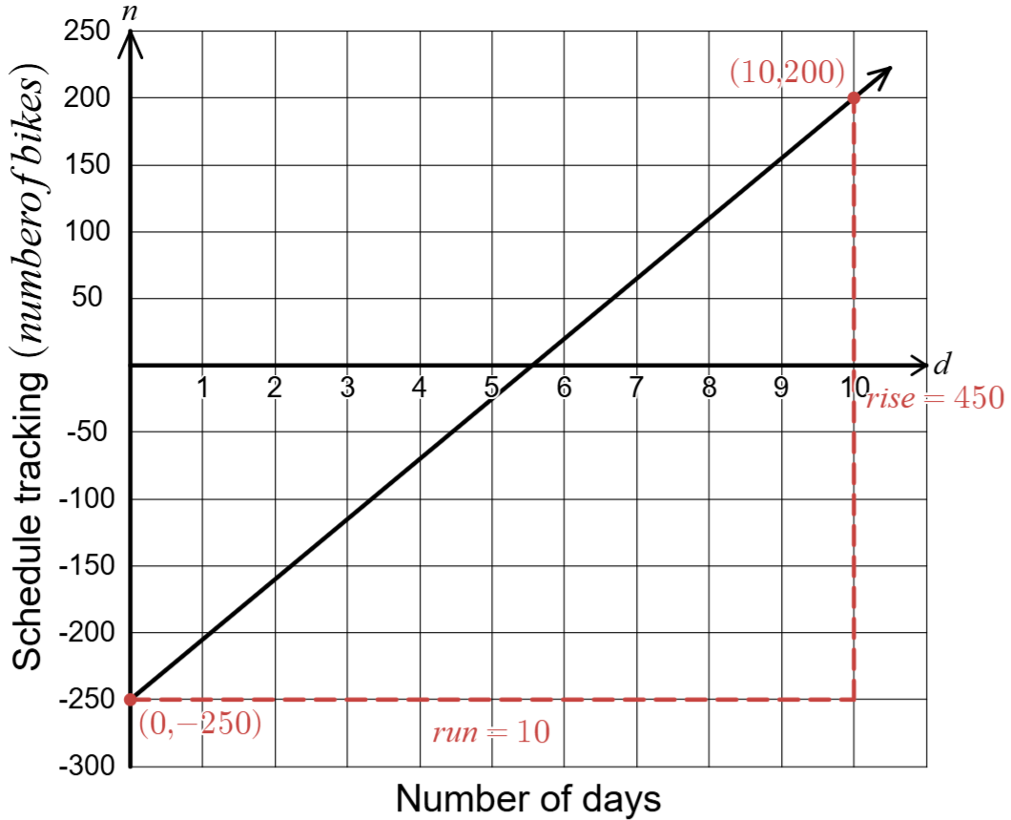
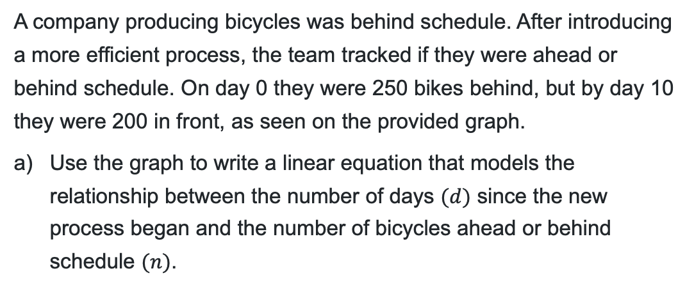
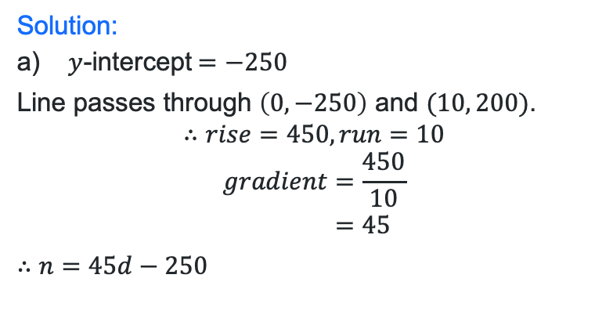

Worked example (3)
Example 2
A company producing bicycles was behind schedule. After introducing a more efficient process, the team tracked if they were ahead or behind schedule. On day 0 they were 250 bikes behind, but by day 10 they were 200 in front, as seen on the provided graph.
Use the graph to write a linear equation that models the relationship between the number of days $(d)$ since the new process began and the number of bicycles ahead or behind schedule $(n)$.
Why does the line begin at $−250$?
Solution:
$y$-intercept$=−250$
Line passes through $\left(0,−250\right)$ and $(10, 200)$.
$$∴rise=450, run=10$$
$$gradient=\frac{450}{10} \\ =45$$
$$∴n=45d−250$$
Why were these points chosen?

Slide 17
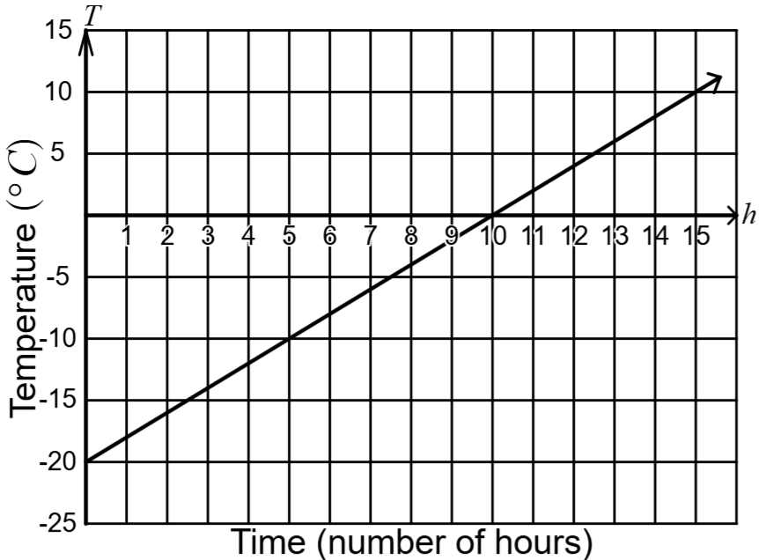
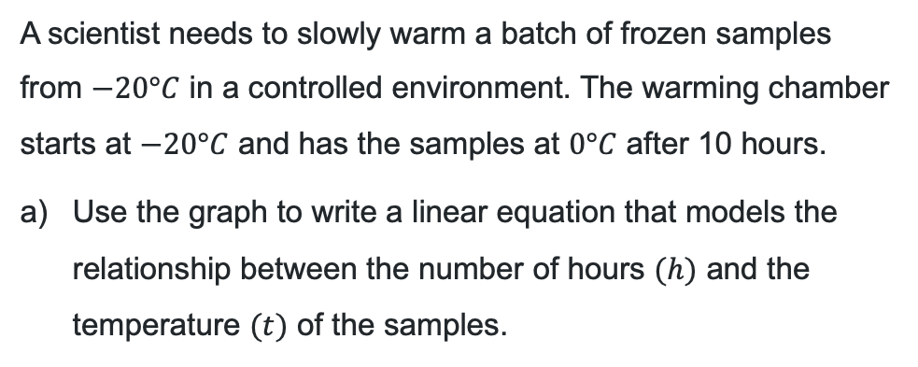


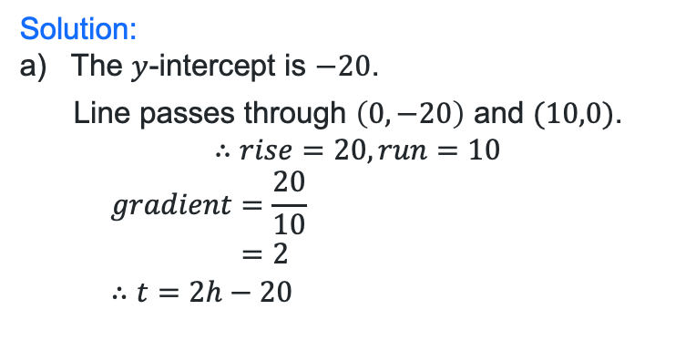
Your turn (3)
Question 2
A scientist needs to slowly warm a batch of frozen samples from $−20°C$ in a controlled environment. The warming chamber starts at $−20°C$ and has the samples at $0°C$ after 10 hours.
Use the graph to write a linear equation that models the relationship between the number of hours $(h)$ and the temperature $(t)$ of the samples.
$$rise=20$$
$$run=10$$
Solution:
The $y$-intercept is $−20$.
  Line passes through $\left(0,−20\right)$ and $(10,0)$.
$$∴rise=20, run=10$$
  $$gradient=\frac{20}{10} \\ =2$$
  $$∴t=2h−20$$

Slide 18
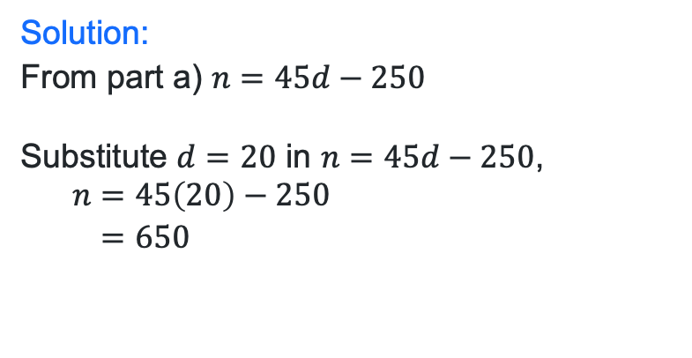
Worked example (4)
On what day does the company get back on schedule?
Example 2
Day 0 = 250 bikes behind, Day 10 = 200 in front
Determine the number of bicycles produced ahead of schedule after 20 days.
Solution:
From part a) $n=45d−250$
Substitute $d=20$ in $n=45d−250$,
  $$n=45\left(20\right)−250 \\ =650$$

Slide 19
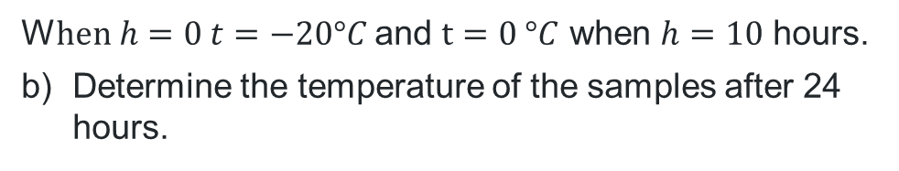


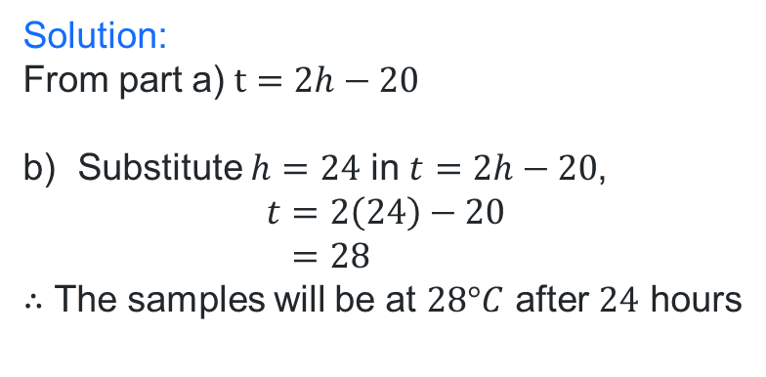
Your turn (4)
Question 2
W$hen h=0 t=−20°C$ and $t=0 °C$ when $h=10$ hours.
Determine the temperature of the samples after 24 hours.
Solution:
From part a)$t=2h−20$
Substitute $h=24$ in $t=2h−20$,
$$t=2\left(24\right)−20 \\ =28$$
$∴$ The samples will be at $28°C$ after $24$ hours
$$rise=20$$
$$run=10$$

Slide 20
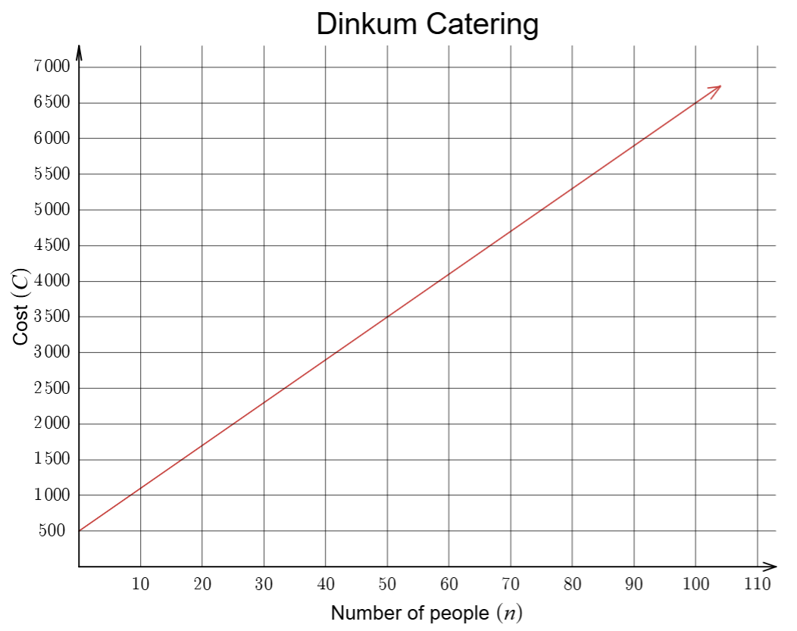
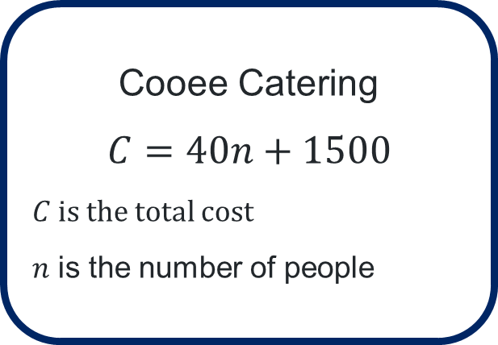
Catering companies
Which company should they choose?
Cooee Catering
$$C=40n+1500$$
$C$ is the total cost
$n$ is the number of people
or
Nae is hosting a party for 60 guests. Dan is hosting an event for 40 people.

Slide 21
References
This presentation contains NSW Curriculum and syllabus content. The NSW Curriculum is developed by the NSW Education Standards Authority. This content is prepared by NESA for and on behalf of the Crown in the right of the State of New South Wales. The material is protected by Crown copyright.
Please refer to the NESA Copyright Disclaimer for more information https://educationstandards.nsw.edu.au/wps/portal/nesa/mini-footer/copyright.
NESA holds the only official and up-to-date versions of the NSW Curriculum and syllabus documents. Please visit the NSW Education Standards Authority (NESA) website https://educationstandards.nsw.edu.au/wps/portal/nesa/home and the NSW Curriculum website https://curriculum.nsw.edu.au.
Mathematics Standard Stage 6 Syllabus © NSW Education Standards Authority (NESA) for and on behalf of the Crown in right of the State of New South Wales, 2024.

Slide 22
Copyright
© State of New South Wales (Department of Education), 2026
The copyright material published in this resource is subject to the Copyright Act 1968 (Cth) and is owned by the NSW Department of Education or, where indicated, by a party other than the NSW Department of Education (third-party material).
Copyright material available in this resource and owned by the NSW Department of Education is licensed under a Creative Commons Attribution 4.0 International (CC BY 4.0) license.
This license allows you to share and adapt the material for any purpose, even commercially.
Attribution should be given to © State of New South Wales (Department of Education), 2026.
Material in this resource not available under a Creative Commons license:
the NSW Department of Education logo, other logos and trademark-protected material
Material owned by a third party that has been reproduced with permission. You will need to obtain permission from the third party to reuse its material.
Links to third-party material and websites
Please note that the provided (reading/viewing material/list/links/texts) are a suggestion only and implies no endorsement, by the New South Wales Department of Education, of any author, publisher, or book title. School principals and teachers are best placed to assess the suitability of resources that would complement the curriculum and reflect the needs and interests of their students.
If you use the links provided in this document to access a third-party’s website, you acknowledge that the terms of use, including licence terms set out on the third-party’s website apply to the use which may be made of the materials on that third-party website or where permitted by the Copyright Act 1968 (Cth). The department accepts no responsibility for content on third-party websites.

